Slide 1
Compute Canada ARC

Slide 2
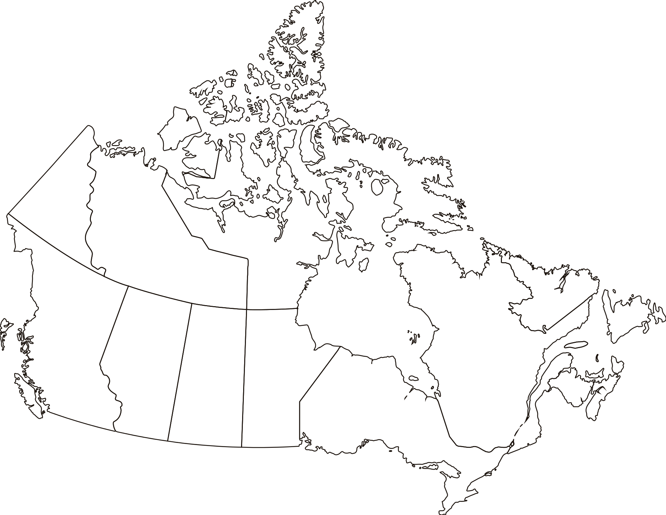



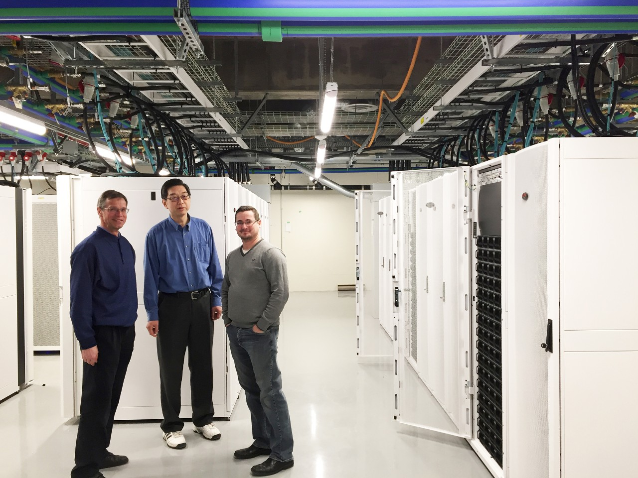
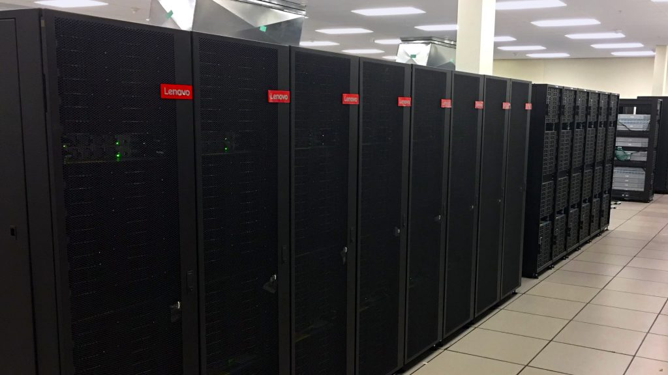
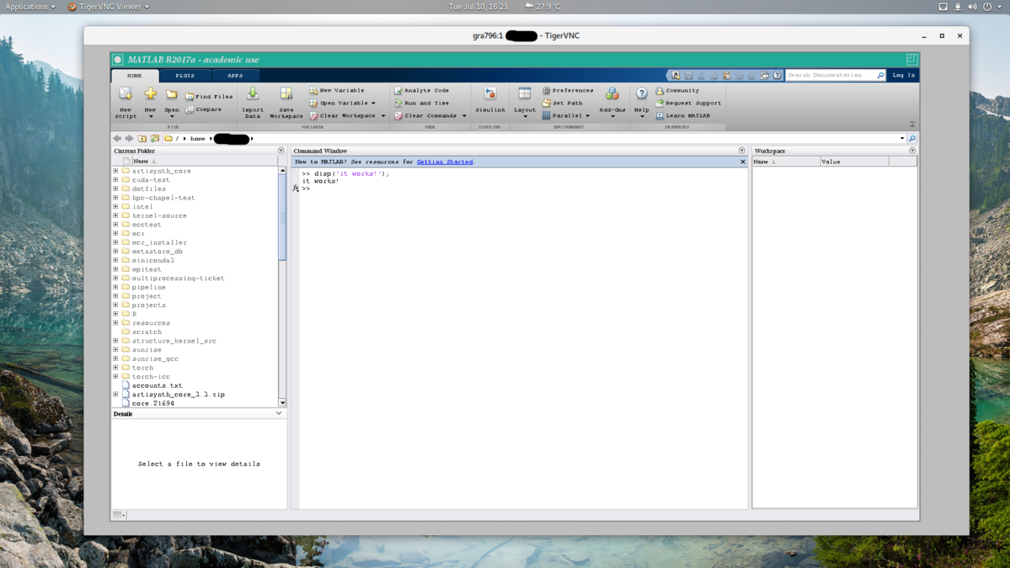
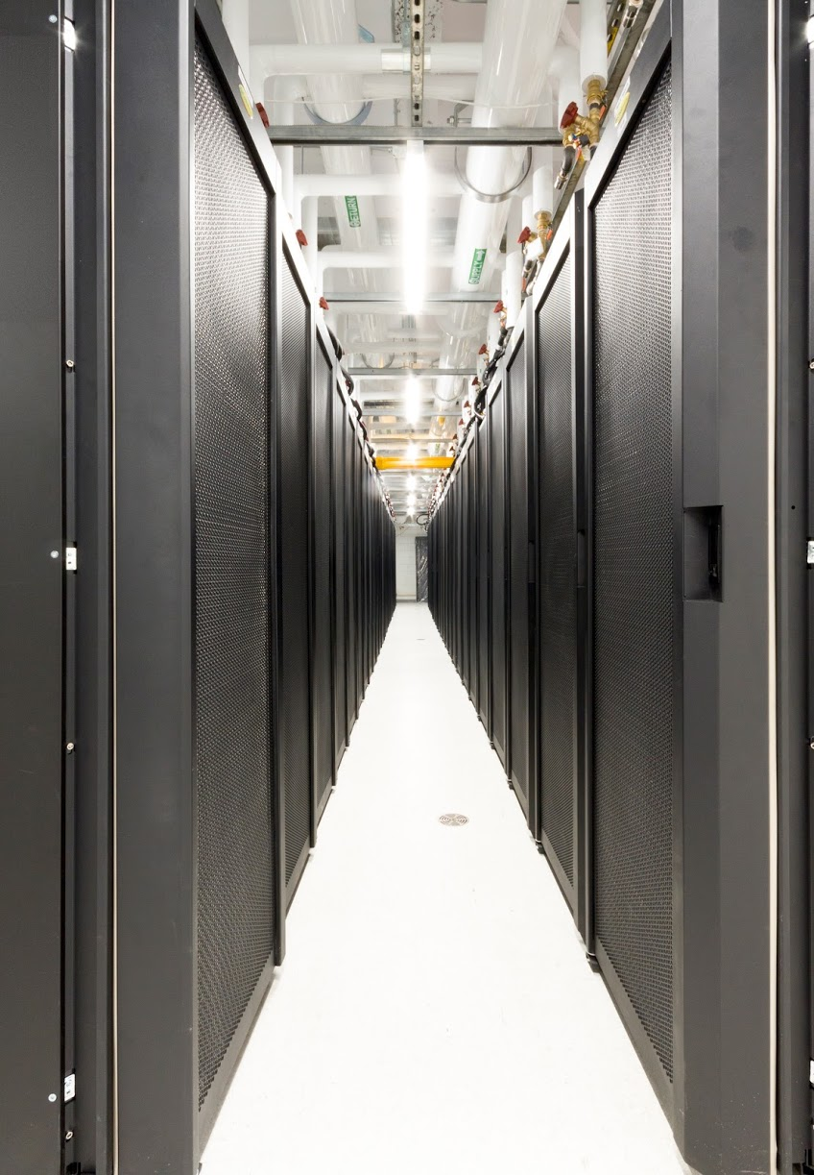
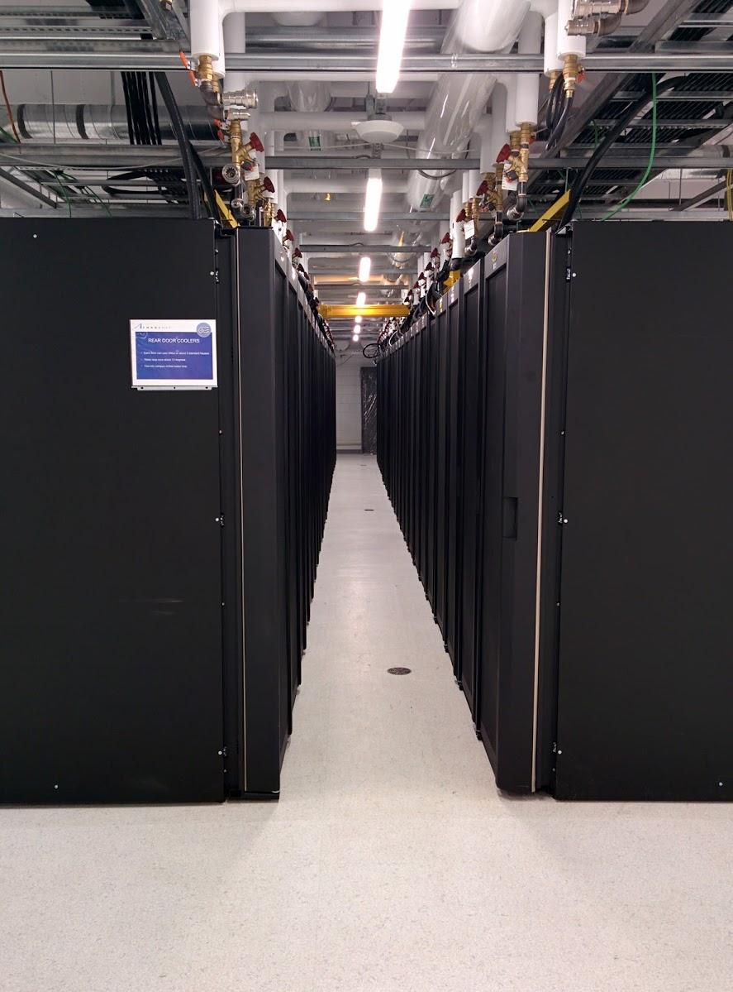
ARC in Canada
It started with supercomputers !
Now we run
  Supercomputers
  IaaS
  BaaS
  Big Data
  VDI
  And much more..

Slide 3
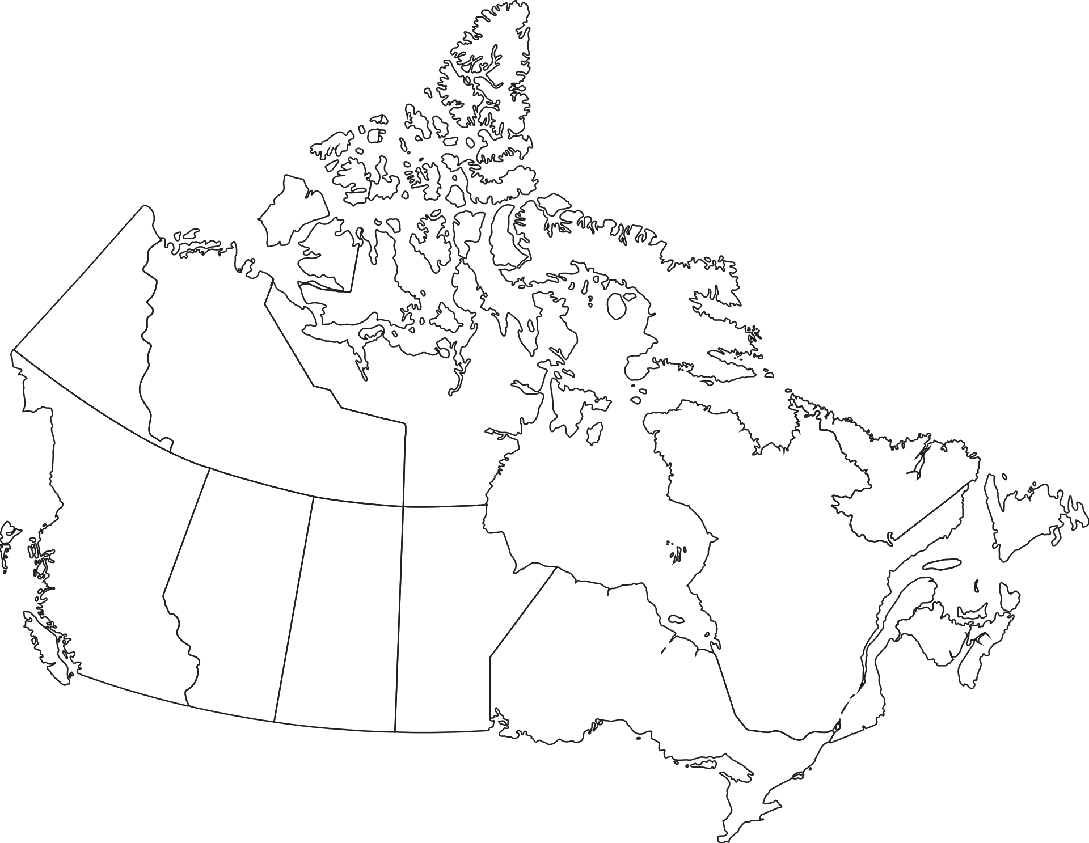
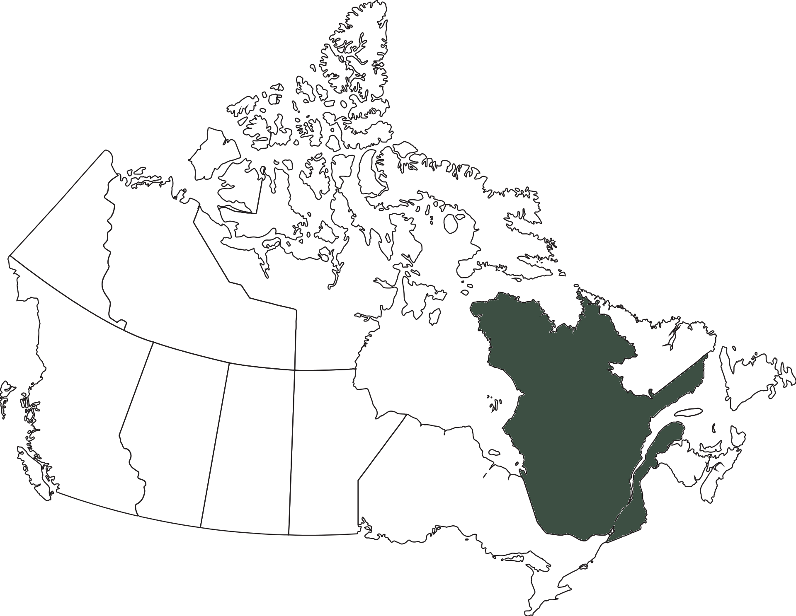
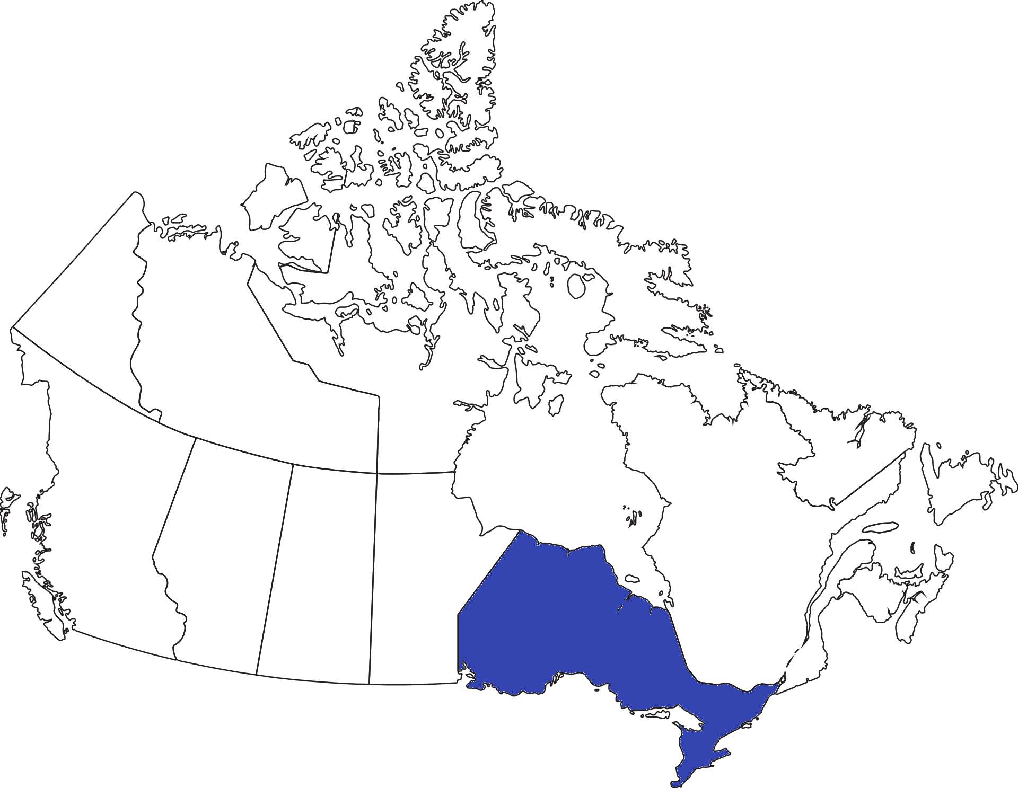
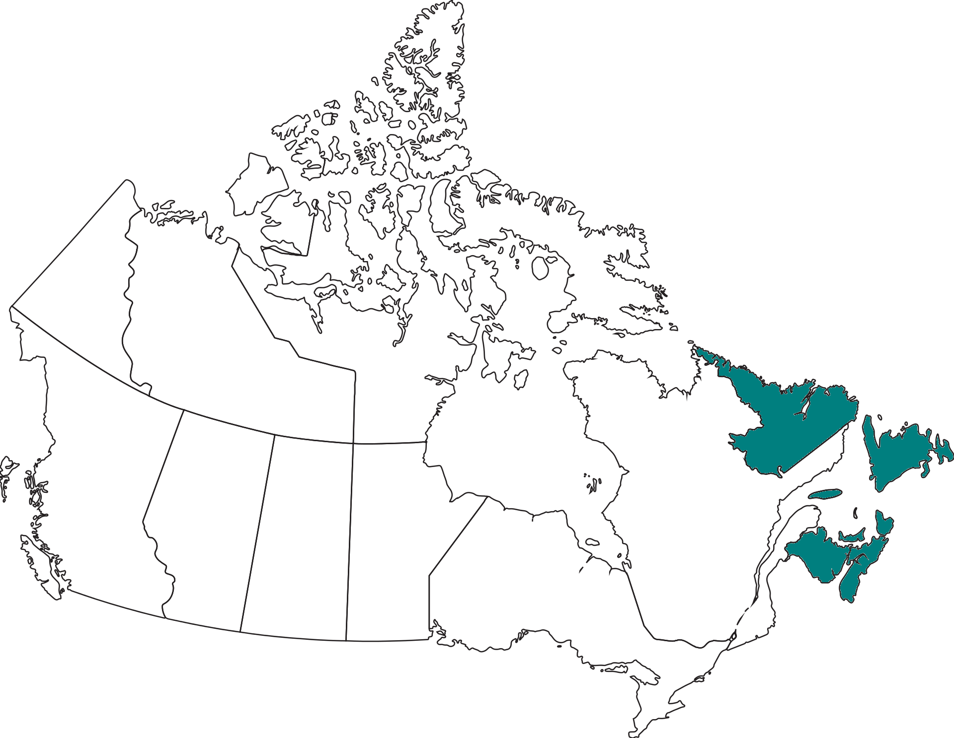
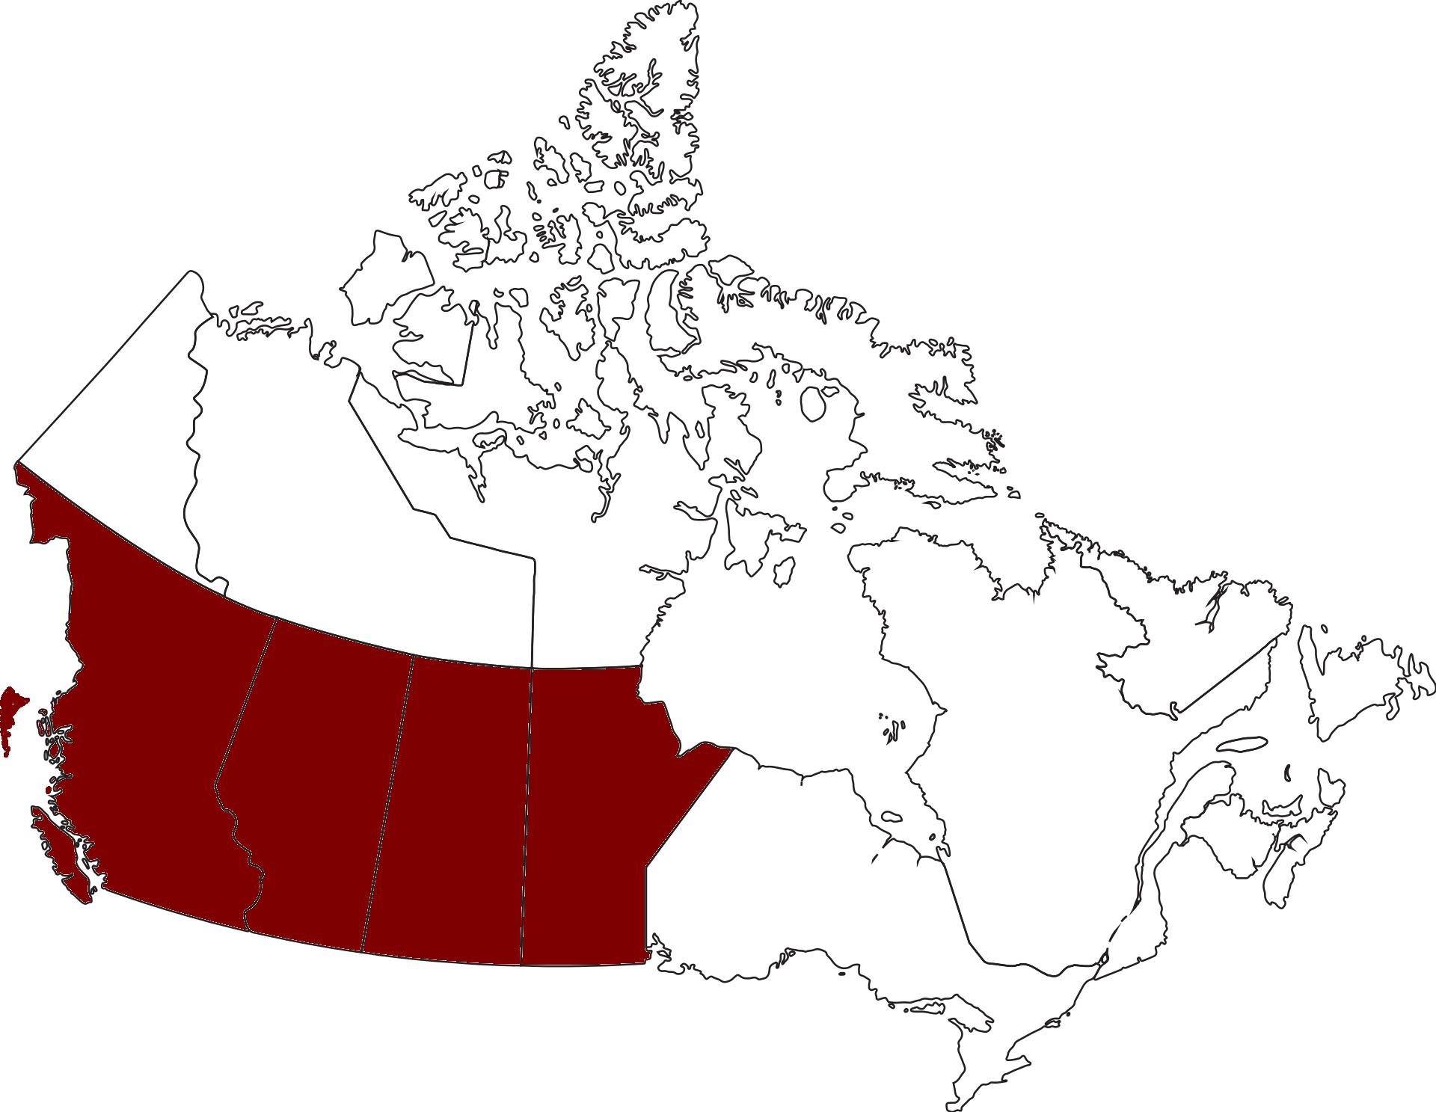





Organizations
Acenet: NB, NS, PEI, NL
Compute Ontario
Calcul Quebec
Westgrid: AB, SK, MB, BC
Compute Canada

Slide 4
Canadian ARC in numbers
4 Supercomputers (#59, #190 & #271 in Top 500 list)
  ~190,000 physical CPU cores
5 major Cloud deployments
  ~15,000 physical CPU cores
  ~ 7 PetaBytes CEPH storage
  ~1.4 Million VMs created since commissioned
~ 60 PetaBytes of online storage,
~ 60 PetaBytes of nearline and backups

Slide 5
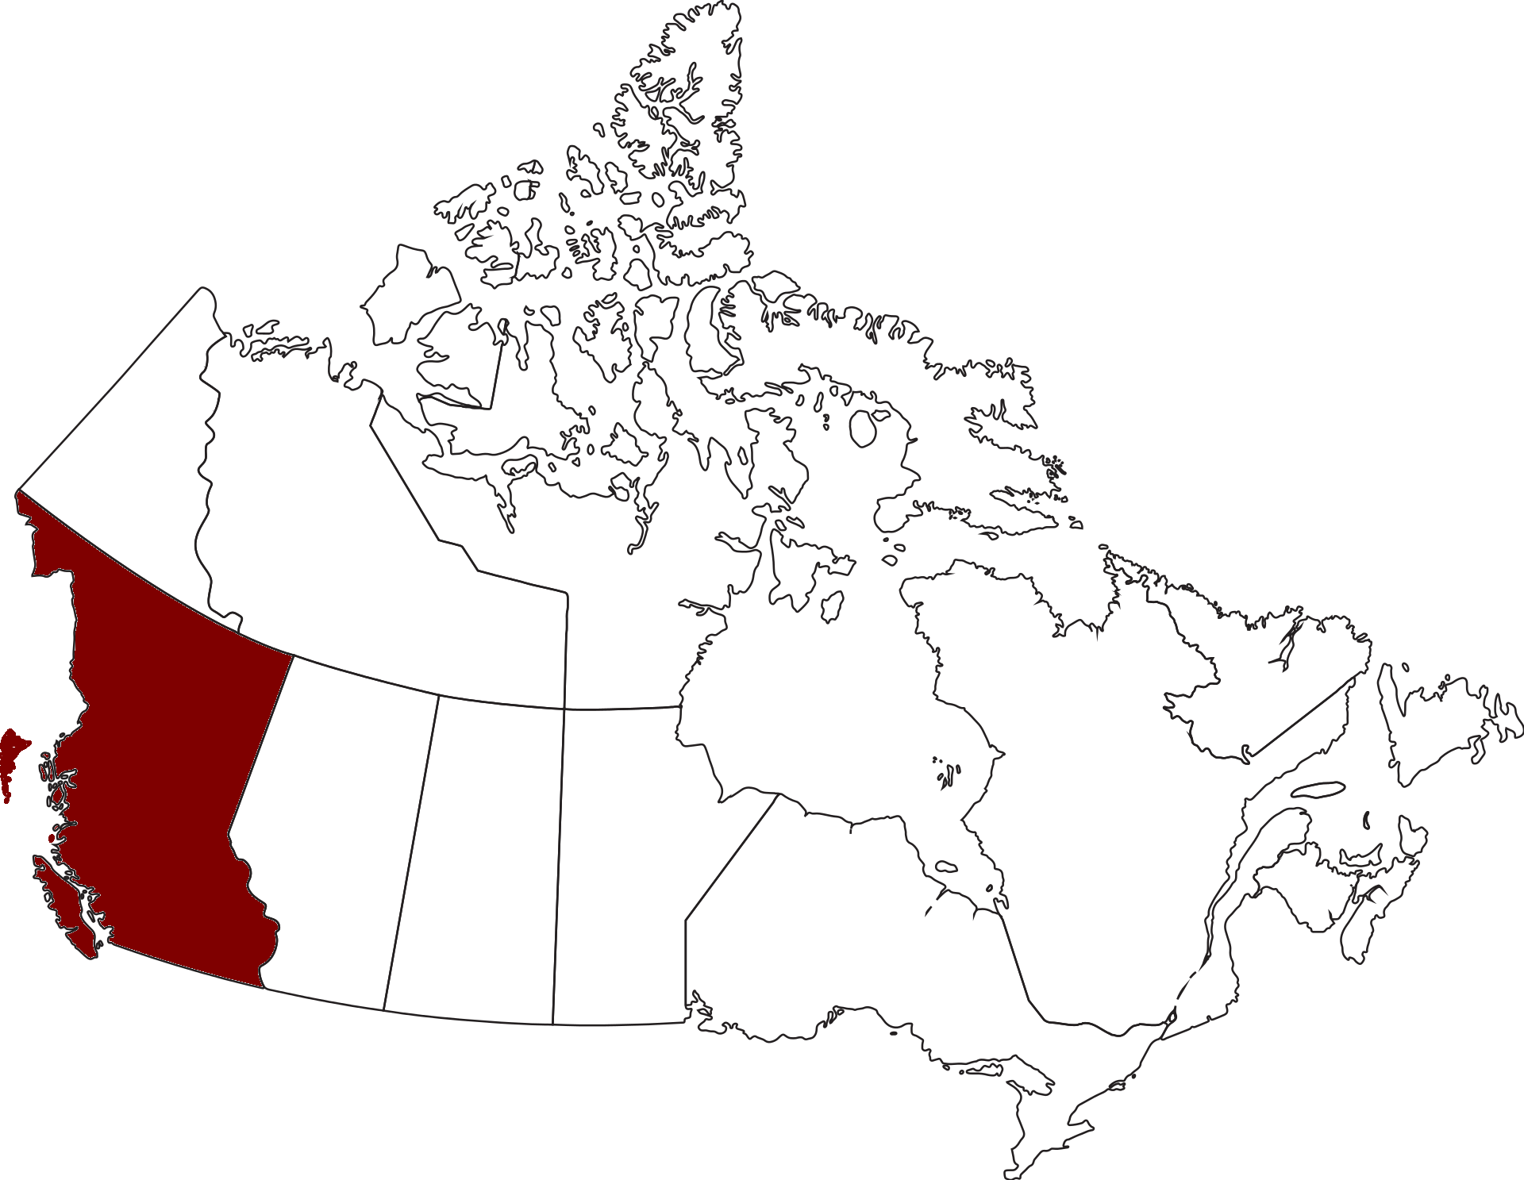
Adoption of Openstack
Realizing the need !
Started in 2014 with two Clouds
Icehouse release
Services added gradually
Upgrades … Or Migrations
Now 5 Major Clouds

Slide 6
National cloud platform
x86 Clouds
Accelerators: GPUs/FPGA
CEPH backends
10/25GbE interconnect
100Gb Backbone links

Slide 7











National Cloud Team
Responsible for:
  Architecture, deployment and operations of the national cloud platform
  User support
Distributed Team
Meet the team:

Slide 8

Evolution of Deployment - West Cloud Phase 1
Limited hardware footprint:
6 control plane nodes
13 storage nodes
40 compute nodes
Installation of OpenStack and Ceph:
All packages were downloaded and installed to each machine
Manually configured on each host individually
Notes:
2014
Automation on the horizon but not ready

Slide 9
West Cloud - Phase 1
 | 2014 West Cloud - P1
Compute Cores | 640
Compute Nodes | 40
Storage (Raw) | 500 TB
Storage (Usable) | 180 TB

Slide 10

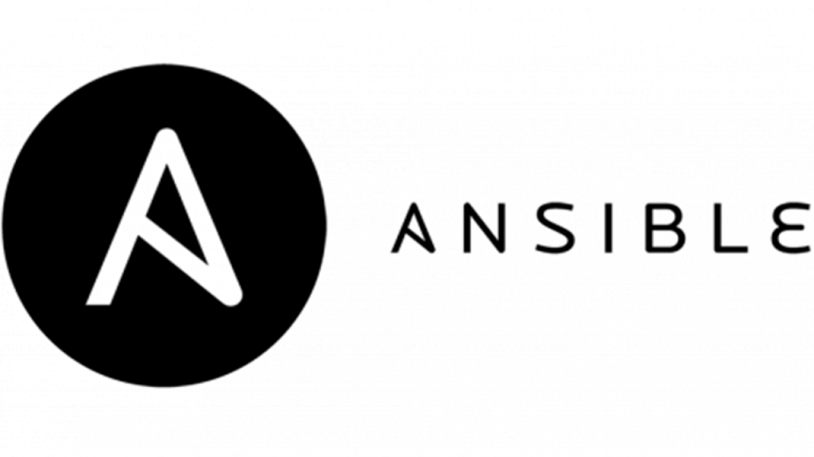
Evolution of Deployment - West Cloud Phase 2
Many more pieces of hardware to configure:
8 control plane nodes
18 storage nodes
280 compute nodes
Significantly more complex:
Many more nodes to configure
Started with self generated Bash Scripts
Moved on to using in-house developed Ansible plays
Notes:
2016
Automation starting to work into the process

Slide 11
West Cloud - Phase 2
 | 2014 West Cloud - P1 | 2016 West Cloud - P2
Compute Cores | 640 | 7600
Compute Nodes | 40 | 280
Storage (Raw) | 500 TB | 2.2 PB
Storage (Usable) | 180 TB | 750 TB

Slide 12
Evolution of Deployment - Arbutus Cloud
Design Decisions:
Brand new cloud on brand new hardware
Migration of West Cloud projects to Arbutus Cloud
Migration of hardware resources

Slide 13
Evolution of Deployment - Arbutus Cloud
Many more pieces of hardware to configure… again:
14 control plane nodes
44 storage nodes
350 compute nodes
Significantly more complex:
OpenStack Ansible Project
Ceph Ansible Project
Notes:
2018
Complexity reduced by adding automation
Fully automated deployment

Slide 14
Our Current Installation - Arbutus Cloud
 | 2014 West Cloud - P1 | 2016 West Cloud - P2 | 2018 Arbutus Cloud
Compute Cores | 640 | 7600 | 9000
Compute Nodes | 40 | 280 | 350
Storage (Raw) | 500 TB | 2.2 PB | 5.8 PB
Storage (Usable) | 180 TB | 750 TB | 4.4 PB

Slide 15
Evolution of Deployment - Arbutus Cloud
Not only did the amount of hardware change the underlying technology changed as well
Storage changed from a triple replicated storage scheme to an erasure coded scheme
Usable storage in triple replication was ⅓ of raw capacity (2.2 PB meant 750 TB usable)
Usable storage with erasure coding is roughly ¾ of raw capacity (5.8 PB means 4.4 PB usable)
Introduction of new compute nodes enables higher performance and more features for the end user with each upgrade cycle

Slide 16
Deployment Tools
Physical Provisioning: xCAT
IPMI BMC Control
Remote console
Remote power control
Remote rebuild
OpenStack Installation and Orchestration: OpenStack Ansible
Stages, deploys, and configures OpenStack
Required additional glue code and site-specific configuration plays
Notes:
Small, distributed team: we needed tools to make this job doable.
Remote access to everything, remote automated provisioning, redeploy from bare metal from anywhere with Internet
OpenStack-Ansible from OSF makes deployment reproducible, consistent, provides framework to extend site-specific plays

Slide 17
Development Tools and Process
Revision Control: GitLab
The single source of truth
Separate feature branches for every issue in progress
Protected Deployment branches for dev, prod, remote sites
Continuous Integration testing automatically on every commit
Stated Goal: The entire deployment should be reproducible at any time with just the data in Git
Proven with continuous ongoing rebuilds of dev cloud from its deployment branch
Removes the “iceberg of unknown configuration” that plagues many cloud deployments
Notes:
Collaboration on config and code means rev control
If it’s not in Git, it don’t exist; pipeline from issue-tracked feature branches to master to protected deploy branches
Committing to rev control means knowing and being able to reproduce all config, nothing hiding that “just got typed in”

Slide 18
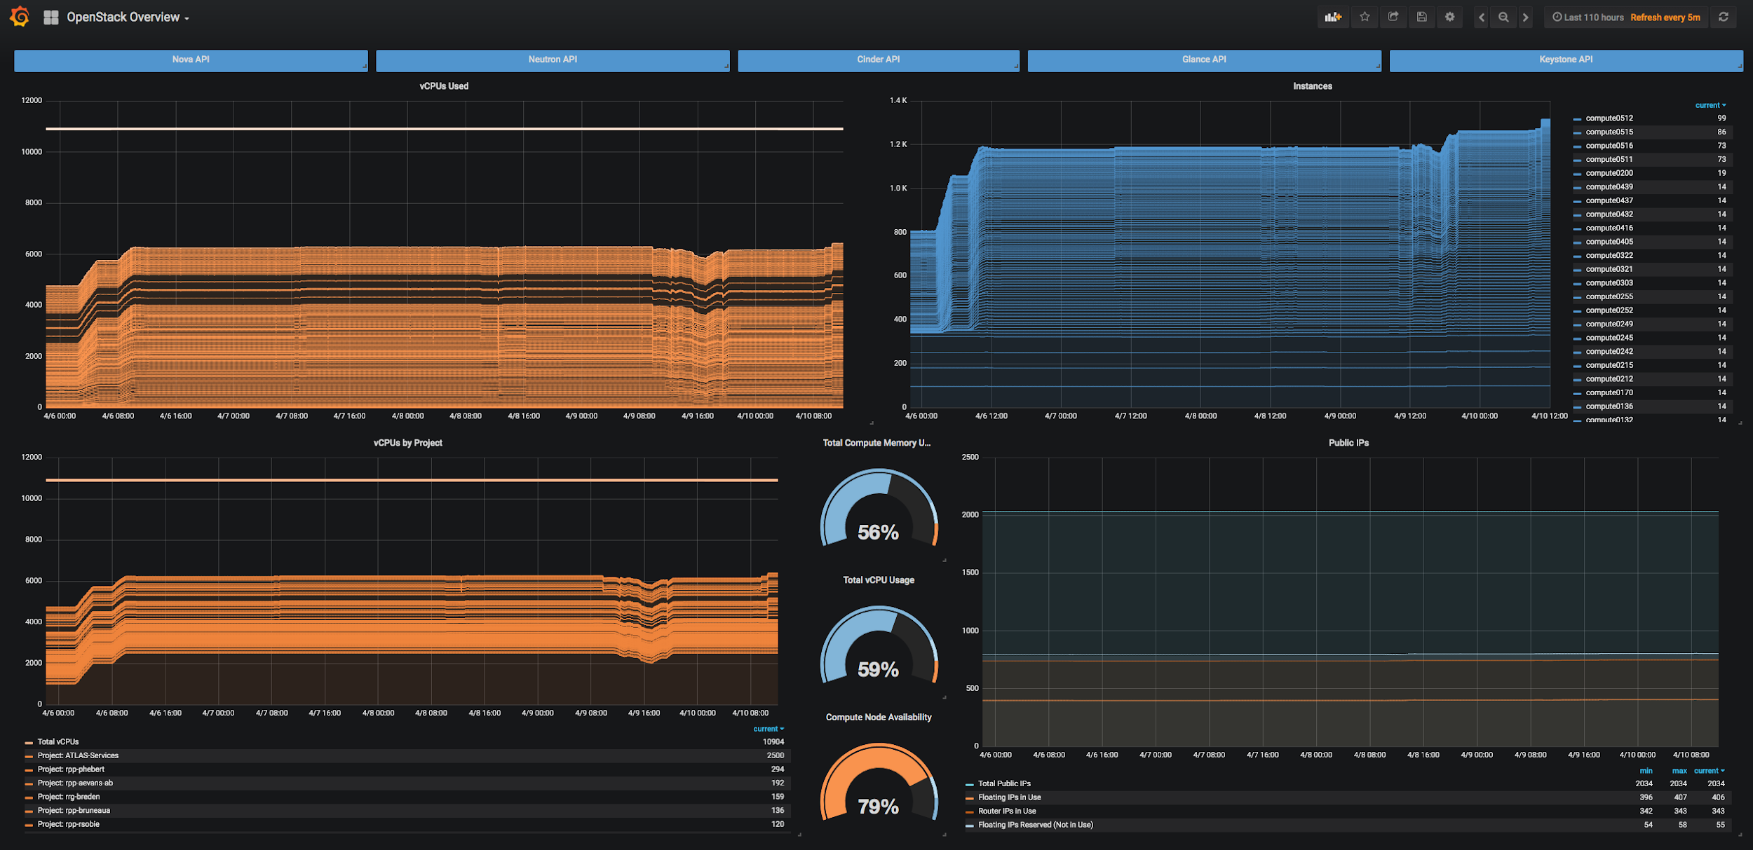
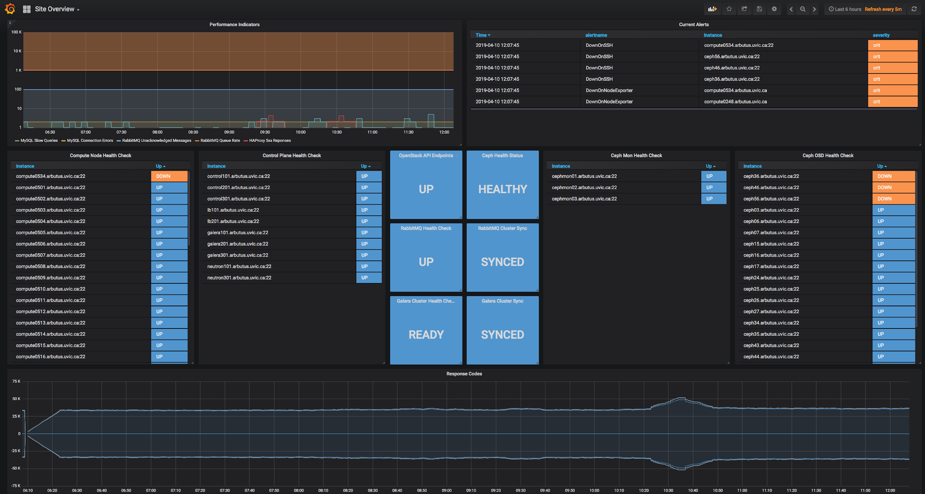
Observability
Metric Collection: Prometheus
Lightweight pull-only exporters written in Go
Hyper-efficient time-series data store server
Durable storage into InfluxDB
Visualization: Grafana
Community-sourced and custom-built dashboards
Native Prometheus integration
Alerting: Prometheus / FLARE
Notes:
Prometheus: Lightweight stat collectors so as not to waste compute resources; long-term retention and federation
Grafana: good base with community dashboards; extended those patterns to create site-specific custom viz
Prom-to-FLARE: alerting on stats, stat trends - also syslog agg to FLARE for log-pattern-based alerting

Slide 19
National Collaboration
Cloud sites across Canada operate using these same techniques
Architectural decisions are made by consensus across the Cloud National Team
Cloud National Team members are active contributors to OpenStack projects, including OpenStack Ansible, and serve as members of OpenStack governance committees
Commitment to revision control shows how cloud sites differ while ensuring a common base

Slide 20
Thanks for Your Time!
Any Questions?
cloud@computecanada.ca

