Slide 1

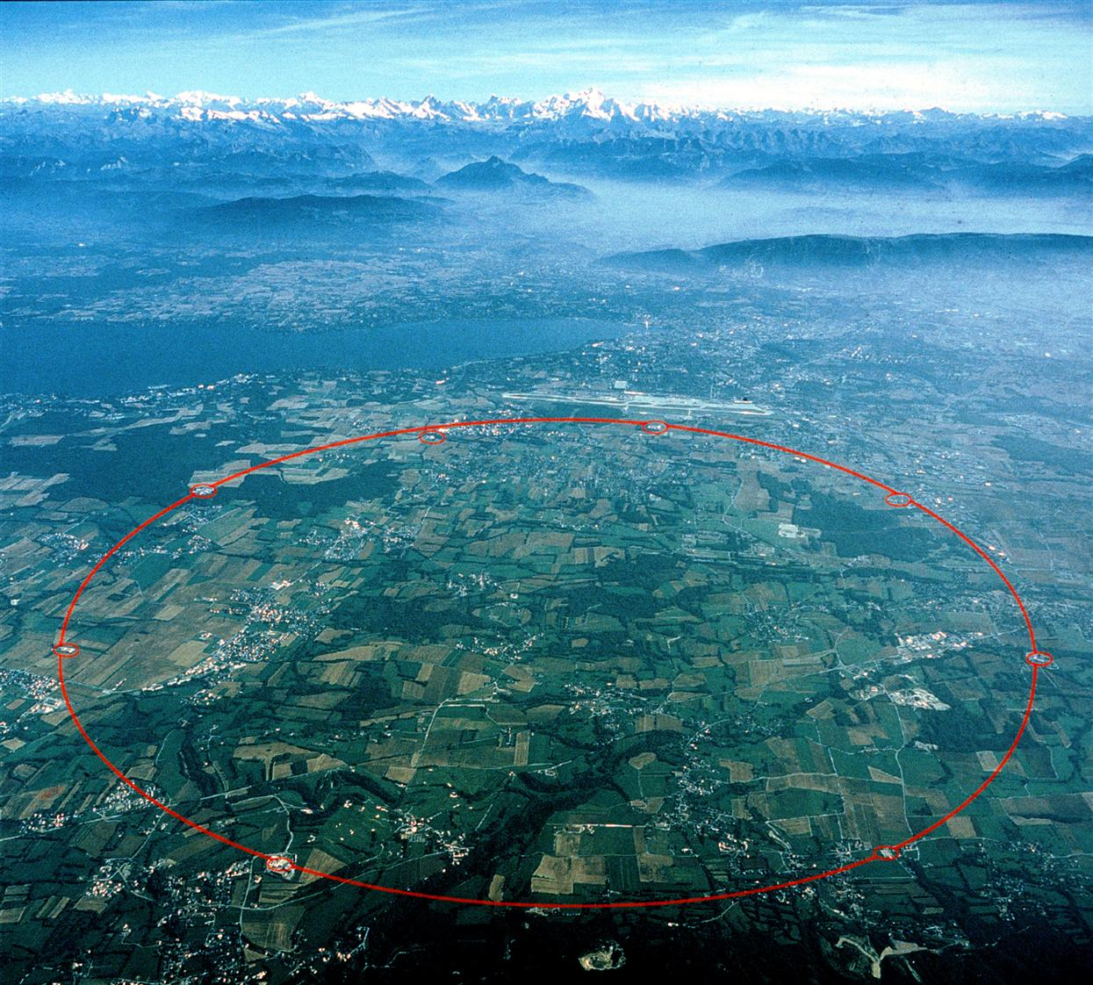
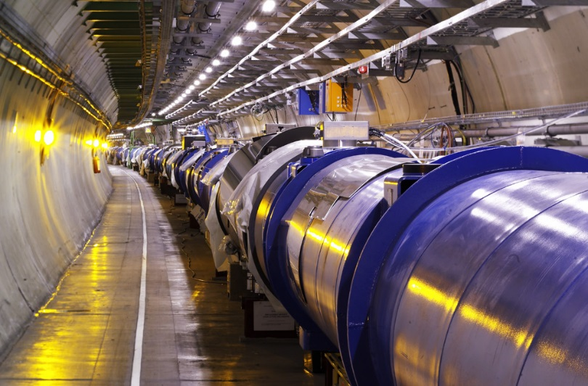

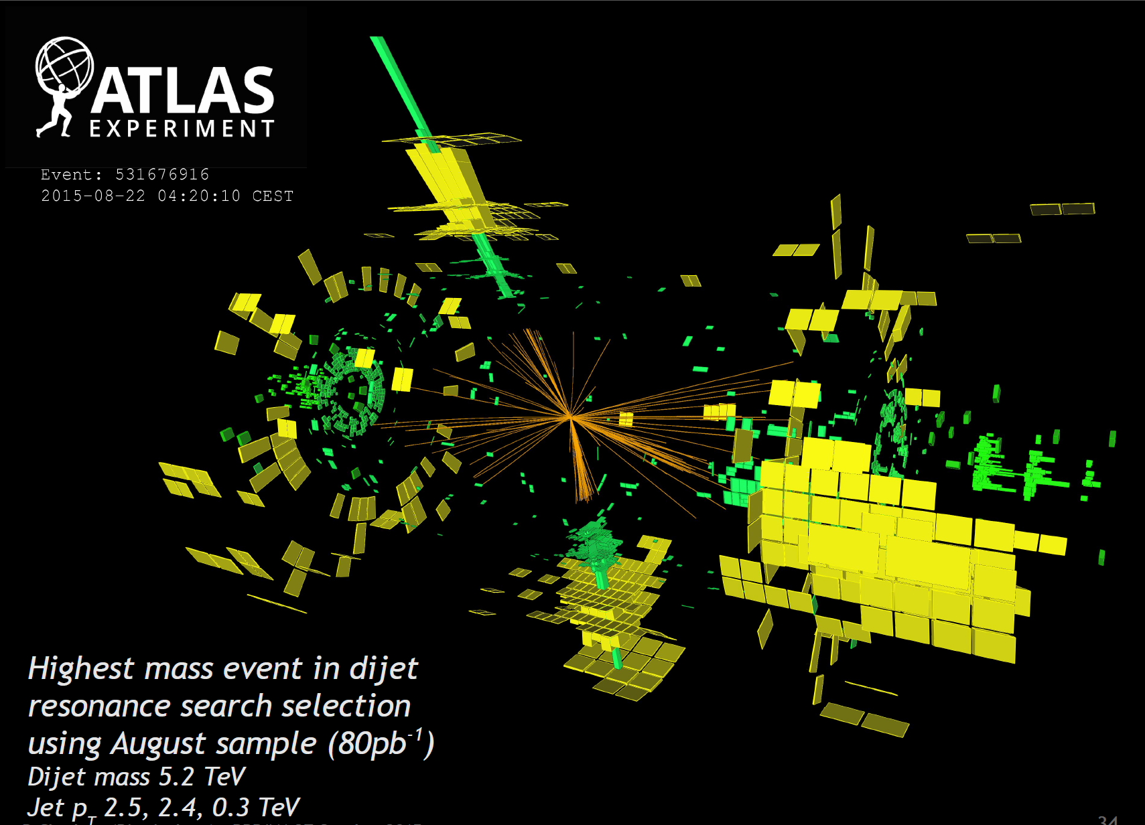
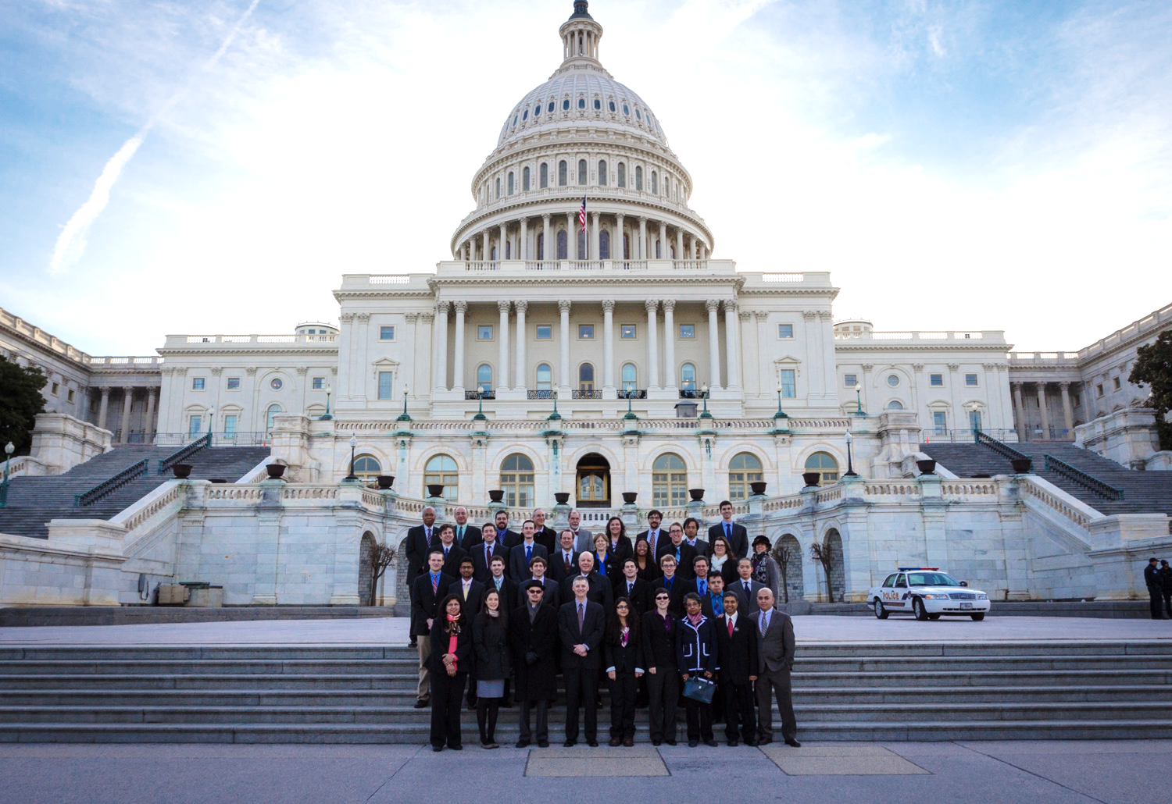
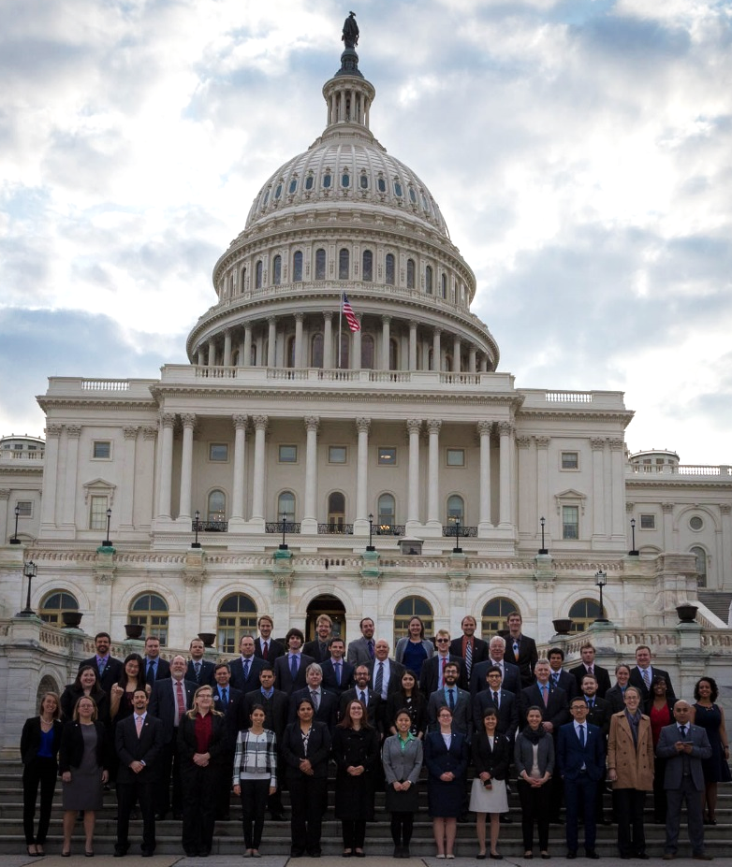
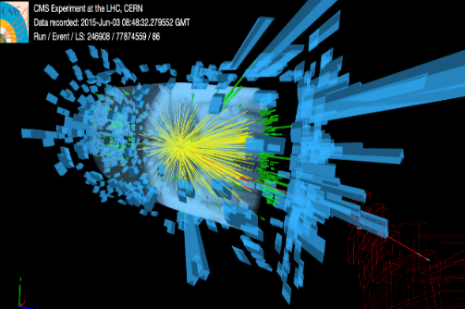

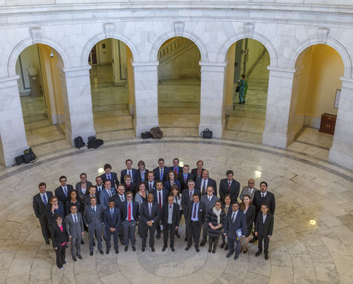
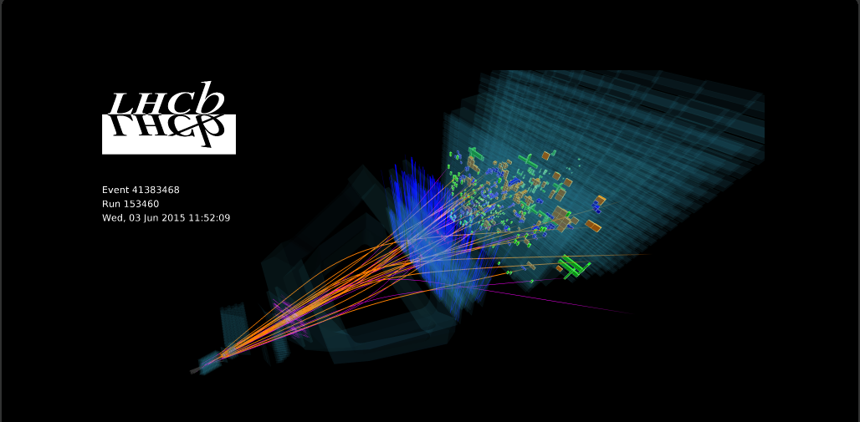
US LUEC Chair Report
HEPAP Review,
Research Funding
and FAS Visit Notes
Harvey Newman June 10 2019
Notes:
1

Slide 2
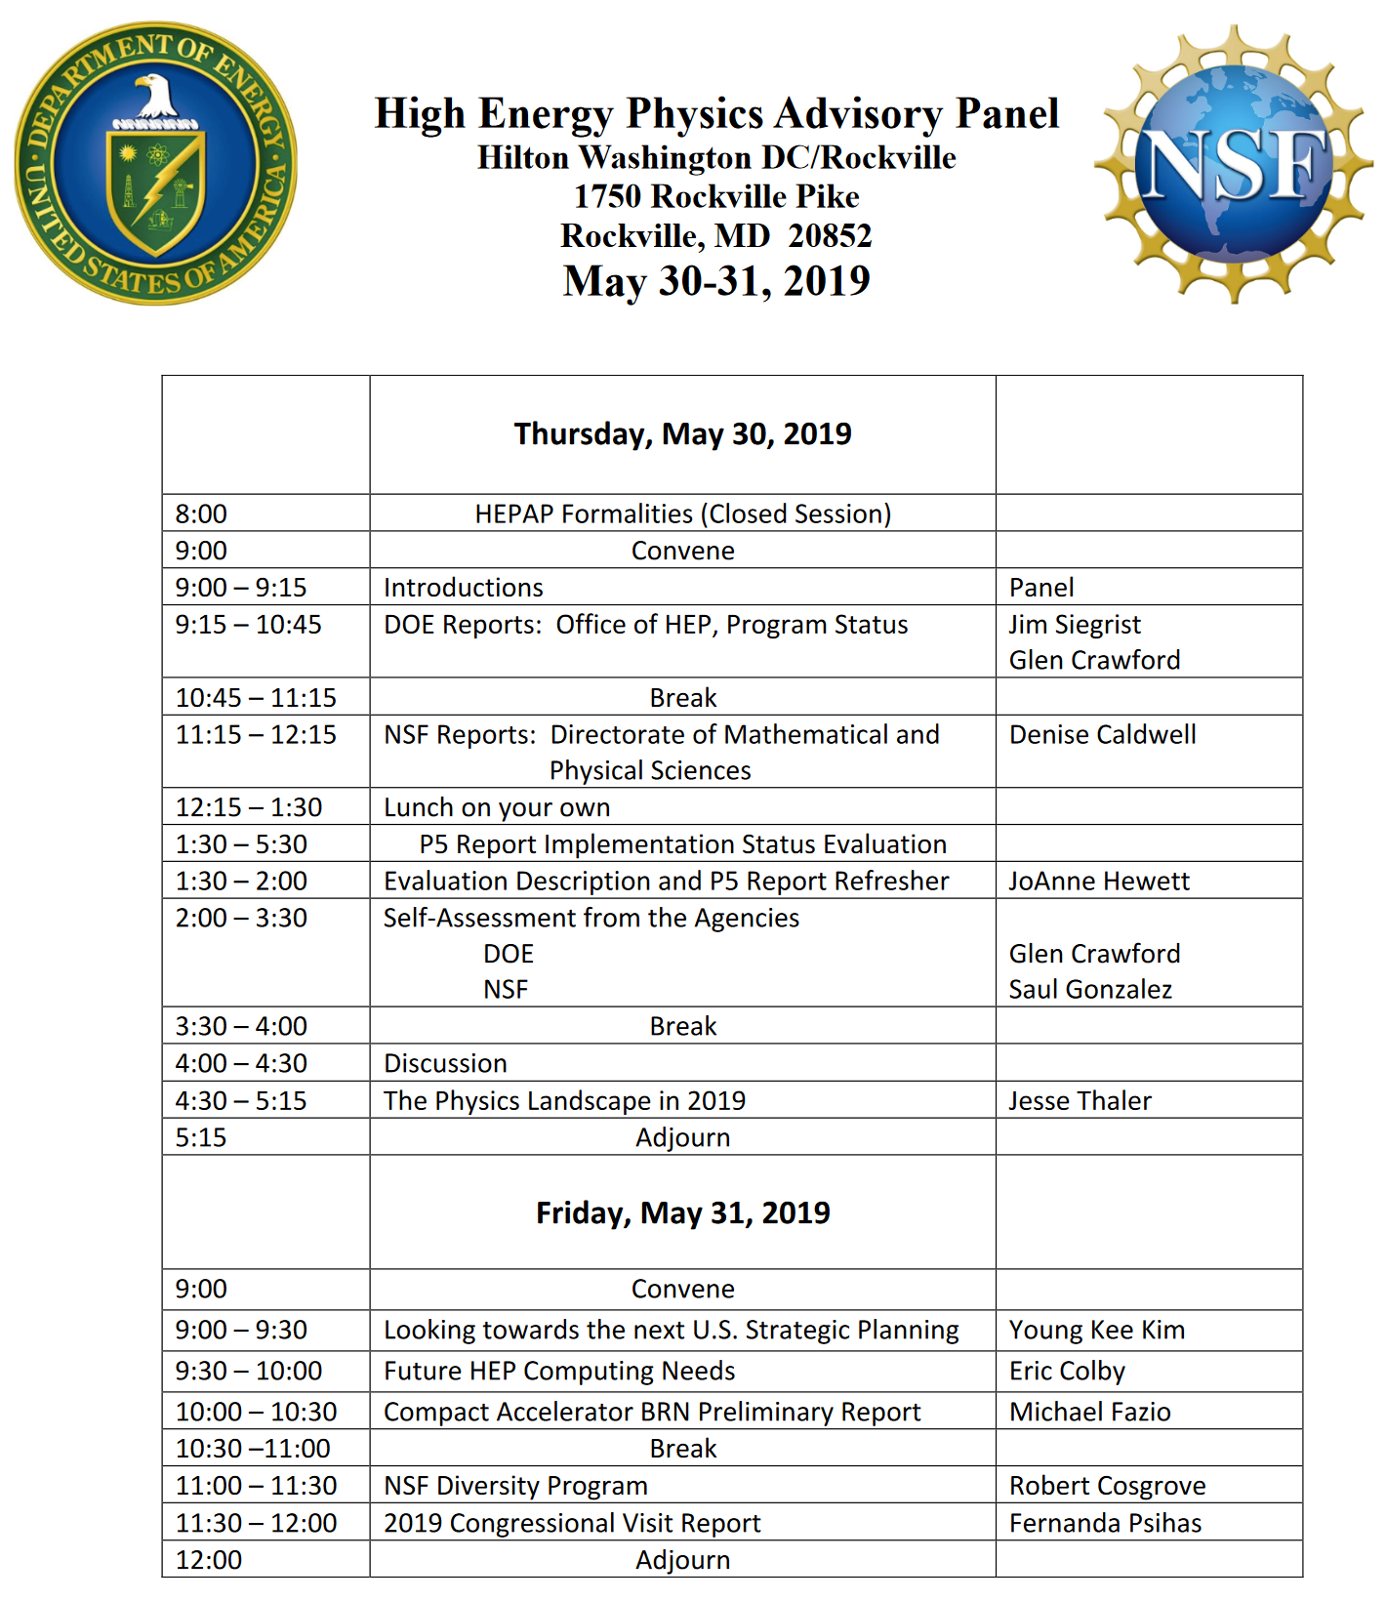
https://science.osti.gov/hep/hepap/Meetings/201905
✴
✴
✴
✴
✴
✴
Notes:
2

Slide 3
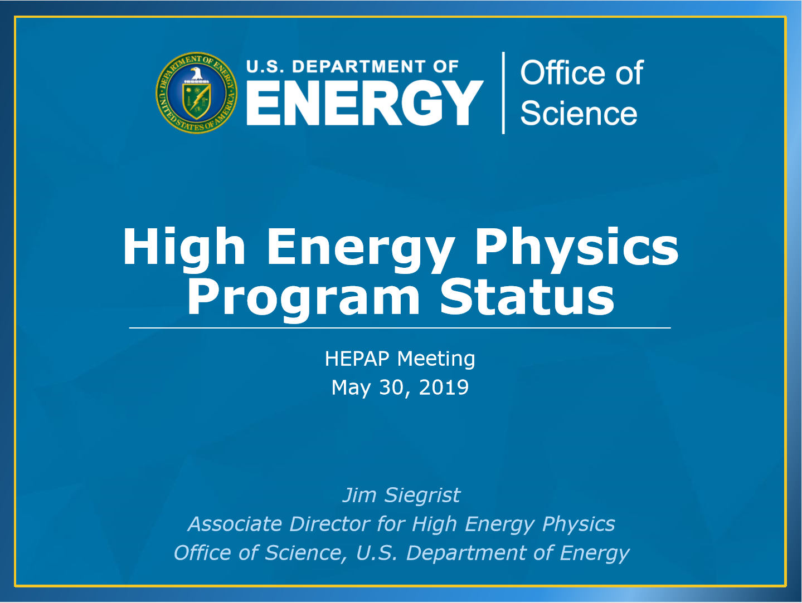
Notes:
3

Slide 4
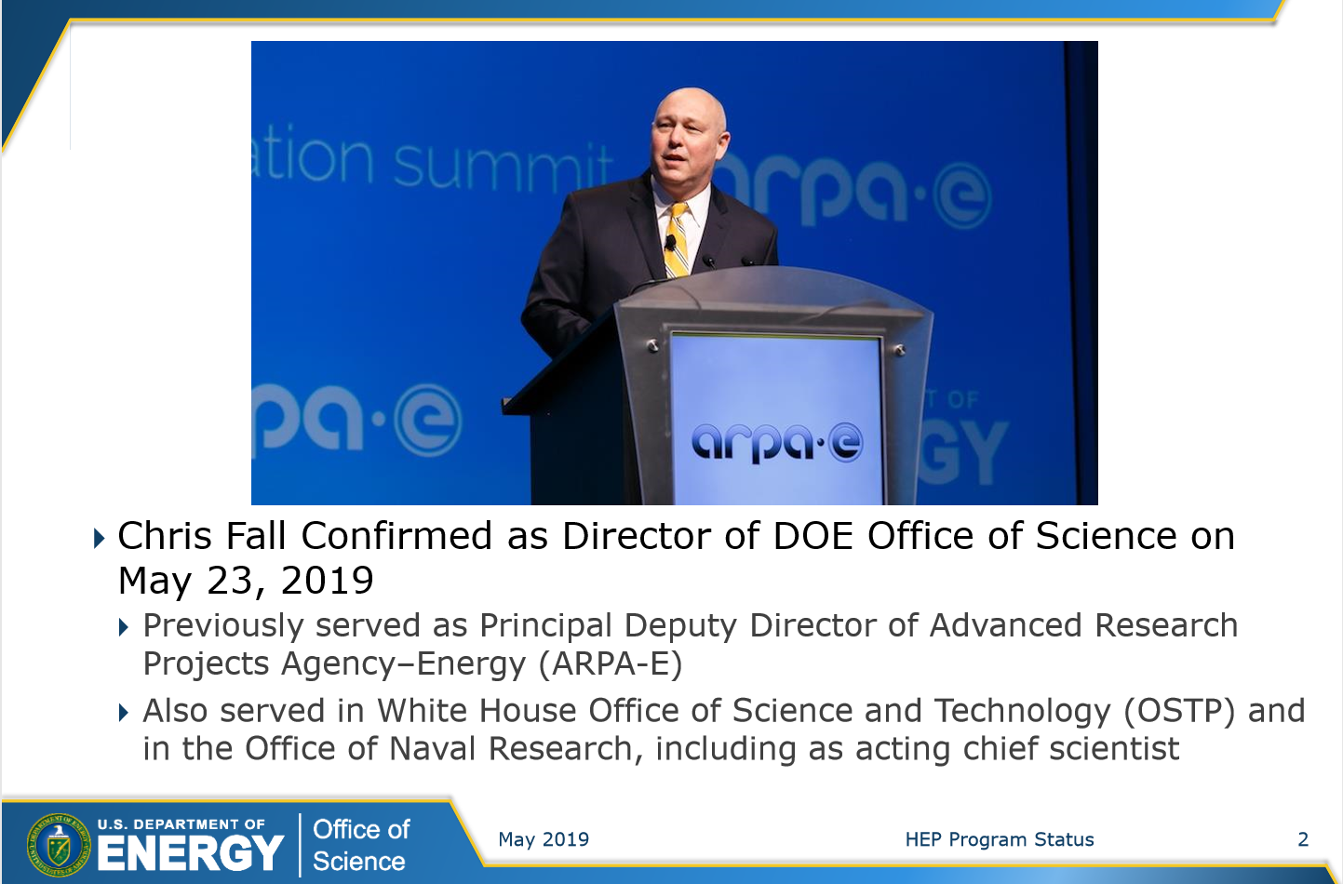
Notes:
4

Slide 5
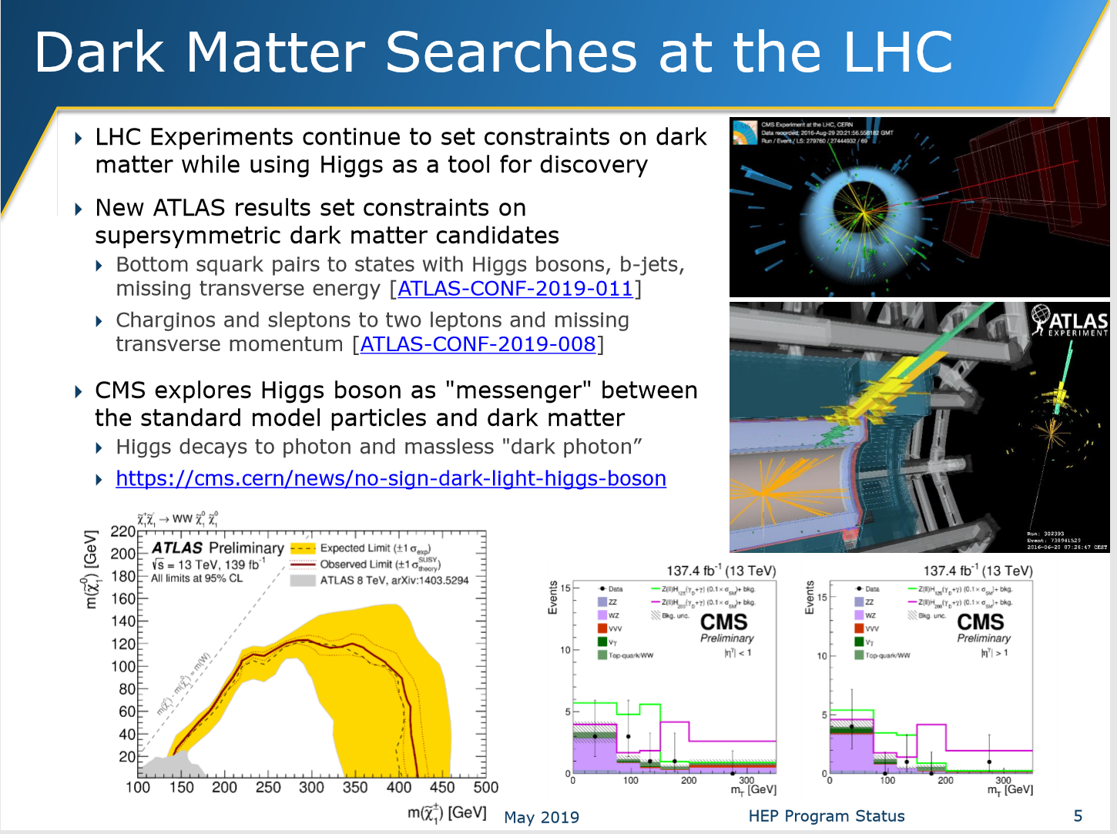
Highlights: LHC, SuperKEKB, PIP II, DES, ADMX-G2, CMB-S4, HEP-QIS,
International Cooperative Engagements
Notes:
5

Slide 6
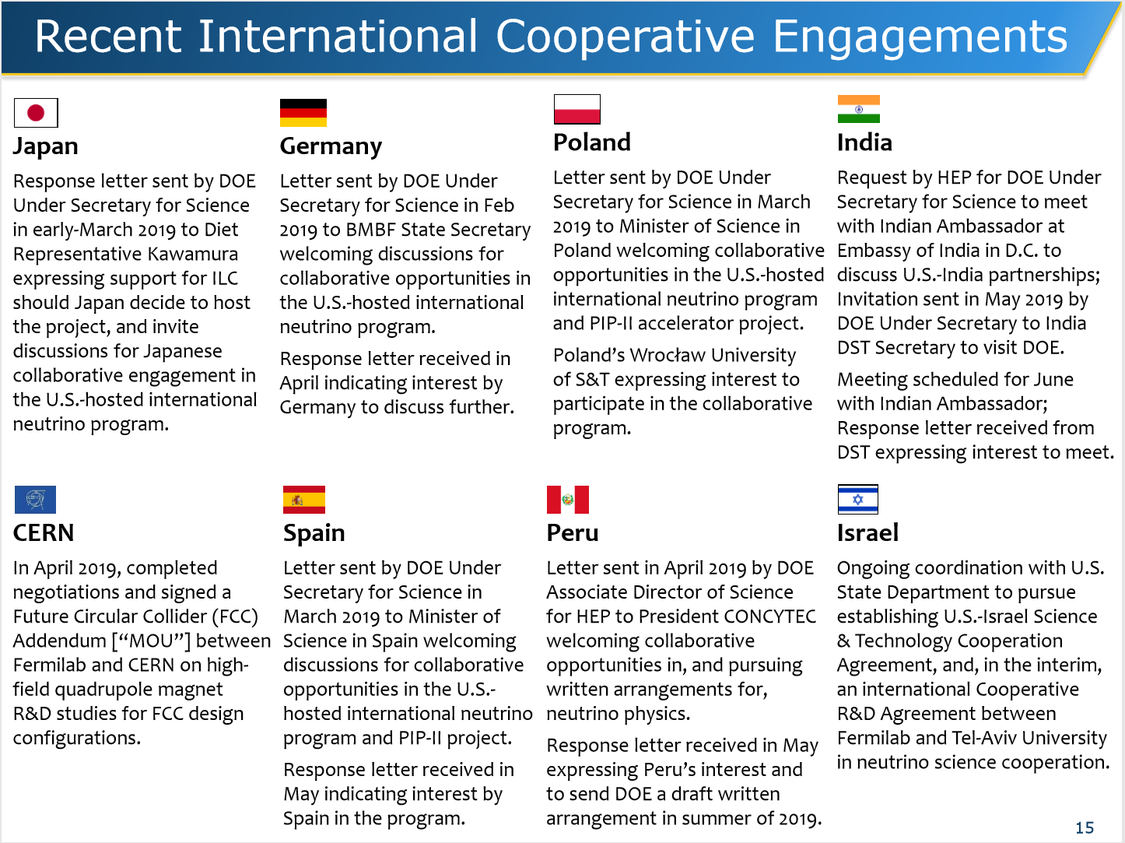
Notes:
6

Slide 7
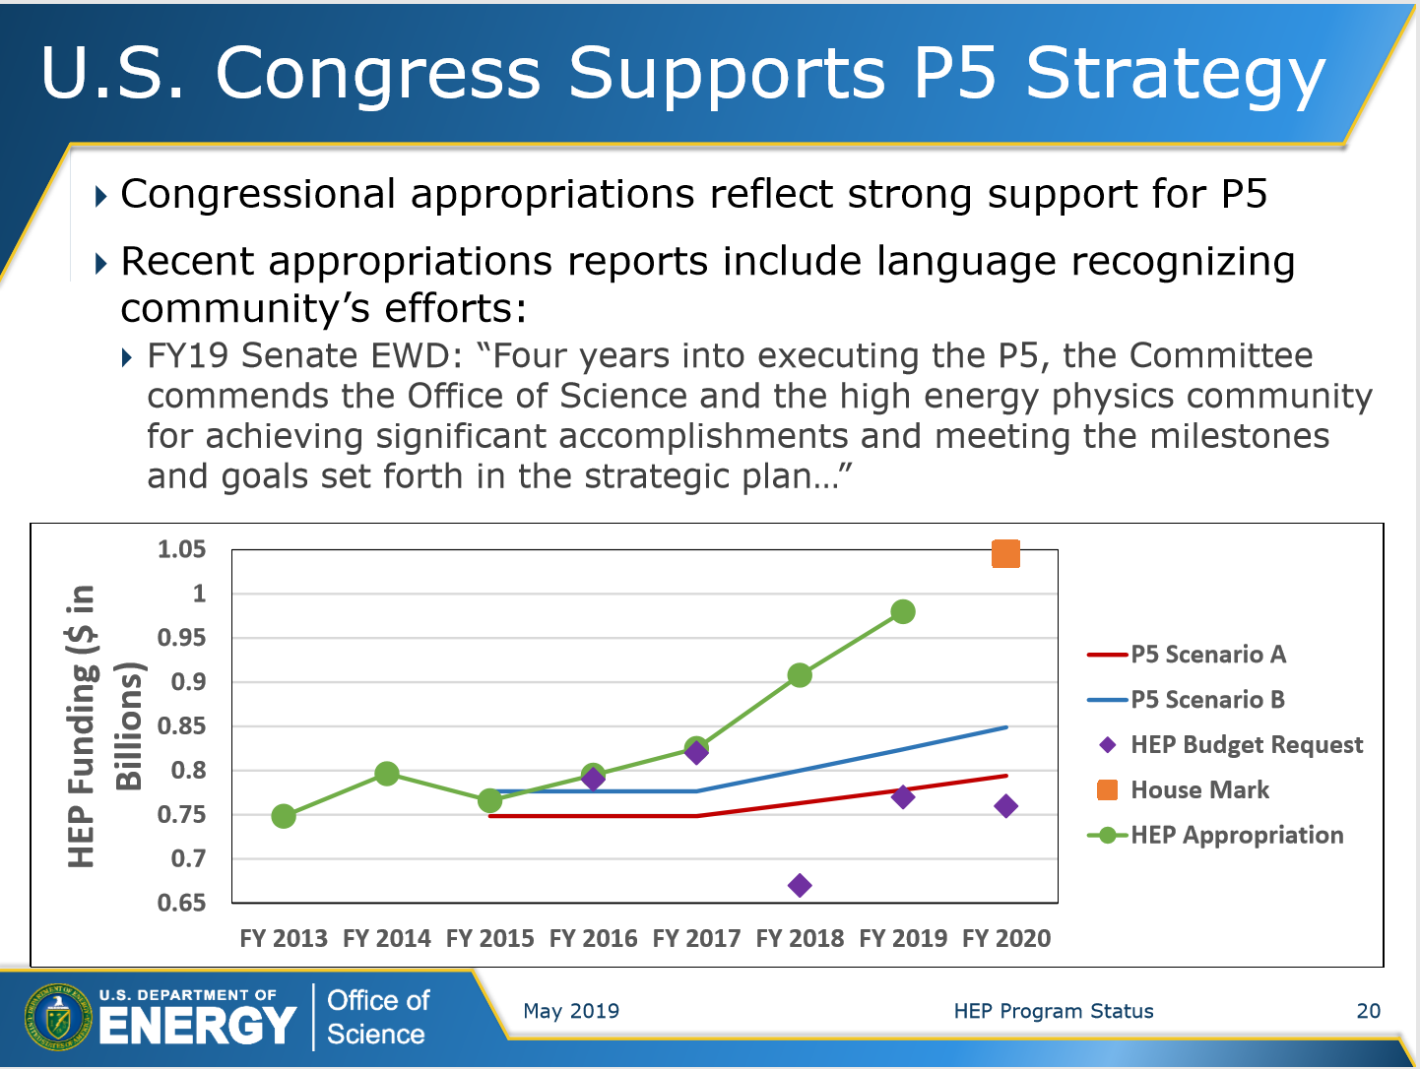
Pressure on
the Core Research Program
Continues
This is an Issue Given the Large
and Rising
top line budget appropriations
At or above P5 Scenario C
$ 1.045B House Mark Equals
HEP Community Ask for FY2020
B
A
Notes:
7

Slide 8
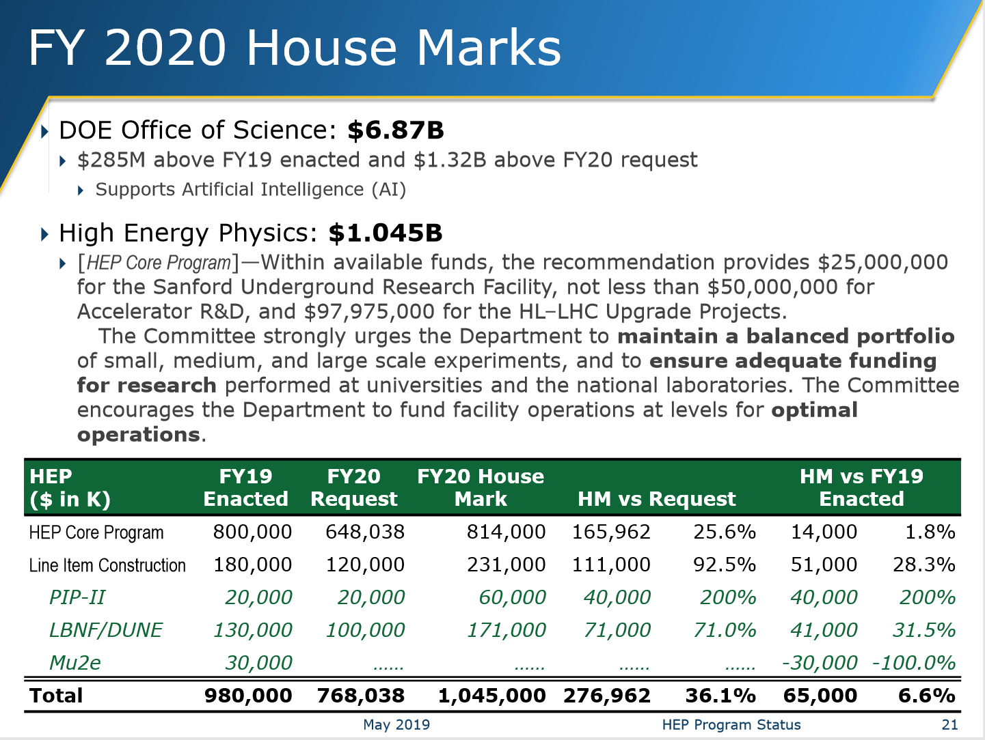
Close to $ 7B ES Coalition + HEP Community Ask
Equals HEP Community Ask
Notes:
8

Slide 9
Core Research, LHC and Other Ops Budget Pressures and Issues (to discuss)
Causes of Pressures in spite of favorable Congressional allocations
  “Acceleration” of LBNF/DUNE Schedule vs. P5 and OMB Guidance
  Project cost increases; rebalancing among the frontiers
  Advocacy in Congress specific to the Intensity Frontier needs,
  versus community advocacy which covers all of HEP
  Resulting specific Congressional earmarks that squeeze
  the rest of the program
Additional (Normal) Factor: Accommodating New Initiatives such as QIS
Issue: Increased Difficulty and Increased Risk
  Meeting personnel and financial needs of the ongoing LHC, HL LHC
  and other programs
  Managing the transition to the next generation(s), giving them the physics and career opportunities they require and deserve
  Maintaining the health of the field, both in the US and globally
Rising Issues in Government Relations
  Natural presumptions in Congress that the young students they meet,
  who are among our best advocates, are well funded
  Our claims that all our projects are “on time, and on budget”, and
  fit within Congress’ (relatively generous) funding allocations
9
Notes:
9

Slide 10
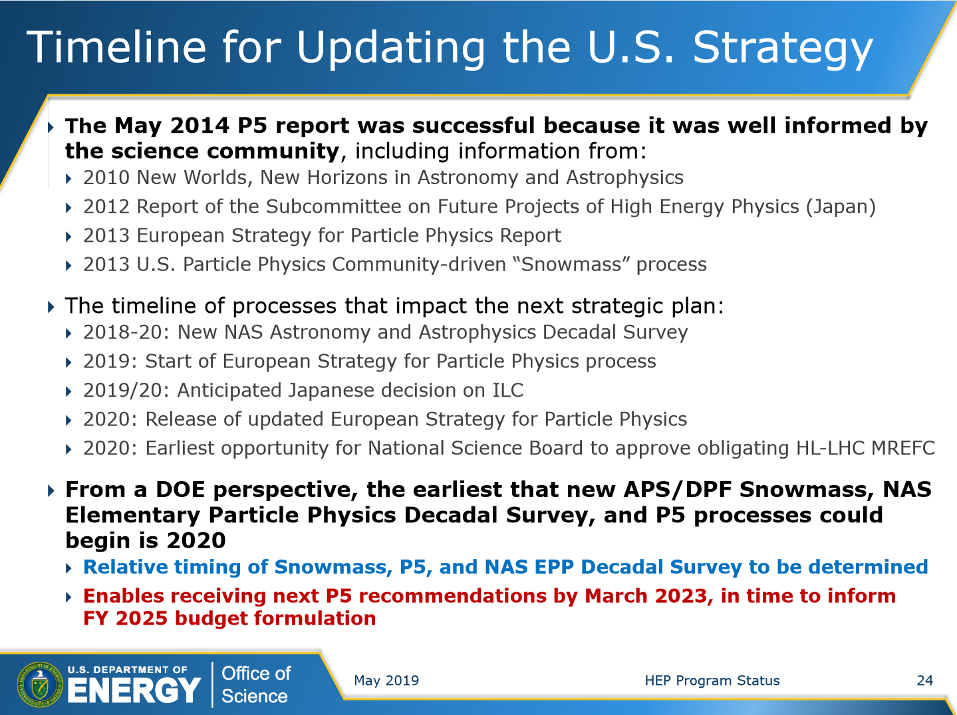
Upcoming Planning Discussions at the PI Meeting and “Snowmass” Lunchtime Session During the APS DPF Meeting at Northeastern July – August
Notes:
10

Slide 11
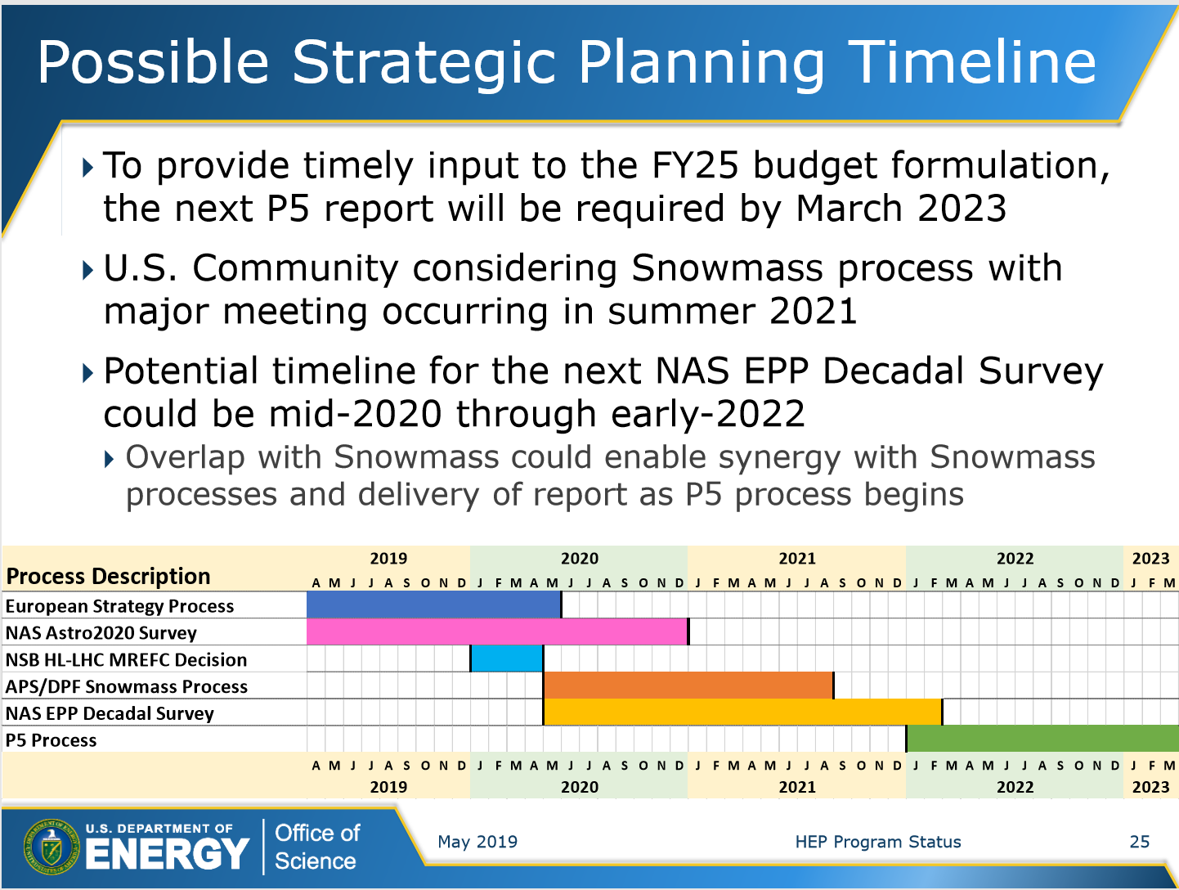
Questions:
Is a March 2023 schedule for the next P5 Report
early enough,
given the requests for information
from Congress?
Is a 3 year lag after the European Strategy Report acceptable ?
How will the next
P5 interact with the 2020-22 NAS EPP Decadal Survey ?
Notes:
11

Slide 12
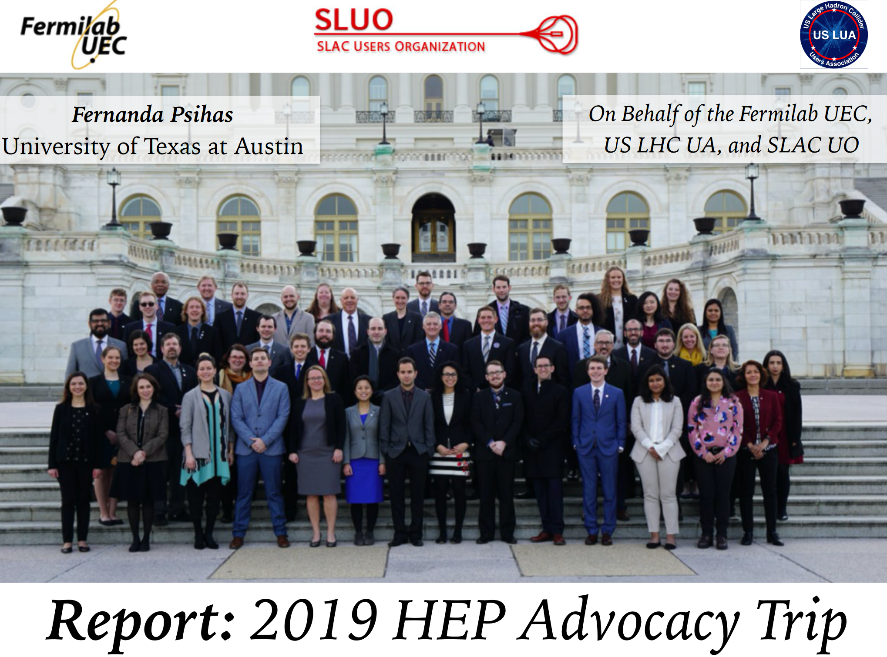
Notes:
12

Slide 13
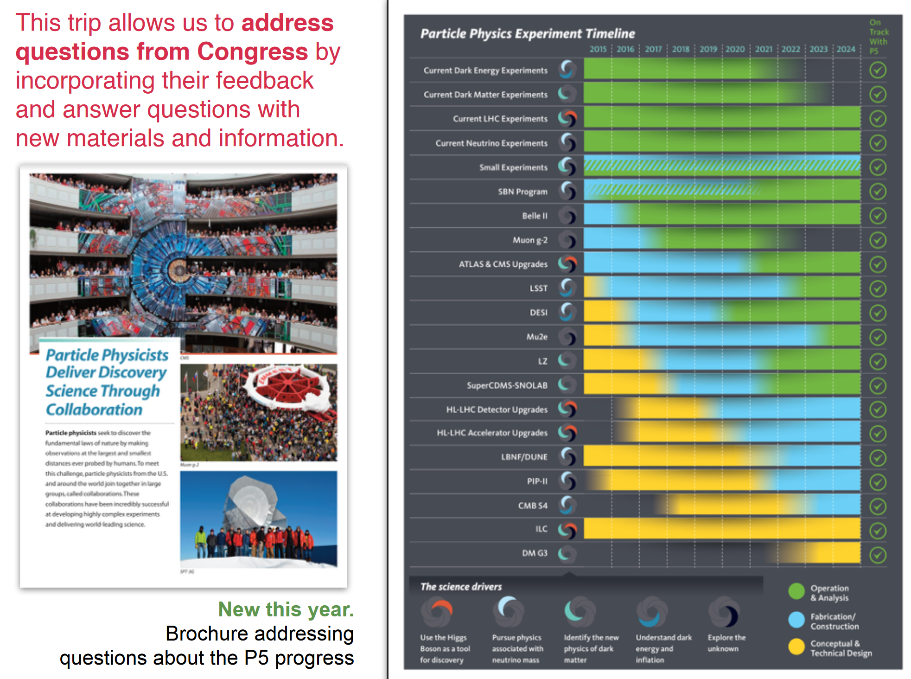
Notes:
13

Slide 14
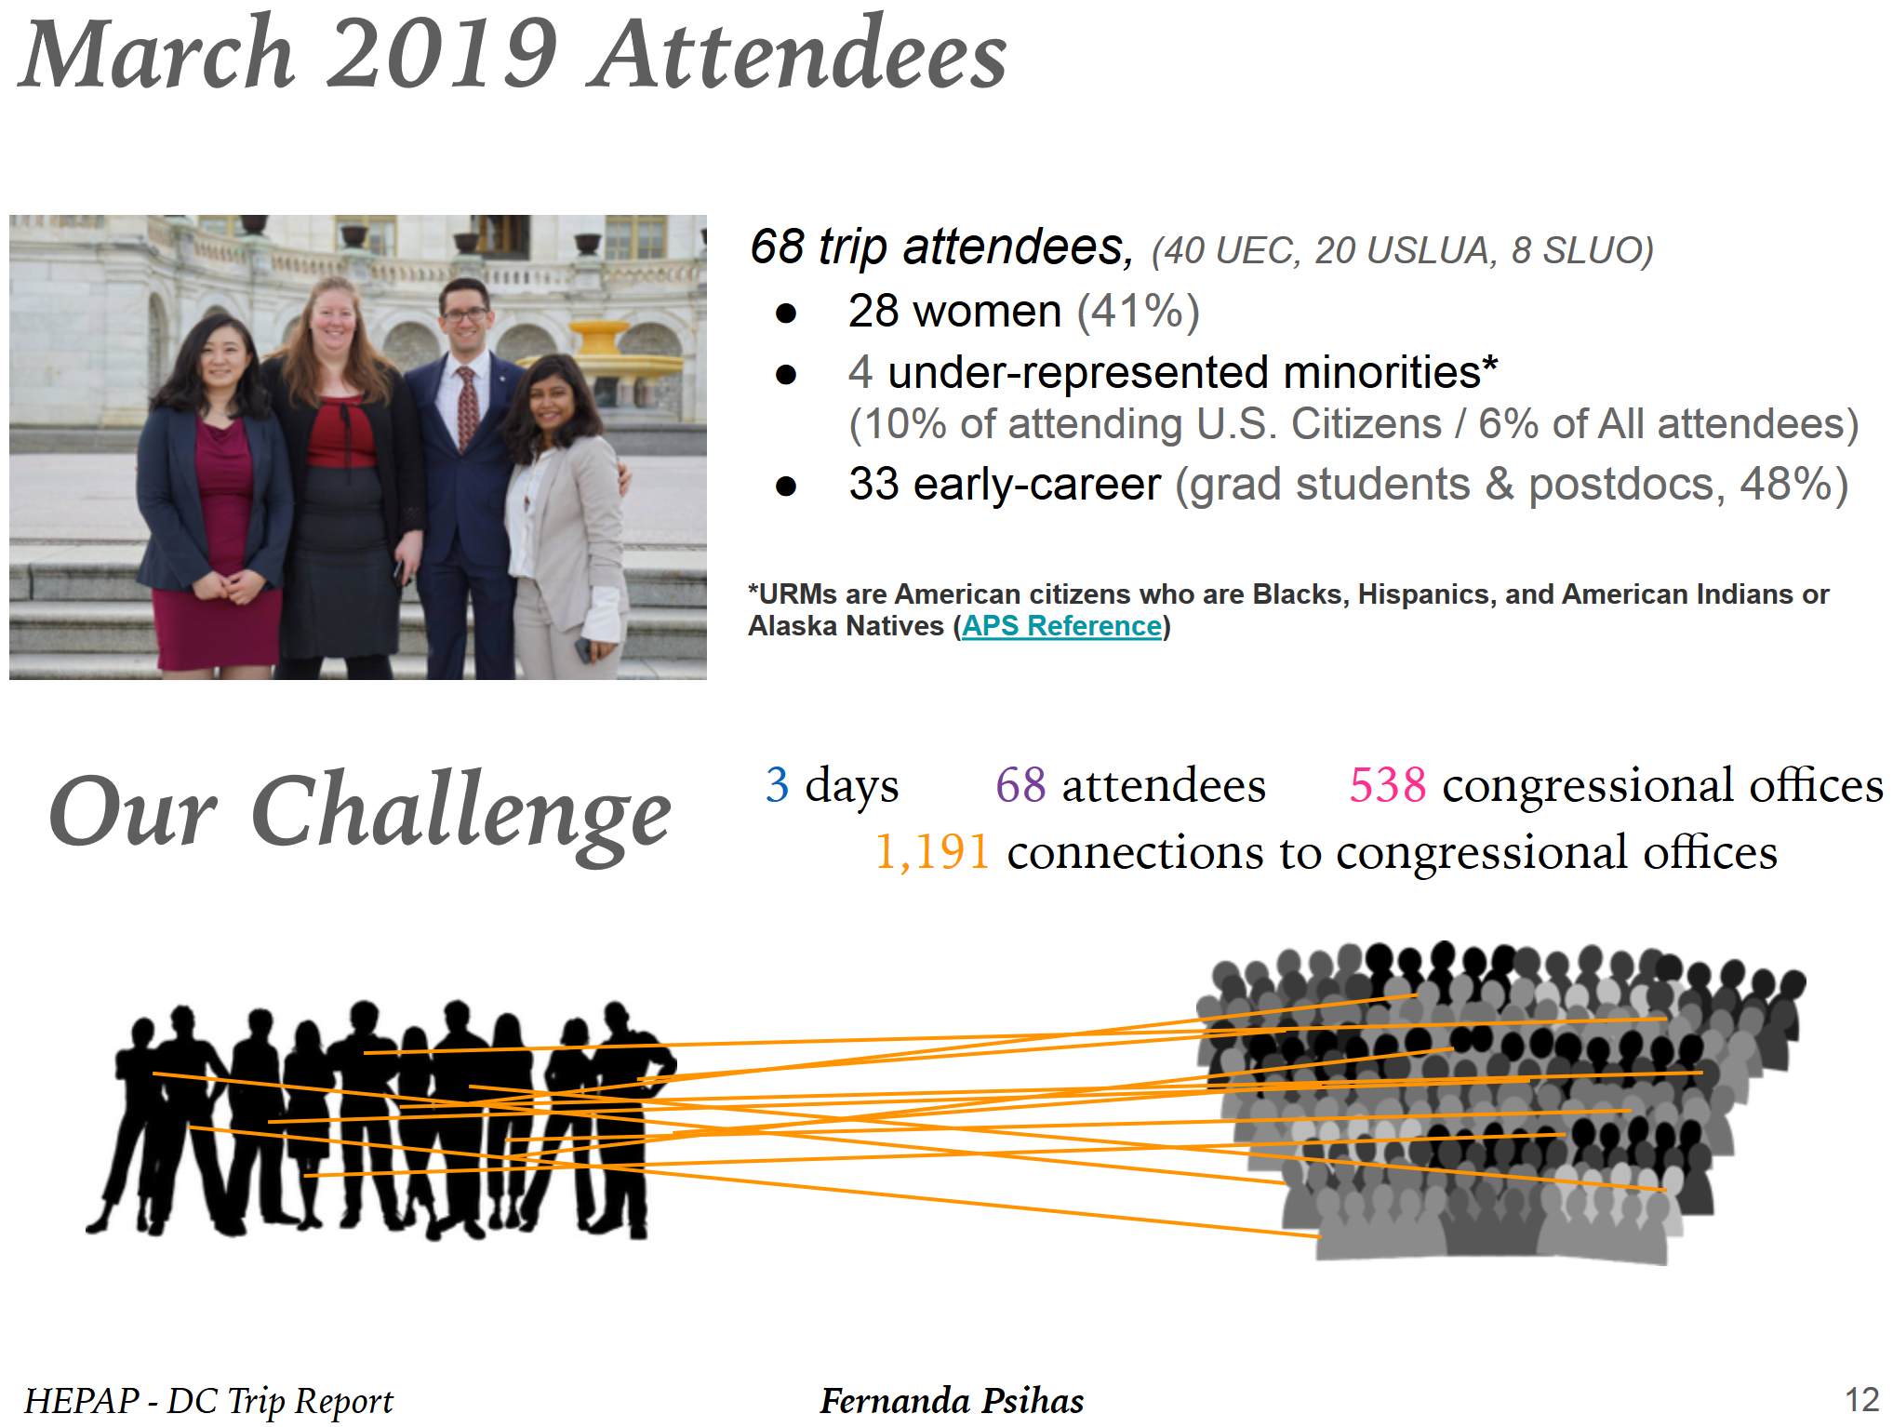
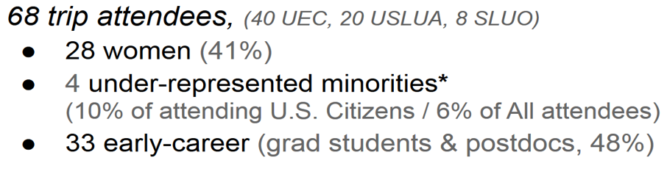
Notes:
14

Slide 15
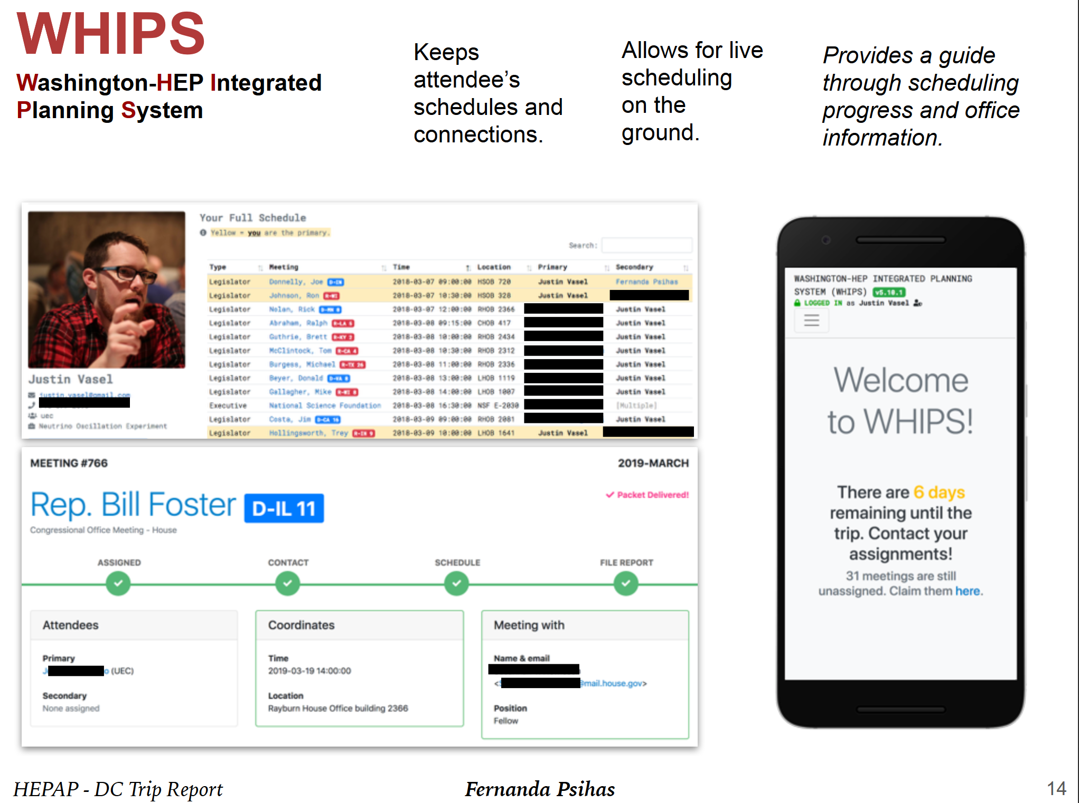
https://www.uec-whips.org/ Justin Vasel and Fernanda Psihas
Notes:
15

Slide 16
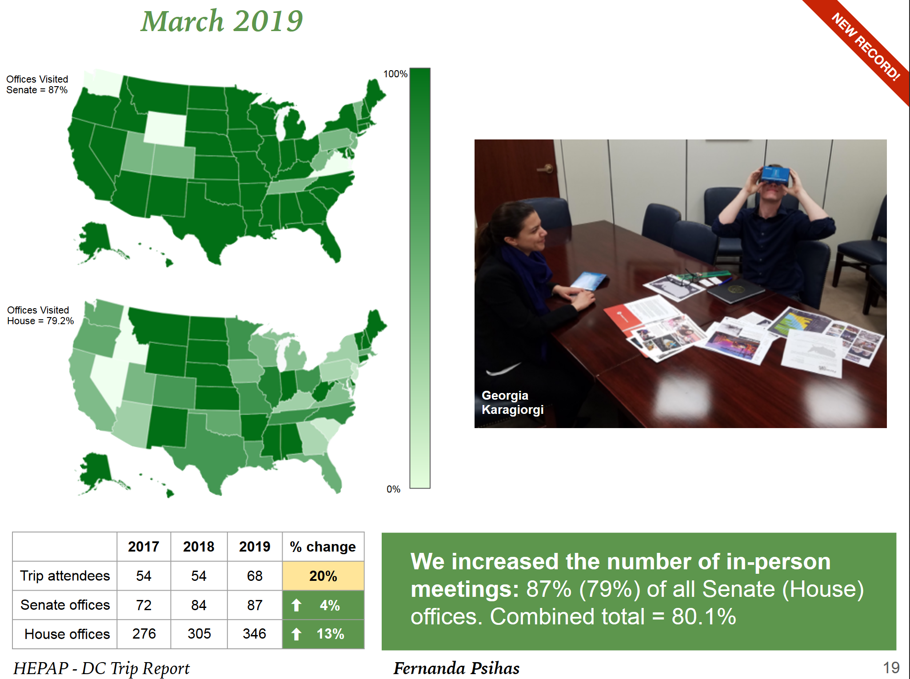

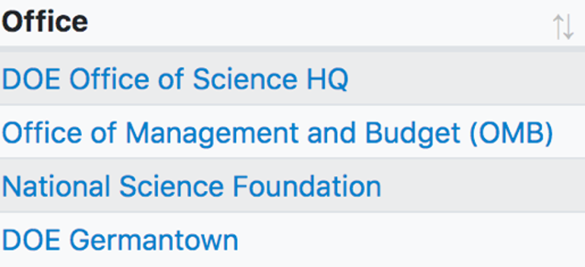
+ Agency and Executive
Office Visits
Notes:
16

Slide 17
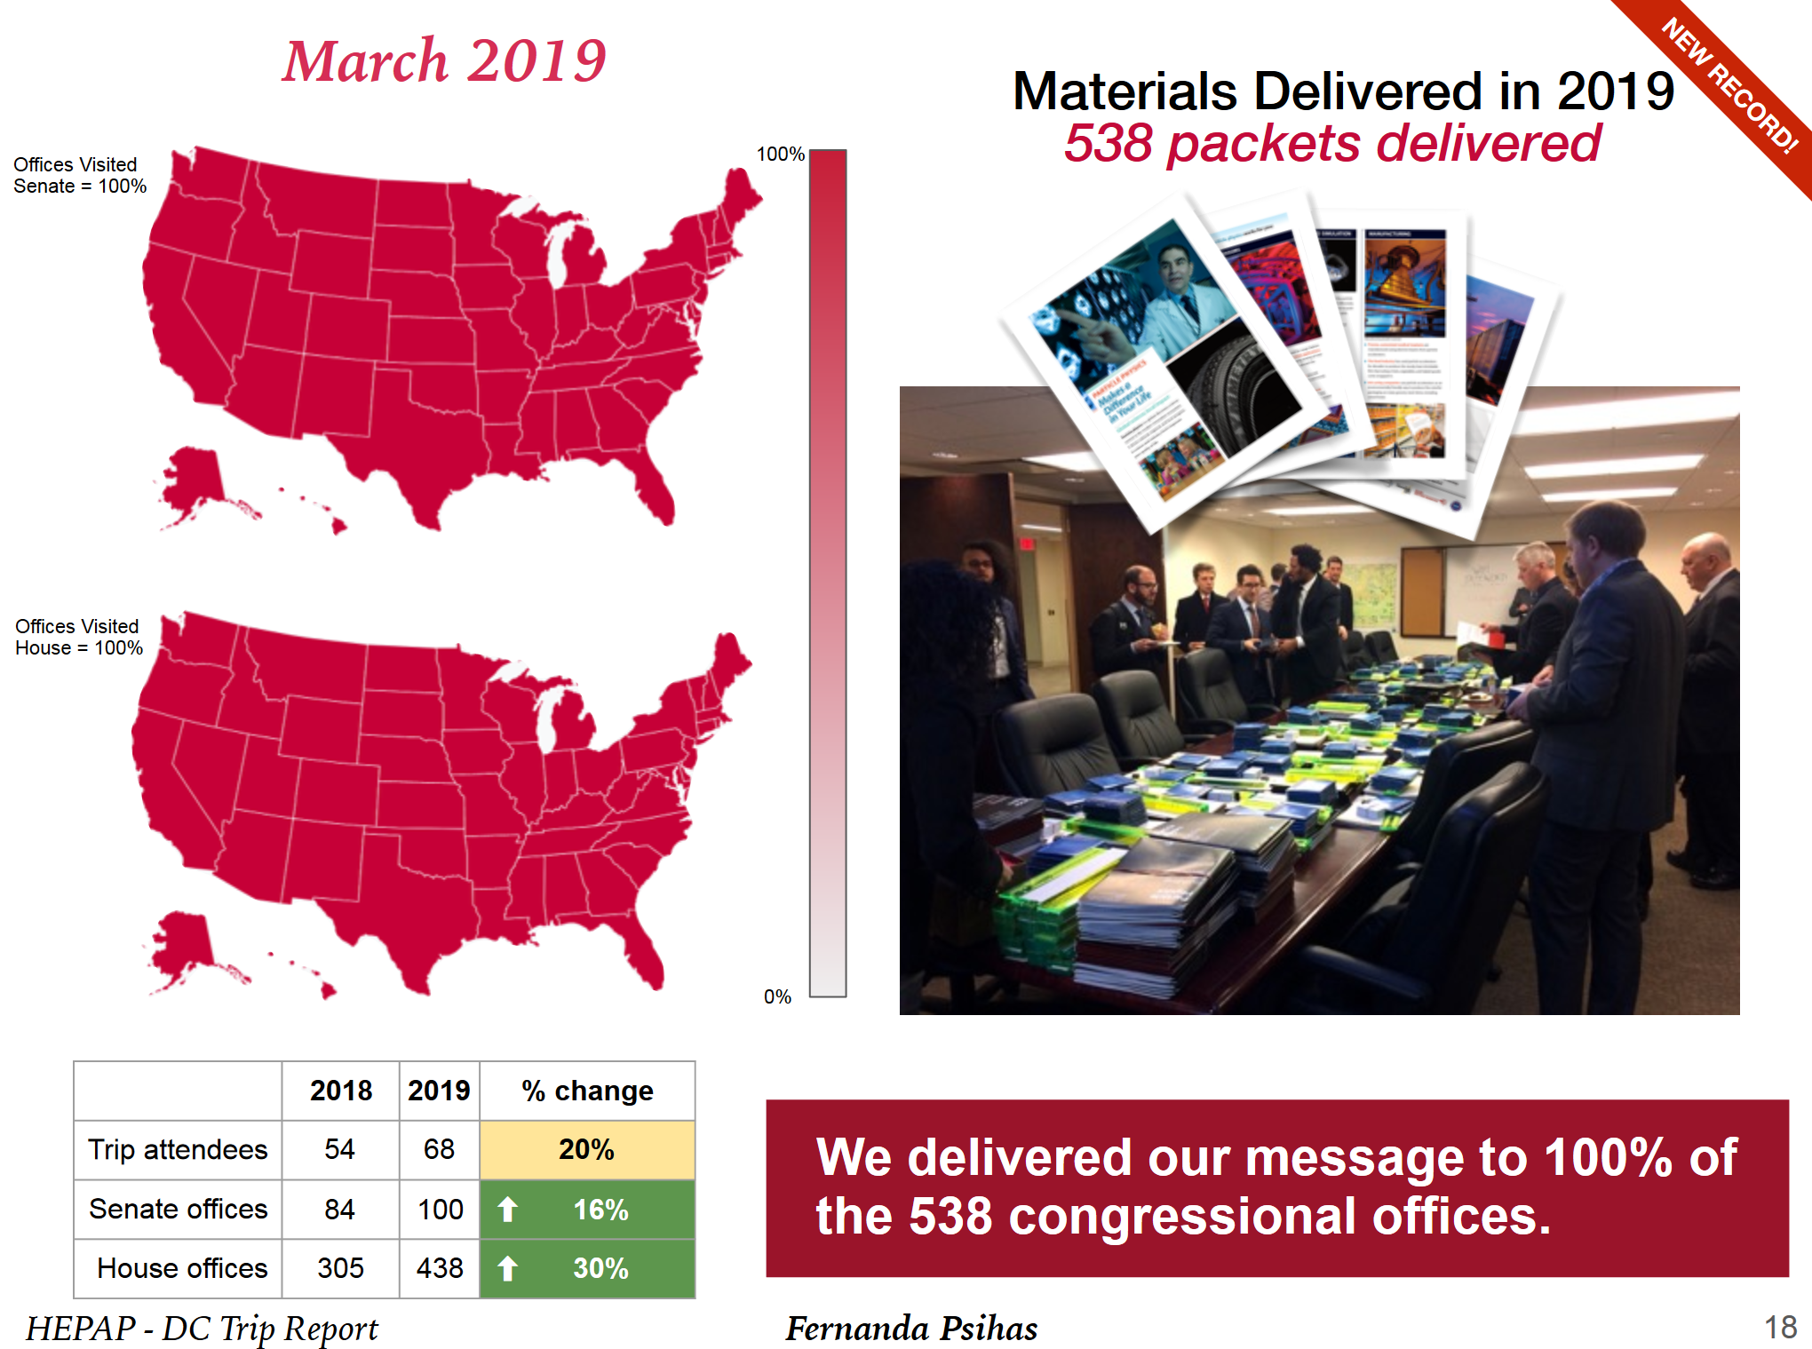
Notes:
17

Slide 18
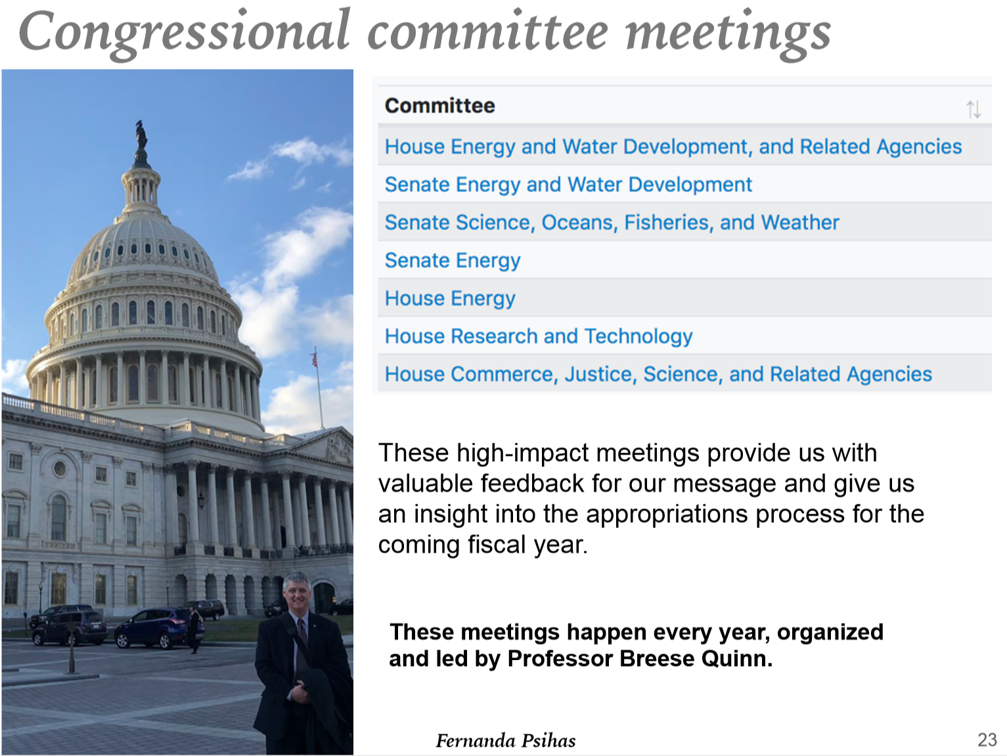
Notes:
18

Slide 19
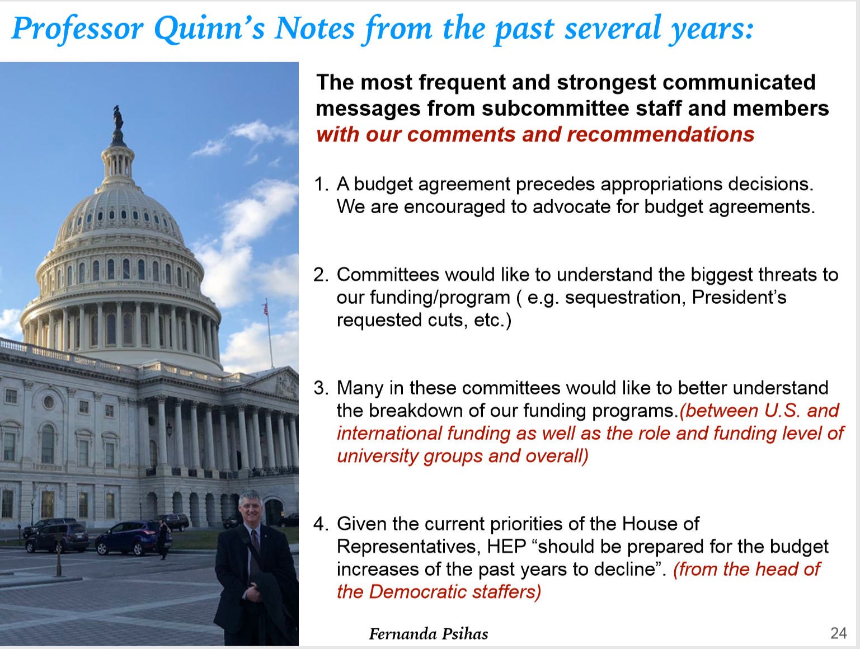
Notes:
19

Slide 20
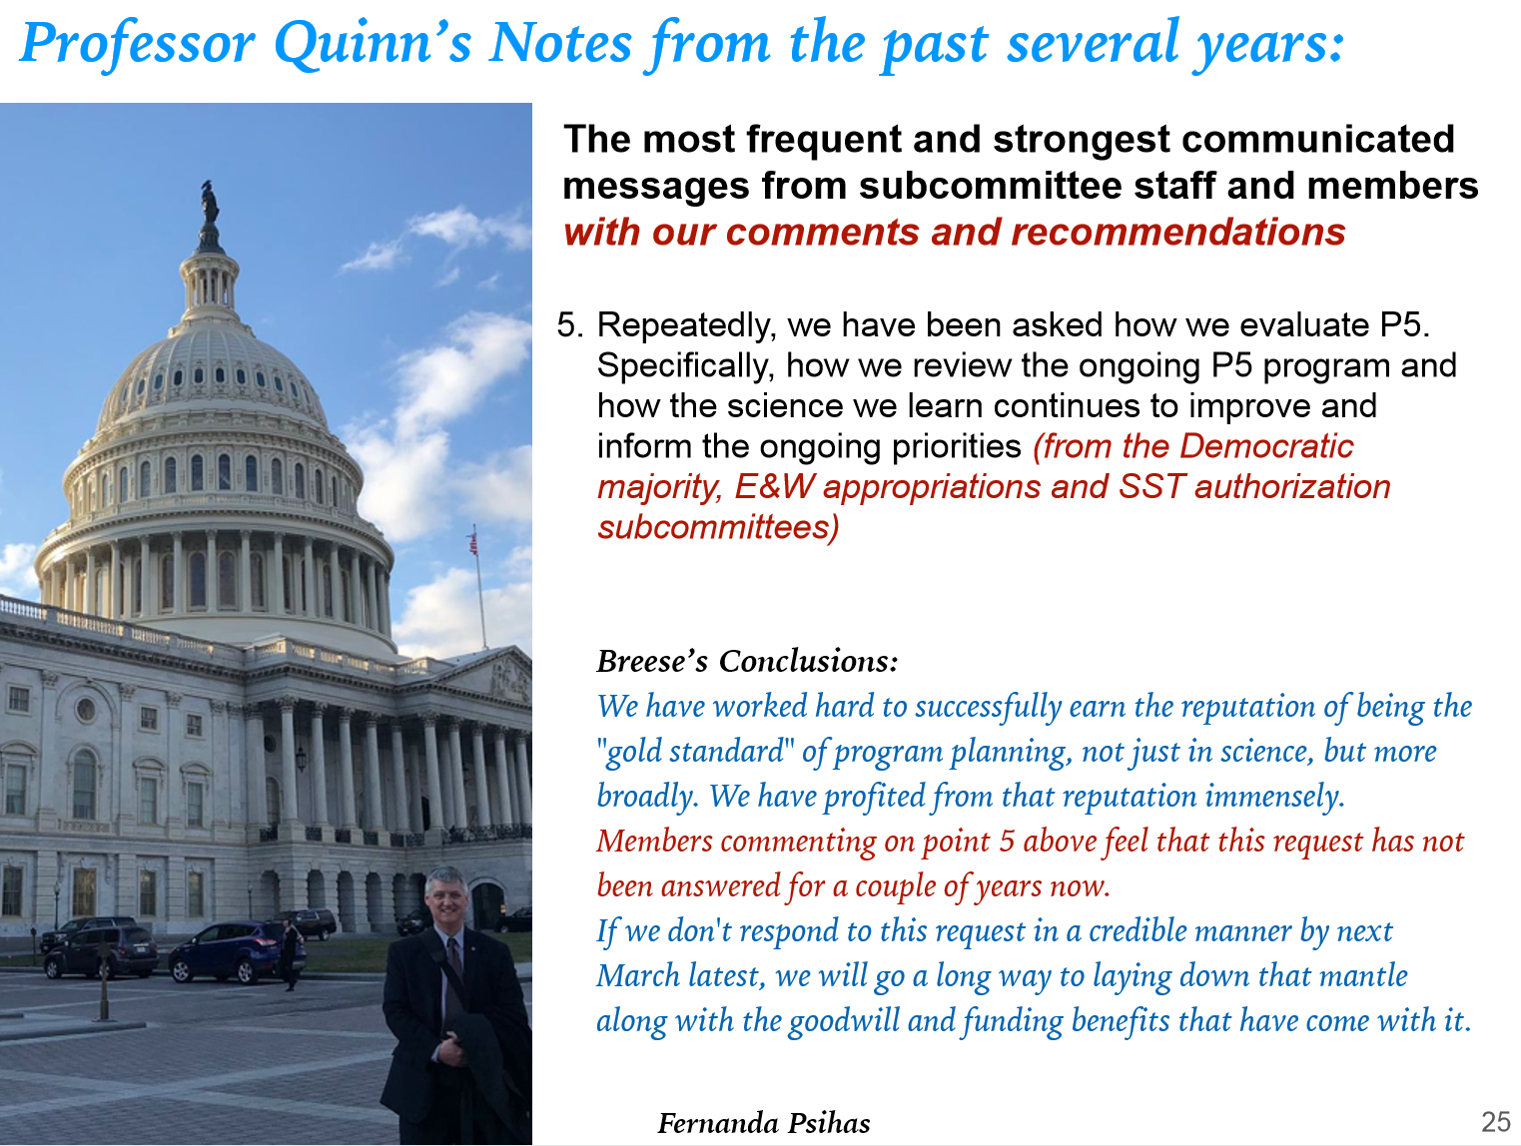
Notes:
20

Slide 21
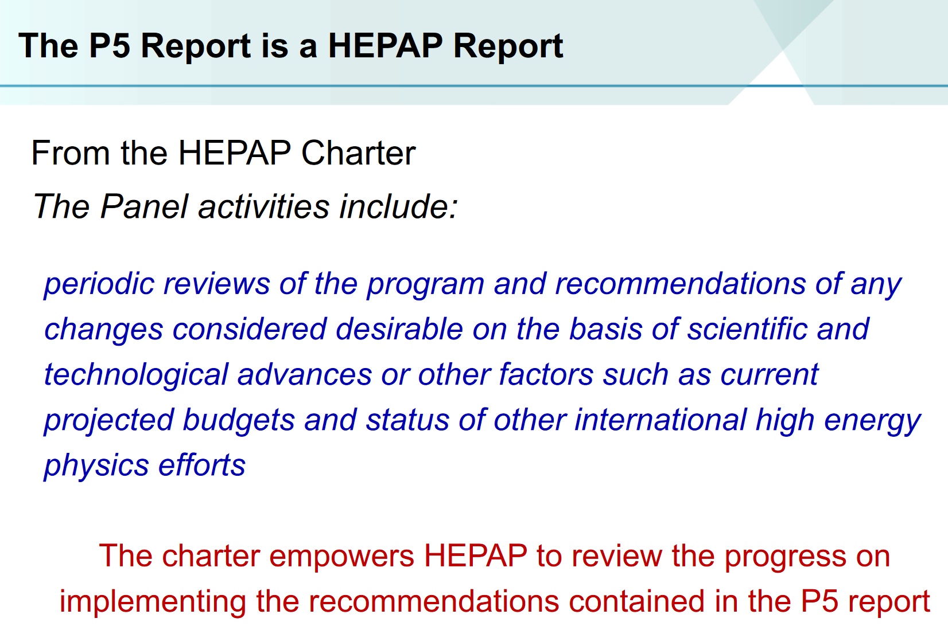
JoAnne Hewett, HEPAP Chair
P5 Refresher and Evaluation
Notes:
21

Slide 22
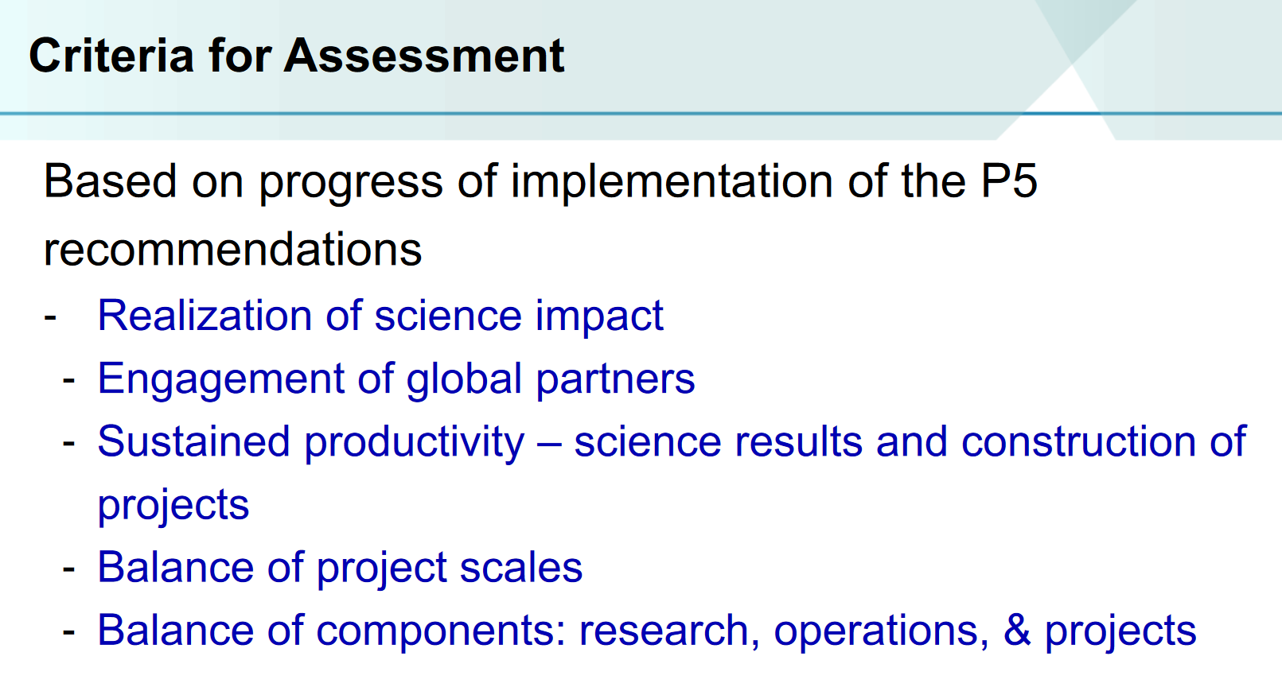
Notes:
22

Slide 23
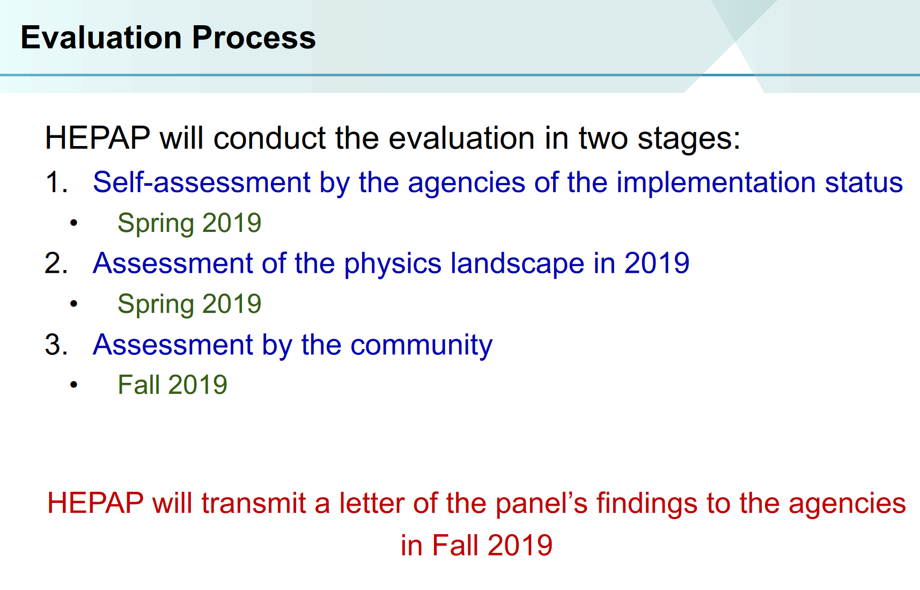
Notes:
23

Slide 24
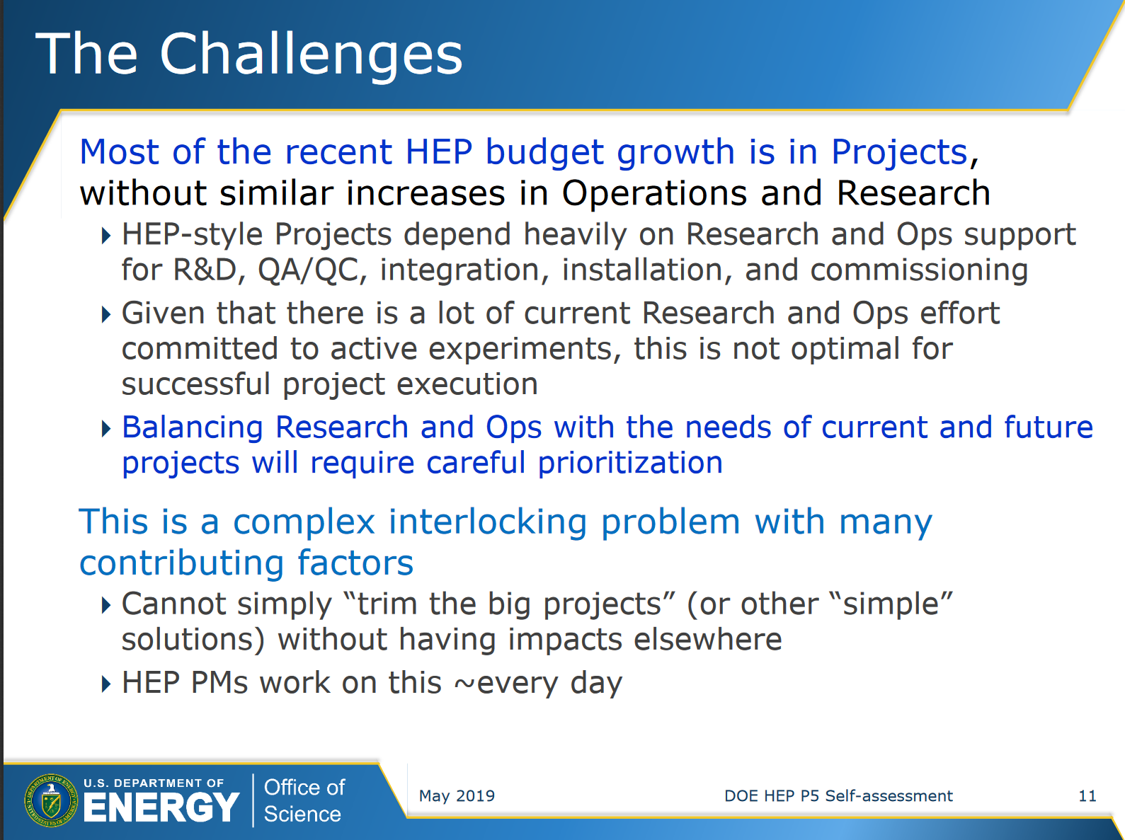
Glen Crawford, DOE HEP P5
Self Assessment
Notes:
24

Slide 25
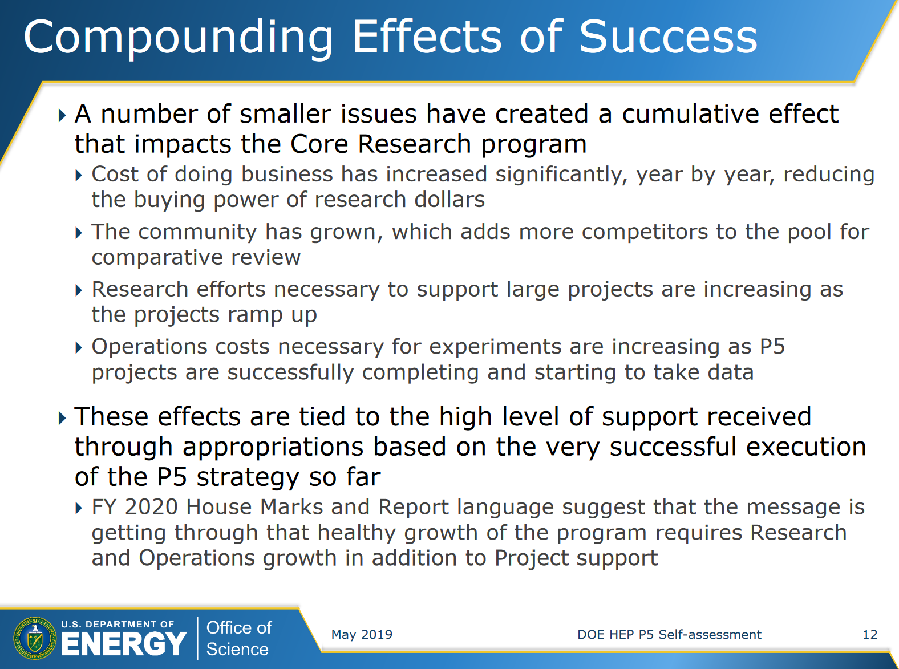
Notes:
25

Slide 26
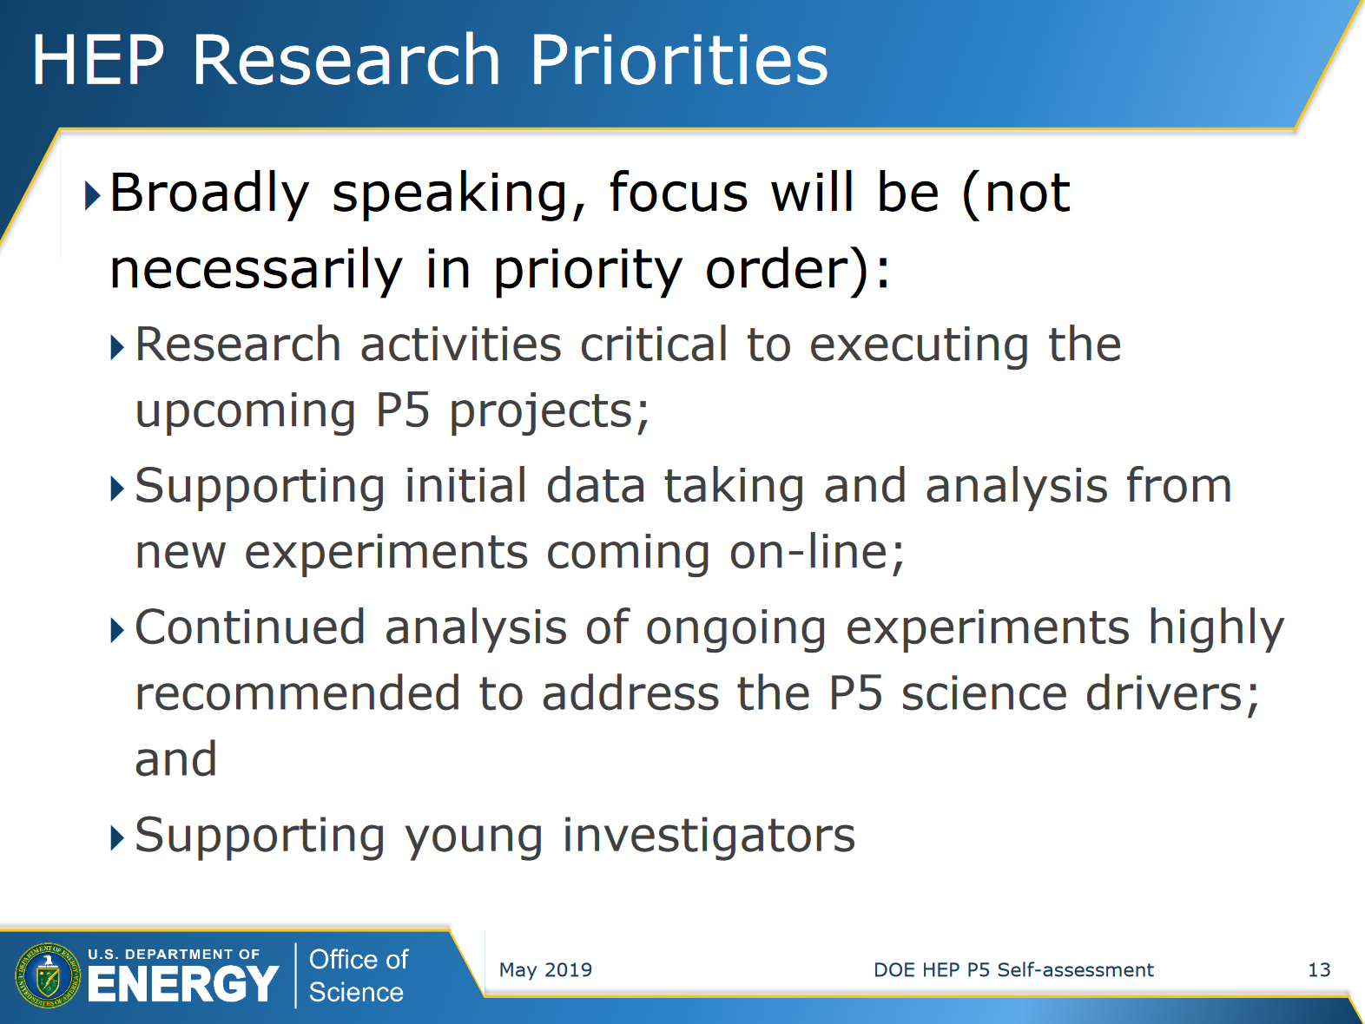
Notes:
26

Slide 27
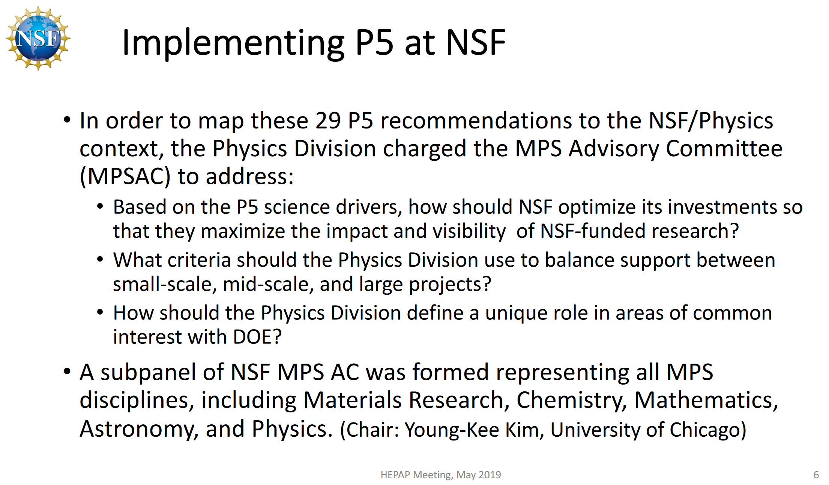
Saul Gonzalez, NSF EPP P5 Self Assessment
See his HEPAP Talk for NSF Response and Comments on Each P5 Recommendation
Notes:
27

Slide 28
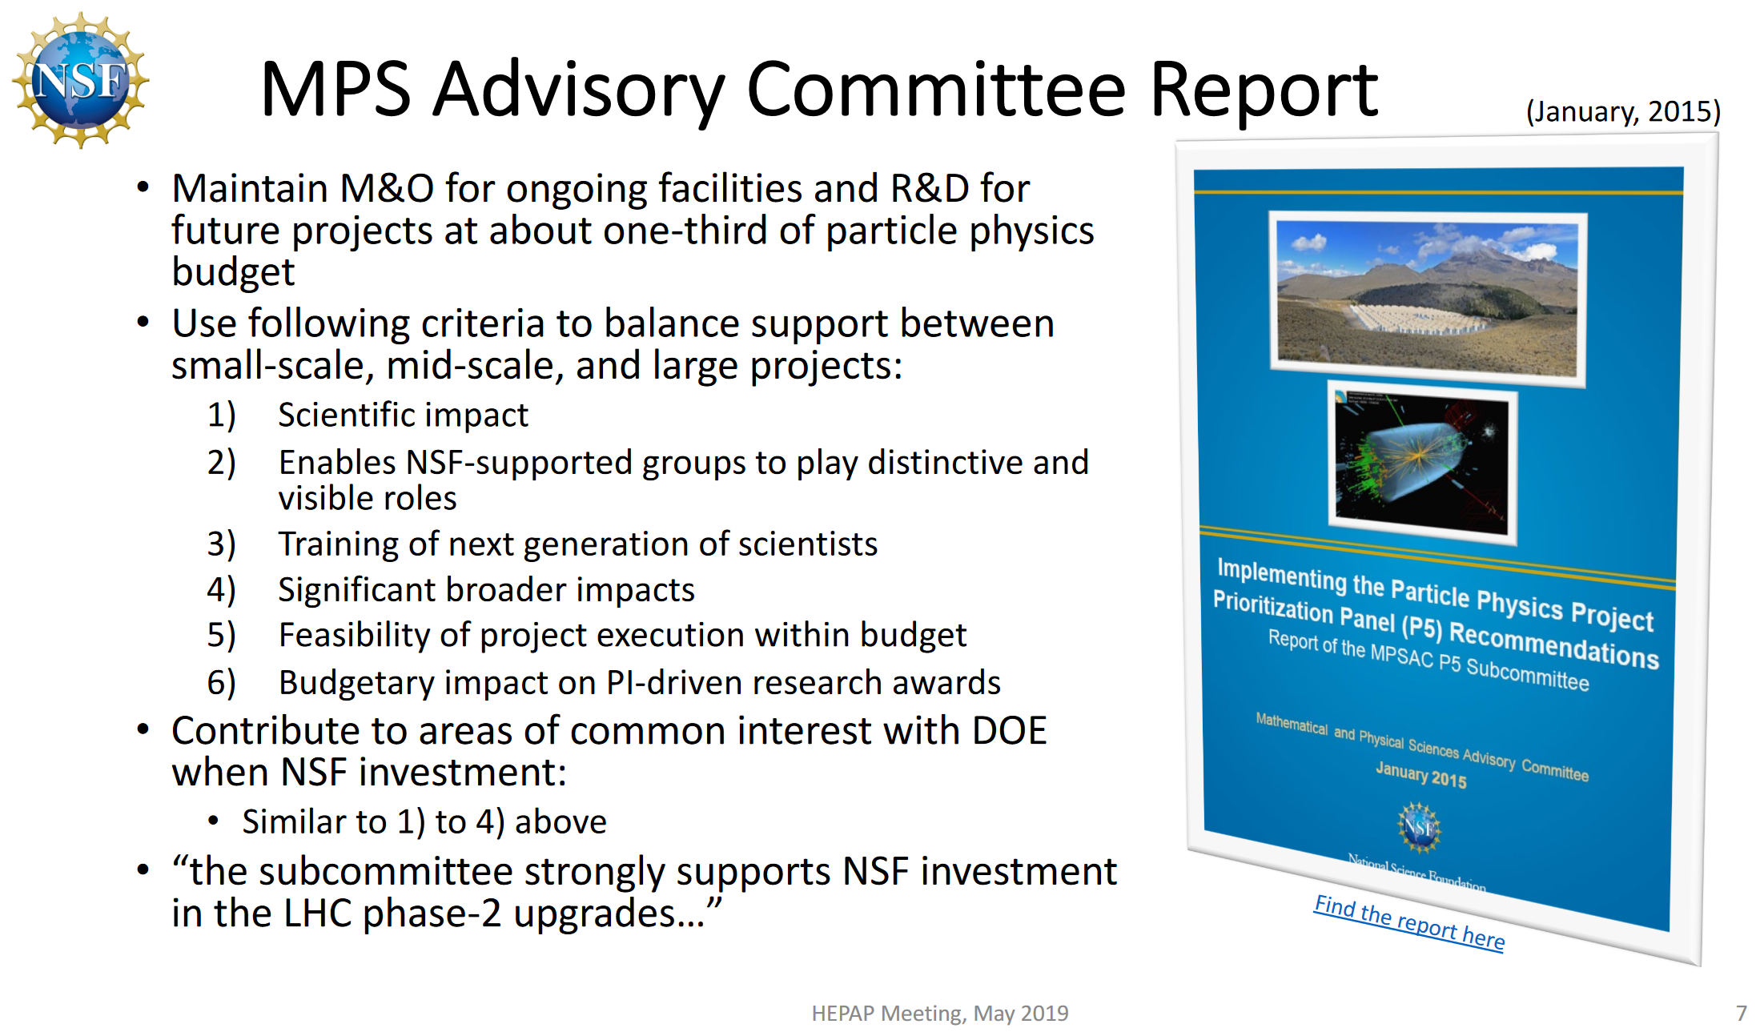
https://www.nsf.gov/mps/advisory/mpsac_other_reports/subcommittee_report_p5_recommendations_final.pdf
Notes:
28

Slide 29
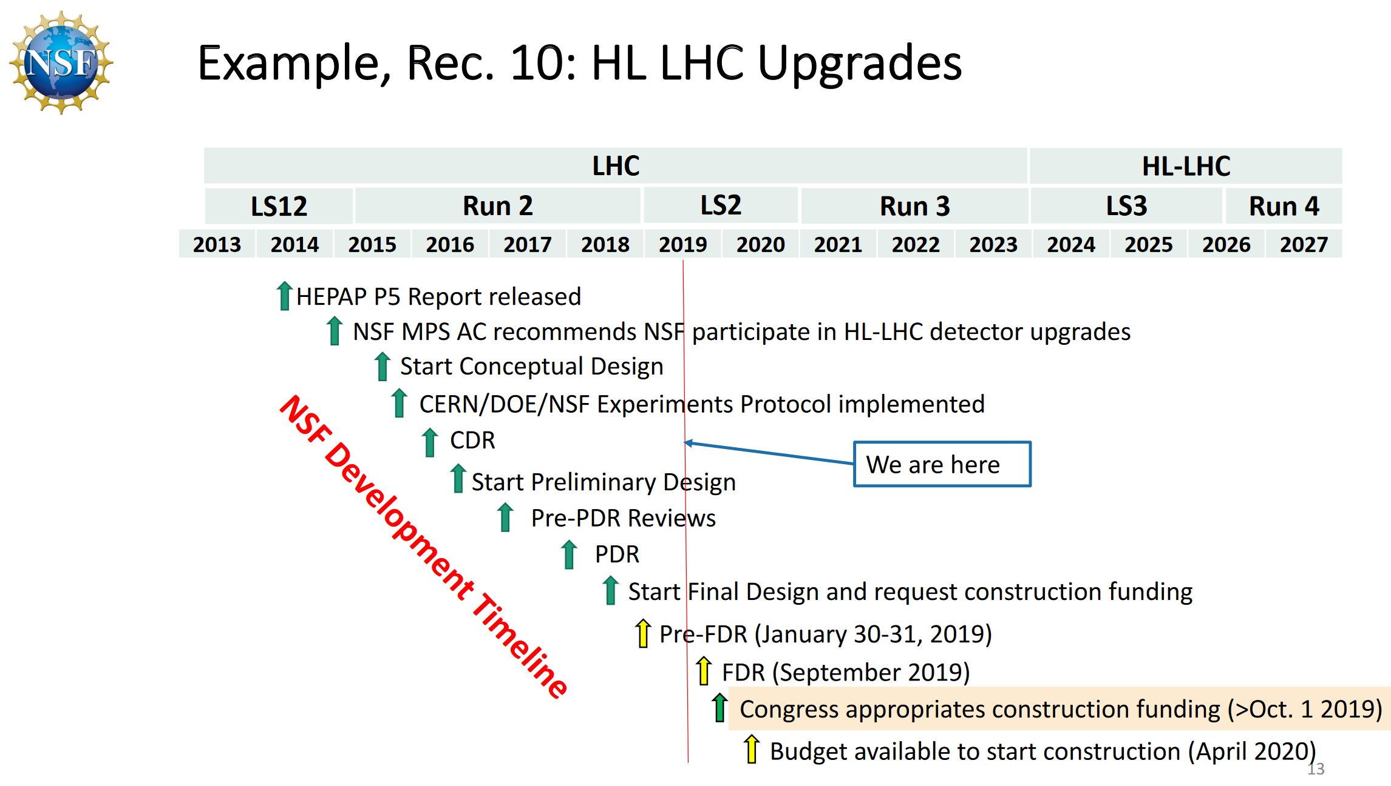
NSF MRE-FC for
US ATLAS and US CMS
$ 150M for ATLAS + CMS
Final Design Review 9/20
Construction Start ~4/20
Major Achievement
Notes:
29

Slide 30
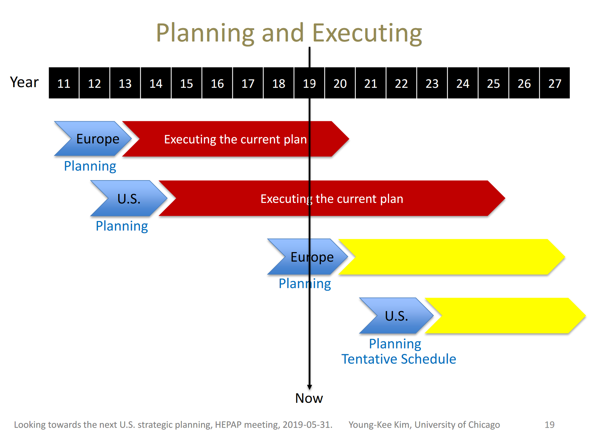
Looking Towards the Next U.S. Strategic Planning
Young-Kee Kim, DPF Chair
Notes:
30

Slide 31
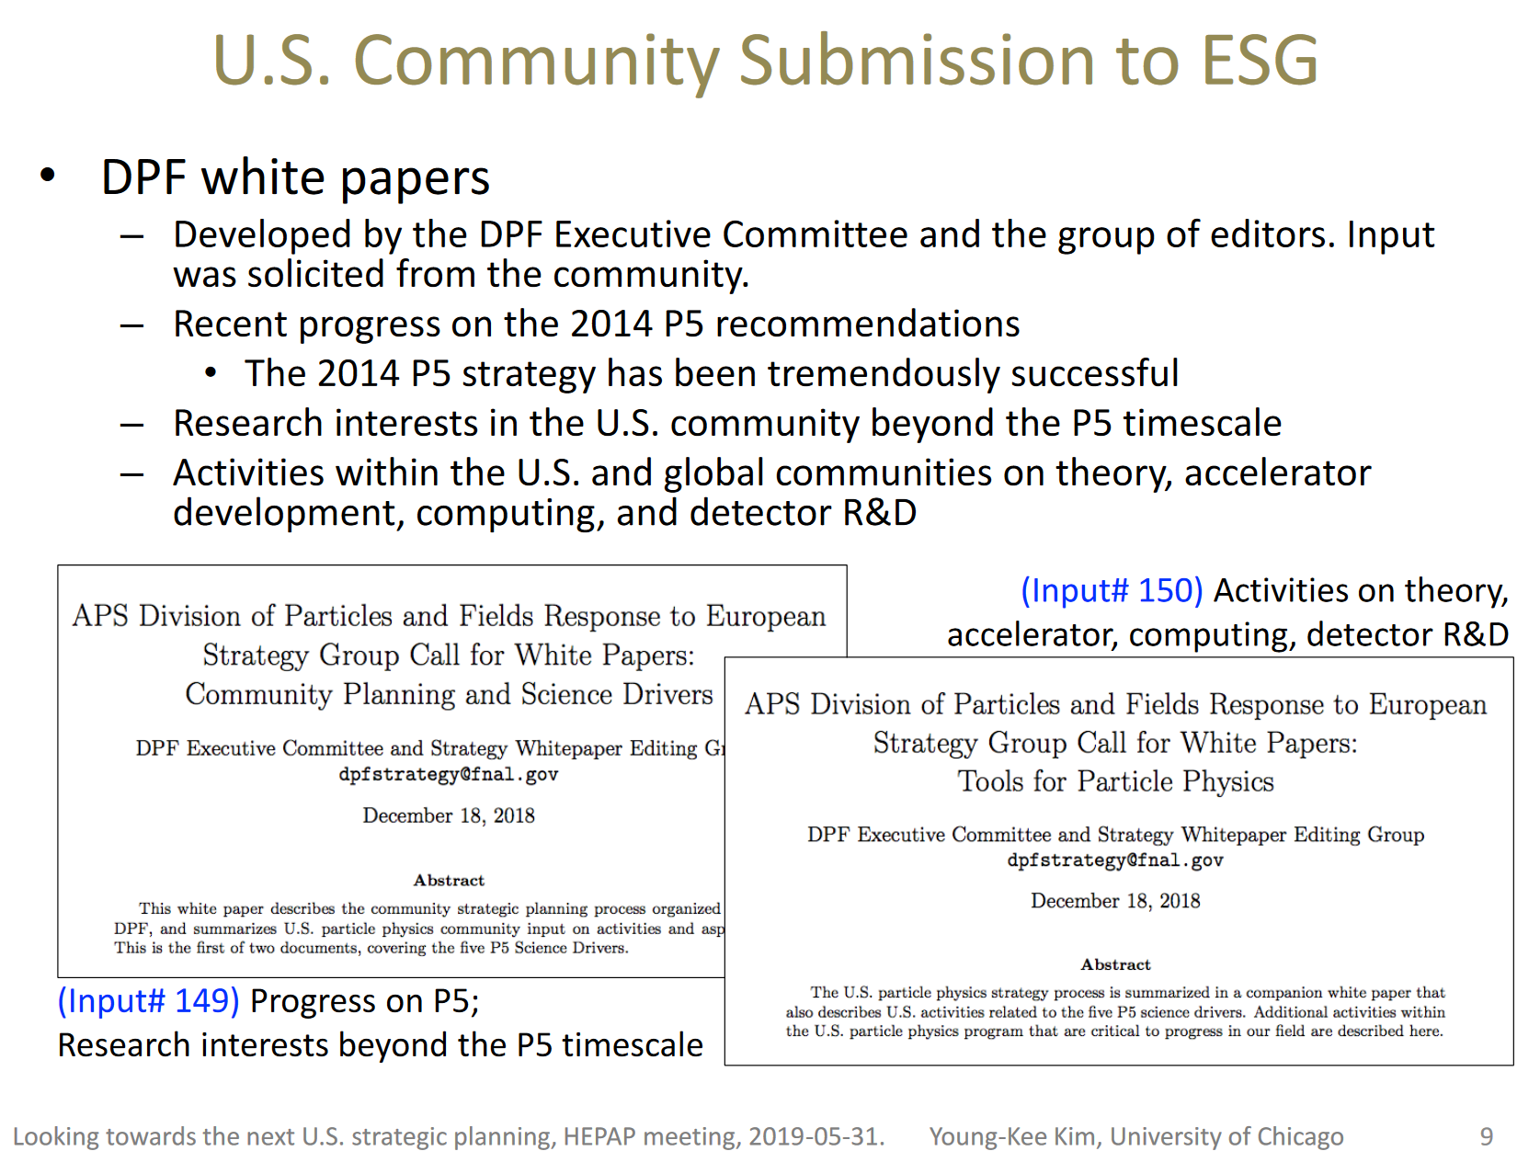
Plus many individual submissions on future programs covered in Young-Kee’s talk
Notes:
31

Slide 32
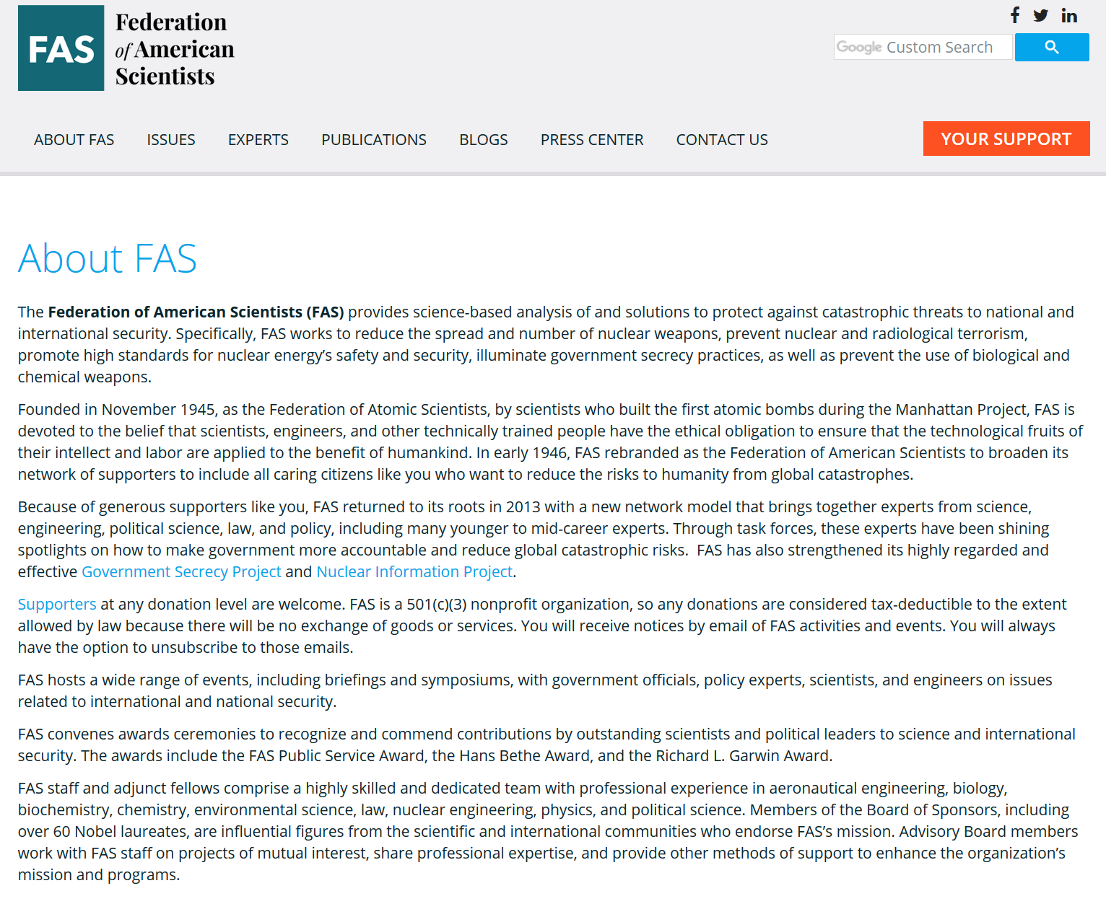
Visit to Ali Nouri, Federation of American Scientists
1112 16th Street NW, June 5, 2019
Notes:
32

Slide 33
Visit to Ali Nouri, Federation of American Scientists
Follow up on Ali Nouri’s Visit to CERN last April
Meeting Subjects:
Funding avenues and roles for US LUA:
  Possible Foundation Sources: Moore, Schmidt, etc.;
  FAS Contacts
  Science Policy-related mission and study of issues
  International meetings and workshops, white papers
  Possible closer engagement with Congressional committees
  dealing with science policy
  Possible joint work with FAS, compatible with US LUA’s mission
  US LUA subcommittee ?
Bill in Grassley’s Senate Finance Committee that day (June 5):
on a panel representing the funding agencies, CIA and FBI that would
aim to develop common strategies for controlling research
Follow up with Ali by HN, Yangyang and others in the US LUEC
Notes:
33

Slide 34
Backup Slides Follow
Notes:
34

Slide 35
US LUA Executive Committee: Now 15 Members
2019 Membership (2 Year Terms)
Name Institution Collaboration Term Expires
Darin Acosta Florida CMS 2020
Kevin Black Wisconsin CMS 2020
Zeynep Demiragli Boston CMS 2020
Eva Halkiadakis Rutgers CMS 2020
Jane Nachtman Iowa CMS 2020
Louise Skinnari Cornell CMS 2020
Michael Williams MIT LHCb 2020
David W. Miller (Observer) U. Chicago ATLAS
Viviana Cavalieri BNL ATLAS 2019
Yangyang Cheng Cornell CMS 2019
Verena Martinez Outschoorn U. Mass ATLAS 2019
Corrinne Mills UIC CMS 2019
Harvey Newman (Chair) Caltech CMS 2019
Gianluca Sabbi (Secretary) LBL LARP 2019
Anthony Timmins U. Houston ALICE 2019
Gordon Watts (Treasurer) Washington ATLAS 2019
Totals: CMS 9, ATLAS 3, LHCb 1, ALICE 1, LARP 1; 1 Observer
Ex-Officio: US ATLAS and CMS PMs, Deputies, CB Chairs, IB Chairs;
35
Notes:
35

Slide 36
US LUEC Sub-Committees 2018
Quality of Life: Usha Mallik (Chair and ACCU Representative);
Darin Acosta, Verena Martinez Outschoorn, Viviana Cavaliere,
Harvey Newman, Corrinne Mills, Toyoko Orimoto, Anthony Timmins
Gov’t Relations: Yangyang Cheng (Chair), Jahred Adelman, Harvey Newman, Usha Mallik, Verena Martinez Outschoorn, Corrinne Mills,
Gianluca Sabbi, Anthony Timmins
Outreach: Verena Martinez Outschoorn (Chair), Jahred Adelman, Harvey Newman, Toyoko Orimoto, Gianluca Sabbi, Julia Gonski,
Jane Nachtmann
Web Presence: Viviana Cavaliere (Chair), Gordon Watts, Darin Acosta, Jane Nachtmann, Toyoko Orimoto
Finance, Fund Raising: Gordon Watts (Chair), Harvey Newman
Communications: Darin Acosta (Chair), Yangyang Cheng, Toyoko Orimoto, Gordon Watts, Julia Gonski
Annual Meeting TF: H. Newman (Chair); Corrinne Mills, Verena Martinez, Anthony Timmins
Rules & Elections Taskforce: Jahred Adelman (Chair); Gianluca
Sabbi, Usha Mallik, Harvey Newman, Sheldon Stone
36
Notes:
36

Slide 37




HEP DC Trips: Joint Effort of UEC, US LUA, SLUO
with DPF on Behalf of Entire US HEP Community
  Communicate the nature, excitement, importance of the physical sciences, and
  the key roles of HEP in particular
    To science, education, innovations and
    to the leadership of the nation
    Visit as many Congressional Offices as
    possible; build upon or develop as
    strong ongoing connections as possible
    Establish and develop the foundation
    that leads to the funding needed by HEP
    Also in hard or controversial times: promote
    the value of the long term science mission
  Boosted by our unity (the P5 Report),
  the grand breakthroughs in science
  (LIGO and past Nobel Prizes among them)
  Inspiring the young to fulfill their aspirations
Running for ~36 Years
US LUA for 12 Years
Notes:
37

Slide 38

Strategy for Success
With thanks to
Sal Rappoccio
Who we are: 6000 scientists, engineers and technologists from 180 universities and laboratories working in the US and overseas
The Science we do is exciting; drives innovation, and trains the workforce
  Remind / inform them of previous and present successes
  Tell them what is coming in the next
  5-10 years
Don’t make it political
  Strong bipartisan support for HEP (really)
  The bills containing our budget passed unanimously in the House in 2017
We are succeeding: “On time and on budget”
  Say it Every. Single. Meeting.
  We went through strong a community
  -wide planning exercise
  We agreed on the priorities; made hard
  decisions about what to fund
  Long term projects need sustained
  support to succeed
  We need, are worthy of public funding
There is no guaranteed return for the private sector; our goals are long term
  We drive tomorrow’s technologies,
  but we cannot predict what they will be
They love the pins. Bring lots of pins.
Don’t forget the pins.

Slide 39
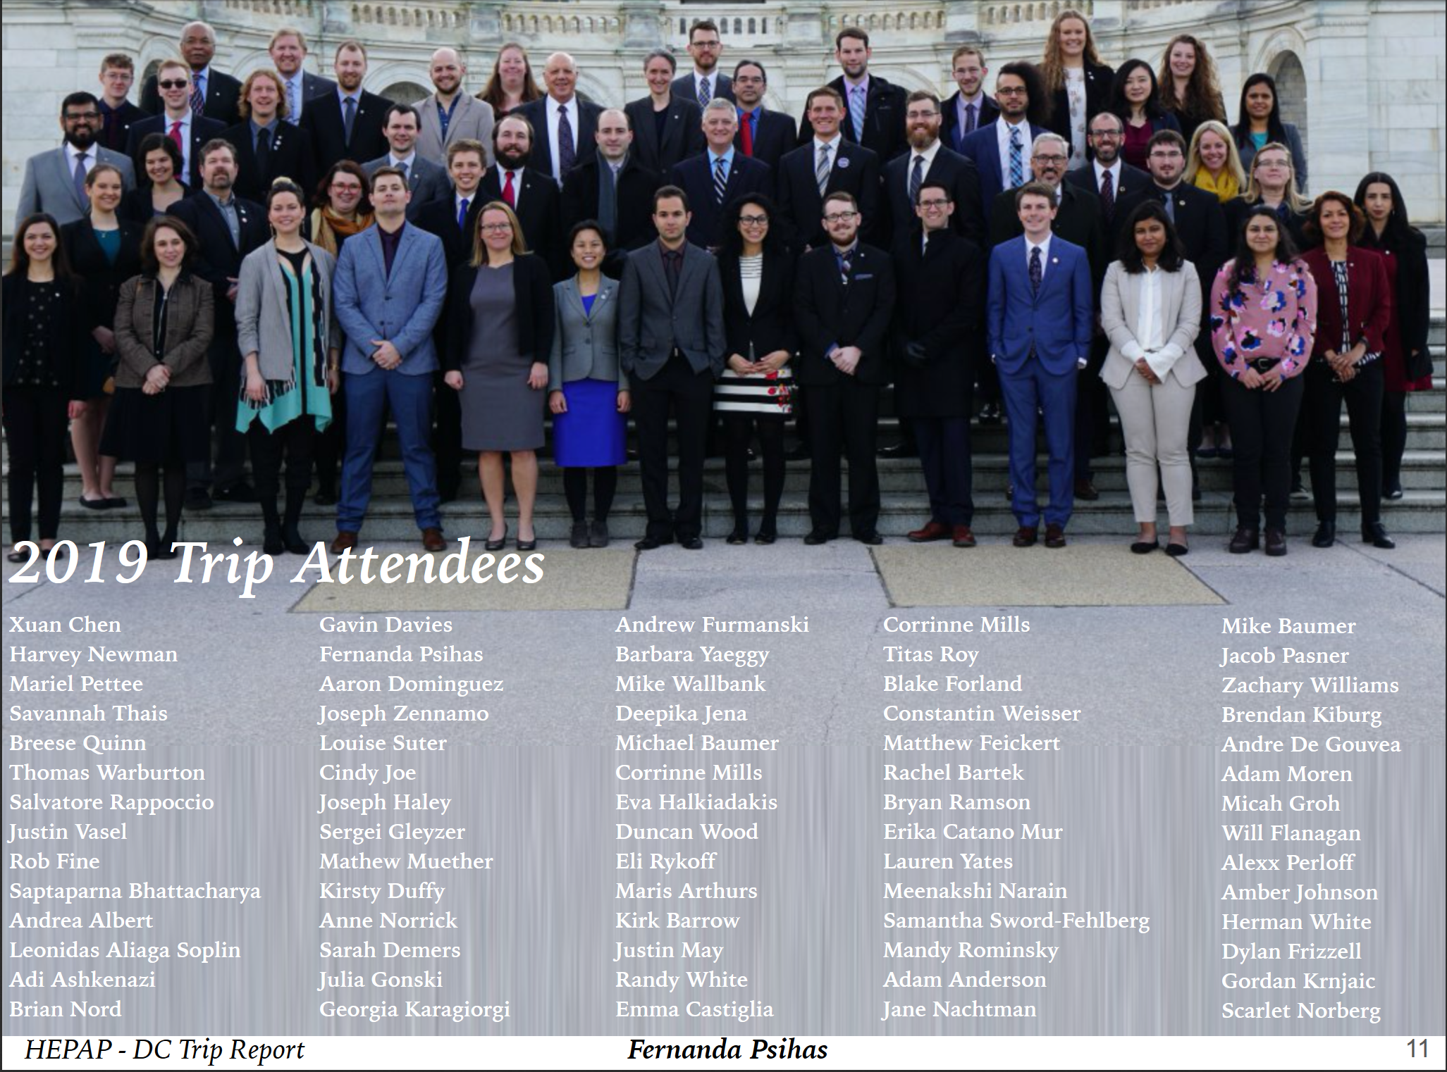
Notes:
39

Slide 40
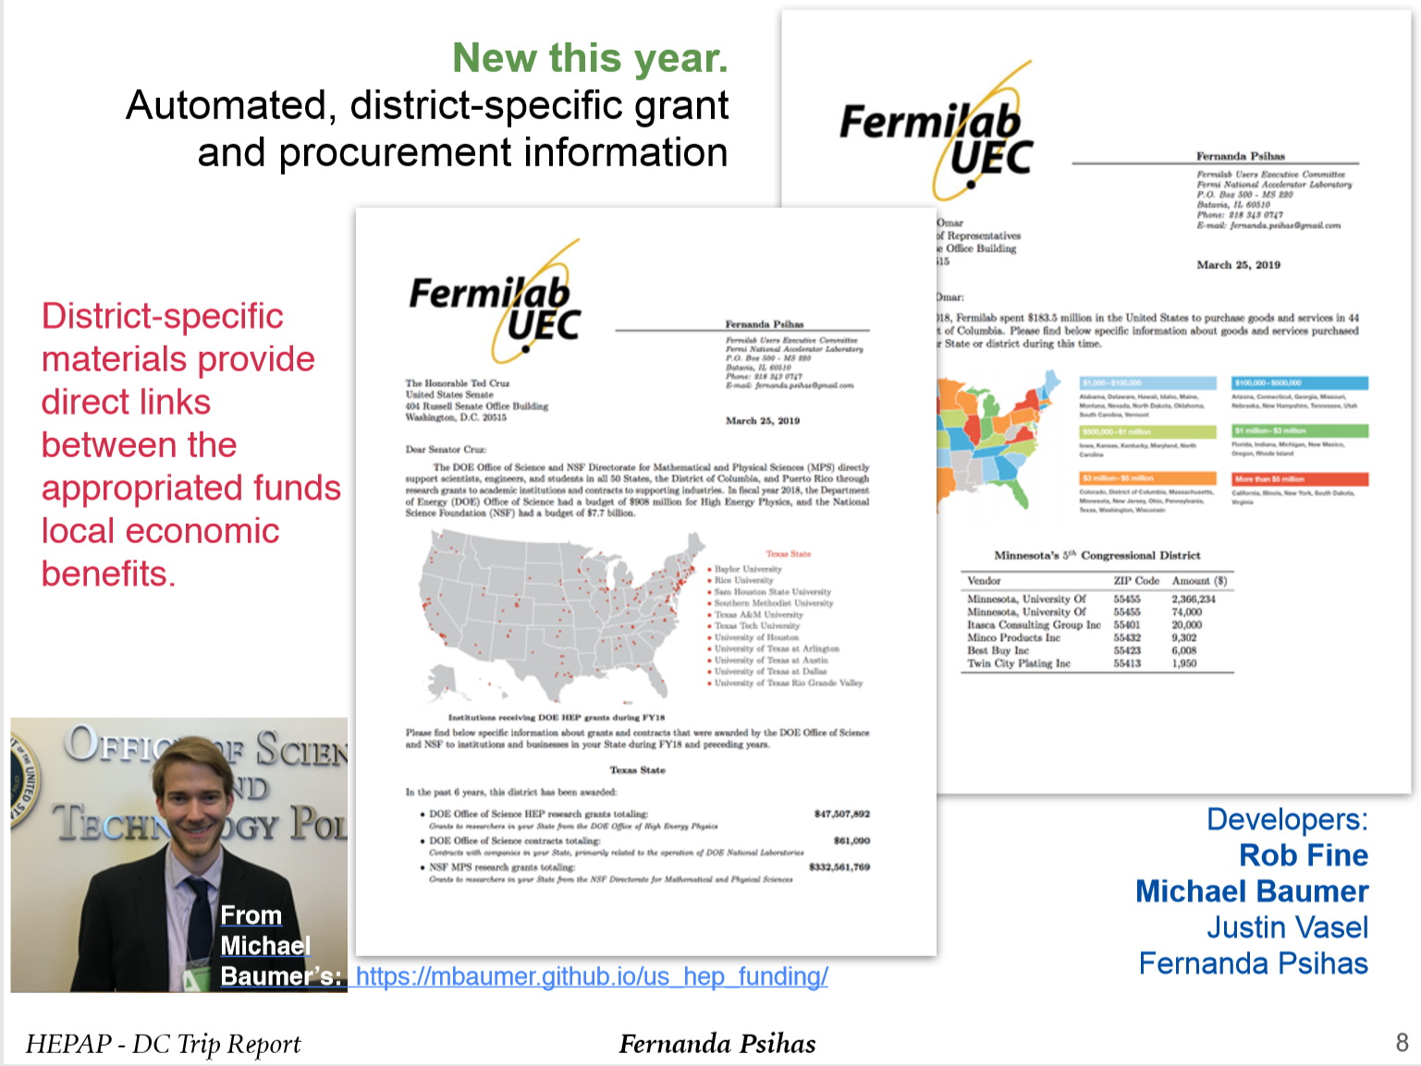
Notes:
40

Slide 41
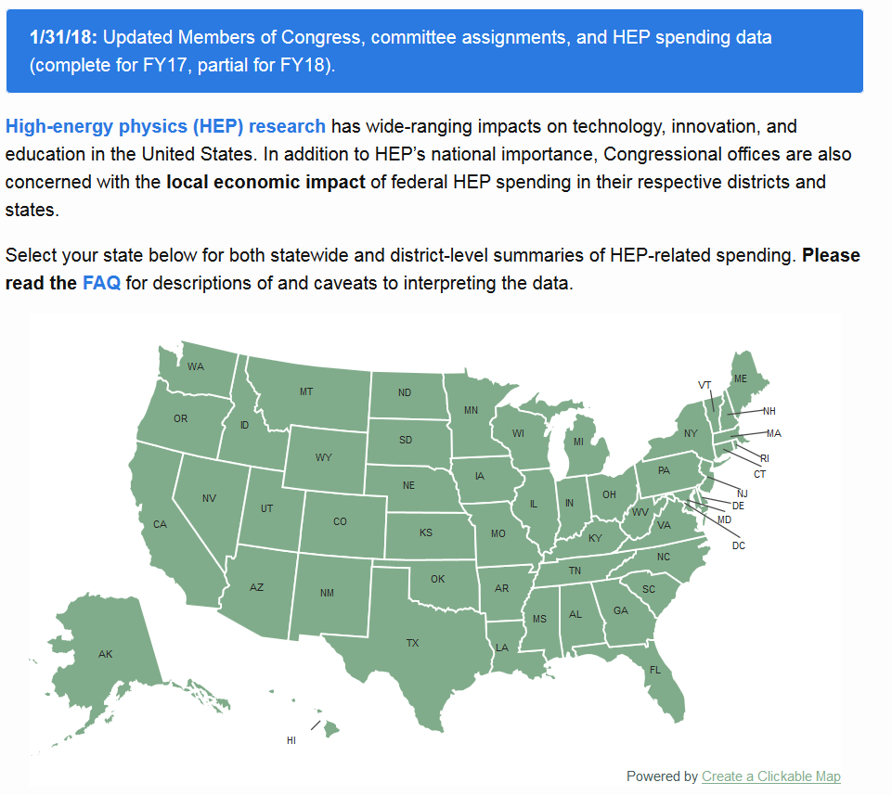
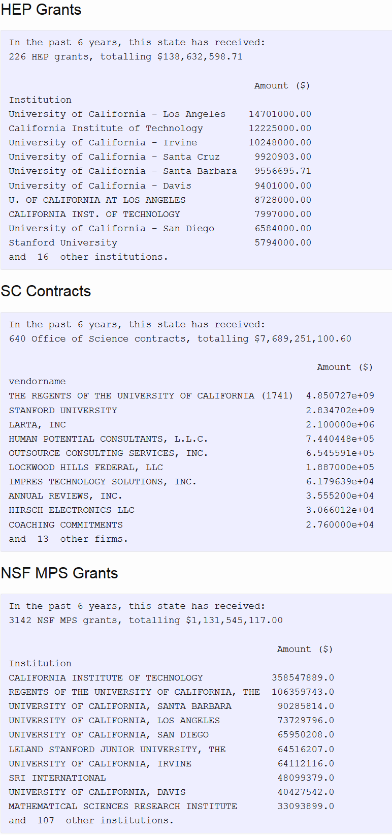
Where is High Energy Physics Funding Spent ?
By State, District, Institution, Agency
California Example
With Thanks to Michael Baumer (Stanford)
Notes:
41

Slide 42
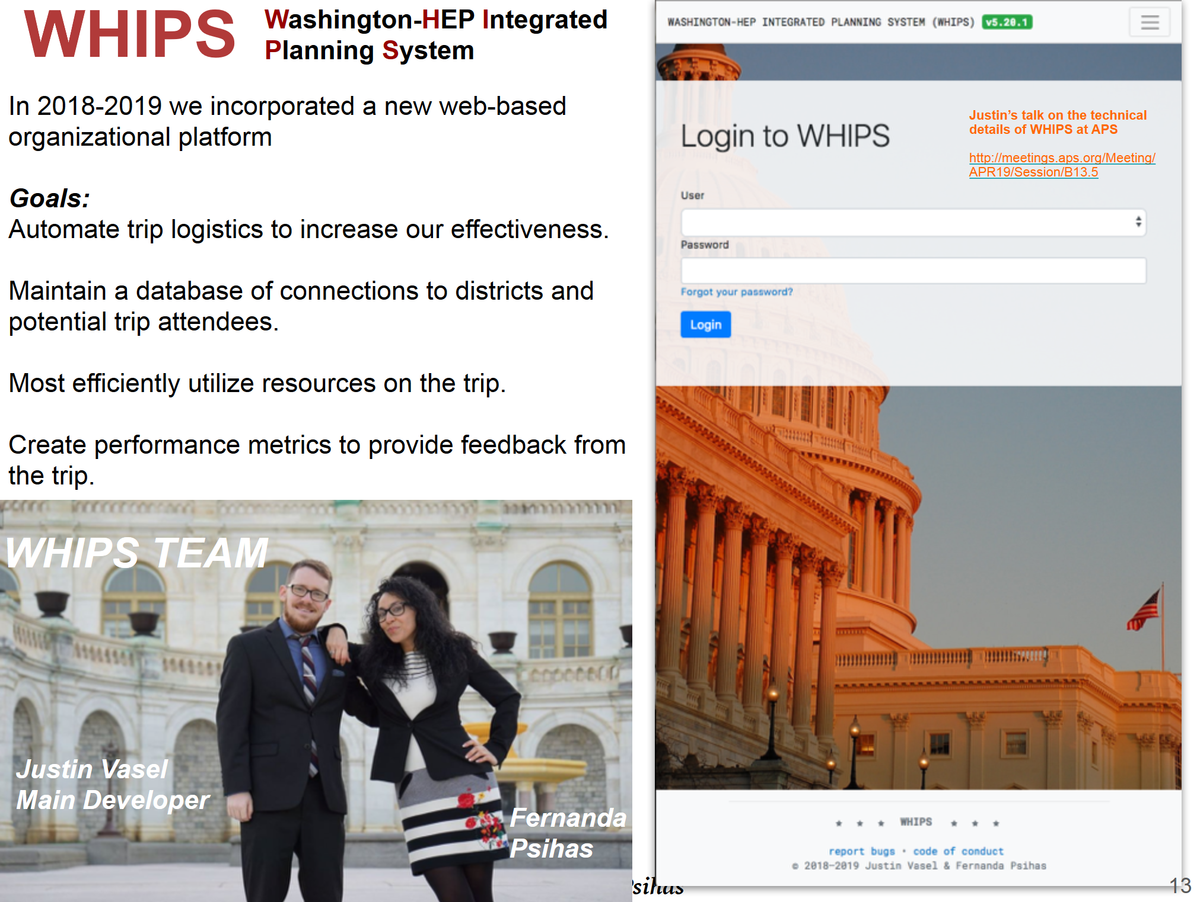
https://www.uec-whips.org/
Notes:
42

Slide 43
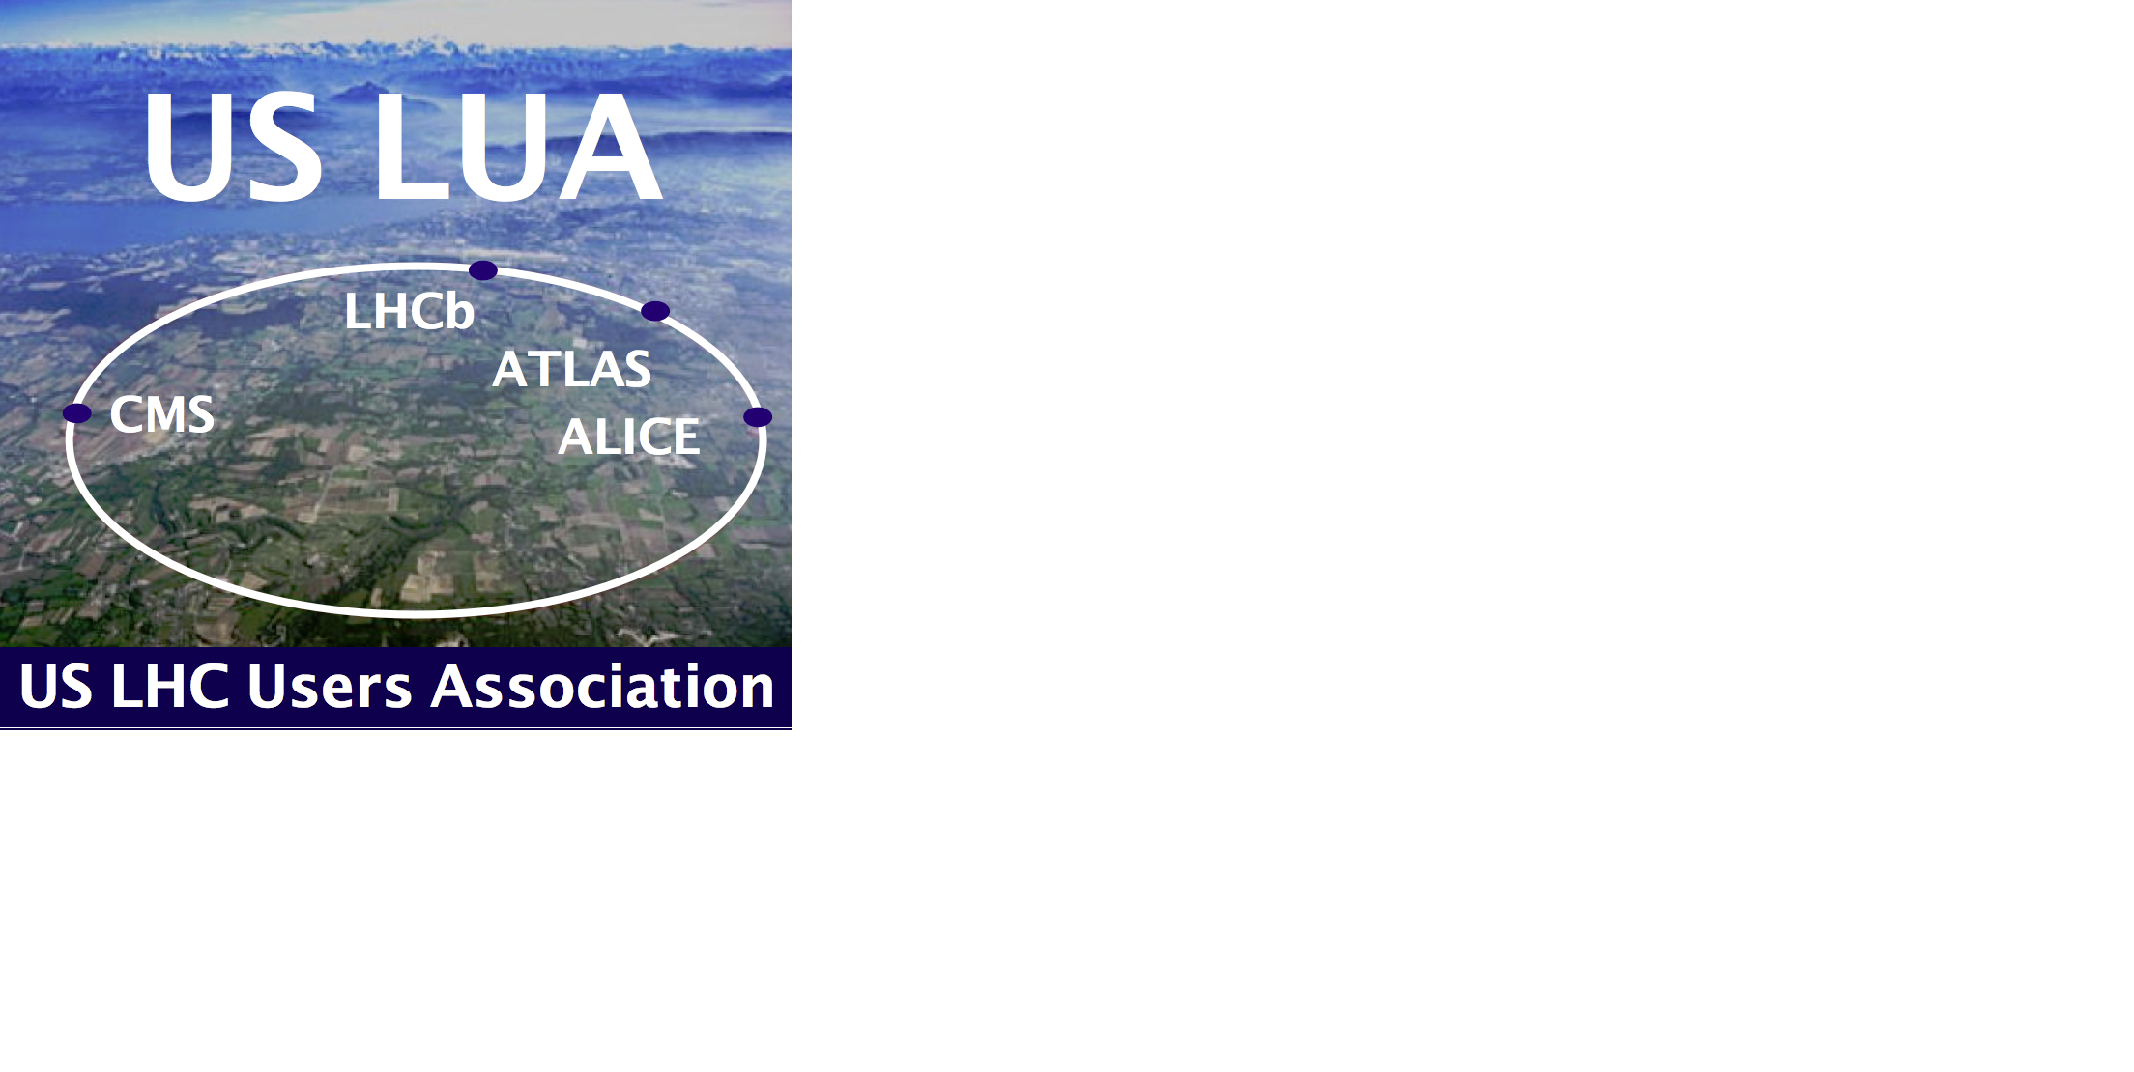

We have come a long way;
we have a long way to go.
We will need your support.
If your group members or colleagues involved in the LHC Program are not already US LUA Members, ask them to please sign up at
www.uslua.org
Notes:
43

Slide 44
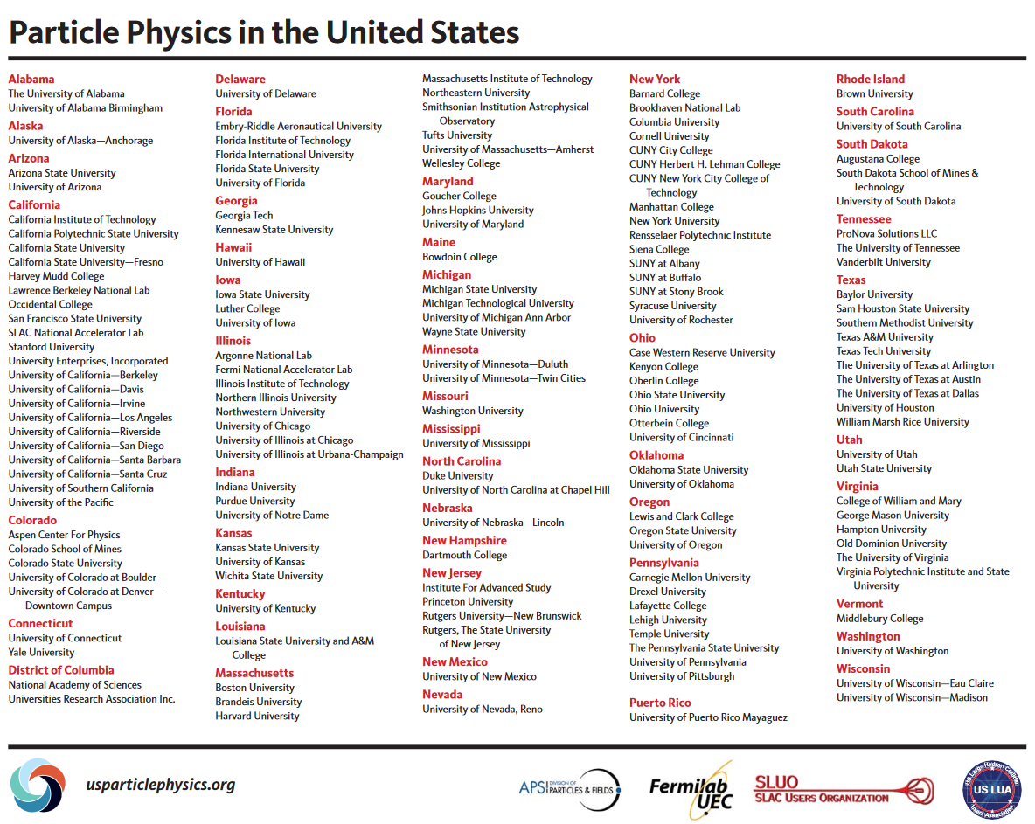
Particle Physics in the United States

