Slide 1


Higher power couplers at Helmholtz-Zentrum Berlin
BESSY VSR and bERLinPro
Emmy Sharples
25.06.2019
FG-ISRF, Helmholtz-Zentrum Berlin / BESSY II
World Wide Fundamental Power Coupler meeting #5, CERN, June 25-26, 2019.

Slide 2
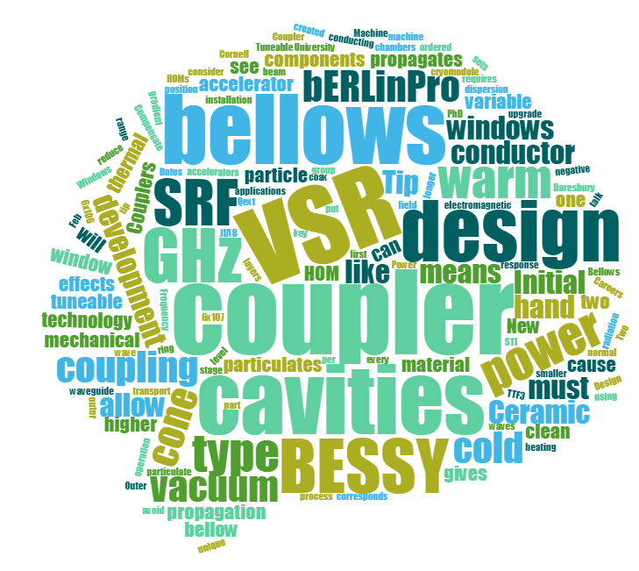
Outline
BESSY VSR a brief intro
Coupler design
  RF response
  Mechanic design
  Thermal analysis
Diagnostic prototype and testing
Coupler kicks
Status update
bERLinPro brief intro
bERLinPro coupler update

Slide 3
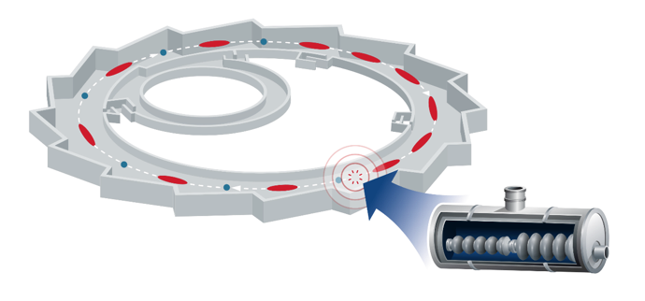


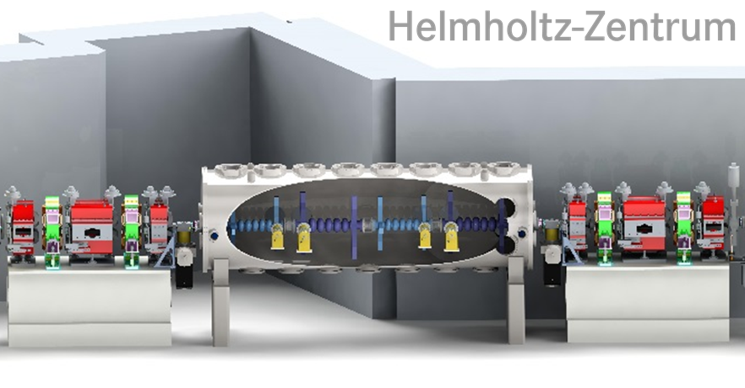
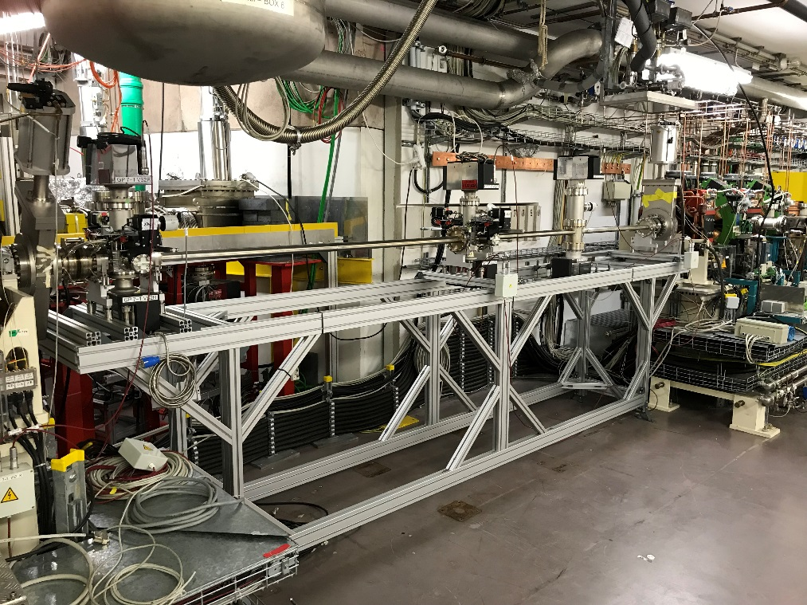
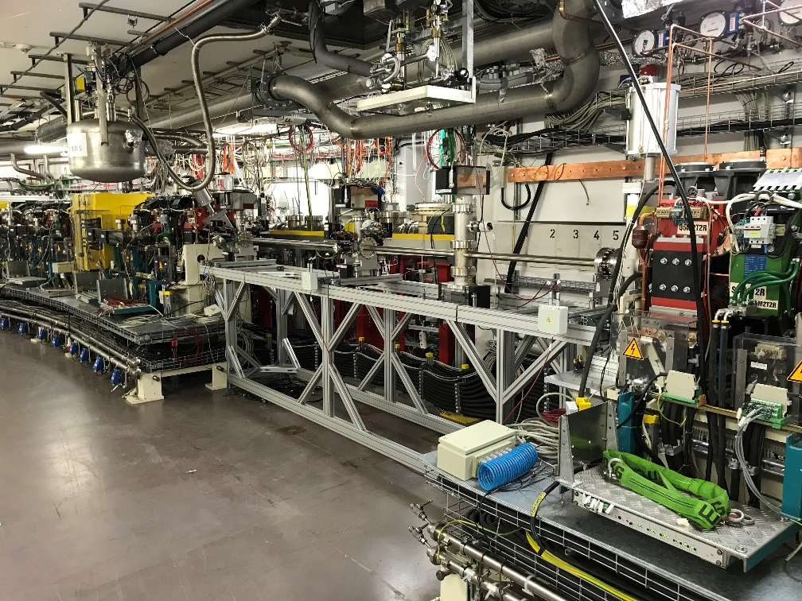
BESSY VSR: An SRF upgrade
VSR
Into BESSY II
Upgrade requires four SRF cavities, two 1.5 GHz cavities and two 1.75 GHz cavities. The RF beating produces simultaneously long and short bunches.
Notes:
As well as space, installing into the existing ring means me must deal with the fact it’s not design for SRF and so there is a chance of radiation being incident on the module and we need to shield against this or we run the risk of a quench

Slide 4
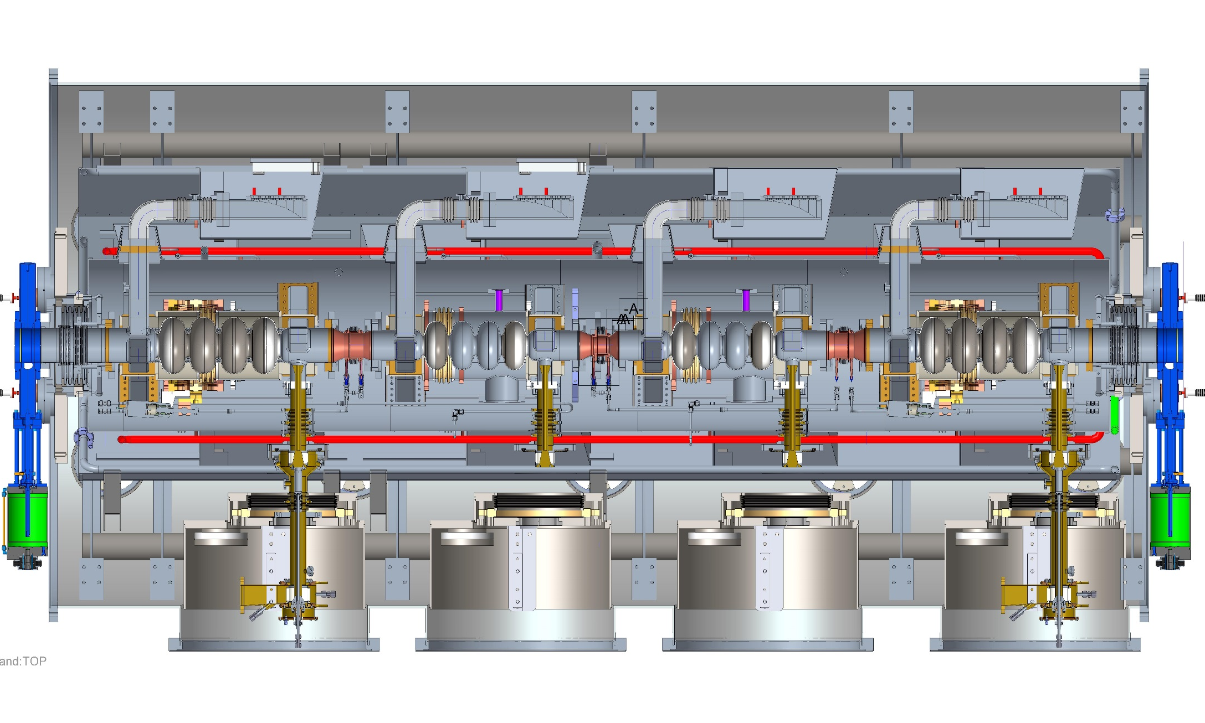
BESSY VSR: Module
1.5 GHz cavity and coupler
Notes:
Here is the full Bessy VSR module as viewed from a horizontal cut through.
All this must fit in that space shown before (don’t talk too much)
Here you see the cold string, with cavitities couplers , hom loads and shielded bellows, but also the other components that make up the module, the support fram, the sheilds

Slide 5
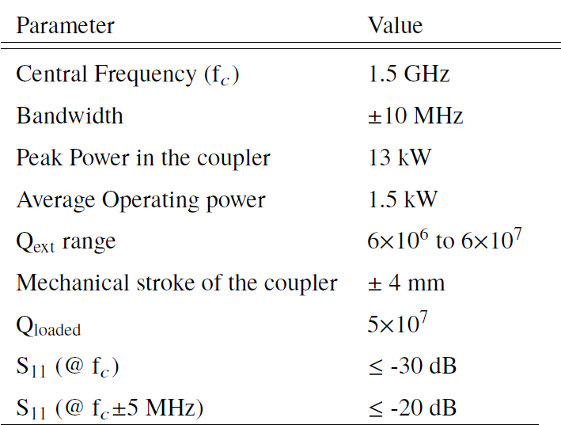
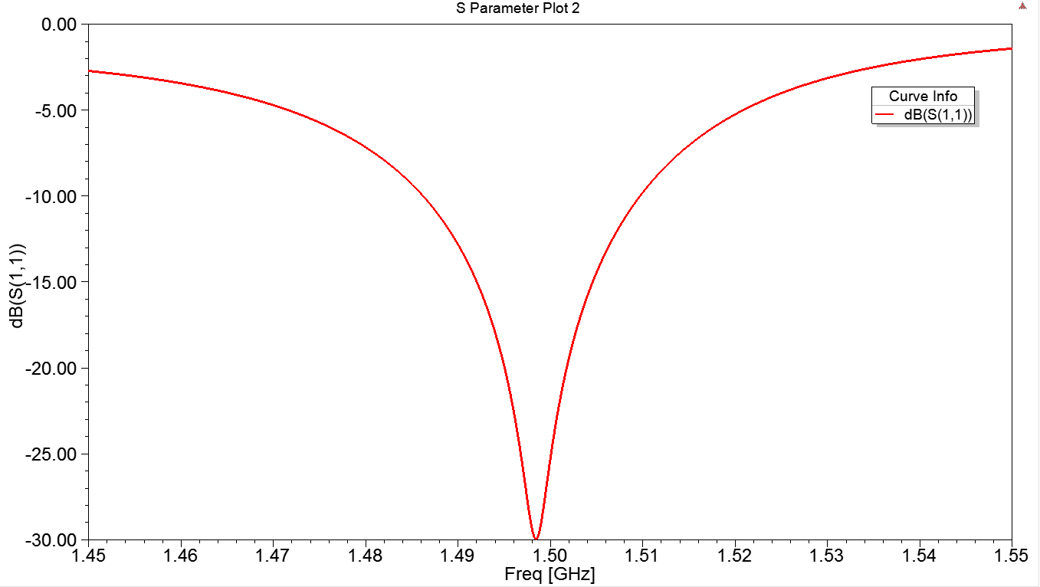
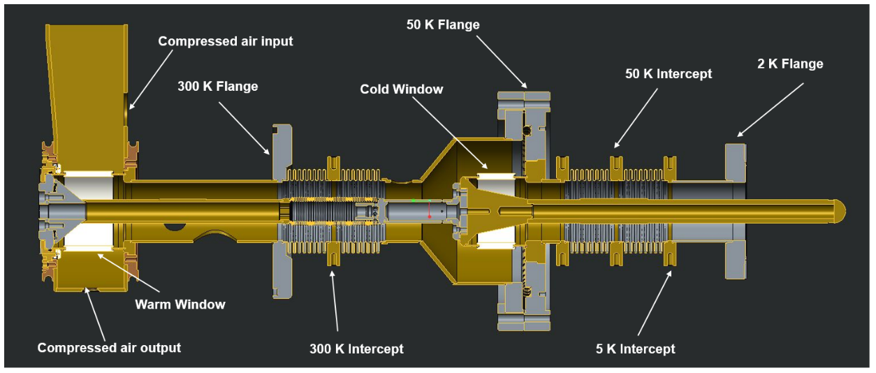
Coupler specs: 1.5 GHz coupler
Key parameters of the 1.5 GHz coupler
Since the coupler is inspired by an existing coupler design that has shown reliability in operation, the basic RF design was very straightforward.
The challenge with the couplers for VSR is the realisation of an operational mechanical design. The specifications for BESSY VSR impose a higher operation frequency and thus require smaller dimensions. These smaller dimension posed the greatest challenge in creating the coupler design.
Initial coupler design as presented at WWFPC #4
Desired S11 response for the 1.5 GHz coupler
Notes:
Basic RF design straighforwards scaling and changing of the matching components

Slide 6
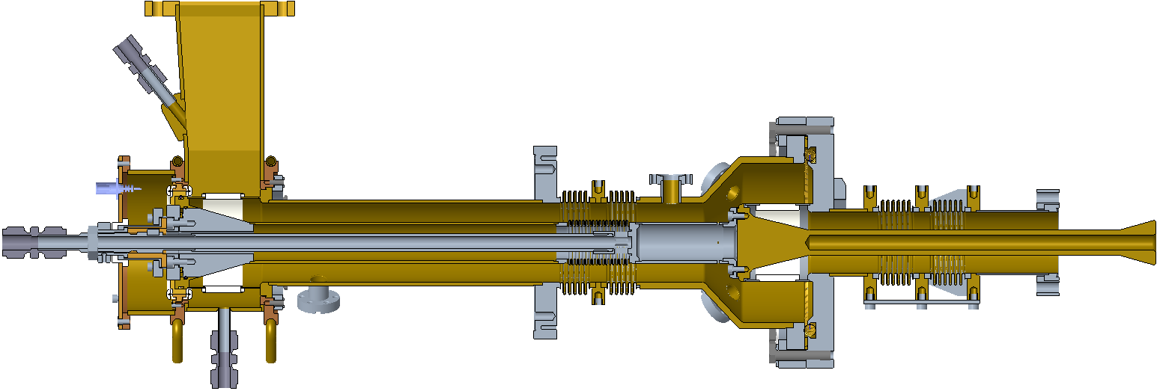
Final Mechanical design
Final engineering model of the 1.5 GHz coupler
Changes since WWFPC #4
Longer warm part: length of warm part increased by λ/2 (100mm).
Larger warm coax: Radii increased to allow for sufficient cross section for air cooling of inner bellow
Shorter warm bellows: To reduce heating peak that occurs at warm bellow.
Bellows copper coating increased: New coating 30μm to improve thermal transport.
Tip shape changed: Shifted to the hollow conical tip to ensure
IR camera ports shifted: Position of the IR cameras changed to give better view of cold window.
Notes:
Longer warm part: length of warm part increased by λ/2 (100mm), to ensure the coupler fits in the module
Larger warm coax: Warm part coax increased to allow for sufficient cross section for air cooling of inner bellow
Shorter warm bellows: To reduce heating peak that occurs at warm bellow. Copper coating on all bellows increased to 30μm to improve thermal transport.
Tip shape changed: Shifted to the hollow conical tip to ensure Qext range can be met with the reduced coupler stroke as a result of the shorter warm bellows
IR camera ports shifted: Position of the IR cameras changed to give better view of cold window.

Slide 7
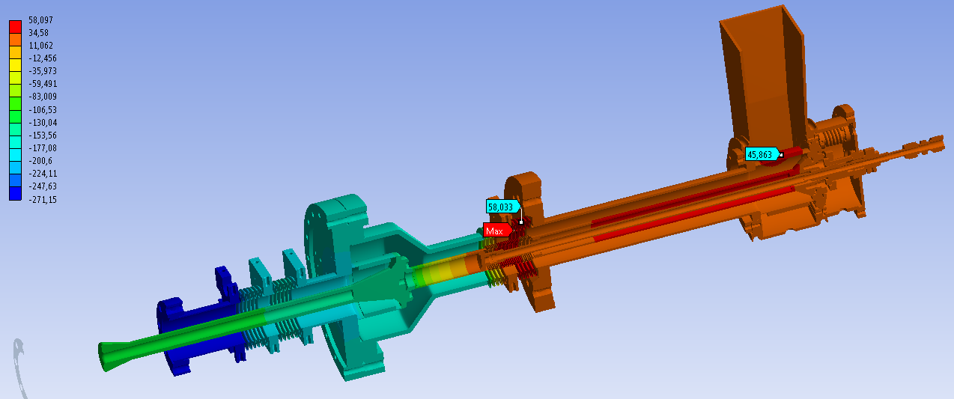
Thermal analysis
319K
330K
Thermal analysis by Marc Dirsat
Two hot spots: Warm bellows and warm window
Heating on warm bellows significantly reduced since results last year
  Bellows shortened, thicker copper coating, shifted off a field peak
Heating on window mitigated by compressed air and water cooling around waveguide
Compressed air cooling of the inner coax bellows
  Not realisable without a change to the coax dimension (air flow speed 75 m/s!!!)
  Dimensions shown too small and would cause overpressure in system
Notes:
Heat load on inner bellow 56W with this inner conductor the air flow would be 75 m/s
Need to reduce this to much lower. Can be done wit higher pressure 6bar or much greater inner diameter

Slide 8
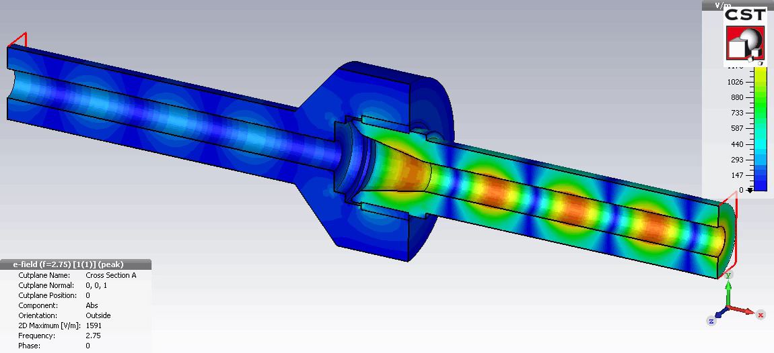
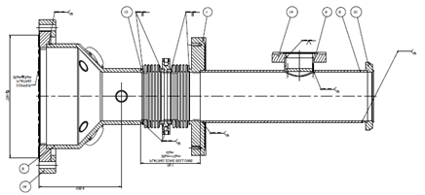
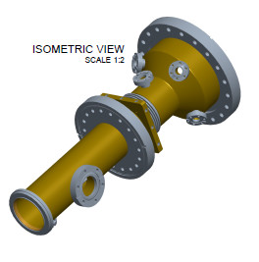
Coaxial dimension constraints
Warm Coax
D_{i}= 33 mm
D_{o}= 64 mm
Reasons:
Provide sufficient cross section for air cooling of the inner bellow.
Provide sufficient space for tooling to assemble coupler
Limited my size of 70 K flange and connection to cryomodule at this point.
Cold coax
D_{i}= 20 mm
D_{o}= 49 mm
Reason: Minimise possibility of HOM propagation from the cavity to the cold window.
D_{i}
D_{o}
HOM-mode, 2.75GHz
For HOMs the EM waves are mainly reflected back from first RF windows – forming a standing wave.
HOM power at FPCs are mainly concentrated at higher coaxial mode TE11 while the cavity will be fed by the TEM mode. Fixing the coax reduces propagation
Notes:
Heat load on inner conductor 56W
Increase in diameter means lower pressure required and more manageable flow rate. We wanted a diameter of at leas 18 mm we have that now.

Slide 9
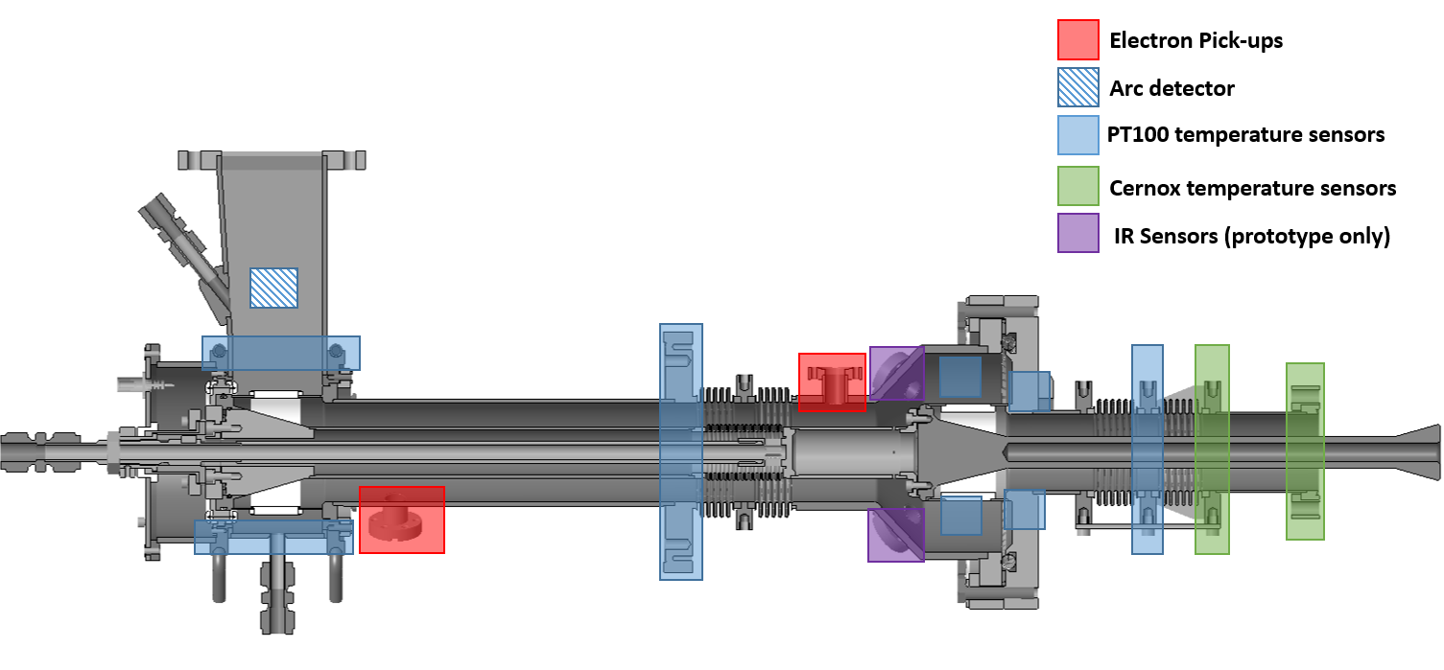
Diagnostic prototype
Two diagnostic prototypes ordered, only for testing on the test stand not module
Replacement warm outer conductor w/o IR sensors for RF conditioning on the test stand and module tests.
Additional thermal stress tests for seen to ensure critical components able to handle cool down
Spare ceramic windows in different design to be ordered and tested according to
Leak test => Thermal Shock => Visual Inspection => Leak Test
Notes:
PT100s: 2-4 @ 80K and 300K intercept, 2-4 around cold window, 4-6 at WG/coax transition
Cernox/PT1000: 2-4 at both the 5K and 2K flanges
Biased electron pickups: 2 as shown in figure. None on Cavity side due to lack of space and discussions at last WWFPC
IR cameras: 4 around the cold window, position determined by diagnostic prototype.
Arc detector: Above warm window on the WG

Slide 10
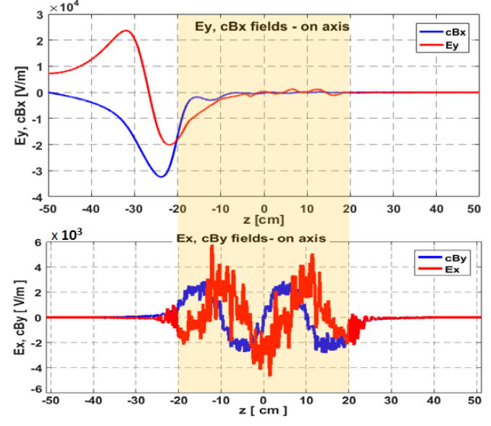
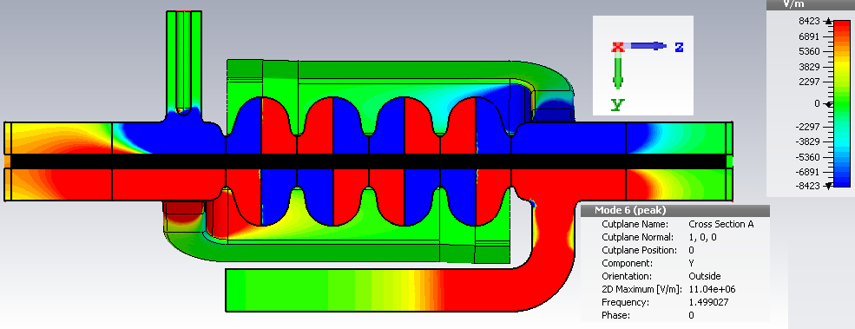
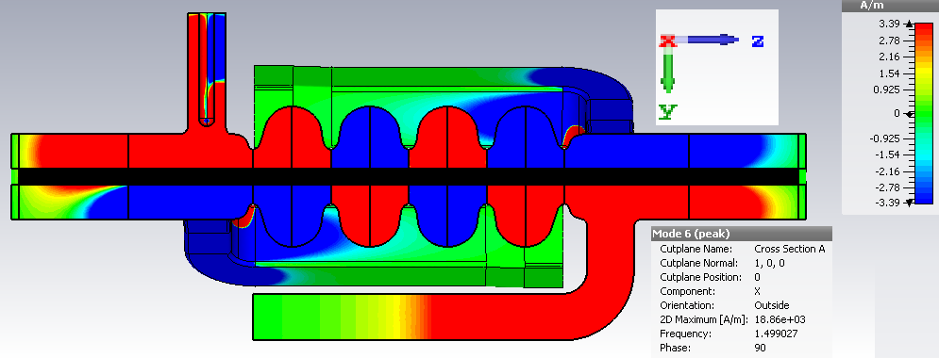
The coupler and cavity: Coupler kicks
Coupler kicks: Disruptions in the cavity electromagnetic field as a result of the coupler.
Ey field
Bx field
On axis transverse field profiles of TM010 π-mode
contributing to horizontal (top) and vertical (bottom) kicks
The FPC Induces horizontal transverse kicks to the beam with amplitudes of 6.24x10^3 mπrad and of 7.06x10^3 mπrad for the 1.5 GHz and 1.75 GHz cavities respectively. The signs or directions of these kicks depend on the orientation of the FPCs and on the local RF phase when the bunch passes, providing some alternation between the coupler positions should cancel the kicks effects out.
Courtesy of A. Tsakanian
Notes:
The HOM mode is a TEM mode

Slide 11
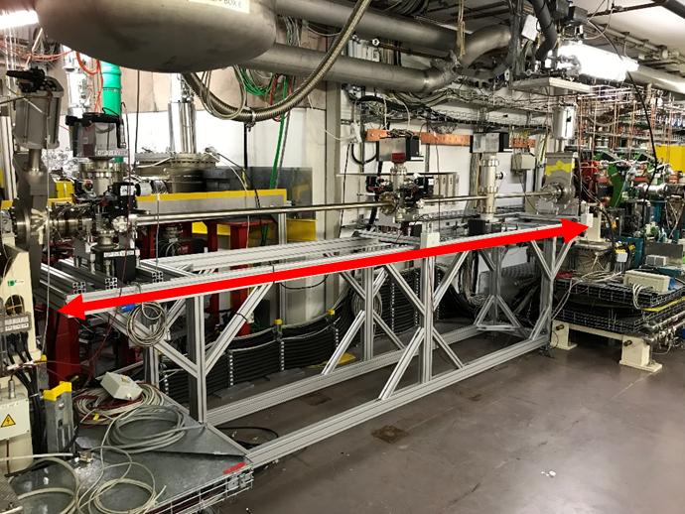
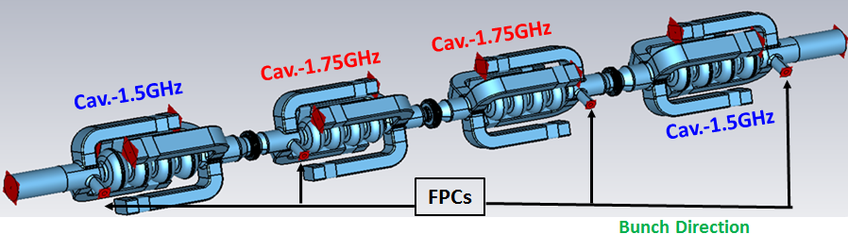
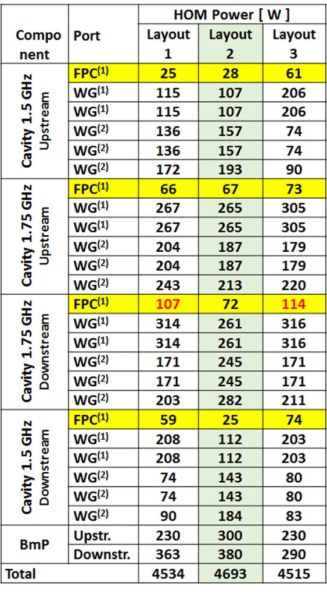
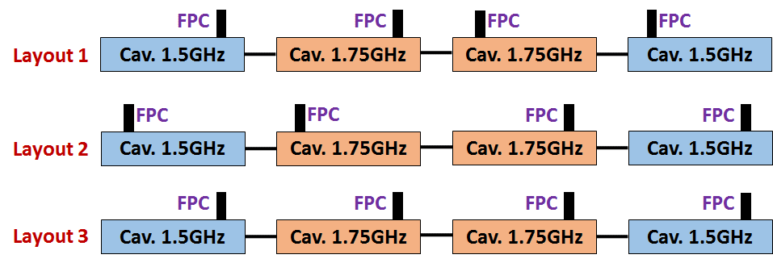
Coupler kicks and HOM power levels
Space constraints limit coupler position to all on the one side.
Different FPC positions of the 4-cell cavity arrangement in SRF module
Layout 2
Layout 2 is the optimal setup in terms of equally distributed HOM power portions along the SRF module.
Low HOM power at FPC to protect RF windows.
Technically difficult to achieve due to the limited space in the low-beta straight of the ring.
Courtesy of A. Tsakanian

Slide 12
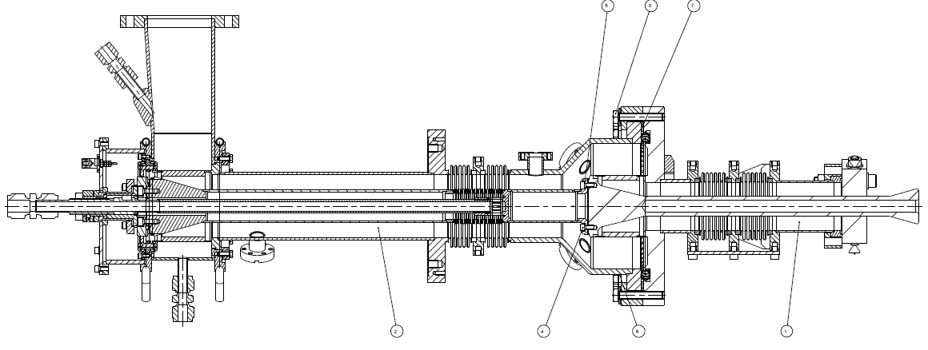
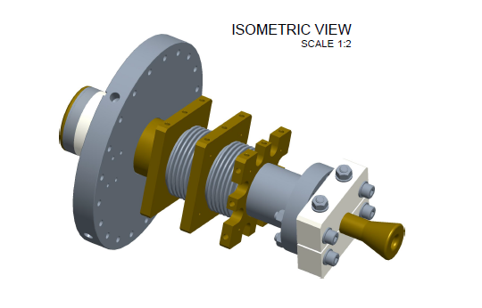
Drawings

Slide 13
Project Status
Procurement
Tender opened May 2019
Company selection for bidding opened June 17th
Bids in on July 21st
Manufacture set to start September 2019
First 1.5 GHz prototypes expected September 2020
Series 1.5 GHz couplers expected June 2021
Prototypes for 1.75 GHz Couplers expected October 2021
Series 1.75 GHz couplers expected September 2022
On going
Multipacting studies on the 1.5 GHz coupler design.
Design of the coupler test stand.
  RF design: complete
  Mechanical design: awaiting an engineer
Finalisation of 1.5 GHz drawings
Procurement of sample ceramics for testing
To do
Design of the 1.75 GHz coupler
Procurement of coupler test stand.
Testing of bERLinPro couplers
May 2019 Tender open
Sept 2019 Manufacture begins
Sept 2020 1st 1.5 GHz prototypes
June 2021 1.5 GHz series
Oct 2021 1.75 GHz Prototypes
Sept 2022 1.75 GHz series expected
Notes:
Hold

Slide 14
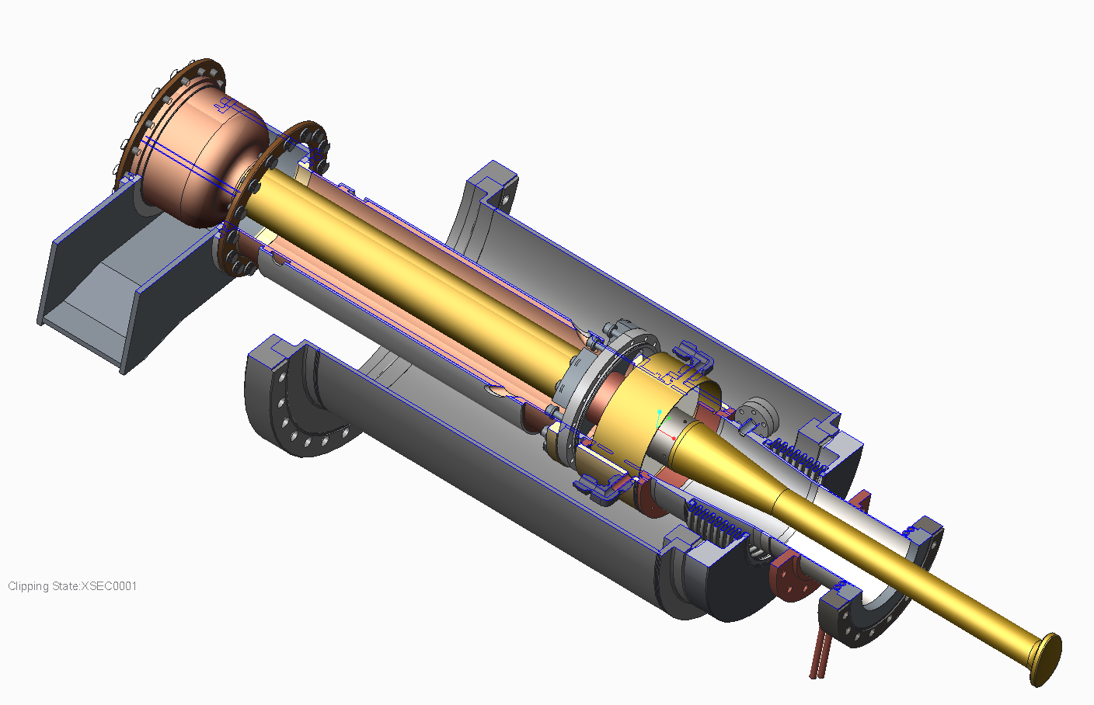
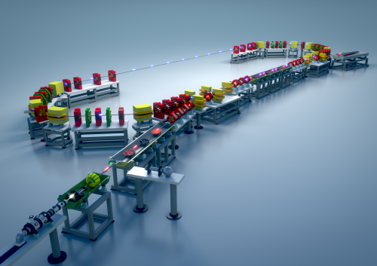
bERLinPro Couplers

Slide 15
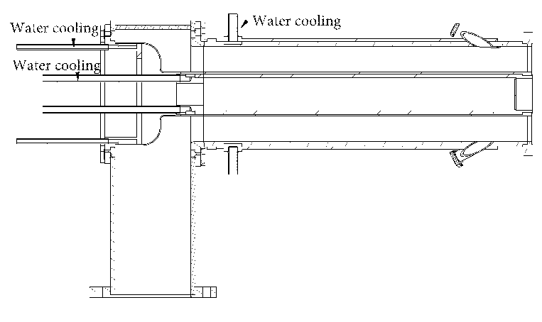
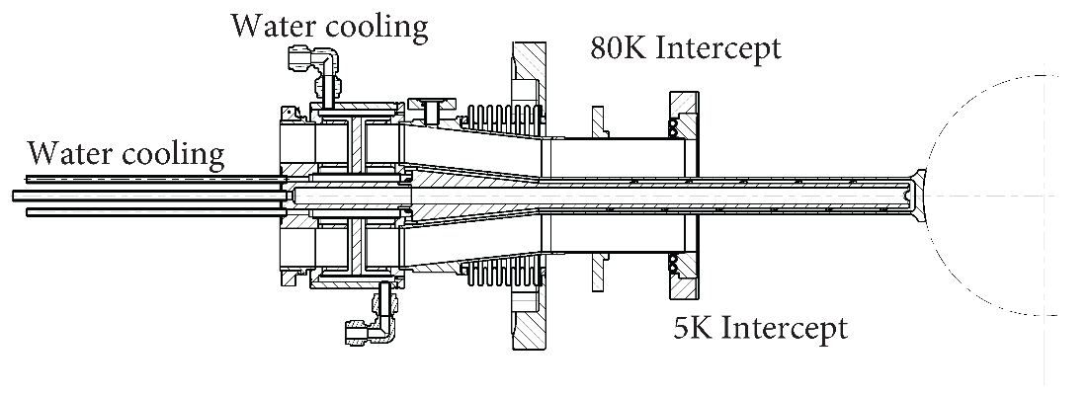
bERLinPro couplers Overview
Parameter | Value
Central Frequency | 1.3 GHz
Bandwidth | ± 1 MHz
Max RF power supplied by the amplifier | 120 kW
Mean power per coupler | 110 kW
Number of ceramic windows | 1
Q_{loaded} | 1.05 × 10⁵
Total Heat Leak to 2 K | < 1 W
Total Heat Leak to 5 K | < 5 W
Total Heat Leak to 80 K | < 80 W
In standing wave operation the coupler will only experience ¼ of the total power.
Water cooling of inner conductor
Currently Status: Cold part- Delivered
Warm part sent back for re machining

Slide 16
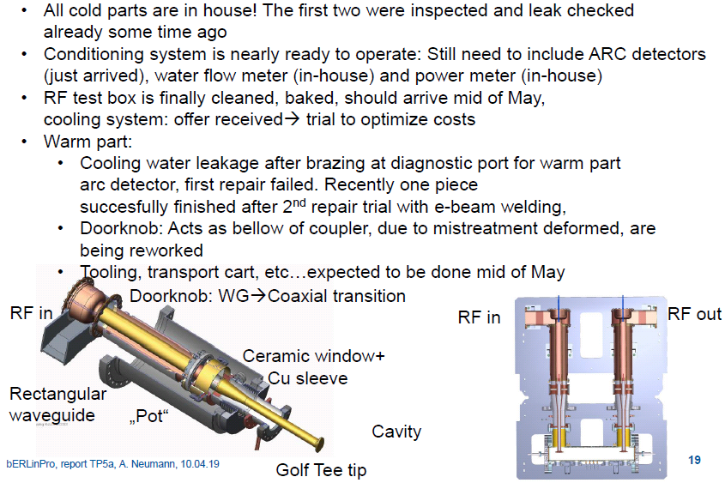
Status of bERLinPro
Not yet
Not yet

Slide 17
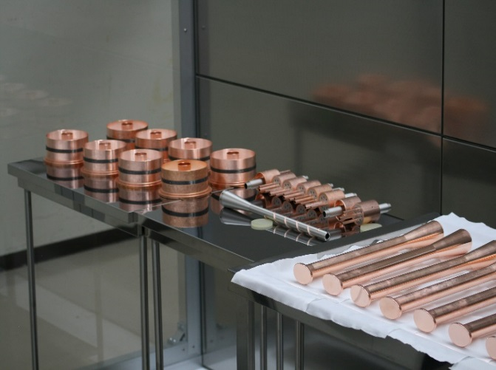
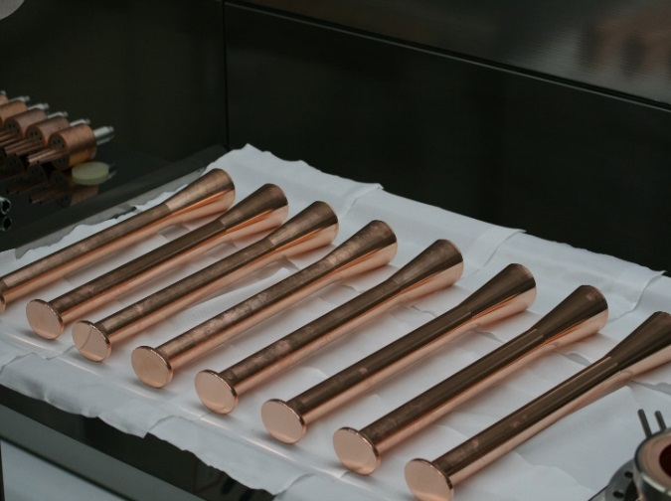
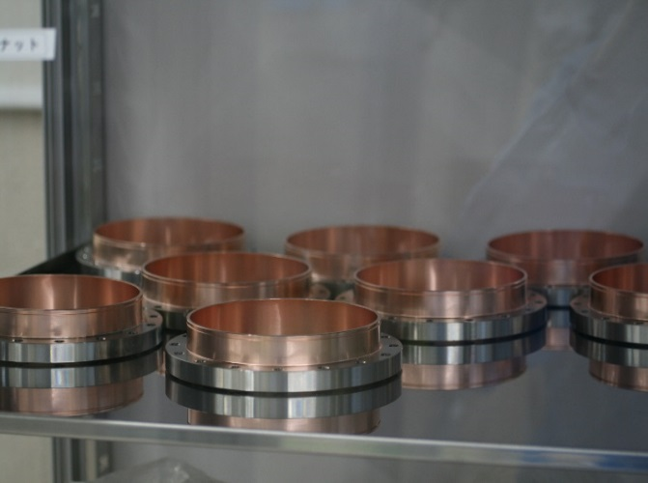
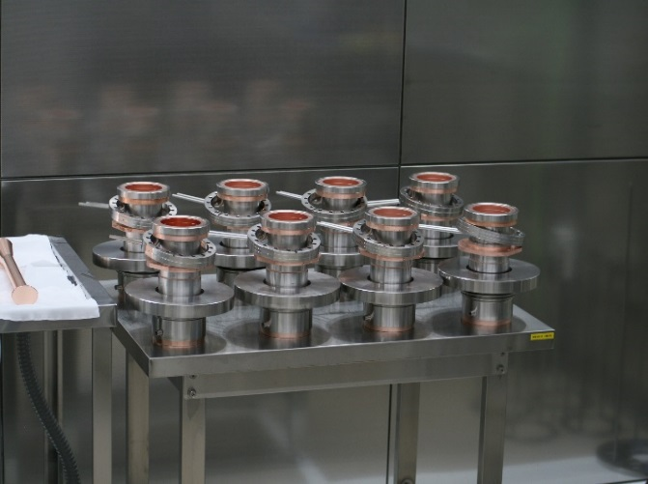
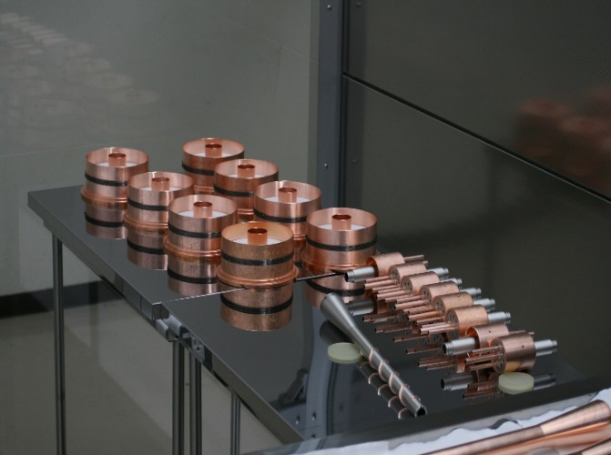
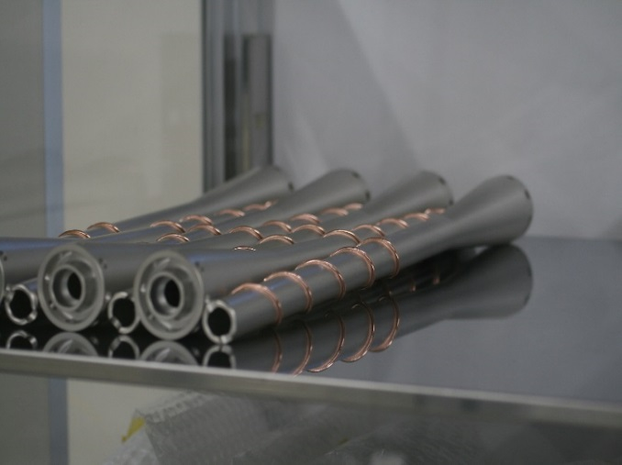
Production of cold part
All parts of cold part manufactured and awaiting final braze.
Coupler tips outer
Warm to cold transition flange
Outer conductor including cavity flange (including cooling)
Ceramic windows and supports
Coupler tips inner part showing cooling channels

Slide 18
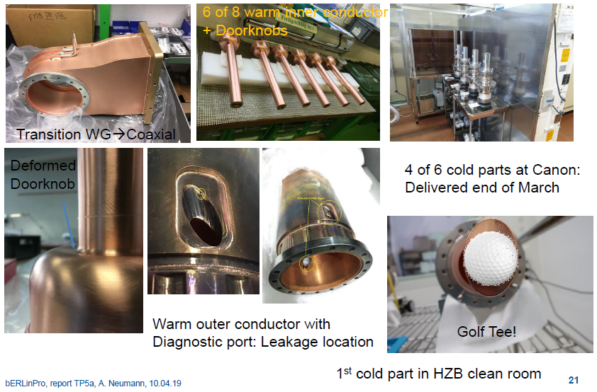
Production of the parts

Slide 19
Thank you for your attention
Any Questions?

Slide 20
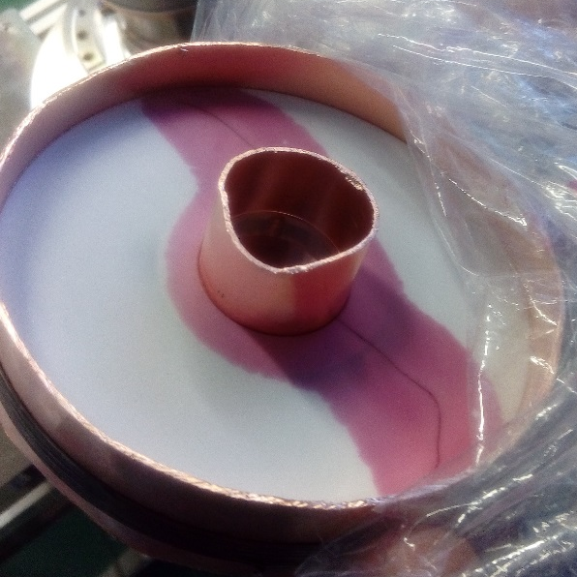
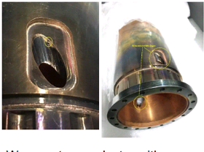
bERLinPro Horror stories
Damaged ceramic from bERLinPro
E-beam weld mess up with the port on the warm part

Slide 21
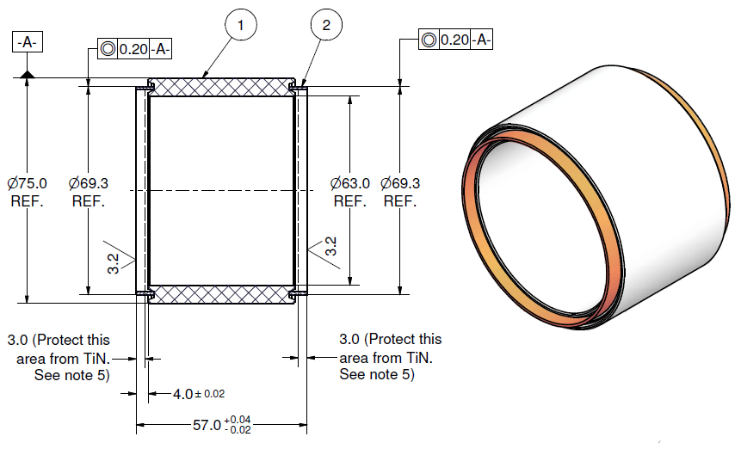
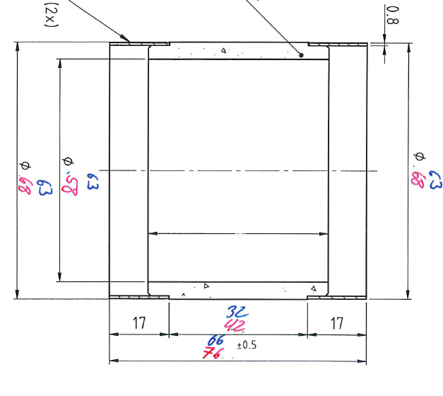
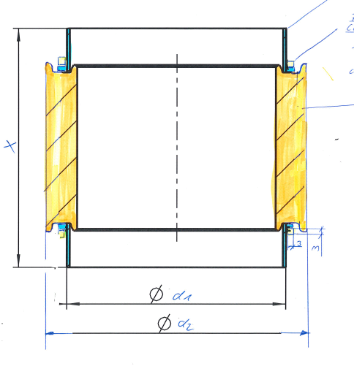
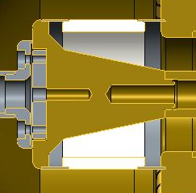
Ceramic window
We have fixed the ceramic window design for the cold window, but are still going back and forth with the design of the warm window.
All will be AL2O3
All will be coated with TiN
Just the connector and connection method that are different

