Slide 2
Manage Small and Medium projects with JIRA WBS Gantt Chart Plugin
White Area Lectures - June 2019
Maria Alandes – IT/CDA

Slide 3
Outline
JIRA Introduction
Planning and Scheduling tips
WBS Gantt Chart

Slide 4
Some questions
Who is a MS Project user?
Who has followed MS Project courses?
Who has followed Open SE courses?
Who needs planning and scheduling to do their job?
Who uses already JIRA?
Who uses a tool for planning and scheduling different from MS Project/JIRA?
Which one?

Slide 5
Some words about JIRA

Slide 6
JIRA Introduction
What is JIRA?
  Gojira → Japanese word for Godzilla
  Issue Tracking and Project Management
  Developed by Atlassian
  CERN runs JIRA 8.0.2 in https://its.cern.ch
  Three products
    JIRA Core
    JIRA Software
    JIRA Service Desk
  CERN has unlimited number of licenses for JIRA Software Licenses that contains JIRA Core

Slide 7
WBS Gantt-Chart plugin
What is Gantt-Chart plugin?
  Third Party tool developed by Ricksoft
  It provides visual project planning through Gantt charts
  Some interesting functionality
    Task dependencies with drag-and-drop interface
    Modify schedules and dependent issues update automatically
    Smart workload allocation with resource monitoring
    Critical path
    Baseline plan
  CERN has now unlimited number of licenses for this plugin
  CERN runs now version 9.9

Slide 8
JIRA Basics
JIRA issues
  JIRA building blocks
  They could represent a story, a bug, a task, or another issue type in your project
  For planning and scheduling
    We will use them as tasks
    Issues = Tasks or sub-tasks from now on
    Tasks and sub-tasks are treated in the same way

Slide 9
Planning and scheduling tips

Slide 10
Project Master Schedule
Survey Start
Tool Selection
4/9/2018
6/25/2018
Survey End
5/10/2018
Mar
Apr
May
Jun
Jul
Aug
Sep
Oct
Nov
Dec
2019
Feb
2019
2018
Today
3/1/2018
Evaluate Tools
7/15/2018
137 days
3/1/2018
Survey
5/15/2018
76 days
6/26/2018
Tool Validation
9/30/2018
97 days
9/15/2018
Training
12/15/2018
92 days
10/15/2018
Migration
2/28/2019
137 days

Slide 11
Project Master Schedule
Starting point before defining the coordination schedule (Gantt Chart)
The master schedule is a summary
It should be intuitive
It should contain the whole project overview
Starting from the main phases of the master schedule, the remaining tasks can be defined

Slide 12
WBS Gantt-Chart

Slide 13
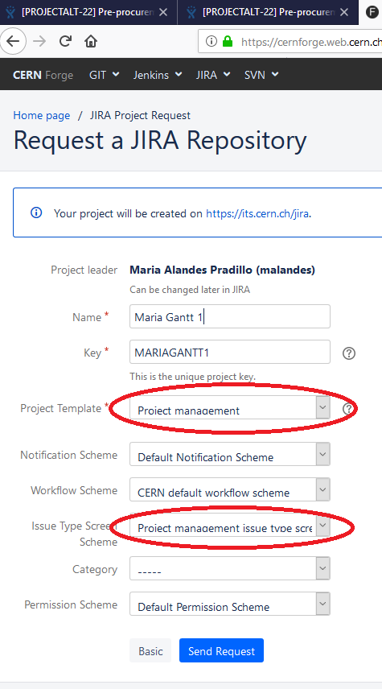
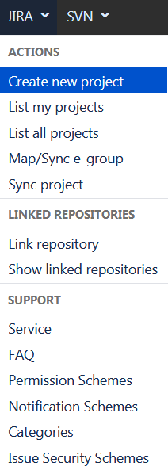
Create a JIRA
Project
https://cernforge.web.cern.ch/jira
Select Advanced to see all the options

Slide 14
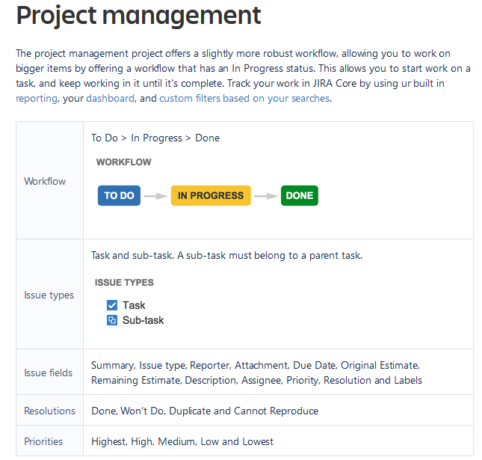
Project Template
Projects should be created with:
  Project Management template
More information about project templates:
  https://cern.service-now.com/service-portal/article.do?n=KB0005975

Slide 15
Who will be notified in your project
Projects are created with:
  Default notification scheme
You can change this in:
  https://cernforge.web.cern.ch/jira/myprojects/
For more details on notification schemes:
  https://cernforge.web.cern.ch/jira/notificationschemes/

Slide 16
Task workflow
Projects are created by default with the workflow defined in the Project Template
However, the workflow can be reconfigured
  For more information please check:
      https://cern.service-now.com/service-portal/article.do?n=KB0002999
Learn more also about board workflows
  https://cern.service-now.com/service-portal/article.do?n=KB0001729
  You can create your own workflow in the board configuration by adding status and columns

Slide 17
To display Gantt Chart fields
Projects should be created with:
  Project management issue type screen scheme
    This allows to display Gantt Chart fields in the JIRA task
This screen type is available for all project templates
  Not only for Project Management template!
For existing projects
  Open a SNOW ticket requesting this type of screen to be activated for your project

Slide 18
Who can watch your Gantt
Projects are created with:
  Default Permission Scheme
    This means the project is only visible to project members
    The same for the Gantt Chart
You can change this in:
  https://cernforge.web.cern.ch/jira/myprojects/
For more details on permission schemes: https://cernforge.web.cern.ch/jira/permissionschemes/0/

Slide 19
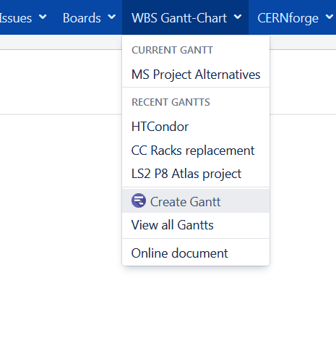
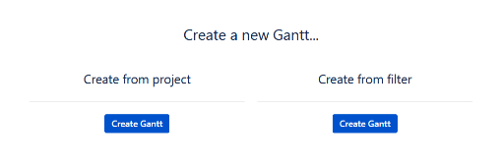
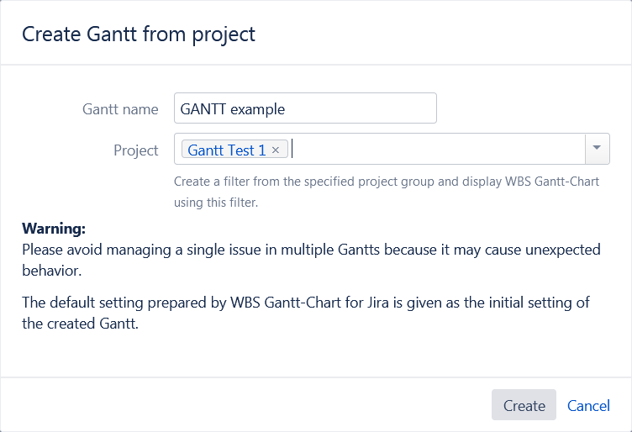
Create a Gantt Chart

Slide 20
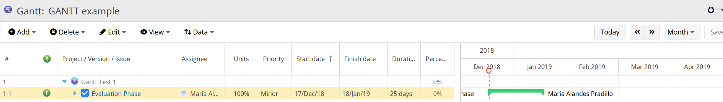
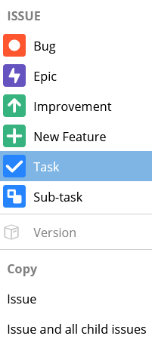
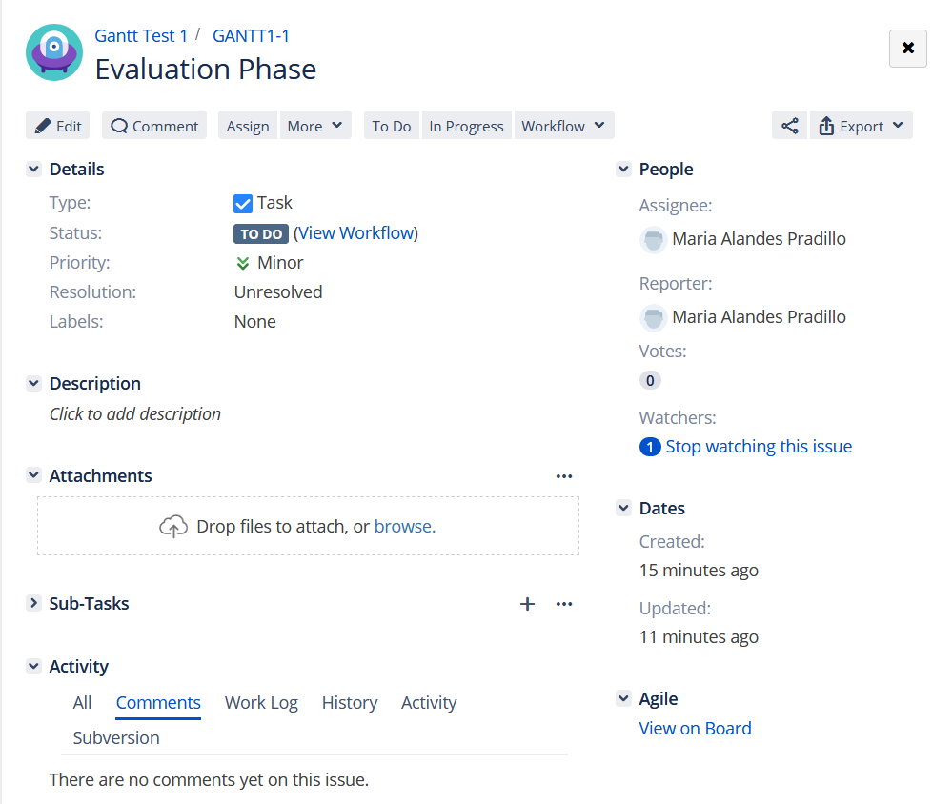
Add Tasks
Edit the values directly here or in the JIRA classic view
Task Name
Assignee
% of time allocated to the task
Start and Finish date or Duration
Percentage completed

Slide 21
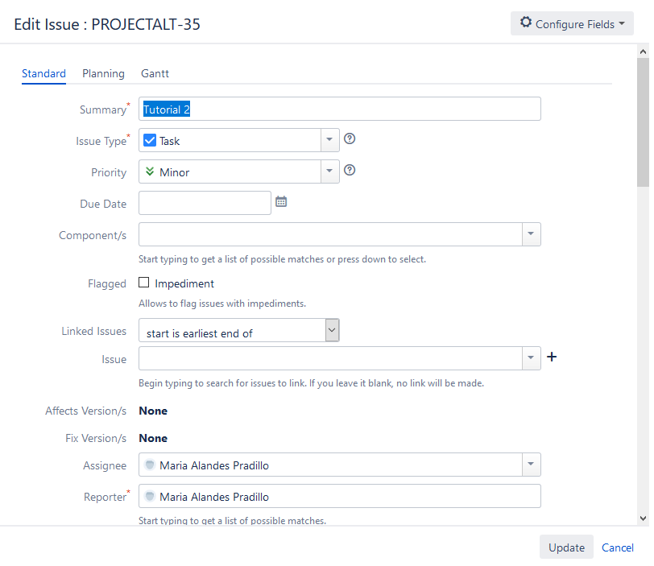
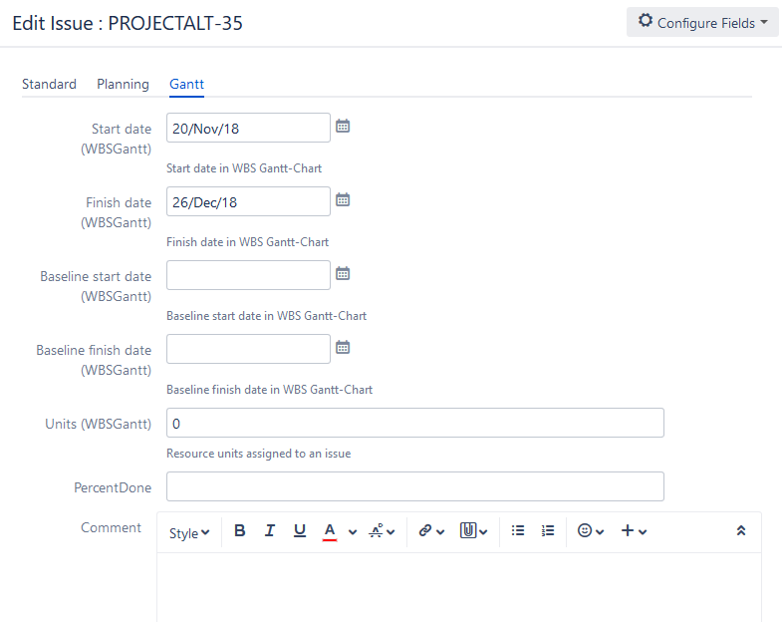
Gantt Chart Fields
Gantt Chart related fields
Note that Gantt Chart fields are visible in the task only if the project was created with the right screen template
The fields are displayed in the task screen only if they have some value:
  Edit the task
  Check the Gantt tab
  Fill in the fields

Slide 22
Task depencies
The easiest is to drag and drop directly in the Gantt chart to create task dependencies
  Start to End
  End to Start
  Start to Start
  End to End
In the Edit Menu you can also
  Indent/Outdent to modify the task hierarchy
  Move up or down to reorganise the task order

Slide 23
About Task bars
Colours
  Parent bars: blue
  Children bars: green
  Completed issues: light blue or green
  Baselines (see later): light grey bar
Task Names
  They appear on the left
  Feature request to allow to drag and drop: WGC-856

Slide 24
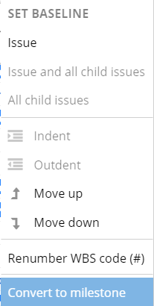
Milestones
Create first a Task
Then convert to Milestone from Edit Menu

Slide 25
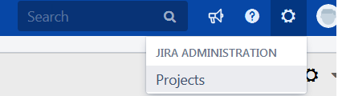
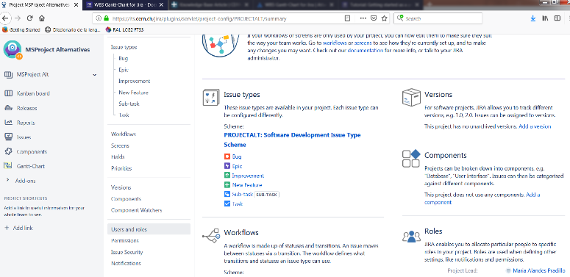
Add Users

Slide 26
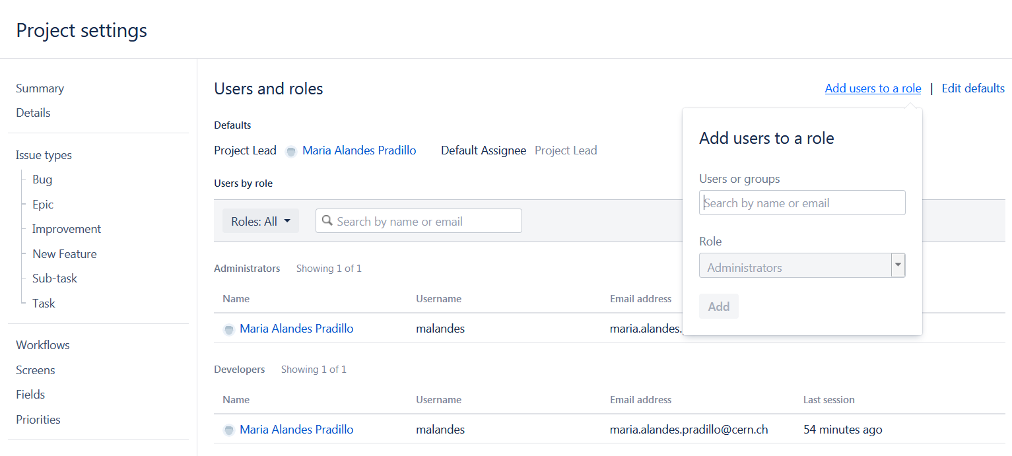
Add Users
Add users to Developers role (permissions to modify issues)
Note that Users role are users who can create issues. Maybe this is not what you want if using JIRA for project management
Note that you can change the permissions of each user type anyway
Be aware that CERN users need to have logged in at least once in JIRA to be able to see them as JIRA users!

Slide 27
Adding users through e-groups
You can add all the users of an e-group by adding the e-group to a role
  But please, note that tasks can only be assigned to a single user
If your e-group is not recognised by JIRA
  Go to https://cernforge.web.cern.ch/jira/egroup/sync/
  Add the e-group
  You should now be able to see it in JIRA

Slide 28
Dummy Users
Dummy users may be needed for your project
  For short term tasks
  To calculate needed resources and estimate effort
In order to create dummy users:
  Create a service account
  Log in once in JIRA with the new account
  You can now assign that account to your project

Slide 29
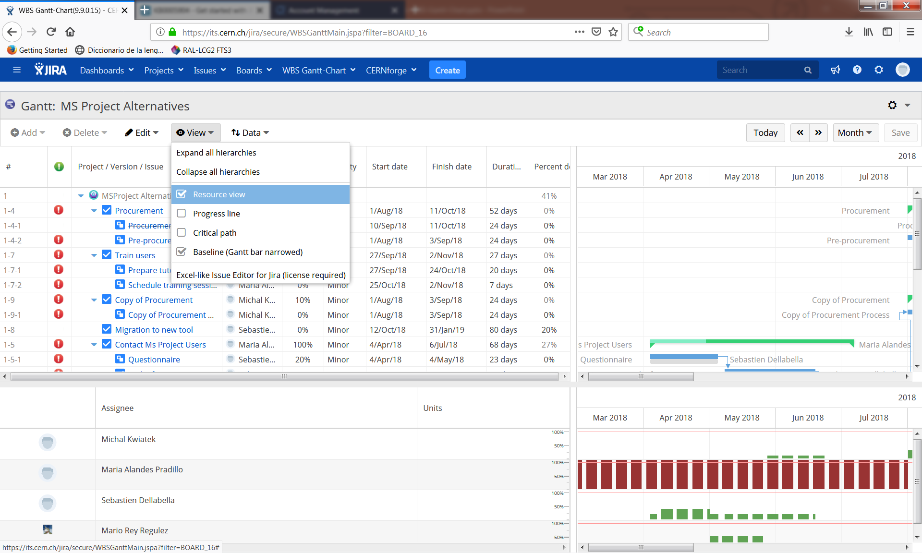
Resource View
Basic resource management and allocation
Tasks have fixed duration: changing units won’t have an impact on the duration of the tasks
Tip: calculate the duration of the tasks taking into account the availability of the resources and adjust both units and duration if necessary

Slide 30
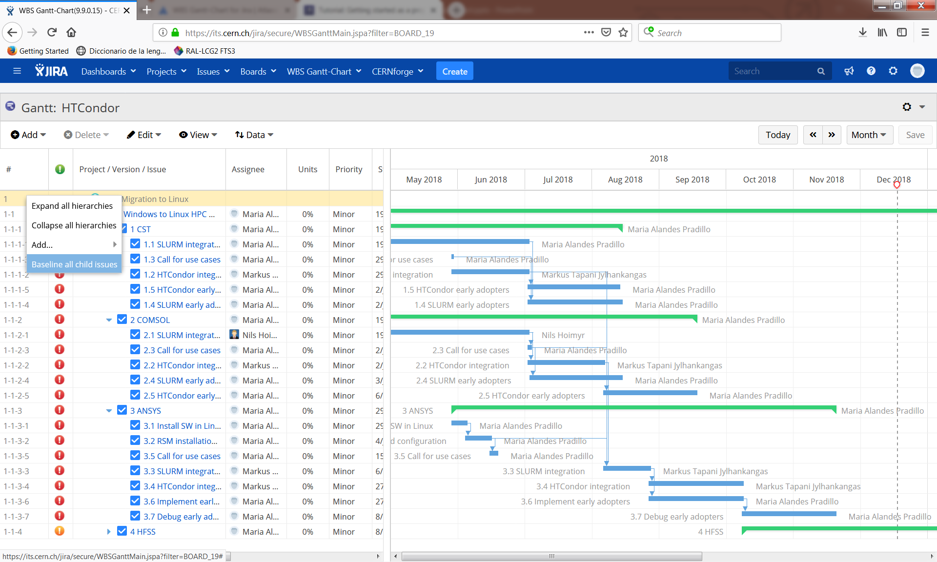
Baseline
Right-Click on the project task

Slide 31
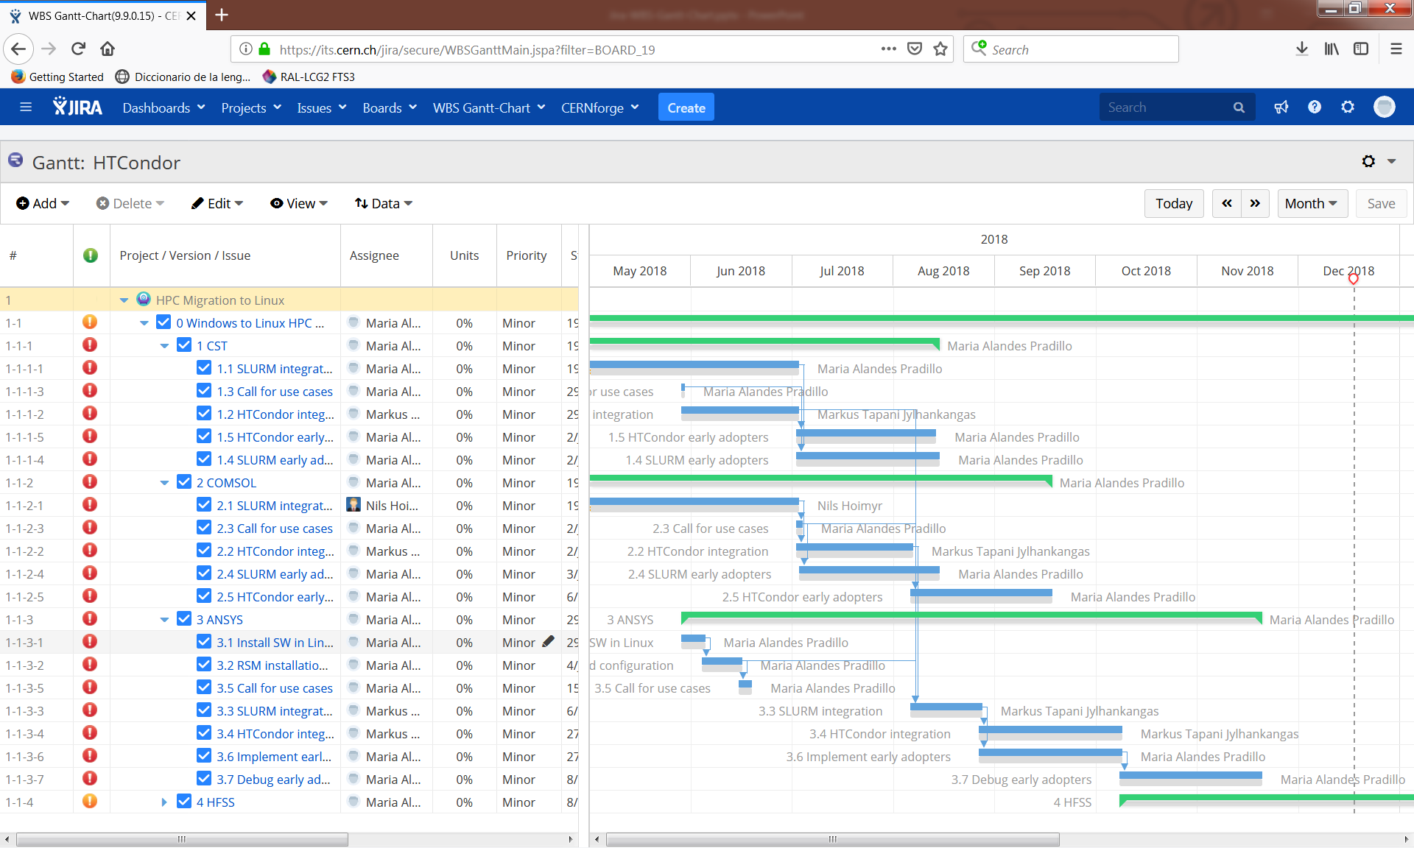
Baseline
The grey bars show the baseline: your original plan
Enable/Disable it in the View Menu

Slide 32
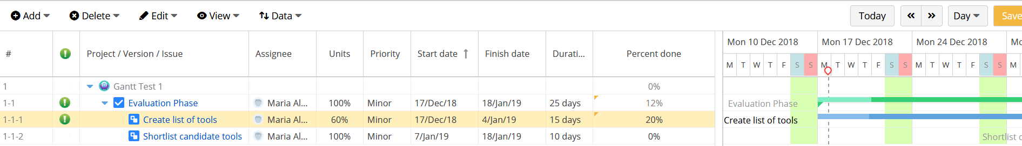
Progress
Warnings
  Tasks about to start
  Task not started by the start date
  Task not finished by the end date
Percent done
Current date: see whether you are late or ahead of schedule

Slide 33
Progress
Criteria to update progress needs to be defined
  Frequency
    Every week?
    Every project review?
  Who?
    Any user?
    Project leader?
Accuracy depends on the criticality of this information
  Find a balance between progress reporting overhead and usefulness for project control and follow-up

Slide 34
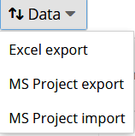
Export (I)
In the Data Menu
  Export to Excel
  Export to MS Project (xml)
    It could be useful for people working with subcontractors who may use MS Project
  Import from MS Project (see next slides)

Slide 35
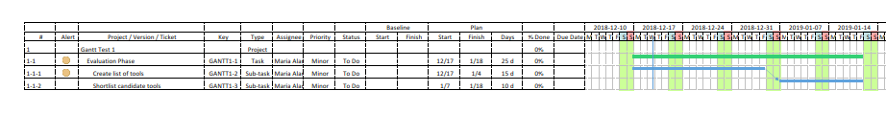
Export (II)
Print Button suggested by some users
  To print on paper? on PDF?
  Feature request for printing: WGC-855
Several Workarounds:
  Export to Excel and then print from PDF (From the Data Menu)
    Feature request to display task names in the Gantt Chart: WGC-859

Slide 36
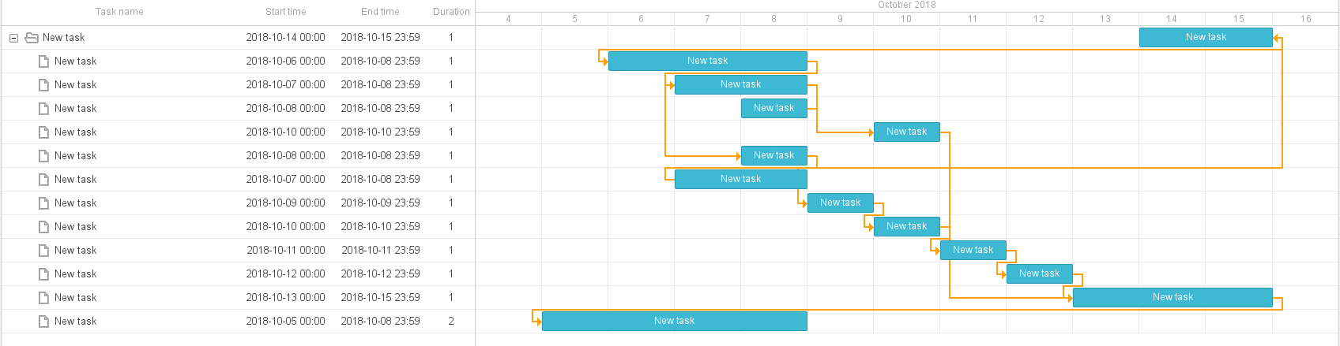
Export (III)
DHTMLX viewer tool that will be soon available in CERNbox
  Export to MS Project (XML)
  Open on CERNbox
  Export to PDF, PNG, etc…

Slide 37
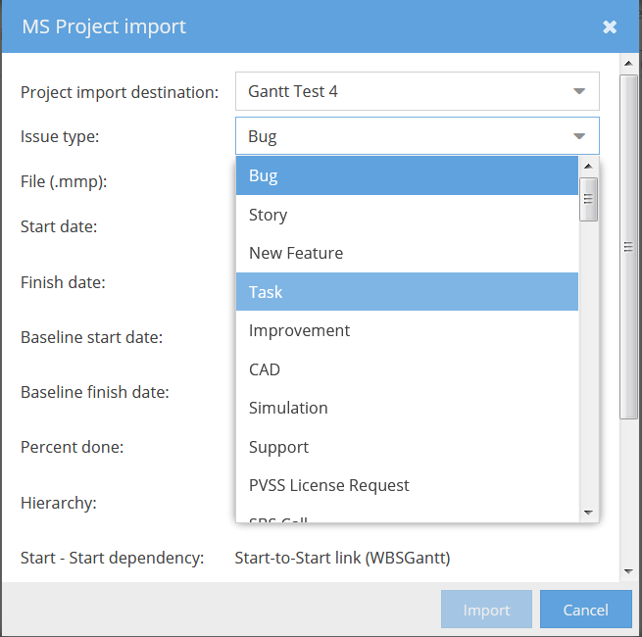
Importing MS Project files
Make sure to select Task type!
Make sure user importing MS Project file has « Assignable » permission
  User needs to have a Developer role!
Be patient, the progress bar displays status per task!
When start or finish dates are not defined
  WGC-858

Slide 38
Other Useful Functionality
Holiday calendar
  https://rssupport.atlassian.net/wiki/spaces/WGCE0909/pages/350289943/Configuring+the+holiday+calendar
Critical Path
  https://rssupport.atlassian.net/wiki/spaces/WGCE0909/pages/350290112/Information+on+analysis+tools+and+functions#Informationonanalysistoolsandfunctions-Viewingthecriticalpath
Progress line
  https://rssupport.atlassian.net/wiki/spaces/WGCE0909/pages/350290112/Information+on+analysis+tools+and+functions#Informationonanalysistoolsandfunctions-Viewingtheprogress
Adding more columns
  https://rssupport.atlassian.net/wiki/spaces/WGCE0909/pages/350289989/Configuring+additional+columns
Complete documentation
  https://rssupport.atlassian.net/wiki/spaces/WGCE0909/overview

Slide 39
JIRA Python API
Python API
  https://pypi.org/project/jira/
Gitlab project
  https://gitlab.cern.ch/it-dep-cda/jira-api-utils
  Python libraries and functions to interact and manipulate JIRA projects
  I would like to offer this through SWAN service (work in progress)

Slide 40
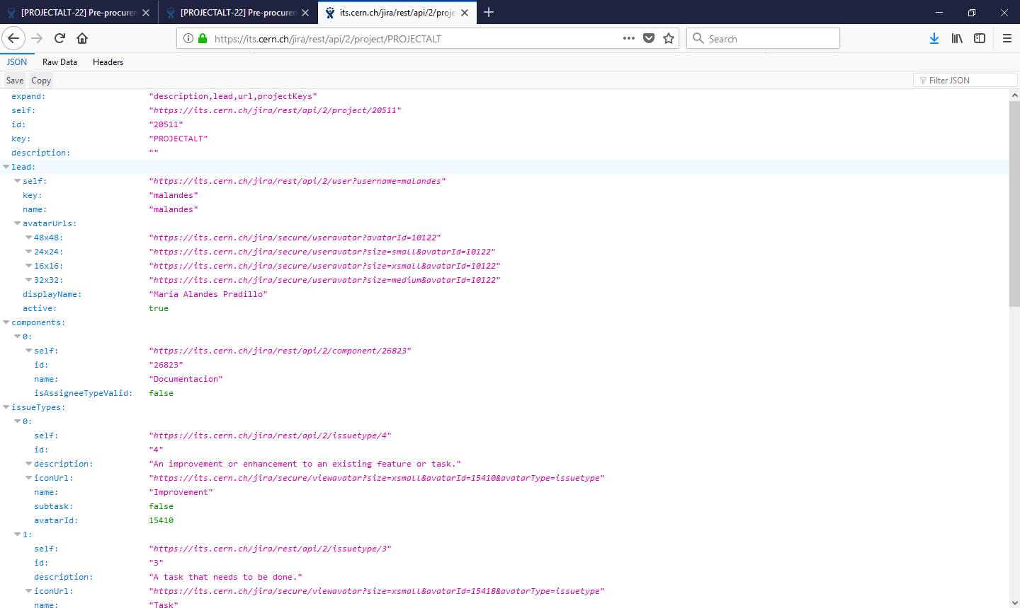
JIRA REST API
REST API
  https://cern.service-now.com/service-portal/article.do?n=KB0002188

Slide 41
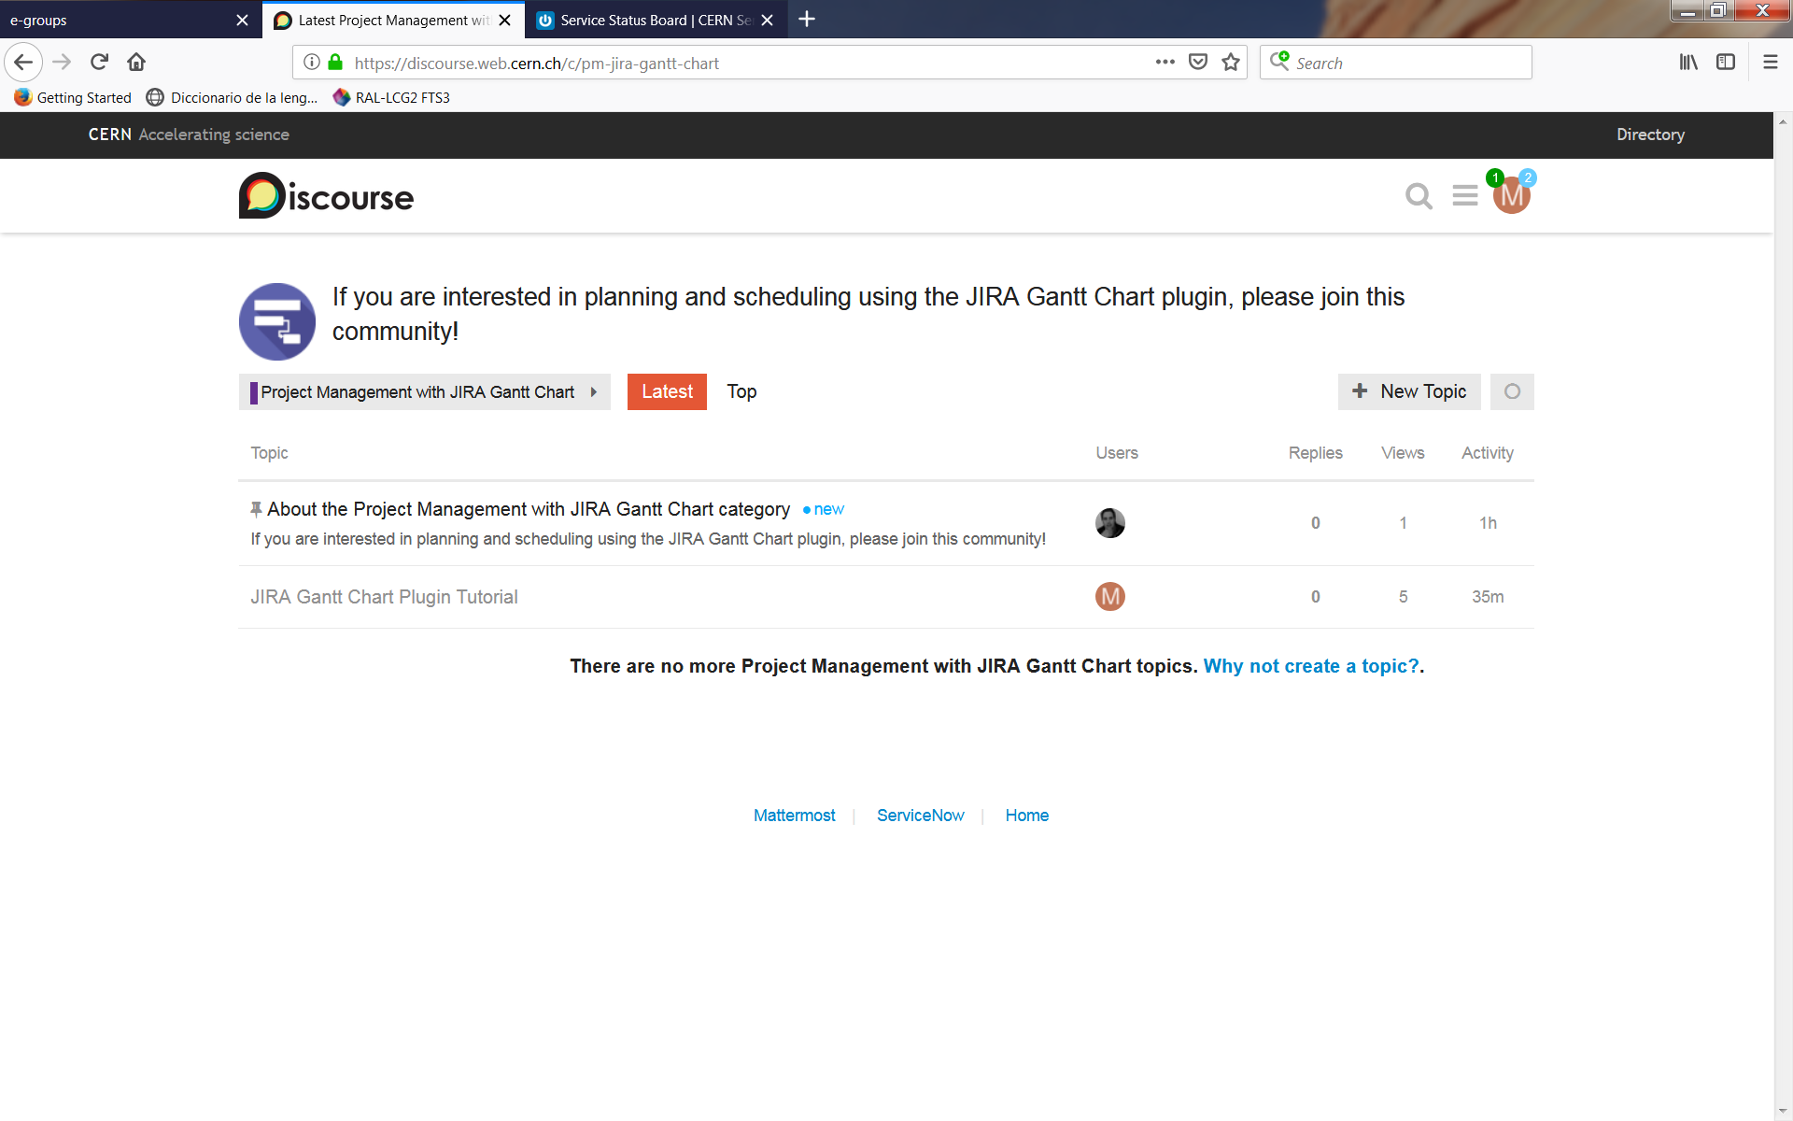
Keeping up to date
Egroup jira-gantt-chart-plugin-forum:
Community forum:
  https://discourse.web.cern.ch/c/pm-jira-gantt-chart

Slide 42
Documentation
Get started with JIRA KB
  https://cern.service-now.com/service-portal/article.do?n=KB0005904
  WBS Gantt Chart for JIRA Demo
  https://www.youtube.com/watch?v=nkUbKEaveXA

