Slide 1
ChDR Point Spread Function (4)
A. Potylitsyn, D. Shkitov, S. Gogolev
Outline
KEK ATF experiment
Simulations of the ChDR PSF
Conclusion

Slide 2
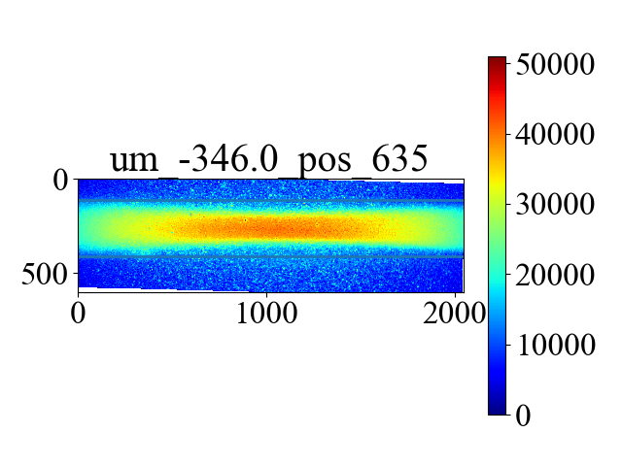
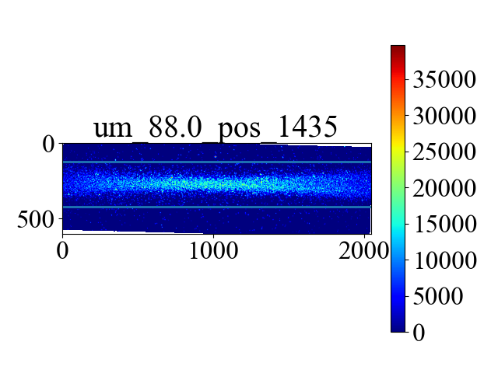
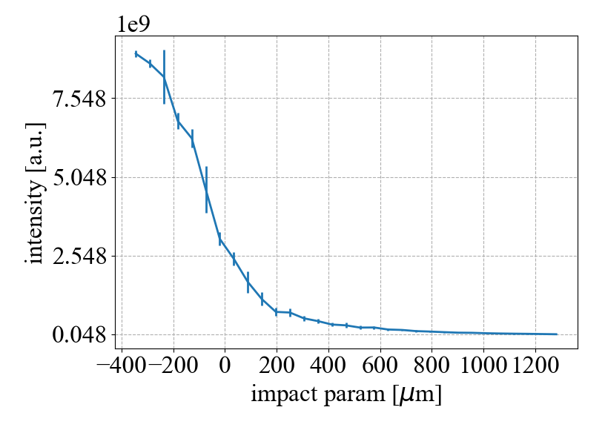
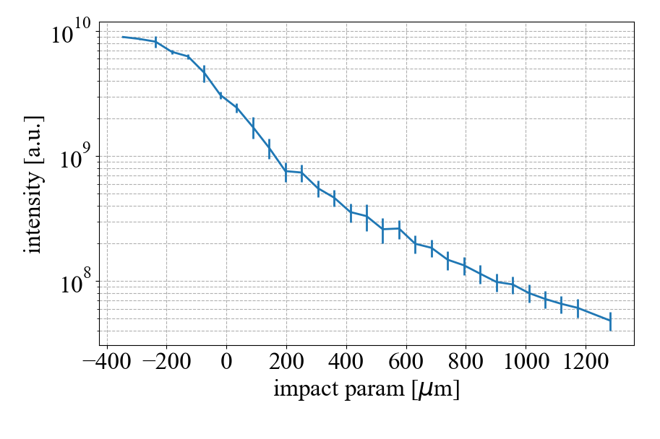
Impact parameter scan
Total intensity linear scale
Total intensity log scale

Slide 3
Simulation of 1-D ChDR PSF
Assumptions:
Cross-section of the LSF at the fixed position of the trajectory trace is considered as one-dimensional PSF;
Both polarization components of the ChDR field are simulated using the polarization currents method neglecting by refraction and attenuation effects;
ChDR fields are simulated for far field zone;
Unit magnification of the optical system.

Slide 4
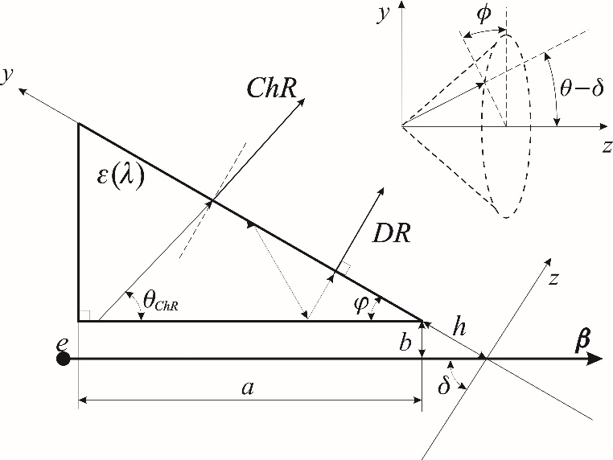
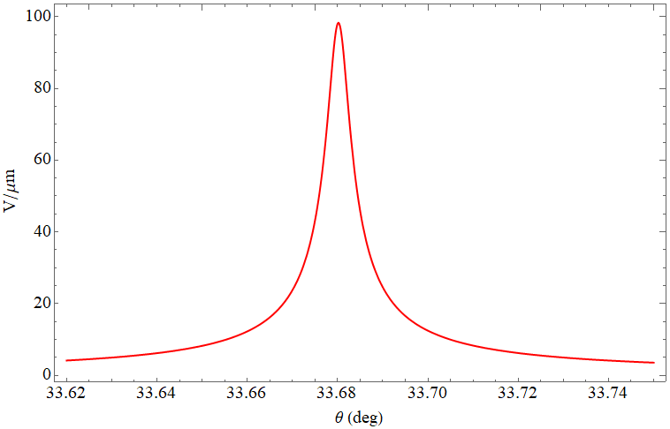


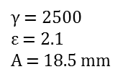

ChDR in a vacuum
Polarization currents model in the far field zone
$γ$ = 2500
$ε$ = 2.1
A = 18.5 mm
$θ_{ChR}^{max}$ = 33.68 deg
$I$ (arb. units)
A
$θ$ (deg)
Scheme of the generation of polarization radiation
ChDR angular distribution

Slide 5
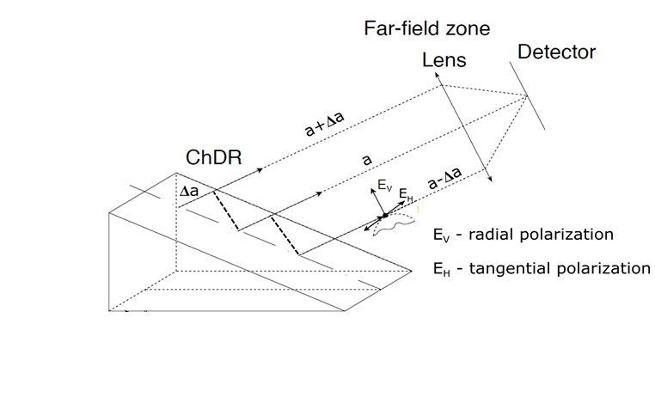
ChDR generation scheme
Trajectory image
2σ_{x}
h
e⁻
2σ_{y}
Δa ≠ 0
There is defocusing effect due to Δa ≠ 0

Slide 6
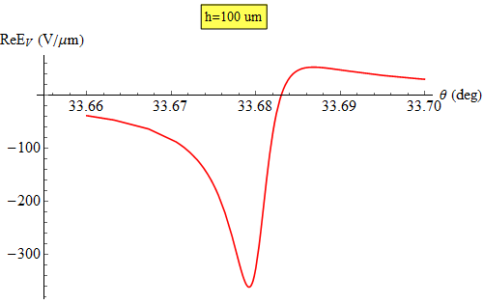
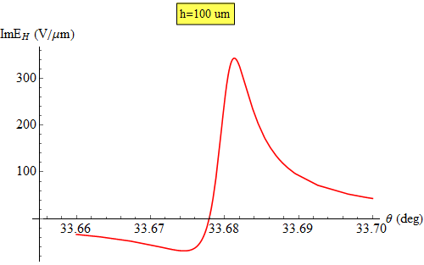
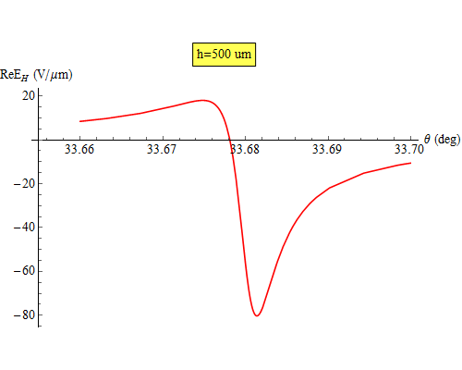
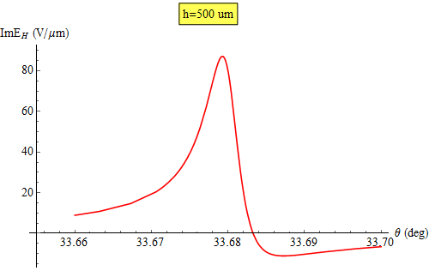
Dependence of the field Ev on the polar angle θ

Slide 7
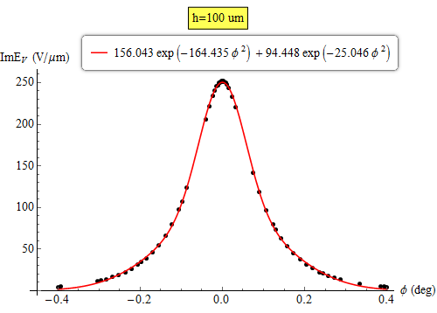
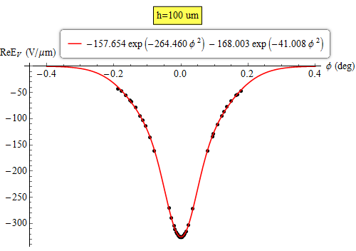
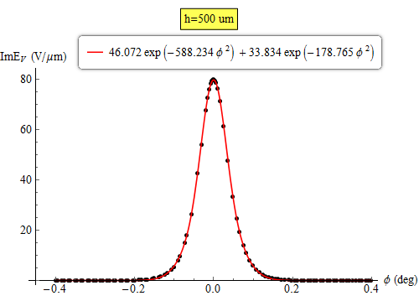
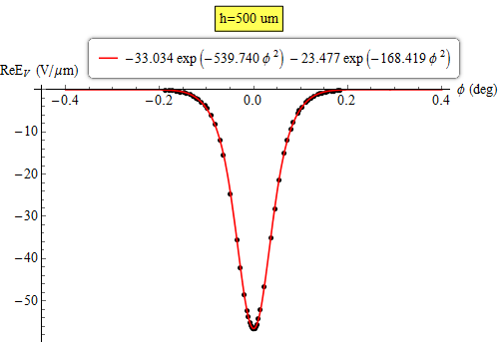
Dependence of the field Ev on the azimuthal angle ϕ

Slide 8
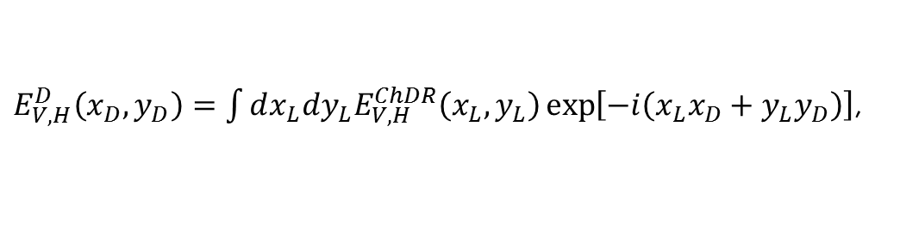


PSF simulation.
Dimensionless variables
$E_{V,H}^{D}\left(x_{D},y_{D}\right)=\int{dx_{L}dy_{L}E_{V,H}^{ChDR}\left(x_{L},y_{L}\right)}\exp\left[−i\left(x_{L}x_{D}+y_{L}y_{D}\right)\right]$,
lens
aperture
where
$x_{L}=\frac{γ}{a}X_{L}$,
$x_{D}=\frac{2π}{γλ}X_{D}$,
here $X_{L,D}$ – in micrometers, a is the distance between a source and a lens.
$W_{V,H}^{D}\left(x_{D},0\right)={\left|E_{V,H}^{D}\left(x_{D},0\right)\right|}^{2}={\left|{ReE}_{V,H}^{D}\left(x_{D},0\right)\right|}^{2}+{\left|{ImE}_{V,H}^{D}\left(x_{D},0\right)\right|}^{2}$.
Image from a single charge: ${PSF}_{V,H}{⇒ W}_{V,H}^{D}\left(x_{D},0\right)$.
10

Slide 9
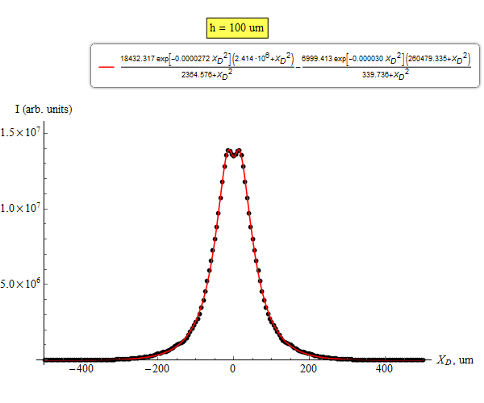
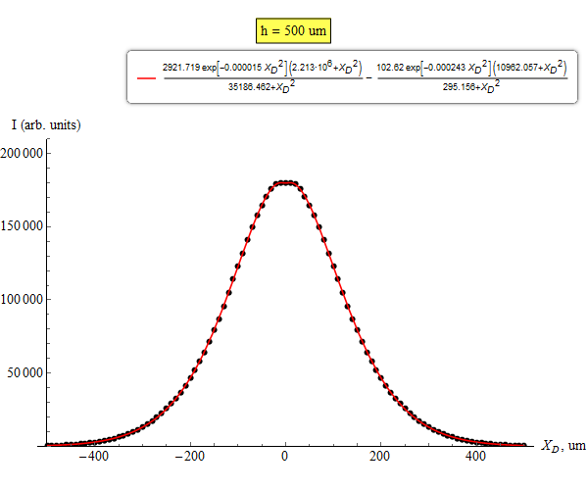
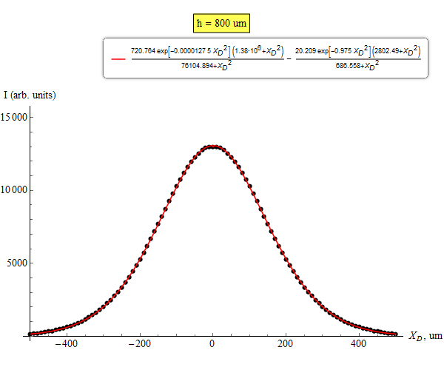
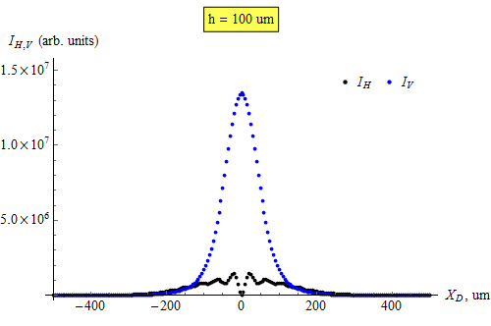
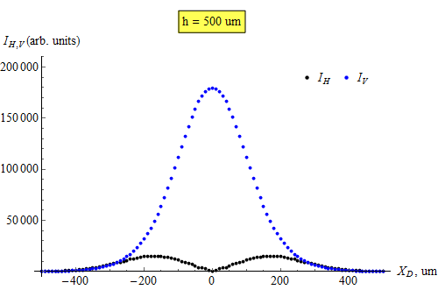
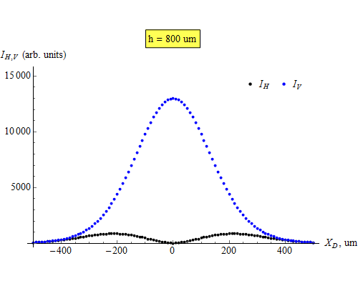
PSF distributions
$$with taking into account both field Ev components (ReEv, ImEv)$$

Slide 10
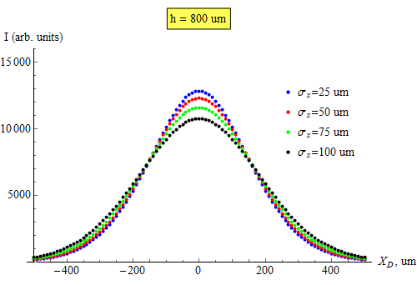
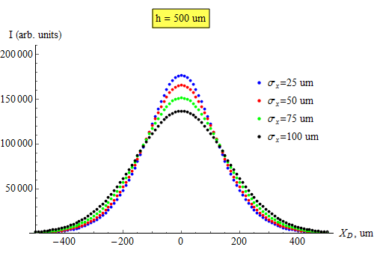
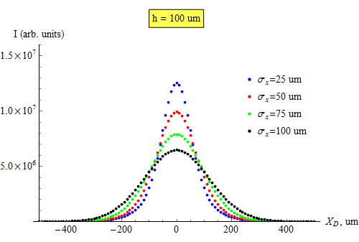

Beam profile images
$γ$ = 2500; $λ$= 0.7 um; M=1

Slide 11
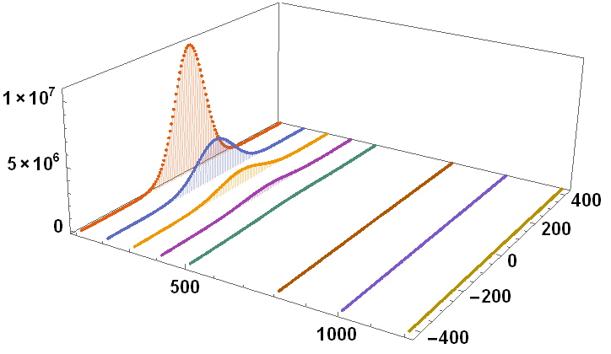


ChDR PSF (vertical polarization)
γ = 2500
λ = 0.7 um
PSF for vertical component
$I$ (arb. units)
Exponential “decay” with impact-parameter rise
h (um)
$$x_{D }\text{(}\text{um}\text{)}$$
x_{D} = 1 (dimensionless) X_{D} = γλ/2π = 280 um

Slide 12
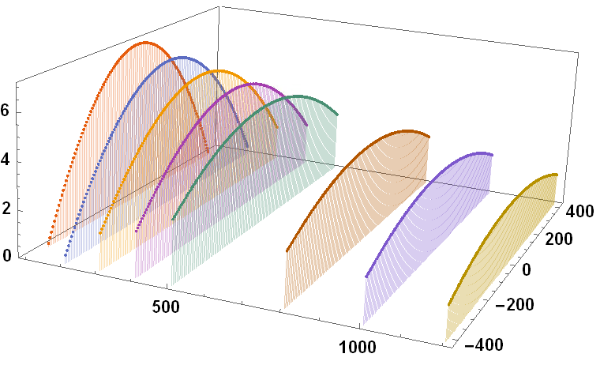


ChDR PSF (vertical polarization, log scale)
PSF for vertical component
γ = 2500
λ = 0.7 um
lg$I$ (arb. units)
$$x_{D }\text{(}\text{um}\text{)}$$
h (um)

Slide 13
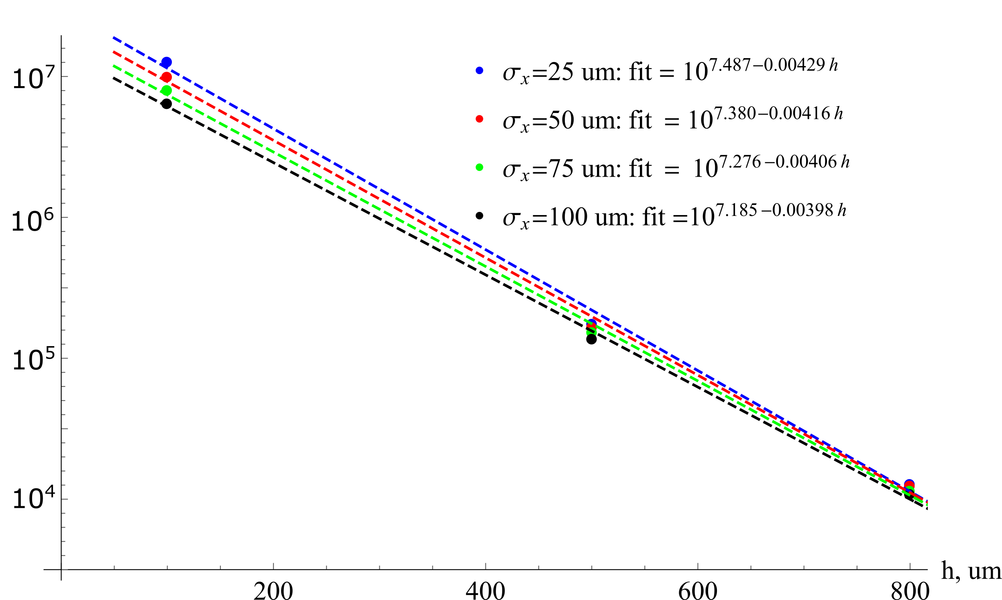
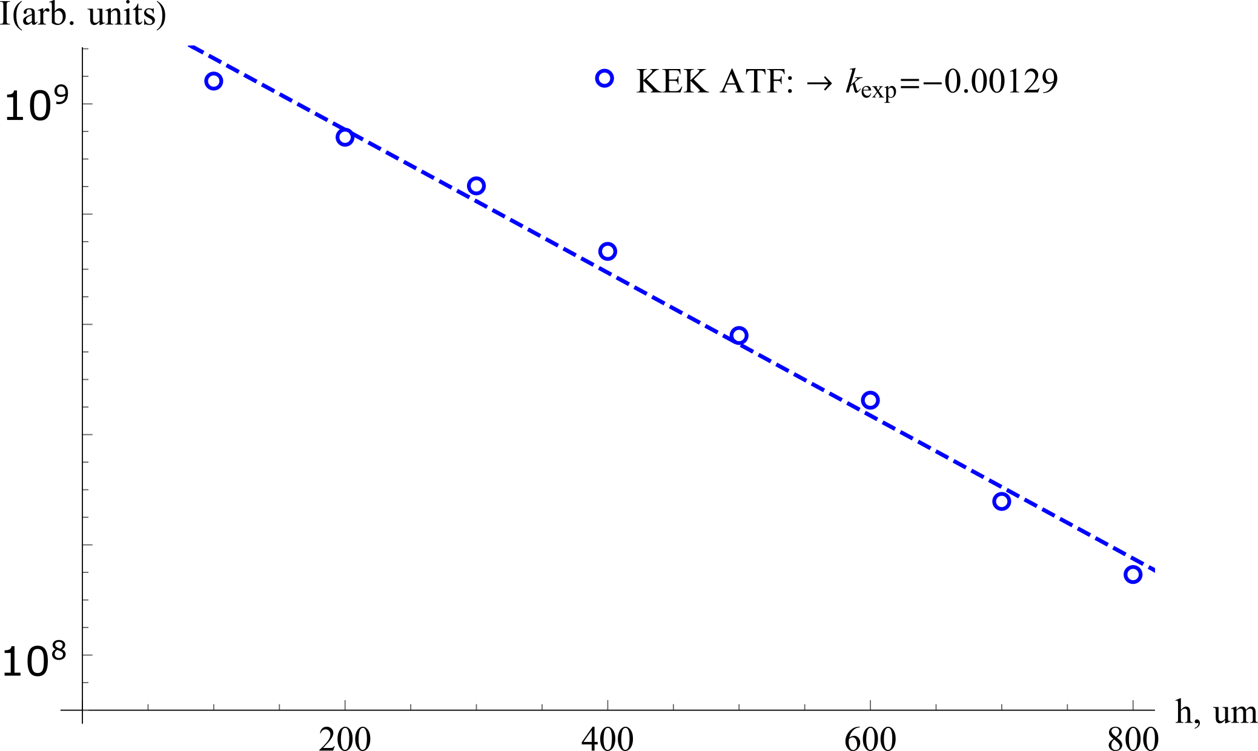
“Decay” dependence of the image maxima on the impact-parameter
Model
KEK experiments
The “decay” parameter is mush “shorter” than the experimental value
in our model decreases much quicker than in experiment

Slide 14
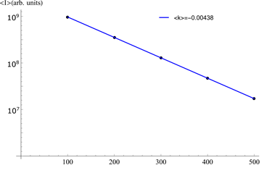
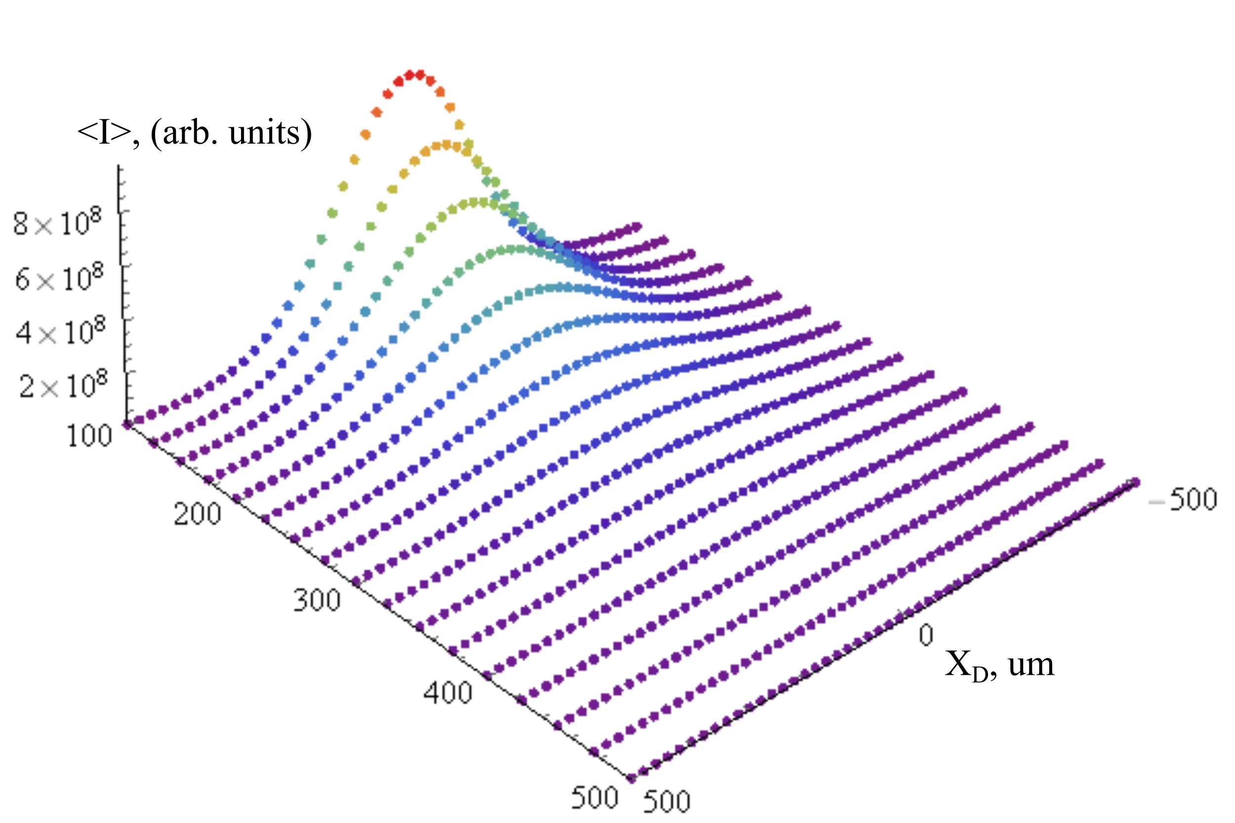
Averaging of the image over impact-parameter in the range h0±σy
Model
h0, um
h0, um
KEK experiments
Averaged impact-parameter is remained
almost the same (no “stretching”)

Slide 15
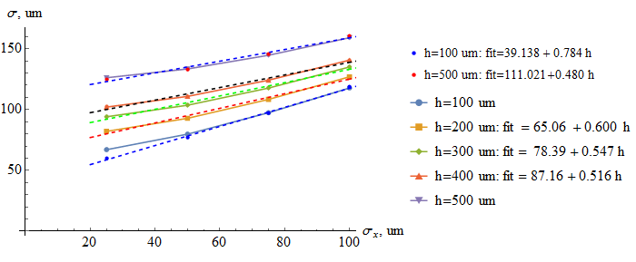
Dependence of the image sizes on the beam size after averaging
0
0
0
0
0

Slide 16
Conclusions
ChDR angular distributions were simulated with taking into account ReEv, ImEv in the far-fields zone;
Comparison of the beam image sizes with initial beam sizes shows significant broadening;
Beam images averaged over beam size (h0±σy, σy = 50 um) was simulated;
The calculated “decay” parameter is changed weekly in comparison with fixed impact-parameter (without averaging);
The model “decay” parameter is much less than the experimental value ;

