Slide 1


Universität Siegen ARIES update
QPR Update
Stewart Leith, Michael Vogel
Authors would like to acknowledge the support provided by European Union’s ARIES collaboration H2020 Research and Innovation Programme under Grant Agreement no. 730871.

Slide 2
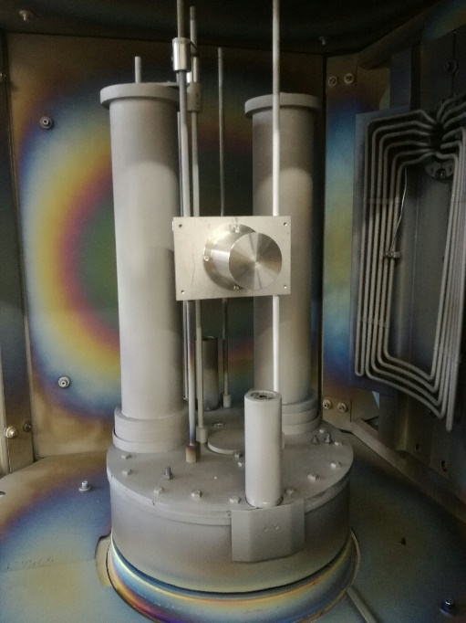
  Test QPR machined to determine positioning of actual QPR
  New Cathode cover machined to ensure cathode is covered during plasma ignition and pre-sputter target cleaning process
  After 6 weeks Al coating for different project: Machine refitted with new Nb target (RRR 300). Baked out and reconditioned
  Base pressure issues – to be investigated.
  Fume hood to be placed over coating machine week of 8 July
  Setup ready on 15 July
  QPR coating: DCMS, Nb @ 650 °C, 3 µm

