Slide 1


Universität Siegen ARIES update
Small Samples Update
Stewart Leith, Michael Vogel
Authors would like to acknowledge the support provided by European Union’s ARIES collaboration H2020 Research and Innovation Programme under Grant Agreement no. 730871.

Slide 2
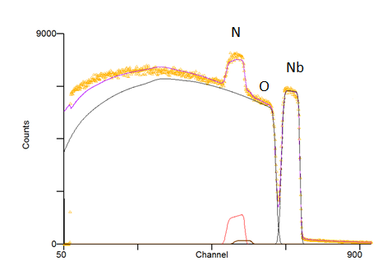
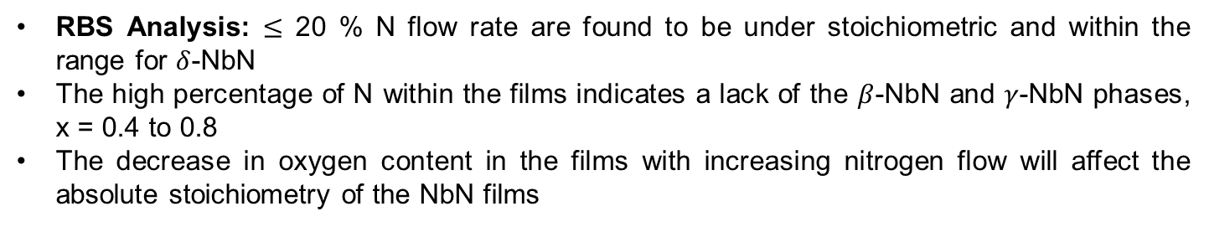
RBS Analysis: $≤$ 20 % N flow rate are found to be under stoichiometric and within the range for $δ$-NbN
The high percentage of N within the films indicates a lack of the $β$-NbN and $γ$-NbN phases, x = 0.4 to 0.8
The decrease in oxygen content in the films with increasing nitrogen flow will affect the absolute stoichiometry of the NbN films
N₂ flow % | Nb (at.%) | N (at.%) | O (at.%) | x
10 | 48.8 | 46.2 | 5 | 0.95
15 | 48.75 | 45.17 | 6.07 | 0.93
20 | 48.30 | 45.75 | 6 | 0.95
25 | 45.71 | 51.37 | 2.90 | 1.12
30 | 48.70 | 50.86 | 0.43 | 1.04

Slide 3
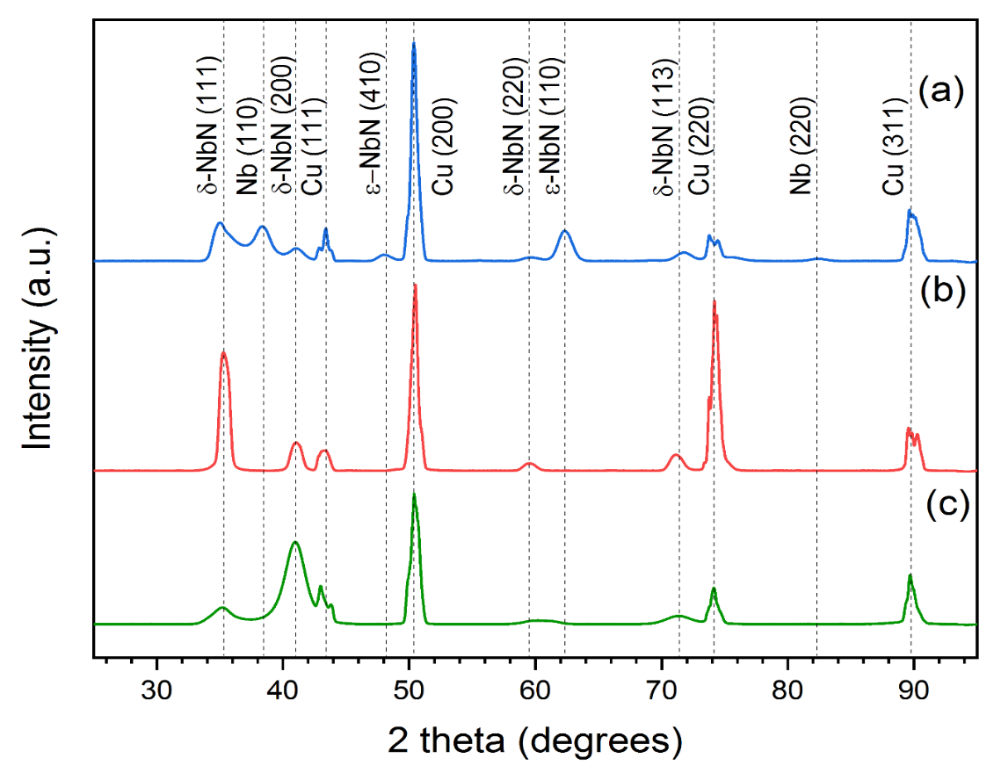
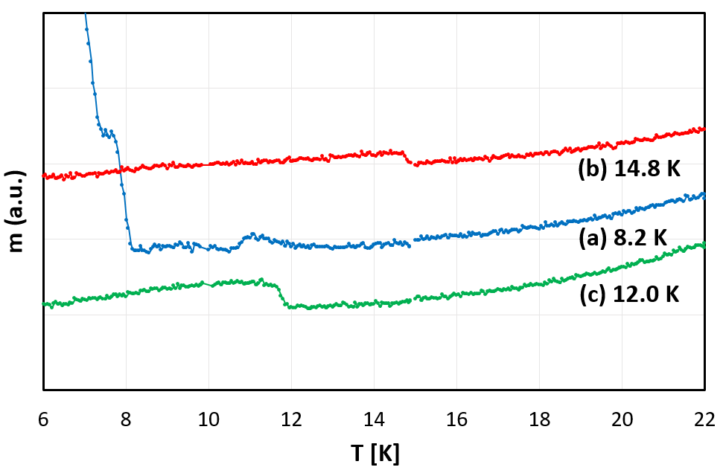

Slide 4
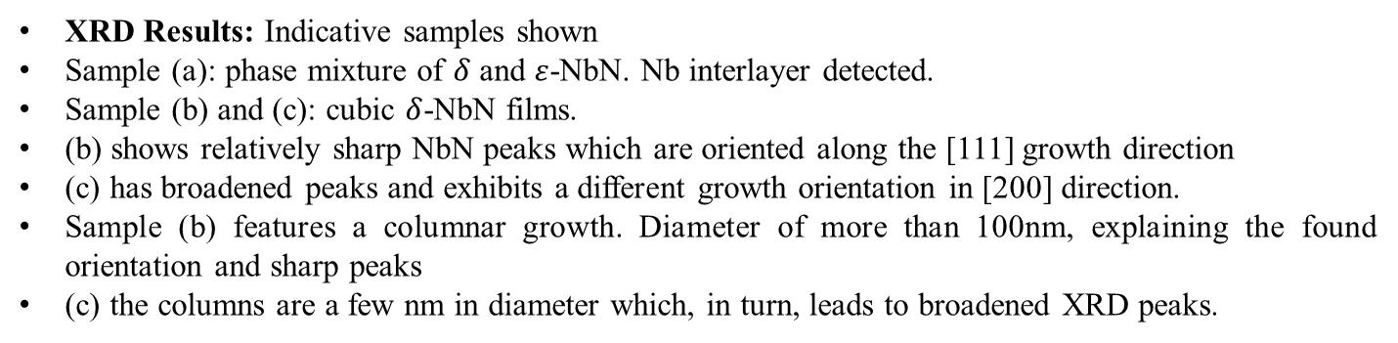
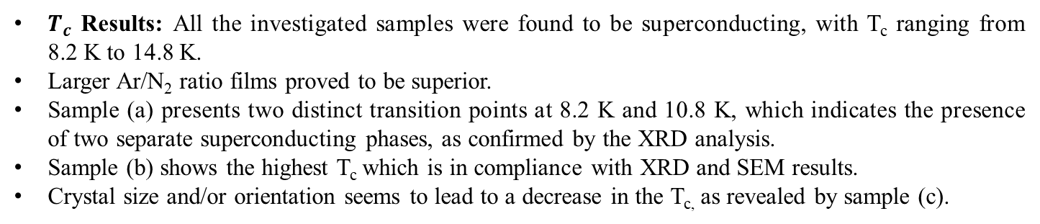
For your later reference
$T_{c}$ Results: All the investigated samples were found to be superconducting, with T_{c} ranging from 8.2 K to 14.8 K.
Larger Ar/N₂ ratio films proved to be superior.
Sample (a) presents two distinct transition points at 8.2 K and 10.8 K, which indicates the presence of two separate superconducting phases, as confirmed by the XRD analysis.
Sample (b) shows the highest T_{c} which is in compliance with XRD and SEM results.
Crystal size and/or orientation seems to lead to a decrease in the T_{c,} as revealed by sample (c).
XRD Results: Indicative samples shown
Sample (a): phase mixture of $δ$ and $ε$-NbN. Nb interlayer detected.
Sample (b) and (c): cubic $δ$-NbN films.
(b) shows relatively sharp NbN peaks which are oriented along the [111] growth direction
(c) has broadened peaks and exhibits a different growth orientation in [200] direction.
Sample (b) features a columnar growth. Diameter of more than 100nm, explaining the found orientation and sharp peaks
(c) the columns are a few nm in diameter which, in turn, leads to broadened XRD peaks.

Slide 5
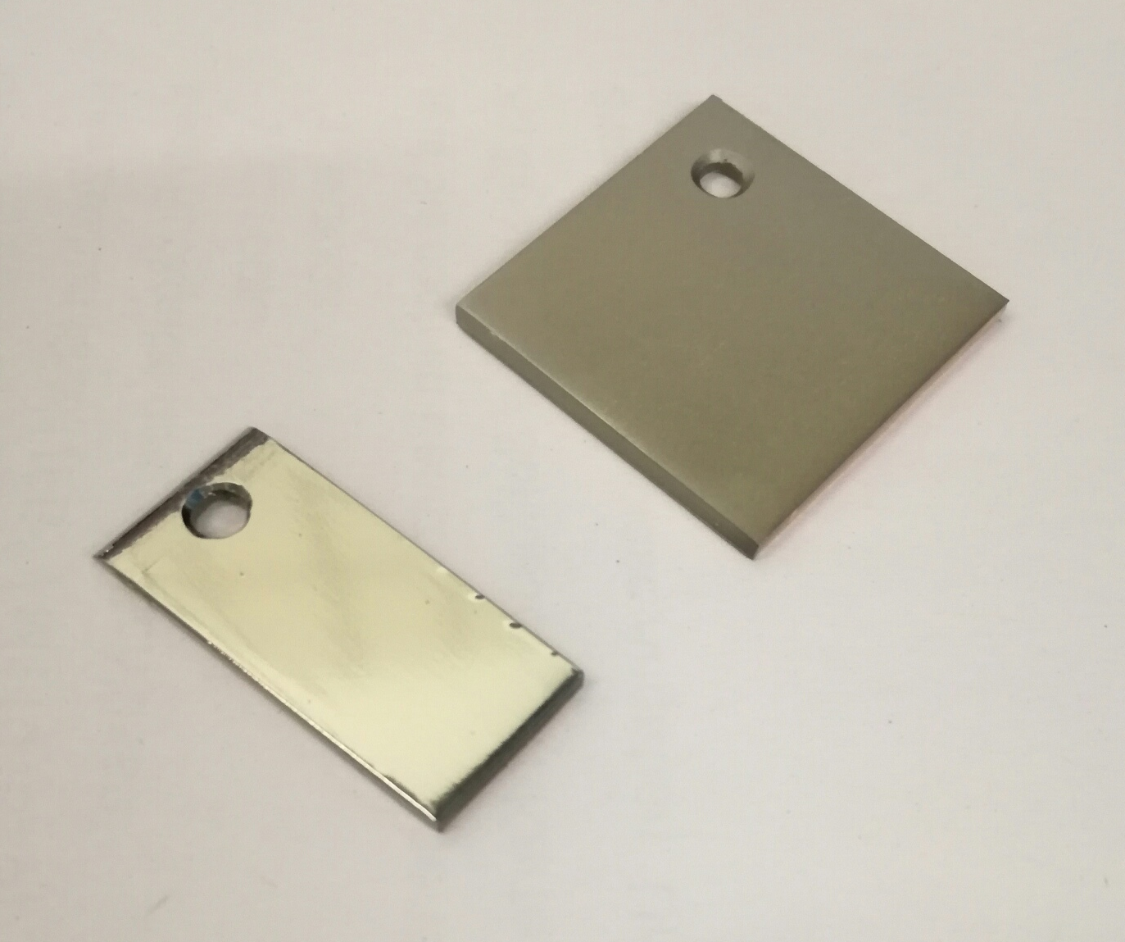
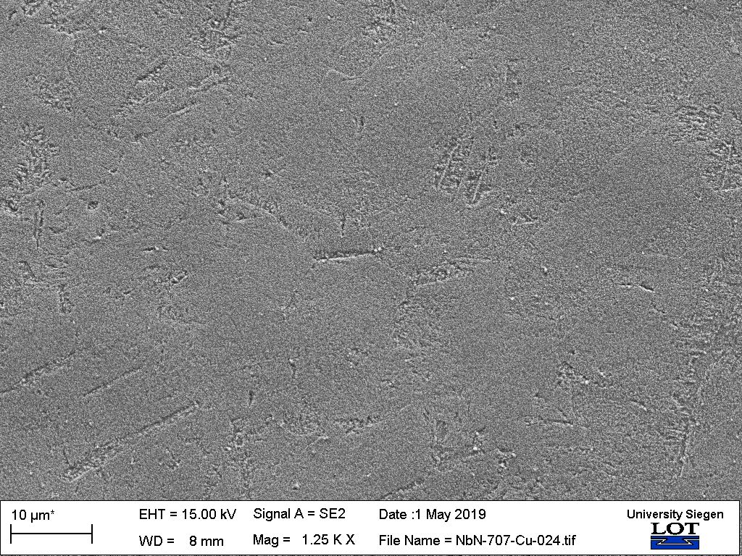
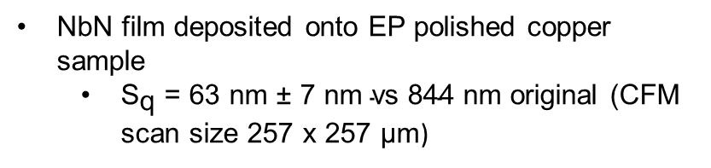
  Film deposition
  NbN film deposited onto EP polished copper sample
    ${\text{S}}_{\text{q}}\text{ = 63 }\text{nm} \text{±}\text{ 7 }\text{nm} \text{vs}\text{ 844 }\text{nm}$ original (CFM scan size 257 x 257 $\text{μm}$)
  Figure: (Left) Nitric Acid NbN/Cu. (Right) EP NbN/Cu

Slide 6
  Future Work
Investigate the use of interlayers and deposit optimised NbN films onto different surface treated copper surfaces
Deposit HiPIMS Nb and NbN films
Deposit multilayer samples onto copper (e.g. Nb – AlN – NbN or Nb – NbN)
Investigate N-doped Nb thin films on copper

