Slide 1

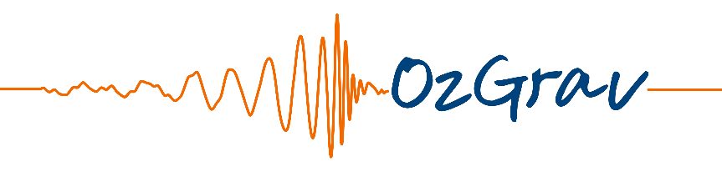
Gravitational Wave Discoveries and Science from the First,
Second and Third Observing Runs of Advanced LIGO and
Advanced Virgo
Susan Scott
Research School of Physics
The Australian National University
Chief Investigator
ARC Centre of Excellence for Gravitational
Wave Discovery − OzGrav
LIGO Scientific Collaboration
Nutsinee Kijbunchoo
1

Slide 2
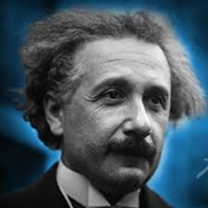
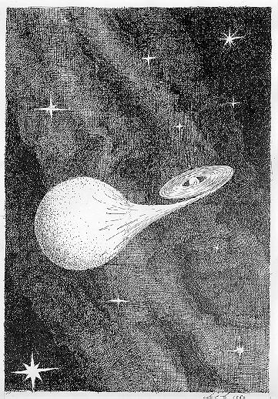
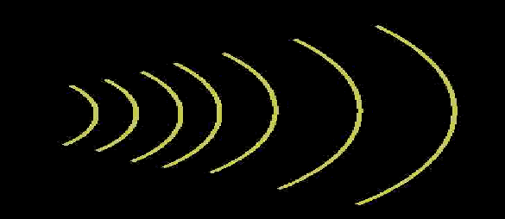
Gravitational Waves:
a different kind of waves
They were predicted by Einstein in 1916
Moving masses jiggle space-time around them!
Gravitational waves move as distortions of space-time
Not light waves!! But they also have different wavelengths…
2

Slide 3
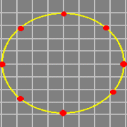
The passage of a gravitational wave
3

Slide 4
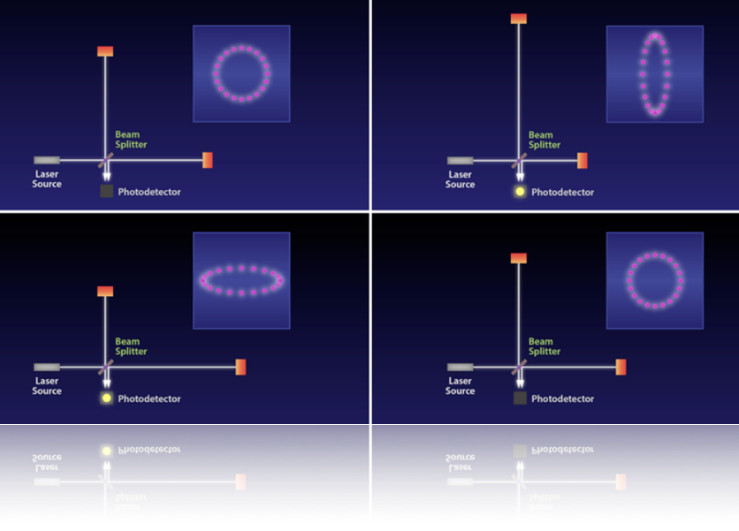
Gravitational wave interferometry
4

Slide 5
LIGO Hanford, Washington State – LH1 4km
LIGO Livingston, Louisiana – LL1 4km
O3a 1 April 2019 ⎯ 30 September 2019
O3b 1 November 2019 ⎯ 30 April 2020
O1 12 September 2015 ⎯ 19 January 2016
O2 30 November 2016 ⎯ 25 August 2017
5

Slide 6
KAGRA Kamioka, Japan – K1 3 km
Virgo Cascina, Italy – V1 3 km
cryogenic and under 1,000 m of granite!
Advanced Virgo detector joined O2 on 1 August 2017
KAGRA should join O3 later this year
6

Slide 7
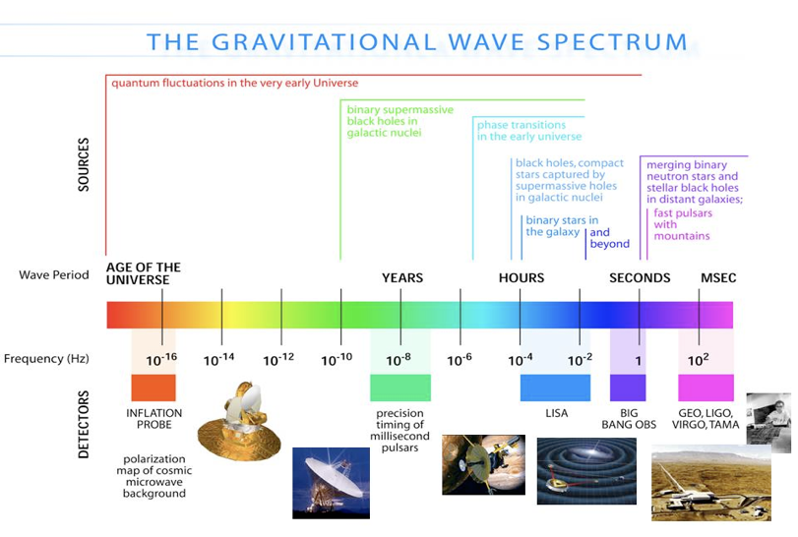
They travel at the speed of light
Not light waves!! But they also have different wavelengths…
7
Notes:
Ripples in the curvature of space-time. Spherically symmetric stars pulsating radially will not produce gravitational waves.

Slide 8
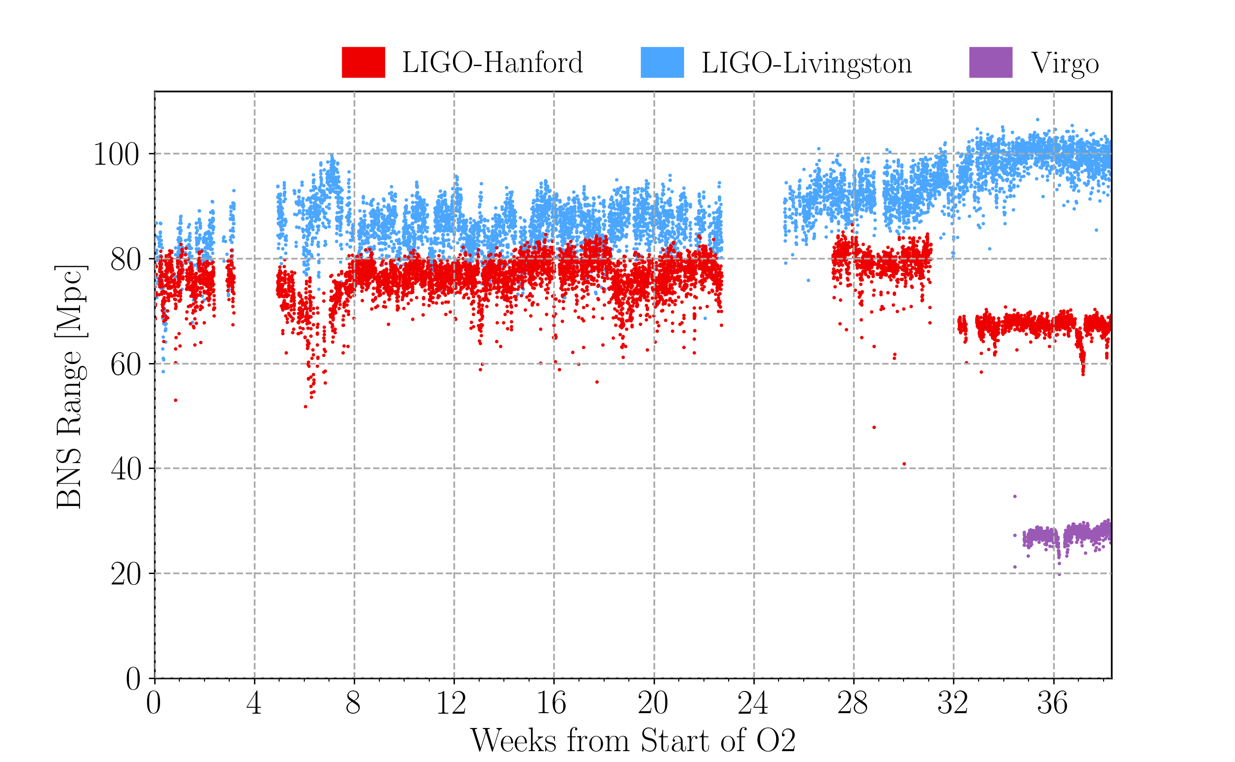
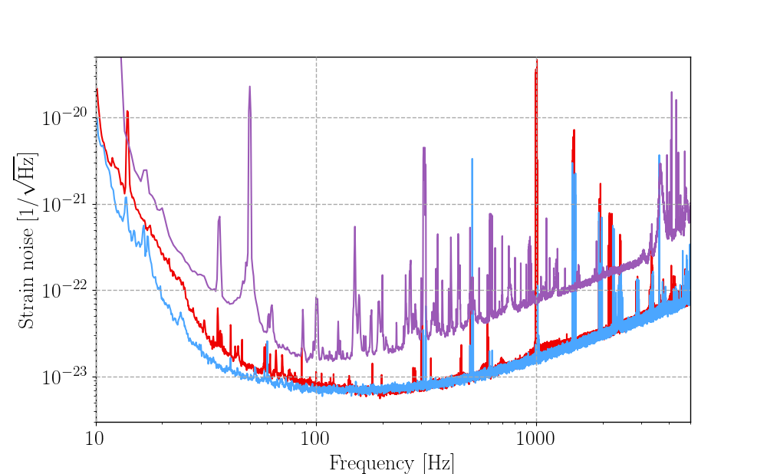
Earthquake in Montana (week 31)
Sensitive distance to binary neutron star
mergers for each detector during O2
Total strain noise for each of the detectors
8

Slide 9
Compact Binary Coalescences (CBCs)
black hole – black hole black hole – neutron star neutron star – neutron star
binary black hole system
binary neutron star system
9

Slide 10
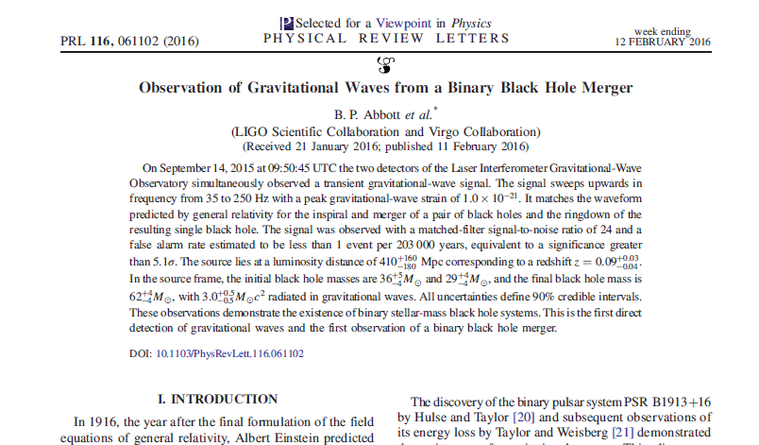
First Direct Detection of
Gravitational Waves!
10
Notes:
This is the discovery paper!

Slide 11
Parameters for the binary system
11

Slide 12
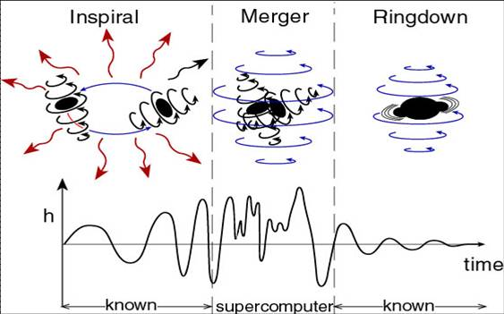
Binary black hole mergers:
gravitational waves
Image: Kip Thorne
12

Slide 13
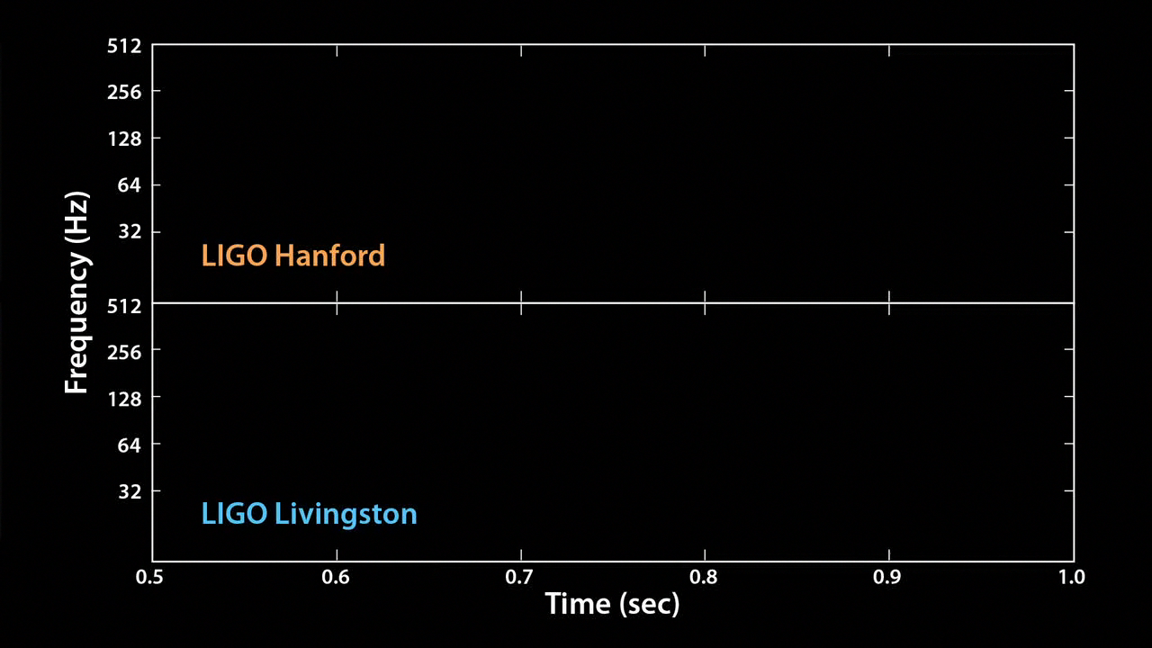
THE ‘SOUND’ SPREADING ACROSS THE UNIVERSE
13

Slide 14
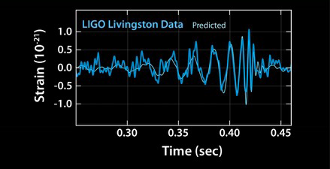
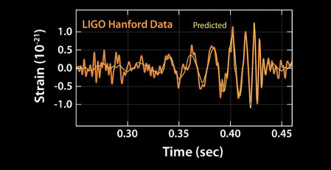
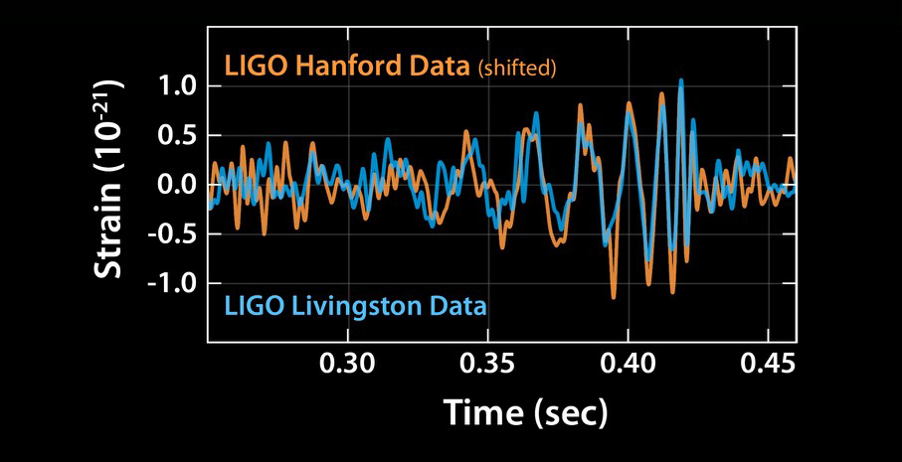
Processed waveform of GW150914
14

Slide 15
THE DISCOVERY EVENT
The first direct detection of a gravitational wave on Earth
The first detection of a black hole binary system
The first observation of black holes merging
The first test of General Relativity when the gravitational
field is very strong and highly dynamical during the black
hole merger
15

Slide 16
Binary system parameters
16

Slide 17
First detection of a binary neutron star system merger
GW170817
NSF/LIGO/Sonoma State University/
A. Simonnet
17

Slide 18
GW170817
First observation of a binary neutron star inspiral
The component masses of the binary lie in the range 1.17 – 1.60 solar masses
Total mass of the system 2.74 solar masses
The source was localised within a sky region of 28 deg² (90% probability)
Luminosity distance of 40 Mpc
This is the closest and most precisely localised gravitational wave signal yet
Associated with the gamma-ray burst GRB 170817A detected by Fermi GBM 1.7s after the colalescence
First direct evidence of a link between neutron star mergers and short gamma-ray bursts
Subsequent identification of transient counterparts across the electromagnetic spectrum in same location
DAWN OF THE AGE OF GRAVITATIONAL WAVE ASTRONOMY
18

Slide 19
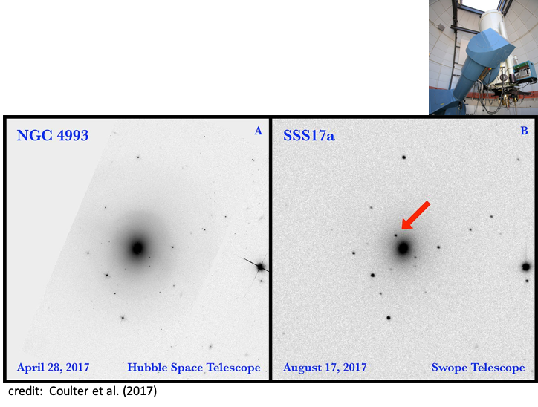
SWOPE – 11 hours later
19

Slide 20
GWTC-1
Abbott et al.
GWTC-1: A Gravitational-Wave Transient Catalog
First LIGO-Virgo Gravitational-wave Transient Catalog (GWTC-1) released in December 2018
10 binary black hole (BBH) mergers
1 binary neutron star (BNS) merger
14 marginal candidates < 50% chance of being astrophysical
20

Slide 21
CATALOGUE OF EVENTS FOR O1 AND O2
Event | m₁/M☉ | m₂/M☉ | χ_{eff} | M_{f}/M☉ | E_{rad} /(M☉c²) | d_{L} /Mpc | ∆Ω/deg²
GW150914 | 35.6 | 30.6 | -0.01 | 63.1 | 3.1 | 430 | 179
GW151012 | 23.3 | 13.6 | 0.04 | 35.7 | 1.5 | 1060 | 1555
GW151226 | 13.7 | 7.7 | 0.18 | 20.5 | 1.0 | 440 | 1033
GW170104 | 31.0 | 20.1 | −0.04 | 49.1 | 2.2 | 960 | 924
GW170608 | 10.9 | 7.6 | 0.03 | 17.8 | 0.9 | 320 | 396
GW170729 | 50.6 | 34.3 | 0.36 | 80.3 | 4.8 | 2750 | 1033
GW170809 | 35.2 | 23.8 | 0.07 | 56.4 | 2.7 | 990 | 340
GW170814 | 30.7 | 25.3 | 0.07 | 53.4 | 2.7 | 580 | 87
GW170817 | 1.46 | 1.27 | 0.00 | ≤ 2.8 | ≥ 0.04 | 40 | 16
GW170818 | 35.5 | 26.8 | −0.09 | 59.8 | 2.7 | 1020 | 39
GW170823 | 39.6 | 29.4 | 0.08 | 65.6 | 3.3 | 1850 | 1651
21

Slide 22
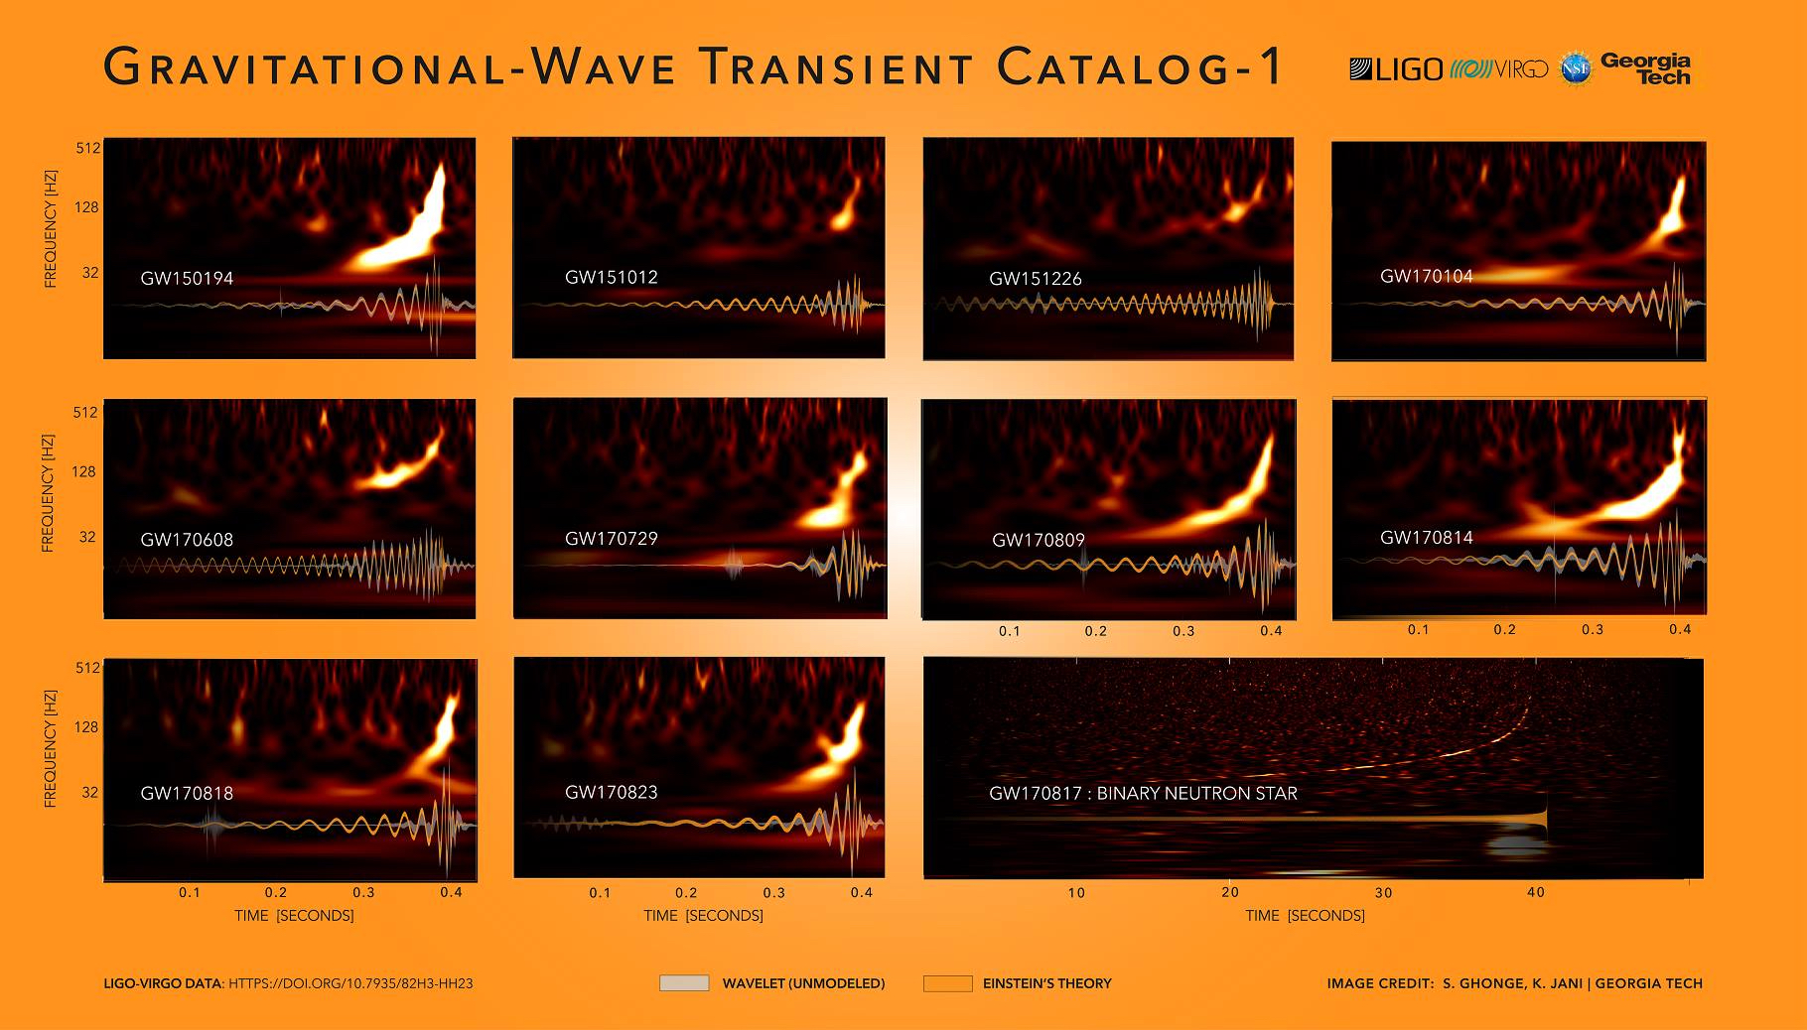
22

Slide 23
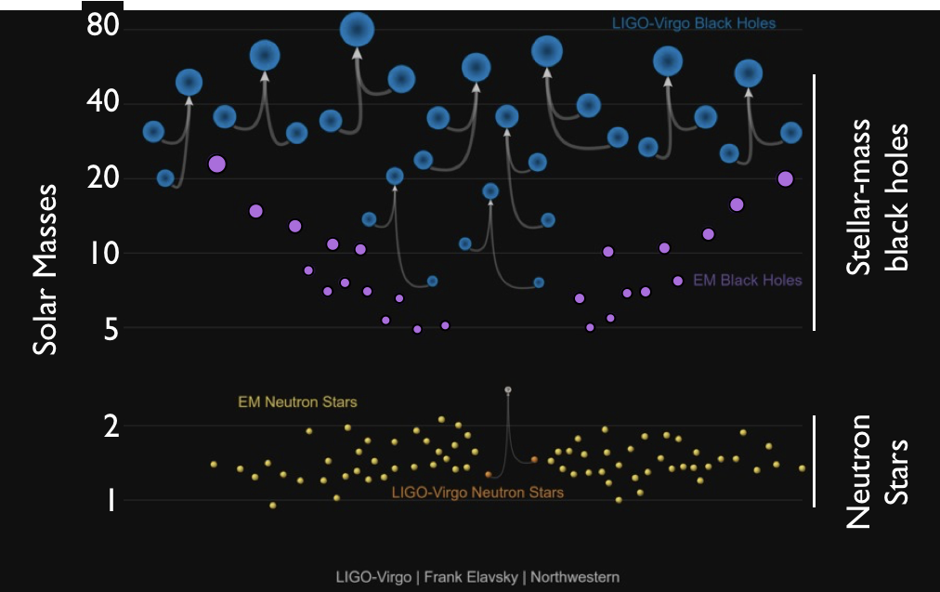
MASSES IN THE STELLAR GRAVEYARD
23

Slide 24
Inferred merger rates
The data for O1 and O2 include approximately one gravitational wave detection per
15 days of data searched
Inferred merger rates at the 90% confidence intervals:
9.7−101 Gpc⁻³ y⁻¹ for binary black holes
110−3840 Gpc⁻³ y⁻¹ for binary neutron stars
a neutron star – black hole merger rate 90% upper limit of 610 Gpc⁻³ y⁻¹
24

Slide 25
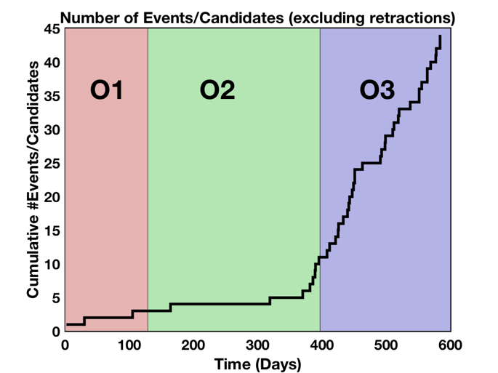
25

Slide 26
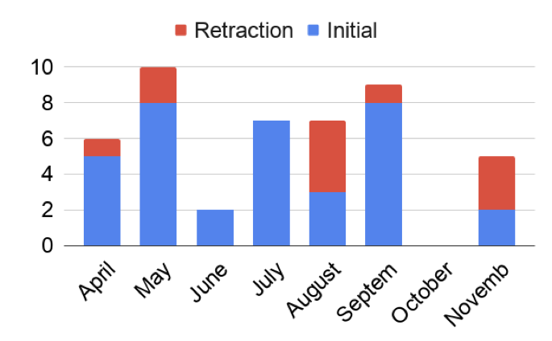
O3 Alerts & Retractions
26

Slide 27
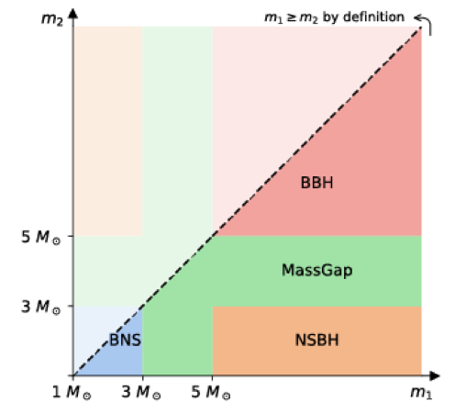
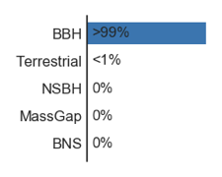
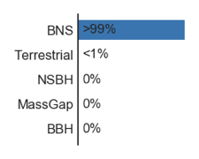
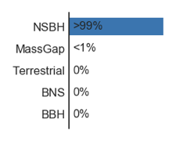
Observing run O3
Sum of probabilities in each category
~22.5 BBH
~3.5 NSBH
~3 BNS
~2.25 Gap
~3.75 Terr
S190707q
S190425z
S190814bv
No multi-messenger counterparts so far
27

Slide 28
PHYSICS QUESTIONS
Determine the speed of gravitational waves
Probe alternative theories of gravity
Test the Post-Newtonian approximation during inspiral
Use neutron star collisions to determine the rate of expansion of the Universe
Continue to refine compact binary coalescence rates
Theories of formation and evolution of compact binary systems
Probe the neutron star equation of state
Investigate the black hole mass gap
What is the most massive neutron star?
What is the least massive black hole?
28

Slide 29
Objectives for ground-based observatories
To test relativistic gravity and to develop gravitational wave detection as an astronomical probe
Anticipated gravitational-wave signals
Transient signals: compact binary coalescence, supernovae, cosmic string kinks, black hole ringdown
Continuous signals: spinning neutron stars in isolation & in binaries
Stochastic signals from cosmological sources
Serendipitous signals: unanticipated sources in all these categories
Gravitational waves carry information about the structure and dynamics of the sources
29

Slide 30
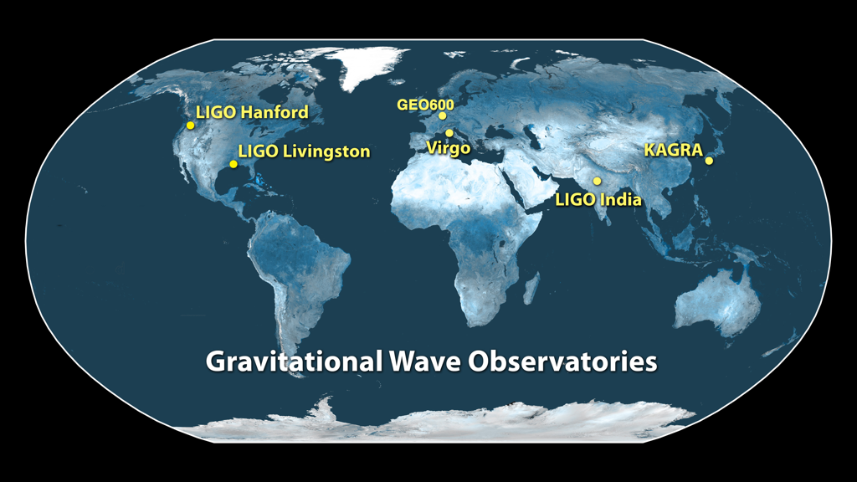
International Gravitational-Wave Observatory Network (I-G-W-N)
30

Slide 31
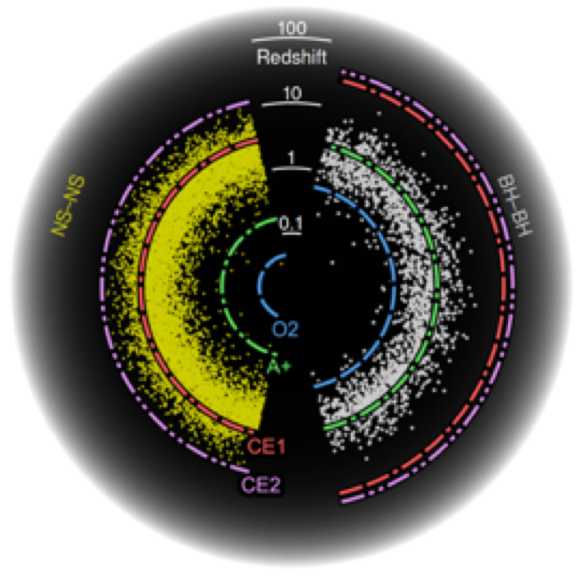
THE FUTURE
31

