Slide 1
Status of the SPL cryo-module development
(report from WG3)
V.Parma, TE-MSC
(with contributions from WG3 members)

Slide 2
Outline
Introduction
New orientation and work organisation
Layout studies and machine sectorisation (vacuum+cryogenics)
Recent advances:
  Supporting schemes
  Cryogenics
Summary

Slide 3
Working group (WG3)
System/Activity | Responsible/member | Lab
Machine architecture | F.Gerigk | CERN
WG3 coordination | V.Parma | CERN
Cryo-module design & Integration CERN | V.Parma. Team: N.Bourcey, P.Coelho, O.Capatina, D.Caparros, Th.Renaglia, A.Vande Craen | CERN
Cryo-module design & Integration CNRS | P.Duthil (P.Duchesne) + CNRS Team | CNRS/IN2P3-Orsay
Cryostat assembly tooling | P.Duthil (P.Duchesne) | CNRS/IN2P3-Orsay
WG 2 activity (RF cavities/He vessel/tuner, RF coupler) | W.Weingarten/S.Chel/O.Capatina/E.Montesinos | CERN, CEA-Saclay
Vacuum systems | S.Calatroni | CERN
Cryogenics | U.Wagner | CERN
Survey and alignment | D.Missiaen | CERN

Slide 4

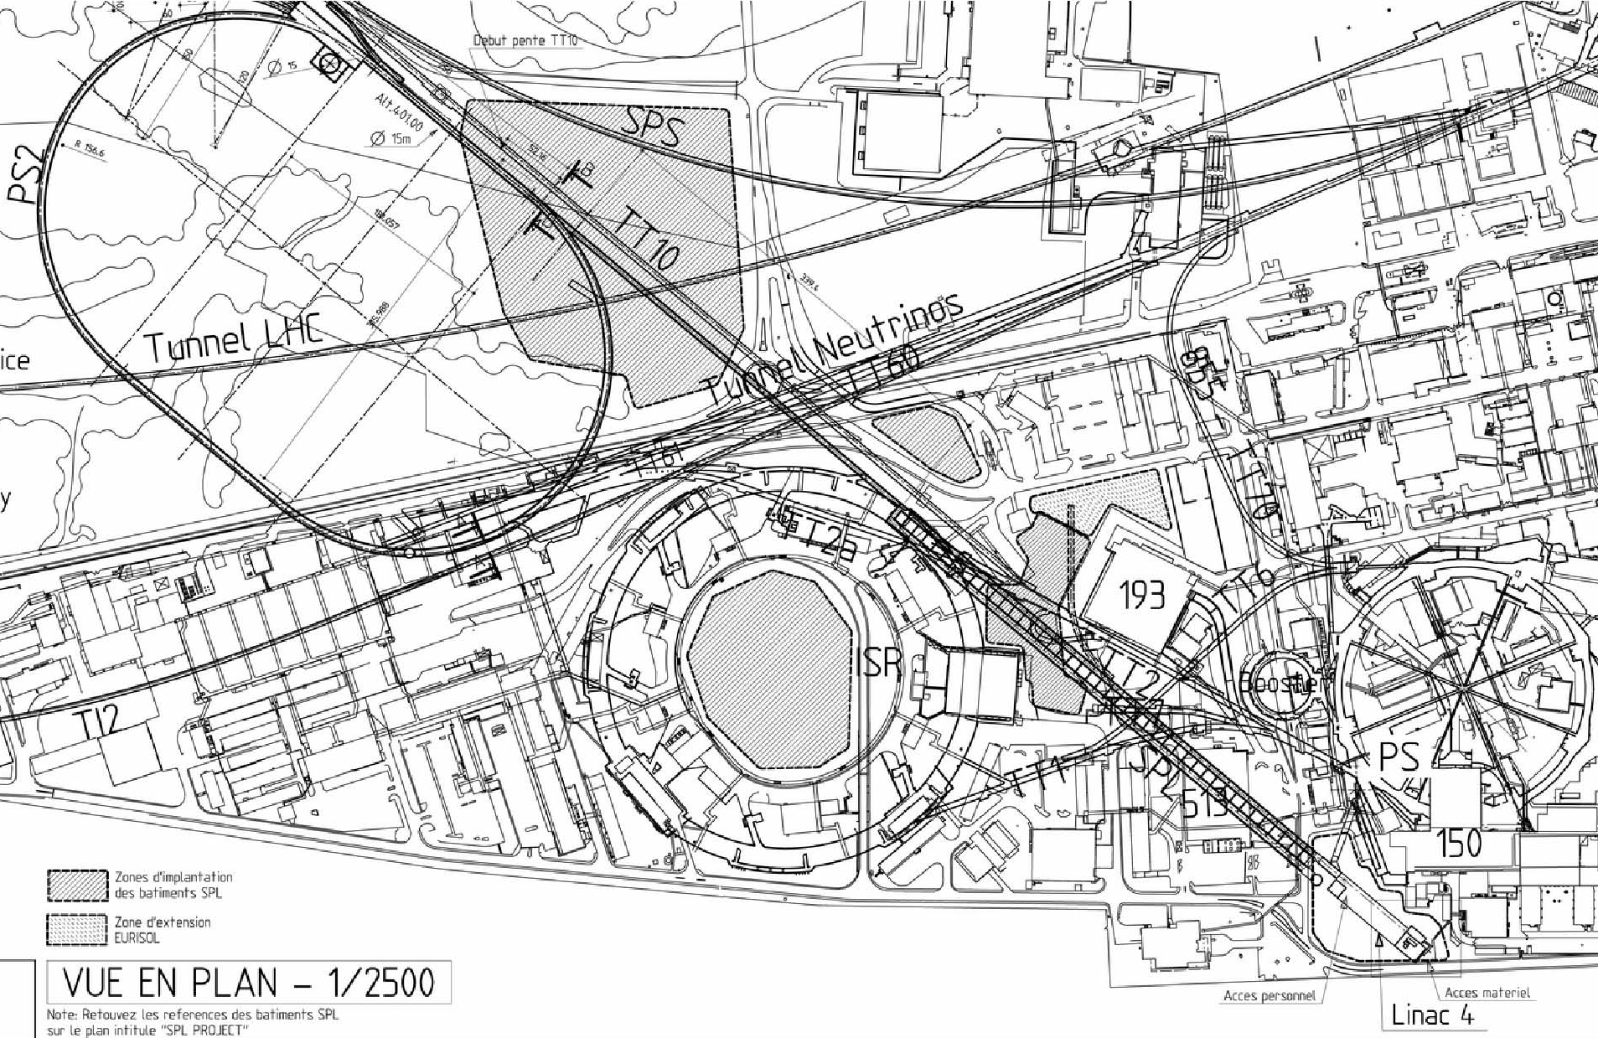
Layout injector complex
SPS
PS2
ISOLDE
PS
SPL
Linac4

Slide 5
The SPL study at CERN
R&D study for a 5 GeV and multi MW high power beam, the HP-SPL
Major interest for non-LHC physics: ISOLDEII/EURISOL/Fixed Target/Neutrino Factory
0 m
0.16 GeV
110 m
0.79 GeV
186 m
1.4 GeV
~300 m
2.5 GeV
~500 m
5 GeV
Medium β cryomodule
High β cryomodules
High β cryomodules
High β cryomodules
Debunchers
From Linac4
Ejection
Ejection
To fixed target/μ factory
20 x 3
β=0.65 cavities
5 x 8
β=1 cavities
TT6 to
ISOLDE
6 x 8
β=1 cavities
to Eurisol
12 x 8
β=1 cavities
Length: ~540 m
HP-SPL beam characteristics

Slide 6
The SPL study: new orientation
New objective of the SPL study:
Up to 2013:
Focus on R&D for key technologies for the high intensity proton source (HP SPL)
In particular:
Development, manufacture and test of high-gradient β=1, 5 cellules ,704 MHz cavities
Development, manufacture and test of RF couplers
Testing of a string of 4 β=1 cavities in machine-type configuration:
  Housed in helium vessels
  Equipped with tuners
  Powered by machine-type RF coupler
Need for a short cryomodule for testing purposes

Slide 7
Short cryo-module: Goal & Motivation
Goal:
Design and construct a ½-lenght cryo-module for 4 β=1 cavities
Motivation:
Test-bench for RF testing on a multi-cavity assembly driven by a single or multiple RF source(s)
Enable RF testing of cavities in horizontal position, housed in their helium tanks, tuned, and powered by machine-type RF couplers
Validate by testing critical components like RF couplers, tuners, HOM couplers in their real operating environment
Cryomodule-related goals:
Learning of the critical assembly phases:
  preparation of a long string of cavities in clean room
  alignment/assembly in the cryostat;
Proof-of-concept of the innovative supporting of cavities via the RF couplers
Explore cryogenic operation issues

Slide 8
Planned supplies for β=1 short cryo-module
Institute | Responsible person | Description of contribution
CEA – Saclay (F) | S. Chel (G.Devanz) | Design & construction of 1 β=1 cavities (EuCARD task 10.2.2) Design & construction of 5 helium vessels for β=1 cavities (French in-kind contribution) Supply of 8 tuners (French in-kind contribution)
CNRS - IPN – Orsay (F) | P. Duthil (P.Duchesne) | Design and construction of prototype cryomodule cryostat (French in-kind contribution) Design & construction of cryostat assembly tools (French in-kind contribution)
Stony Brook/BNL/AES team | I.Ben-zvi | (Under DOE grant) Designing, building and testing of 1 β=1 SPL cavity.
CERN | O.Capatina | 8 β=1 cavities 4 He tanks in titanium 1 He tank in st.steel
CERN | E.Montesinos | 8 +1 RF couplers (testing in CEA, French in-kind contribution)
In blue, recent changes

Slide 9
Relevant events since last collaboration meeting
Workshop on cryogenic and vacuum sectorization of the SPL
  CERN, 9-10 Nov.2009, http://indico.cern.ch/conferenceDisplay.py?confId=68499
  22 participants from CEA, IPN Orsay, FNAL, ORNL, JLAB, SLAC, DESY, ESS, and CERN
Review of SPL RF power couplers
  CERN, 16-17 March 2010, http://indico.cern.ch/conferenceTimeTable.py?confId=86123#20100316
  24 participants from CEA, IPN Orsay, BNL, FNAL, ANL, JLAB, DESY, Lancaster Univ., Uppsala Univ., and CERN
Intermediate meetings of the WG3:
  minutes on CERN EDMS
  Cryomodule documentation on https://twiki.cern.ch/twiki/bin/view/SPL/CryoModules

Slide 10
SPL parameters
(https://twiki.cern.ch/twiki/bin/view/SPL/SPLparameterList, by F.Gerigk)
Parameter | Unit | HP-SPL | HP-SPL | LP-SPL
 |  | low-current | high-current
Energy | [GeV] | 5 | 5 | 4
Beam power | [MW] | 4 | 4 | 0.192
Repetition rate | [Hz] | 50 | 50 | 2
Average pulse current | [mA] | 20 | 40 | 0-20
Peak pulse current | [mA] | 32 | 64 | 32
Source current | [mA] | 40 | 80 | 40
Chopping ratio | [%] | 62 | 62 | 62
Beam pulse length | [ms] | 0.8 | 0.4 | 0.9
filling time constant tau_{l} (b=0.65/1.0) | [ms] | 0.54/0.55 | 0.27/0.27 | 0.54/0.55
actual cavity filling time: ln(4) x tau_{l} | [ms] | 0.75/0.76 | 0.37/0.38 | 0.75/0.76
RF pulse length (filling time + flat top) | [ms] | 1.55/1.56 | 0.78/0.78 | 1.65/1.66
Protons per pulse for PS2 | [10¹⁴] | 1.0 | 1.0 | 1.13
Beam duty cycle | [%] | 4 | 2 | 0.18
RF duty cycle | [%] | 7.8 | 3.9 | 0.33
Cryogenics duty cycle | [%] | 8.2 | 4.1 | 0.35

Slide 11
Cryogenic-specific parameters
(https://twiki.cern.ch/twiki/bin/view/SPL/SPLparameterList, by F.Gerigk)
Parameter | Units | Beta = 0.65 | Beta = 1
 |  | nominal/ultimate | nominal/ultimate
Cavity bath temperature | [K] | 2.0 | 2.0
Beam loss | [W/m] | 1.0 | 1.0
Static loss along cryo-modules at 2 K | [W/m] | TBD | TBD
Static loss at 5-280 K | [W/m] | TBD | TBD
Accelerating gradient | [MV/m] | 19.3 | 25
Quality factor (x10^9) |  | 6/3 | 10/5
R/Q value |  | 290 | 570
Cryogenic duty cycle | [%] | 4.09/8.17 | 4.11/8.22
Coupler loss at 2.0 K | [W] | <0.2/0.2 | <0.2/0.2
HOM loss at 2.0 K in cavity | [W] | <1/<3 | <1/<3
HOM coupler loss at 2.0 K (per coupler) |  | <0.2 /0.2 | <0.2/0.2
HOM & Coupler loss 5-280 K | [g/s] | 0.05 | 0.05
Tunnel slope | [%] | 1.7% | 1.7%
Magnet operating temperature | [K] | ambient | ambient
No of cavities |  | 60 | 200
No of cryostats |  | 20 | 25
Cavities per cryostat |  | 3 | 8
Dynamic heat load p. cavity | [W] | 4.2/13.4 | 5.1/16.2
Nominal: 40 mA/0.4 ms beam pulse ; Ultimate: 20 mA/0.8 ms beam pulse.

Slide 12
Cryogenics and vacuum sectorisation
Outcome of workshop on cryogenic and vacuum sectorisations of the SPL
(November 9-10, 2009)

Slide 13
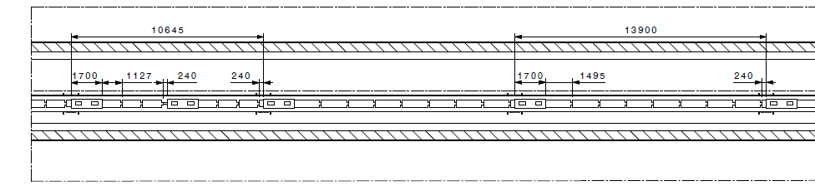
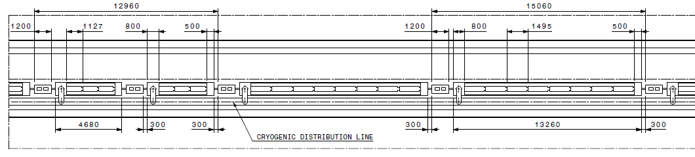
Longitudinal mechanical layouts
«Continuous» vs. «fully segmented» cryostat SPL layouts
Continuous cryostat "Compact" version (gain on interconnections):
➔ 5 Gev version (HP): SPL length = 485 m (550 m max available space)
"Warm quadrupole" version (with separate cryoline):
➔ 5 Gev version (HP): SPL length = 535 m (550 m max available space)

Slide 14
Main issues
Machine availability:
  “work-horse” in the injection chain
Reliability of built-in components and operational risks
  Typical faults expected on: cavities, couplers, tuners...
  Operation with degraded performance (cavities, optics, leaks...)
Maintainability:
  Warm-up/cool-down . Time and reliability. Need for partial or complete warm-up of strings to replace built-in components or even one cryo-module
  Accessability of components for regular maintenance or repair
Design complexity of compared solutions
Operational complexity (e.g.cryogenics with 1.7% slope)
Installation and commissioning
Safety. Coping with incidents (MCI): Loss of beam and/or insulation vacuum (helium and air leaks):
Cost differences between options

Slide 15
“continuous” cryostat
“Long” and “continuous” string of cavities in common cryostat
Cold beam tube
“straight” cryogenic lines in main cryostat
common insulation vacuum (between vacuum barriers, if any present)
String of cryo-modules between TSM
Technical Service Module (TSM)
Cold-Warm Transition (CWT)
Insulation vacuum barrier
Warm beam vacuum gate valve

Slide 16
“segmented” cryostat
Cryostat is “segmented”: strings of (or single) cryo-modules, 2 CWT each
Warm beam zones (where warm quads can be)
Cryogenic Distributio Line (CDL) needed
Individual insulation vacuum on every string of cryo-module (Vacuum Barriers, w.r.t. CDL)
Cryogenic Distribution Line (CDL)
String of (or single) cryo-modules
Technical Service Module (TSM)
Cold-Warm Transition (CWT)
Insulation vacuum barrier
Warm beam vacuum gate valve

Slide 17
Conclusions on sectorisation
Drivers:
  Availability:
    Reliability/Maintainability. Components with technical risk:
      RF Coupler, single window. No in-situ repair possible
      Cavity/tuner, reduced performance. No in-situ repair possible
      Beam/cavity vacuum leaks. No in-situ repair possible
  → calls for quick replacement of complete cryo-module (spares needed)
  Safety: coping with incidents: accidental loss of beam/cavity vacuum:
    Cold valves not available (XFEL is considering their development)
  →Adopt warm, interlocked valves (not necessarily very fast, XFEL experience)
“Segmented” layout with CDL has clear advantages in these respects
Additional advantages:
  Magnets can be warm: classical “off-the shelf”, easy alignment/maintainability/upgrade
  and cryo-module internal positioning requirements can ne relaxed (by a factor of 3)
Drawbacks:
  Less compact layout (~+10% extra lenght)
  More equipment (CDL, CWT, instrumentation...):
    Capital cost
    More complexity = less reliability?
  Higher static heat loads (but dynamic loads dominate!)

Slide 18
Cryogenic and vacuum sectoriz.of the SPL
Continuous cryostat "Compact" version (gain on interconnections):
➔ 5 Gev version (HP): SPL length = 485 m
Segmented layout (warm quads, with separate cryoline):
Preferred for SPL
➔ 5 Gev version (HP): SPL length = 535 m

Slide 19
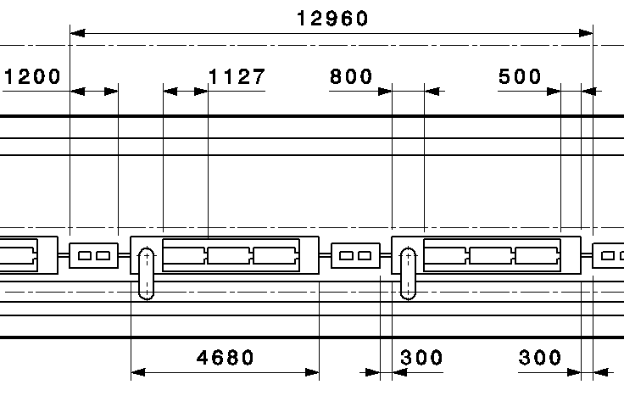
β=0.65 cryo-module

Slide 20
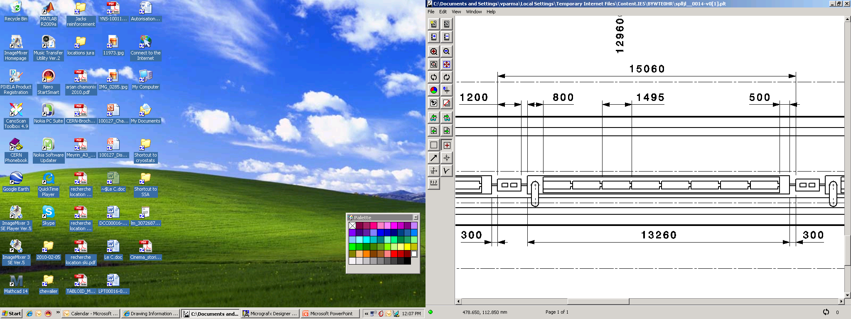
β=1 cryo-module

Slide 21
Coupler position: top or bottom...?
Pros | Contras
Easier mounting of waveguides | Interferes with bi-phase tube → move sideways
Easier access (needed?) | Waveguides/coupler more exposed to personnel/handling (damage, breaking window?)
... | ...
Pros | Contras
Centered bi-phase tube→ symmetry | Space needs for waveguides under cryostat
Waveguides/coupler protected | If coupler not a support (bellows)→ support on top, i.e. centered tube not possible
... | ...
No strong decision-making argument...

Slide 22
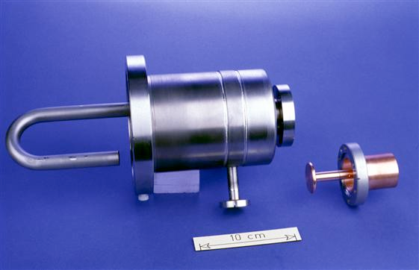
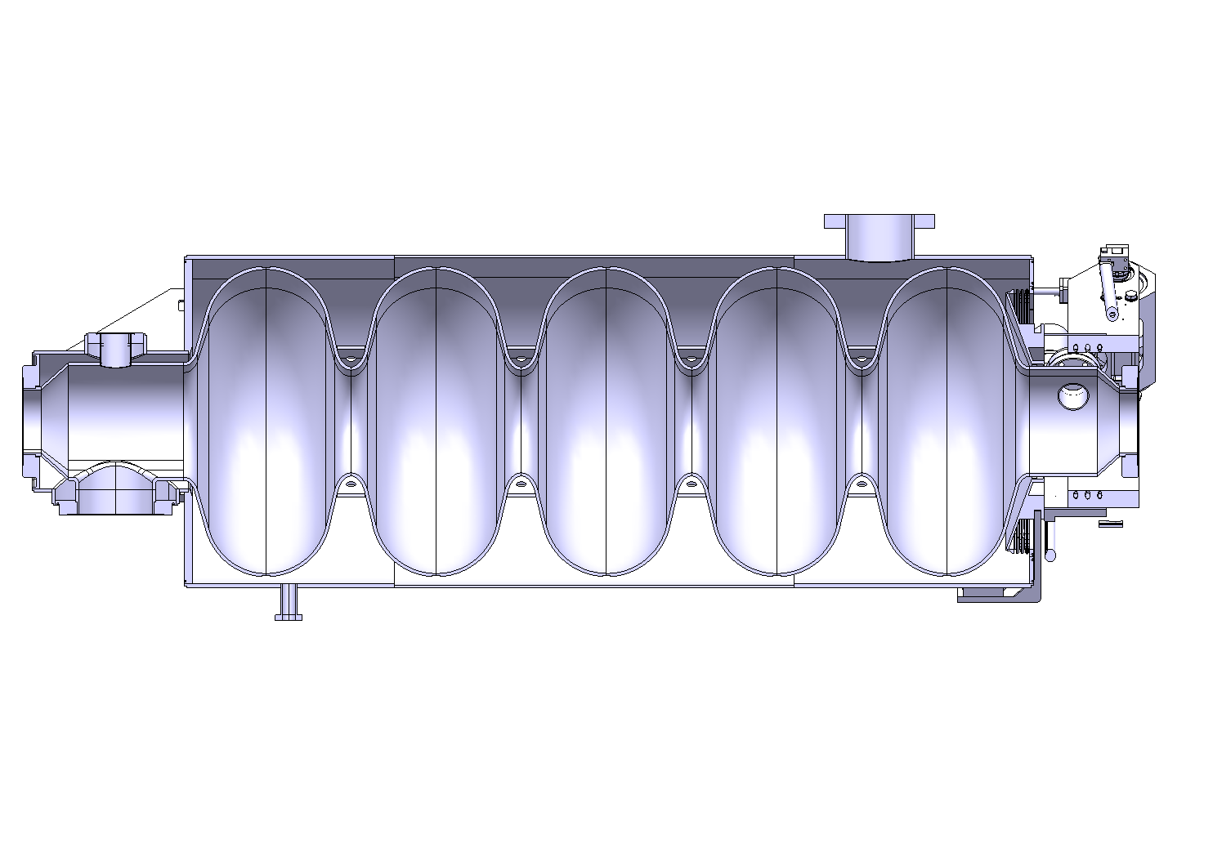
HOM coupler
Provisions made to house an HOM coupler (resonator type)
Port foreseen opposite to RF coupler port
Superconducting, cooled at 2K
The HOM coupler needs to be on top
...so the RF coupler is at the bottom
e.g. LHC HOM coupler
HOM port
RF coupler port

Slide 23
Cavity Supporting System
Transversal position specification
BUDGET OF TOLERANCE
Step | Sub-step | Tolerances (3σ) | Total envelopes
Cryo-module assembly | Cavity and He vessel assembly | ± 0.1 mm | Positioning of the cavity w.r.t. beam axis ± 0.5 mm
 | Supporting system assembly | ± 0.2 mm
 | Vacuum vessel construction | ± 0.2 mm
Transport and handling (± 0.5 g any direction) | N.A. | ± 0.1 mm | Stability of the cavity w.r.t. beam axis ± 0.3 mm
Testing/operation | Vacuum pumping | ± 0.2 mm
 | Cool-down
 | RF tests
 | Warm-up
 | Thermal cycles
Construction precision
Long-term stability

Slide 24
Comparing supporting solutions
A) Coupler supporting scheme
B) “standard” supporting scheme
Pros | Contras
Design simplicity: cost effectiveness | Vacuum vessel: Stiffness (thickness, stiffeners) Dim. stability Precision machining Cost
Single cavity adjustment at assy | Positioning stability (thermal, weld relieving...)
 | Inter-cavity guiding
Pros | Contras
Better mechanical isolation of cavities from external perturbations: dim. changes (thermal, weld relieving), vibrations... | Design complexity and cost
Vacuum vessel simplicity: Reduced machining precision reduced thickness | Central support needed (?)
 | Complex cavity adjustment at assy
A) Chosen as baseline (“simple is nice”)

Slide 25
Need inter-cavity support structure?
Layout
Equivalent sketch
No
- If sag small enough
- If strenght OK
- isostatic
Yes
l
- couple cavities
- hyperstatic
inter-cavity guides

Slide 26
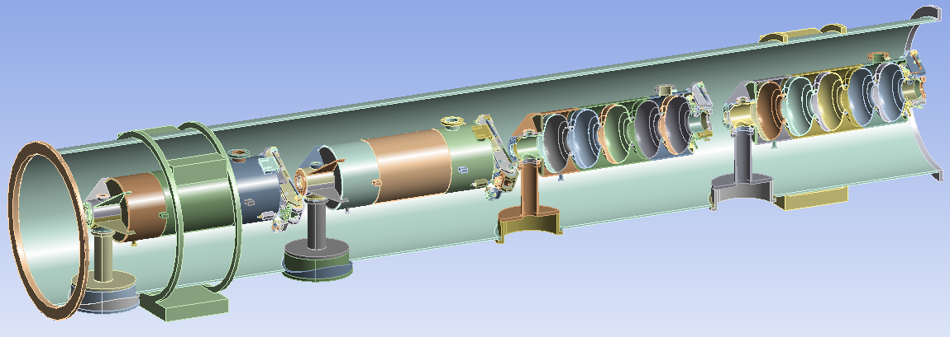
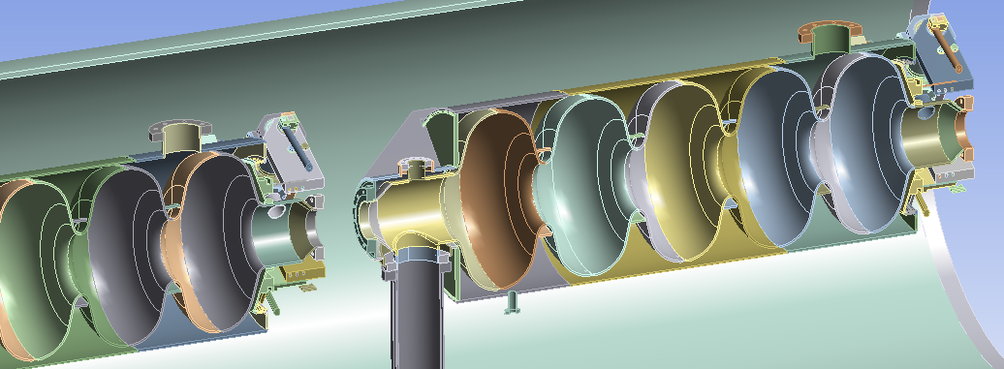
P.Coelho Moreira de Azevedo

Slide 27
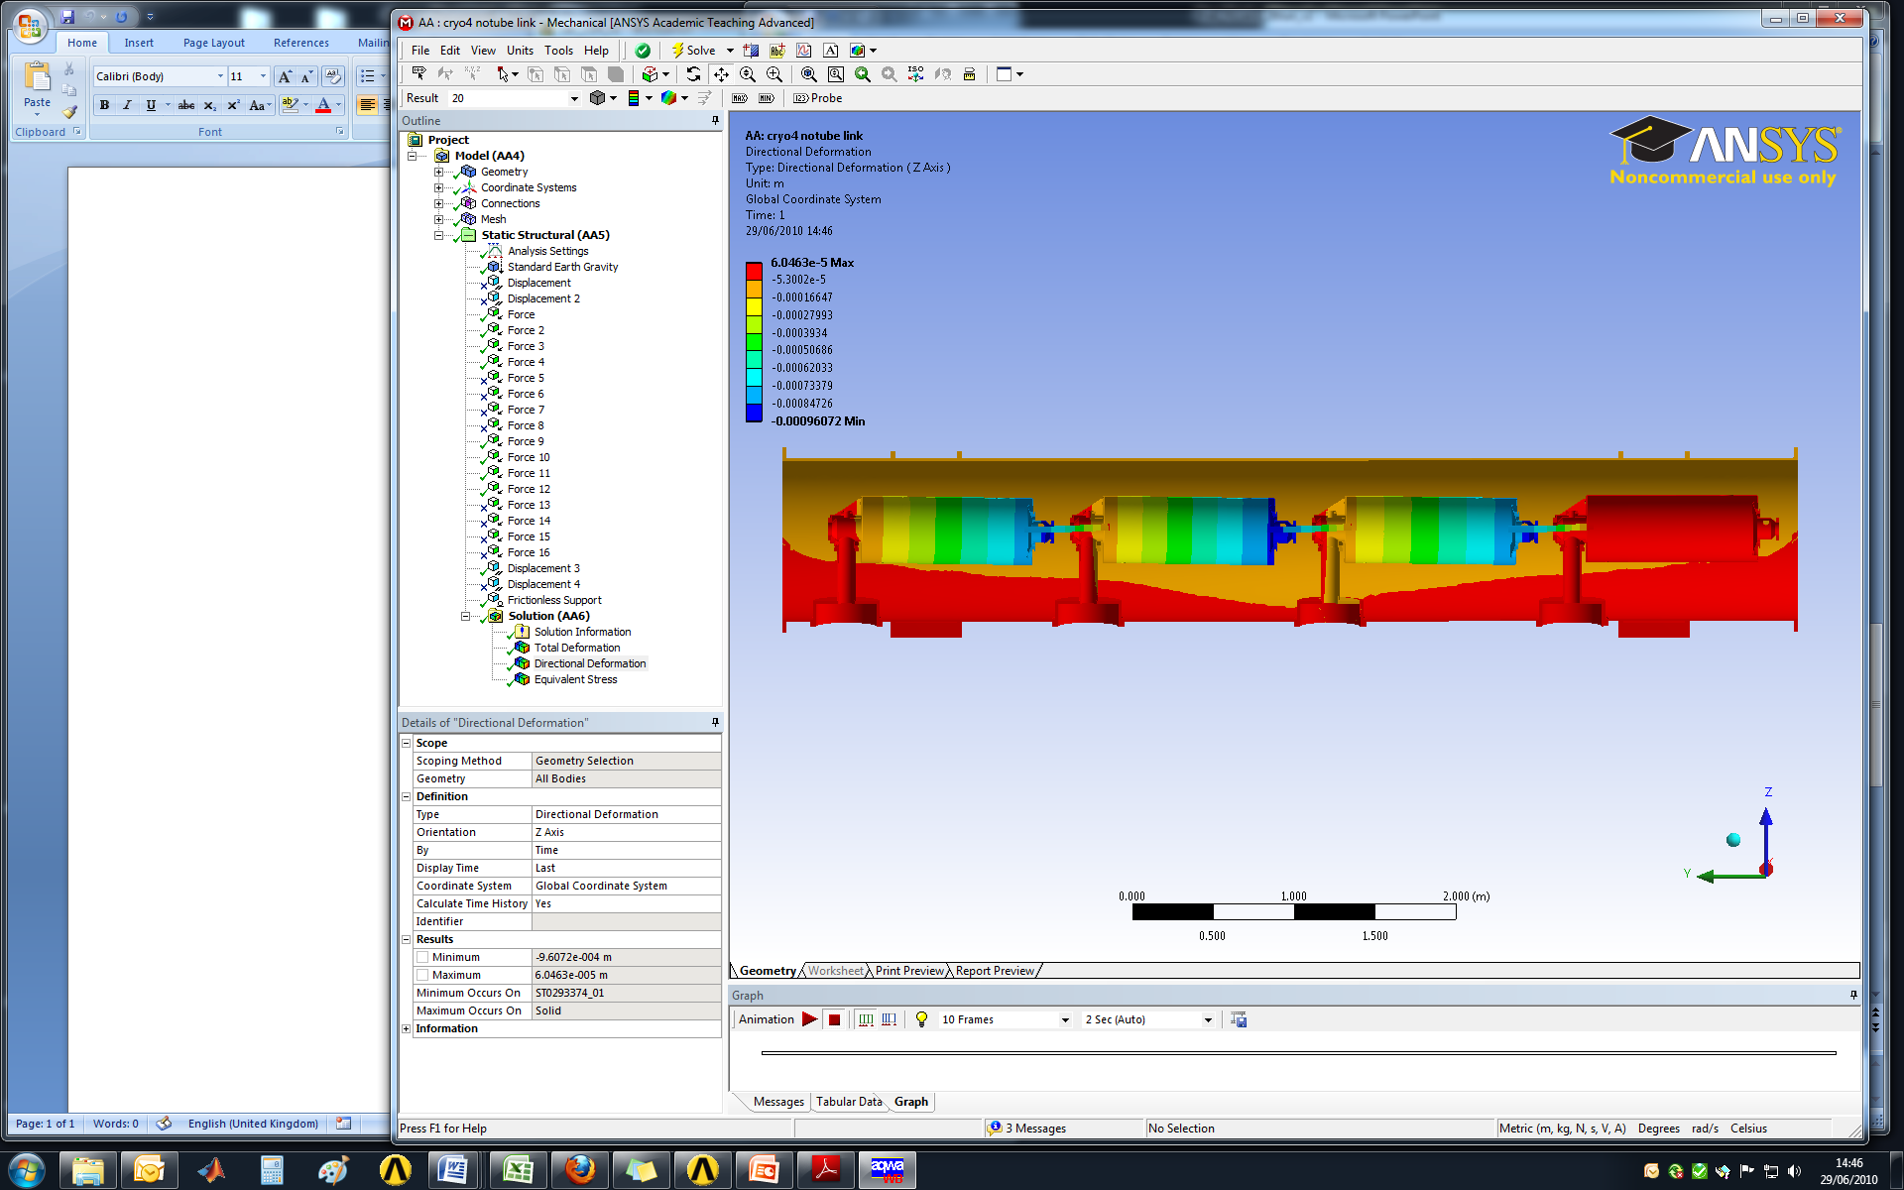
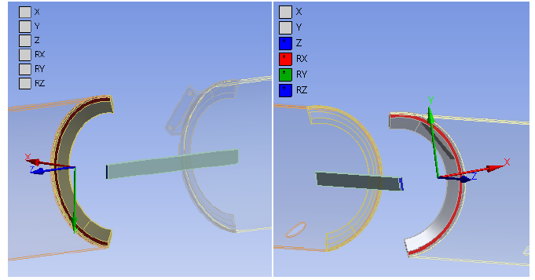
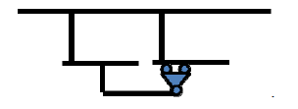
Vertical displacement in m (body deformation amplified 20 times):
W_{cav} (x4)
W
W_{tuner} (x4)
The cavities are not part of the model. The loads are the distributed weight of the represented components, tuners and cavities.
Deflections still excessively high! → goal is 0.1mm (cavity self-weight straigtness),
....still work to do!
The link between the cavities is established as shown:
P.Coelho Moreira de Azevedo

Slide 28
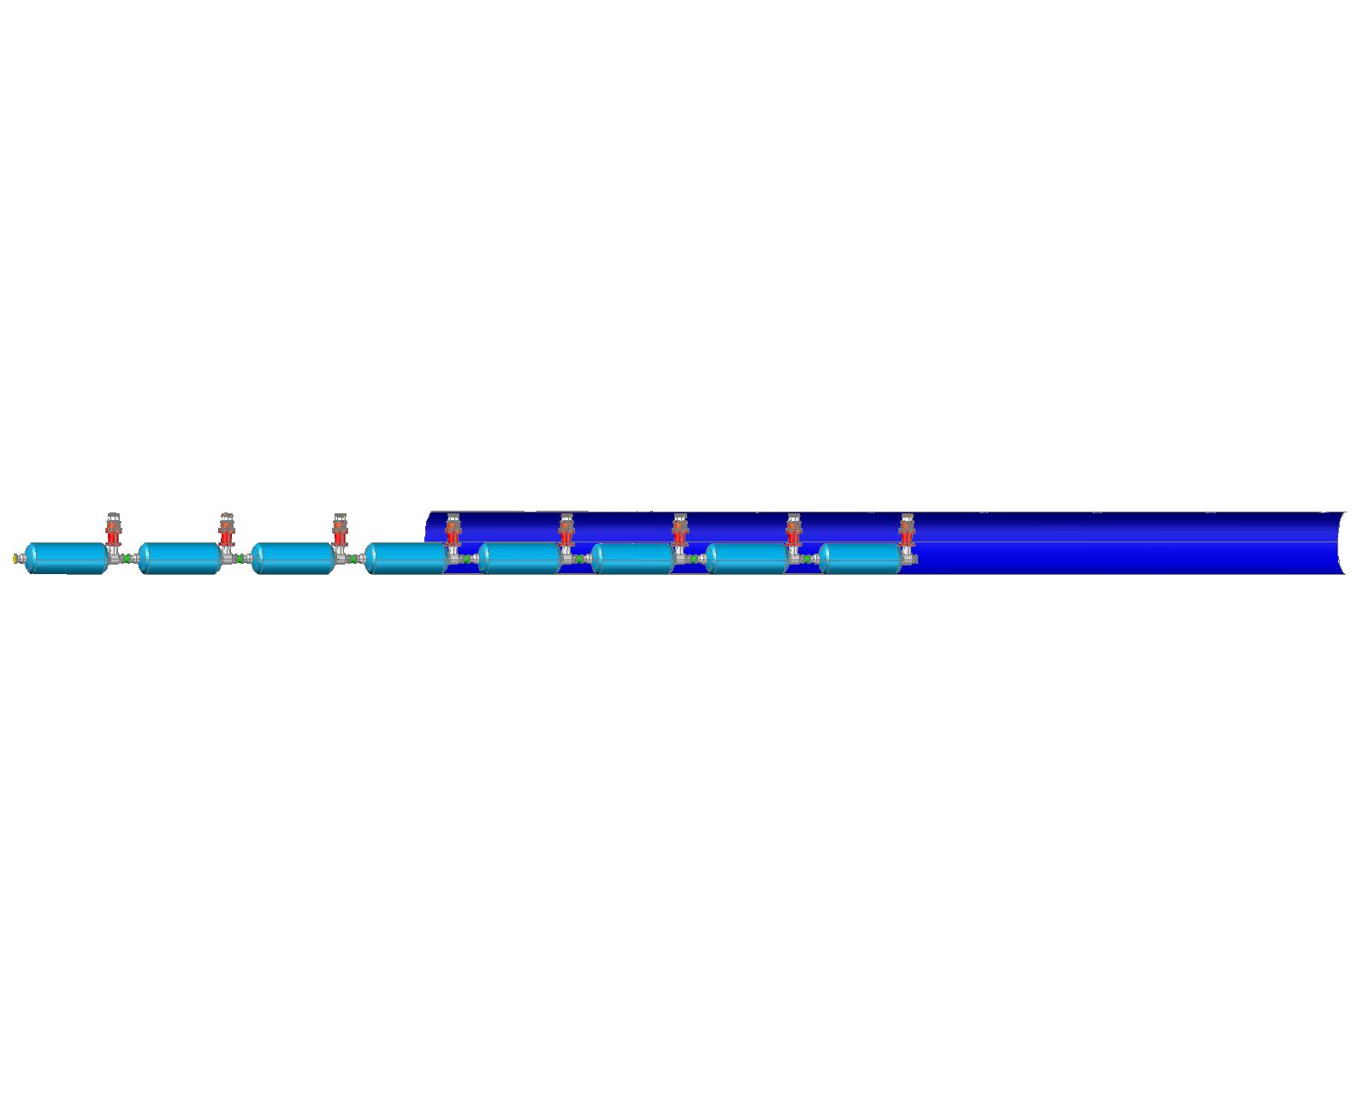
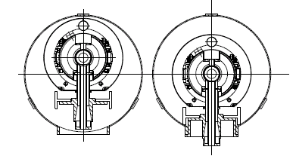
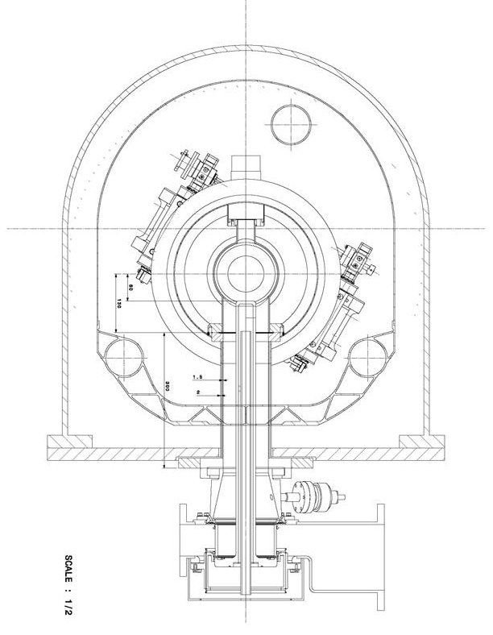
Assembly possibilities...
Either...
Single-window RF coupler → needs assembly to cavities in clean room
Defines minimum diameter of “pipeline” type vessel:
  Lenght of double-walled tube
  Integration of thermal shield
Or...
More in CNRS’s talk
Simple in the cross section...
But...
Non trivial design of end-caps
Leak-tightness: seal? welded?
(Th.Renaglia)

Slide 29
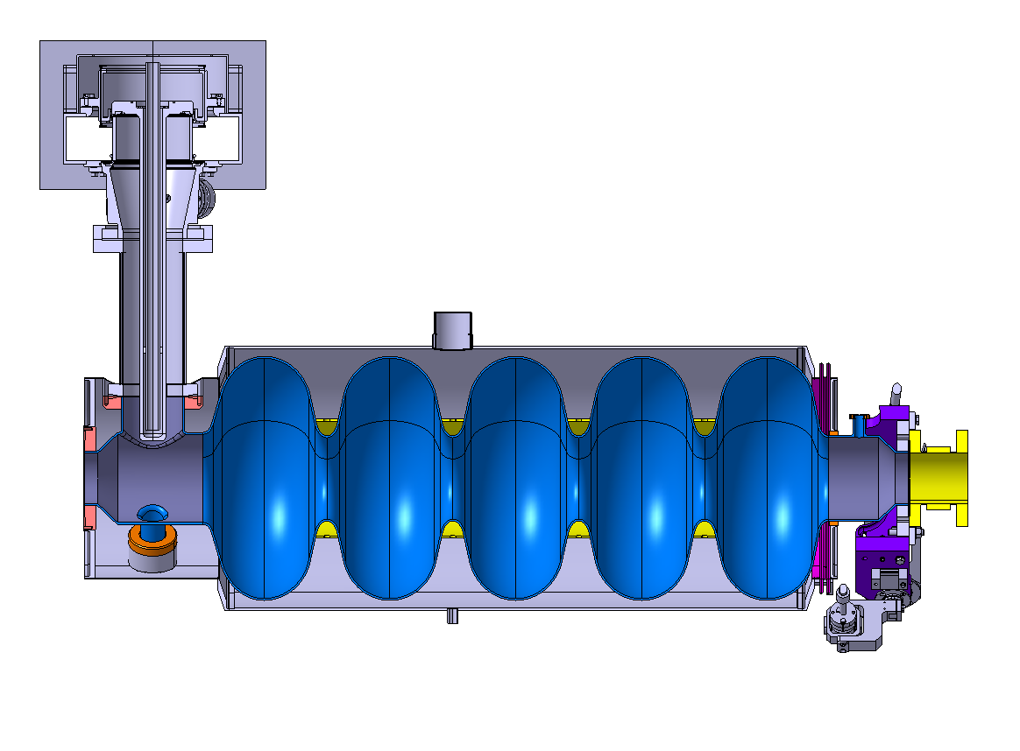
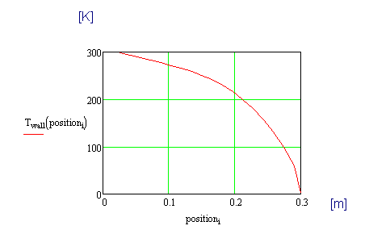
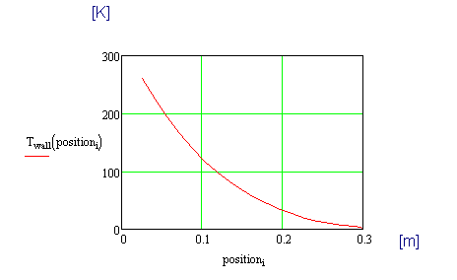
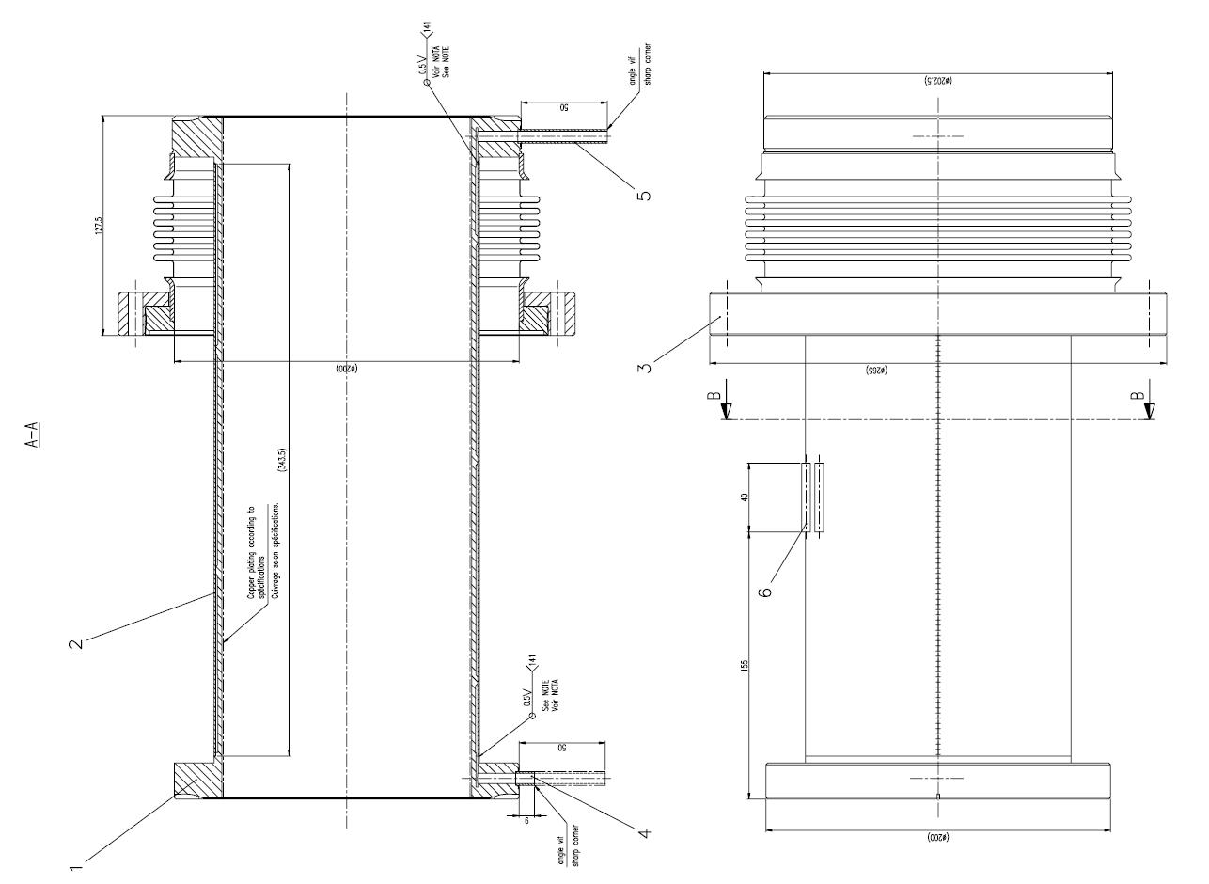
Actively cooled RF coupler tube
SPL coupler double walled tube, active cooling to limit static heat loads
  Connected at one end to cavity at 2K, other end at RT (vessel)
  Requires elec. Heater to keep T > dew point (when RF power off)
More in Ofelia’s talk
  No cooling T profile
  → 21W to 2K
Vacuum vessel
  Cooling (42 mg/sec) T profile
  → 0.1 W to 2K
Massflow mgram/sec | 21 |  | 23 |  | 28 |  | 35 |  | 42
Power | ON | OFF | ON | OFF | ON | OFF | ON | OFF | ON | OFF
Temp. gas out | 286 K | 277 K | 283 K | 273 K | 271 K | 242 K | 255 K | 205 K | 232 K | 180 K
Q thermal load to 2K | 2.4 W | 0.1 W | 1.7 W | 0.1 W | 0.4 W | 0.1 W | 0.1 W | 0.1 W | 0.1 W | 0.1 W
Q heater | 19 W | 32 W | 21 W | 34 W | 29 W | 38 W | 39 W | 41 W | 46 W | 44 W
ΔL | 0.1 mm (0.63-0.53)mm |  |  |  | 0.05 mm (0.66-0.61) |  | ~ 0 mm (0.67-0.67)
4.5 K
Heater
300 K
→ Yields a certain degree of position uncertainty (<0.1 mm?)
  (O.Capatina, Th.Renaglia)
Helium gas cooling the double wall

Slide 30
From 8 to 4 cavities…How??
…just remove 4 cavities!

Slide 31
Coping with the “ghost” cavities…
Assume they still exist
Design the systems as if they where there:
  Cryogenics (p,T, mass flows)
  Distribution lines (ID, pres.drops)

Slide 32
Heat Loads
Heat loads @ 2K (He bath) | b=0.65 | b=1
 | nominal/ultimate
beam loss | 1 W | 1 W
static losses | <1 W (tbc) | <1 W (tbc)
accelerating field | 19.3 MV/m | 25 MV/m
quality factor | 6/3 x 10⁹ | 10/5 x 10⁹
cryo duty cycle | 4.09%/8.17% | 4.11%/8.22%
power coupler loss at 2 K | <0.2/<0.2 W | <0.2/<0.2 W
HOM loss in cavity at 2 K | <1/<3 W | <1/<3 W
HOM coupler loss at 2 K (per coupl.) | <0.2/<0.2 W | <0.2/<0.2 W
dynamic heat load per cavity | 4.2/13.4 W | 5.1/16.2 W
Total @ 2 K | 7.6/18.8 W | 8.5/21.6 W
+15% margin (for testing) | 8.7/21.6 W | 9.8/25 W
For 8 beta=1 cavity cryomodule: 8x25=200W, equivalent to 10 g/s helium flow

Slide 33
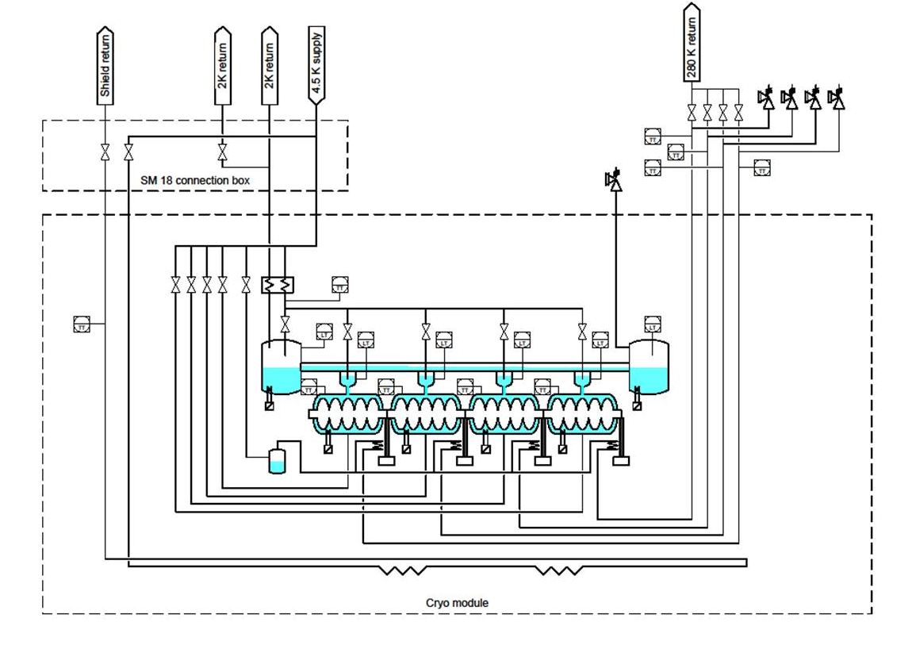
Cryogenic scheme (preliminary)
C
XB
C3
X
Y
C1
C2
L
E’
E

Slide 34
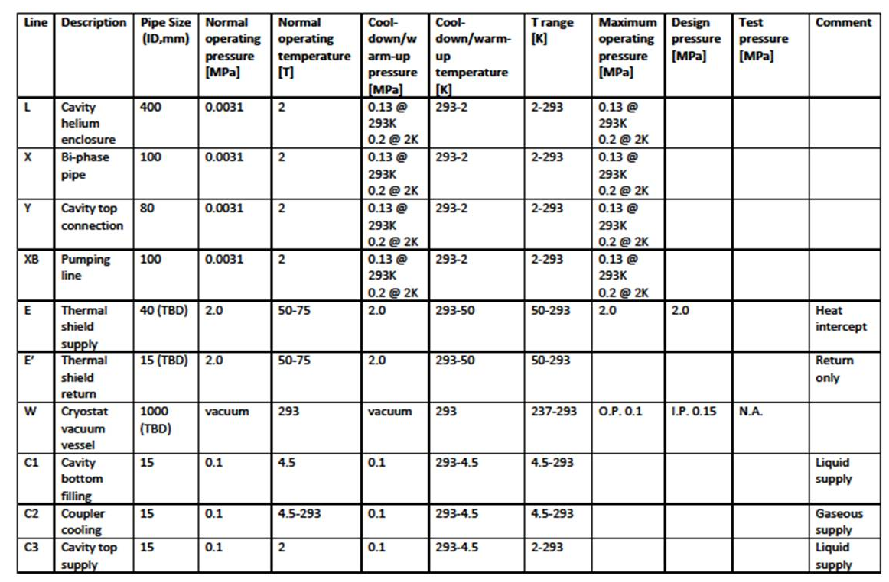
Pipe sizes and operating conditions (preliminary)

Slide 35
Short cryomodule: layout sketch
Connection to cryo distribution line
Cryo fill line, top left
End
Module
Technical Service
Module
CW transition
RF coupler, bottom left side
Cavity additional support
1.7% Slope (adjustable -2% to +2%)

Slide 36
Helium tank interfaces: issues for discussion
More about sizing
in Ofelia’s talk
DN 80

Slide 37
Lines X and Y
DN 100 (for m=14g/s → v<2m/s, preserves He stratification, i.e. efficient counter-current flow )
St.steel, titanium tube/bellows?
X
DN 80
(more about sizing in Ofelia’s talk)
Y
titanium/st.steel transition?
HOM assy
space ?

Slide 38
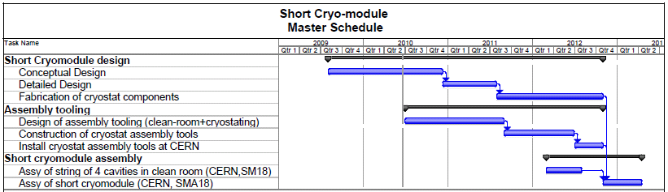
Master Schedule
Preliminary Design Review
Detailed Design Review
Start of assembly at CERN

Slide 39
Summary
SPL cryomodule studies are now concentrated on a 4 β=1 cavity short cryomodule aimed at testing the cavities in machine-like configuration
The short cryomodule is designed as a shortened machine unit
The short cryomodule will also allow exploring important design issues for machine cryomodules:
  Innovative supporting system
  Assembly principles
  Cryogenic operating schemes
  …
Position of the coupler at the bottom is now settled
The cryogenic scheme is being elaborated
As a consequence piping sizes and pressures are being defined
A technical specification for the cryomodule is in preparation and possibly ready by September next
A preliminary design review will take place by the end of 2010

Slide 40
Thank you for your attention!

Slide 41
Spare slides

Slide 42
Possible cryogenic feeding:
“continuous” cryostat
Cryo-plant
1.7% tunnel slope
CIB
10 β=0.65 + 5 β=1 cryo-modules
6 β=1 cryo-modules
17 β=1 cryo-modules + 2 demodulators
Isolde extraction
Eurisol extraction
CIB
Cryogenic Interconnect Box
Cryo Unit
Cryogenic bridge

Slide 43
Possible cryogenic feeding:
Cryogenic Distribution Line
Cryo-plant
1.7% tunnel slope
CIB
10 β=0.65 + 5 β=1 cryo-modules
6 β=1 cryo-modules
17 β=1 cryo-modules + 2 demodulators
Isolde extraction
Eurisol extraction
CIB
Cryogenic Interconnect Box
Cryo-module Units
Cryogenic Distribution Line

Slide 44
Possible supporting schemes
“standard” supporting scheme
Two-support preferrable → isostatic (=well defined forces on supports)
...but is cavity straightness enough?? If not...
RF coupler (with bellows)
Invar longitudinal positioner
Inertia beam
Fixed support
Sliding support
External supports (jacks)

Slide 45
Possible supporting schemes
“standard” supporting scheme
...add 3rd support → becomes hyperstatic (= forces depend on mech. coupling vessel/inertia beam)
RF coupler (with bellows)
Invar longitudinal positioner
Inertia beam
Fixed support
Sliding support
External supports (jacks)

Slide 46
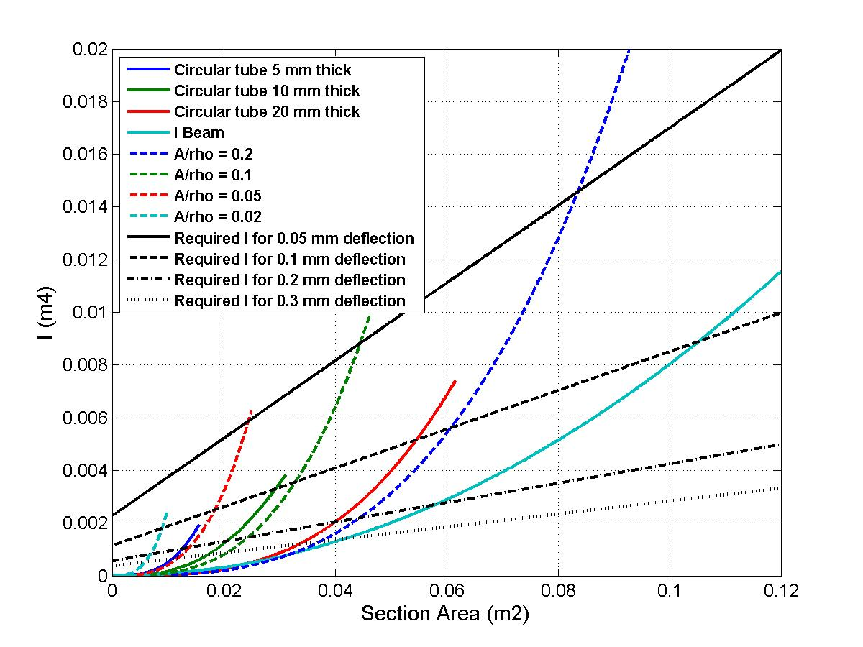
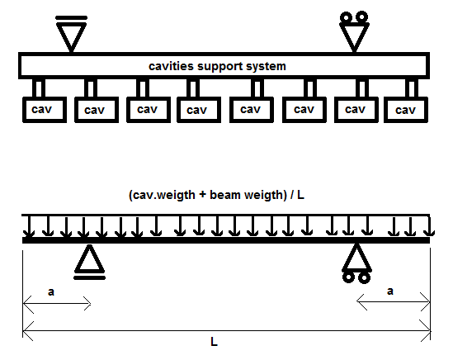
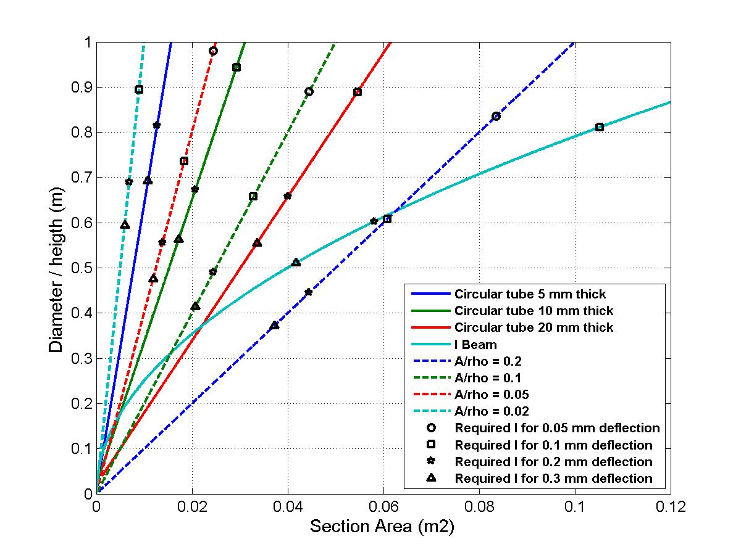
“standard” supporting
Max. sag minimized at a/L=0.20.
To limit self-weight sag below 0.2 mm, requires
an inertia beam equivalent to a 10-mm thick ~700-mm diam. tube (almost vac.vessel size)
→ A 3rd central support is mandatory

Slide 47
Possible supporting schemes
Alternative: coupler supporting scheme
...the coupler is also a supporting/aligning element
RF coupler + longitudinal positioner + vertical support
Intercavity support structure
External supports (jacks)

