Slide 1


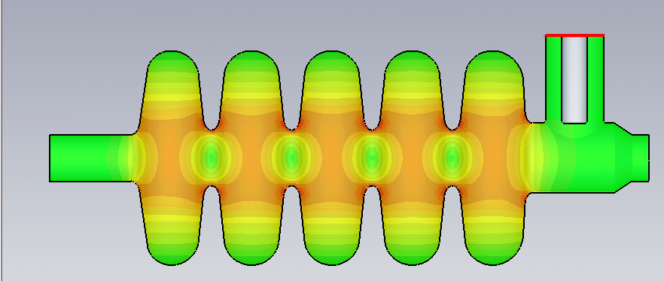

Status of the beta=0.65 cavity for SPL linac
G. Olry, CNRS-IPN Orsay

Slide 2
outline
Requirements
Since November 2009 (last SPL coll. meeting), studies in 2 phases
Nov ‘09 – March ‘10: first design
  2D (Superfish™) and 3D (CST Microwave Studio™) calculations on:
    Cell-to-cell coupling factor
    Adjustments and shape sensitivity for field flatness
    Positioning of the power coupler (external Q)
  Mechanical design
    Static load (2 bars @300K), Lorentz forces detuning
  Helium tank design
April ‘10-nowadays (still on-going): new design
  New parameters for vacuum load: 1.5 bars@300K
  Proposal for another design: new end-groups (same as β= 1 CEA)
Conclusion & Planning

Slide 3
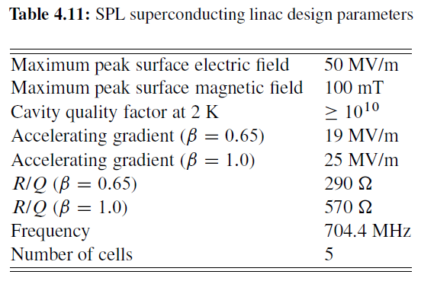
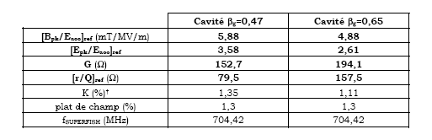
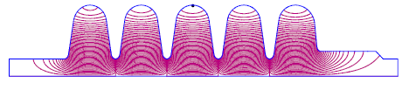
requirements
GOALS
Epeak/Eacc < 2.6
Bpeak/Eacc < 5.2 mT/(MV/m)
+
Cell-to-cell coupling factor k ≈ 1.5 %
Conceptual design of the SPL II, CERN-2006-006
Starting point :
1999, EUROTRANS cavity β= 0.65
J-Luc Biarrotte, PhD Thesis, 2000, Orsay

Slide 4
Nov ‘09 – March ‘10: first design

Slide 5
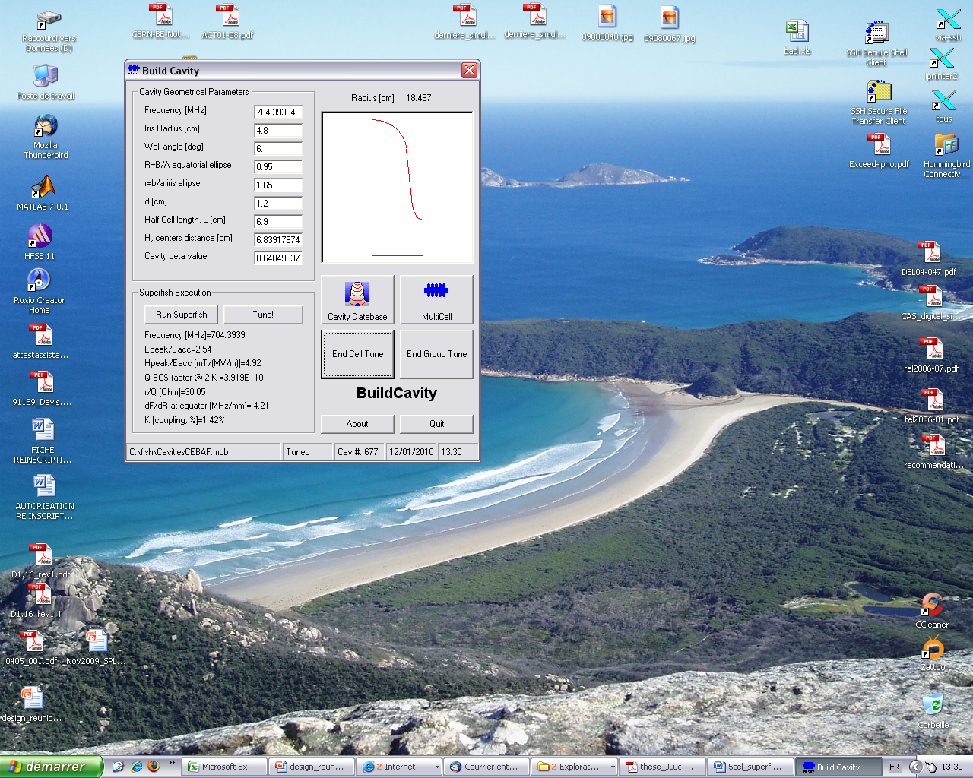
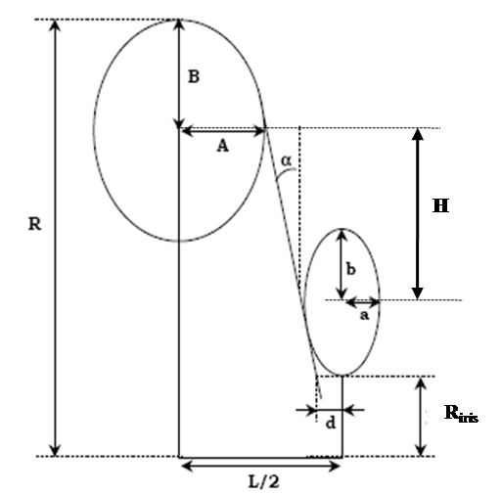
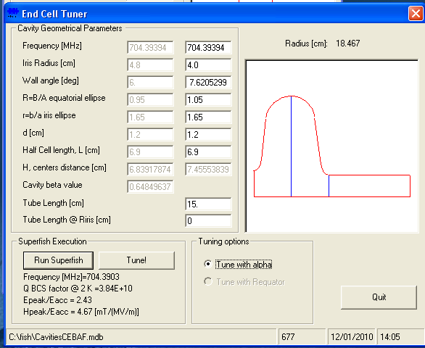
2D study (superfish)
Designed with Build cavity (Paolo Pierini, INFN Milano)
Poisson Superfish Interface for multi-cell cavity design.
Parameterisation :
The different parameters were iteratively optimised & the frequency readjusted by retuning the cell radius “R”.

Slide 6
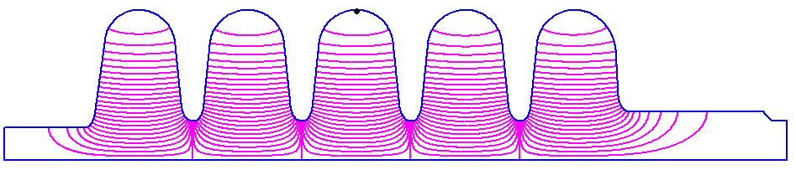
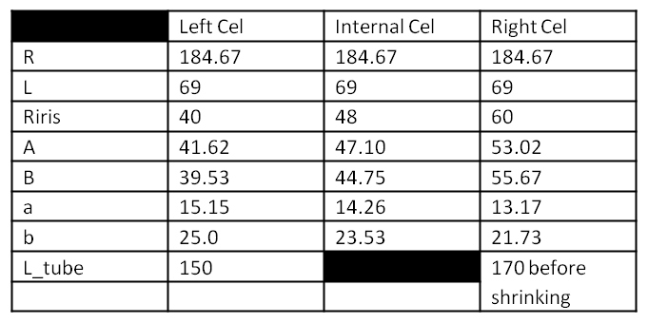
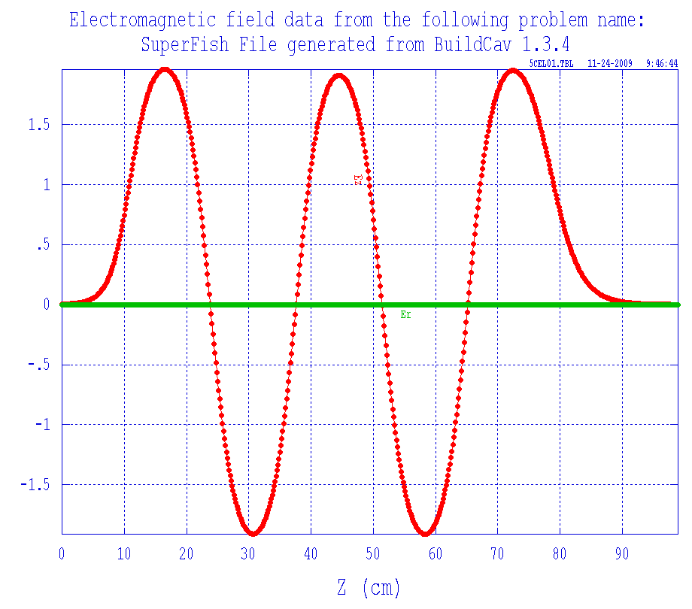
2D study (superfish)
Design of the cells
Input for 3D calculations with RF coupler port
1.96
1.91
1.95
F. Bouly (IPNO)
Frequency = 704.407 MHz
Q0 (@ 2K ) = 3.9 10¹⁰
At β_{g} = 0.65
r/Q = 299
Epeak/Eacc = 2.5
Bpeak/Eacc = 4.9 mT/(MV/m)
-1.91
-1.91
OK
Field Flatness : 2.55%

Slide 7
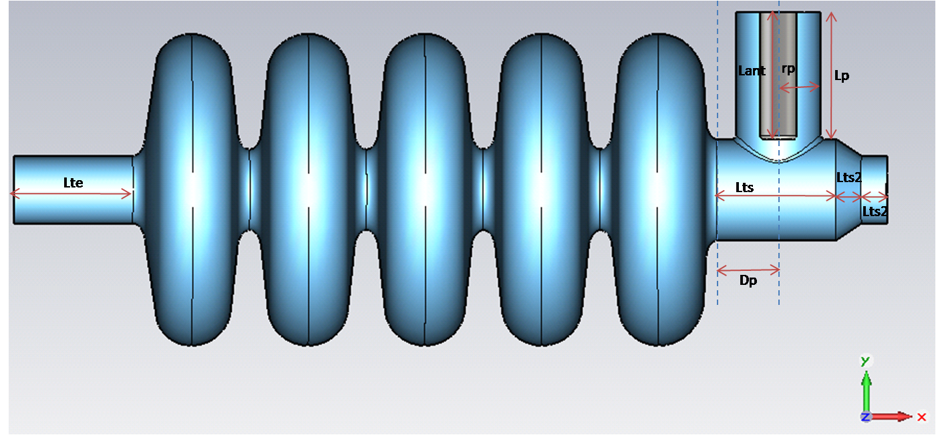
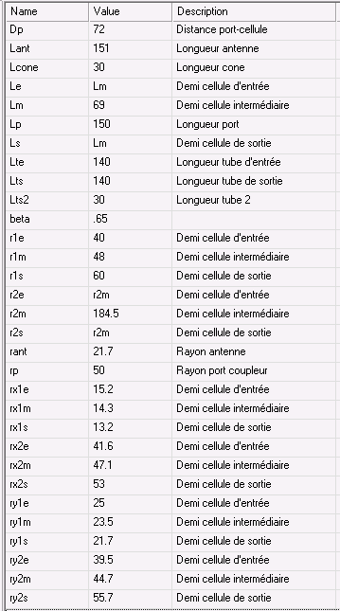
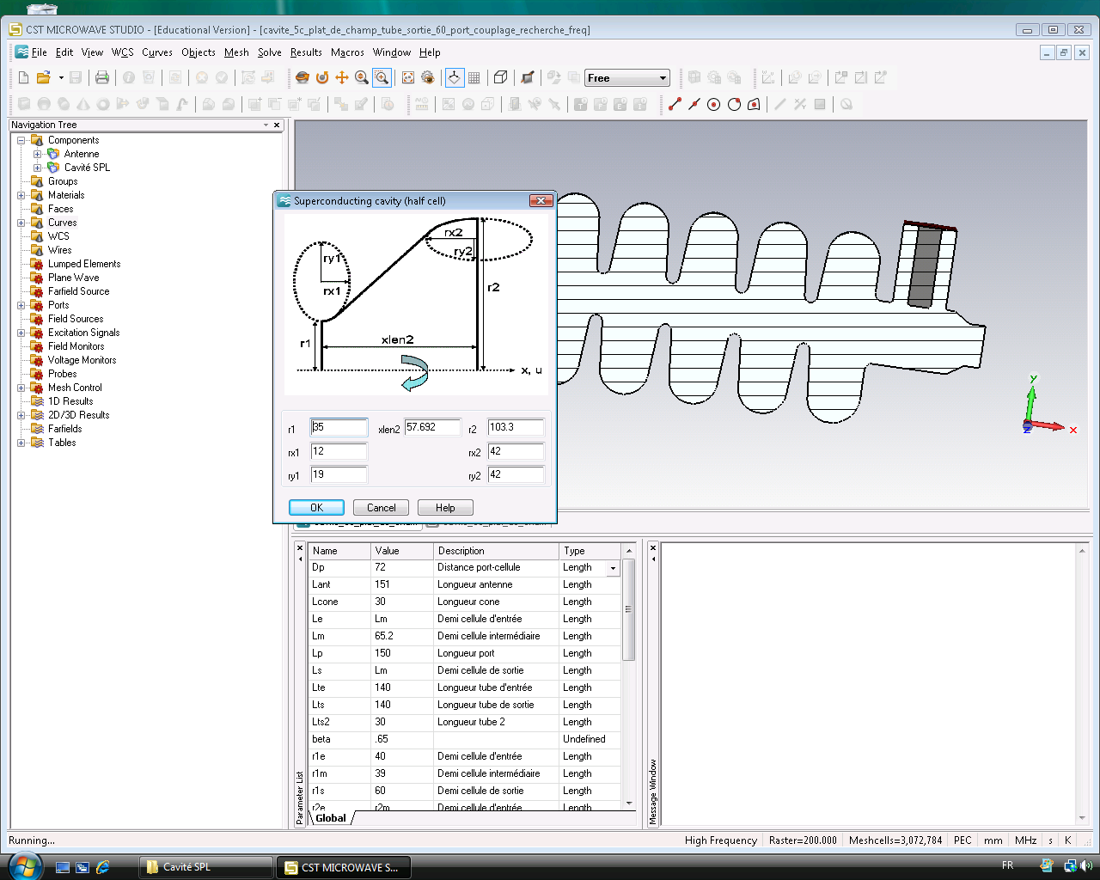
3D Calculations (MWS)
1
1
Modified for Helium vessel integration + Qext calculation
2
3
Retuned for frequency adjustment
3
2
Adjusted for field flatness

Slide 8
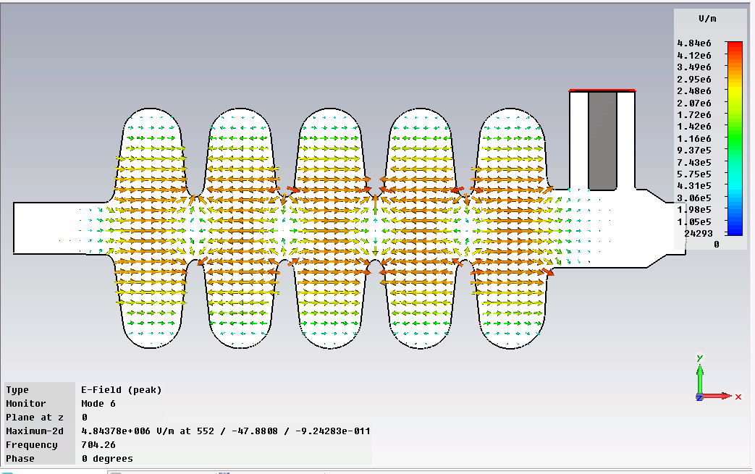
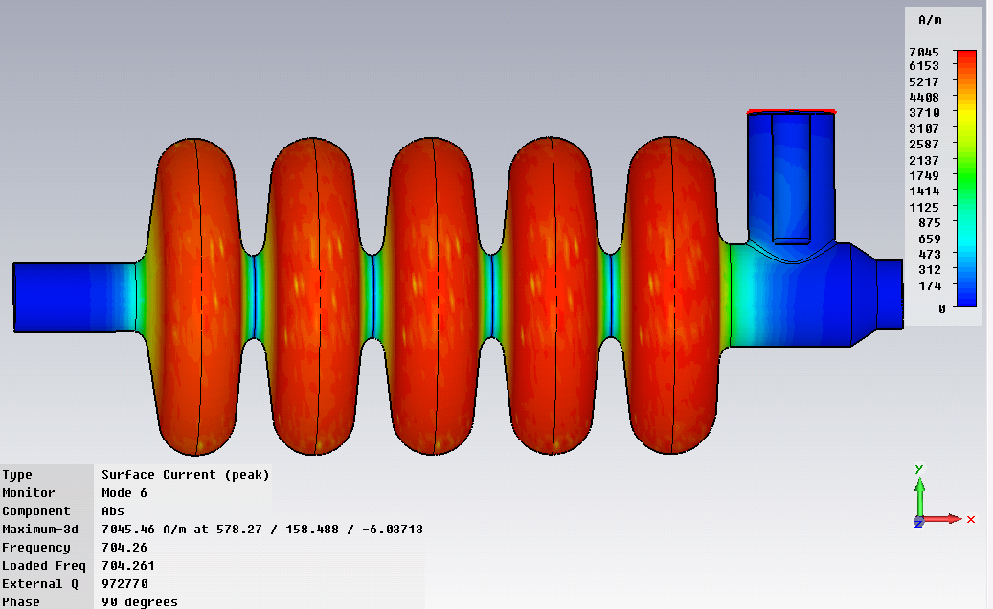
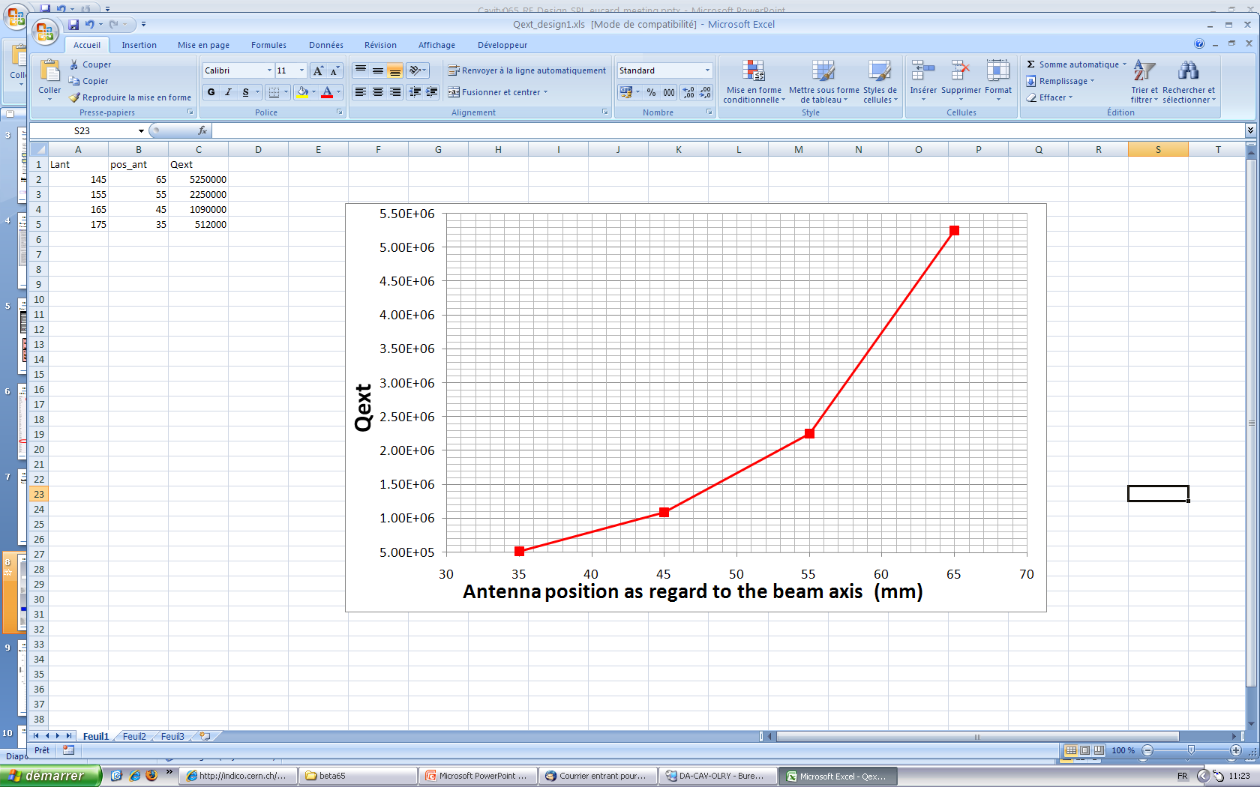
3D calculations: fields & Qext
Freq = 704.3 MHz
Q_{ext} = 1.09 10⁶
Q0 (@ 2K ) = 2.8 10¹⁰
K = 1.47 %
External coupling adjusted with the penetration length of the antenna
F. Bouly & D. Longuevergne (IPNO)
Q_{ext}≈10⁶

Slide 9
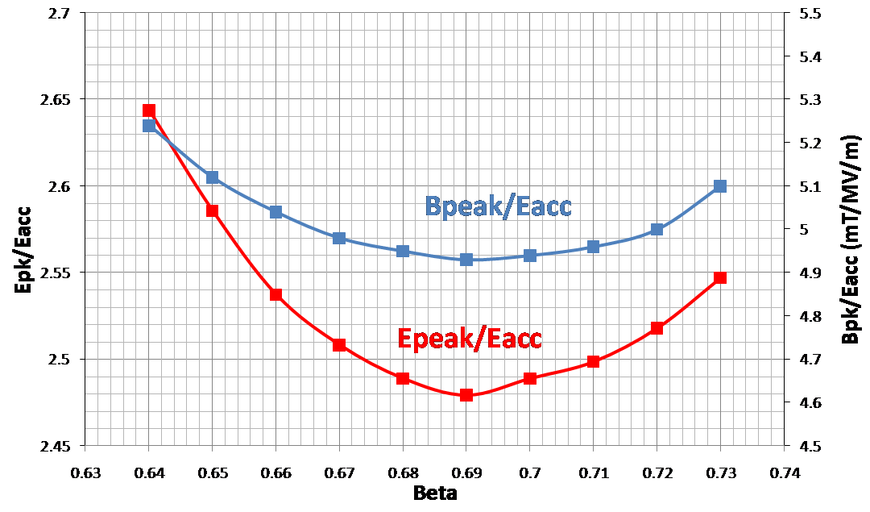
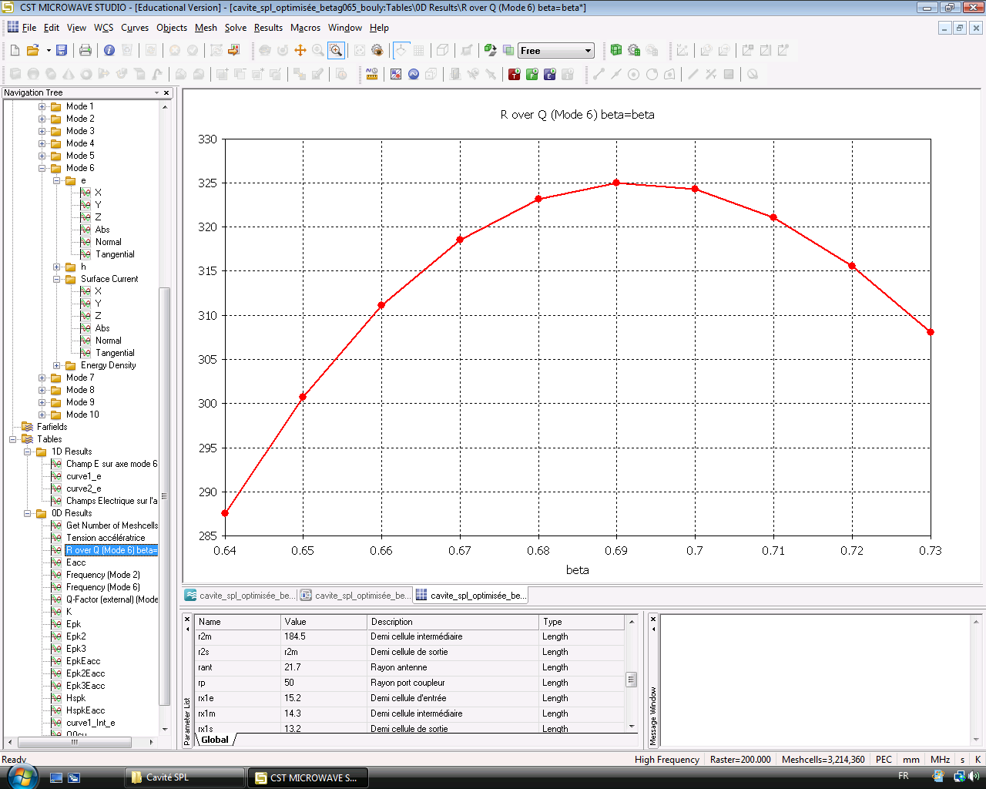
3d calculations: rf parameters
Evolution of the peak fields ratios as function of the reduced velocity β
At βg = 0.65
Bpk/Eacc = 5.1 mT/(MV/m)
Epk/Eacc = 2.6
r/Q ≈ 300
At βopt = 0.69
Bpk/Eacc = 4.9 mT/(MV/m)
Epk/Eacc = 2.5
r/Q ≈ 325
F. Bouly (IPNO)
R/Q maximum for βopt.
For 0.64 < β < 0.73 → 285 < r/Q < 325

Slide 10
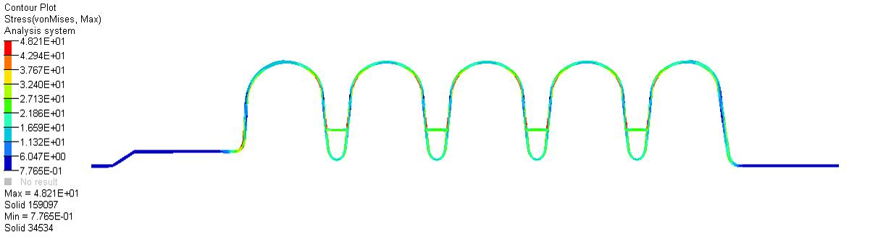
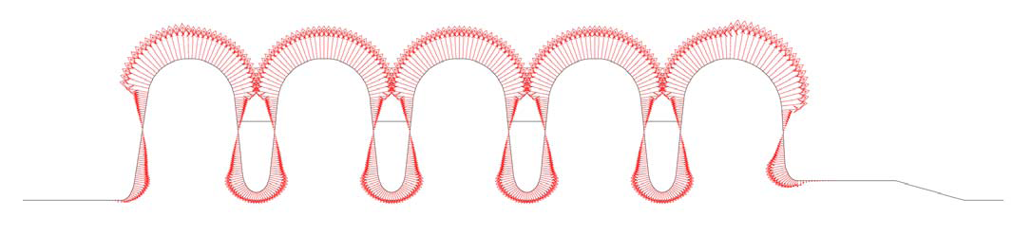
mechanical calculations
Main pb: Von Mises stresses > 50 MPa for 2 bar @ 300K with only 4 mm → end-cell thickness increased to 5mm
45MPa
48MPa
28MPa
free
fixed
5mm
4mm
5mm
P. Duchesne (IPNO)
Lorentz forces detuning with 1 stiffening ring between cells: K_{L}< -1 Hz/(MV/m)²
94mm
H-M Gassot (IPNO)
beam axis

Slide 11
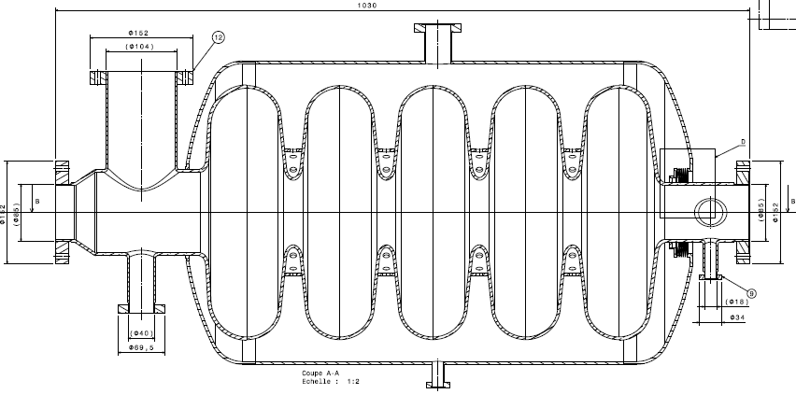
Helium vessel integration
No-cooling RF coupler port
No tuning system test ability
● Influence of the thermal contraction 300K→4K
Volume decrease : V × 0.99857
→ Cavity frequency shift: +1 MHz
● Influence of the chemical etching
Assumption : 100μm removed uniformly from the cavity walls
→ Cavity frequency shift: - 0.4 MHz

Slide 12
aPRIL ’10 -...: new design

Slide 13
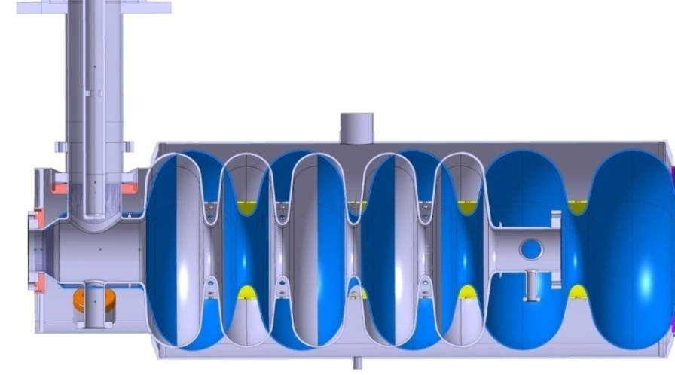
New Design: new options
Starting point: discussions with CERN & CEA → get the same end-groups than those designed for the β=1 SAME INTERFACES
Main changes:
Bigger beam tubes apertures on both sides
New design of the 2 external half cells (field flatness)
New helium vessel (including the tuning system interface)
New position of the power coupler (Qext)
+
New parameters for vacuum load: 1.5 bar @300K

Slide 14
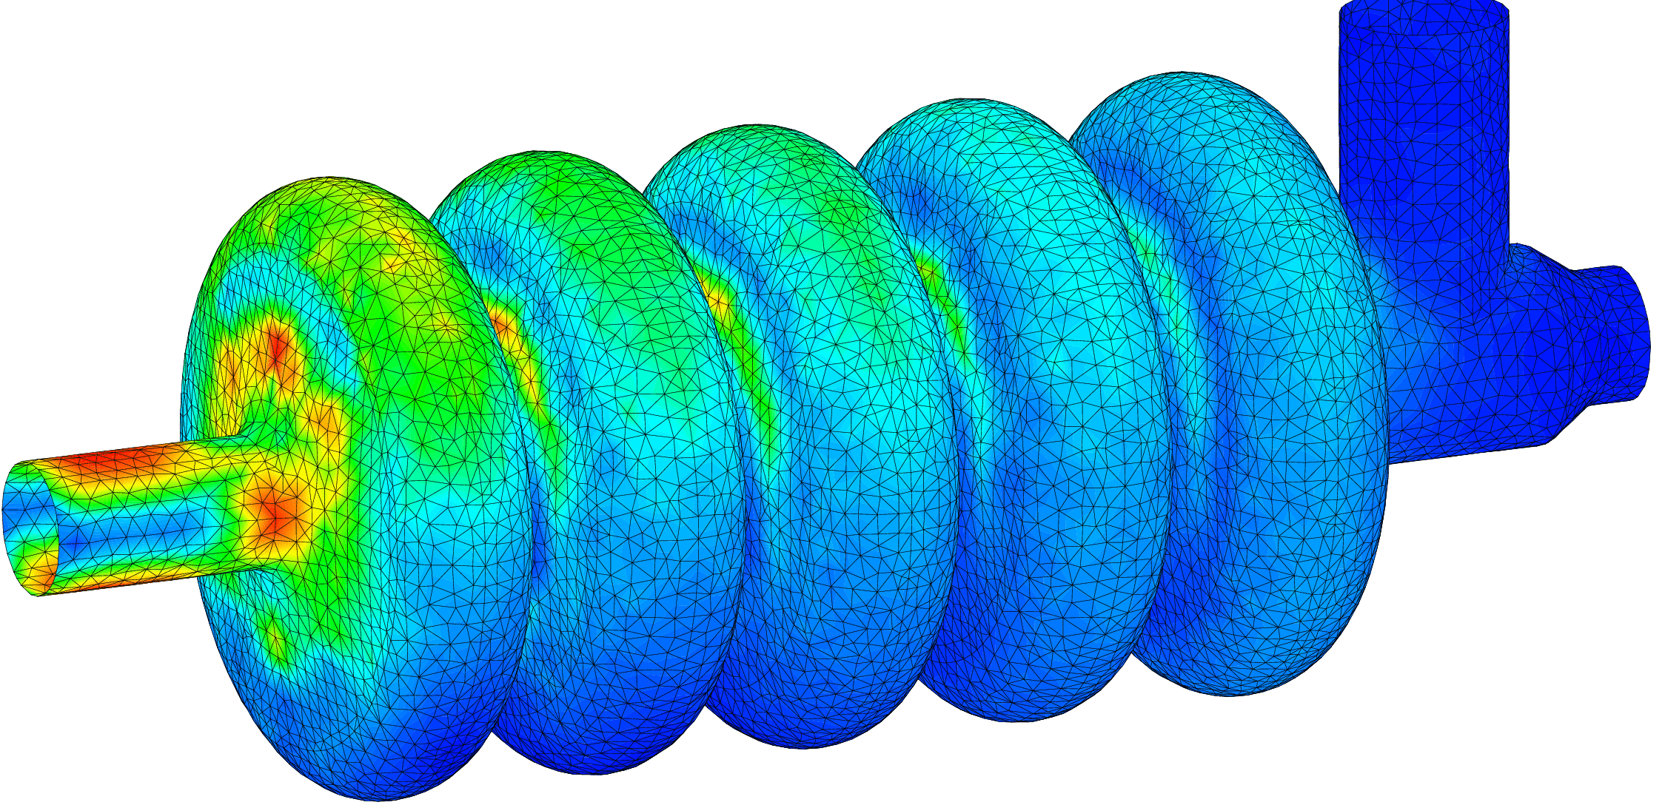
mechanical calculations
Von Mises stresses for 1.5 bar @ 300K < 50 MPa with 4mm (3.5mm should be ok for the inner cells)
H-M Gassot (IPNO)
46 MPa
Cavity walls = 4mm
Lorentz forces detuning (still 1 ring) : K_{L}~ -1.6 Hz/(MV/m)²

Slide 15
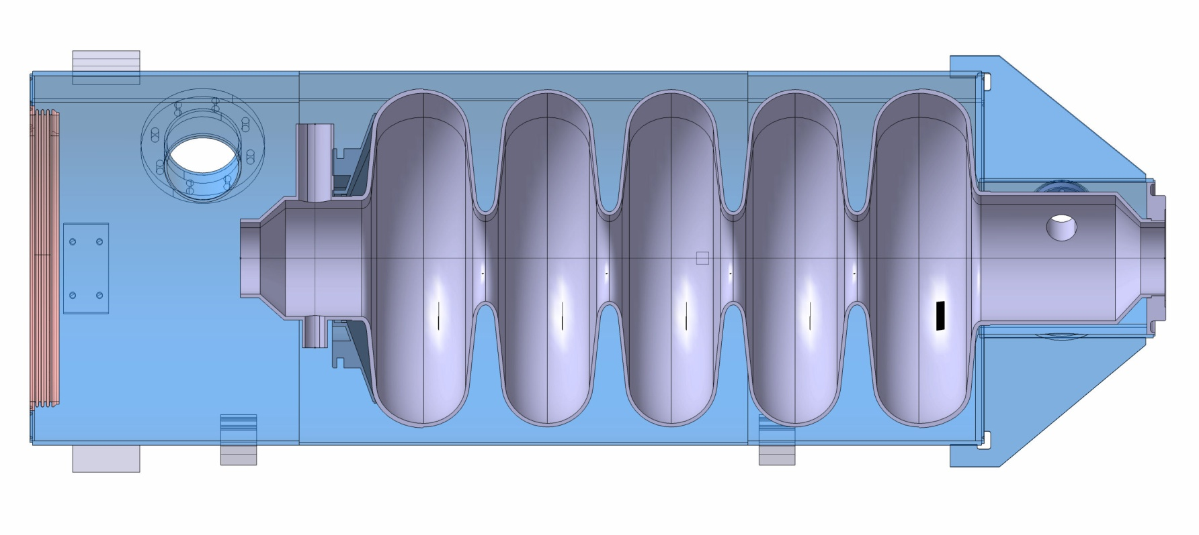
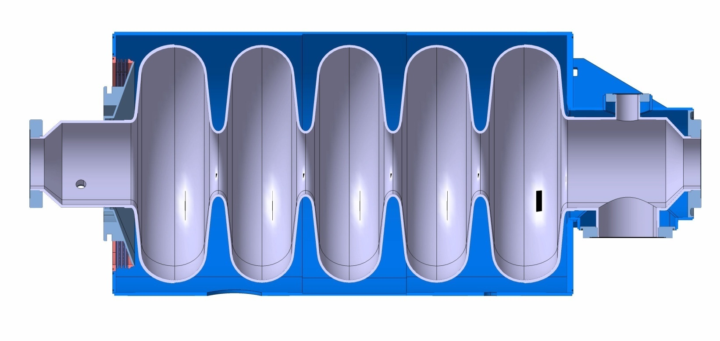
Cavity integration
beta=0.65 cavity inside beta=1 helium vessel
S. Rousselot (IPNO)
+5 to 10mm
+5 to 10mm
Still on-going...

Slide 16
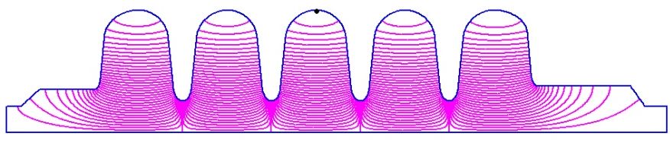
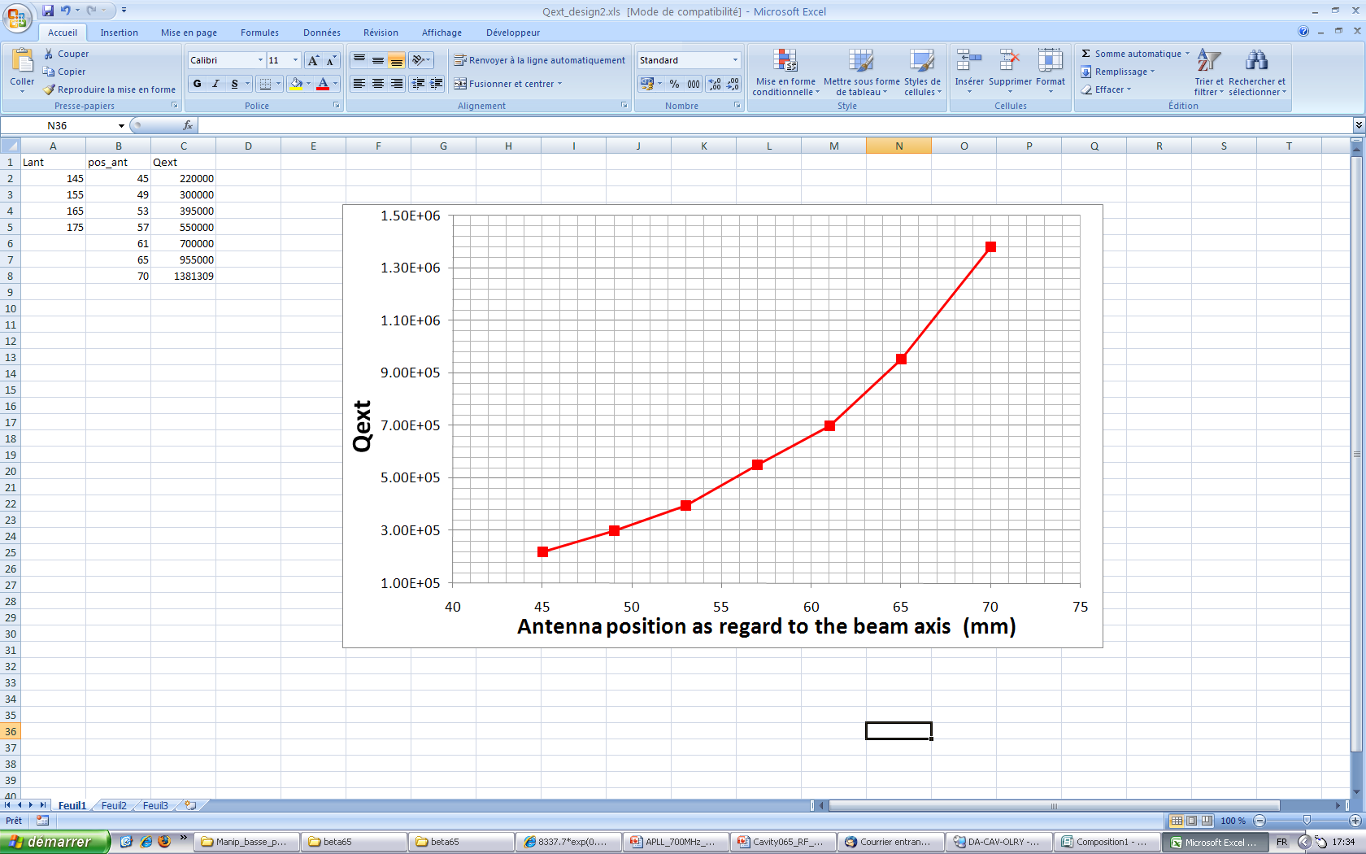
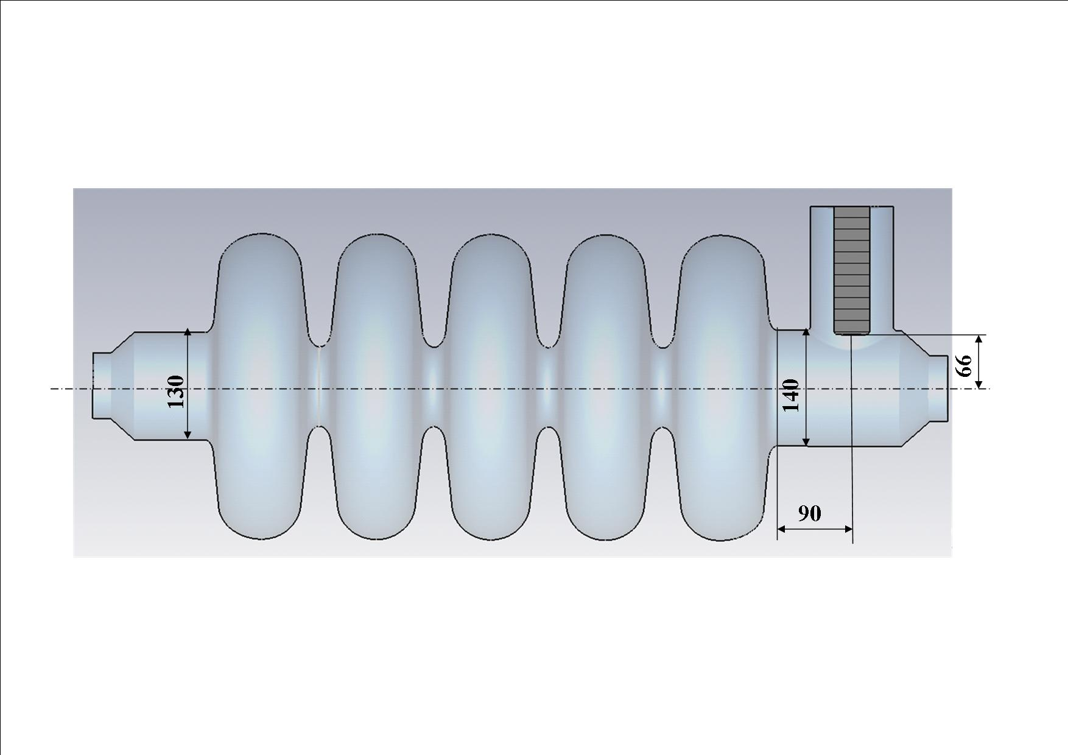
RF Design
2D and 3D studies
Increased
 | Left Cell [tuning system side] | Inner Cell | Right Cell [coupler side]
R | 184.6 | 184.6 | 184.6
L | 69 | 69 | 69
Riris | 65 | 48 | 70
A | 52.2 | 47.1 | 53.0
B | 41.8 | 44.75 | 37.1
a | 10.7 | 14.3 | 10.7
b | 19.3 | 23.5 | 21.5
L_tube | 85 (before conical reduction) |  | 150 (before conical reduction)
Retuned
(40)
(60)
No changes
F. Bouly (IPNO)
Q_{ext}≈10⁶
for 4mm antenna penetration

Slide 17
Rf parameters…still ok
First Design
Second Design with new end-groups
f (MHz) | 704.3
Epk/Eacc | 2.58
Bpk/Eacc (mT/MV/m) | 5.10
K (%) | 1.47
r/Q (Ohm) | 301
G (Ohm) | 200
Vacc @βg & 1 Joule (MV) | 1.16
Qo (@2K, Rres=2nΩ) | 3.8 10¹⁰
Transit Time Factor | 0.7
f (MHz) | 704.0
Epk/Eacc | 2.63
Bpk/Eacc (mT/MV/m) | 5.12
K (%) | 1.45
r/Q (Ohm) | 275
G (Ohm) | 197
Vacc @βg & 1 Joule (MV) | 1.11
Qo (@2K, Rres=2nΩ) | 3.9 10¹⁰
Transit Time Factor | 0.65

Slide 18
conclusions
RF Design: best compromise to fulfil requirements, especially adjusting k% & Epeak/Eacc.
Mechanical calculations: OK
2 designs of cavity + tank
Planning
July-Aug’10: Technical drawings & call for tender preparation (cavity + Niobium)
Sept-Oct’10: Call for tender
Nov’10: Choice of the manufacturer
Dec’10: Start of the fabrication
Sept’11: Cavity delivery (w/o tank)
Oct’11: Field flatness
Nov’11: Cavity + tank delivery
Dec’11: Preparation (BCP + HPR) and test (Vertical cryostat)
Thank you for your attention

