Slide 1
WP5 Elliptical cavities
G. Devanz
4th SPL collaboration meeting jointly with ESS
Lund – 2010/07/01

Slide 2

Objectives
The main objective of this WP 5 is to provide the engineering design of the fully equipped cryomodules for both medium and high beta elliptical 704 MHz cavity sections of the ESS linac operating at 2 K with an accelerating field of about 15 MV/m.
One goal of the Design Update phase is to prepare for construction :
  The Technical Design report which will also include
    a cost evaluation with a 20% accuracy
    Preparation of PBS and WBS for construction
    Preparation of upgrade scenario
Prototypes will be fabricated to demonstrate the feasibility and performance of critical components.

Slide 3
Work Breakdown structure
Work units
5.1 Management
5.2 Medium beta elliptical cavity
5.3 High beta elliptical cavity
5.4 Power coupler
5.5 Elliptical cavity cryomodule
5.6 Superconducting quadrupoles
5.7 Prototypes and tests

Slide 4
Medium beta cavity design
704 MHz beta = 0.65 5-cell cavity.
Eacc = 15 MV/m (baseline)
RF and mechanical study of the medium beta elliptical cavity with its helium vessel.
RF and mechanical design of the HOM couplers according to the damping specifications provided by WP2 and WP8-RF modeling WU.
Design of the magnetic shield of the medium beta cavity.
Write-up of TDR section on the medium beta elliptical cavities, including costing.
Similar development going on for SPL Eucard at IPNO

Slide 5
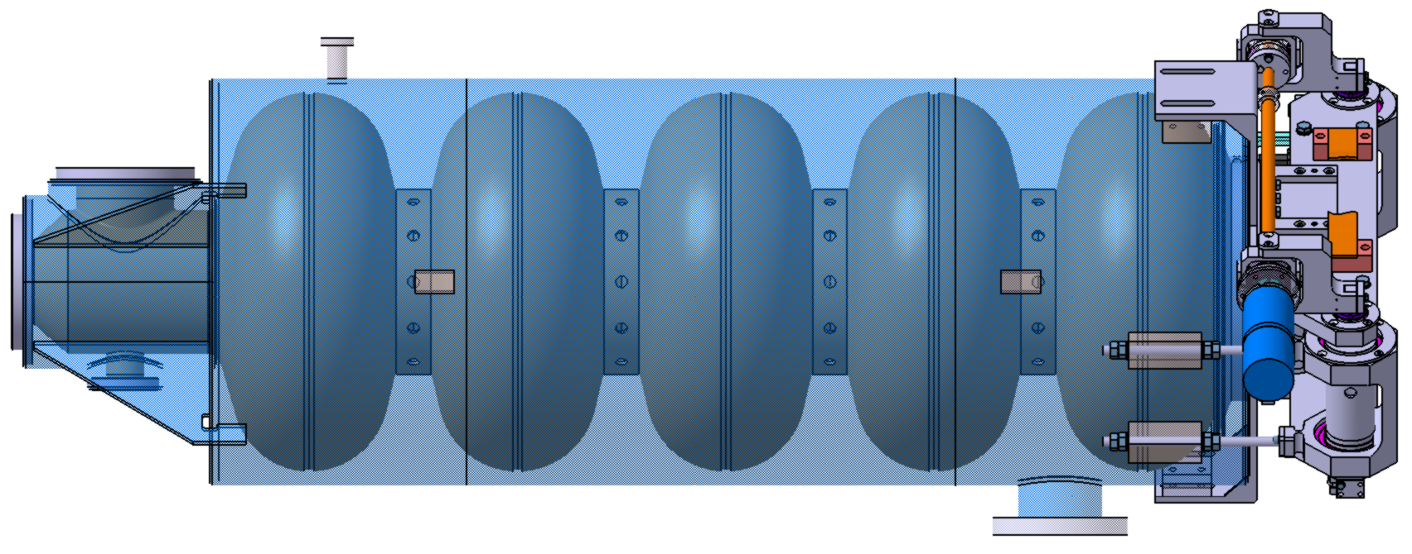
High beta cavity design
704 MHz beta = 0.92 5-cell cavity.
Eacc = 15 MV/m (baseline)
Study of the preparation procedure
RF and mechanical study of the high beta elliptical cavity with its helium vessel.
RF and mechanical design of the HOM couplers according to the damping specifications provided by WP2 and WP8-RF modeling.
Design of the magnetic shield of the high beta cavity.
Design of the cold tuning system combining slow and fast tuning
Write-up of TDR section on the medium beta elliptical cavities, including costing.
Similar development going on for SPL Eucard at CEA-Saclay (beta=1)

Slide 6
Power coupler design
704 MHz 1 MW peak power, max 10% duty cycle
The design should be compatible with any upgrade scenario
RF and mechanical study
Thermal – cooling study
Write-up of TDR section on the power coupler, including costing.
Similar development going on at CERN and CEA for the SPL

Slide 7
Elliptical cavity cryomodules
Contain 8 cavities operating at 2K
  The work is focusing on the high beta cryomodule. The medium beta cryomodule will share the same mechanical and cryogenic design, assembly and alignment methods but the additionnal modeling/CAD work is included
  Conceptual designs with SC quads and with external RT quads have to be compared (tradeoff between energy efficiency and complexity, capital cost)
  Mechanical design of the high beta cryomodule. This phase takes into account the assembly phase of the cavity string inside the modules, vacuum and cryogenic sectorisation, mechanical and thermal loading of the system, alignment, and integration of the instrumentation and superconducting quadrupoles.
  Cryogenic and vacuum design of the modules. This includes the detailed design of the valve box, cryo and vacuum interfaces.
  Mechanical design of the clean room cavity string assembly tools.
  Mechanical design of cryomodule assembly tools.
  Write-up of cryomodule interface document
  Write-up of the TDR section on elliptical cavities cryomodules including costing.
Similar development going on at CERN and IPNO for the SPL short scale cryomodule

Slide 8
Superconducting quads
Caracteristics not defined as of now
  Magnetic design of SC quads and steerers
  Mechanical design
  Current feeds design
  Write-up of the TDR section on SC quads including costing.

Slide 9
Prototyping and testing
  Fabrication of cavity, tuner, coupler prototypes
  Design and procurement of coupler test bench and tooling
  Design and procurement of cavity tuning bench
  Design and procurement of cavity preparation and handling tools
  Prototype cavities preparation and tests

Slide 10
State of the art
Main SRF accelerating components similar to ESS needs have been fabricated and tested. Example of what is installed on running linacs or tested in horizontal cryostats, in the 0.7-1GHz frequency range
Beta <1 elliptical multi-cell cavities freq < 1 GHz for high power pulsed beams
New related developments
  FNAL 650 MHz R&D program
  SPL and Eucard R&D program (CERN,CEA,IPNO)
  SLHC-PP lorentz detuning compensation tests at Saclay
 | F (MHZ) | beta | cells | Eacc operating range (MV/m) | Number of cavities
SNS | 805 | 0.61 | 6 | 9-16 | 33
 |  | 0.81 | 6 | 8-16 | 48
J-PARC | 972 | 0.725 | 9 | 12 | 2
CEA-Saclay | 704 | 0.47 | 5 | 16 | 1

Slide 11
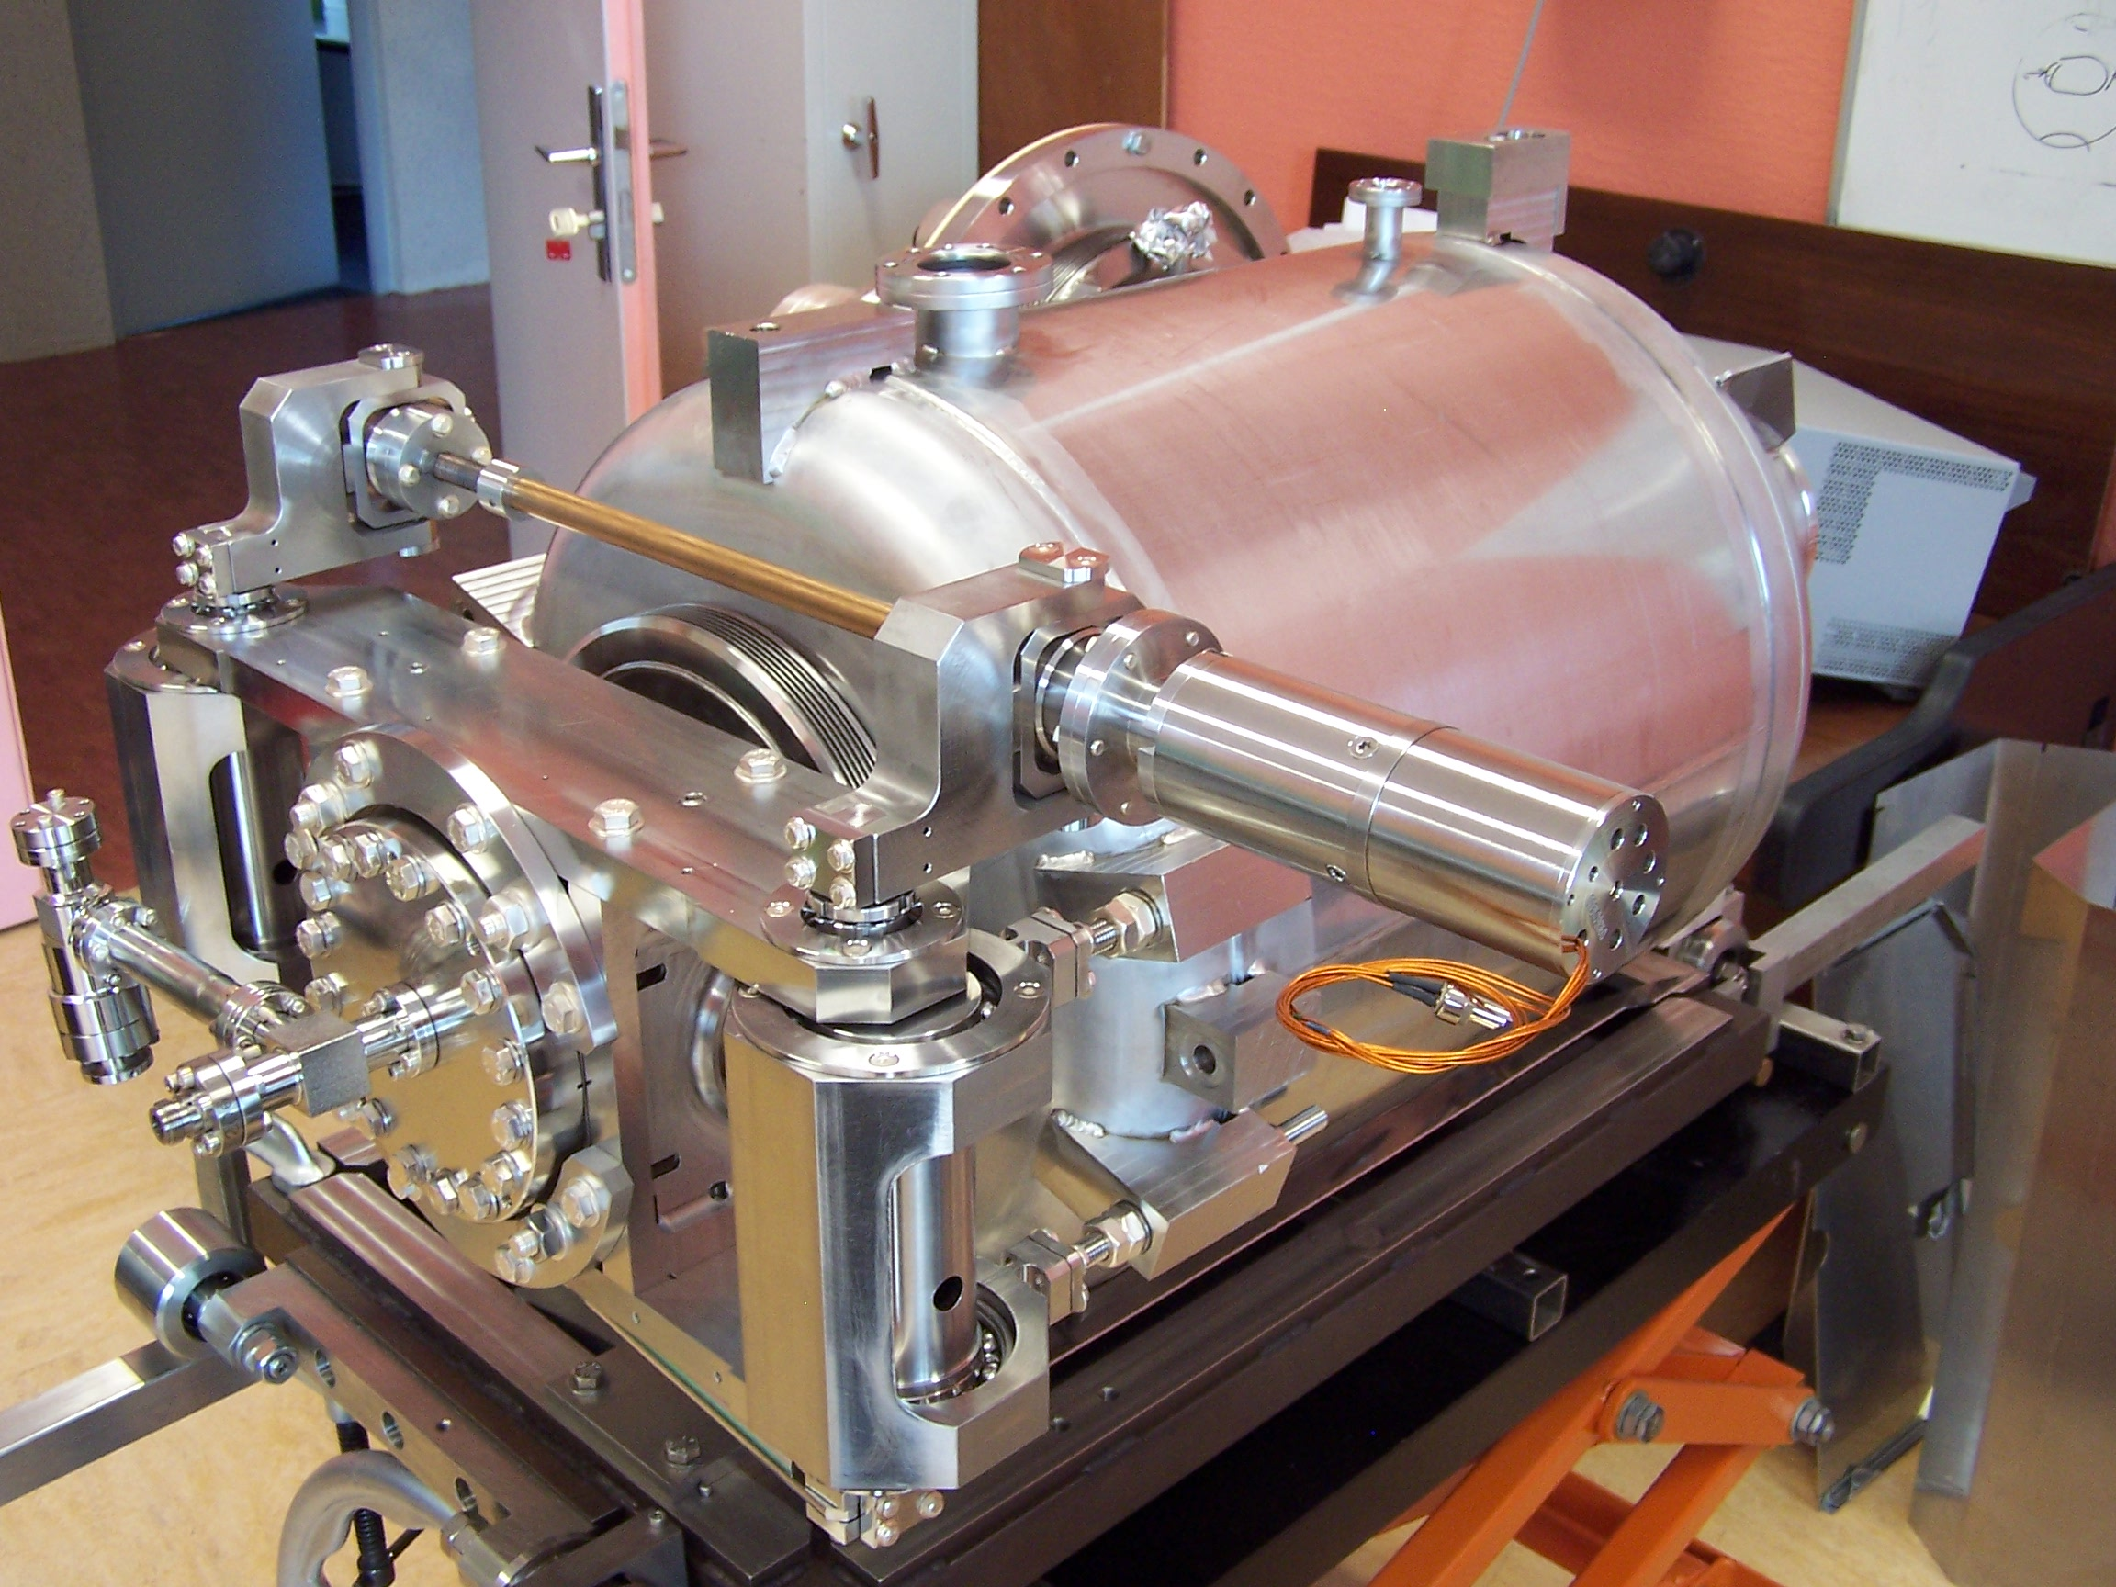
State of the art
LDF compensation on the Saclay beta=0.47 704 MHz 5-cell cavity with the piezo tuner (Saclay-V)
Eacc = 13 MV/m. RF pulses 2 ms 50 Hz. Static KL=-3.8 Hz/(MV/m)²
 | Piezo off | Piezo on
Phase excursion on flat top | +/- 25 deg. | +/- 8 deg.
Amplitude variation on flat top | 45% | 1.4%
Good repeatability although mechanical modes have no time to decay between successive RF pulses (10 pulses recorded with CERN LLRF crate)

Slide 12
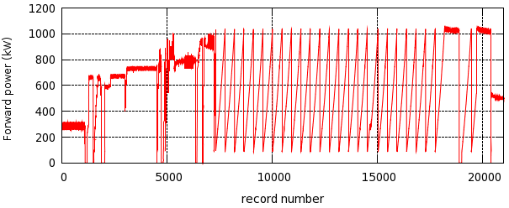
State of the art
Existing power couplers, high peak power, high average power tested in cryogenic environment freq < 1 GHz, pulsed mode
Recent developments:
  CERN R&D for SPL
  Recent results from CEA coaxial coupler 1MW 2ms 50Hz in full reflection on a SC 704 MHz cavity at 2K
 | F (MHZ) | Max Peak power TW (kW) | Rep. Rate (Hz) | Pulse length | Max. avg power (kW) | Number
SNS | 805 | 1000 | 60 | 1.3 | 80 | 81+
J-PARC | 972 | 1000 | 25 | 0.6 | 30 | 2
CEA-Saclay | 704 | 1200 | 50 | 2 | 120 | 2
All of the above derive from KEK-B design. Power values on room temperature test stand
Notes:
J-PARC 50Hz, 1MW, 0.6ms = 30 kW avg
25 Hz 3ms 350 kW = 26 kW avg

Slide 13
Critical design requirements
Reliability – availability above 95%
Power couplers
  The nominal power forward is set no higher than 900 kW. This ultimately limits the gradient of the cavities to 12 MV/m in the 75 mA upgrade scenario
  A test of couplers up to 1.5-2 MW would be very desirable in order to check the operational margins. No test place with the required RF power exist as of now. An option is to upgrade the CEA 1MW 50Hz existing test stand running a pair of 1MW klystrons driven by a single HV modulator
Consistent performance of cavities
  From the large scale SNS experience, limitation due to field emission heating the end groups (not cooled) and HOM couplers
  Cavity preparation procedures must meet the higher standards and follow latest developments, yet not trade for large dispersion in cavity test results

Slide 14
Prototypes
Early prototypes (end 2012)
    A pair of high beta cavities without HOM couplers. Tested in vertical cryostat and horizontal cryostat.
    piezo tuner
Late prototypes (launched mid/end 2012)
    A pair of medium beta cavities
    A pair of fundamental power couplers
Later prototypes (after 2012)
    8 fully equipped cavities (tank, FPC, HOM couplers, tuner, magnetic shield)
    Full length cryomodule (test place with RF power + cryogenics?)

Slide 15
SPL short scale prototype cryomodule
A SPL short scale cryomodule will be designed by CERN and IPNO, built and ready to be tested at CERN in 2013. It will contain 4 fully equipped elliptical cavities.
It is agreed between SPL and ESS that common specifications for this module will allow the projects to gather sufficient data from the test to consolidate the design produced for the full scale “machine cryomodule” in the design update.
The work of defining the set of features of the machine cryomodule needed to be included in the half scale prototype is starting today.
    What can be tested within the upgraded test places capabilities
    Start to List of assembly driven, aligment driven, cryo driven, tunnel space driven features

Slide 16
Scientific Collaboration
Identified partner laboratories
  CERN
  IPN-Orsay
  INFN-Milano
  CEA
  Royal Holloway University of London
  ESS-Lund
  Joining very recently and potential partners J-Lab, U-Rostock

