Slide 1
Development of SC Spoke Resonators at FNAL
G. Apollinari – Fermilab
4th SPL Collaboration Meeting with ESS
Lund, Sweden – July 1st 2010

Slide 2
Project-X Evolution
In the last year Project-X has evolved within the financial constraints of DOE to better meet the physics mission of US HEP community along 3 major lines of research:
  Long baseline neutrino beam
  High intensity, low energy protons for kaon and muon based precision experiments
  A path toward a future muon facility – neutrino factory or muon collider
Initial Configuration 1 (IC-1)
  8 GeV Linac in MI, ILC paramters
Initial Configuration 2 – v1
  2 GeV CW Linac + 2-8 GeV RCS
Initial Configuration 2 – v2 (IC-2v2)
  3 MW @ 3 GeV CW Linac
CW nature requires SCRF acceleration
from very low energies (2.5 MeV)

Slide 3
PrX – Beam Physics “Gospel”
The zero-current phase advances of transverse and longitudinal oscillations should be kept below 90° per focusing period to avoid instabilities at high current.
The wavenumbers of transverse and longitudinal particle oscillations must change adiabatically along the linac. This feature minimizes the potential for mismatches and helps to assure a current-independent lattice.
Minimize derivative of zero-current longitudinal phase advance along lattice, to reduce halo excitation.
Avoid the n=1 parametric resonance (zero current) between the transverse and longitudinal motion.
Avoid energy exchange between the transverse and longitudinal planes via space-charge resonances either by providing beam equi-partitioning or by avoiding instable areas in Hofmann’s stability charts .
Provide proper matching in the lattice transitions to avoid appreciable halo formation.
The length of the focusing period must be short, especially in the front end.
Beam matching between the cryostats: adjust parameters of outermost elements (solenoid fields, rf phase)
See: P. Ostroumov talk, Feb.2, 2010, FNAL

Slide 4
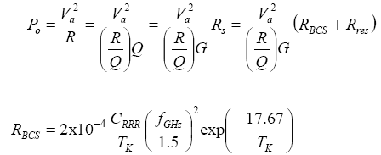
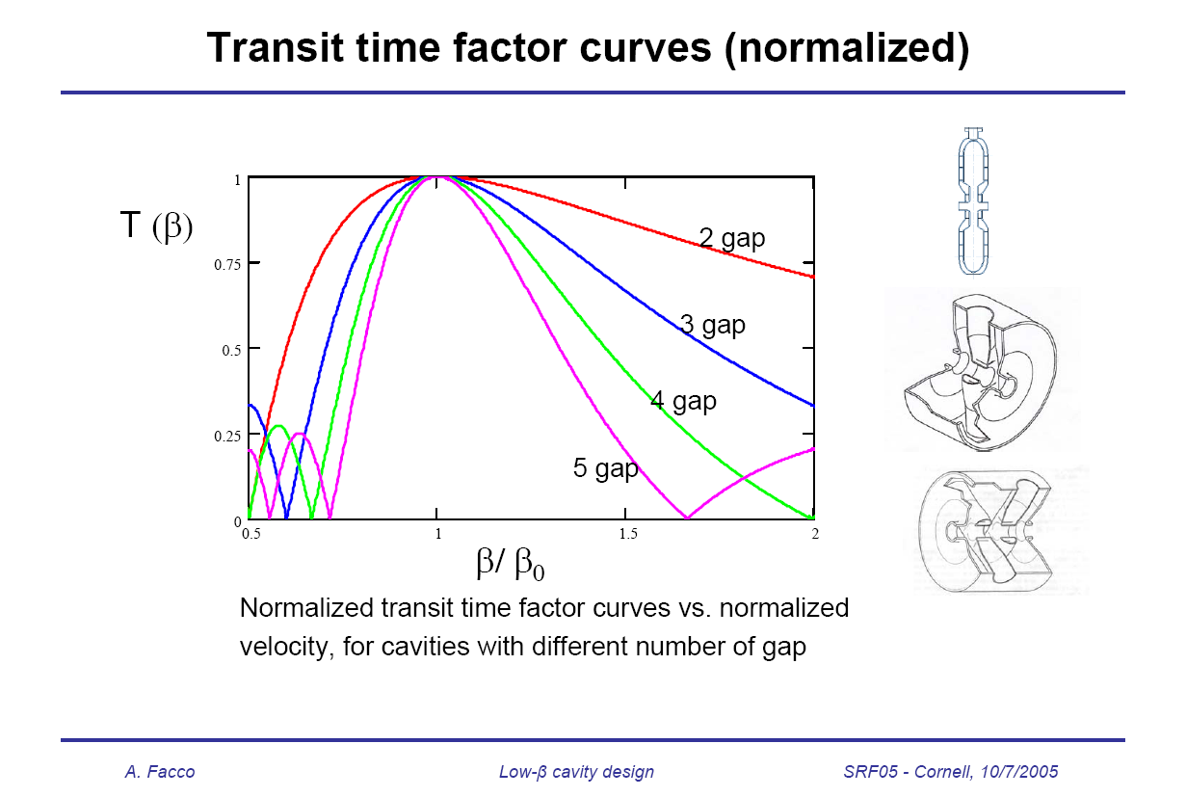
Choice of Cavities
To be efficient at low-β
  Low cryogenic losses
    High (R/Q)G
  High Gradient
    Low E_{p}/E_{acc} and low B_{p}/E_{acc}
  Large Velocity acceptance
    Few accelerating gaps
  Frequency Control
    Low sensitivity to microphonics & low energy content
http://www.lns.cornell.edu/public/SRF2005/talks/sunday/SuA04_talk_srf2005.pdf

Slide 5
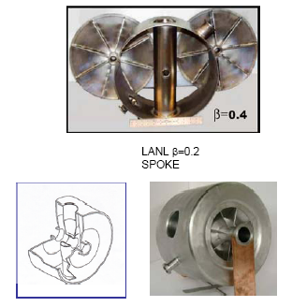
Spoke Resonators
Advantages
  No dipole Steering
  High performance
  Lower R_{sh} than HWRs
  Wide β range
Potential Problems
  Not easy access
  Difficult to tune
  Larger size the HWRs
  More expensive than HWRs
  Quadrupole Steering
325 < f < 805MHz, 0.15 < β < 0.6

Slide 6
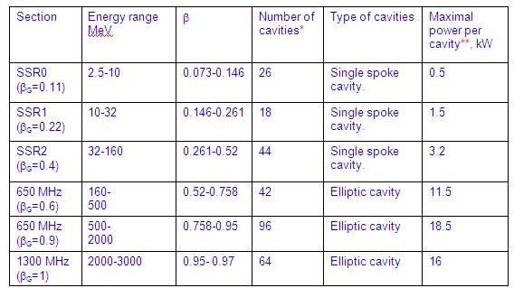
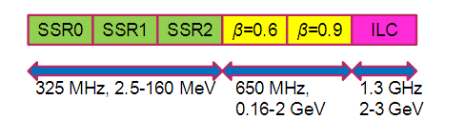
PrX - Initial Configuration 2
For historical reasons(2005 Proton Driver) SSR(1) was the first SC low-β cavity developed at FNAL within the context of a pulsed 8 GeV Linac with SC cavities from 10 MeV.
CM segmentation, number of cavities/CM and the gap between CMs
  88 SSRs (325 MHz)
  138 Ellipt. (650 MHz)
  64 Ellipt. (1.3 GHz)
(Initial) Performance Goals
  Freq (MHz) B_{pk}(mT) G (MV/m) Q @T (K)
  325 60 15 1.4E10 2
  650 72 16 1.7E10 2
  1300 72 15 1.5E10 2

Slide 7
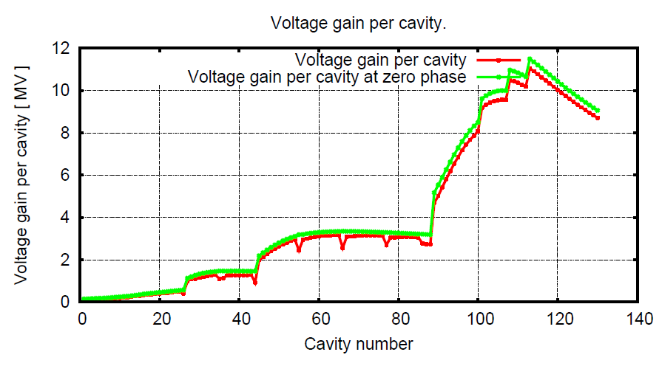
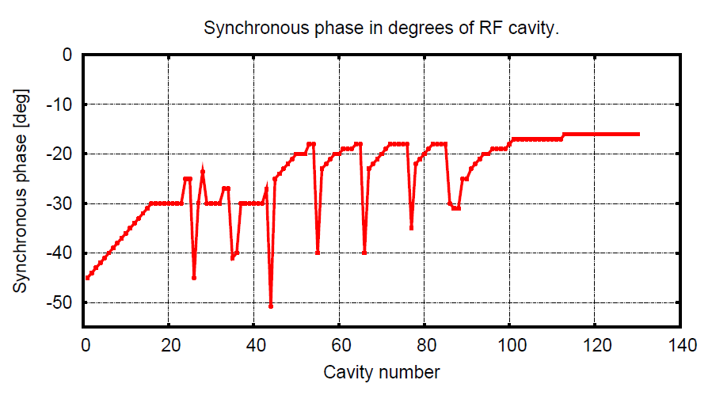
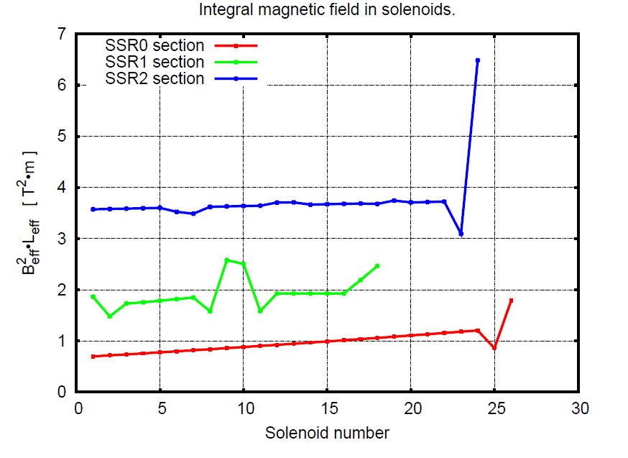
PrX – Initial Beam Elements Specs
Beam dynamics design completed and optimized for regular lattice, with break points and cavity types determined
LB 650
SSR0
SSR1
LB 650
SSR0
SSR2
SSR1
SSR0

Slide 8
Spoke Resonator Challenges
Design Optimization (SSR1)
Construction
  (Feasibility of) Assembly
  Engineering Safety
Operations
  Gradient and Q₀ performance
  Tunability
    Lorentz Force Detuning (Pulsed) and Microphonics (CW)
  High Power Operations
Cryomodule Integration and Test Facility
  (Beamline) Integration
    Focusing Elements
    Instrumentation
  Cryomodule Assembly & Commissioning
  Meson Detector Building Test Facility

Slide 9
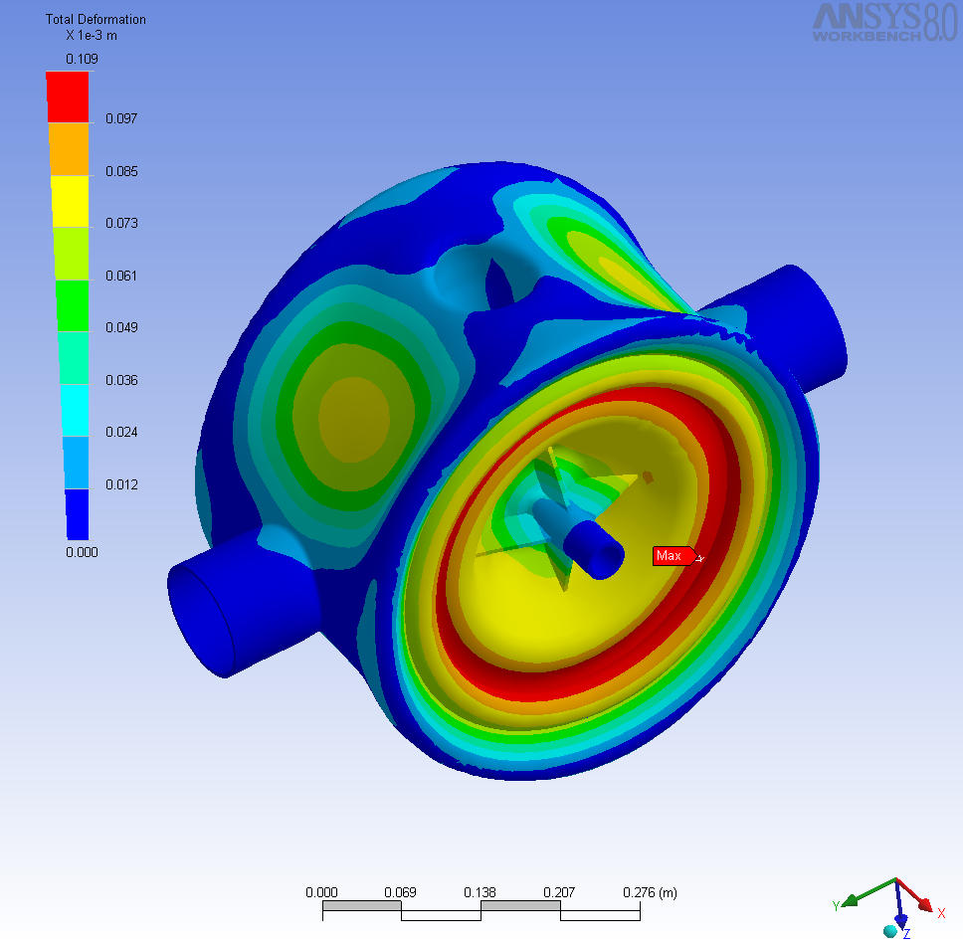
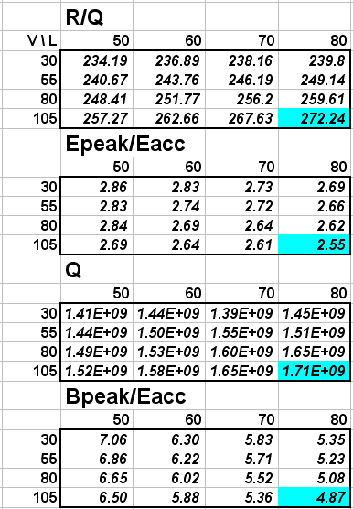
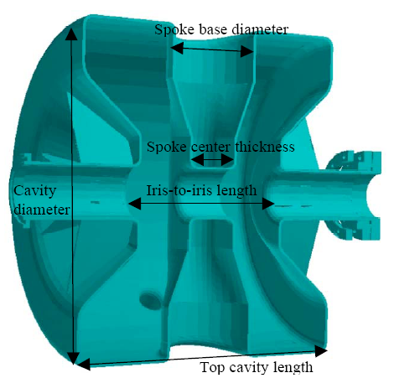
SSR1 Design Optimization
RF Design optimization
Mechanical analysis and optimization
L
V
Total Deformation at 2 atm.
Reinforcement Type | Total Deformation | Von Mises [MPa]
none | 329 | 352.8
flat | 283 | 256.0
tubular | 266 | 254.4
Flat + gussets | 137 | 65.08
Tubular + gussets | 109 | 65.85
Built 2 prototypes + 2 additional from IUAC (India).

Slide 10
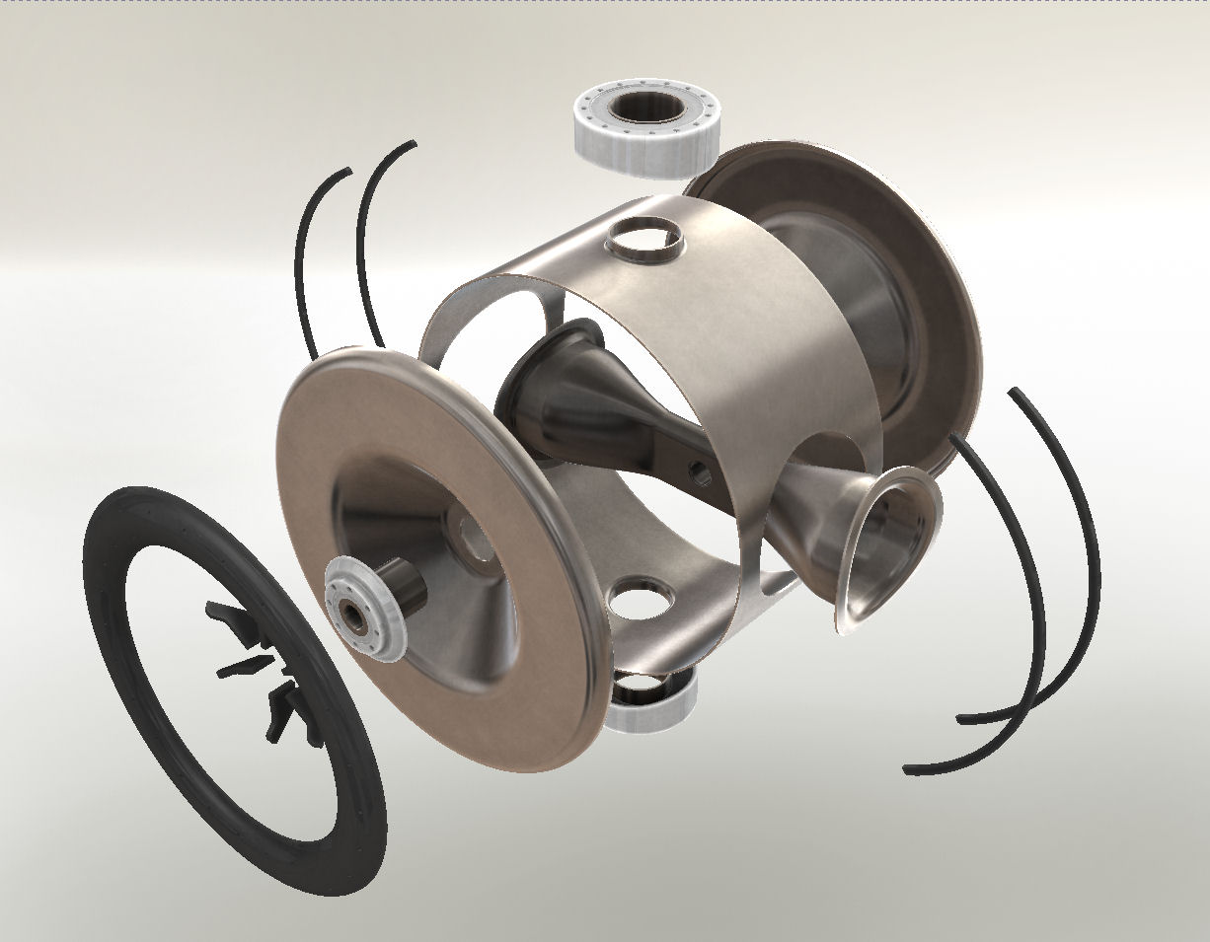
Assembly Model
Vacuum port
Bridge ribs
Shell
End wall
Beam port
spoke
Daisy ribs
Donut rib
Coupler port

Slide 11
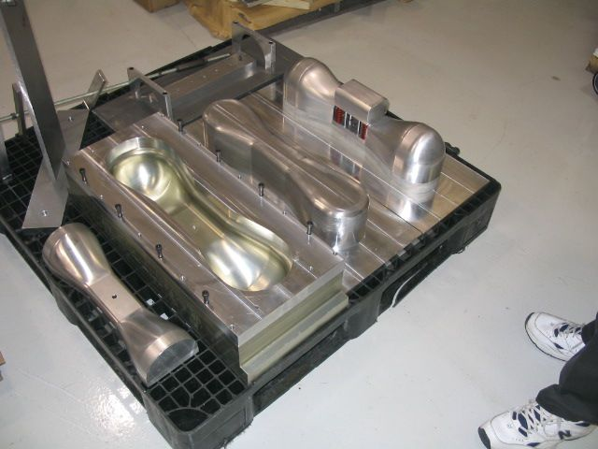
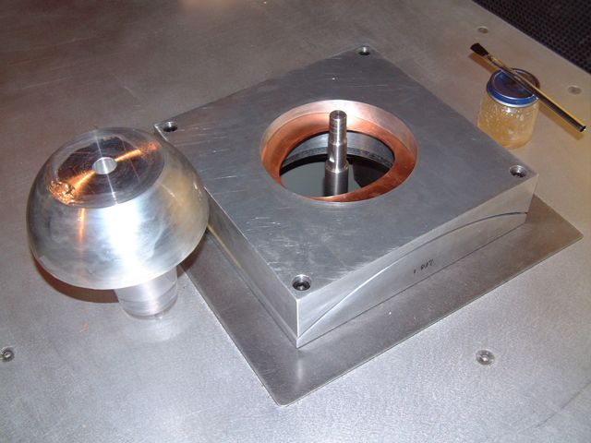
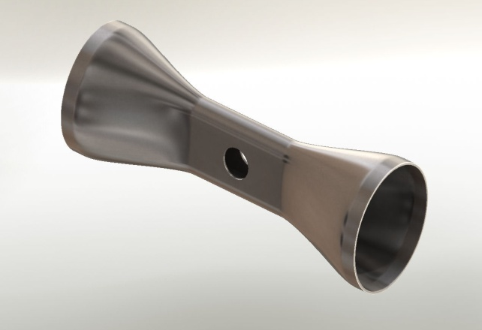
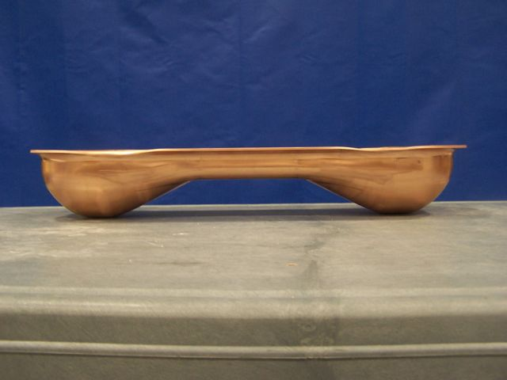
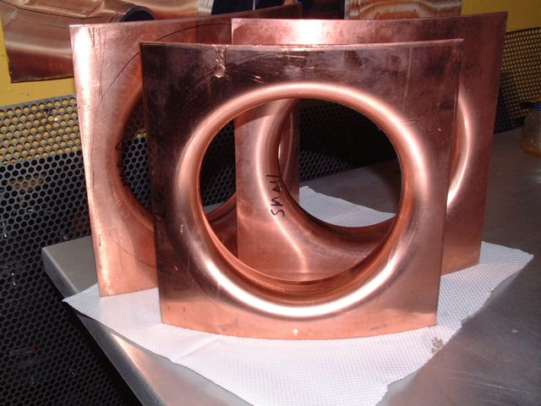
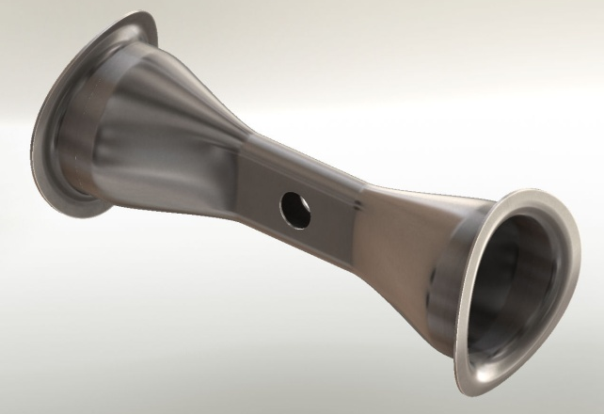
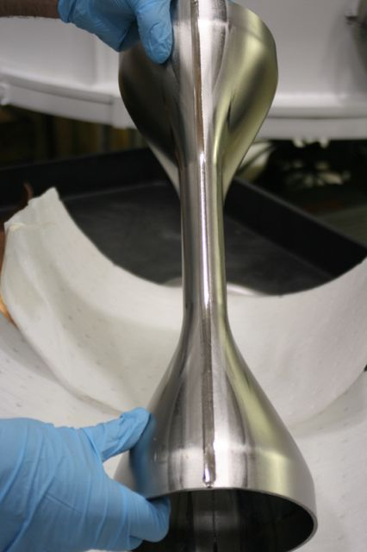
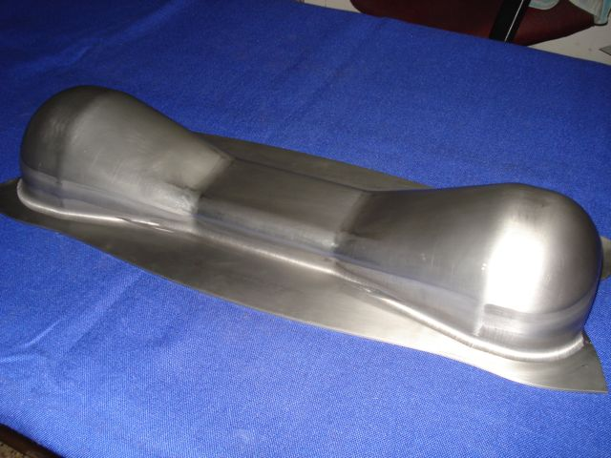
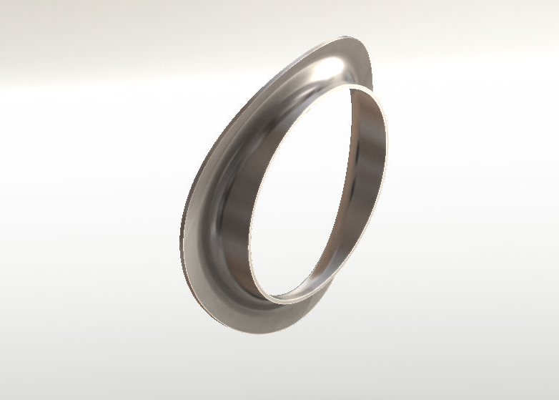
Spoke Assembly
Spoke Forming
Collar Forming
Spoke Welding

Slide 12
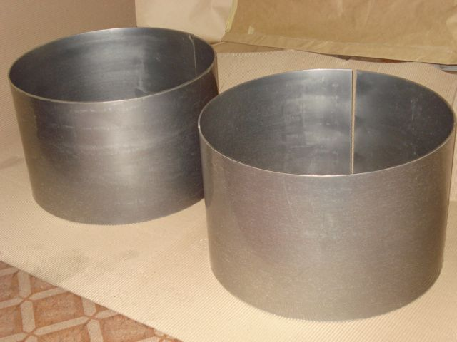
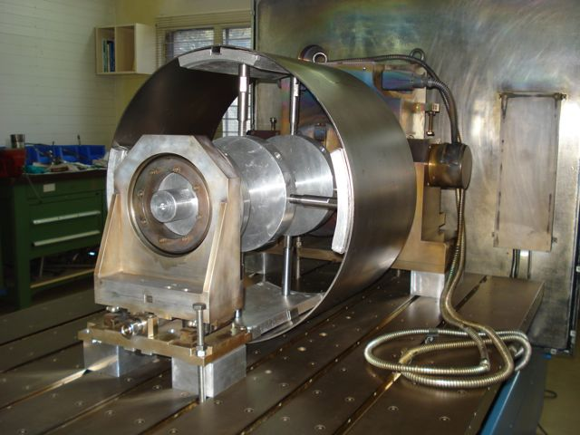
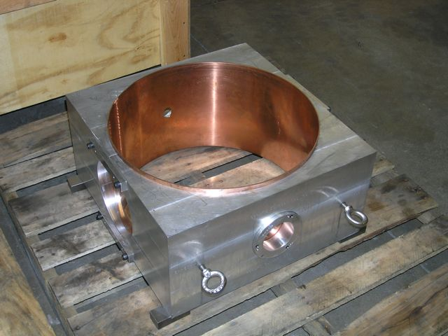
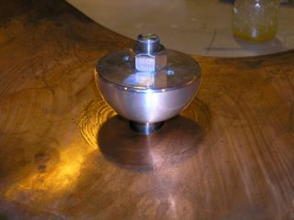
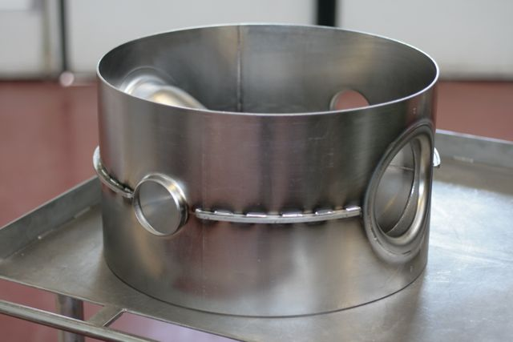
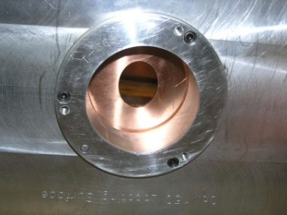
Shell Assembly

Slide 13
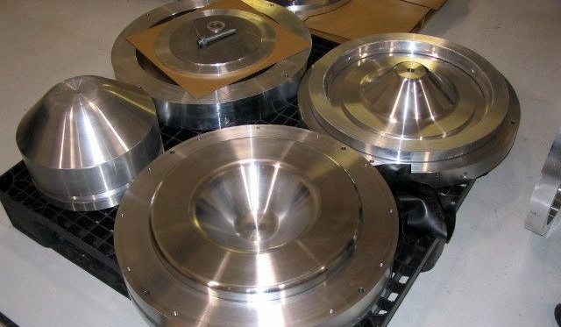
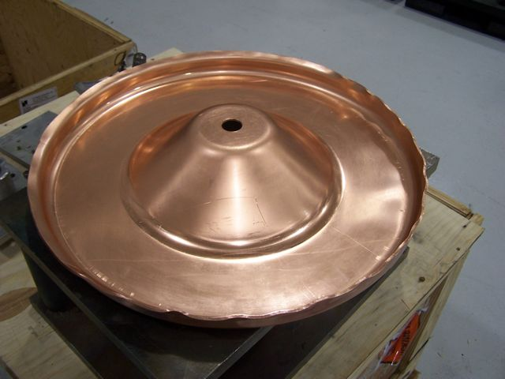
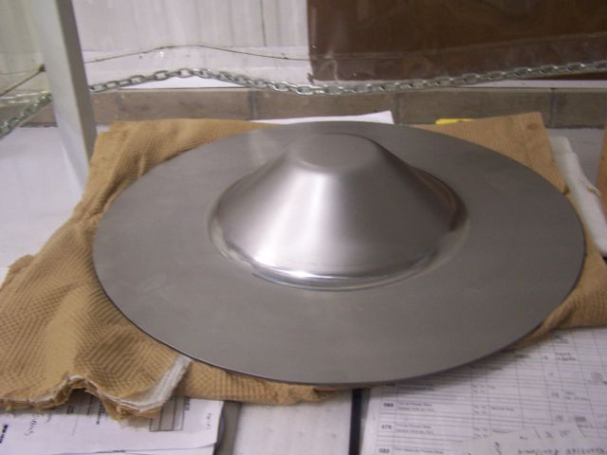
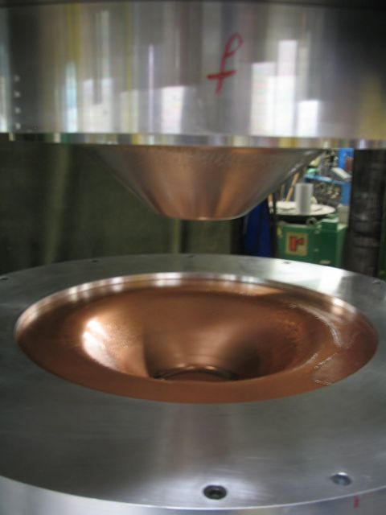
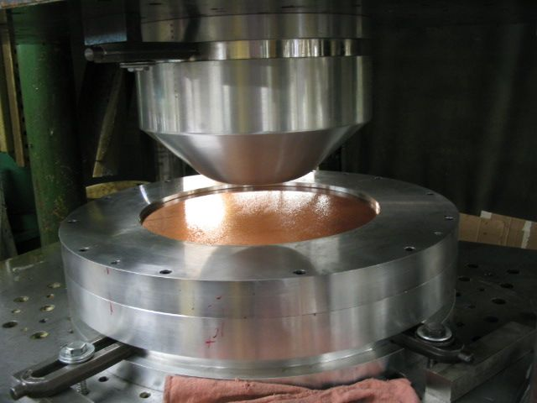
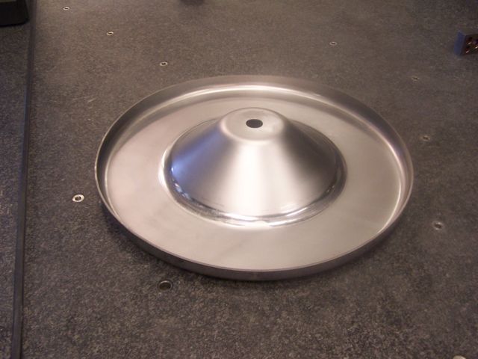
End-walls Forming

Slide 14
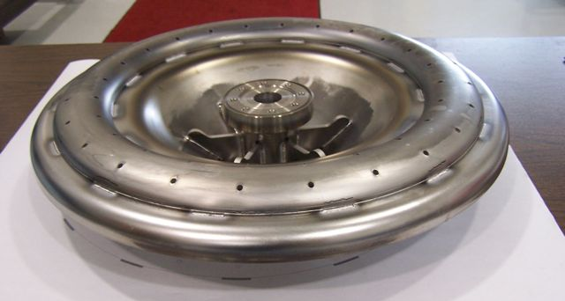
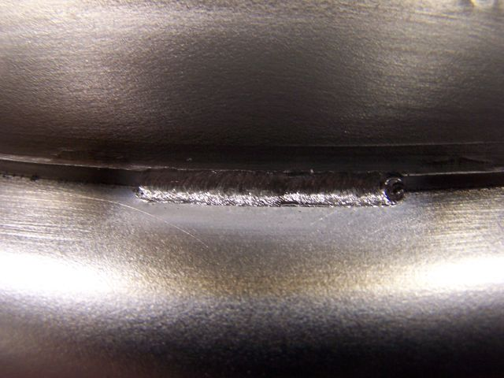
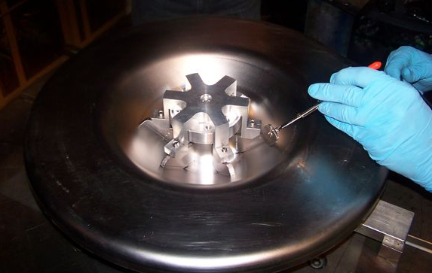
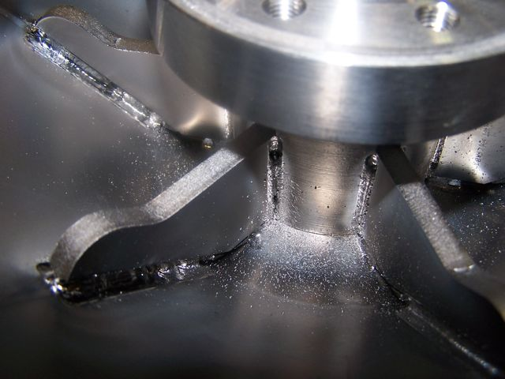
“Stiffening” Ribs
Caveat: Ribs designed for Pulsed Operation Stiffening

Slide 15
Brazed Ports for He Vessel
Vacuum port
Brazing Process
  Initially developed at CERN (1987) later modified at ANL (2003)
  Filler metal: CDA-101 high purity copper wire
  SST flanges pre-machined, stress relieved at 1100 C and finished
  Yield limit 6700 lbs
  Allows assembly of SS He-Vessel
Bridge ribs
Shell
End wall
Beam port
spoke
Daisy ribs
Donut rib
Coupler port
T
Braze spike
soak
Cool down
Ramp up
vent
t

Slide 16
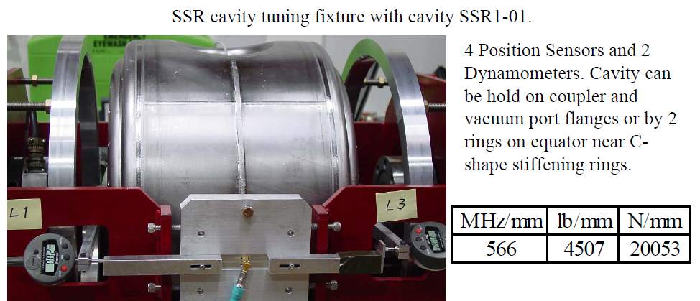
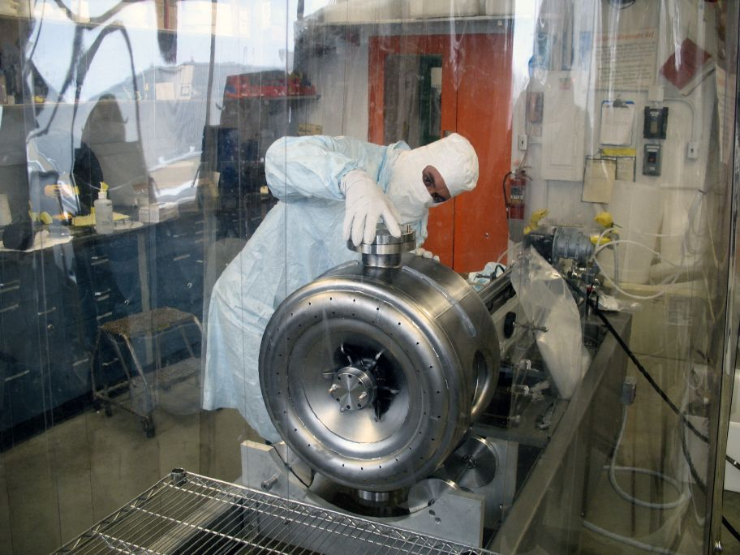
Cavity Tuning
At a glance
Weight | ~ 40 kg
Length | 342 mm
Height | 615 mm
Nb thickness | 2.8 - 3.2 mm
RRR Nb | ~ 18 ft²
RG Nb | ~ 5 ft²
Transitions | Cu Braze
MAWP | 34 psi
Spring K | ~ 20 N/μm
BCP at ANL

Slide 17
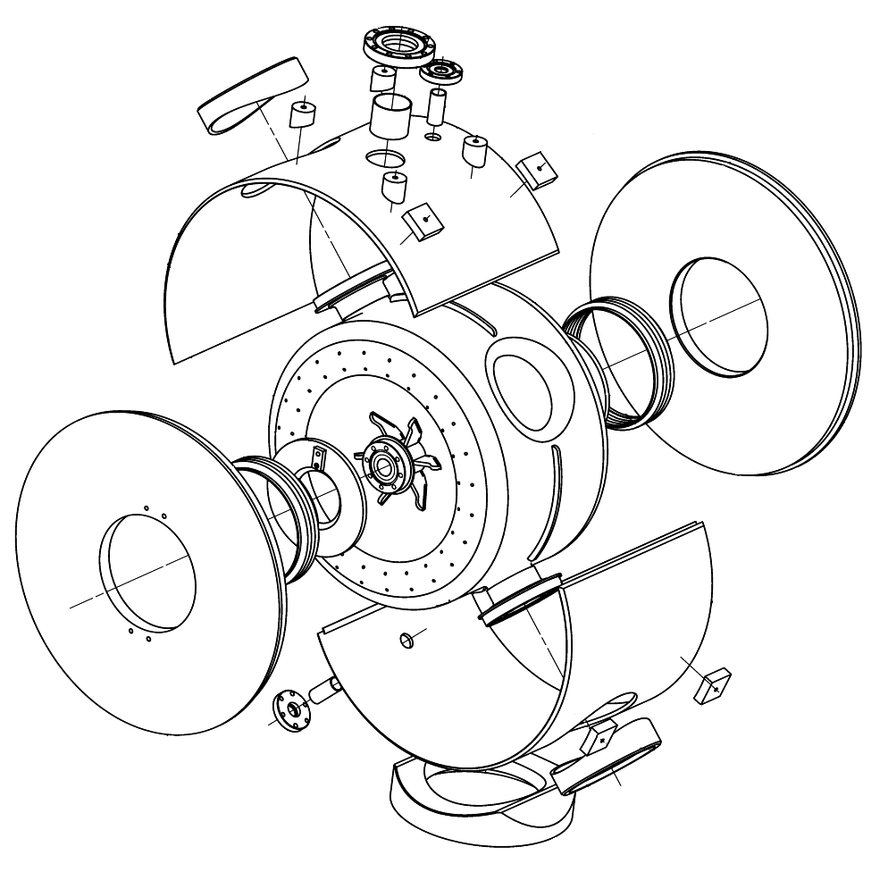
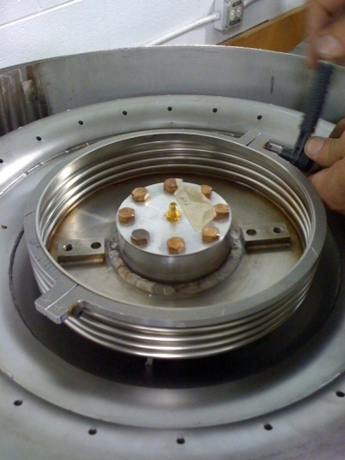
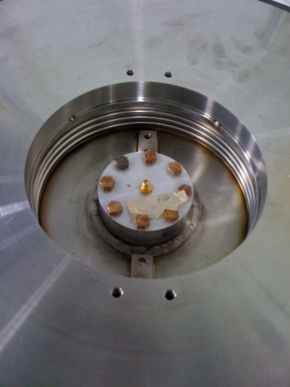
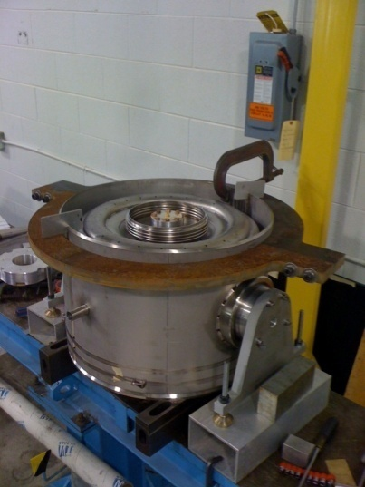
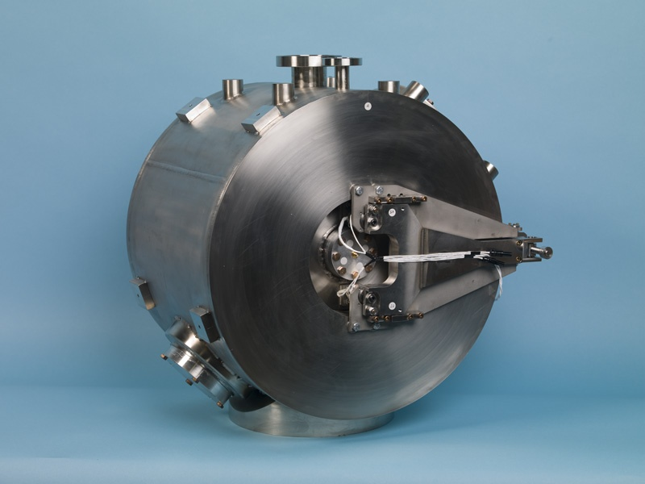
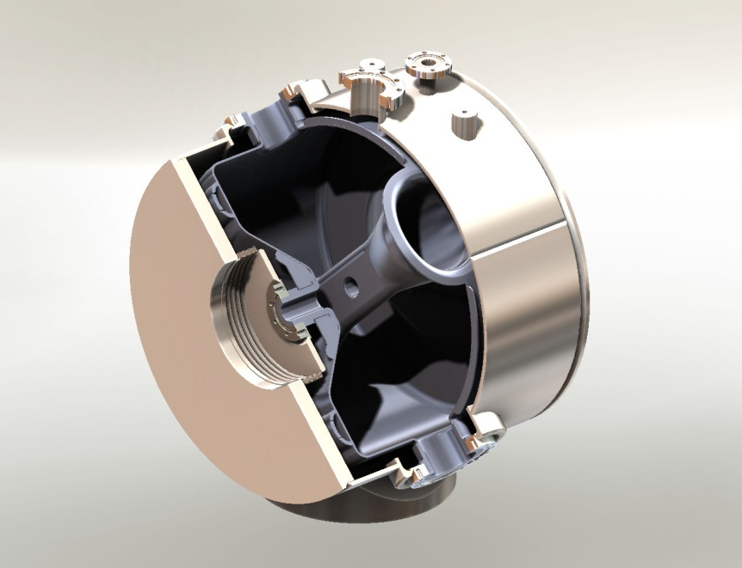
Helium Vessel Assembly
Bellow and End-plate welding process
3-D Model

Slide 18
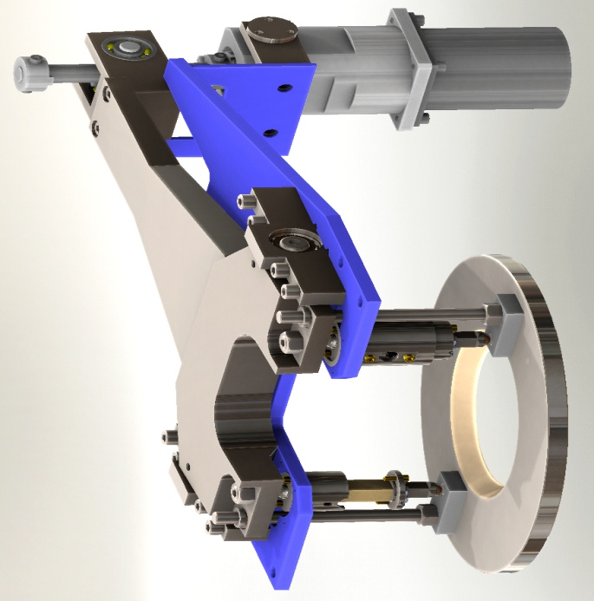
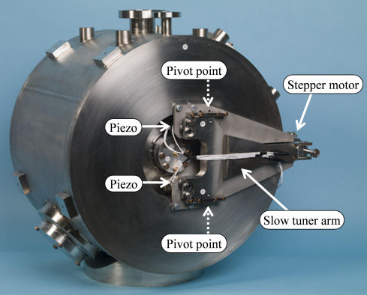
SSR Tuner
Stepper Motor & Harmonics Drive
Slow Tuner Arm
“
Safety Rod” attached cavity
flange to slow tuner arm

Slide 19
Engineering Note & Safety
“ASME Boiler and Pressure Vessel” code (US) introduced in 1905 to address exploding boilers (before then, individual state regulations).
  Δp > 15 psi (~1 atm.) & Dimension > 6 in (15 cm)
EU has “Pressure Equipment Directive” (PED) since ~2005, individual countries regulations before then
  Δp > 0.5 atm & Volume > 1 L
SCRF assemblies cannot meet fully the requirements of the US-ASME code (ex: Nb is not a code-allowed material)
(Possible) strategies:
  Director’s “magic wand” for exceptional vessel approval
  SNS/JLAB approach: coded cryomodule vacuum vessels as pressure containment
  Develop standards such that necessary deviation from code (Nb) are handled by special procedures (measuring the mechanical properties of samples of the niobium from the lot of material from which the cavities are made)

Slide 20
Engineering Analysis
Present Strategy:
  Minimize number of “exceptions” to code
    Use of Nb (not explicitely allowed by the code)
    No ultrasonic examination of EB welding along entire length
    Lack of WPS (Weld Procedure Specs) PQR (Procedure Qualification Records) and WPQ (Welder Performance Qualification) for Nb and SS assemblies
    Nb-SS brazing did not have a Brazing Procedure Specification
  Demonstrate safety by engineering analysis and pressure testing

Slide 21
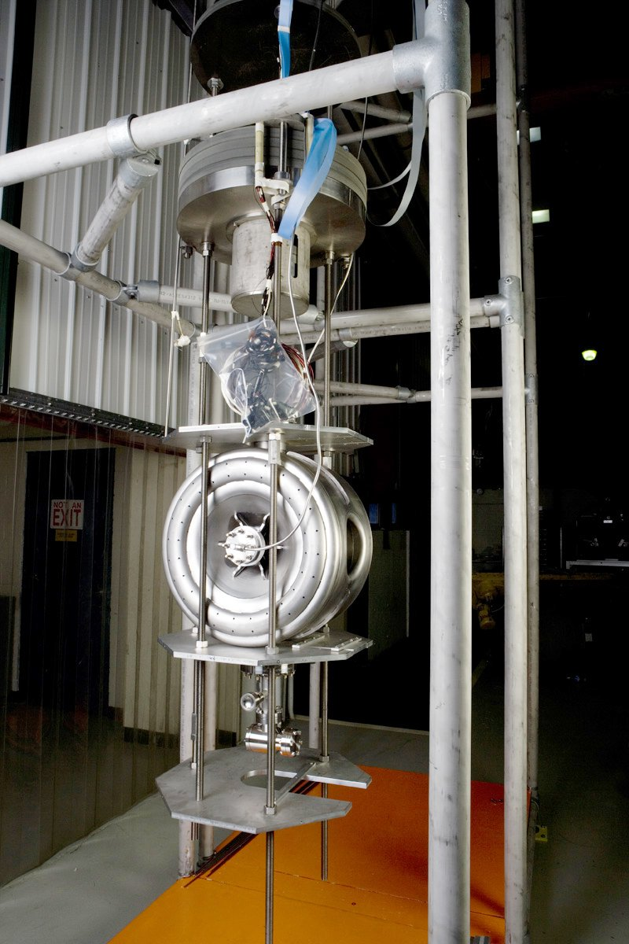
Spokes Cavity Vertical Test
SSR1-1
  Four VTS tests between March 2008 and March 2009
  Vacuum problems in first two tests
  Active pumping added to VTS before 4th test
  4th test included cool-down dwell at 100° K in attempt to induce Q-disease
  Will next be tested in new test cryostat in coming months
SSR1-2
  One VTS test in 2009
  Reached gradient – 33MV/m
  E_{acc}=Acc. Voltage/L_{iris}
  =Acc. Voltage/2/3 βλ

Slide 22
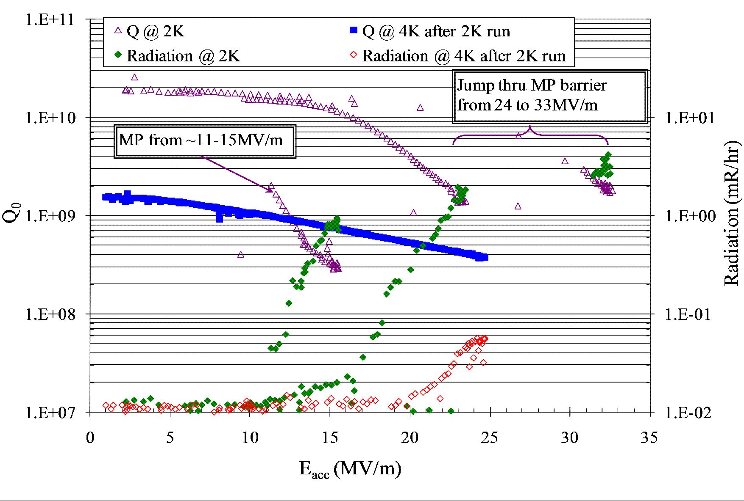
SSR1-2 First VTS Test
60 mT

Slide 23
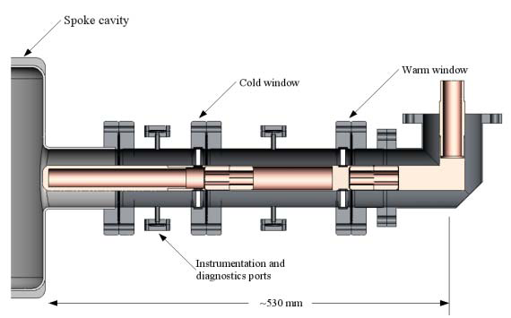


PC High Power Test Fixture
Three Fermilab-designed couplers produced and in house
Average power of 4.2 kW (2 Hz, 3 ms, 700 kW) was sustained for 2 hours, and an additional 3 hour test at 3.3 kW (2 Hz, 3 ms, 550 kW) was performed.

Slide 24




High Power Test
Horizontal Test Cryostat for High Power (~250 kW) SSR testing

Slide 25
Spoke Resonator Challenges
Design Optimization (SSR1)
Construction
  (Feasibility of) Assembly
  Engineering Safety
Operations
  Gradient and Q₀ performance
  Tunability
    Lorentz Force Detuning (Pulsed) and Microphonics (CW)
  ~ High Power Operations
Cryomodule Integration and Test Facility
  (Beamline) Integration
    Focusing Elements
    Instrumentation
  Cryomodule Assembly & Commissioning
  Meson Detector Building Test Facility

Slide 26

SSR1 Cryomodule Model
Present concept of SSR1 Cryomodules
  Contain 9 SSR1 cavities and 9 solenoids
  Project X expects that these designs could be extended to SSR0 and SSR2 requirements

Slide 27


Cryomodule Assembly
Assembly performed using the same or similar tooling to that used for 1.3 GHz (XFEL/ILC) final assembly
Also studying the advantages/disadvantages of “bath-tub” assembly

Slide 28



3-Cavity Cryomodule Concept

Slide 29






SSR0 RF Design Optimization
F(MHz) | 325 | 325 | 325 | 325
β_{optimal} | 0.135 | 0.117 | 0.11 | 0.22
R_{cavity},mm | 210 | 191.5 | 180 | 245.6
R/Q, Ω | 150 | 130 | 120 | 240
TTF, Average | 0.891 | 0.944 | 0.953 | 0.952
E_{max}/E_{acc}/E_{max}/E_{acc*} | 5.4/6.1 | 6.8/7.1 | 7.0/7.3 | 3.9/4.1
H_{max}/E_{acc}/H_{max}/E_{acc*} (mT/MV/m) | 10.9/12.3 | 10.3/11 | 10.8/11.3 | 5.8/6.1
D_{eff} =(2*βλ/2),mm | 124.6 | 108 | 101.5 | 203
blue
red
E_{acc*}=E_{acc}(β_{optimal})* TTF, Average
green
E Field
B Field

Slide 30



SSR0 Mechanical Optimization
Displacement 0.1 mm
Force reaction 315 x 4
K = 315*4/0.1 = 12600 N/mm ~ 13 N/µm

Slide 31
Meson Detector Building Setup
MDB/HINS initially (2005) conceived as development ground for 325 MHz Front End for the initial Project X configuration (8 GeV Pulsed Linac, SC from 10 MeV)
Initial Goals:
  Testing ground/conditioning for all 325 MHz equipment
  Accelerate beam from 0 to ~60 MeV through RFQ, MEBT, RT section (2.5-10 MeV) and SC SSR1 section (10-60 MeV)
  Control RF power to cavities
  Beam Chopper Development
  Beam Instrumentation Development
Revised Goals:
  In CW design, RT section eliminated. Probably replaced by “short” SSR0 cryomodule (~3 cavities) for “proof of principle” acceleration with SSRs
  Testing ground for MEBT section, chopper and beam diagnostic

Slide 32

Layout for 3-Cavity SSR0 Cryostat
18° spectrometer ~2.7 m length
actual HINS absorber/shielding
0.5 m end
10 m MEBT/CHOPPER
0.5 m end
2.4 m cryostat
Existing ion source and RFQ
0 m
10.5 m
13.4 m
16.9 m
14.2 m
10.5 foot ceiling

Slide 33

RFQ and 2.5 MeV Beamline

Slide 34

First 2.5 MeV Beam through RFQ
Signals from toroid and two BPM buttons, all downstream of the RFQ
Upper display: 2 μsec/div
Lower display: 20 nsec/div
Lower display shows the 44nsec delay expected for transit of 2.5 MeV beam between the BPM two buttons separated by 0.96 meters
Beam current is about 3 mA

Slide 35
Conclusions
Project X has adopted Superconducting Spoke Resonators for the Front End
Design and development of bare cavities is by now a “routine” operation
Valuable experience is being gained in the assembly and operation of “dressed” cavities.
Design of the SSR cryomodule is still in its early stages.

Slide 36
Supporting Slides

Slide 37

Quarter Wave Resonator
Advantages
  Compact
  Modular
  High performance
  Low Cost
  Low Beta
Potential Problems
  Field asymmetry (to be compensated by dipole steering or gap shaping)
  Mechanical Stability
40 < f < 160 MHz, 0.001 < β < 0.2
OPERATING

Slide 38

Half-Wave Resonator
Advantages
  No dipole Steering
  High performance
  Lower E_{p} than QWR
  Wide β range
  Very compact
Potential Problems
  Not easy access
  Difficult to tune
  Less efficient than QWRs
160 < f < 350MHz, 0.09 < β < 0.3

Slide 39

PrX – Beam Physics “Gospel” (cont.)
Provide proper matching in the lattice transitions to avoid appreciable halo formation. In the perfect “current-independent” design, matching in the transitions is provided automatically if the beam emittance does not grow for higher currents.
Stability for zero current beam, defocusing factor should be < 0.7. (Defocusing factor is less for lower frequencies for given E_{m})
The length of the focusing period must be short, especially in the front end.
Beam matching between the cryostats: adjust parameters of outermost elements (solenoid fields, rf phase)
In the frequency transition, the longitudinal matching is provided by 90° “bunch rotation”, or bunch compression

Slide 40


SSR1-1 Early VTS Results
SSR1-1 Q vs. E
O
Dressed Cavity Operating Goal @ 4 K (Pulsed)
This test ended when multipacting due to poor cavity vacuum became unacceptable.
Accelerating Gradient MV/m

Slide 41
SSR1-1 Final Test Results

Slide 42

Spoke Cavity Horizontal Test Cryostat in MDB

Slide 43

“Complete” Layout
Existing RF1-3900P80 and
RF2-1300P300
Existing RF9-325CW0.4
NEW
RF3-1300CW30 and
RF6-650CW30
HTS-2
Existing RF8-325P2500
325
CAGE
NEW
RF11-325CW1.5
Relocated 325 MHz RF Component Test Facility
Caveats:
Physical Sizes of RF4-1300P1000, RF7-650P100 and RF10-325CW30
are not known
Layout does not show RF5-1300P100. It is assumed that RF2-1300P250 or
RF4-1300P1000 serves that purpose.
NEW
RF4-1300P1000
and RF7-650P100
NEW
RF10-325CW30

Slide 44
Goals
Complete “Six-Cavity Test” – June 2011
  Demonstrate individual Phase/Amplitude control with DQM shifters.
Demonstrate that solenoid beam axis can be aligned to 0.5 mm rms – by Oct 2011
Select bunch frequency (162.5 or 325) by demonstrating a broad-band chopper – by July 2013 (CD2)
Complete test of SSR0 “short” cryomodule (3/4 cavities, 4/5 solenoids + correctors, BPMs) (prototype for a “long” cryomodule) with beam and broad-band chopper – by Sept 2014
Ongoing development of instrumentation, optics, couplers, LLRF

Slide 45




Ion Source Emittance Scan Data
Horizontal
50 keV beam from HINS proton ion source
Vertical
I_{b} = 4 mA
I_{b} = 12 mA

Slide 46

HINS 2.5 MeV Beam Profiles

Slide 47

Linac Enclosure
(Under Construction)

Slide 48


RFQ Problem & its solution
Note RF joint seal
RF joint seal buckled

