Slide 1
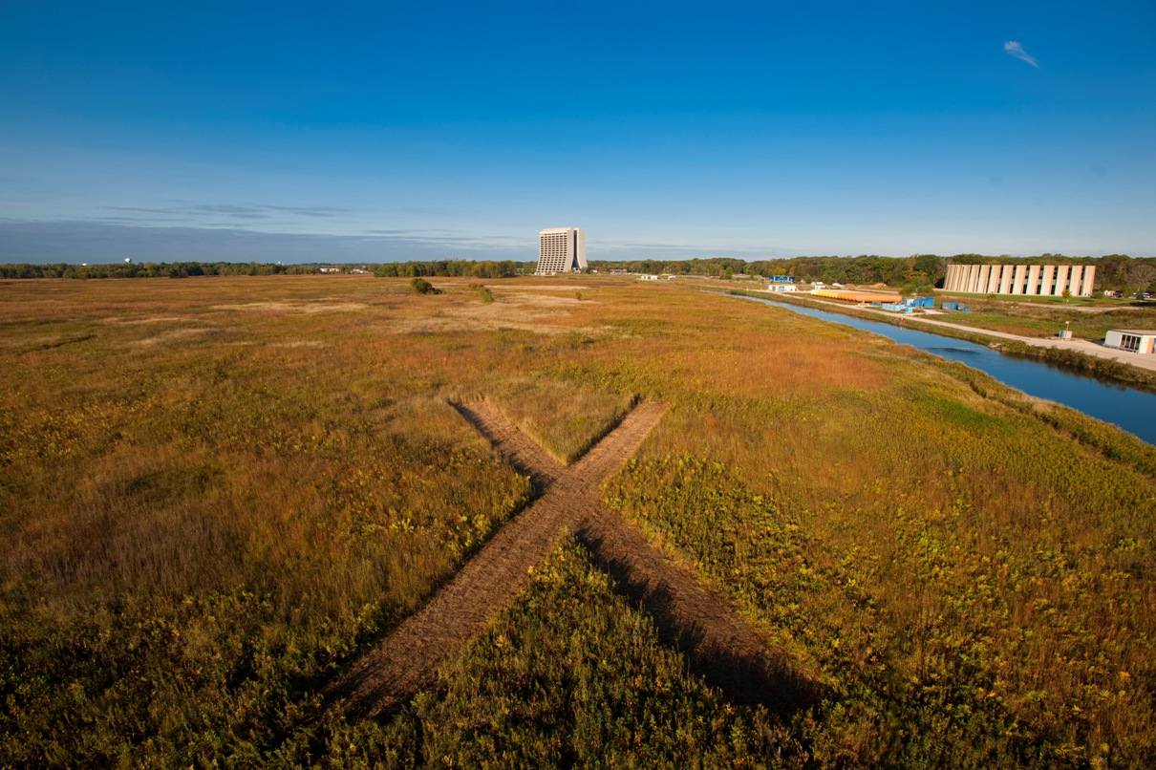
Project X:
A Multi-MW Proton Source at Fermilab
Manfred Wendt & Steve Holmes
SPL/ESS Collaboration Meeting
Lund
June 30, 2010

Slide 2

Outline
Evolution of the Fermilab Complex
Project X Goals and Initial Configuration(s)
Project X R&D Program
Relationships to other Programs
Collaborations
Strategy
Project X website: http://www.fnal.gov/pub/projectx/
Notes:
Test
2

Slide 3
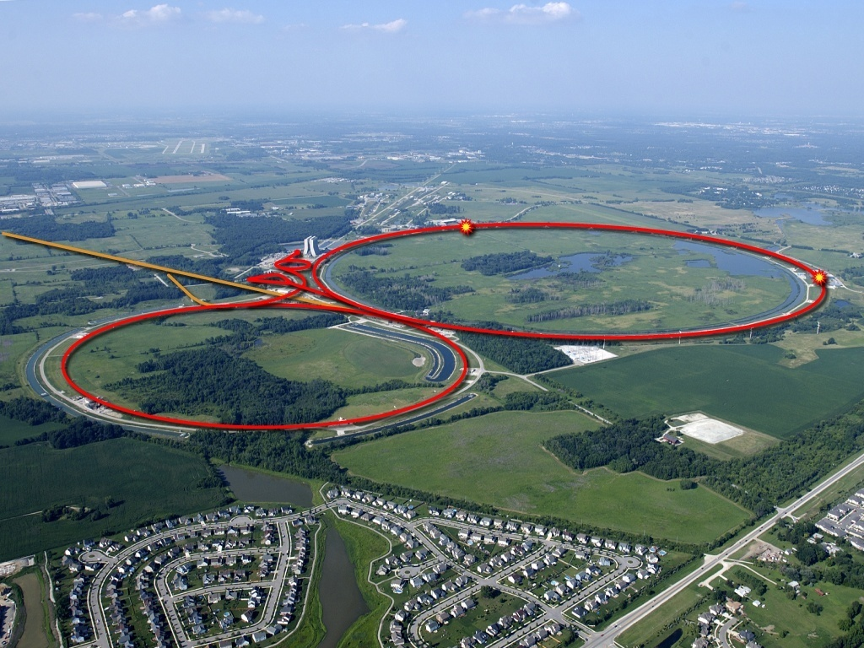
Strategic Context: Fermilab and the World Program
The Tevatron has now ceded the energy frontier to LHC
Operations at 2 TeV will continue through September 2011
Fermilab operates the highest power long baseline neutrino beam in the world.
J-PARC is initiating a competitive program
To Soudan

Slide 4
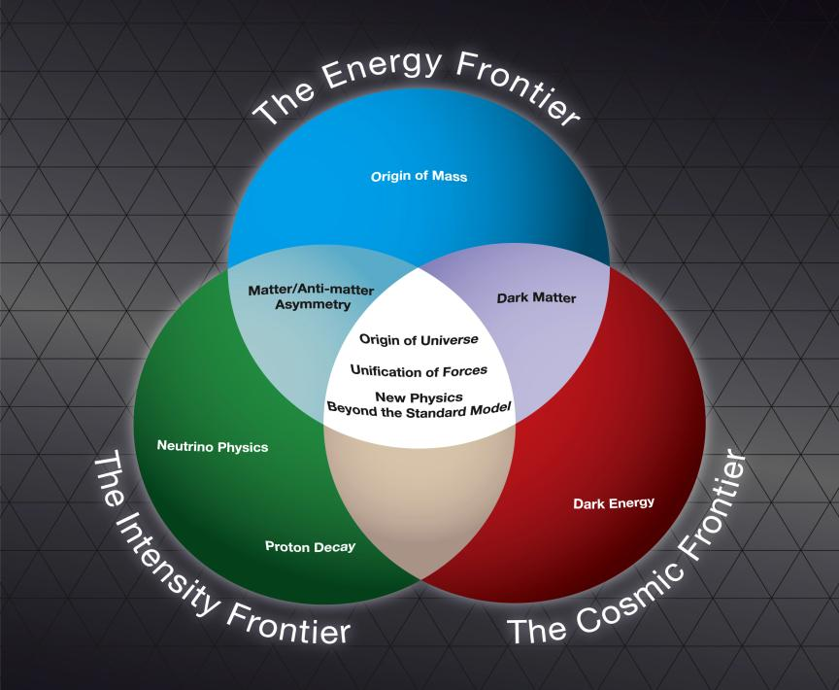
Fermilab Long Range Plan
Fermilab is the sole remaining U.S. laboratory providing facilities in support of accelerator-based Elementary Particle Physics
The Fermilab strategy is to
mount a world-leading program
at the intensity frontier, while
using this program as a bridge
to an energy frontier facility
beyond LHC in the longer term.

Slide 5
Evolution of the Fermilab Accelerator Complex
A multi-MW Proton Source, Project X, is the linchpin of Fermilab’s strategy for future development of the accelerator complex.
Project X provides long term flexibility for achieving leadership on the intensity and energy frontiers
  Intensity Frontier:
  NuMI→ NOνA→ LBNE/mu2e→ Project X → Rare Processes → NuFact
    Continuously evolving world leading program in neutrino and rare processes physics; opportunities for applications outside EPP
  Energy Frontier:
  Tevatron → ILC or Muon Collider
    Technology alignment
    Fermilab as host site for ILC or MC

Slide 6
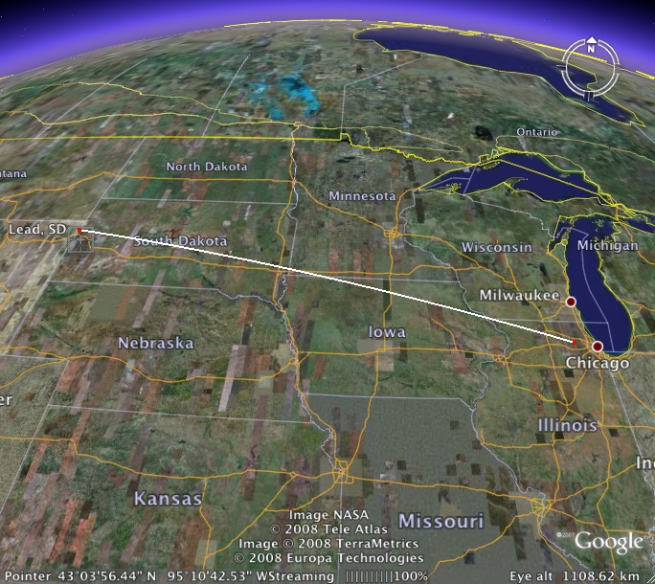
Mission Objectives – P5 Report
A neutrino beam for long baseline neutrino oscillation experiments
  2 MW proton source at 60-120 GeV
High intensity, low energy protons
for kaon and muon based precision
experiments
  Operations simultaneous with the
  neutrino program
A path toward a muon source for a
possible future Neutrino Factory
and/or a Muon Collider
  Requires upgrade potential to 2-4 MW at ~5-15 GeV.

Slide 7
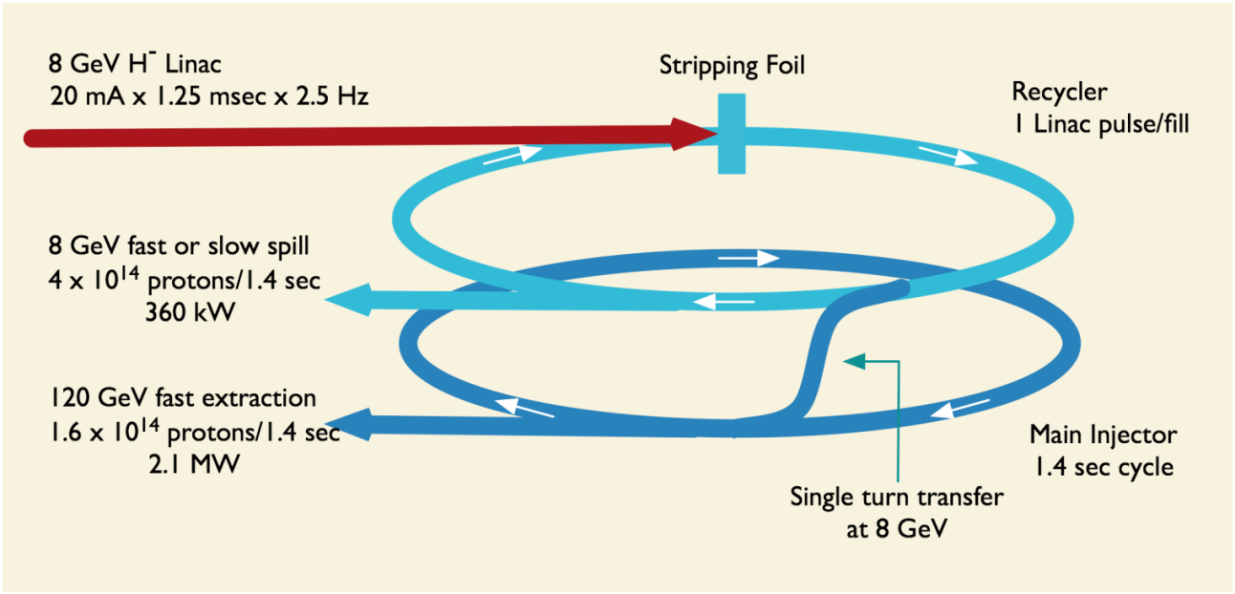
Initial Configuration-1
Initial Configuration-1
Strong alignment with ILC technologies
Initial Configuration Document-1 V1.1 released March 2009
  Accompanying cost estimate ~$1.5B
  (US accounting, i.e. overheads, contingency, labor, etc.)

Slide 8
Initial Configuration - 1
Issues
IC-1 does a great job of meeting the long baseline neutrino mission, but…
does not provide a strong platform for mounting a low energy rare processes program
  The Recycler is ill-suited to providing high intensity slow spilled beam
    Large tune-spread, high chromaticity
  The Debuncher appears limited to <150 kW in this mode
    Unacceptable high losses at the septa
  We believe there is a fundamental limit on the amount of beam power that can be delivered via a resonant extraction system
  Difficulties supporting multiple users with differing spill structure requirements
  These considerations led to the development of IC-2

Slide 9
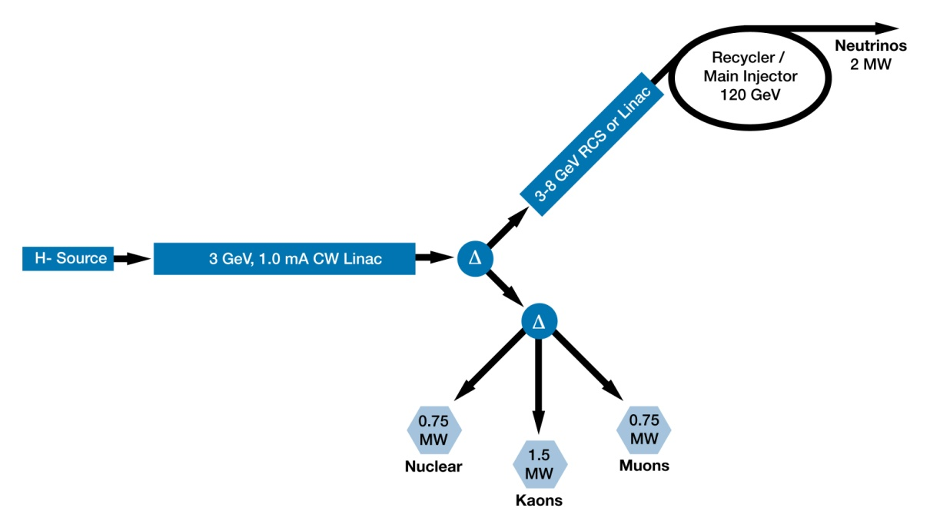
Initial Configuration-2
Initial Configuration-2
3 GeV CW linac provides greatly enhanced rare process program
  3 MW; flexible provision for beam requirements supporting multiple users
Options for 3-8 GeV acceleration: Pulsed linac (1.3 GHz) or RCS
  Linac would be 1300 MHz SCRF with 4-30 msec pulse length
Initial Configuration Document-2 in preparation for summer release

Slide 10
Initial Configuration-2 Performance Goals
CW-Linac
Particle Type H⁻
Beam Kinetic Energy 3.0 GeV
Average Beam Current 1 mA
Linac pulse rate CW
Beam Power 3000 kW
Beam Power to 3 GeV program 2870 kW
Short / long pulsed Linac [RCS]
Particle Type H⁻ [protons]
- Beam Kinetic Energy 8.0 / ~6 [8.0] GeV
Pulse rate 10 / 2 [10] Hz
Pulse Width 4.3 / 25 [0.002] msec
Cycles to MI 6 / 1 [6]
Particles per cycle to Recycler / Main Injector [MI] 2.6×10¹³
Beam Power to 8 GeV program 200 kW
Main Injector/Recycler
Beam Kinetic Energy (maximum) 120 GeV
Cycle time 1.4 sec
Particles per cycle 1.6×10¹⁴
Beam Power at 120 GeV 2200 kW
simultaneous

Slide 11
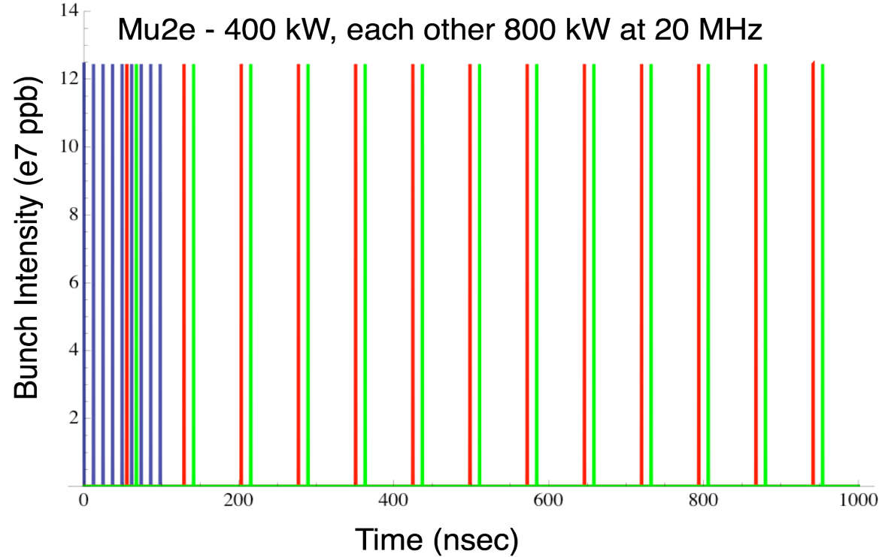
Initial Configuration-2
Operating Scenario
1 μsec period at 3 GeV
mu2e pulse (9e7) 162.5 MHz, 100 nsec 400 kW
Kaon pulse (9e7) 27 MHz 800 kW
Nuclear pulse (9e7) 27 MHz 800 kW
Separation scheme

Slide 12
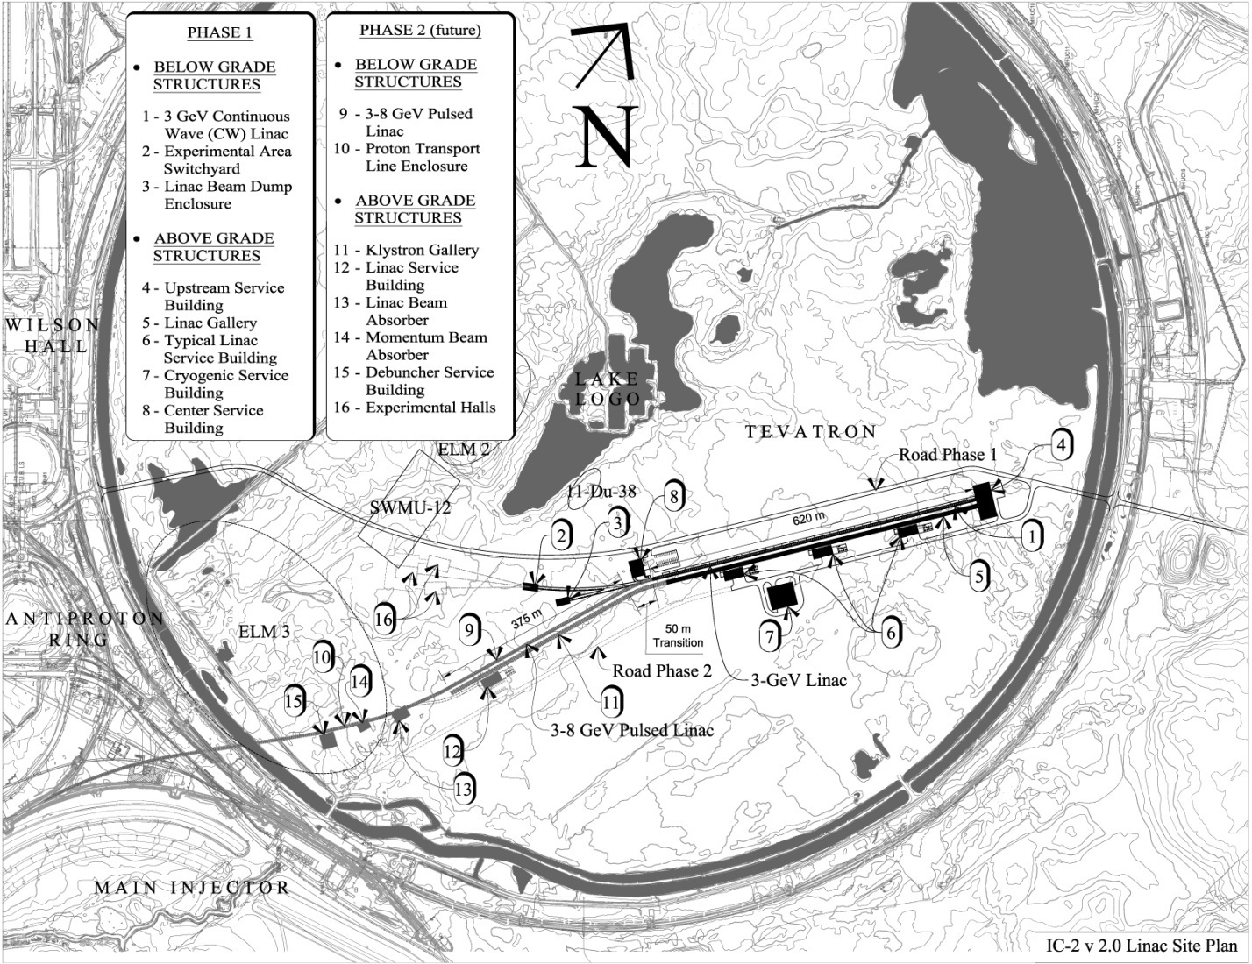
Initial Configuration-2
Provisional Siting
Page 12
Page 12

Slide 13
Initial Configuration-2
SCRF Technology Map
SSR0
SSR1
SSR2
β=0.6
β=0.9
ILC
325 MHz
2.5-160 MeV
650 MHz 0.16-2 GeV
1.3 GHz 2-3 GeV
Section | Freq | Energy (MeV) | Cav/mag/CM | Type
SSR0 (β_{G}=0.11) | 325 | 2.5-10 | 26 /26/1 | SSR, solenoid
SSR1 (β_{G}=0.22) | 325 | 10-32 | 18 /18/ 2 | SSR, solenoid
SSR2 (β_{G}=0.4) | 325 | 32-160 | 44 /24/ 4 | SSR, solenoid
LB 650 (β_{G}=0.61) | 650 | 160-520 | 42 /21/ 7 | 5-cell elliptical, doublet
HB 650 (β_{G}=0.9) | 650 | 520-2000 | 96 /12/12 | 5-cell elliptical, doublet
ILC 1.3 (β_{G}=1.0) | 1300 | 2000-3000 | 64 / 8/ 8 | 9-cell elliptical, quad

Slide 14
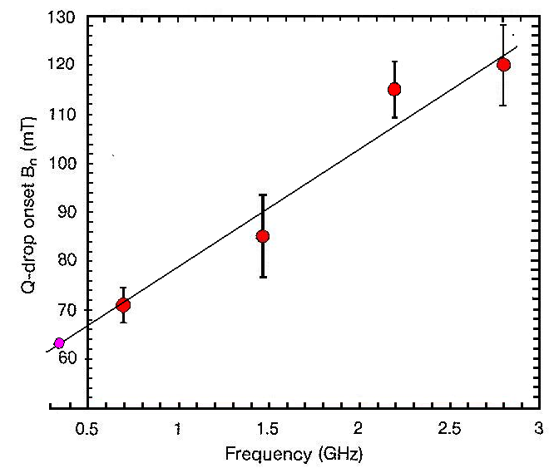
R&D Program
Choice of Cavity Parameters
Identify maximum achievable surface (magnetic) field on basis of observed Q-slope “knee”
Select cavity shape to maximize
gradient (subject to physical
constraints)
Establish Q goal based on
realistic extrapolation from
current performance
  Goal: <20 W/cavity
Optimize within (G, Q, T) space
(Initial) Performance Goals
  Freq (MHz) B_{pk}(mT) G (MV/m) Q @T (K)
  325 60 15 1.4E10 2
  650 72 16 1.7E10 2
  1300 72 15 1.5E10 2
HF Q-slope onset vs. Frequency (JLAB)

Slide 15
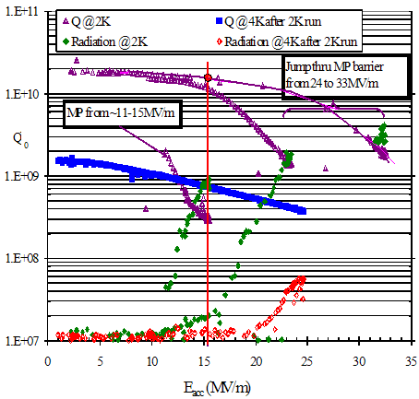
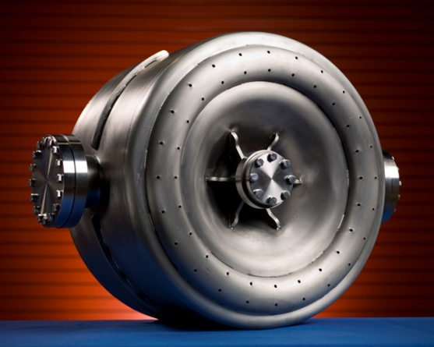
R&D Program
Choice of Cavity Parameters
SSR1:
325 MHz
Q₀=1.4∙10¹⁰ @ 2K
60 mT
72 mT
ILC:
1.3 GHz
Q₀=1.5∙10¹⁰ @2K

Slide 16
Integrated SRF Plan
ILC + Project X

Slide 17
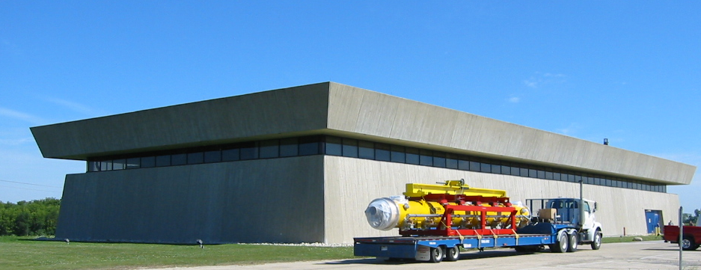
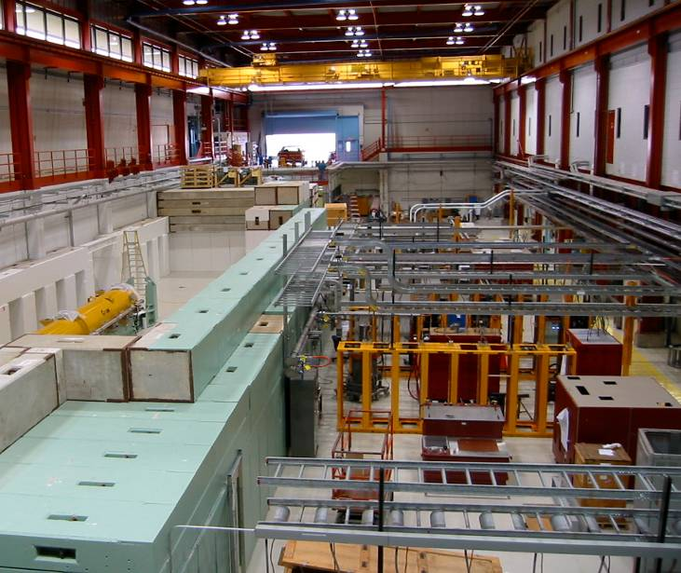
Integrated SRF Plan
ILC + Project X
NML test facility: ILC and Project X R&D

Slide 18
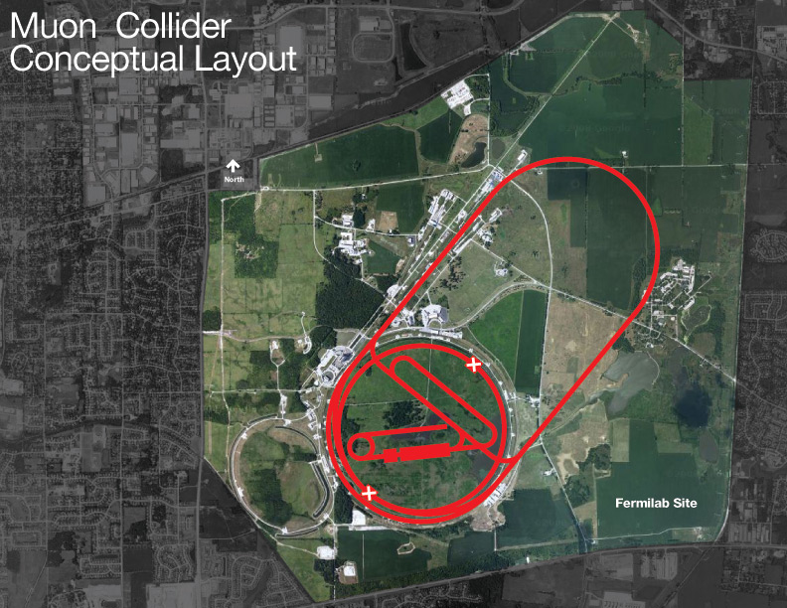
Joint PX/NF/MC Strategy
Project X shares many features with the proton driver required for a Neutrino Factory or Muon Collider
  NF and MC require ~4 MW @
  10± 5 GeV
  Primary issues are related to
  beam “format”
    NF wants proton beam on
    target consolidated in a few
    bunches
    Muon Collider requires a
    single bunch
  Project X linac is not capable of
  delivering this format
It is inevitable that new ring(s) will be required to produce the correct beam format for targeting.

Slide 19
Collaboration Plan
A multi-institutional collaboration has been established to execute the Project X RD&D Program.
  Organized as a “national project with international participation”.
    Fermilab as lead laboratory
    International participation via in-kind contributions, established through bi-lateral MOUs. (First MOU with India in place)
  Collaboration MOU for the RD&D phase outlines basic goals, and the means of organizing and executing the work. Signatories:
  ANL ORNL/SNS BARC/Mumbai
  BNL MSU IUAC/Delhi
  Cornell TJNAF RRCAT/Indore
  Fermilab SLAC VECC/Kolkota
  LBNL ILC/ART
  Collaborators to assume responsibility for components and sub-system design, development, cost estimating, and potentially construction.

Slide 20
Collaborations with ESS / SPL
Fermilab invites ESS & SPL colleagues
to collaborate on Project X!
  Many R&D activities beyond the “frequency problem”
    SCRF technologies
    Beam dynamics
    Beam instrumentation and diagnostics
    Machine protection
    …
  Beam studies at test accelerators
    Fermilab operates two test facilities:
    HINS (325 MHz protons / H⁻ front-end) and
    ILCTA-NML (SCRF test accelerator using electrons)
  Exchange of visiting scientists
  …

Slide 21
Strategy
Next six months: Complete all preliminary design, configuration, and cost range information for IC-2
  ICD-2v2.0
  Cost estimate
Continue conceptual development on outstanding technical questions
  Baseline concept for the chopper (broadband / resonant)
  Concepts for marrying a 3-8 GeV pulsed linac to CW front end
  Injection into a RCS or Main Injector / Recycler, laser or foil stripping
Pursue R&D aimed at the CW linac
  Emphasis of SCRF development at all relevant frequencies
  Engage external collaborators and identify roles
U.S. Department of Energy has advised that the earliest possible construction start is FY2015
We believe that we could construct Project X over a five year time period, assuming a commensurate funding profile
Project X could be up and running ~2020

Slide 22
Summary
Project X is central to Fermilab’s strategy for development of the accelerator complex over the coming decade
  World leading programs in neutrinos and rare processes
  Aligned with ILC and Muon Accelerators technology development;
  Potential applications beyond elementary particle physics.
The design concept has evolved over the last year, providing significantly enhanced physics capabilities
Current configuration (snapshot 2010):
  >2 MW at 60-120 GeV, simultaneous with 3 MW at 3 GeV
  Flexibility for supporting multiple experiments
  CW linac is unique for this application, and offers capabilities that would be hard/impossible to duplicate in a synchrotron
Project X could be constructed over the period ~2015 - 2020

Slide 23
Backup Slides

Slide 24
Accelerator Requirements: Rare Processes
 | Proton Energy (kinetic) | Beam Power | Beam Timing
Rare Muon decays | 2-3 GeV | >500 kW | 1 kHz – 160 MHz
(g-2) measurement | 8 GeV | 20-50 kW | 30- 100 Hz.
Rare Kaon decays | 2.6 – 4 GeV | >500 kW | 20 – 160 MHz. (<50 psec pings)
Precision K⁰ studies | 2.6 – 3 GeV | > 100 mA (internal target) | 20 – 160 MHz. (<50 psec pings)
Neutron and exotic nuclei EDMs | 1.5-2.5 GeV | >500 kW | > 100 Hz

Slide 25
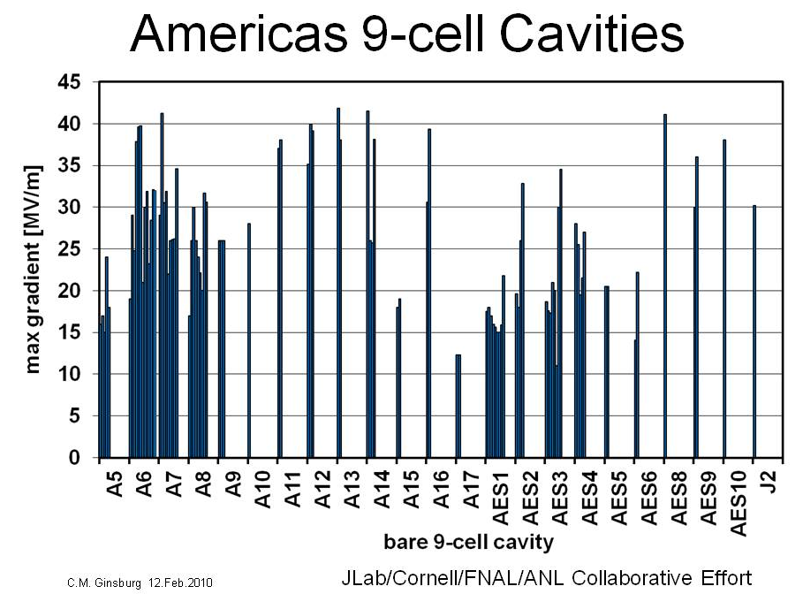
SRF Development
Cavity Gradient
ANL/FNAL!
KEK pit repair
+ ANL/FNAL!
ILC goal
PX goal

Slide 26
Initial Configuration-2
Technology Map
SSR0
SSR1
SSR2
β=0.6
β=0.9
ILC
325 MHz, 2.5-160 MeV
650 MHz 0.16-2 GeV
1.3 GHz 2-3 GeV
Notes:
  Discontinuity may be reduced significantly with β=0.95, low loss cavity design
  650 MHz, β=0.9, 5-cell cavities are same physical length as 1300 MHz, β=1.0, 9-cell cavities
650 MHz,β=0.9
1300 MHz,β=1.0
650 MHz,β=0.6

Slide 27
R&D Program
1300 MHz 3-8 GeV Pulsed Linac
Current concept:
  Use standard ILC cavities and cryomodules
  Operate with ILC-like RF system
  4-5 ms 1 mA beam pulses at 10 Hz (5-6 pulses to fill Recycler)
  Operate at ~ 25 MV/M gradient
  Adjust couplers for ~ 10 mA to decrease cavity fill time at the expense of reflected power during acceleration
A 3-8 GeV linac requires
  200 ILC β=1, 9 cell cavities in 25 Type IV cryomodules
A Rapid Cycling Synchrotron is still an option
  A 3-8 GeV RCS costs the ~ same as a 3-8 GeV linac
  But… the linac has more up side potential in terms of power, technology alignment with ILC, and flexibility for the future

Slide 28
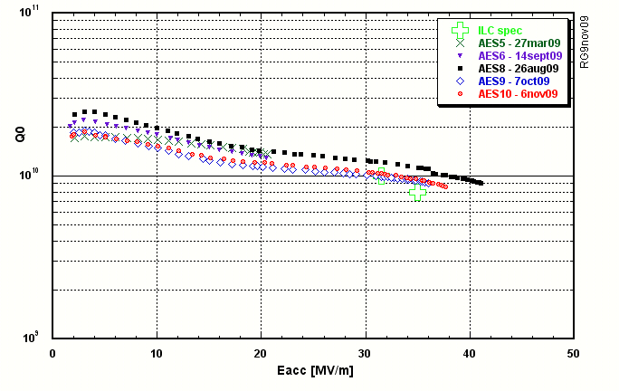
SRF Development
Summary of recent 9-cell results: U.S.
PrX
Courtesy R. Geng, Jlab

