Slide 1

sLHC
REPORT FROM WG4 ( BEAM DYNAMICS)
Coordinated by A. Lombardi (CERN) and R. Baartman (TRIUMF)
Activity report
Future activities

Slide 2
sLHC
Mohammad Eshraqi
Piero Posocco
Participants to the WG
-CERN/BE/ABP : end-to-end multiparticle tracking; layout definition/validation; WG coordination.
-CERN/TE/ABT : extraction areas; transfer lines ; collimation
-CERN/AB/RF : HOM calculations.
-ESS-S : end-to-end multiparticle tracking; layout definition/validation
- CEA Saclay : consulting on beam dynamics, provide tracking code
-Soltan Institute : collimation
STFC/ Cockroft institute : collimation
TRIUMF : HOM calculations , WG coordination.

Slide 3
sLHC
Topics :
Layout definition/validation, including connection from LINAC4, extraction at 1.4 GeV and 2.5 GeV, transfer lines
Definition of tolerances (quads alignment and field quality, RF phase and amplitude)
Definition of correction and monitoring system (steerers, diagnostics)
HOM effects
Compatibility with e-
Impact of cavity performance: lower than nominal field (19MV/m low-beta 25MV/m high beta) , modules switched off….

Slide 4
sLHC
Priorities!
Study which have a strong impact on layout :
          Include enough space for extraction areas
Study which have a impact cryo design :
          Alternative focusing systems
          Position of corrective elements
          Position diagnostics (?)
          Alignment studies
The rest :
          Collimation / Loss control
          Beam dynamics fine tuning
          H- stripping

Slide 5
sLHC
Achievement since last meeting :
1) solidified a baseline layout including
transition at 1.4 GeV and 2.5 GeV,
compatible with cryo segmentation and
linac4 beam
2) Verified the stripping limit and given input to quadrupole design (needed integrated field, minimum length)
3) Further longitudinal error studies to be used as input to HOM studies.
4) Longitudinal error studies taking input from RF power distribution and low level RF architecture studies
5) Studied a “mixed structure” with doublet focusing at low energy and FD focusing at high energy which optimizes cryo segmentation and quadrupole gradients.

Slide 6
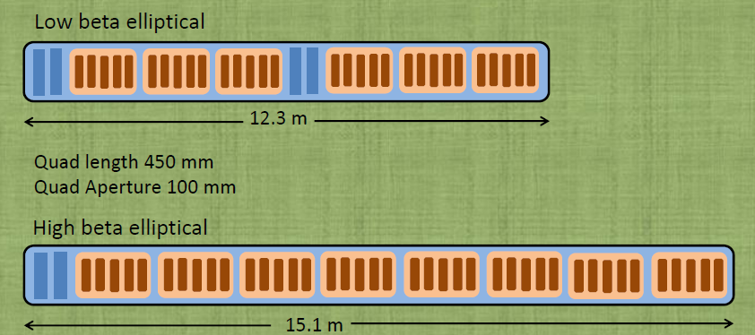
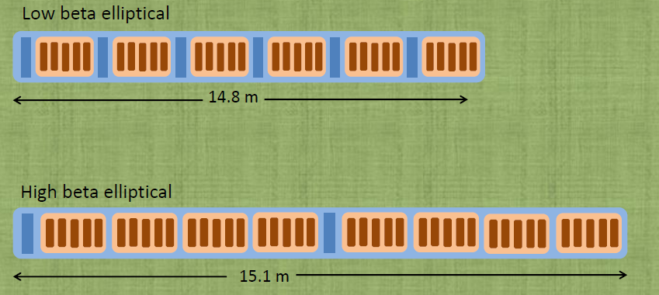
sLHC
From nov 2009 collaboration meeting summary
Building blocks for
Doublet
Building blocks for
FODO

Slide 7
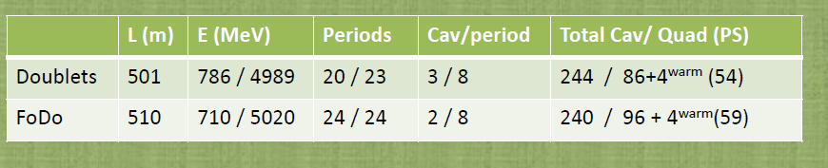
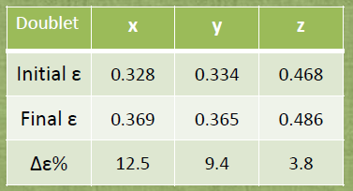
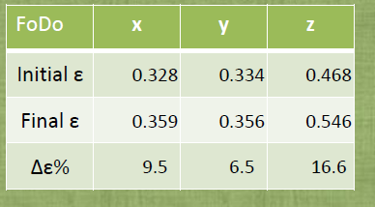
sLHC
At the nov 2009 collaboration meeting the Doublet was chosen
Compare Doublet vs FODO on
1) structure
2) beam dynamics
3) sensitivity to alignment
4) impact on cryo layout
Structure : only difference is that the gradient of the quadrupoles is lower in FODO
Beam dynamics : no real difference

Slide 8
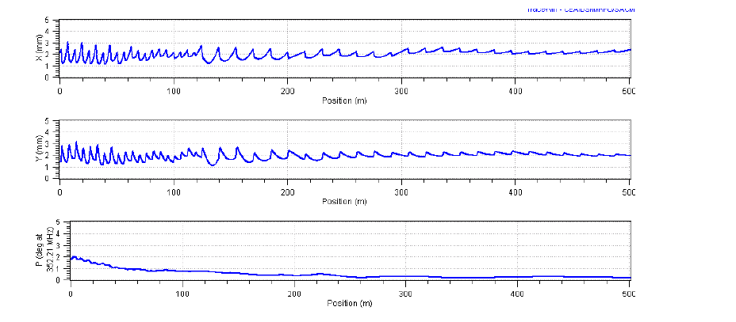
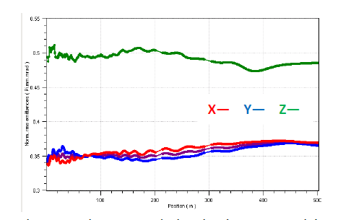
End-to-end (45 keV-5 Gev)
sLHC
Envelope is regular notwithstanding the transitions at 1.4 and 2.5 GeV
Emittance growth is limited to 10% also with a beam coming from 45 keV

Slide 9
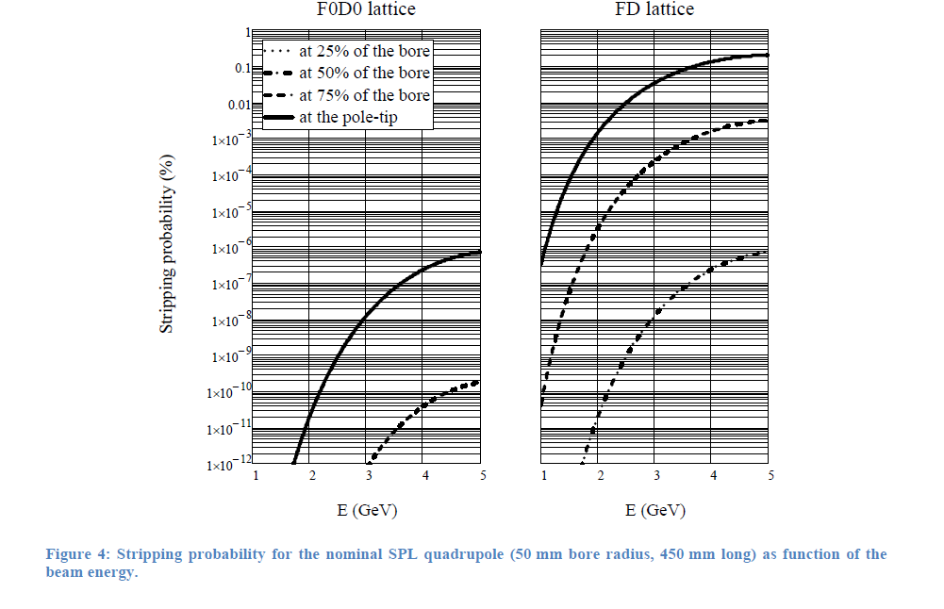
Unwanted H- stripping
sLHC
Quadrupole integrated gradient is determined by phase advance per period, ratio transverse to longitudinal phase advance, etc
Quadrupole bore and length are determined by acceptance and integration consideration
The higher the magnetic field in the quad the higher the probability that H- is stripped and consequently lost.
Stripping probability is a function of energy, beam radius, halo extension and alignment.

Slide 10
The mixed structure
sLHC
Attempt to combine
    cryo segmentation flexibility
    Reduce the probability of stripping in the quads
Using the fact that
    the H- stripping probability is higher at higher energies
    Focusing period can be made longer at higher energies

Slide 11
Future activities
sLHC
Definition of layout with integrated diagnostics, alignment an RF tolerances.
      layout
      diagnostics specification, number and location
      RF tolerances (need to iterate with LLRF people)
2) Definition of a collimation system - more critical for HPSPL
3) Impact of cavity performance
4) Considering the idea of BPM for envelope information
5) Tracking in field map to verify cross-talk transverse long

Slide 12
sLHC
Objective of this meeting for SPL-WP4:
Discuss the mixed layout
Input from WG2 for further longitudinal studies .
Define a path to finalize diagnostics requirement.
Define a path to study collimation .

