Slide 1
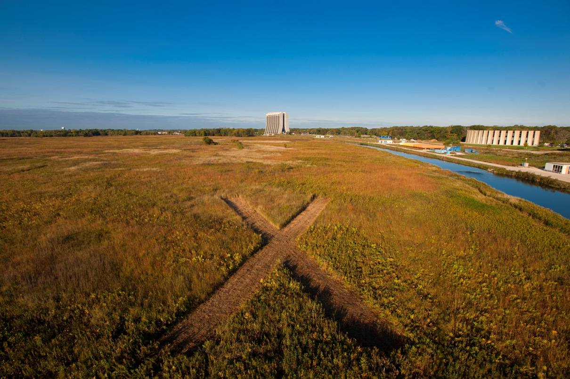
Beam Instrumentation & Diagnostics for Project X
Manfred Wendt
SPL/ESS Collaboration Meeting
Lund
July 1, 2010

Slide 2
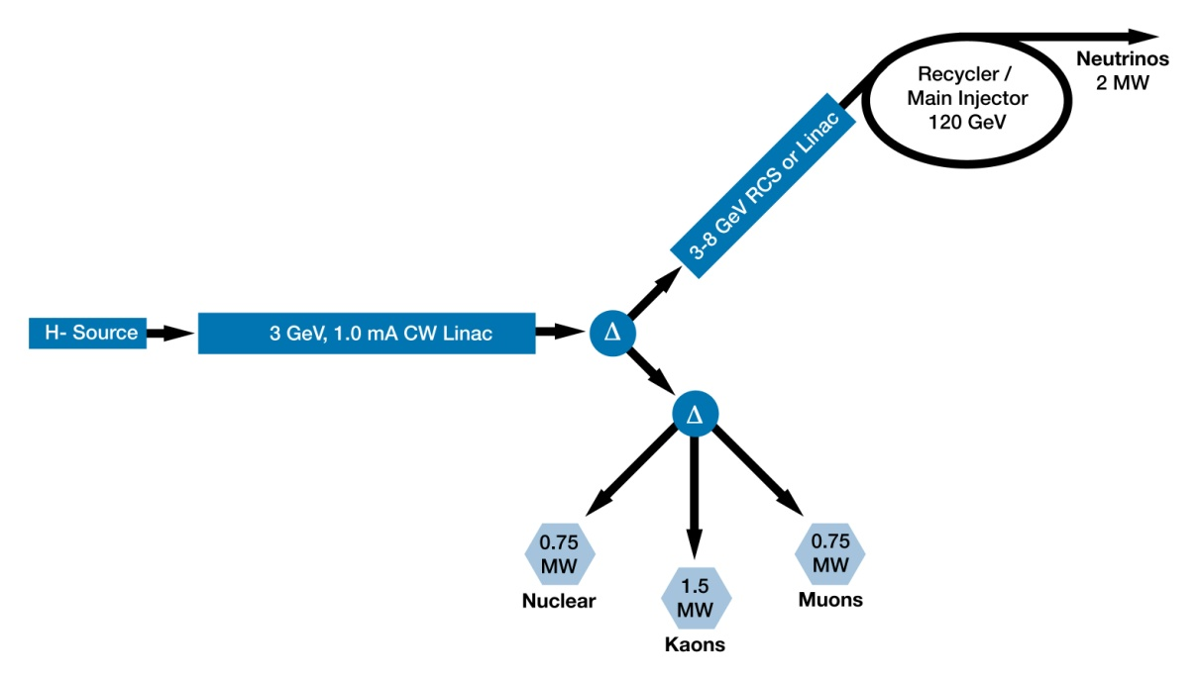
Project X in a Nutshell
H⁻ source & 3 GeV / 3 MW CW SCRF linac
  1 mA average, 10 mA bunch current
  (sub) ILC frequencies: [162.5], 325, 650, 1300 MHz
  broadband MEBT beam chopper (preferred)
  or resonant chopping schema
3-8 GeV acceleration options:
  Pulsed SCRF 1.3 GHz linac , with
  short (<5 msec) or very long pulse (20-30 msec)
  Rapid cycling synchrotron
8-120 GeV acceleration in existing Main Injector (2 MW beam power)

Slide 3
Beam Instrumentation R&D
Standard Beam Diagnostics
  Toroids
  BLMs
  BPMs (cold and warm), including beam phase and TOF
  Wirescanners and multiwires (invasive, temporary)
Advanced Beam Instruments
  LPM, laser slit (emittance) monitor, longitudinal laser scanner
  E-beam scanner
  Beam halo diagnostics (vibrating wire, time resolved SEM)
  Invasive long. bunch diagnostics (Feschenko, fast Faraday cup)
Related Issues
  SCRF segmentation (location of complex beam detectors)
  Beam detectors inside the cryostat, BPMs, what else?
  Minimum-invasive beam profile measurements (“pollution-free”)
  Protons vs. H⁻ beams (photo detachment methods)
Beam diagnostics is close connected to beam optics / dynamics / simulations
  Definition of requirements, e.g. resolution, precision, dynamic range, locations,…

Slide 4
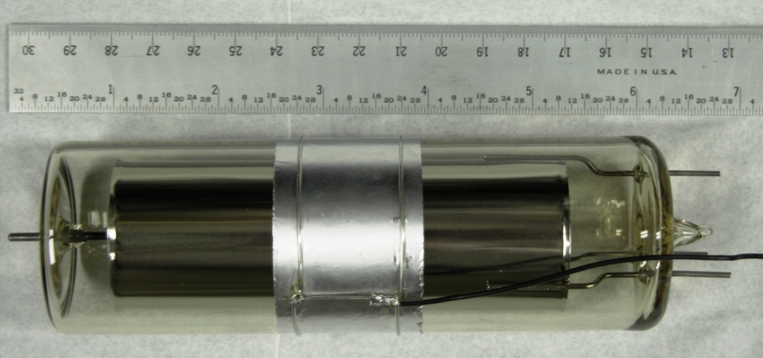
Ionization Chamber BLM
Signal Out
Guard Lead
Cathode @
+2000 V
Specifications
Materials | Glass, Nickel
Volumen | 110 ccm Argon gas at 1 Atm
Calibration | 70 nC / rad
Response time | 1-2 µsec
Leakage current | < 10 pA
Operating range | 1 mrad – 100 rad
1.5” ANODE
Guard to reduce
Leakage current

Slide 5
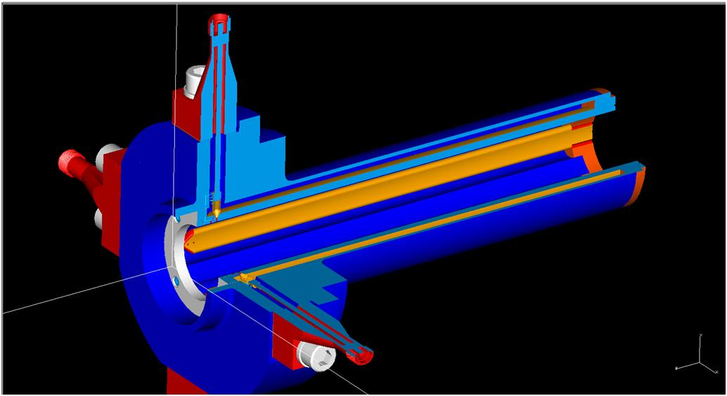
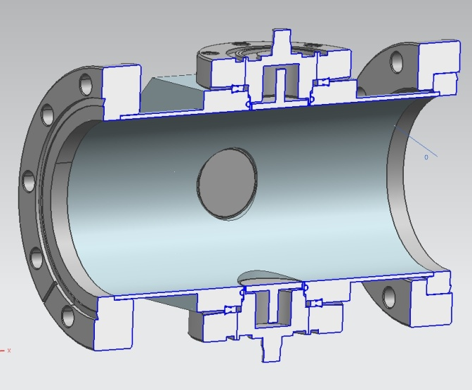
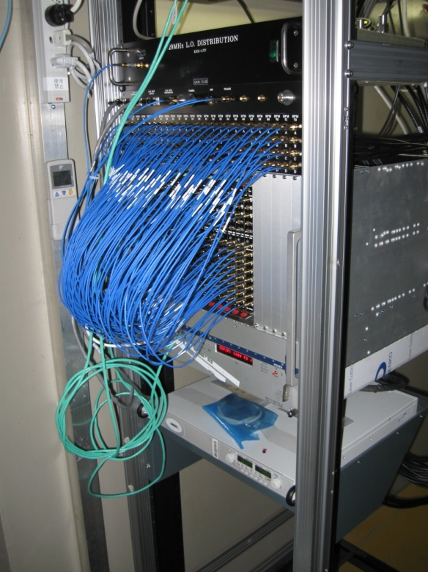
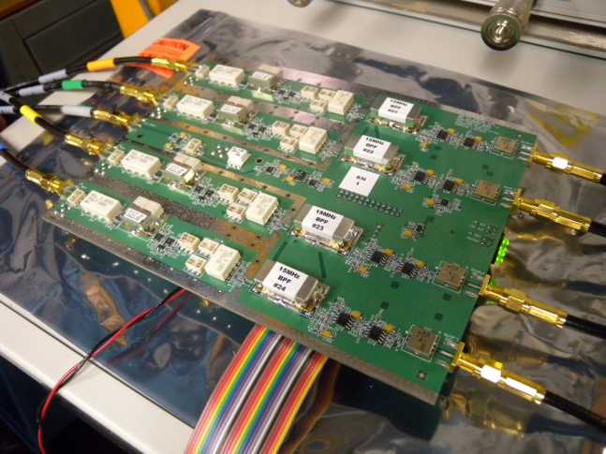
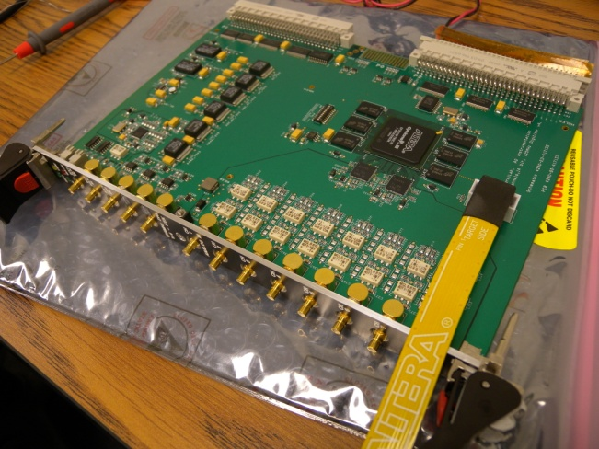
BPM R&D
(KEK Collaboration)

Slide 6
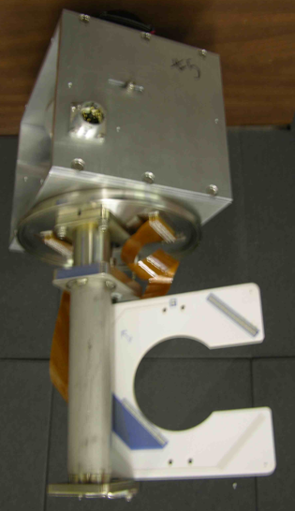
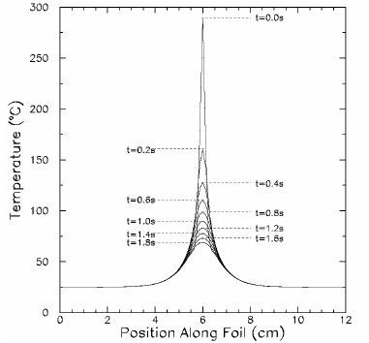
Multiwire/Foil SEM
(UTA Collaboration)
FNAL type
  Wire: 25 µm Ti (before W/Au)
  Ceramic substrate, w beam gap, wires epoxied to pads.
University of Texas type
  100x5 µm Ti strips
NuMI beam
  Energy: 120 GeV
  Intensity/pulse: 3x10¹³ protons
  Beam time: 8.56 µsec / 2.2 sec
  Power/spill: 140 kJoule
  Σ total: > 3x10²⁰ protons
Extrapolation
  5 µm Ti strip (1660 degC – 10 %): ~1.6x10¹⁴ protons (max)
thermal simulation 5 µm strip, 3x10¹³ p

Slide 7
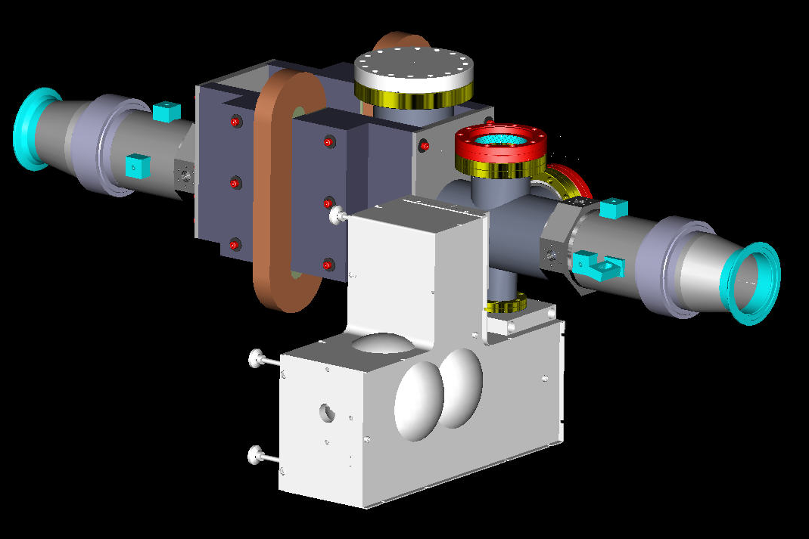
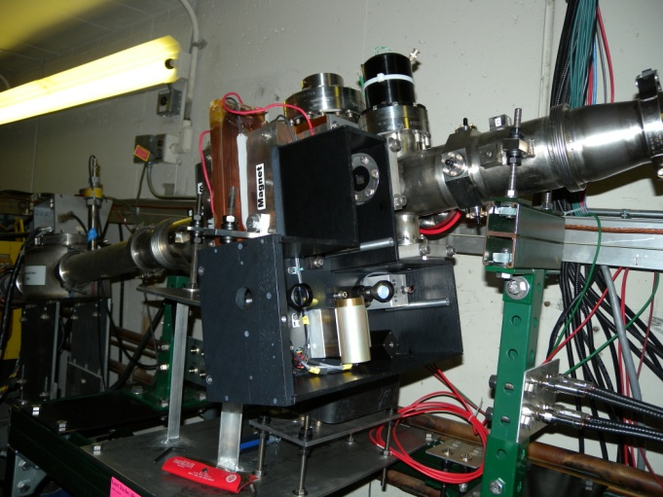
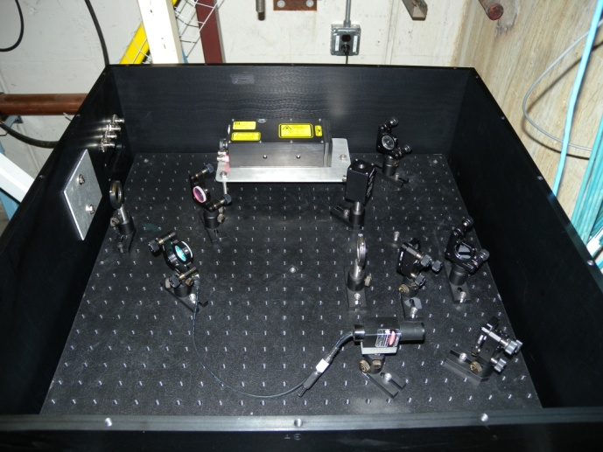
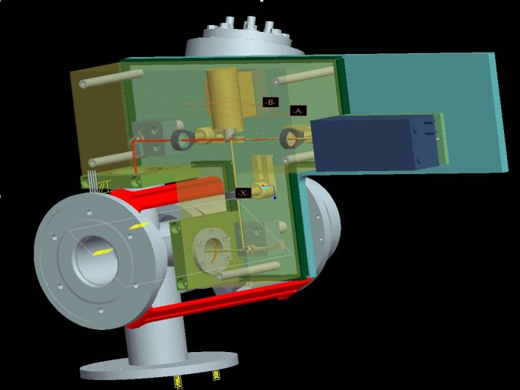
LPM R&D
(BNL & LBNL Collaborations)
detector port
Laser Profile Monitor details
  Q-switch laser
  Laser energy: 50 mJoule
  Wavelength: 1064 nm
  Pulse length: 9 nsec
  Fast rotating mirrors
  (±4⁰ / 100 µsec)
  e⁻ detector: scintillator & PMT
BPM
BPM
double dipole
H⁻ beam
laser beam
optical box

Slide 8
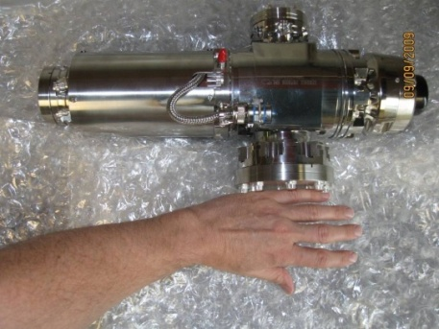
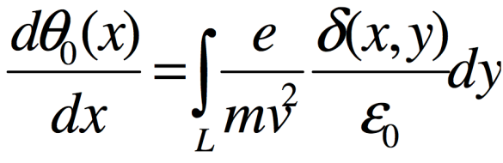
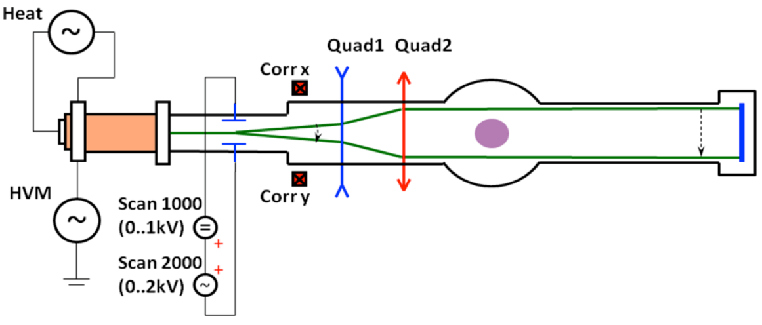
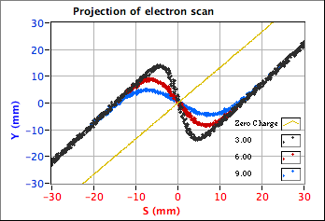
Electron Beam Scanner
(SNS Collaboration)
Look at the deflected projection of a tilted sheet
of electrons due to the proton beam charge
  Neglect magnetic field (small displacement of projection)
  Assume path of electrons is straight (they are almost straight)
  Assume net electron energy change is zero (if symmetric).
  or, take the derivative to get the profile
Kimball Physics e⁻ Gun
60 KeV
6 mA
Focusing and steering
elements built in
protons
Markers
electrons
Y
S
X

Slide 9
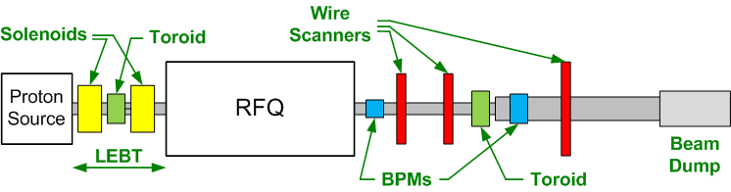
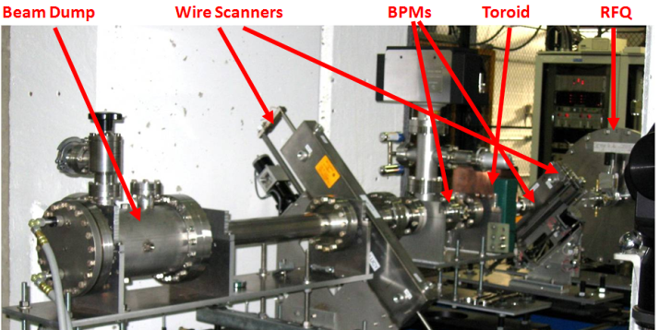
HINS Beam Studies
HINS: High Intensity Neutrino Source
  Initial Setup with
  p-source & RFQ
  Temporary diagnostics beam-line
  Beam dynamics & instrumentation playground

Slide 10
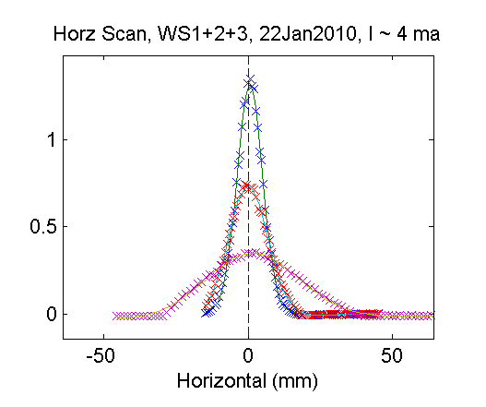
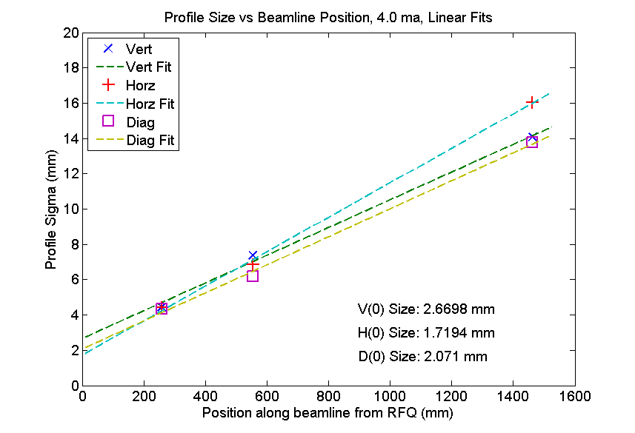
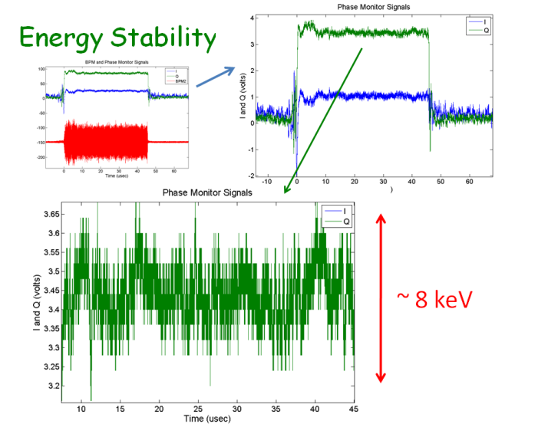
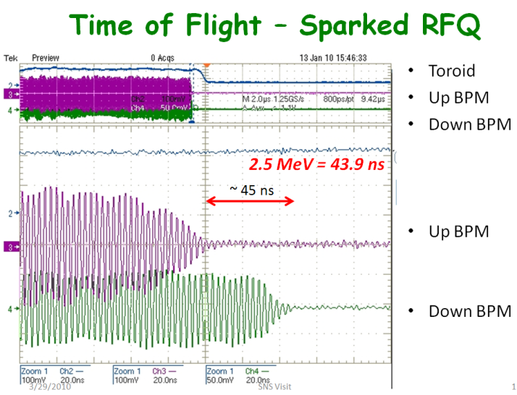
HINS Beam Studies (cont.)

Slide 11
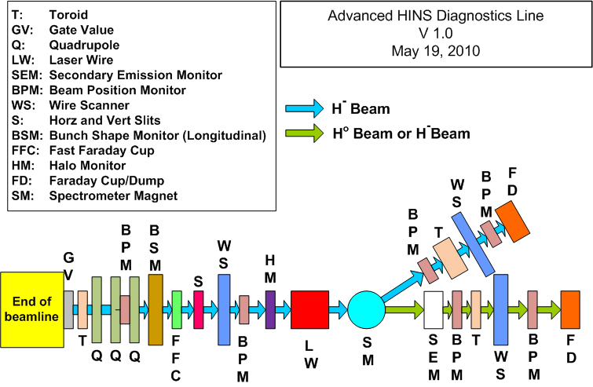
HINS Diagnostics R&D

Slide 12
Miscellaneous Diagnostics
Other beam diagnostics R&D include
  Monitoring of HOM coupler signals as BPM, also bunch-by-bunch.
  Read-out electronics and algorithms in collaboration with DESY.
  Electron cloud beam studies applying the RF transmission method. Collaboration with LBNL.
  Electron beam diagnostics for the NML test facility, e.g. screen monitors (OTR, YaG), EOS, interferometer techniques, fiber laser TOF, etc.
Various (non-beam) instrumentation needs are supported, e.g.
  Faraday cups for high power cryomodule tests
  Wire position monitor (WPM) system inside the cryomodule
  Machine protection system electronics
  Klystron protection interlock system, also in test stands
  2nd sound & temperature monitoring
  …

Slide 13
Summary & Remarks
Beam instrumentation & diagnostics R&D needs beams(!),
i.e. beam test facilities (HINS, NML).
  The beam is the ultimate test to verify guide and acceleration fields.
  Beam dynamic issues are expected in the low energy, space charge driven part of the hadron linac.
SCRF based linacs may have issues operating invasive diagnostics, e.g. wires, slits, and other physical targets.
  H⁻ beams offer the use of photo detachment techniques,
  e.g. laser wire profile monitor, longitudinal LW, laser slit
  Invasive beam diagnostics can be installed temporary at the end of the linac, or in long warm sections (segmentation).
Fermilab invites ESS & SPL for fruitful collaborations!
  Use upcoming events to strengthen the discussions, e.g.
  HB2010 ICFA workshop in Switzerland end of September.

