Slide 1
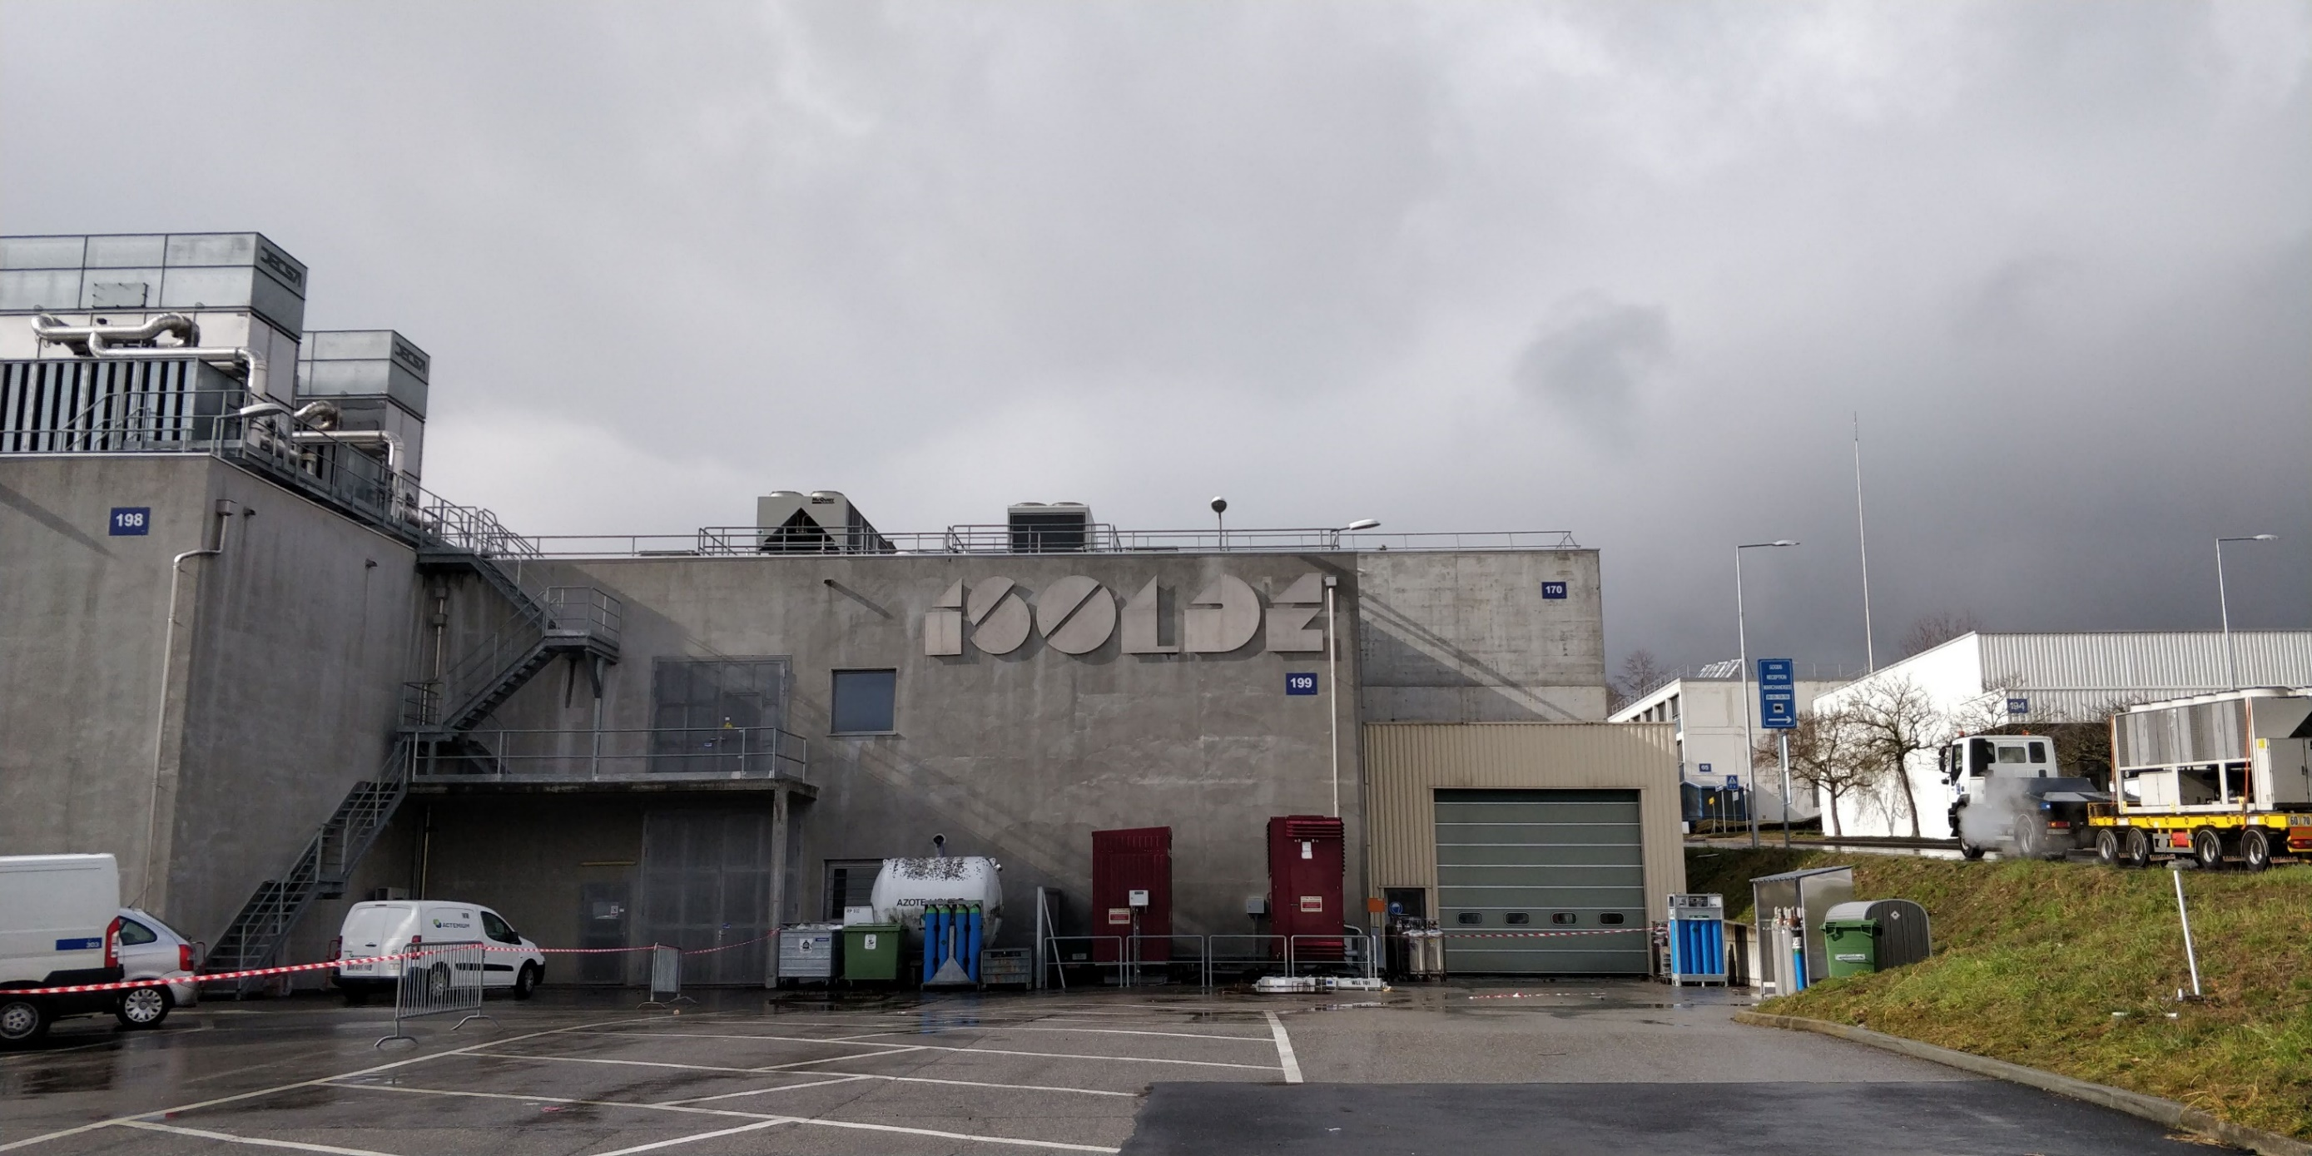

ISOLDE physics coordinator report: INTC 61
Karl Johnston
Summary of end of 2018 physics
Shift Count
Physics highlights
Shift status for INTC

Slide 2
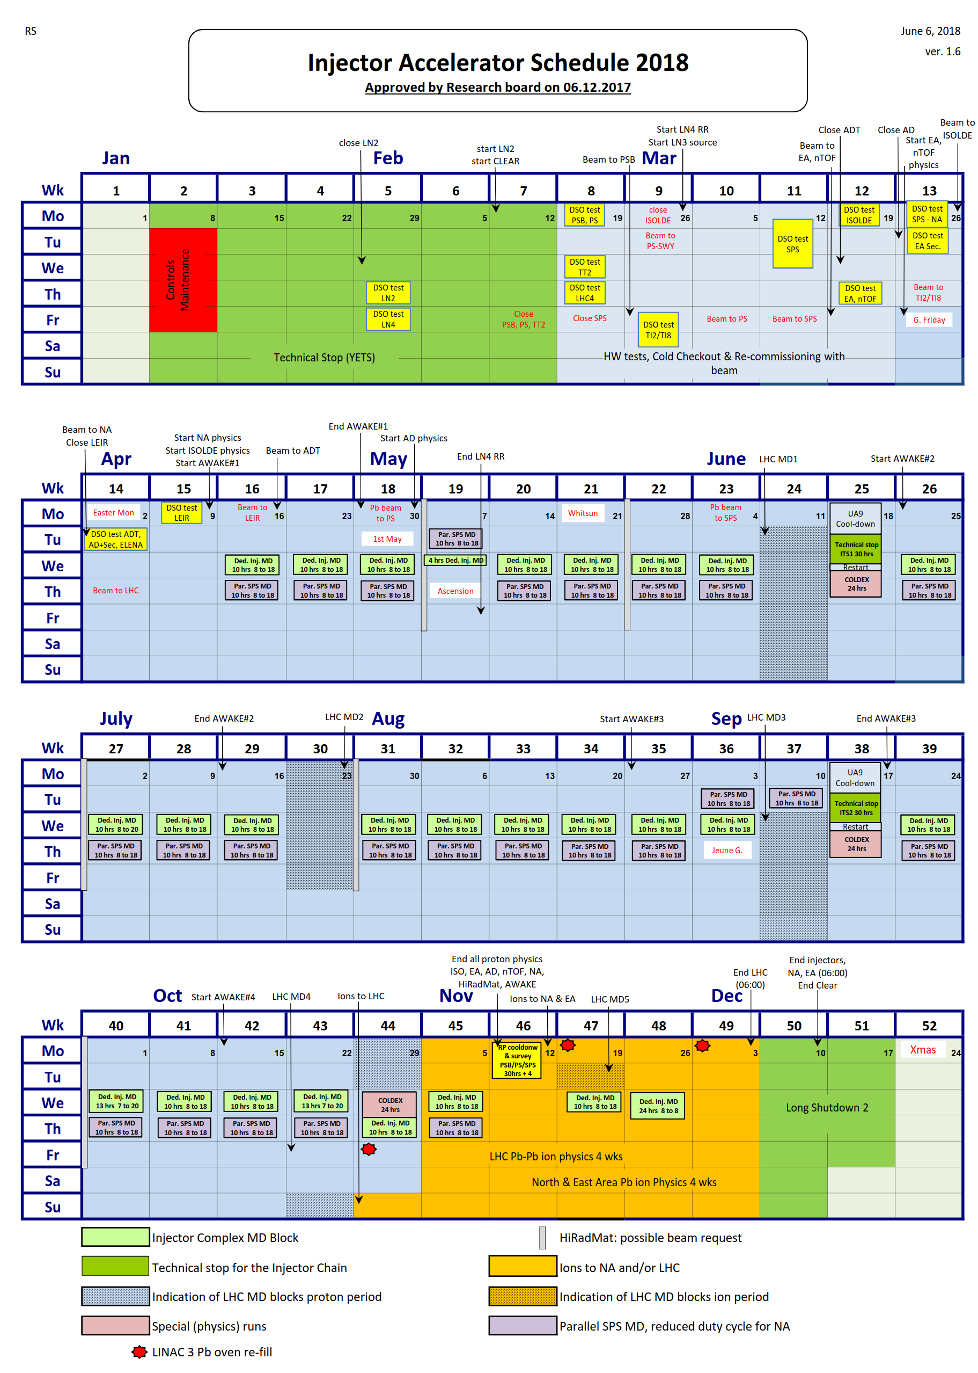
Protons available for physics to ISOLDE from 9th April – 12th November 2018.
(no extension possible)
1 week less physics with protons than 2017
217 days compared to 224
HIE ISOLDE was ready from 9th July after 90 days of LE physics
HIE: Started with a Coulomb excitation block then focused on the reaction experiments
More setup time often needed for these plus more varied setups.
All three HIE beamlines in use e.g. ISS calibrating/commissioning while Miniball ran CE, installations ongoing at XT03.
Low energy runs allowed for some breathing space (and exchange of EBIS cathode). To allow for best use of machine, some experiments ran in parallel/invisible mode e.g. Solid state physics: one dedicated run in 2018 i.e. blocking CBL and with new target.
Focus on LOIS at end of year: Winter physics programme began in Week 46 for HIE and CRIS

Slide 3
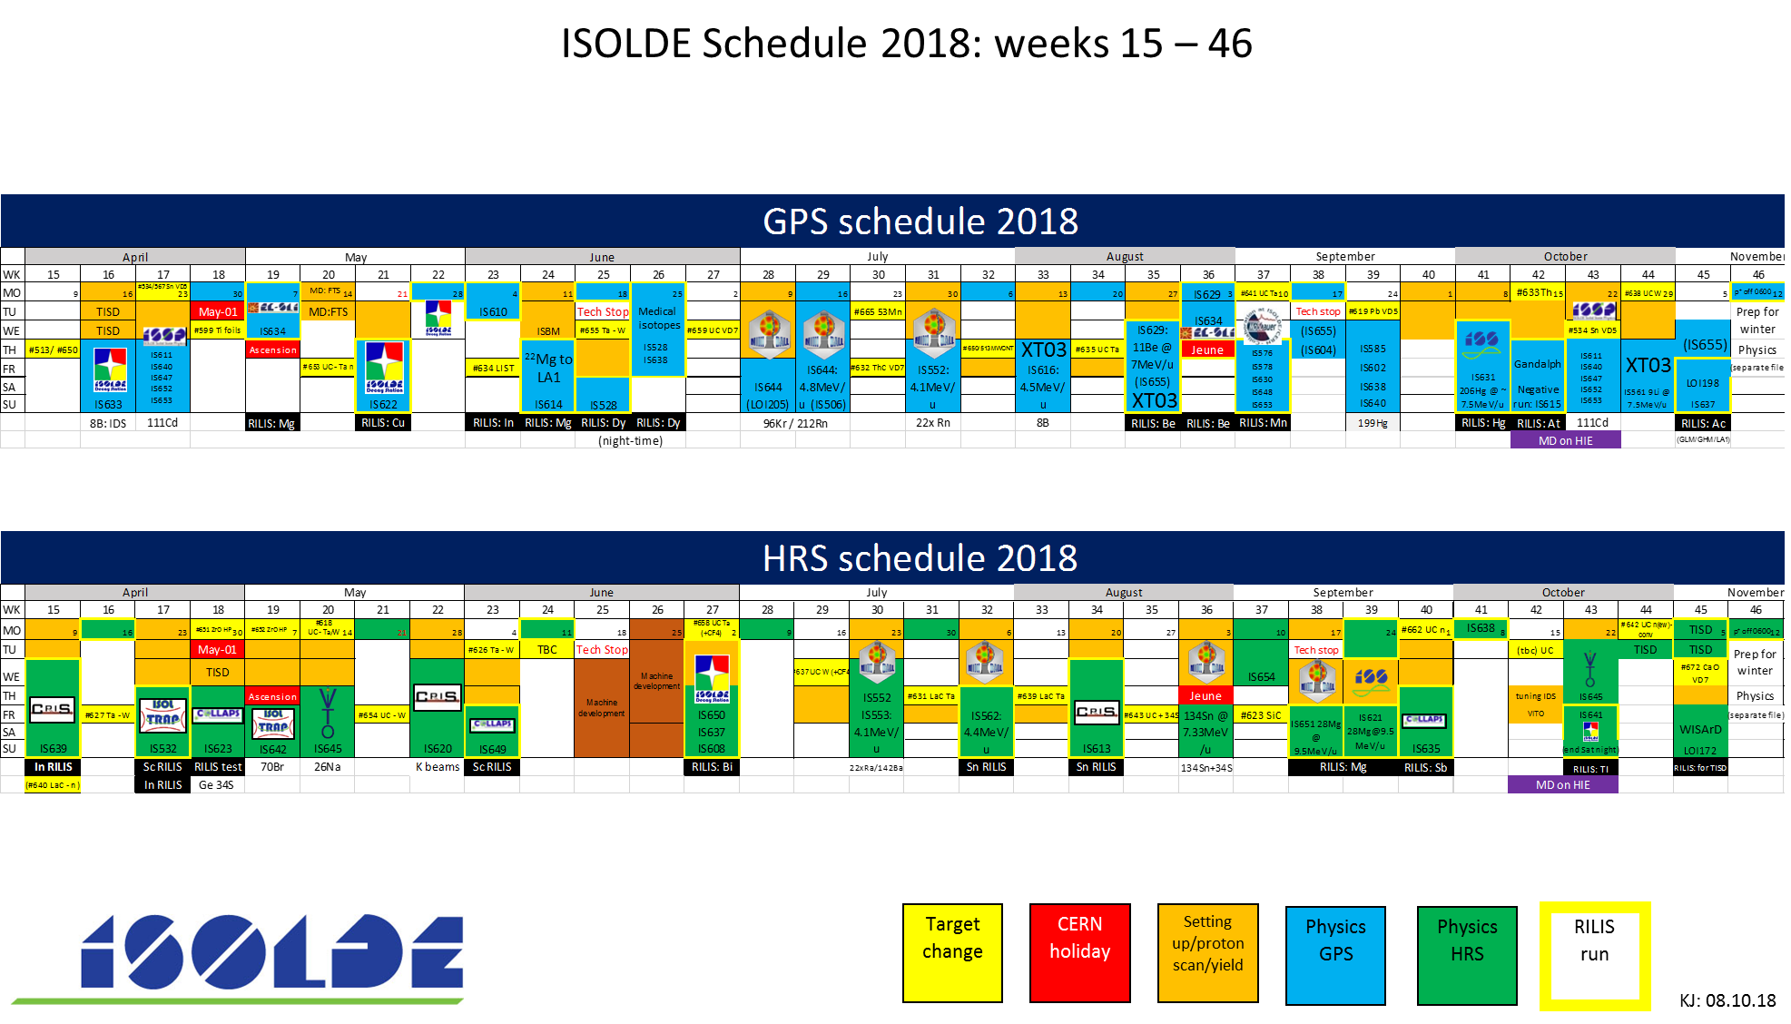







Medical
Biophysics
TISD/MD
Parallel Hg/Cd
Travelling
-ve beams
LIST
New n-conv
RFQ MD
HIE MD
FTS commissioning
(no LIEBE)
Cu FT
In FT
Bi FT/in-source
Tl/Hg SPEDE
n-def In
n-rich K
n-def Sn
119Sb for biopac
149Tb/152Tb
199Hg
Ac beam development
8B @ LA1
22Mg @ LA1
Ac development
(2 setups)
GANDALPH (-ve)
Mg,Be
Mn, Ac
Next…
XT03
Ge + S
Sc
n-rich Sb
Sc/In
70Br
β-NMR on liquids
Good Mn run

Slide 4
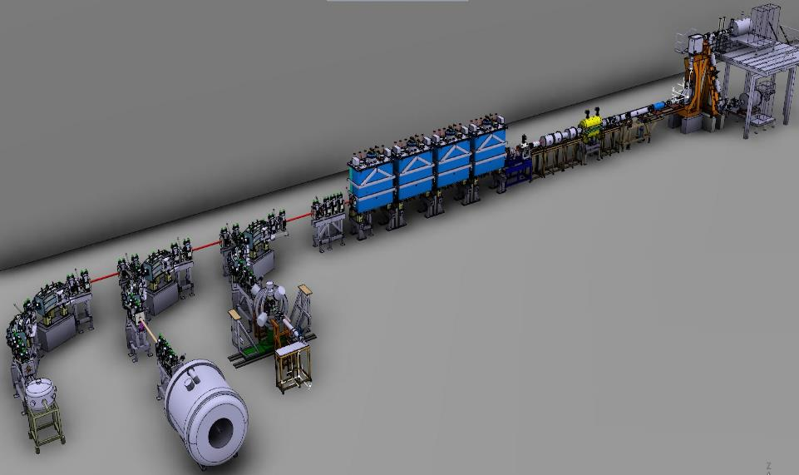


HIE-ISOLDE EXPERIMENTS 2018 reaching 9.5 MeV/u with HIE-ISOLDE
Reactions:
⁸B(⁶⁴Zn) @ 4.900 MeV/u (SEC)
¹¹Be(decay) @ 7.498 MeV/u (SEC-TPC)
^{132,134}Sn(d,p) @ 7.200 MeV/u (Miniball)
²⁸Mg(t,p) @ 9.473 MeV/u (Miniball)
²⁸Mg(d,p) @ 9.473 MeV/u (ISS)
²⁰⁶Hg(d,p) @ 7.380 MeV/u (ISS)
⁹Li(t,p) @ 7.5xx MeV/u (SEC)
Disappointments: multi nucleon transfer 94Rb and other strong primary beams. Procedure now in place and approved but would have restricted too many other experiments from running/setting up in 2018.
Cancellation of 132Sn in October run after difficulties encountered in August.
Phase 2 – 2018
XT01
Coulomb excitation (Miniball):
⁹⁶Kr @ 5.325 MeV/u
²¹²Rn @ 4.355 MeV/u
    @ 3.824 MeV/u
²²²Ra @ 4.305 MeV/u
²²⁸Ra @ 4.310 MeV/u
¹⁴²Ba @ 4.190 MeV/u
²²²Rn @ 4.230 MeV/u
^{224,226}Rn @ 5.080 MeV/u
¹⁰⁶Sn @ 4.404 MeV/u
XT02
XT03
Miniball
Scattering chamber (SEC)
ISOLDE Solenoidal Spectrometer (ISS)

Slide 5
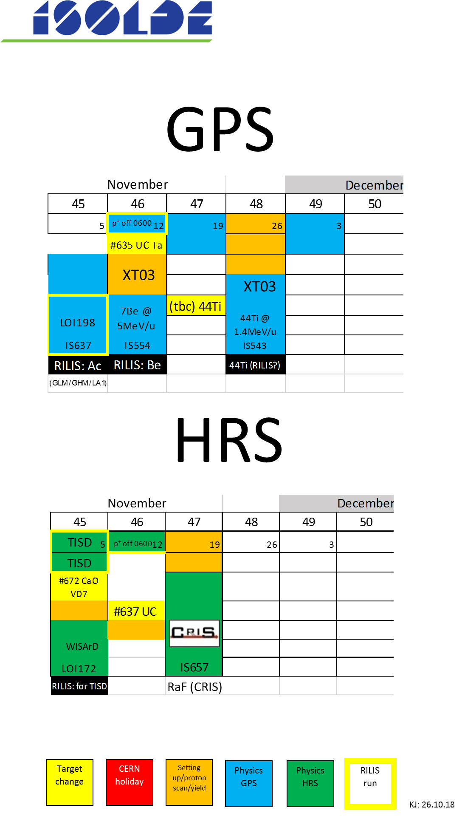
Winter physics programme:
7Be @ 5MeV/u to XT03 (similar setup to recently used 9Li run)
Target irradiated in October (cold). Be mass marker.
RaF for CRIS: target with CF4 leak irradiated at MEDICIS.
44TI for Edinburgh chamber (similar to 59Cu in 2017). Doubts over the efficiency of the ion source resulted in this being cancelled (CRIS continued to run until the very end!)
Very successful and smooth campaign with Be and RaF.

Slide 6
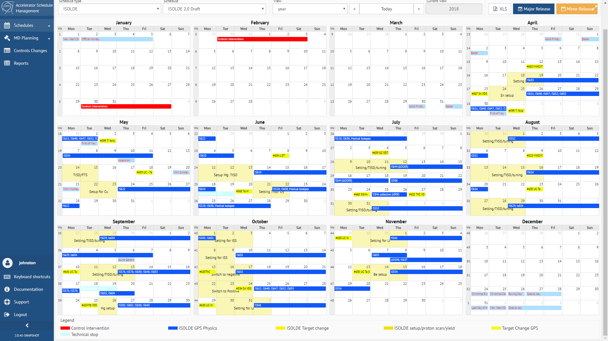
NEW CERN-wide ASM tool: how the GPS would have looked using the tool last year…

Slide 7
Example of how schedule is represented in excel (colour choice can be worked on…)
Advantages: instant output to excel format etc….will aid for schedule updates and weekly planning.
Ease of use has improved considerably since the early version in 2018. Now fit for purpose and will be used for schedules after LS2 (perhaps also for stable runs in 2020).
Will still produce the existing one page ISOLDE schedule.

Slide 8
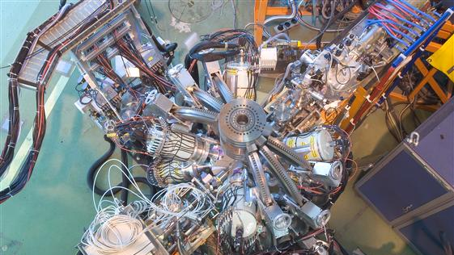
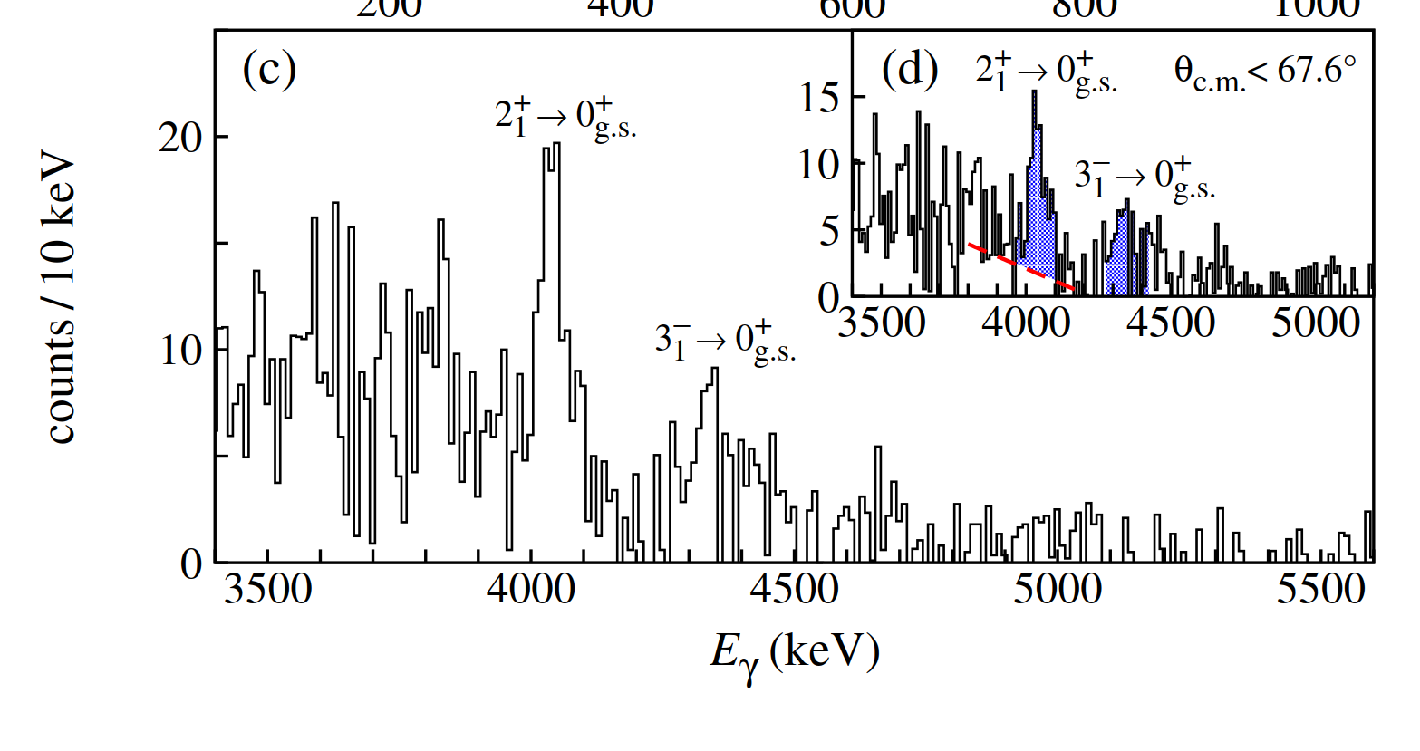
Recent output from HIE ISOLDE: Enhanced Quadrupole and Octupole Strength in Doubly Magic 132Sn
Confirmation of doubly magic nature of 132Sn
D. Rosiak et al. Phys. Rev. Lett. 121, 252501

Slide 9
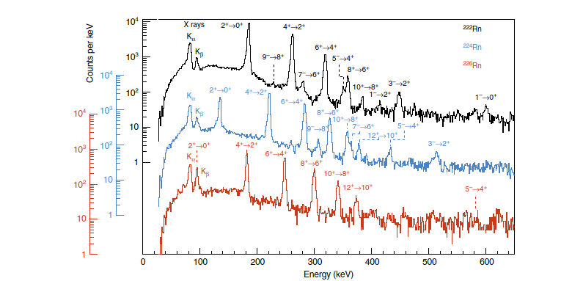
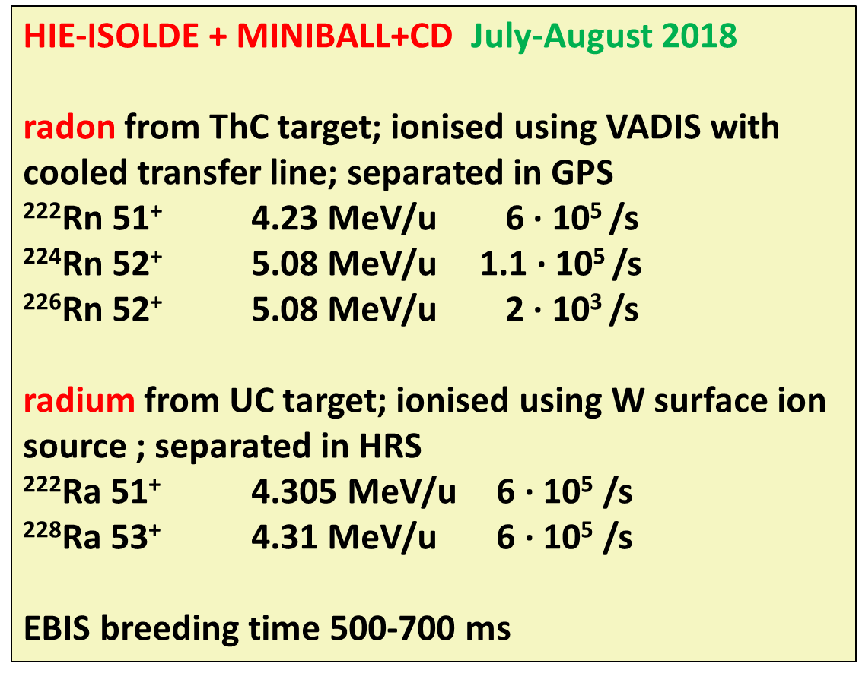
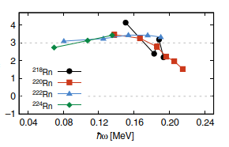
Output from HIE ISOLDE: II
Challenging beamtime (many changes in isotopes…energies)
Rn isotopes undergo octupole vibrations but not static pear-shapes in their ground states

Slide 10
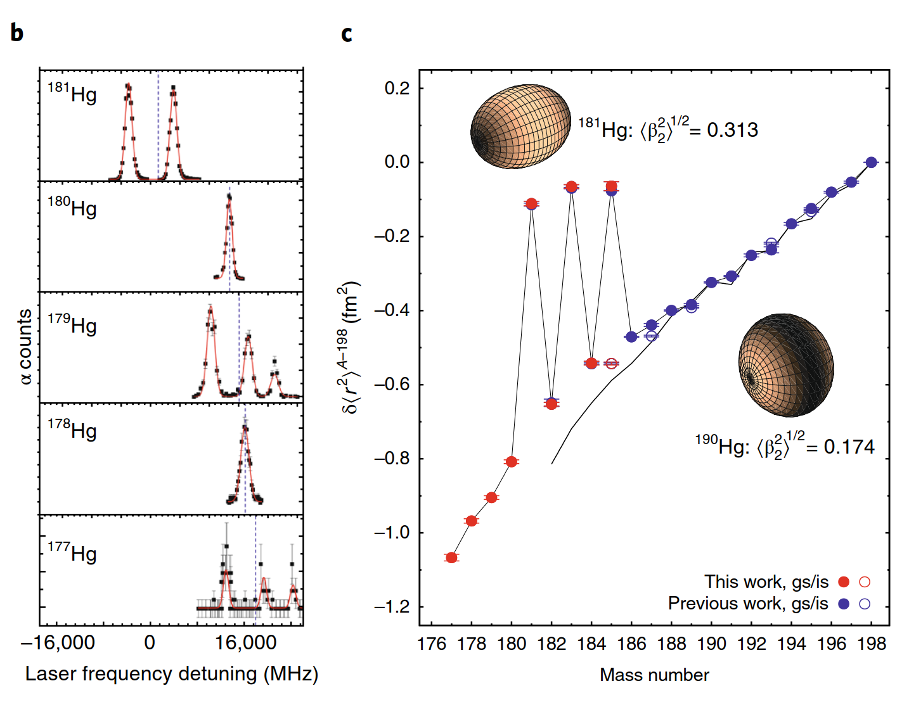
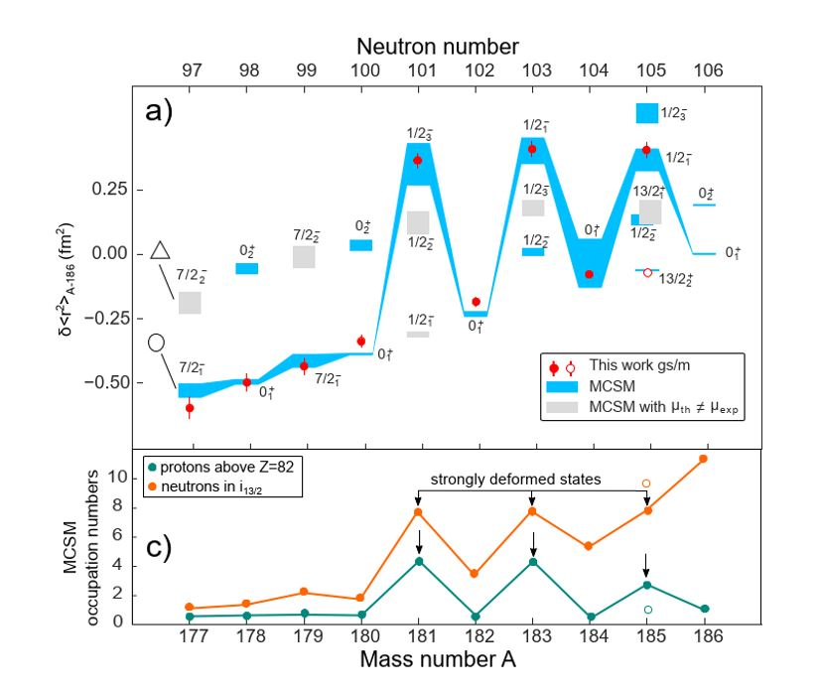
Characterization of the shape-staggering effect in mercury nuclei
B. Marsh et al., Nature Physics 14, 1163 (2018).

Slide 11
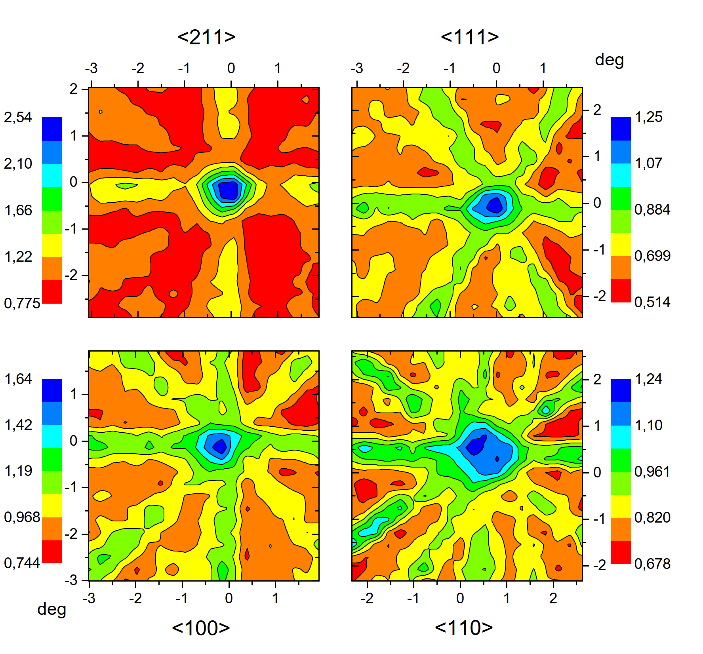
Thorium clock: LOI198
Study of isomeric level by removing IC decay path. Check this with implantation into CaF (wide band gap material)
Preliminary data indicate from 229Ac beam that significant fraction on substitutional sites: study of isomer possible.
Complemented with new setup to measure low energy conversion electrons…
arXiv:1904.10245v1

Slide 12
WISArD = Weak-interaction studies with Ar32 decay
coll. Bordeaux, Leuven, LPC Caen, NPI-Prague
Measure kinematic shift using β-p coincidences in β-delayed p decay
B
vector scalar
catcher
e⁺
beam
P
E_{p}
E_{p}
B
P
e⁺
beam
catcher
E_{p}
E_{p}

Slide 13
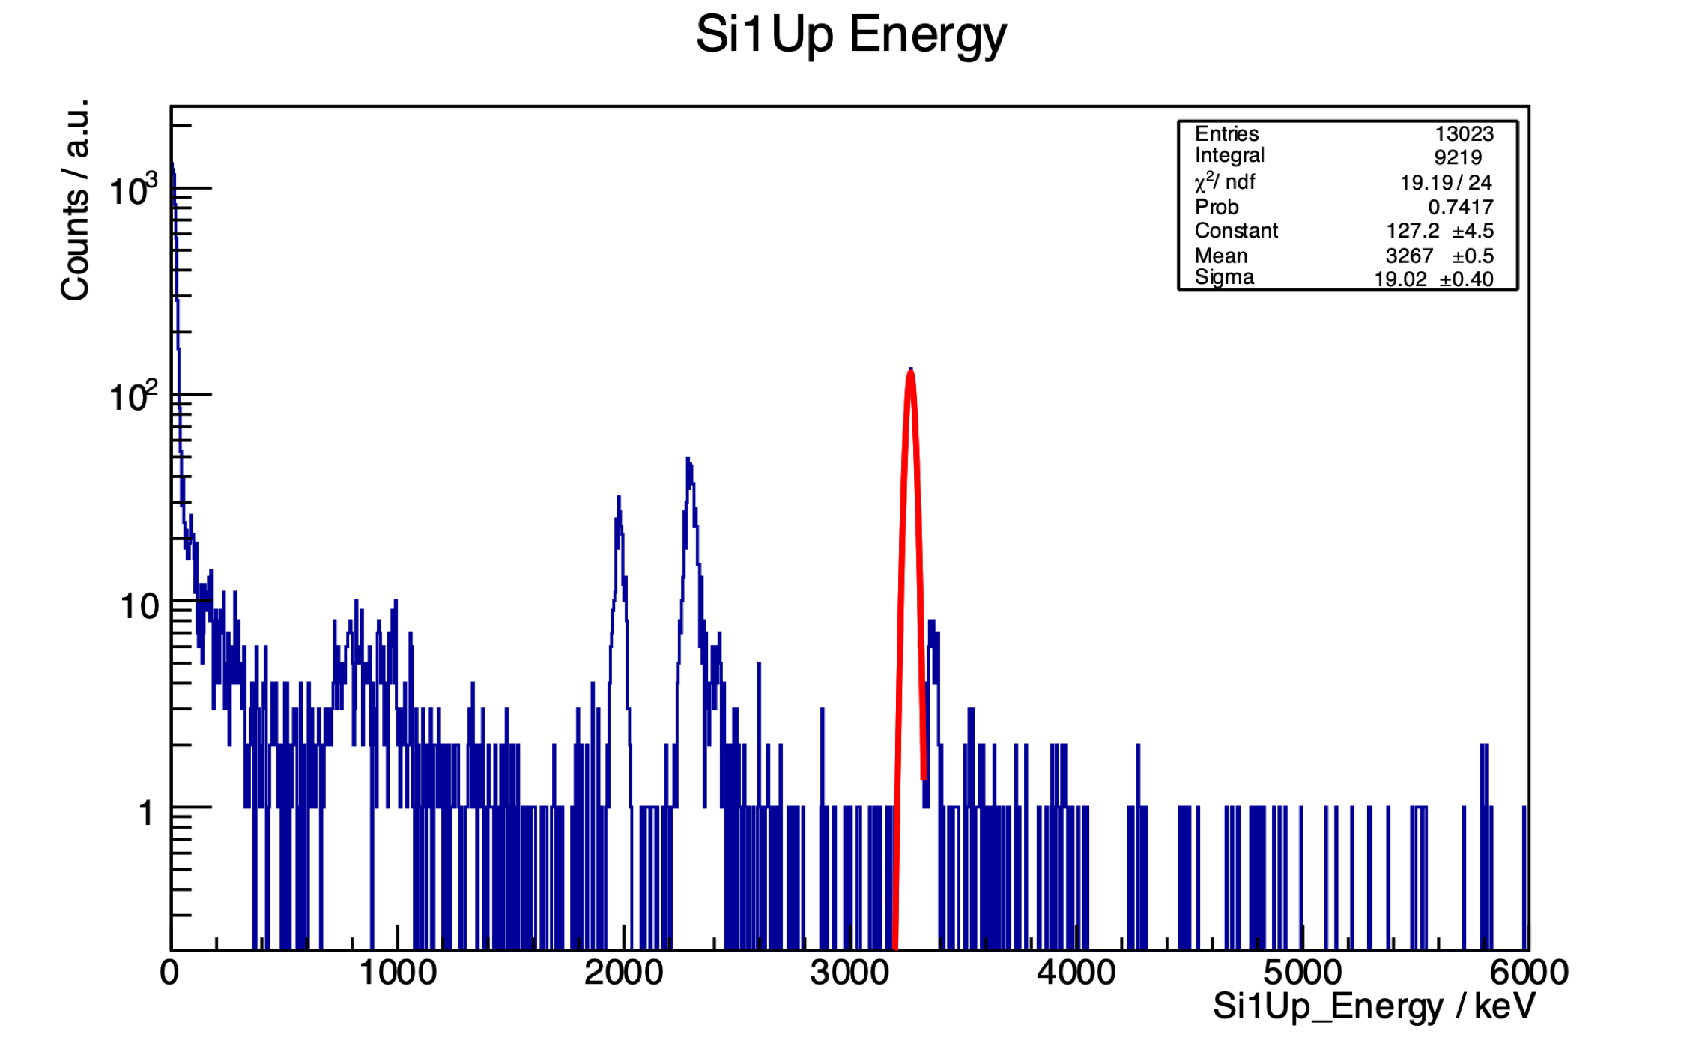
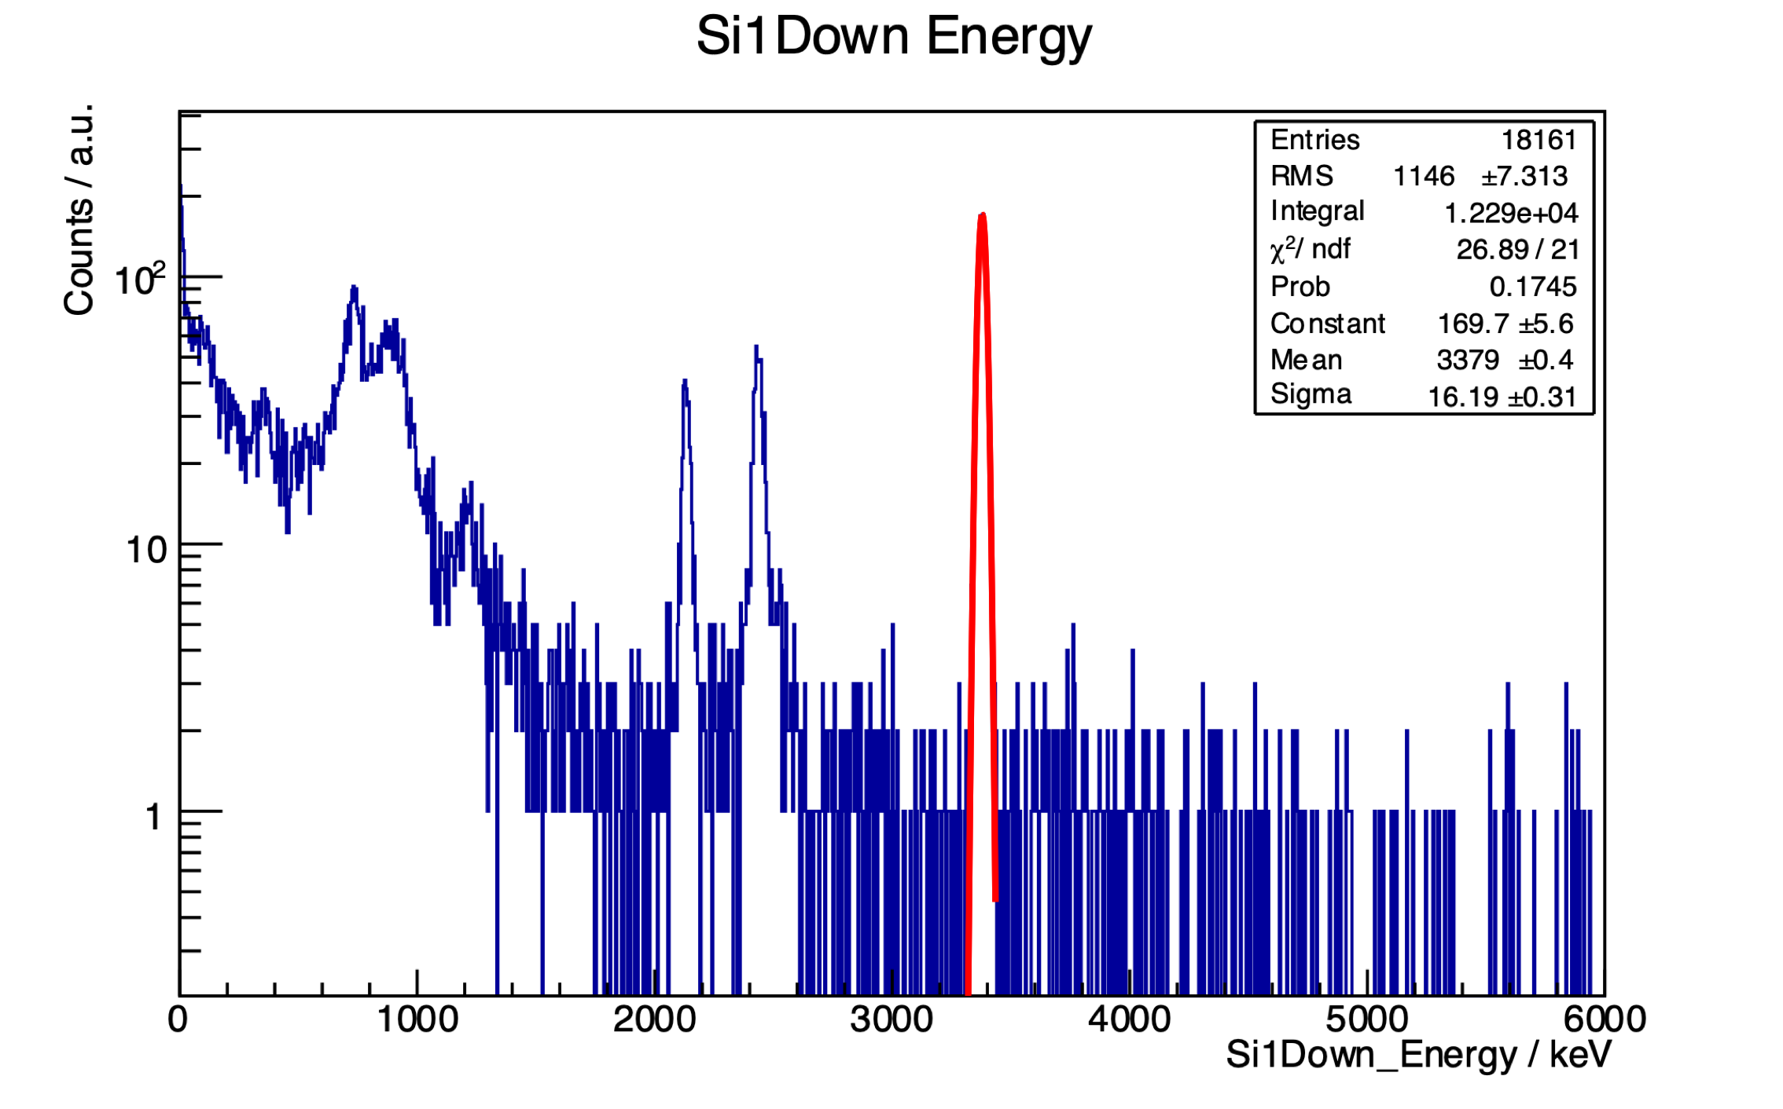
Online proton spectra from the IAS
after the b–decay of ³²Ar
Positron up → recoil nucleus down → proton emitted upwards from downwards moving nucleus → lower energy
Positron up → recoil nucleus down → proton emitted downwards from downwards moving nucleus → higher energy
PRELIMINARY

Slide 14
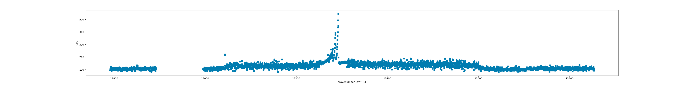
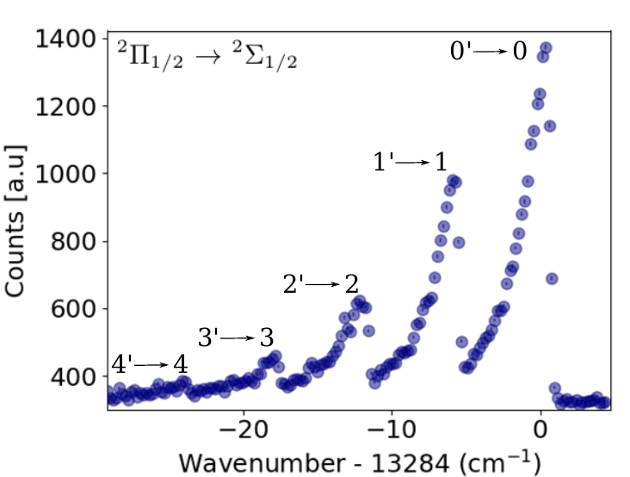
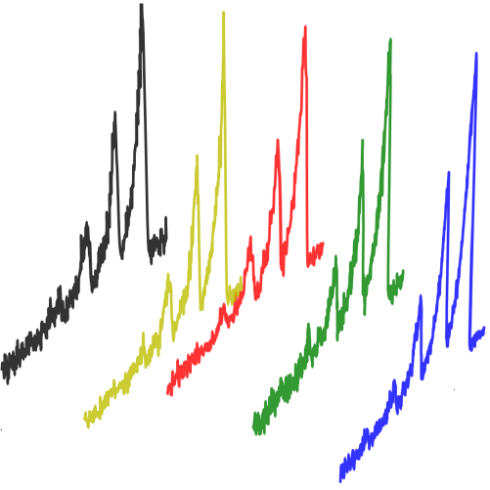
CRIS RaF: Results (November 2018)
25
~10⁶ /s
²²⁶RaF
PRELIMINARY
~1000 cm⁻¹ (30 THz) → only 4 hours!
²²³RaF
(T_{1/2}~11 days)
²²⁴RaF
(3 days)
²²⁵RaF
(15 days)
²²⁶RaF
(1600 y)
²²⁸RaF
(6 years)
²²⁶RaF
(T_{1/2}=1600 days)
counts
[Garcia Ruiz et al. In preparation (2019)]
Frequency

Slide 15
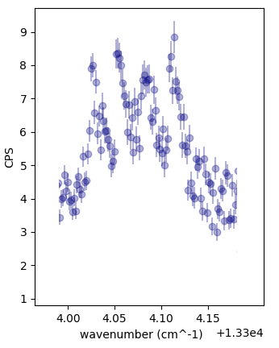
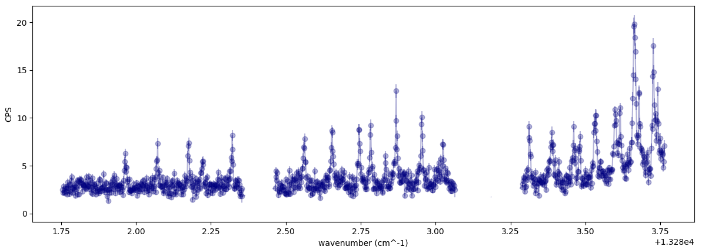
RaF: Results (November 2018)
26
Molecular Hyperfine structure
²²⁶Ra(I=0)F
PRELIMINARY
²²³Ra(I=3/2)F
300 MHz
²²⁶Ra(I=0)F
[Garcia Ruiz et al. In preparation (2019)]
~ 15 GHz
From THz to MHz

Slide 16
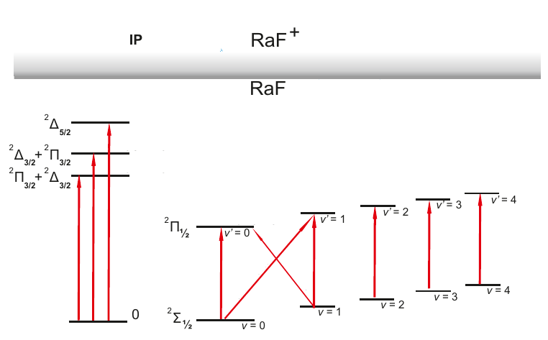
Radioactive Molecules: RaF Results
27
→ Low-lying structure of RaF?
… and many-more properties successfully measured!
→ For the first time: Low-lying structure, Ionization potential, ...
→ A suitable laser cooling scheme has been established!
→ Measurements extend to ²²³RaF, ²²⁴RaF, ²²⁵RaF, ²²⁶RaF, ²²⁸RaF
→ Hyperfine structure of ²²³Ra(I=3/2)F successfully measured
?
PRELIMINARY
?
?
?
?
?
?
?
?
?
?
[Garcia Ruiz et al. In preparation (2019)]

Slide 17
Irradiations for ISOLDE at MEDICIS
MEDICIS collaboration board approved use of MEDICIS for non-medical applications, as long as they are approved by INTC.
⁷Be (53.22d) at 5 MeV/u for IS554
#635-UCx - 7.96E17 p (direct)
+4 indirect irradiations
2.2 days – EoB 23/10/2018
²²³RaF (11.4d), ²²⁵RaF (14.8d), ²²⁶RaF (1600 a) for IS657
#637-UCx - 6.74E17 p (direct)
3.4 days – EoB 19/10/2018
6 extra days of beamtime (16/11->21/11) for ISOLDE
IS554
12 extra days of beamtime (21/11->03/12) for ISOLDE
IS657
Total of 18 days (~54 shifts) of extra beam time for ISOLDE physics thanks to MEDICIS!
Adapted from Ramos (ISOLDE workshop 2018)

Slide 18
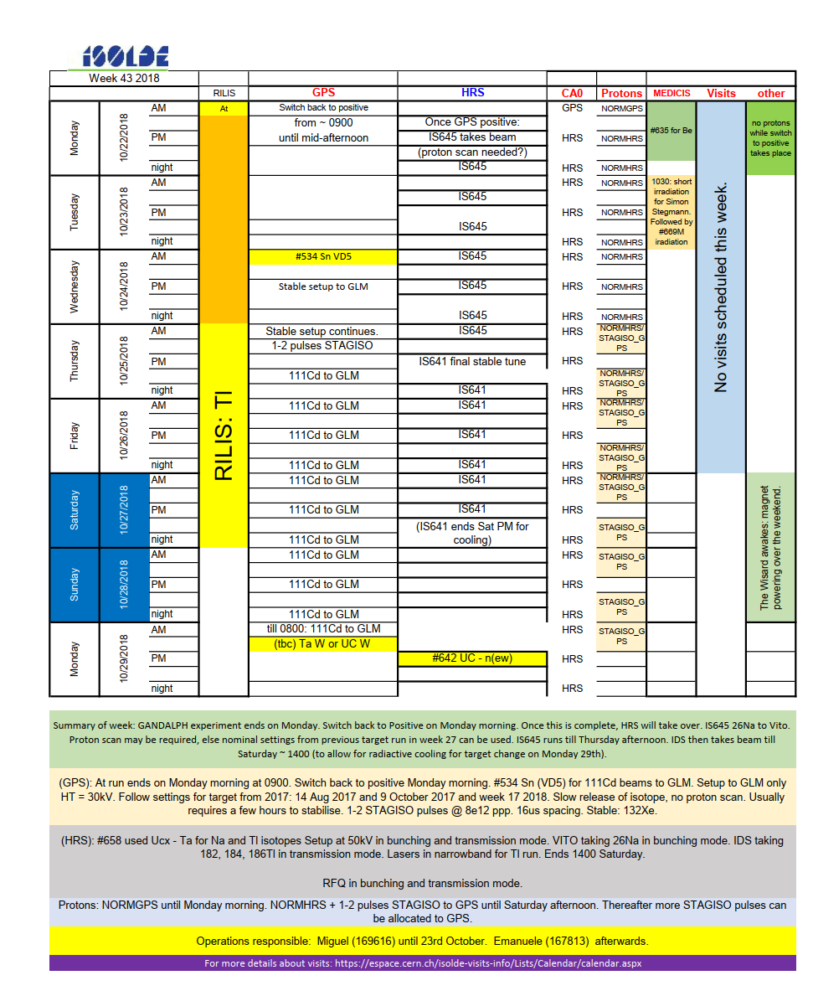
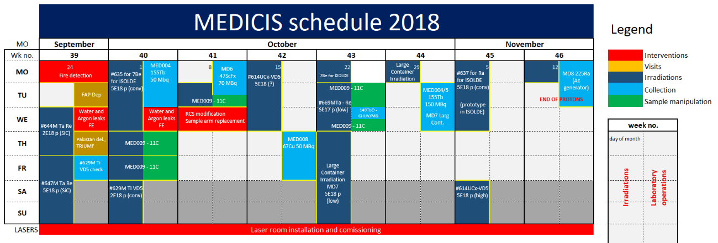
Interaction with MEDICIS
Interaction with MEDICIS has been constructive.
No serious impact on ISOLDE physics programme and the irradiation possibilities for winter physics was a great boost for ISOLDE as a whole.
Possibility of non-medical isotope collections after LS2 can also be beneficial to the facility as a whole.

Slide 19
Shift and experiment count for 2018
Étiquettes de lignes | Nombre de Delivered 2018
Biophysics | 4
COLLAPS | 3
COLLAPS; VITO
Collections :7Be
Collections: 163Ho
CRIS | 4
Gandalph | 1
HIE | 12
IDS | 5
ISOLTRAP | 2
la1 | 1
MEDICAL | 2
Medicine
Miniball
NICOLE
REX | 1
Special | 1
SSP | 13
TAS
TISD
VITO
Windmill/IDS
Windmill; ISOLTRAP | 1
WITCH | 1
(vide)
Total général | 51
Delivered | 2018 | 2017 | 2016 | 2015 | 2014 | 2012 | 2011
Protons | TBC | 8.00E+19 | 7.80E+19 | 9.40E+19 | 5.50E+19 | 1.15E+20 | 8.05E+19
Shifts for IS exp | 463 | 394 | 343 | 263 | 208.5 | 416 | 313.5
Shifts for LOIs | 11 | 5 | 10 | 4 | 6.5 | 15.5 | 16
HIE/REX shifts (IS +LOI) | 162.5 | 182 | 95 | Special | - | 221.5 | 190.5
Average IS shifts/day | 1.94 | 1.76 | 1.65 | 1.4 | 1.55 | 1.61 | 1.55
An intense year: a big thanks to all the technical and operations teams for their commitment and also to the users for their understanding and cooperation (especially at the end of the year)
532 shifts (including TISD, reserve etc) in 2018

Slide 21

Status January 2019
Étiquettes de lignes | Sum of Shifts remaining (Feb 2018) | Sum of Delivered 2018 | Count of Delivered 2018 | Count of Exp. no. | Sum of Shifts remaining 2018 | Sum of Shifts remaining Jan 2019
Biophysics | 79,5 | 31 | 4 | 6 | 48,5 | 48,5
COLLAPS | 69 | 35,5 | 3 | 6 | 33,5 | 33,5
COLLAPS; VITO | 13 |  |  | 1 | 13 | 13
Collections :7Be | 24 |  |  | 1 | 24 | 24
Collections: 163Ho | 6 |  |  | 1 | 6 | 6
CRIS | 85,5 | 57 | 4 | 8 | 28,5 | 28,5
Gandalph | 17 | 9 | 1 | 2 | 8 | 8
HIE | 746,5 | 152,5 | 12 | 48 | 594 | 585
IDS | 92 | 36 | 5 | 12 | 56 | 56
ISOLTRAP | 51 | 17 | 2 | 8 | 34 | 34
la1 | 37 | 10 | 1 | 6 | 27 | 27
MEDICAL | 25 | 20,5 | 2 | 2 | 4,5 | 0
Medicine | 4 |  |  | 3 | 4 | 4
Miniball | 2 |  |  | 1 | 2 | 2
NICOLE | 29 |  |  | 2 | 29 | 29
Special | 3 | 3 | 1 | 1 | 0 | 0
SSP | 138,5 | 66,5 | 13 | 27 | 72 | 72
TAS | 11,5 |  |  | 3 | 0 | 0
TISD | 14 |  |  | 3 | 14 | 14
VITO | 0 |  |  | 1 | 0 | 0
Windmill/IDS | 22,5 |  |  | 1 | 22,5 | 22,5
Windmill; ISOLTRAP | 3 | 3 | 1 | 1 | 0 | 0
WITCH | 15 | 5 | 1 | 1 | 10 | 10
(vide) | 0 |  |  | 2 | 0 | 0
REX | 47 | 8 | 1 | 6 | 39 | 6
Total général | 1535 | 454 | 51 | 153 | 1069,5 | 1023

Slide 22
INTC meetings in 2019
776.5 shifts requested to be retained (some may be released after collaboration meetings in 2019…)
Effective backlog now ~776.5 shifts, some experiments may change after collaboration meetings.
New proposals may be accepted in early 2020 (tbc).
Étiquettes de lignes | Sum of Shifts remaining Jan 2019
Biophysics | 48,5
COLLAPS | 23
Collections :7Be | 24
Collections: 163Ho | 6
CRIS | 23,5
Gandalph | 8
HIE | 461
IDS | 33
ISOLTRAP | 22
la1 | 20
Miniball | 2
NICOLE | 29
SSP | 43
TISD | 11
Windmill/IDS | 22,5
Total général | 776,5

