Slide 1
n_TOF Report
Daniela Macina, EN-STI-BMI
Oliver Aberle, EN-STI-TCD

Slide 2
Outlook
n_TOF organization during LS2
Main activities for LS2 - Facility
  Horizontal beam line
  Target exchange
Main activities for LS2 – Experiment
  Electronic lab
  Detectors

Slide 3
n_TOF organization during LS2
n_TOF Experiment LS2 Coordination Meetings
(chair: D. Macina)
  INDICO link: https://indico.cern.ch/category/10884/
Mandate: Coordinate the LS2 activities in the experimental areas (EAR1, EAR2), in the electronics laboratory and control room
Meeting frequency: Twice a month
n_TOF Facility Technical Coordination Meetings
(chair: O. Aberle, scientific secretary: M. Barbagallo)
  INDICO link: https://indico.cern.ch/category/11206/
Mandate: Steering of global activities related to the n_TOF Facility during LS2
Meeting frequency: Every 6 weeks

Slide 4
Main n_TOF LS2 activities
Beam line
Replacement sweeping magnet in EAR1 with a permanent one (same technology as in EAR2)
Installation of a new system remotely controlled to exchange big and small second collimator in EAR1)
New SEM grid upstream of the target in the FTN line (replacing a BTV)
EAR1 and EAR2 (type A laboratory)
Implementation of the recommendation by the French and Swiss authorities in matters of safety:
  Audible alarms for beam imminent warning, fire detection and ventilation stop
  buffer zone
  sink to wash hands
Remote monitoring gas system
Control room
Move control room and offices to barrack 506 close to EAR2
Electronic laboratory
Install a laboratory to develop, test and commission detectors to be used for the new beam line commissioning and physics data taking
About 50 m2 equipped with:
  Fume cupboard to handle chemicals and for soldering
  Mini-DAQ -> standard data taking (only calibration mode) and storage data same format as in operation
  Standard furniture
  Tests with radioactive sources
Possible location:
  Either new barrack 506 (preferred) or
  Barrack 547 (actual laboratory) to be upgraded in space and equipment
DAQ
Consolidation work
WEB interface to the nTOF database for the handling and bookkeeping of operational data and information
BEAM OPERATION
Discussion with OP and BI on how to improve beam monitoring in view of the higher intensities reachable by the injectors
Discussion with CO on a dedicated nTOF VISTAR page to improve communication
New target
Remove target No. 2 and replace it with a new design, Target No. 3
New target shielding
Remove fixed wall shielding and replace it by a mobile shielding
Renewal of cooling station
Dismantle water cooling circuit and replace it with a N2 gas cooling circuit

Slide 5
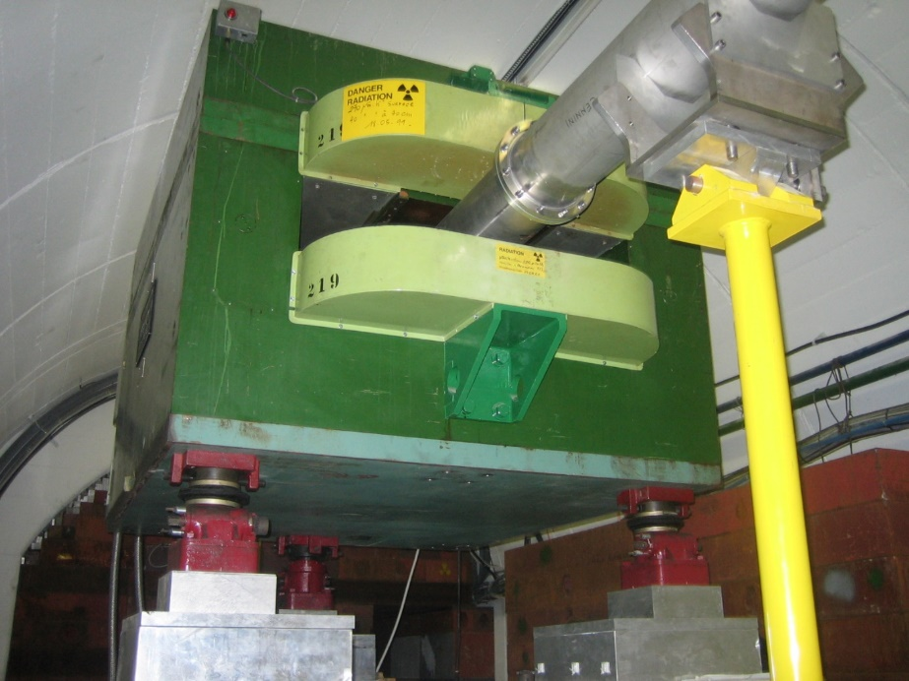
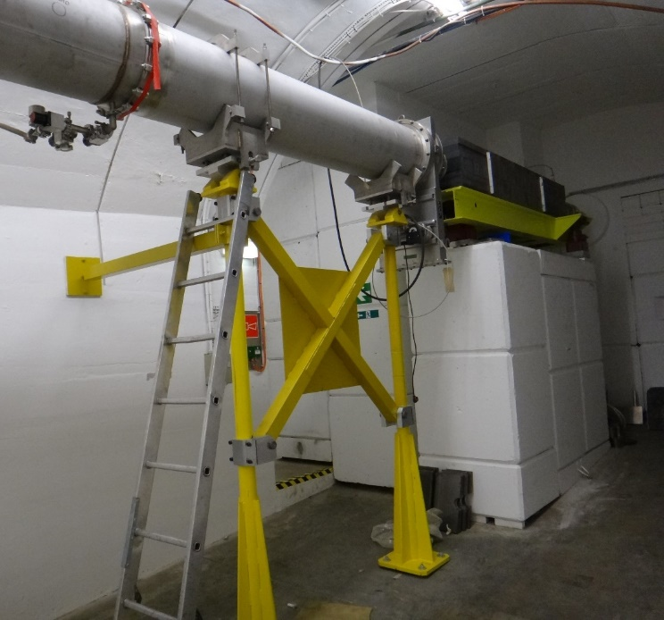
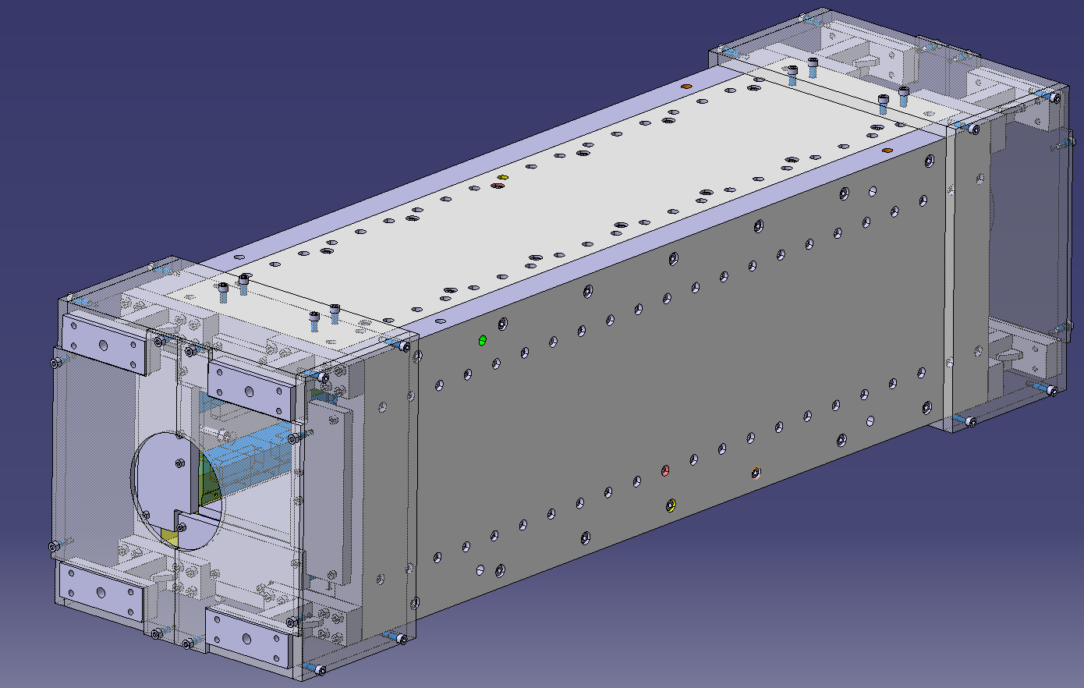
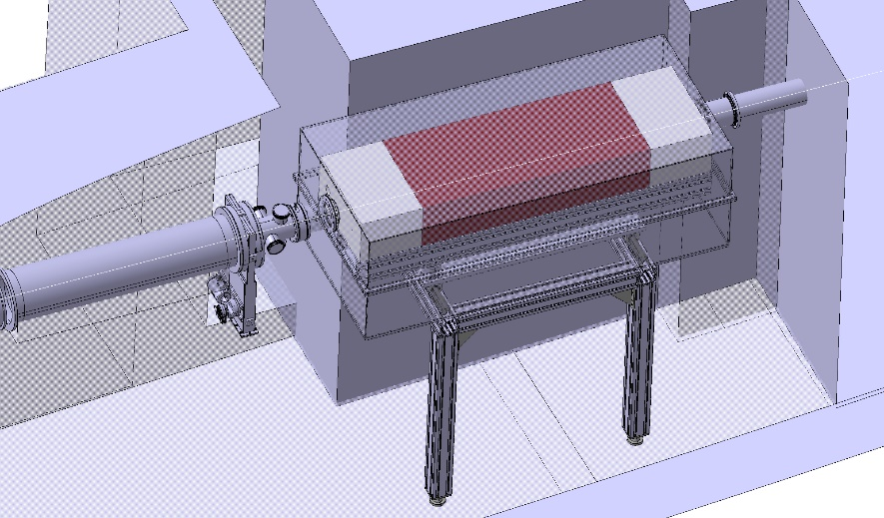
Main n_TOF LS2 activities
New sweeping magnet
Consolidation of collimator Nº2

Slide 6
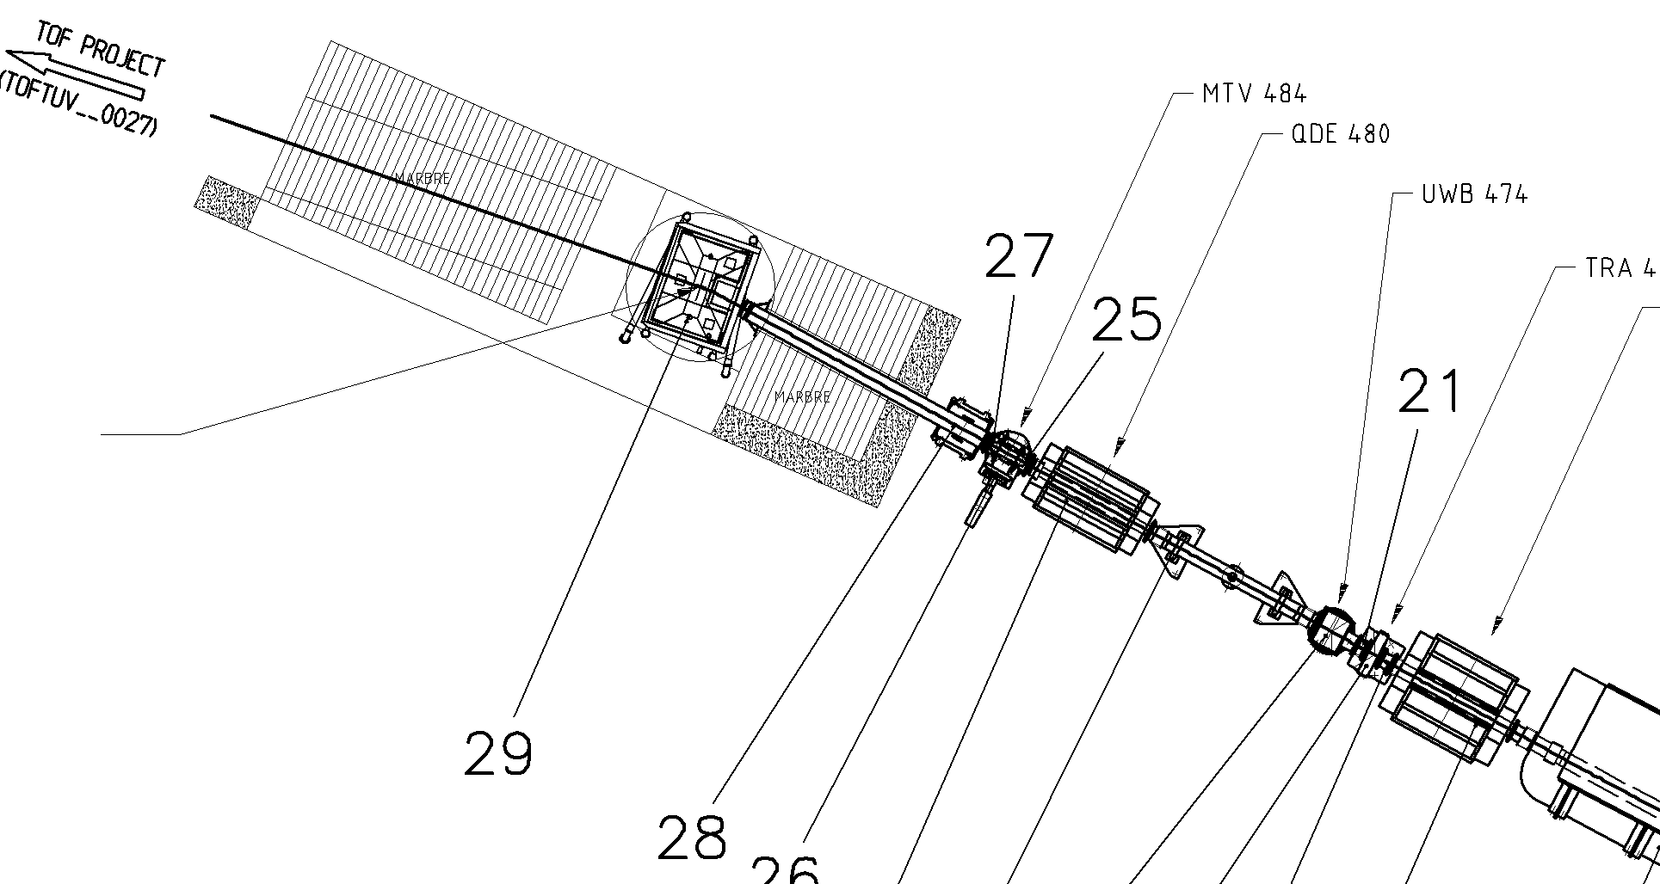
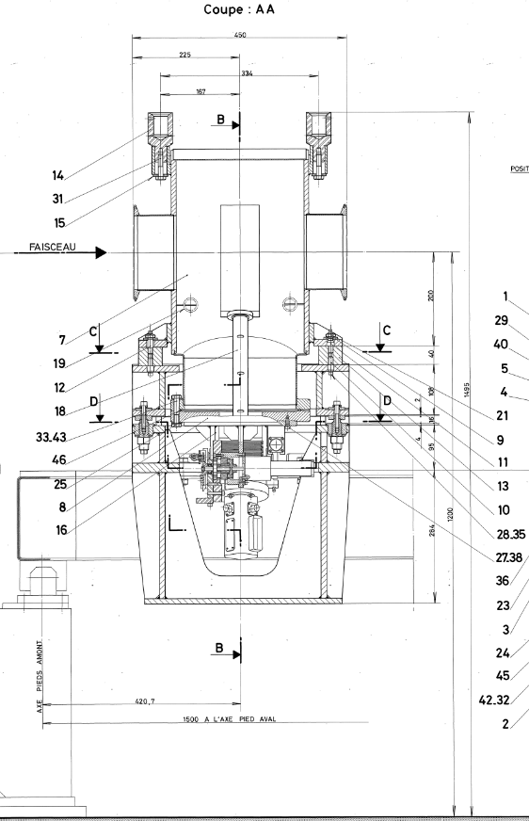
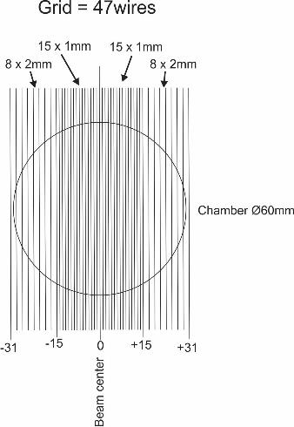
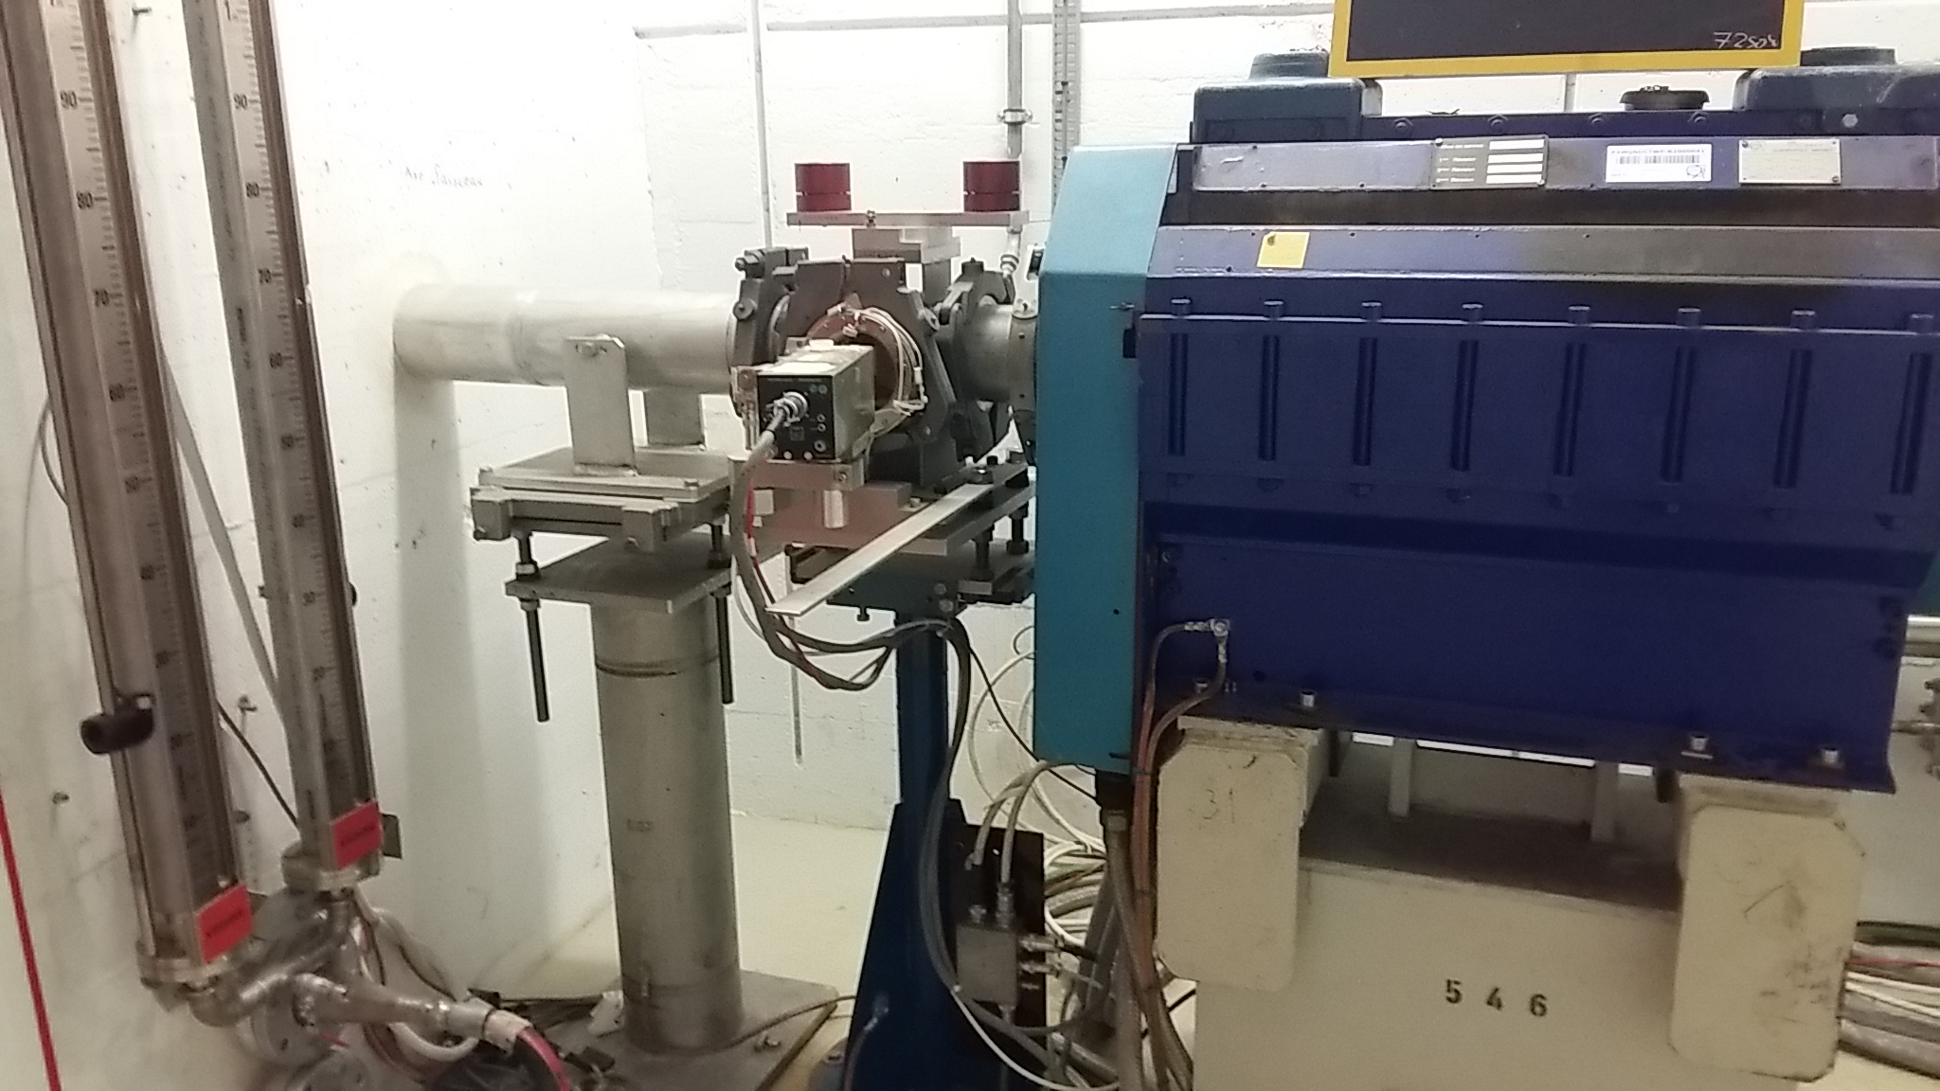
SEM grid replacing BTV

Slide 7
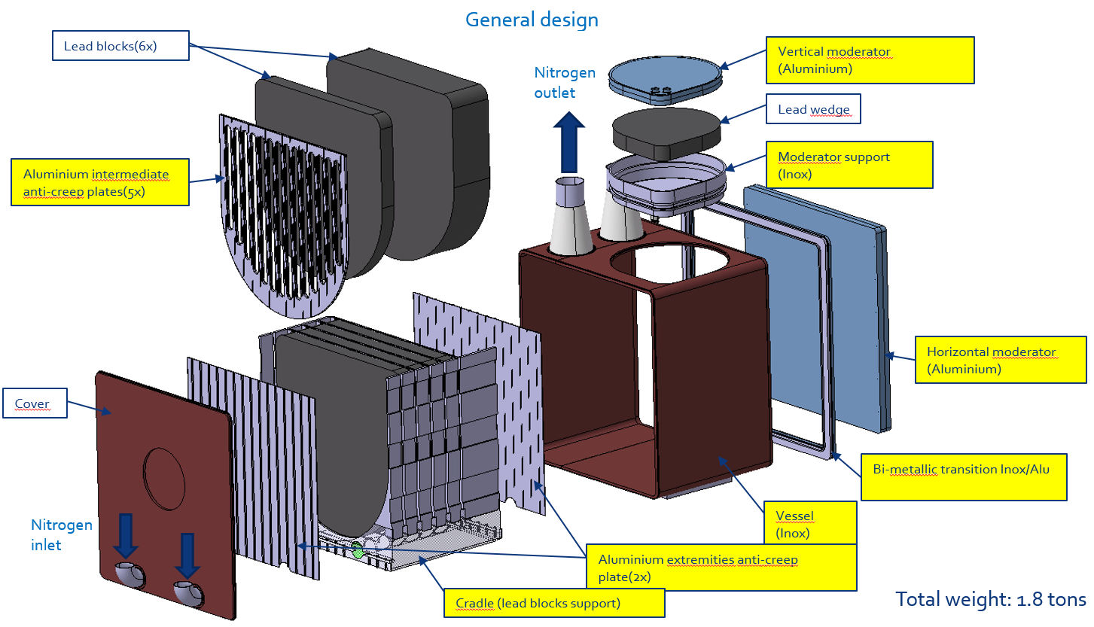
n_TOF target #3
n_TOF Target #3 Production Readiness Review, held on May 29th
https://indico.cern.ch/event/807540/contributions/3360962/attachments/1853310/3044330/n_TOF_Target_review_3.pdf
The review committee will provide a complete list of findings and recommendations around mid-July.
- Go ahead and start production!

Slide 8
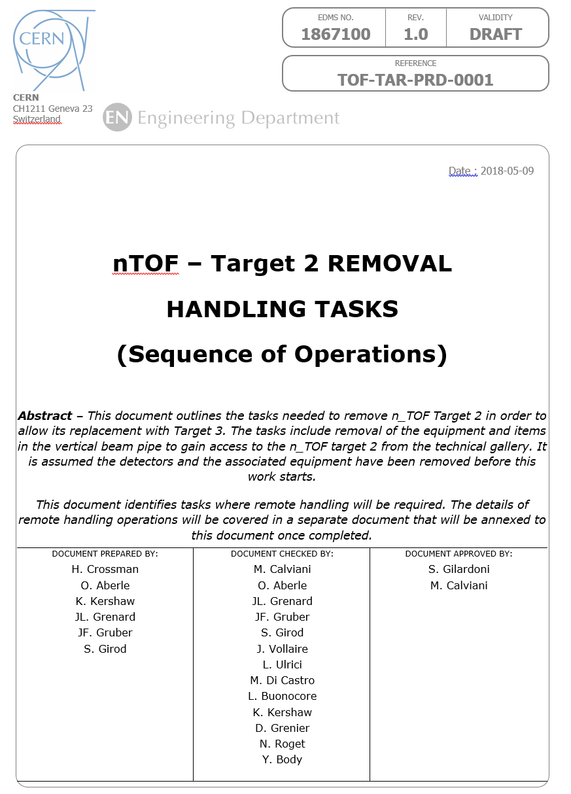
n_TOF target #2 removal
https://edms.cern.ch/document/1867100/0.4

Slide 9
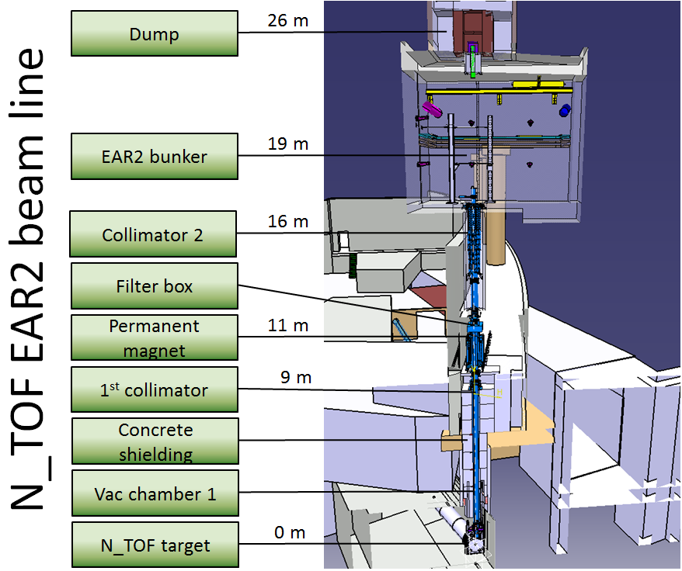
n_TOF target #2 removal

Slide 10
n_TOF target #2 removal

Slide 11
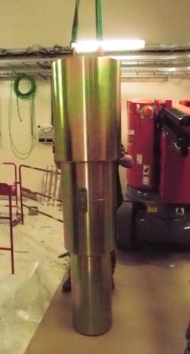
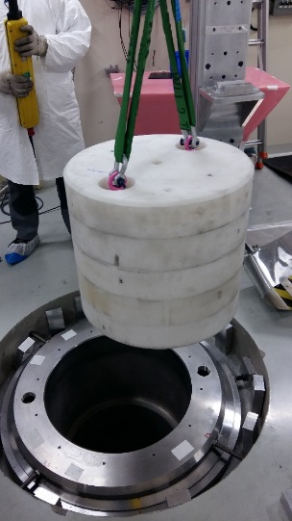
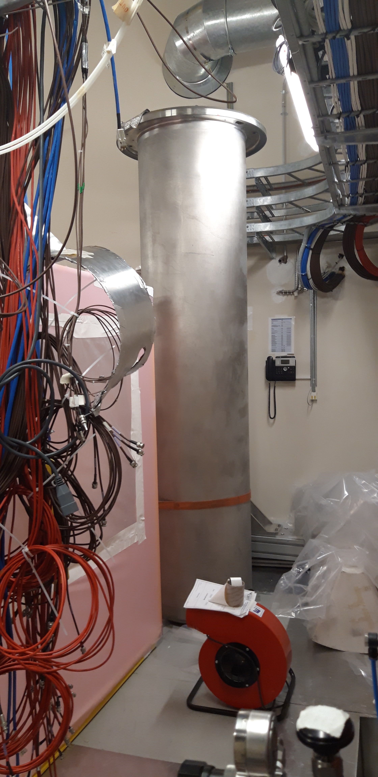
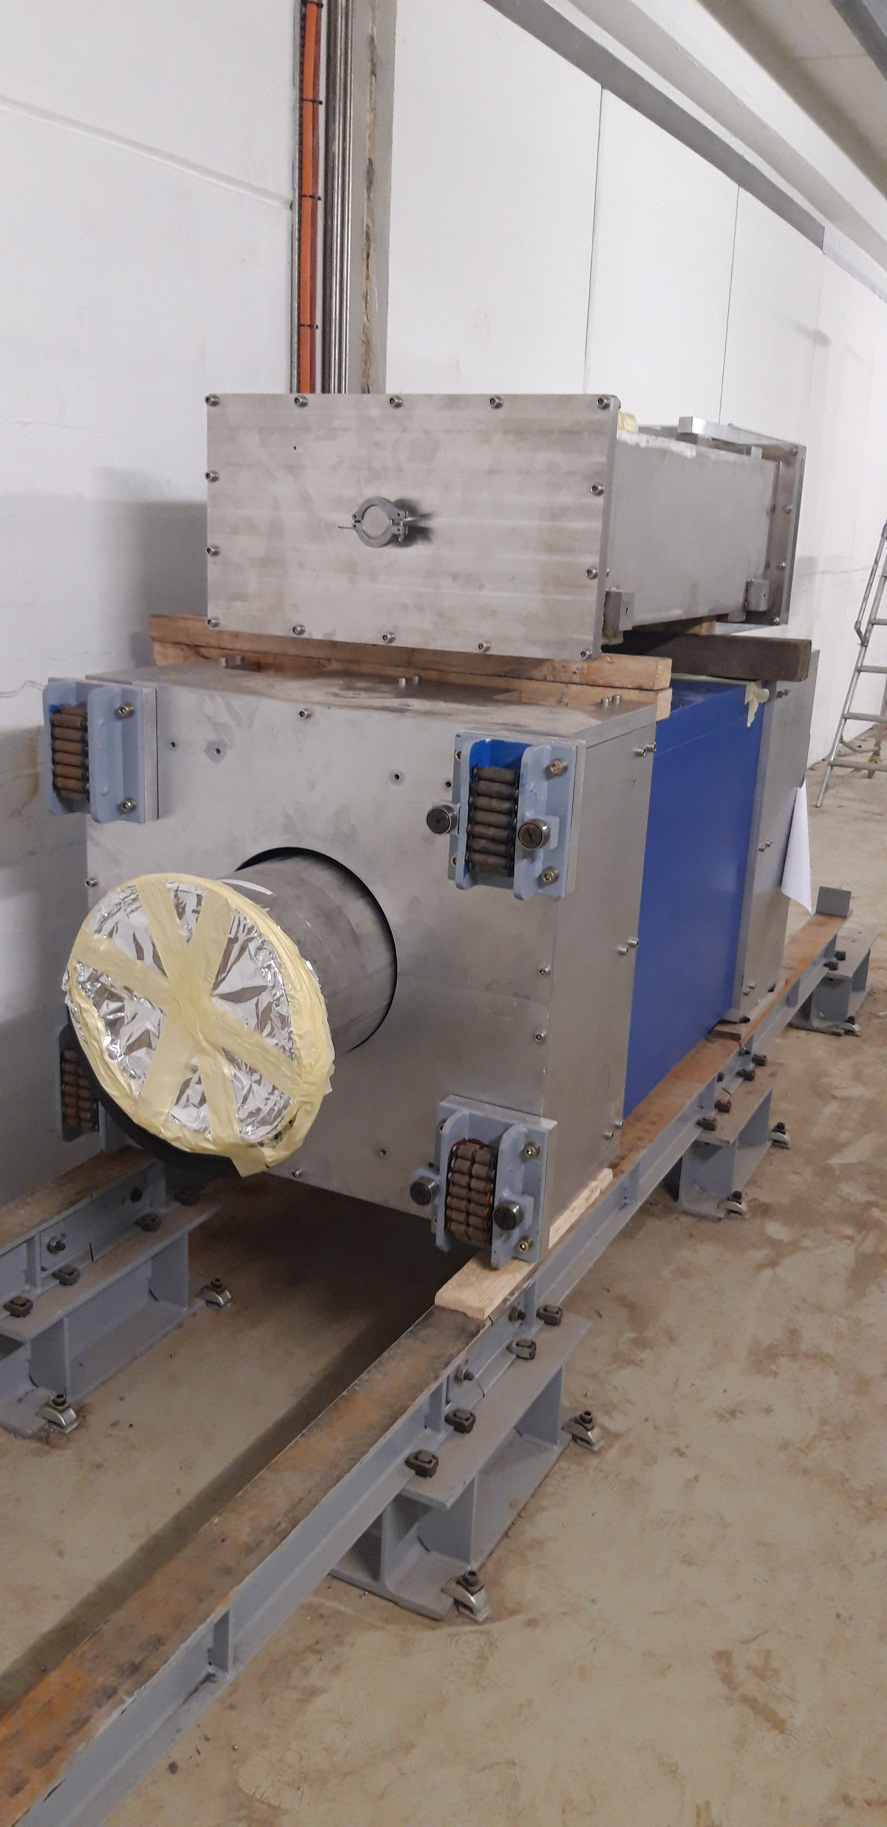
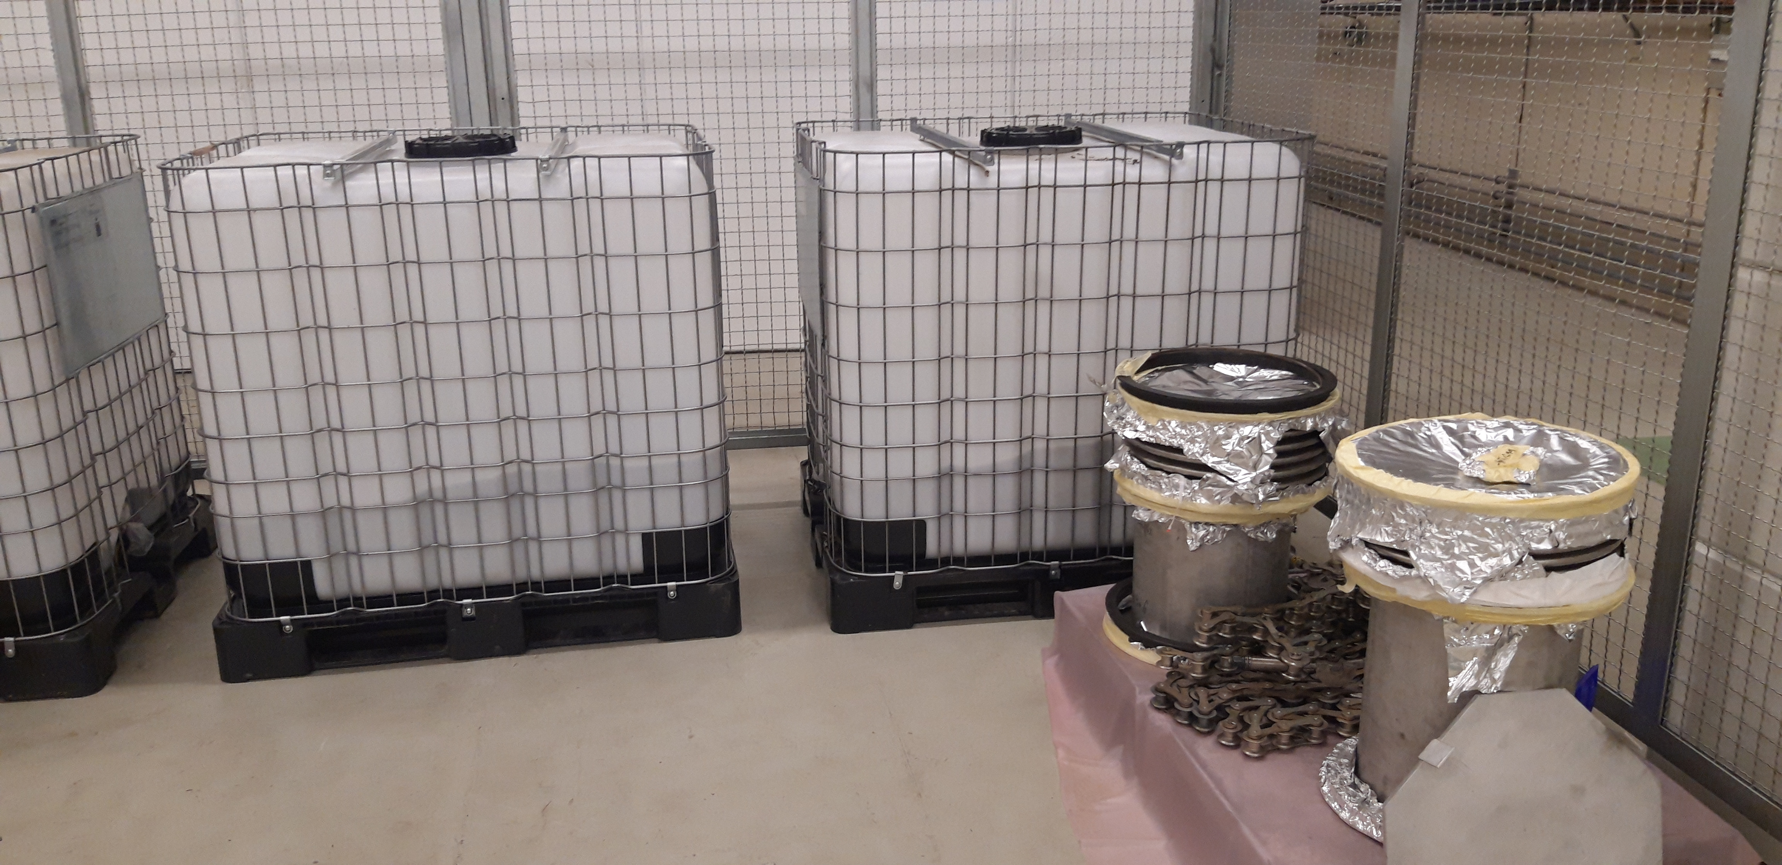
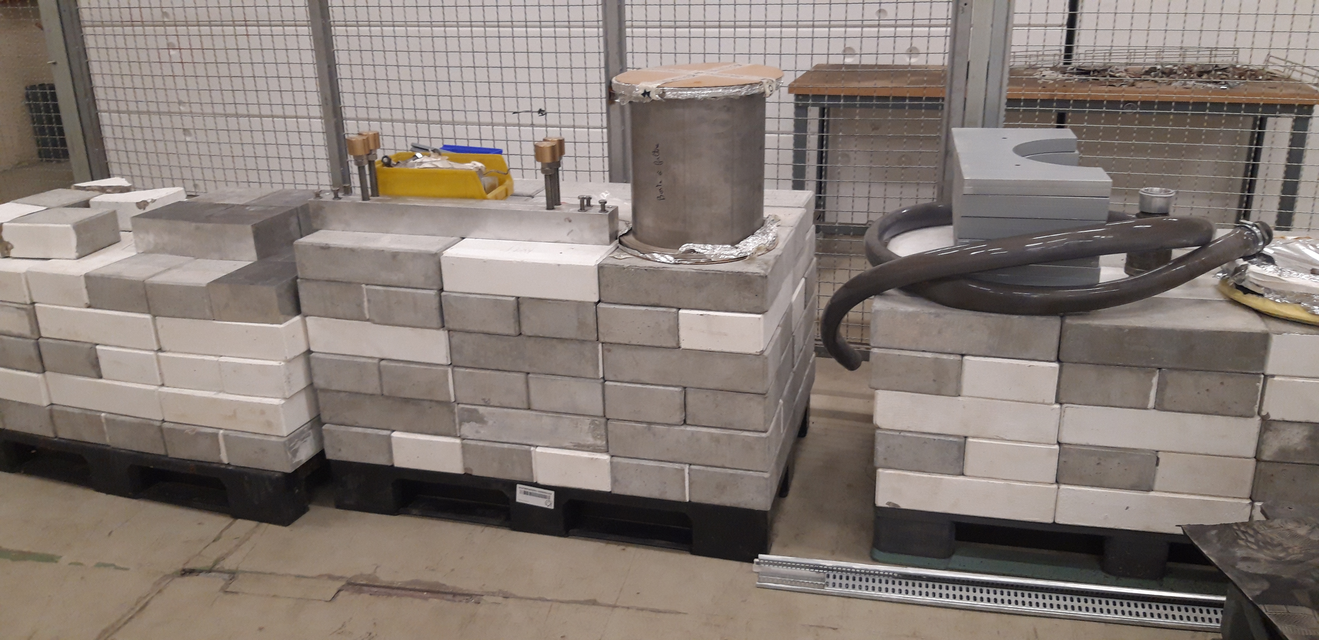
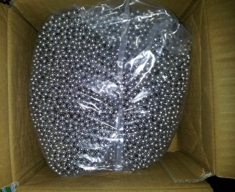
Removal of Items Above Technical Gallery
  Vacuum chamber
  Permanent magnet
  Collimator
  Shielding

Slide 12
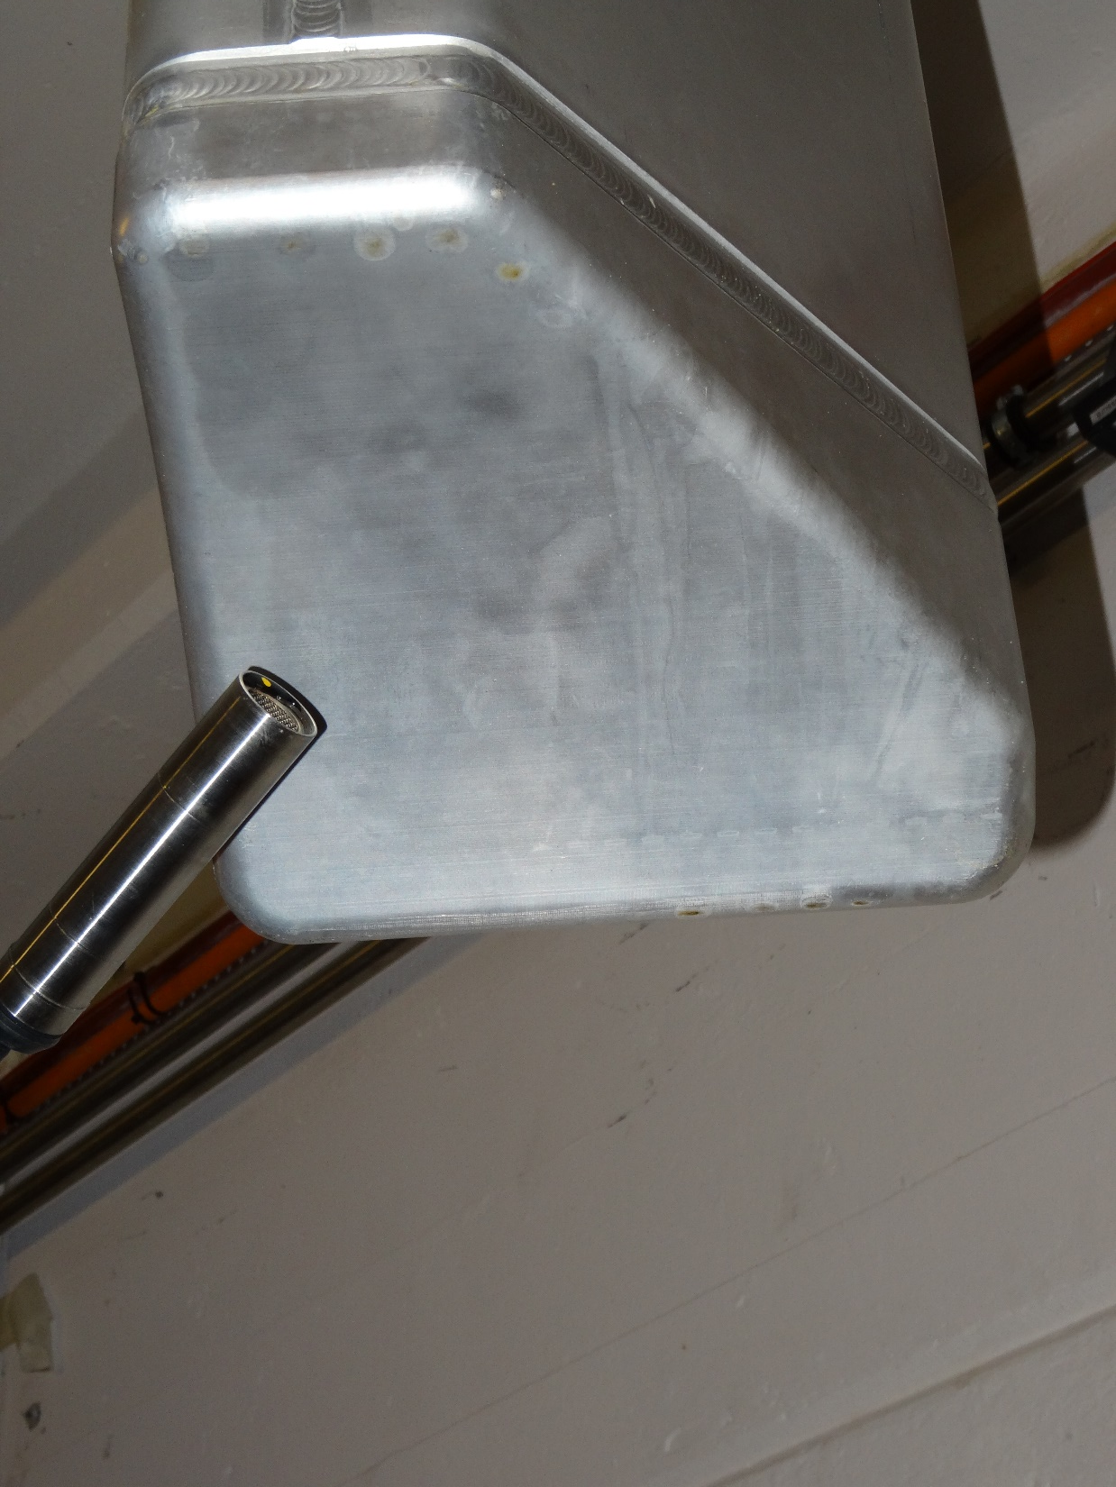
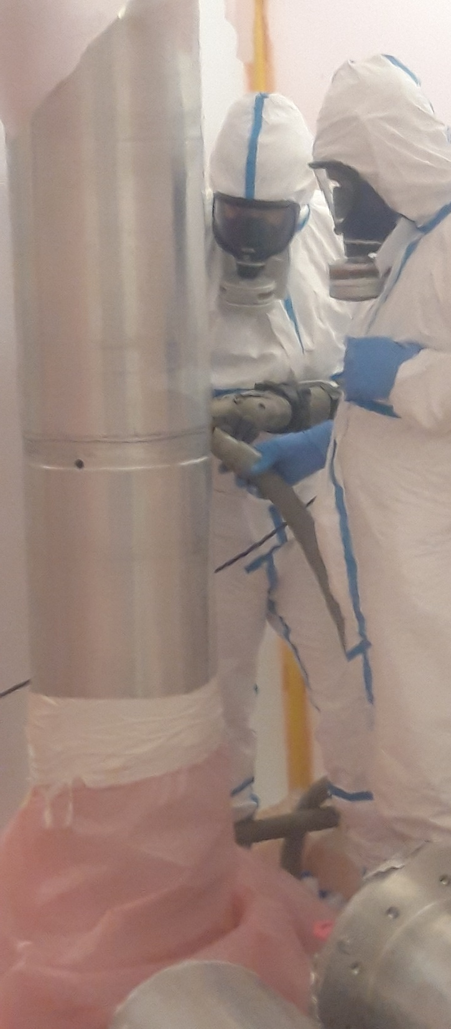
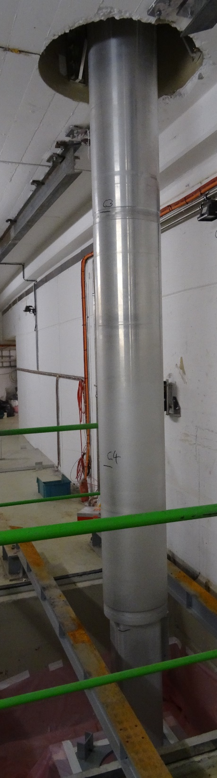
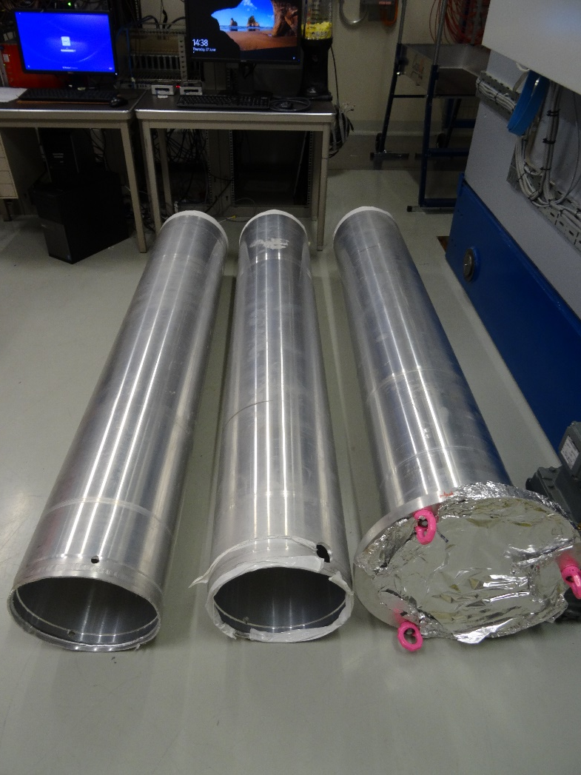
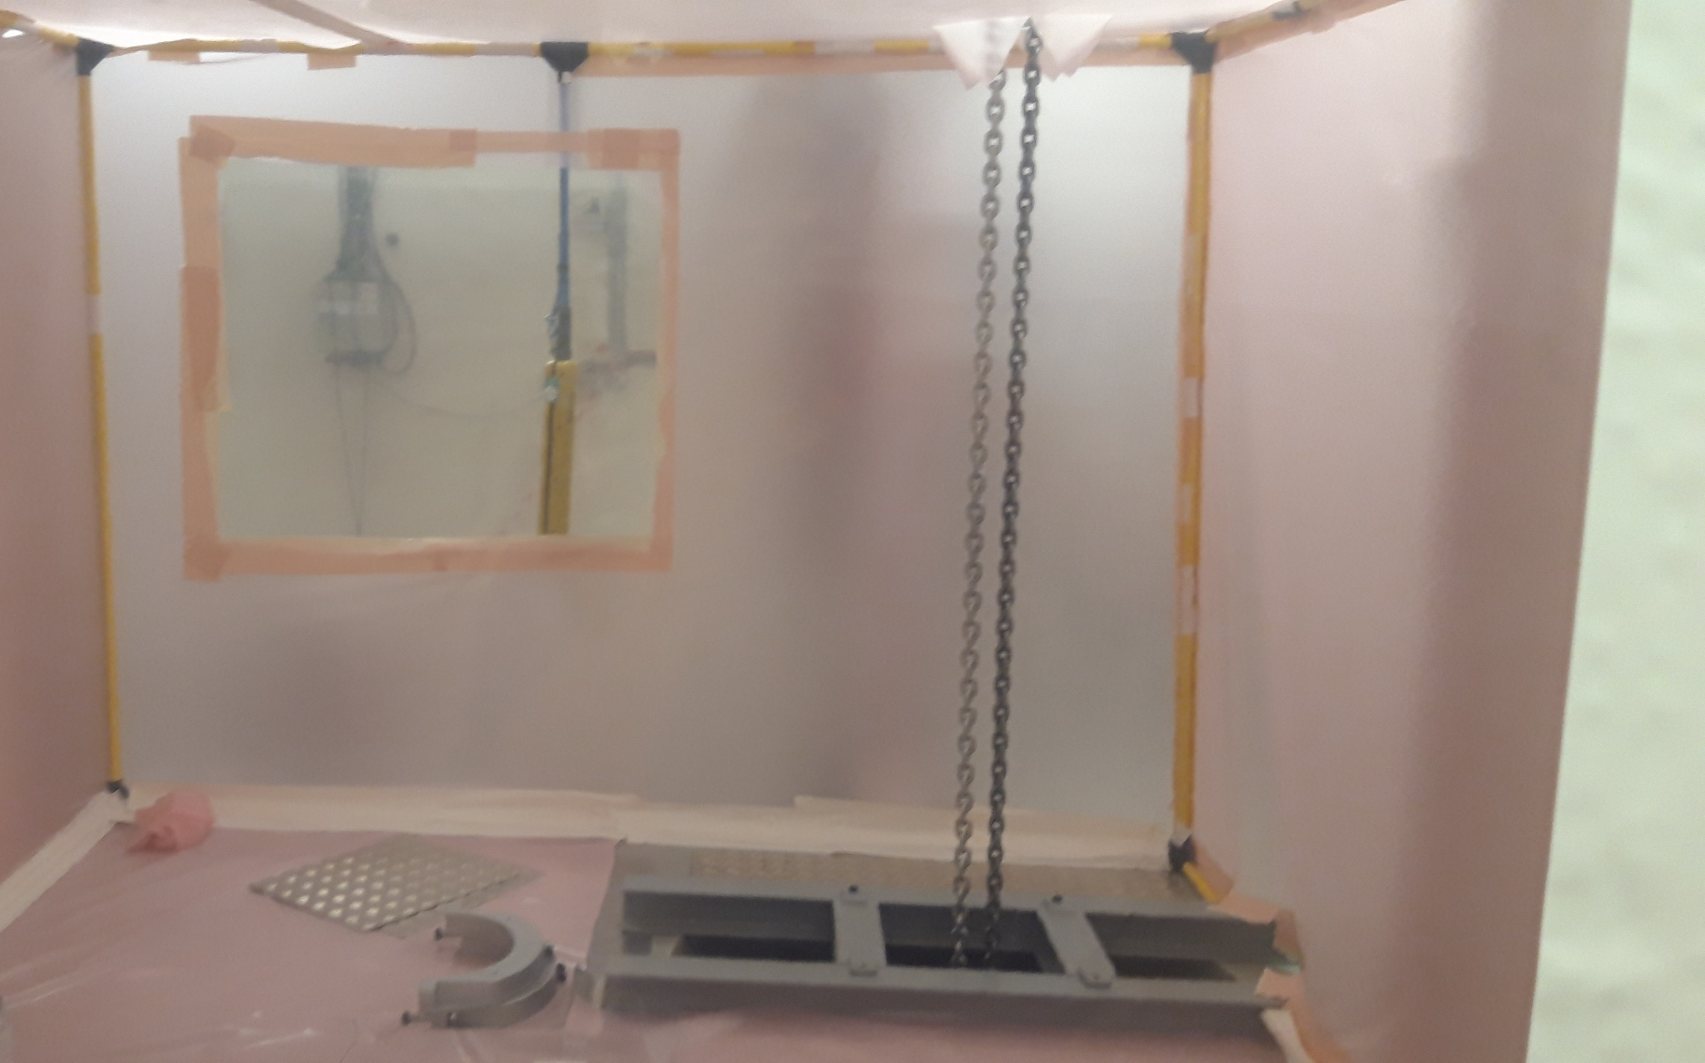
Removal and cutting of vertical n_TOF target beam pipe
  Vertical cutting of low activated part
ALARA Committee 03/06/2019:
EDMS 2158214
  Dose rates as predicted by simulations (hot spot on the bottom window at 2 mSv/h).
  No contamination found.
  Only the last part (1 m) is classified as contaminated
  Low dose upper part of the beam pipe (3 x 2 m, 1 x 1.2m)
  SAS in EAR 2 above the target pit

Slide 13
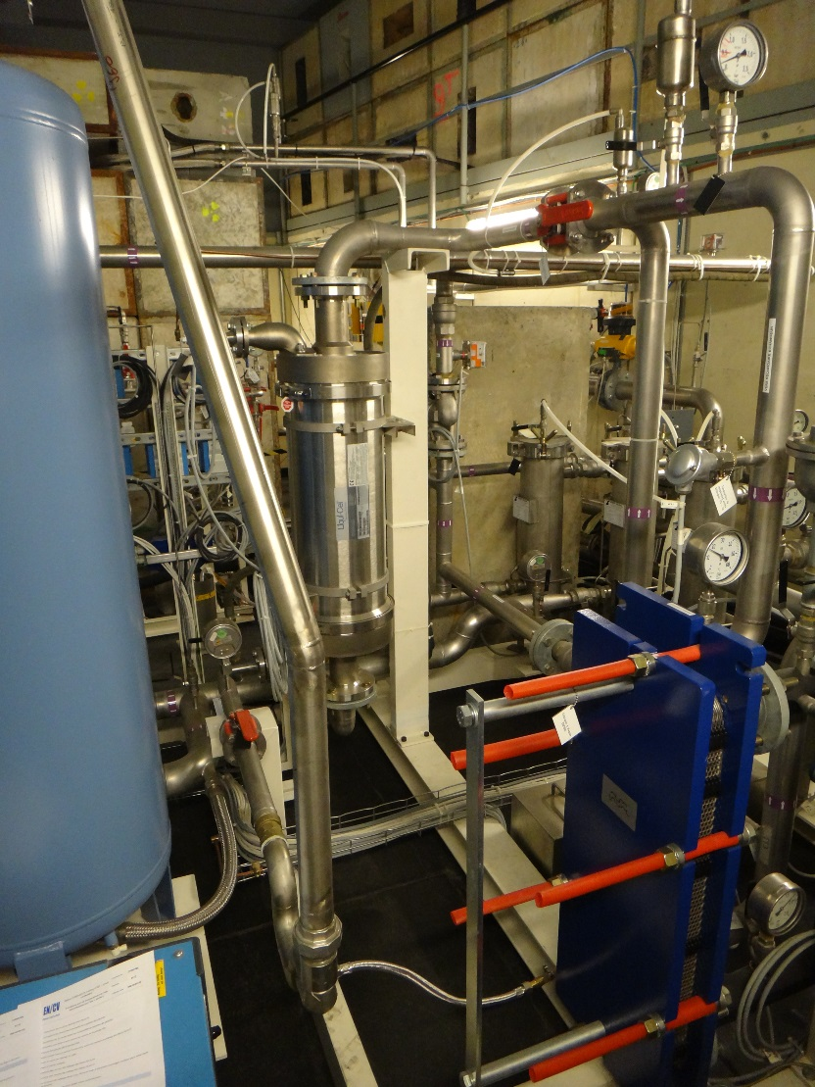
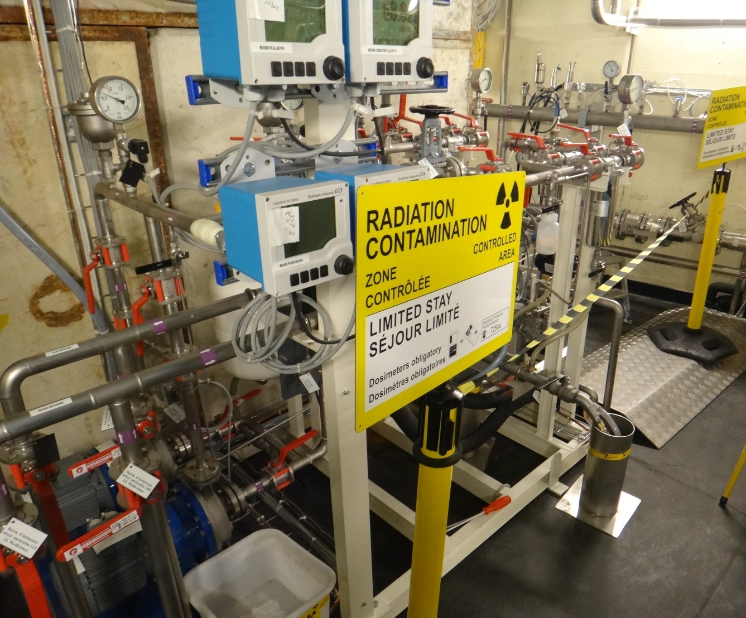
n_TOF target cooling station

Slide 14
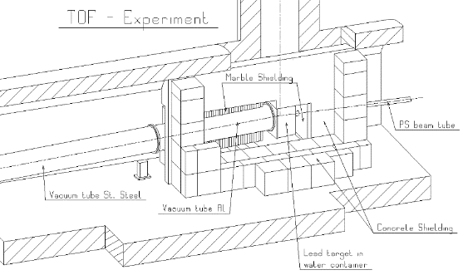
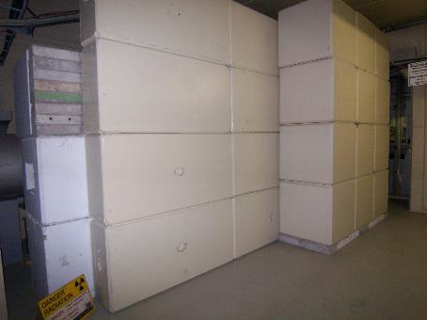
Modification of the target side shielding
Reconfiguration of the (fixed) shielding around the spallation target,
Shielding to be changed to a mobile shielding
which dates back to the original installation of the facility in 1999

Slide 15
nTOF Experiment LS2 Coordination Meeting
Projects followed up until now:
  Experimental Areas Prepartion for the LS2 work. In particular,
    remove all radioactive samples and sources to be stored by RP
    Contamination control perfomed by RP confirms absence of contamination
  Cabling campaign in EAR1 (remove the old sweeping magnet cables, replace the detector cables in the rack/bunker area)
  Implementation of the ASN-OFSP safety recommandations in EAR2
  Consolidation of the gas system in EAR2
  Consolidation of the alignment system
  Upgrade of the nTOF electronics laboratory and control room
  DAQ upgrade
  Consolidation and R&D program for detectors

Slide 16
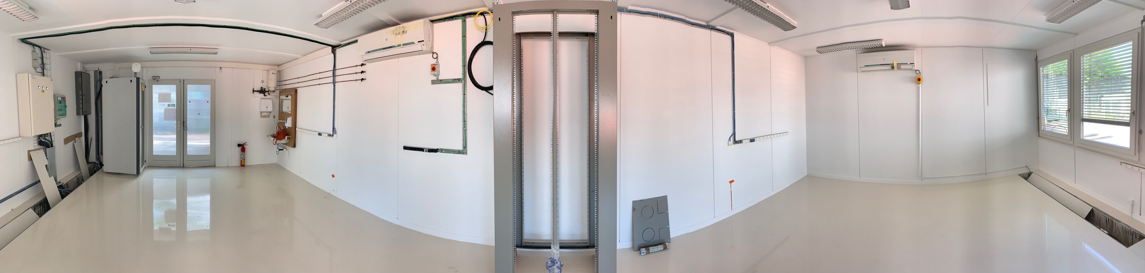
Upgrade of the nTOF electronics laboratory
Doubled the surface
Laboratory fully equipped to perform tests in parallel on two different detectors
DAQ system identical to the one used in the areas
Laboratory declared as Supervised Area to allow tests with sealed sources
New access system with dosimeter
Available in autumn 2019

Slide 17
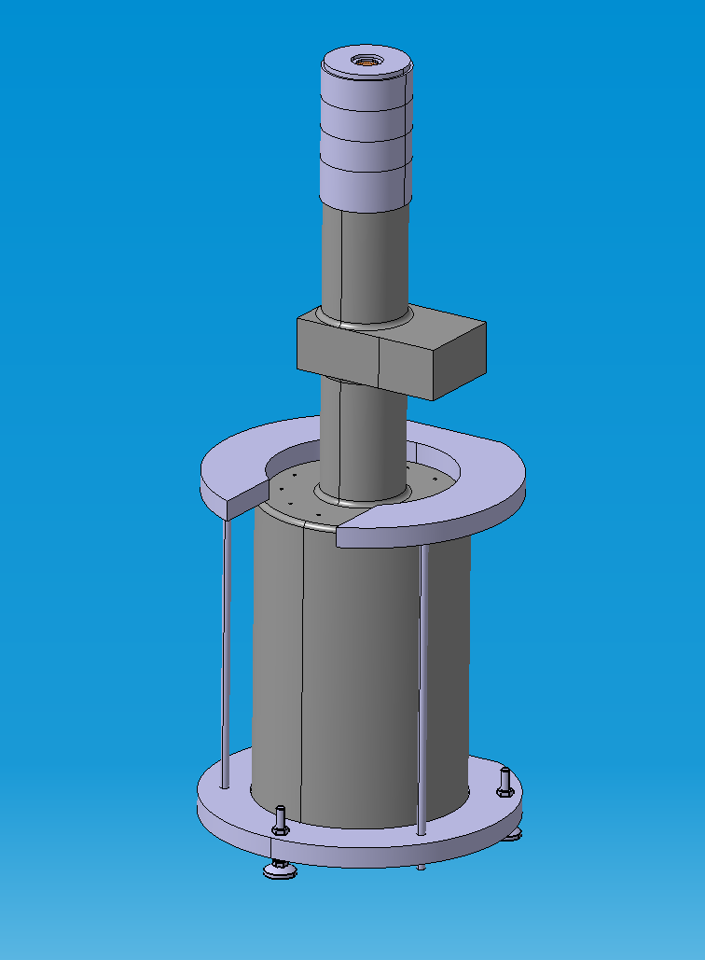
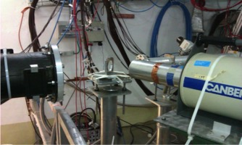
Detector Consolidation and R&D
A new program has been set up for the detector consolidation
and R&D (Coordinator M. Barbagallo).
Consolidation: PPAC, Sili Monitor, MGAS, Bicron Scintillator, L6D6 scintillator, BaF2, Timepix
R&D: Germanium, Optical TPC, Detector for g-ray detection based on SiPM, Sili for (n,cp) reaction
Ge detector mechanical structure designed ad hoc to hold both the detector and the radioactive source
CERN local team is working on the consolidation of the Silicon
Monitor and L6D6 scintillator and on the Germanium detector R&D

Slide 18
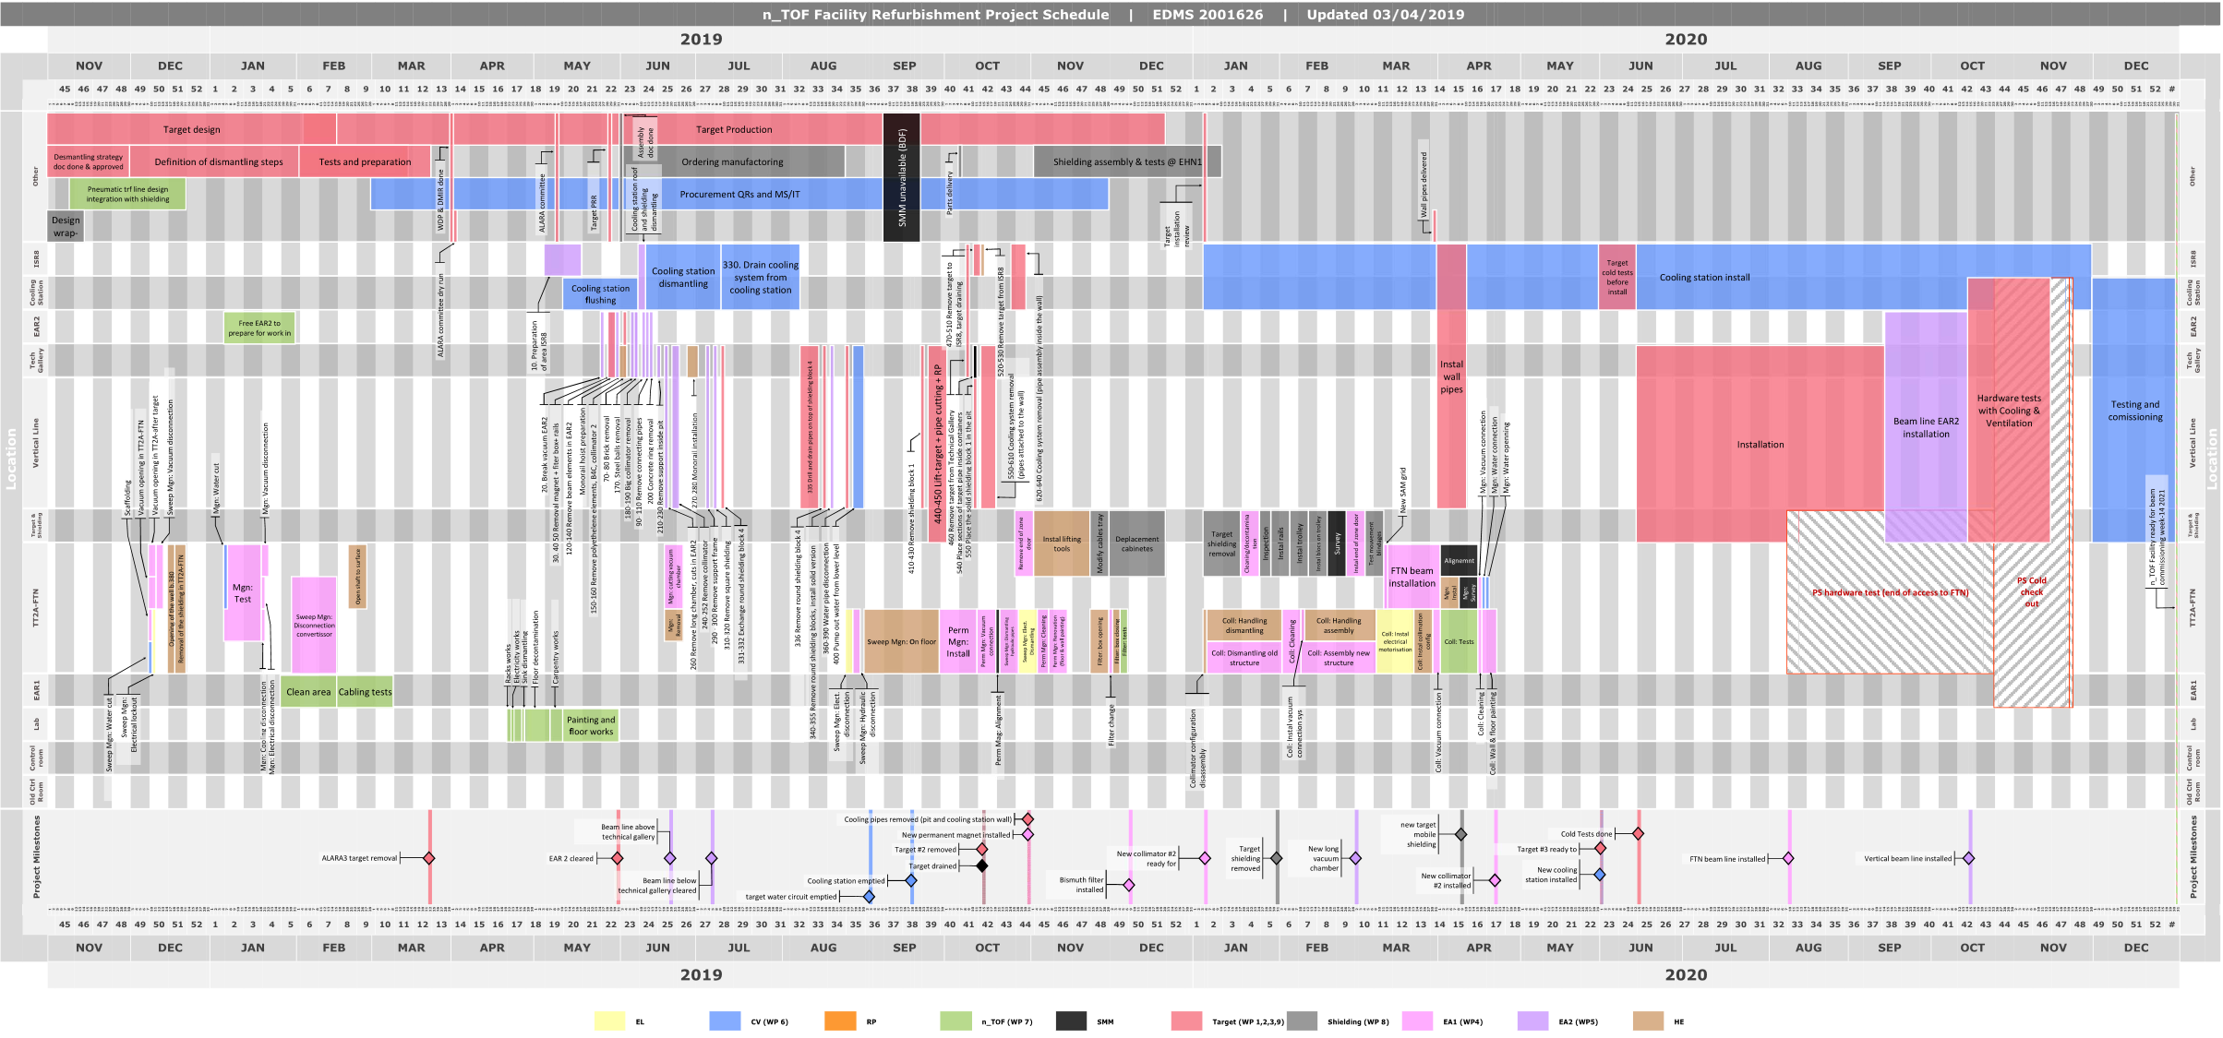
Schedule and coordination
n_TOF Facility Refurbishment Project Schedule: EDMS 2001626
Target removal

Slide 19
Thank you

