Slide 1
“New” group for transfer experiments
at ISOLDE, collaborating with T-Rex group
Originally proposed in 2013. No changes – this is still the experiment that we want to do.

Slide 2
1⁻
3⁻
2⁻
0⁻
2⁻
1⁻
⊗ π(p_{1/2})⁻¹
ν(s_{1/2})
ν(d_{5/2})
ν(d_{5/2})³_{J=3/2}
coupled to proton hole
coupled to proton hole
ν(s_{1/2})
ν(d_{5/2})
ν(d_{5/2})³_{J=3/2}
π(p_{1/2})⁻¹
^{16,18,20}N
^{18,20}N
ν(d_{5/2}) occupancy:
¹⁶N
one particle half full one hole
A = 16 18 20

Slide 3
MeV
1⁻
3⁻
2⁻
2
0⁻
2⁻
1⁻
⊗ π(p_{1/2})⁻¹
ν(s_{1/2})
ν(d_{5/2})
ν(d_{5/2})³_{J=3/2}
“OK”
1
Not OK
This is for the latest SM calculations
using a priori interaction (Otsuka).
Other calculations get ¹⁶N correct
and ¹⁸N incorrect.
Nobody can get both correct.
This one gets ¹⁸N right, most get ¹⁶N.
0
exp SM
exp SM
¹⁶N
¹⁸N
ground state
ν(d_{5/2})¹
ν(d_{5/2})³
s_{1/2} states
0
2
number of neutrons in d_{5/2} orbital

Slide 4
MeV
1⁻
3⁻
2⁻
2
0⁻
2⁻
1⁻
⊗ π(p_{1/2})⁻¹
ν(s_{1/2})
ν(d_{5/2})
ν(d_{5/2})³_{J=3/2}
“OK”
1
Not OK
0
exp SM
exp SM INOY N3LO CDB2K
¹⁶N
¹⁸N
No-Core SM
3 different NN intns
Saxena & Srivastava
arXiv 1902.01712v4
17 June 2019
ground state
ν(d_{5/2})¹
ν(d_{5/2})³
s_{1/2} states
0
2
number of neutrons in d_{5/2} orbital

Slide 5
MeV
1⁻
3⁻
2⁻
2
0⁻
2⁻
1⁻
⊗ π(p_{1/2})⁻¹
ν(s_{1/2})
ν(d_{5/2})
ν(d_{5/2})³_{J=3/2}
1
0
exp SM
exp SM
exp SM
exp SM
¹⁶N
¹⁸N
²⁰N
²²N
ground state
ν(d_{5/2})¹
ν(d_{5/2})³
ν(d_{5/2})⁻¹
ν (d_{5/2})⁶ (s_{1/2})¹
s_{1/2} states
0
2
4
6
number of neutrons in d_{5/2} orbital

Slide 6
Nobody can get both correct.
Why is this?
ν(s_{1/2})
ν(d_{5/2})
¹⁶N
¹⁸N

Slide 7
The respective isotones…
¹⁷O
¹⁹O
… are very well described
in both cases
And what’s more….
So are ¹⁵C & ¹⁷C even though
the ν(s_{1/2}) starts to intrude!
ν(s_{1/2})
ν(d_{5/2})
¹⁶N
¹⁸N

Slide 8

Why is nitrogen different?
Something seems to be happening, just for the nitrogen isotopes.
It could perhaps be cross-shell excitations giving additional neutron occupancy,
which subtly affects the magnitude of the summed proton-neutron interactions…
(this is something that better ab initio calculations should be able to address)
ν(s_{1/2})
ν(d_{5/2})
¹⁶N
¹⁸N

Slide 9
Something seems to be happening, just for the nitrogen isotopes.
OR it could perhaps be the monopole shift arising from the removal of the 0p1/2
proton, which affects the details of the neutron-neutron interactions…
(this is something that large basis SM calculations really should be able to get right)
ν(s_{1/2})
ν(d_{5/2})
¹⁶N
¹⁸N

Slide 10
MeV
1⁻
3⁻
2
0⁻
2⁻
⊗ π(p_{1/2})⁻¹
S ≥ 0.58 tentative
ν(s_{1/2})
ν(d_{5/2})
ν(d_{5/2})³_{J=3/2}
not observed
Experimental situation
S = “0.69±0.03”
1
1⁻
There is some SF information.
If the 1⁻ in red is populated strongly
then so should be the 0⁻ in red ?!?
That’s why S ≥ 0.58 for the 1⁻ because
uncertainty allows for unresolved 0⁻
But the 0⁻ is more likely to be hidden
by the 3⁻ so the 0.69±0.03 is suspect
Also the 1⁻ assignment is tentative
All of this can be greatly improved
S ≤ 0.05
0⁻
S = 0.67±0.03
3⁻
2⁻
2⁻
0
1⁻
exp SM
S ≤ 0.07
¹⁸N
Only previous (d,p) results:
C.R. Hoffman et al., Phys. Rev. C88, 044317 (2013)

Slide 11
S_{n} = 2.828 MeV
MeV
1⁻
3⁻
2
0⁻
2⁻
⊗ π(p_{1/2})⁻¹
S ≥ 0.58 tentative
ν(s_{1/2})
ν(d_{5/2})
ν(d_{5/2})³_{J=3/2}
not observed
Gamma-Rays to the Rescue!
S = “0.69±0.03”
1
1⁻
0⁻
Eγ= 121, 155, 466, 621, 742, 1170 keV
… after Doppler correction
Resolution ≤ 25 keV, ΔEγ ≥ 121 keV
So states are easily RESOLVED
and also uniquely IDENTIFIED
(The weak 155 keV branch is not
unique/essential but with ΔEγ=34 keV
should also be resolved).
S ≤ 0.05
S = 0.67±0.03
3⁻
2⁻
2⁻
0
1⁻
exp SM
S ≤ 0.07
¹⁸N
Only previous (d,p) results:
C.R. Hoffman et al., Phys. Rev. C88, 044317 (2013)

Slide 12
In many ways, the previous study at HELIOS raises more interesting questions than it answers…
Unbound ¹⁸N states that will
probably decay into
gamma-decaying ¹⁷N states.
These are likely π = + and
with astrophysical relevance
in supernovae scenarios.
BOUND
UNRESOLVED
2⁻ ,3⁻ ,0⁻ that we will resolve
tentative 1⁻ that we will confirm
States that will gamma-decay,
and hence reveal their nature,
possibly of ν(d_{5/2}² d_{3/2})
character or maybe π = +
C.R. Hoffman et al., Phys. Rev. C88, 044317 (2013)

Slide 13
negative parity
positive parity
0⁺,1⁺
(d,p)
(d,p)
¹⁸N
¹⁸N

Slide 14
S_{n} = 2.828 MeV
MeV
1⁻
3⁻
2
0⁻
2⁻
⊗ π(p_{1/2})⁻¹
S ≥ 0.58 tentative
ν(s_{1/2})
ν(d_{5/2})
ν(d_{5/2})³_{J=3/2}
not observed
Gamma-Rays to the Rescue!
S = “0.69±0.03”
1
1⁻
0⁻
Eγ= 121, 155, 466, 621, 742, 1170 keV
… after Doppler correction
Resolution ≤ 25 keV, ΔEγ ≥ 121 keV
So states are easily RESOLVED
and also uniquely IDENTIFIED
(The weak 155 keV branch is not
unique/essential but with ΔEγ=34 keV
should also be resolved).
S ≤ 0.05
S = 0.67±0.03
3⁻
2⁻
2⁻
0
1⁻
exp SM
S ≤ 0.07
¹⁸N
Only previous (d,p) results:
C.R. Hoffman et al., Phys. Rev. C88, 044317 (2013)

Slide 15
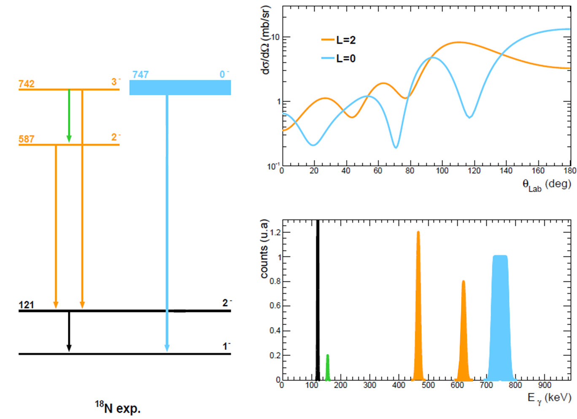

Slide 16
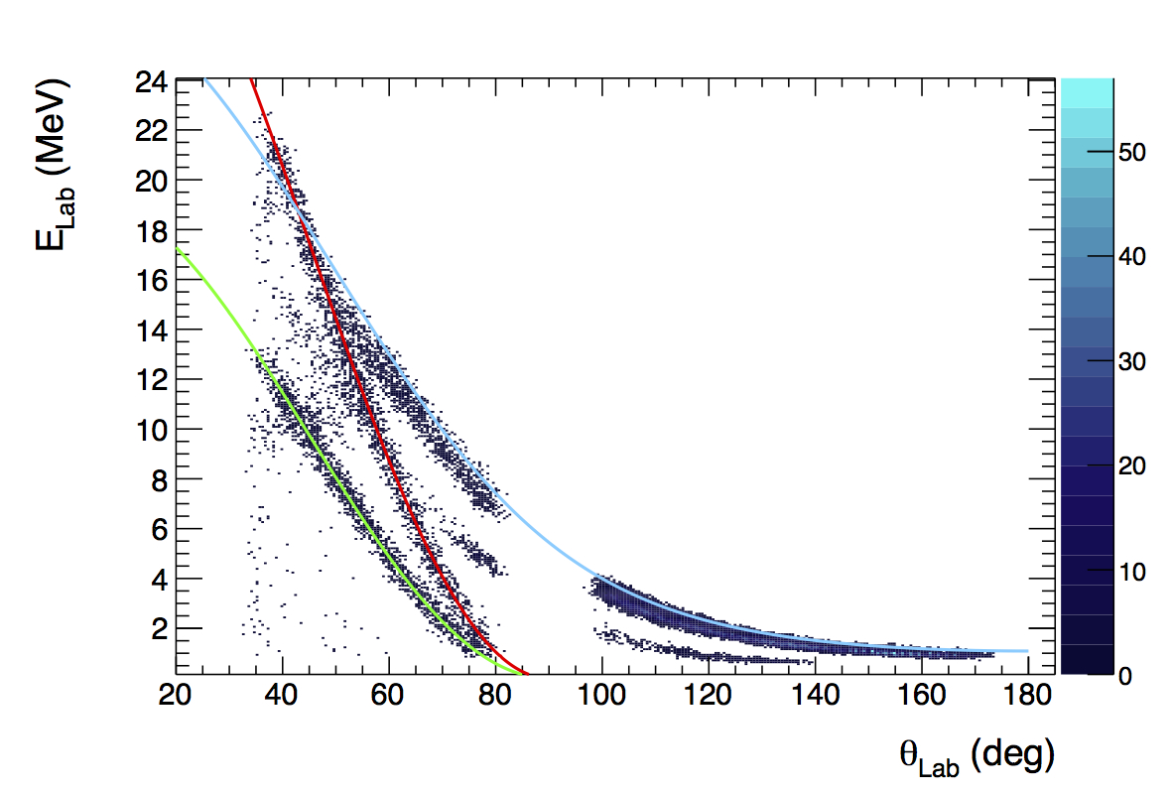
WHAT WE SHOULD OBSERVE WHEN WE PLOT THE T-REX ENERGY AGAINST LAB ANGLE
(d,d)
(d,p) centre of mass angle
40
0
(p,p)

Slide 17
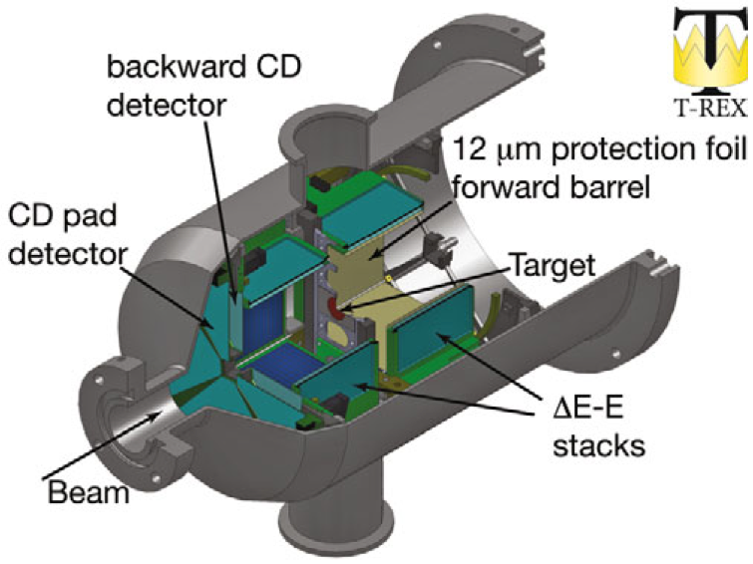

Slide 18
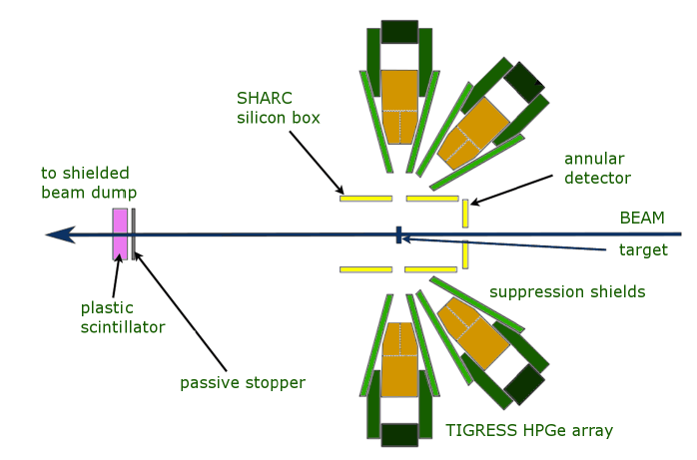
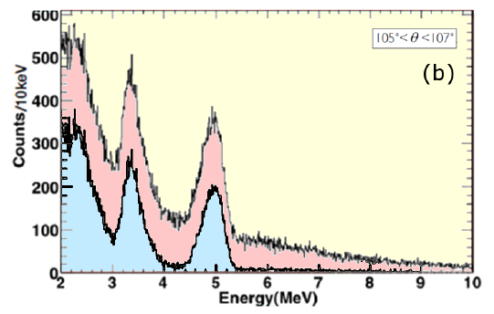
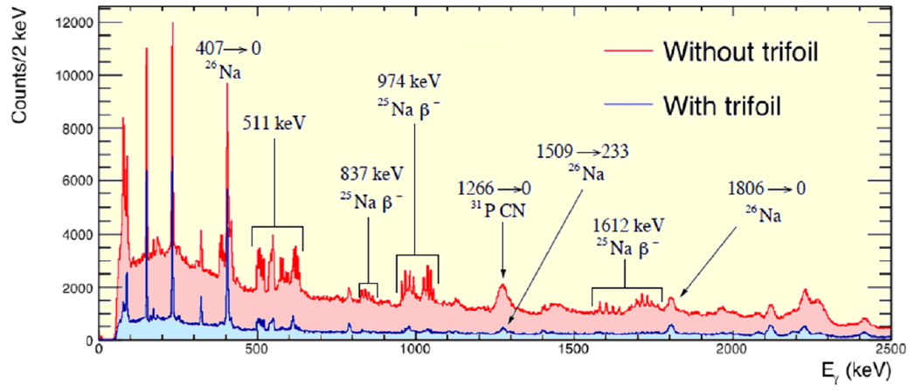
THE TRIFOIL
PARTICLES
GAMMA-RAYS

Slide 19
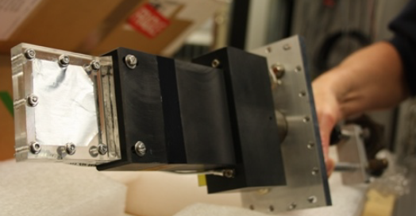
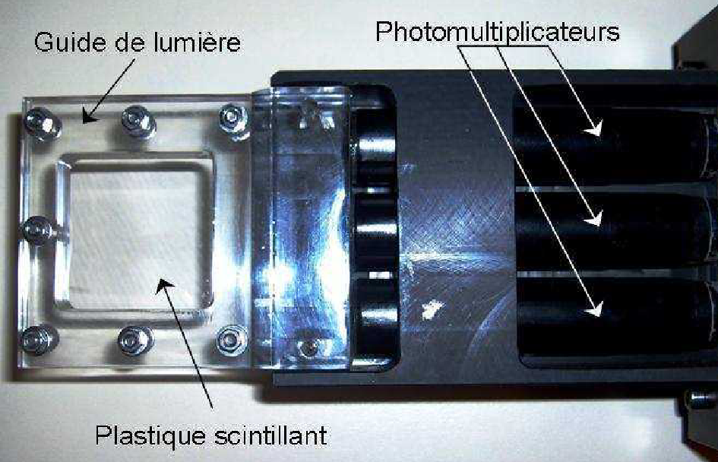
THE TRIFOIL
TRIFOIL DETECTOR
LPC Caen

Slide 20
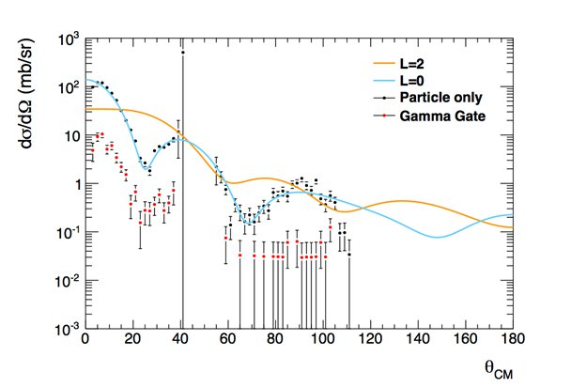
SIMULATION OF THE DIFFERENTIAL CROSS SECTION FOR ONE OF THE 0⁻/1⁻ s-WAVE STATES
Actual predicted statistics for one week of running with 0.5 mg/cm² target
Angle bins: 2 degrees in c.m.

Slide 21
SUMMARY of REQUEST
We are requesting 27 shifts of ¹⁷N beam at 5.5 MeV/A
With this, we will perform (d,p) with the ¹⁷N beam, and study all populated
states in ¹⁸N, using gamma-rays to select and identify the closely spaced levels.
Of this, 21 shifts are required in order to perform the (d,p) measurement.
We believe that we can save time by not running on a carbon target.
We would run on a carbon target (target contaminant) if time permits.
We have allowed 6 shifts for optimising the charge state to accelerate
(to minimise contaminants) (extraction will use NO⁺ from nanoCaO+O₂, + plasma)
and stripping methodology (what foils, and where) to eliminate ¹⁷O.
We are requesting 3 shifts for setting up with a stable pilot beam, to
ensure that detectors and electronics are set up correctly
We request 10⁴ pps for the ¹⁷N beam, on the reaction target.
The beam should be delivered at the T-REX + Miniball setup.
We have allowed for a 5mm diameter beam spot on target (dominates the resolution).

Slide 22
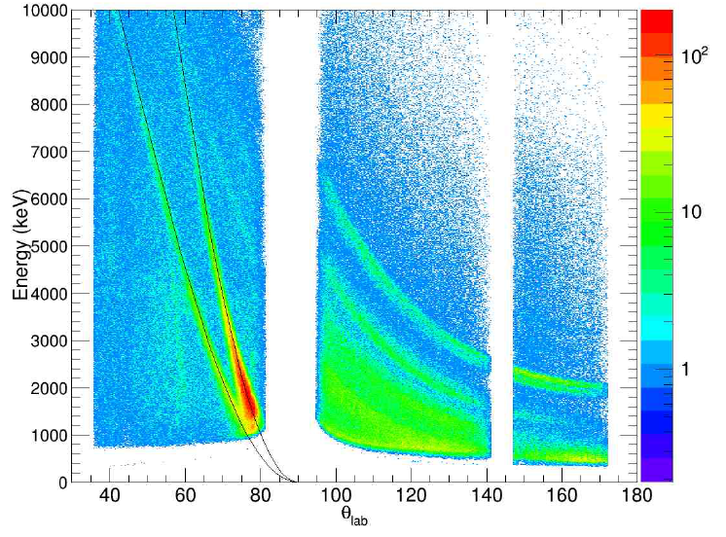

Slide 23
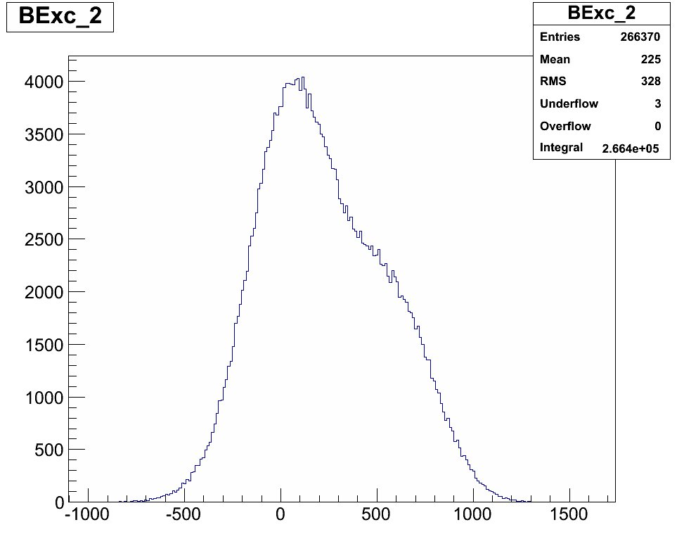
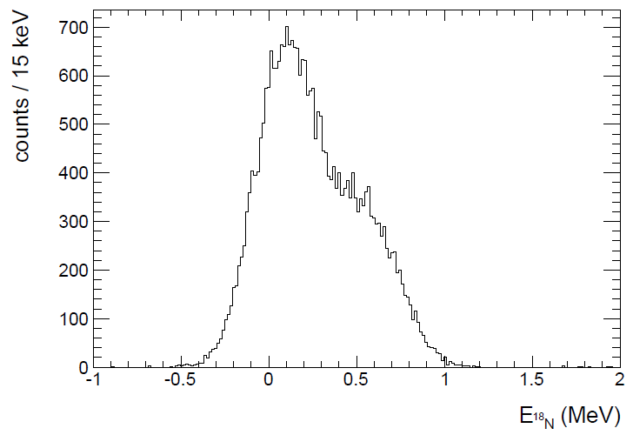
Reconstructed excitation energy for lowest four known states, assuming isotropic production
Klupp/Muecher @ Munich
Matta @ Surrey/LPC (approx)

