Slide 1
Status of the CM4 repair work
W. Venturini Delsolaro and M. Therasse, on behalf of all the CERN teams involved
INTC meeting- 2 July 2019

Slide 2
Outline
HIE ISOLDE SC linac in 2018
CM4 refurbishing plans and changes occurred
Work done so far (January - June 2019)
Next steps
Projected energy reach of HIE ISOLDE SC linac at the restart

Slide 3
Reminder: HIE ISOLDE in 2018
During hardware commissioning a non conformity was evidenced on Cavity 3 of CM4: faulty contact at the input coupler
We decided not to put power in this cavity: the risk was to contaminate the whole cryomodule in case of release of material in the common vacuum.
A few cavities are limited by field emission (in CM1 and CM2), it was decided to downgrade their settings rather than re-condition them in situ.
Upon initiative of BE-RF, the LS2 committee gave green light to exchange CM4 in 2019
No resources to intervene on more than one CM
Detailed analysis confirmed that CM4 exchange offered the highest potential for improving the performance of the machine (by recovering one full cavity)

Slide 4
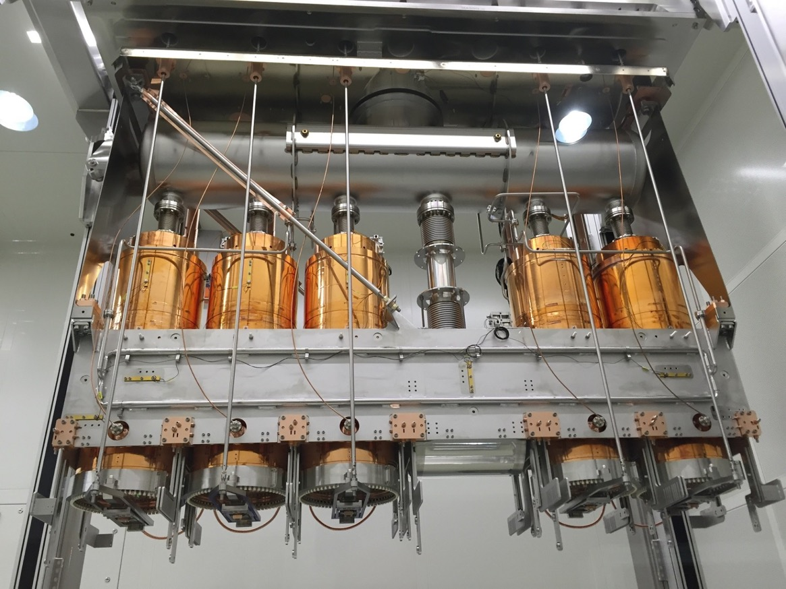
CM1
Cryomodule 4 layout
Beam
SC solenoid
QSS.1 (XLH3.5)
QS23.1 (XLH3.4)
QS22.2 (XLH3.3)
QS19.1 (XLH3.2)
QS17.2 (XLH3.1)

Slide 5
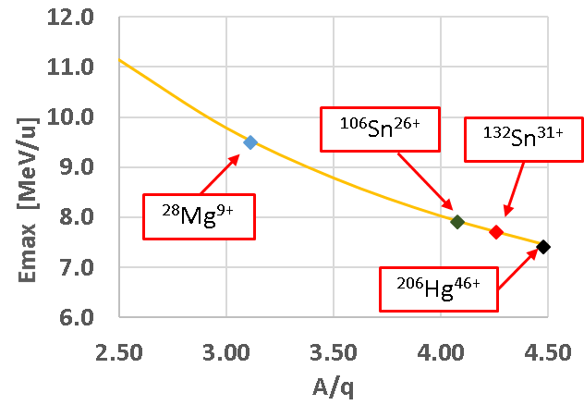
2018 settings (locked) and E/u versus A/q reachable in 2018 run
cavity | proposal [MV/m] | Achieved [MV/m]
XLL2.1 | 5 | 5
XLL2.2 | 5 | 5
XLL2.3 | 5 | 5
XLL2.4 | 5 | 5
XLL2.5 | 2 | 2
XLH1.1 | 5.5 | 4
XLH1.2 | 5.5 | 4.5
XLH1.3 | 5.5 | 5.5
XLH1.4 | 5.5 | 4
XLH1.5 | 5.5 | 5
XLH2.1 | 5 | 5.5
XLH2.2 | 4 | 5.5
XLH2.3 | 5 | 5.5
XLH2.4 | 5 | 5.5
XLH2.5 | 5 | 5.5
XLH3.1 | 5 | 4.2
XLH3.2 | 5 | 4.2
XLH3.3 | 0 | 0
XLH3.4 | 5 | 4.5
XLH3.5 | 5 | 4
CM1: OK, CAV5 has repopulated FE, it can be conditioned in situ if needed
CM2: Anomalous static heat load and microphonics. Not understood. Disappeared during the run. CAV2 has mild FE, can be conditioned in situ
CM3: Initial stability issues during hardware commissioning but finally very good
CM4: Apart from cavity 3 (not used), also low Q on two others and stability issues
Courtesy A. Rodriguez Rodriguez

Slide 6
Stress test after physics run on 7 December 2018: cavities locked for a few hours to higher fields
cavity | proposal [MV/m] | Achieved [MV/m] | Stress test [MV/m]
XLL2.1 | 5 | 5 | 6
XLL2.2 | 5 | 5 | 5
XLL2.3 | 5 | 5 | 5.5
XLL2.4 | 5 | 5 | 5
XLL2.5 | 2 | 2 | 2.5
XLH1.1 | 5.5 | 4 | 5.5
XLH1.2 | 5.5 | 4.5 | 6
XLH1.3 | 5.5 | 5.5 | 6
XLH1.4 | 5.5 | 4 | 6
XLH1.5 | 5.5 | 5 | 5
XLH2.1 | 5 | 5.5 | 5
XLH2.2 | 4 | 5.5 | 6
XLH2.3 | 5 | 5.5 | 5.5
XLH2.4 | 5 | 5.5 | 6
XLH2.5 | 5 | 5.5 | 5
XLH3.1 | 5 | 4.2 | 4.5
XLH3.2 | 5 | 4.2 | 4.5
XLH3.3 | 0 | 0 | 0
XLH3.4 | 5 | 4.5 | 5.2
XLH3.5 | 5 | 4 | 5.2

Slide 7
Foreseen steps for CM4 refurbishment
Re-deployment of “logistic area” in the extension building (available in Jan 2019)
Disconnection of CM4 just after the winter stop (Jan. 2019)
Transport to SM18 (March. 2019), in front of the HIE ISOLDE clean room
Finalize set of spare cavities (at least with QSS3 fully qualified), prepare them and store for installation (Nov 2018-March 2019)
Open CM4 in clean room, remove all cavities, rinse 2, replace the others (window between April- August 2019- no scheduled power cuts when CM is open!)
Closure, cold test in M9 (September-December 2019)
Re-install CM4 in the HIE ISOLDE linac (as from January 2020)

Slide 8
Changes occurred and new baseline
Of the three spare cavities available
  QSS3 did not perform well at vertical test. The reason is now understood (foreign macro-particle on Nb)
  QSS2 and QS18 had excellent performance in vertical test, but…
In both cases, after final rinsing particles were found in the filter of the exhaust water
A careful investigation (optical inspections, SEM/EDX analysis of particles) was conducted
We can’t exclude these particles be fragments of the Nb film detached from the cavity surface
Consequently, and in order to minimize the risk for the users,
BE-RF-SRF and TE-VSC-CC agreed on the following actions:
  Reinforce mesures for slow venting, and avoid re-rinsing of already installed cavities
  Limit the intervention to the repair of the RF line, wihtout replacing working cavities*
  Re-test the spare cavities in vertical cryostats (in second half of 2019)
*N.B.: spare cavities would have offered lower cryogenics consumption, not higher fields, with respect to the installed ones. Howevere operations in 2018 were not limited by cryogenics power

Slide 9
Case of QS18 and QSS2
EDX confirmed the particles are composed of pure Nb and their thickness is at least 2 𝜇m

Slide 10
Work done on CM4 so far (main points)
CM transport to SM18 (14 March)
RF measurements
Slow venting
CM opening and RP inspection, shutters closure
Survey
Diagnosis and repair of RF line of CAV3
Inspection and re-soldering of RF cables where needed
Re alignment
Closure, slow pump down, leak checks under pressure
Transport and positioning in M9 (26 June)

Slide 11
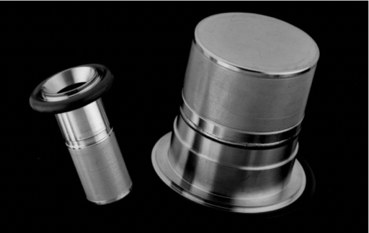
Slow venting of CM4
Improvements respect to CM1:
Venting from the top has the advantage the flow goes in same direction as gravity.
A diffuser filtering particles ≥ 0.003 μm was installed in the clean room. The space between the filter and the shutoff valve was assembled in clean conditions
Dosing valve to control the flow. This time we have targeted a venting time of maximum 2 mbar/min, final value was set to 0.8 mbar/min.
Courtesy J A. Ferreira Somoza

Slide 12
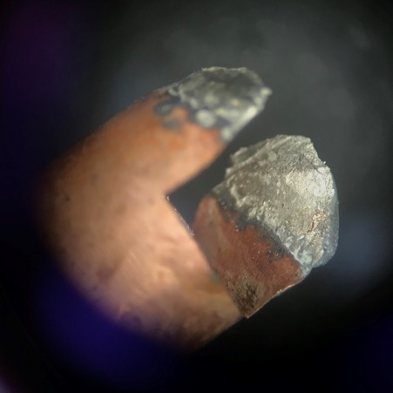
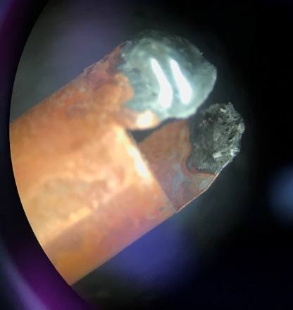
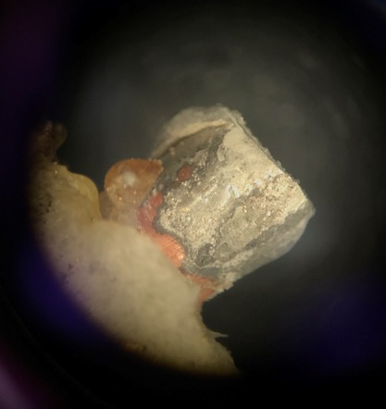
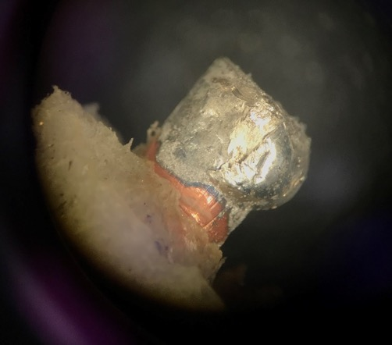
So, what was the matter with CAV3?
-
The soldering of inner conductor of the coax cable to coupler antenna was damaged after the first cool down.

Slide 13
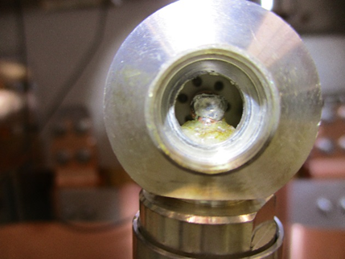
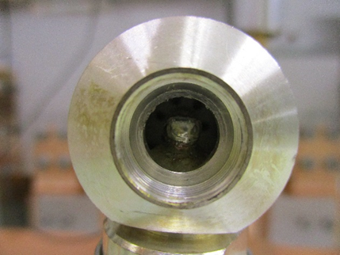
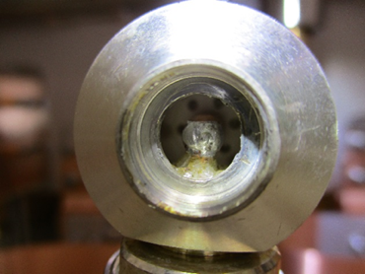

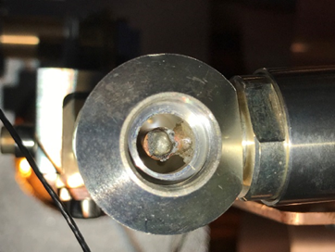
Inspection of the weak spot at all other cavities revealed similar features albeit less severe
QS17
QS19
QS22
QS23
QSS1

Slide 14
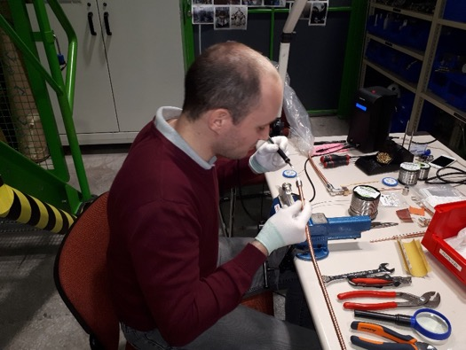
Soldering re-done with improved technique

Slide 15
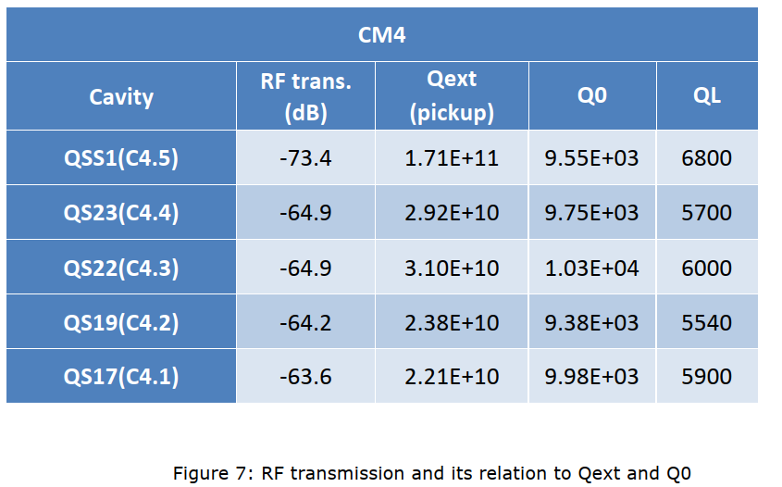
RF measurements at warm
2017 measurements (EDMS 1879571 v.1)

Slide 16
RF measurements at warm: frequency and tuning range
QS17
QS19
QS23
101.253 MHz
101.269 MHz
101.257 MHz
101.259 MHz
101.273 MHz
101.261 MHz
Flat
Flat
Flat
Target
7.2 KHz
19 KHz
21.6 KHz
Target
42.75 KHz
47.19 KHz
51.35 KHz
Target
Middle
Middle
Middle
15.55 KHz
35.89 KHz
28.26 KHz
Bottom
Bottom
Bottom
101.296 MHz
101.316 MHz
101.308 MHz

Slide 17
RF measurements at warm: frequency and tuning range
QS22
QSS1
101.256 MHz
101.262 MHz
Flat
101.259 MHz
101.265 MHz
Flat
21.3 KHz
14.8 KHz
Target
42.97 KHz
56.88 KHz
Middle
Middle
Target
18.86 KHz
38.7KHz
Bottom
Bottom
101.299 MHz
101.319 MHz

Slide 18
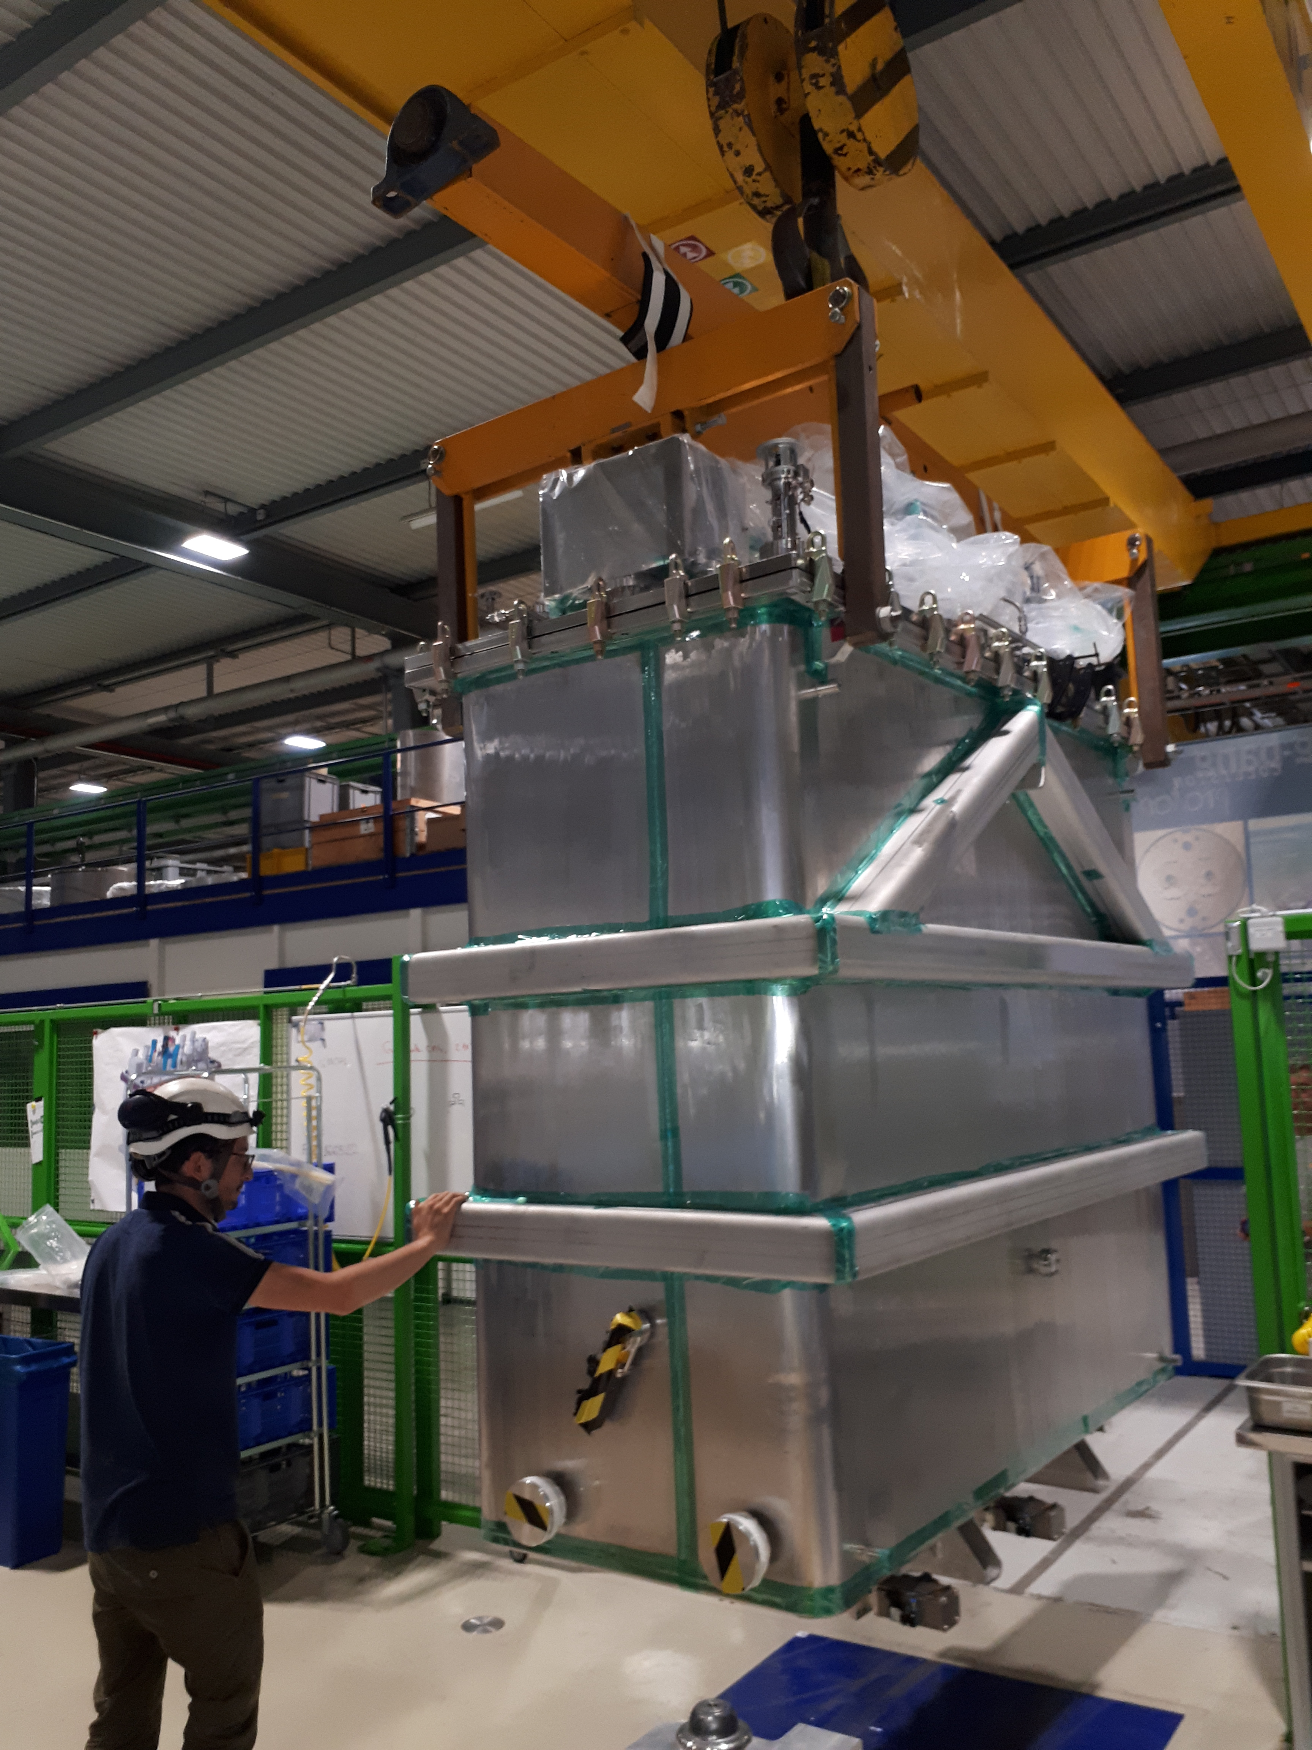
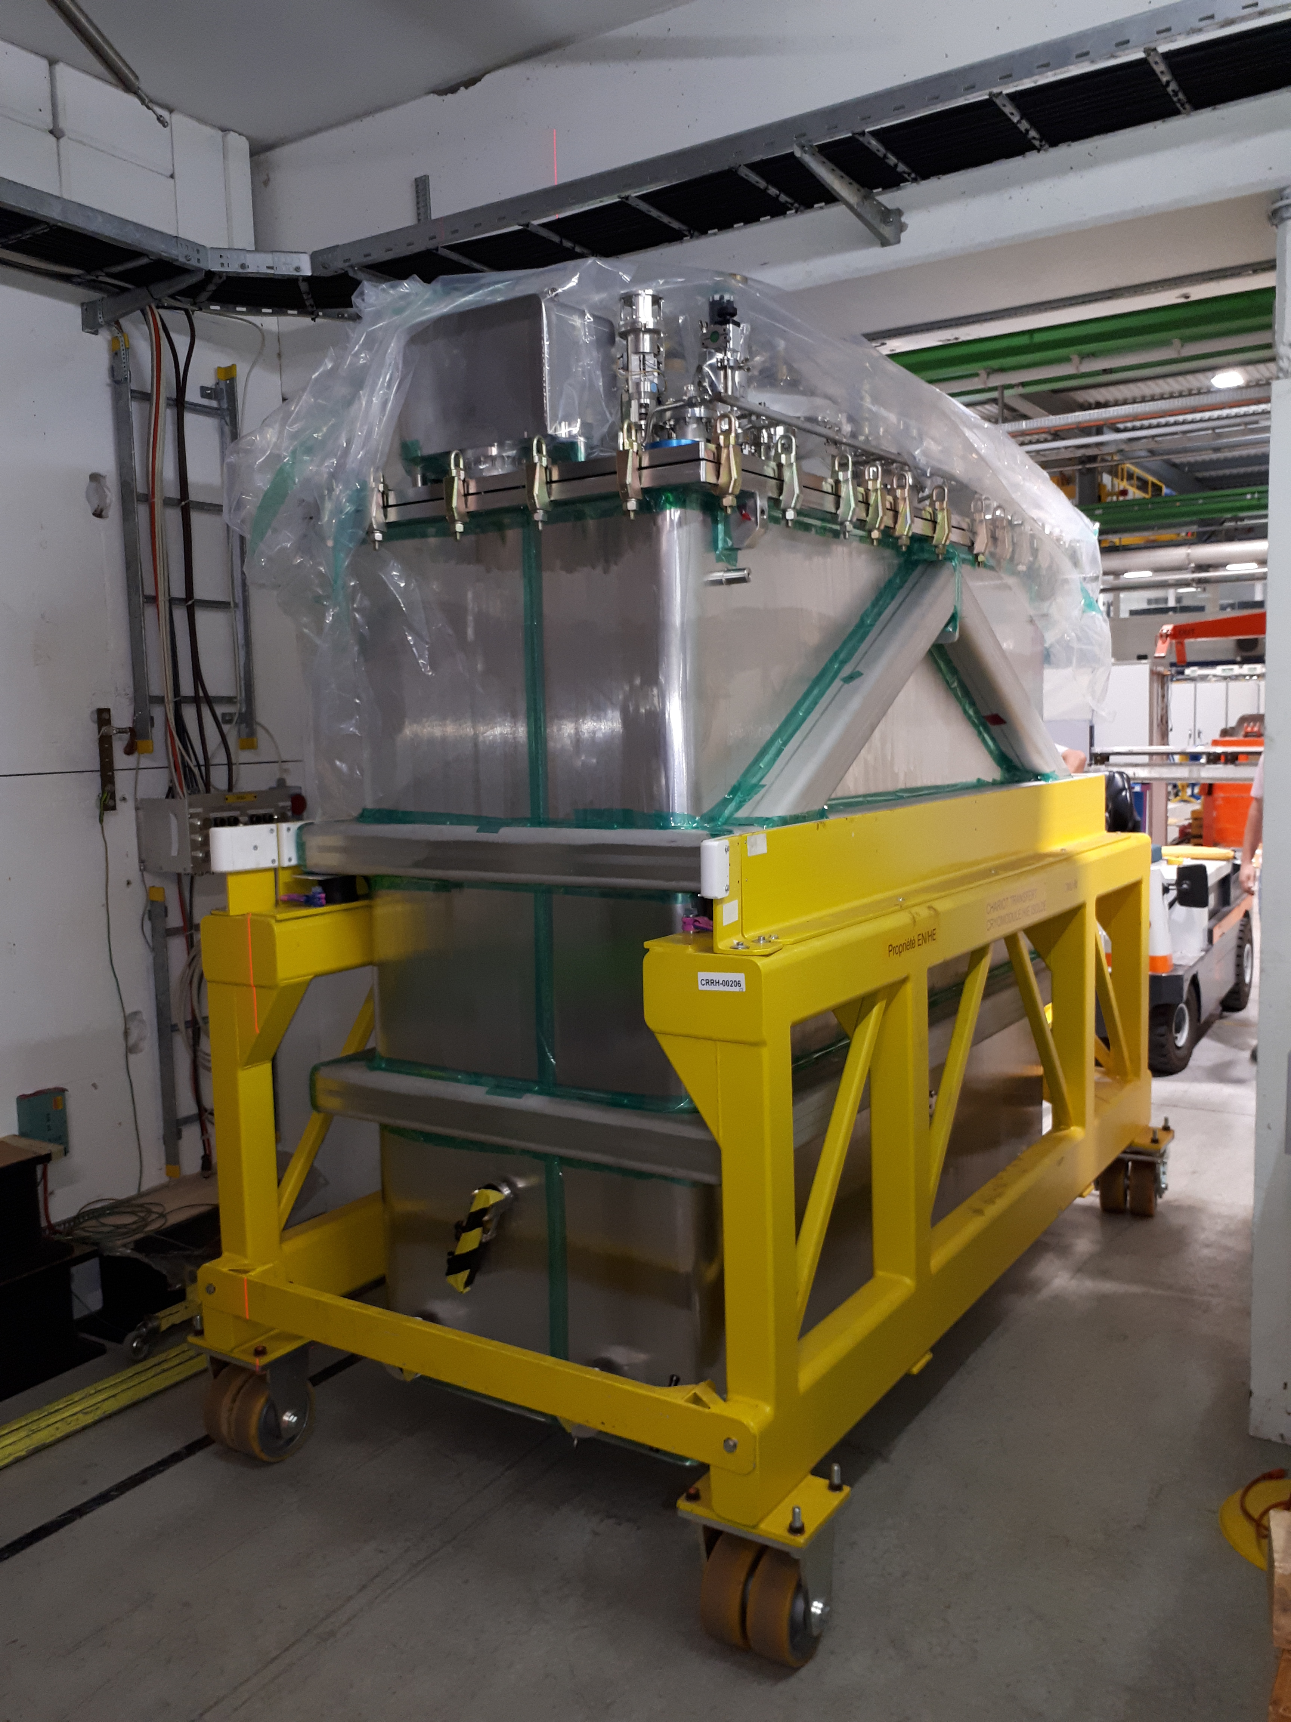
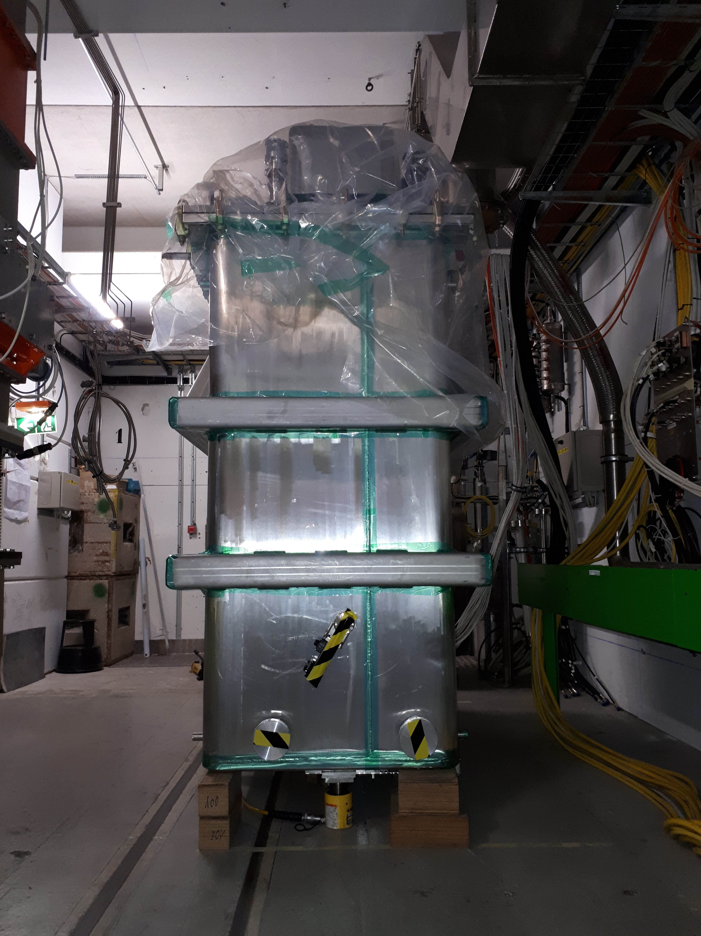
CM4 transport to the test bunker (June 26)

Slide 19
Next steps
Cryogenics connections
RF, solenoid, controls and instrumentation cabling
Interlock checks
Cool down start ( ~ 15 July onwards)
Cavity conditioning above Tc (end July)
Cold test (August- September)
If cold test OK, transport to ISOLDE by end 2019

Slide 20
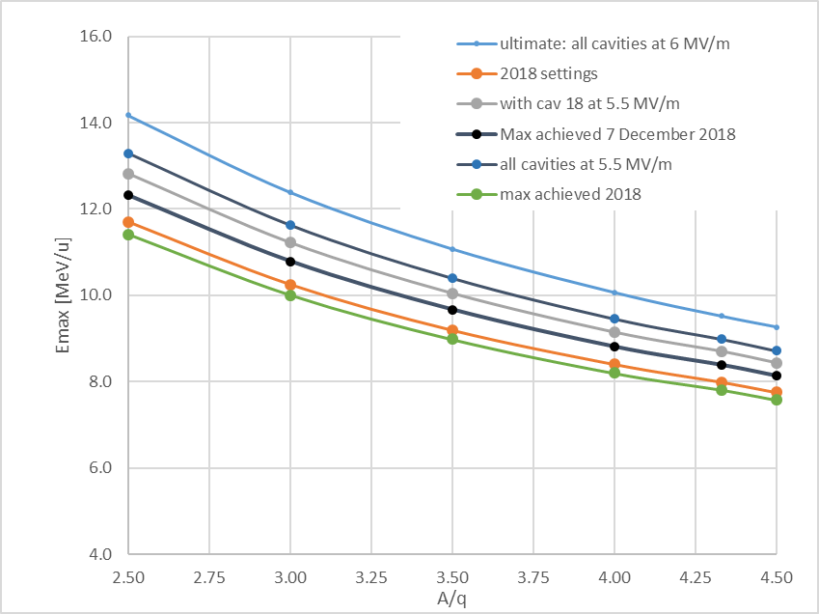
Foreseeable energy reach of the HIE ISOLDE linac after LS2
10 MeV/u at A/q=3.5
9 MeV/u at A/q=4
8.4 MeV/u at A/q=4.5

Slide 21
Summary
CM4 repair work proceeding on schedule
Issues with spare cavities (suspect delamination of Nb film)
Technical choices dictated by minimum risk approach in terms of energy reach at HIE ISOLDE after LS2
Main limitation to stabilize ultimate fields (6 MV/m in all cavities) comes from pressure fluctuations in the cryo-plant
A further consolidation envisaged is to complete the set of spares with missing components to build a fifth cryomodule and install it on line
This proposal was presented and is being considered by Accelerator Consolidation Project management

