Slide 1
WP5: Detector Performance: status and plans
Notes:
Tittle page and out line

Slide 2
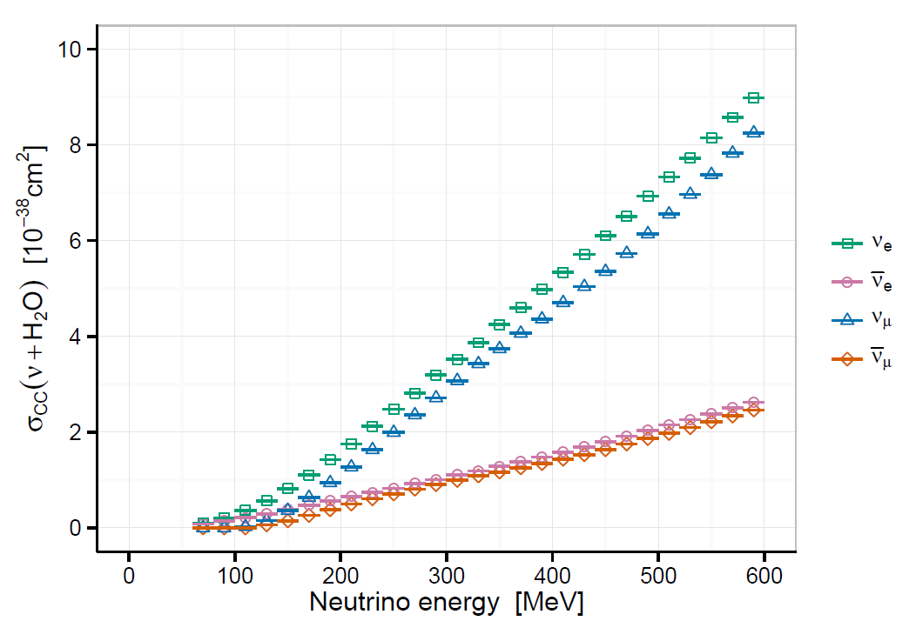
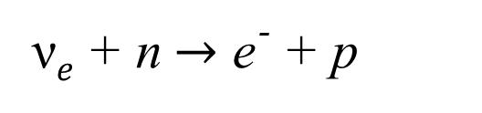
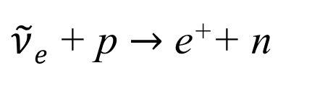
Processes to be measured
QE with a muon in the final state:
QE with an electron/positron
in the final state:
ν$e$+ n$→$ e־ + p
$\tilde{ν}e$+ p $→$ e⁺+ n
Small admixture (< 5% ?) of single pion production:
E_{th}=277 MeV
Default GENIE 2.8.0
E_{th}=485 MeV
Important (not known) background
in the Far detector (difficult to measure):
E_{th}=145 MeV

Slide 3
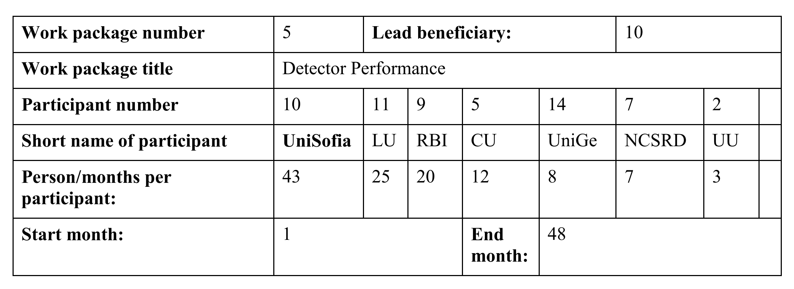
Work package provisions

Slide 4
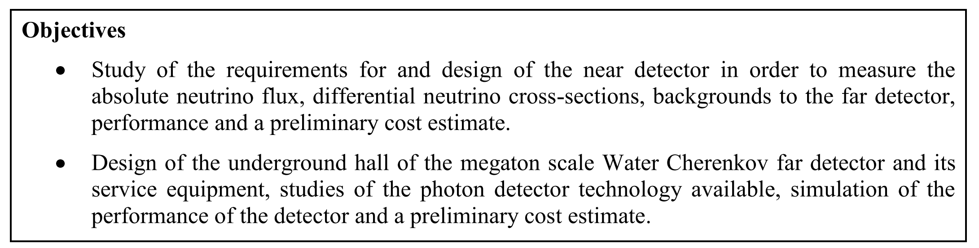
Work package objectives

Slide 5
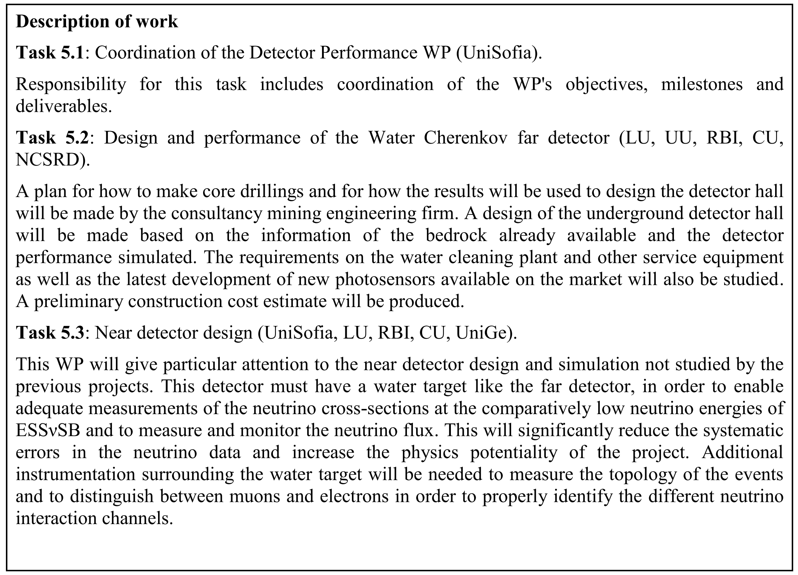
Description of work

Slide 6
Deliverables & Milestones
Delivered
 | No. | Deliverable name | Delivery date (months)
5.1 |  | Near detector requirements | 8
5.2 |  | Mine evaluation for the far detector | 24
5.3 |  | Design of near detector | 36
5.4 |  | Design of the far detector and its performance evaluation | 42
Approaching…
No. | Milestone Name | WP | Due date (months) | Means of verification
MS8 | Design concept of the near detector | 5 | 24 | Design concept of the near detector
MS16 | Choice of optimal baseline scenario | 5,6 | 40 | Choice of optimal baseline scenario
Approaching…

Slide 7
Status

Slide 8
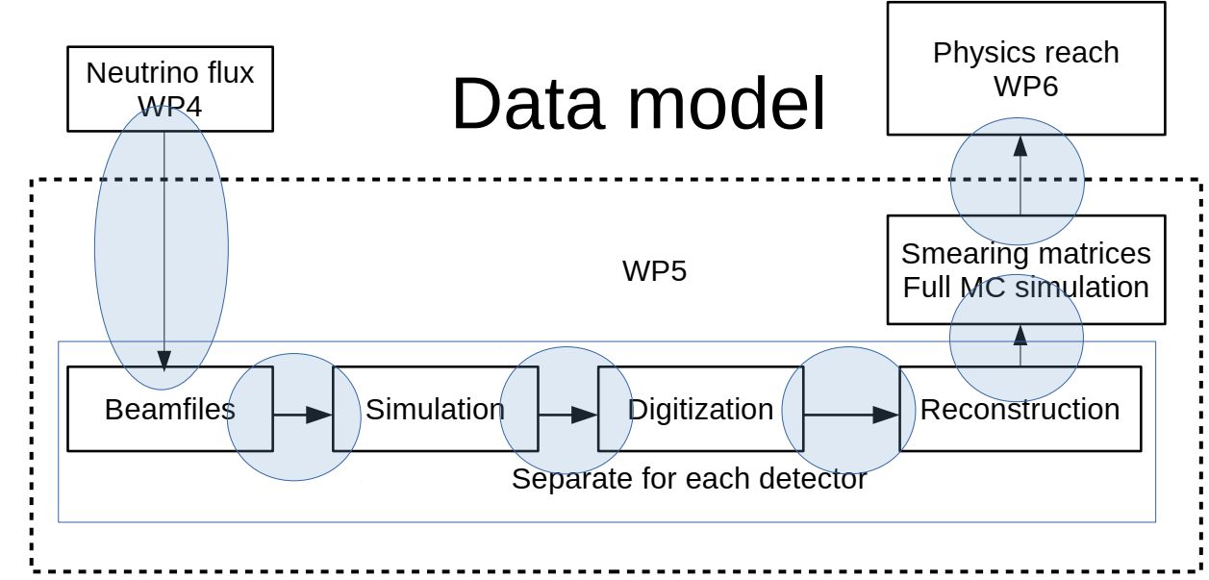
Software framework
Software stack:
C++11, FairRoot – framework to put everything together, ROOT v6 – data model, data persistency, geometry definition, ROOTVMC – for particle propagation (using Geant3/Geant4); included in FairRoot, GENIE – neutrino event generator, CMAKE – build system; included in FairRoot; DoxyGen – documentation system; GitHub – software repository.
Simulation flow and data model defined
FairRoot based software framework (EsbRoot) developed and in use
simulation/reconstruction codes for water Cherenkov detectors: MEMPHYS and WCSim/fiTQun are installed and development of our own upgrades/tunes is in progress

Slide 9
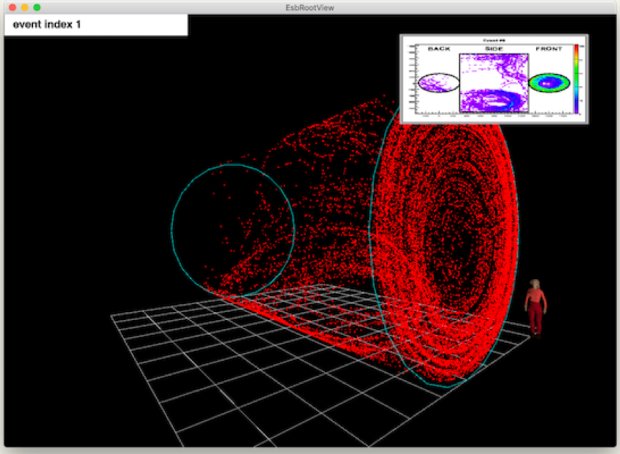
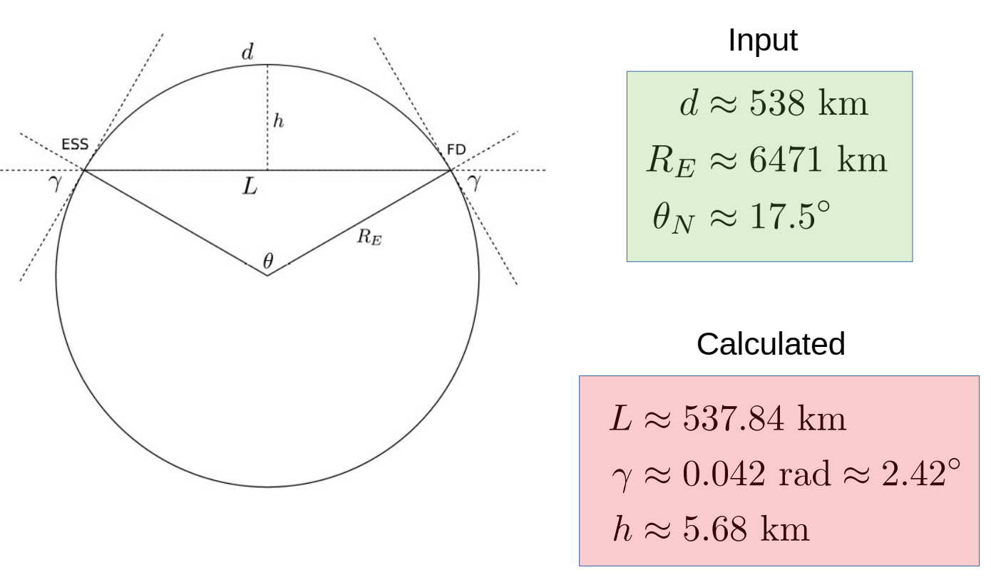
Software framework (cont’d)
Global and local coordinate systems have been defined and transformations between them calculated and agreed upon
Access to the computing cluster of the University of Zagreb (in total about 3100 processor cores, with 10TB of disk space allocated for us, https://www.srce.unizg.hr/en/isabella-cluster )
Realistic neutrino flux in GENIE (version 3.0.4) implemented
EsbRootView (version 2.0.0) is available:
sFGD detector can be displayed in either solid or wire-frame cubes, bash script for cuts and filters to look at specific processes and particles is available, event-time video can be watched, possible development for outreach is possible.

Slide 10
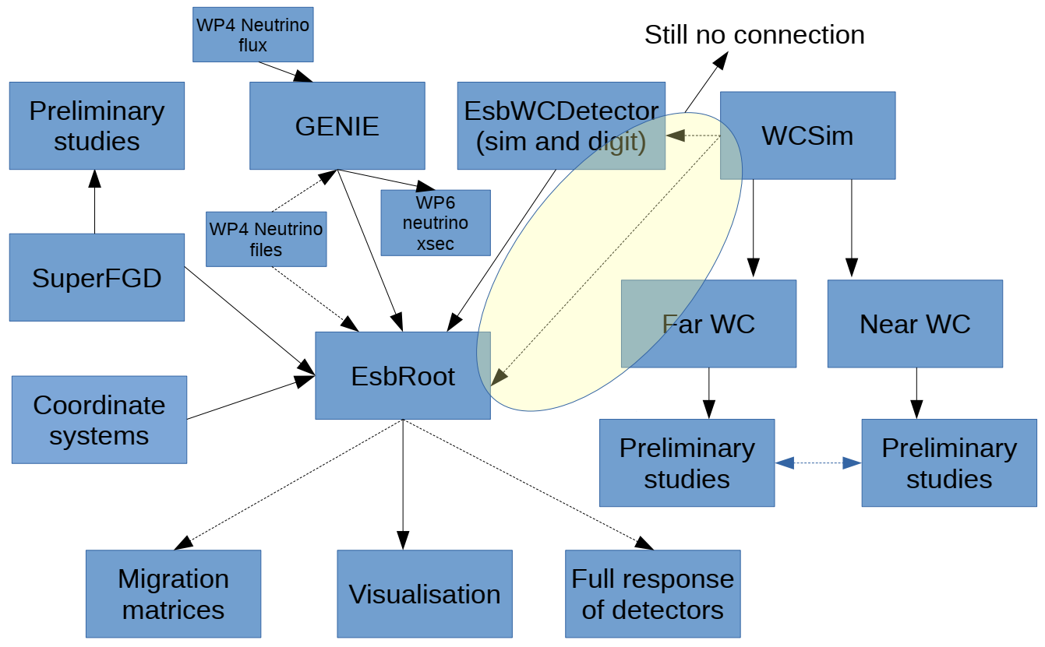
Our software schema

Slide 11
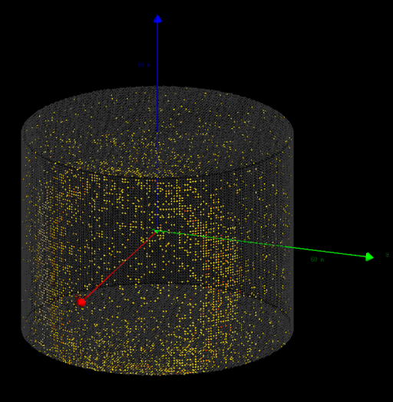
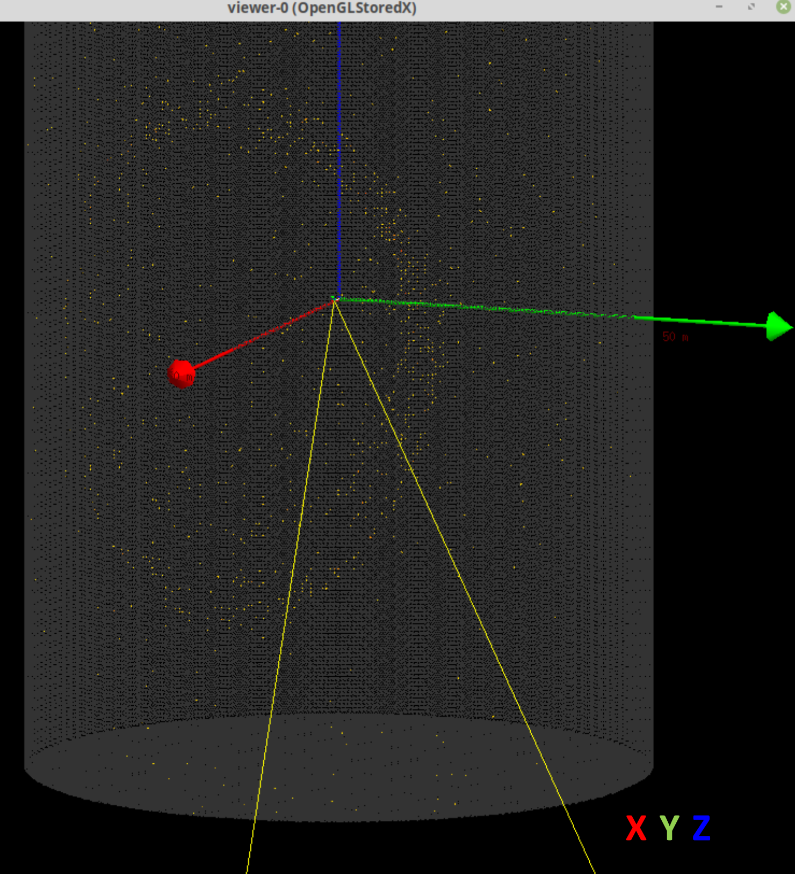
Far detector
MEMPHYS type water Cherenkov detector, ~500 ktonnes fiducial mass, two standing cylindrical tanks
WCSim simulation package and fiTQun reconstruction one are installed, tested and in use. For the moment HyperK geometry (70.8 m diameter, 54.8 m height) and single particle with fixed energy generator is used. Optimisation of the detector geometry and coverage of the walls with photo-sensors, using realistic neutrino beam is ahead.
MEMPHYS geometry (65 m diameter, 103m height, ~30% PMT coverage, 8-inch or 10-inch, is implemented in WCSim. The aim is to reproduce the EUROnu results. fiTQun tuning is needed for this geometry.

Slide 12
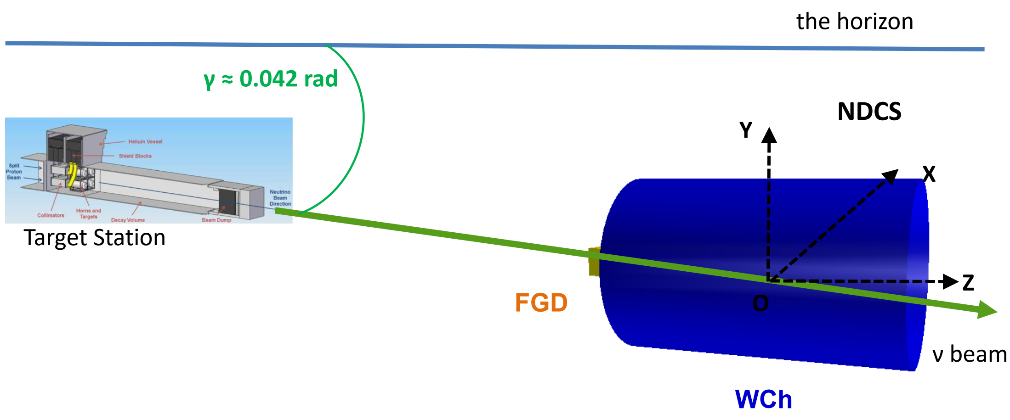
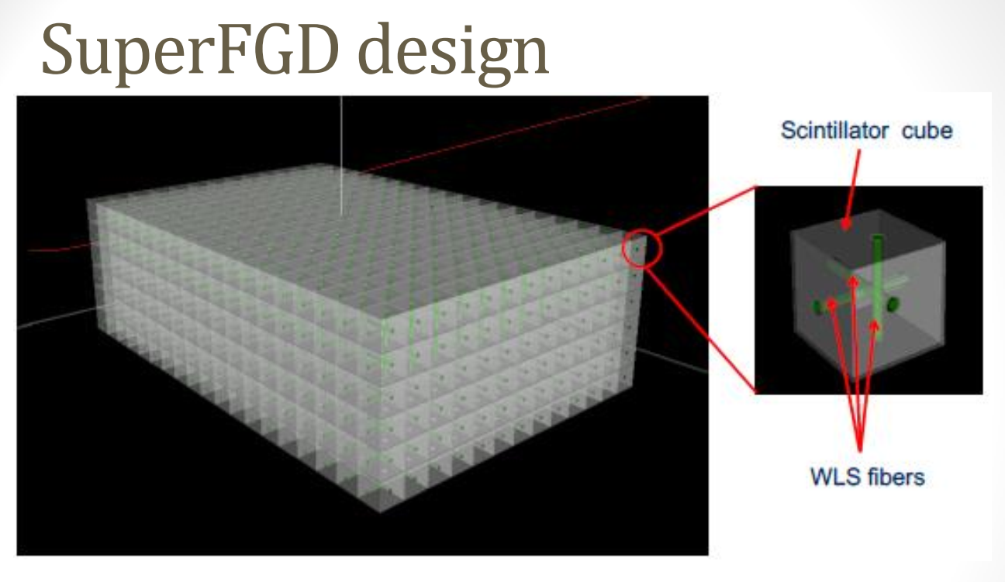
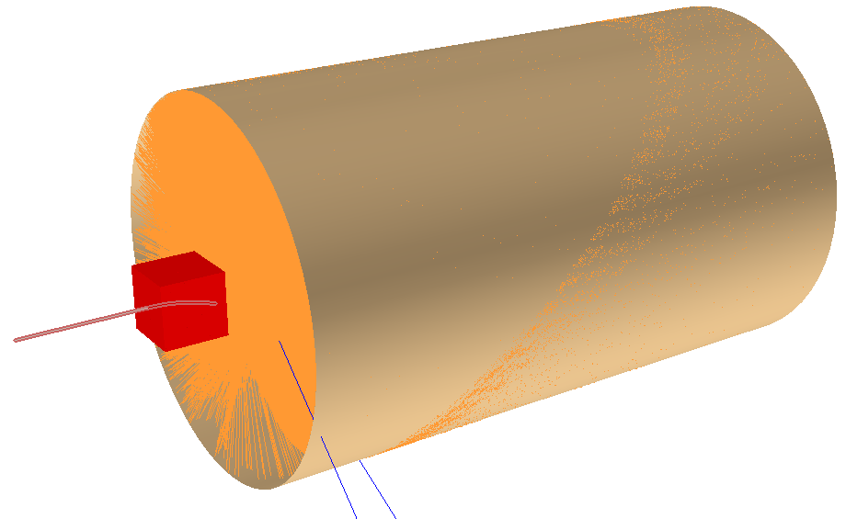
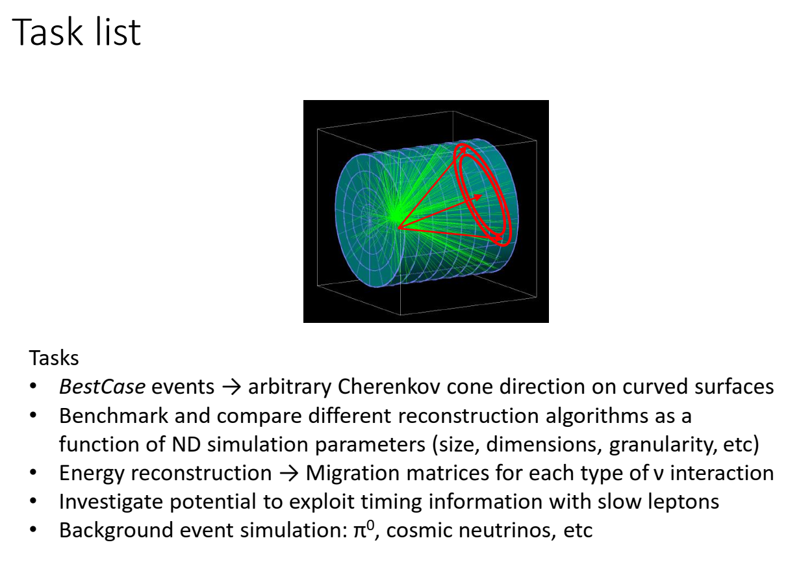
Near detector
Near detector: Fine grained tracker in (~1 tonne) magnetic field + ktonne mass water Cherenkov detector
A muon passing through FGD (0.5T field) and entering into the near WC creating Cherenkov light and decaying (the two blue tracks are neutrinos).

Slide 13
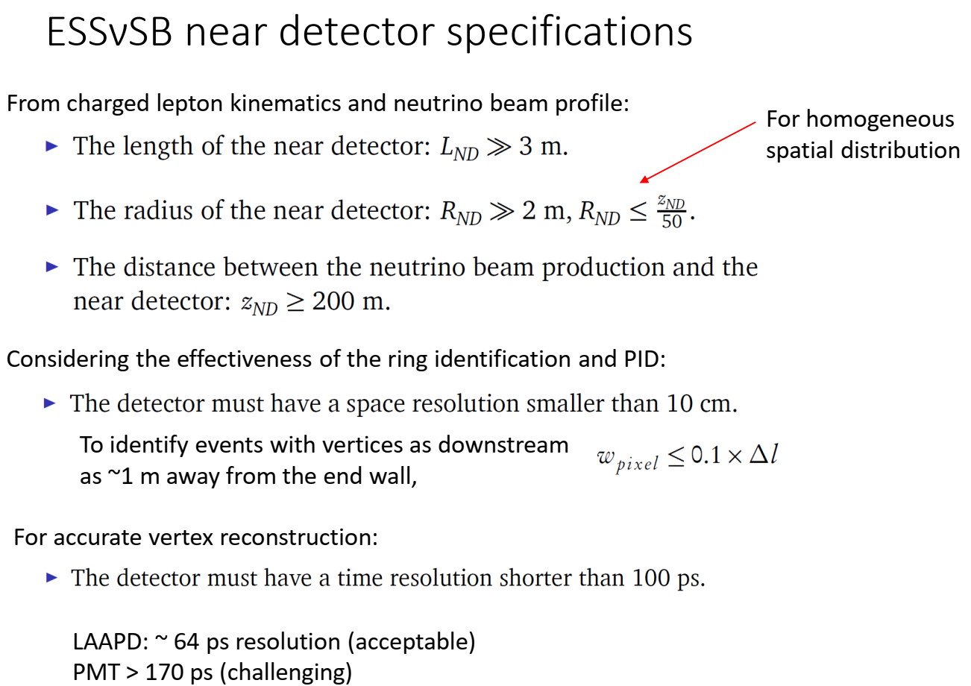
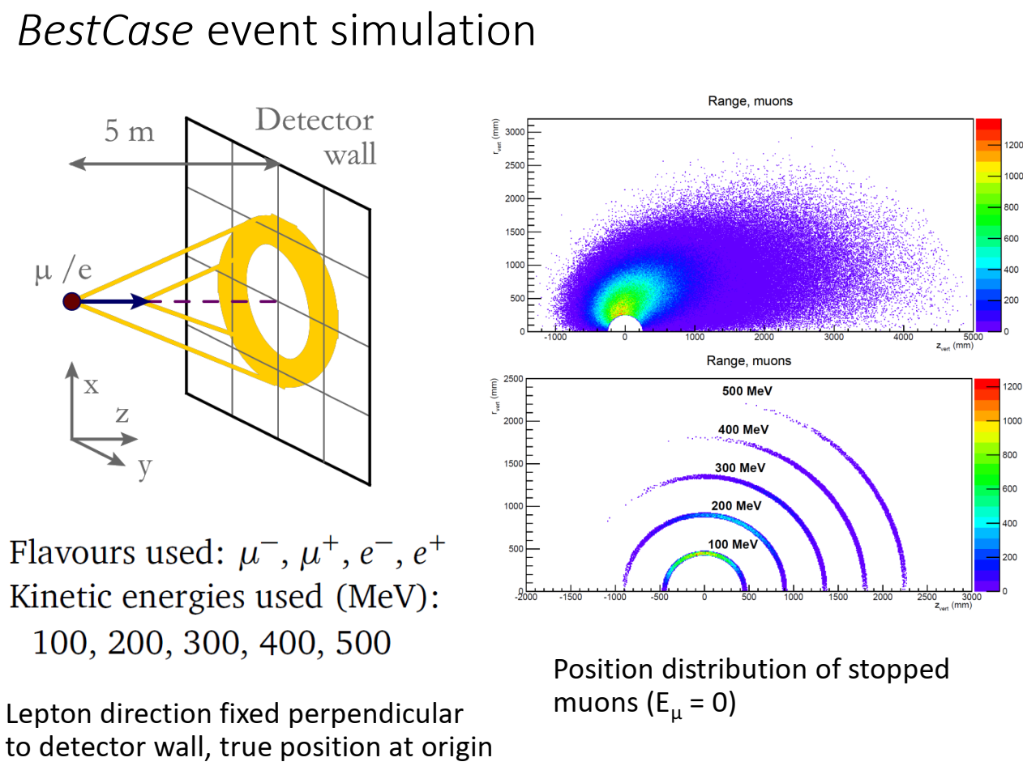
Water Cherenkov near detector

Slide 14
WCh near detector (cont’d)
Combined simulations of FGD and WCh
Simulation of a WCh near detector by scaling down the HyperK geometry exactly by a factor of 5, i.e. 20-inch PMT diameter to 4-inch. This resulted in a ND dimensions of 10.96-m length and 7.08-m radius. Both the HyperK and this ND have exactly the same number of PMTs: 38448. fiTQun results without dedicated tuning for this ND geometry still gave reduced reconstructed energies: E_{rec}/E_{true} ~ 50% for electrons and ~ 65% for muons in the range 0.5-500 MeV
Scripts to run on WCSim output files to extract true vertex/direction/energy information, as well as PMT hit information for comparison with fitQun and EsbRoot outputs.
Comparison of the simulated response of 300 MeV electrons in WCSim and EsbRoot. The results looked very similar but there was a bit more pronounced tail (large signals) in WCSim. The time response is also compared and WCSim has a long tail which was not seen in EsbRoot.

Slide 15
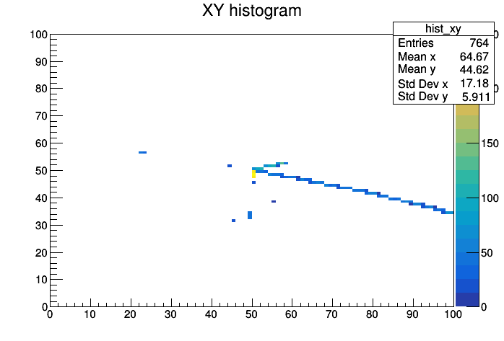
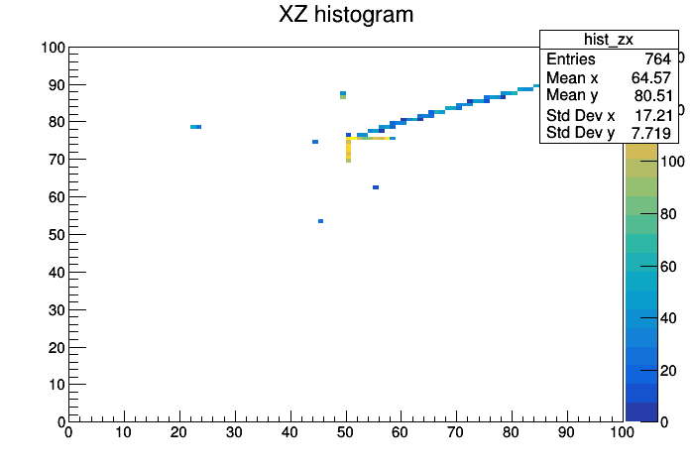
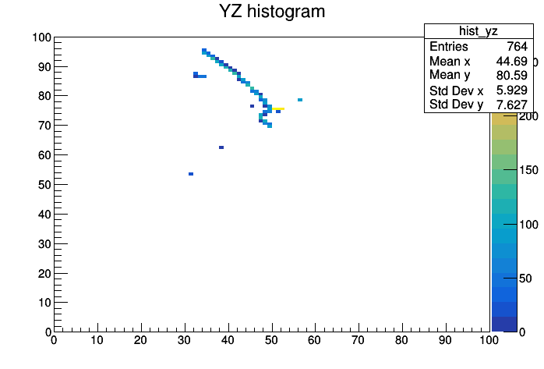
sFGD
Digitization for FGD implemented.
Visualization of projections reading from MPPC (photon detectors) available.
Added visualization of events with the CERN ROOT EvE platform for the FGD and near water Cherenkov detector.
Own algorithm for pattern recognition of hit topologies developed; good preliminary results for example case with 0.6 GeV neutrino interactions in sFGD in magnetic field.

Slide 16
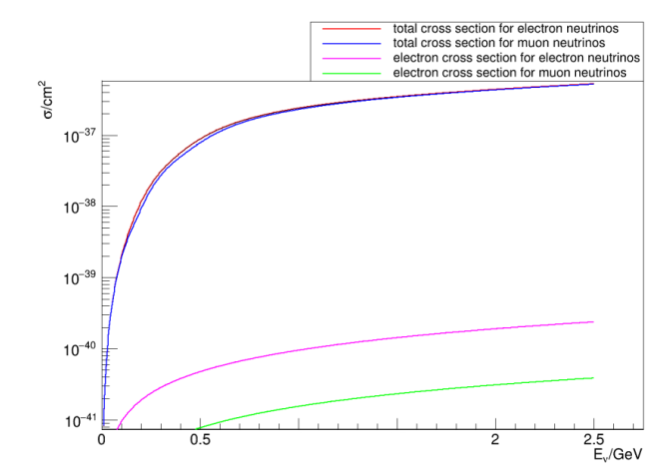
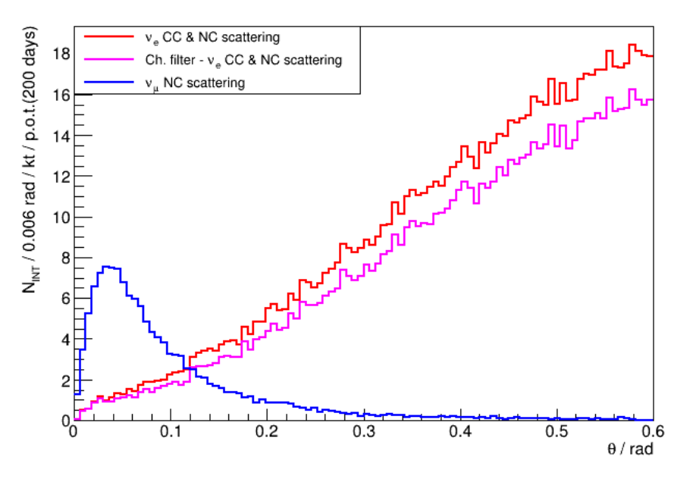
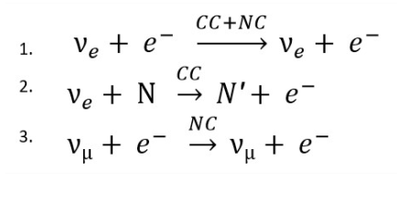
Flux measurement through neutrino scattering off atomic electrons
θ₂E_{e} - good variable for background suppression
achievable flux precision similar to MINERVA (~2%) or better…
An idea is put forward to use a stack of nuclear emulsion sheets for flux measurement, too.

Slide 17
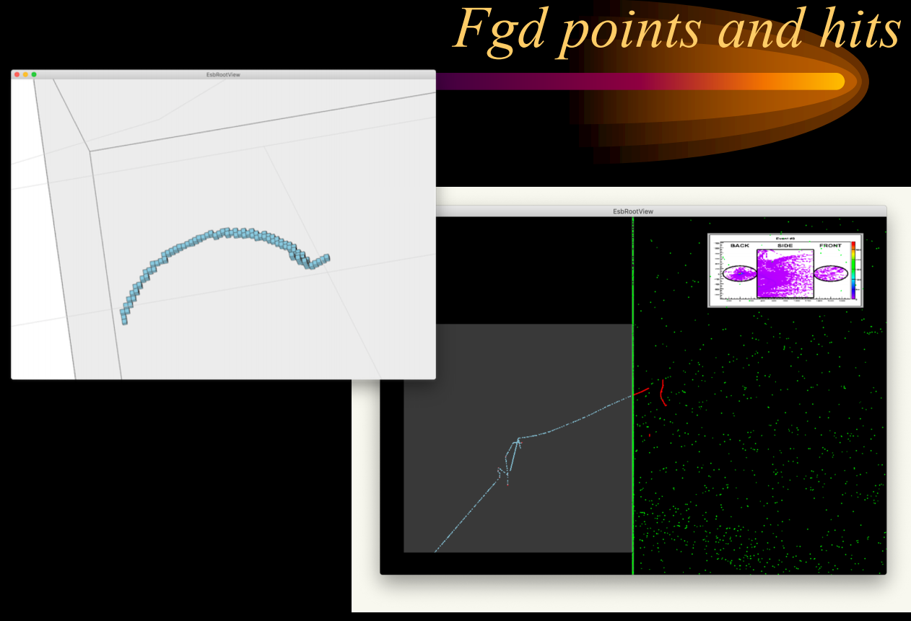
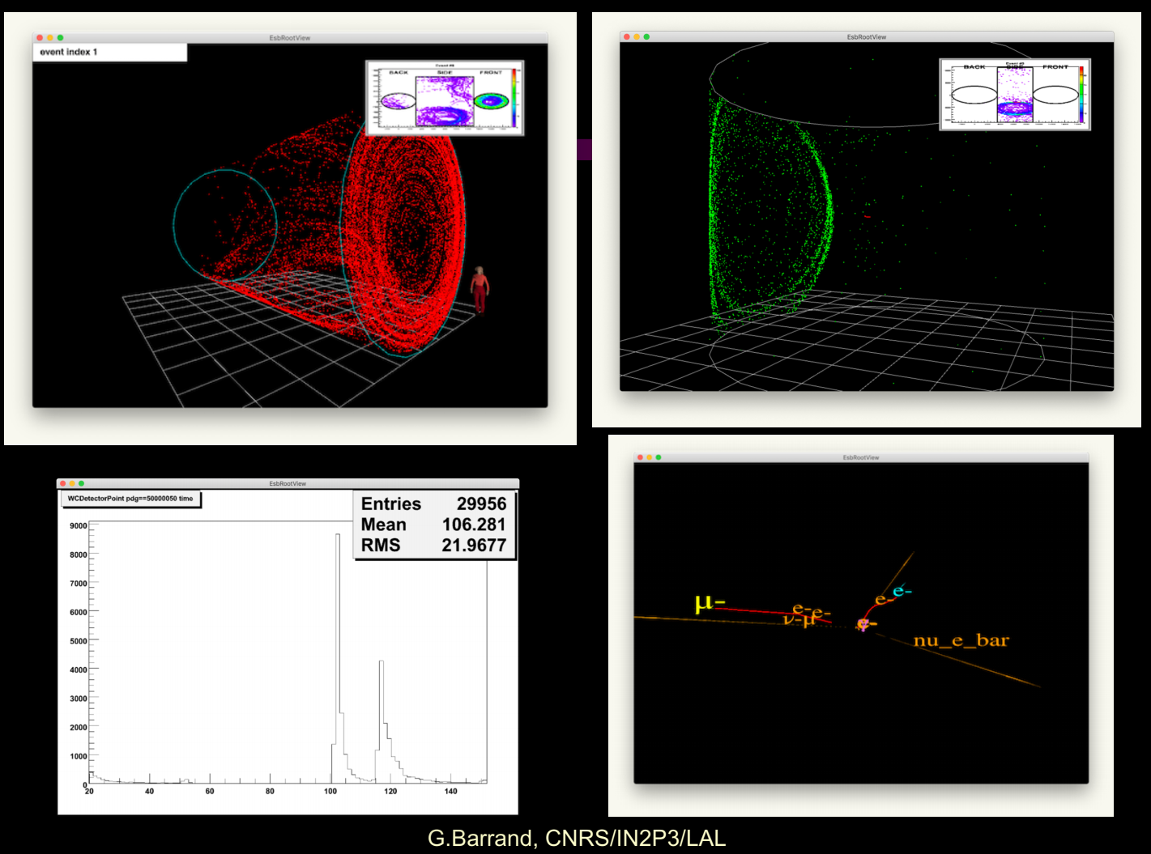
Visualization: EsbRootView
https://gbarrand.github.io/EsbRootView/2.0.0_1/index.html -> Gallery

Slide 18
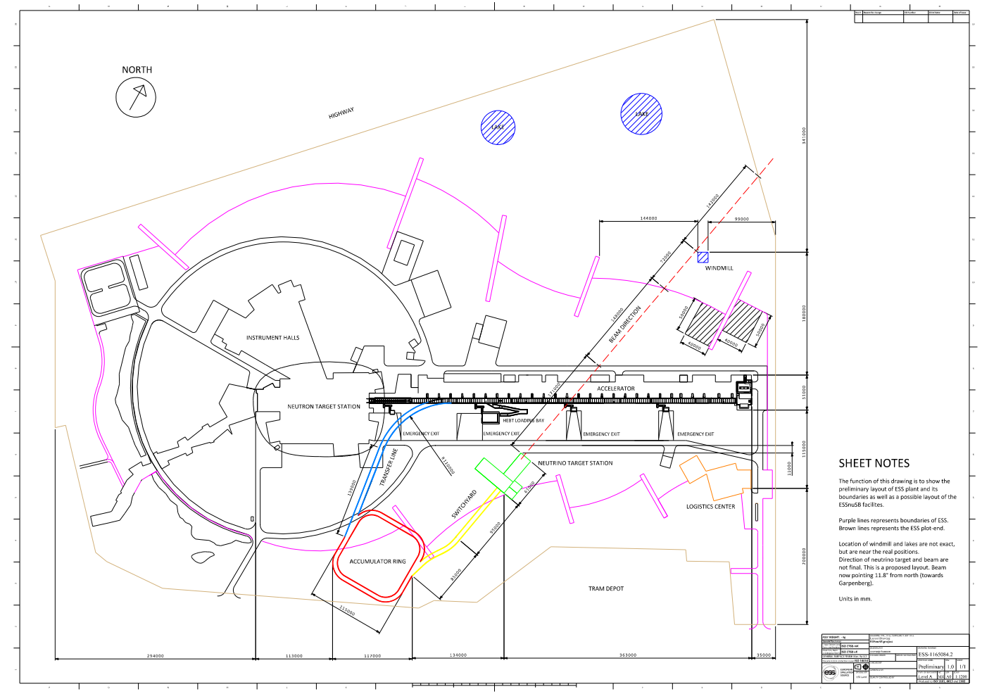
Detector sites
Far detector cavern(s): rock properties, excavation
A working group was set up to evaluate from a geological and technical point of view the suitability of Garpenberg and Zinkgruvan mines in Sweden, and possibly other ones, as Far Detector location. The group is led by David Saiang, an associate professor in mining and rock engineering at Luleå Technical University in Sweden. A contract was signed with the Division of Mining and Rock Engineering at Lulea University of Technology for this work. The first assessment should be available around Month 24 .
Near detector site: distance from the target
Nick Gazis and Rasmus Johansson from ESS involved. Preliminary study in progress.

Slide 19
Thanks for the attention!
Future plans will be discussed in my concluding talk.

Slide 20
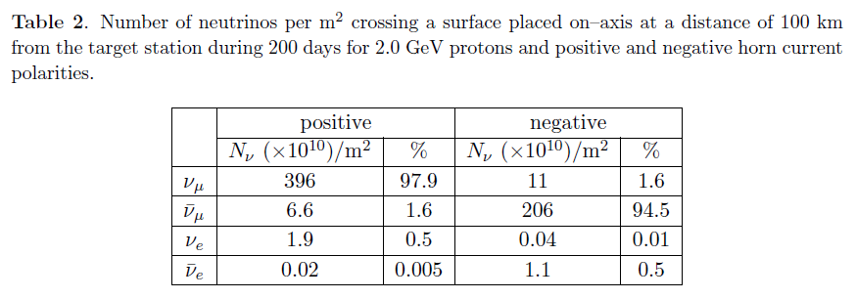
Event rates at 100 m from the source
ESSνSB paper, arXiv:1309.7022
Order of magnitude estimation:
Beam divergence (from kinematics) ~40 mrad.
Beam spot at 100 m ~50 m² . At this distance
the numbers in Table 2 would correspond to a flux per mm²
if the illumination is uniform.
Thus, at ~100 m from the source one would have had
~5x10⁷ ν_{e} crossed a surface of ~50 m² for 200 days.
Event rate for ν_{e} CC interactions in 1 kt water Cherenkov detector for 200 days:
(1.9x10¹⁰x100)x(1/18x6x10²³x10⁹)x(2x10⁻³⁸)x(0.5_{eff})
≈ 6x10⁵ events.

