Slide 1
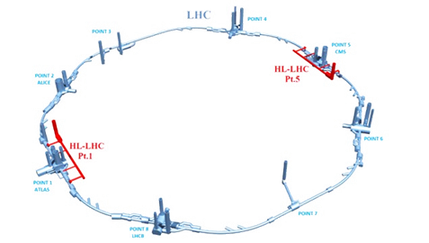
HL-LHC control architecture proposal
WG #3
TE-CRG-CE
27.06.2019

Slide 2
Last meeting “ACTION”
Electrical architecture details
Add pictures representative of the different types of existing
racks (QYC01-QYC02)
M. Pezzetti – 27.06.2019 – TE/CRG/CE

Slide 3
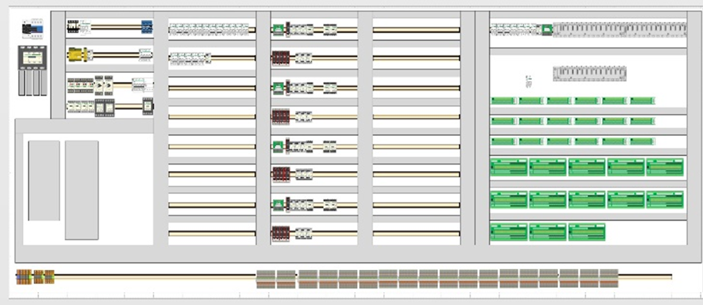
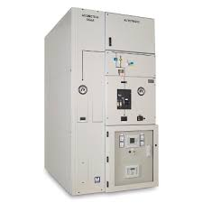
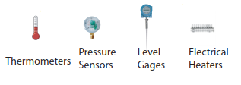
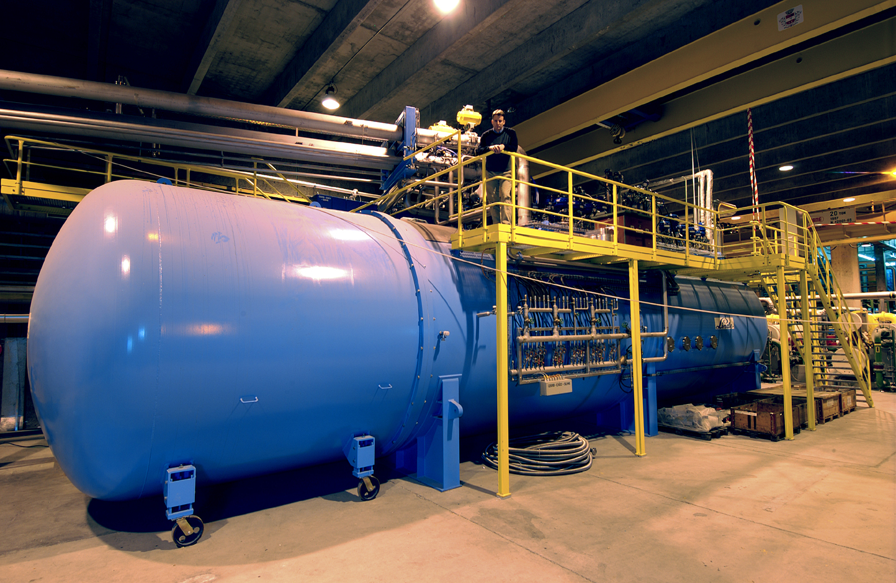
LHC Cryogenics “Electrical” System Refrigerators Architecture (Px)
400V
230V
Redundant
24 VDC
EN/EL resp
For technical details please
refer to additional slide..
Other building
50 m Feedback signal
(Fiber Optics solution)
PLC
Cabling, AL / Linde resp.
IO
HW cable for Order
(48 V)
EM01
NE48 cables
Cryo
Field Boxes
Cryo Field Boxes
NE02 cables
3.3 kV cell
Cryo plant “Frigo”

Slide 4
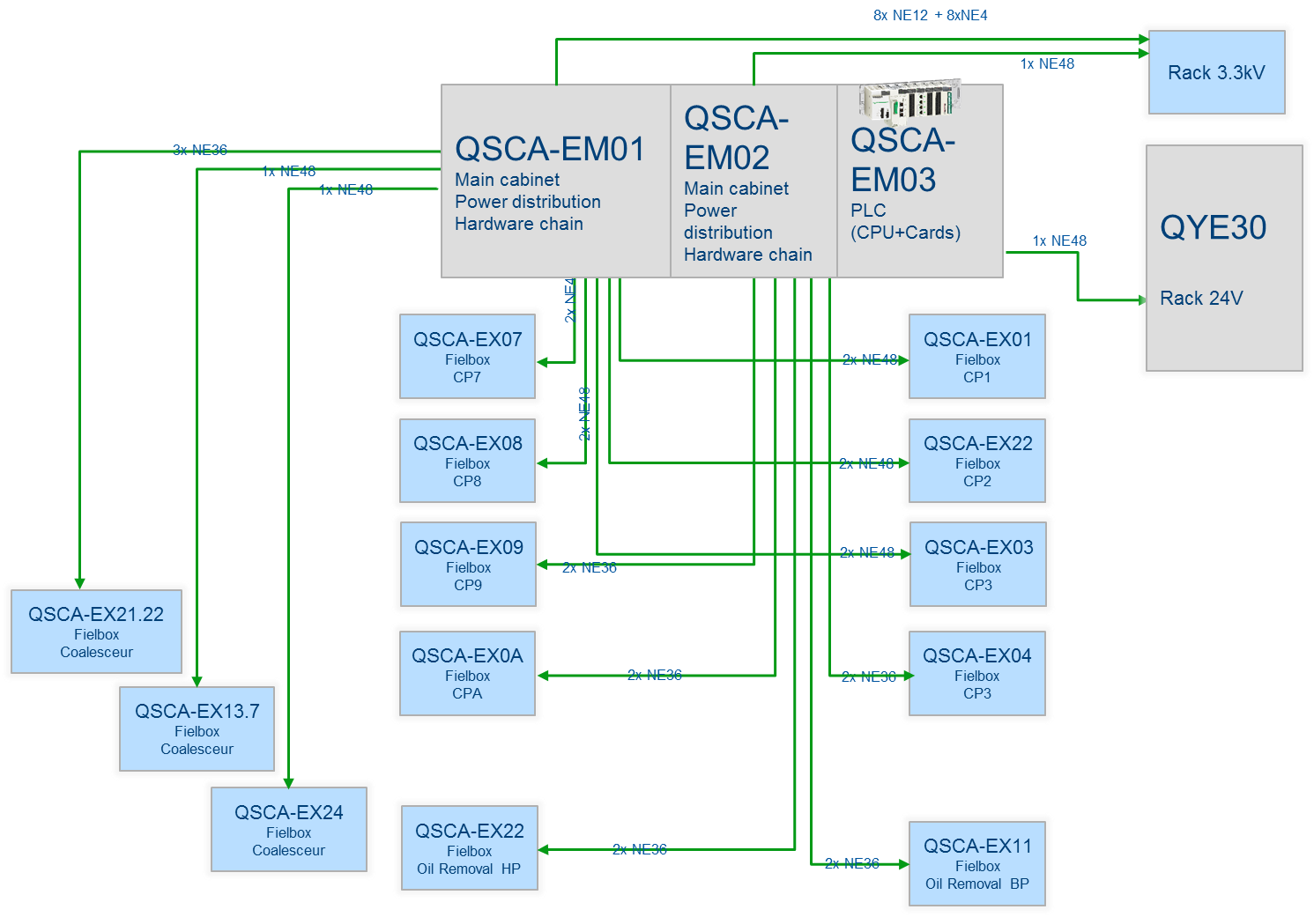
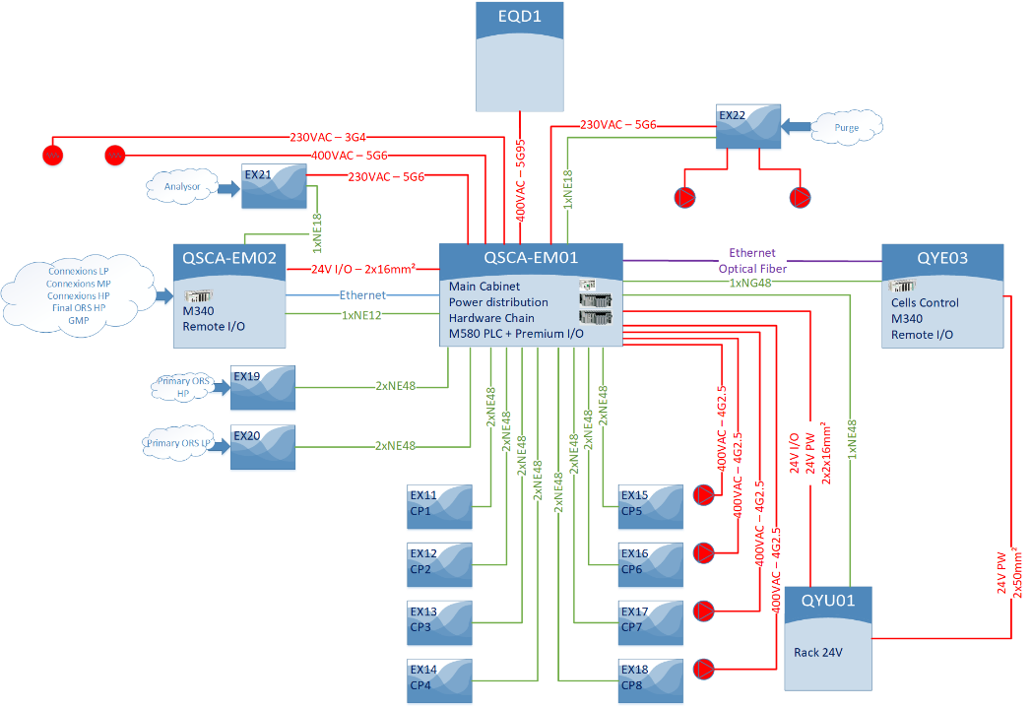
LHC refrigerator “Control Architecture” 1/2
OLD
NEW
M. Pezzetti – 27.06.2019 – TE/CRG/CE

Slide 5
LHC refrigerator “Control Architecture” 2/2
M. Pezzetti – 27.06.2019 – TE/CRG/CE

Slide 6
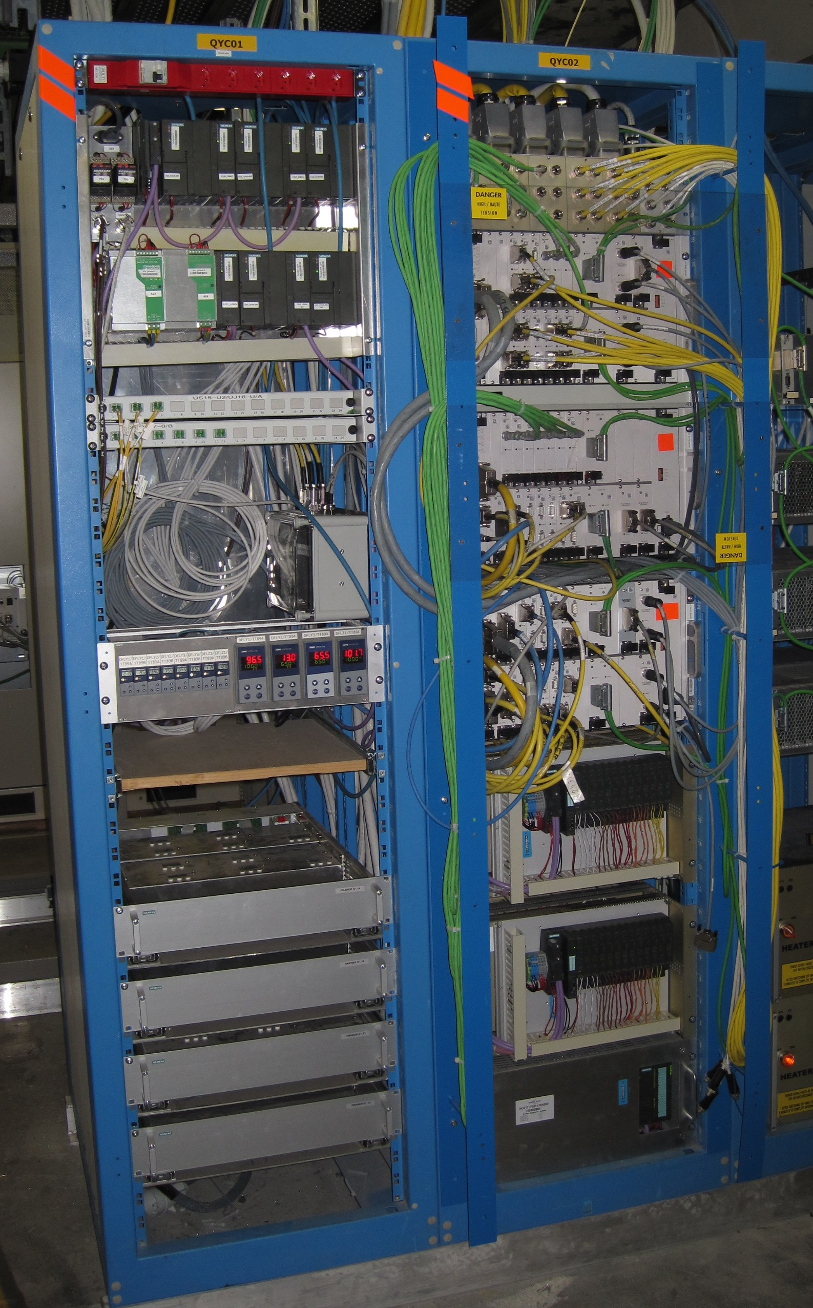
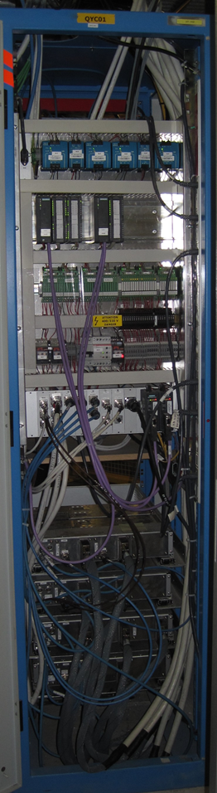
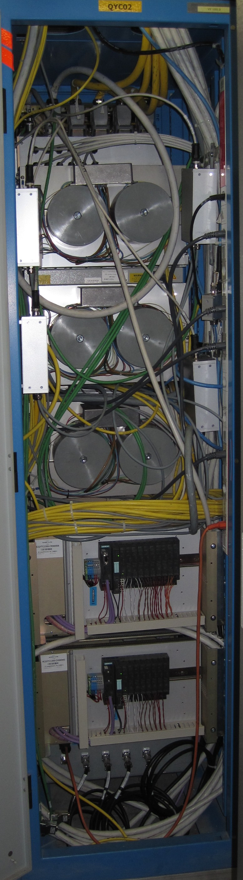
QYC01 & QYC02 Front View
QYC01 & QYC02 Back View
M. Pezzetti – 27.06.2019 – TE/CRG/CE

Slide 7
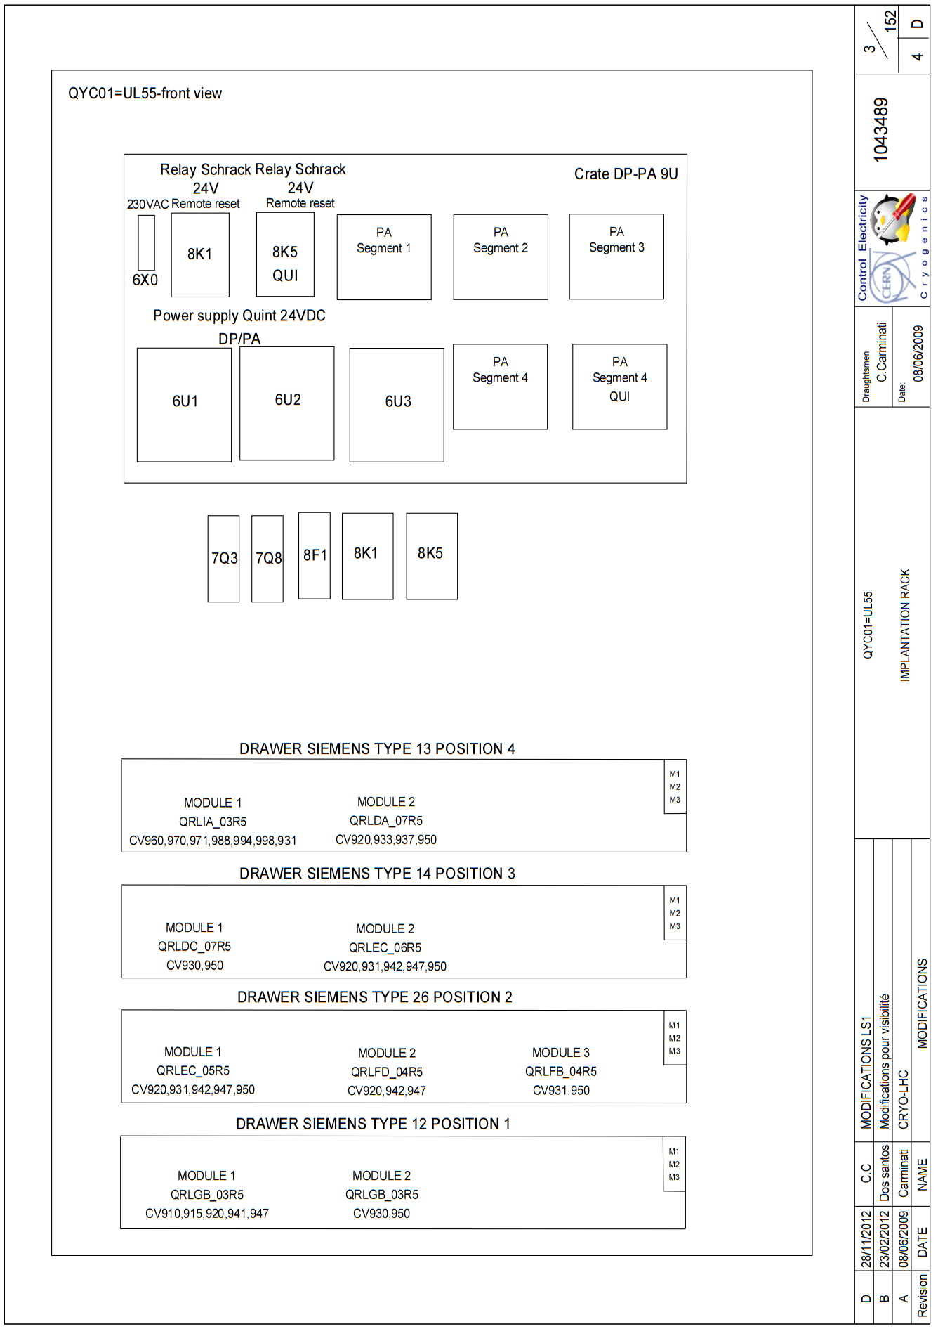
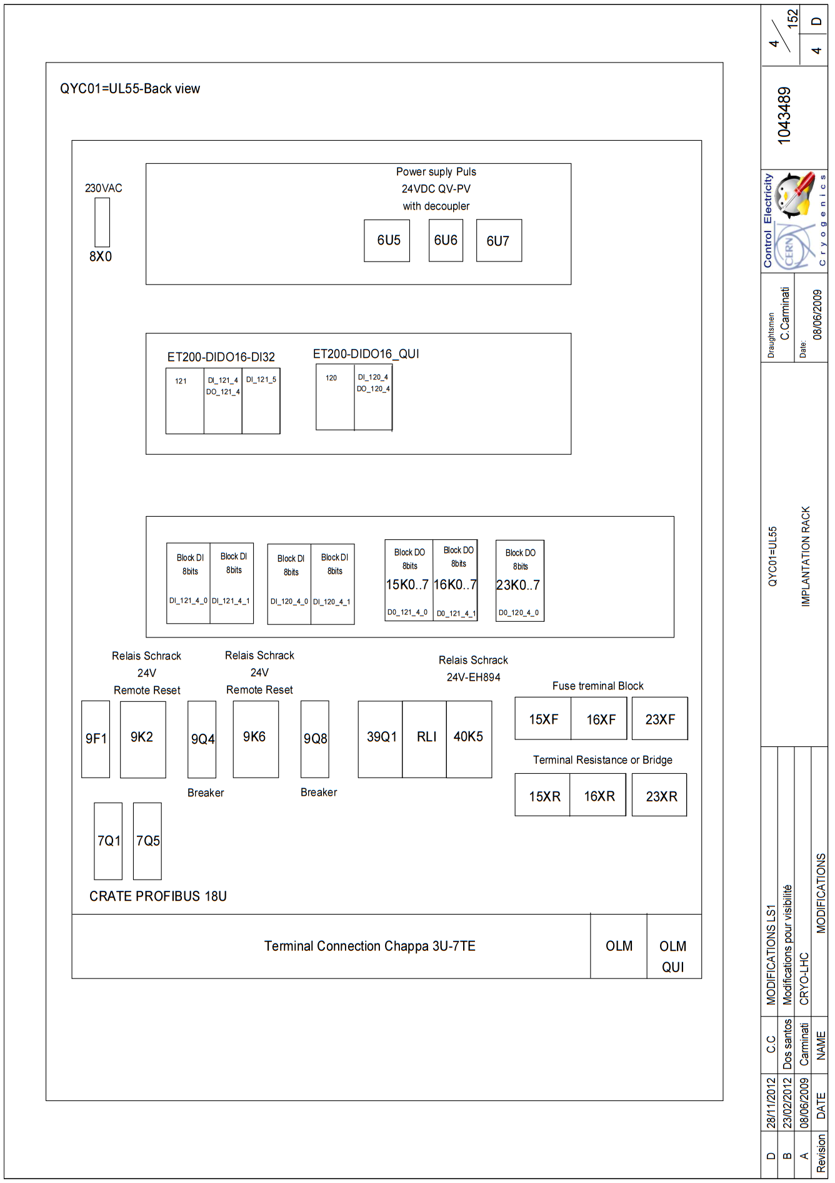
QYC01 “schematics” Front View
QYC01 “schematics” Back View
M. Pezzetti – 27.06.2019 – TE/CRG/CE

Slide 8
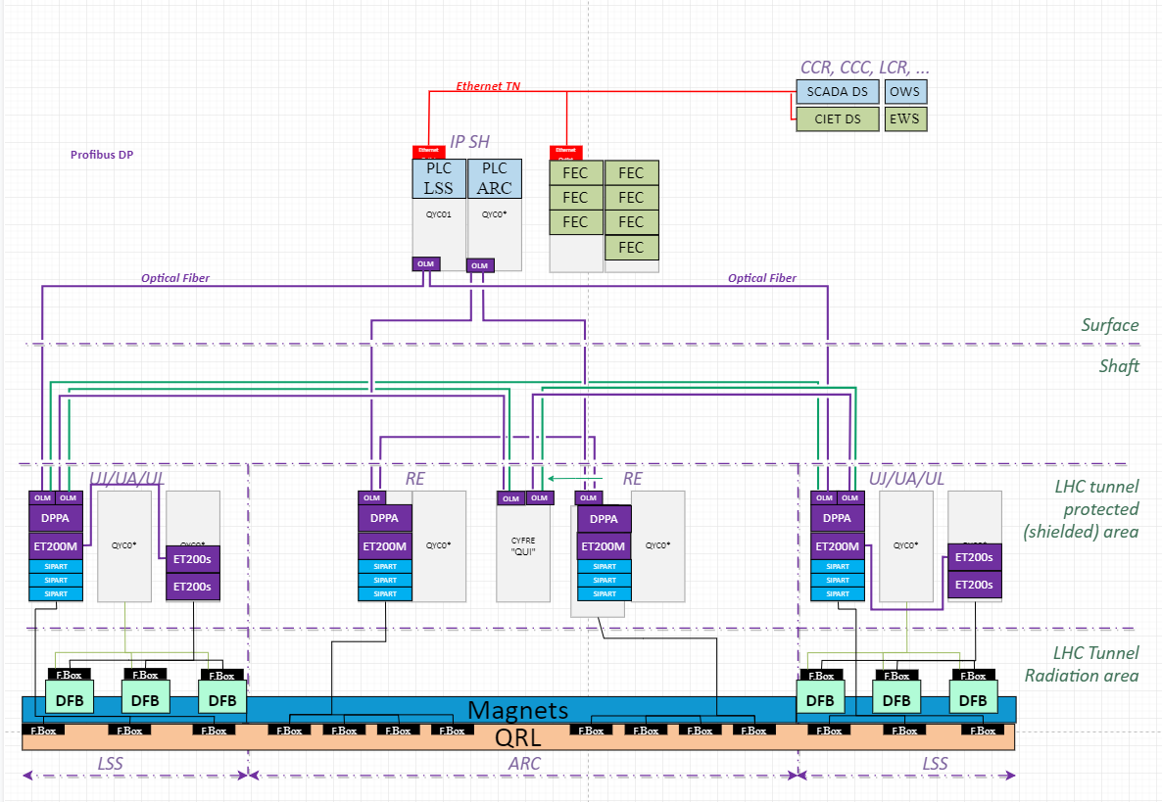
LHC typical “PROFIBUS” Optical Fiber schematics
LHC Run2 period installation
after S34 “comm cut”
M. Pezzetti – 27.06.2019 – TE/CRG/CE
N. B. Not real position of “CYFRE QUI rack”
only for fiber connection comprehension

Slide 9
“Preliminary” HL-LHC typical schematics per point
M. Pezzetti – 27.06.2019 – TE/CRG/CE

Slide 10
P1/P5 Cryogenic architecture
18 kW equivalent at 4.5 K, including 3 kW at 1.8 K
Warm compressor station
SHE
QSVB
GHe storage tanks
Surface piping
SHM
QSCG
QSAG
Dryer
QSP
Surface cold box
SLN
SD
SLN
Liquid Nitrogen tank(s)
Quench tank
QSDQ
QSRG
QSDN
Surface
QPP
QPLG
Vertical transfer line
Shaft
Underground
US
Cold compressors box
QURCG
DFHX
DFHM
(existing)
DFBL
UR
UL
QUIG
DSHX
DSHM
LHC tunnel
Interconnection box
DSL
Q1
Q2a
Q2b
Q3
CP
D1
D2
CC
Very limited impact identified for QXL headers
CC
Q4
Q5
Q6
QRP
QXL
HRL

Slide 11
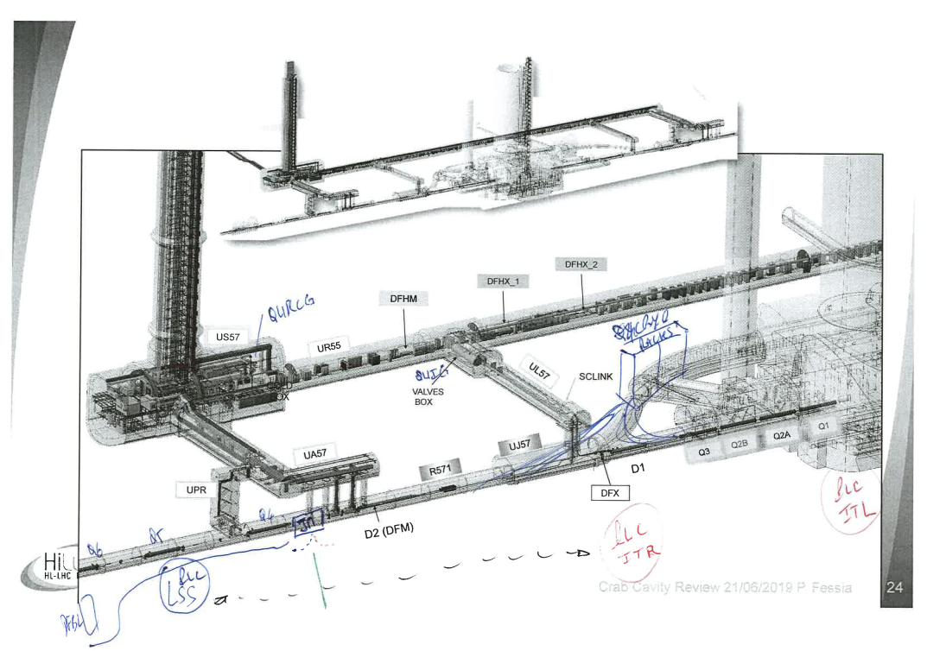
HL-LHC point Geo Layout per racks positioning
M. Pezzetti – 27.06.2019 – TE/CRG/CE

Slide 12
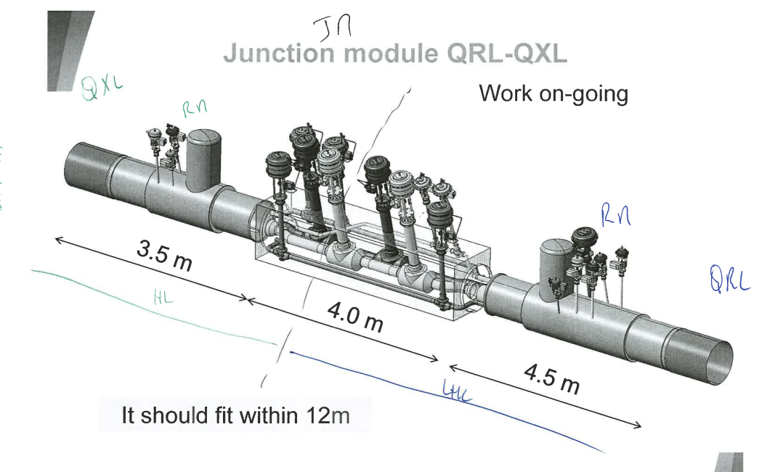
HL-LHC “JM” Junction Module schematics
M. Pezzetti – 27.06.2019 – TE/CRG/CE

Slide 13
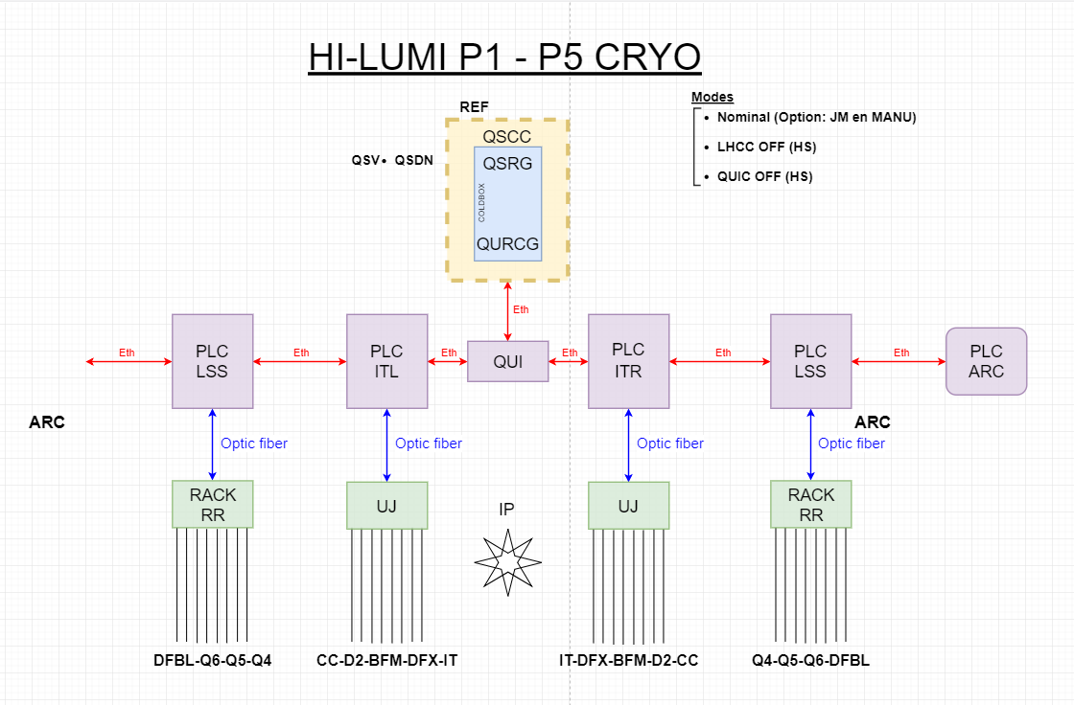
“Preliminary” HL-LHC architecture schematics (proposal for discussion)
M. Pezzetti – 27.06.2019 – TE/CRG/CE

Slide 14
Back up
Slides

Slide 15
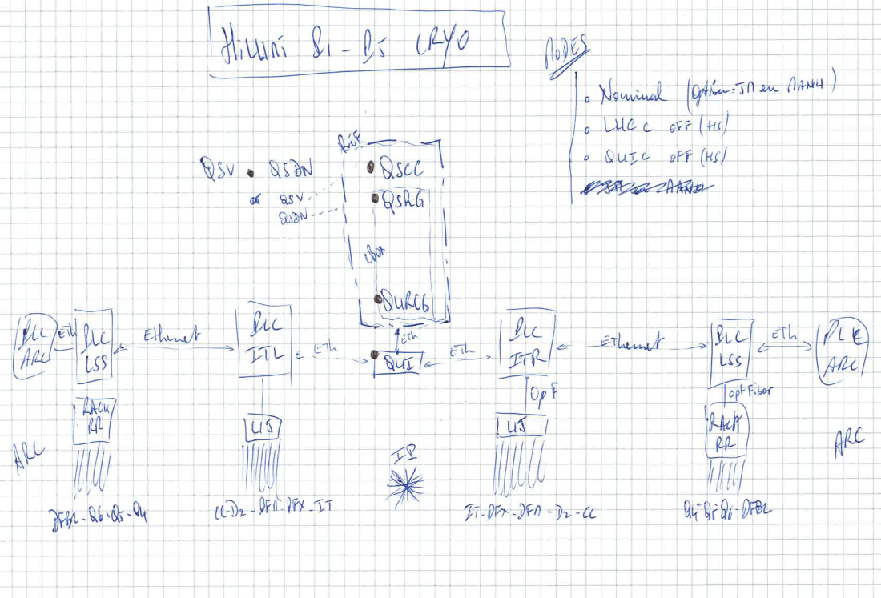
M. Pezzetti – 27.06.2019 – TE/CRG/CE

Slide 16
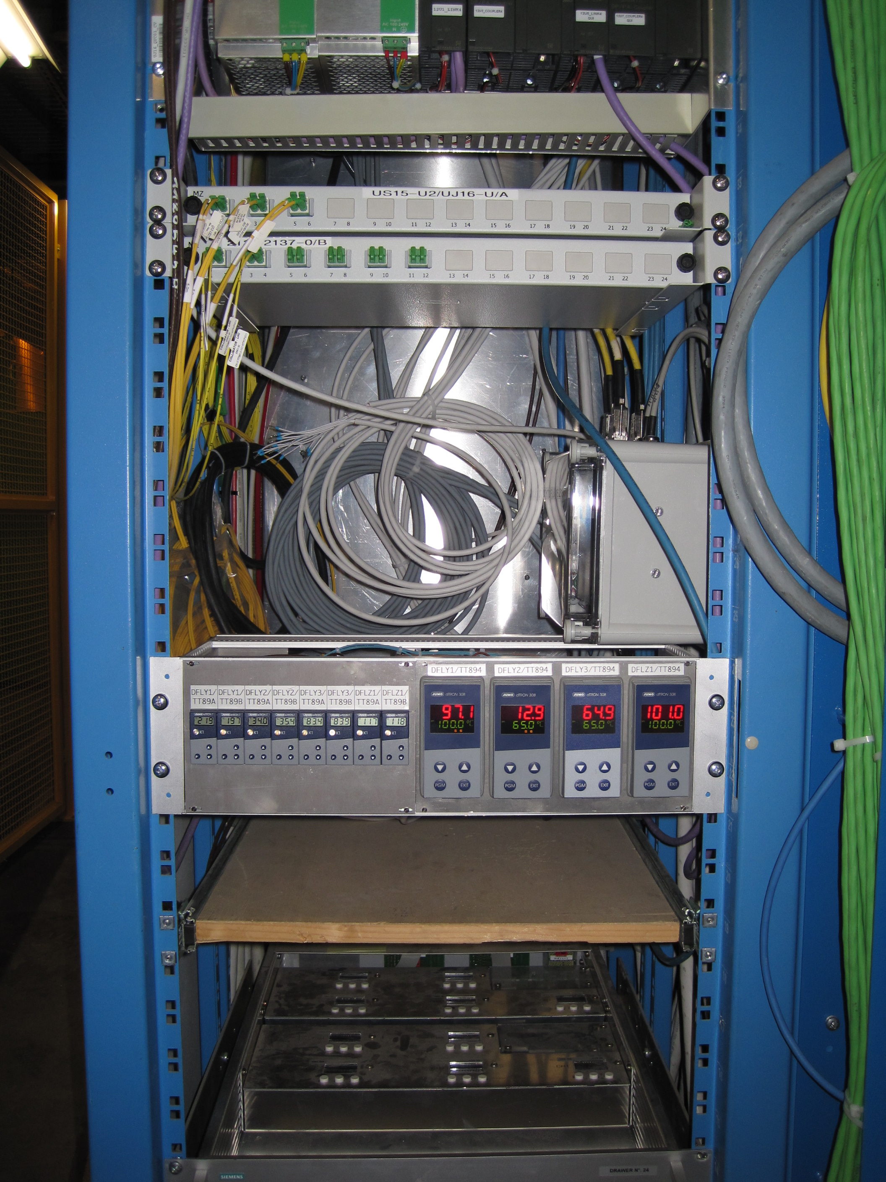
Optical Fiber
Patch panel
Ethernet Start point
Double electrical alimentation
M. Pezzetti – 27.06.2019 – TE/CRG/CE

Slide 17
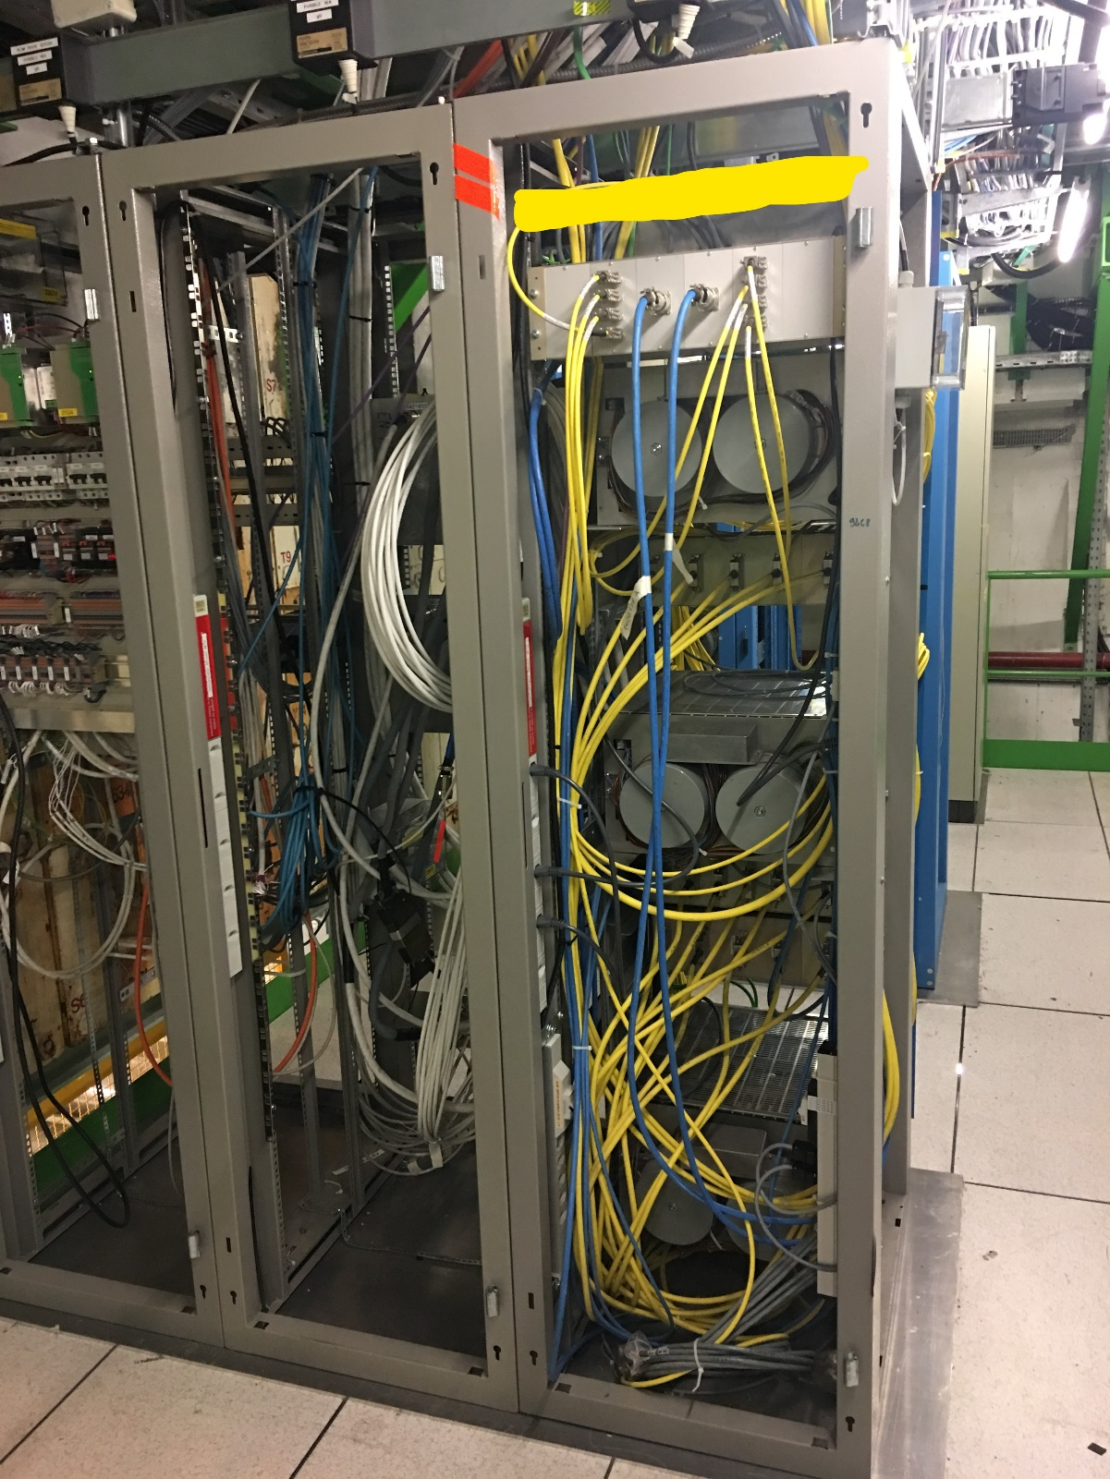
QYC01 & QYC02 Back View
M. Pezzetti – 27.06.2019 – TE/CRG/CE

Slide 18
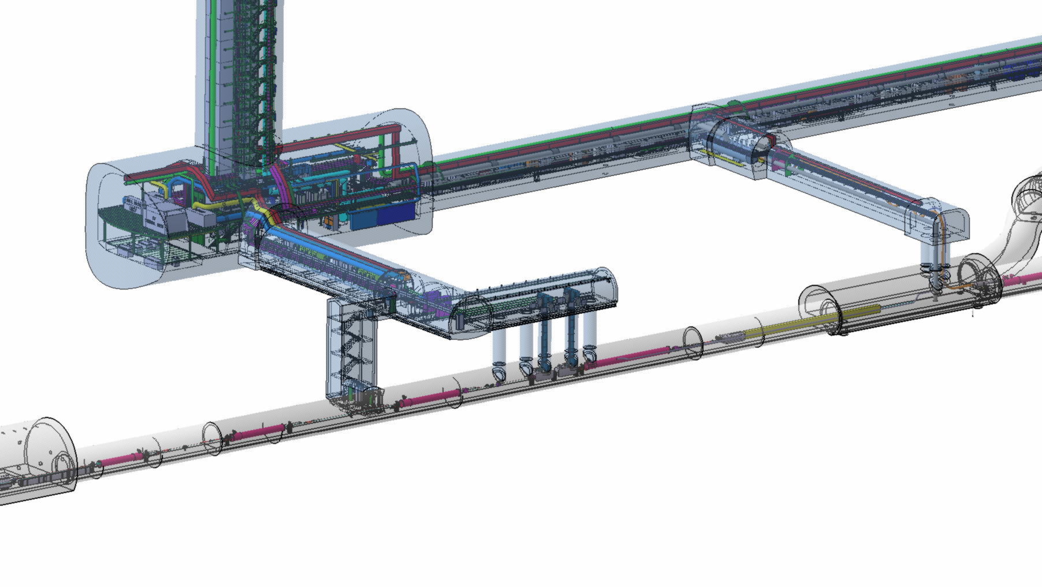
HL-LHC point Geo Layout per racks positioning
Return Module
Return Module
D2
QXL
QRL
Q4
Q5
Access / safety / sectorisation ?
Powering from existing RR & DFBL, corresponding cooling of DFBL and SAM’s to be with same origin
(QRL or QXL but not mixed)
Q4 and Q5 possibly with remote alignment, compatible with QRL ?
3D models to be implemented and then integrated (Q2-2018 for CRG)
Q6
NEW Jan’18
HL
Q4-Q5 could remain at 4.5K (already the case for Q6),
and moved towards the arc by 10-11m
LHC
Present limit for QRL/QXL

Slide 19
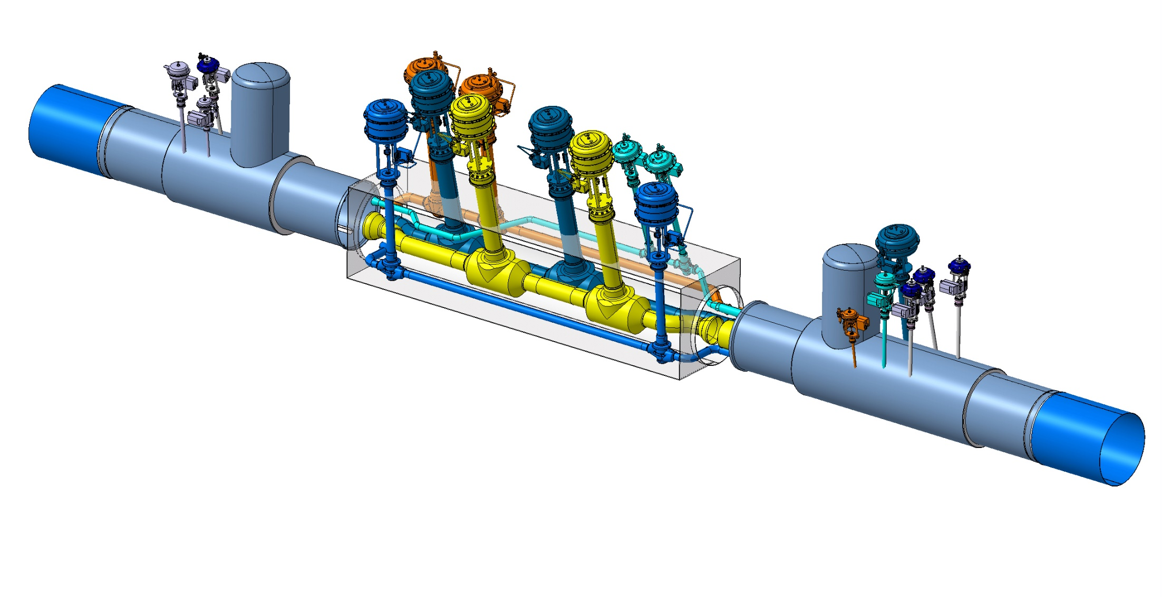
Junction module QRL-QXL
3.5 m
4.0 m
4.5 m
It should fit within 12m

