Slide 1
Harnessing data science for the informed control of systems
Sandra G. Biedron, Ph.D.
Element Aero
ICALEPS 2019, Brooklyn, New York
6 october 2019

Slide 2
Thanks for the invitation!
Thanks to Marco Lonza and Manuel Gonzalez Berges for organizing this gathering and the inivtaiton.
Thanks to Richard Farnsworth and the entire ICALEPS team on the organization on the conference including support for students (including mine).

Slide 3
Today
How does an accelerator scientist and engineer arrive at the realization of data science.
General overview of intelligent methods of examining and using data and reminding ourselves we cannot be decoupled from computing advances.
Examples of several applications of using intelligent techniques in the physical sciences including in the engineering of systems (e.g. control of scientific facilities including accelerator science and engineering).
Point the attendee to the many resources in our global community, to help better guide them to their own solutions, including reference materials for recent workshops, resources of past efforts in related fields, and to recent initiatives for ethical design of intelligent systems (e.g. IEEE – see back-up charts).
Thoughts for the future of how to better weave data science processes into our future scientific systems – specifically particle accelerators and laser facilities and well as these systems’ research outputs.

Slide 4
My story
Those of you that know me understand that I have a wide variety of interests.
I have used data science techniques for building simulation codes as well as controlling aspects of accelerators.
I actually came to use intelligent data science methods in the control of general aviation aircraft and other aerial platforms for security purposes in the post 9/11 era.
For accelerators and peripheral sub-systems, I recognized that deployed systems and the ever more complex light source systems would require additional attention.
Having worked on defense and industrial projects since the very beginning of my career, I apply approaches such as model-based systems engineering. The “model” is increasingly important and is not steady state.
User facilities requiring high quality, repeatable performance for several thousands of hours per year.
Ship-board FELs for defense

Slide 5
Digression for a moment to the concept of a model

Slide 6
Models
Models of systems can help provide insight into the dependencies and interfaces between the various subsystems.
In systems engineering practices, models reign.
  One definition - “Model-Based Engineering (MBE): An approach to engineering that uses models as an integral part of the technical baseline that includes the requirements, analysis, design, implementation, and verification of a capability, system, and/or product throughout the acquisition life cycle.” (Source Final Report, Model-Based Engineering Subcommittee, National Defense Industrial Association, Feb. 2011).
  This definition does not capture the model being used after a system is delivered but the model can be used later – like being updated constantly for refining the understanding of the system and being used to monitor its health as well as controlling it.
If I just looked at the FEL for defense, I saw clearly that a more comprehensive model was needed that could help better design and understand the system as well as for health monitoring of the system and control the system out to the use case.
Data science helps build off of our first principles models, help systems that might not have first principles models, and help understand systems that might not have much experimental data, etc.
“All models are wrong, but some are useful” George E. P. Box
but we can to our best try to build the best model possible.

Slide 7
Data science
- not any one simple definition fits all
- Is one tool we can use
Artificial Intelligence (AI)
Numerical Analysis
Machine Learning (ML)
Techniques that enable artificial
systems (computers) to mimic human
intelligence using logic, if-then rules,
decision trees, machine learning, and
deep learning.
Optimization (including genetic algorithms)
Interpolation, extrapolation, and regression
Systems of equations
Eigenvalue and singular value problems
Numerical differentiation
Numerical integration
Etc.
A subset of AI that includes the use of complex statistical algorithms to improve performing tasks as experience
Increases.
Deep Learning
A subset of ML with algorithms to allow software to train itself to perform tasks such as image recognition through multilayered neural networks.
“[Machine Learning is the] field of study that gives computers the ability to learn without being explicitly programmed.” - Arthur Samuel in 1959

Slide 8
Machine learning
Machine learning is a data analysis method that can identify patterns, learns from them and utilizes for making accurate predictions and better decisions without or with minimal human guidance.

Slide 9
What else MIGHT we need for data science?
Knowledge of where the data originates (in data science terms “its domain”)
Exploratory data analysis
Mathematics
Statistics
Visualization
High performance computing
Specialized computer hardware – FPGAs, application-specific integrated circuit (ASIC), including tensor processing units (TPUs), neural engines
Etc…

Slide 10
KEEP IN MIND!
One of the things to keep in mind when thinking about which algorithms to use is that the people that developed a certain algorithm were concerned about making a better algorithm and not about your exact data set. The algorithm might have been developed on random data.
This is one reason I mention later about technically diverse teams.

Slide 11
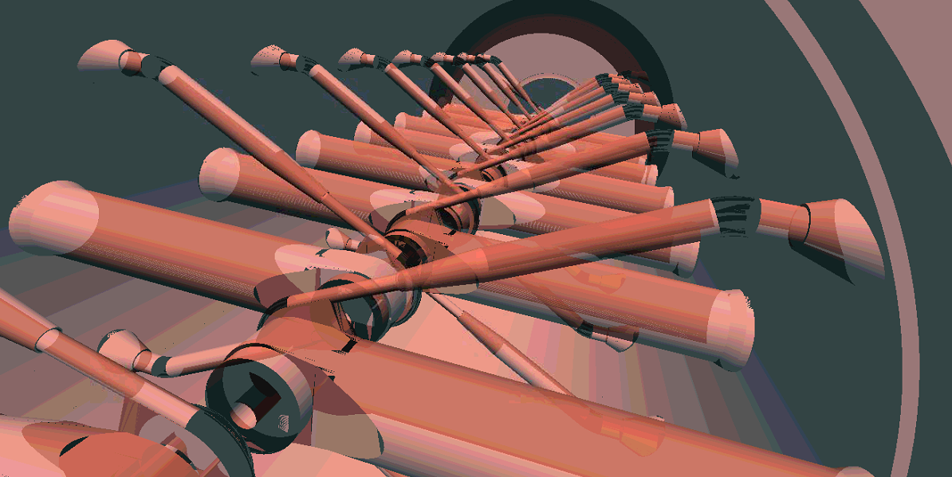
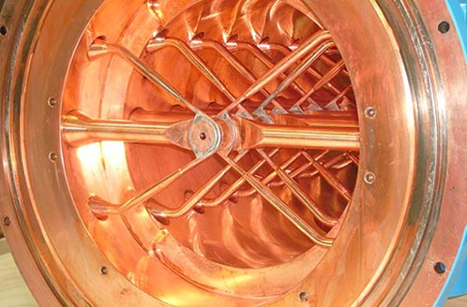
Back to models for a moment
MODEL
DEVICE (SYSTEM)
Tech-X’s VSim engineering and physics models courtesy of Salvador Isaac Guitron Sosa

Slide 12
Back to models for a moment
GOAL
is to make identical
MODEL
First principles, design to requirements, etc.
DEVICE (SYSTEM)
Operation, controls, maintenance records, etc.
DATA SCIENCE
HPC
There can be a data exchange process that begins from the first principles simulations and eventual model of a device with the behaviour and control of the device if well monitored can improve the model continuously through data science.
Tech-X’s VSim engineering and physics models courtesy of Salvador Sosa

Slide 13
Where can data science be applied

Slide 14
An example from the physical sciences
High-Energy Physics

Slide 15
High Energy physics
Employing AI/ML algorithms has demonstrably sped up calculations (e.g. one million times for analysis of strong lenses) and produced clear cost-savings (30% increase in effective detector volume for neutrino flavor tagging with neural networks).
These faster algorithms enable accelerated science, and in some cases they lead to paradigm shifts: in situations where it once required one day for a human to analyze a single object.
Also see a recent talk/work by Gabriel Perdue (FNAL) -> next chart
Y. D. Hezaveh, L. P. Levasseur, and P. J. Marshall, “Fast automated analysis of strong gravitational lenses with convolutional neural networks,” Nature, vol. 548, pp. 555–557, Aug. 2017; P. Adamson et al., “Constraints on oscillation parameters from ne appearance and nμ disappearance in nova,” Phys. Rev. Lett., vol. 118, p. 231801, Jun 2017. [Online]. Available: https://link.aps.org/doi/10.1103/PhysRevLett. 118.231801; M. A. Acero et al., “New constraints on oscillation parameters from ne appearance and nμ disappearance in the nova experiment,” Phys. Rev. D, vol. 98, p. 032012, Aug 2018. [Online]. Available: https://link.aps.org/doi/10.1103/PhysRevD.98.032012
Courtesy Jim Amundson

Slide 16
Courtesy Jim Amundson

Slide 17
An example of a system
Example of a life saving system with humans in the loop
Fire segmentation in thermal imaging for situational awareness

Slide 18
Motivation
Fire fighters carry sensors such as thermal imaging cameras
There is a need for creating a situational awareness system for first responder crews
Automatic detection of fire and smoke is part of this situational awareness - Fire segmentation rather than just fire detection allows one to determine the extent of the fire and the smoke.
Neural network procedures can fully characterize the fire ground by producing natural language descriptions of the scene.
The method must be real-time and unsupervised
Courtesy of Manel Martinez-Ramon
Notes:
A situational awareness method processes in real time all the data conveyed by the gear sensors (cameras, microphone, gas sensors, physiolgical sensors) to construct a summary of what is going on in the fire ground, and it is presented to the commander and fire fighters using a given user interface.
The Fire detection must be unsupervised because we do not have labelled images of all possible fires, and they are so heterogeneous that labelling all of them is nearly impossible.
Fire segmentation rather than just fire detection allows to determine the extent of the fire and the smoke.
We also have neural network procedures to fully characterize the fire ground by producing natural language descriptions of the scene.

Slide 19
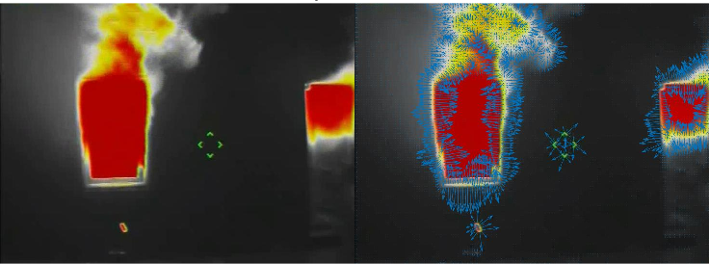
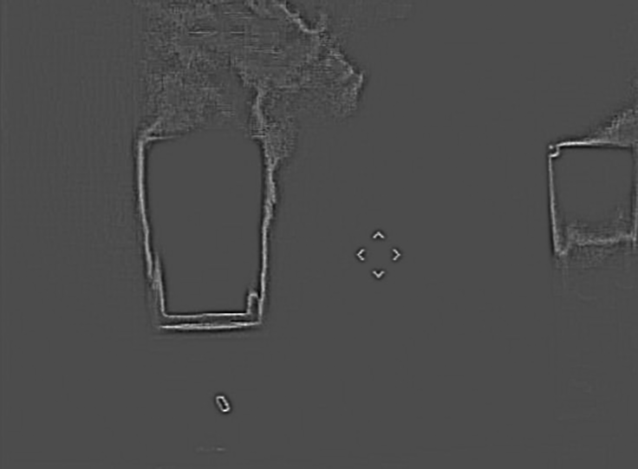

Proposed algorithm
Sequence acquisition
(thermal images at 30 fps)
Feature
Extraction
Intensity
Velocity
Divergence SIFT
Segmentation
Comparison: K-means, GMM, GMRF, MRF
Image
Velocity
Divergence
SIFT - scale invariant feature transform
Features processed by ML: Construction of a probabilistic model of the features
Three conditional probability distributions: background, fire, smoke
Different models are compared. Markov Random Fields is the best algorithm
Courtesy of Manel Martinez-Ramon, to be published IEEE Access
Notes:
We extract velocity (or optical flow and divergence). We also tried SIFT (scale invariant feature transform) but it does not add information
Compared segmentation models construct a probability model for the pixels x. The model has three conditional probabilities:
p(x|fire), p(x|smoke), p(x|background)
We compute from this the posteriors
p(fire|x), p(smoke|x) and p(bg|x) and decide using the maximum a posteriori criterion.
Models are K-means, Gaussian mixture models (GMM), Gaussian markov Random Fields and general Markov Random Fields. The two last take into account the relationships between close pixels, and the first wo consider that the pixels are independent

Slide 20
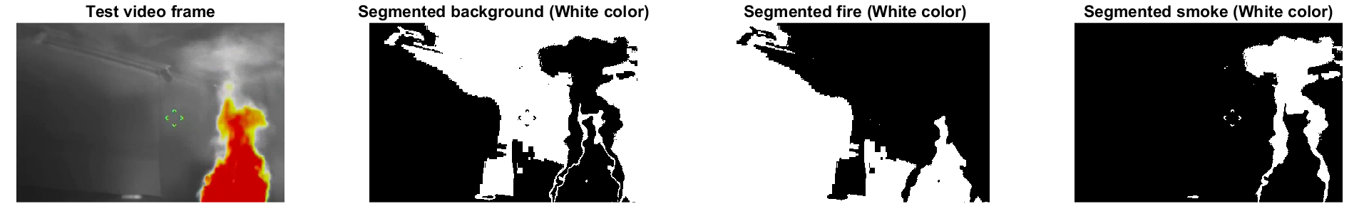
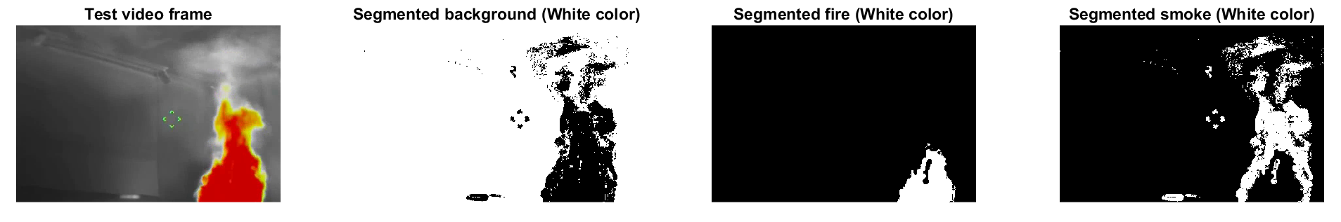
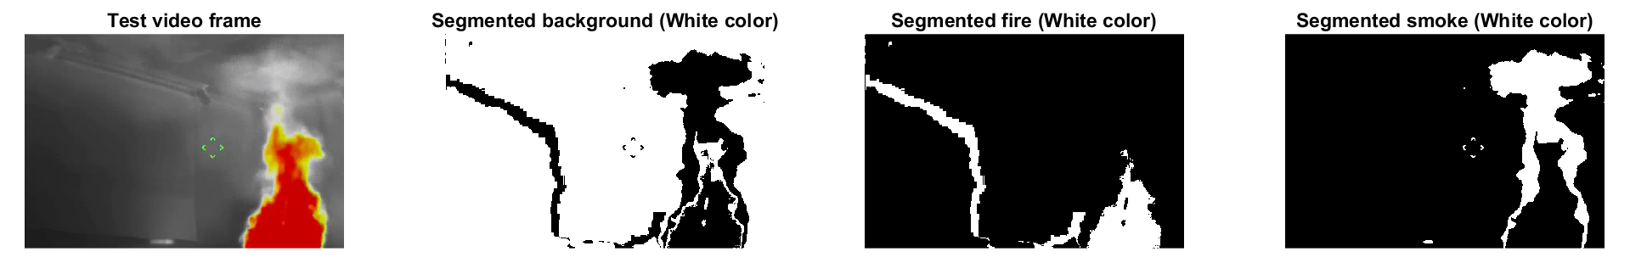
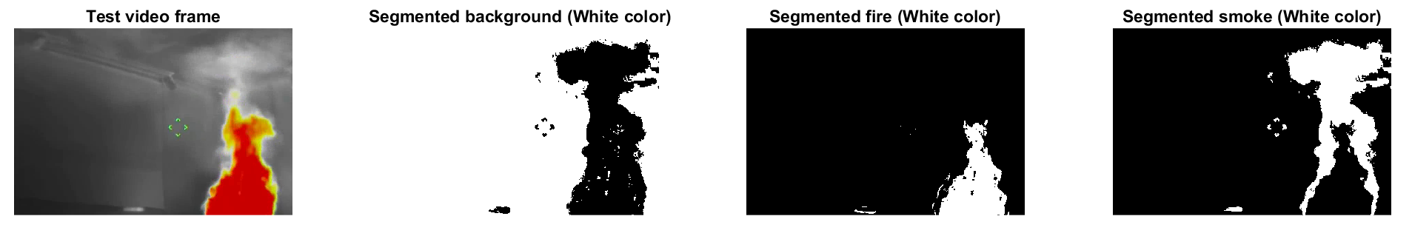
Courtesy of Manel Martinez-Ramon, to be published IEEE Access
Results
KNN
Gaussian mixture models (GMM)
Gaussian markov Random Fields (GMRF)
General Markov Random Fields
(MRF)
Notes:
This is a sample of the segmentation results.
KNN gives a poor performance as it is not able to identify the fire
GMM is better but smoke is not properly segmented
GMRF shows some errors in fire detection
MRF is the one showing the best performance

Slide 21
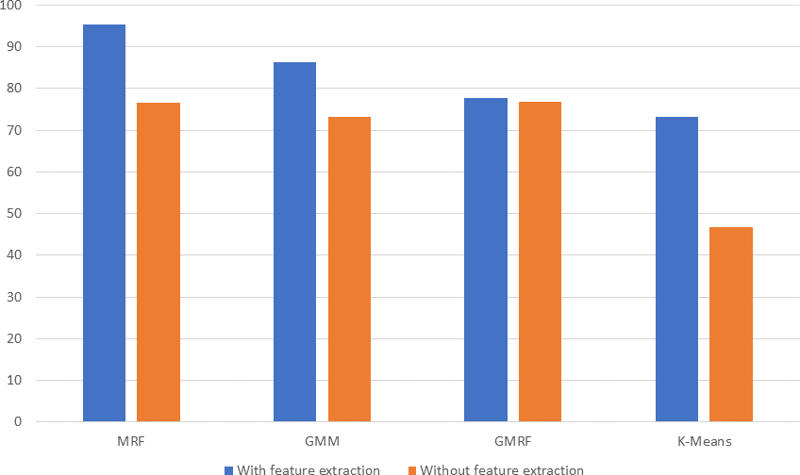
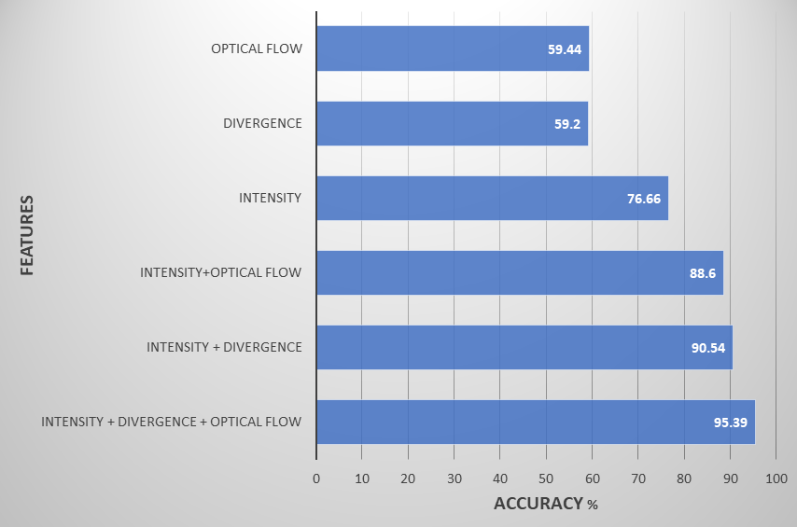
Results
Performance comparison among algorithms
MRF performance with different
feature combination
Courtesy of Manel Martinez-Ramon, to be published IEEE Access
Notes:
Left: comparison among algorithms. Blue bars show the performance when we use all features in the algorithm (intensity, velocity, divergence). Orange is when we only use intensity for the segmentation.
Right: Results using different combinations of features and the MRF algorithm
Optical flow is the velocity.
SIFT is finally not used because it does not add any information.

Slide 22
SO WHAT ABOUT scientific systems such as particle Accelerators as Intelligent Systems?
How can we best use data science to better design, control, and understand our machines and make better models.
  AI/Intelligence/ML is one way and it is more than just algorithms, it is data, sensors, computing platforms and analysis techniques! (Stated succinctly by J. Amundson, Fermilab)
  Coming back to the point of algorithms usually developed on random data – the sciences, including the machines enabling science, have “more interesting” data sets, including errors in data and embedded physics.

Slide 23
Accelerator toolbox
Physics, Chemistry, Mechanical Engineering, Electrical Engineering, Etc.
Lasers
Radiation and dosimetry
Pulsed power
Survey and alignment
High performance computing
Data science, including mathematical optimisation and machine learning
Etc…
Materials science
Vacuum science
Collective effects
Electromagnetism
Vacuum electronics/RF sources
Instrumentation
Controls engineering
Computational techniques
Since we as a community already have such a filled skill set (toolbox), this has led to a slow adaptation of data science as we thought we could solve problems in other ways (already in our toolbox).

Slide 24
Accelerator toolbox
Physics, Chemistry, Mechanical Engineering, Electrical Engineering, Etc.
Lasers
Radiation and dosimetry
Pulsed power
Survey and alignment
High performance computing
Data science, including Mathematical optimisation and machine learning
Etc…
One of the hard parts of examining data is that one needs to understand where the data comes from and what it means. The data is not disconnected from the system from which it originates.
This makes choosing the right data science tools for each accelerator “challenge” difficult. Why? Our toolbox of systems is so large and so integrated/overlapping so the data science techniques have to be chosen very carefully.
This means that a data scientist cannot just walk in off the street from a different field. The solutions we need are accelerator-domain specific, complicated, chosen by experience, and are in no way a single, magic band-aid.
As was stated over and over by the community last week at the Department of Energy’s INNOVATION XLAB Artifical Intelligence Summit in Chicago – NOT ONE PERSON CAN MAKE ML/AI USEFUL - WE ADD DATA SCIENTISTS TO EXPERT TEAMS AND EXPERTS TO DATA SCIENCE TEAMS TO SEE THE BENEFIT.
Materials science
Vacuum science
Collective effects
Electromagnetism
Vacuum electronics/RF sources
Instrumentation
Controls engineering
Computational techniques
Since we as a community already have such a filled skill set (toolbox), this may have led to a slow adaptation of data science as we thought we could solve problems in other ways (already in our toolbox).

Slide 25

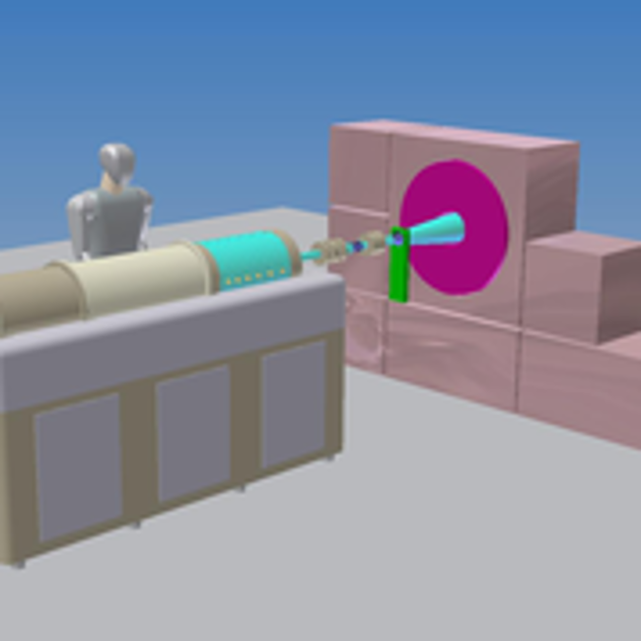
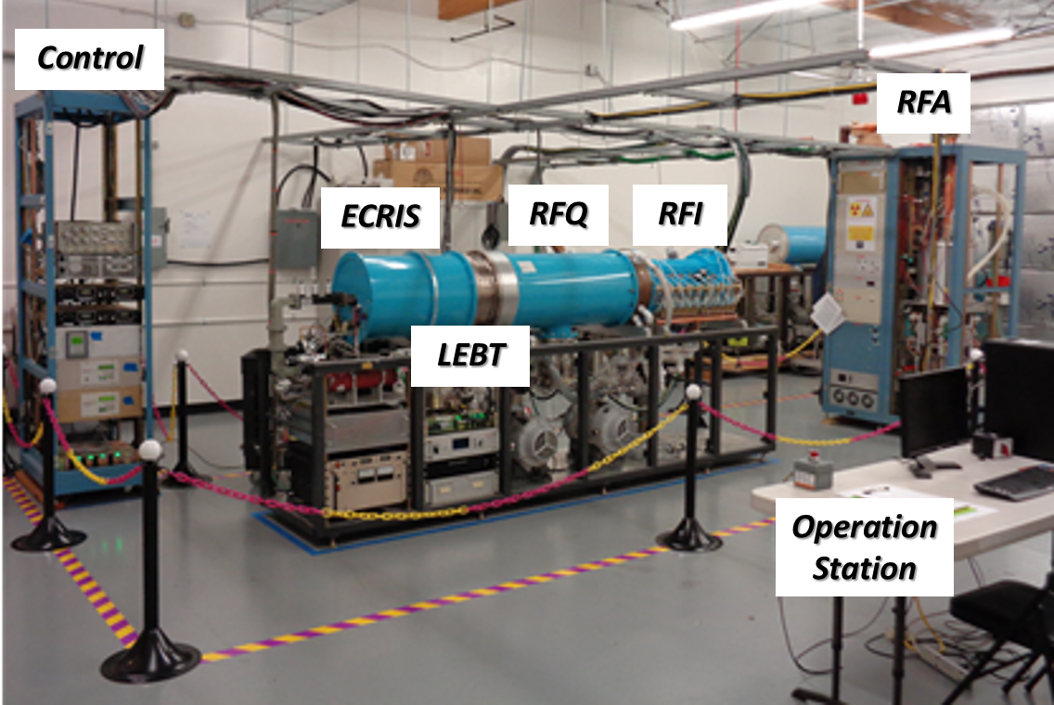
Intelligent Controls for Medical Accelerators
ILS has developed a medical linac for cancer therapy based on the Neutron Capture nuclear interaction:
  Cancerous cells are tagged and then radiated with a beam of (slow) epithermal neutrons.
The NC process releases a large radiation dose within a micrometer range, i.e. no radiation damage to healthy cells.
NC has a small cross section. A high-flux of neutrons is then required to maximize the number of NC interactions
  The linac needs to be controlled to produce and hold steady a high-current proton beam for producing neutrons.
Scheme for BNCT cancer therapy with ILS accelerator.

Slide 26






Intelligent Controls for Medical Accelerators
AI controllers can help the linac operate in an optimal configuration that, as one example, maximizes beam current.
A Neural Network (NN) can help find the a very good suite of set-points for a set of requirements based on the available diagnostic instrumentation readouts.
The NN can adjust the machine online provided (e.g. pre-trained offline).
The NN can be trained with large amounts of data from two sources:
  Recorded data from operations and experiments.
  Generated data from first principles simulations.
$$x_{1}$$
$$x_{2}$$
Input the readouts from instruments
$$y_{1}$$
Output the optimal setpoints
$$x_{3}$$
…
…
…
…
$$y_{2}$$
$$x_{n}$$
Hidden layers
This technology has the potential of making medical accelerators more affordable and efficient.

Slide 27
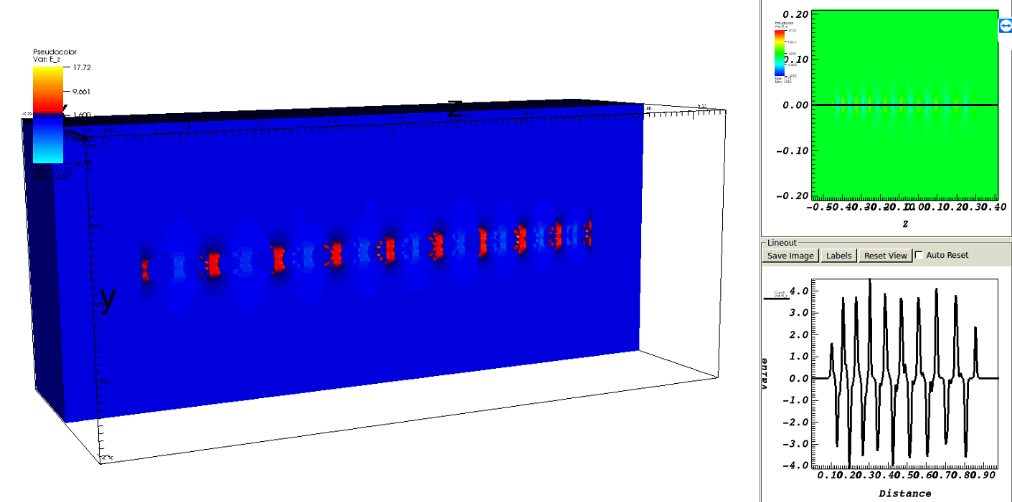
Intelligent controls for Medical Accelerators
Production of training data using electromagnetic and PIC simulation software VSim10.
Scanning the parameter space assuming numerous injected beams, which depend on ion source and LEBT configurations:
  Hydrogen flow
  Power supplies
  Water temperature
  RGA data
  Vacuum levels, etc.
  Target material, condition etc.
Propagate numerous beams and determine optimal machine states being used as training data for the NN controller.
Use of HPC (THETA at the Argonne Leadership Computing Facility) in order to generate thousands of training points.
VSim10 model and actual picture of the ILS linac accelerating RF structure.
VSim10 simulation of the longitudinal E-field along the axis of the RF structure.
Tech-X’s VSim engineering and physics models courtesy of Salvador Sosa

Slide 28
for LLRF and Resonance Control Systems
LLRF and Resonance control is an important element to achieve desired beam quality.
Phenomena affecting the field stability include:
  Microphonics
  Lorentz force detuning
  Thermal acoustic oscillations
  …
  All need to be compensated by the LLRF!
Effects are both non-linear and difficult to characterize, making Neural Networks one of several promising methods to improve existing control.
O. Kononenko, 3D multiphysics modeling of superconducting cavities with a massively parallel simulation suite. PRAB, 2017
Active Resonance Control developed at Fermilab for TESLA cavities
Courtesy Jorge Alberto Diaz Cruz

Slide 29
for LLRF and Resonance Control Systems
We are exploring intelligent techniques as a tool to improve performance of existing LLRF and resonance control systems.
Simulations are performed to create data for training of Neural Networks. (Eventually to merge with experimental data.)
Gaussian processes, genetic algorithms and Neural networks are all part of the artificial intelligence framework under test.
Courtesy Jorge Alberto Diaz Cruz; NAPAC2019, LLRF, ICALEPS

Slide 30
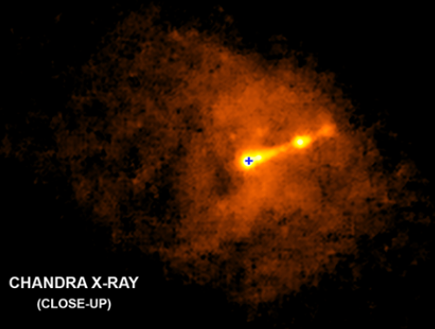
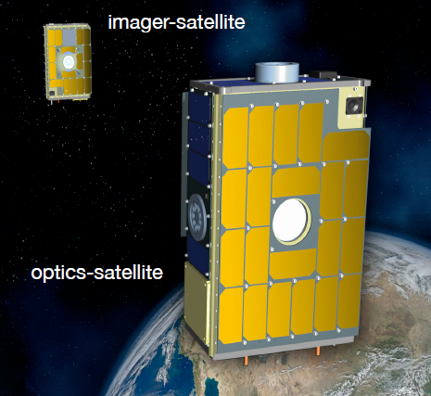
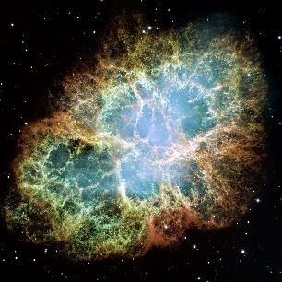
Virtual Telescope for X-Ray Observations (VTXO)
A telescope made up of 2 separate satellites in 2 different orbits
Accuracy requirements are sub-arcsecond relative attitude accuracy and 1 mm relative position accuracy
Approximately 1 hour observing the Crab Nebula
Applications
1) Investigating the nature of space (Like dark matter)
2) Covering the Sun (To see planets and stars behind it)
3) Understanding more about black holes
4) Detecting space phenomena like star collisions
5) Finding other life forms
An example of X-Ray observation
Imager
Virtual Telescope
Optics
Optics
Imager
Earth
Courtesy Reza Pirayesh

Slide 31
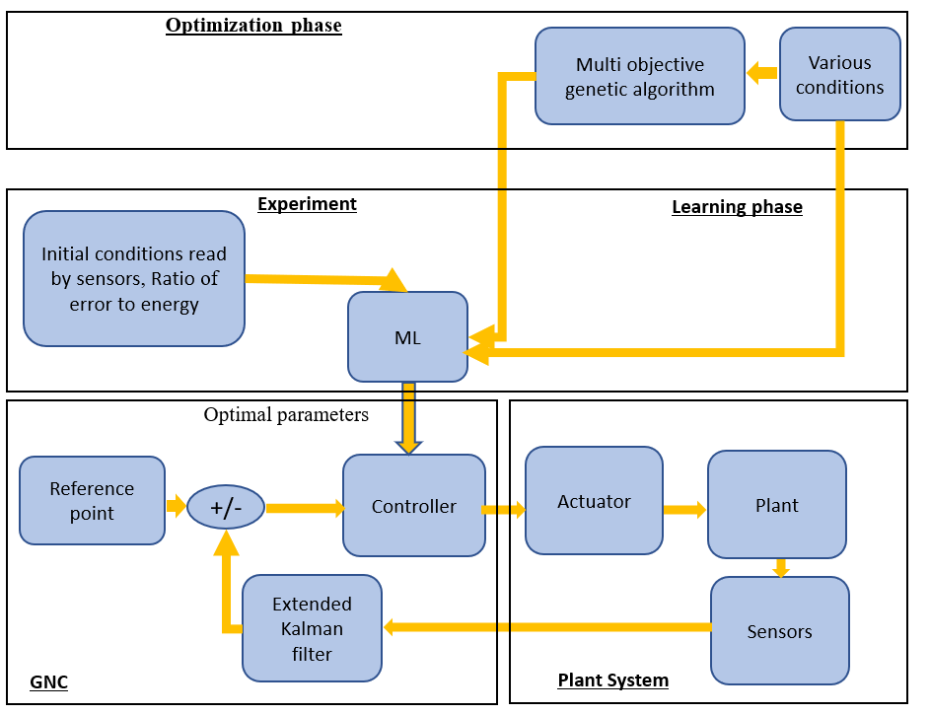
Virtual Telescope for X-Ray Observations(VTXO)
Applying more sensors and sensor fusion algorithm
Develop artificial intelligence algorithms to decrease the error in pointing to the targets in space
Combining relative position control and attitude control algorithms to increase the performance of the formation flying control system
Energy
Gaussian processes
Confidence interval
Initial conditions, Error
Performance
Deep learning
Optimal parameters
Courtesy Reza Pirayesh; Small Sat, ICALEPS

Slide 32
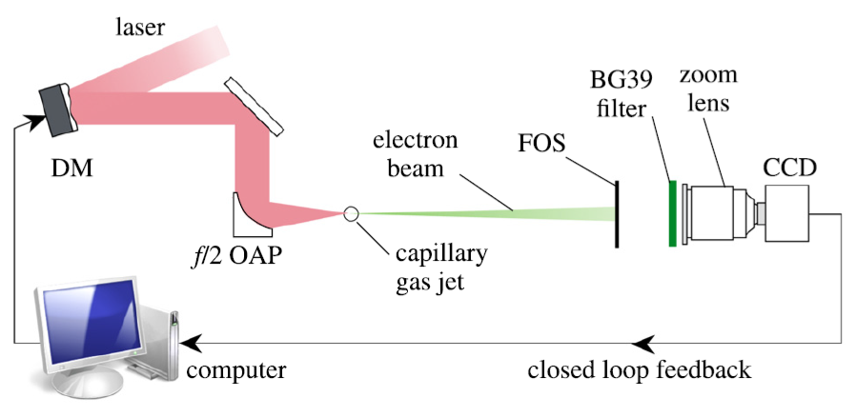
coherent control of plasma dynamics in a laser wakefield electron acceleration experiment
The first input of the genetic algorithm under open-loop conditions and the corresponding final output of the genetic algorithm will be used as input and relevant output respectively to train the neural network.
Output for training
Input for training
CNN Architecture
Convolutional Neural Networks take advantage of local spatial coherence in the input (often images), which allow them to have fewer weights as some parameters are shared.
This process, taking the form of convolutions, makes them especially well suited to extract relevant information at a low computational cost.
Courtesy A. Aslam, research with the University of Michigan (Thomas, Krushelnick)

Slide 33
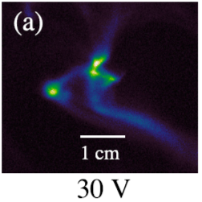

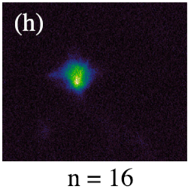
coherent control of plasma dynamics in a laser wakefield electron acceleration experiment
V1
V2
:
V37
CNNTraining
Deformable Mirror
The first input of the genetic algorithm under open-loop conditions and the corresponding final output of the genetic algorithm will be used as input and relevant output respectively to train the neural network.
Courtesy A. Aslam, research with the University of Michigan (Thomas, Krushelnick)

Slide 34
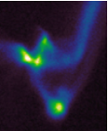

coherent control of plasma dynamics in a laser wakefield electron acceleration experiment
Input Layer
Fully Connected Layer
Convolutional Layers
Output Layer
32
1
1
V1
V2
:
:
V37
2
2
32
n
n
Once trained successfully, much faster, and easy to implement.
Can be improved evolutionary while being used as a feed-forward control.
Most of the real-world problems have non-linear and complex relationship between input and output and NNs have ability to learn and model such relationship.
Courtesy A. Aslam, research with the University of Michigan (Thomas, Krushelnick)

Slide 35


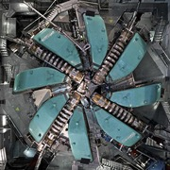
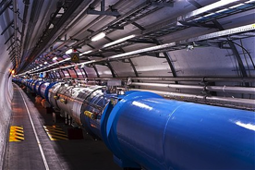
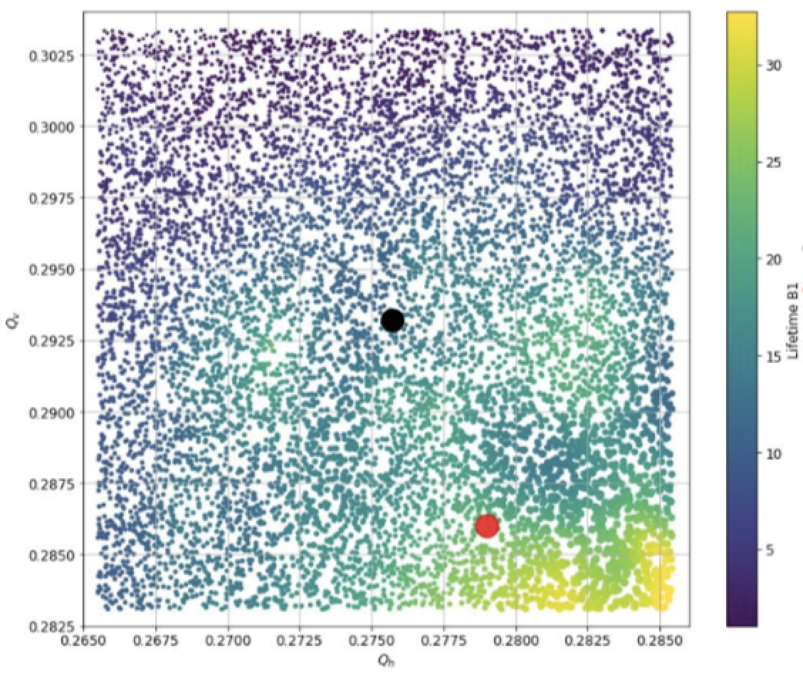

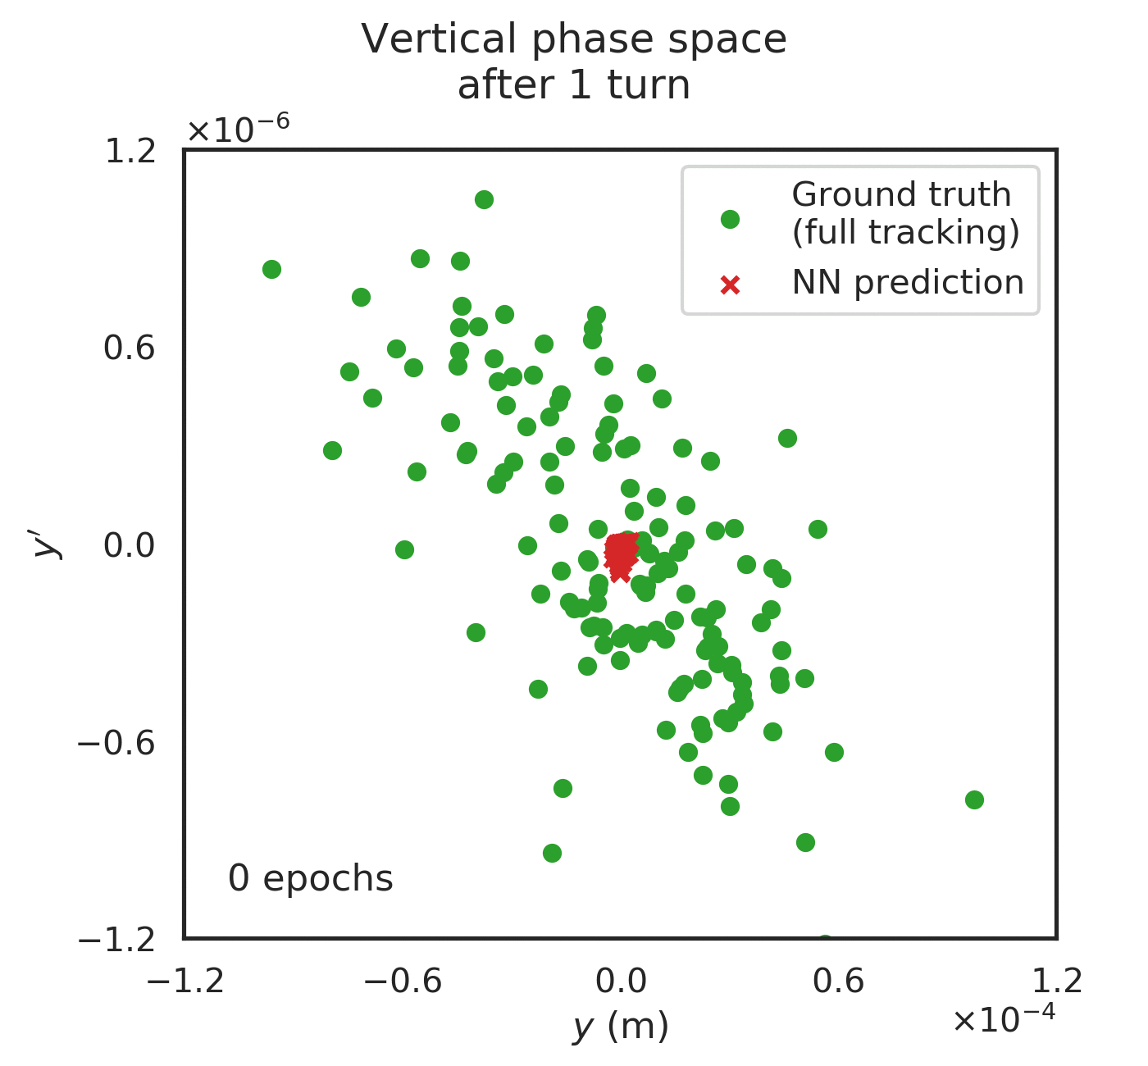
PACMAN: Particle Accelerators & Machine Learning
Co-PIs: Partner(s): PostDocs & PhDs: | Jochem Snuverink (PSI), Tatiana Pieloni (EPFL), Andreas Adelmann, Markus Janousch, Davide Reggiani (PSI) Olivier Schneider (EPFL), Anastasia Pentina (SDSC) Jaime Coello, Loïc Coyle, Sichen Li, Michael Schenk
Problem : Utilising ML to operate particle accelerators safely (LHC and HIPA): Minimise beam losses Better control of accelerator parameters Prevent unnecessary machine interruptions Improve beam dynamics modelling
Solution: Two Tier Model Construct surrogate models from data and sim. Apply surrogate models to online operation and compare to predictions Several lines of attack: Safe Bayesian Optimisation Surrogate models to enhance performance Prognostics to detect changes in the system Neural networks instead of particle tracking
Impact: Safe and improved operation Reduced component damage Increased uptime Improve or change future accelerator design Optimise data storage for ML
Beam lifetime
Nominal
Optimised
NN tracking training
phase space
after 1 turn
speedup factor: 20 x
Courtesy of Jochem Snuverink

Slide 36
LHC beam lifetime _> With the LHC physics fills of 2018 year they built a surrogate model of the LHC at injection energy. With that model they determined the best working point (RED DOT). Then they did and experiment scanning the various parameters they had in the model and measured lifetimes (color code points). The yellow area is where the lifetime is the highest and also the prediction of the surrogate model. They believe larger emittances in some cases because of collective instabilities that the trained model did not have (thus a small yellow area).
Courtesy of Jochem Snuverink

Slide 37

recent events highlighting intelligent techniques including in control these will certainly lead to opportunities in our controls community
Four town halls are being conducted to collect input on the needs and visions of the community. Several of my team members and I attended the meetings at Argonne and LBL and tried provided view points of the controls and scientific facilities communities.
Invite-only summit to launch the AI office in DOE with members of industry, government, labs, and academia
Several of the accelerator facility community were part of the controls, computing mad design cross-cut panel. Report expected in the coming months.

Slide 38
Series of Recent and related Workshops
In the last years, workshops have been held demonstrating the interest in artificial intelligence techniques in particle accelerators as well as one for physics in general, and 18 in high-energy physics
“Intelligent Controls for Particle Accelerators,” was held 30-31 January 2018 at Daresbury Laboratory www.cockcroft.ac.uk/events/ICPA/
“ICFA Beam Dynamics Mini-Workshop: Machine Learning Applications for Particle Accelerators,” was held 27 February-2 March 2018 at SLAC conf.slac.stanford.edu/icfa-ml-2018/
“Physics Next: Machine Learning,” was held by the American Physical Society Physical Review publications group in New York on 8-10 October 2018 https://journals.aps.org/physics-next/2018/
“2nd ICFA Workshop on Machine Learning for Charged Particle Accelerators,” was held from 26 February 2019 to 1 March 2019 at PSI https://indico.psi.ch/event/6698/
In HEP - 18 Workshops in ML for HEP between 2015-2018 See list in Promise and Challenges of Machine Learning in Particle Physics, Astrophysics, and Cosmology Kyle Cranmer (New York University) https://cdn.journals.aps.org//cf3bab2e-015c-4eac-813a-570bc512c5e9/KyleCranmer.pdf
ETC

Slide 39
ALSO – Looking over the fence
We need to look over the fence at groups such as HEP for guidance with large-scale data acquisition.
Not all improvements need to be focused around AI. There are many controls algorithms, for instance, that can be adapted from other fields first. (See list of journals in the back-up charts).
We need to be smart about using intelligence (See background from the IEEE Standards society working to ethical design practices.)

Slide 40
How do we get there?
WARNING! – Data science is not a magic black box. It is not magic. It is just another tool that like all of our tools, can be powerful if implemented properly. (one way is through AI)
AI

Slide 41
Systems engineering is part of the equation
Building In Intelligence And Data Science From Day 1
We as a community do not apply systems engineering principles to particle accelerators. (including model based engineering).
When planning a new or upgrading an old-ish machine, we need to remind ourselves that we need to come out of the 1930s when architecting the machines.
If we want to use data science tools, then we need to architect this goal into the system (or system upgrades) – real-time data logging, local computing (e.g. GPUs, FPGAs), application-specific integrated circuits, co-location to a powerful cluster or HPC, better diagnostics, better electronics, etc.
We need to be able to architect in how we can integrate/upgrade with new technologies.
From our experience, for instance, powerful and smart controls tools cannot be mounted onto systems not architected to handle such data science applications!
If we want to have data science as a priority, the facets of data science must be architected into our system or sub-system.

Slide 42
research for us to do
ML can look for glitches in our software (simulation software as well as controls software). ML, for instance, can learn where the glitches are, find vulnerabilities, and even help detect cyber breaches (control and data systems). Think of this as having a few extra (thousand, million, etc.) friends helping manually verify the software and protect your accelerator.
Use of specialized computing hardware — such as FPGAs, application-specific integrated circuits, systems-on-a chip are in wider use by our cousins in HEP and are natural stepping stones toward dedicated AI hardware – if we can implement, test and continue to develop on many accelerator systems.
In the case of the quest for compact, accelerators, the more data we have on a “prototype” the better and cheaper we can make the next versions to be produced and sold. Intelligent methods will be important here.
We need to generate new intelligent techniques and algorithms specifically to address the underlying physics in an accelerator and peripheral systems (e.g. lasers).
We have some of the most interesting data sets in the world generated on our machines and by our users. Just in the acquired data thus far, we can be exploring accelerator-specific data science techniques.
We need to be aware that controls using traditional techniques and/or more intelligent techniques could be improved through better use of data science.

Slide 43
Conclusions
To effectively apply data science to the accelerators, you must have knowledge of the system and physics, engineering, materials, chemistry, etc. behind it.
Need to choose the right algorithm to tell you about the system, not just about the data interpretation you already know.
Need to find the right data set for the question(s) you have. This includes the diagnostic (how you got the data).
We need to realize that we ourselves have to improve our own methods or adapt to a “new job” (e.g. we are now taking something we examined with genetic algorithms and now using a deep belief network algorithm to formulate our control.)
We need to convince the managers as well as the funding agencies that data science is a low-hanging fruit in scientific systems.
Better reliability and ease of operation can help make compact accelerators a reality! BUT WE NEED DATA SCIENCE (and systems engineering). E.g. the lifetime of an optical grating of your laser needs to be in your model, inspection/test data, etc.
The difference between training a horse, for instance, and a machine is that we have control over the systems engineering architecture of the machine itself and the algorithms but not in the case of the horse. [Control starts from day 1.]
Architect in from day 1 the computational resources. Things will change over time and eventually computing will be some convergence of neurons, bits, and qubits. Be prepared that AI will drive some of these changes and that your system could be architect to “accept” these.
Don’t forget about the end user – their systems need to be part of your model and their systems can also be better automated.
Lots of work yet to do.
The only working model of a universe is a universe.
“

Slide 44
Acknowledgements
Thanks to Jim Amundson, Josh Stein, John Cary, Richard Farnsworth, Steve Lidia, John Petillo, Massimo Dal Forno, Mark Curtin, Manel Martinez-Ramon, Stephen Milton, Jorge Alberto Diaz Cruz, Aasma Aslam, Trudy Bolin, Salvador Issac Guitron Sosa, Reza Pirayesh, and to ONR, DOE, Sincrotrone Trieste, and NASA for support that inspired this work either directly or indirectly.

Slide 45
Back up materials

Slide 46
Contacts at the IEEE
Alpesh Shah, alpesh.shah@ieee.org and Sam Sciacca, s.sciacca@ieee.org
https://ethicsinaction.ieee.org/standards/ p7000/

Slide 47




Working together toward a human-centric AI?
Socio-political Awareness
Socio-political Awareness
Legislative actions
Regulative Actions/ Codes
Engagement of civil society
Does the top-down
meet the bottom-up?
Open Standardization (IEEE,BSI)
Code building (EAD IEEE)
Internal Boards (Google)
External Boards (SAP)
Consortia (Partnership on AI)
Industry self-regulation

Slide 48
Lots of people suggest “AI Principles”
Several lists, some original, some “cut and paste” from others
Reflecting various interests and agendas (industry lobbies, activist NGOs, proxy-religions, existential fears, etc.)
Confusing categorization, mixing of political, cultural and technical levels
Partly overlapping, even conflicting aspects
For this OECD group to have a chance to succeed, we will need to establish rather fast a conceptual framework to address the categorization problem.
A possibility to conceptualize at a higher level such principles could be to follow the categorization implicit in slide 2 of Ms Doaa "Multi-disciplinary approaches to Ethical AI"

Slide 49
From “interdisciplinary approaches” to “principles categories” ?
Philosophical Approaches Values principles/aspirational intentions
Which societal, moral, cultural, political values do we intend to promote through intelligent systems?
Self-determination, political autonomy/democracy, dignity, privacy, social fairness,….
Legal Approaches Legal principles/obligations
Which current or emerging legal frameworks must we take into account?
Human rights, children rights, personal data protection, liability laws, ...
Computational Approaches Systems design principles/ - technical implementations
Are the systems dependable, ie are they doing what they are supposed to do?
How to measure and verify?
The 3 principles on Slide 5 of Ms Doaa fall under this category.

Slide 50

IEEE’s Path toward a human-centric AI
Established in 2016 the IEEE Global Initiative on Ethics of Autonomous and Intelligent Systems
It is an open, global and inclusive (regionally, culturally, gender etc.) community of experts and interested persons from technology and human science to address this question
Within two years, a community of ~ 1500 people from all continents,
~ 40 % women
Its mission is to ensure that every stakeholder involved in the design and development of autonomous and intelligent systems is educated, trained, and empowered to prioritize ethical considerations so that these technologies are advanced for the benefit of humanity
  There seems to be a great affinity between this and OECD’s mission regarding a human-centric AI.
  Other adjacent IEEE (SA) Initiatives:
  Global Council on Extended Intelligence
  Open Community for Ethics in Autonomous and Intelligent Systems (OCEANIS)

Slide 51

Works of the IEEE Global Initiative on Ethics of Autonomous and Intelligent Systems
Ethically Aligned Design
An iterative process over 3 years with open and massive participation toward a better understanding of the fundamental issues, combined with a process for suggesting high-level principles and actions to address them. No corporate or geopolitical or activists agendas seem to dominate the process. Crowd-sourced, collective, unbiased intelligence at its best
    EAD V1 (2016) and V2 (2017) received 100s of pages of public feedback
    Currently, 13+ Committees are creating content for V3 (early 2019)
    The most comprehensive, crowd-sourced global treatise regarding the ethics of Autonomous and Intelligent Systems available today
    Provides an open platform for thought leadership and action
    to prioritize values-driven, ethically-aligned design for
    autonomous and
    intelligent systems.
P7000 series of standardization projects
Where we believe that - beyond suggesting high-level
principles - we may become more concrete and achieve
consensus in a meaningful time frame.
Education material/curricula
Establishment of EAD University Consortium (in 2019).
Notes:
Dialogue between technologists and policy makers is necessary to gain benefit from many technologies.
Facilitating the dialogue with the goal of connecting the unconnected through our internet inclusion activiets.

Slide 52
Global Council on Extended Intelligence
IEEE-SA and the MIT Media Lab announced the launch of the global Council on Extended Intelligence (CXI) on 22 June 2018
The goals of CXI are to build a new narrative for autonomous and intelligent technologies inspired by principles of systems dynamics and design.
CXI will promote the deals of responsible participant design, data agency and metrics of economic wellbeing prioritizing people and planet over exponential growth, including these projects:
    Extended Intelligence - Awareness and Action – will focus on creating an introduction to Extended Intelligence and Participatory Design
    Digital Identity - Democracy by Design – will focus on creation of Data Policy template for governments and organizations to utilize in helping individuals and society reclaim their digital identity in the algorithmic age
    Enlightened Indicators - Measuring What’s Good Versus Simply Growth – will focus on creating a Wellbeing Indicator template, a metric governments and organizations can utilize in genuinely measuring prosperity in terms of benefit to all

Slide 53
Open Community for Ethics in Autonomous and Intelligent Systems (OCEANIS)
IEEE-SA jointly launched and became a founding member on 25 July 2018
OCEANIS is a high level global forum for discussion, debate and collaboration among organizations interested in the development and use and development of standards in autonomous and intelligent systems.
Community will address needs for coordination and collaboration related to the unprecedented challenges faced by those working in ICT standards and related spaces.
OCEANIS is open to all interested organizations.
In addition to IEEE-SA, Founding Members include the:
  -African Regional Organization for Standardisation (ARSO)
  -Austrian Electrotechnical Association (OVE)
  -Austrian Standards International (A.S.I.)
  -British Standards Institution (BSI)
  -China Electronic Standardizations Institute (CESI)
  -CIO Strategy Council (Canada)
  -International Electrotechnical Commission (IEC)
  -Ecuadorian Service for Standardization (INEN)
  -National Standards Authority of Ireland (NSAI)
  -Turkish Standards Institute (TSE)
  -Verband und Deutsche Kommission Elektrotechnik Elektronik Informationstechnik

Slide 54
IEEE Initiatives & activities around autonomous/intelligent systems:
Standards | Other Activities
IEEE 7000 Series Standards: 7000 - Model Process for Addressing Ethical Concerns During System Design 7001 - Transparency of Autonomous Systems 7002 - Data Privacy Process 7003 - Algorithmic Bias Considerations 7004 - Standard for Child and Student Data Governance 7005 - Standard for Transparent Employer Data Governance 7006 - Standard for Personal Data Artificial Intelligence (AI) Agent 7007 - Ontological Standard for Ethically Driven Robotics and Automation Systems 7008 - Standard for Ethically Driven Nudging for Robotic, Intelligent and Autonomous Systems 7009 - Standard for Fail-Safe Design of Autonomous and Semi-Autonomous Systems 7010 - Wellbeing Metrics Standard for Ethical Artificial Intelligence and Autonomous Systems 7011 - Standard for the Process of Identifying and Rating the Trustworthiness of News Sources 7012 - Standard for Machine Readable Personal Privacy Terms 7013 - Inclusion and Application Standards for Automated Facial Analysis Technology | Industry Connection Group: The IEEE Global Initiative on Ethics of Autonomous and Intelligent Systems Launch of the NeuroTech Industry Connections Group
 | IEEE Brain Initiative Workshop on Advanced NeuroTechnologies
 | IEEE Brain Sensors Workshop

Slide 55
Other related IEEE Activities
Journals-examples
IEEE Transactions on Neural Networks and Learning Systems IEEE Intelligent Systems IEEE Transactions on Fuzzy Systems IEEE Transactions on Nuclear Science IEEE Transactions on Human-Machine Systems IEEE Transactions on Cybernetics EEE Transactions on Control Systems Technology IEEE Transactions on Automation Science and Engineering IEEE Transactions on Industrial Informatics IEEE Transactions on Systems, Man, and Cybernetics: Systems IEEE Transactions on Circuits and Systems IEEE Transactions on Pattern Analysis and Machine Intelligence IEEE Transactions on Cognitive and Developmental Systems IEEE Transactions on Image Processing IEEE Robotics and Automation Letters IEEE Transactions on Emerging Topics in Computational Intelligence

Slide 56
Other related IEEE Activities
Journals- special issues- examples
Computer – Sept 2018 – The future of AI IEEE JSAC (Journal on Special areas in Communications) Special Issue on Artificial Intelligence and Machine Learning for Networking and Communications IEEE Transactions on Engineering Management - Special Issue: Services Computing Management for Artificial Intelligence and Machine Learning IEEE Transactions on Network Science and Engineering-Special Issue on Big Data and Artificial Intelligence for Network Technologies Journal of Biomedical and Health Informatics – Special issue -Pervasive Sensing and Machine Learning for Mental Health IEEE Internet of Things Journal - RRCPS: Reliable and Resilient Cyber-Physical Systems

Slide 57
Other related IEEE Activities
Artificial Intelligence (34)-conferences
2018 International Conference on Advanced Computation and Telecommunication (ICACAT), 28 Dec - 29 Dec 2018 2018 IEEE International Conference on Artificial Intelligence and Virtual Reality (AIVR), 10 Dec - 12 Dec 2018 2018 3rd International Conference on Pattern Analysis and Intelligent Systems (PAIS), 24 Oct - 25 Oct 2018 2018 IEEE 3rd Advanced Information Technology, Electronic and Automation Control Conference (IAEAC), 12 Oct - 14 Oct 2018 2018 First International Conference on Secure Cyber Computing and Communication (ICSCCC), 11 Oct - 13 Oct 2018 2018 IEEE International Conference on Systems, Man, and Cybernetics (SMC), 07 Oct - 10 Oct 2018 2018 First International Conference on Artificial Intelligence for Industries (AI4I), 26 Sep - 28 Sep 2018 2018 Joint IEEE 8th International Conference on Development and Learning and Epigenetic Robotics (ICDL-EpiRob), 17 Sep - 20 Sep 2018 2018 Intelligent Systems Conference (IntelliSys), 06 Sep - 07 Sep 2018 2018 IEEE International Conference on Autonomic Computing (ICAC), 03 Sep - 07 Sep 2018 2018 IEEE Conference on Computational Intelligence and Games (CIG), 14 Aug - 17 Aug 2018 2018 International Conference on Computer and Applications (ICCA), 06 Aug - 07 Aug 2018 2018 IEEE International Work Conference on Bioinspired Intelligence (IWOBI), 18 Jul - 20 Jul 2018 2018 33rd Annual ACM/IEEE Symposium on Logic in Computer Science (LICS), 09 Jul - 12 Jul 2018 2018 10th International Conference on Modelling, Identification and Control (ICMIC), 02 Jul - 04 Jul 2018 2018 10th International Conference on Electronics, Computers and Artificial Intelligence (ECAI), 28 Jun - 30 Jun 2018 2018 19th IEEE/ACIS International Conference on Software Engineering, Artificial Intelligence, Networking and Parallel/Distributed Computing (SNPD), 27 Jun - 29 Jun 2018 2018 IEEE International Conference on Smart Computing (SMARTCOMP), 18 Jun - 20 Jun 2018 2018 Second International Conference on Intelligent Computing and Control Systems (ICICCS), 14 Jun - 15 Jun 2018 2018 Global Internet of Things Summit (GIoTS), 04 Jun - 07 Jun 2018

Slide 58
Other related IEEE Activities
Artificial Intelligence (34)-conferences
2018 International Conference on Optical Network Design and Modeling (ONDM), 14 May - 17 May 2018 2018 International Symposium on Consumer Technologies (ISCT), 11 May - 12 May 2018 2018 9th International Conference on Information and Communication Systems (ICICS), 03 Apr - 05 Apr 2018 2018 International Conference on Control, Automation and Diagnosis (ICCAD), 19 Mar - 21 Mar 2018 2018 13th ACM/IEEE International Conference on Human-Robot Interaction (HRI), 05 Mar - 08 Mar 2018 2018 International Conference on Intelligent Autonomous Systems (ICoIAS), 01 Mar - 03 Mar 2018 2018 International Conference on Emerging Technologies in Data Mining and Information Security (IEMIS), 23 Feb - 25 Feb 2018 2018 Second International Conference on Computing Methodologies and Communication (ICCMC), 15 Feb - 16 Feb 2018 2018 International Conference on Communication information and Computing Technology (ICCICT), 02 Feb - 03 Feb 2018 2018 International Conference on High Performance Computing in Asia-Pacific Region (HPC Asia), 29 Jan - 31 Jan 2018 2018 IEEE International Conference on Future IoT Technologies (Future IoT), 18 Jan - 19 Jan 2018 2018 10th International Conference on Agents and Artificial Intelligence (ICAART), 16 Jan - 18 Jan 2018 2018 IEEE International Conference on Big Data and Smart Computing (BigComp), 15 Jan - 17 Jan 2018 2018 8th International Conference on Cloud Computing, Data Science & Engineering (Confluence), 11 Jan - 12 Jan 2018

Slide 59
What not to do
Resist to dogmata
Do not oversimplify
Don’t confuse science with marketing

Slide 60
Step 1. Get the data
We need to gather the data from our challenging accelerator or accelerator sub-system(s).
This can be difficult as in especially challenging cases, you might not collect the correct data OR maybe you think something is outside the possibility of influencing a sub-system (so data not logged or not even monitored from this source).
Make certain you collect (or generate if simulation only) enough data.

Slide 61
Step 2. data preparation
May not need if you are doing more traditional data analytics not involving AI/machine learning.

Slide 62
Reduce the number of features
A dataset can contain a large amount of features associated with it.
Reduction in features essentially summarizes the data, playing an important role in being able to apply techniques of data science.
Why do we need to do this? EXAMPLES
Help reduce the computation or training time by algorithms.
Preserve limited storage space.
Permit use of some algorithms that do not perform well with large dimensions.
Removes redundant features (reduce multicollinearity).
Reductions helps in visualizing data (as reducing to 2D or 3D may permit plotting and observing patterns more clearly.

Slide 63
Dimensionality reduction
Formally - Dimensionality reduction is the process of reducing the number of random variables under consideration. Through reduction, one obtains a set of principal variables.
Algorithms like Principal Component Analysis, Linear Discriminant Analysis, Random Forest, Single Value Decomposition, Missing Value Ratio, Low Variance Filter, High Correlation Filter, Backward Feature Elimination, Forward Feature Selection, Independent Component Analysis, Factor Analysis, Methods Based on Projections, Uniform Manifold Approximation and Projection (UMAP), t-Distributed Stochastic Neighbor Embedding (t-SNE) can be used to reduce the dimensionality.
Again, such reduction will improve the results of, for instance, classification with a neural network.

Slide 64
Splitting the data
Need to split the data into two separate pots - training and evaluation data.
You want to train your model on the training data and then evaluate the model’s effectiveness through the evaluation data.

Slide 65
Step 3. Choose a learning method
Choose a learning (training) method that is appropriate from the many that exist already suited to your data (image, text, numbers, etc…)
Again – this is not a black box. Many algorithms and infinite combinations

Slide 66
Statistical examination of the data
We need to realize that not all the data we collect makes sense in terms of volume, type, or if there are errors.
Mean average - determines overall trend of a data set
Standard deviation - the spread of data around mean
Regression - examines relation between variables
Outlier detection & treatment - used where noise is present
Support Vector Machines (SVM) based anomaly detection
Clustering-based anomaly detection
Hypothesis Testing

Slide 67
Step 4. Allow the machine to learn
Build a candidate model from the data using the selected learning method.
This can take many iterations.
NOTE unsupervised ML models have the ability to self-learn patterns to deliver answers even when input data is unlabeled and has unknown outcomes.
“All models are wrong, but some are useful” George E. P. Box

Slide 68
Step 5. evaluate
Test your model on the evaluation data.

Slide 69
Step 6. Refine the model – tuning step(S)

Slide 70
7. Prediction OR USE step!

Slide 71
DATA SET
Randomize and split into training and and evaluation data sets
DS1
DS2
DS3
DS4
DS5
DS6
Training data
Test data
Data reduction
DS1
DS2
DS3
DS4
DS5
DS6
Reduced training data
Reduced
test data

Slide 72
Select informative voxels and determine any optimal parameters
DS1
DS2
DS3
DS4
DS5
DS6
Ready training data
Reduced
test data
Model building (e.g. Decision Trees,
Neutral Networks, Linear regression,
Bayesian networks, Nearest Neighbor, Support Vector Machine)
Test model
Evaluation
Repeat as necessary

Slide 73
A few Additional examples
A few examples recently exploiting intelligent methods and HPC applied to particle accelerators.

Slide 74
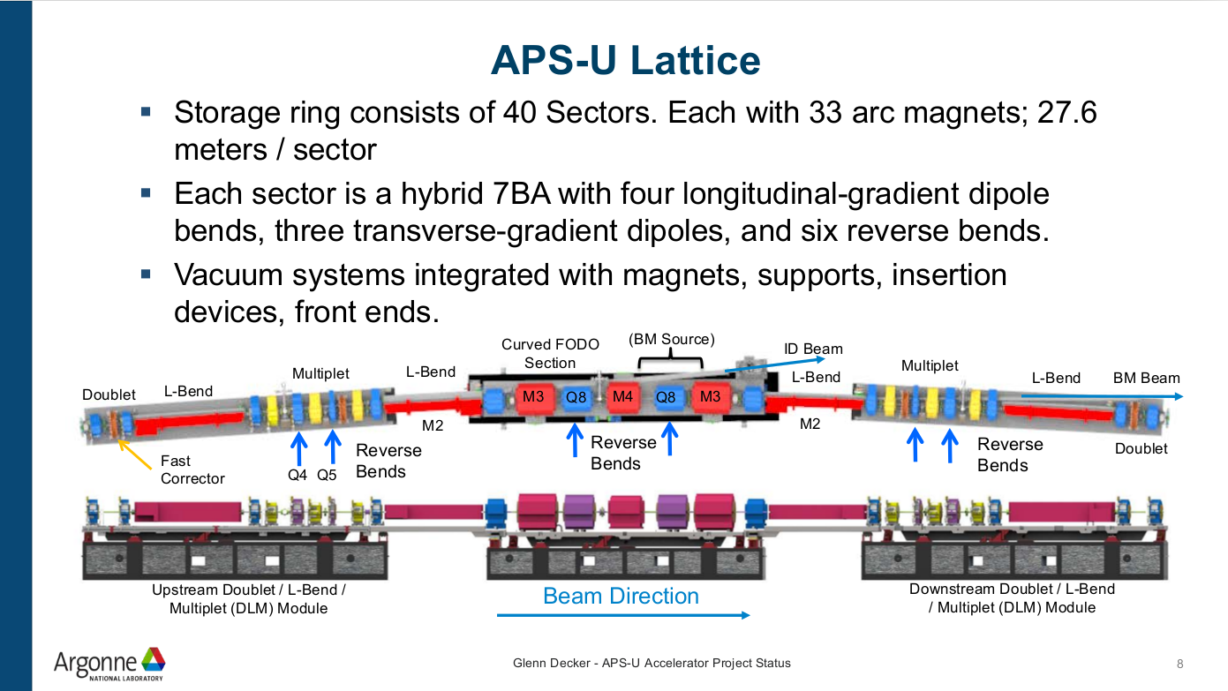
Simulations and HPC are central to the APS Upgrade (M. Borland)
Massively parallel multi-objective genetic optimizer to develop physics design
Design of complex multi-function magnets using 3D codes
Simulation of collective behavior of high-charge, multi-bunch electron beams
Simulation of vacuum system performance in response to synchrotron radiation
Simulation of commissioning and operational performance
Understanding and pushing intensity limits in the injector complex
Prediction of radiation levels and shielding requirements
Image courtesy G. Decker, APS-U
74

Slide 75
Courtesy M. Borland Argonne

Slide 76
Courtesy Jean-Luc Vay, LBL

Slide 77
Minimizing high-frequency jitter
In order to compensate for the PID algorithm deficiencies, we wanted to build a system that
  Acted in a feed forward way, for correction of high-frequency jitter
  Increased the bandwidth in order to avoid re-tuning when conditions change.
We recorded data from the machine in order to train a neural network to predict a future deviation based on past records.
We complemented the system with an optional PI algorithm to further decrease remaining deviations.

Slide 78
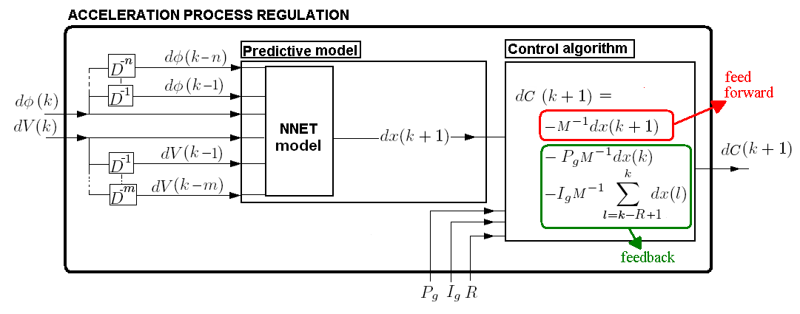
Predictive model (left block): The Neural Network (NNET) receives lagged values of the perturbed klystron phase and voltage. It gives a prediction of the next pulse position deviation dx(k+1) used to compute the feed forward correction.
Control algorithm (right block): The algorithm is composed of a feed forward (first term) augmented by PI control terms (second and third terms) to compute the correction to apply dC(k+1) .

Slide 79
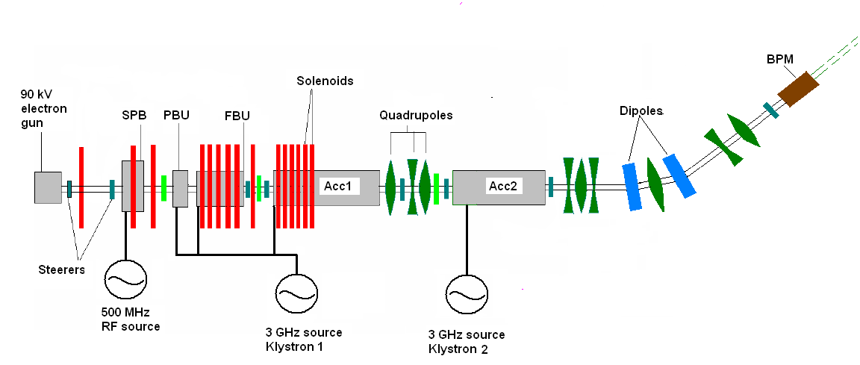
ACC1 and ACC2 provide 100 MeV beam @ 1-10Hz.
BPM resolution ~50μm , white noise level ~0.11 mm rms
Jitter are induced in klystron 1 phase and voltage and corrected using
klystron 2 voltage
Slow actuator response limits the experiment to max. ~0.075 Hz

Slide 80
Real time energy control
Both the hyperbolic tangent network (HTN) and radial basis function network (RBFN) received 7 lagged values of V₁ and 5 lagged values of φ₁. The HTN and RBFN had 7 and 76 hidden neurons, respectively.

Slide 81
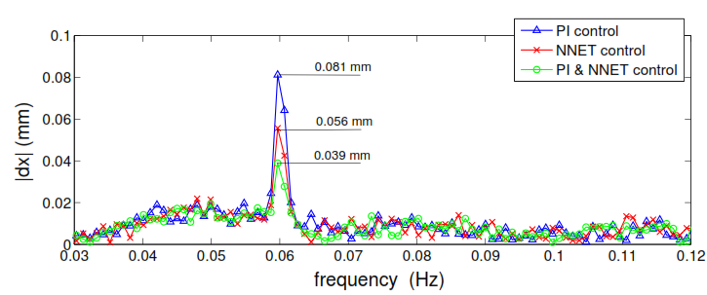
Real Time energy feed-forward feedback control.
Real time energy feed forward-feedback combined control:
The PI controller was tuned for a 0.4 Hz perturbation.
The NNet was trained to correct the same 0.4 Hz perturbation .
A shift in frequency to 0.6 Hz shows that the NNet operates better than the PI, and
that the combined controlled provides further decrease of the perturbation
amplitude.
E. Meier, M. Morgan, S.G. Biedron, G. LeBlanc, J. Wu, 2009, “Development of a Combined Feed Forward- Feedback System for an Electron Linac,” Nuclear Instruments and Methods in Physics Research Section A: Accelerators, Spectrometers, Detectors and Associated Equipment 609, 79-88.

