Slide 1
ERL option for high-energy high-luminosity FCC e⁺e-
Preliminary studies
Vladimir N Litvinenko and Thomas Roser

Slide 2
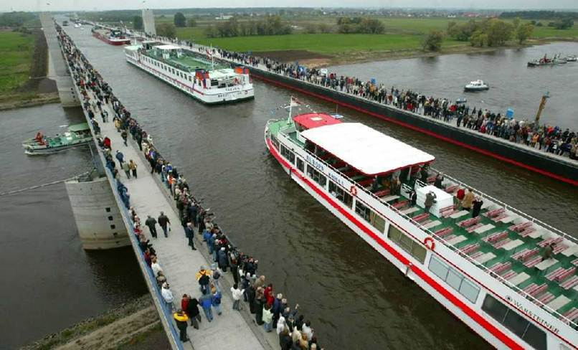
Our approach: ERL with cooling rings
Avoid accesses

Slide 3
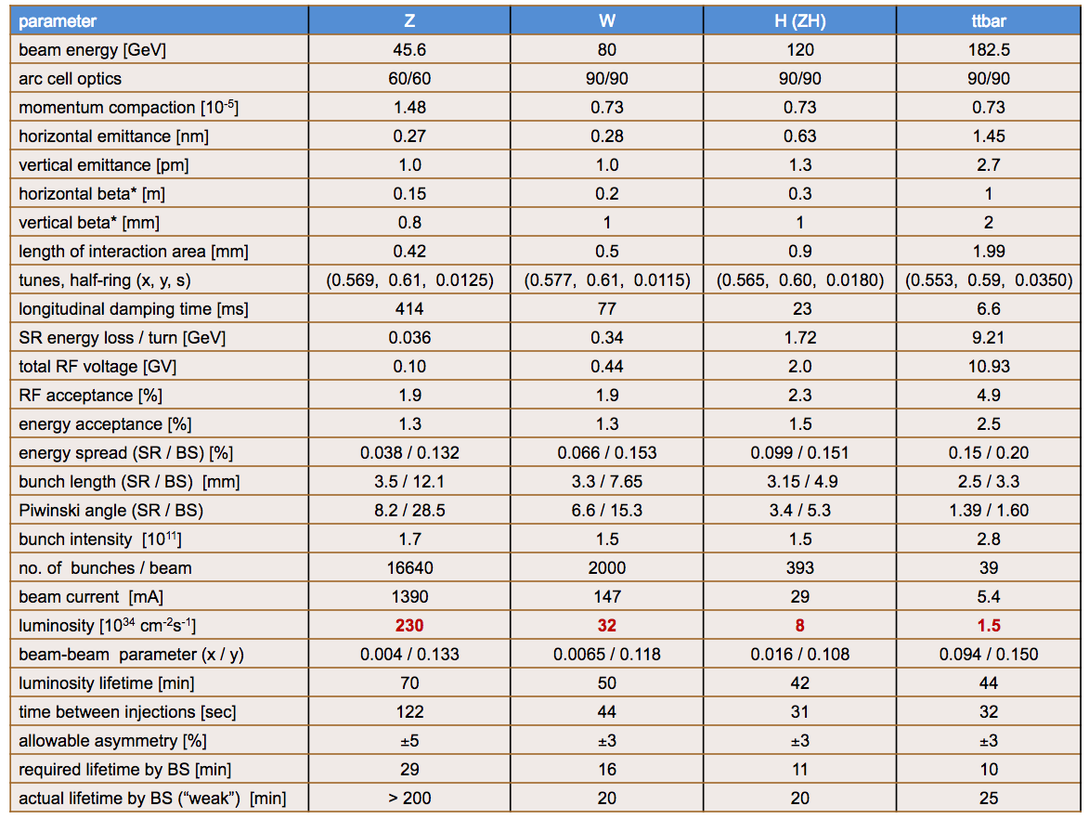
The ring-ring FCC ee is power hungry
100 MW SR losses, ~ 200 MW wall plug power

Slide 4
What ERL can offer: Green FCC ee with 10% of R-R power consumption Note that 100 MW SR power is not what we are proposing*
?
?
ERL based FCC ee at 100 MW SR
ERL based FCC ee at 10 MW SR
*Luminosity scaled linear with SR power – would see other limitations

Slide 5
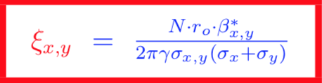
Comparison of ERL and Ring-Ring
The way to reduce SR power is to reduce beam currents in both electron and positron beam. To keep luminosity high, one would need to reduce one, two or all in
In storage rings there are additional limitations: maximum allowable beam-beam tuned shift and IP chromaticity (e.g. how small is β*)
.
< 0.1-0.15
which favors high beam currents, large emittance and high collision frequencies.

Slide 6
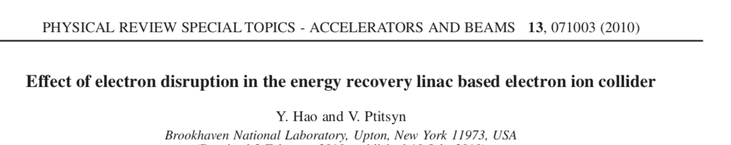
Comparison of ERL and Ring-Ring
In ERL-ERL collider the beams are used only once in collisions and beam-beam tune shift is no longer relevant. The relevant number is the disruption parameter:
where σ_{z} is RMS bunch length. As part of the ERL-based eRHIC studies we demonstrated that disruption parameter up to 200 can be tolerated in the following sense in ERL scheme: transverse beam emittance will double in a single collision, but the beam than can be comfortably energy recovered. Here is a sample of electron beam colliding with proton beam with disruption parameter d=156 : electrons execute 2 full oscillation in the opposing beam. Tails are formed due to the nonlinearity and beam emittance doubles.
.

Slide 7
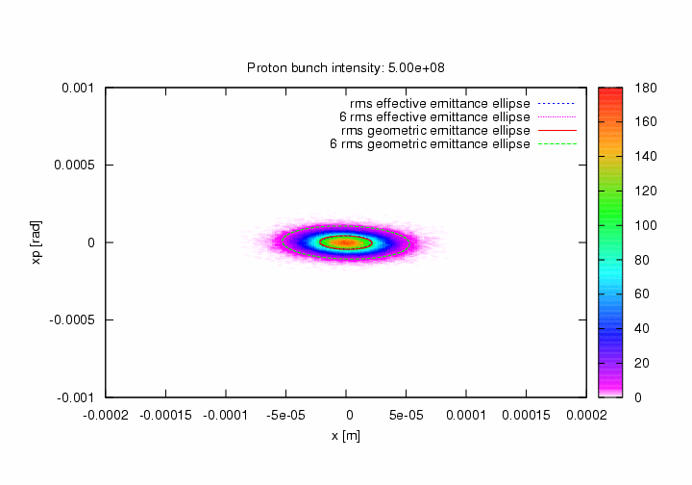
Movie of the disruption effect evolution of the transverse phase space is shown and function of increasing disruption parameter
Courtesy of Y. Hao

Slide 8

IR1
IR2
IR..X
SRF linac 1
SRF linac 2
FCCee
2 GeV
electron
“cooling” ring
with top-off
2 GeV
positron
“cooling” ring
with top-off
Explored layout of the ERL-based FCC ee:
Flat electron and positron beams are cooled in 2 GeV cooling rings with top-off injection to keep intensity constant
Bunches are ejected from the rings with frequency required by the collider – the beams are accelerated to the collision energy in 4 or 6 passes through the super-conducting RF (SRF) linacs bypassing IRs. Each path requires an individual arc.
At the top energy beams collide in IR(s), their phases are changed to deceleration and they return most of the energy back into the SRF
Portion of the beam energy is lost in form of synchrotron radiation. Additional energy loss occurs in the cooling ring, where particles circulated for two e-fold damping time to restore the initial emittance. Cooled bunches are extracted for the next trip to the top energy and collision. A very low average current 2-GeV top-off system – common in modern accelerators – will compensate for loss of particles.

Slide 9
e⁻ and e⁺ beam energy evolution in 6-path ERL with two 16 GV SRF linacs (32 GeV boost per turn) and top energy of 182.5 GeV for t-tbar regime

Slide 10
e⁻ and e⁺ beam energy evolution in 4-path ERL with two 14.9 GV SRF linacs (29.8 GeV boost per turn) and top energy of 120 GeV for H(ZH) regime

Slide 11
Cooling rings
Energy | 2 | GeV
B | 1 | T
Loss rate | 1512 | GeV/sec
Filling factor | 0.67
e-cool time | 0.002 | sec
# of cooling times | 2
Accumulatin time | 0.004 | sec
Ring circumference | 900 | m
Revolution frequency | 0.33 | MHz
2 GeV storage ring equipped with damping wigglers will provide for low emittance (1 nm rad horizontal geometrical emittance and 0.2% coupling)
Bunches will be long to keep IBS under control
Bunches will be compressed to the design values in the ERL using large R₅₆ of low energy arcs
It is proven technology in 4th generation light sources and cooler rings
Energy | 2 | GeV
γ | 3914
Emittance, horizontal | 1 | nm rad
Em. normalized, hor | 4 | μm rad
Em. normalized, vert | 8 | pm rad
Coupling | 0.002

Slide 12
Important considerations
I derived following formula for average change of the beam energy in beam-beam collision
This number is included in the table at the next slide
In addition to disruption, at high energy, there is another dangerous effect - beamstrahlung: synchrotron radiation in strong EM field produced by opposing beam during collision
It can cause significant amount of energy loss, induce large energy spread and loss of the particles
Using very flat beams is the main way of mitigating this effect*
The goal of this exercise was to maintain energy spread in colliding beams at the same level as in ring-ring FCC ee: 0.15-0.2%
* Using round beams will reduce attainable luminosity by one-to-two orders of magnitude.

Slide 13
Main table: for 10 MW SR power for 4-path ERL and 15 MW SR power for 6-path ERL (both beams)
Data is for head-on collisions – no need for crab-crossing and/or crab-focus
Luminosity exceeds that of ring-ring FCC ee with 100 SR MW power loss at H and t-tbar energies
It also has a decent luminosity of 4x10³⁴ cm⁻²s⁻¹ at double Higgs production energy
Multiple IRS need more detailed considerations
By the quick nature of this exercise, all these numbers are not optimized
Energy recovery definitely beneficial when compared with linac-linac case: 83% of 182.5 GeV and 81% of 250 GeV beam energy is recovered in 4-path ERL scheme.
Scheme does not have advantage for operating at FCC’s lowers energy of 45.6 GeV

Slide 14
Discussions
In contrast with linear collider, the transverse position jumps/jitter caused by pulsed ejector magnets can be corrected at the first arc when beam path around the FCC – the position and angle can be detected at the arc entrance and corrected at its exit. Hence an argument used in “"FCC-ee: Your Questions Answered" about the emittance spoiling is not applicable to ERL scheme;
Geometric emittance and transverse beam sizes are minuscular, which makes natural using magnets with small gap
Similarly, in contrast with storage rings, the ERL arcs do not require large dynamic aperture, e.g. one can use a combined function (shifted quads) magnets with constant bending magnetic field and nearly 100% packing factor – while it gives only ~ 35% savings in the radiated power it still an advantage
Alternating gradient combined magnets (bend quadrupole channel) has extremely high tolerance to energy deviations – it energy acceptance measured in units of energy, not in percent
As LEP demonstrated, synchrotron radiation with MeV photons degrades the surrounding hardware – hence reducing this power extends the life-cycle of the FCC ee and would make it available for future FCC he
Layout of ERLs
Beams are injected at 2 GeV in linacs (e⁻ in linac 1. e⁺ in linac 2) and extracted from the opposite linac at 2 GeV (in e dedicated extraction point)
Energy of accelerating and decelerating beams are not the same for high energy operation – it is result of the SR losses.
Beams are combined for propagation through linacs and separated to propagate in individual arcs by magnetic structures which very originally called “combiners” and “separators”

Slide 15
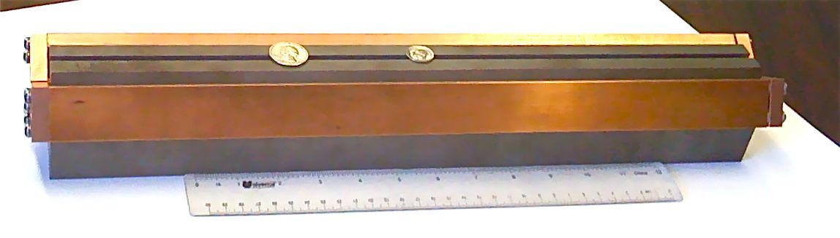
Possible arcs layout for 4-path of 182.5 GeV ERL Electrons and positrons alternate the inside and outside passes
IRs side arcs (after linac 2)
Main portion (5/6) of the ring arcs
e⁻
e⁺
2 GeV decel.
e⁻
e⁺
14.45 GeV decelerating
e⁻
25.25 GeV accelerating
61.02 GeV decelerating
37.7 GeV decel.
182.25 GeV
colliding e⁺e⁻
48.5 GeV accel.
71.74 GeV accelerating
84.33 GeV decel.
108.28 GeV decelerating
94.86 GeV accel.
118.02 GeV accelerating
131.85 GeV decel.
158.33 GeV decelerating
140.24 GeV accel.
163.12 GeV accelerating
Small gap magnets with 5 mm gap
Prototyped for eRHIC at 0.43 T: FCC ee needs only 0.04 T,
e.g. it is very low power consumption magnet

Slide 16
Preliminary conclusions
ERL option, in combination with 2 GeV cooler rings, would be advantageous for FCC ee high energy operation
This option allows both significant (6-fold to 10-fold) reduction in required RF power while delivering higher luminosities at top energies
This scheme does not have advantages at lowest FCC ee energy of 46.5 GeV
There is clearly no problem with beam stability in ERL – the average current is very low. Modern HOM dumpers will be sufficient to keep beams stable.
We did not find – so far – any showstoppers for this version of FCC ee

