Slide 1
Status of the PIP-II project at FNAL
Eduard Pozdeyev
PIP-II Project Scientist
4th ICFA Mini-Workshop on Space Charge CERN, November 4-6, 2019
In partnership with:
India/DAE
Italy/INFN
UK/STFC
France/CEA/Irfu, CNRS/IN2P3

Slide 2
Outline
LBNF/DUNE/PIP-II: Context and science objectives
PIP-II Project Overview and Design Highlights
PIP2IT – Testbed For PIP-II Critical Technologies
Recent Progress
Summary

Slide 3
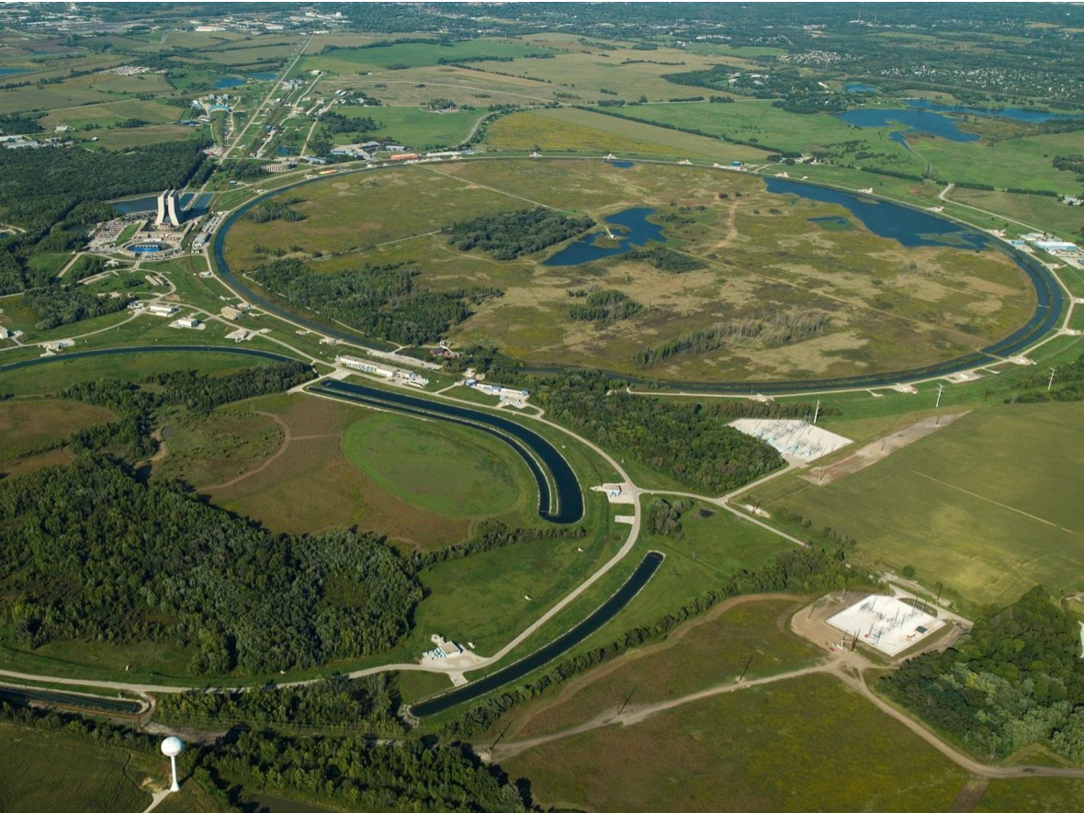
Fermilab at a Glance
America's particle physics and accelerator laboratory
6,800 acres of federal land
~1,800 staff
4,000 scientists from >50 countries use Fermilab facilities
Core expertise areas:
Particle Physics
  Neutrinos (LBNF/DUNE)
Accelerator technology and SRF
Detector development
High performance computing
Quantum computing
Outreach and education

Slide 4
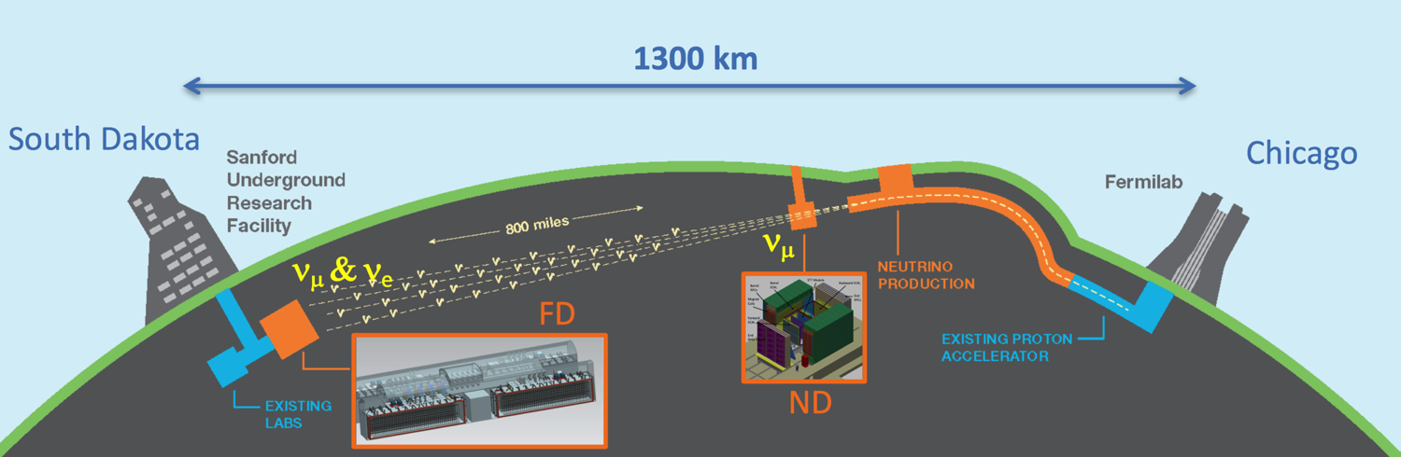
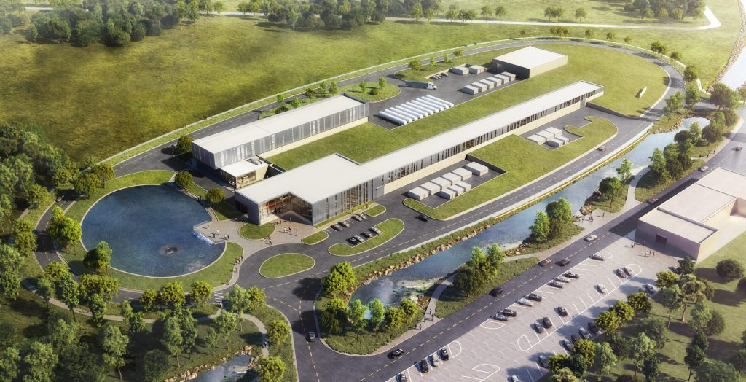
LBNF / DUNE / PIP-II
Powerful proton beams (PIP-II)
  1.2 MW upgradable to multi-MW (2.4 MW Phase 2) to enable world’s most intense neutrino beam with wideband capability
Dual-site detector facilities (LBNF)
  Deep underground cavern (1.5 km) of 70kt liquid argon fiducial volume
  A long baseline (1300 km)
Deep Underground Neutrino Experiment (DUNE)
  Liquid Argon – the next-generation neutrino detector
PIP-II ACCELERATOR

Slide 5




DUNE Science Objectives
Neutrinos – most ubiquitous matter particle in the universe, yet the least understood. Opportunities for game changing physics discoveries:
Origin of matter
Investigate leptonic CP violation, mass hierarchy, and precision oscillation physics
  Discover what happened after the big bang: Are neutrinos the reason the universe is made of matter?
Neutron Star and Black hole formation
Ability to observe supernovae events
  Use neutrinos to look into the cosmos and watch the formation of neutron stars and black holes in real time
Unification of forces
Investigate nucleon decay targeting SUSY-favored modes
  Move closer to realizing Einstein’s dream of a unified theory of matter and energy

Slide 6
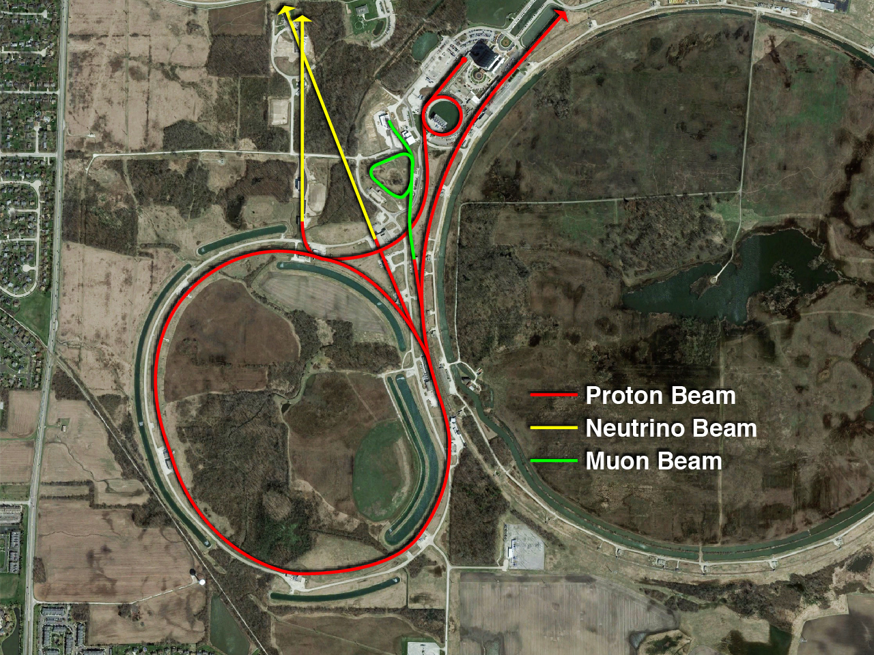
Fermilab Accelerator Complex
750 kW, 120 GeV
Booster ν beam
SBN program
NuMI ν beam
NOvA, MINERvA, MINOS+
Fermilab operates the largest US particle accelerator complex, producing the world’s most powerful ν beams, along with muon and test beams.
DUNE ν beam

Slide 7
Fermilab Accelerator Complex
750 kW, 120 GeV
Booster ν beam
SBN program
NuMI ν beam
NOvA, MINERvA, MINOS+
Fermilab operates the largest US particle accelerator complex, producing the world’s most powerful ν beams, along with muon and test beams.
DUNE ν beam
P5 Recommendation: Upgrade the Fermilab proton accelerator complex to provide proton beams of >1 MW by the time of first operation of the new long-baseline neutrino facility.

Slide 8
Fermilab’s Path to 1.2 MW on LBNF Target
Increase the number of protons per Booster pulse from 4.3e12 (present) to 6.5e12
Increase Booster rep. rate from 15 Hz to 20 Hz
Reduce Main Injector cycle from 1.33 s to 1.2 s
Implementation
PIP-II SRF linac, 800 MeV, 2 mA beam, painting injection
  Increased energy, reduced space charge, improved beam quality in the Booster
Increase in Booster injection energy, pulse intensity and repetition rate require upgrades to Booster, Recycler Ring (RR), and Main Injector (MI).

Slide 9
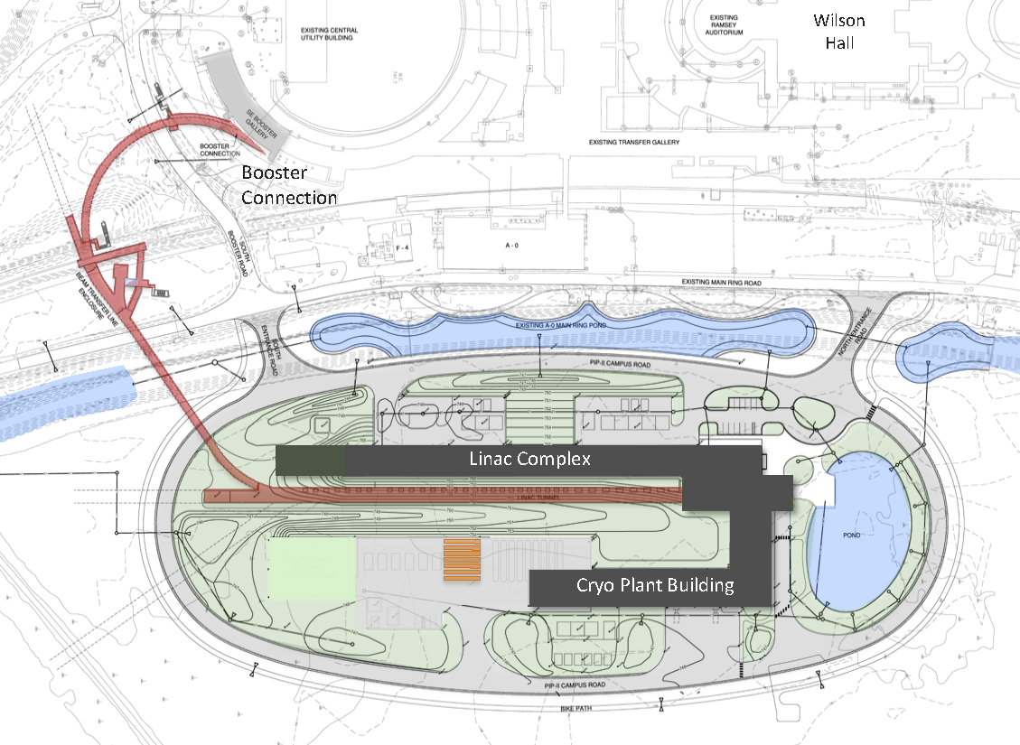
PIP-II Scope Overview
800 MeV H− linac
  Warm Front End
  SRF section
Linac-to-Booster transfer line
  3-way beam split
Upgraded Booster
  20 Hz, 800 MeV injection
  New injection area
Upgraded Recycler & Main Injector
  RF in both rings
Conventional facilities
  Site preparation
  Cryoplant Building
  Linac Complex
  Booster Connection
The PIP-II scope enables the accelerator complex to reach 1.2 MW proton beam on LBNF target.

Slide 10
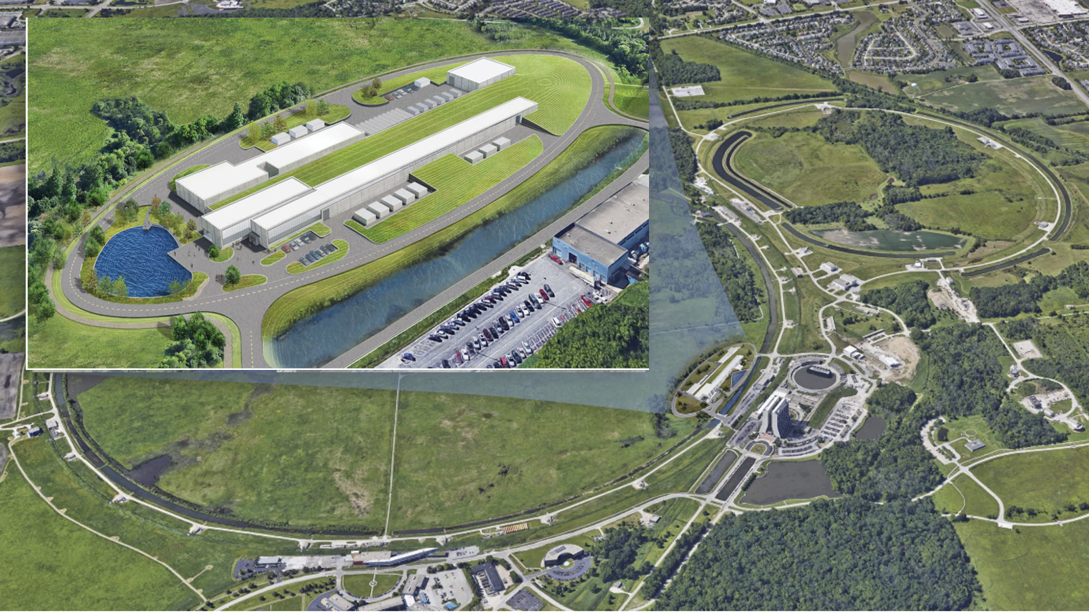
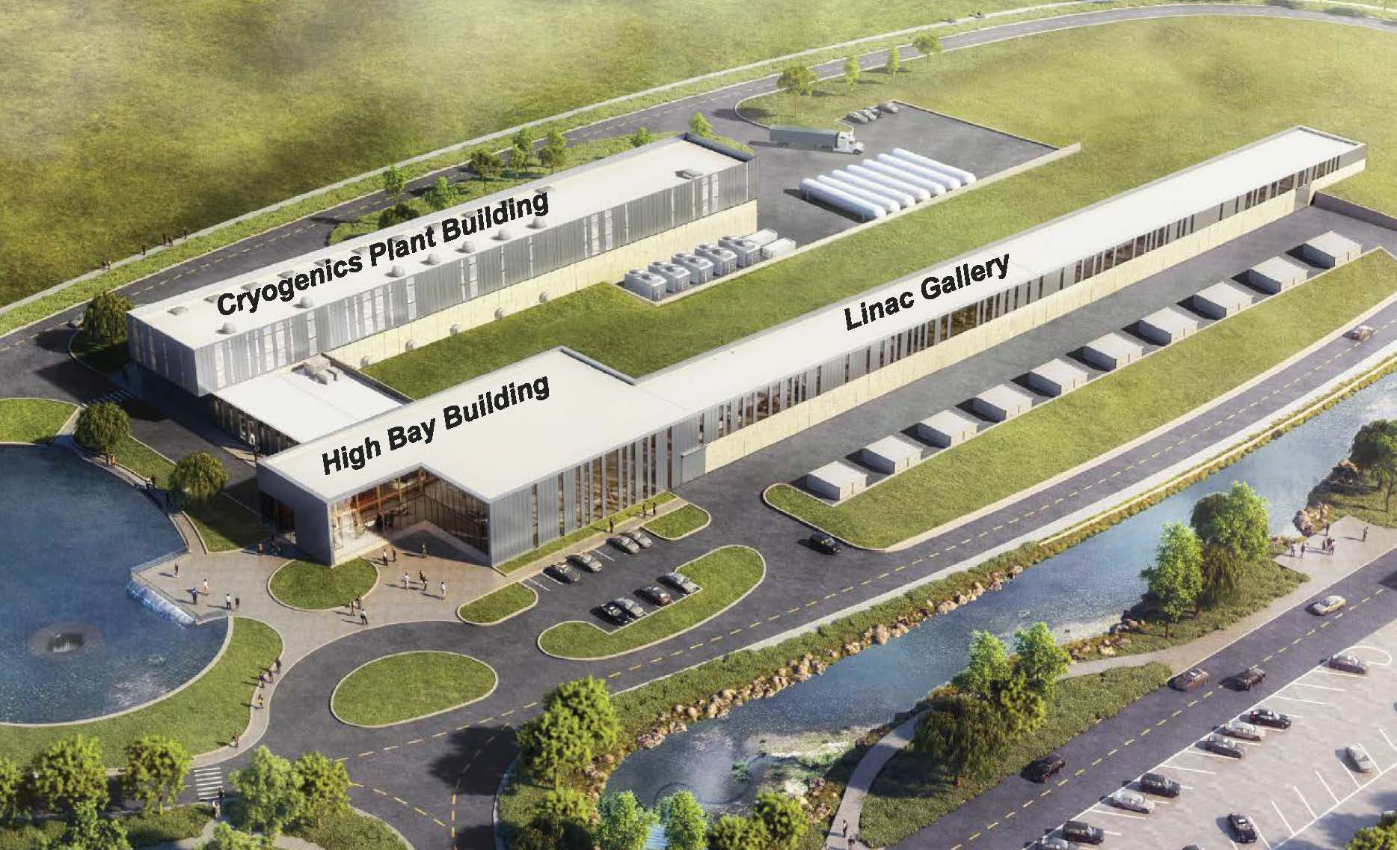
PIP-II Site at Fermilab

Slide 11
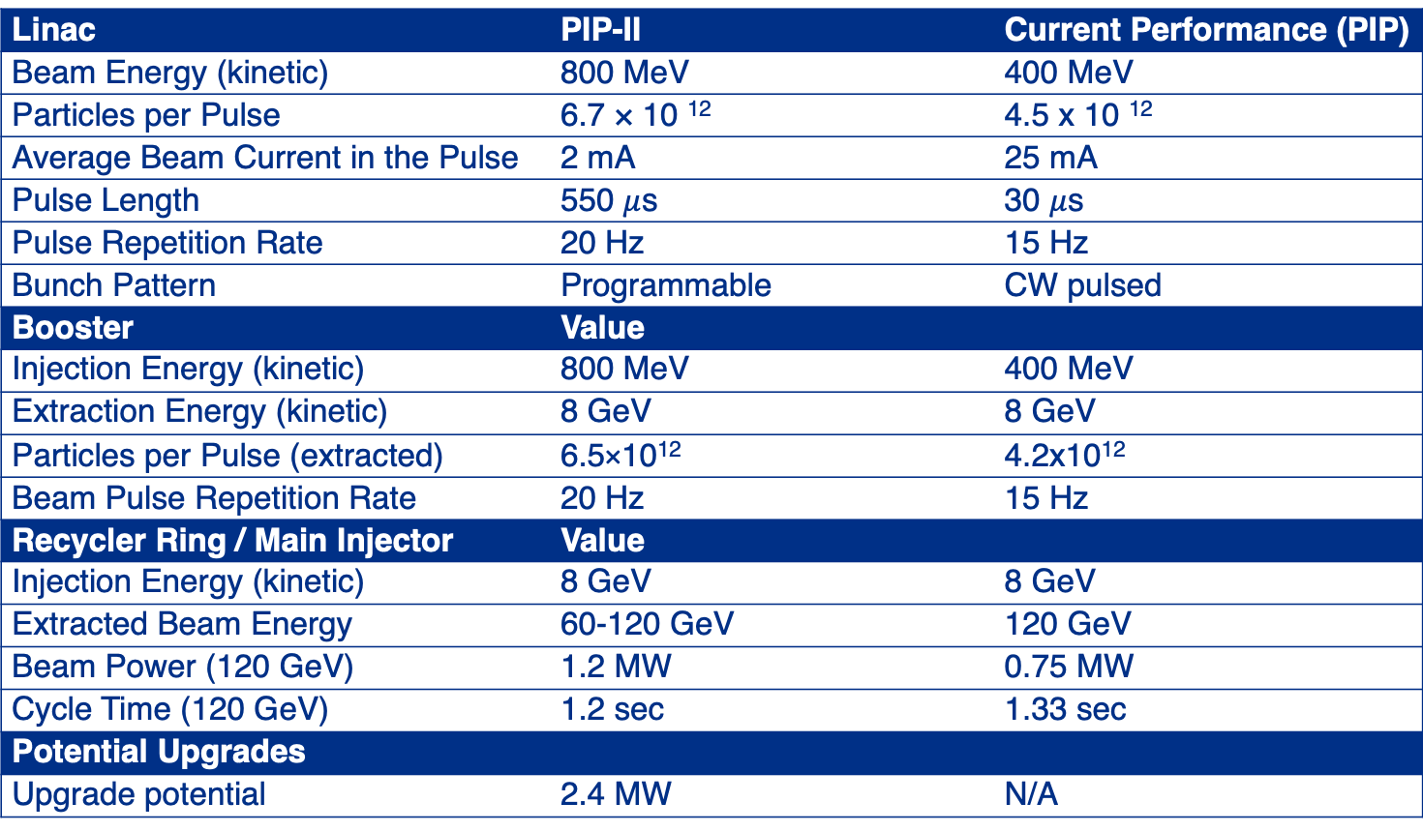
PIP-II Performance Requirements Defined
Linac | PIP-II | Current Performance (PIP)
Beam Energy (kinetic) | 800 MeV | 400 MeV
Particles per Pulse | 6.7 × 10 ¹² | 4.5 x 10 ¹²
Average Beam Current in the Pulse | 2 mA | 25 mA
Pulse Length | 550 $μ$s | 30 $μ$s
Pulse Repetition Rate | 20 Hz | 15 Hz
Bunch Pattern | Programmable | CW pulsed
Booster | Value
Injection Energy (kinetic) | 800 MeV | 400 MeV
Extraction Energy (kinetic) | 8 GeV | 8 GeV
Particles per Pulse (extracted) | 6.5×10¹² | 4.2x10¹²
Beam Pulse Repetition Rate | 20 Hz | 15 Hz
Recycler Ring / Main Injector | Value
Injection Energy (kinetic) | 8 GeV | 8 GeV
Extracted Beam Energy | 60-120 GeV | 120 GeV
Beam Power (120 GeV) | 1.2 MW | 0.75 MW
Cycle Time (120 GeV) | 1.2 sec | 1.33 sec
Potential Upgrades
Upgrade potential | 2.4 MW | N/A

Slide 12
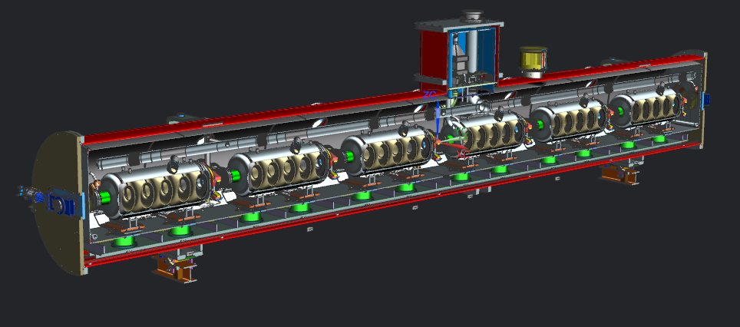
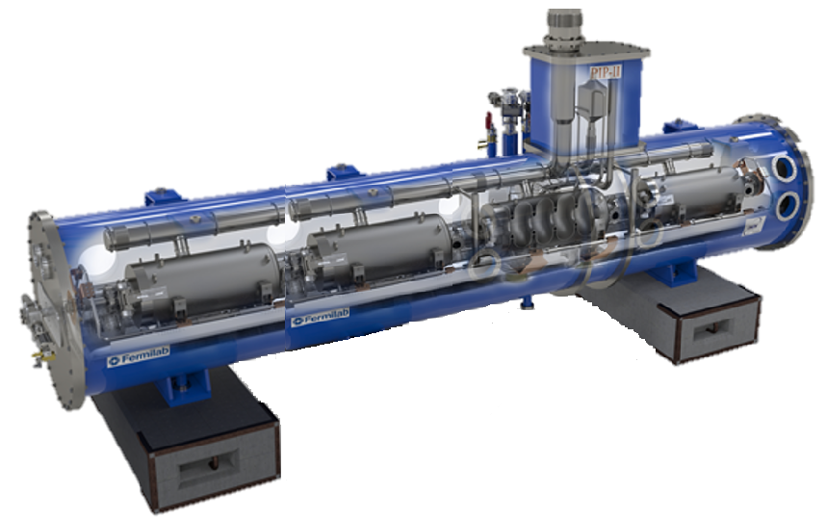
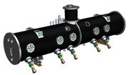
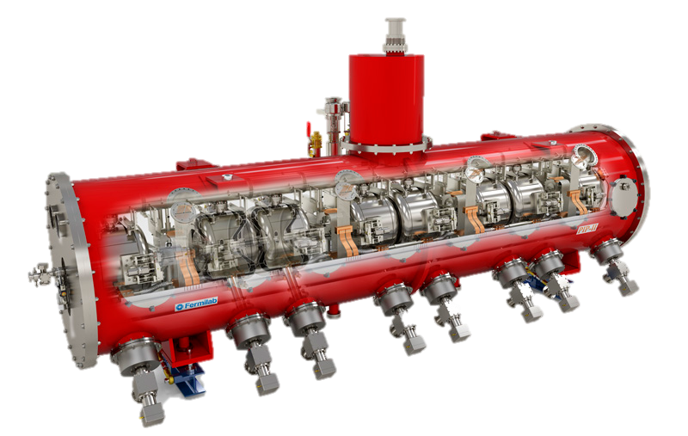
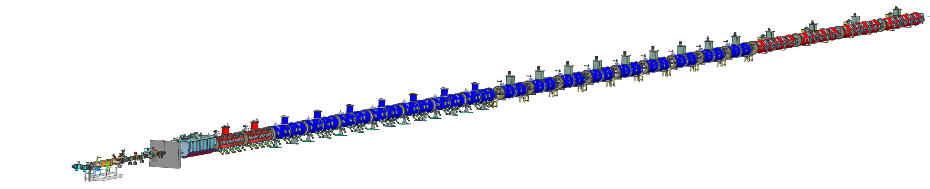
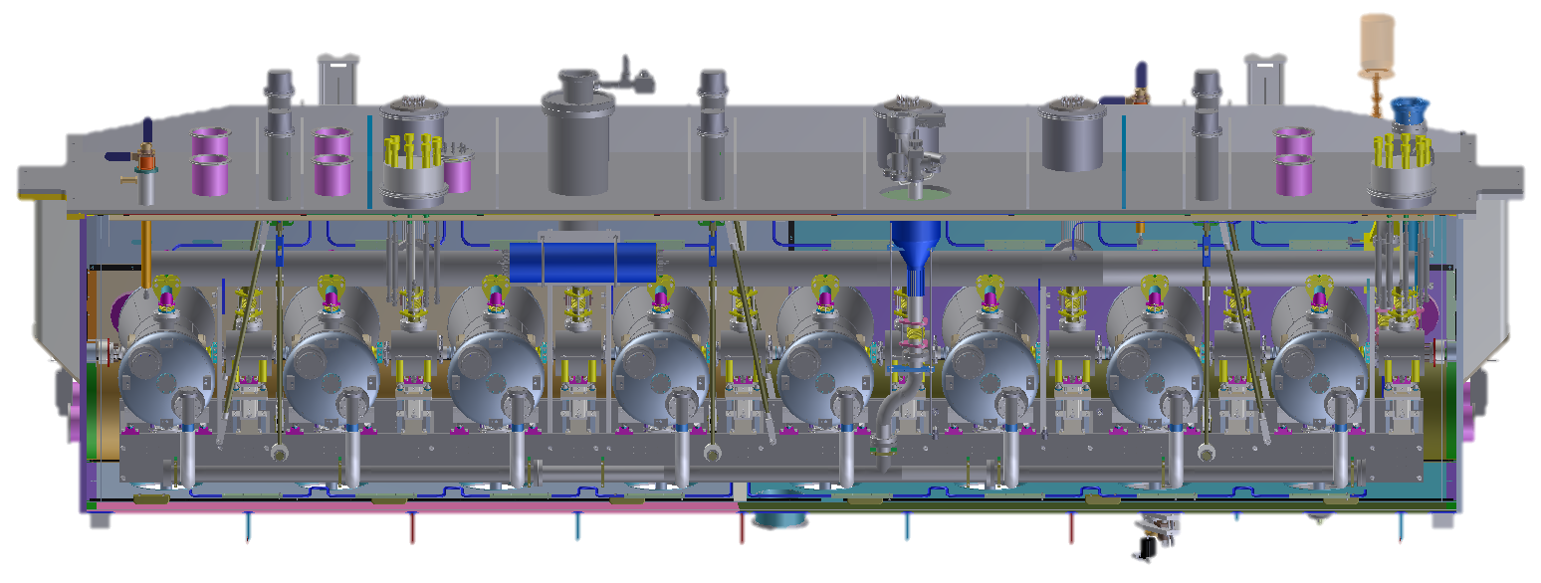
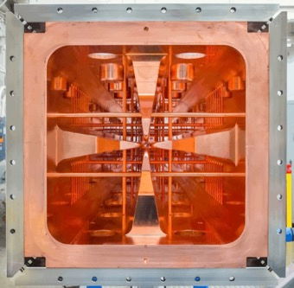
PIP-II 800 MeV Linac
5 Types of Cavities, 23 Cryomodules, 119 Cavities
HB650
4 CM
24 Cav
650 MHz
LB650
9 CM
36 Cav
650 MHz
SSR2
7 CM
35 Cav
325 MHz
SSR1
2 CM
16 Cav
325 MHz
HWR
1 CM
8 Cav
162.5 MHz
833 MeV
516 MeV
177 MeV
10 MeV
32 MeV
2.1 MeV
RFQ

Slide 13
SRF Linac Lattice Developed
End-to-End tracking simulations performed with realistic 3D fields
  TraceWin and TRACK give nearly identical results
No loss, no halo growth detected
Design is fault-tolerant
Beam Energy | 833 MeV
Beam Current | 2 mA
Emittance (trans/long) | 25 / 32 mm・mrad
Simulations with 3D fields
show no significant halo growth

Slide 14
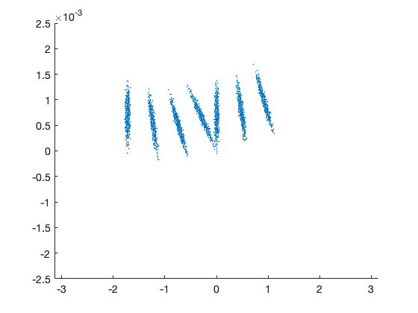
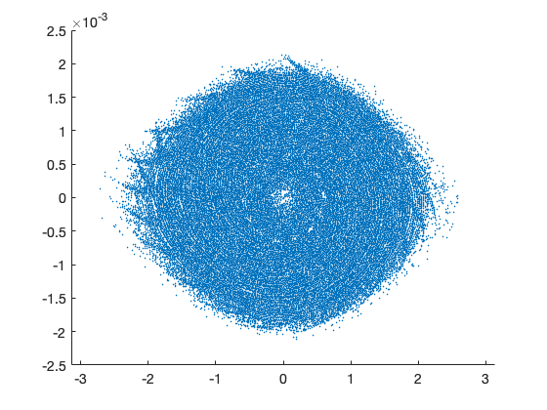
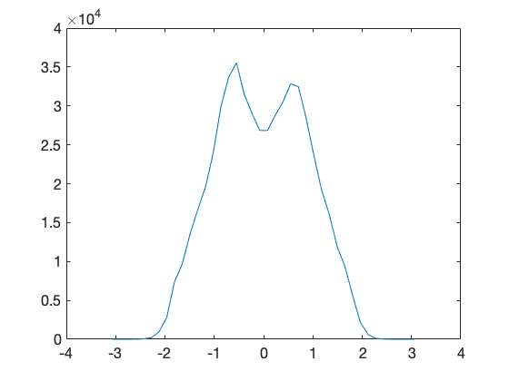
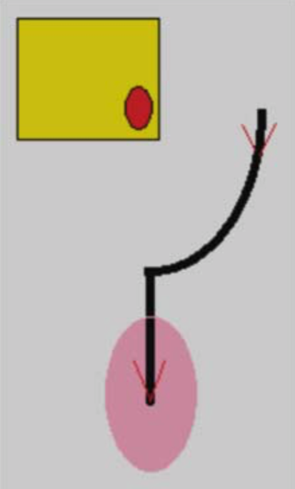
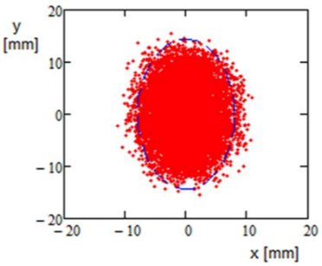
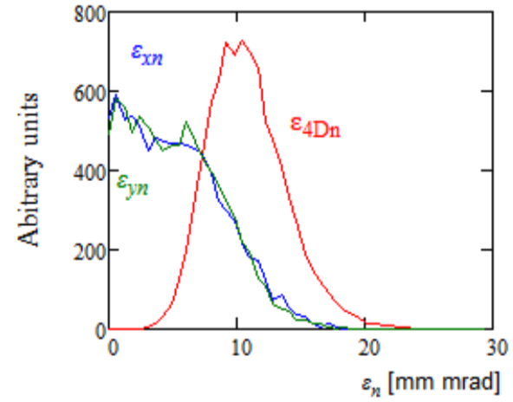
Booster Injection Optimized to Reduce
Peak Charge Density and Space Charge Tune Shift
Painted distribution after 270 turns has low longitudinal emittance, less tails, lower peak density, and lower transverse space charge than
Longitudinal Painting
Bunches injected only if phase fits the offset dashed box.
dp/p
dp/p
Intensity (arb. units)
First 4 turns
After 270 turns
Phase (rad)
Phase (rad)
Phase (rad)
Transverse Painting
Orbit trajectory relatively to the foil during painting
Nearly uniform distribution
after injection
4-D distribution is similar to KV-distribution
Foil
Final
Beam

Slide 15
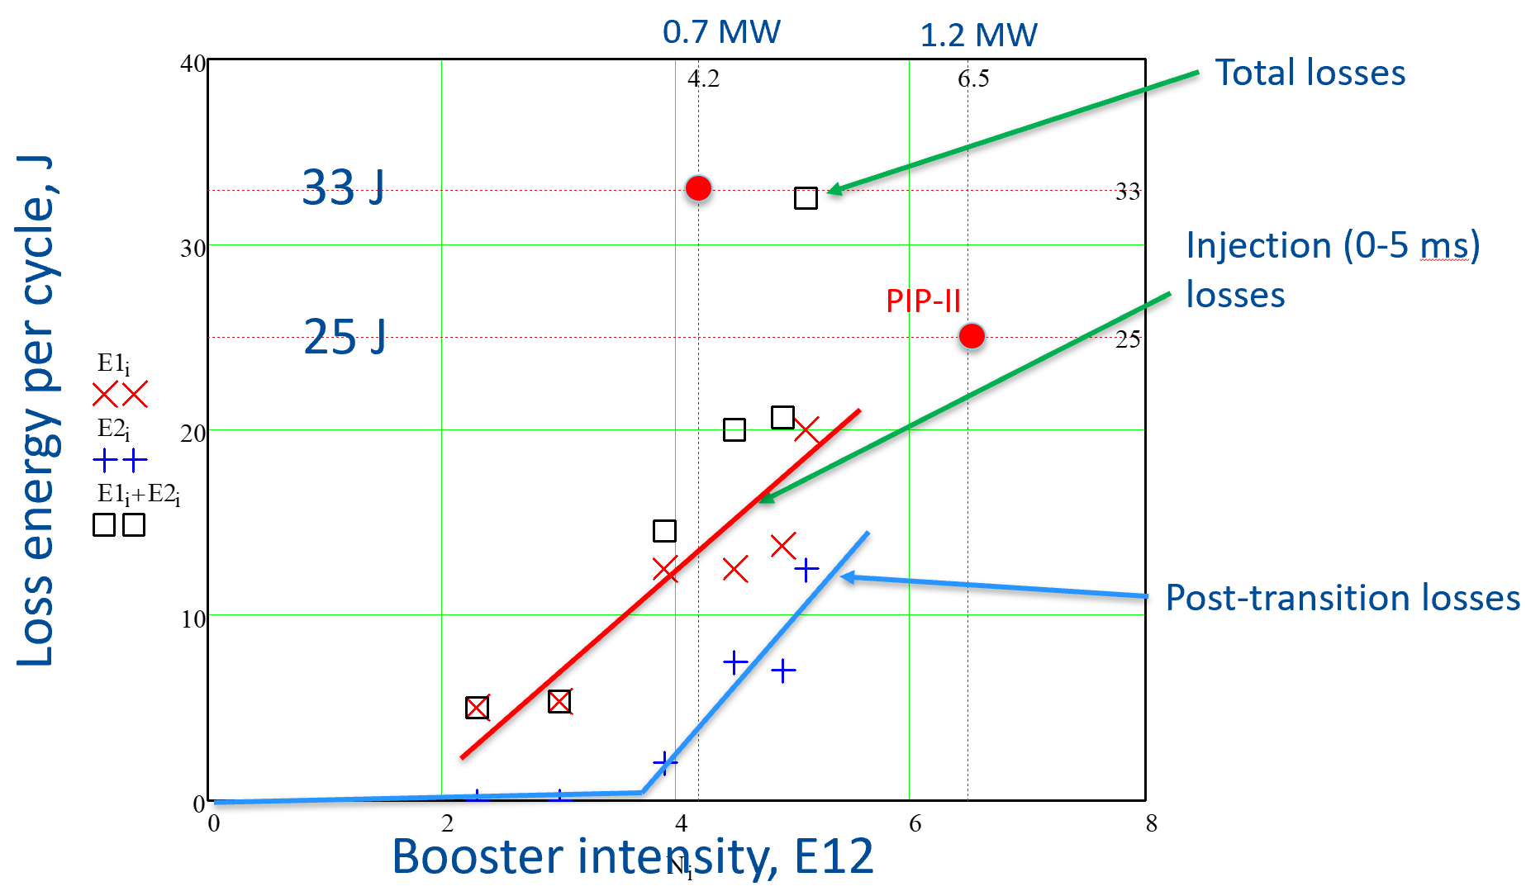
Presently, Losses in Booster
Limit Beam Intensity [2]
See Jeff Eldred’s talk
W. Pellico,
S. Nagaitsev

Slide 16
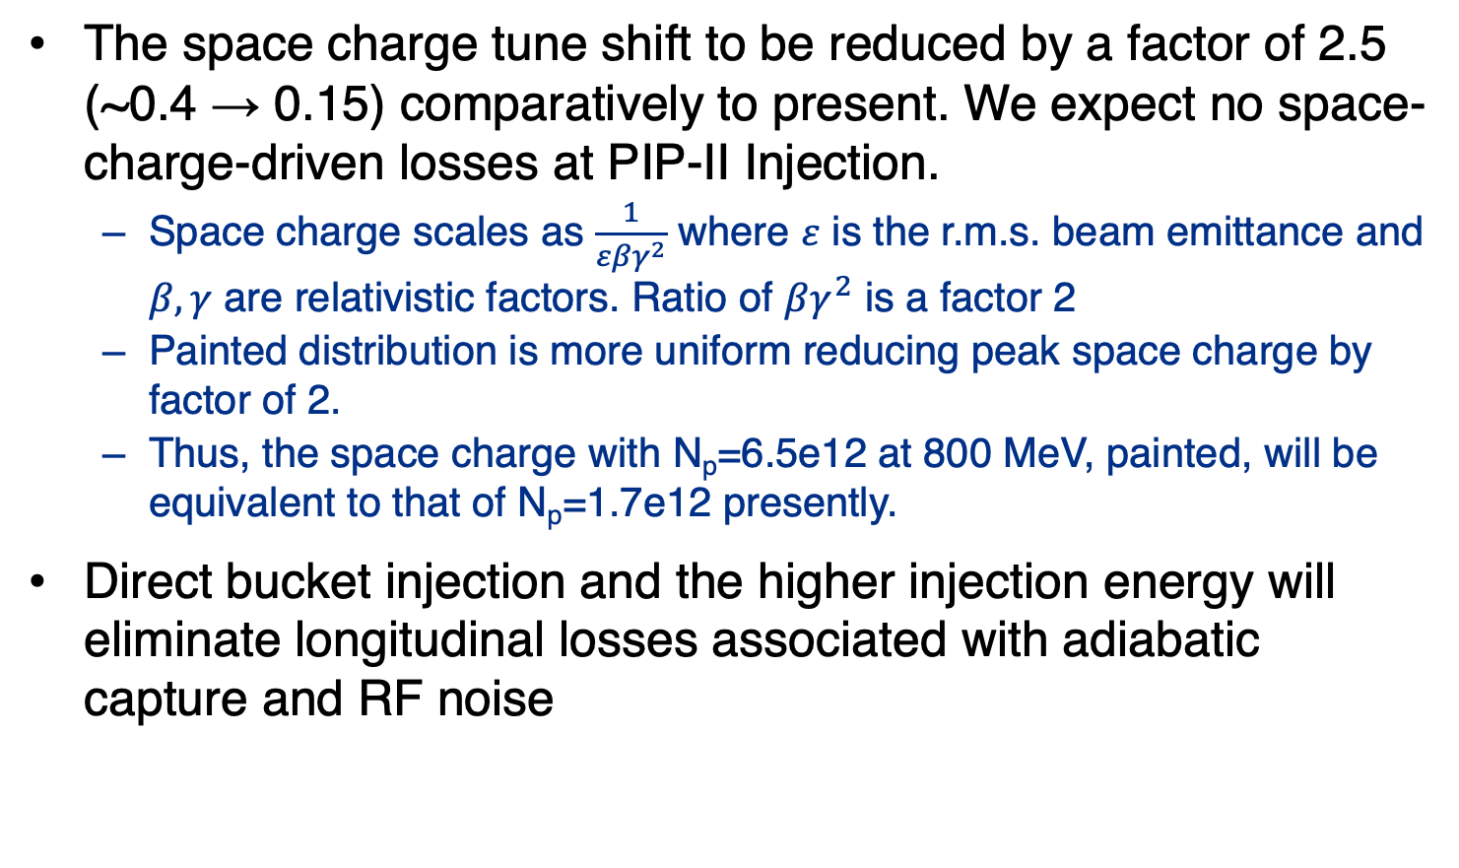
PIP-II Higher Injection Energy and Painting
Mitigate Losses at Booster Injection
The space charge tune shift to be reduced by a factor of 2.5 (~0.4 → 0.15) comparatively to present. We expect no space-charge-driven losses at PIP-II Injection.
  Space charge scales as $\frac{1}{εβγ^{2}}$ where $ε$ is the r.m.s. beam emittance and $β, γ$ are relativistic factors. Ratio of $βγ^{2}$ is a factor 2
  Painted distribution is more uniform reducing peak space charge by factor of 2.
  Thus, the space charge with N_{p}=6.5e12 at 800 MeV, painted, will be equivalent to that of N_{p}=1.7e12 presently.
Direct bucket injection and the higher injection energy will eliminate longitudinal losses associated with adiabatic capture and RF noise

Slide 17
PIP-II Technical Challenges
Bunch-by-Bunch chopping – Demonstrated in 2017-2018
SRF
  High Q₀ and high gradient HB650 MHz cavities
  LB650 cavities, procedures to apply nitrogen doping have to be optimized for the cavity shape
  Suppression of Microphonics and LLRF
Booster
  Intensity limits need to be understood
  The Booster is an old machine not originally designed to run this intensity
    Magnet pole tips are directly exposed to beam field.
    Operation of Booster systems with new parameters requires upgrades and modifications of ancillary systems

Slide 18
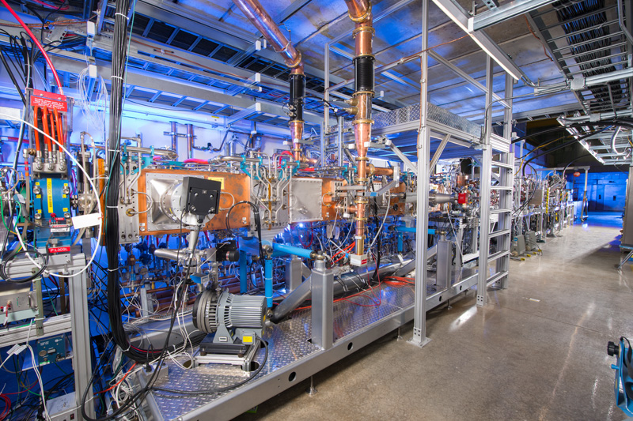
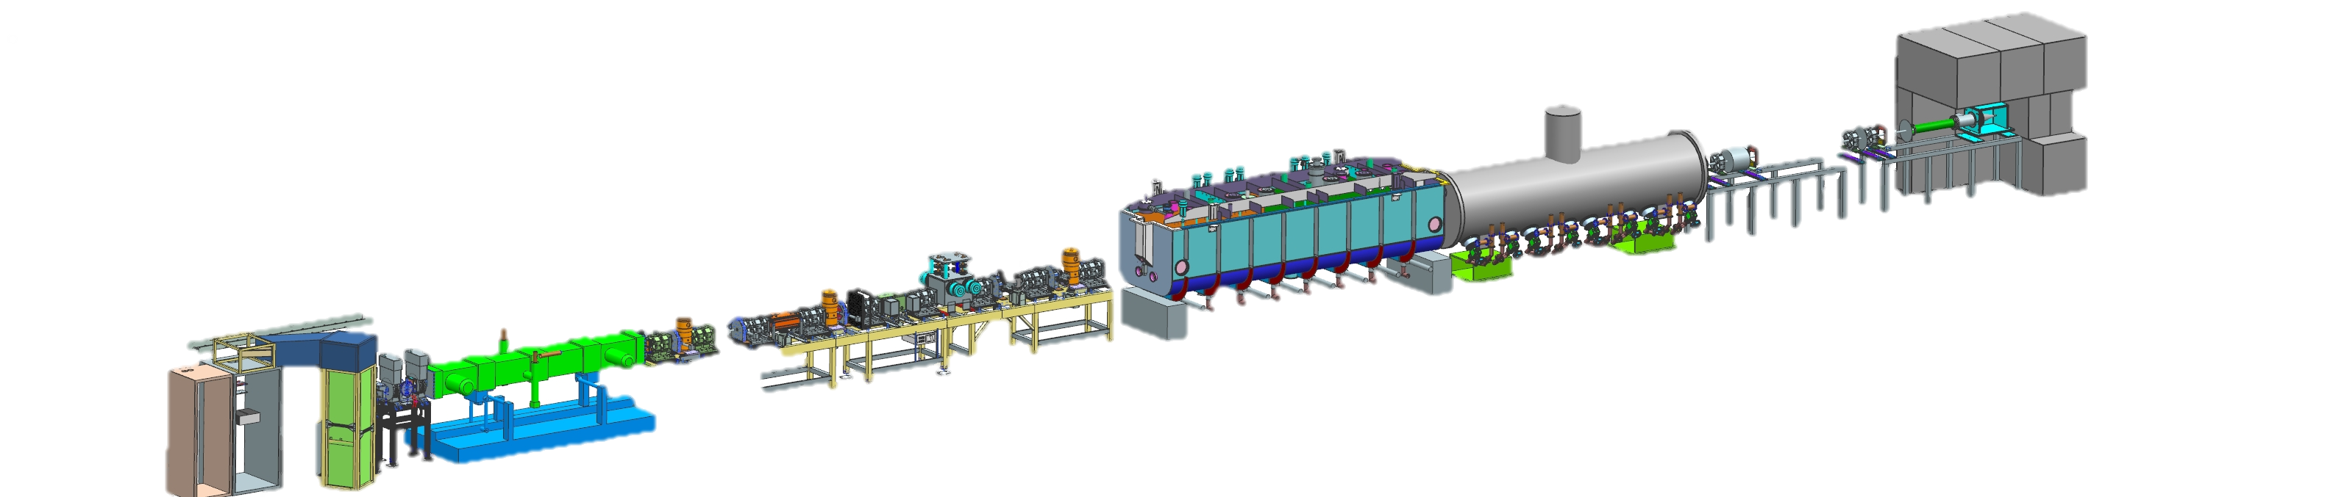
PIP2IT Serves As Testbed for Critical Technologies
PIP2IT is used to demonstrate critical technologies:
RFQ ✔️
Bunch-by-bunch chopper ✔️
Beam dynamics in Front End ✔️
HWR and SSR CMs with cavities
LLRF
Laser wire profile monitor
HWR and SSR1 - Fall-Winter 2019-2020
Beam Test test to April to Oct 2020
CM test facility after beam test
PIP2IT
HWR
SSR1
HEBT
MEBT
RFQ
30 keV
2.1 MeV
10 MeV
22 MeV

Slide 19
PIP2IT Serves As Testbed for Critical Technologies
PIP2IT is used to demonstrate critical technologies:
RFQ ✔️
Bunch-by-bunch chopper ✔️
Beam dynamics in Front End ✔️
HWR and SSR CMs with cavities
LLRF
Laser wire profile monitor
HWR and SSR1 - Fall-Winter 2019-2020
Beam Test test to April to Oct 2020
CM test facility after beam test
PIP2IT
Tested with beam
In 2017-2018
HWR
SSR1
HEBT
Added in
2019
MEBT
RFQ
30 keV
2.1 MeV
10 MeV
22 MeV

Slide 20
Schedule Overview
Planned Project Complete (early CD-4)
CD-2
CD-3a
CD-1
Approval
CD-3
Tier 0 - CD-4
PIP2IT Program
Cryoplant Building Construction
Linac Complex Civil Construction
HWR procurement
Procurement of components
Installation & Commissioning
FY17
FY18
FY19
FY20
FY21
FY22
FY23
FY24
FY25
FY26
FY27
FY28
FY29
FY 30
PDR Complete
Receipt of largest
single in-kind contribution
Retirement of several high technical risks
Beneficial Occupancy of the Linac Tunnel
DOE Activity
DOE and International Partners
DOE and International Partners

Slide 21





PIP-II First US Project with Major In-Kind Contributions
Subsystem (count) | Cavities | Cryomodules | RF Systems & Cryoplant
HWR (1) |  | US (ANL) | US
SSR1 (2) |  | US | DAE
SSR2 (7) |  |  | DAE
LB650 (11) |  |  | DAE
HB650 (4) |  |  | DAE
Cryoplant (1) |  |  | DAE
DOE
DAE
CNRS/IN2P3
INFN
CEA
UKRI
International partnerships are essential for the success of the
PIP-II Project

Slide 22
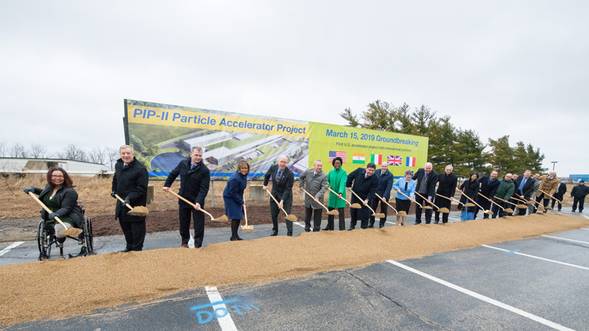
PIP-II Groundbreaking – 15 March 2019

Slide 23
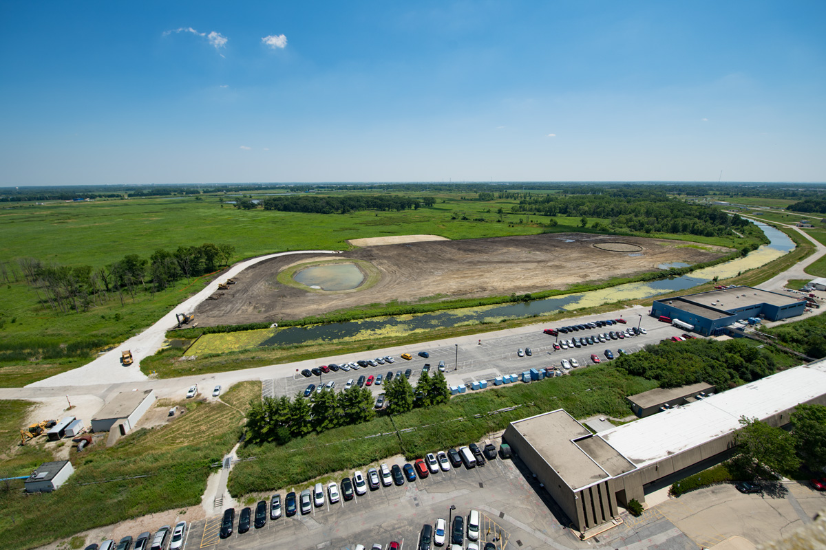
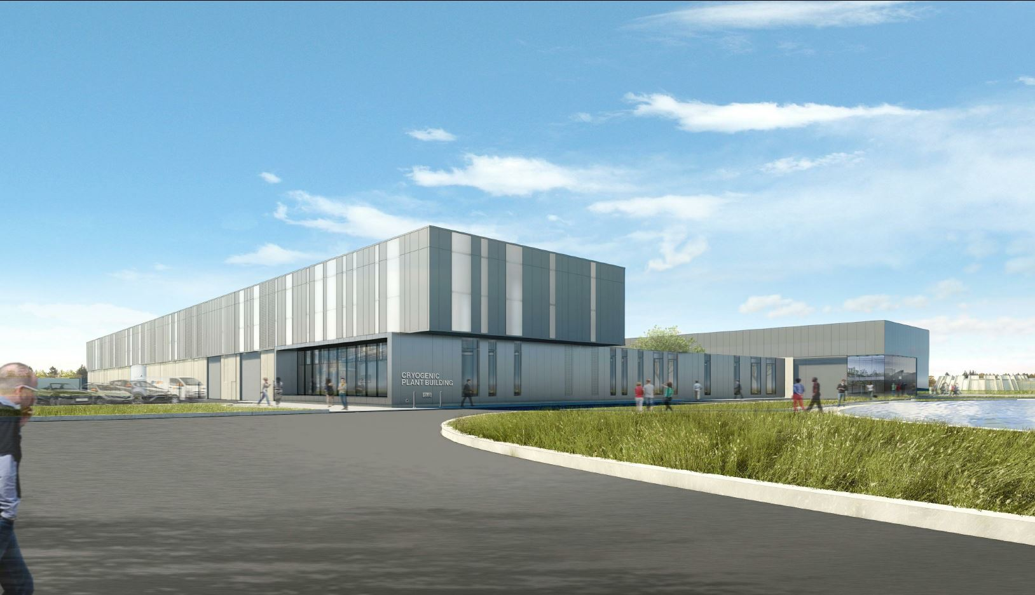
Conventional Facilities
Site Clearing Complete
Under special authorization
prior to CD-2/3a granted by DOE
Cryogenics Plant Building
Design Complete;
Ready for Procurement

Slide 24

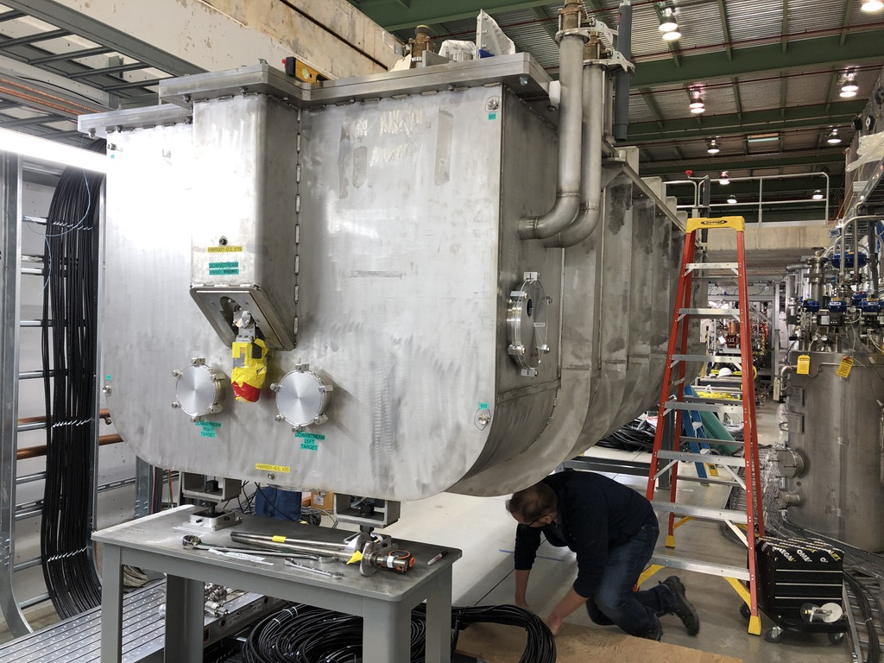
HWR Cryomodule Moved to PIP2IT
Developed and Built by Argonne National Lab
8 x 162.5 HWR, up to 2 MeV energy gain per cavity, 8 solenoids
Delivered to Fermilab in August 2019
Cooldown in December
Beam acceleration planned in April

Slide 25
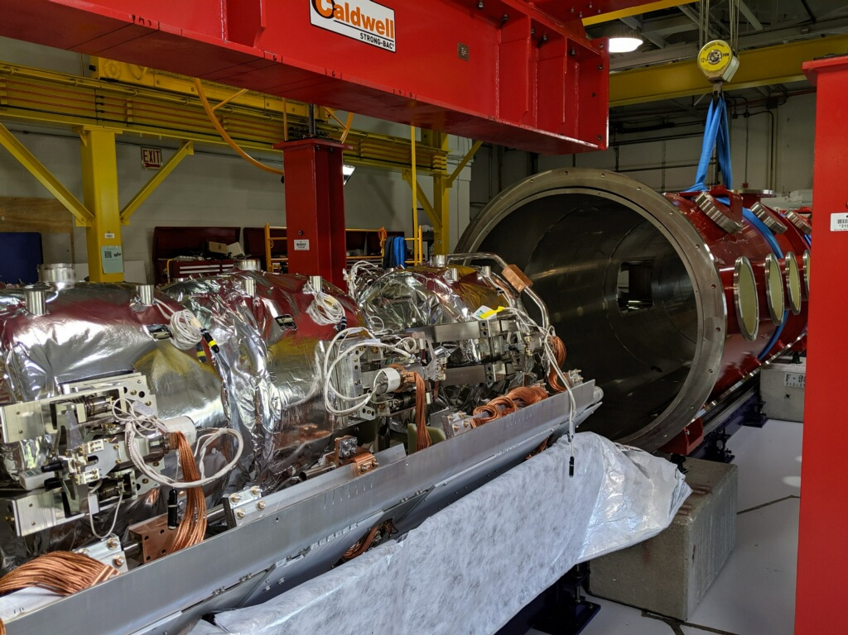
SSR1 Will be Moved to PIP2IT in December 2019
Developed and built at Fermilab
8 x 325 MHz Single Spoke Resonators, up to 2.05 MeV energy gain per cavity, 4 solenoids
  Includes Partner cavity
To be moved to PIP2IT in December
Beam acceleration in Summer

Slide 26

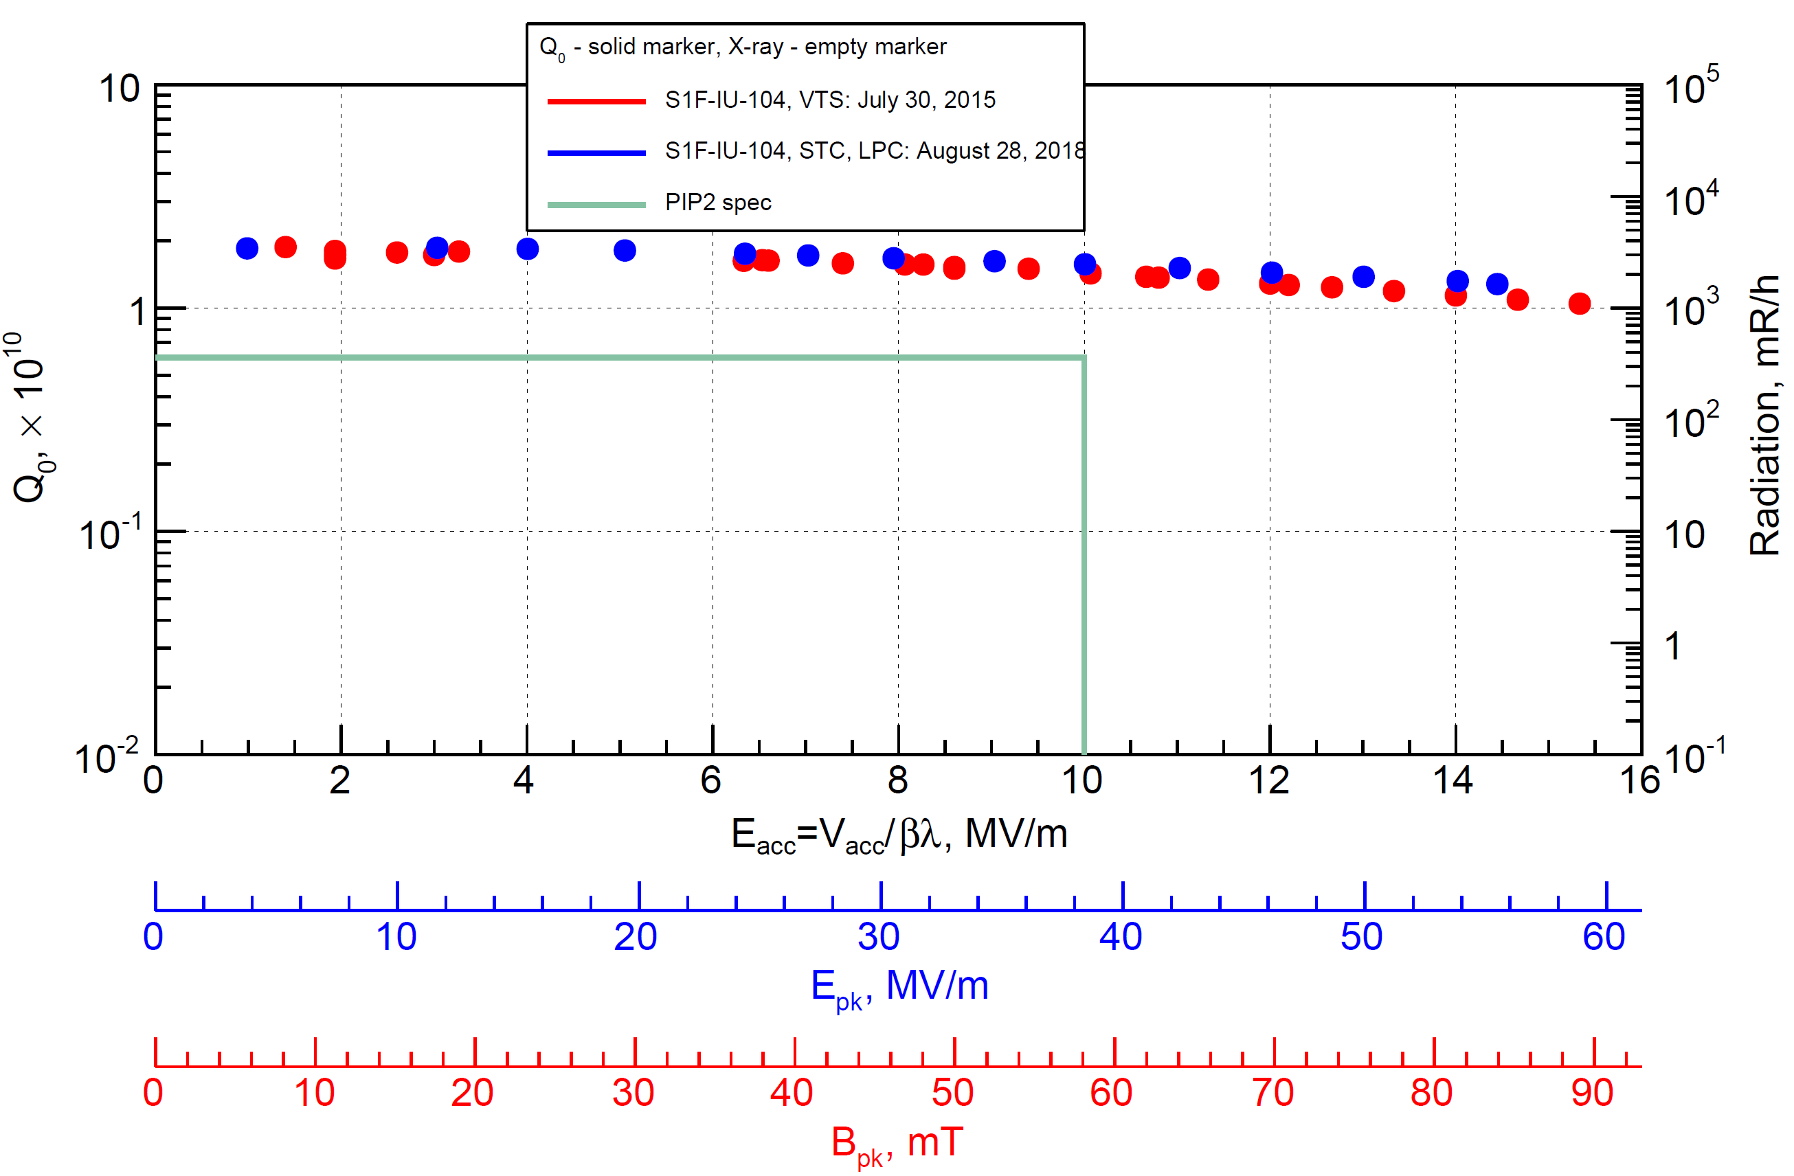
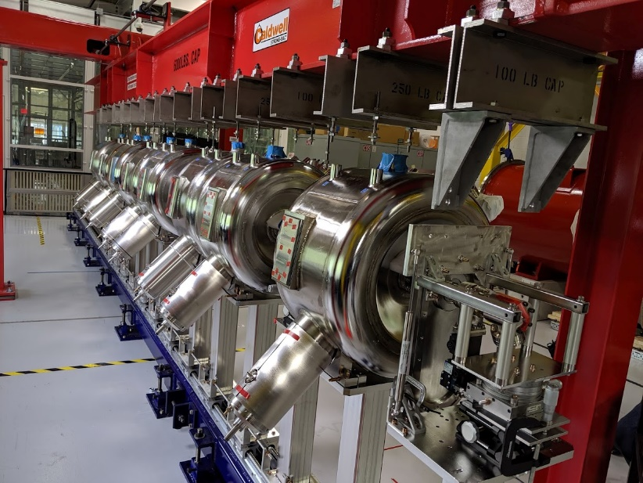
SSR1 – Indian Cavity Meets Performance
Data by A. Sukhanov
High Q at high gradient and field emission free
BARC cavity has the best cavity Q performance up to date

Slide 27
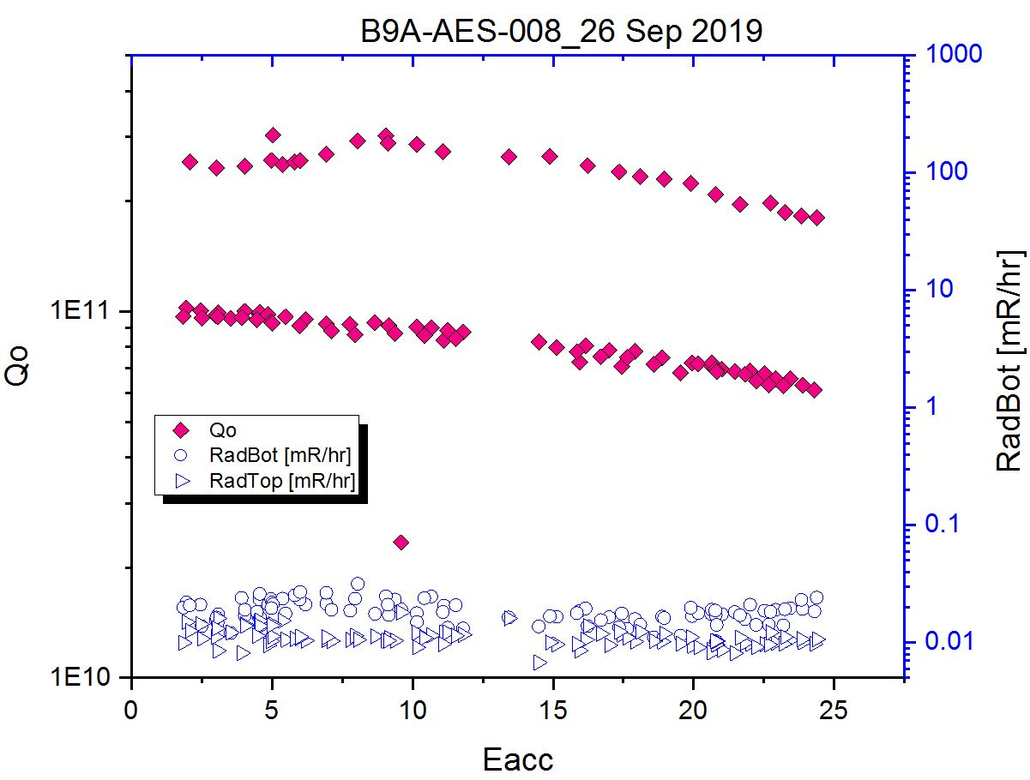
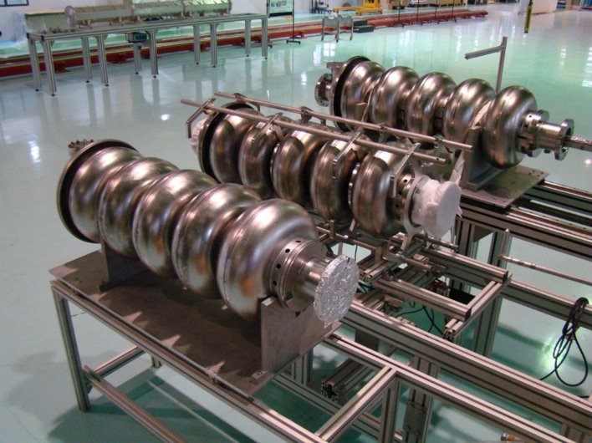
Cavity Processing Recipe Optimized, HB650
Optimization of the processing procedure (EP) for the nitrogen
doped cavities resulted in cavities exceeding requirements

Slide 28
Joint PIP-II/AD Booster Intensity Studies Team and Task Force Were Formed
Joint PIP-II/AD studies team has been created
  Numerical and experimental studies of high intensity effects in Booster at injection and transition
  PyOrbit and Synergia for injection
  Locally developed codes for transition as well as Synergia
AD formed a task force
  Understand impact of the PIP-II interfaces on the accelerator complex
  Investigate beam dynamics issues associated PIP-II in details

Slide 29
Summary
The project makes good technical progress towards completing the preliminary design and with prototyping of critical technologies. The main focus is
  Cryoplant building
  SRF and Cryomodules
  Test of HWR and SSR1 prototype with beam at PIP2IT
  Interfaces with the Booster
DOE baseline review (CD-2) is scheduled in January 2020
  Scope
  Cost
  Schedule

Slide 30
Backup slides

Slide 31
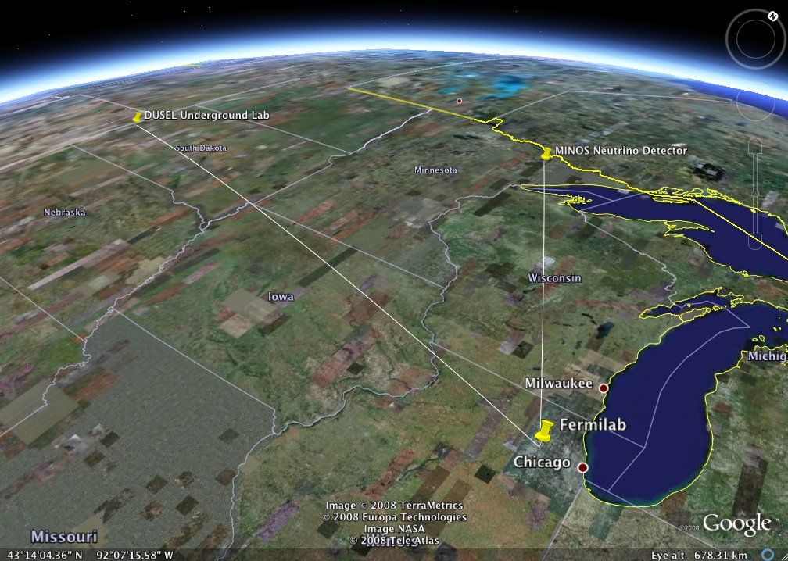
Neutrinos to Minnesota…generation 2 → 3 (DUNE)
NOvA…our present flagship neutrino experiment

Slide 32
Linac Design is Robust, Fault-Tolerant
Fault studies were performed using TraceWin
Linac can tolerate loss of any single element, and meet requirements after retuning
  Last one or two HB650 cavities can be used to compensate loss of cavities and keep the energy constant
Linac can operate if cavities of one single type underperform by 20%.
  There is little effect on the beam dynamics if cavities underperform by 10%
Linac can meet KPPs with one of following cryomodules lost: 1) last SSR2 CM, 2) first LB650 CM, 3) last LB650 CM, 4) last HB650

Slide 33
Accelerator Complex Upgrades
Upgrades to Booster, Recycler, and Main Injector (MI) required to accommodate:
  increased injection energy (400 MeV to 800 MeV)
  increased intensity (4.3E12 to 6.5E12 Booster, 5E13 to 7.5E13 MI)
  higher repetition rate (15 Hz to 20 Hz)
Scope of Ring upgrades:
  New Booster Injection girder
  New 53 MHz Recycler cavities
  Upgraded Main Injector RF Cavities
    Two Power Amplifiers (PA) operation of MI RF cavity
New beam line from the superconducting Linac to the Booster, new beam absorber line and beam dump
MI Cavity Model with two PAs

Slide 34
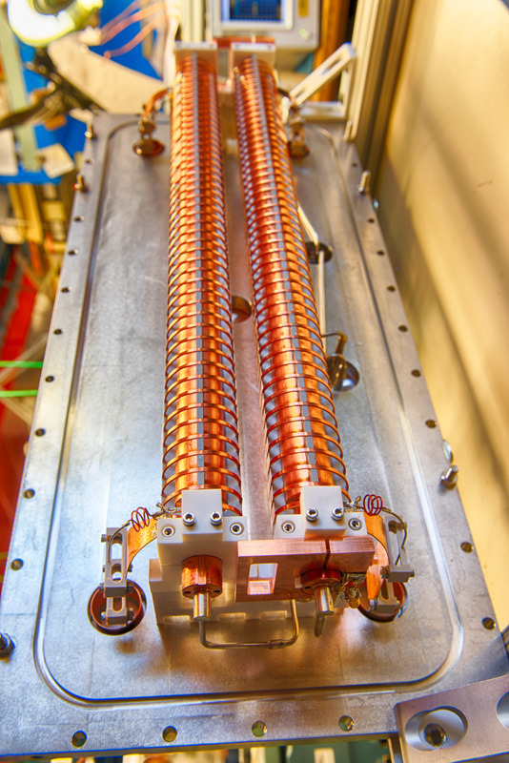
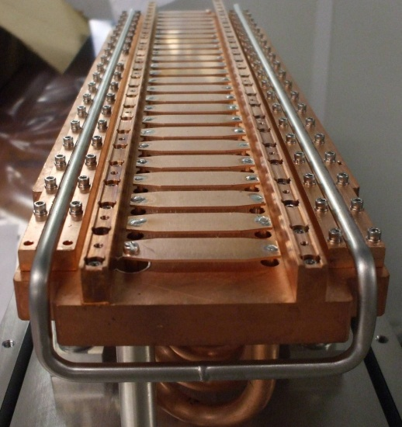
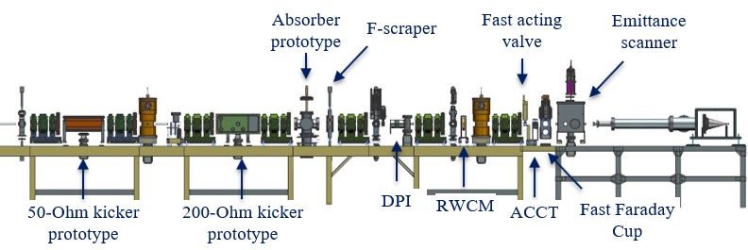
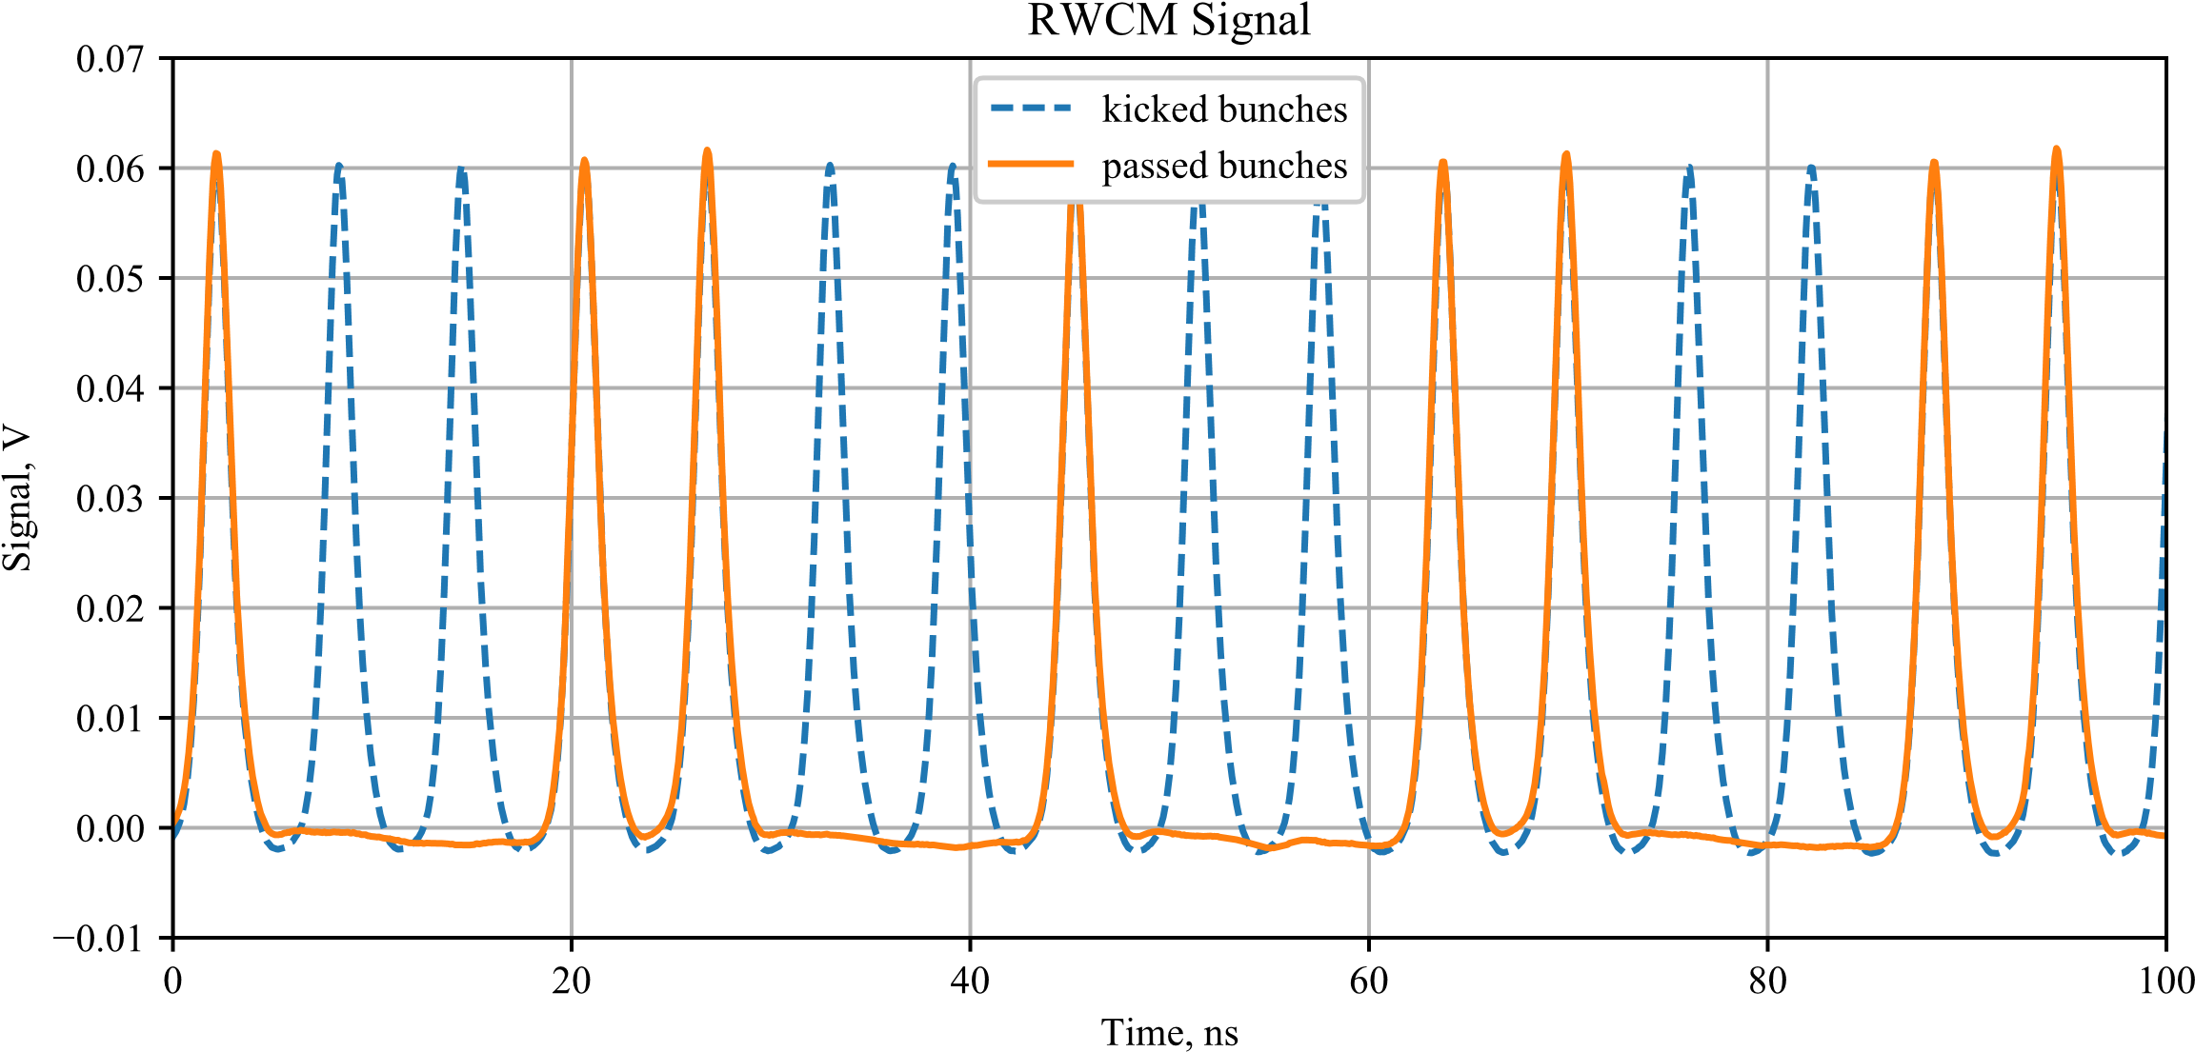
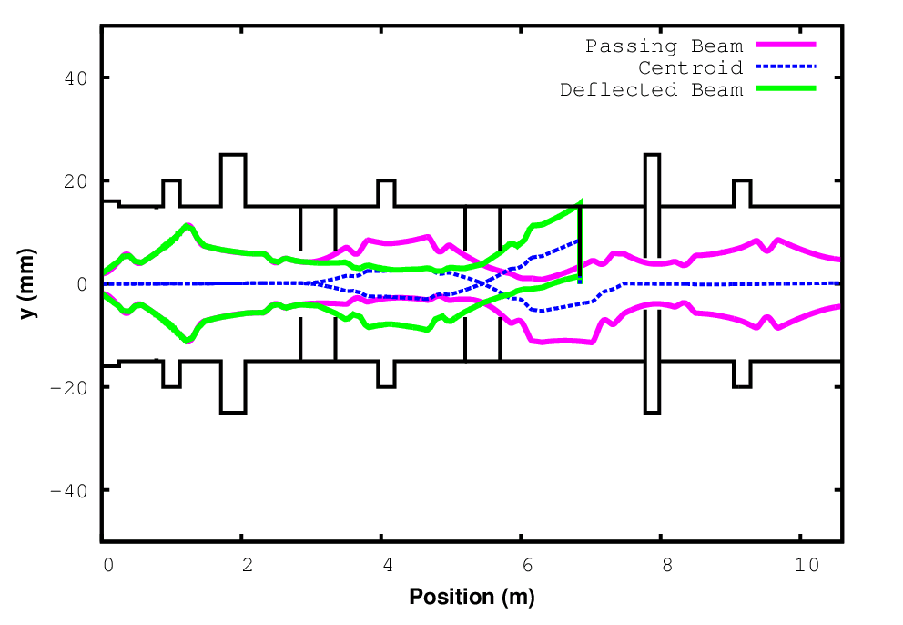
Bunch-by-Bunch Chopping Demonstrated
Arbitrary chopping patterns out of 162.5 MHz bunch trains at 20 Hz can be obtained
Kicked bunches intercepted with a scraper → passing bunches recorded with Resistive Wall Current Monitor (RWCM)
F-scraper
50-Ohm Kicker
200-Ohm Kicker
DPI

Slide 35
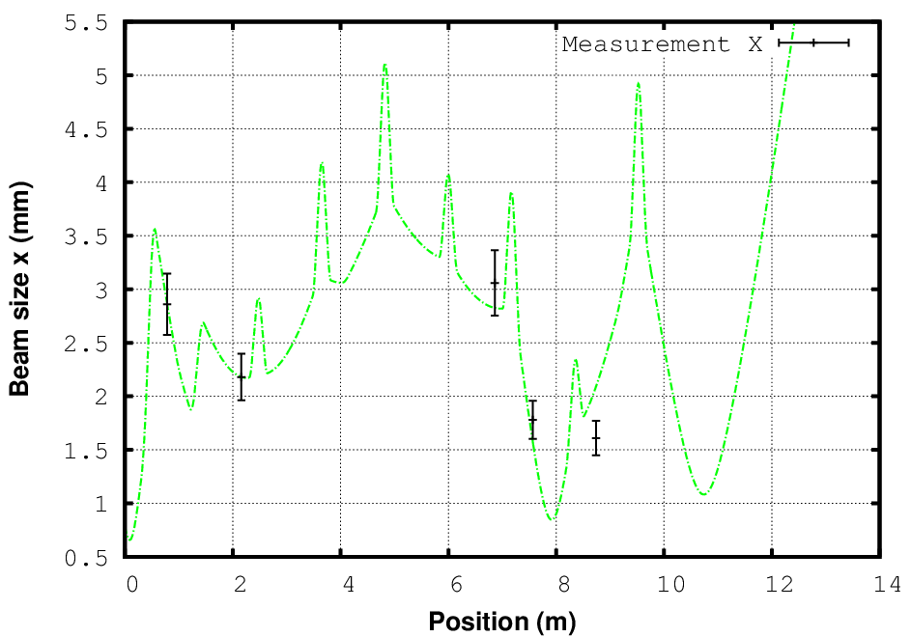
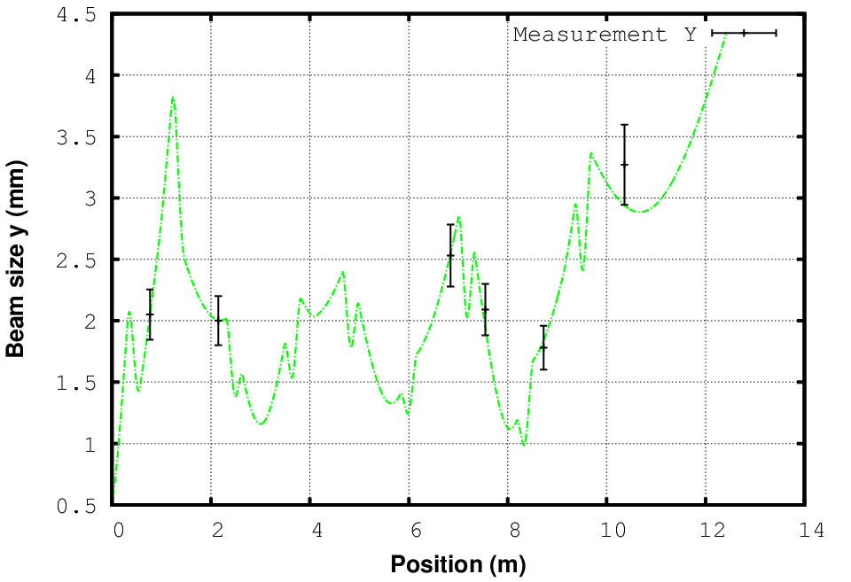
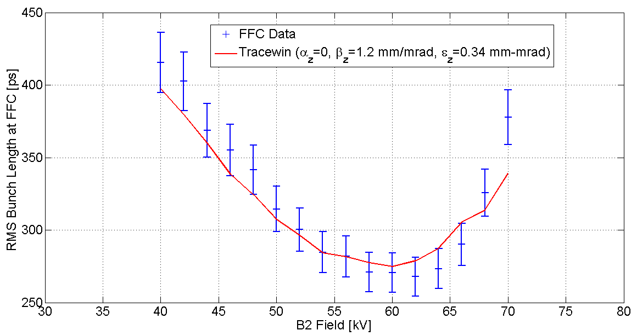
Beam in Dynamics in MEBT Meets Expectations
Transverse Beam Envelopes
Simulated and Measured
Charge 1.b,c
Beam dynamics in PIP2IT closely matches simulations. Beam quality meets requirements
Measured transverse emittance 0.22 mm*mrad
Measured longitudinal emittance 0.34 mm*mrad
Garcia
Bunch length vs. buncher cavity voltage

Slide 36
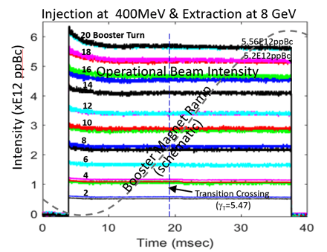
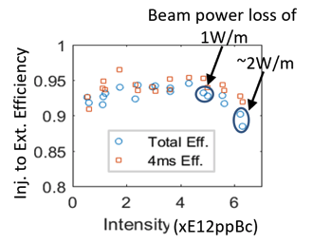
Presently, Losses in Booster
Limit Beam Intensity [1]
C. Bhat
Majority of intensity losses happen in 5 ms after injection
Losses below 5E12 are likely longitudinal, related to not optimal adiabatic capture and feedback performance
Losses significantly increase after intensity exceeds 5E12.

