Slide 1

Experience with the symplectic 3D SC Kick
Frank Schmidt in collaboration with Yuri Alexahin (Fermilab)

Slide 2
Overview 1/2
Theory and MAD-X Implementation have been published and Yuri gave a nice presentation during last year’s “2nd SC collaboration meeting at CERN”.
The main emphasis is here to discuss how the SigmaMatrix approach allows for beam-based optics calculations and how well the tool describes the PS experiment with a moderate SC tune-shift of ΔQ_{x} = 0.05.
One of the main issues are unphysical code properties. In particular, one finds that the SigmaMatrix approach is very sensitive to special features of the particle distribution. In fact, one may find singularities.
Due to the fact that the emittances are renormalized every turn in the adaptive mode, noise is being introduced into the simulations. Measures to deal with this problem will be discussed.

Slide 3
Overview 2/2
Emittance blow-up and beam profiles are being compared with the 2012 PS experiments.
In the coming years the plan is to deal with certain limitations of the code and to expand the features of the code to fully treat any ring accelerator up to the ultimate tune-shift of ~1.
Disclaimer: Malte Titze will discuss on Tuesday a very systematic SC study for the PS, albeit in a quite different state, E.G. twice as large tune-shift etc, and also the SPS. He uses different tools and in particular also PIC codes. One could argue that these two studies are complementary to each other.

Slide 4
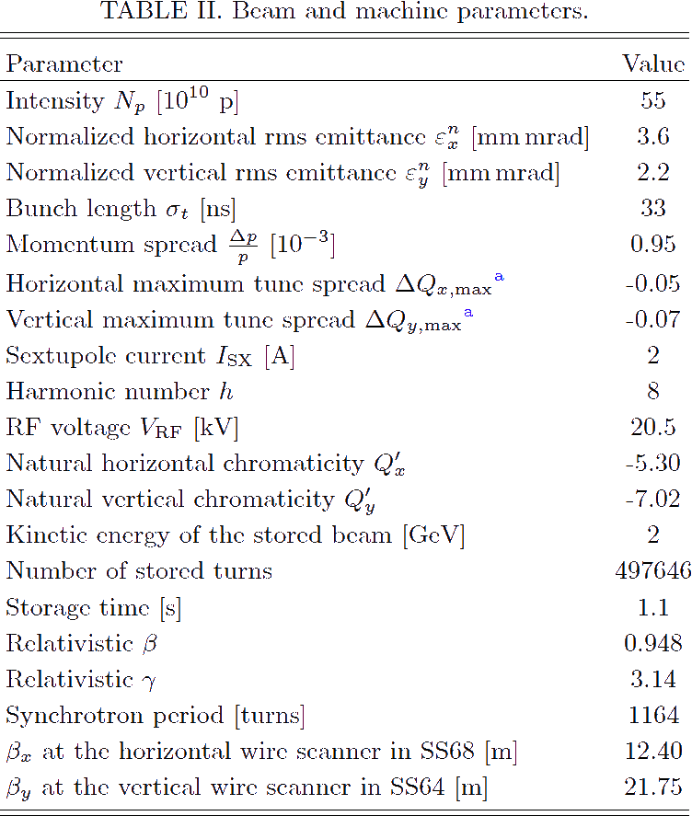
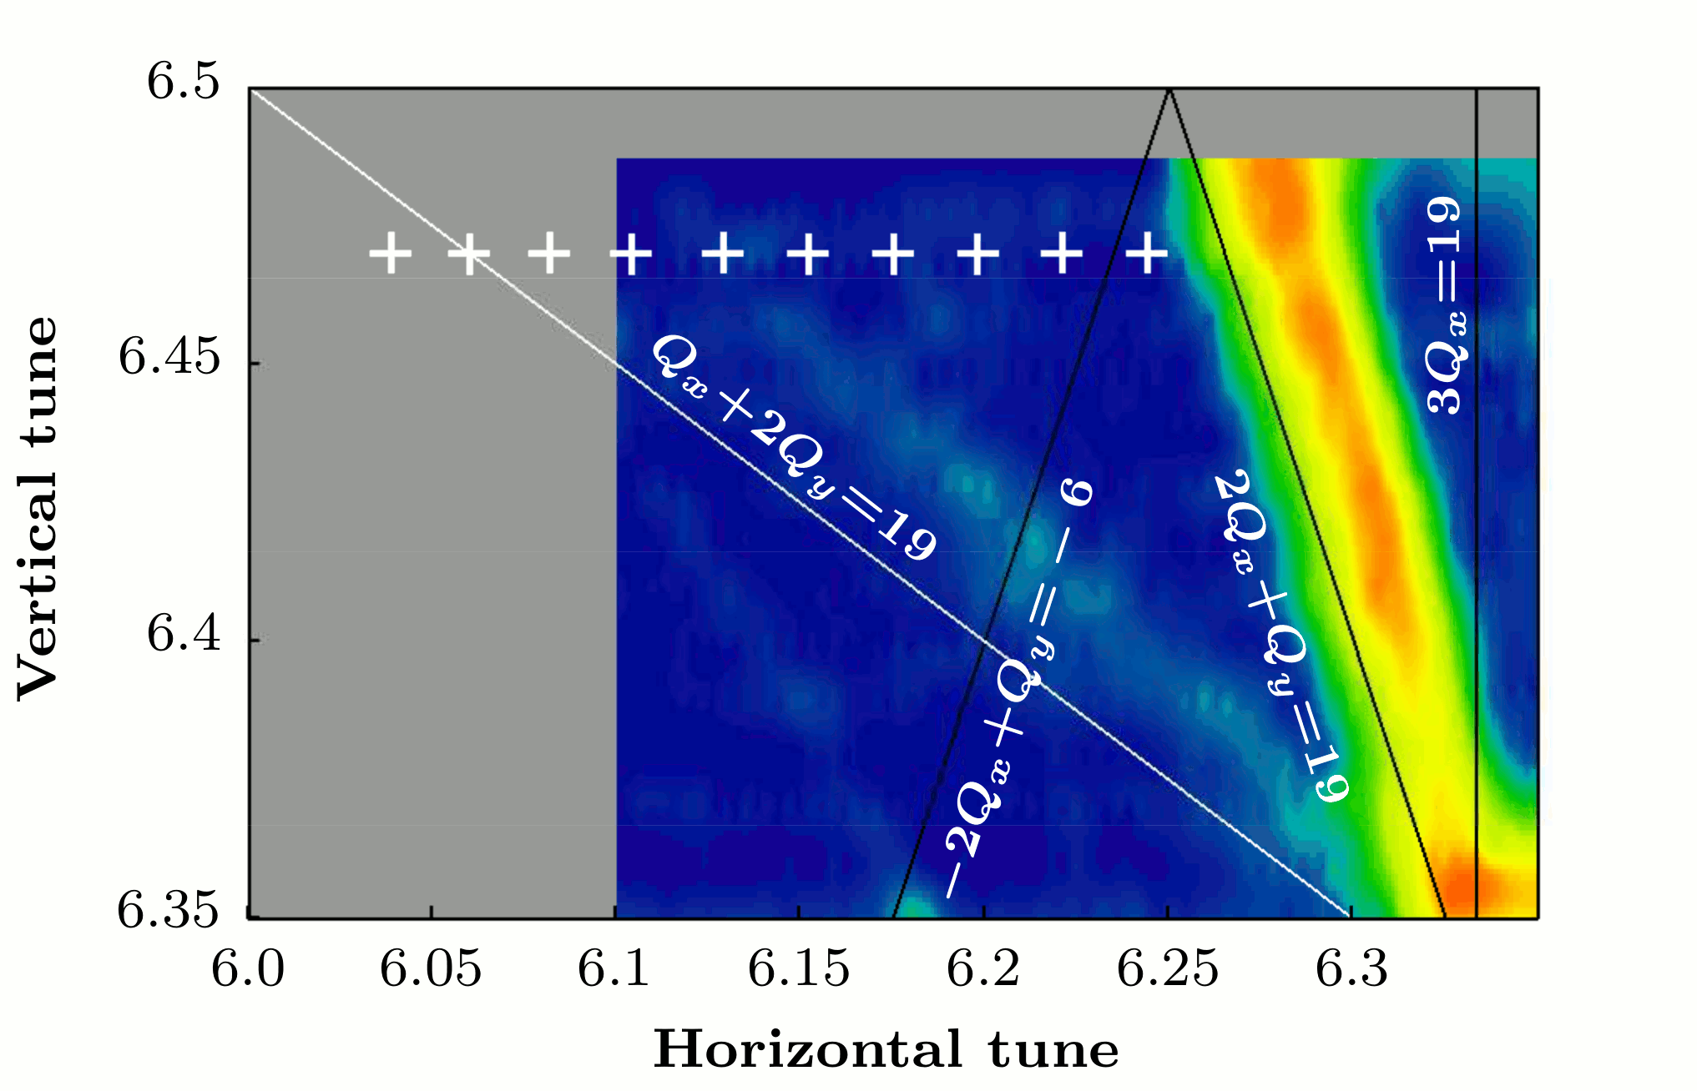
PS 2012 Experiment as an Example
Integer
Resonance
Coupled
Resonance
Safest
Spot

Slide 5
Facts: Symplectic 3D SC Kick 1/2
The flow of derivation goes as follows:
Starting point is the 3D bunch charge density
In the long bunch approximation the 3D SC potential can be factorized into two factors, the longitudinal charge density λ(z – v₀t) and the transverse potential Φ(x, y).
In this approximation symplecticity is guaranteed: the transverse field (and the associated kick) is proportional to the charge density at the particle location λ(z), but also it is complemented by a longitudinal kick dependent on the transverse coordinates.
The transverse potential can then be brought into its final form.
Traditionally, the transverse potential will be treated in three regimes: small, large and intermediate transverse displacements.
The compromise between speed and precision has been decided to allow for a precision of 6 digits in all 3 regimes.
Essential is that the symplecticity can be kept in all operations (other than through the unavoidable rounding error in double precision data operations).

Slide 6
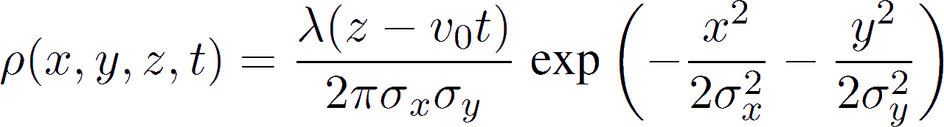
Facts: Symplectic 3D SC Kick 2/2
Most relevant equations are shown here:
3D bunch charge density
3D SC potential
4. Final transverse potential

Slide 7
Evolution of the Implementation
Version I: True frozen and adaptive - 2012 | Version II: 3D symplectic kick - 2018
Ad-hoc only the transverse kick due the longitudinal density is considered ➔ loss of symplecticity | Due to 3D Potential, kicks in both planes ➔ Symplecticity guaranteed
Code functioning requires stable Twiss ➔ Close to low order resonance even for small SC tune-shift not guaranteed! | Introduction of the SigmaMatrix from beam data to derive optics, dispersion. Works great except when it fails! ➔ see later!
Emittances derived by formula. | Iterative process to derive effective Beam Sigmas from the SigmaMatrix.
Using Twiss & Dispersion from MAD-X ➔ effective Beam Sigmas at every SC Kick. | Transfer of the SigmaMatrix to all SC kick locations. (See next slide for details)
Too aggressive adaptive technique in the longitudinal plane had to be suppressed. ➔ artificial emittance blow-up | These iteration procedures may not converge or not fast enough . Therefore damping or weighting terms had to be introduced.

Slide 8
“Free” and “Periodic” Mode
Transfer of the sigma-matrix from observation point to the SC elements around the ring can be performed in two ways:
1) "free sigma" (open line) mode - sigma2=T*sigma1*T_transposed - corresponds to free oscillations of the beam envelope;
2) “periodic sigma“ mode: the periodicity of the beam envelope is imposed every turn (requires stable optics to exist)
The "free sigma" mode allows to study Gluckstern’s particle-envelope resonance but is sensitive to statistical noise.
The “periodic sigma“ mode is more robust and can be used for long-term tracking.

Slide 9
Code Limitations

Slide 10
SigmaMatrix: Singularity & Correlation
Case | Twiss Method | Issues | Npart | β_{x11} | β_{x12}
FNAL Booster | MAD-X | - | - | 33.66 | 0.0
 | SigmaMatrix | Equal transverse Emittances | 1’000’000 | 22.31 | 12.40
CERN PS | MAD-X | - | - | 19.483 | 0.0
 | SigmaMatrix | No issue | 2’000 | 19.225 | 9.570 10⁻²
 | SigmaMatrix | No issue | 455’000 | 19.488 | 2.953 10⁻⁸
 | SigmaMatrix | Data Correlation | 2’000 | Error: Iteration Failure
 | SigmaMatrix | Data Correlation | 1’000’000 | 1.501 | 10.68

Slide 11
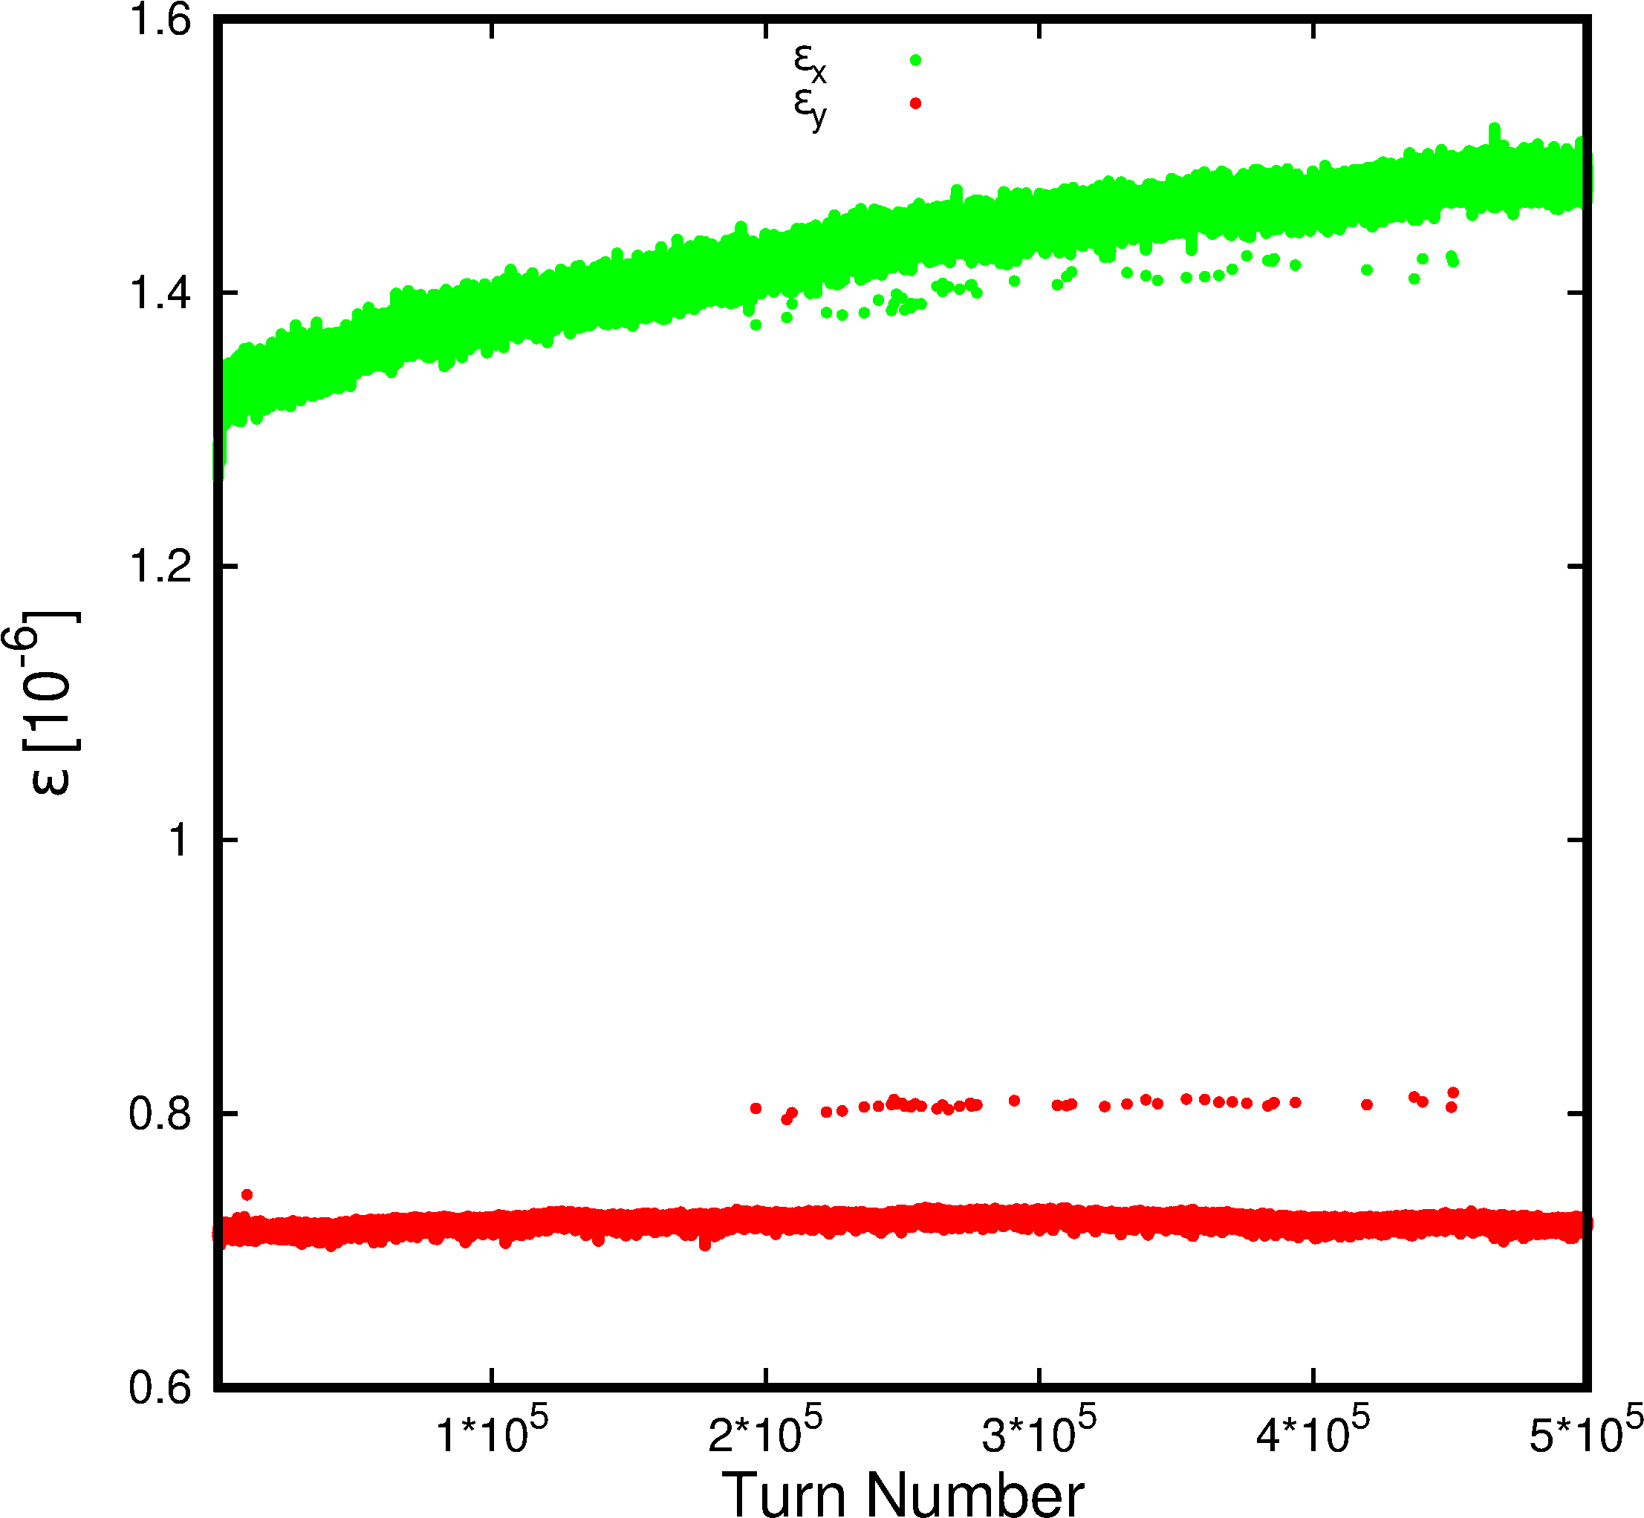
Emittance Spikes
PS Example:
Qx = 6.039
500’000 Turns
Spikes

Slide 12
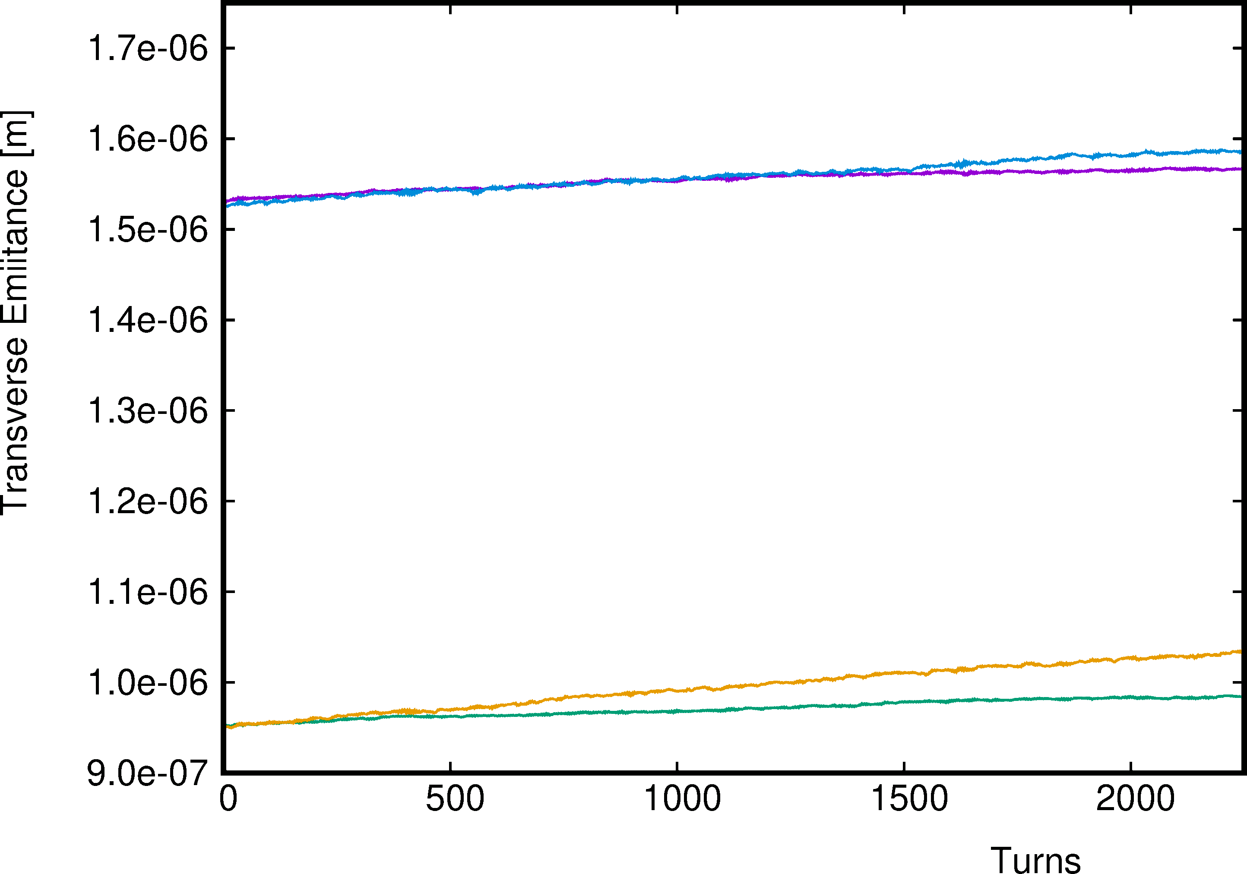
Emittance Blow-Up in the Free Mode
8’000 Particles
ε_{x}
16’000 Particles
ε_{y}
8’000 Particles
16’000 Particles

Slide 13
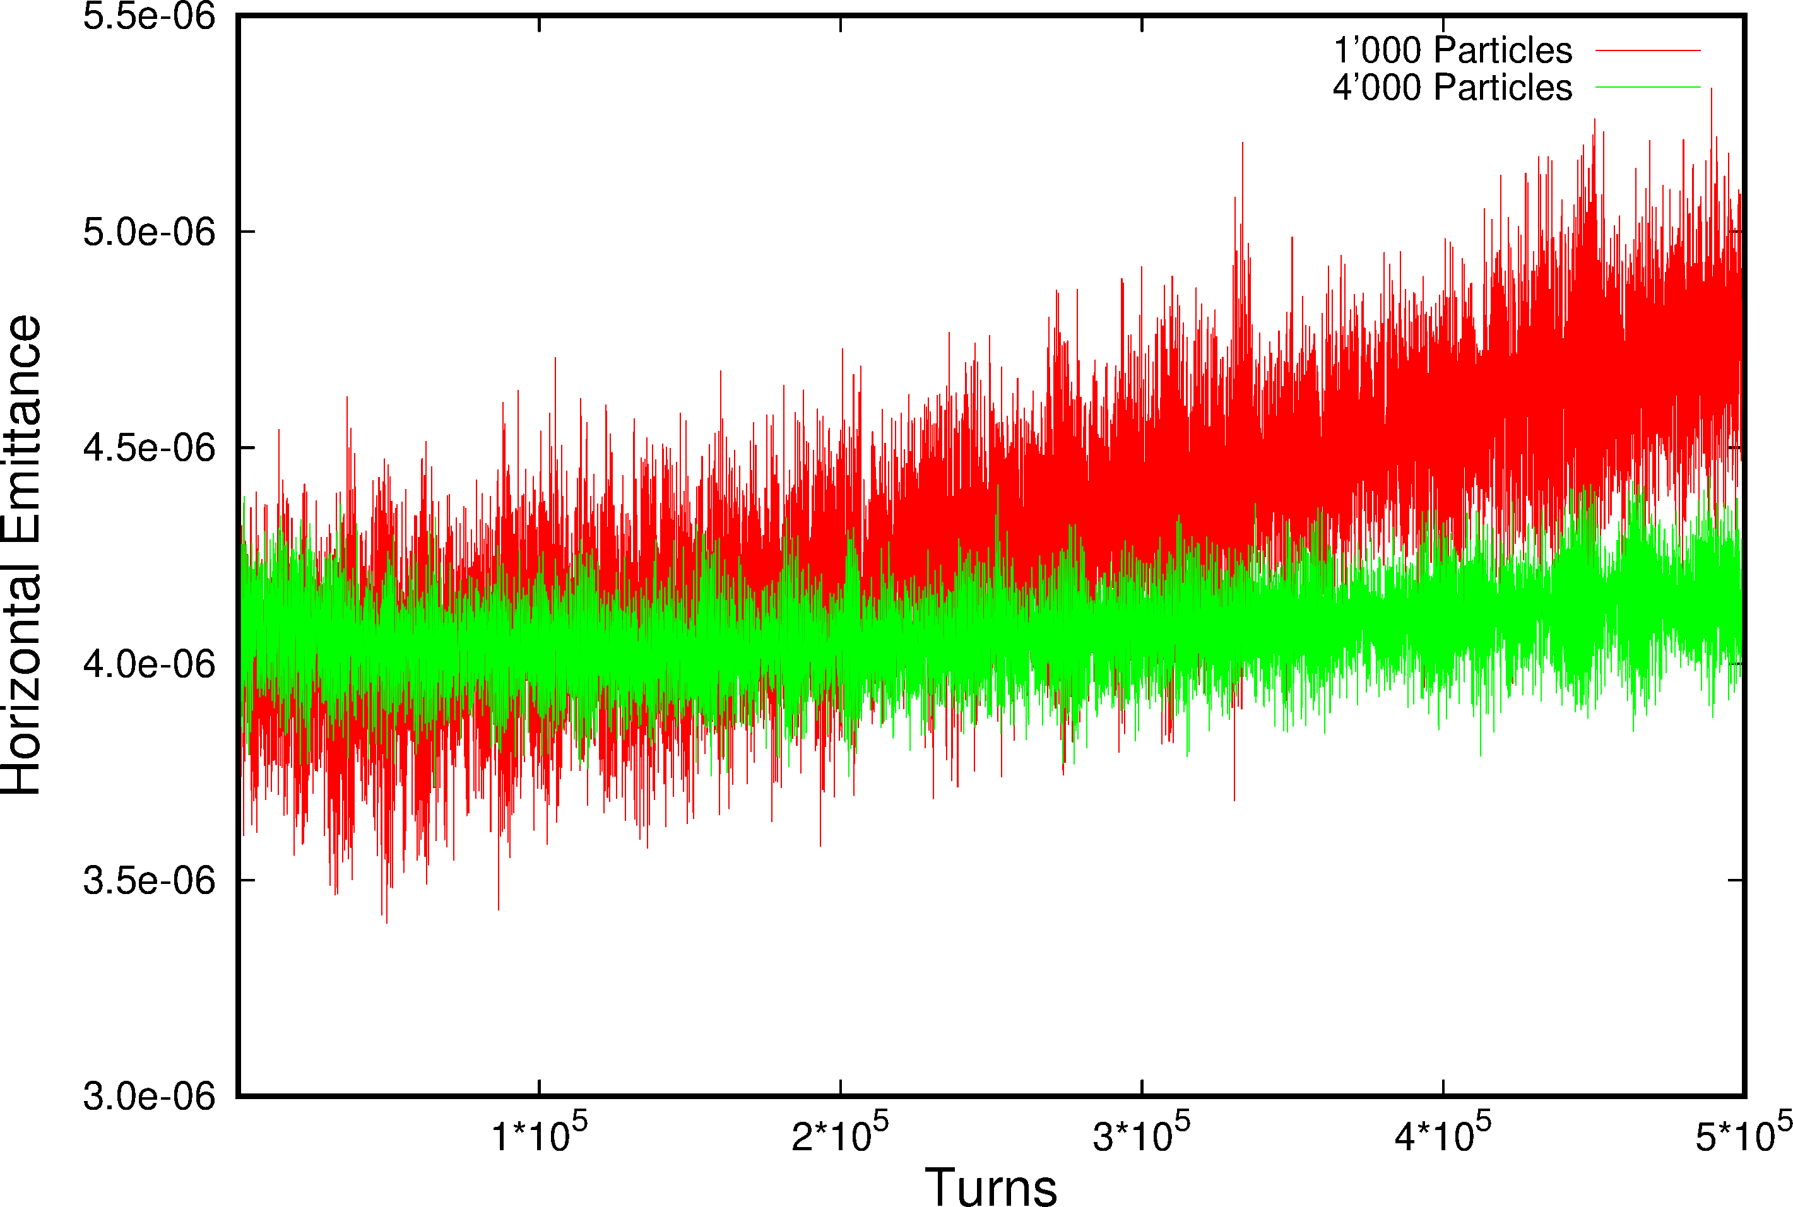
Adaptive Noise Reduction

Slide 14
Code Limitations
The SigmaMatrix is very sensitive due certain properties of the distribution:
  Equal transverse Tunes
  Data correlation in the distribution
  General artificial coupling is always found.
Long-term studies (500’000 turns) show occasional emittance spikes. Most likely it could be a weakness in the SigmaMatrix iteration procedure. ➔ Certainly on our Todo list!
The noise in the FREE propagating Mode decreases significantly doubling the macro particle numbers from 8’000 to 16’000, yet the artificial emittance blow-up remains noticeable after only 2500 turns.
In the last simulation campaign of 2017 with the former adaptive mode it could be shown that both an overall and locale blow-up could be noticed over 500’000 turns with 1’000 macro particles. Both effects have been reduced substantially for a four-fold increase of the macro particles. We are expecting similar results for “Periodic” mode but tests need to be repeated. As a consequence we typically use 2’000 macro particles for most studies.

Slide 15
Dispersion: Map Property

Slide 16
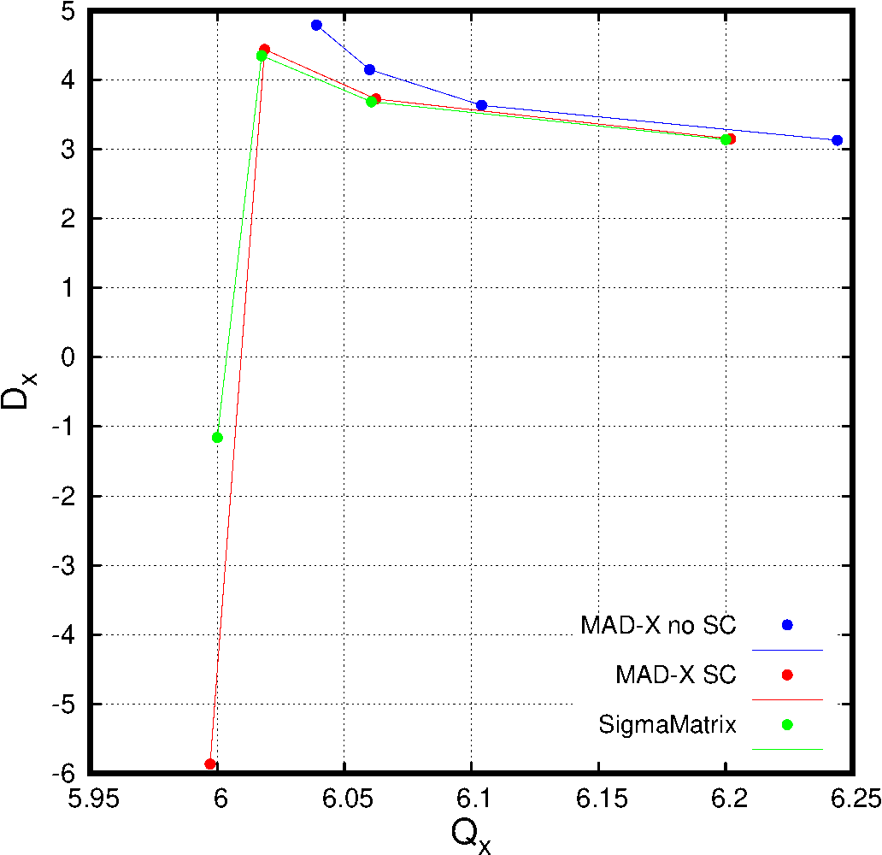
Horizontal Dispersion

Slide 17
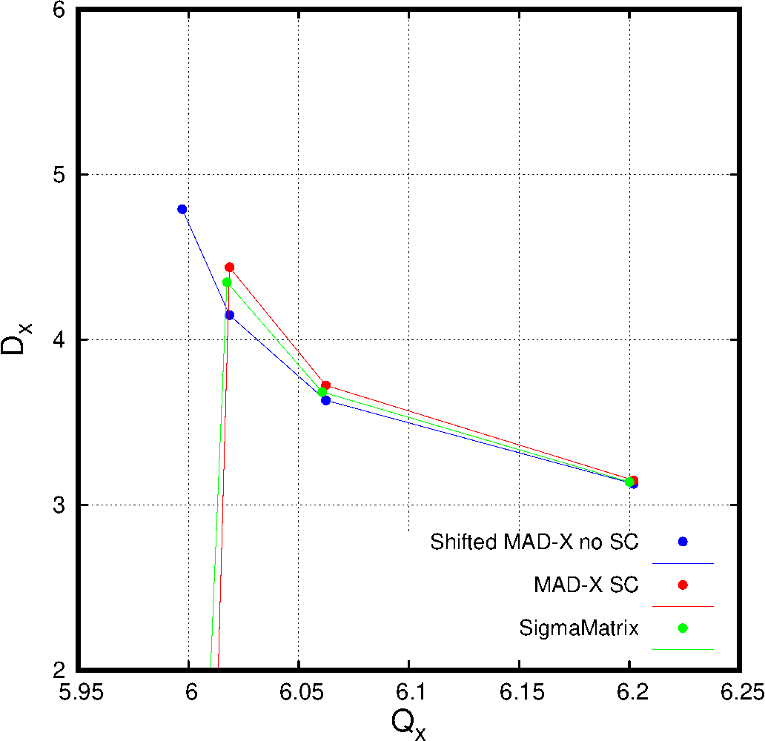
Horizontal Dispersion (Blow UP)

Slide 18
Dispersion: Map Property
  Dispersion is a 5D concept
  i.e. the delta-p/p dependent 4D closed can be expressed as a Taylor series in D^{n}’.
  the lowest order is what we call dispersion
  Unfortunately, in MAD-X like all delta-p/p dependent parameters the Dispersion must be multiplied by the relativistic beta ➔ In MAD-X the 5th coordinate is pt and not delta-p/p.
  It can be calculated from the transfer map M via:
  d_{x}=-(d₁ - M₂₂*d₁ + M₁₂*d₂)/(-1 + M₁₁ + M₁₂*M₂₁ + M₂₂ - M₁₁*M₂₂)
  d’_{x}=-(M₂₁*d₁ + d₂ - M₁₁*d₂)/(-1 + M₁₁ + M₁₂*M₂₁ + M₂₂ -M₁₁*M₂₂)
  d₁=M₁₅
  d₂=M₂₅
  With linear coupling the 4D dispersion version is needed: ~50 terms for each 4 components.
  Yuri Alexahin and more recently Malte (➔ see tomorrow!) have made an attempt to get dispersion directly from components of the SigmaMatrix.
  I haven’t been very successful with Yuri’s approach but by reverse engineering of the transfer map M by using the eigenvector matrix A from the SigmaMatrix, its inverse A⁻¹ and rotation R by calculating the SC tune-shift with the simulation of the zero amplitude particle together with the macro particle distribution. The transfer map is then determine via:
  M = A⁻¹.R.A
  I tried to determine dispersion in the 6D case, not the 5D case.

Slide 19
Optical Functions: Map Eigenvectors
Here the horizontal Betafunction is shown.
Up to this point Dispersion and Betafunctions have been evaluated at the starting point of the machine ➔ Next what happens around the ring?
Again ➔ Malte will add much more on this subject tomorrow!

Slide 20
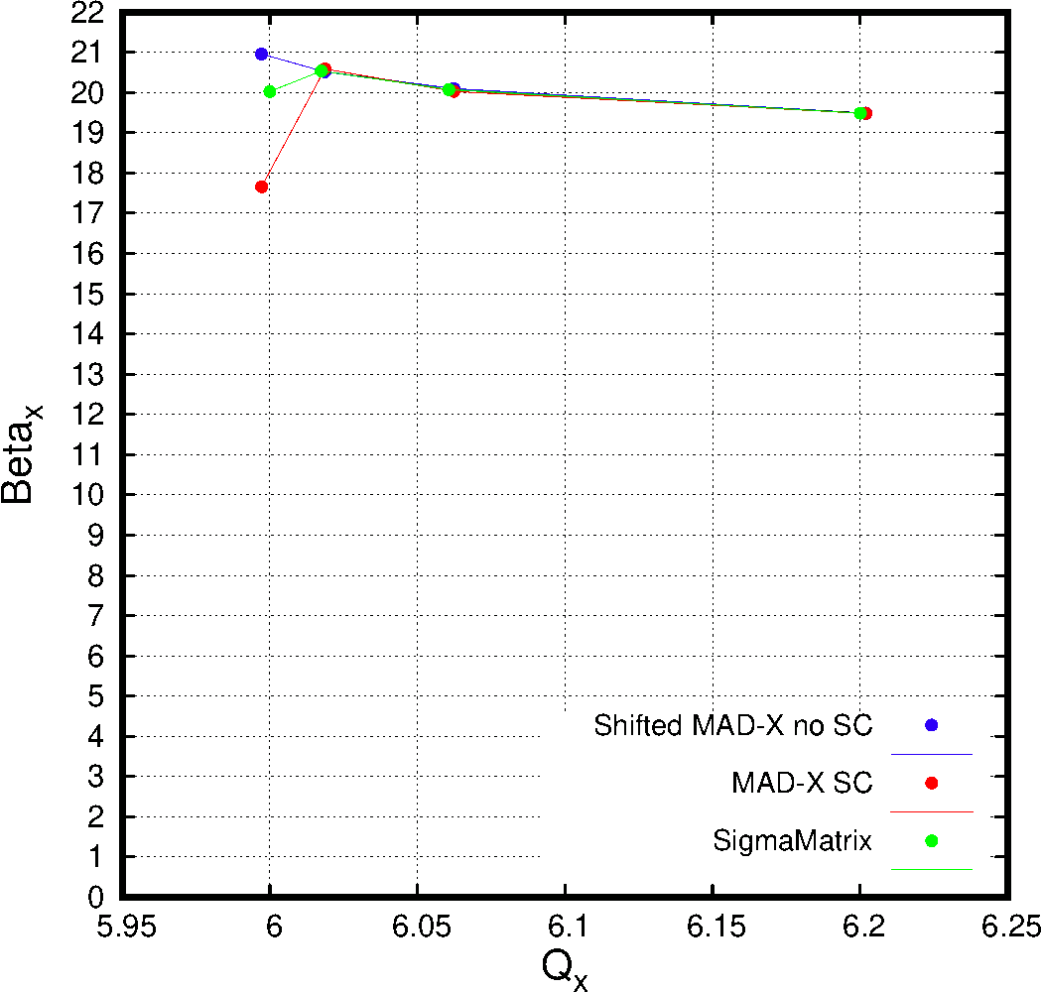
Horizontal β Function

Slide 21
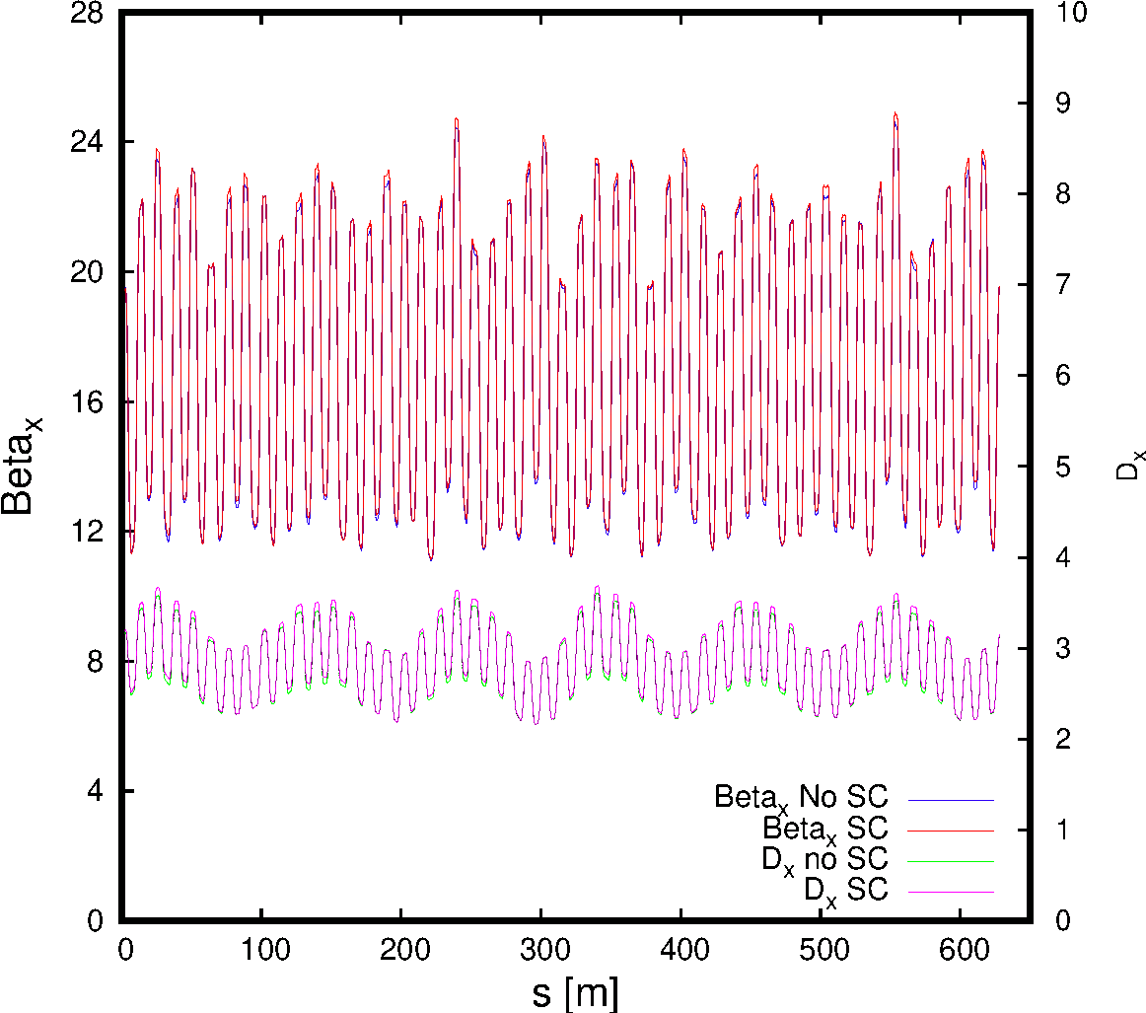
H β & Dispersion at Q_{x} = 6.244

Slide 22
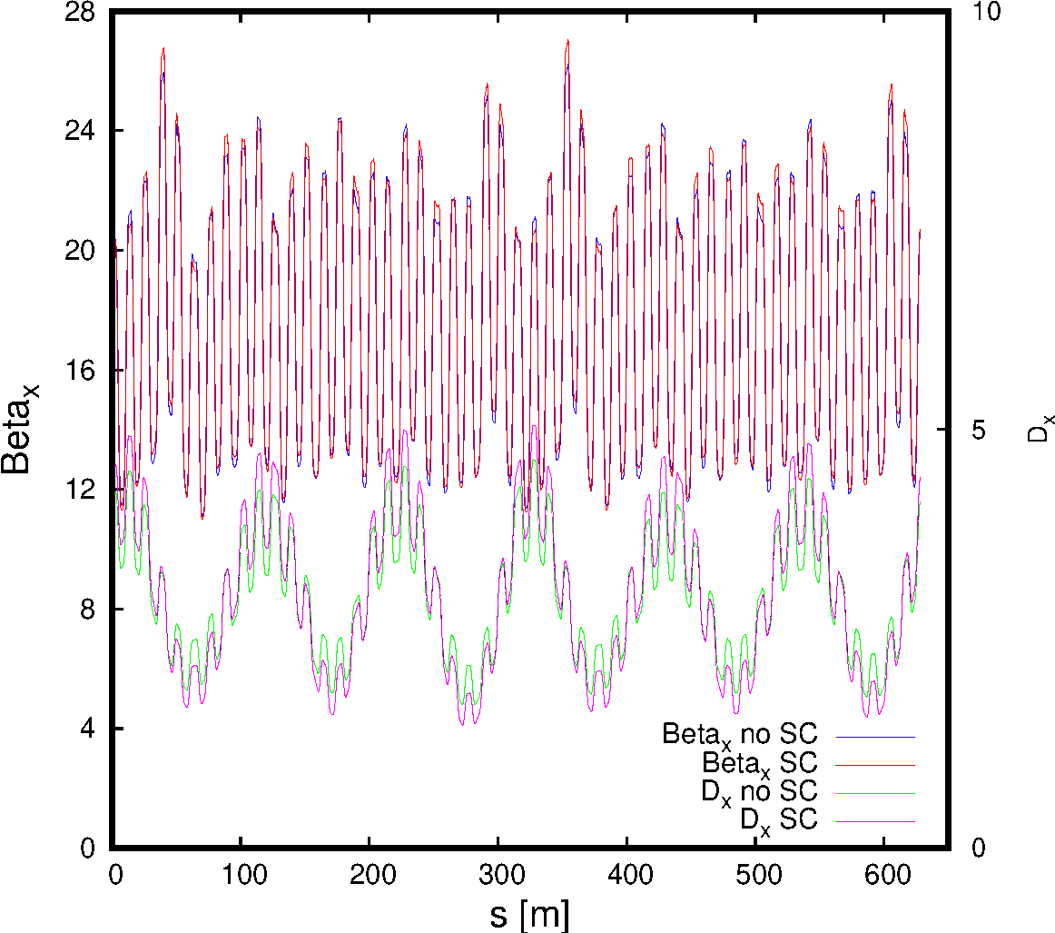
H β & Dispersion at Q_{x} = 6.060

Slide 23
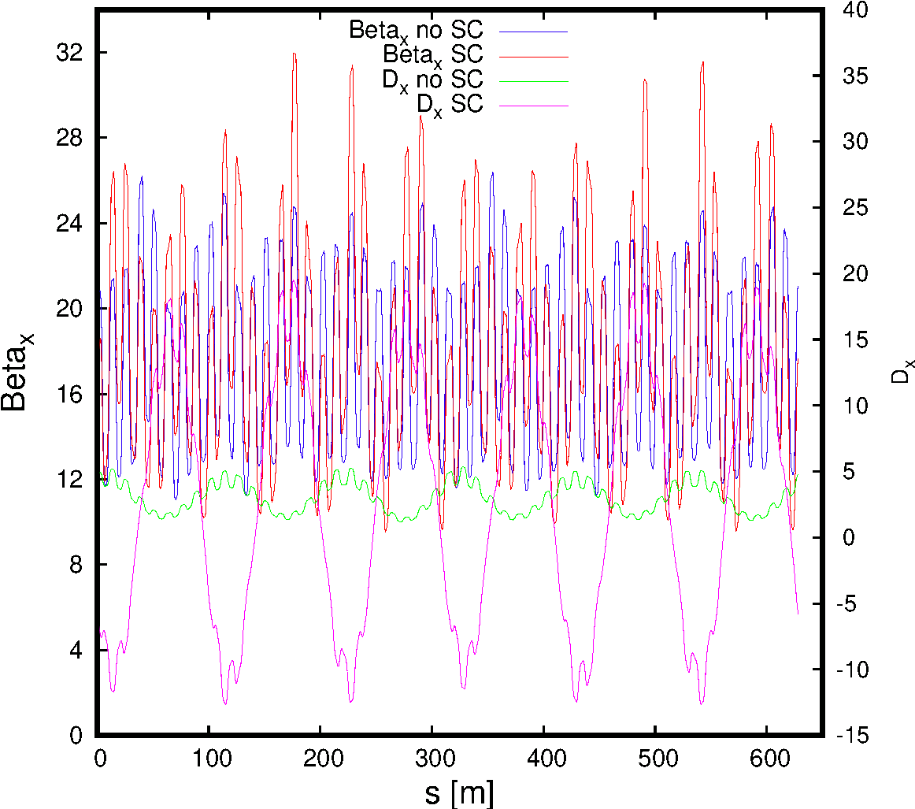
H β & Dispersion at Q_{x} = 6.039

Slide 24
SC Tune Spreads

Slide 25
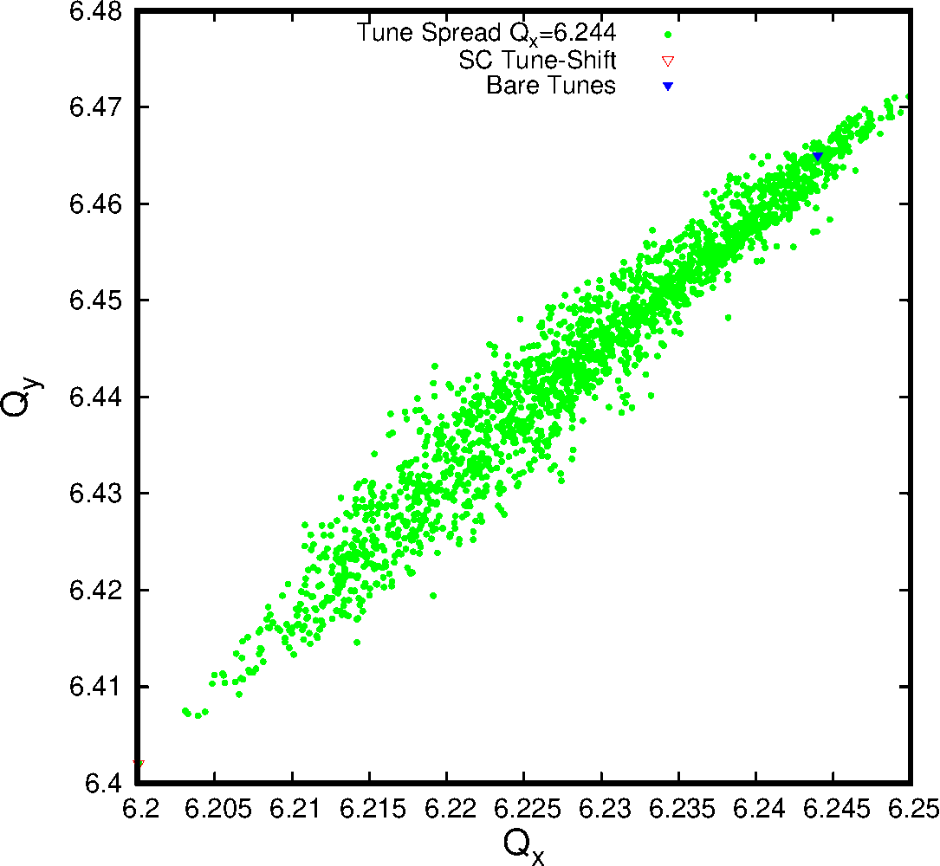
Tune Spread Q_{x} = 6.224

Slide 26
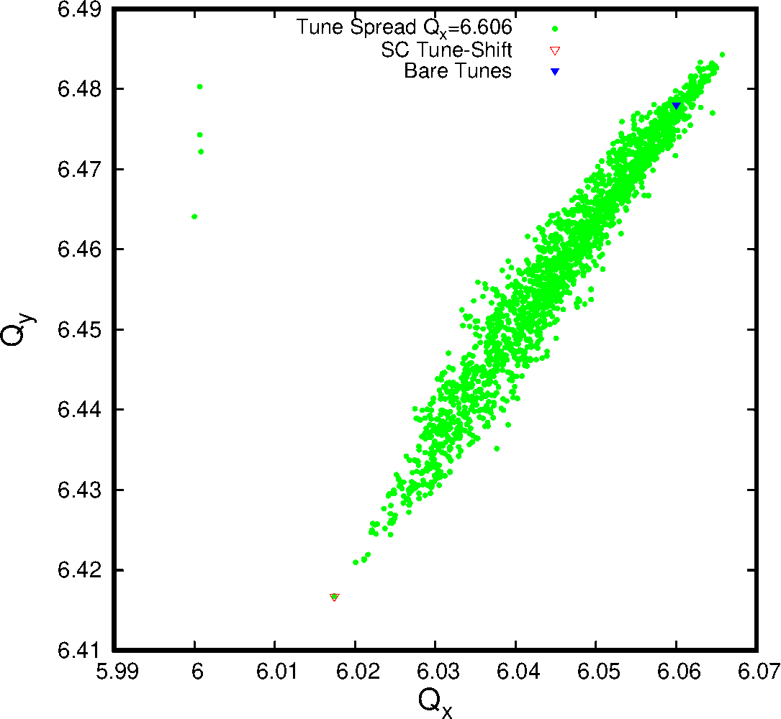
Tune Spread Q_{x} = 6.060
A few particles locked to the integer resonance

Slide 27
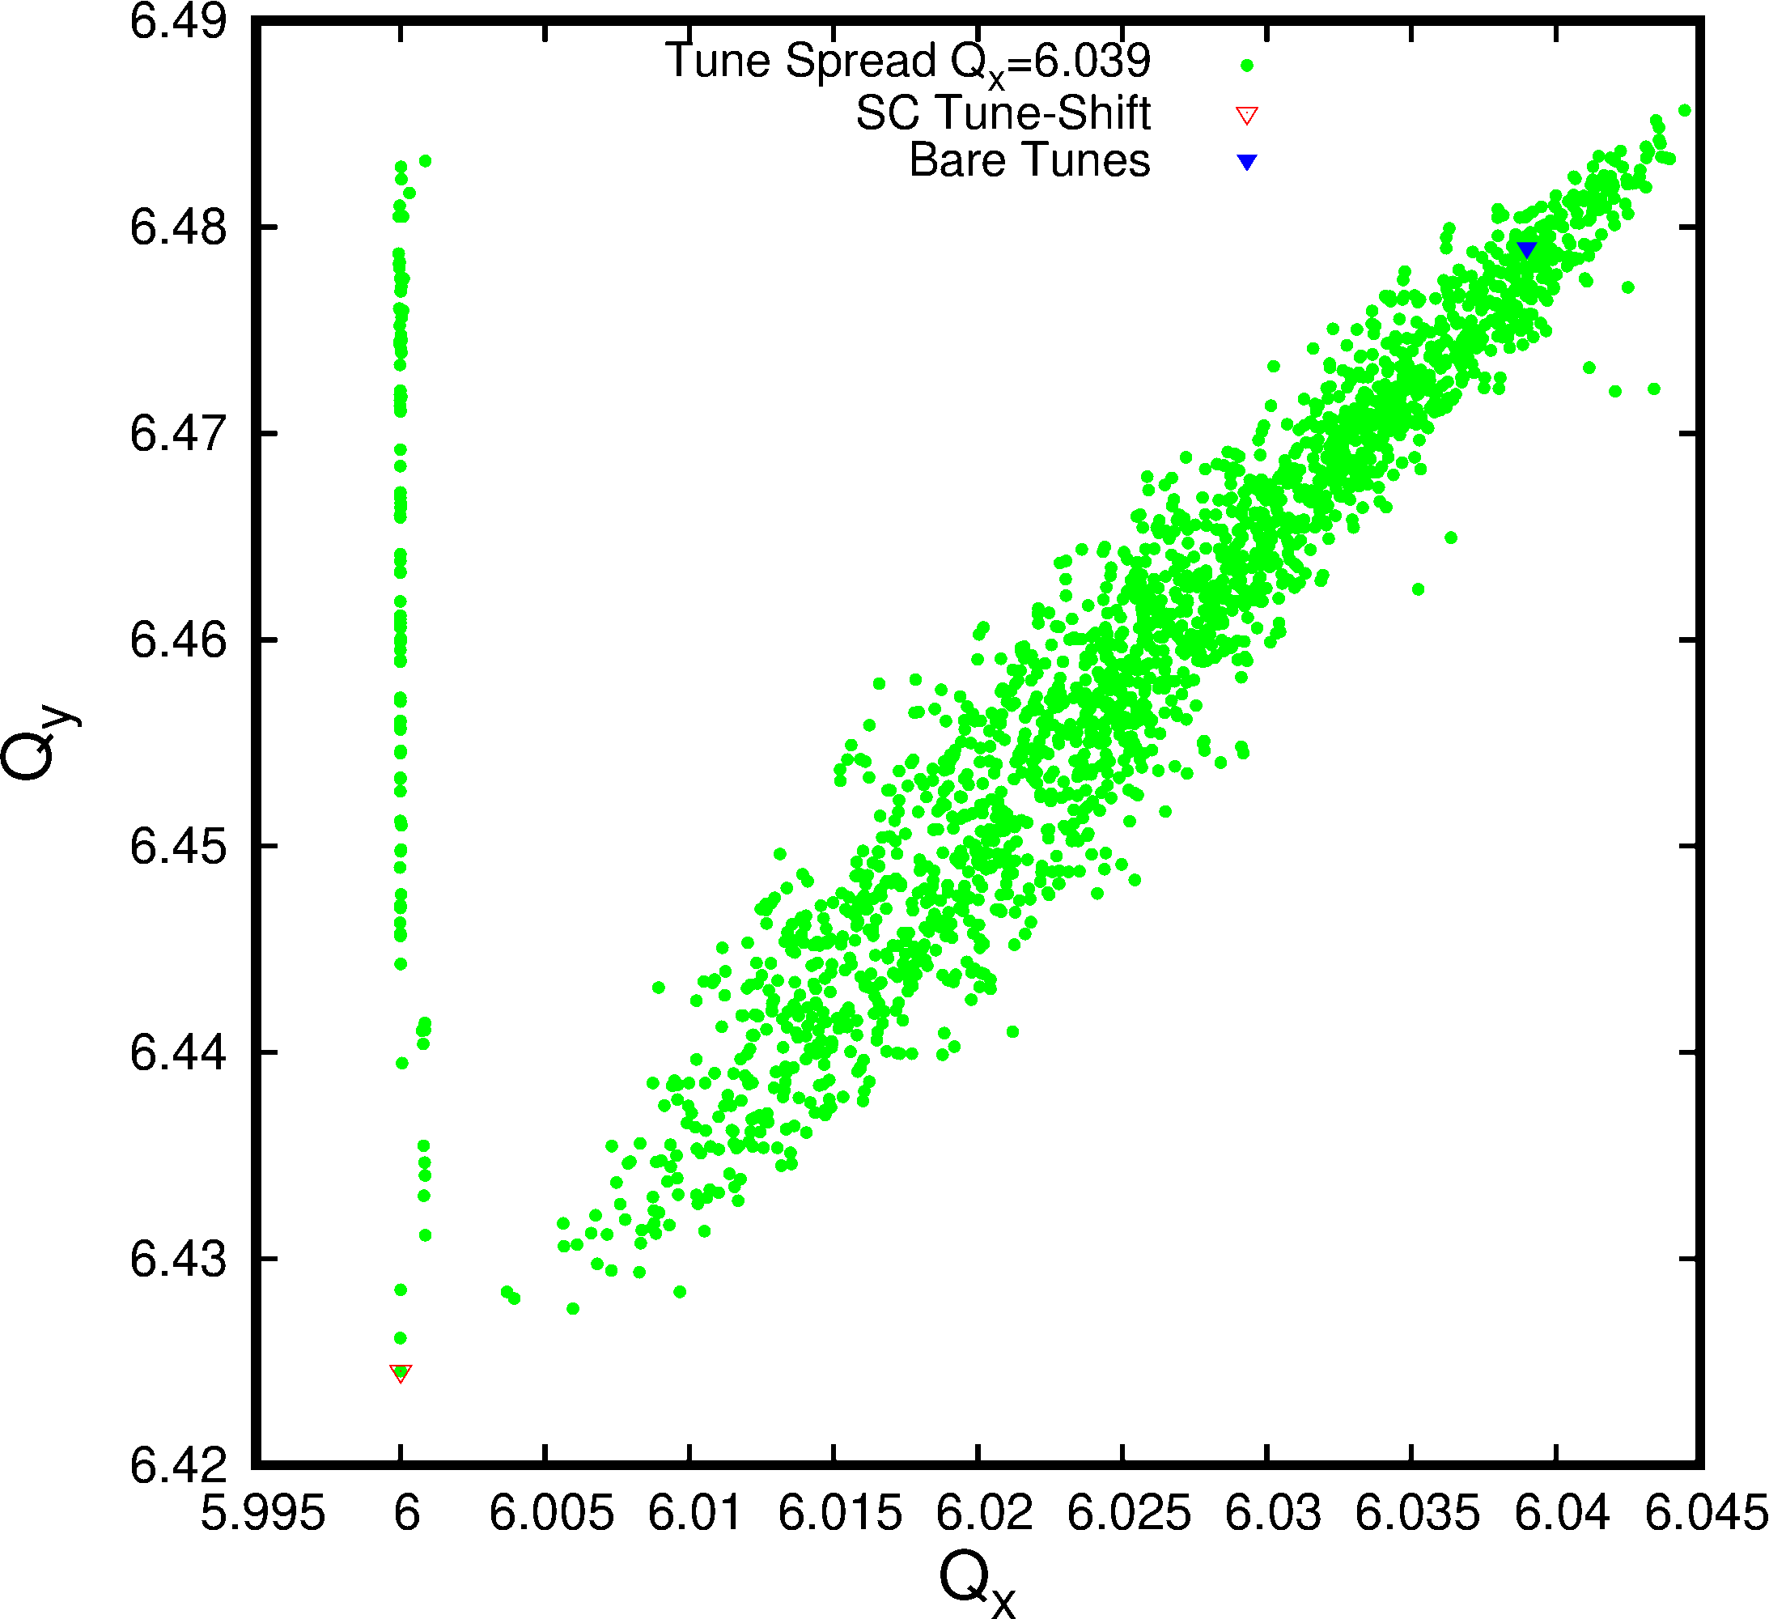
Tune Spread Q_{x} = 6.039

Slide 28
SC Tune Spreads
A lot can be learned from the SC tune spread (aka “Necktie”)
Typically one should find very well defined shapes when calculating tunes. However, it turns out that one needs multiple synchrotron periods for well defined tunes. In fact, a minimum of two such periods is just sufficient!
On the other hand using the phase advance over one turn the images are very fuzzy and tend to be all over the place.
The bare tunes are the matched tunes without SC.
Most relevant parameter is of course the SC tune-shift and it is essential that it agrees with the analytical estimate! In the above figures this has been shown implicitly: The MAD-X calculation agrees very well with the tunes calculated from the zero amplitude particles.
This SC tune-shift test can be seen as an essential sanity check of any SC code and should be applied for all relevant SC simulation studies.
Yes Again! ➔ Malte will also add more on this subject tomorrow!

Slide 29
Back to PS close to Integer

Slide 30
Tune Spread Q_{x} = 6.039

Slide 31
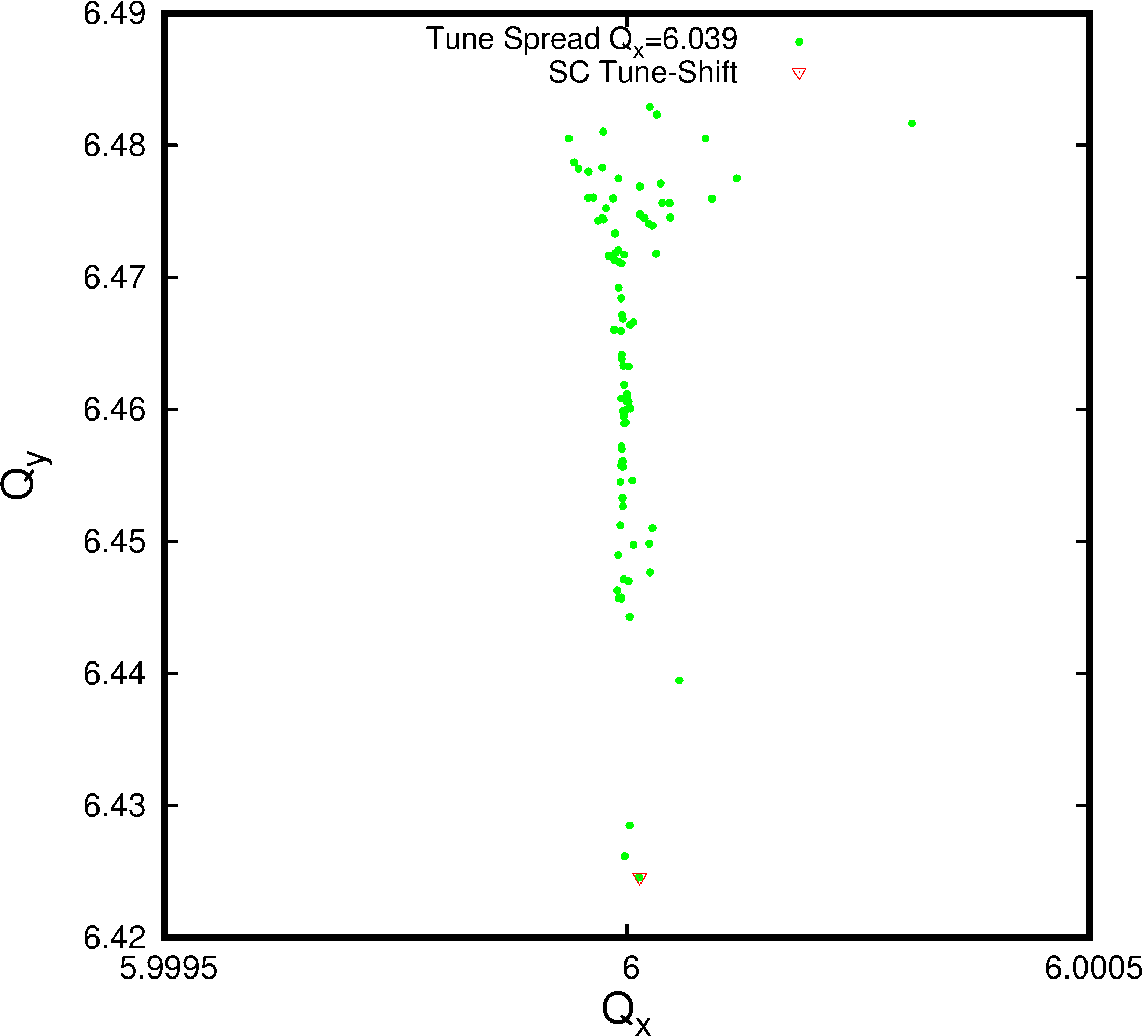
Tune Spread Q_{x} = 6.039 Close-Up

Slide 32
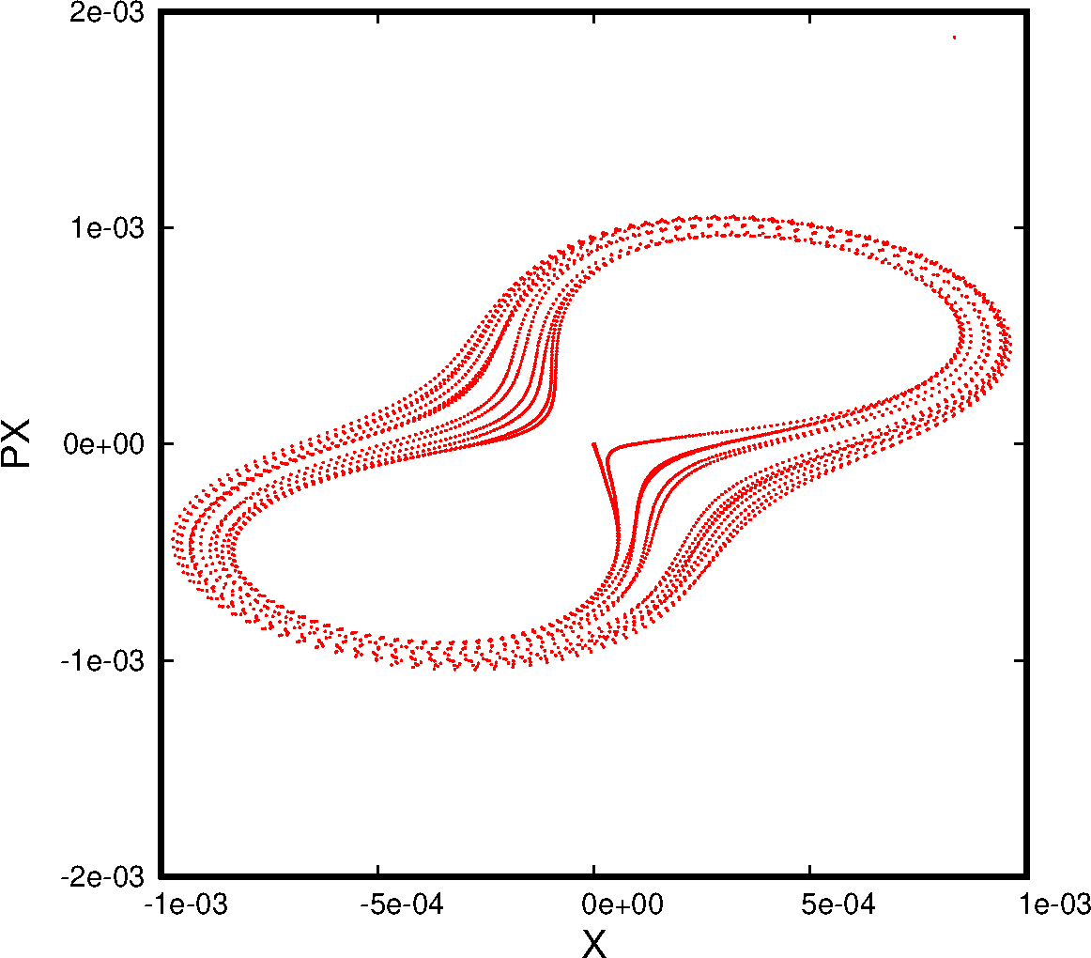
H Phase Space Q_{x} = 6.039 (0 Ampl.)
~1/8 of 2σ

Slide 33
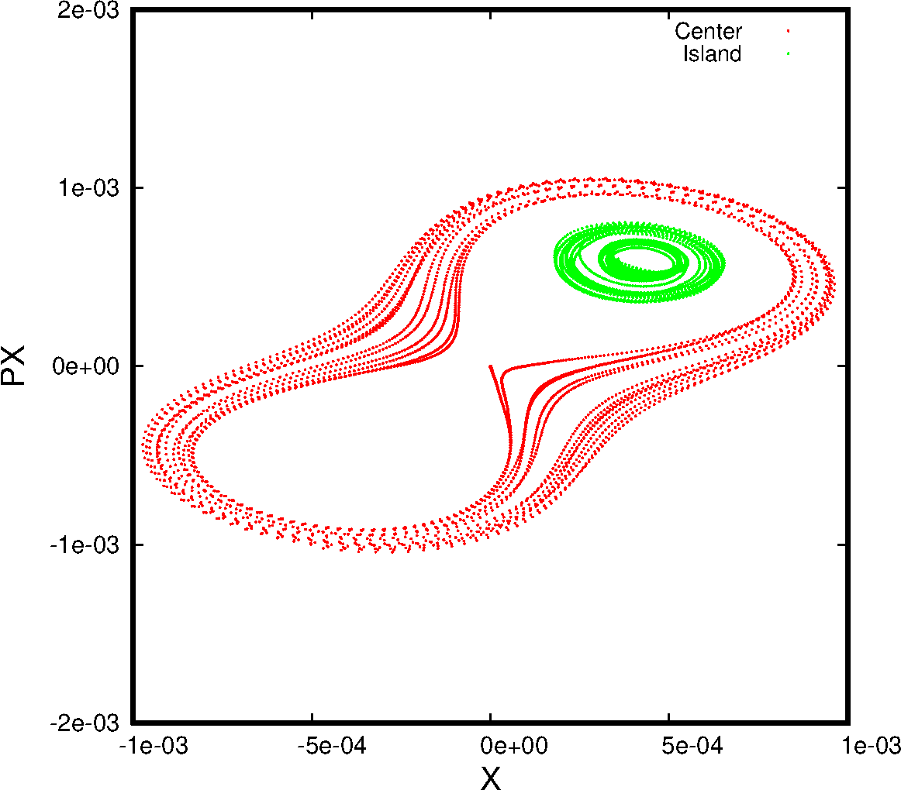
H Phase Space Q_{x} = 6.039 (0 Ampl. and Island )

Slide 34
PS close to Integer ➔ Two Large Islands
The population at or close to the integer could be addressed to particles close
small amplitudes but more detailed studies are needed.
The appearance of two islands seems to imply that this is in fact a SC resonance. Since we are close to the integer a particle can only appear in one of the islands, of course.
This is just a conjecture which needs to be confirmed by a more in-depth investigation.
In the meantime, traditional perturbation theory has been extended to SC ➔ Foteini & Hannes have just published a report on the subject.
Last, one of the essential MAD-X extension will be to include the 3D symplectic SC kick into PTC so that resonances will be determined automatically with NormalForm techniques.

Slide 35
Profile development
In the experiment the beam is injected at safe tunes and only then shifted to the tune of interest.
Therefore, in the simulation a particle distribution is created at the safe tunes and used at all studied tunes.
This is in particular important at Q_{x} = 6.039 close to the integer. In fact, a particle distribution created based on the optics at the integer is not matched and blows up.
To create the following beam profiles the distributions are simulated for a synchrotron period so that slight mismatches have been “washed” out.

Slide 36
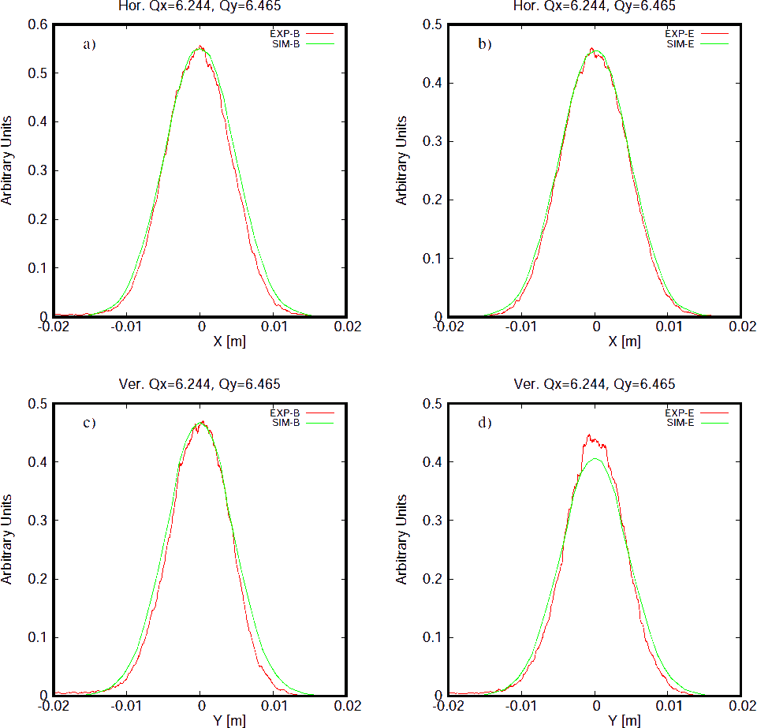
Profile Q_{x} = 6.244
Start
End
H
V

Slide 37
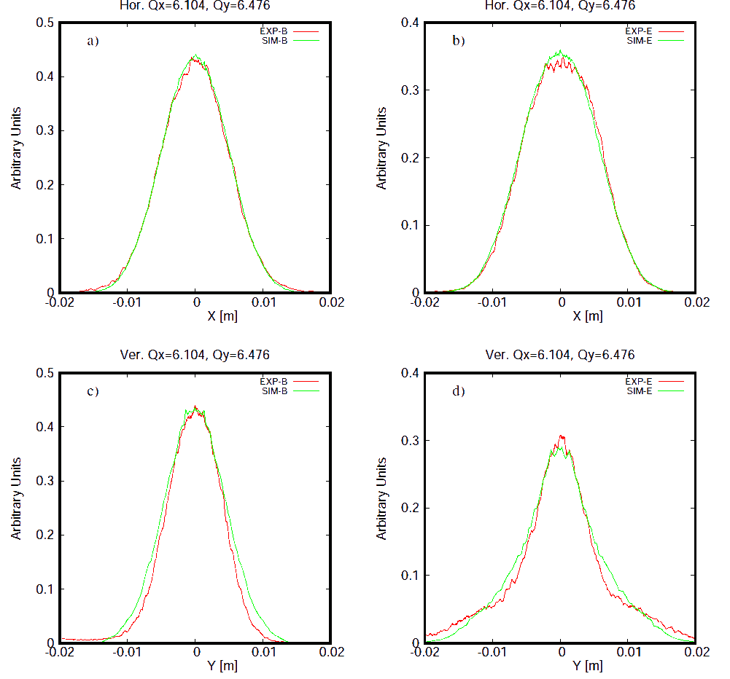
Profile Q_{x} = 6.104
End
Start
H
V

Slide 38
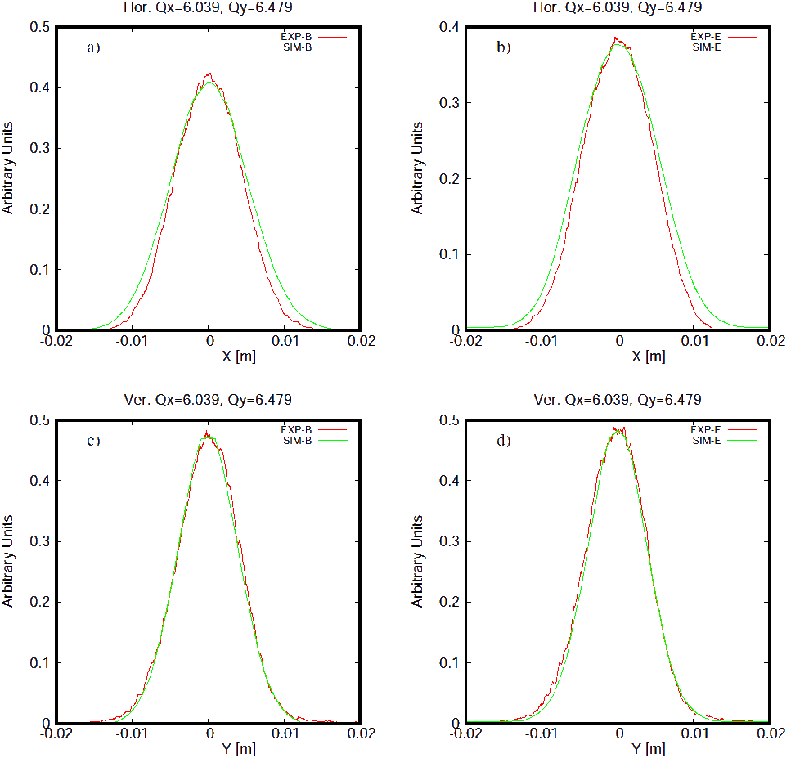
Profile Q_{x} = 6.039
Start
End
H
V

Slide 39
Conclusion
The 3D sympletic SC kick and the SigmaMatrix have been successfully installed into a special MAD-X version. The legacy version has been kept except for some bug fixing. In particular, the old version no longer leads to artificial emittance blow-up at the integer.
It was found that a fully selfconsistent adaption of the effective Beam Sigmas, the so-called “Free” mode, leads to unacceptable high transverse emittance blow-up. This is clearly noise that is introduced and indeed can be reduced by increasing the number of Macro-particles. However, this render this “Free” mode almost useless for long-term studies.
We are therefore using the so-called “Periodic” mode. This allows to perform long-term studies over 500’000 turns for the PS, because the noise could be sufficiently reduced with some 2’000 - 4’000 Macro-particles. This holds for both versions.
Tests at the PS with a relative small SC tune-shift of ~0.05 have been successfully completed.
Supportive studies concerning the optics and dispersion functions under the influence of SC have also been presented.

Slide 40
Outlook
The present implementation is in the process of being ported to the standard Mad-X version.
This will also include the set-up and matching routines such that the code can be used without the external preparation procedure presently be required.
Harry Renshall is continuously helping us with the OPENMP instrumentation (almost done) and various issues like proper treatment of “lost particles” and MAD-X pitfalls.
We need to overcome the emittance spike issue.
We need progress on minimizing artificial transverse coupling and introduce real coupling. Both may be combined to achieve the actual coupling present in the machine.
We still need to fully decouple the code from MAD-X Twiss and rely solely on the SigmaMatrix.
One would need a fresh start to attack the noise problem as one of the serious limiting issue in all modes. It also needs to be better categorized with respect a wide range of applications.
It is urgent to allow for distributions different from Gaussian. This is particularly important in the longitudinal plane since it may be far from Gaussian. Just the fact that it needs to be typically cut at 2.5 σ to fit into the bucket is a deviation from a true Gaussian profile.
The end goal is an implementation that covers any application up to the ultimate space charge tune shift of ~1.
Equally relevant is to include the 3D symplectic SC kick into PTC and NormalForm.

Slide 41
Reserve

Slide 42
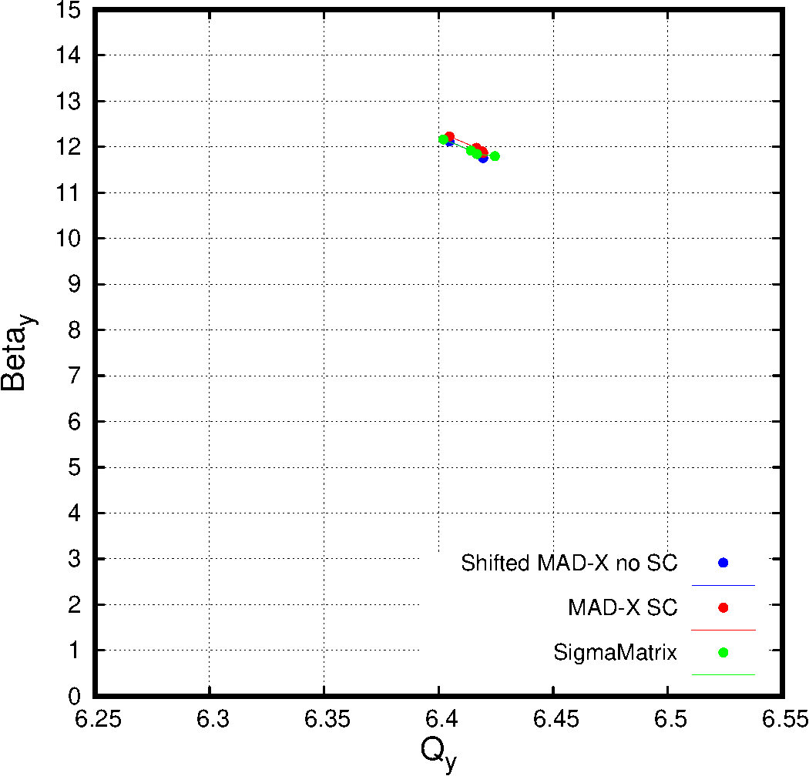
Vertical β Function

Slide 43
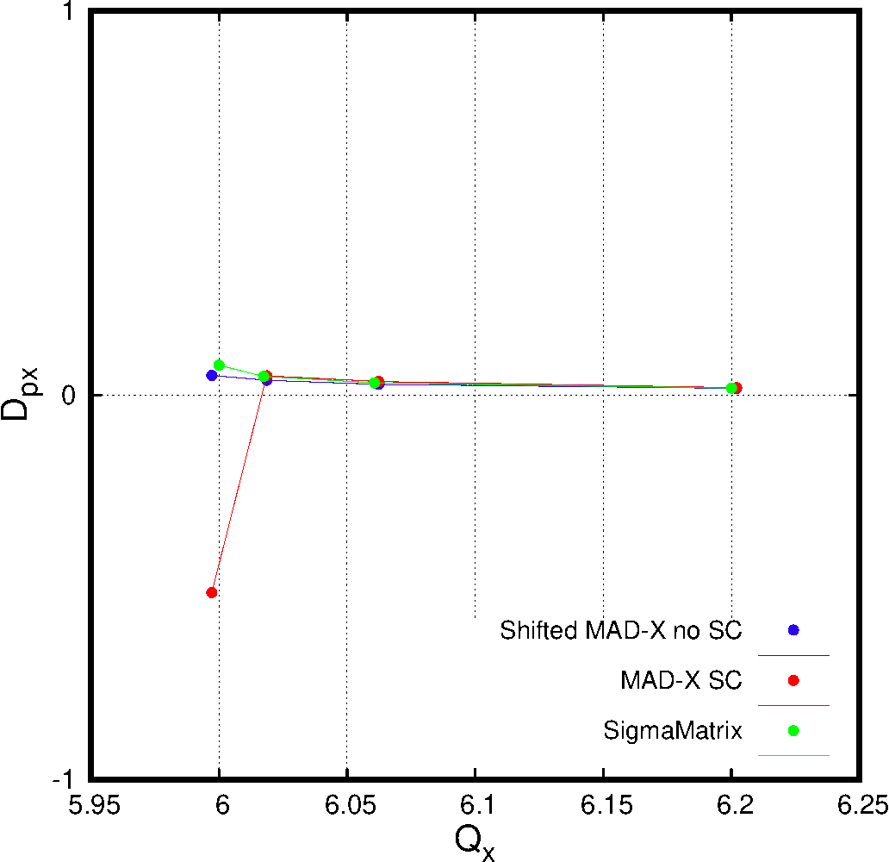
Horizontal D_{px}

Slide 44
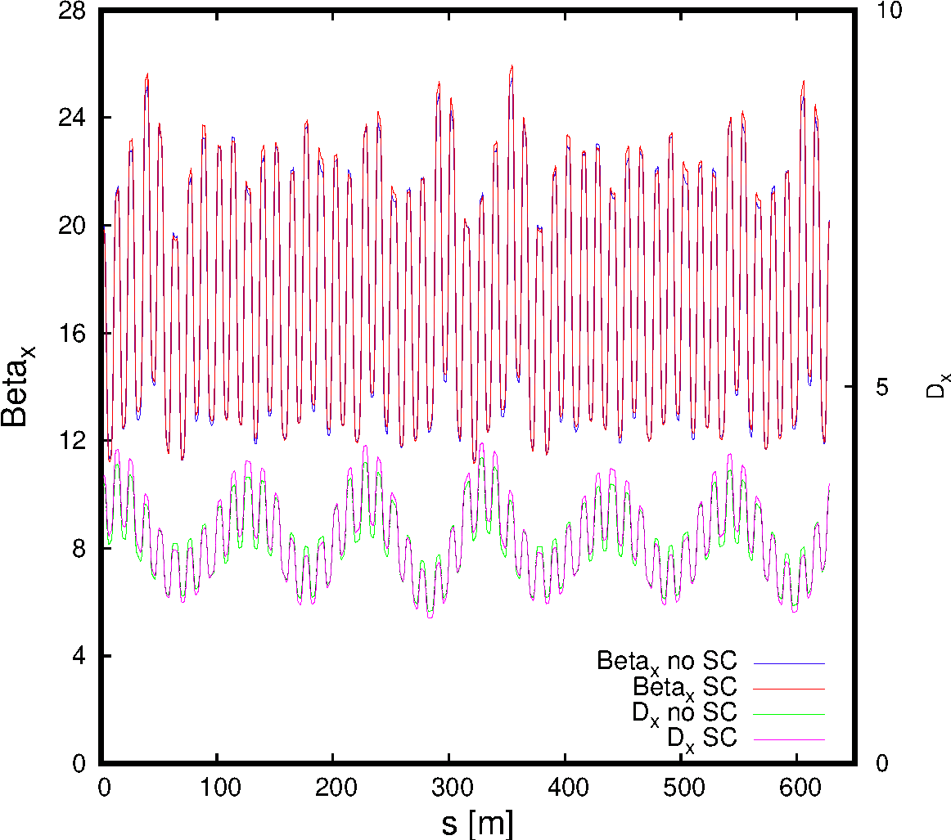
H β & Dispersion at Q_{x} = 6.104

Slide 45
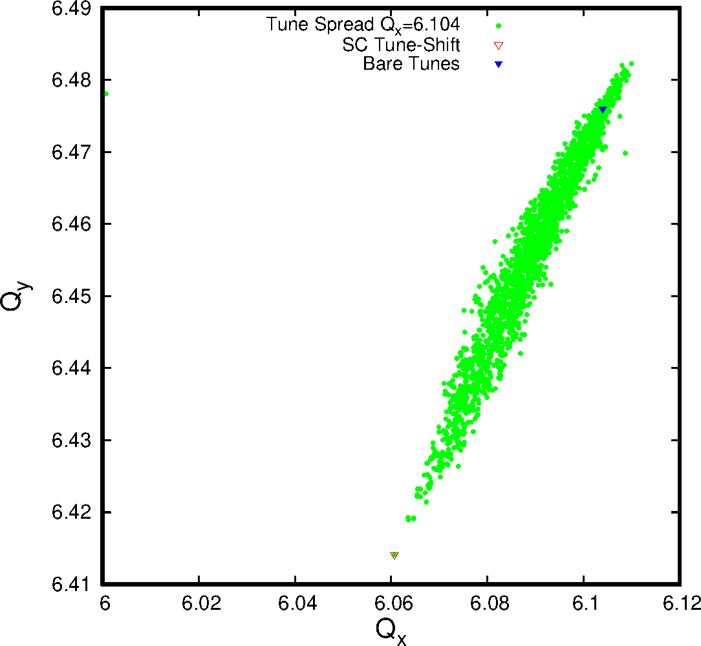
Tune Spread Q_{x} = 6.104

Slide 46
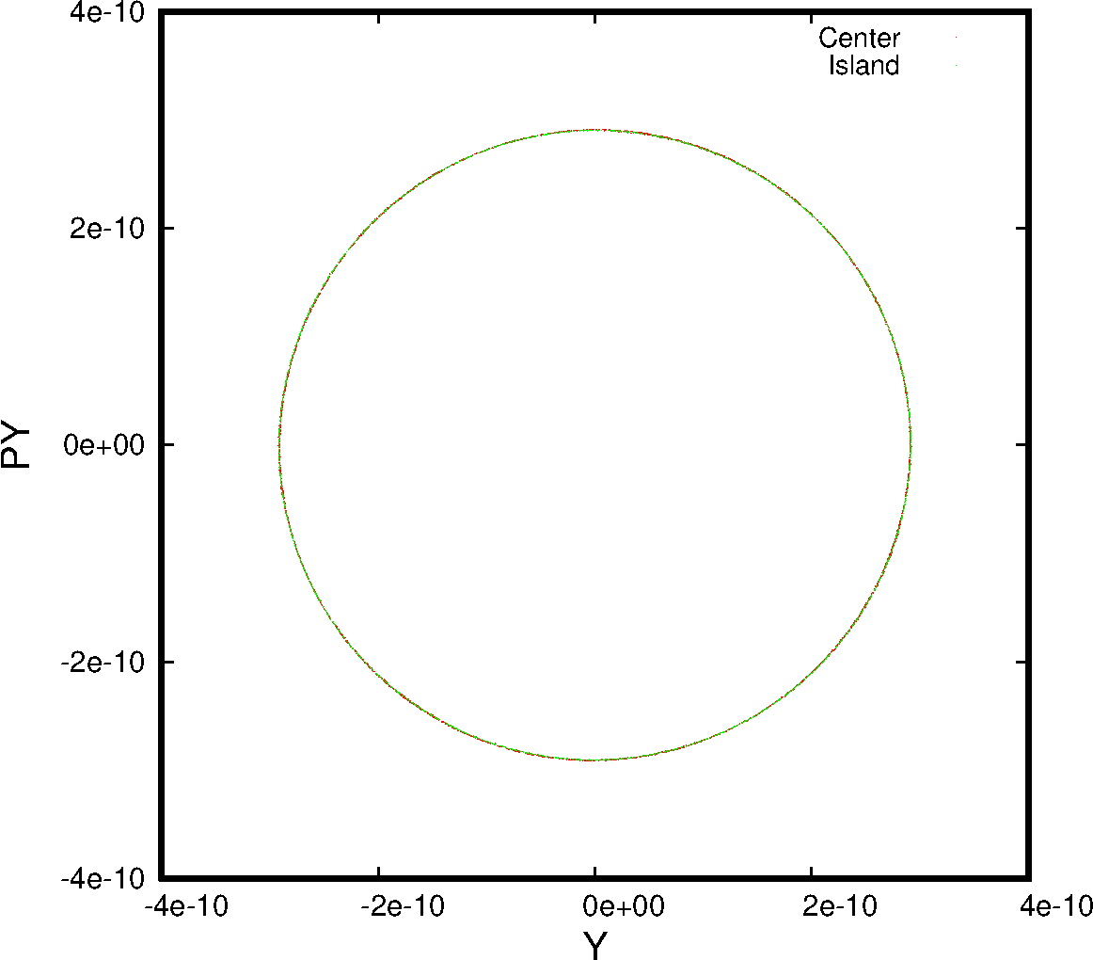
V Phase Space Q_{x} = 6.039 (0 Ampl.)

Slide 47
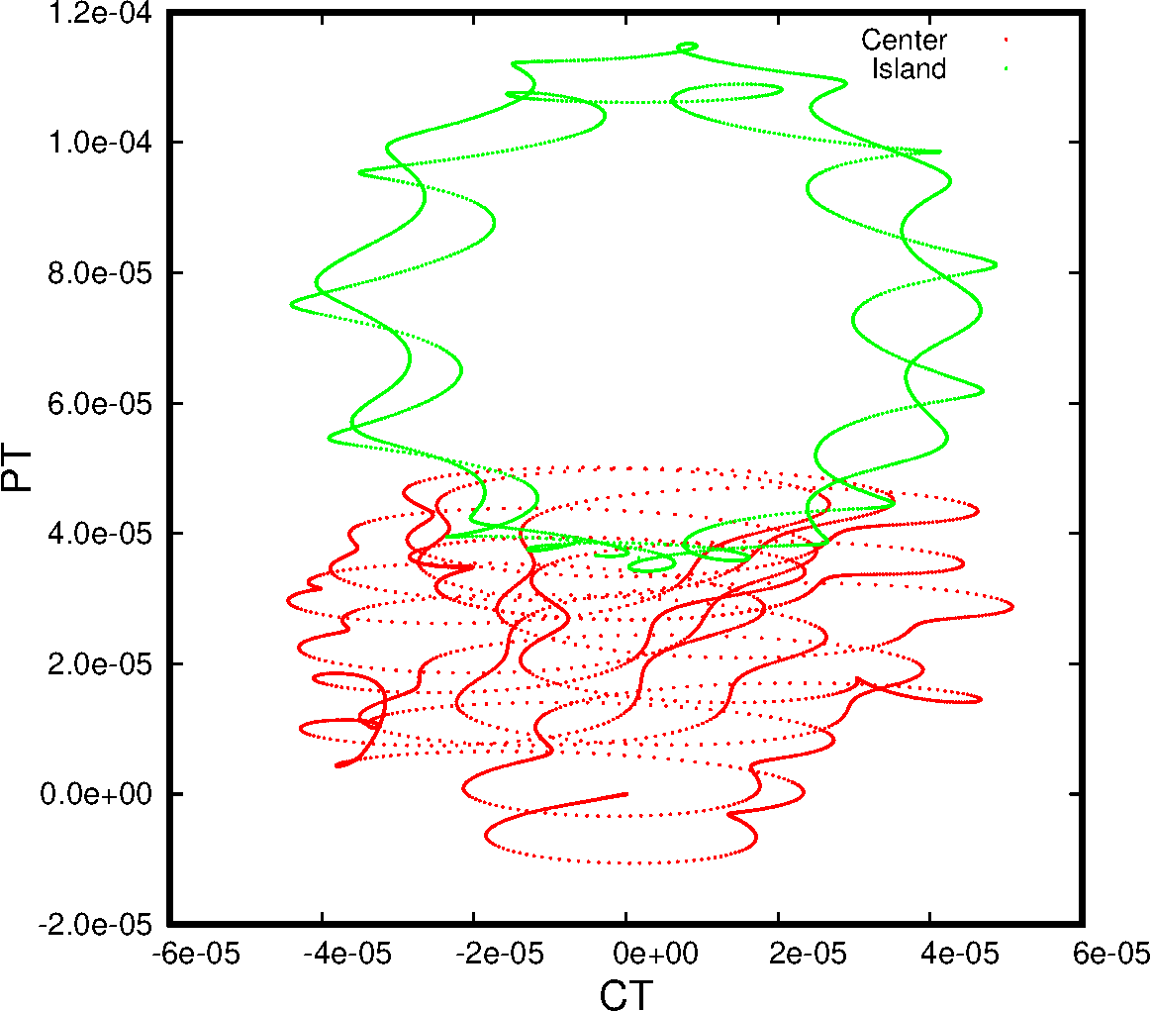
L Phase Space Q_{x} = 6.039 (0 Ampl.)

