Slide 1
Modelling of the PS main magnets
A. Huschauer
4th ICFA Mini-Workshop on Space Charge, 06 November 2019
Acknowledgements
S. Gilardoni, M. Giovannozzi, J. Renedo Anglada, G. Sterbini, D. Tommasini

Slide 2
Outline
Motivation
Magnetic model of the PS main units
Optical model of the PS
Impact of the low-energy quadrupoles on the optics
Concluding remarks

Slide 3
Outline
Motivation
Magnetic model of the PS main units
Optical model of the PS
Impact of the low-energy quadrupoles on the optics
Concluding remarks

Slide 4
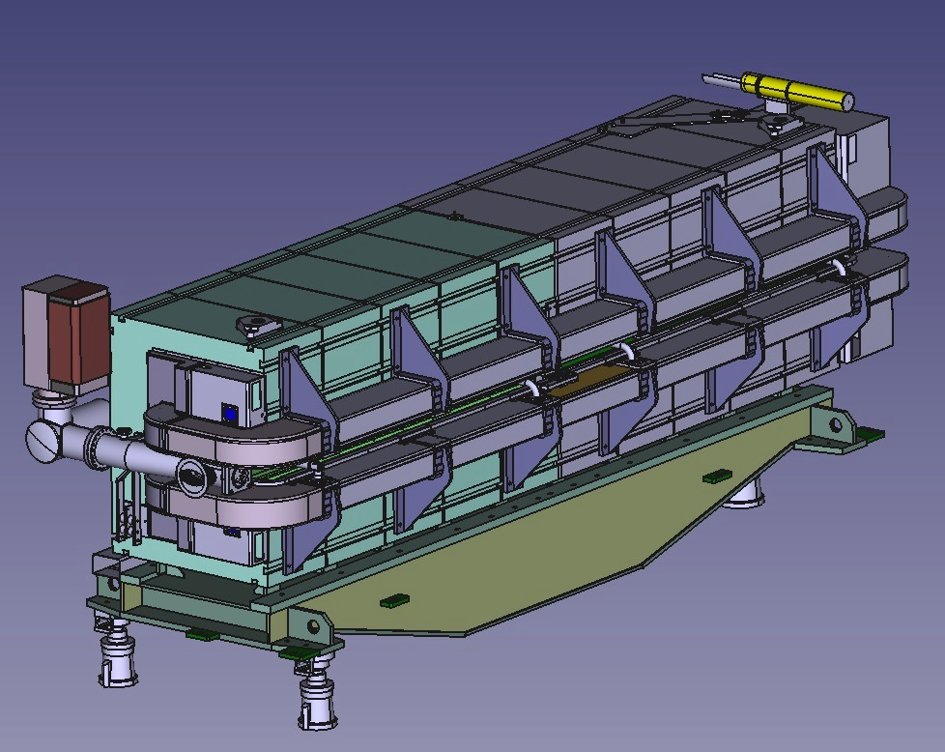
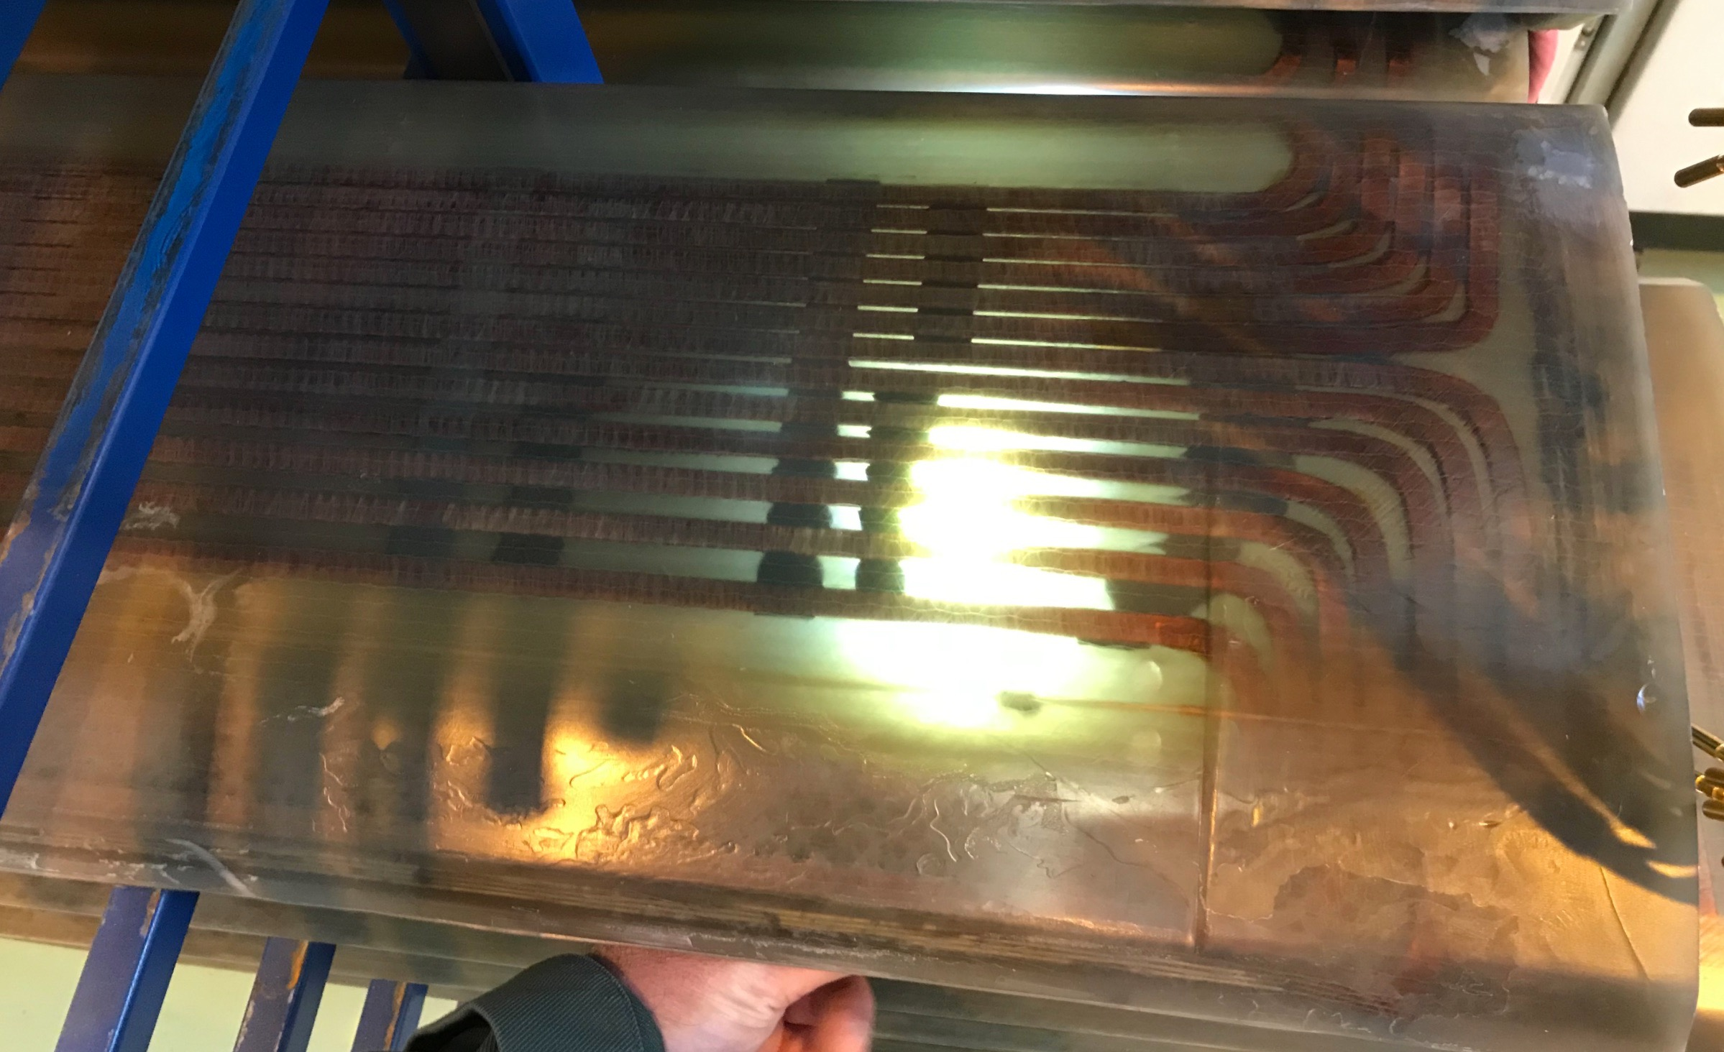
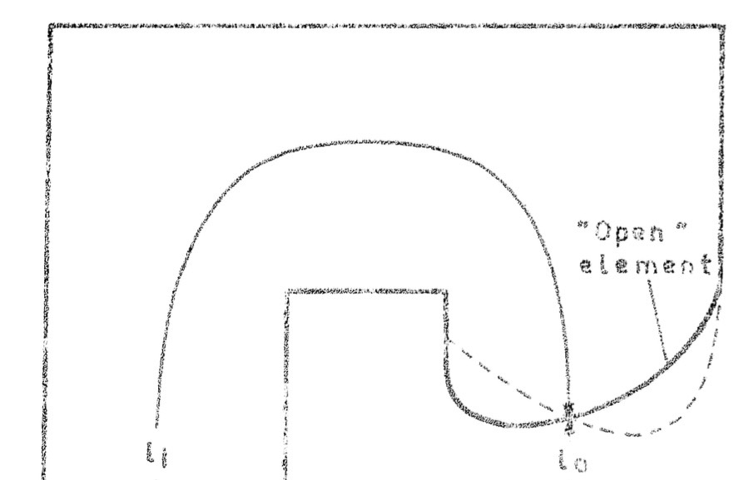
Motivation
Understanding, modelling and simulating the field distribution inside the PS main units (MUs) is a complex task
  Combined function magnets with single main coil to excite
  dipole and quadrupole components
  Additional Pole Face Windings to adjust tunes and chromaticities
  40 low-energy quadrupoles to adjust tunes below 3.5 GeV/c

Slide 5
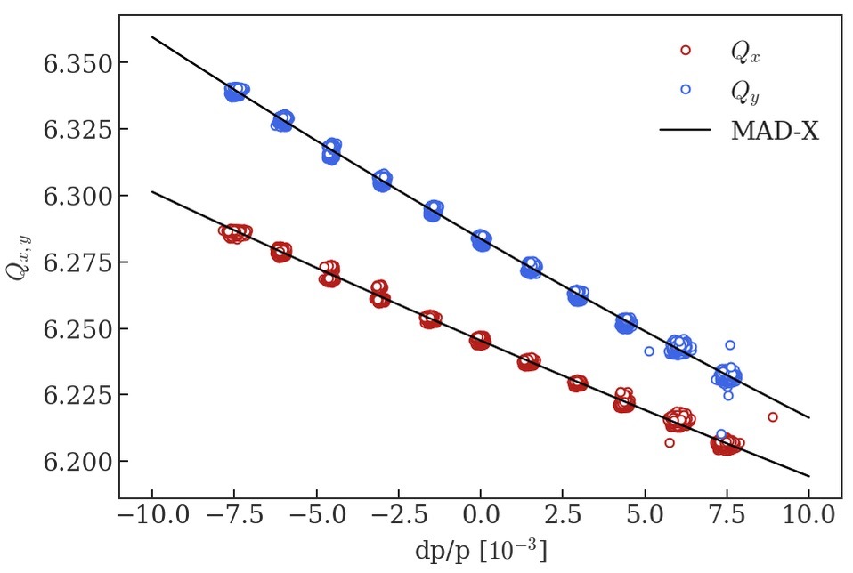
Motivation
Understanding, modelling and simulating the field distribution inside the PS main magnets (MUs) is a complex task
  Combined function magnets with single main coil to excite
  dipole and quadrupole components
  Additional Pole Face Windings to adjust tunes and chromaticities
  40 low-energy quadrupoles to adjust tunes below 3.5 GeV/c
Beam dynamics studies use a beam-based effective model
  No information on the distribution of magnetic errors available
  Non-linear chromaticity measured for different configurations and
  used as matching constraint in MAD-X
  If only tunes are matched → disagreement mainly on the vertical
  chromaticity
Bare machine
(combined function magnets only)
 | Q_{x} | Q_{y} | Q_{x}’ | Q_{y}’
measurement | 6.245 | 6.284 | -5.35 | -7.16
PTC after Q-matching | 6.245 | 6.284 | -5.31 | -6.15

Slide 6
Motivation
Collaboration with magnet experts started over 10 years ago to improve the knowledge of the PS MUs
  Initial simulations only 2D
  Today a 3D model of the PS magnets is available in OPERA
    provided new information about the distribution of non-linearities inside the magnets
  Large potential to gain information on the harmonics from the 3D model and incorporate them into the MAD-X optics model
  Ultimate goal: working point predication based on the magnetic model, identification of magnetic errors
Improvements to the OPERA and the MAD-X description were required
  Long Shutdown 2 perfect time slot to review the PS models

Slide 7
Outline
Motivation
Magnetic model of the PS main units
Optical model of the PS
Impact of the low-energy quadrupoles on the optics
Concluding remarks

Slide 8
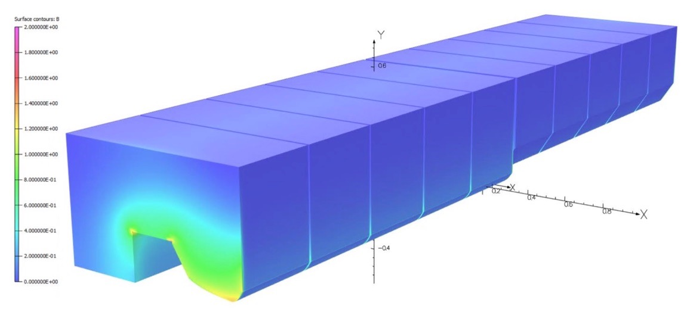
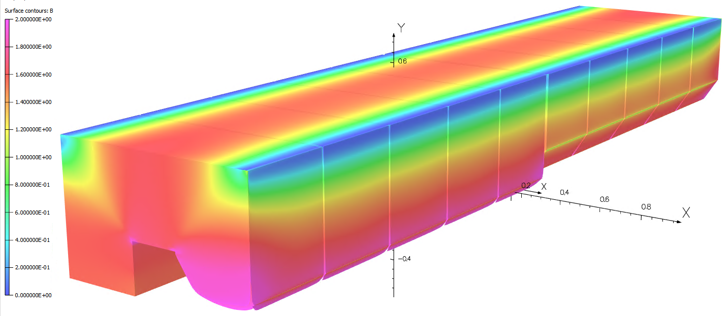
Magnetic model of the PS MUs
Field distributions at different energies
  Pole tips in saturation at top energy
Injection – 2.49 GeV/c
Extraction – 26 GeV/c

Slide 9
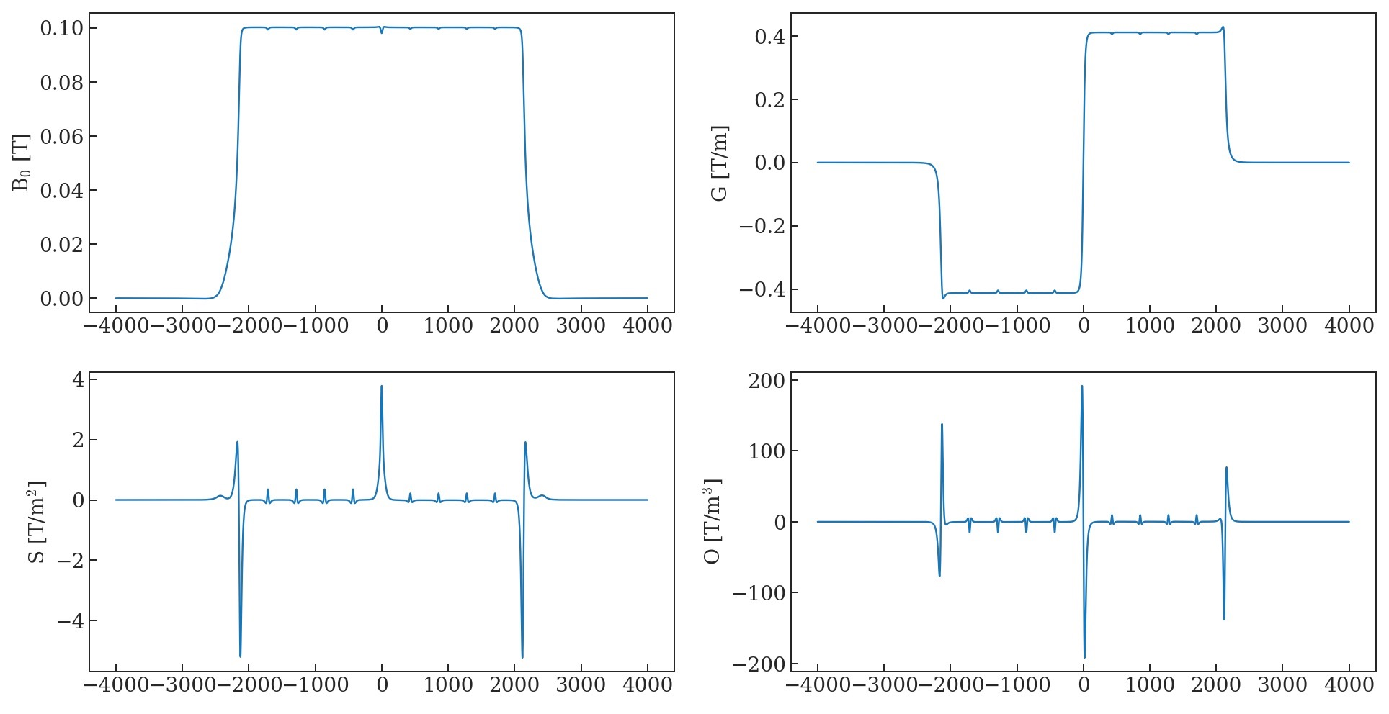
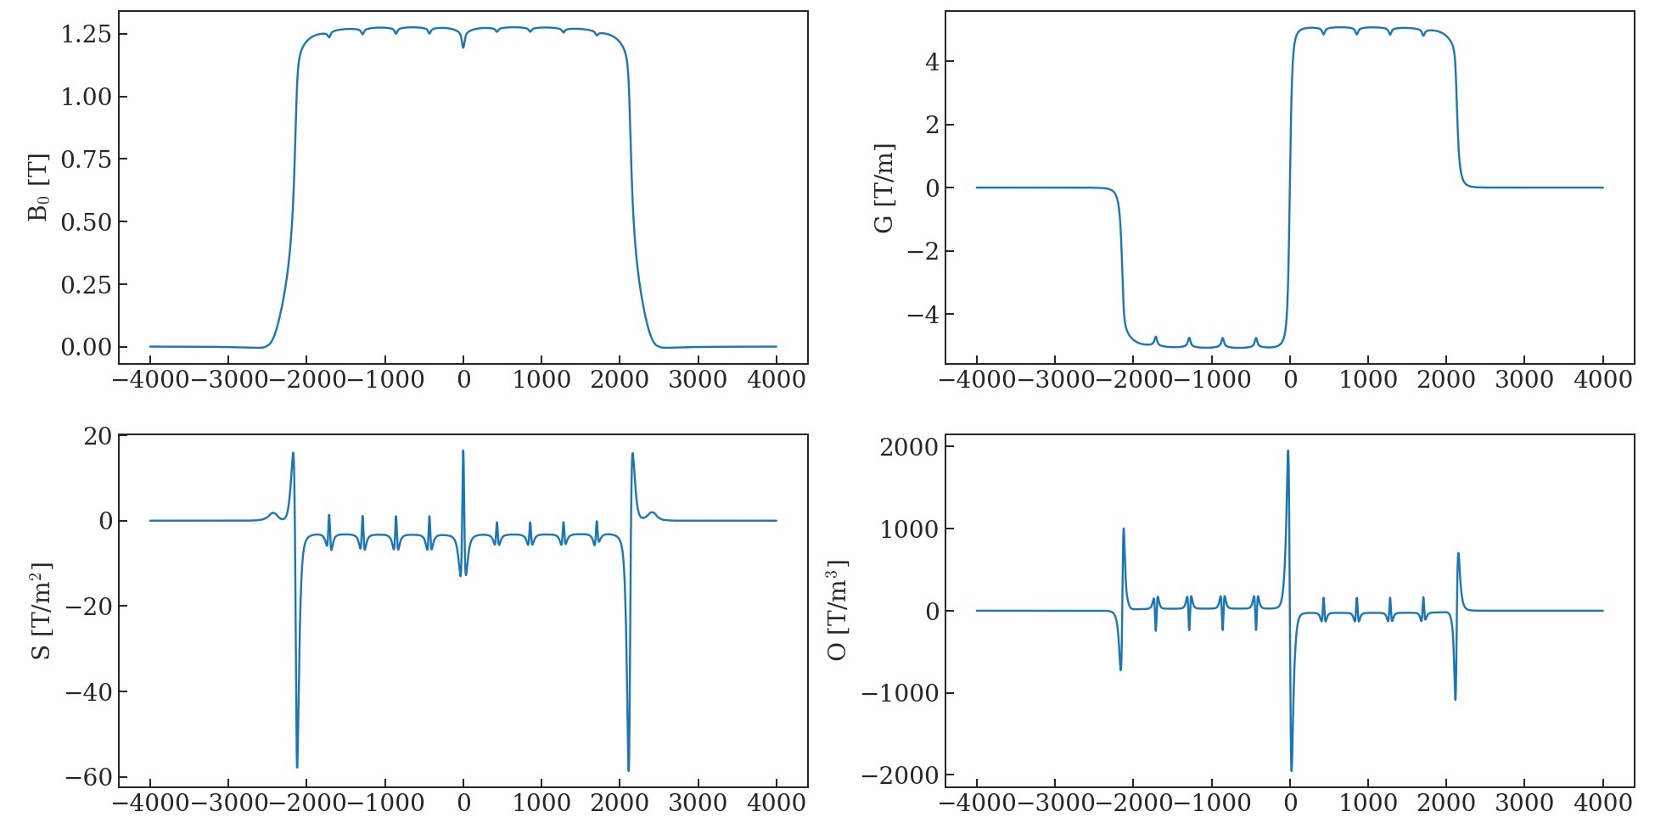
Magnetic model of the PS MUs
Field distributions at different energies
  Pole tips in saturation at top energy
  Higher order components mainly located at the entry, exit and the central junction
    Once in saturation, the body shows an important contribution as well
Injection – 2.49 GeV/c
Extraction – 26 GeV/c

Slide 10
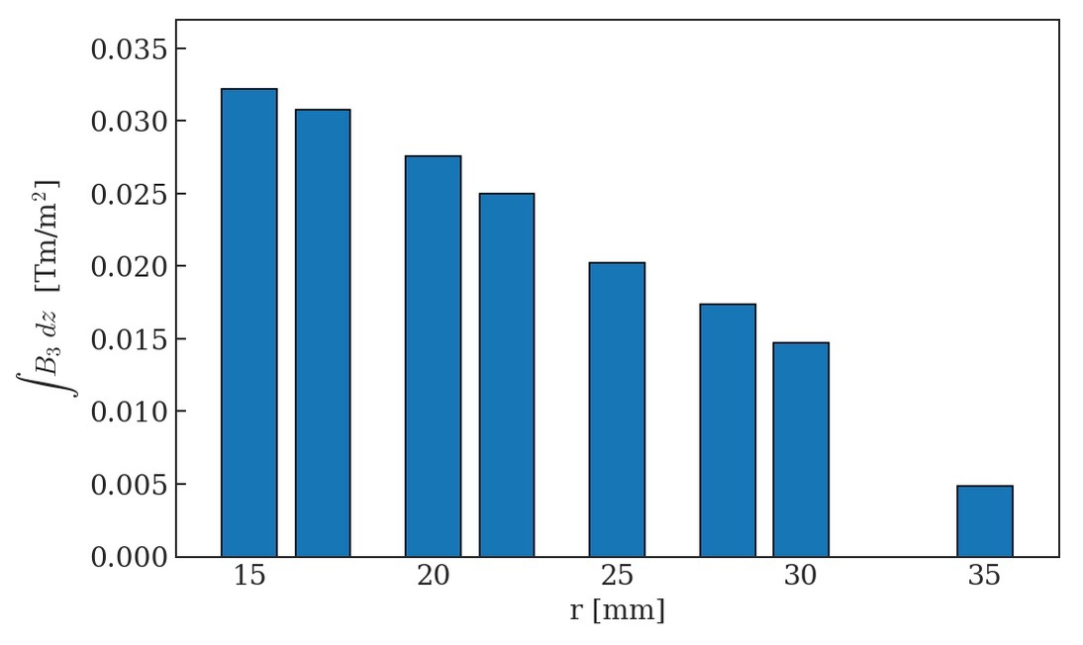
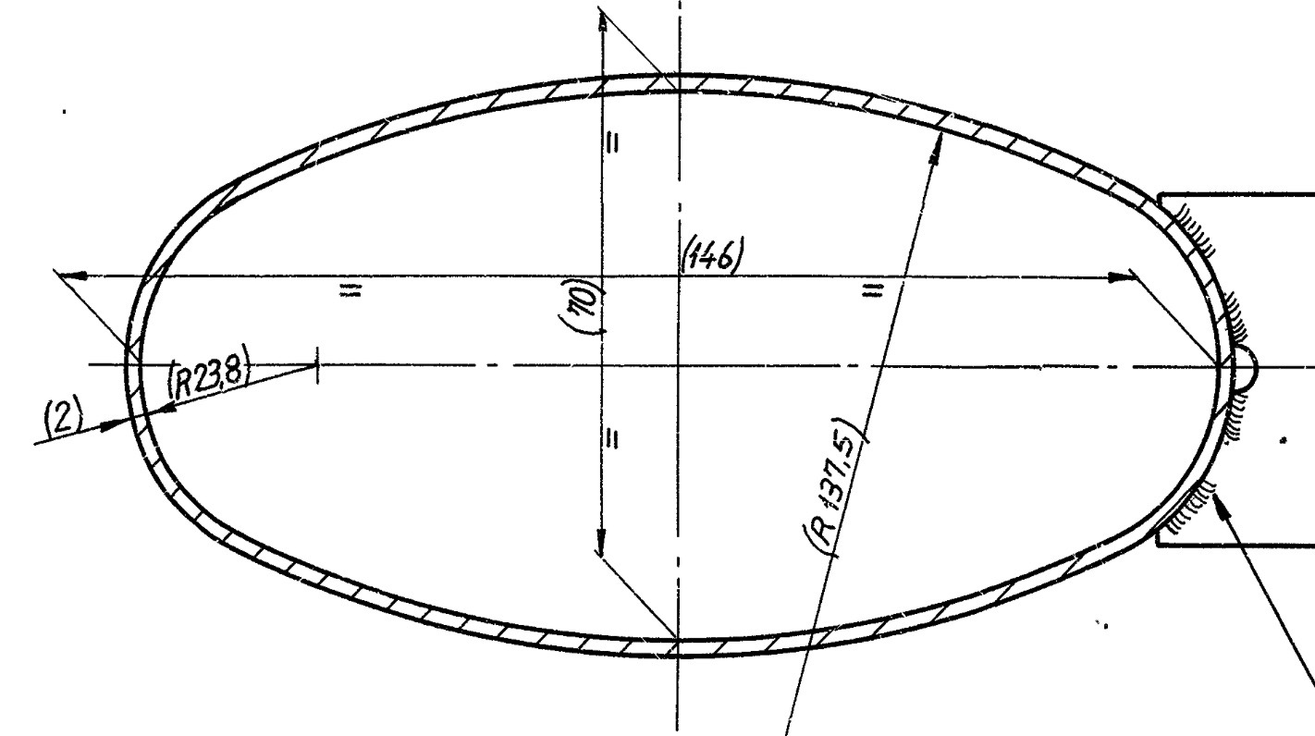
Magnetic model of the PS MUs
Harmonics computed around a certain reference radius
  Initial model didn’t show convergence, i.e. the resulting integrated harmonics were highly dependent on the reference radius
Typical PS aperture

Slide 11
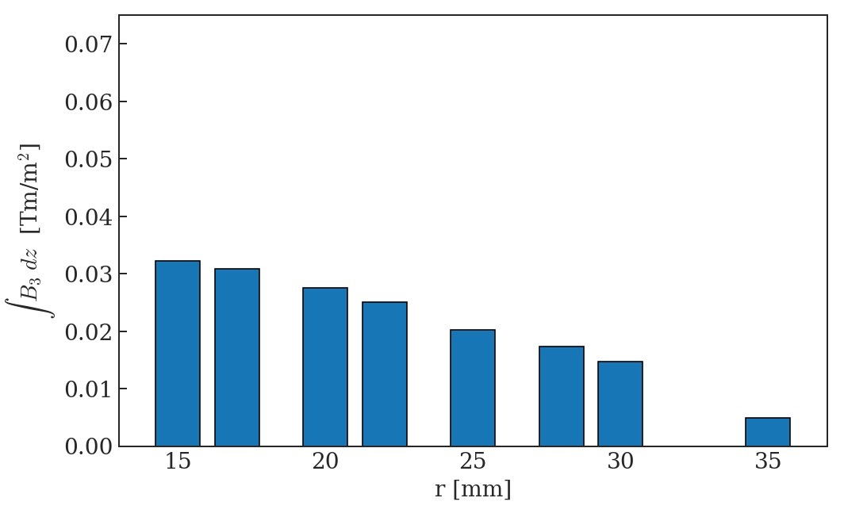
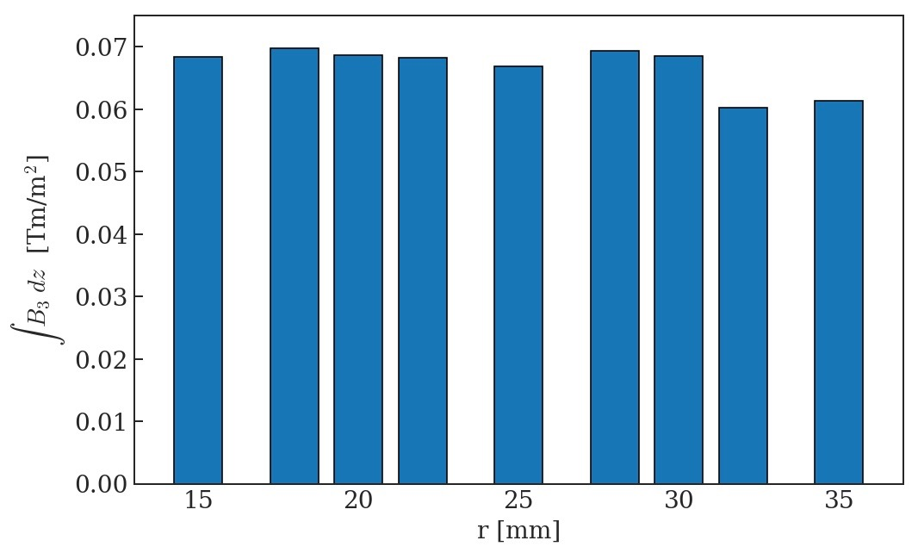
Magnetic model of the PS MUs
Harmonics computed around a certain reference radius
  Initial model didn’t show convergence, i.e. the resulting integrated harmonics were highly dependent on the reference radius
  Significantly improved convergence achieved by modifying the mesh and packing factor of the laminations
    Results basically independent of reference radius
Old model
New model

Slide 12
Outline
Motivation
Magnetic model of the PS main units
Optical model of the PS
Impact of the low-energy quadrupoles on the optics
Concluding remarks

Slide 13
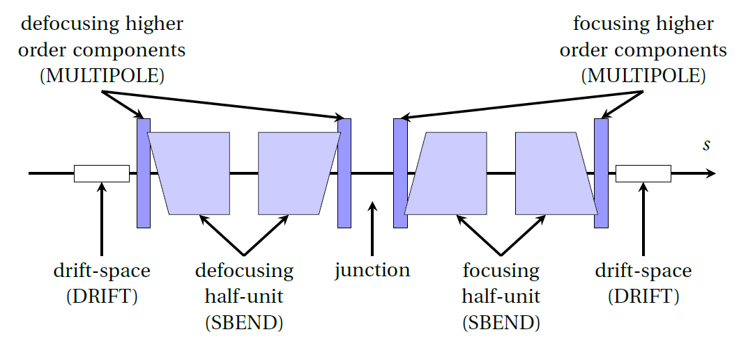
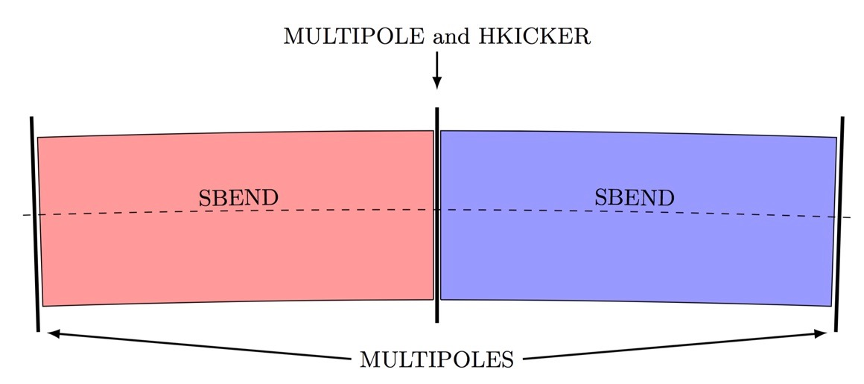
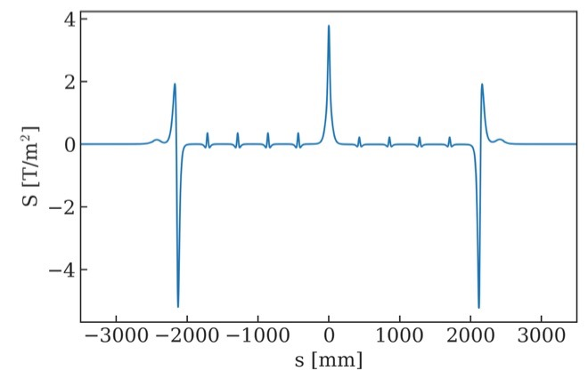
Optical model of the PS
MAD-X description of the PS MUs
  Description improved based on information from OPERA simulations
  Higher order components included by thin multipoles at the entry, exit and the central junction
  Additional modification to the lattice concerns the treatment of the effect of the PFW:
    Previously incorporated using the multipoles, their quadrupolar and sextupolar effect are now directly assigned to the SBENDs
    Only octupole (and higher order) components will still be included using the multipoles
  Saturation effects at high-energy are now also accounted for by distributing the bare-machine non-linearities between multipoles and SBENDs
Old model
New model

Slide 14
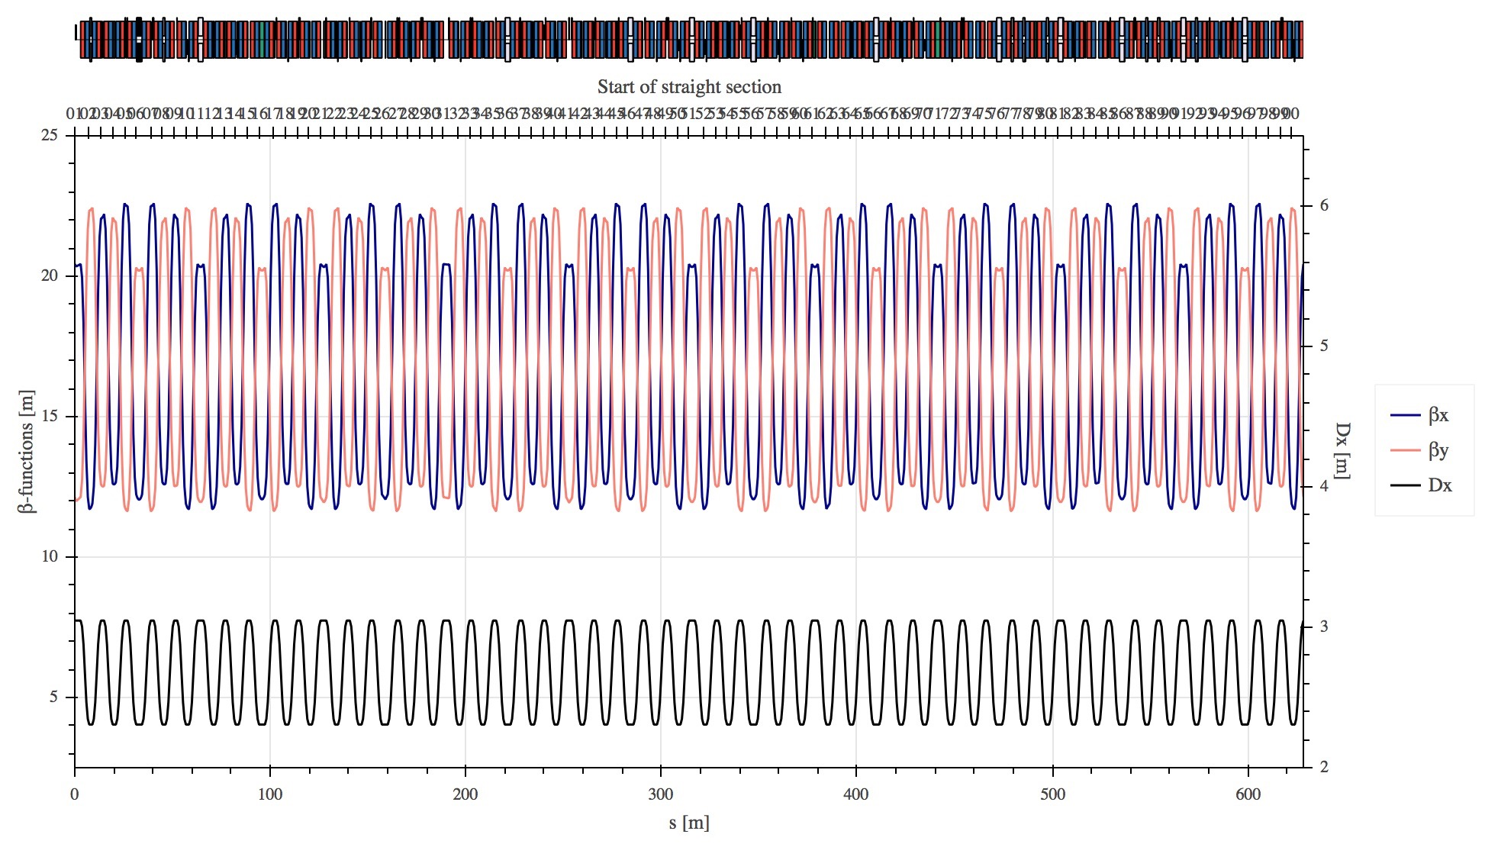
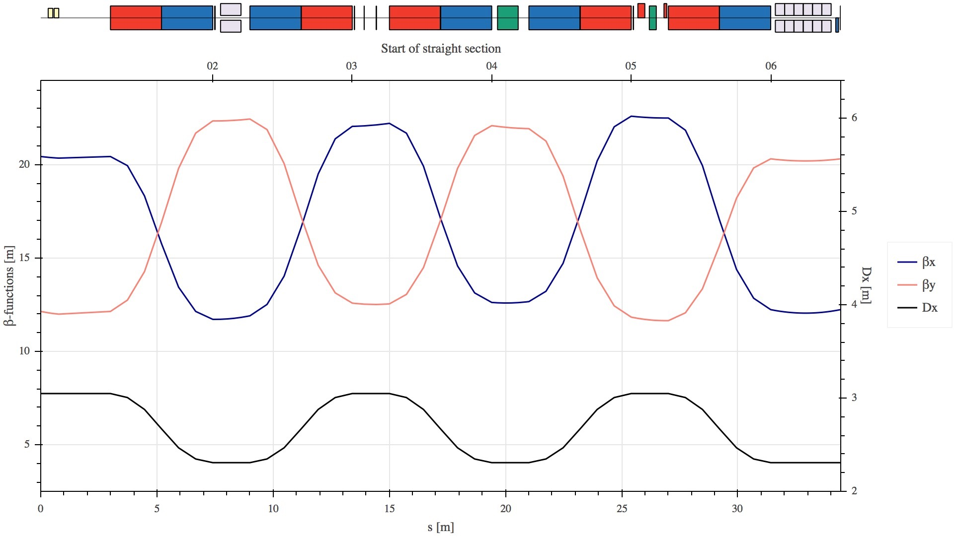
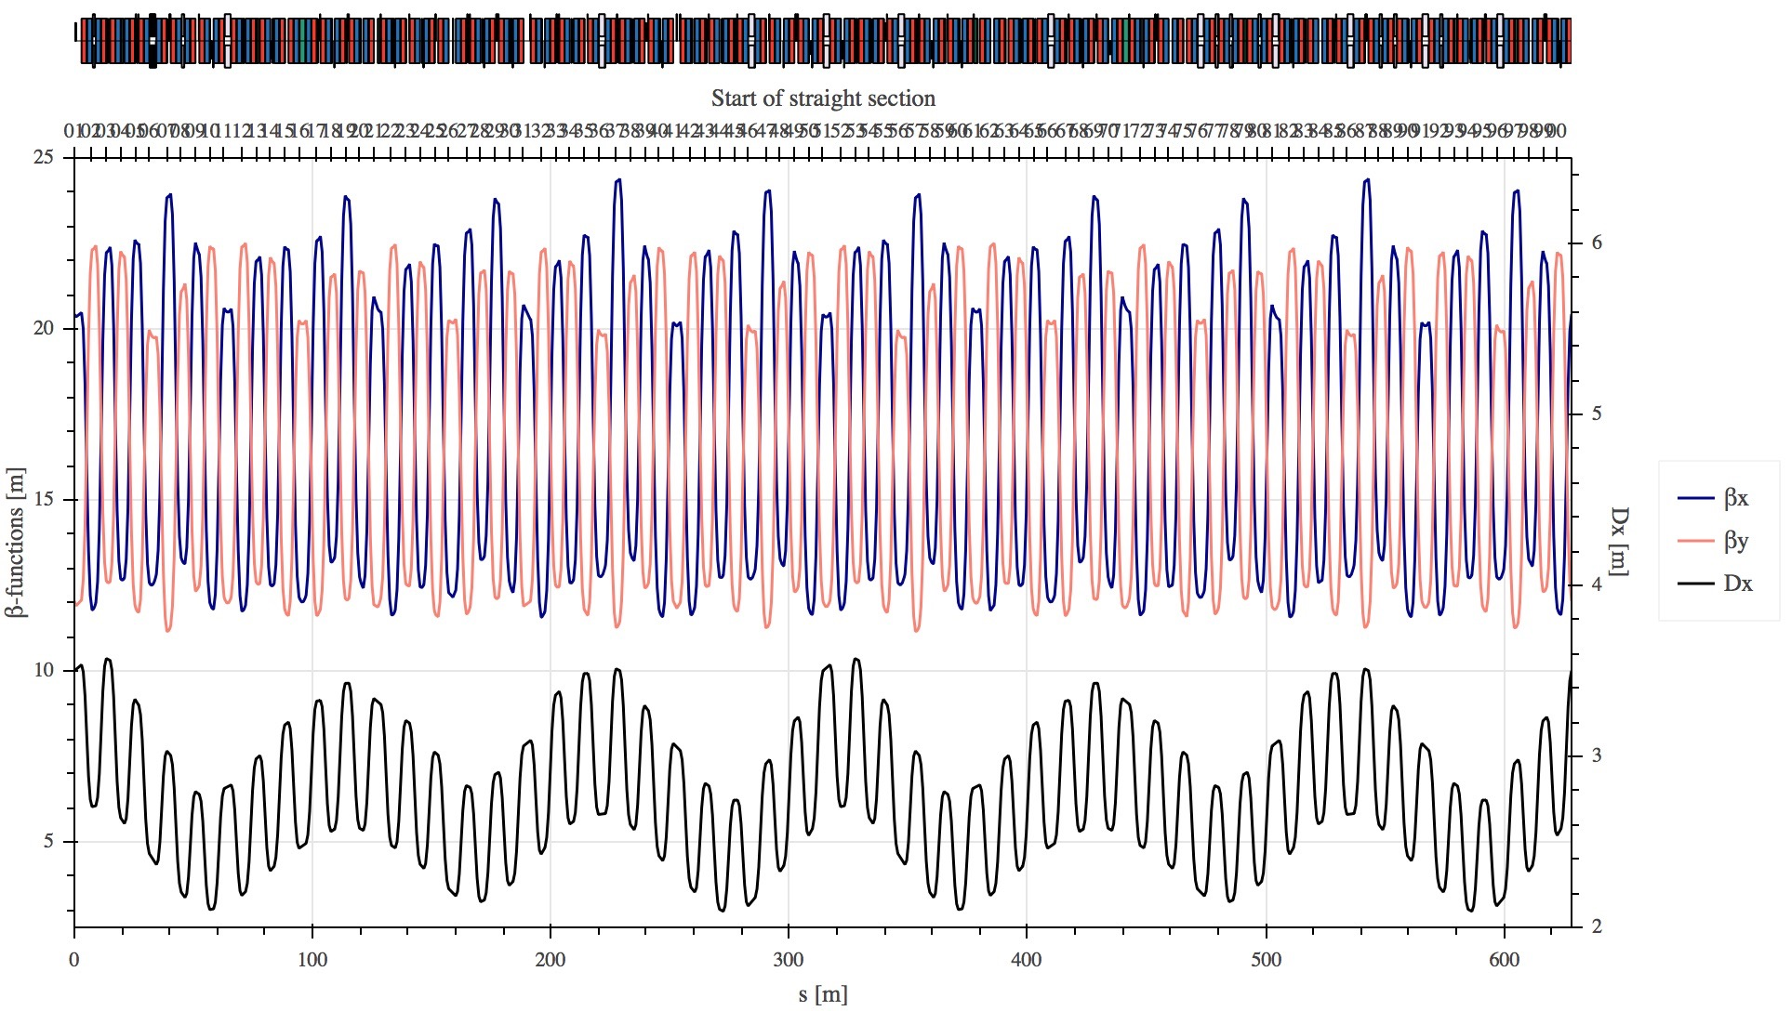
Optical model of the PS
Comparison of the optics between the old and new model
  Bare machine optics defined by the combined function magnets is very regular and quasi-independent of the model
  Use of the low-energy quadrupoles modulates the optics significantly (especially dispersion)

Slide 15
Optical model of the PS
Comparison of the optics between the old and new model
  Bare machine optics defined by the combined function magnets is very regular and quasi-independent of the model
  Use of the low-energy quadrupoles modulates the optics significantly (especially dispersion)
  Comparison between the two models at special working point (6.118, 6.225 → see Malte’s talk on Tuesday) reveals:
    Small impact on the beta-beating
    Important phase shift of the dispersion function observed
  Measurements after LS2 required for verification

Slide 16
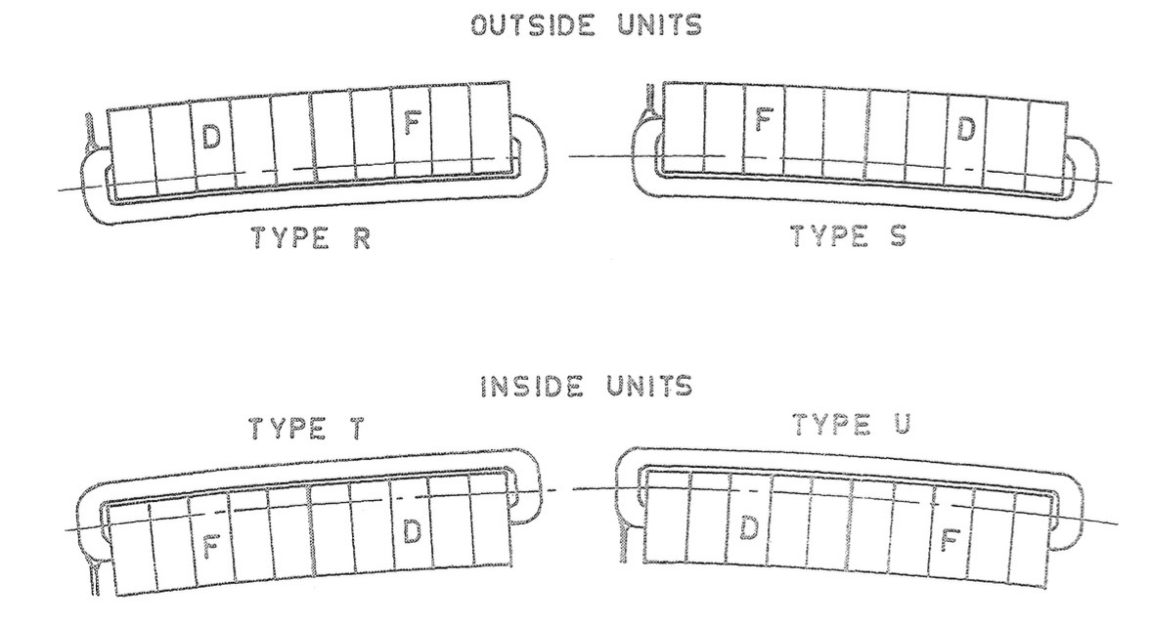
Optical model of the PS
Using the input from the magnetic model
  Small but nevertheless important difference on the quadrupolar component
  Important discrepancy on the sextupolar components
Potential explanations of the discrepancies
  Remanent fields in the MUs
  Magnetic model is actually straight → impact of the air wedges between the iron blocks?
  Actually 4 different PS MU types → symmetries to be implemented in the optical model
  Numerical effects, multipole conventions, …
 | Q_{x} | Q_{y} | Q_{x}’ | Q_{y}’
measurement | 6.245 | 6.284 | -5.35 | -7.16
PTC after Q-matching | 6.245 | 6.284 | -5.31 | -6.15
Input from magnetic model | 6.209 | 6.310 | -3.14 | -8.96
Difference [%] | 0.6 | 0.4 | 41.3 | 25.2

Slide 17
Outline
Motivation
Magnetic model of the PS main units
Optical model of the PS
Impact of the low-energy quadrupoles on the optics
Concluding remarks

Slide 18
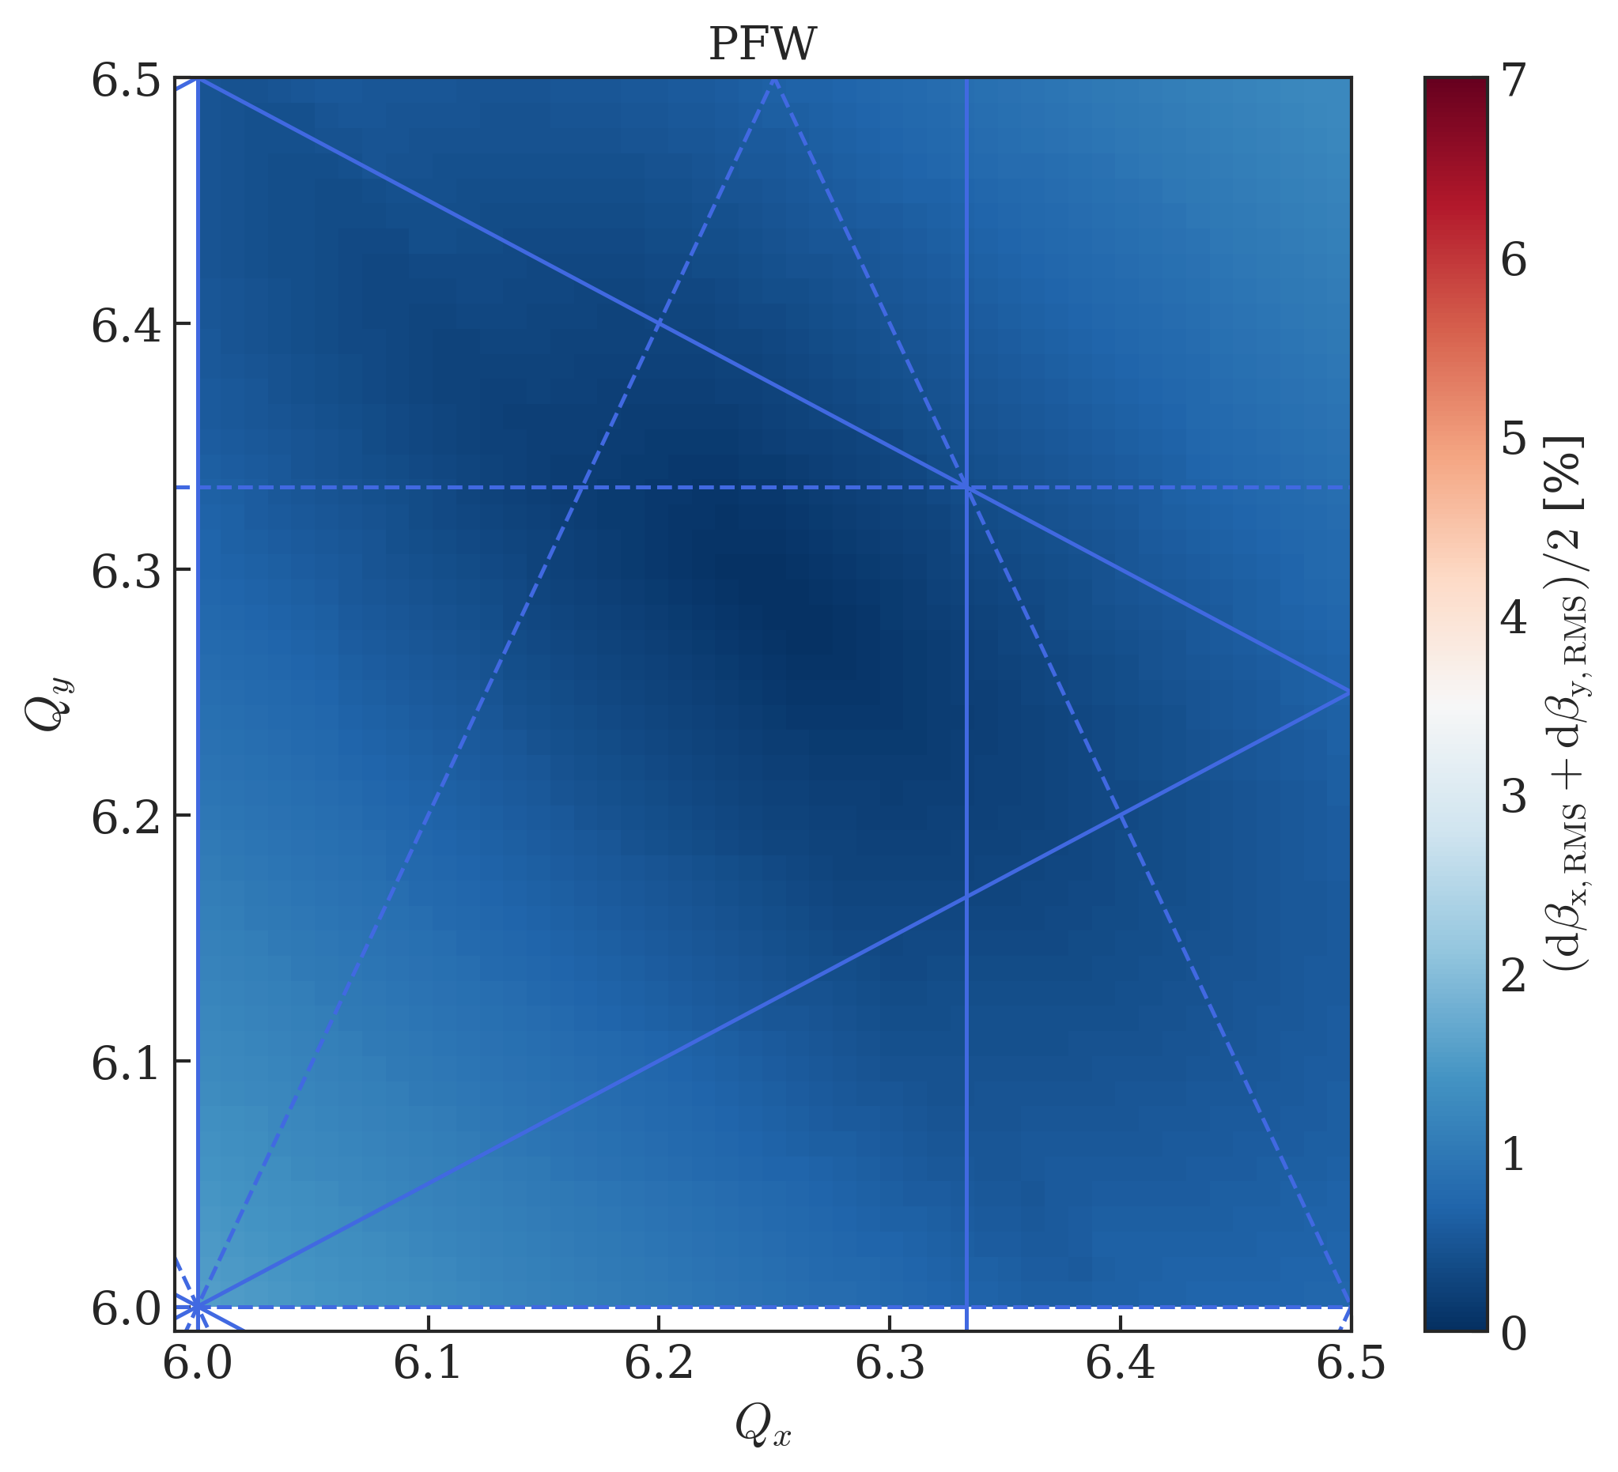
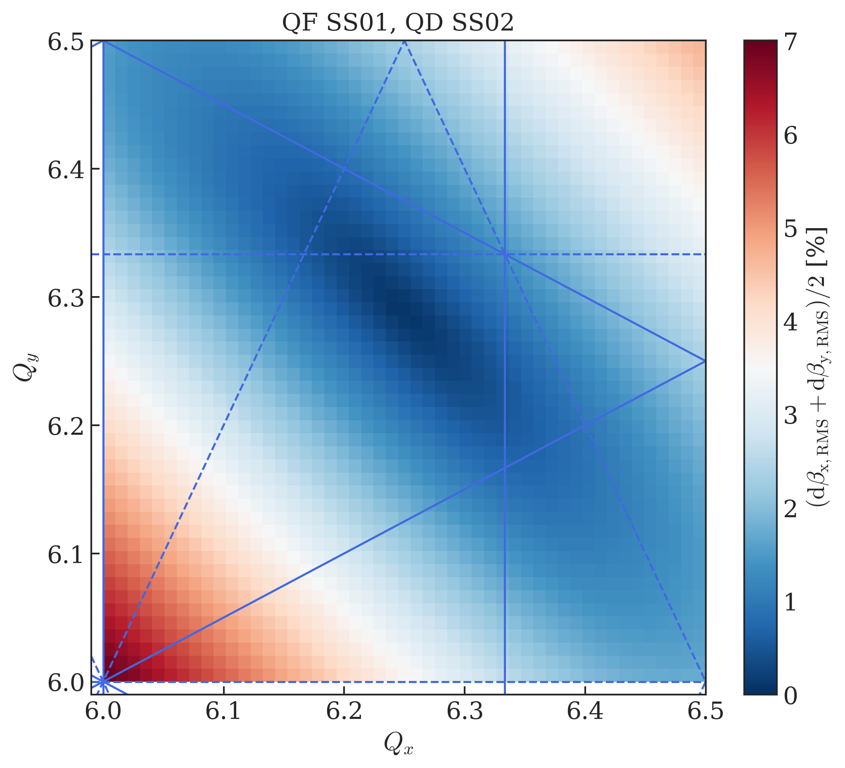
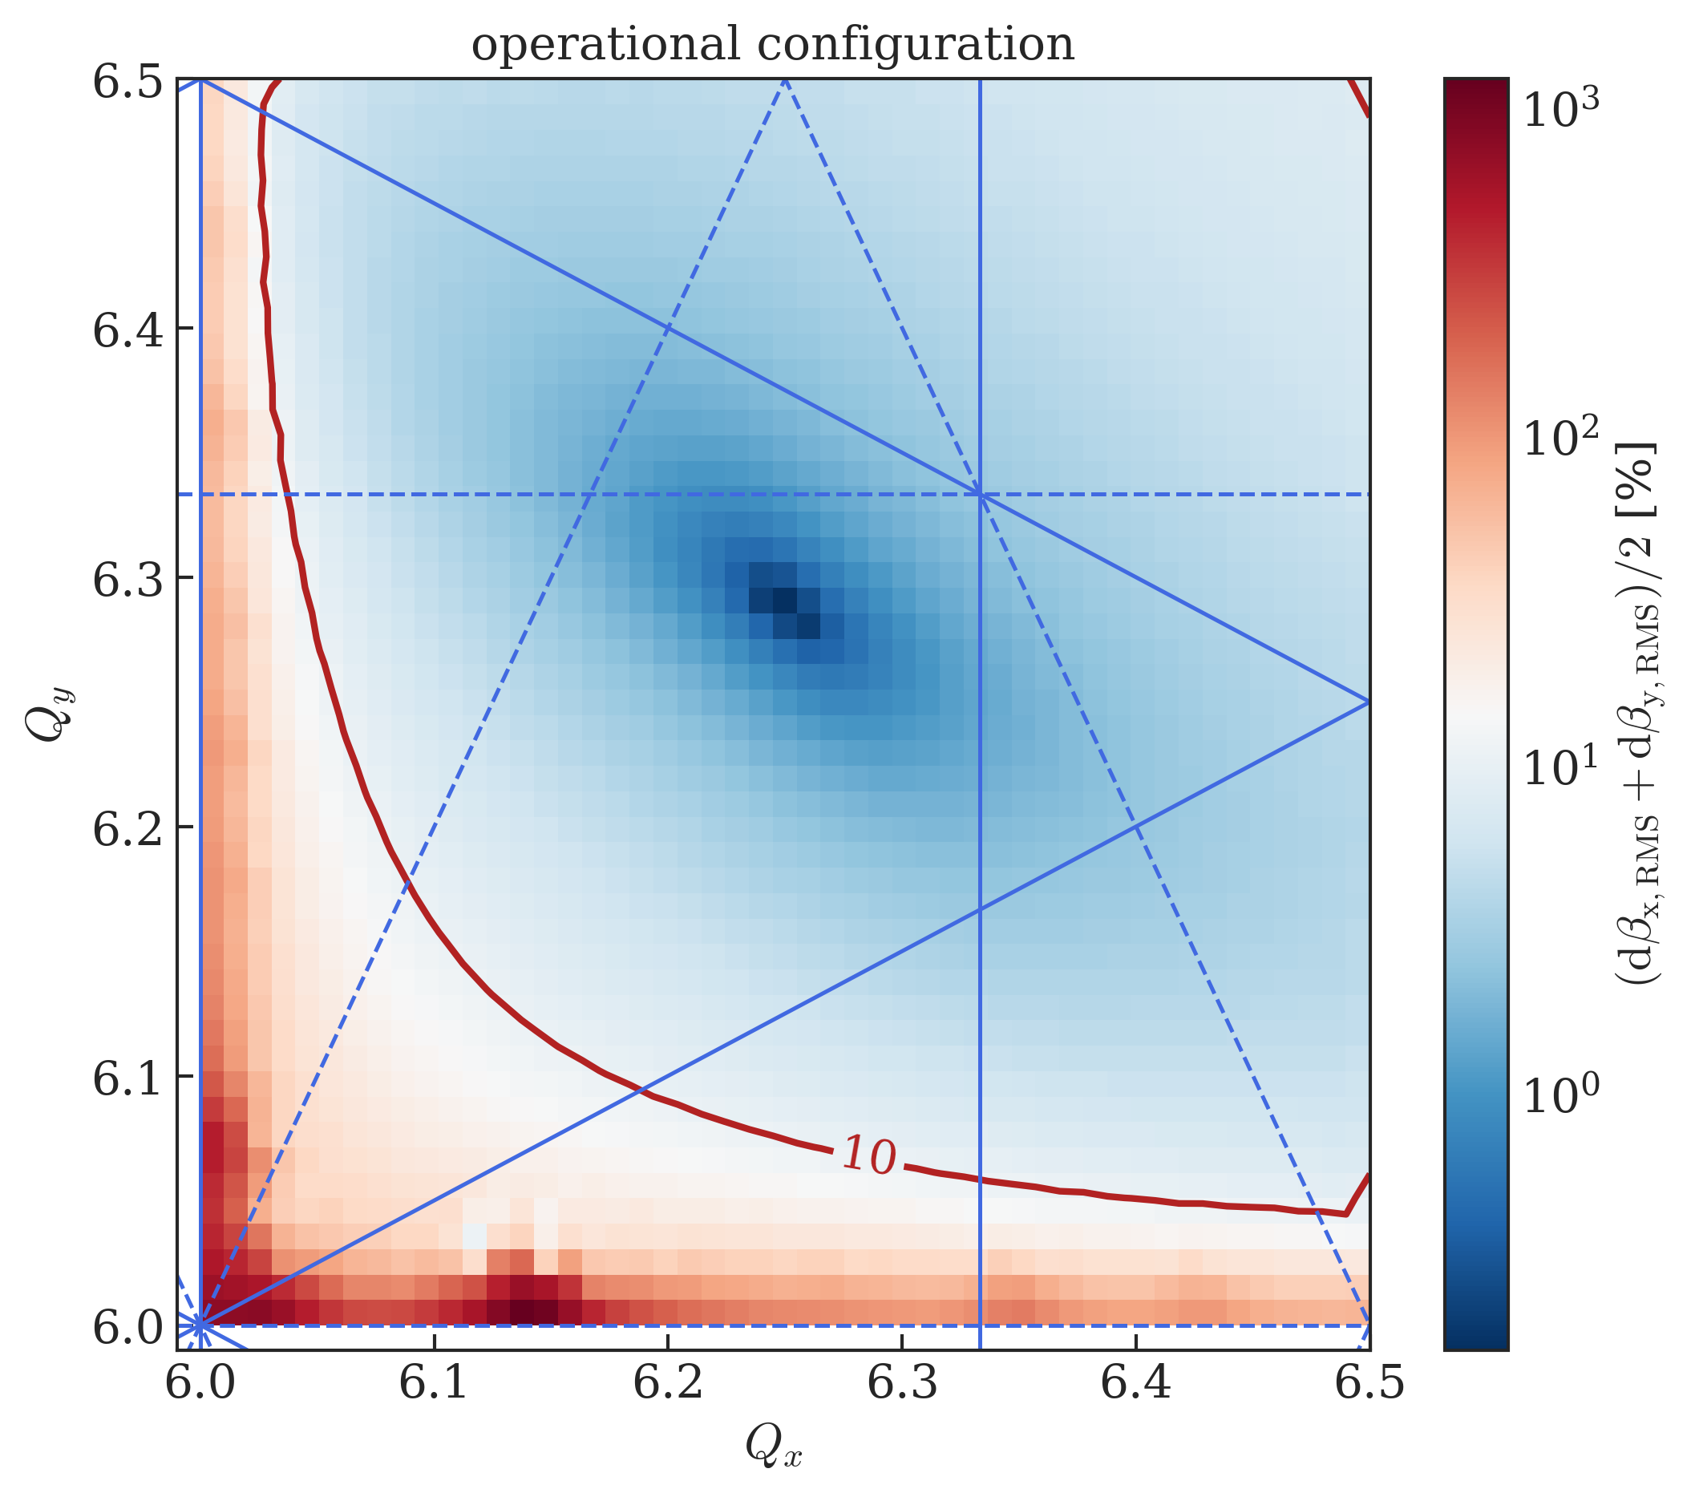
Impact of the low-energy quadrupoles on the optics
Operationally the low-energy quadrupoles
are used to adjust the tunes up to 3.5 GeV/c
  Installed at 40 different locations
  around the ring
  These locations do not follow any symmetry considerations
Significant distortion of the optics functions
  Plots show the RMS beta-beating wrt. the bare machine working
  point
  Operational configuration limits the achievable WP reach due to
  positioning of the quadrupoles
    See also talk by Haroon on Monday
  Intelligent placement of the quadrupoles reduces the beating
  sizably
  Beating basically absent when using the well-distributed PFW

Slide 19
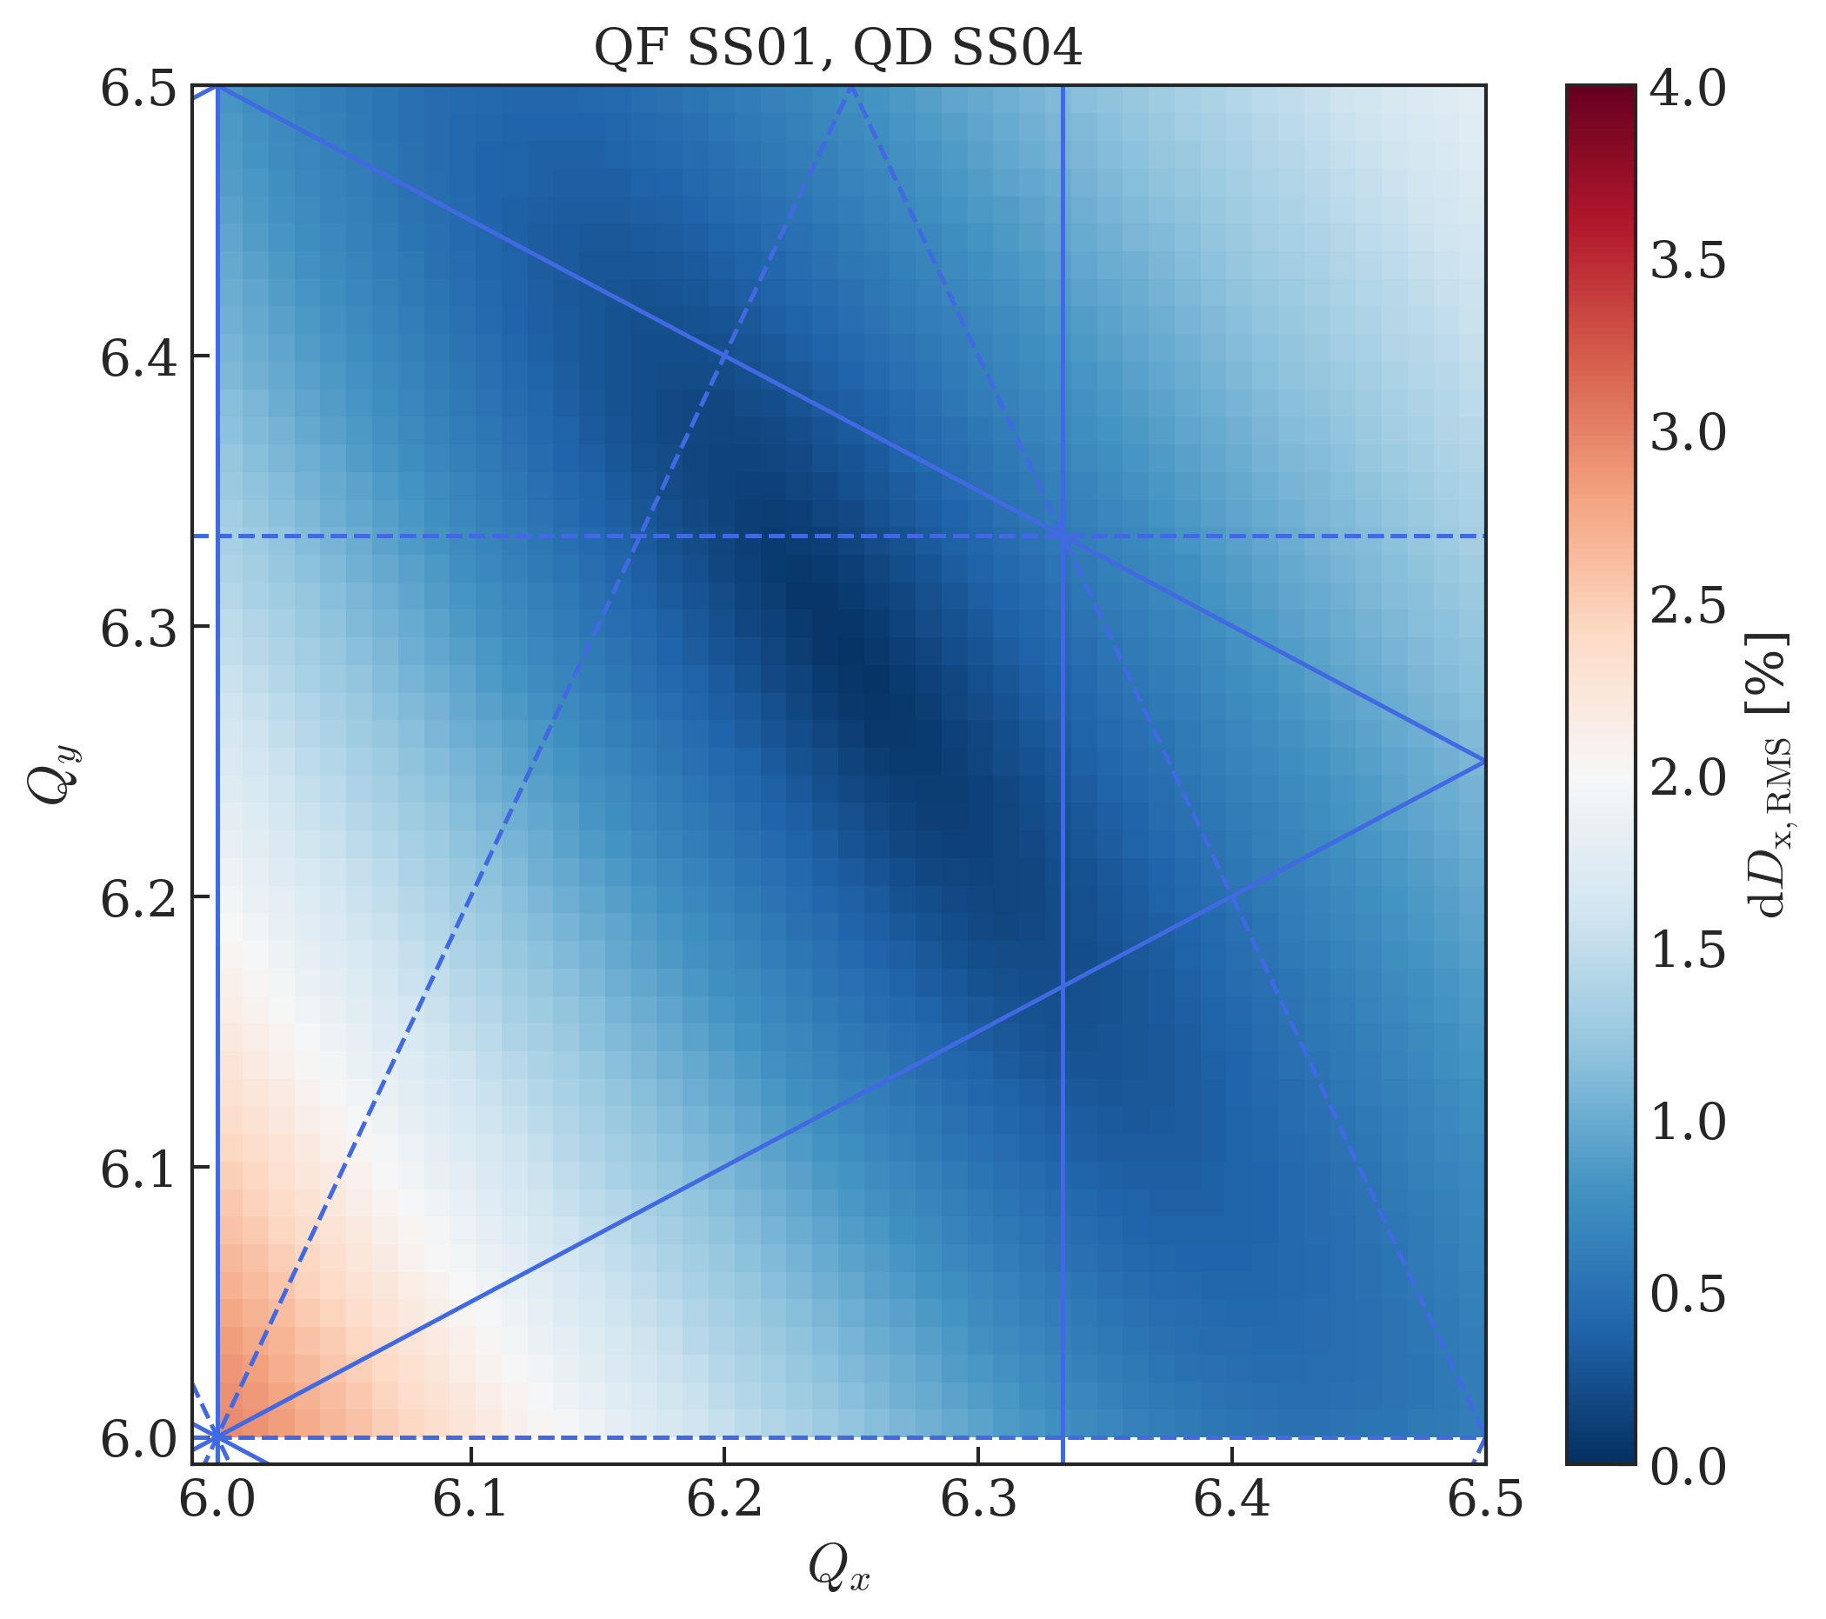
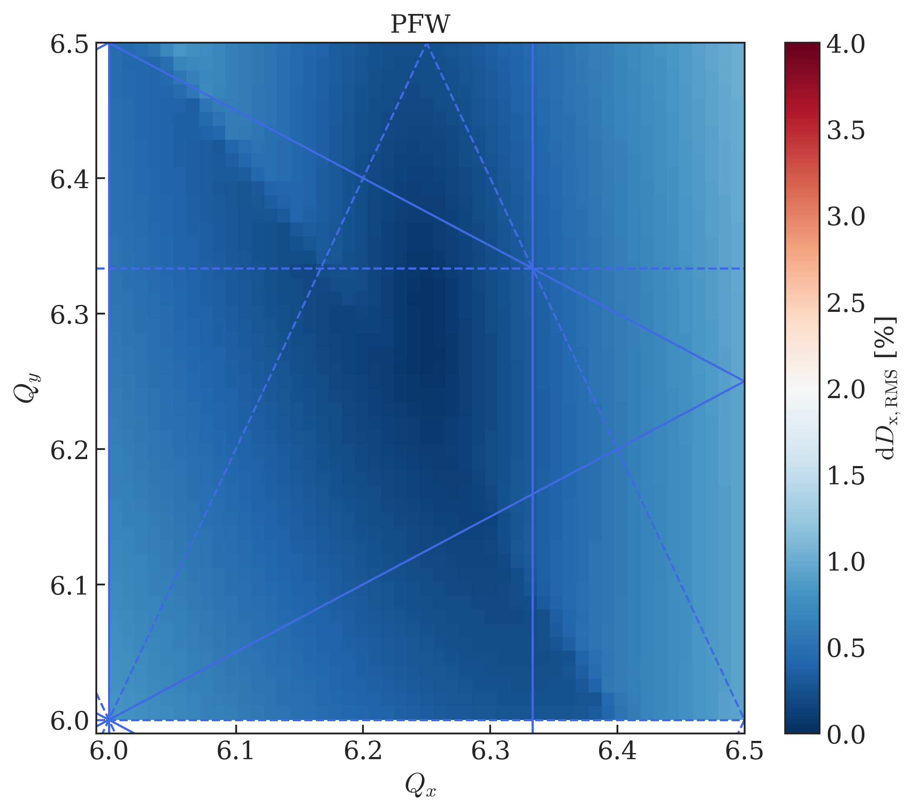
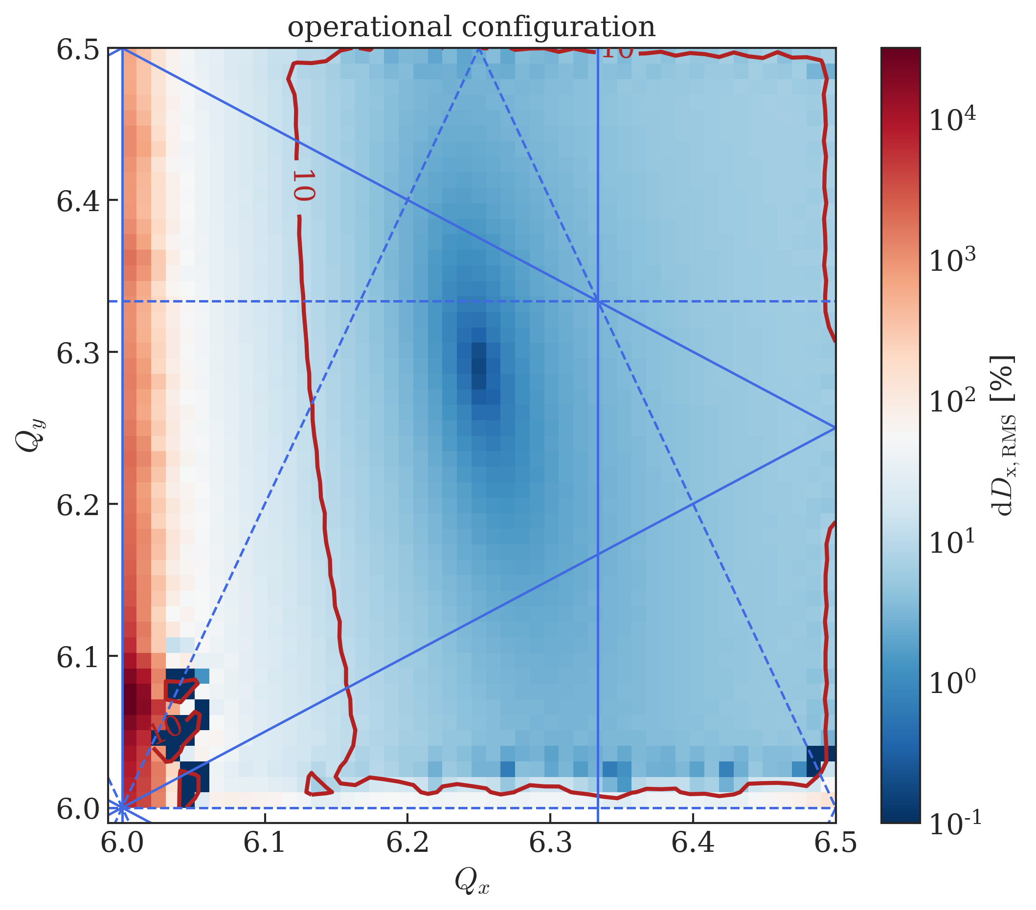
Impact of the low-energy quadrupoles on the optics
Significant distortion of the optics functions
  Plots show the RMS dispersion-beating wrt. the bare machine
  working point
Initially 50 well-distributed quadrupoles
  Removed over the years to make space for other equipment
Outlook: study optimized quadrupole placement
to minimize the beating and potentially emittance
growth/beam loss
  Or use PFW for tune control → excitation of non-linear
  components
    Impact on LHC beam quality on long flat bottom to be
    investigated

Slide 20
Outline
Motivation
Magnetic model of the PS main units
Optical model of the PS
Impact of the low-energy quadrupoles on the optics
Concluding remarks

Slide 21
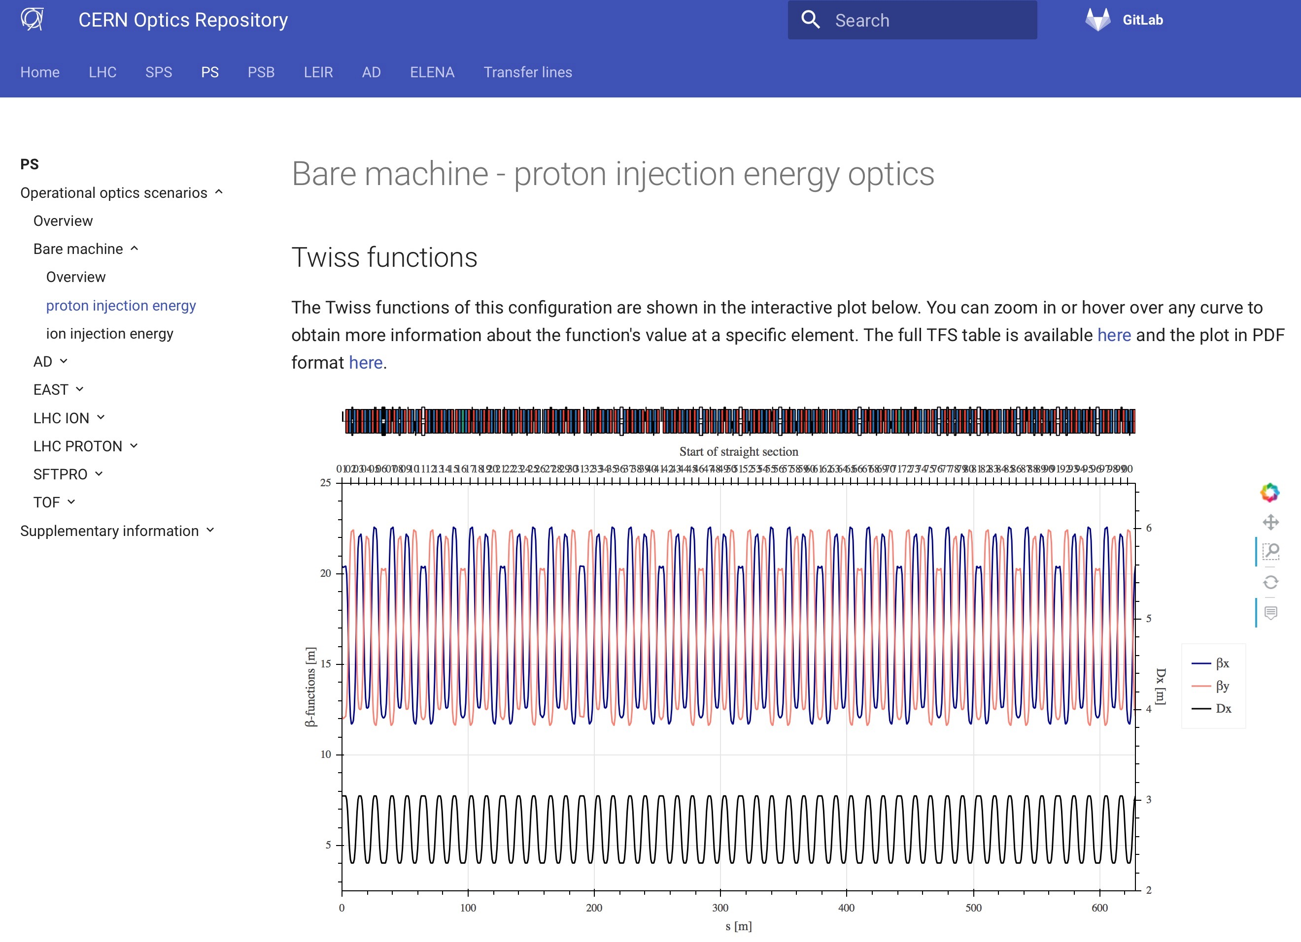
    The new CERN optics repository - http://acc-models.web.cern.ch
Information about the optics for the whole chain is centralized on a new webpage/repository
  For the moment up-to-date for LEIR, PSB and PS – other machines to come
  Central location for all optics models for the different accelerators to interface to the accelerator control system (LSA)

Slide 22
Concluding remarks
Recent improvements of the PS optics model based on progress with the magnetic model
  Collaboration with magnet experts provided new information about the distribution of non-linearities inside the MUs
  Using the input of the magnetic model for the optics model still leads to small discrepancies on the quadrupole and more pronounced discrepancies on the sextupole components
  Further work related to symmetries of the four different MU types, bent model, contribution of remnant fields, field errors due to mechanical properties, ...
Simulations revealed large beta-beating induced by the low-energy quadrupoles
  Improved placement scheme to be identified
New PS optics model established for all different beam configurations
  Input from 2018 reference measurement campaign
  Available on a new web-repository, also for the other machines of the complex

Slide 23
Questions
Experience with modelling of complex magnetic structures and linking them to an optics model?
Experience with predicting magnet settings based on magnetic models for operational machines (i.e. without proper knowledge on the field errors)?
Is there an analytical way to transform the field from a straight model to a bent one?

Slide 24
Backup slides

Slide 25
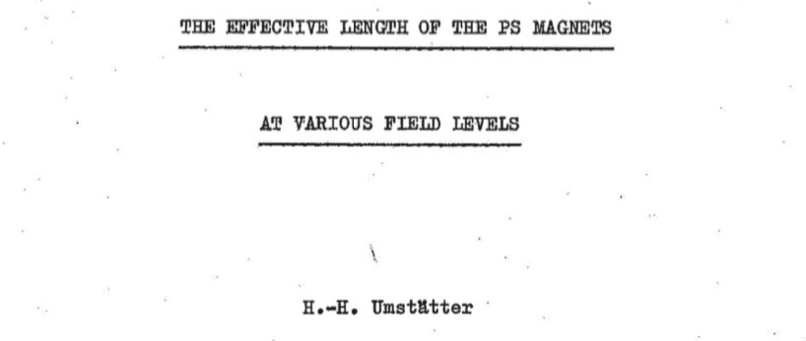



Layout of the PS lattice
Revision of the SS and MU definitions
  In 1972 H. Umstätter nicely described the nominal PS layout in the following document (EDMS2026379)
  Nominal circumference:
    Including 20 SSs with a length of 3.0 m and 80 SSs with 1.6 m
    (188.0 m in total)
    This leads to a magnetic length of each MU of
    And a bending radius of

Slide 26
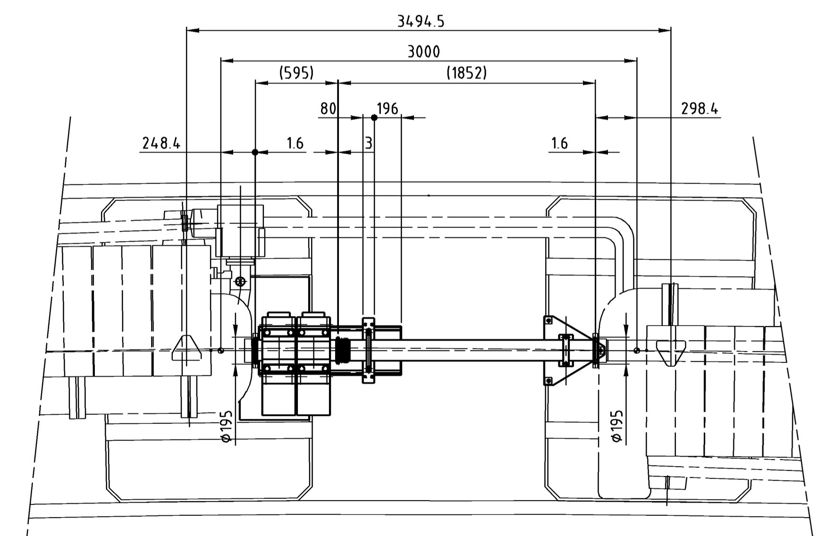
Layout of the PS lattice
Previous PS sequence description considered SSs to extend from flange to flange
  Resulting in 20 long SSs of 2.4 m and 80 short SSs of 1.0 m
  Low-energy quads (LEQ) and BPMs were therefore allocated to the MUs as they are mounted in the drift space between the main coils
  In view of extracting the sequence from LDB this had to be corrected

Slide 27
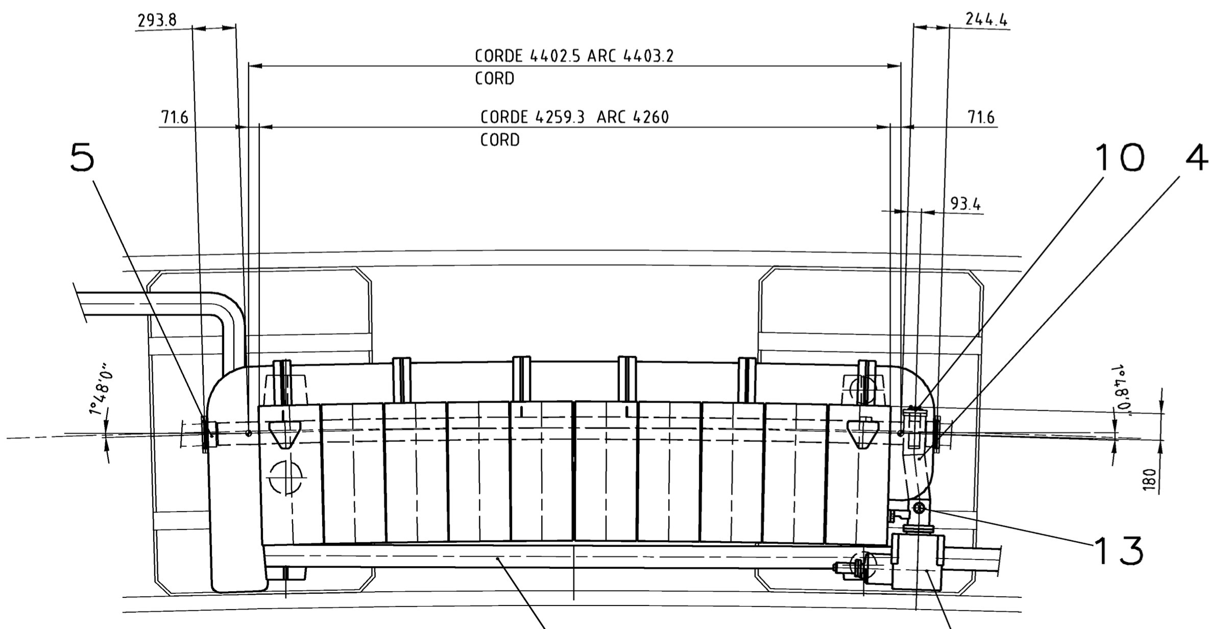
Layout of the PS lattice
Definition of SSs and MUs has been updated to adhere to this definitions
  Collaboration with Tom (EN-ACE) to update the LDB accordingly
  Length of MUs is defined as their magnetic length as indicated by the two reference points on the drawings
    The full MU assembly length is therefore composed of the lengths of the iron blocks, the central and the mini junctions and a correction length between end of the iron and magnetic length reference point
Example of SS01 and MU01

Slide 28
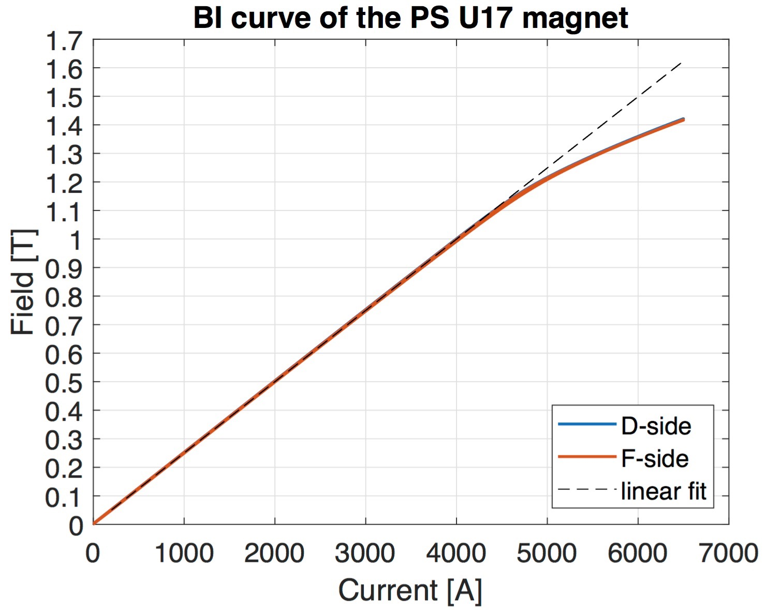
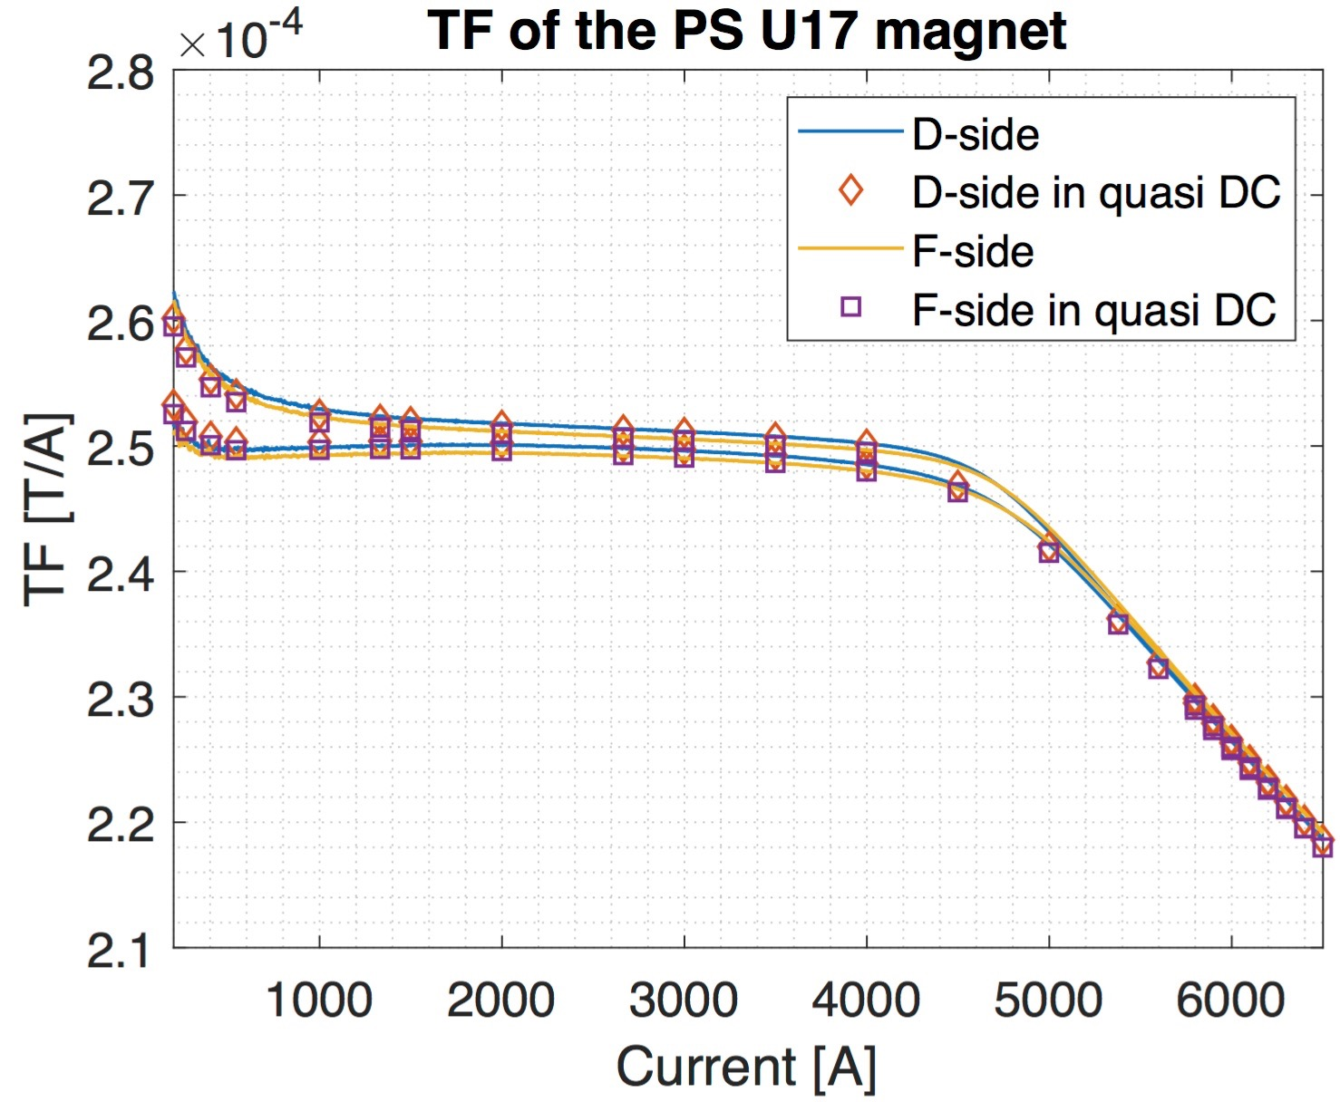
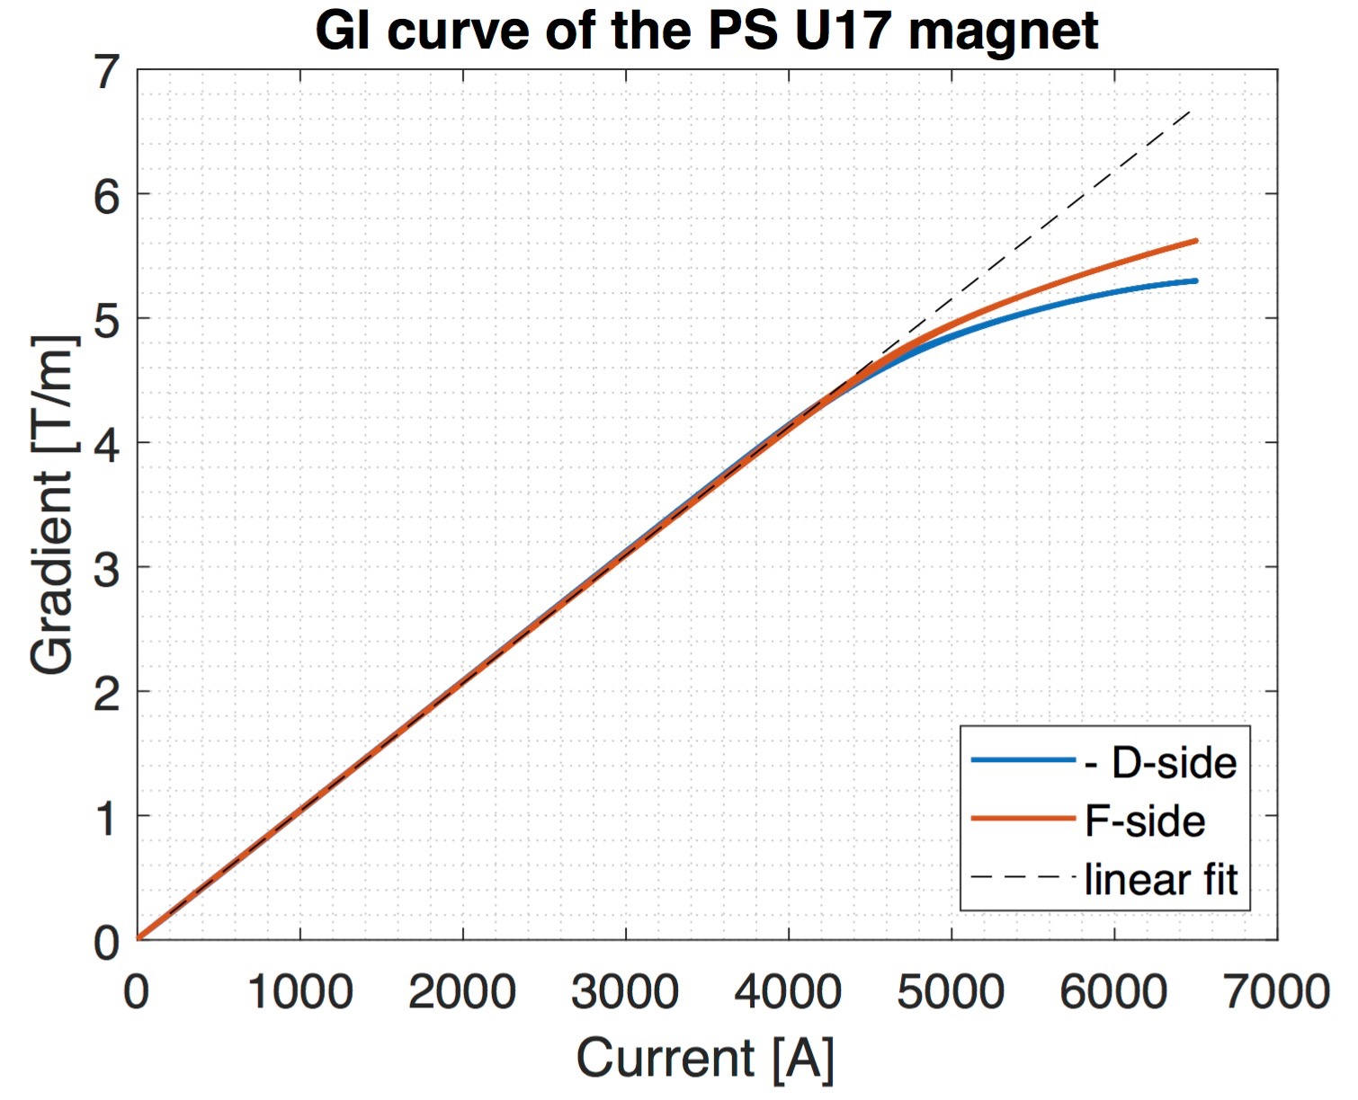
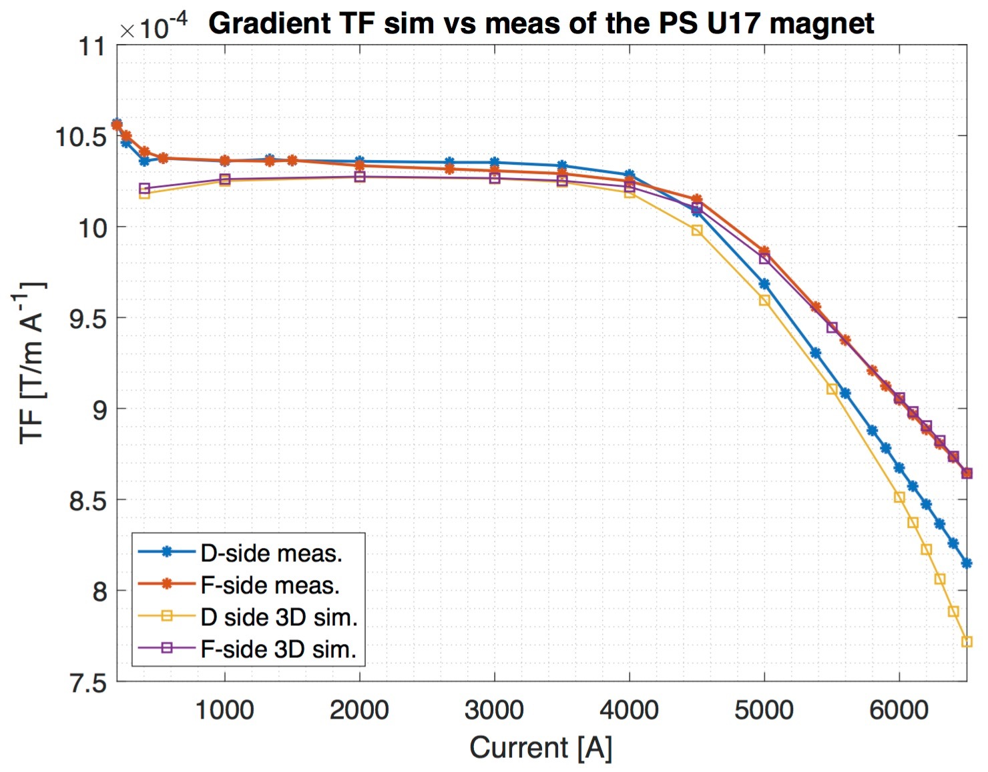
Magnetic measurements of the PS MUs

Slide 29
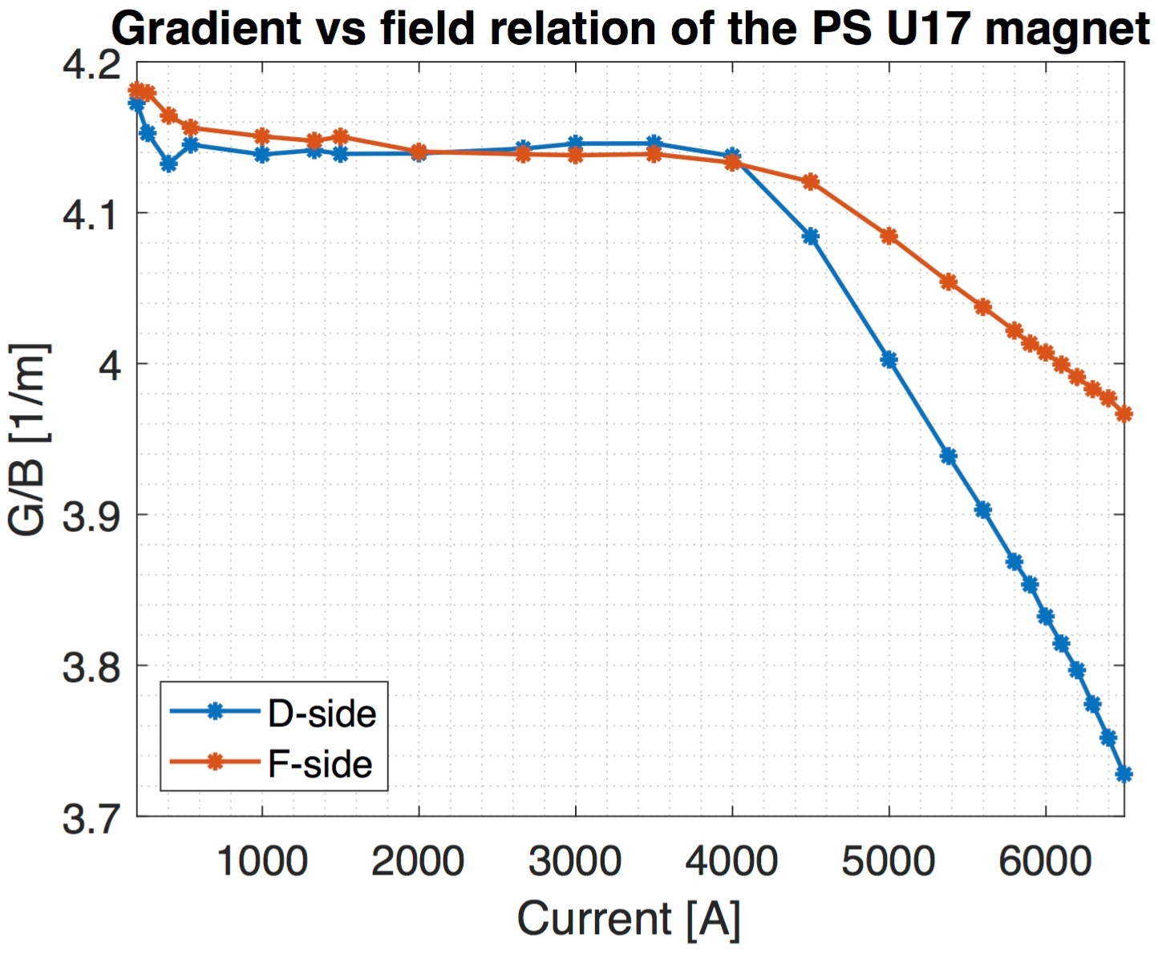
Magnetic measurements of the PS MUs

Slide 30
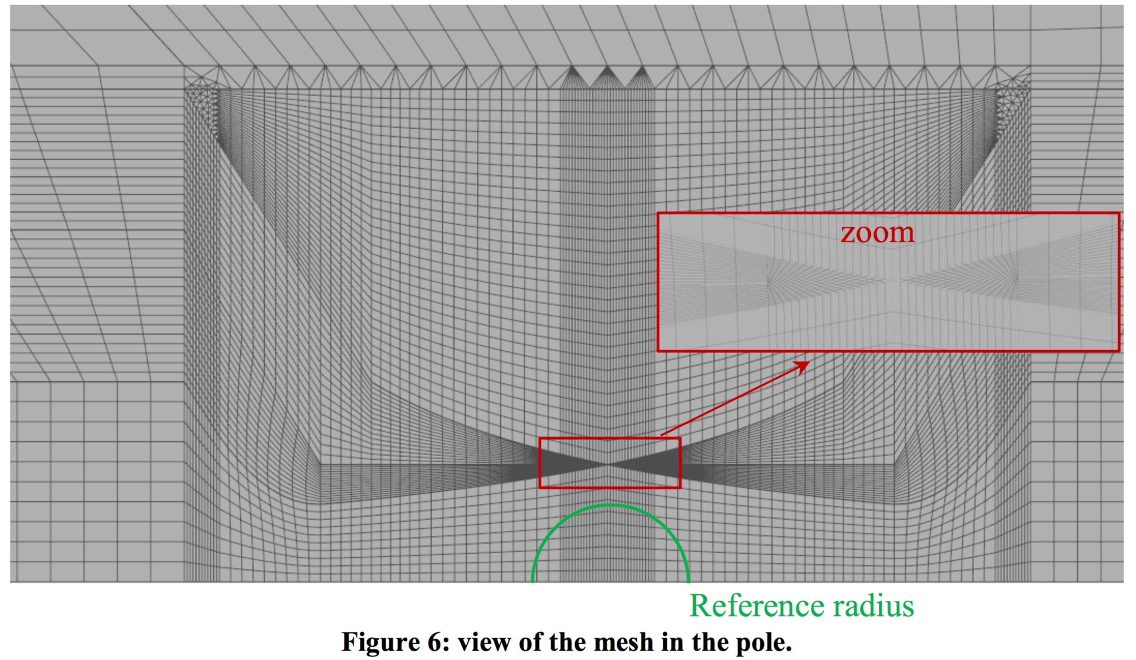
Meshing in the OPERA model

Slide 31
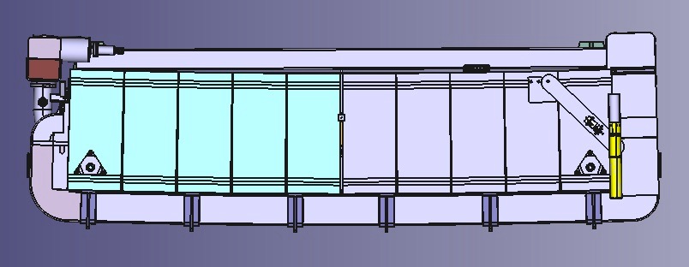
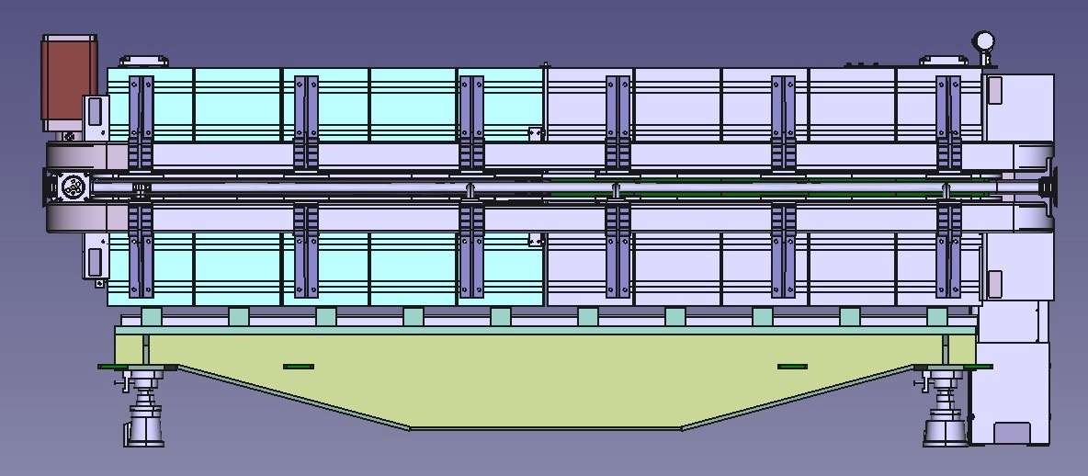
The PS MUs

