Slide 1


Work in progress
June 2019
J. Boumaaza
Supervising professor: Y. Tayalati
Mohammed V University, Rabat, Morocco
Notes:
CNRST
Innova Qualité International

Slide 2
Room renovation
Most of the renovation work is done

Slide 3
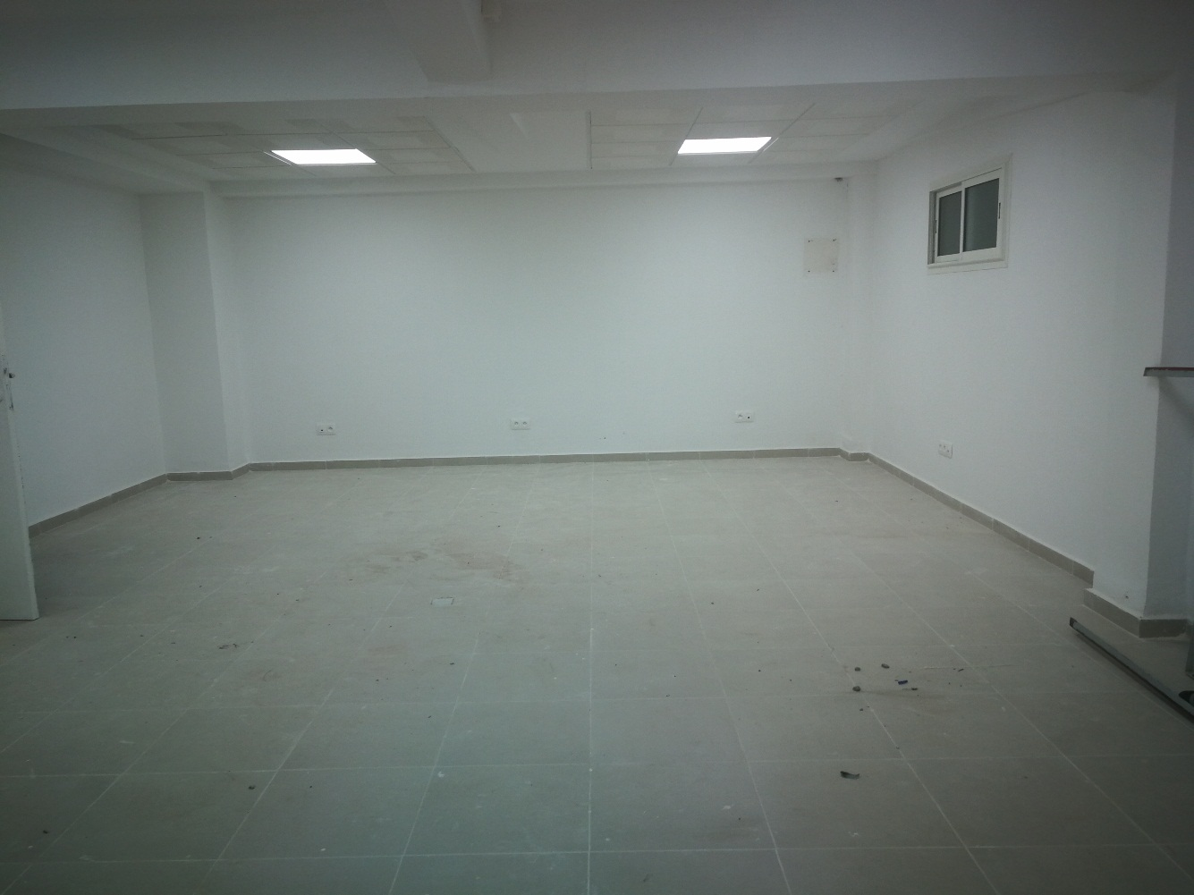
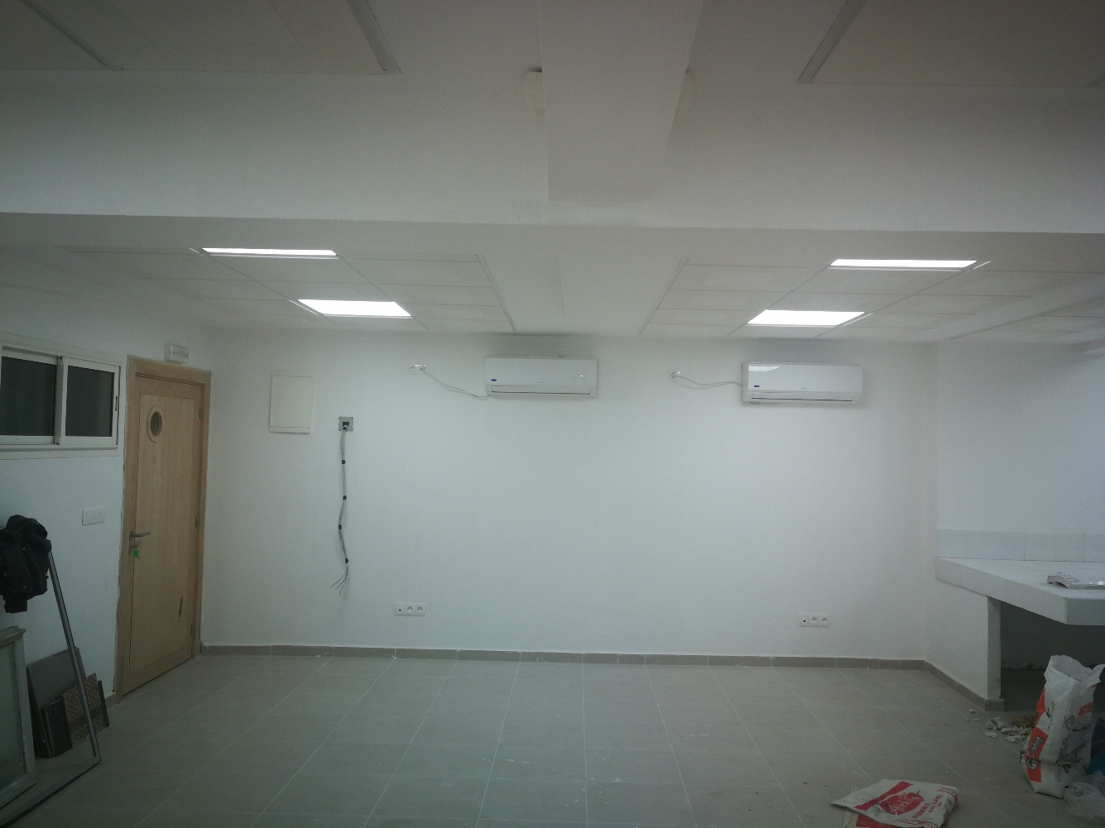
Room renovation

Slide 4
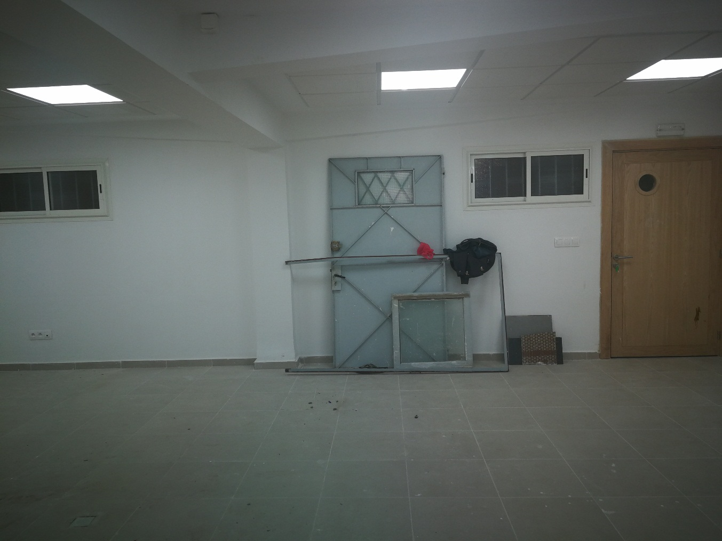
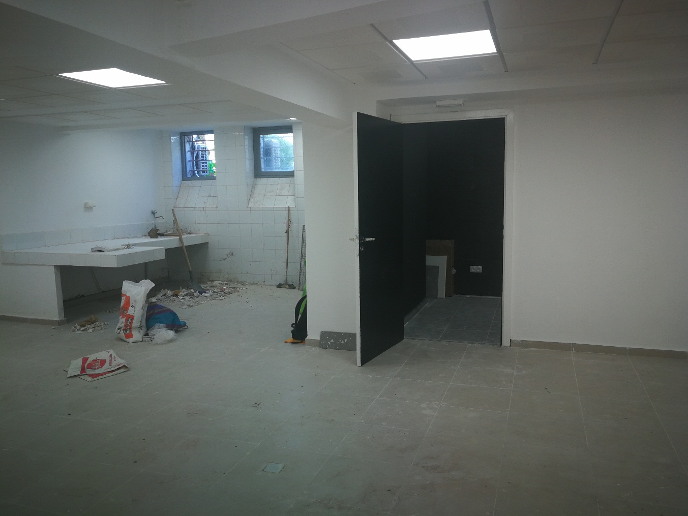
Room renovation

Slide 5
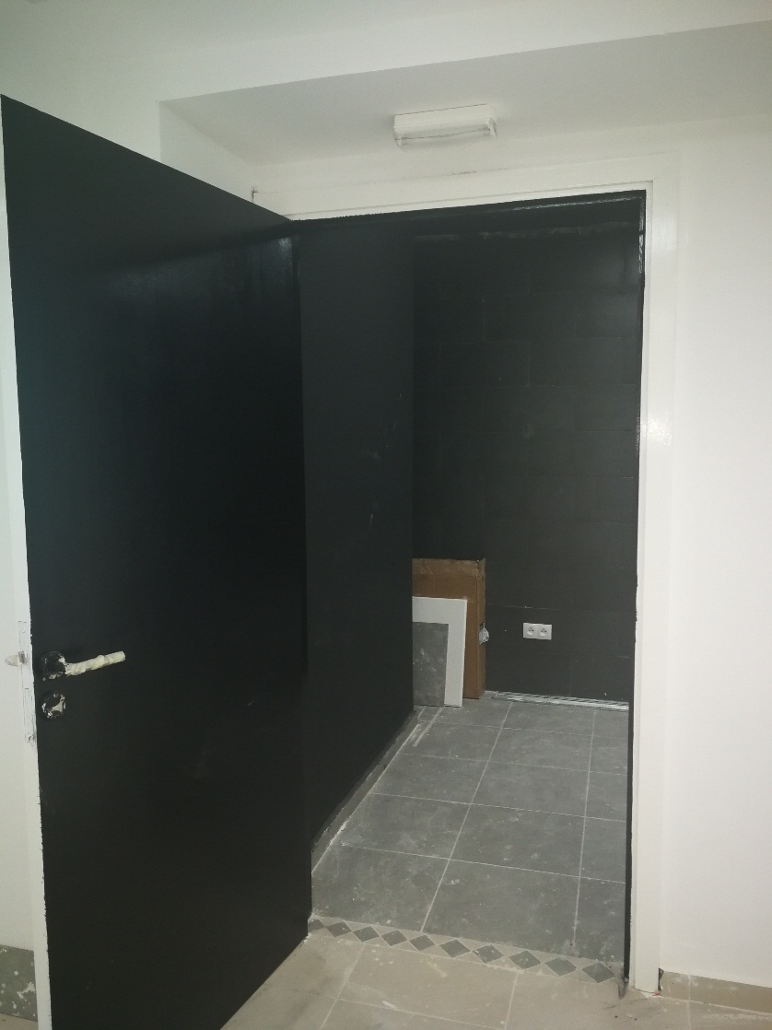
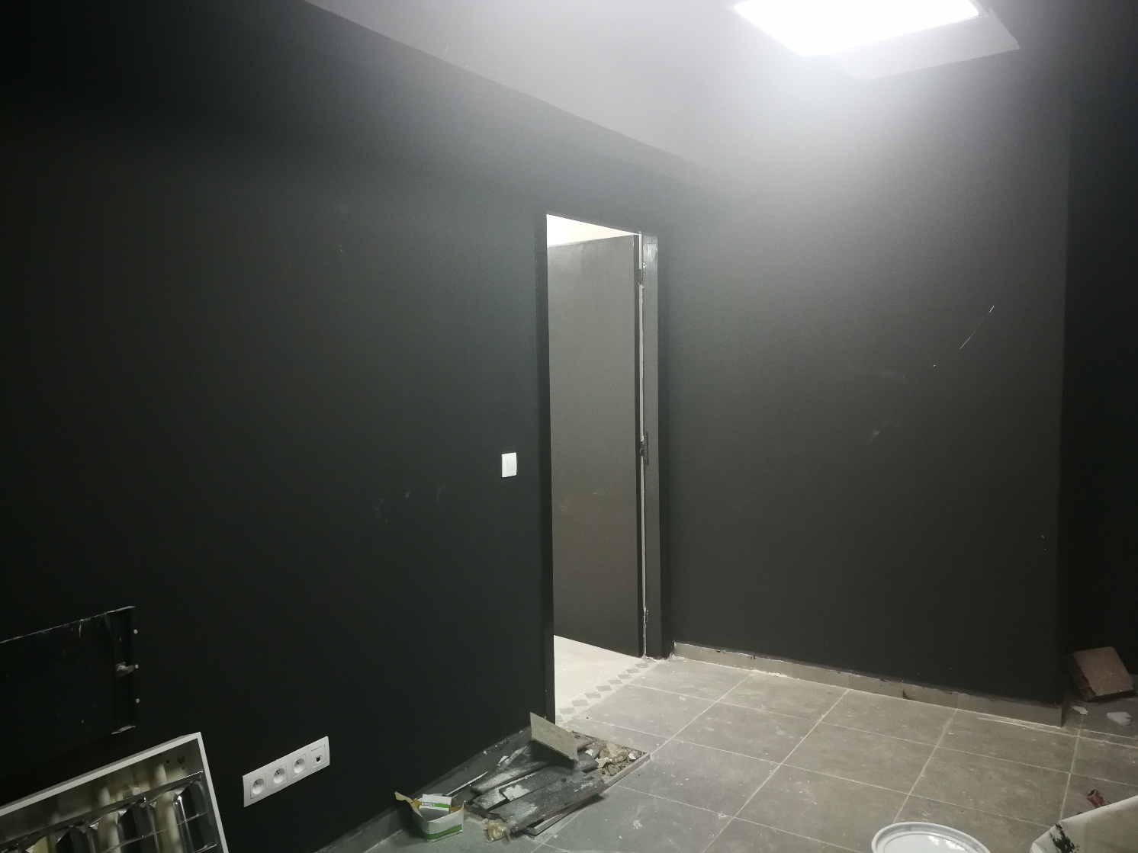
Room renovation

Slide 6
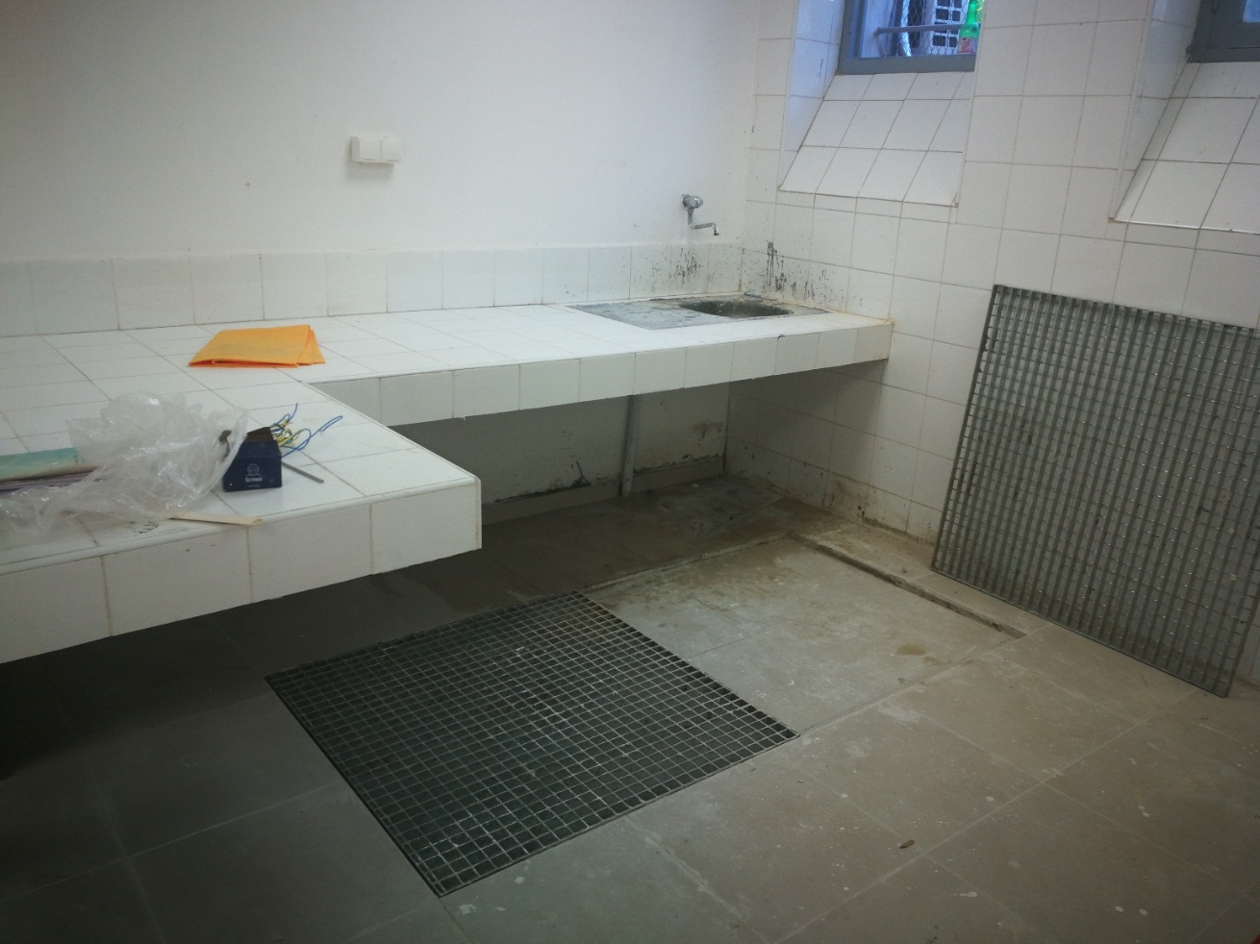
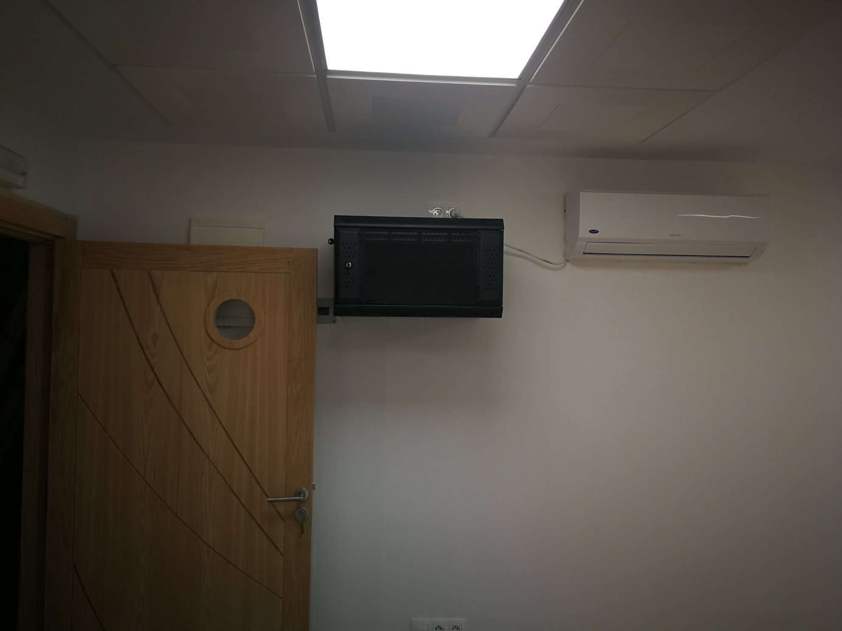
Room renovation

Slide 7
Introduction
The production includes magnetic monopoles, atmospheric muons and neutrinos (latest MC production)
The simulation based on KYG of magnetic monopoles has been performed, for β = 1.
Data collected by the ANTARES telescope up to 2017 has been used (~2507 days).
.
The plot of tχ² and Nhit does not show a good agreement between Data (0 runs) and MC (mupage).
Simulation of magnetic monopoles and reconstruction of MC for β free are ongoing.
1

Slide 8
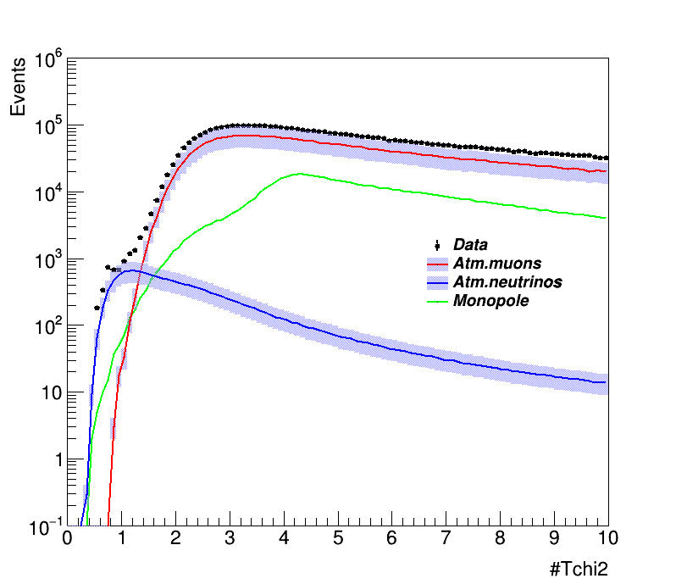
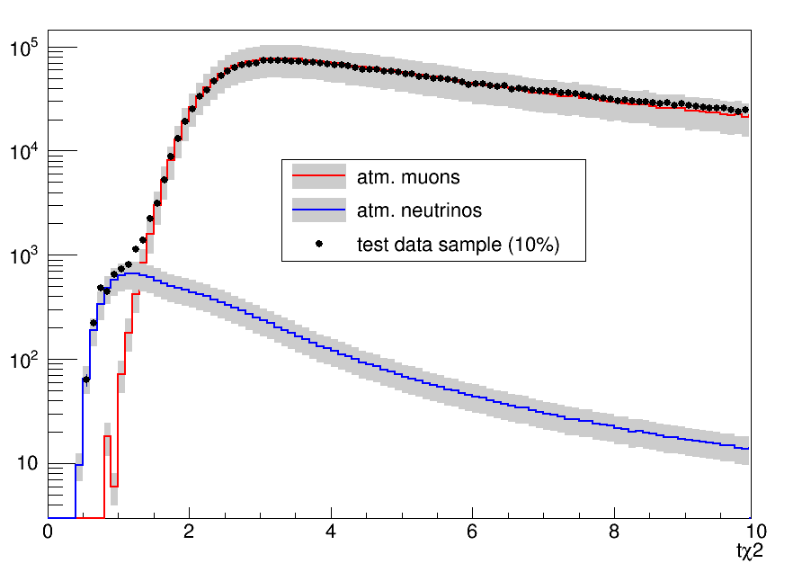
Agreement plots
tχ2 : Quality of reconstruction
Data up to 2016 is considered (~1802 days)
Mupage V03
Data up to 2017 is considered (~2507 days)
Mupage V04
2

Slide 9
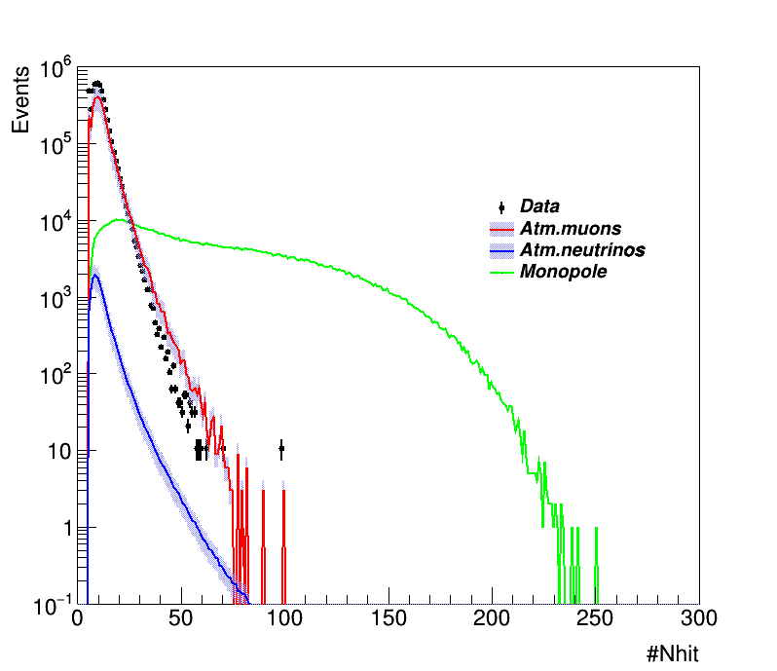
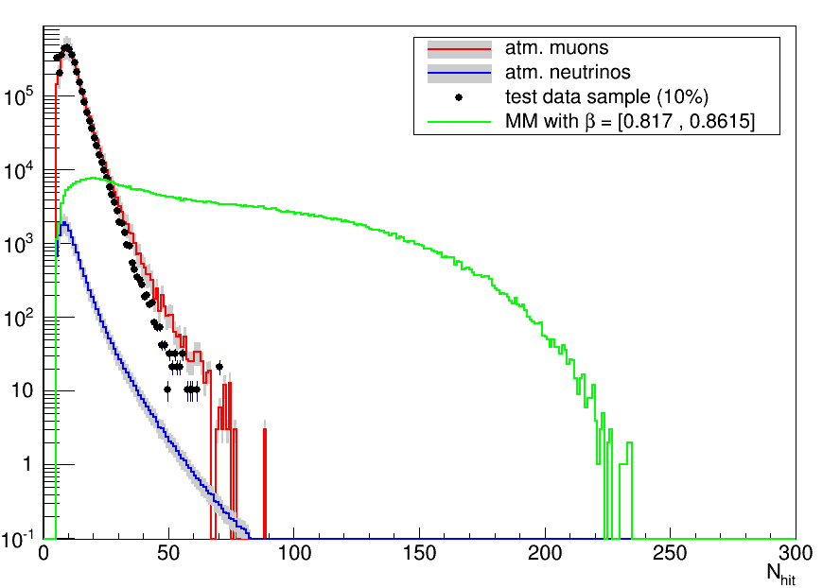
Agreement plots
Nhit : Number of floors with the chosen track hits
Data up to 2016 is considered (~1802 days)
Mupage V03
Data up to 2017 is considered (~2507 days)
Mupage V04
3

Slide 10
Investigation
To see the agreement, we proposed to plot Data 0runs vs MC (mupage V4) for the runs up to 2015 (run 79222) and for runs from 2015 to 2017 (79222 to 85683).
4

Slide 11
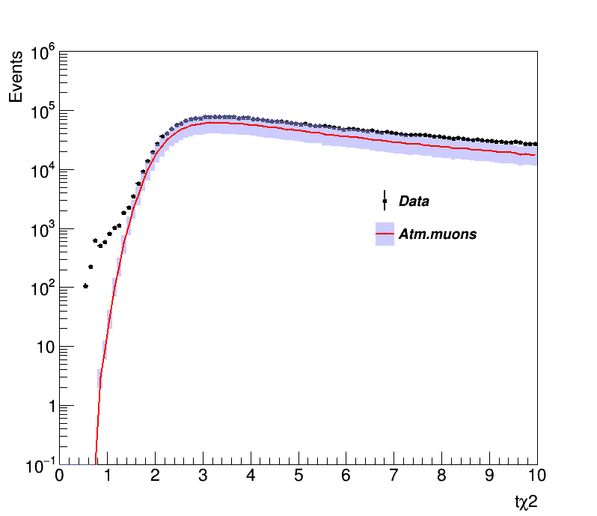
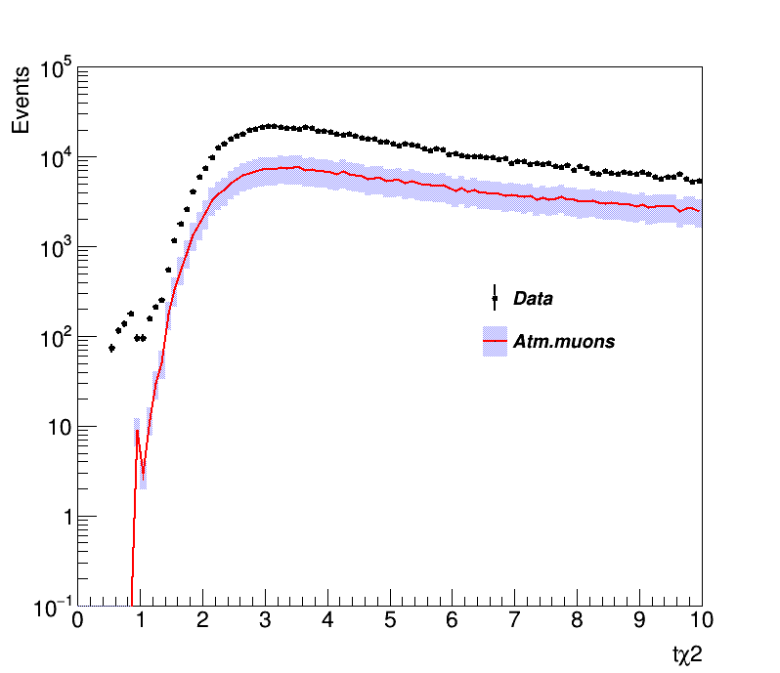
Agreement plots
tχ2 : Quality of reconstruction
Data up to 2015 is considered
Final run 79222
Data between 2015 and 2017is considered
Runs between 79222 and 85683
5

Slide 12
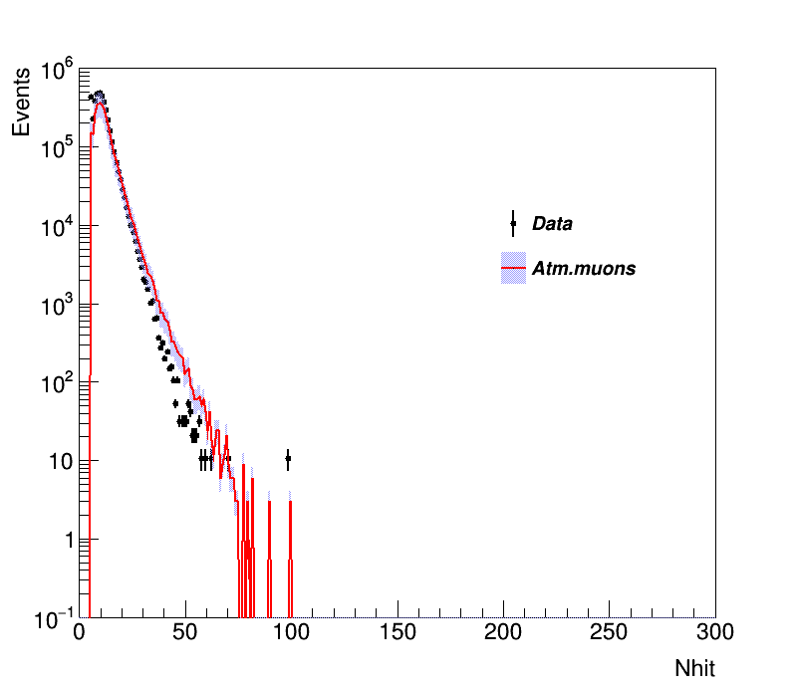
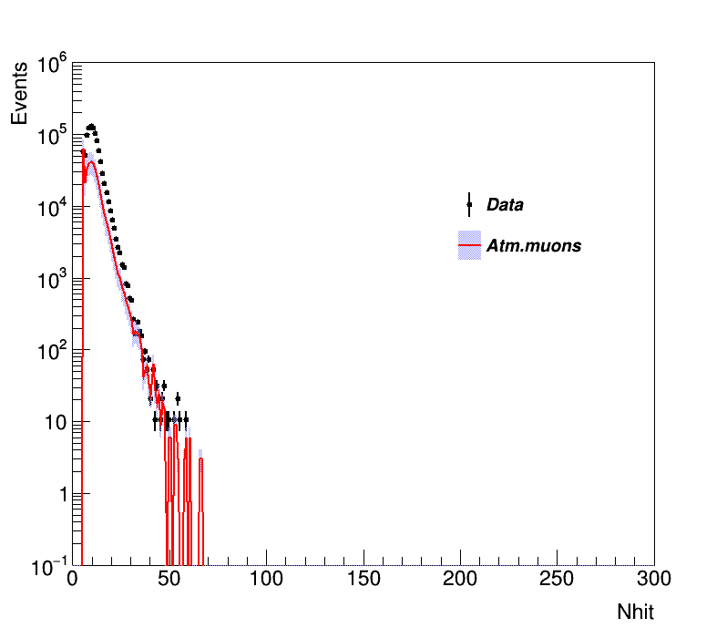
Agreement plots
Nhit : Number of floors with the chosen track hits
Data up to 2015 is considered
Final run 79222
Data between 2015 and 2017is considered
Runs between 79222 and 85683
6

Slide 13
What to do ?
Solve the problem of the agreement for the plots of the initial cut
Is it sufficient to work with just runs until 2015 ?
Finish off the extrapolation and calculate the sensitivity for the high ranges of β (β=1)
Finish off the reconstruction and simulation for the lower ranges of β (β free)
A discussion with Luigi had been initiated
7

