Slide 1
BGC Tests on HEL Test Stand
J. Glutting, G. Schneider, R. Veness
With thanks to
T.Dodington, S.Mazzoni, A.Rossi, A.Salehilashkajani, H.Zhang,
01/07/2019

Slide 2
Contents
Introduction and status
The BGC experimental roadmap
Experimental goals and limitations of the HEL tests
Installed hardware on the HEL test stand
Summary

Slide 3
Introduction and Status
Gas jet diagnostic R&D funded by HL-LHC as part of UK-HL collaboration
  2 instrument deliverables with tests and personnel
  First deliverable (called v2) is built and being tested at Cockcroft Institute (CI) with a 0.65 mW/5 keV CW electron gun
  Second instrument (v3), designed for LHC installation, will be delivered early 2020, with Phase 1 integrated directly in LHC
    This is the instrument we will install on the HEL test stand
    Latest details from BGC collaboration meeting [*] held 2 weeks ago at CI
  CI have submitted proposal for phase II production in-kind
Background gas experiment in the LHC
  An optical system, observing the existing BGI background gas injection system in the LHC was approved and installed in the LHC in YETS 17/18
  This took data for protons and heavy ions at injection and top energy during the 2018 run
  Very interesting preliminary data – will request an upgraded system for run 3, using the v3 interaction chamber
[*] https://indico.cern.ch/event/817655/

Slide 4
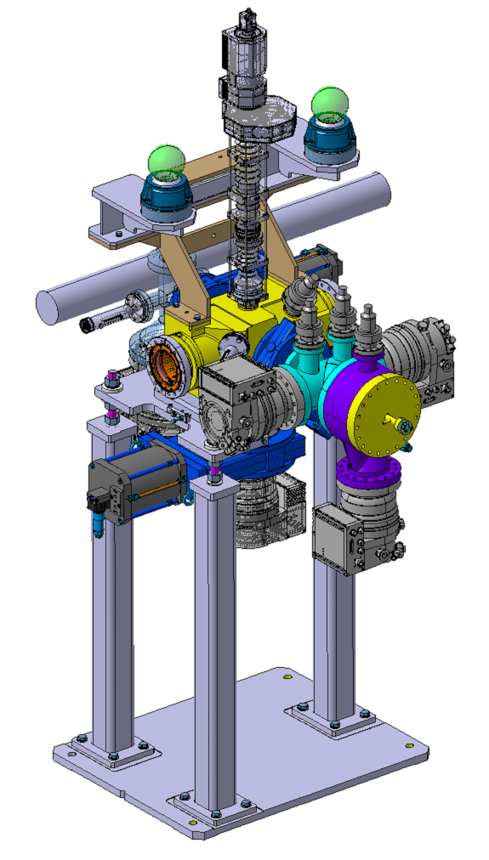
BGC demonstrator v3 design
Phase 1
  Interaction chamber
  BGC supports
  Optical and geometer supports
  Optical calibration target
Phase 2
  Gas injection
  Dump
  Pumping
  Optics design

Slide 5
BGC demonstrator (V3) Vacuum Layout
1
Hi-pressure nozzle
2
Between skimmers 1-2
Gauge: Penning
Ne
3
Between skimmers 2-3
Gauge: Piezoelectric (?)
Gauge: 2xPenning + Pirani
Gauge: 2xPenning + Pirani
Gauge: 2xPenning + Pirani
4
Interaction chamber
5
Dump area
max. 1E-3 mbar
~1E-5 mbar
~1E-7 mbar
~1E-9 mbar
nozzle
skim1
skim2
skim3
blackened insert
32mm
10 bar injection
Backscattering reducer
1
2
3
DN63
4
DN63
5
DN100
separator cone
min. spacing
200mm
DN100
DN100
DN100
DN100
TMP
700l/s
TMP
300l/s
TMP
300l/s
Note: No diagnostic chamber and pump
TMP
300l/s
63/100 adpt.
TMP
300l/s
Gauge: Penning + Pirani
Note: Pumps are suggestions
Primary
Primary
Primary
Leak det. valve
2 venting valves
Leak det. valve
2 venting valves
Leak det. valve
2 venting valves
Leak det. valve
2 venting valves
Leak det. valve
2 venting valves

Slide 6
BGC experimental roadmap
Complete v3 instrument Phase 2 in the LHC
Install the v3 Phase 1 in the LHC
v3 commissioning & experimental programme in the LHC
v3 test in HEL stand
2019
2020
2021
2022
2023
Long shutdown 2
YETS
YETS
LS3
Background gas test programme
Modify optics (and gas injection?) for a new background gas measurement

Slide 7
Summary of experimental goals on HEL test-stand
Validating the e- image for the instrument
  Validating extrapolations from the Cockcroft test programme for higher intensity and signal/noise
  Studying/mitigating photon noise background from the HEL e-gun
Interactions with solenoid field
  Exploring signal distortions from solenoid field (for N2 and Ar)
  Potential electron trapping and remedies (clearing electrode)
Validation of the full experimental and vacuum set-up at CERN before LHC installation
  Operation with the full vacuum control system
  Injection of background gas (Ne, N2, Ar) allows for benchmarking with CI results
The ideal HEL test stand will duplicate the final HEL operating conditions as closely as possible

Slide 8
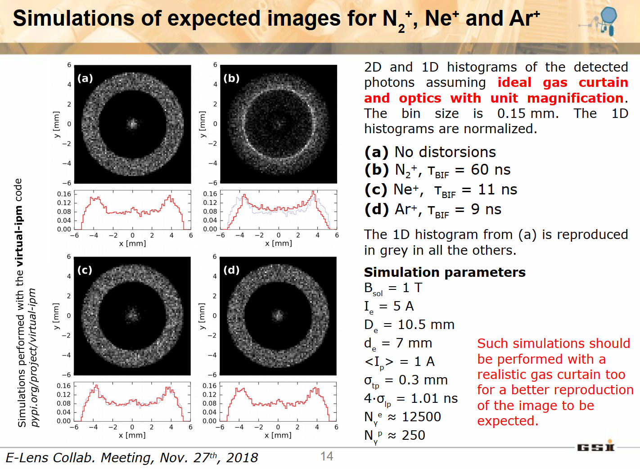
Slide courtesy S.Udrea

Slide 9
HEL test stand constraints
5 A intensity, but initially limited to 2x10e-4 duty cycle (limited by collector/YAG screen)
  Camera (and even gas) can be gated, so signal/noise will be an improvement on the CI test stand
  However, integrated intensity is 1 mA cf. 0.65 mA at CI, so data integration times will not significantly improve
  Would like to push duty cacle as close as possible to HL operating conditions
Geometry of gun and solenoids is different from the final design
  Can make some tests for photon background and mitigation (masking/blackening of surfaces)
  Would be interesting to move the HEL to a distance from the gun that is close to the final design
  We could make preliminary tests for electron trapping, but would need simulations too

Slide 10
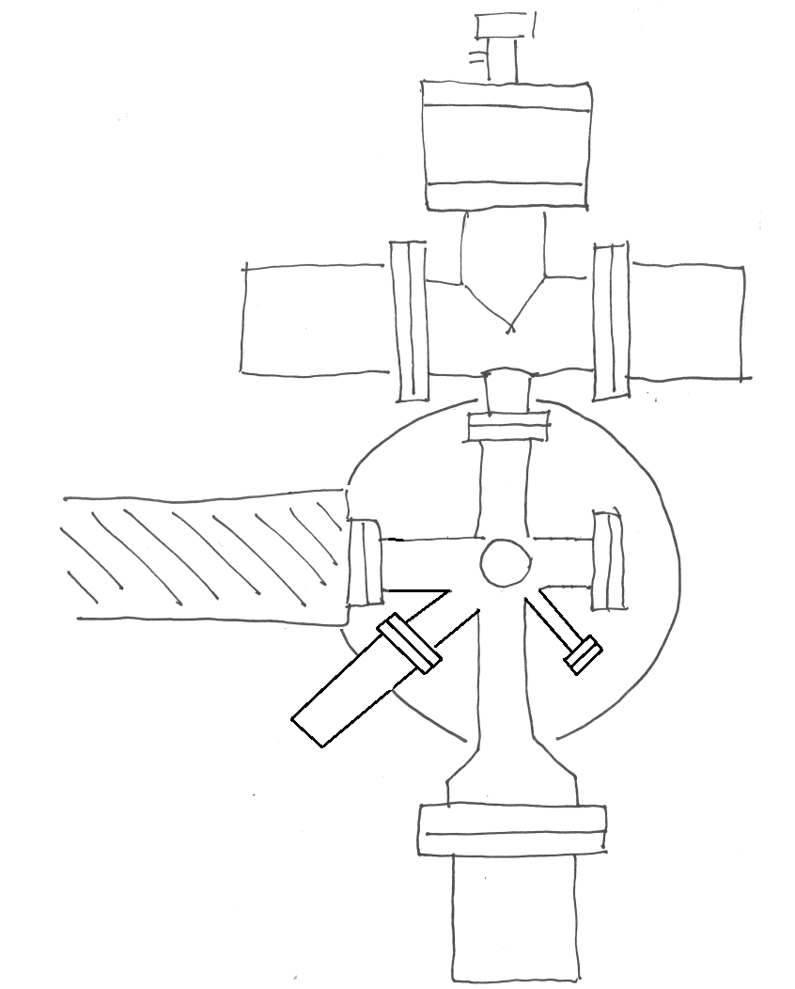
BGC On HEL test design (Preliminary!)
Gas injection from above→ no additional support needed here
Support?
→ Maybe change the position for calibration target port or/and port for clearing electrode
No intersection with cooling devices for the magnets on the right
Flange with blackened surface, in the shadow of egun light
optics
Port for clearing electrode
Calibration target can go in the precise beam position instead of above
Gas jet shoots at a pump

Slide 11
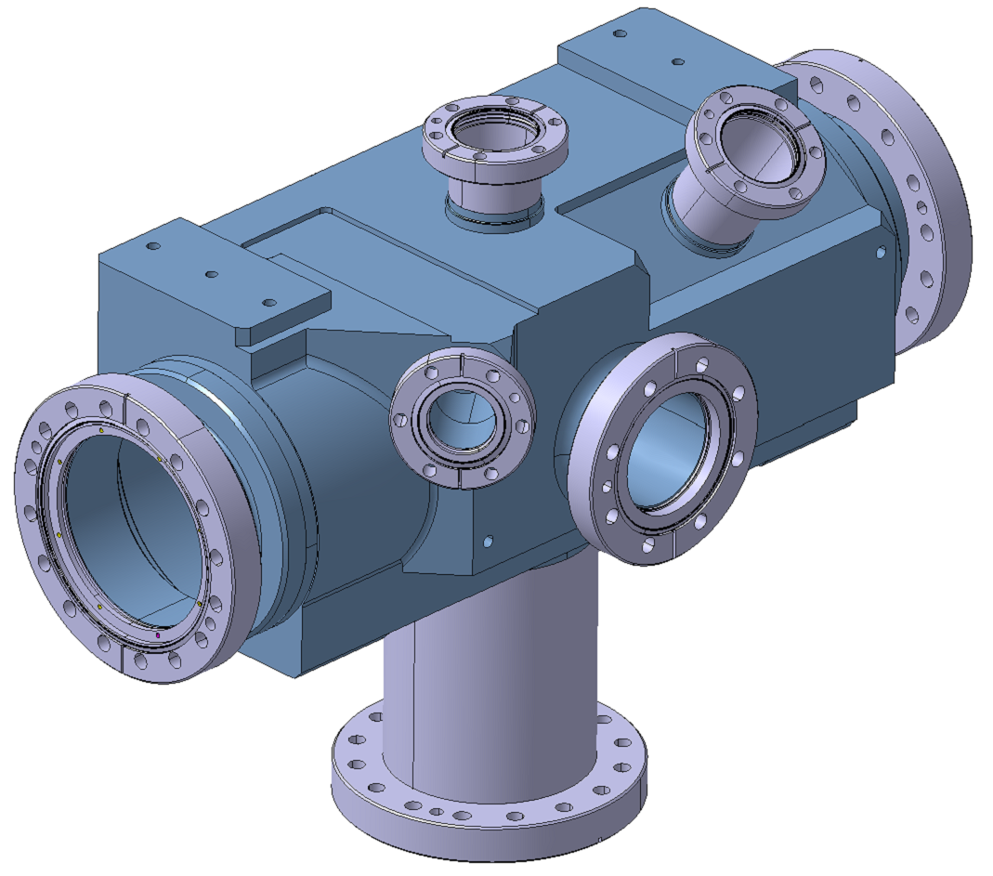
HEL Test specific
Complete re-design of Interaction chamber
Support System
Valves?
BGC V3 Interaction chamber to be redesigned for HEL

Slide 12
Summary
BGC v3 is planned for installation on the HEL test stand in summer 2020, with test programme window upto end of 2021
  Will need design/production of a dedicated interaction chamber
Basic test objectives are identified
  This is being iteratively developed between HEL and BGC
  Personnel for testing would also be available with a successful UK-HL Phase II in-kind collaboration
There are some limitations for the HEL test stand WRT final HEL
  These need to be clearly identified (ultimate test stand vs. installed HEL) and mitigations put-in-place
  Will there be testing on the final HEL before installation?
This HEL test stand will be an important step for the qualification of the ‘High intensity hollow e-beam’ part of the BGC performance

Slide 13
Backup slides

Slide 14
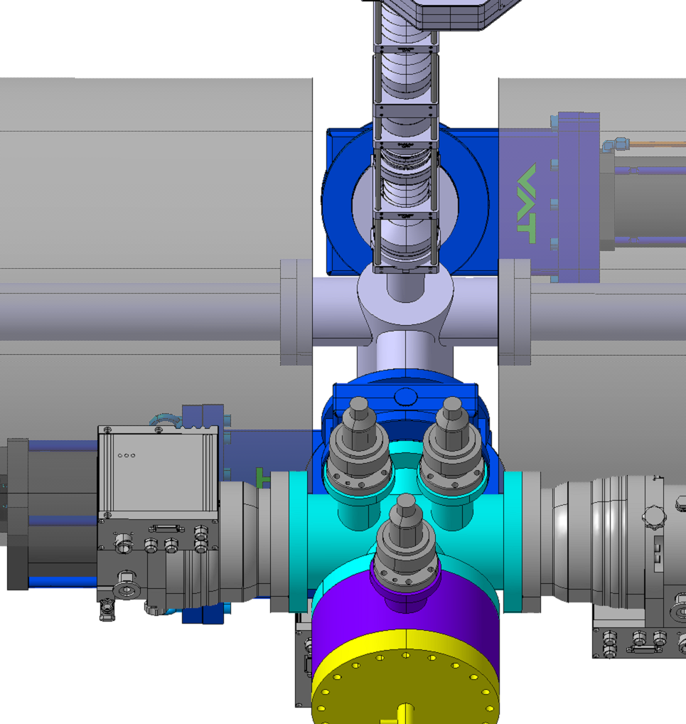
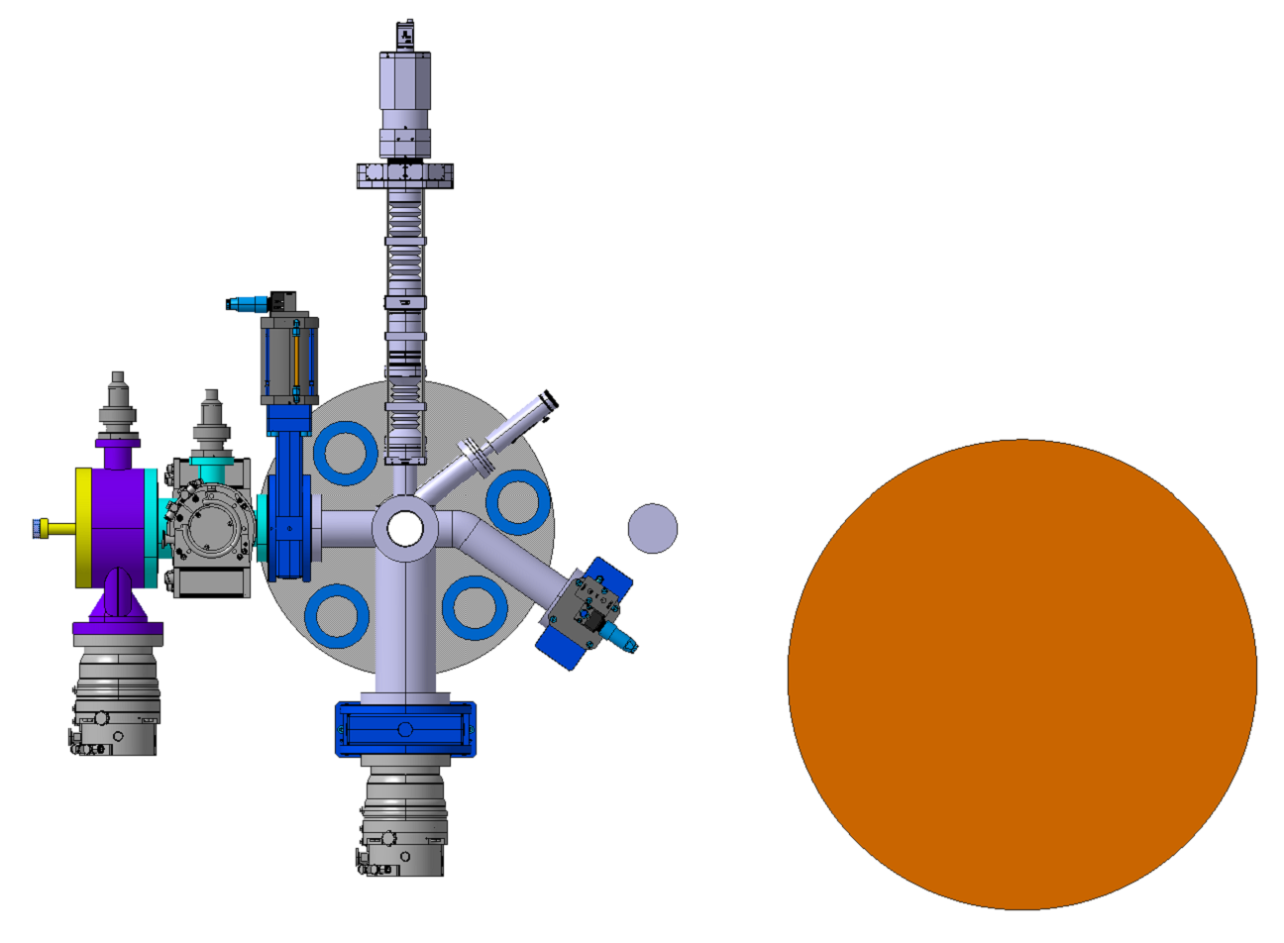
BGC HEL study inner beam line
Significant space constraints
Highly optimised design
Challenging assembly

Slide 15
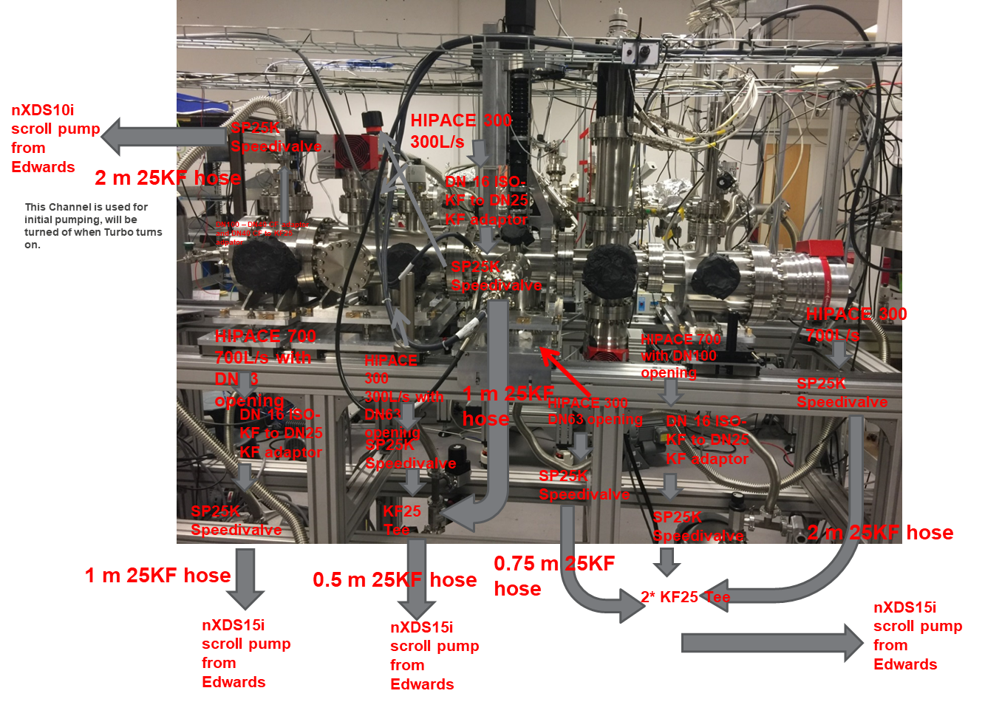
BGC Laboratory Design use at Cockcroft
Courtesy: E. Page, H. Zhang

