Slide 1
HEL collector
Giorgia Gobbi, Antti Kolehmainen, Diego Perini
01/07/2019

Slide 2
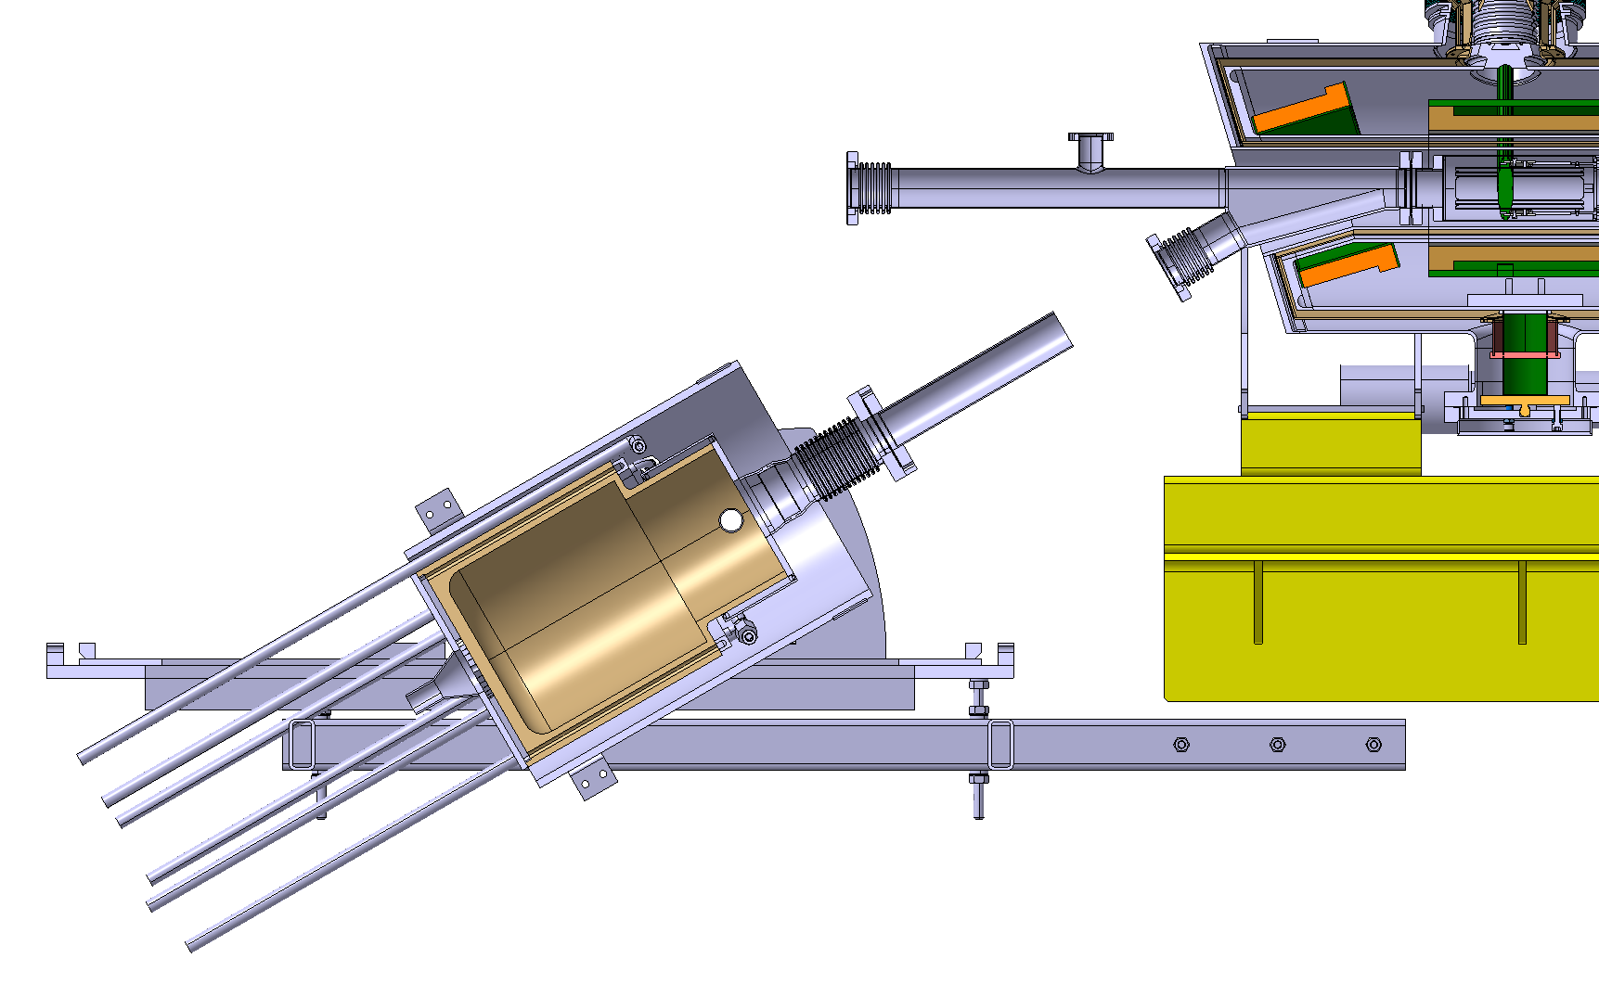
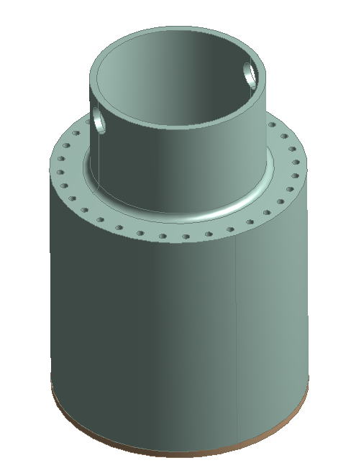

Specifications
electrical insulation
Collector: used to collect electron cloud and dissipate its energy
Material: CuCr1Zr
Dimensions: 340xØ350 mm
Active cooling via circulating water
Power to absorb: 75 kW maximum value
→Magnetic shield
  →Electrical insulation
Restrictions:
  Cu max temperature < 90°C for UHV compatibility
  Initial flow speed max 1.0 m/s
  Size limitations
magnetic shield
cooling circuit
33 channels in parallel Ø = 10 mm
Cooling circuits - Lapland Design

Slide 3
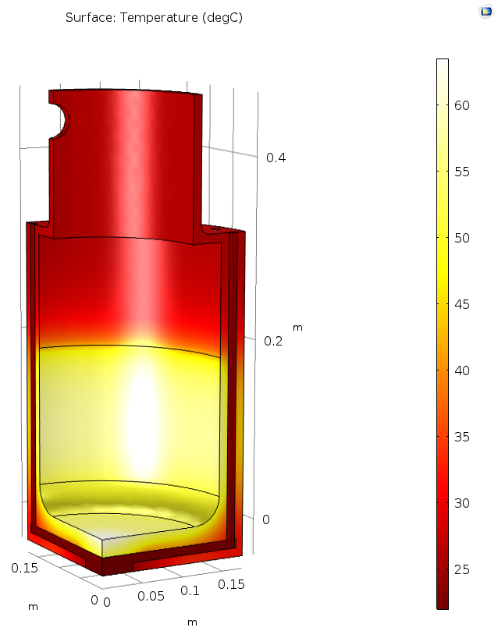
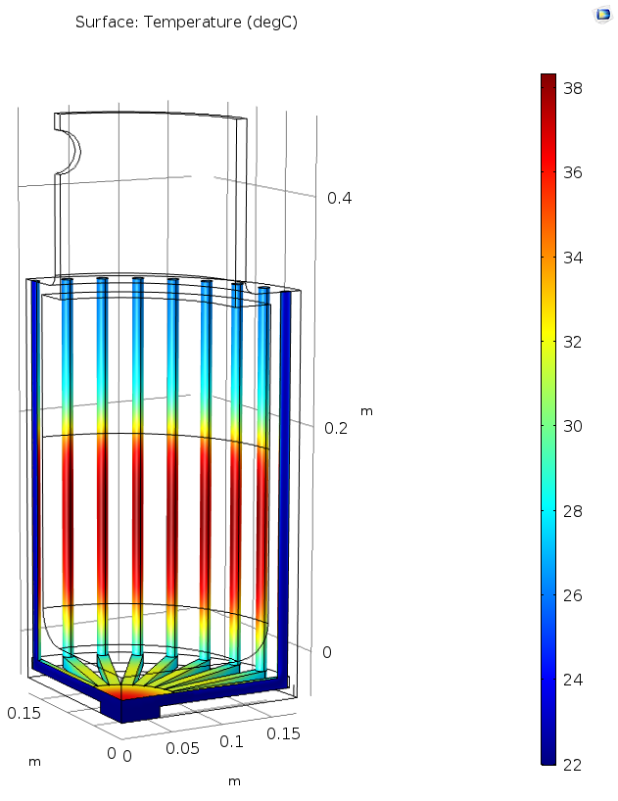
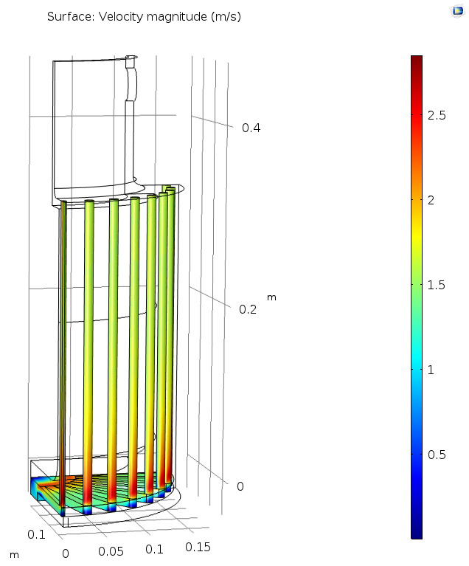
CuCr1Zr - Results
Load: 50 kW
V_{in} water = 1.0 m/s
Material: CuCr1Zr → T_{softening} = 450 - 500 ºC
T_{max} Cu = 63 ºC
ΔT water = 16 ºC
v_{max} water = 2.7 m/s

Slide 4
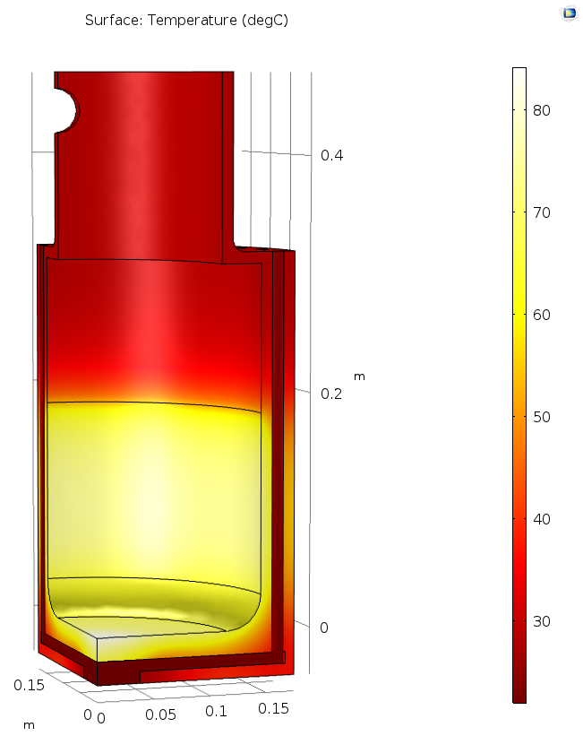
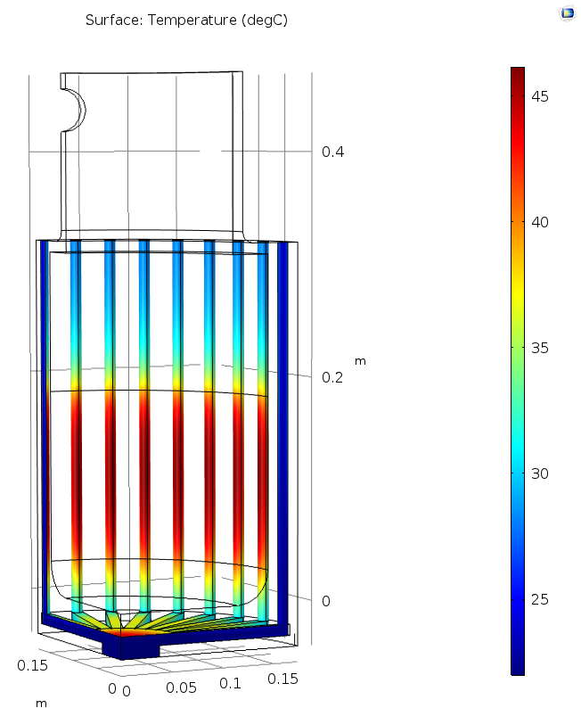
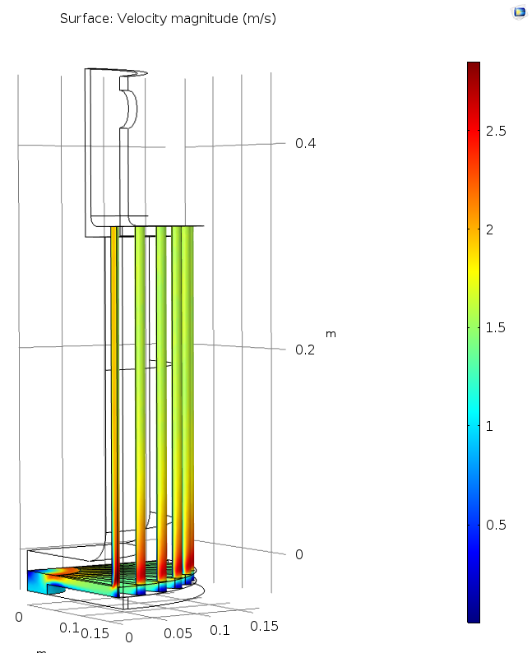
CuCr1Zr - Results (1.5*Load)
Load: 75 kW
V_{in} water = 1.0 m/s
Material: CuCr1Zr → T_{softening} = 450 - 500 ºC
T_{max} Cu = 83 ºC
ΔT water = 24 ºC
v_{max} water = 2.7 m/s

Slide 5
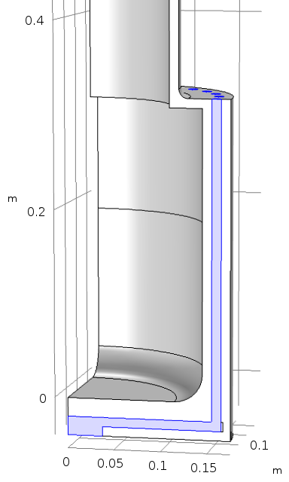
Manufacturing and plan
Flange SS brazed on CuCr1Zr
Drill channels
To be defined based on BINP beam dynamics simulations. It should include:
Electrodes
Resistive coil / permanent magnet
electrical insulation
magnetic shield
Drill channels
cooling circuit
Close with mechanical joint
Drawings → 2 months
Pieces manufactured → 5 months
Inputs from BINP and BE/BI needed as soon as possible

Slide 6
Conclusions
Collector simulations performed starting from previous outcome of particle trajectory
Recommend to use CuCr1Zr for higher softening temperature
With 50 kW and an initial water velocity of 1 m/s collector presents no issues
Tested also at 75 kW and no issues from a structural point of view were detected →T to be checked with vacuum colleagues
Manufacturing feasibility checked with the EN-MME workshop
Waiting from inputs to start with the manufacturing

Slide 7
Thanks for your attention

Slide 8
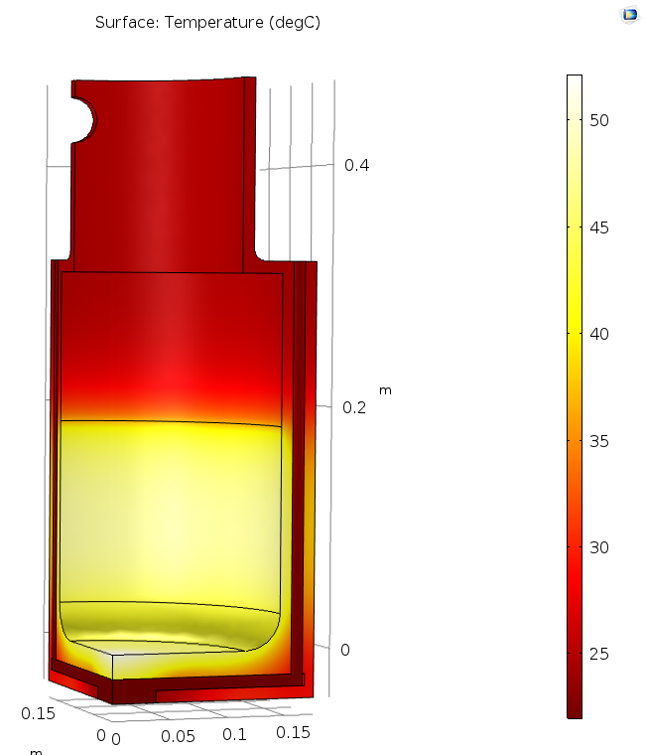
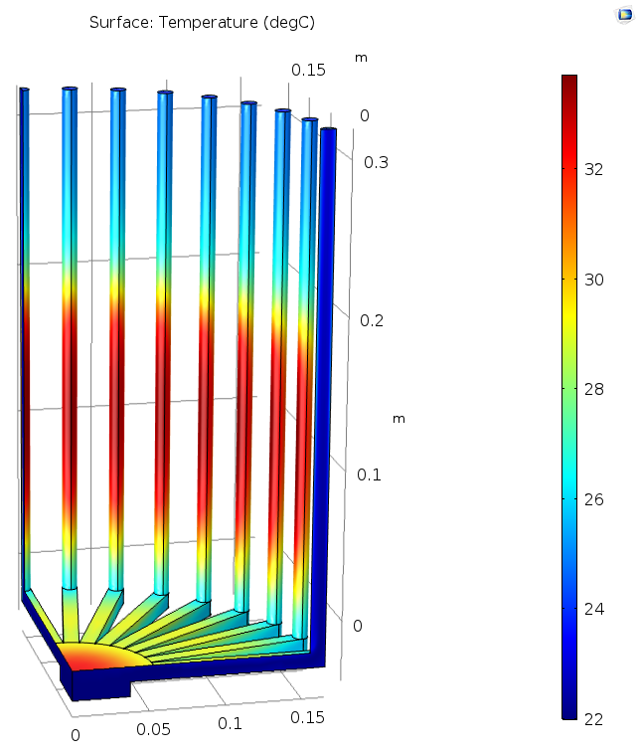
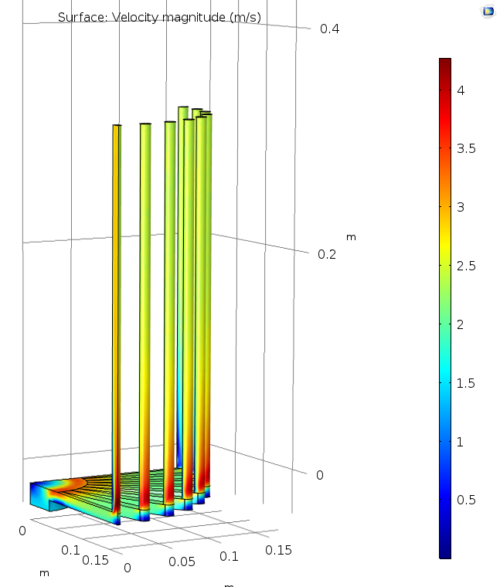
Copper – Results
COMSOL: Coupling heat transfer – turbulent flow analysis
Load: 50 kW
Material: Copper
V_{in} water = 1.5 m/s
T_{max} Cu = 52 ºC
ΔT water = 12 ºC
v_{max} water = 4 m/s

Slide 9
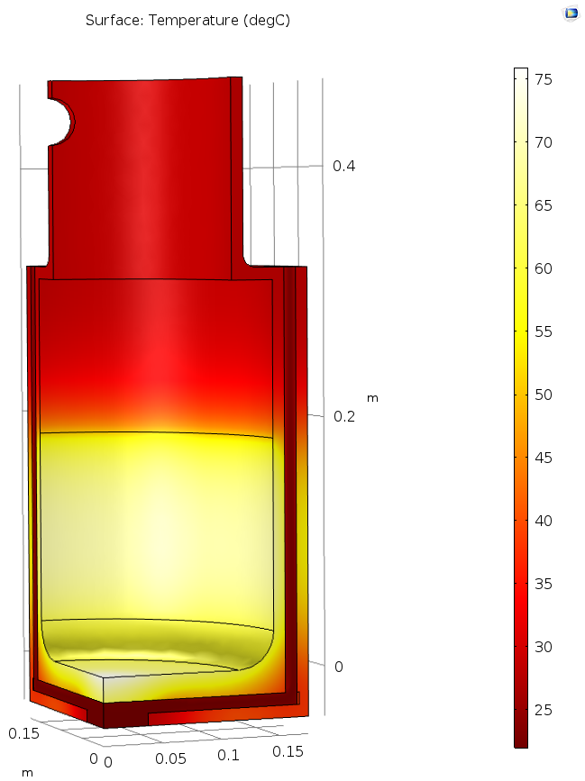
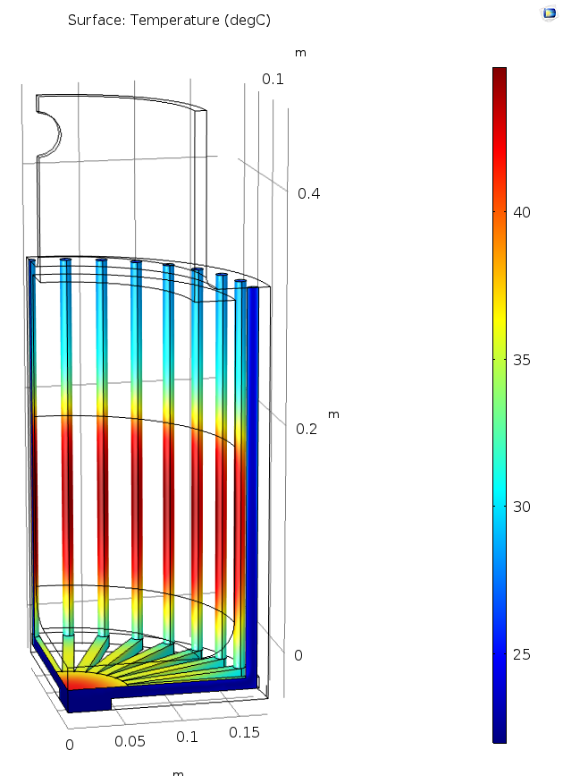
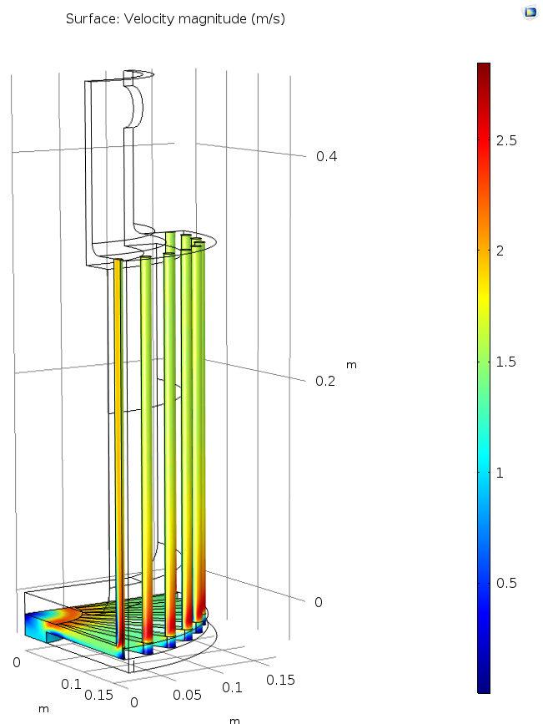
Copper - Results (1.5*Load)
COMSOL: Coupling heat transfer – turbulent flow analysis
Load: 75 kW
Material: Copper
V_{in} water = 1.0 m/s
T_{max} Cu = 75 ºC
ΔT water = 23 ºC
v_{max} water = 2.7 m/s

