Slide 1
LHCb and LHC running conditions

Slide 2
LHC beam conditions
Normal conditions
  Nominal bunch intensity (< 10¹¹ protons)
  ~2800 colliding bunches
  Luminosity 2.10³² (obtained by detuning the beam in LHCb, β* = 10 m
  Average number of collisions per crossing ~ 0.7
Current conditions
  Nominal bunch intensity (++)
  4 and more colliding bunches
  Luminosity very low (< 10³⁰)
  … but higher luminosity per bunch (β* = 3.5 m)
Consequences
  Conditions per crossing “worse” than nominal
  Larger number of collisions per crossing (1.3 to 2.3!!)
  Larger events
  Exponential dependence of reconstruction software
  Exponential dependence of selection software (stripping)

Slide 3
Consequences of LHCb beam conditions
Events size ~ 60-70 kB instead of 35 kB
Trigger rate nominal (in order to maximize event rates)
  2 kevents/s
  120 to 140 MB/s (instead of 70 MB/s)
Reconstruction time increase
  ~25 HS06.s (nominal 12 HS06.s)
Unacceptable stripping time
  ~80 HS06.s (nominal 1 HS06.s)!!!
  Reduced now to ~10 HS06.s
Consequence
  Limit file size (currently 2 GB, can go down probably to 1 GB)
    Nominal is 3 GB
  Reconstruction + stripping jobs take longer than anticipated
    40 kevts * 35 HS06.s = 1.4 10⁶ HS06.s
    Requested queue length: 1800 HS06.mn = 1.08 10⁶ ^{HS06.s}

Slide 4
Processing and reprocessing
So far, 5 successful full (re)-processings
  New production launched on the whole dataset
  Only 3 are kept on disk, one to be scrapped soon
Processing #6 was a failure
  Jobs would have taken more than 7 days wall-clock time to complete!
    Due to much higher pile-up
Processing #7 launched yesterday afternoon
  Only most recent data (as of June 25th with high pile-up)
  Expect reduction of 5 on processing time
    Removed stripping lines
Medium term actions
  Reconstruction being worked on for optimisation
  Careful scrutiny of stripping code
    Factor ~100 to gain from last week’s situation!

Slide 5
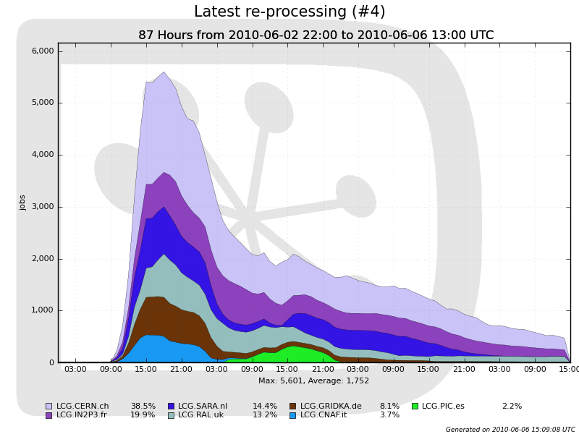
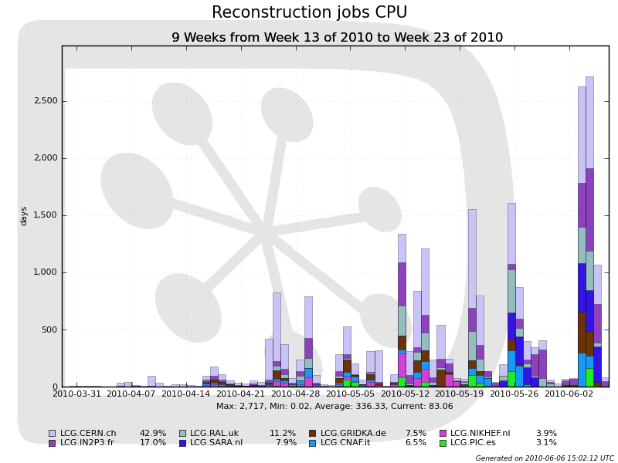
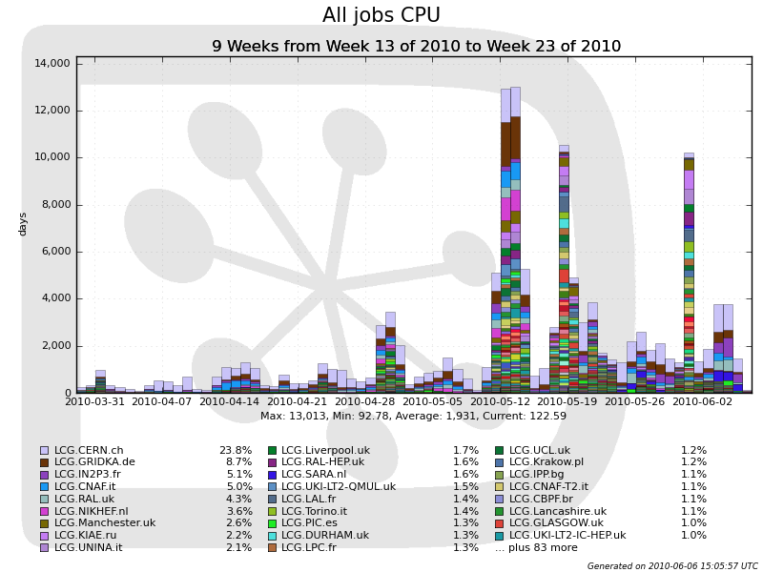
Production jobs
Re-processing #4 took 3 ½ days
7 sites used for reconstruction jobs
109 sites used in total
Now stopped running simulation at Tier1s

Slide 6
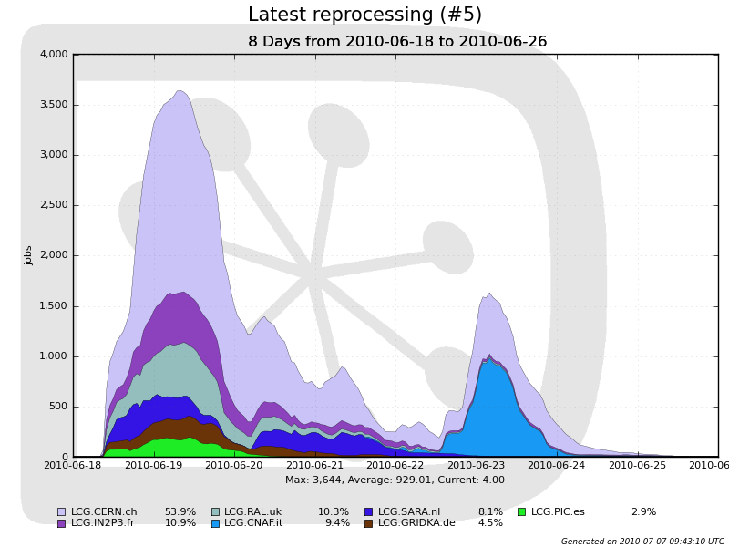
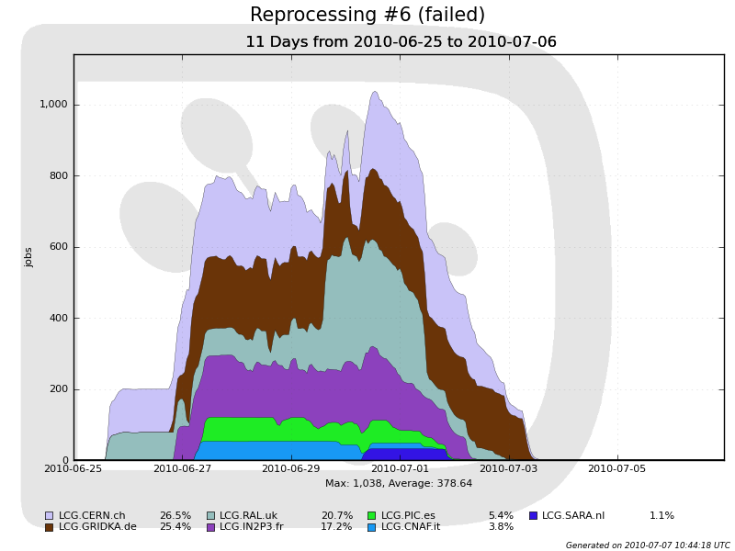
Latest (re-)processings
Took a bit longer as CNAF was not usable from the start
Jobs never completed…
Terminated by CPU time limit
Production stopped

Slide 7
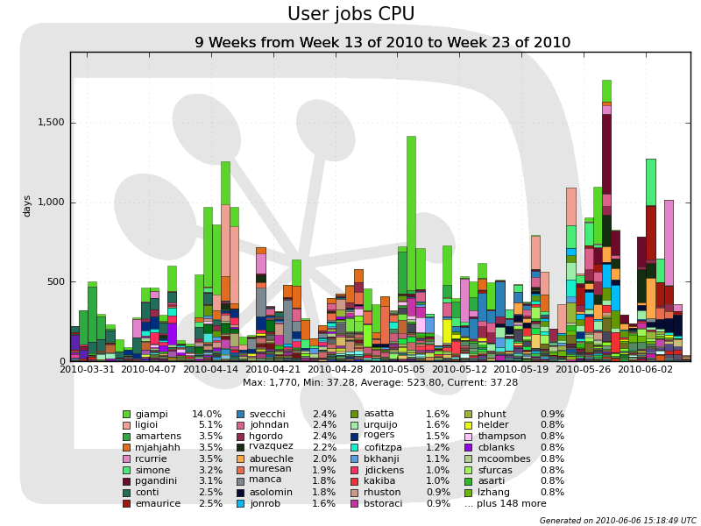
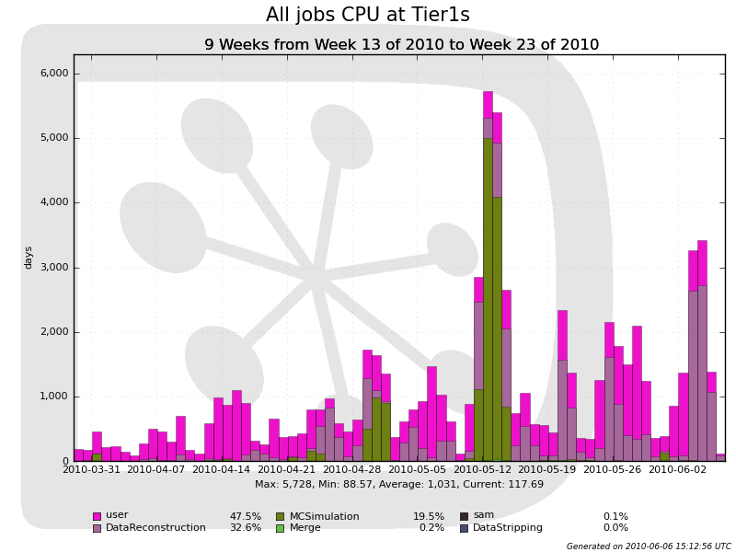
Distributed computing at Tier1s
183 users have been running analysis jobs on the Grid
Resources used by user jobs comparable to (re-)processing

Slide 8
Outlook
Watch carefully (re-)processing #7
  #6 was aborted
  If successful, continue processing new data with this workflow
Software optimisation necessary
  Adapt to beam condition
  Recent conditions are better (LHC had a wrong emittance measurement)
Possible consequences
  Longer queues requested to sites
    Currently 18,000 HS06.minutes
    Would like to go to 3 GB files if possible
    Twice longer queues?
  Possible changes in resource requirements / Computing model
  CPU normalised estimation essential (see Ricardo’s talk)

