Slide 1
ANALYSIS FUNCTIONAL AND STRESS TESTING
Dan van der Ster, CERN IT-ES-DAS
for the HC team: Johannes Elmsheuser, Federica Legger, Mario Úbeda García
WLCG Workshop, 8 July 2010

Slide 2
Outline
Overview – what should we test in Distributed Analysis?
HammerCloud and GangaRobot – Tools for stress and functional testing
Recent Developments – HammerCloud v3 deployment
Next Steps – the AFT, integration with SSB

Slide 3
DA Testing Goals
Functional Testing:
  Test the basic infrastructure
    SAM…Nagios. Not covered in this talk.
  Basic test of the complete analysis workflow
    Client…Workload Mgmt...Site…Worker Node…Storage
  “Special” workflows:
    Complete chain test with Frontier/Squid access
    Tier 3 analysis
Stress Testing:
  On-demand test to help commission/tune/benchmark the analysis sites.
  Standardized tests – end-to-end test with real analyses of “real” data

Slide 4

Intro to HammerCloud
HammerCloud (HC) is a Distributed Analysis testing system serving these two use-cases:
  Robot-like Functional Testing: frequent “ping” jobs to all sites to perform end-to-end DA testing
  DA Stress Testing: on-demand (large-scale) stress tests using real analysis jobs to test one or many sites simultaneously to:
    Help commission new sites
    Evaluate changes to site infrastructure
    Evaluate SW changes
    Compare site performances…
ATLAS has already made a big investment in HC stress testing:
  ~210,000 CPU-wallclock days (that’s 576 CPU-years)
  But this is only a few percent of the global DA resources

Slide 5
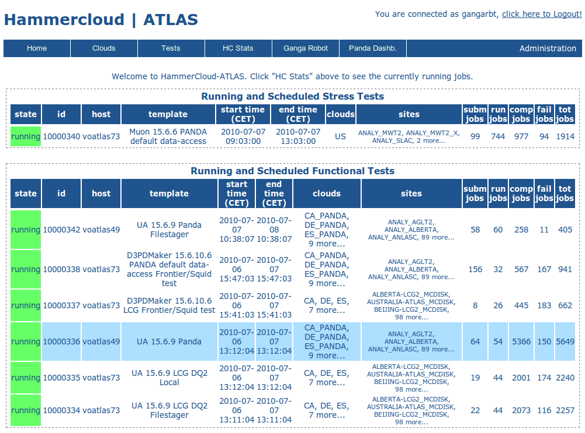
HammerCloud Web UI
http://hammercloud.cern.ch/atlas/

Slide 6
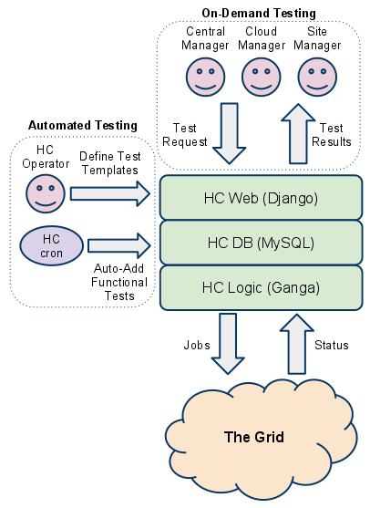
Implementation
The HC UI is implemented as a Django web app:
  View test results
  View cloud/site evolution
  DB Admin
State and results are maintained in MySQL
HC Logic (job submission, monitoring, resubmission) implemented on top of the Ganga Grid Programming Interface (GPI)

Slide 7
HammerCloud v3
HammerCloud v3 was recently deployed
What’s new?
  Test Templates – standardized tests are templated. Templates are instantiated as a Test
  Functional Testing – automatic instantiation of “functional” Templates at a defined frequency (these are the GangaRobot tests)
  Robot Report – graphical display of site efficiencies for the functional tests
  Behind the scenes refactoring – move to SL5, RPMs, generalizing the code for non-Athena/non-ATLAS tests
  Plus many small interface changes…

Slide 8
HC Ops – Functional Tests
Currently active Functional Tests:
UserAnalysis, Athena 15.6.9 with mc0*.merge.AOD.e*_r* on Panda and LCG
  Data access: Panda “schedconfig”, local direct, FileStager
  4 tests in total
D3PDMaker, Athena 15.6.10.6 (Frontier/Squid test) on Panda and LCG
  Data access: Panda “schedconfig”, local direct
  2 tests in total
Each tests is set to keep 1 job running at all sites continuously

Slide 9
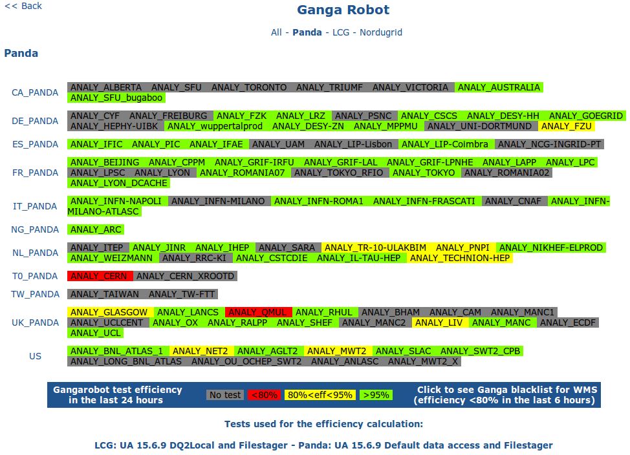
HC Robot Report

Slide 10
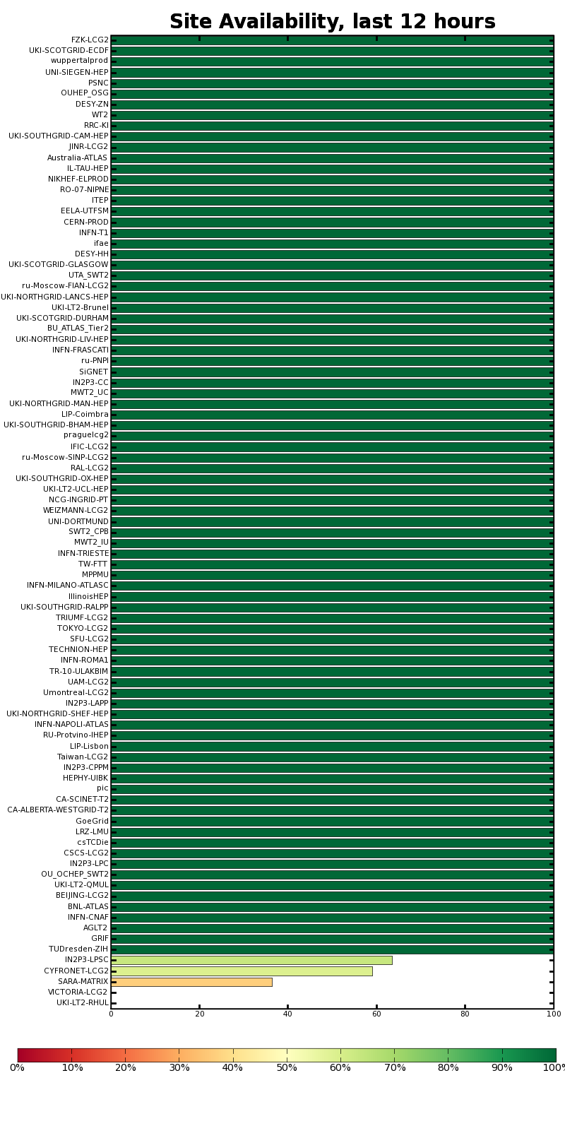
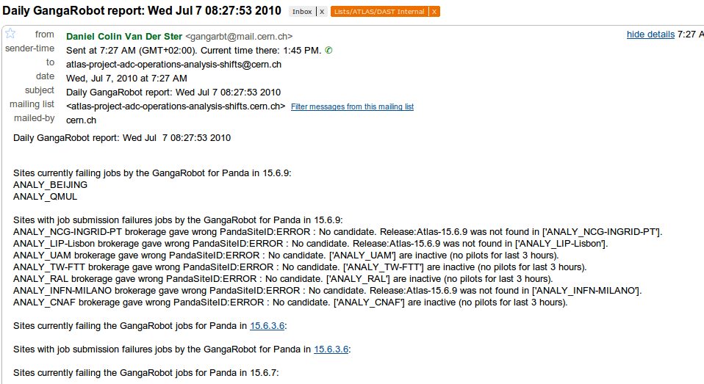
HC in SAM / HC Email Report
http://dashb-sam-atlas.cern.ch
Email robot report (currently sent to DAST)
And available on the web: http://gangarobot.cern.ch/blacklist_hammercloud.html

Slide 11
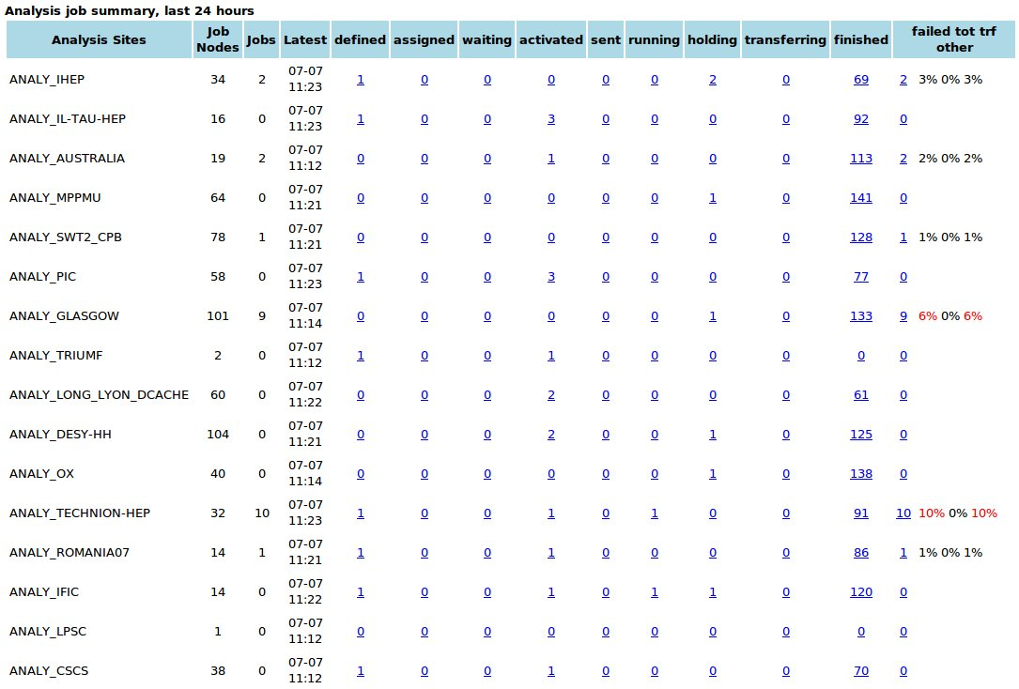
HC in Panda Monitor
Panda processingTypes:
  Functional tests use processingType=gangarobot
  Stress tests use processingType=hammercloud
Browse the HC results in the Panda monitor:
  http://tiny.cc/panda-gangarobot
  http://tiny.cc/panda-hammercloud

Slide 12
HC Ops – Stress Tests
A number of test templates are ready for site or cloud admins to schedule on-demand…
  An HC account is needed. Contact us if you want one.
On Panda or LCG using any data access method (including Panda FileStager or direct access):
  Muon Analysis, Athena 15.6.6, mc09*merge.AOD*.e*r12*
  D3PDMaker, Athena 15.6.10.6, data10_7TeV*physics_*AOD*, Frontier/Squid
Panda Tier 3 Test:
  Muon Analysis, Athena 15.6.6 – you mail us a list of PFNs

Slide 13
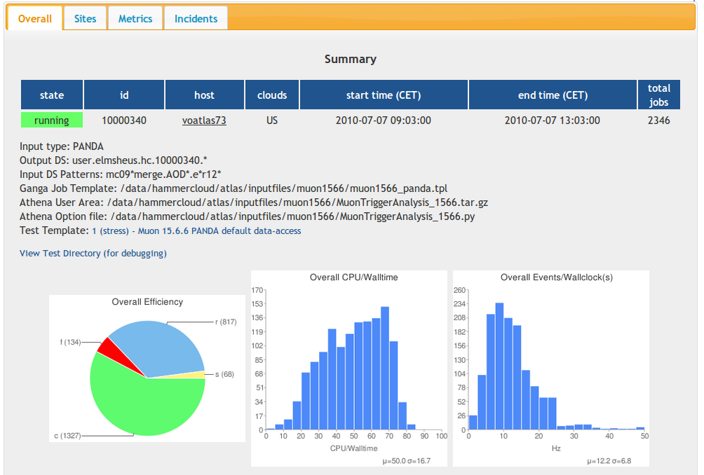
Example Stress Test

Slide 14
Next Steps
Fix the frontier/squid test… ~25% of the jobs are currently crashing
  Is correlated in a non-obvious way to the dESD dataset used – currently replicating a known working dataset to all DE sites (globally later)
Integrate with Site Status Board – this is the long-discussed ADC “Analysis Functional Test”
  SSB implements the policy for site “exclusion”
  Will provide better communication to sites in case of exclusion
Auto-approval for some test requests
  Manual approval isn’t needed if the test is simply an instance of one of the approved Templates
Site Ranking Tool
  Provides a score (per test template) to make comparisons
Robot Web display to present results separated by Test Type (template)
  E.g see only the Frontier/Squid test results.

Slide 15
Conclusions
HammerCloud has taken over responsibilities for all central DA tests: functional and stress testing
New “template” model makes the usage more user friendly
  Not much room for error – enables automatic test approval
Test results are available in a variety of places:
  HC web, Email reports, SAM Dashboard, Panda Monitor, (SSB coming soon)
Acknowledgements to the HC team: Johannes Elmsheuser, Federica Legger, Mario Úbeda García

