Slide 1
WAN area transfers and networking: a predictive model for CMS
WLCG Workshop, July 7-9, 2010
Marie-Christine Sawley, ETH Zurich

Slide 2
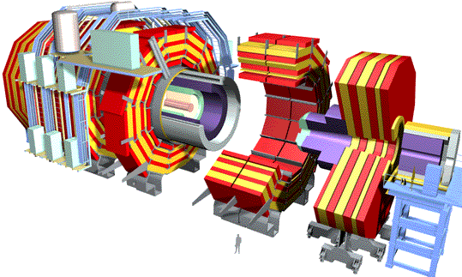
CMS Data Flow in the Computing Grid
Prompt Reconstruction
TIER-0
CAF
Calibration
Express-Stream
Analysis
CASTOR
600MB/s
50-500MB/s
TIER-1
TIER-1
TIER-1
Re-Reconstruction
Skims
50-500MB/s
~20MB/s
TIER-2
TIER-2
TIER-2
TIER-2
Simulation
Analysis
Notes:
2

Slide 3
Purpose of the predictive model
Need to
  Re-examine the computing model according to conditions, and adapt whenever needed
  Keep track of the deployment of the resources at different Tiers
Develop a tool which would yield reliable information for the ramping up for the years to come
  Tool has no value without dialog nor comparison with the measured rates

Slide 4
Exporting custodial data: methodology
T0—> T1s : exporting FEVT
  BW=(RAW+RECO) x Trigger frequency x (1+overlap factor). For the chosen parameters, this yields:
  BW= 2 MB x 300Hz x 1.4 = 840 MB/sec, or 6.75 Gb/sec.
Each T1 receives a share according to its relative size in CPUs
Proportional to the trigger rate, event size and Tier-1 relative size
In 2010 we will continue to send more than 1 copy of the data, but the event size is smaller

Slide 5
CERN to Tier-1 in 2010
Rate is defined by the accelerator, the detector and the data distribution policy
  Livetime of the machine is lower than we expect for the future
    System is specified to recover between fills
  Data is over subscribed
    Will continue as resources allow
  RAW event size is smaller than our estimates
  Event rate is defined by the physics program
We expect the average rate from CERN to Tier-1s will increase, but we would like to track the changes so that planning matches measured rates
  Dimension according to expected bursts or peaks

Slide 6
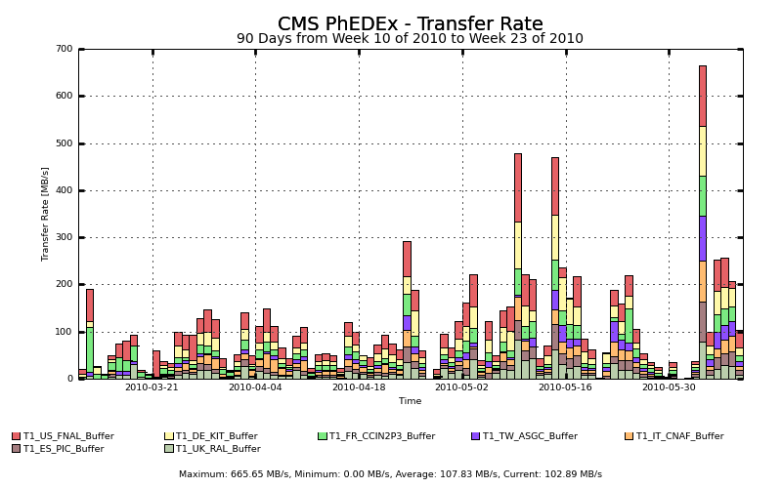
Tier-0 to Tier-1
CERN to Tier-1 Average since beginning of 2010 run
600MB/s

Slide 7
Tier-1 to Tier-1 in 2010
The CMS plan currently is ~ 3.5 copies of the AOD
  After an refresh of the full sample of a year’s running this is 1.6PB of disk to update
  Using 10Gb/s that takes 20 days.
  Achieving 30Gb/s is a week
    The Computing TDR had 2 weeks
    In 2010 we will also be replicating large samples of RECO
Recovering from a data loss event at a Tier-1 is more challenging because the data might be coming from 1 place only
  Could also take longer with the normal risk of double failure

Slide 8
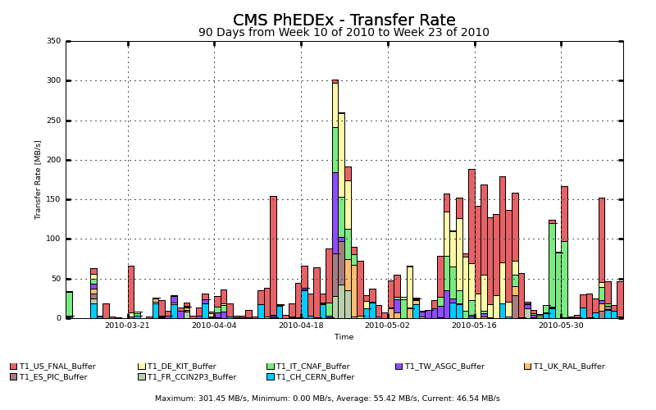
Tier-1 to Tier-1
Transfers are used to replicate raw, reco and AOD data, recover from losses and failures at Tier-1 sites

Slide 9
Tier-1 to Tier-2
Data from Tier-1 to Tier-2 is driven by event selection efficiency, frequency of reprocessing, level of activity
  All of these are harder to predict, but translate into physics potential
The connections between data production sites and analysis tiers needs to allow prompt replication
  CMS is currently replicating 35TB of data that took 36 hours to produce to 3 sites (~100TB)
  These bursts are not atypical

Slide 10
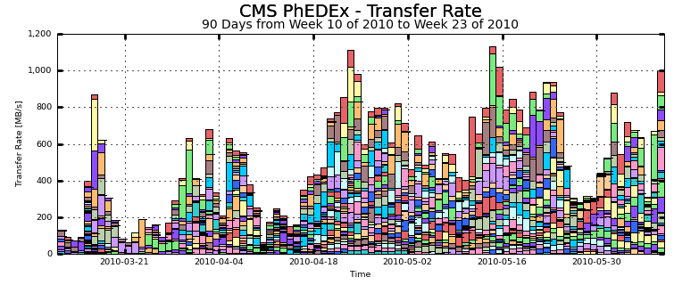
Tier-1 to Tier-2
CMS is very close to completing commissioning the full mesh of Tier-1 to Tier-2 transfers at a low rate
  Working on demonstrating more links at 100MB/s
  Daily average exceeding 1GB/s
June 11/Ian Fisk

Slide 11
2010-2011 Conditions
CONSTANTS
Trigger rate | 300 | Hz
RAW Size | .500 | MB
SimRAW | 2.00 | MB
RECO size | .500 | MB
AOD size | .200 | MB
Total number of events | 2360 | MEvents
Overlap between PD | 40, then 20 | %
Total number of simulated events | 2076 | MEvents
Total size of RAW | 1474 | TB
Total size RECO | 1474 | TB
Total Primary AOD | 472 | TB

Slide 12
Generic Tier1
Tape system
N% Users
2. Data taking: total sample
3. During re-reprocessing
6. Daily export for data analysis:
-from affliliated T2s for the whole AOD sample
(re-RECO)
-from all Tiers 2 for custodial AOD
Number kSP06
TO
Custodial
Data
(prop. to the relative size)
4. AOD Sync
4. AOD Sync
5. MC PROD
Exports
Imports
Affiliated Tier2s
Tier1s

Slide 13
The results
1 slide per regional Tier1
Pledged Cores are for 2010
Remember: this are really raw values
Links:
  Solid line: sustained bandwidth (data taking and re-processing periods ONLY)
  Broken line: peak bandwidth (may happen at any time: numbers shown is the total if it all happens at the same time )
For each Tier 1, the fraction of served users for analysis is a combination based on
  Relative size T2s for analyzing the share of 1srt AOD at considered Tier1, number of users based on the number of supported physics groups
  Relative size of T1 for analyzing the full AOD

Slide 14
FRANCE IN2P3
Tape system
13% Users
2. Data taking: (total sample 300TB)
45 MB/sec
3. During re-reprocessing
50 MB/sec
6. Daily export for data analysis: 70 TB
20 MB/sec
7 Gb/s
IN2P33
9.06 kSP06
TO
1. Data taking
0.40 Gb/s
0.20 Gb/s
4. AOD Sync
2.5 Gb/s
4. AOD Sync
5. MC PROD: 700TB
Exports
370 TB
Imports
520TB
3.5 Gb/s
6 Tier2s
Tier1s

Slide 15
GERMANY FZK
Tape system
8%
Users
2. Data taking: (total sample 280TB)
40 MB/sec
3. During re-reprocessing
40 MB/sec
6. Daily export for data analysis: 36 TB
20 MB/sec
3.5 Gb/s
FZK
10.05 kSP06
TO
1. Data taking
0.3 Gb/s
0.15 Gb/s
2.3 Gb/s
5. MC PROD: 580 TB
4. AOD Sync
4. AOD Sync
Exports
367 TB
Imports
522 TB
3.6 Gb/s
3 Tier2s
Tier1s

Slide 16
ITALY CNAF
Tape system
10 % Users
2. Data taking: (total sample
345TB)
50 MB/sec
3. During re-reprocessing
50 MB/sec
5. Daily export for data analysis: 40 TB
20 MB/sec
3.6 Gb/s
CNAF
12. 5 kSP06
TO
1. Data taking
0.4 Gb/s
0.12 Gb/s
2.8
Gb/s
5. MC PROD: 440TB
4. AOD Sync
4. AOD Sync
Exports
415 TB
Imports
514 TB
3.5 Gb/s
4 Tier2s
Tier1s

Slide 17
SPAIN PIC
Tape system
8 %
Users
2. Data taking: (total sample 151TB)
20 MB/sec
3. During re-reprocessing
20 MB/sec
5. Daily export for data analysis: 32 TB
10 MB/sec
3.0 Gb/s
PIC
5.46 kSP06
TO
1. Data taking
0.2 Gb/s
0.08 Gb/s
1.2 Gb/s
5. MC PROD: 420 TB
4. AOD Sync
4. AOD Sync
Exports
181 TB
Imports
553 TB
3.7 Gb/s
3 Tier2s
Tier1s

Slide 18
TAIWAN ASGC
Tape system
5 %
Users
2. Data taking: (total sample
400 TB)
50 MB/sec
3. During re-reprocessing
50 MB/sec
6. Daily export for data analysis: 5 TB
25 MB/sec
0.4 Gb/s
TAIWAN
14 kSP06
TO
1. Data taking
0.4 Gb/s
0.08 Gb/s
3.10 Gb/s
5. MC PROD: 250 TB
4. AOD Sync
4. AOD Sync
Exports
464 TB
Imports
506 TB
3.40 Gb/s
3 Tier2s
Tier1s

Slide 19
UK RAL
Tape system
15% Users
2. Data taking: (total sample 225TB)
30 MB/sec
3. During re-reprocessing
30 MB/sec
6. Daily export for data analysis: 39 TB
20 MB/sec
3.7 Gb/s
RAL
8.04 kSP06
TO
1. Data taking
0.25 Gb/s
0.2 Gb/s
1.8 Gb/s
5. MC PROD: 700 TB
4. AOD Sync
4. AOD Sync
Exports
267 TB
Imports
530 TB
3.6 Gb/s
4 Tier2s
Tier1s

Slide 20
USA FNAL
Tape system
24 % Users
2. Data taking: (total sample 1230 TB)
165 MB/sec
3. During re-reprocessing
160 MB/sec
6. Daily export for data analysis: 120 TB
80 MB/sec
11 Gb/s
FNAL
44.4 kSP06
TO
1. Data taking
1.30 Gb/s
0.34 Gb/s
10 Gb/s
5. MC PROD: 1274 TB
4. AOD Sync
4. AOD Sync
Exports
1.5 PB
Imports
340 TB
2.3 Gb/s
9 Tier2s
Tier1s

Slide 21
Data rate intake by Tier2 estimate
Data import simulated taking the parameters of the 2010-11 run
The association with Physics groups is taken into consideration
The global processing capacity of Tier1s and the relative disk space of each Tier2 are taken into consideration
Expected rate if all PG work at the same time, on a single day
  Sustained rate on a peak day (any better definition?)
Purpose
  Inform sites about usage/load, planning
  Helping sites which may run into imbalance, such as
    WAN likely to be a limitation, especially if site is serving >1 VO
    Imbalance between number of PG and the amount of local resources

Slide 22
Data rate intake by Tier-2
Preliminary comparison with measured rate
Data from Data Ops
  T1 to T2, best rate from sample of measures over a few hours, between November and March (200 files -2GB each- sent between T1 and T2)
For 27 sites, the simulation gives a number below the measured data rate → satisfactory
For 9 sites, there are no valuable data yet to be compared
For 7 sites, 1 (or more) link is above simulated data rate, however the average is below → monitor and try to understand
For 4 sites, all measured links were below simulated data rate→ go deeper

Slide 23
Possible reasons for significant deviation between results
Simulation may be inaccurate for that particular site
  Model keeps being refined
New measurements keep coming
Real limitations may come from
  WAN
  A few parameters to tune at the Tier-2
  …..
Still very much Work in Progress, do not jump on conclusions before further analysis

Slide 24
Data rate intake for T2s
Country | Tier 2s | data rate Incoming <-- T1 (MB/sec) | Number PG | Installed WAN (Gb/sec) | Measured rate (average) | remark
Austria | T2-AT-Vienna | 70 | 2 | 1 | 54
Belgium | T2-BE-IIHE | 70 | 2 | 2 | 80
Belgium | T2-BE-UCL | 70 | 2 | 2 | 47
Brazil | T2-BR-UERJ | 70 | 2 | 10 | 40
Brazil | T2-BR-SPRACE | 30 | 1 | 10 | 44
China | T2-CN-Beijing | 40 | 1 | 1 | 32
Estonia | T2-EE-Estonia | 47 | 1 | 2 | 73
Finland | T2-FI-HIP | 70 | 2 | ? | 104
France | T2-FR-IPHC | 70 | 2 | 1 | 89
France | T2-FR-GRIF | 100 | 3 | 1 | 56
France | T2-FR-IN2P3 | 130 | 4 | 10
Germany | T2-DE-Desy | 140 | 4 | 10 | 111
Germany | T2-DE-RWTH | 70 | 2 | 10 | 111
Hungary | T2-HU-Budapest | 40 | 1 | 1 | 58

Slide 25
Data rate intake for T2s
Country | Tier 2s | data rate Incoming <-- T1 (MB/sec) | Number PG | Installed WAN (Gb/sec) |  | remark
India | T2-IN-TIFR | 40 | 1 | 1 | 90
Italy | T2-IT-Bari | 40 | 1 | 1 | 30
Italy | T2-IT-Legnaro | 70 | 2 | 2 | 120
Italy | T2-IT-PISA | 70 | 2 | 2 | 54
Italy | T2-IT-Roma | 70 | 2 | 1 | 72
Korea | T2-KR-KNU | 40 | 1 | 20 | 66
Pakistan | T2-PK-NCP | 2 |  | 0.07 |  | Model yields insignificant rate as disk space is very modest
Poland | T2-PL-Warsaw | 5 |  | 2 | 97 | Model yields insignificant rate as disk space is very modest
Portugal | T2-PR-LIP | 1 |  | 1. | 60
Portugal | T2-PR-NGC | 30 | 1 | ? | 70
Russia | T2-RU-IHEP | 1 |  | 0.10 | 45 | Model yields insignificant rate as disk space is very modest
Russia | T2_RU_INR | 1 |  | ? | 29 | Model yields insignificant rate as disk space is very modest
Russia | T2-RU-ITEP | 30 | 1 | 2.5 | 104
Russia | T2-RU-JINR | 70 | 2 | 1 | 42
Russia | T2-RU-PNPI | 1 |  | 0.15 | 41 | Model yields insignificant rate as disk space is very modest

Slide 26
Data rate import for T2s
Country | Tier 2s | data rate Incoming <-- T1 (MB/sec) | Number PG | Installed WAN (Gb/sec) |  | remark
Russia | T2-RU-RRC_KI | 1 |  | 2.5
Russia | T2-RU-SINP | 30 | 1 | 2.5 | 38
Spain | T2-ES-CIEMAT | 100 | 3 | 2.5 | 80
Spain | T2-ES-IFCA | 80 | 2 | 2.0 | 74
Switzerland | T2-CH-CSCS | 40 | 1 | 10 | 106
Taiwan | T2-TW-TAIWAN | 3 |  | 10 | 77 | Model yields insignificant rate as disk space is very modest
Turkey | T2-TR-METU | 4 |  | 1 | 55 | Model yields insignificant rate as disk space is very modest
UK | T2-UK-IC | 100 | 2.5 | 1 | 74
UK | T2-UK-Brunel | 50 | 1.5 | 1 | 76
UK | T2-UK-Southgrid RAL | 40 | 1 | 1 | 102
UKRAINE | T2-UA-KIPT | 2 | 1 | 0.06 | 27 | Model yields insignificant rate as disk space is very modest

Slide 27
Data rate import for T2s
Country | Tier 2s | data rate Incoming <-- T1 (MB/sec) | Number PG | Installed WAN (Gb/sec)
USA | T2_US_Caltech | 100 | 3 | 10 | 107
USA | T2_US_Florida | 110 | 3 | 10 | 56
USA | T2_US_MIT | 100 | 3 | 10 | 97
USA | T2_US_Nebraska | 100 | 3 | 10 | 82
USA | T2_US_Purdue | 100 | 3 | 10 | 111
USA | T2_US_UCSD | 100 | 3 | 10 | 137
USA | T2_US_Wisconsin | 100 | 3 | 10 | 168

Slide 28
Outlook
Development of the model is on going
Taking regularly into account real activities
  CERN to Tier-1s is driven by the detector and the accelerator
  Tier-1 to Tier-1 is driven by need to replicate samples and to recover from problems. See reasonable bursts that will grow with the datasets.
  Tier-1 to Tier-2 is driven by activity and physics choices
  Large bursts already. Scale as activity level and integrated lumi
  Tier-2 to Tier-2 is ramping up.
Keeping the dialog with the sites and the specialists to enrich the model

Slide 29
Thank you
Acknowledgements
Ian Fisk, Daniele Bonacorsi, Josep Flix,
Markus Klute, Oli Gutsche, Matthias Kasemann
Question or feedback?
sawley@cern.ch

