Slide 1

New generation of energy extraction systems for HL-LHC
Bozhidar Panev TE-MPE-EE
04/07/2019

Slide 2
OUTLINE
Introduction
  HL-LHC circuits that will need EE systems
Details from the development phase and performance
  Semiconductors based EE systems
  Vacuum switches based EE systems
Summary

Slide 3
General information
HiLumi circuits per IP side that need EE systems
 | Circuits for HiLumi | Magnet Type | I Ultimate (kA) | Number of circuits per IP side | Quench Heaters | EE
IT | Orbit correctors CP - vertical | MCBXFA | 1.73 | 1 | Baseline | Baseline
 | Orbit correctors CP - horizontal | MCBXFA | 1.59 | 1 | Baseline | Baseline
 | Superferric, order 2 | MQSXF | 0.2 | 1 | no | Baseline
D2 | Orbit correctors D2 | MCBRD | 0.54 | 4 | no | Baseline
MCF table
In total: 28 EE systems (7 per IP side)
EE team strategy:
  2kA EE systems – for MCBXFA
  600A EE systems – for MQSXF and MCBRD

Slide 4
Switching technology selection criteria for
HL-LHC
Opening time: HL-LHC circuits require fast EE systems
  LHC → (10-20)ms
  HL-LHC corrector circuits → few milliseconds
Maintenance free EE systems
  Electromechanical circuit breakers currently in operation require a regular maintenance once per year
Long service life → at least 20 years of operation
  At least 10000 openings at nominal current guaranteed
High reliability
Design complexity
Cost
Development projects:
  Semiconductor based EE systems
  Vacuum switches based EE systems

Slide 5
EE systems based on semiconductors

Slide 6
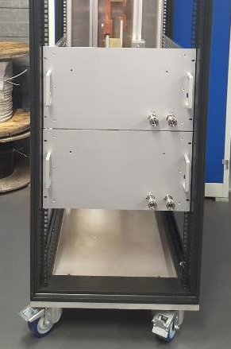
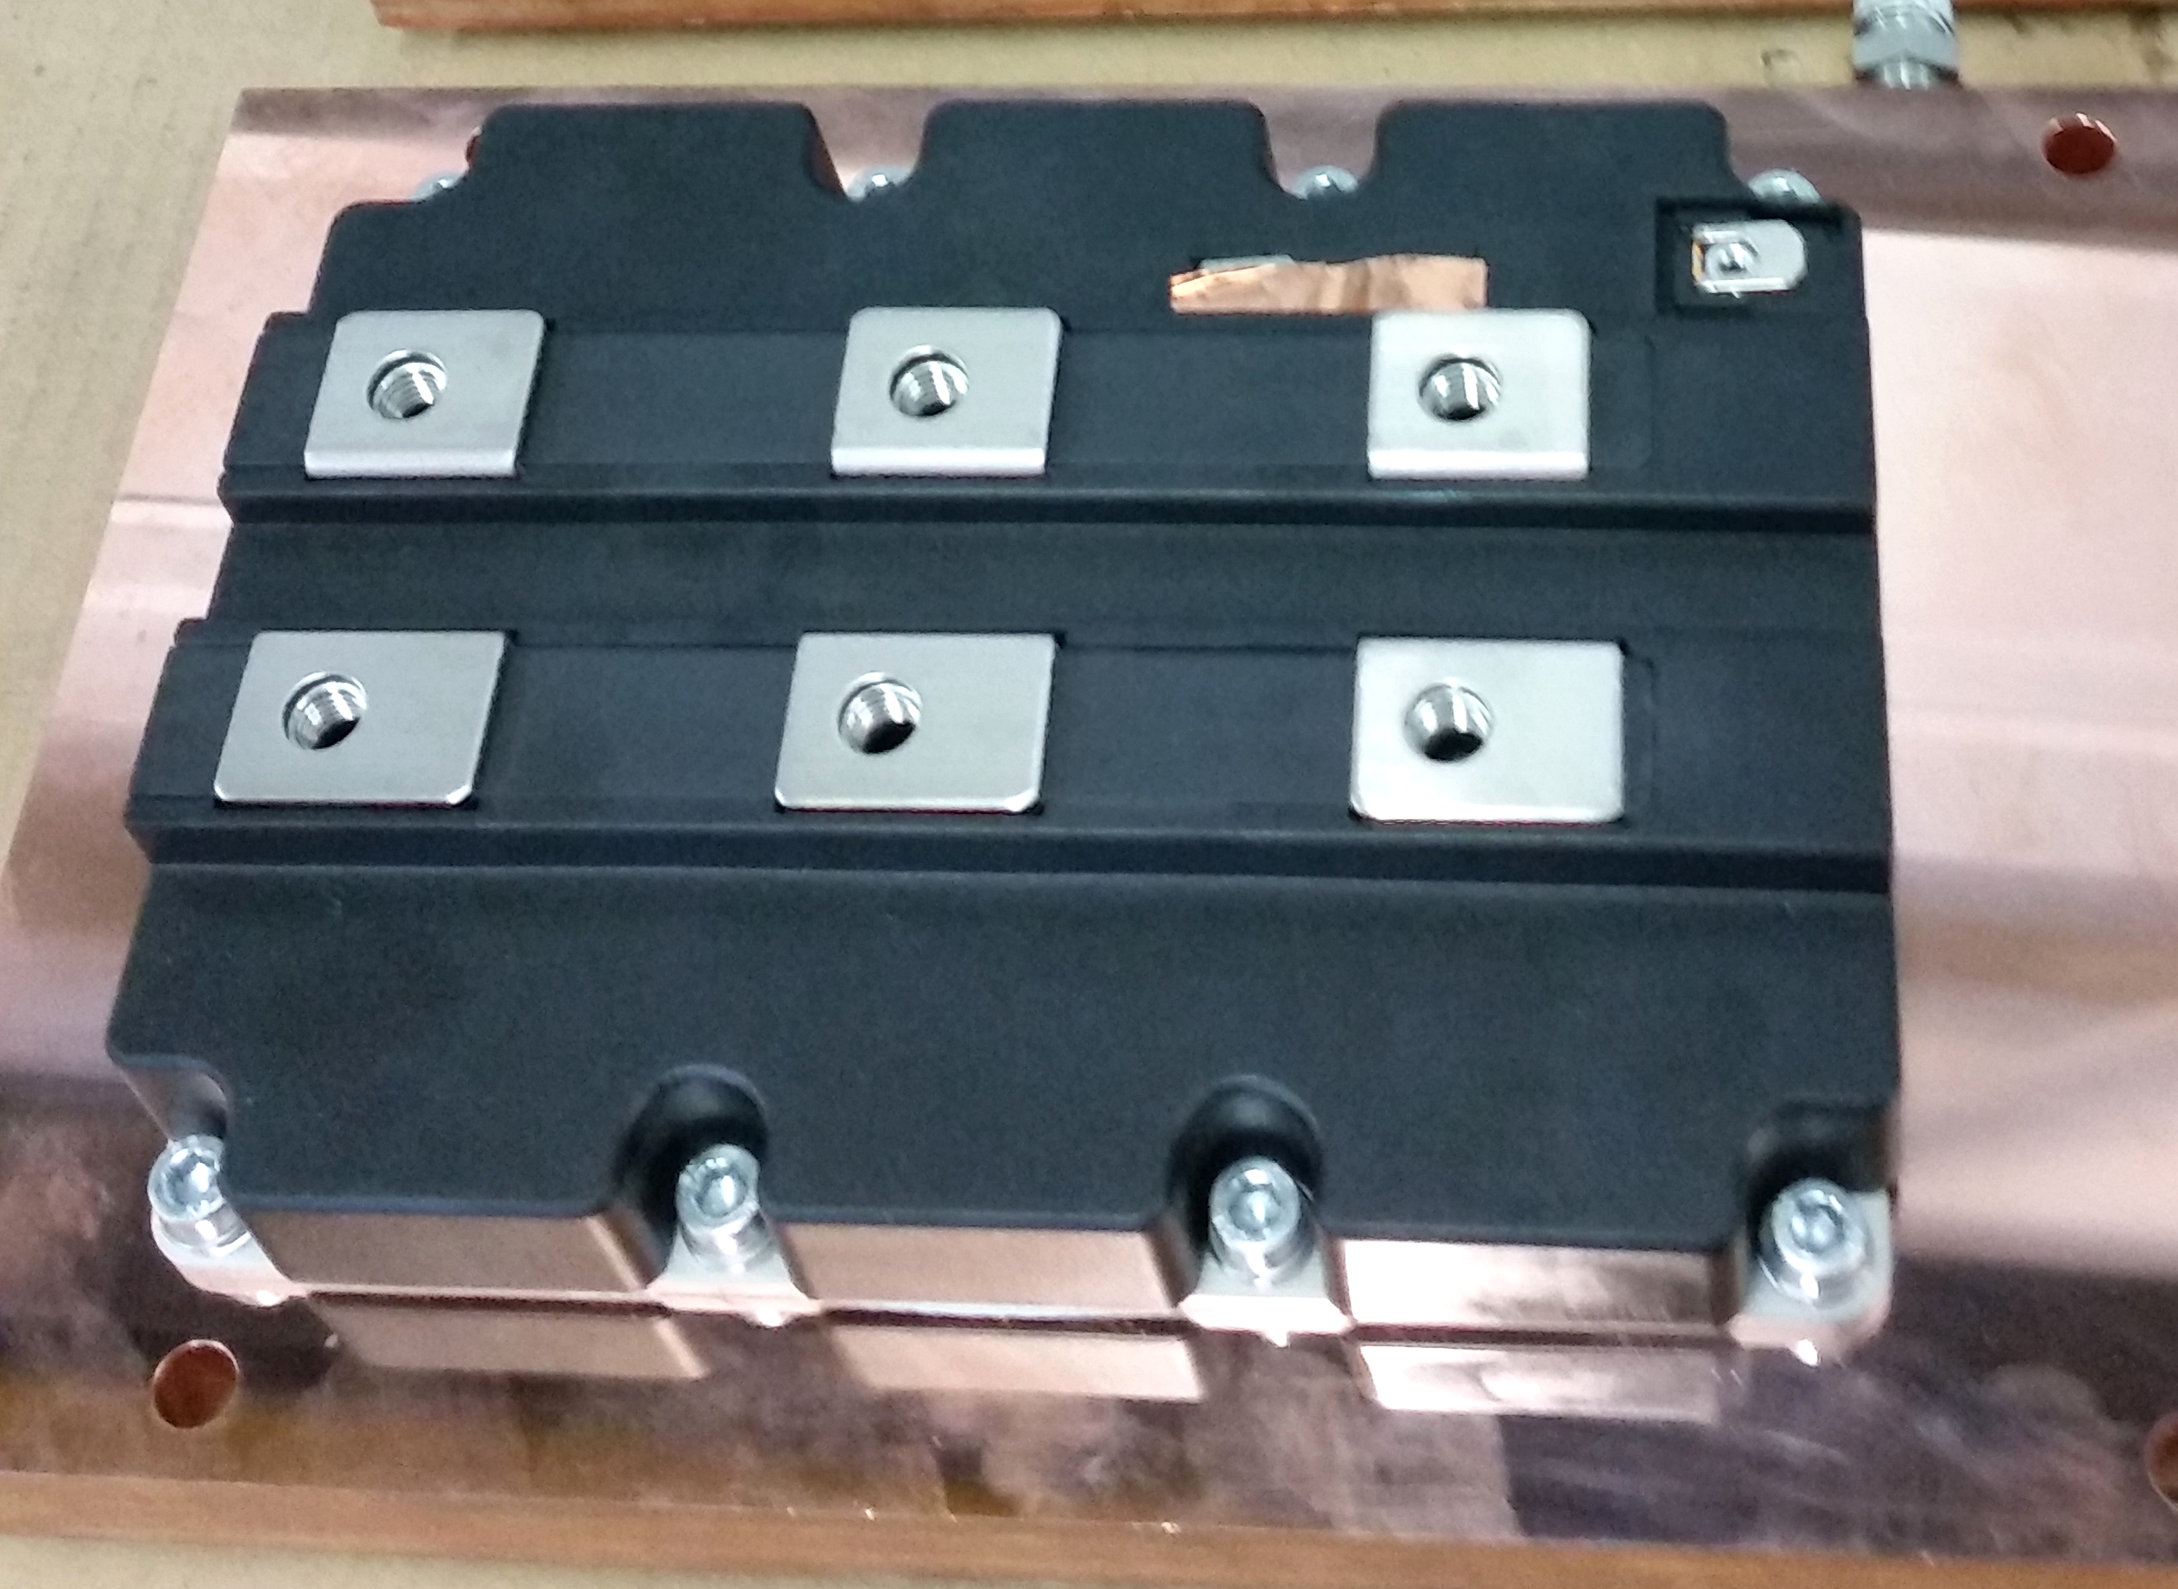
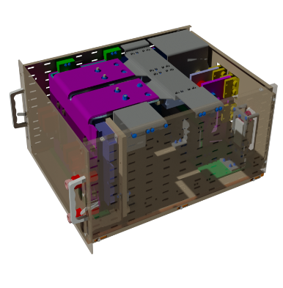
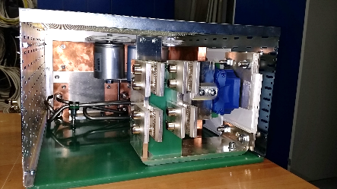
2kA IGBT based EE systems (1)
The IGBT (Integrated Gate Bipolar Transistor) is used as a solid state switch
Design and development started in 2017
  Modular approach is applied in the design
  Single module commutates bidirectionally 1kA
  Two modules connected in parallel for 2kA operation
IGBT
1kA module
housed in a 6U chassis
2 modules
In parallel

Slide 7
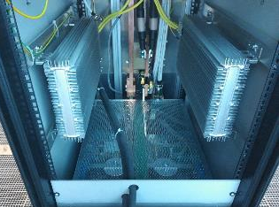
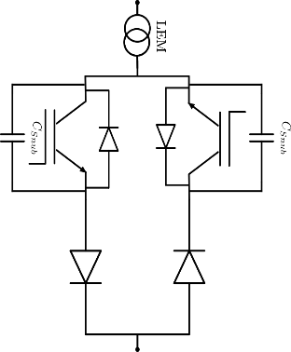
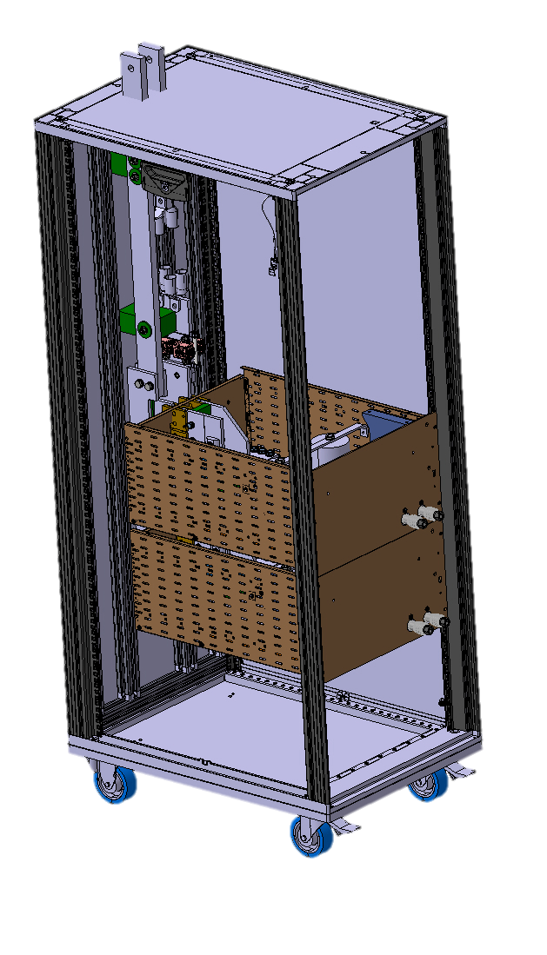
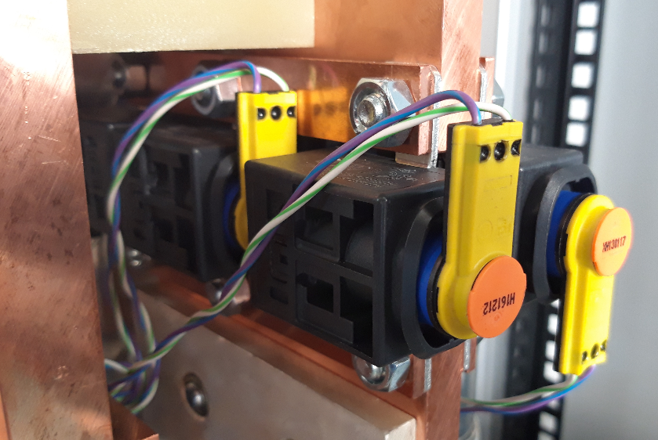
2kA IGBT based EE systems (2)
Details from the design:
  Dump resistor 300mΩ (2 x 600mΩ in parallel)
  Bipolar operation of each 1kA module
  ~2.5V voltage drop (still significant)
  Redundancy achieved through 2kA triggerable fuse
    250us reaction
    Low ohmic losses (200uOhms)
Dump resistors
180 cm
triggerable fuse
Back up protection
with triggerable fuse
1kA module
configuration
90 cm
60 cm

Slide 8
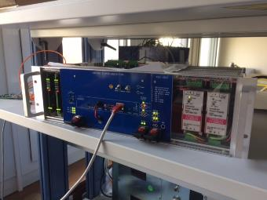
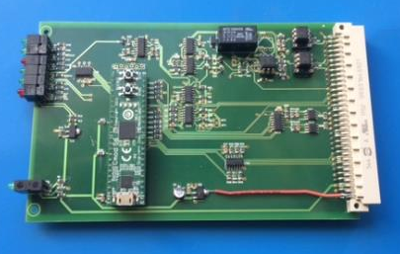
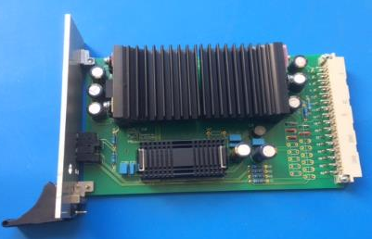
Control electronics IGBT based EE system
Some details of the control electronics
  sbRIO controller
  Two FPA boards
  Hardware interlock board
  Power supply board
NI – sbRIO controller
(single-board)
28 digital I/O
16 analogue inputs
etc.
3U control chassis
housed the electronic boards
FPA and PSU boards

Slide 9
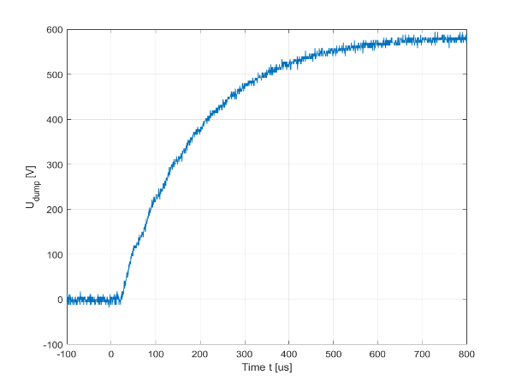
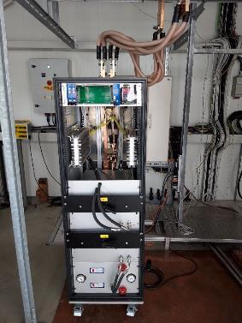
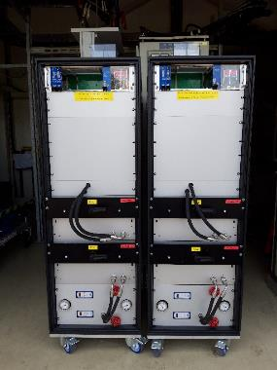
2kA IGBT based EE systems for HL-LHC (3)
Semiconductor based (IGBT) bipolar, compact and complete EE system to be used with the Hi-Lumi corrector magnets (MCBXFA & MCBXFB) at the vertical test bench in SM18
Two systems (final version) fully tested were sent for installation in SM18
Two more systems ordered in the industry – expected in Sep19
730 μs
Performance at 2kA – U_DUMP
System under test
in MPE lab.
In SM18

Slide 10
EE systems with vacuum switches

Slide 11
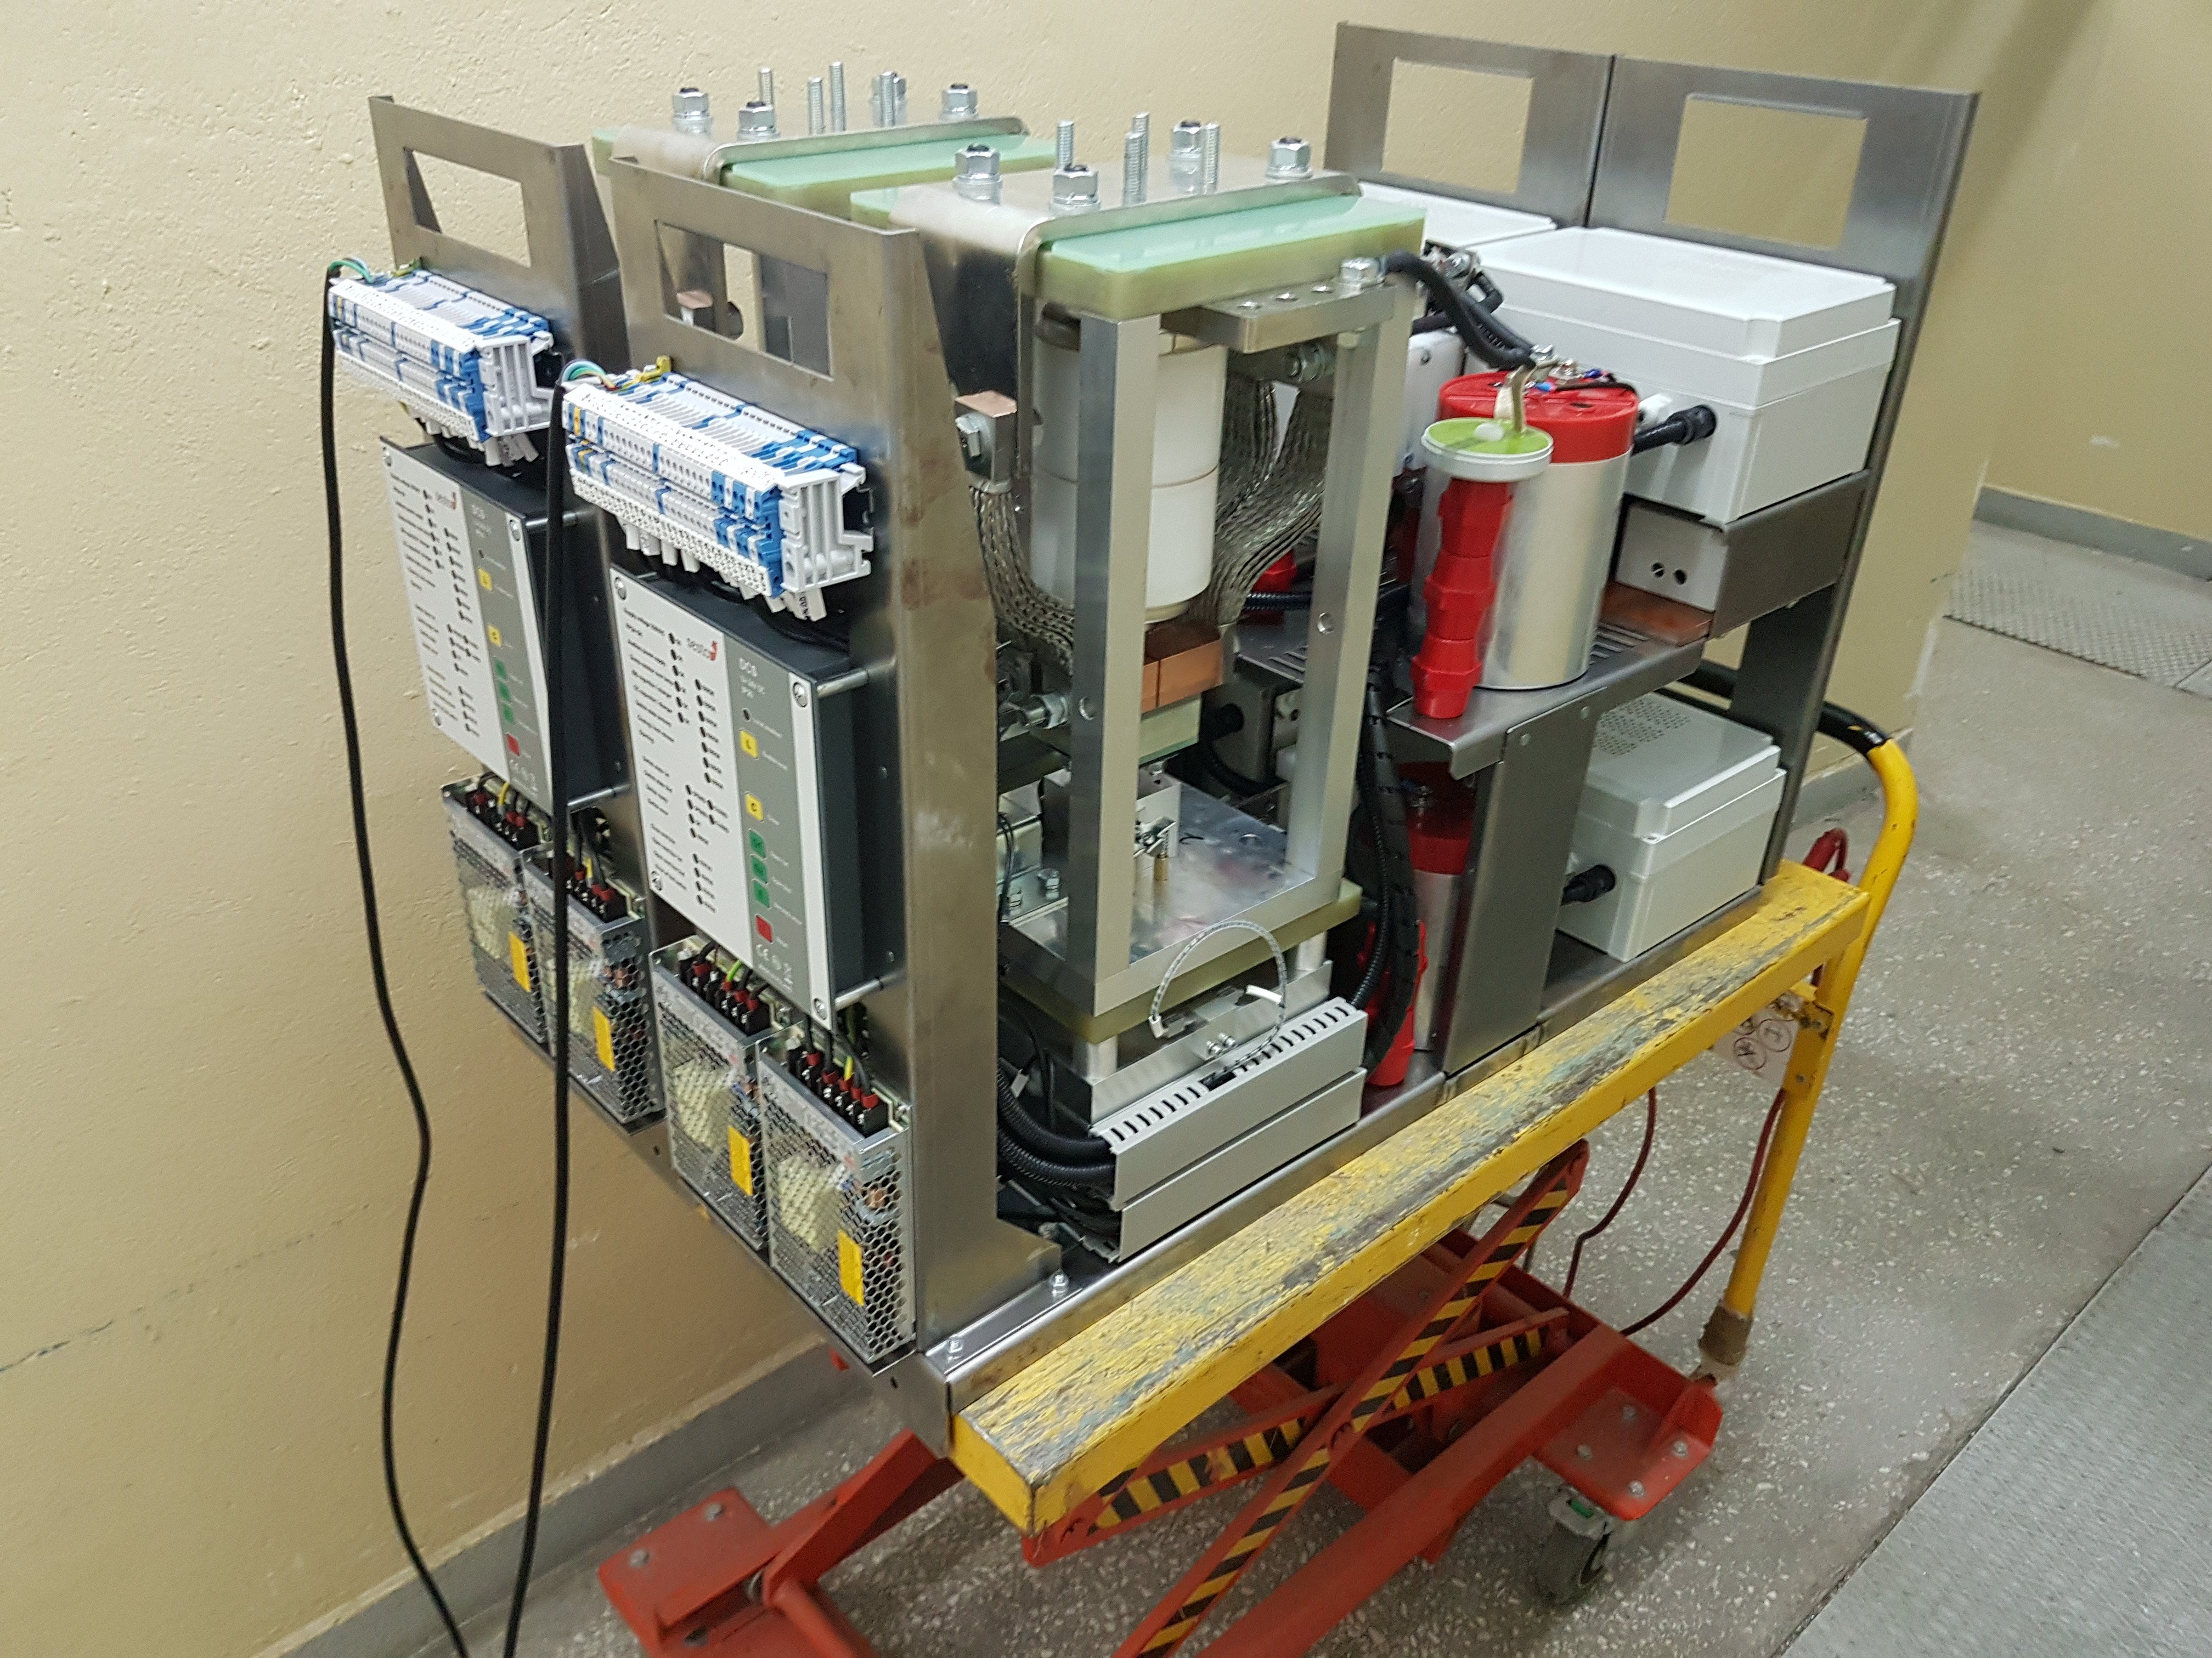
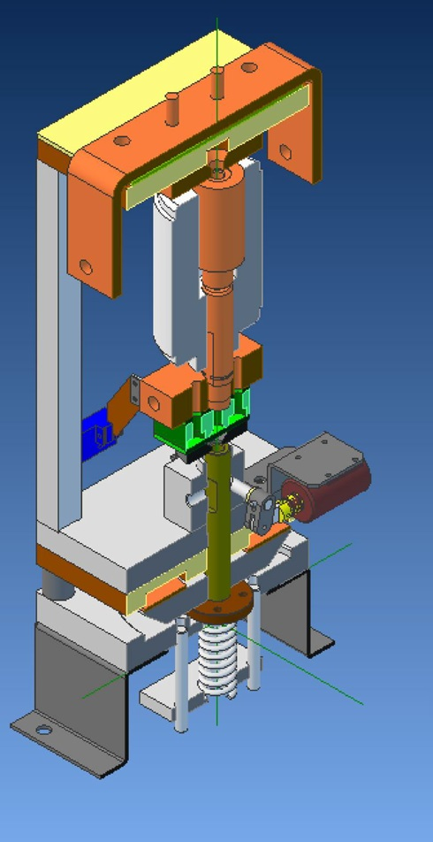
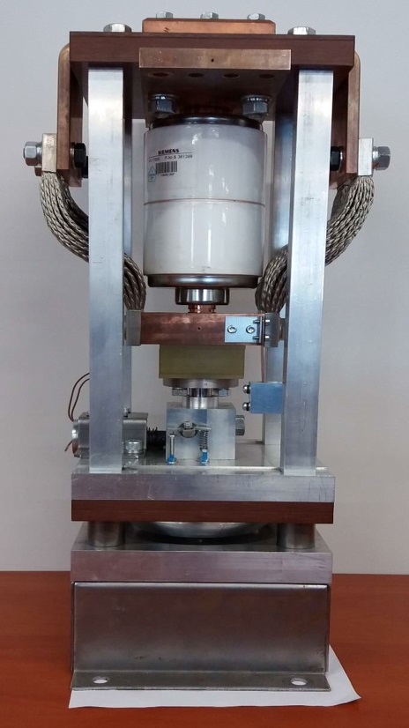
EE system based on vacuum switches (1)
Collaboration project between MPE-CERN and KAE-Lodz, Poland started in 2017
Project included: Design and manufacturing of one EE system for 2kA and two EE systems for 600A
In 2018: the prototypes were delivered and fully tested
Two vacuum switches
built in a sliding cassettes
Vacuum interrupter

Slide 12
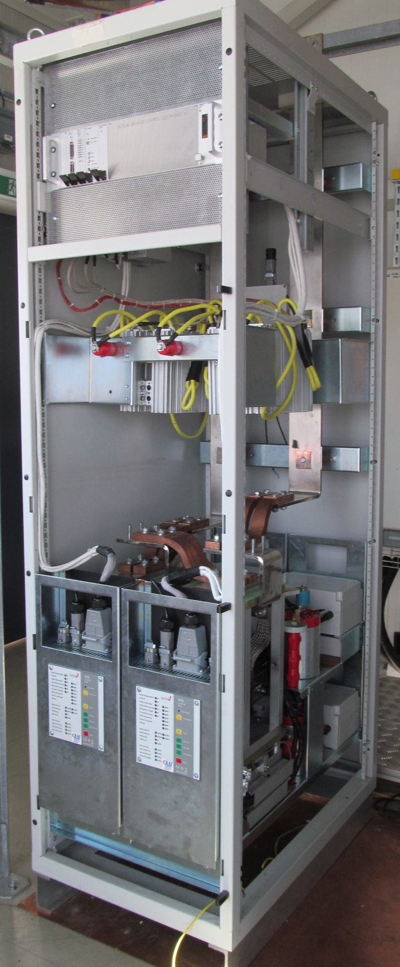
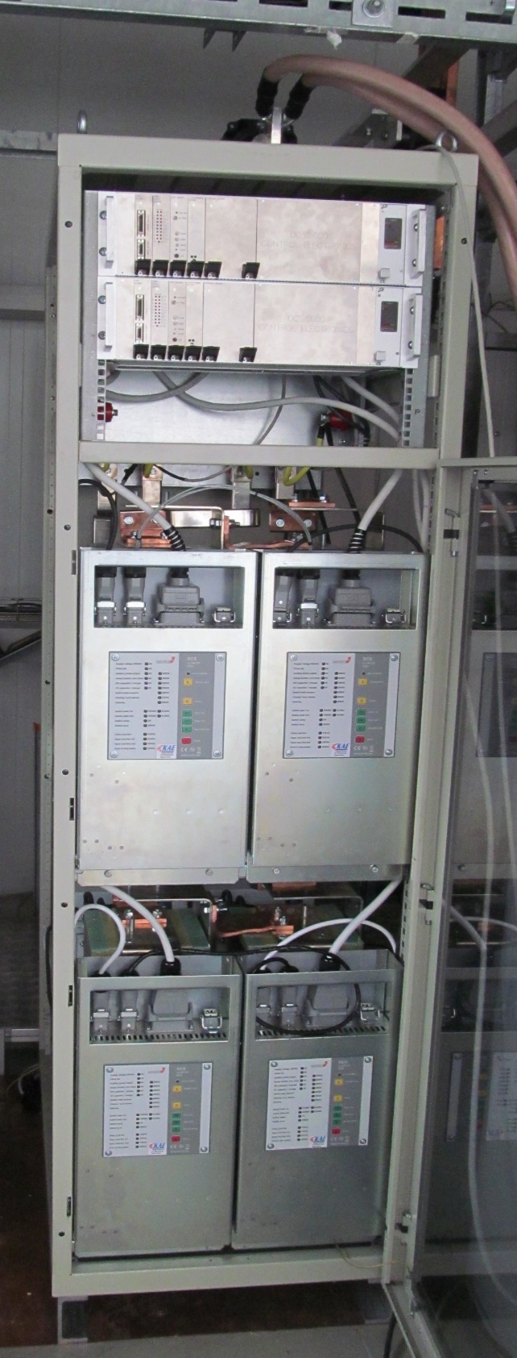
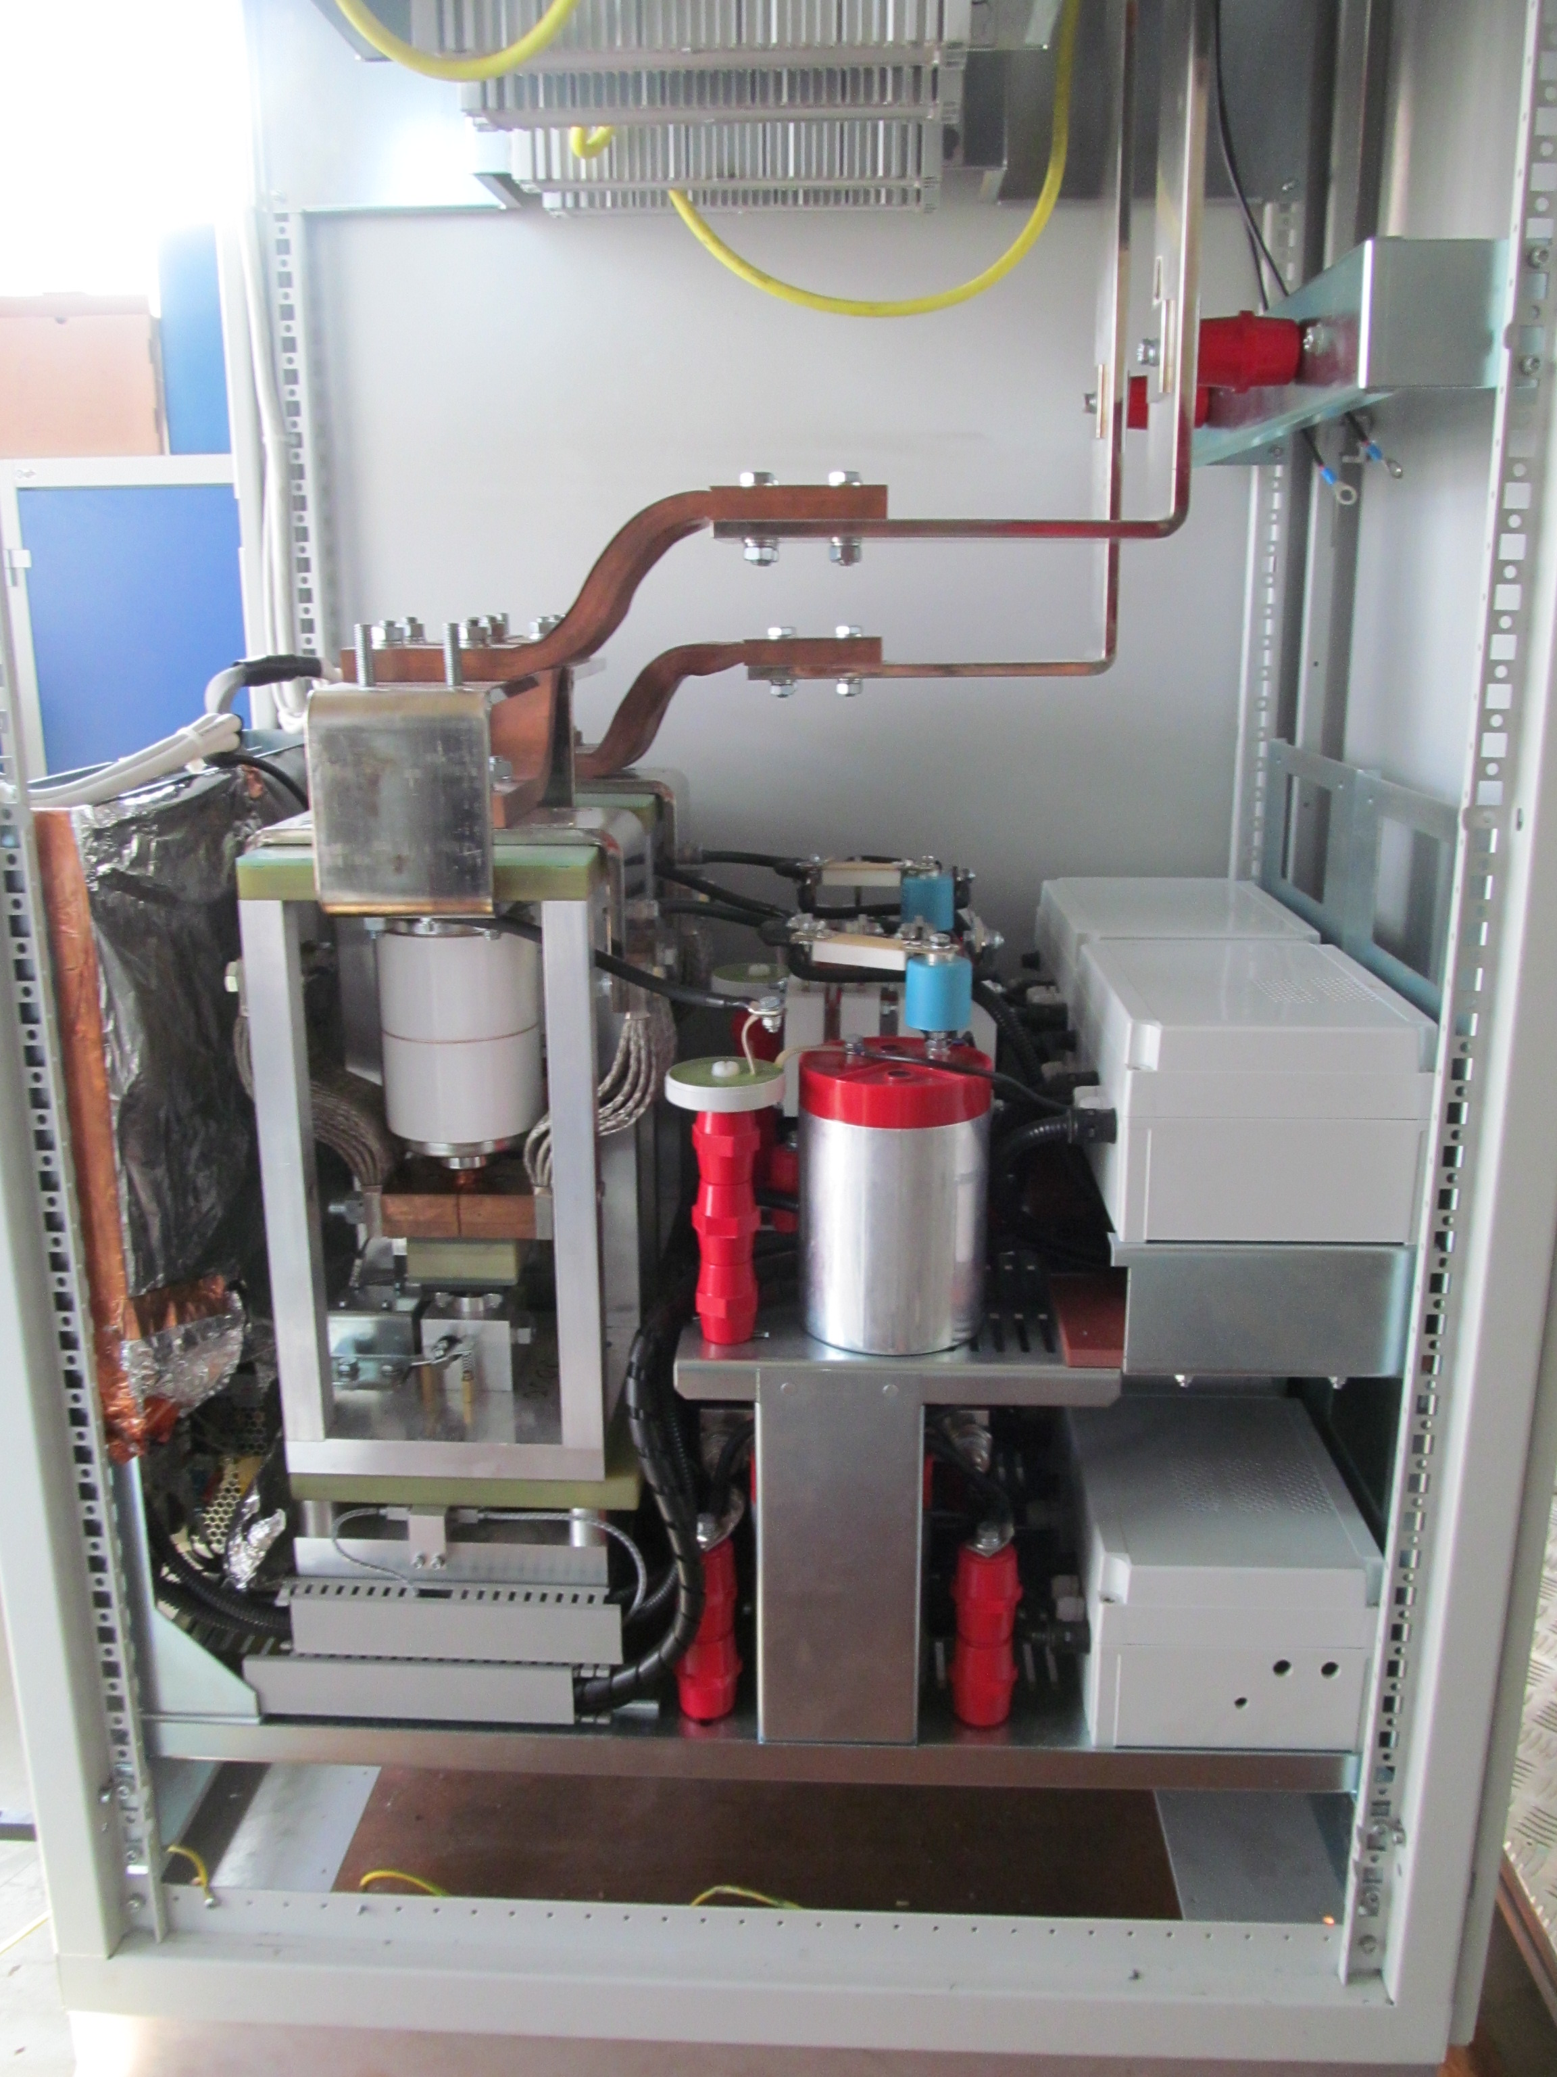
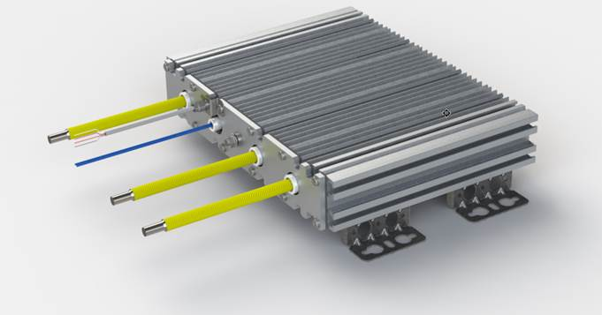
EE system based on vacuum switches (2)
Two independently operating vacuum switches are connected in series and triggered simultaneously
Integration of the EE systems is in the standard euro-rack (600x900x2000)
Auxiliary circuits
Vacuum interrupter
Dump Resistor
2kA EE system
2 system for 600A

Slide 13
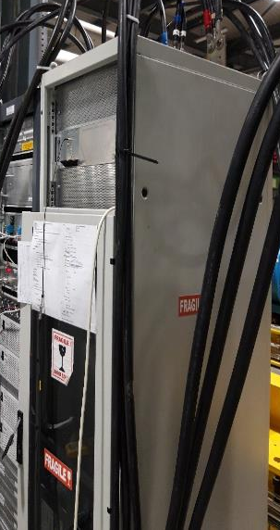
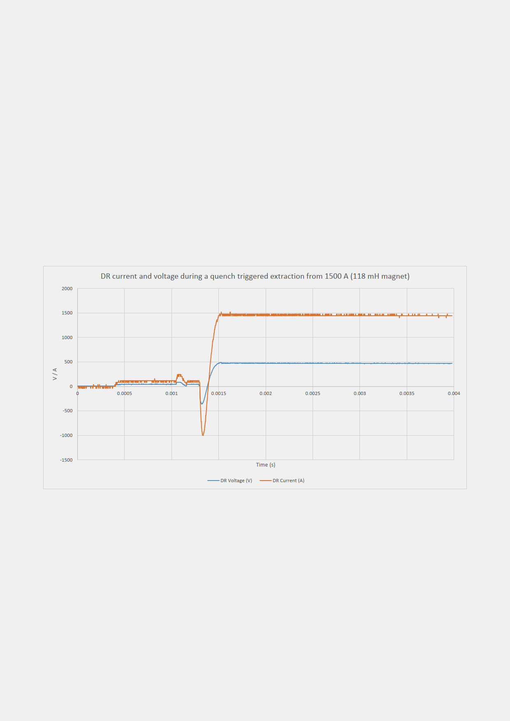
Performance of vacuum switches based EE systems
2kA system installed and commissioned in SM18 for protection of MCBXFB – 15.03.19
2kA vacuum switches based EE system in real operation
EE operation during a training quench of MCBXFB at 1.5kA (15.03.2019) SM18
Circuit current transferred to resistor for ≈1.8ms
Eight systems (pre-series order) delivered last month
  4 systems for 2kA
  4 systems for 600A
  Acceptance tests currently ongoing

Slide 14
Pros and cons (IGBT vs Vacuum switches)
Parameters | IGBT | Vacuum switches
Lifetime | long service life (20 years) | long service life (20 years)
Maintenance | no | Twice for the whole lifetime
Water cooling | Yes (active water cooling) Water supply infrastructure is needed (20l/min per system) | No (natural convection)
Continuous power losses at 2kA | ~ 5000W (2kA EE system) | ~ 400W (2kA EE system)
Opening time | less than 1ms | less than 2ms
Redundancy | Yes (triggerable fuse) | Yes (all levels)
Zero-crossing | Nonlinear behavior | no issue
Control complexity | More complex electronics
Cost | ~ 20% more expensive

Slide 15
Summary
For tunnel installation in HL-LHC: Vacuum switches based EE systems
For Superconducting test stations: IGBT based EE systems
A “pilot” installation in LHC of 4 vacuum switches based EE systems for 600A is planned during LS2
Apart from HL-LHC circuits, the vacuum switches based EE systems will replace in future the existing 600A corrector magnet EE facilities in LHC (EE systems strategy presented on TE-TM in April)

Slide 16
Thank You!

Slide 17

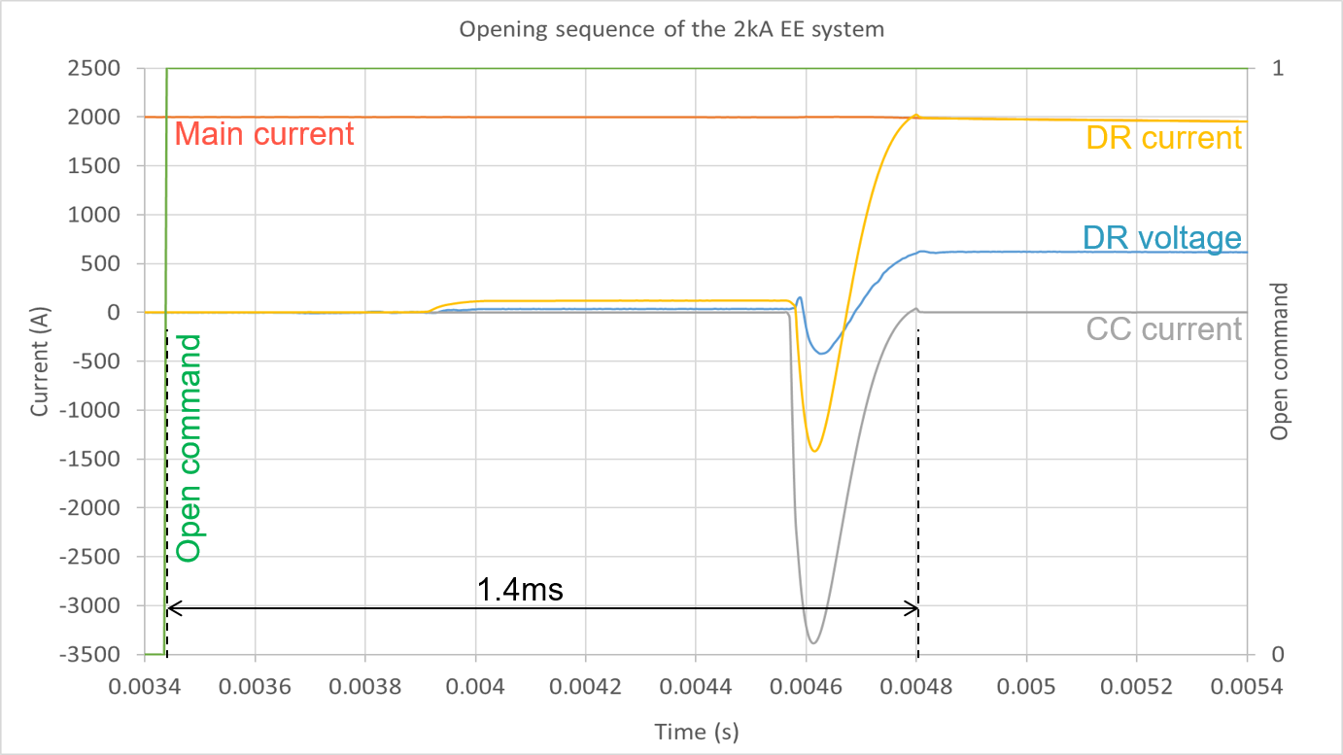
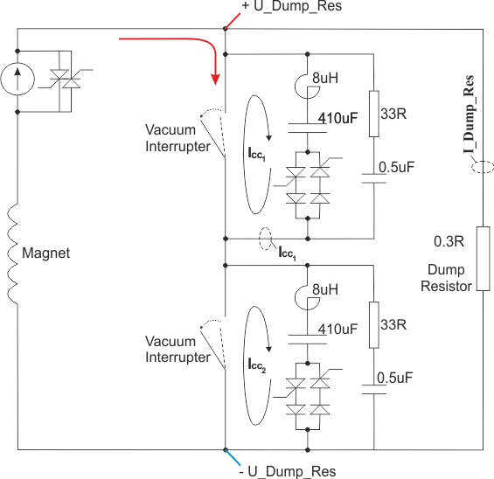
Additional slide (1)
Principle of operation and performance at 2kA vacuum switches based EE system
  The main current is transferred to the dump resistor in less than 2ms
Exponential decay

