Slide 1
RD53B Testchip C
Simulation Results
24.07.19
Florian Winkler

Slide 2
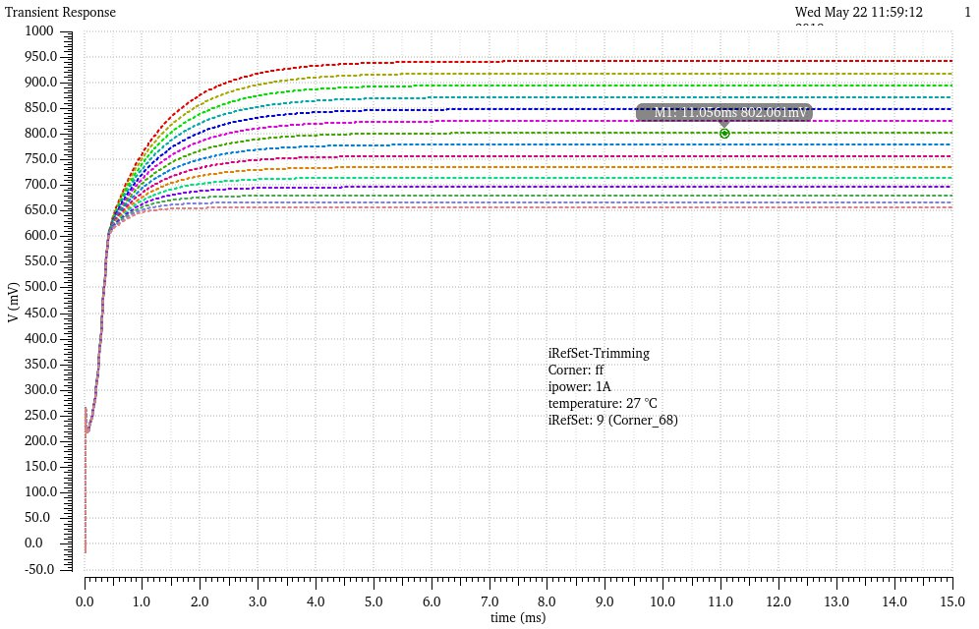
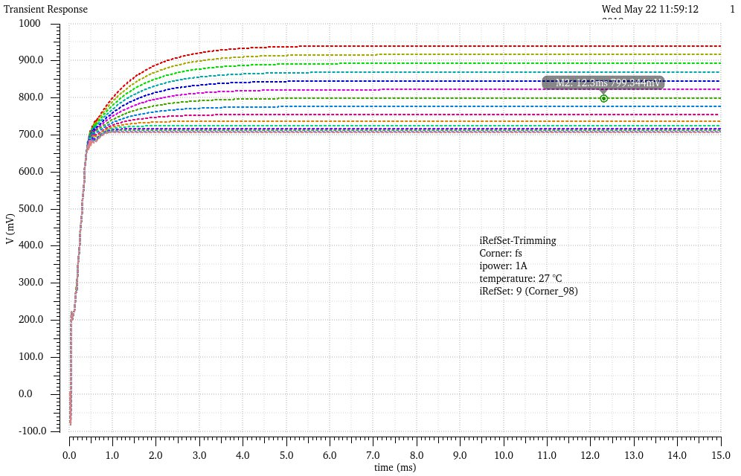
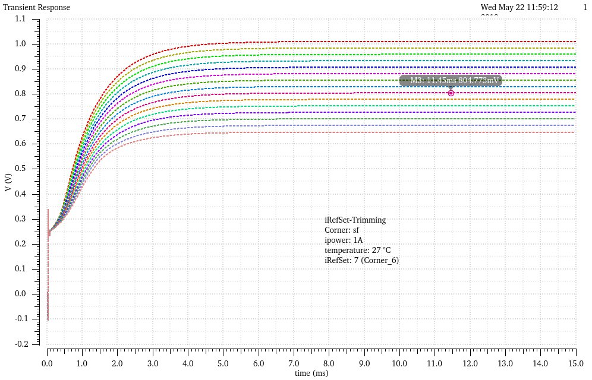
iRefSet Trimming

Slide 3
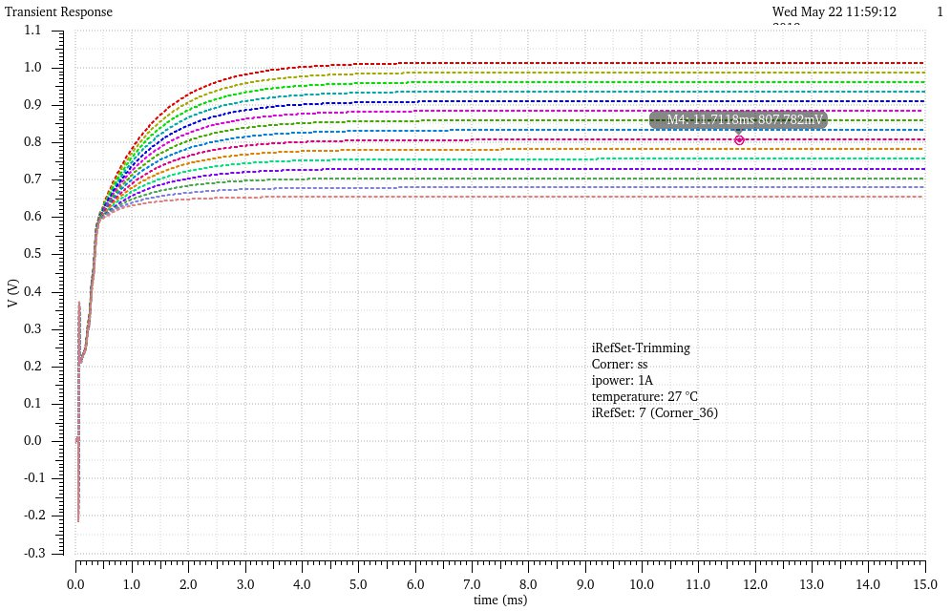
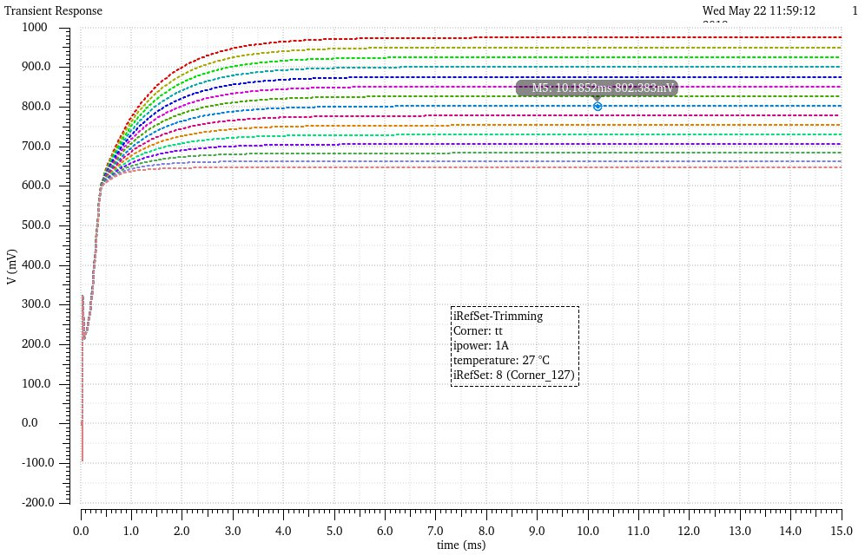
iRefSet Trimming

Slide 4
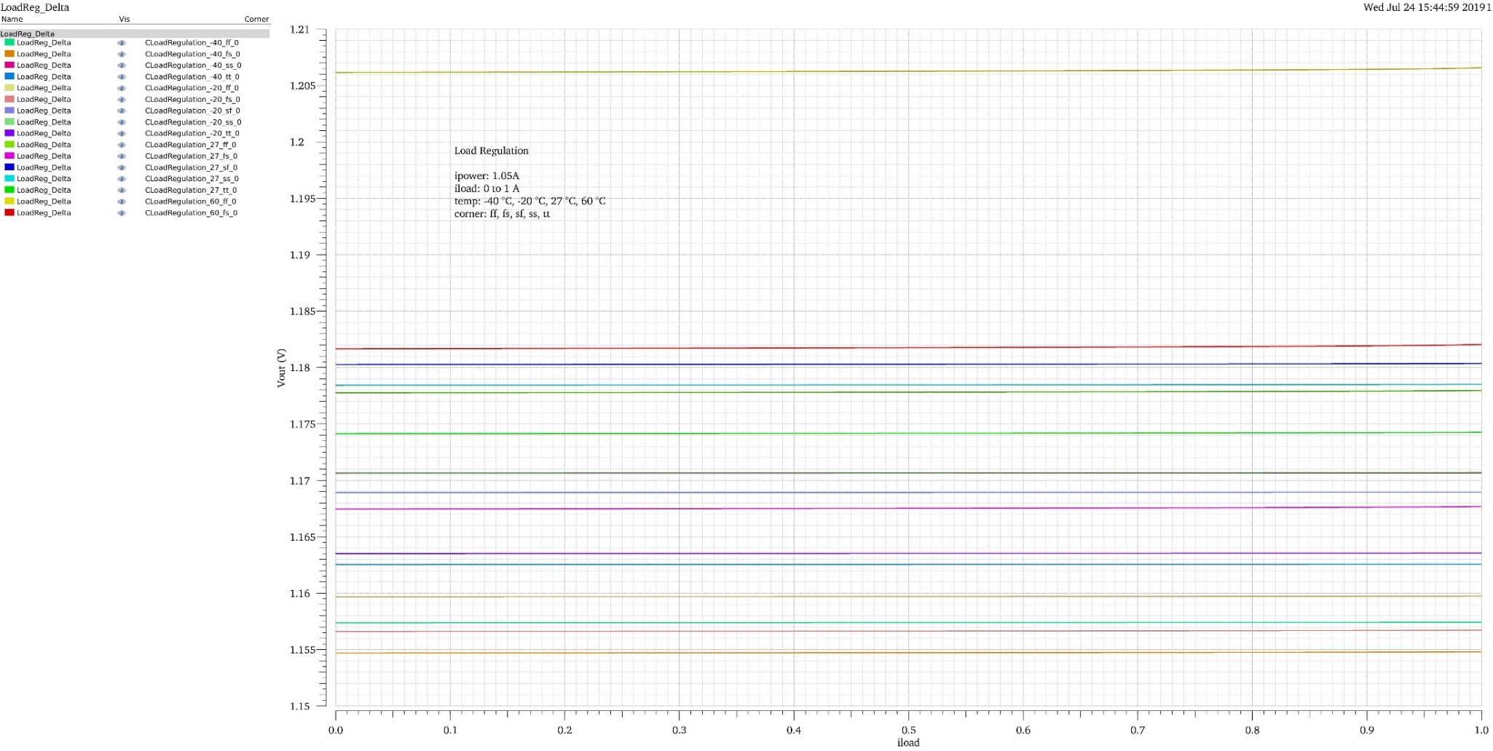
Load Regulation ipower 1.05A
Lowest LoadReg: 29.74 µV ( -40 °C , tt-Corner)
Highest LoadReg: 420.8 µV (60 °C. ff-Corner)

Slide 5
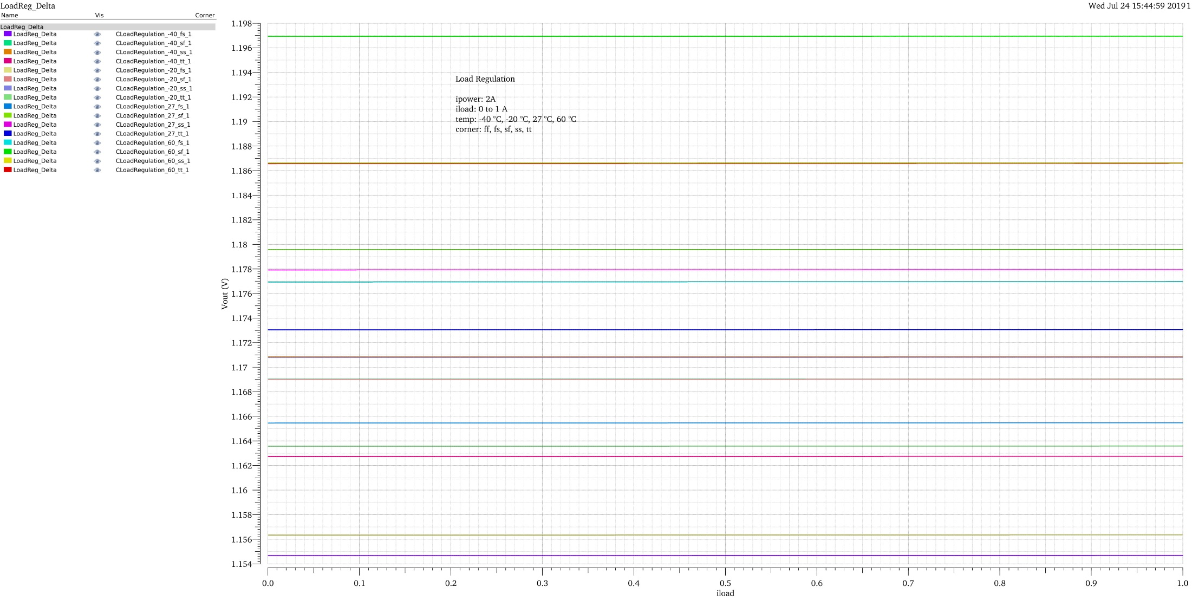
Load Regulation ipower 2A
Lowest LoadReg: 12.74 µV ( -40 °C , ss-Corner)
Highest LoadReg: 27.19 µV (60 °C fs-Corner)

Slide 6
Temperature Vin
Yellow: ff
Green: fs
Purple: tt
Cyan: sf
Blue: ss

Slide 7
Temperature Vout
Yellow: ff
Green: fs
Purple: tt
Cyan: sf
Blue: ss

Slide 8
Temperature Vref
Yellow: ff
Green: fs
Purple: tt
Cyan: sf
Blue: ss

Slide 9
Temperature Vofs
Yellow: ff
Green: fs
Purple: tt
Cyan: sf
Blue: ss

Slide 10
Load Transients 1.1A 0-500mA
Ymax: 31.6 mV ( -20 °C , ss-Corner)
Ymin: 27.53 mV (-20 °C ss-Corner)
Temperature variation in Vout : 51,48 mV

Slide 11
Load Transients 2A 0-500mA
Ymax: 30.62 mV ( -20 °C , ss-Corner)
Ymin: 28.19 mV (-20 °C ss-Corner)
Temperature variation in Vout: 47.31 mV

Slide 12
Load Transients 1.1A 250-750mA
Ymax: 36.36 mV ( -40 °C , ss-Corner)
Ymin: 29.56 mV (-40 °C ss-Corner)
Temperature Variation in Vout: 51.51 mV

Slide 13
Load Transients 2A 250-750mA
Ymax: 31.16 mV ( -20 °C , ss-Corner)
Ymin: 28.45 mV (-20 °C ss-Corner)
Temperature Variation in Vout: 47.31 mV

Slide 14
Start Up 100n 1A Vin

Slide 15
Start Up 100n 2A Vin

Slide 16
Start Up 100n 1A Vout

Slide 17
Start Up 100n 2A Vout

Slide 18
Start Up 1m 1A Vin

Slide 19
Start Up 1m 2A Vin

Slide 20
Start Up 1m 1A Vout

Slide 21
Start Up 1m 2A Vout

Slide 22
Start Up 100m 1A Vin

Slide 23
Start Up 100m 2A Vin

Slide 24
Start Up 100m 1A Vout

Slide 25
Start Up 100m 2A Vout

Slide 26
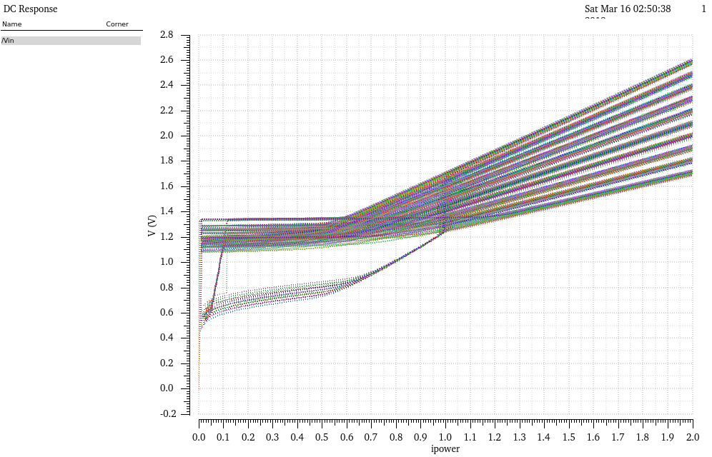
Rext Sweep
Corners: ff, fs, sf, ss, tt
Temps: -40, -20, 27, 60
Rload: 1.2G, 240, 12, 1.2
Rext: Sweep from 450 to 900 in steps of 50

Slide 27
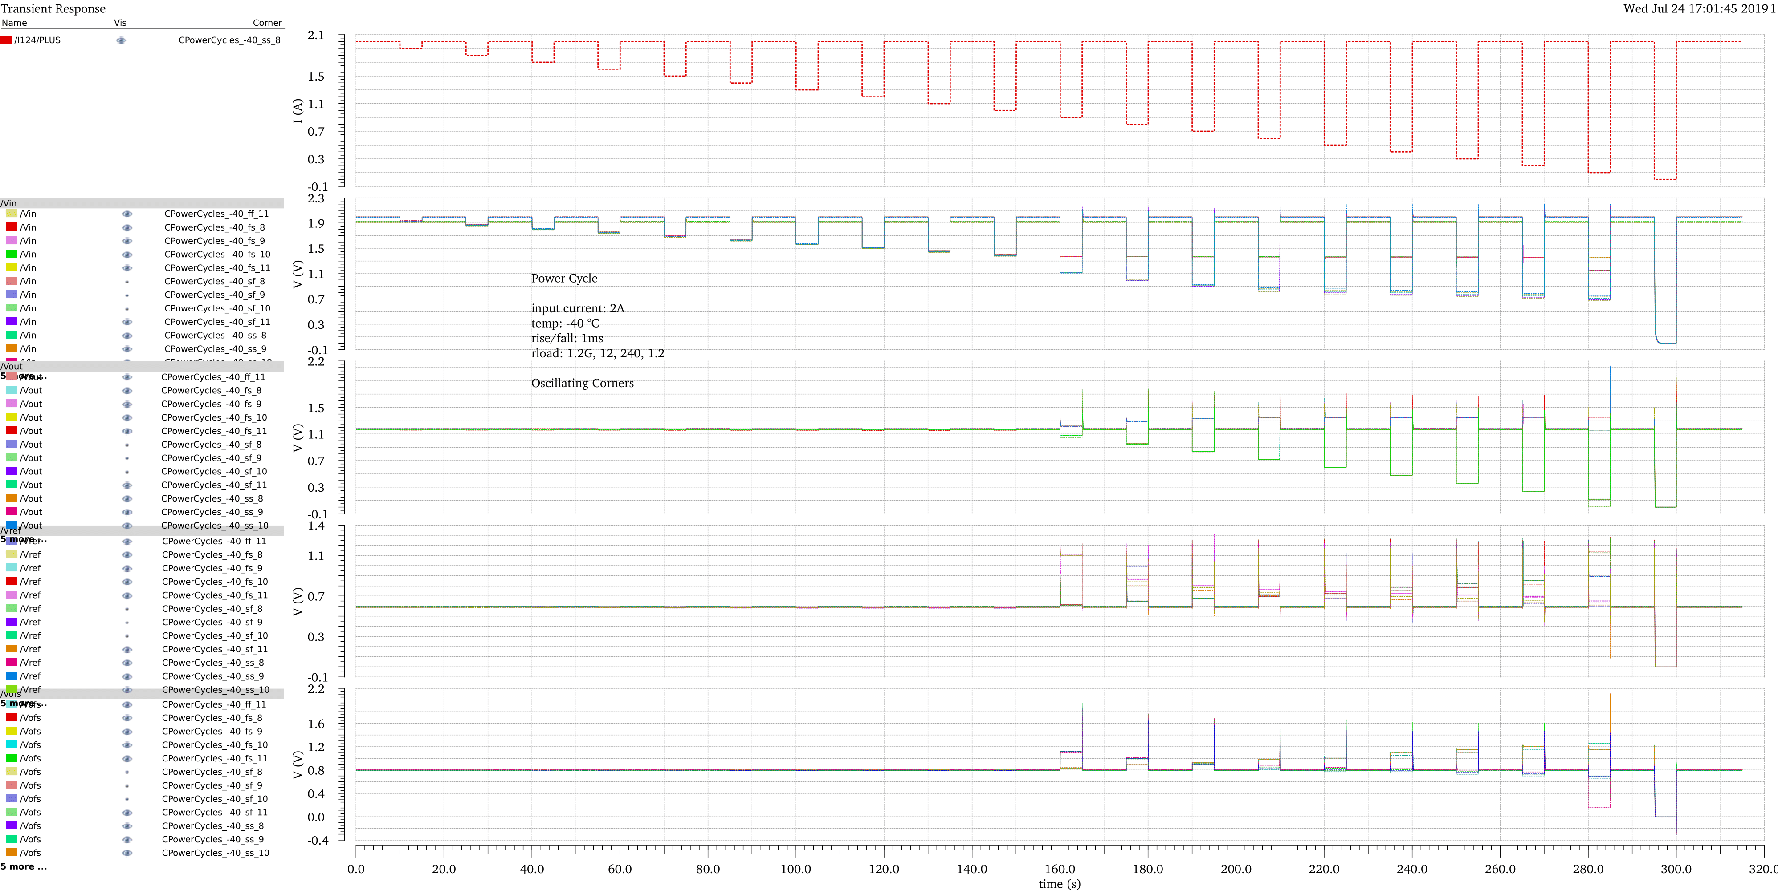
Power Cycles -40 °C 1m rise/fall
Oscillating Corners

Slide 28
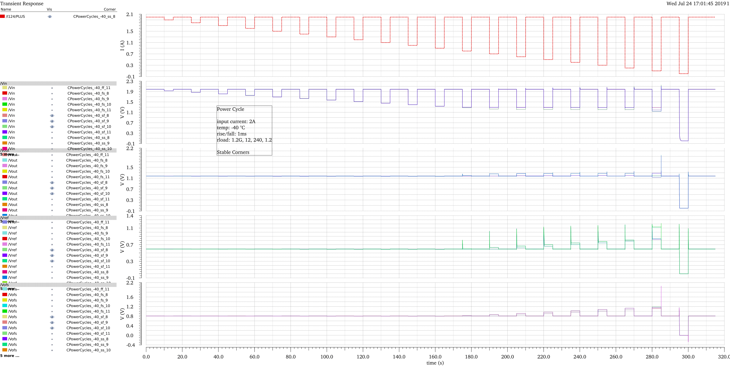
Power Cycles -40 °C 1m rise/fall
Stable Corners

Slide 29
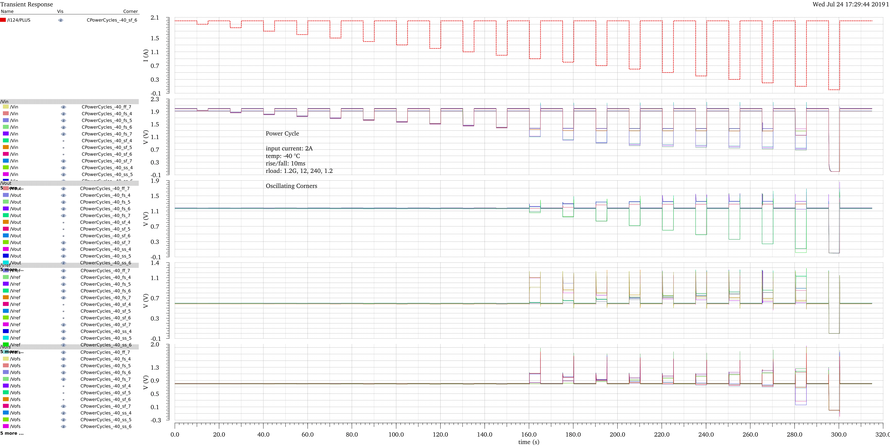
Power Cycles -40 °C 10m rise/fall
Oscillating Corners

Slide 30
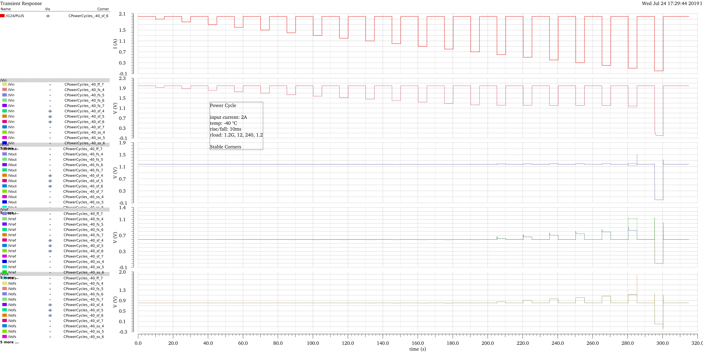
Power Cycles -40 °C 10m rise/fall
Stable Corners

Slide 31
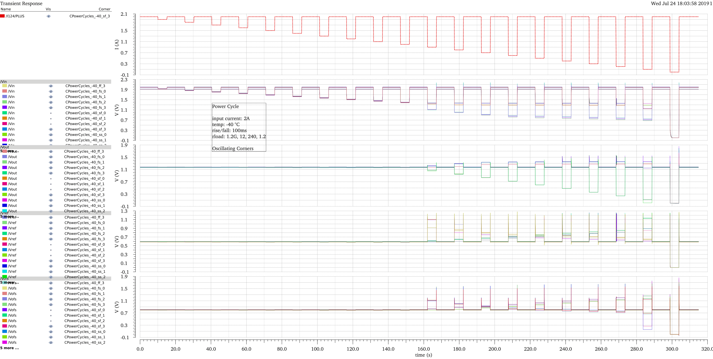
Power Cycles -40 °C 100m rise/fall
Oscillating Corners occur when ipower drops below 1A

Slide 32
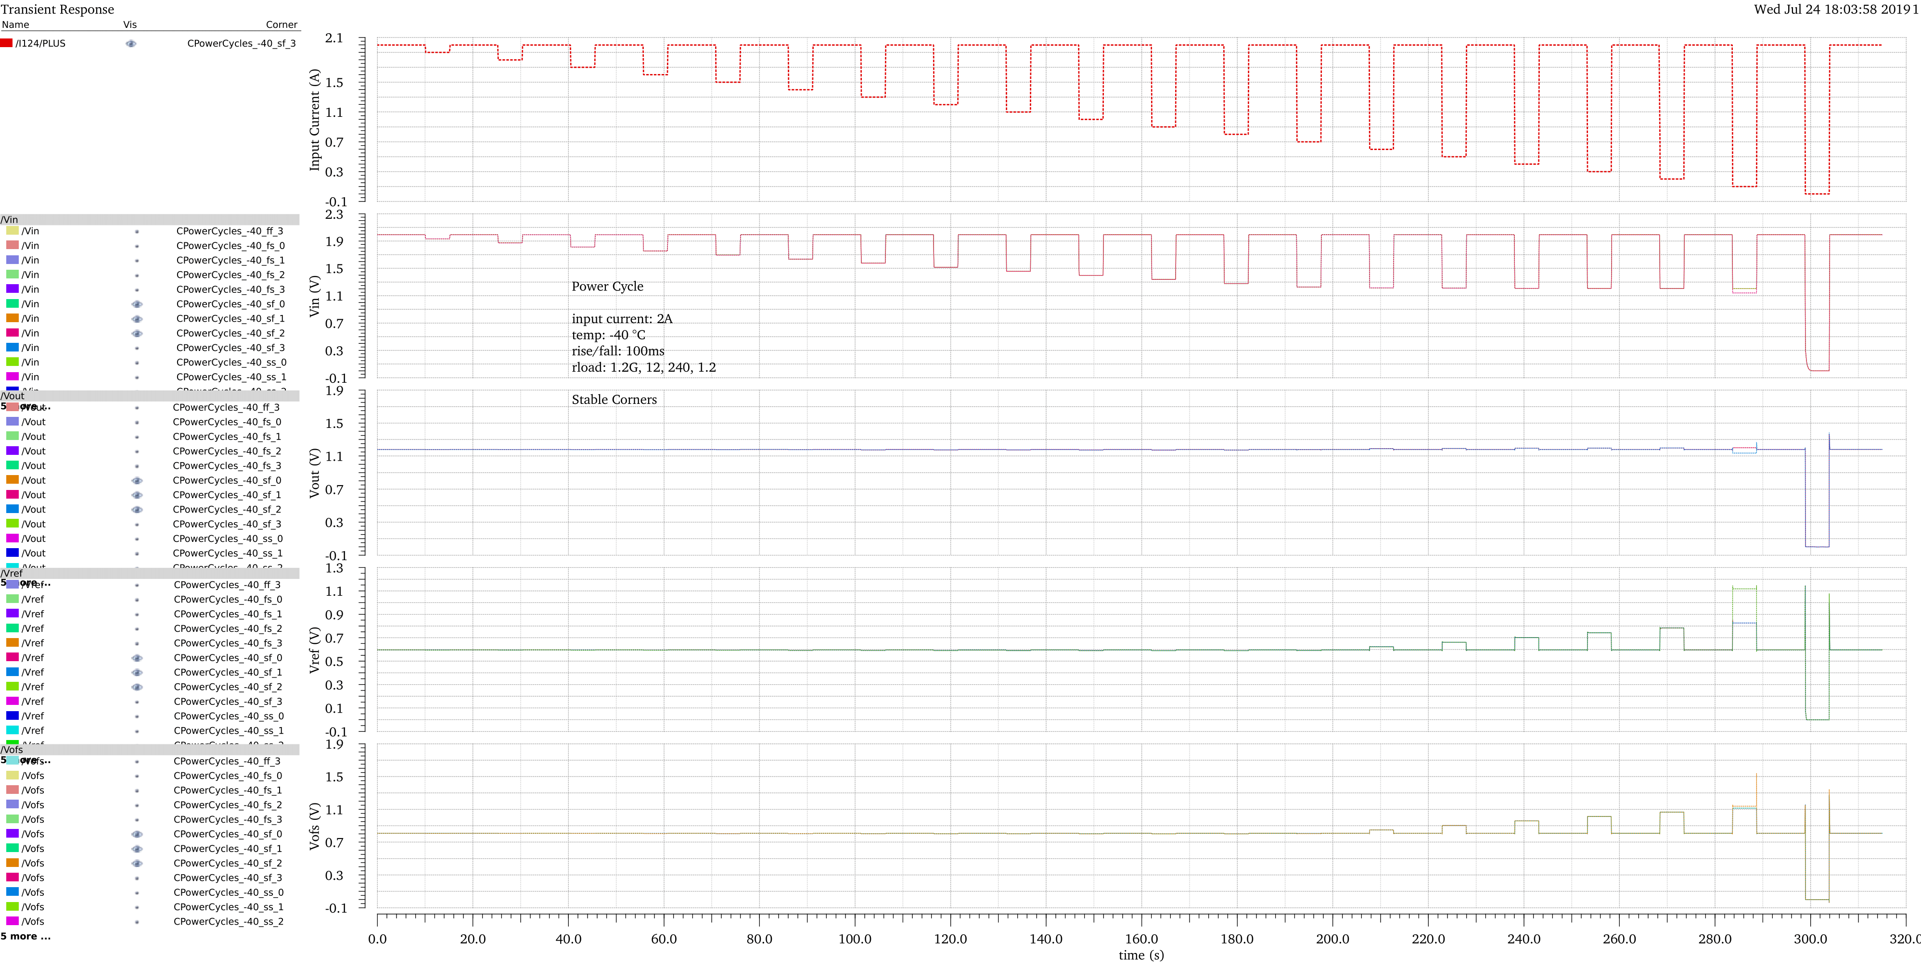
Power Cycles -40 °C 100m rise/fall
Stable Corners

