Slide 1
Shunt-LDO Measurements
RD53B – Testchip 1
Jendrik Zorn
29.05.2019

Slide 2
Line Regulation - LDO
Vref=600mV,Irefset=1110,Rint
 |  | min | max
∆Vofshalf | 0.000986 | 0.404241 | 0.405227
∆Vref | -0.001209 | 0.604567 | 0.605776
∆Vout_Sense | -0.00276 | 1.22925 | 1.23201
∆Iin_Sense | 0.7 | 1.29994 | 1.99994
∆Iout_Sense | -0.000426 | 0.562312 | 0.562738
∆Vrefpre | -3.88E-06 | 4.56E-06 | 8.44E-06
∆Vprereg | 0.00113 | 1.12503 | 1.12616

Slide 3
Line Regulation - SLDO
Vofshalf=400mV,Vref=600mV,Irefset=1110,Rext=600Ω
 |  | min | max
∆Vofs | -0.002997 | 0.400817 | 0.403814
∆Vref | -0.003095 | 0.598851 | 0.601946
∆Vout_Sense | -0.00829 | 1.2163 | 1.22459
∆Iin_Sense | 0.6072 | 1.33075 | 1.93795
∆Iout_Sense | 0.014448 | 0.569847 | 0.584295
∆Vrefpre | 0.00292448 | 0.00218613 | 0.00511061
∆Vprereg | 0.02469 | 1.13612 | 1.16081

Slide 4
Line Regulation - SLDO
Vofshalf=650mV,Vref=600mV,Irefset=1110,Rext=600Ω
 |  | min | max
∆Vofs | -0.003004 | 0.651011 | 0.654015
∆Vref | -0.003288 | 0.597901 | 0.601189
∆Vout_Sense | -0.00526 | 1.2179 | 1.22316
∆Iin_Sense | 0.32065 | 1.65471 | 1.97536
∆Iout_Sense | 0.007925 | 0.567922 | 0.575847
∆Vrefpre | 0.00147807 | 0.00145745 | 0.00293552
∆Vprereg | 0.01368 | 1.13419 | 1.14787

Slide 5
Load Regulation - LDO
Vref=600mV,Irefset=1110,Vin=2V,Rext=600Ω

Slide 6
Load Regulation - LDO
Vref=600mV,Irefset=1110,Vin=2V,Rext=600Ω
 |  | min | max
∆Vofshalf | -0.003265 | 0.401343 | 0.404608
∆Vref | -0.00536 | 0.598823 | 0.604183
∆Vout_Sense | -0.00718 | 1.22144 | 1.22862
∆Iin_Sense | -0.00564 | 1.99403 | 1.99967
∆Iout_Sense | 0.003716 | 0.56314 | 0.566856
∆Vrefpre | 3.577E-05 | 6.44E-06 | 4.22E-05
∆Vprereg | 0.0072 | 1.12726 | 1.13446

Slide 7
Load Regulation - SLDO
Vofshalf=400mV,Vref=600mV,Iin=1.65A,Irefset=1110,Rext=600Ω

Slide 8
Load Regulation - SLDO
Vofshalf=400mV,Vref=600mV,Iin=1.65A,Irefset=1110,Rext=600Ω
 |  | min | max
∆Vofshalf | -0.002157 | 0.398517 | 0.400674
∆Vref | -0.005287 | 0.595359 | 0.600646
∆Vout_Sense | -0.00337 | 1.21432 | 1.21769
∆Iin_Sense | 0.00031 | 1.98867 | 1.98898
∆Iout_Sense | -0.007183 | 0.577626 | 0.584809
∆Vrefpre | -3.16E-03 | 2.07E-03 | 5.23E-03
∆Vprereg | -0.00942 | 1.15251 | 1.16193

Slide 9
Load Regulation - SLDO
Vofshalf=650mV,Vref=600mV,Iin=1A,Irefset=1110,Rext=600Ω

Slide 10
Load Regulation - SLDO
Vofshalf=650mV,Vref=600mV,Iin=1A,Irefset=1110,Rext=600Ω
 |  | min | max
∆Vofshalf | 0.002935 | 0.64932 | 0.652255
∆Vref | 0.001822 | 0.597399 | 0.599221
∆Vout_Sense | 0.00495 | 1.21737 | 1.22232
∆Iin_Sense | 0.00049 | 1.99328 | 1.99377
∆Iout_Sense | -0.009731 | 0.567646 | 0.577377
∆Vrefpre | -2.93E-03 | 9.98E-05 | 3.03E-03
∆Vprereg | -0.01495 | 1.1359 | 1.15085

Slide 11
Sweep: Vofs - SLDO
Vofshalf=375mV-600mV,Vref=600mV,Irefset=1110,Rext=600Ω

Slide 12
Sweep: Vofs - SLDO
Vofshalf=375mV-600mV,Vref=600mV,Irefset=1110,Rext=600Ω
Vofs | Slope | Offset
750 | 0.7499 | 0.5634
800 | 0.755 | 0.6855
850 | 0.757 | 0.7761
900 | 0.747 | 0.8356
950 | 0.7404 | 0.8928
1000 | 0.7374 | 0.9442
1050 | 0.7275 | 1.0054
1100 | 0.7292 | 1.0518
1150 | 0.7211 | 1.1055
1200 | 0.7141 | 1.164

Slide 13
Sweep: Rext - SLDO
Vofshalf=500mV,Vref=600mV,Irefset=1110,Rext=450Ω-600Ω

Slide 14
Sweep: Rext - SLDO
Vofshalf=500mV,Vref=600mV,Irefset=1110,Rext=450Ω-600Ω
Rext | Slope | Offset
450 | 0.5711 | 0.9352
500 | 0.6234 | 0.9433
550 | 0.6811 | 0.9459
600 | 0.7334 | 0.9516
650 | 0.7925 | 0.9485
700 | 0.8473 | 0.9504
750 | 0.8965 | 0.9568
800 | 0.9508 | 0.957
850 | 1.0105 | 0.9547
900 | 1.0643 | 0.9558

Slide 15
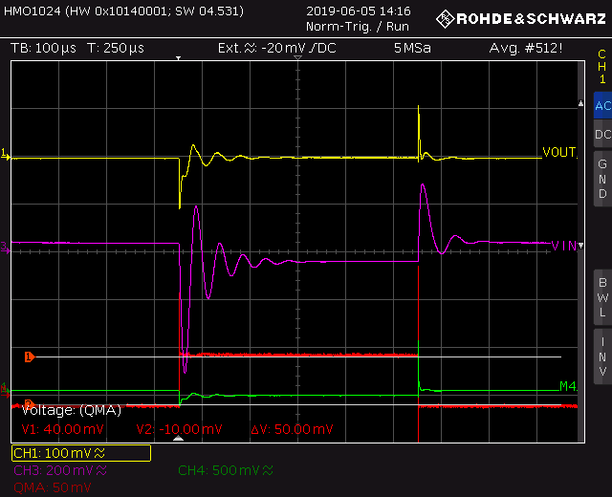
Load Transient - LDO
Vref=600mV,Irefset=1110,Rext=600Ω,Vwave=1.99Vpp,
Iload=0-500mA,Vin=2V

Slide 16
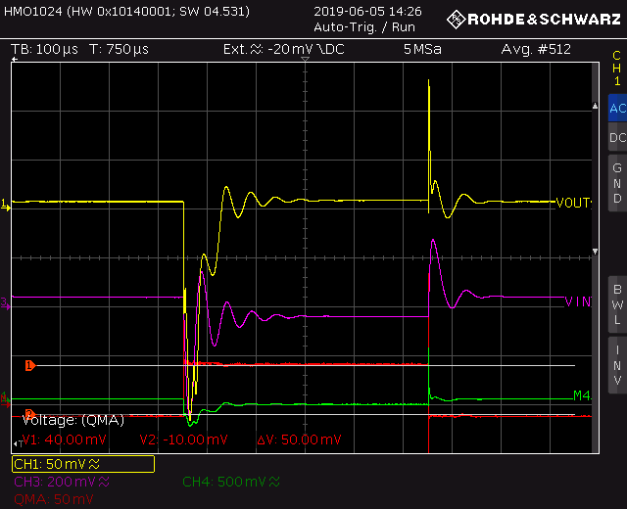
Load Transient - LDO
Vref=600mV,Irefset=1110,Rext=600Ω,Vwave=1.99Vpp,
Iload=0-500mA,Vin=1.4V

Slide 17
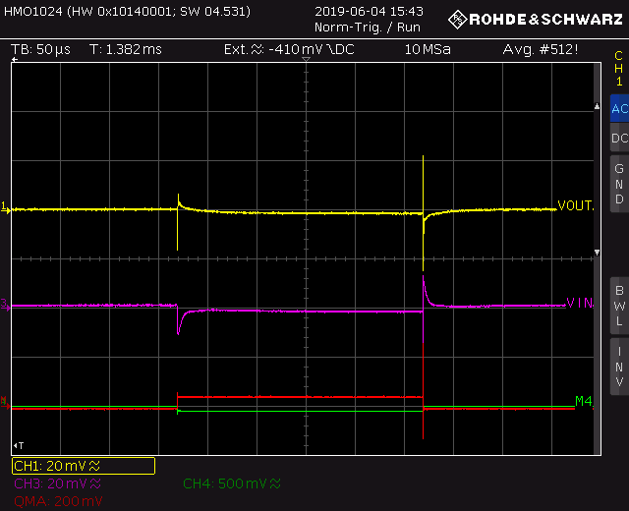
Load Transient - SLDO
Vofshalf=400mV,Vref=600mV,Irefset=1110,Rext=600Ω,Vwave=1.96Vpp,
Iload=0-500mA,Iin=1A

Slide 18
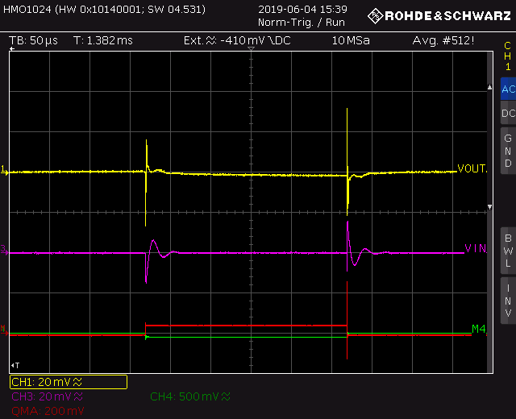
Load Transient - SLDO
Vofshalf=400mV,Vref=600mV,Irefset=1110,Rext=600Ω,Vwave=1.96Vpp,
Iload=0-500mA,Iin=1.7A

Slide 19
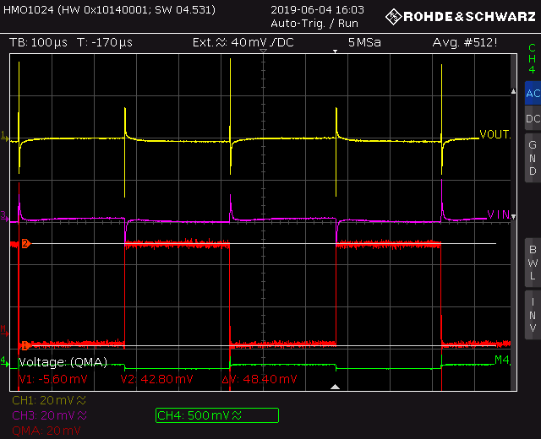
Load Transient - SLDO
Vofshalf=650mV,Vref=600mV,Irefset=1110,Rext=600Ω,Vwave=1.96Vpp,
Iload=0-500mA,Iin=1A

Slide 20
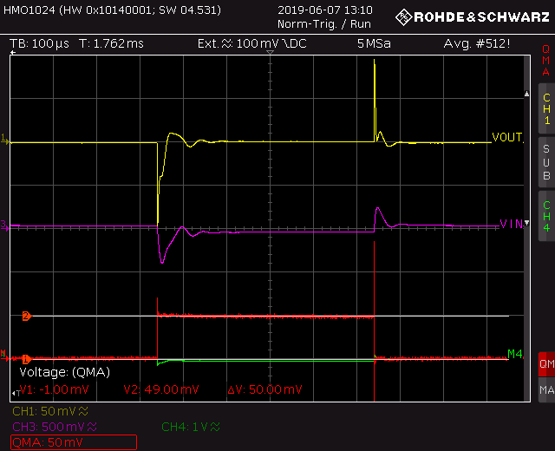
Load Transient - LDO
Vref=600mV,Irefset=1110,Rext=600Ω,Vwave=1.99Vpp,
Iload=450-950mA,Vin=2V

Slide 21
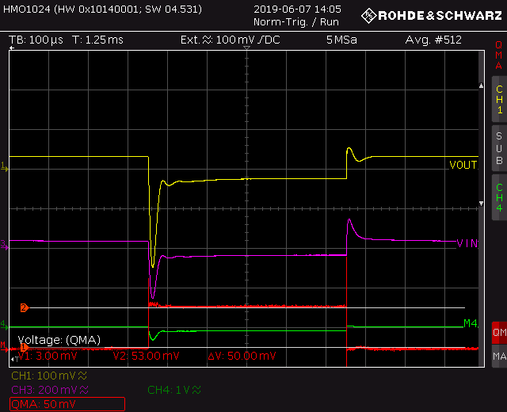
Load Transient - LDO
Vref=600mV,Irefset=1110,Rext=600Ω,Vwave=1.99Vpp,
Iload=450-950mA,Vin=1.4V

Slide 22
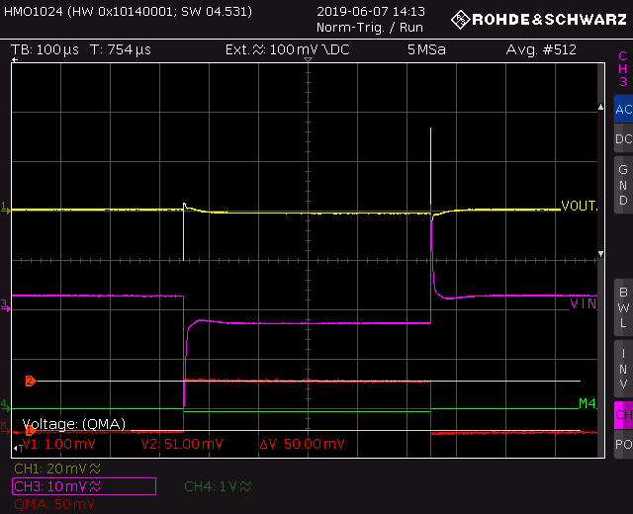
Load Transient - SLDO
Vofshalf=400mV,Vref=600mV,Irefset=1110,Rext=600Ω,Vwave=1.98Vpp,
Iload=450-950mA,Iin=1A

Slide 23
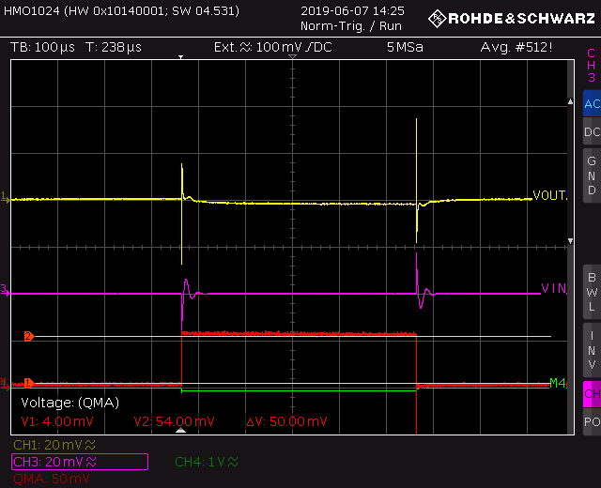
Load Transient - SLDO
Vofshalf=400mV,Vref=600mV,Irefset=1110,Rext=600Ω,Vwave=1.98Vpp,
Iload=450-950mA,Iin=1.7A

Slide 24
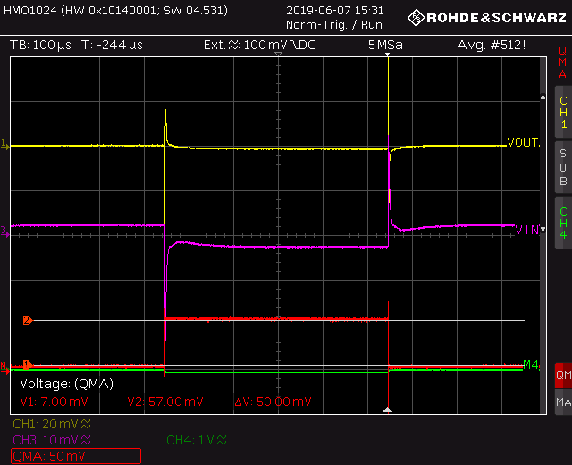
Load Transient - SLDO
Vofshalf=650mV,Vref=600mV,Irefset=1110,Rext=600Ω,Vwave=1.98Vpp,
Iload=450-950mA,Iin=1A

Slide 25
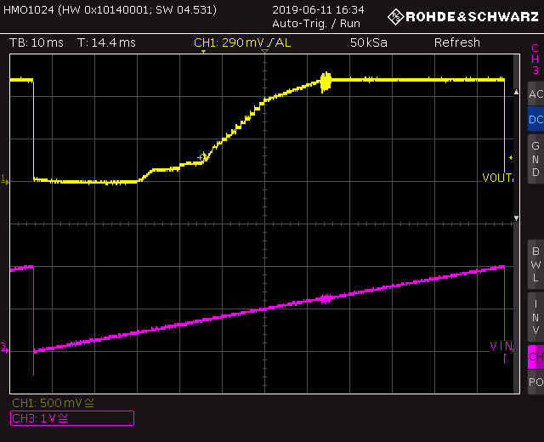
Startup behaviour - LDO
Vref=600mV,Irefset=1110,Rext=600Ω,Vin=0V-2V,trise=110ms

Slide 26
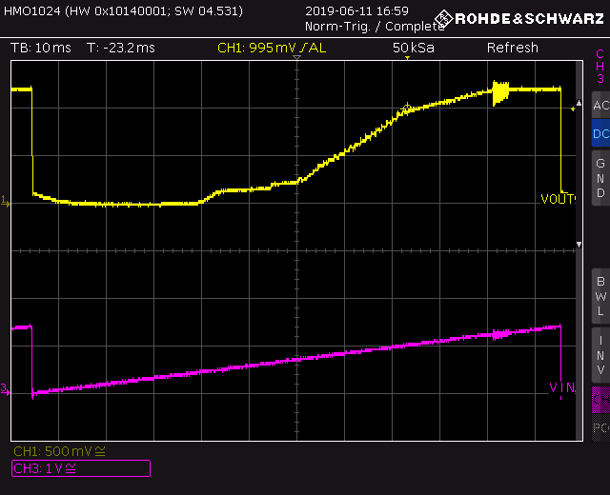
Startup behaviour – LDO
Vref=600mV,Irefset=1110,Rext=600Ω,Vin=0V-1.4V,trise=110ms

Slide 27
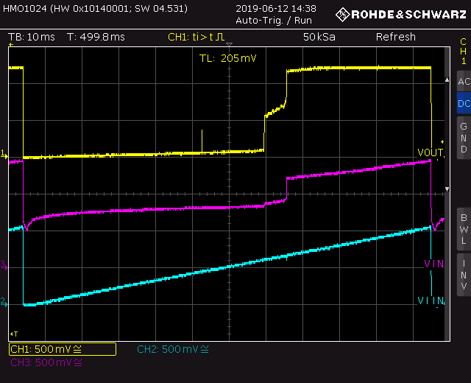
Startup behaviour - SLDO
Vofshalf=400mV,Vref=600mV,Irefset=1110,Rext=600Ω,
Iin=0A-1A,trise=110ms

Slide 28
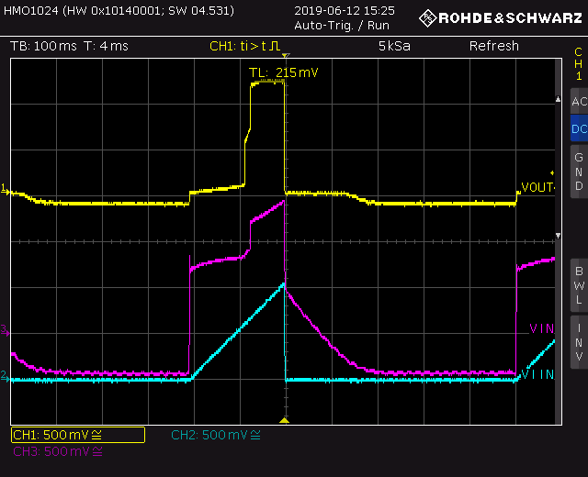
Startup behaviour - SLDO
Vofshalf=400mV,Vref=600mV,Irefset=1110,Rext=600Ω,
Iin=0A-1A,trise=200ms,delay=500ms

Slide 29
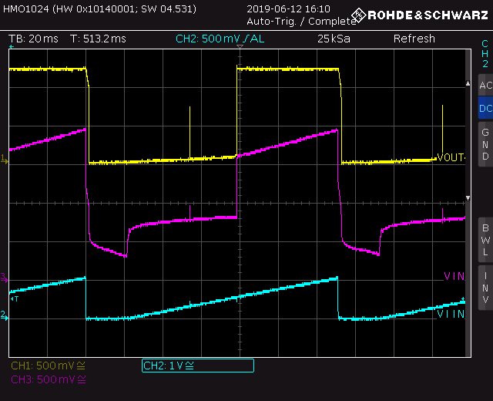
Startup behaviour - SLDO
Vofshalf=650mV,Vref=600mV,Irefset=1110,Rext=600Ω,
Iin=0A-1A,trise=110ms,delay=20ms

Slide 30
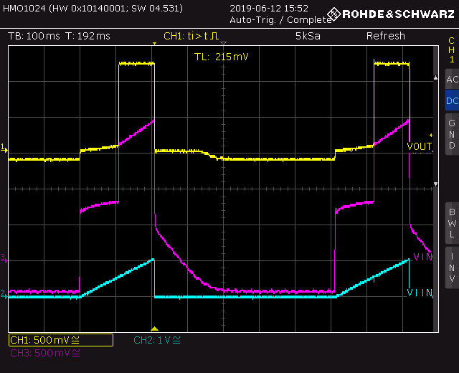
Startup behaviour - SLDO
Vofshalf=650mV,Vref=600mV,Irefset=1110,Rext=600Ω,
Iin=0A-1A,trise=200ms,delay=500ms

Slide 31
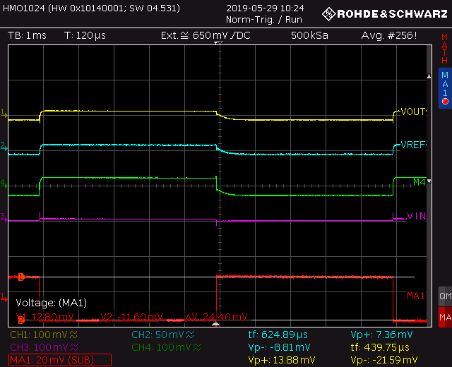
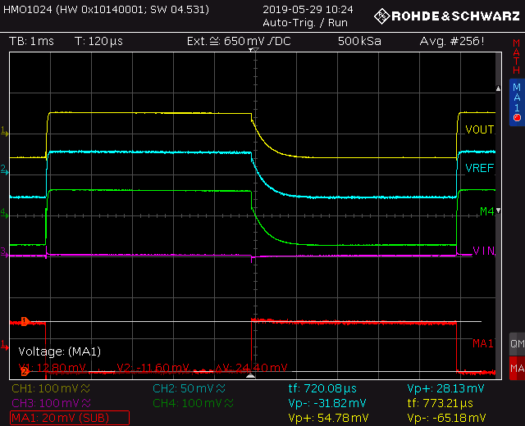
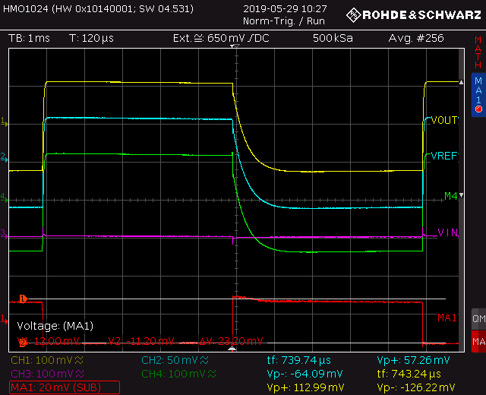
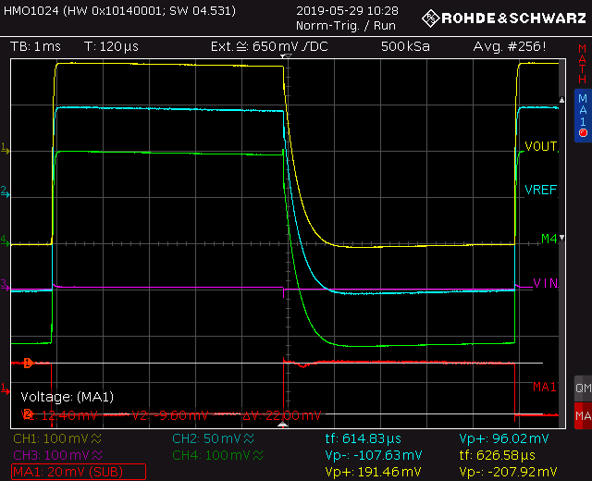
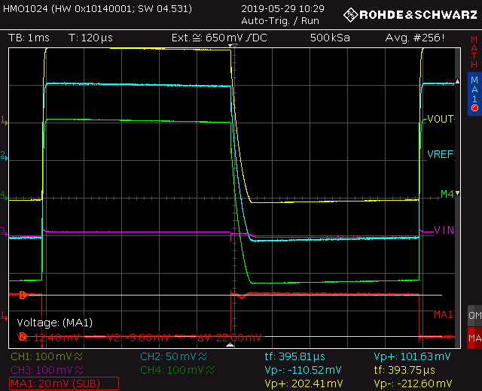
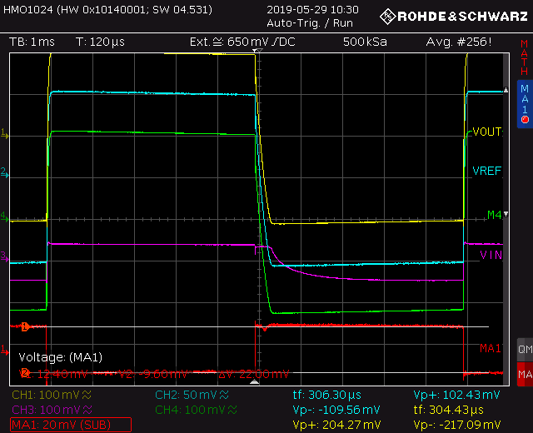
Undershunt Current Protection - SLDO
Vofshalf=400mV,Vref=600mV,Irefset=1110,Rext=600Ω,
Iin=1A,[MA1]*10=I(Vwave)
Iload=755mA+I(Vwave)
Iload=760mA+I(Vwave)
Iload=770mA+I(Vwave)
Iload=780mA+I(Vwave)
Iload=785mA+I(Vwave)
Iload=787mA+I(Vwave)

Slide 32
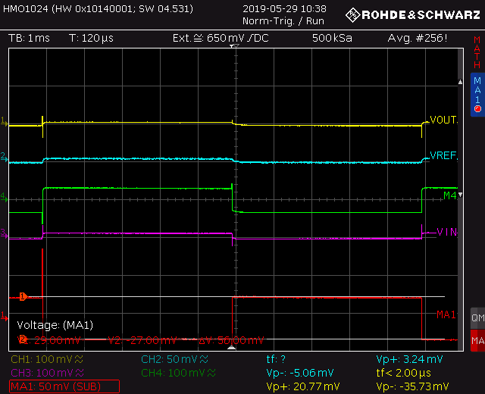
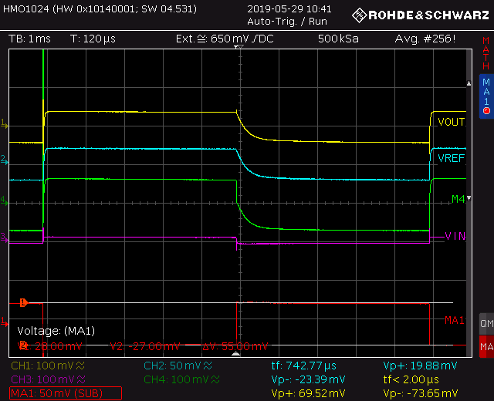
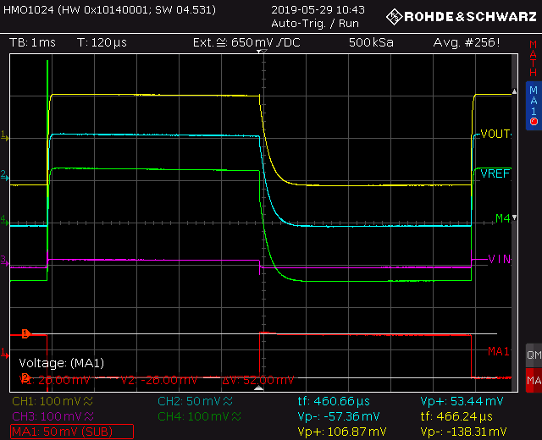
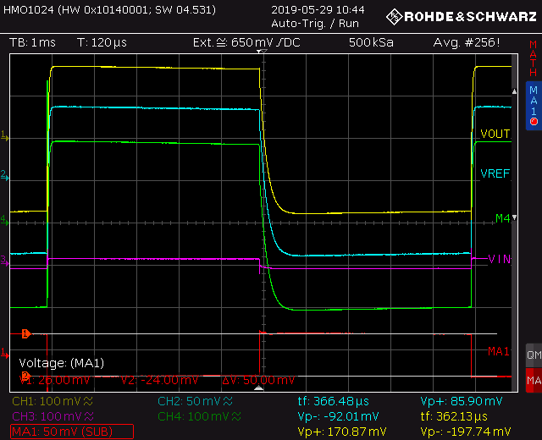
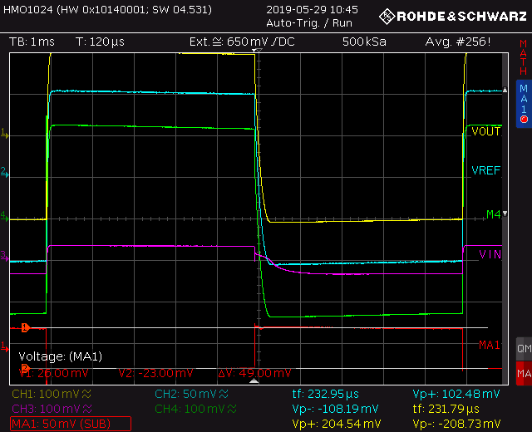
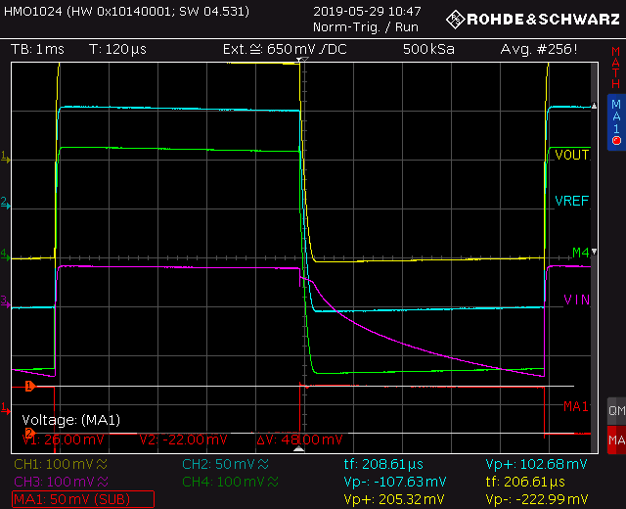
Undershunt Current Protection - SLDO
Vofshalf=400mV,Vref=600mV,Irefset=1110,Rext=600Ω,
Iin=1.4A,[MA1]*10=I(Vwave)
Iload=880mA+I(Vwave)
Iload=900mA+I(Vwave)
Iload=920mA+I(Vwave)
Iload=940mA+I(Vwave)
Iload=960mA+I(Vwave)
Iload=966mA+I(Vwave)

Slide 33
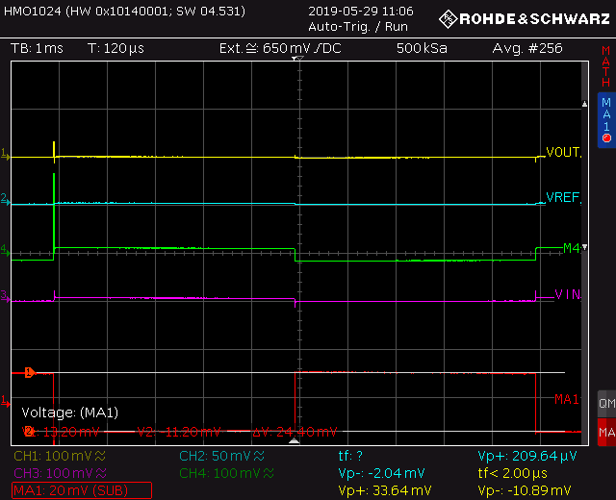
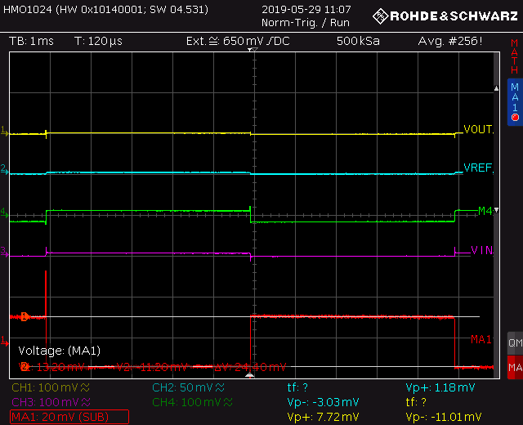
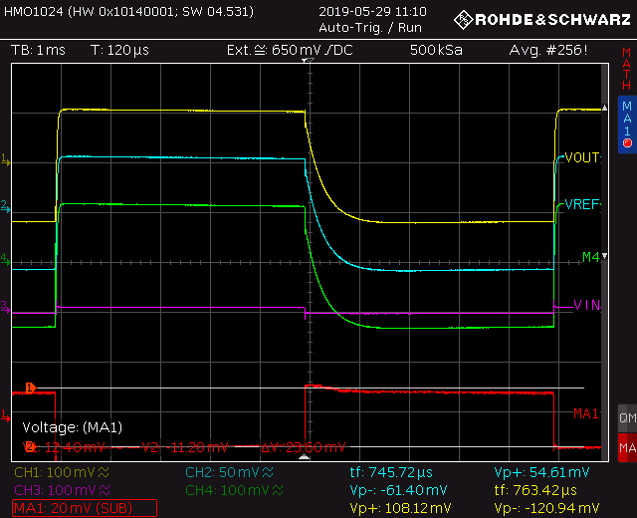
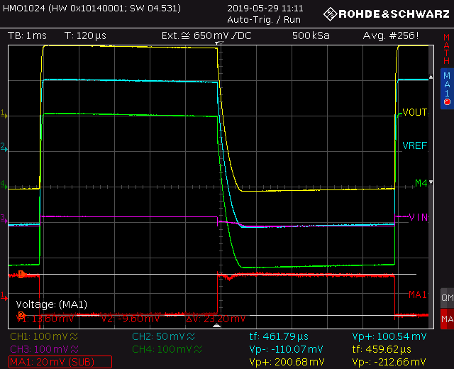

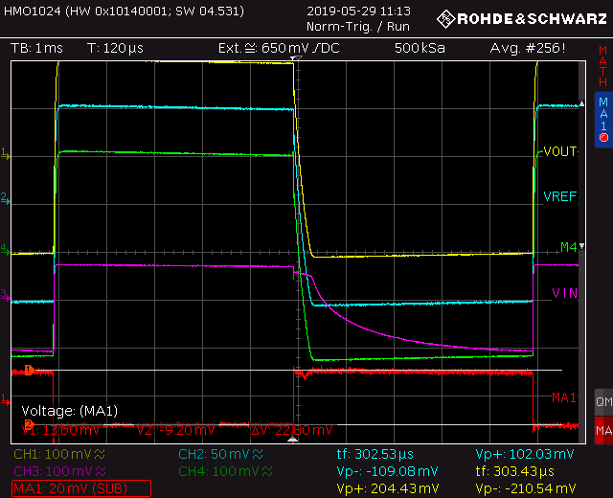
Undershunt Current Protection - SLDO
Vofshalf=650mV,Vref=600mV,Irefset=1110,Rext=600Ω,
Iin=1A ,[MA1]*10=I(Vwave)
Iload=745mA+I(Vwave)
Iload=750mA+I(Vwave)
Iload=770mA+I(Vwave)
Iload=785mA+I(Vwave)
Iload=788mA+I(Vwave)
Iload=790mA+I(Vwave)

