Slide 1
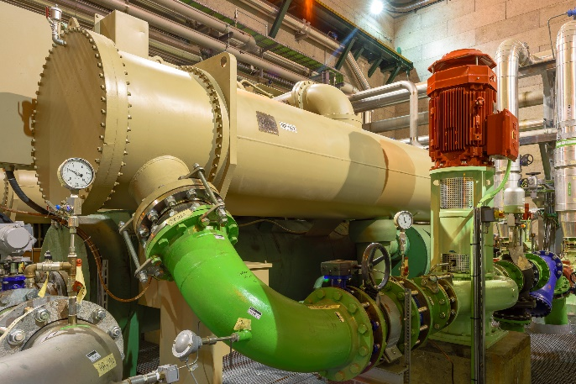
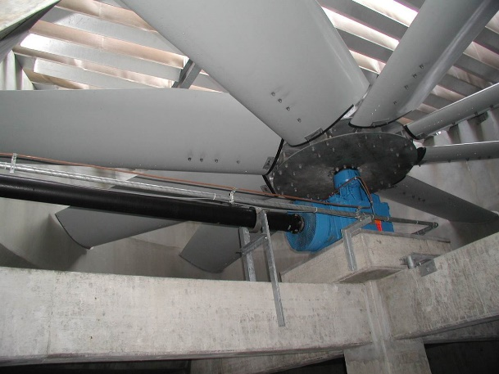
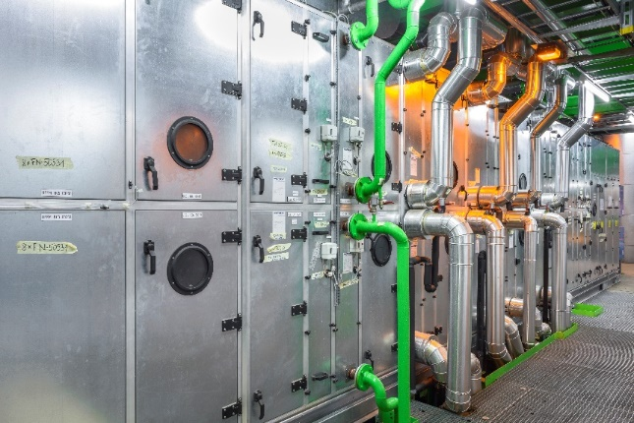
CLIC at 100 Hz
Pedro Cabral
21/06/2019

Slide 2

Table of contents
Cooling and Ventilation for the 50 Hz CLIC
100 Hz Operation
Conclusions

Slide 3
Cooling and Ventilation – 50 Hz
The basic design was done throughout 2018, as well as a cost estimate
Design is documented in the PiP, early presentations and long report that will soon be available in EDMS
Total required cooling power at the cooling towers is approximately 160 MW for the two beam machine
The total C&V cost is approximately 470 MCHF for the two beam machine

Slide 4
100 Hz Operation
The operation at 100 Hz increases greatly the heat loads
    Extra 22 MW for the drive beam injector complex
    Extra 11 MW for the main tunnel
    …
A list of heat loads and fraction air/water is required for a proper CV study
    Are the extra heat loads completely transferred to the water cooling systems?
Will CLIC run at 100 Hz all the time or is it going to be run at 50 HZ as well?
    Combined operational modes might be technically challenging – design is to be done for the highest load. Oversized equipment and infrastructure during 50 Hz run.

Slide 5
Conclusions
The complete list of heat loads including the fraction that is emitted to air and water is required for the 100 Hz operation, even if they are only rough estimates
A clearer picture of the work expected is required
    Cost estimate required?
    Impact on the current design? Level of Detail?
    Final purpose?

