Slide 1

Highlights presented by
Michele BERGAMASCHI – Robert KIEFFER – Sergey SADOVICH – Benedikt WÜRKNER

Slide 2
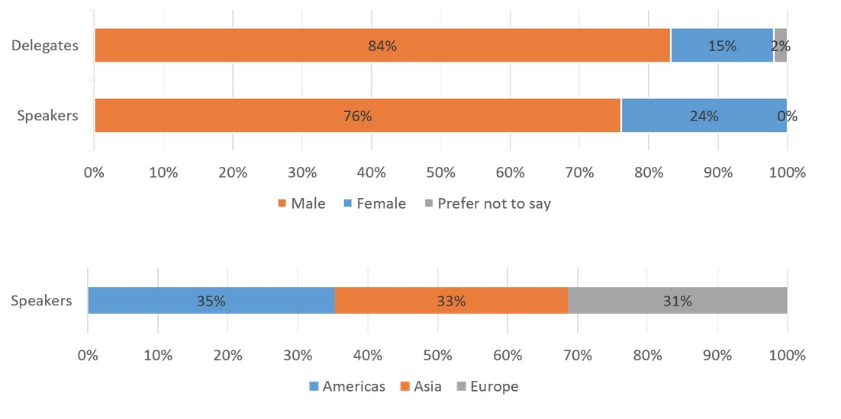
Scientific Program
The scientific program of all IPAC’s are proposed by a Scientific Program Committee (SPC), in collaboration with the International Organising Committee (OC) with significant input from a Scientific Advisory Board (SAB).
The scientific program has: 30-minute invited oral presentations, 20-minute contributed oral presentations, and
poster sessions.

Slide 3
Overview of the selected talks
Oral talk by Massimo Ferrario about new accelerating technologies.
Oral talk by Andrey Tyukhtin about polarisation radiation emitted by Dielectric object and their application in beam instrumentation.
Oral talk by Diktys Stratakis about the Myon Campus at Fermilab
Oral talk by Daniela Leitner about High Performance ECR Sources
Oral talk by Tsung-Yu Lee about a remote-controlled Robot-car for accelerator monitoring during operation
Oral talk by Nazamin Samadi about a Vertical Phase Space Beam Position and Emittance Monitor for Synchrotron Radiation
Oral talk by Nicola Delerue about a test of a 3D printed BPM

Slide 4
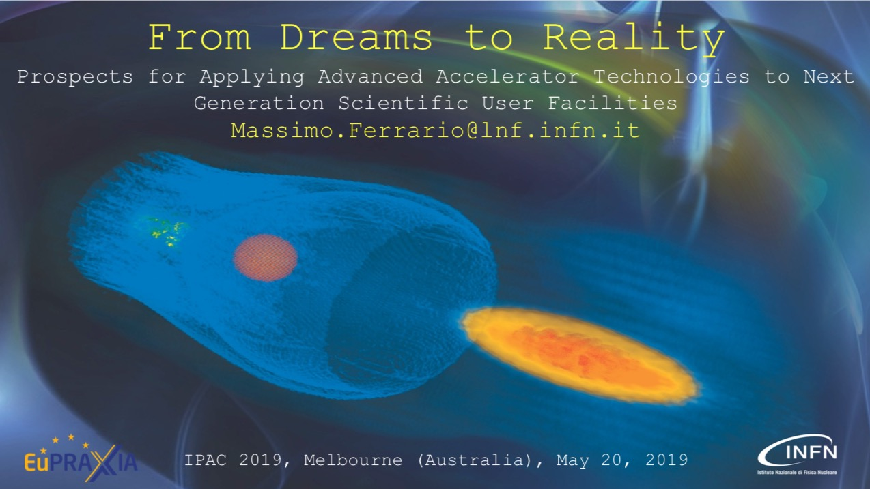

Slide 5
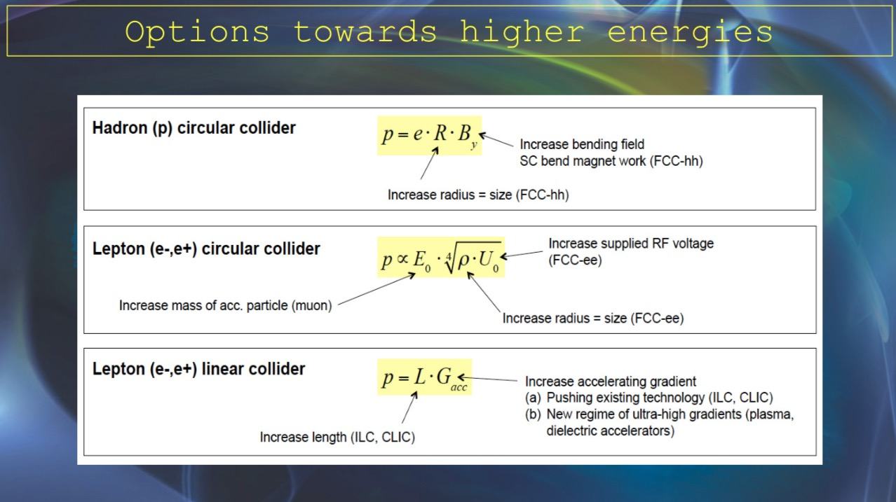

Slide 6
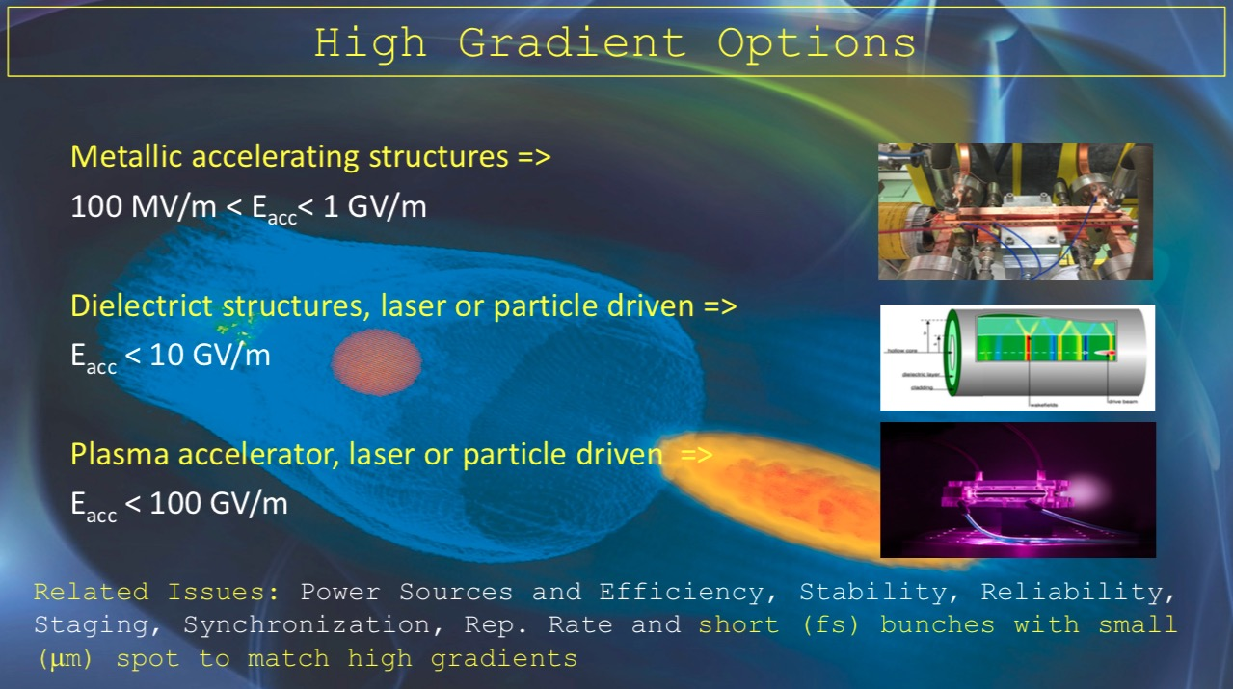

Slide 7
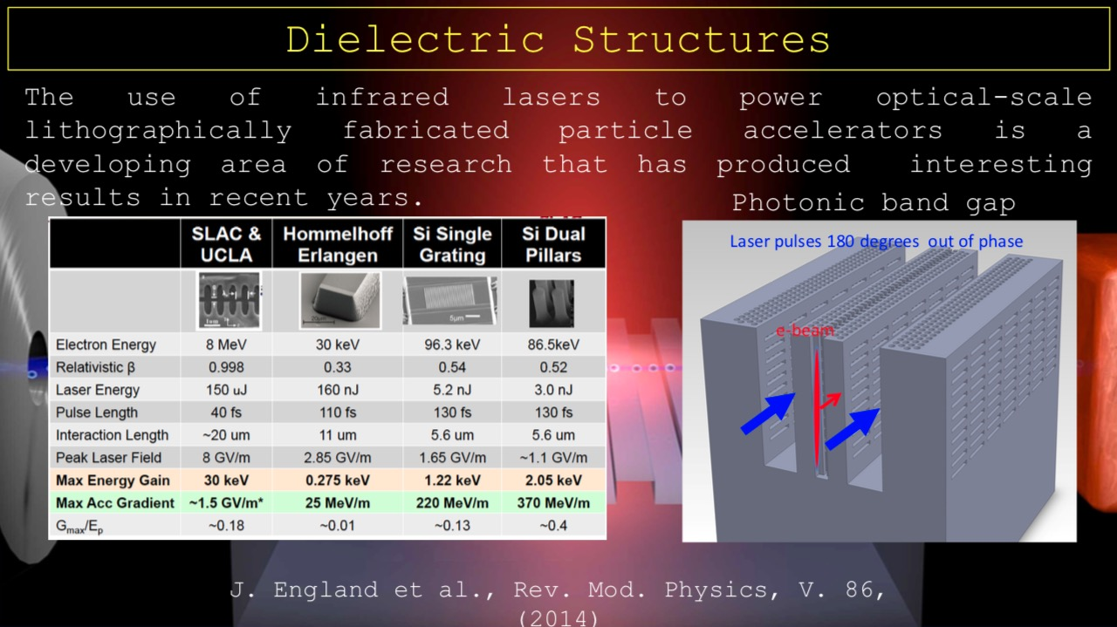

Slide 8
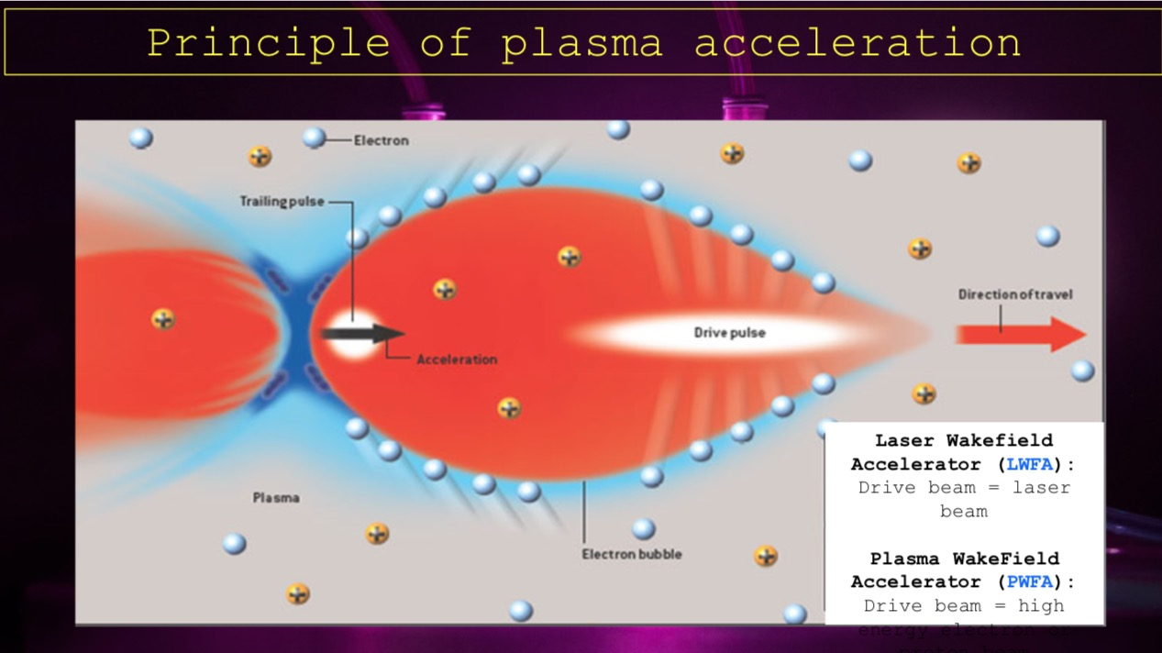

Slide 9
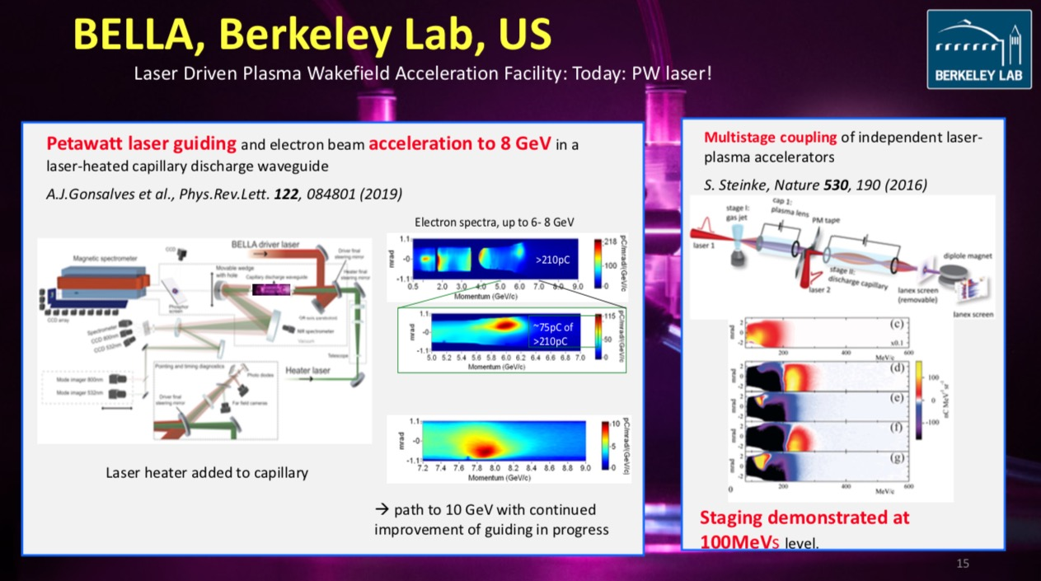

Slide 10
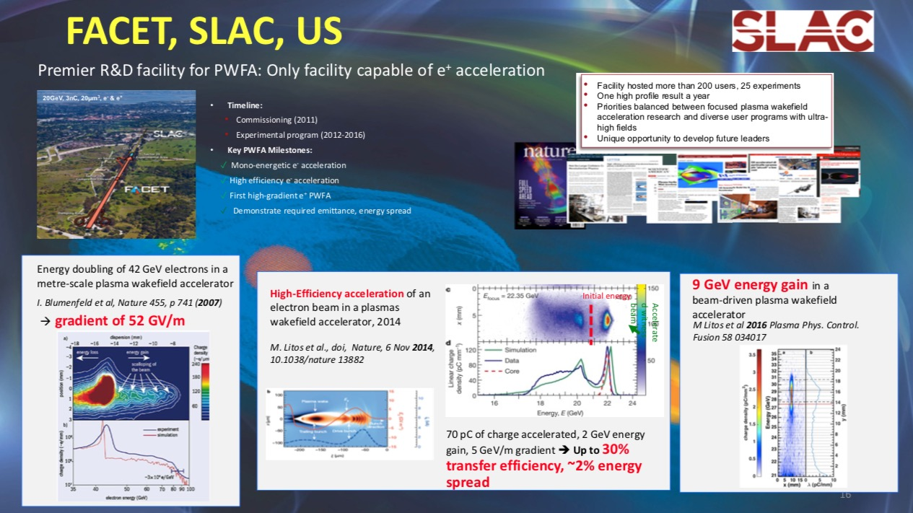

Slide 11
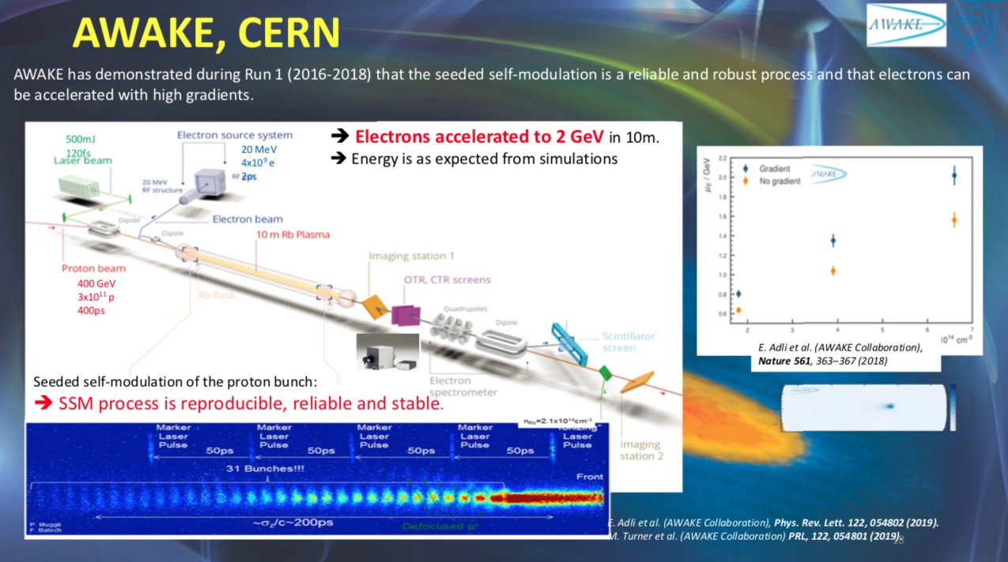

Slide 12
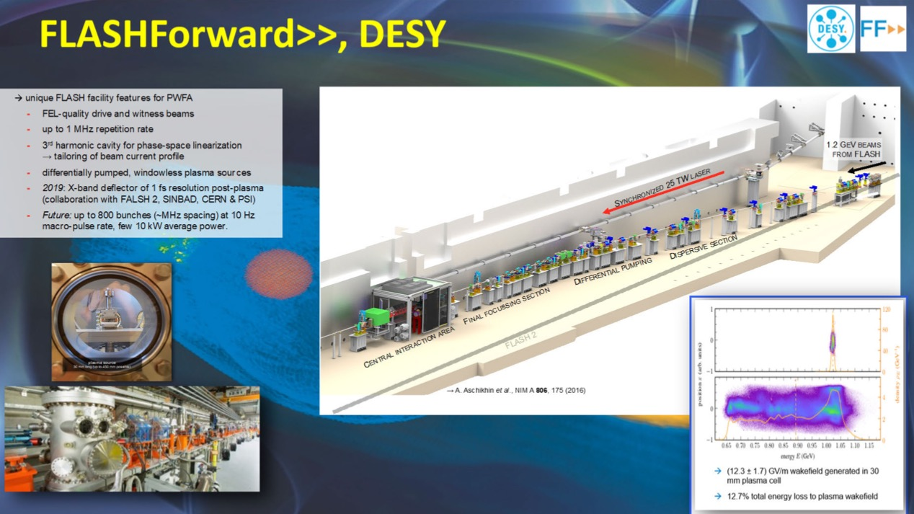

Slide 13
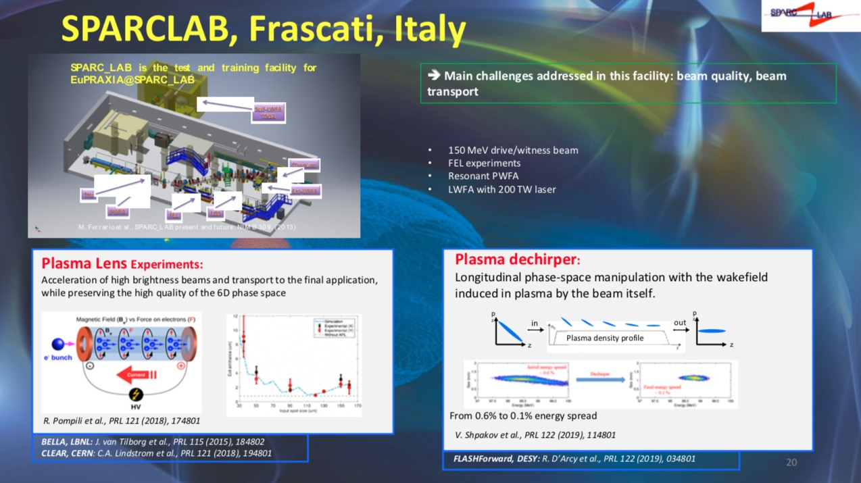

Slide 14
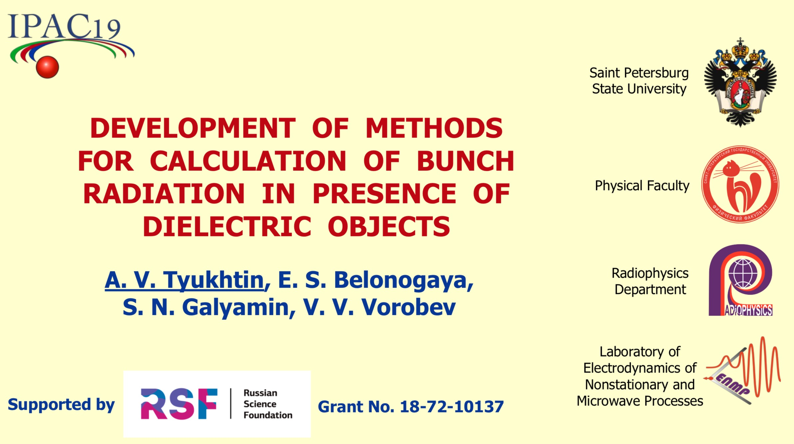

Slide 15
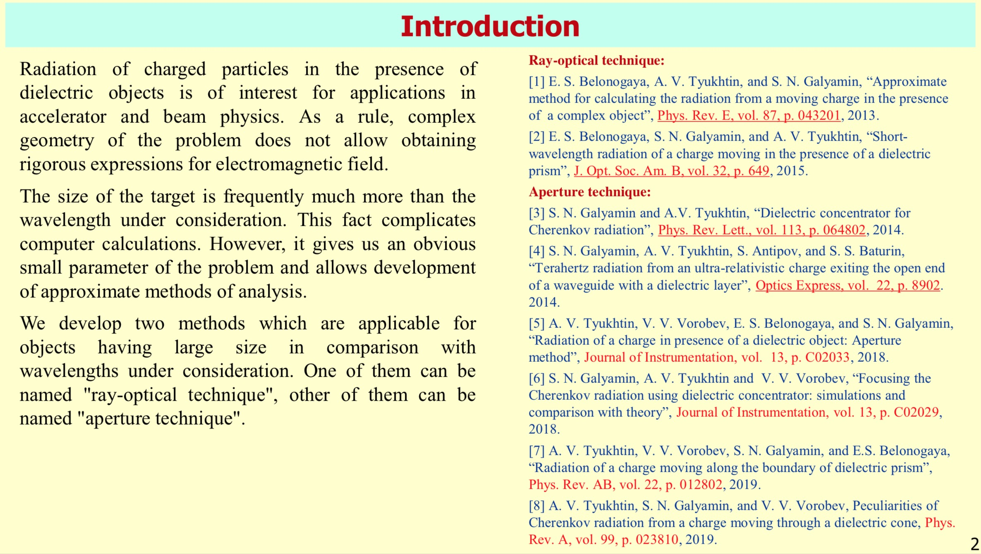

Slide 16
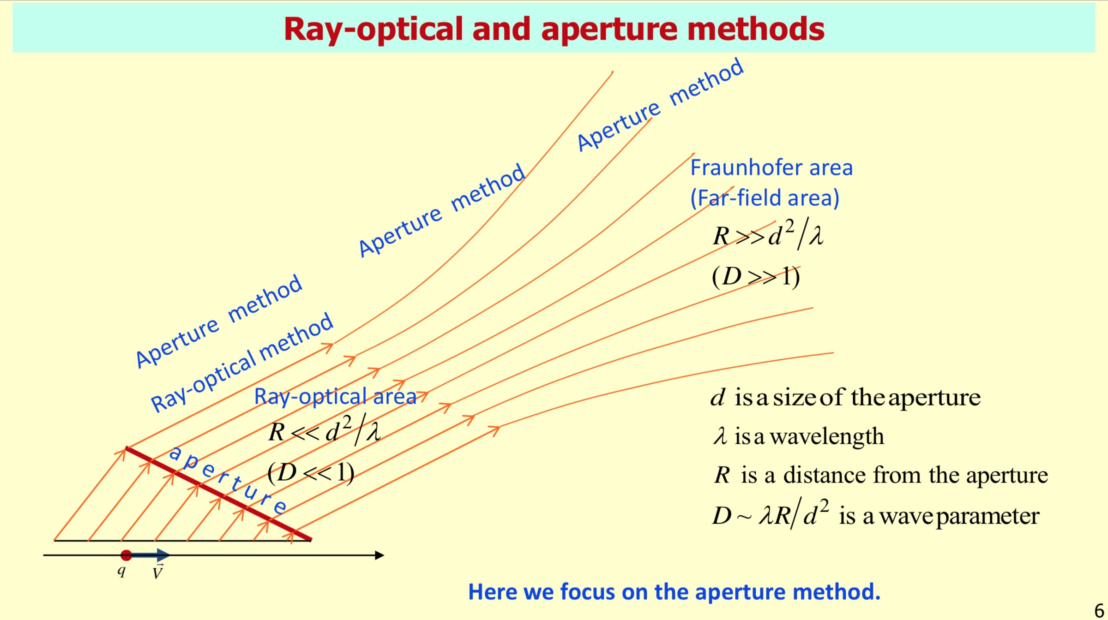

Slide 17
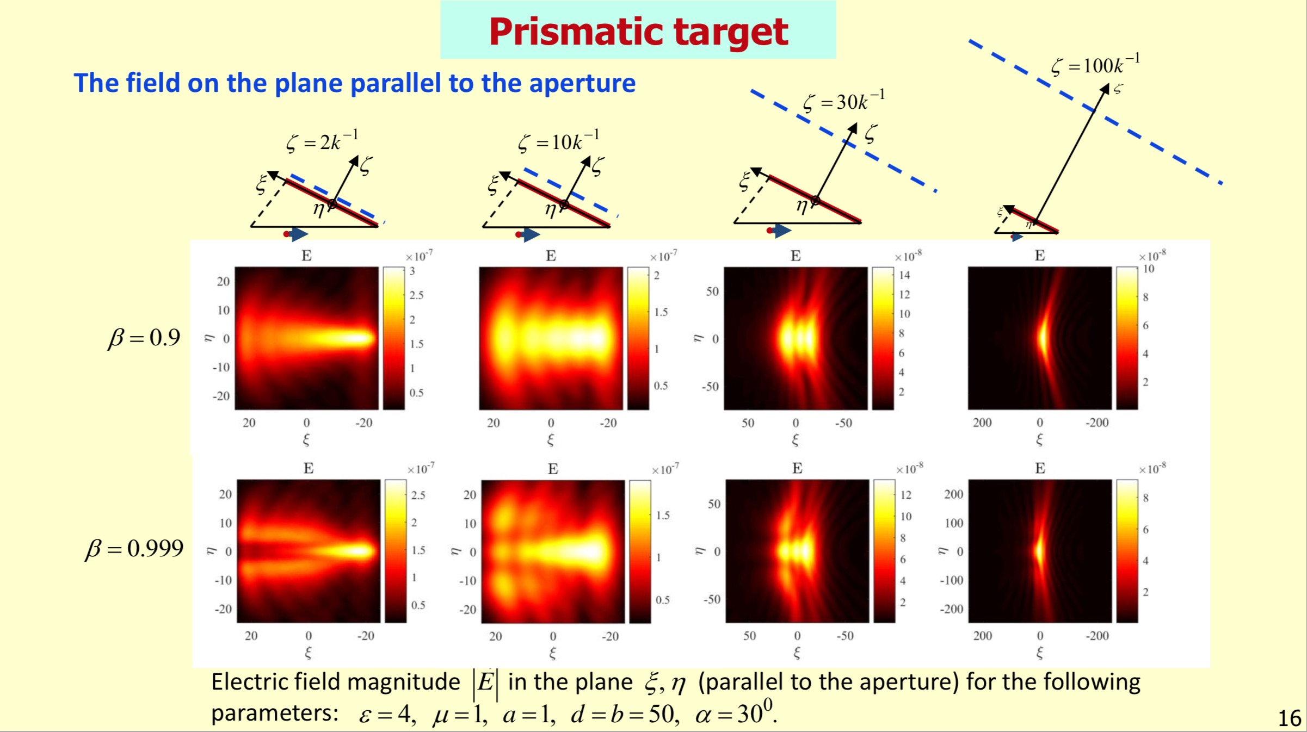

Slide 18
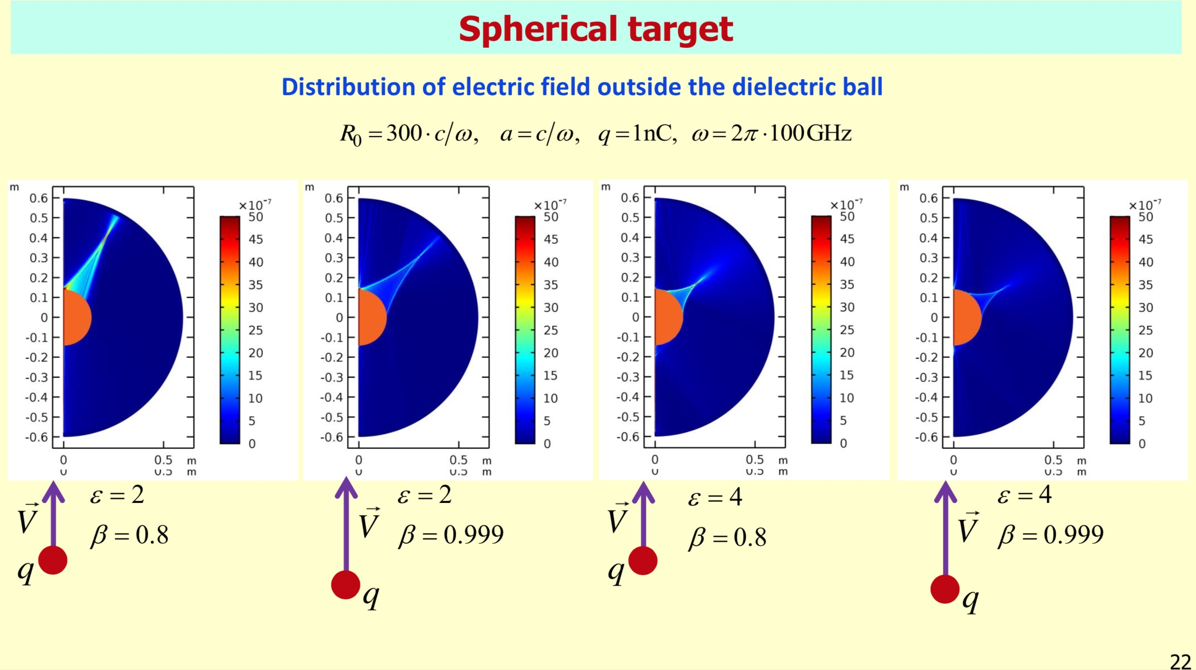

Slide 19
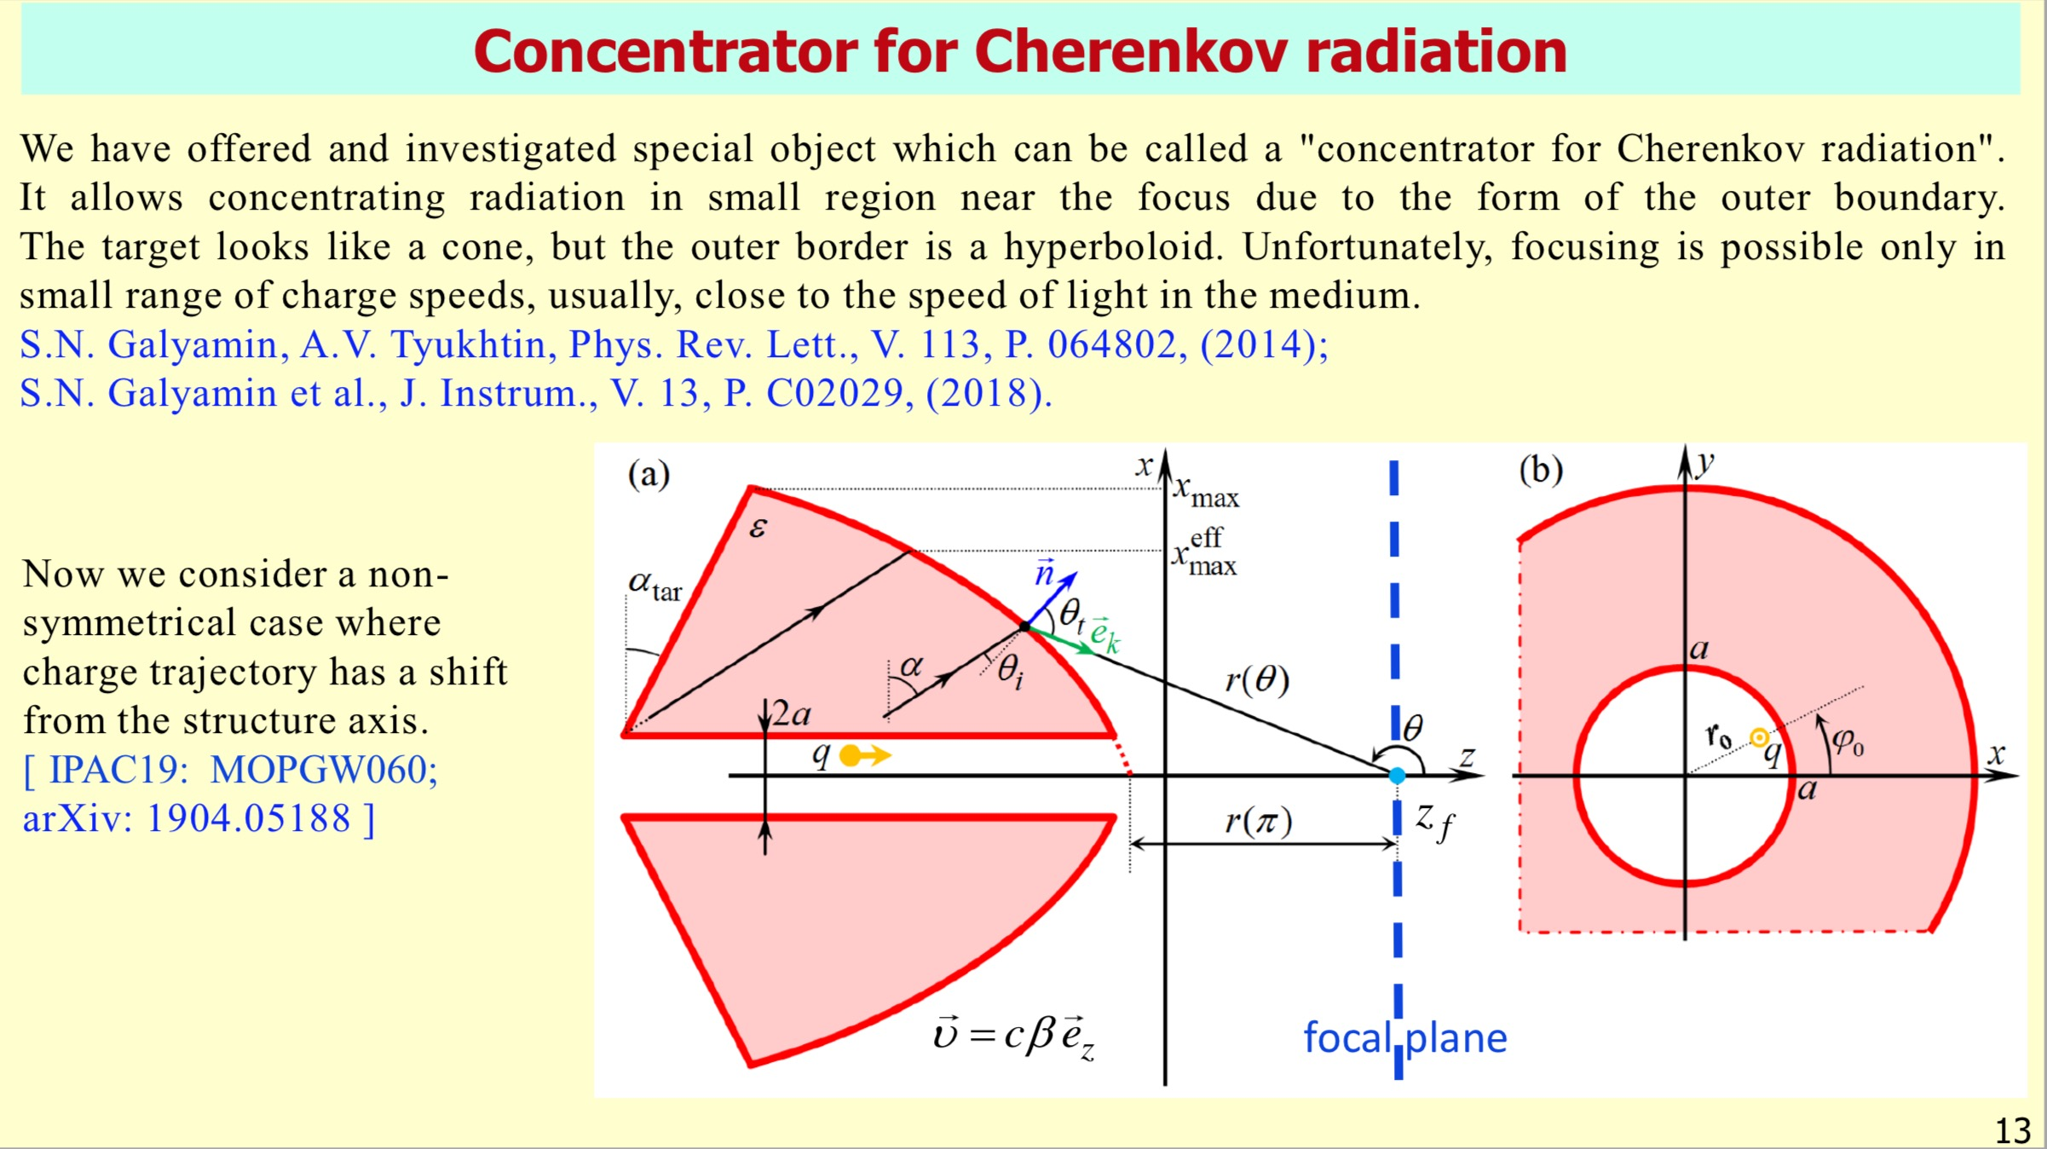

Slide 20
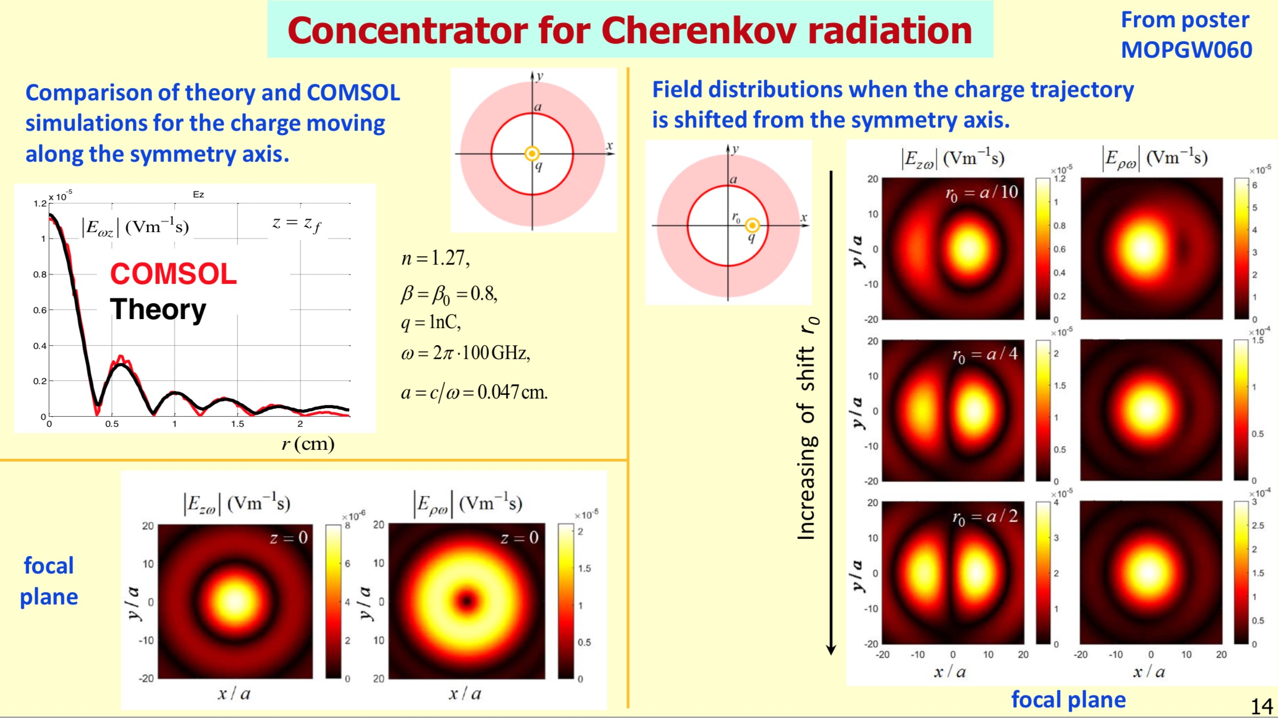

Slide 21
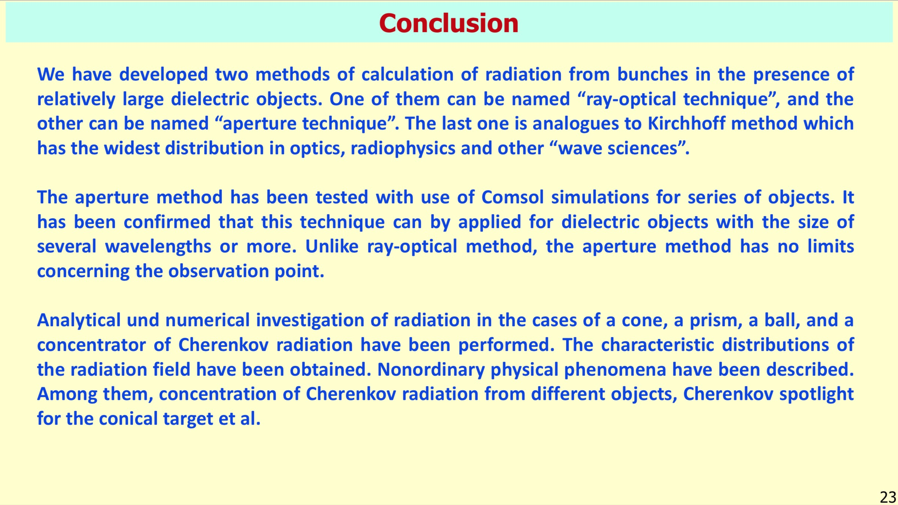

Slide 22
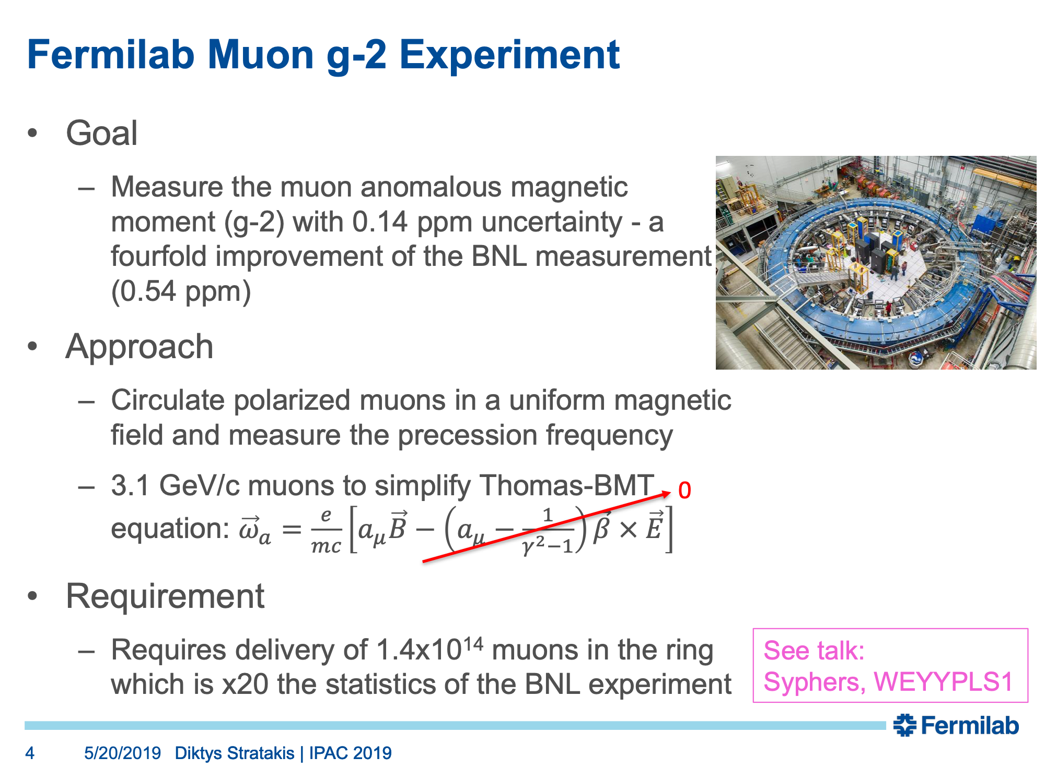

Slide 23
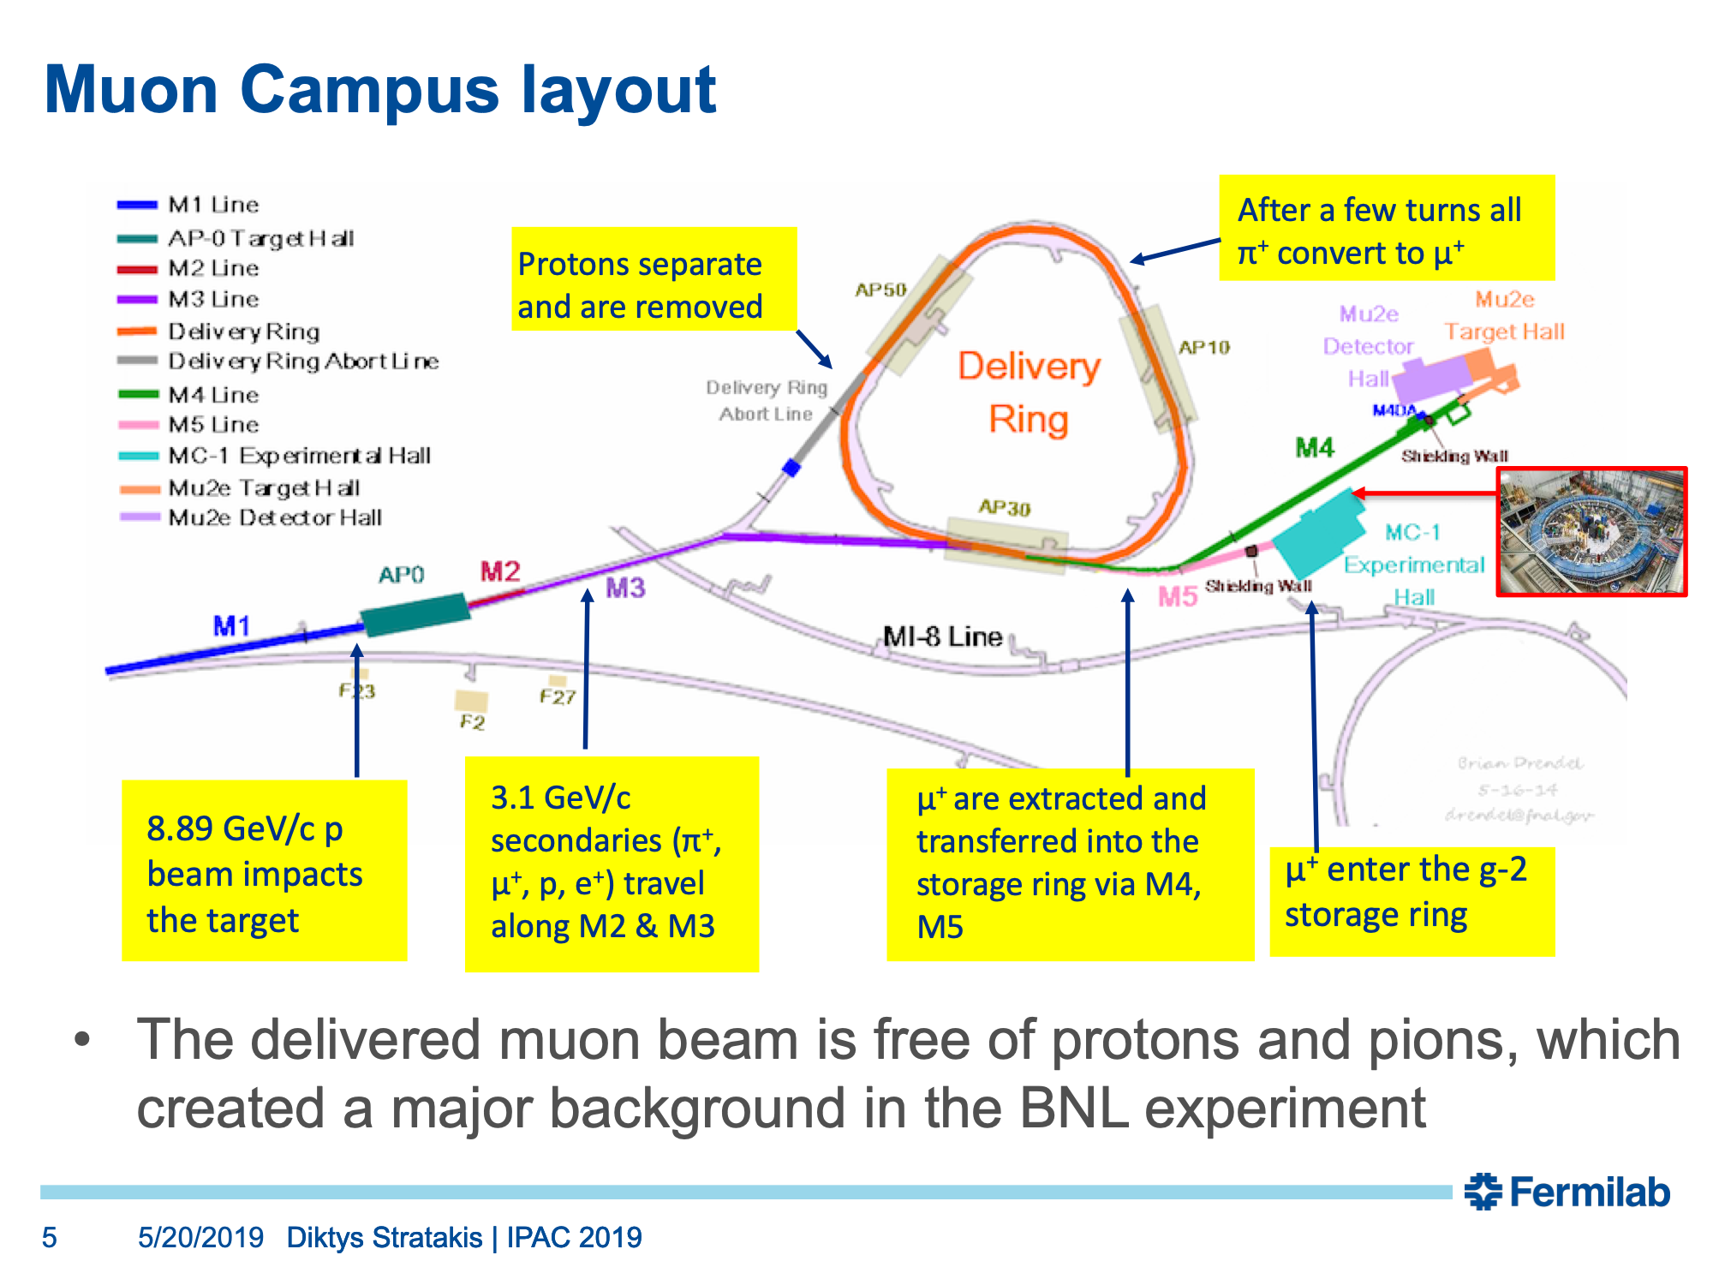

Slide 24
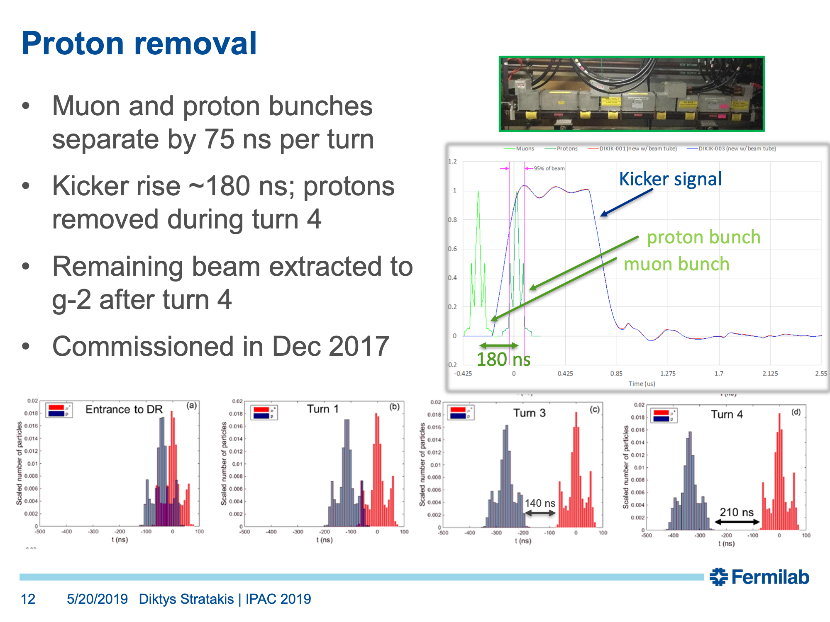

Slide 25
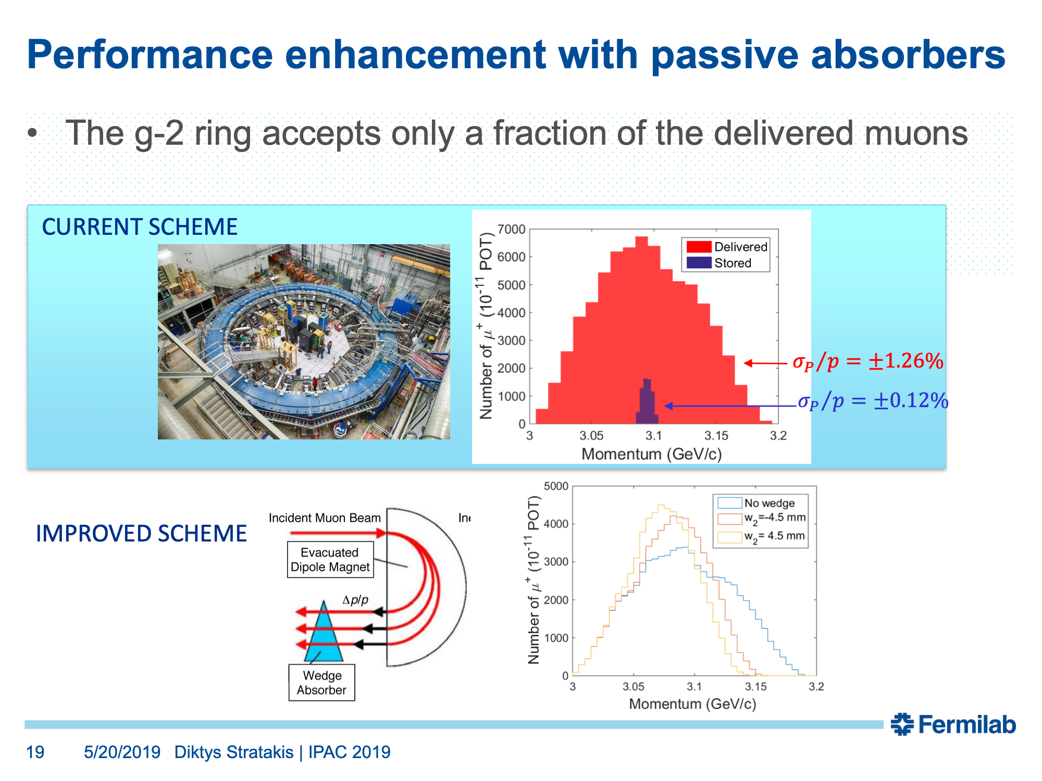

Slide 26
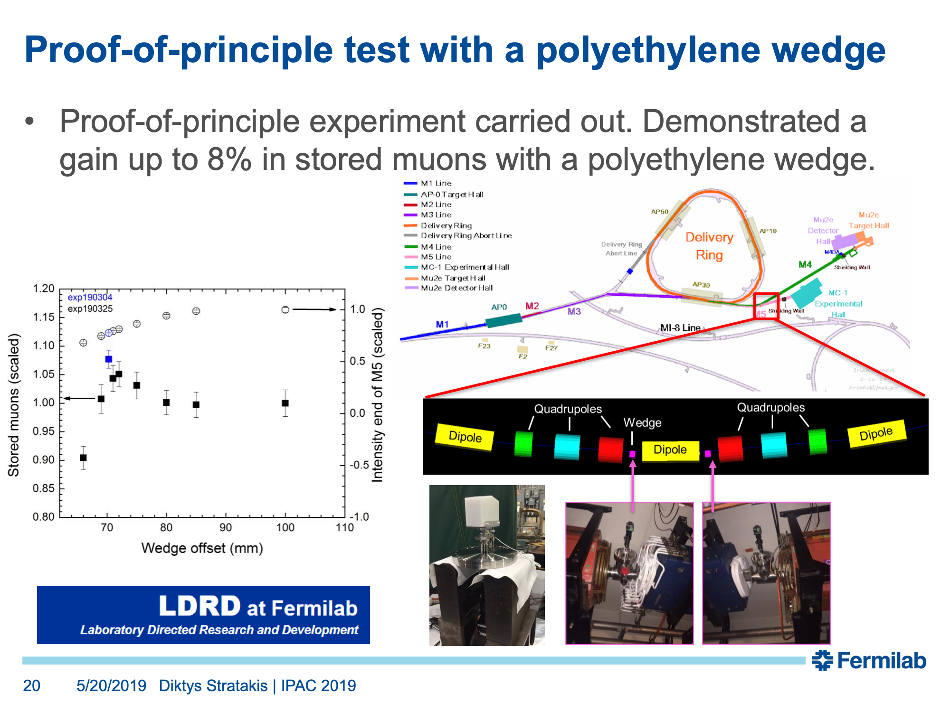

Slide 27
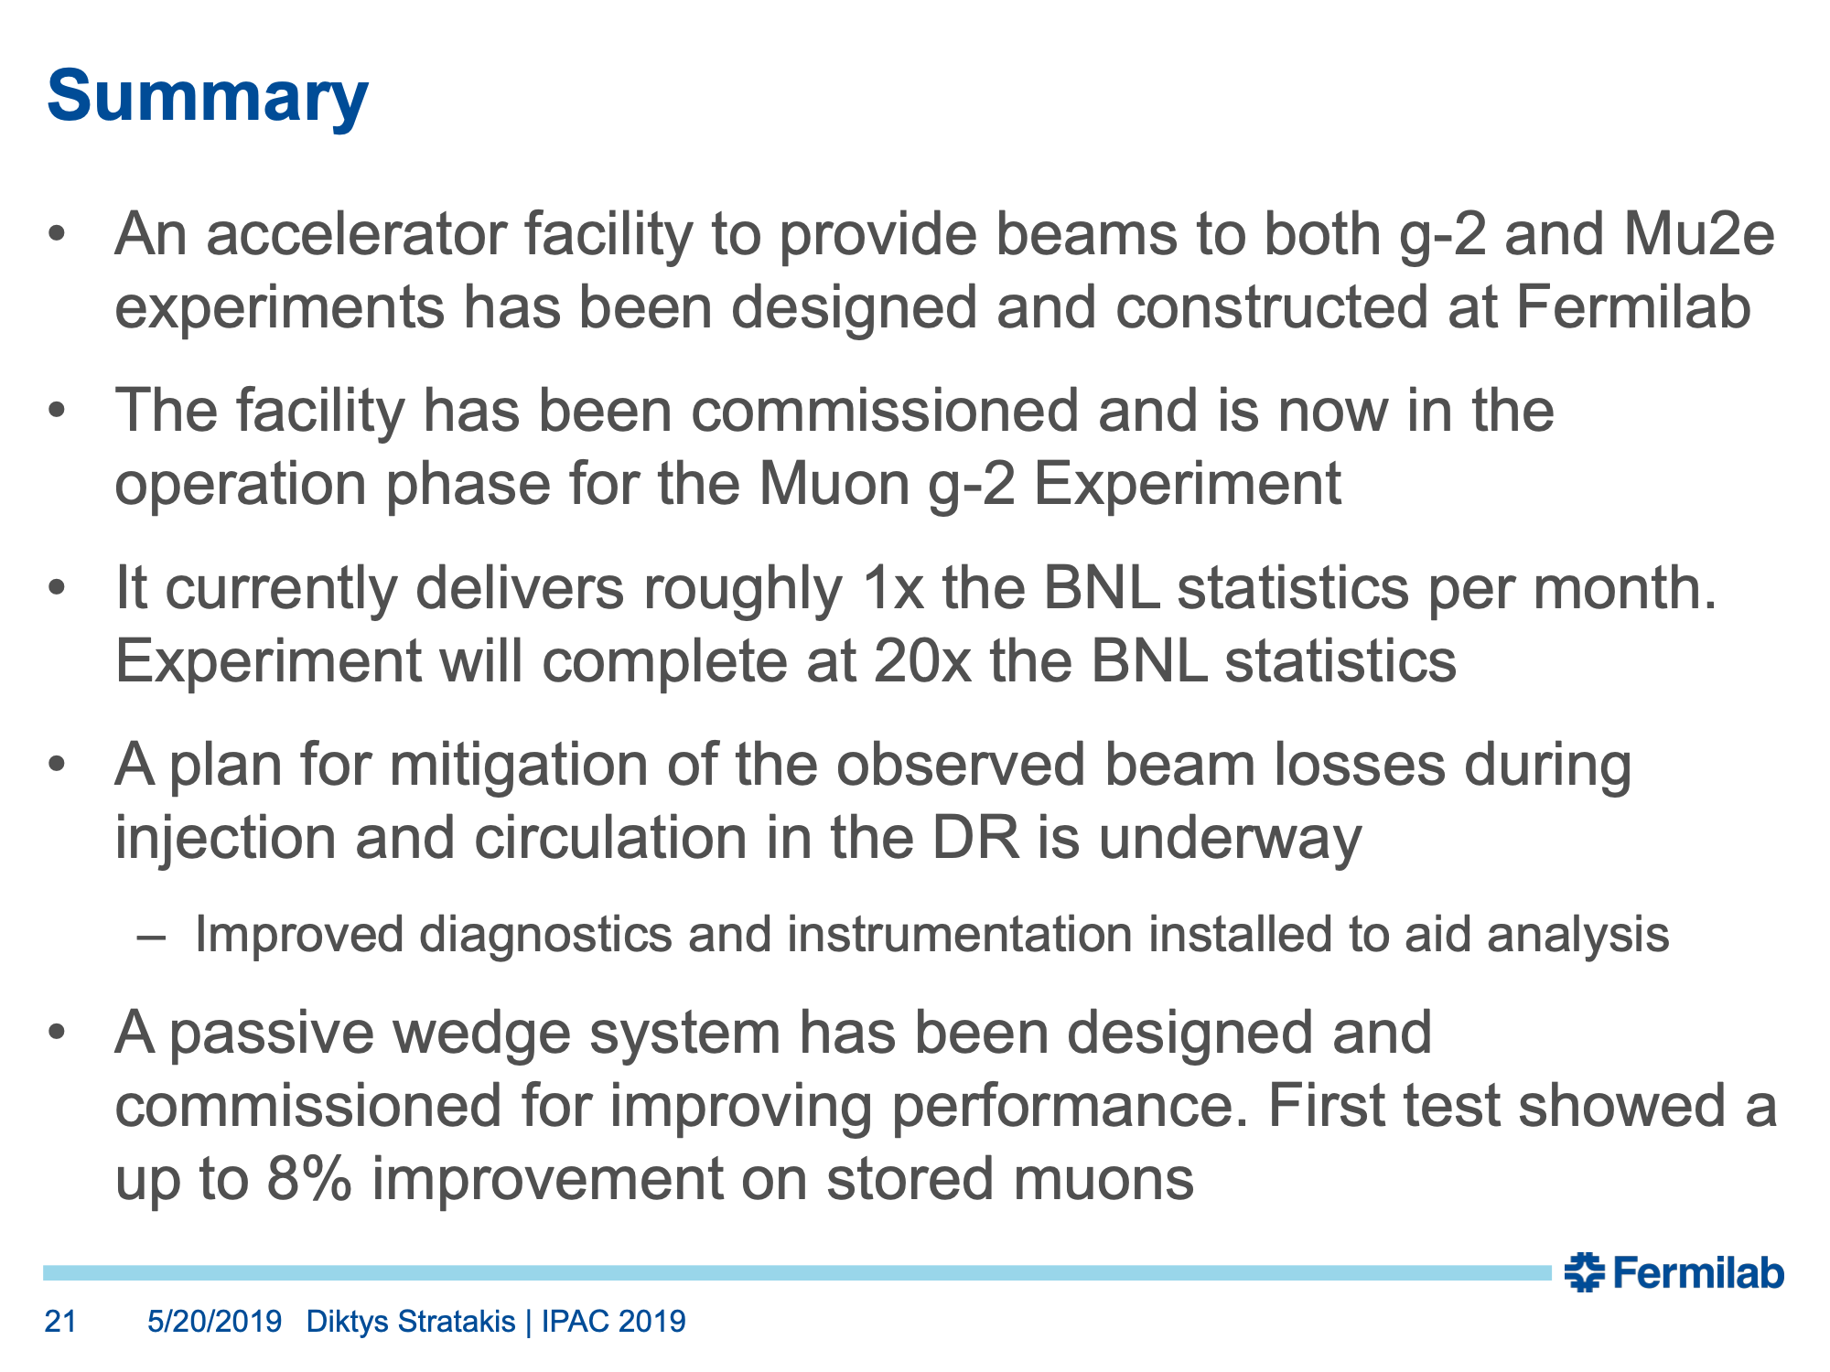

Slide 28
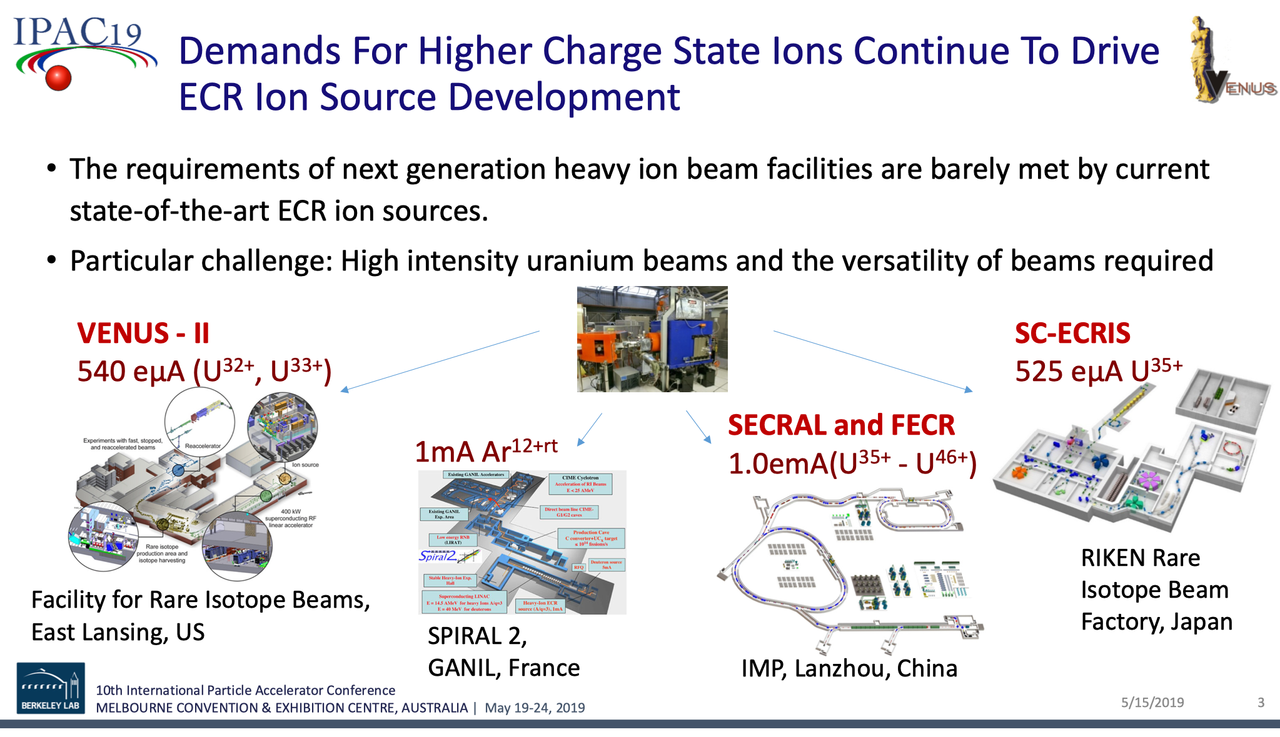

Slide 29
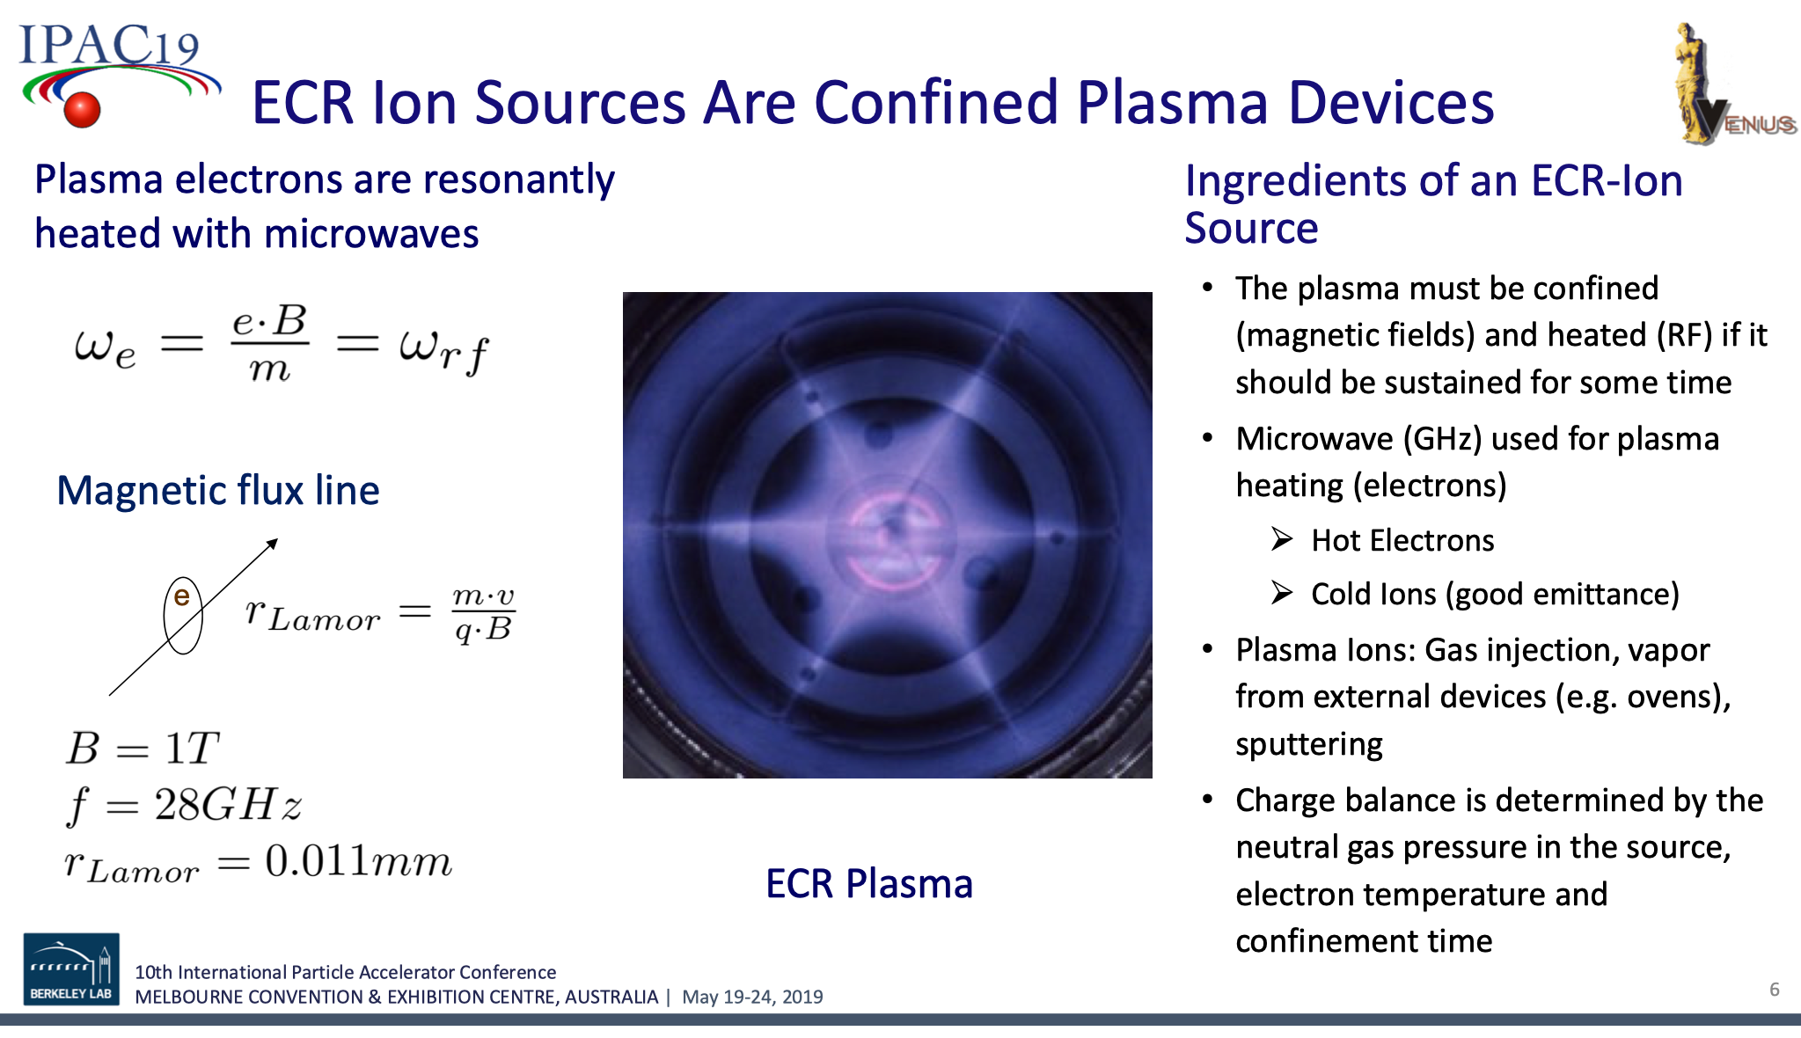

Slide 30
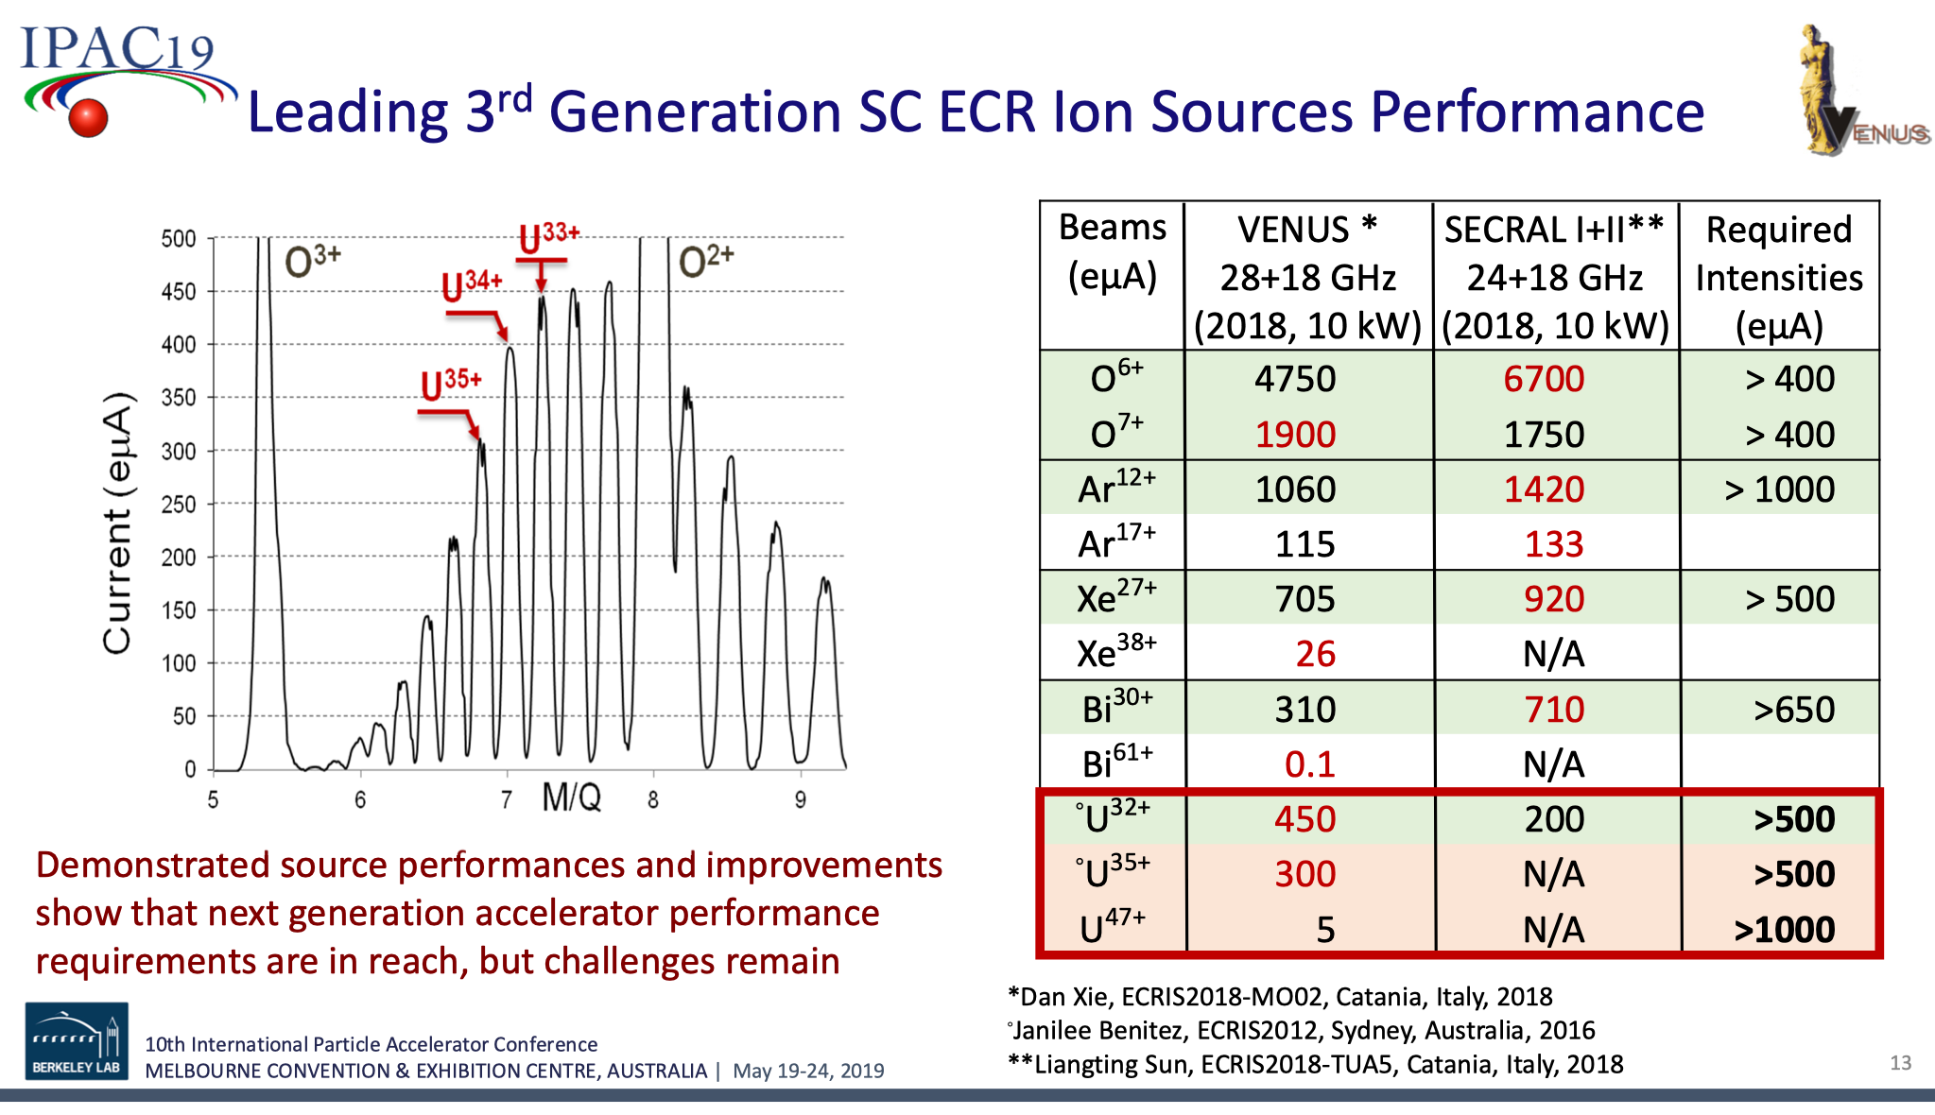

Slide 31
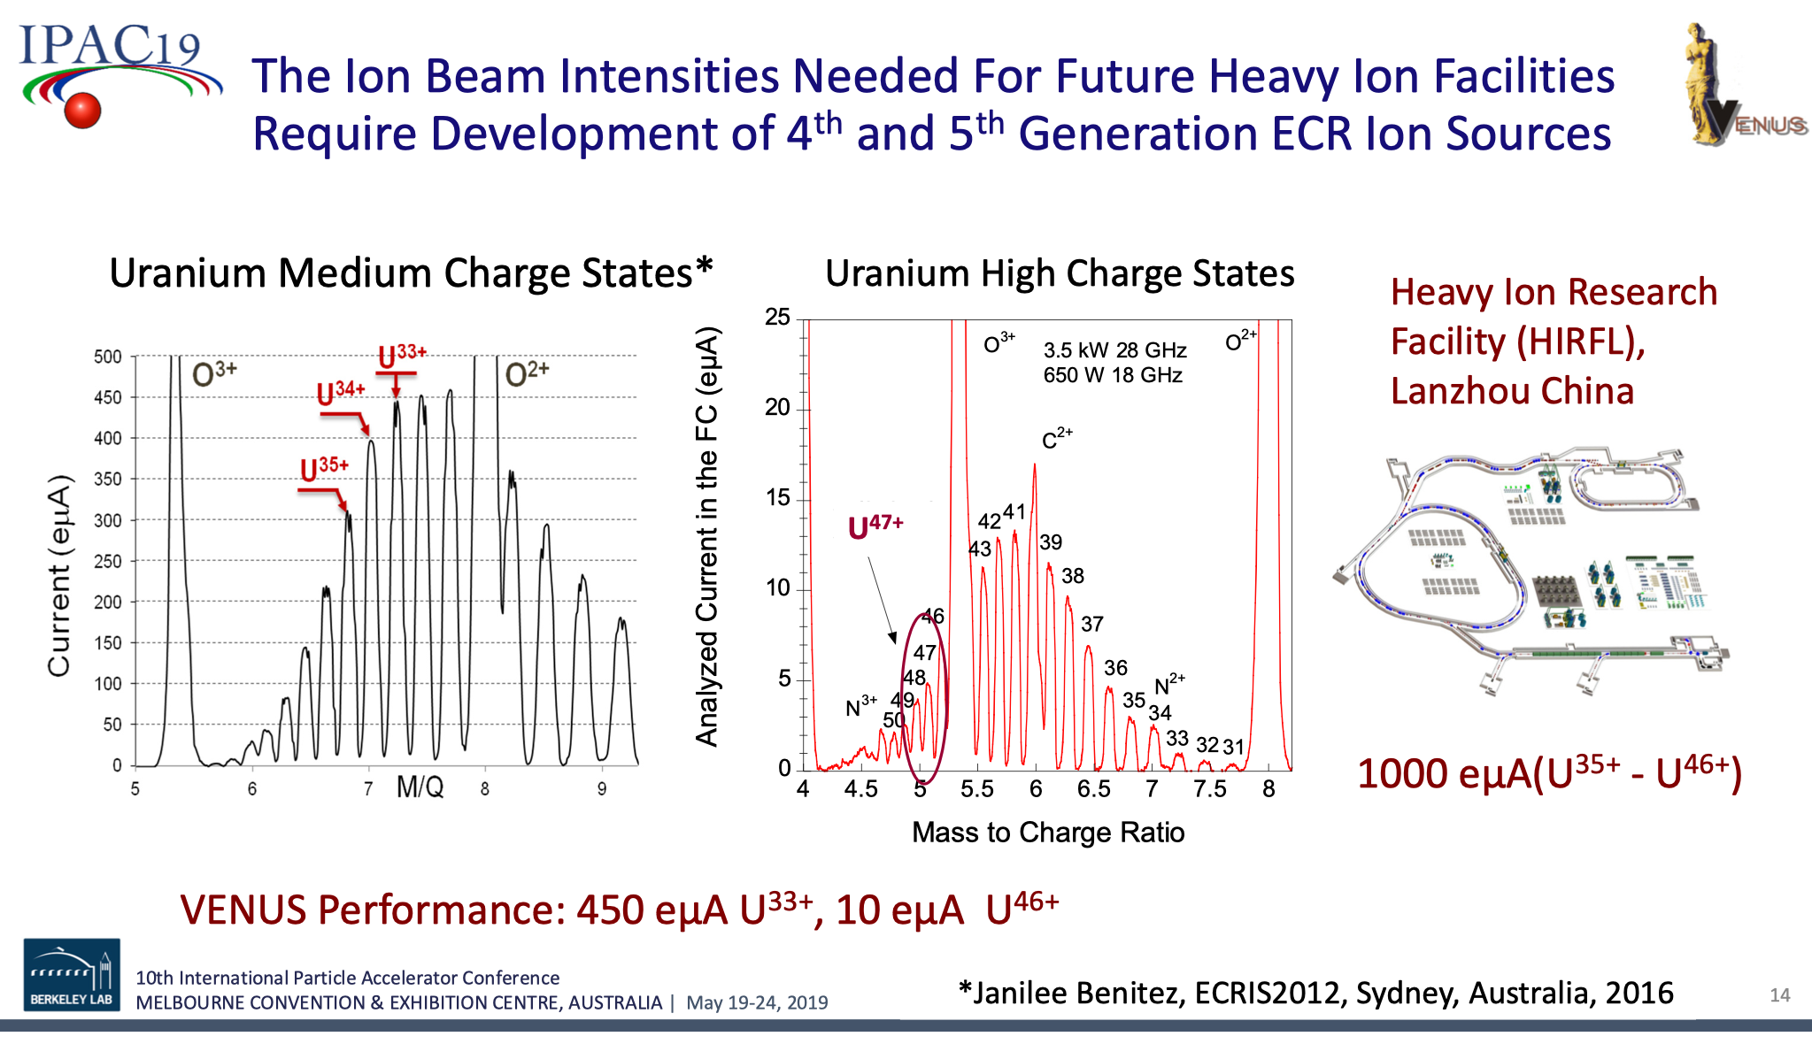

Slide 32
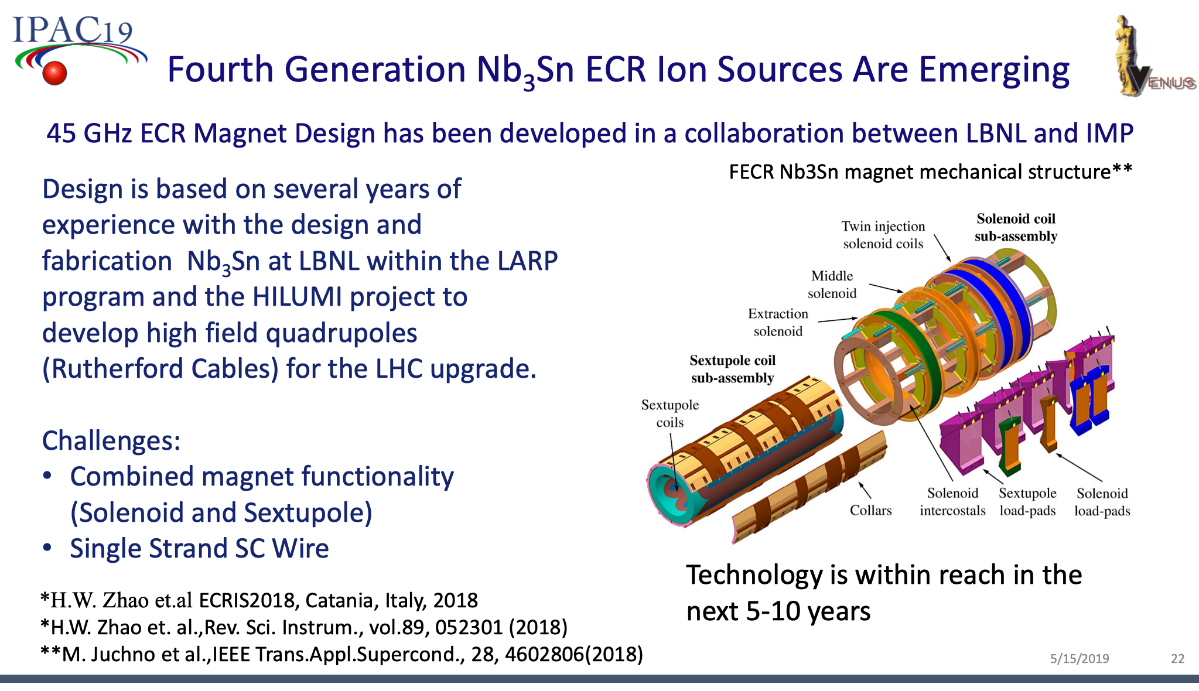

Slide 33
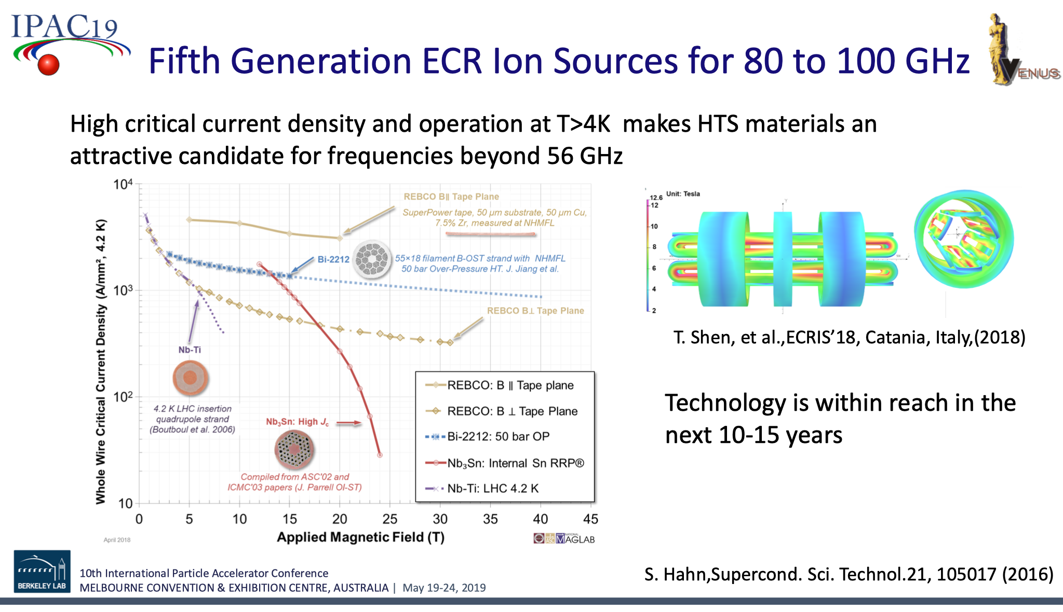

Slide 34
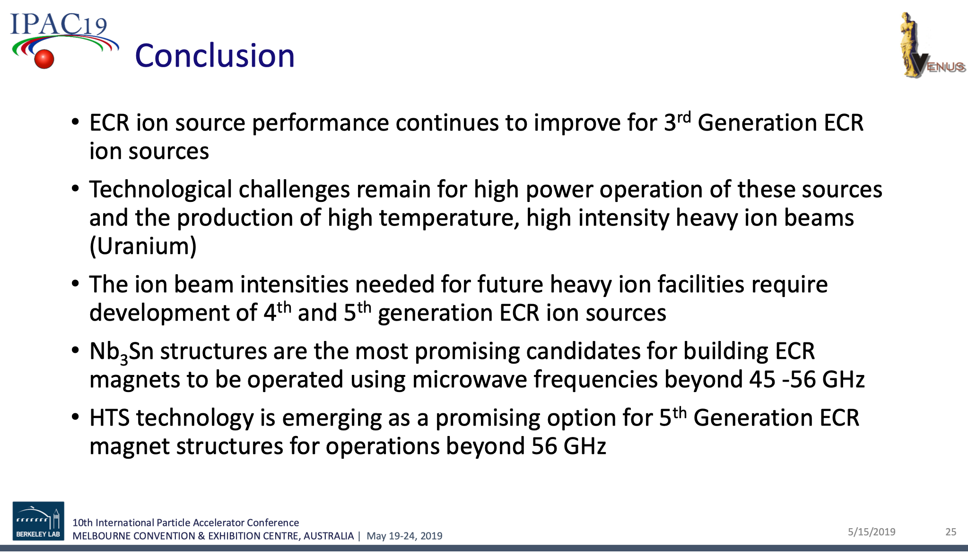

Slide 35
A Remote-Controlled Robot-Car in the TPS Tunnel
T.Y. Lee, B.Y. Chen, T.W. Hsu, B.Y. Huang, C.H. Kuo, and W.Y. Lin

Slide 36
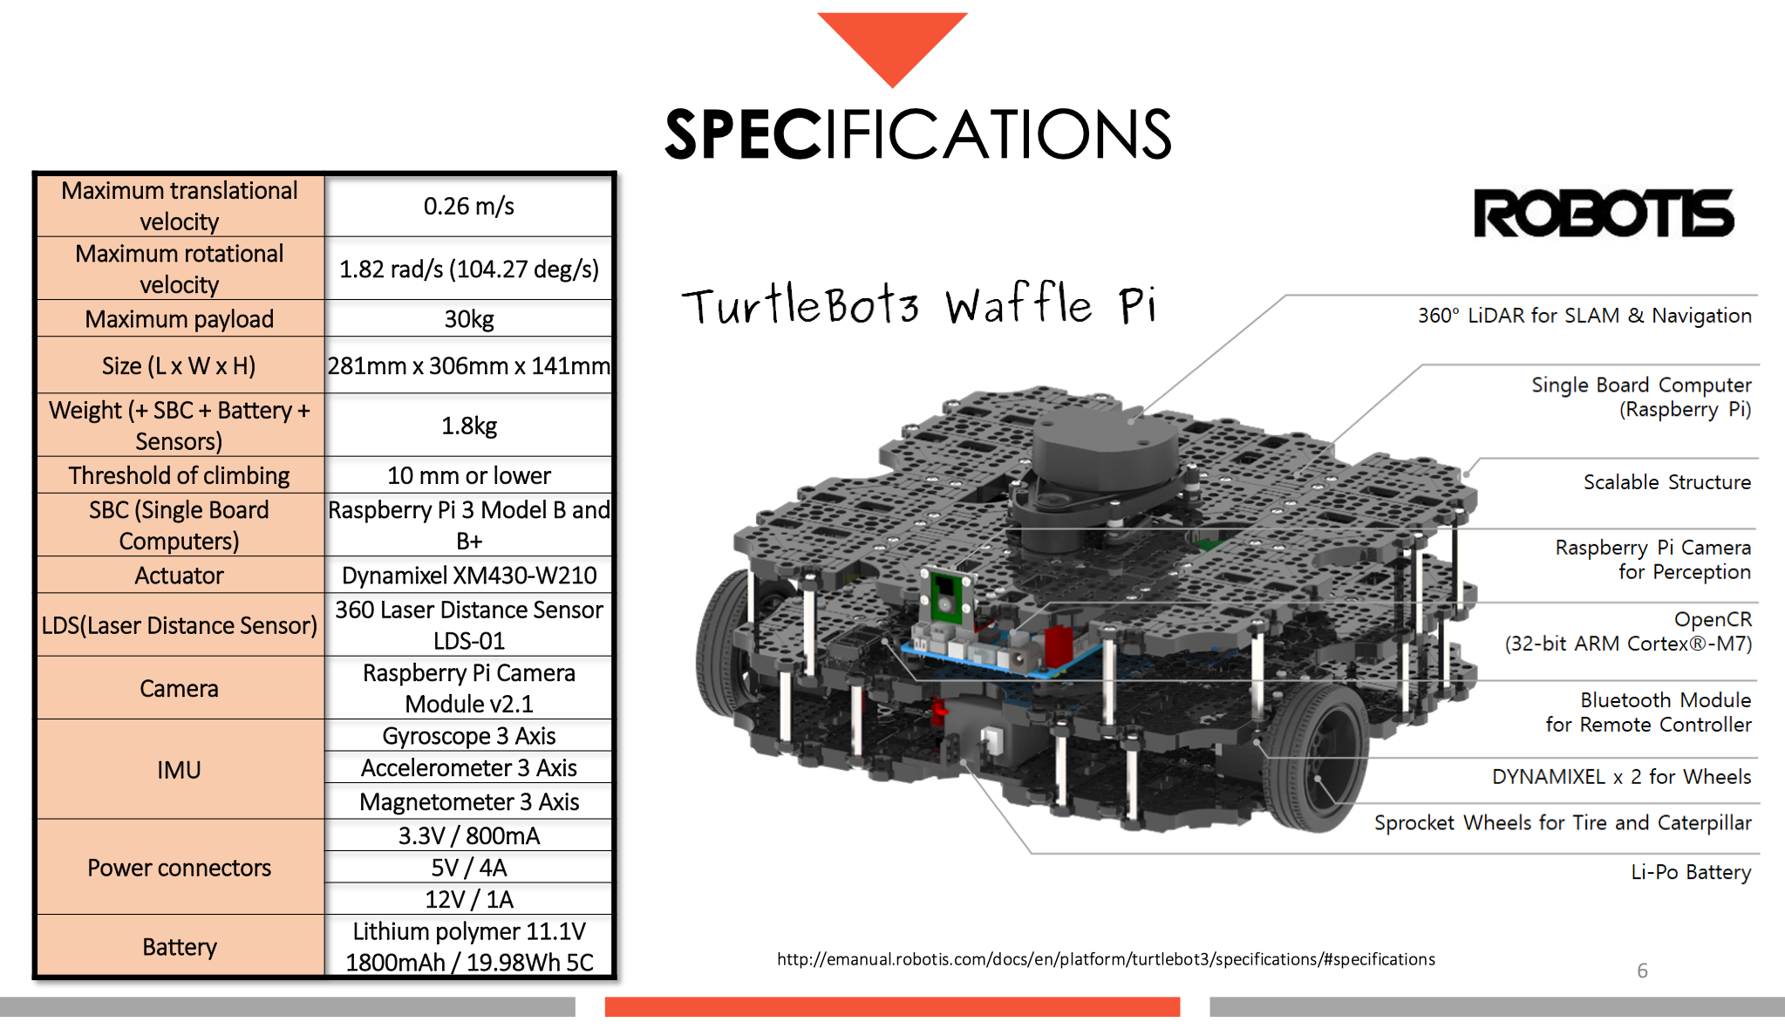

Slide 37
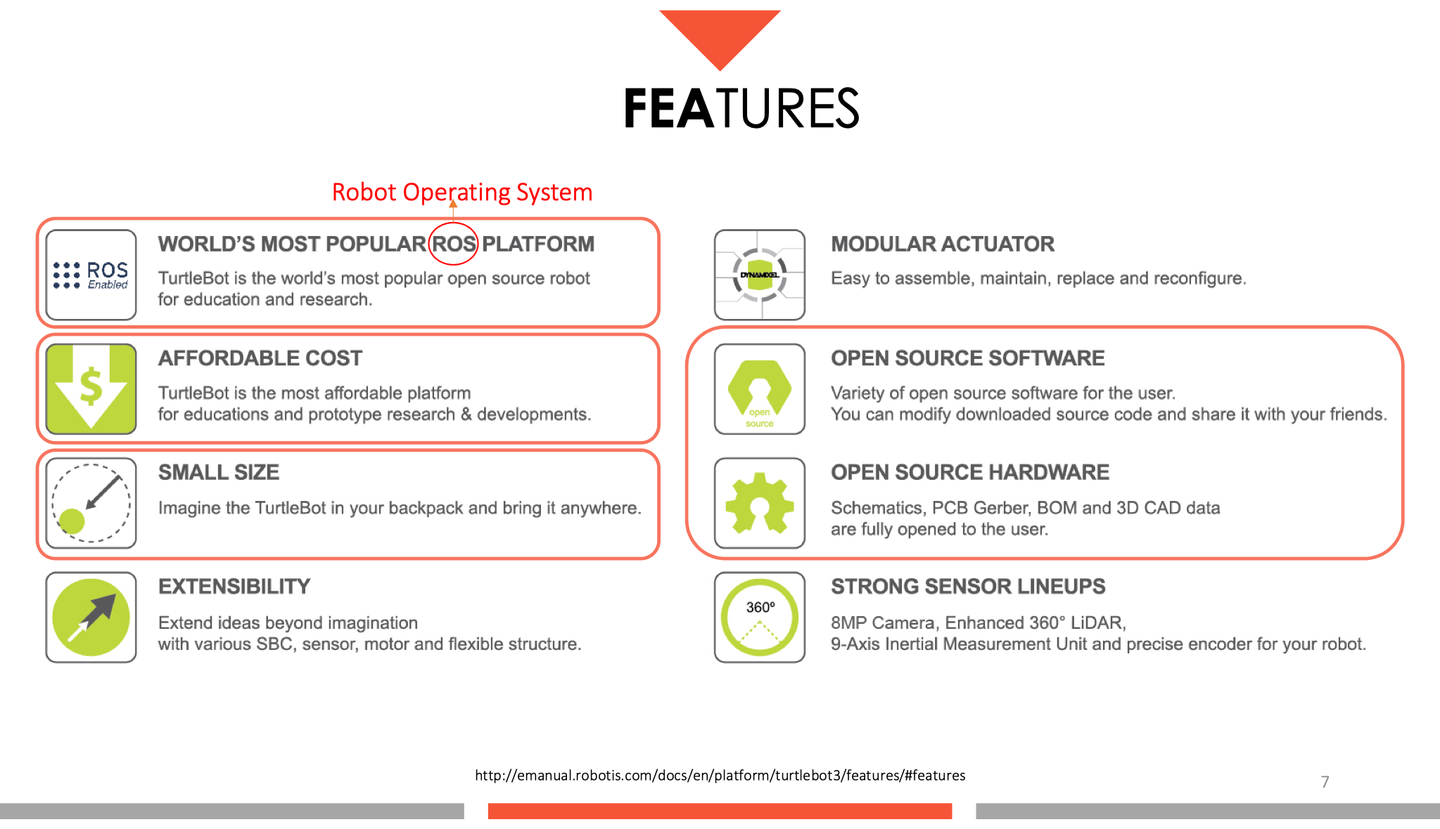

Slide 38
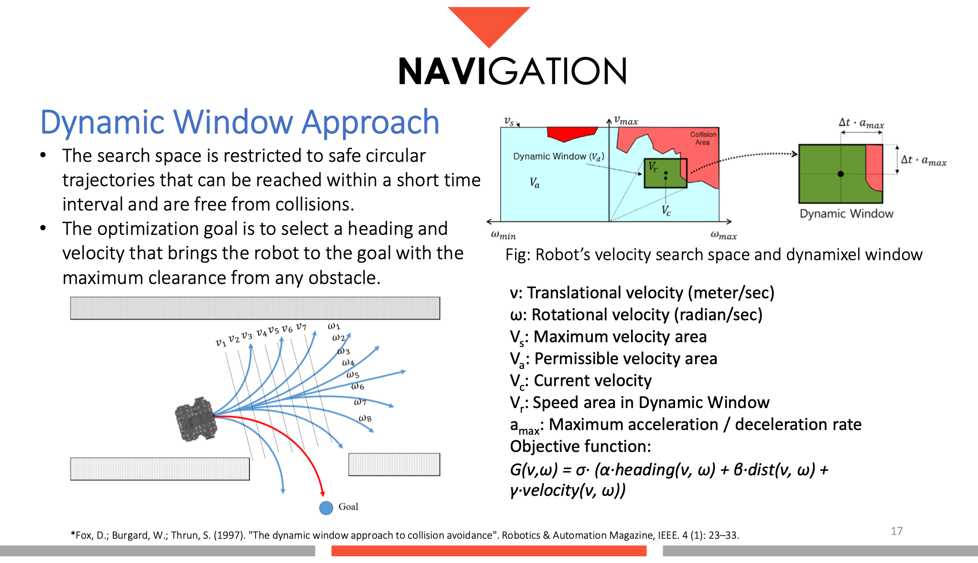

Slide 39
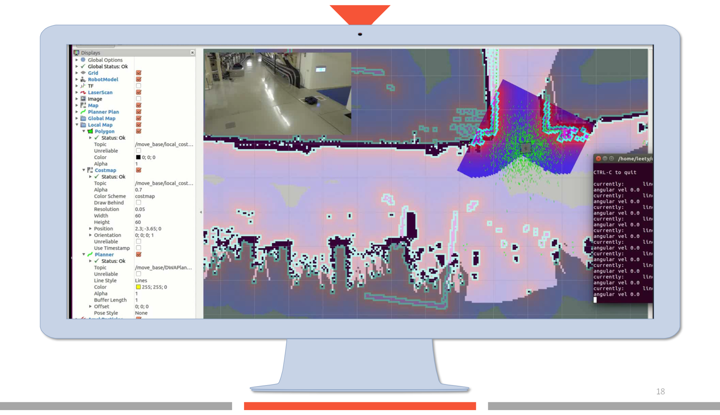

Slide 40
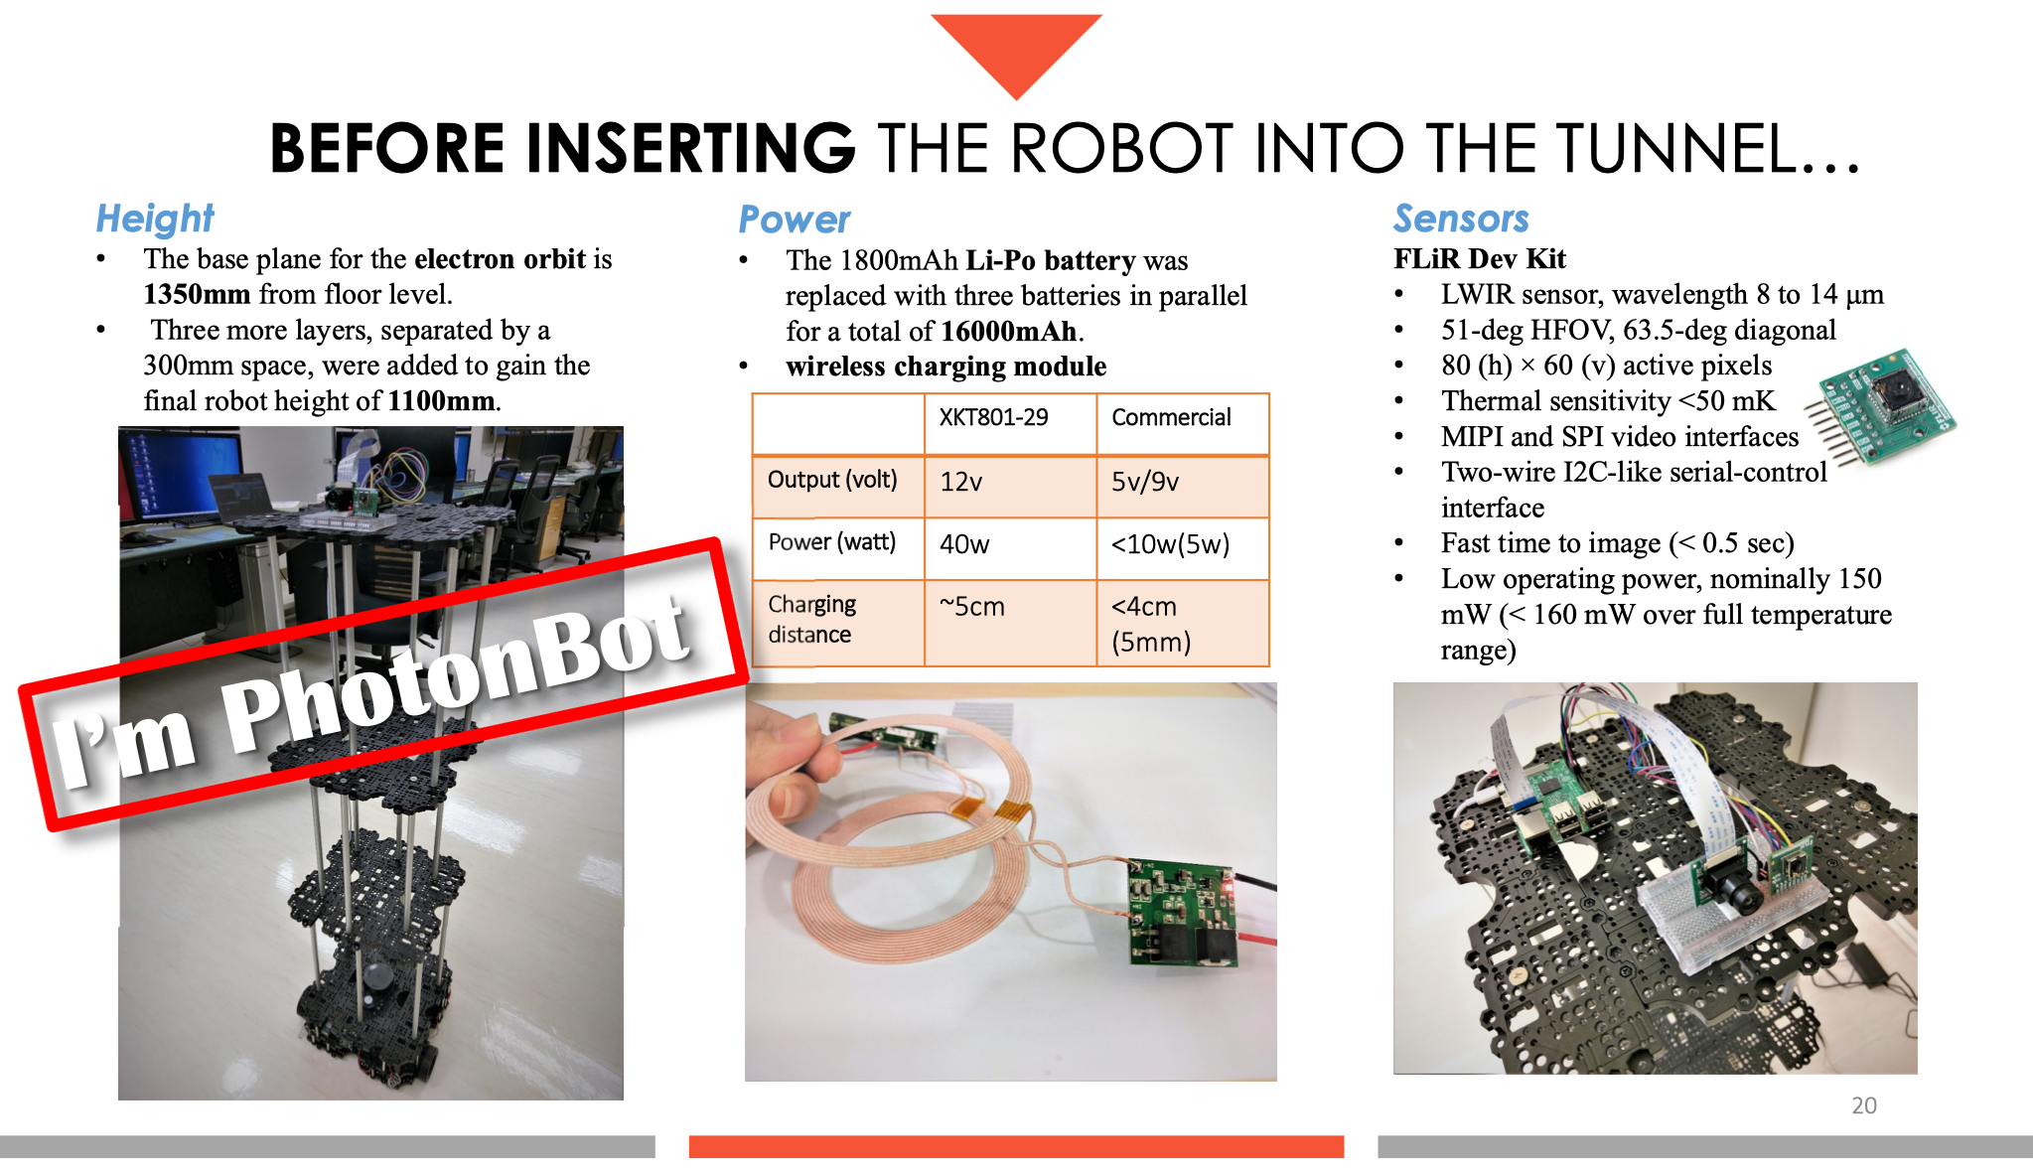

Slide 41
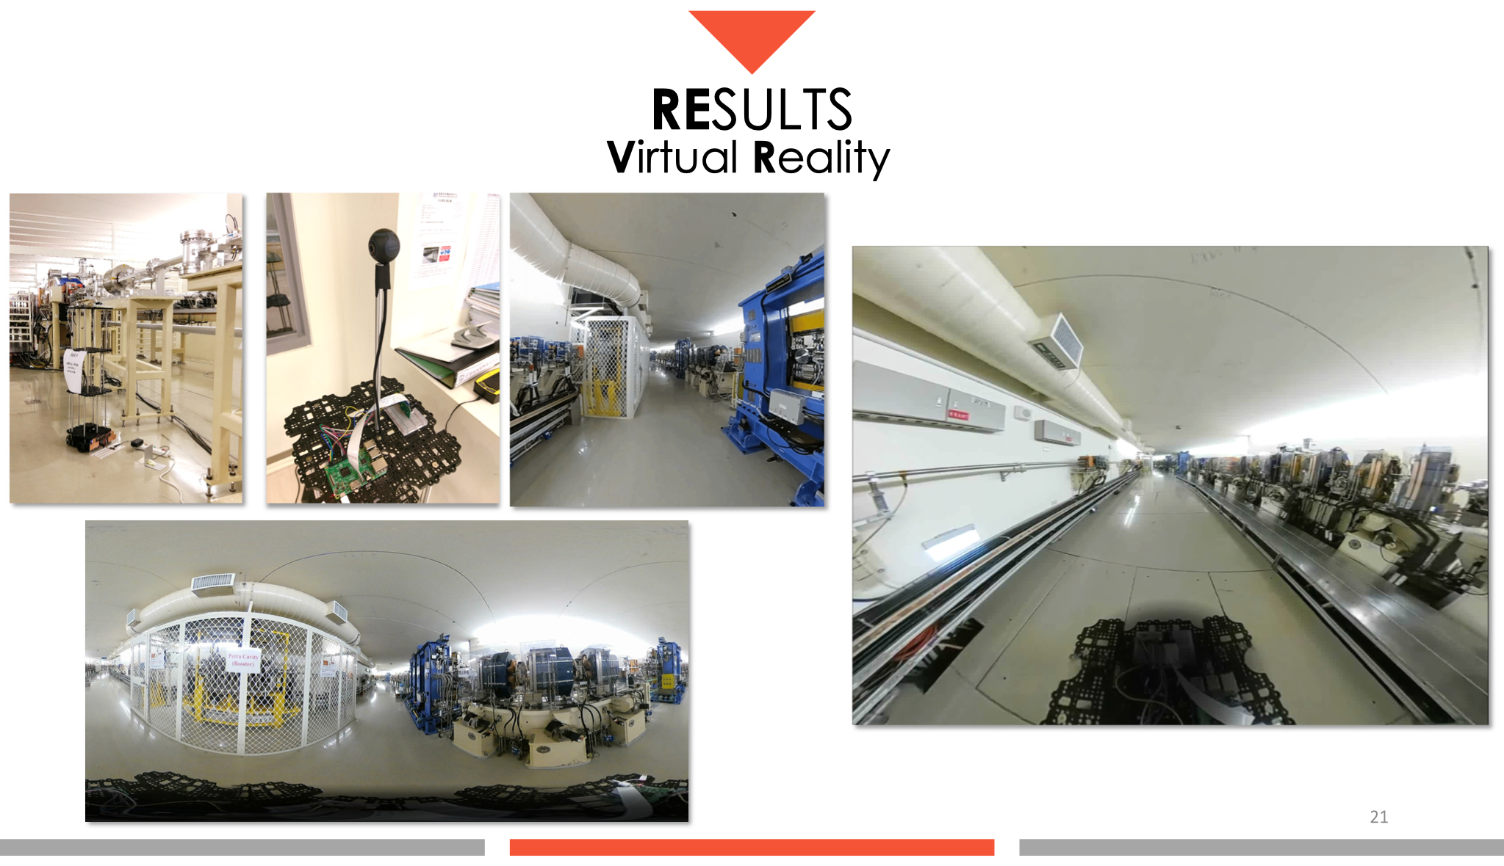

Slide 42
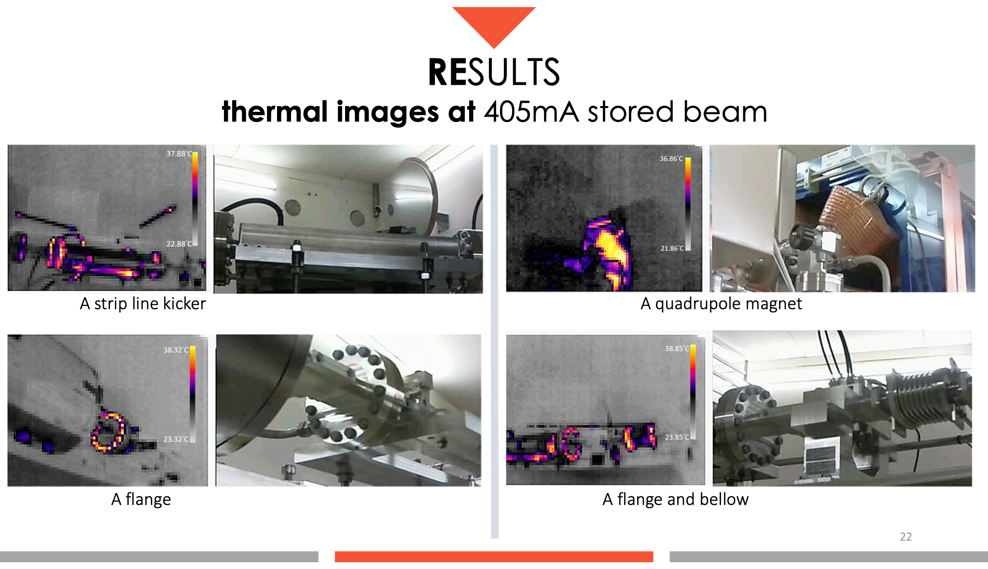

Slide 43
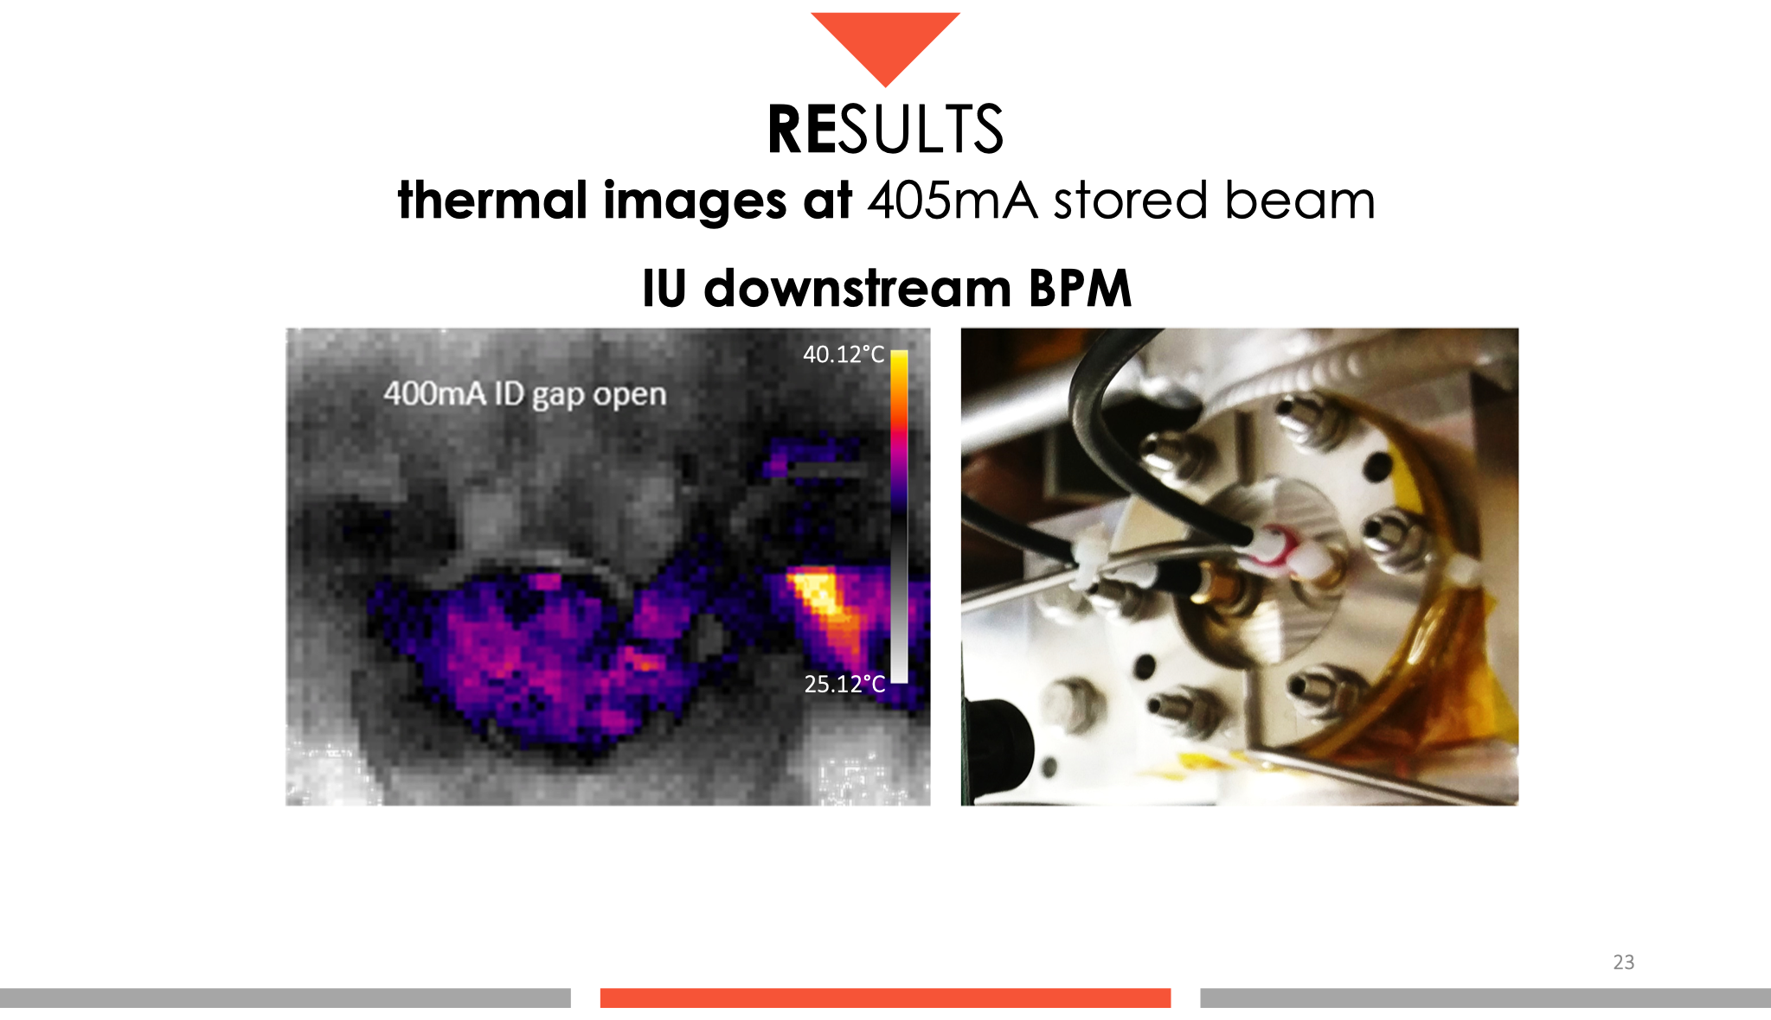

Slide 44
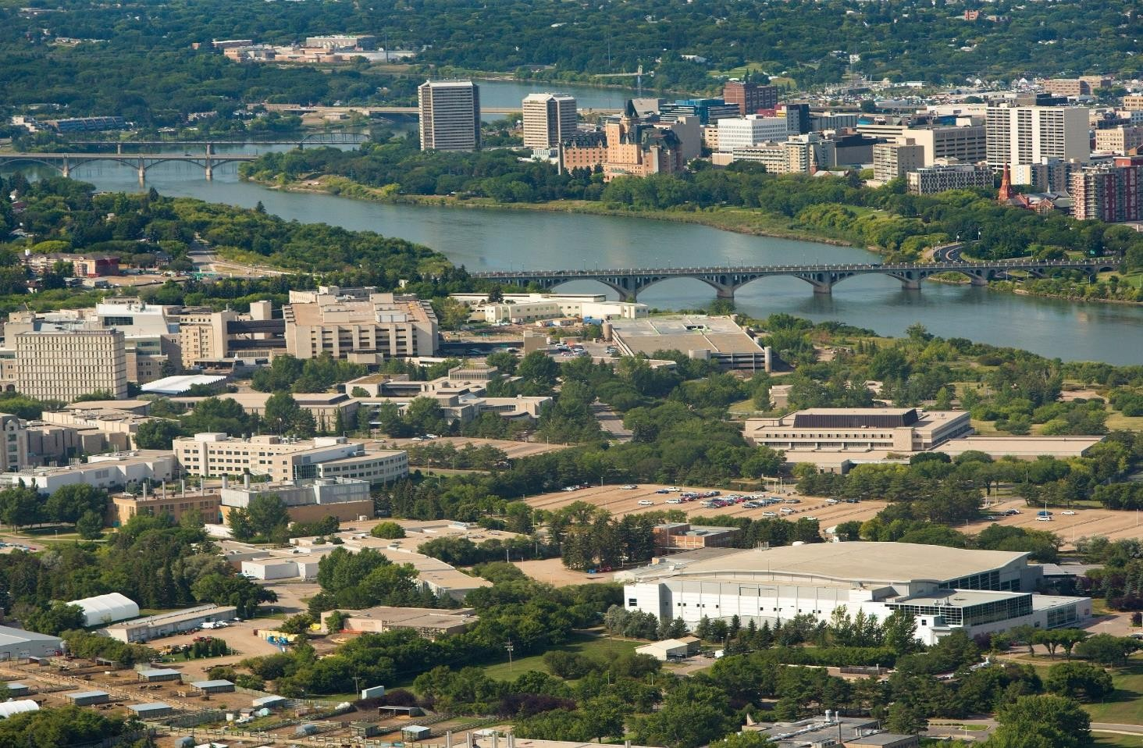
Application of Phase Space Beam Position and Size Monitor for Synchrotron Radiation
Nazanin Samadi PhD Candidate
University of Saskatchewan Canadian Light Source
IPAC19, 24 May 2019

Slide 45

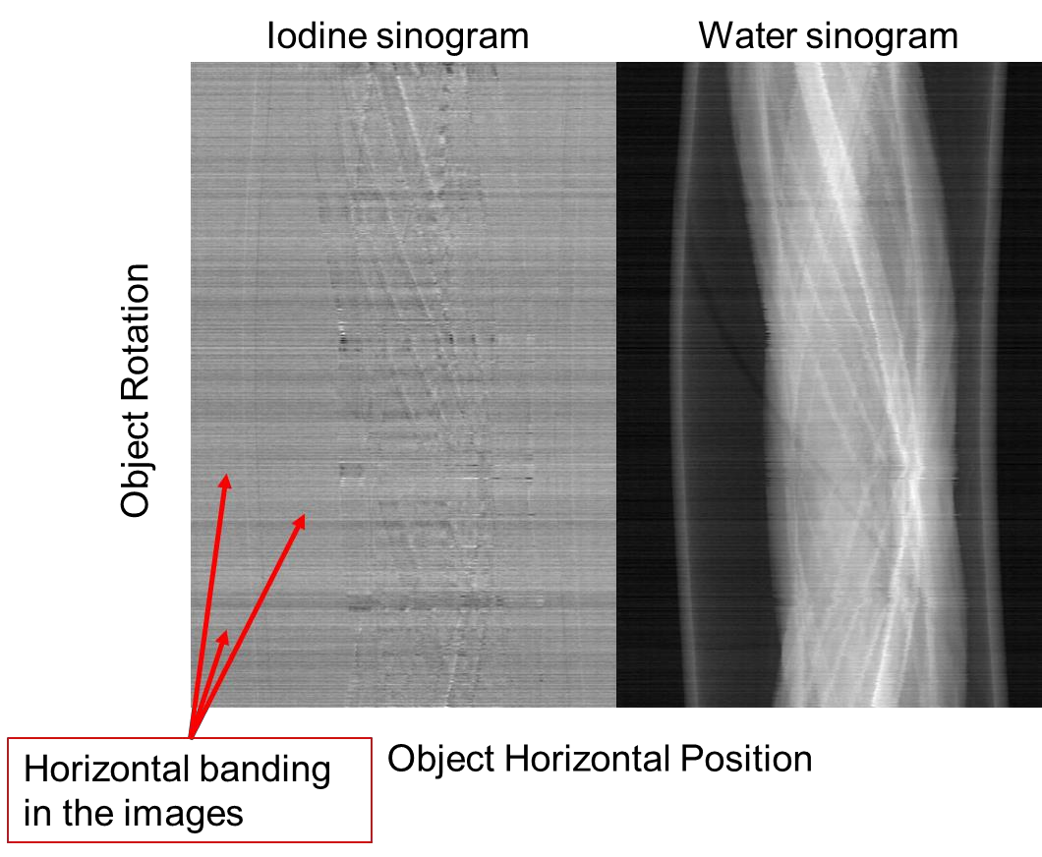
Motivation: Source monitoring & Data Correction
What Happens When the Beam Moves?
New generation light sources with
small emittance
MBA Lattice
_{E}2
Ns: # sectors in the ring Nd: # dipoles/sector
ε ∝
(N N )³
s d
ε _{y} ∝ σ _{y}σ _{y'}
Beam stability and source size measurements challenging and important.

Slide 46
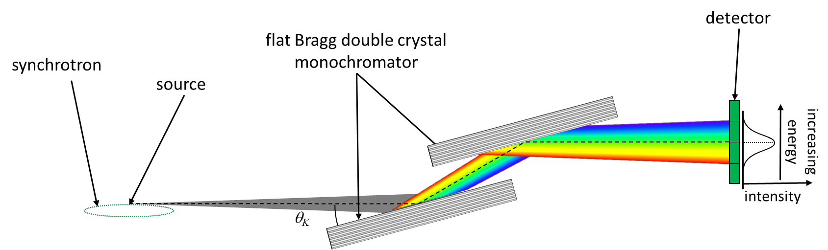

Double Crystal Monochromator
Double Crystal Monochromator (DCM), Creates a nearly monochromatic beam

Slide 47
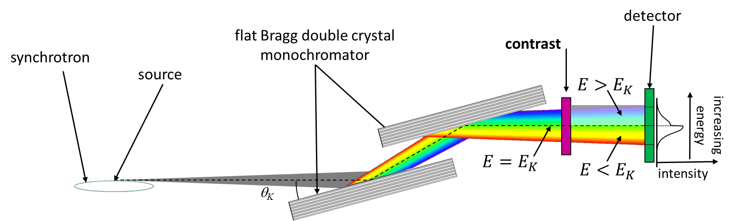

DCM @ K-edge Absorption
Some of the beam above and some of the beam below the edge energy

Slide 48
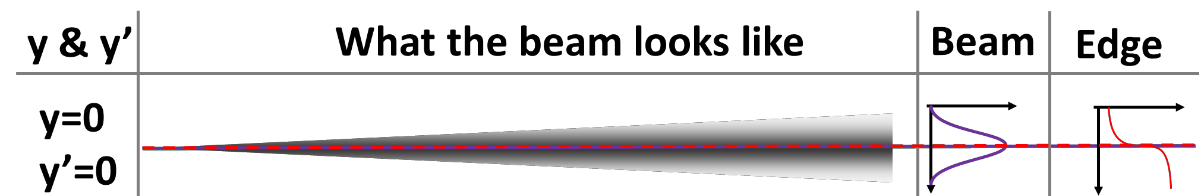


What the Beam Looks Like?

Slide 49
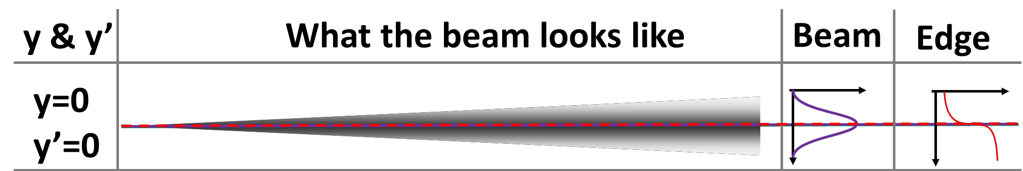
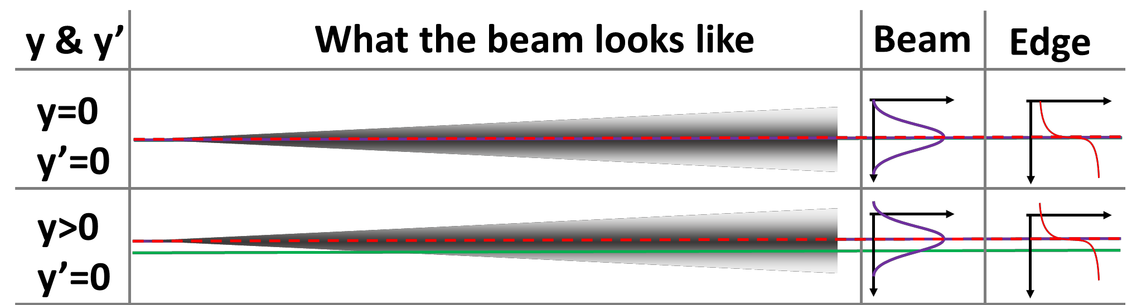
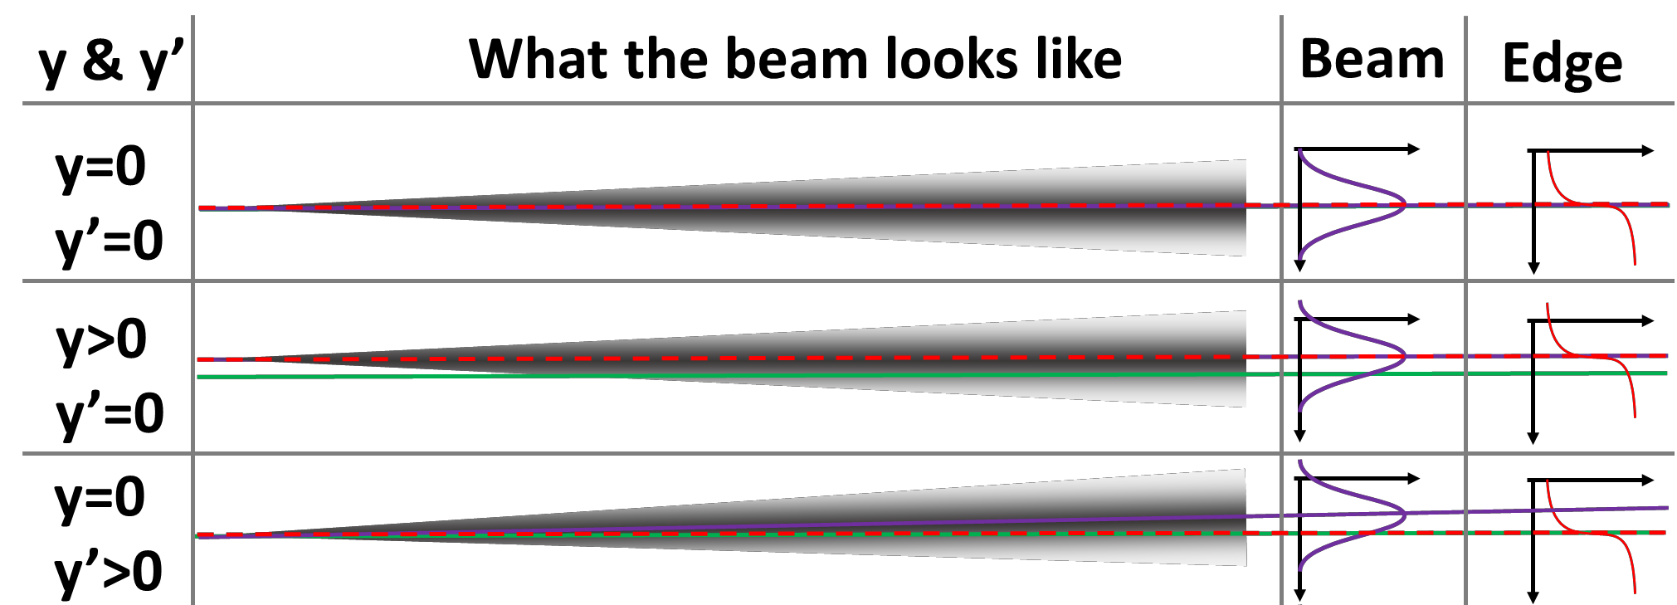
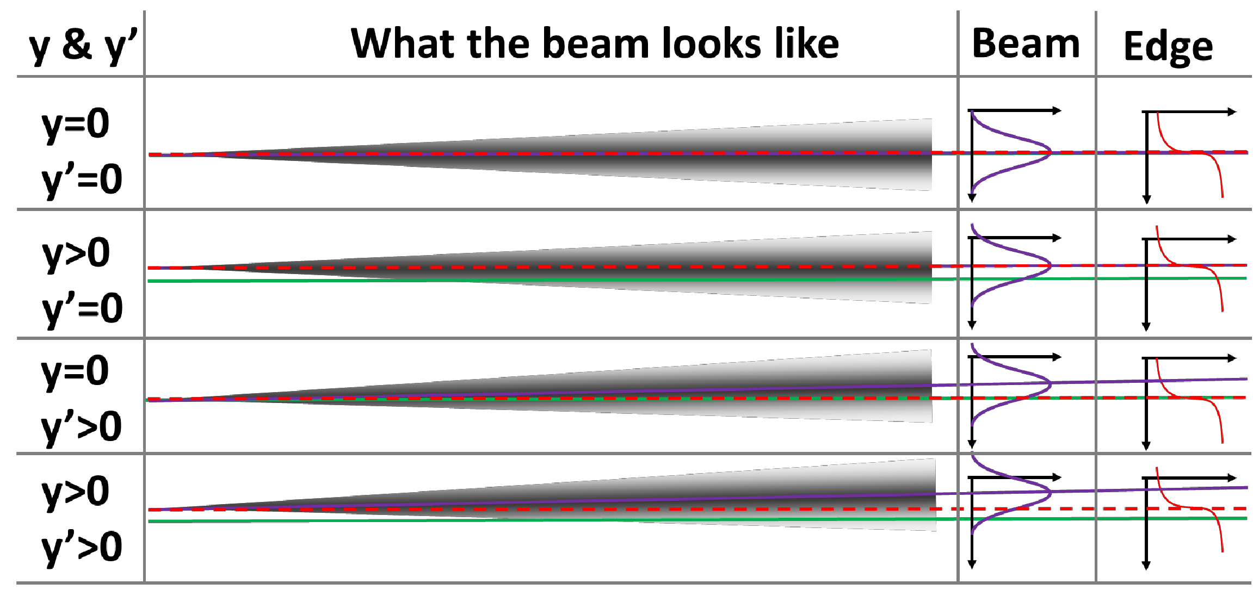
What Happens When the Beam Moves?

Slide 50




The System-Extracting Information
𝒅
-ln
𝜎
𝑒𝑑𝑔𝑒
^{𝜎}𝑏𝑒𝑎𝑚
^{𝑦}𝑒𝑑𝑔𝑒
^{𝑦}𝑏𝑒𝑎𝑚

Slide 51
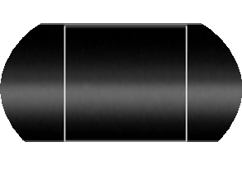


Source position and angle
Beam Side – no filter
𝑦_{𝑏𝑒𝑎𝑚} = 𝑦 + 𝐷𝑦′
^{𝒚}𝒃𝒆𝒂𝒎
Edge Side – contrast filter
^{𝑦}𝑒𝑑𝑔𝑒 ^{= 𝑦}
^{𝒚}𝒆𝒅𝒈𝒆
Beam
Edge
^{𝒚}𝒃𝒆𝒂𝒎^{−𝒚}𝒆𝒅𝒈𝒆
& 𝒚′ =
𝑫
^{𝒚 = 𝒚}𝒆𝒅𝒈𝒆

Slide 52


Beam size and Divergence - Emittance
The Vertical Emittance Comes from the Widths
What we want
Contributions to the K-Edge Width
Contributions to the Unfiltered Beam Width
What we measure
What we need to figure out

Slide 53


Slide 54


Slide 55


Slide 56


Slide 57


Slide 58


Slide 59


Slide 60


Slide 61


Slide 62


Slide 63


Slide 64


Slide 65


Slide 66


Slide 67


Slide 68


Slide 69
Machine Learning and Accelerators

Slide 70

Machine Learning startups:

Slide 71



https://trends.google.com
Machine learning
Artificial intelligence
Data science
Deep learning
Machine learning
Artificial intelligence
Data science
Blockchain

Slide 72


ML vs Blockchain

Slide 73
Number of “###” papers:
 | IPAC10 | IPAC11 | IPAC12 | IPAC13 | IPAC14 | IPAC15 | IPAC16 | IPAC17 | IPAC18 | IPAC19
Machine learning | 0 | 0 | 0 | 0 | 0 | 1 | 0 | 0 | 5⁺⁶ | 12⁺⁷
Artificial intelligence | 1 | 0 | 0 | 0 | 0 | 0 | 0 | 0 | 1 | 0
Data science | 0 | 0 | 0 | 0 | 0 | 0 | 0 | 0 | 0 | 2
Deep learning | 0 | 0 | 0 | 0 | 0 | 0 | 0 | 0 | 1 | 1
Bid data | 0 | 0 | 0 | 0 | 0 | 0 | 0 | 0 | 0 | 1
Electron gun | 4 | 1 | 9 | 10 | 7 | 5 | 7 | 8 | 5 | 9
Diagnostics | 18 | 15 | 14 | 18 | 15 | 12 | 10 | 14 | 15 | 9
Electron lenses | 0 | 0 | 1 | 1 | 2 | 4 | 1 | 2 | 1 | 2

Slide 74





https://indico.cern.ch/event/826766/
LHC Collimator setting up through machine learning

Slide 75

Element Aero is a technological consulting company specializing in particle beam technology, security and defense applications, and environmental issues.

Slide 76


200X – Bid data
  Algorithms SVM(1963,1993),
  Random Forest (1995),
  AdaBoost (2003),…
2011-2012
convolutional neural network (CNN, or ConvNet)
ImageNet
2015-2017
  - Recurrent neural network
  - long short-term memory networks (LSTMs)
  - DeepFace
  - (Voice, Face)

Slide 77

https://indico.cern.ch/event/822126/
Fast Machine Learning
10-13 September 2019
Fermi National Accelerator Laboratory

Slide 78
Examples

Slide 79





The Advanced Photon Source

Slide 80


Slide 81


Slide 82



https://indico.cern.ch/event/826766/

Slide 83






Slide 84



Design:

Slide 85




Diagnostics:

Slide 86



Control:

Slide 87
Conclusions
Not enough data

Slide 88




Slide 89
References
M. Ferrario and R.W. Aßmann, “From Dreams to Reality: Prospects for Applying Advanced Accelerator Technology to Next Generation Scientific User Facilities”, in Proc. IPAC'19, Melbourne, Australia, May 2019, pp. 1-5. doi:10.18429/JACoW-IPAC2019-MOXPLM2
A.V. Tyukhtin, E.S. Belonogaya, S.N. Galyamin, and V.V. Vorobev, “Development of Methods for Calculation of Bunch Radiation in Presence of Dielectric Objects”, in Proc. IPAC'19, Melbourne, Australia, May 2019, pp. 2274-2276. doi:10.18429/JACoW-IPAC2019-WEYYPLS3
D. Stratakis, B.E. Drendel, N.S. Froemming, J.P. Morgan, and M.J. Syphers, “Commissioning and First Results of the Fermilab Muon Campus”, in Proc. IPAC'19, Melbourne, Australia, May 2019, pp. 41-44. doi:10.18429/JACoW-IPAC2019-MOZZPLM3

Slide 90
D. Leitner, “High Performance ECR Sources for Next-Generation Nuclear Science Facilities”, in Proc. IPAC'19, Melbourne, Australia, May 2019, pp. 2224-2229. doi:10.18429/JACoW-IPAC2019-WEXPLS1
T.Y. Lee, B.Y. Chen, T.W. Hsu, B.Y. Huang, C.H. Kuo, and W.Y. Lin, “A Remote-Controlled Robot-Car in the TPS Tunnel”, in Proc. IPAC'19, Melbourne, Australia, May 2019, pp. 3435-3438. doi:10.18429/JACoW-IPAC2019-THYYPLS3
N. Samadi, L.D. Chapman, L.O. Dallin, and X. Shi, “Application of a Phase Space Beam Position and Size Monitor for Synchrotron Radiation”, in Proc. IPAC'19, Melbourne, Australia, May 2019, pp. 4376-4379. doi:10.18429/JACoW-IPAC2019-FRXXPLS3
N. Delerue, D. Auguste, J. Bonis, F. Gauthier, S. Jenzer, and A.M. Moutardier, “Tests of a 3D Printed BPM with a Stretched Wire and with a Particle Beam”, in Proc. IPAC'19, Melbourne, Australia, May 2019, pp. 4368-4371. doi:10.18429/JACoW-IPAC2019-FRXXPLS1LS1

