Slide 1
LIU-PS EVM Status
Data extraction: 25 June 2019

Slide 2
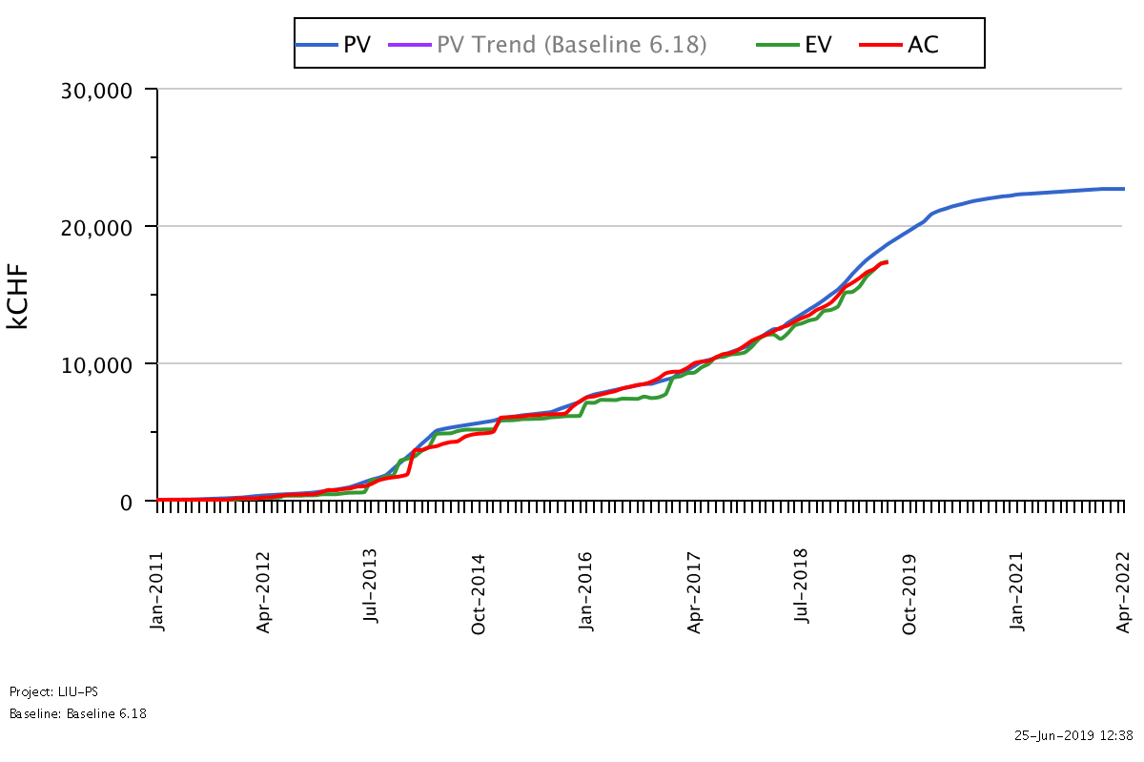
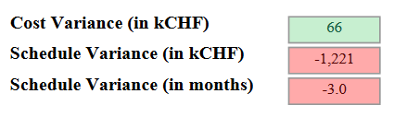
LIU-PS Dashboard
Was 3.3 on the 28.05.19
Reporting up-to-date for 94% of the workunits

Slide 3

LIU-PS Crosstab by Group

Slide 4
Spare Slides

Slide 5
LIU-PS Crosstab – BE Department

Slide 6
LIU-PS Crosstab – EN Department

Slide 7
LIU-PS Crosstab – HSE Department

Slide 8
LIU-PS Crosstab – TE Department

