Slide 1
LIU-PS Planning report

Slide 2
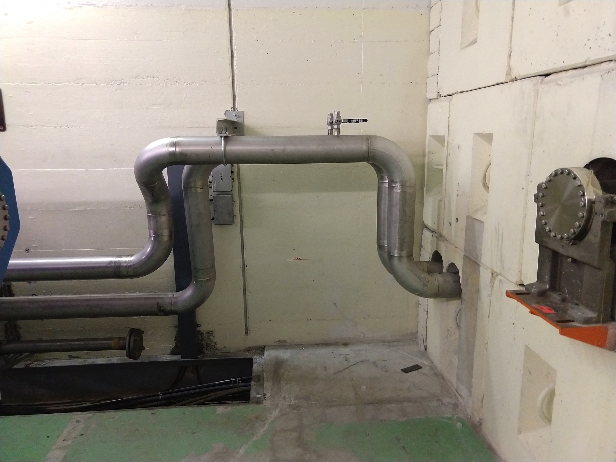
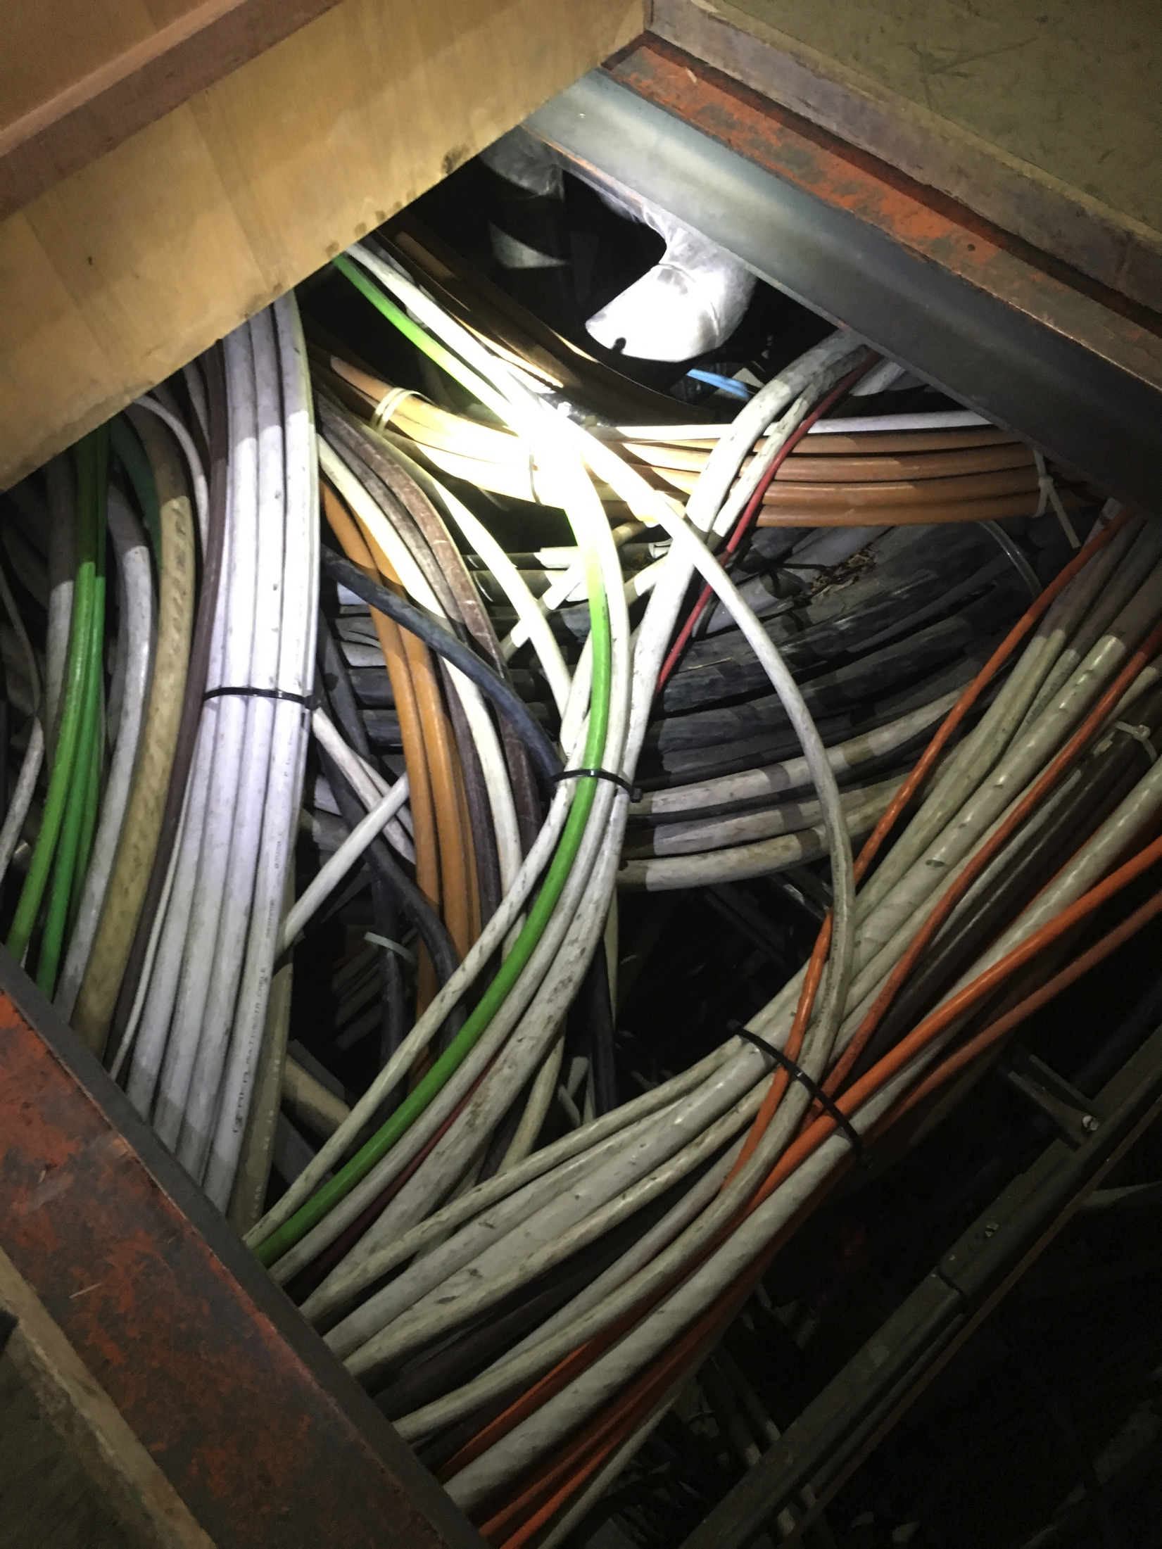
New demineralized water circuit
  Pipes installation in the central ring and the 4 galleries has been completed
  Works performed in the PS SWY to try to connect the PS SWY to the TT2 (2 extra days are still needed)
  Connection between gallery 1 and the ring as been completed
  Works in the TT2 have been completed
  Connection to B.269 is postponed due to lack of space
  Connection between gallery 3, 5 and 7 to the outer side of the ring have been postponed (new date not yet defined)
Courtesy of S. Deleval

Slide 3
B.365 – KFA45 area
  Cabling C15 campaign completed (an additional cabling campaign is foreseen later)
  Oil pipes will be installed next week
  EN-EL LV consolidation works have been completed but the system is on a temporary power source (final power source will be available end of June)

Slide 4
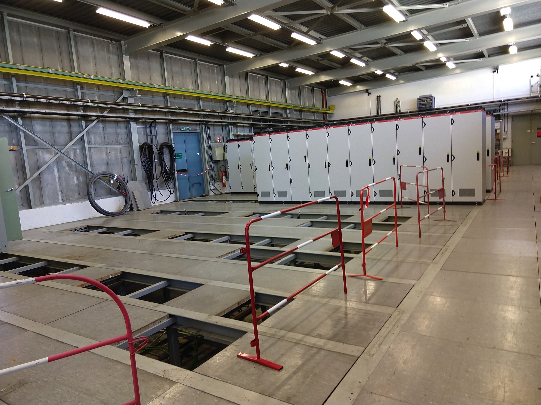
B.365 – PCs area
CV pipes installed – the missing balancing valves will be installed in October in the slot foreseen to install the flexible pipes
Power converters installation – only 5 installed
  1 is still with the ABT test stand
  The others are late (already announced by EPC few months ago)

Slide 5
B.269
False floor structure installation will be completed this week
PCB cleaning will be completed tomorrow
Power transformers installation postponed to next week
CV pipes installation ongoing
Integration problems discussed yesterday morning on-site and a solution was found between the teams concerned (CV, SMB and EN-EL)

Slide 6
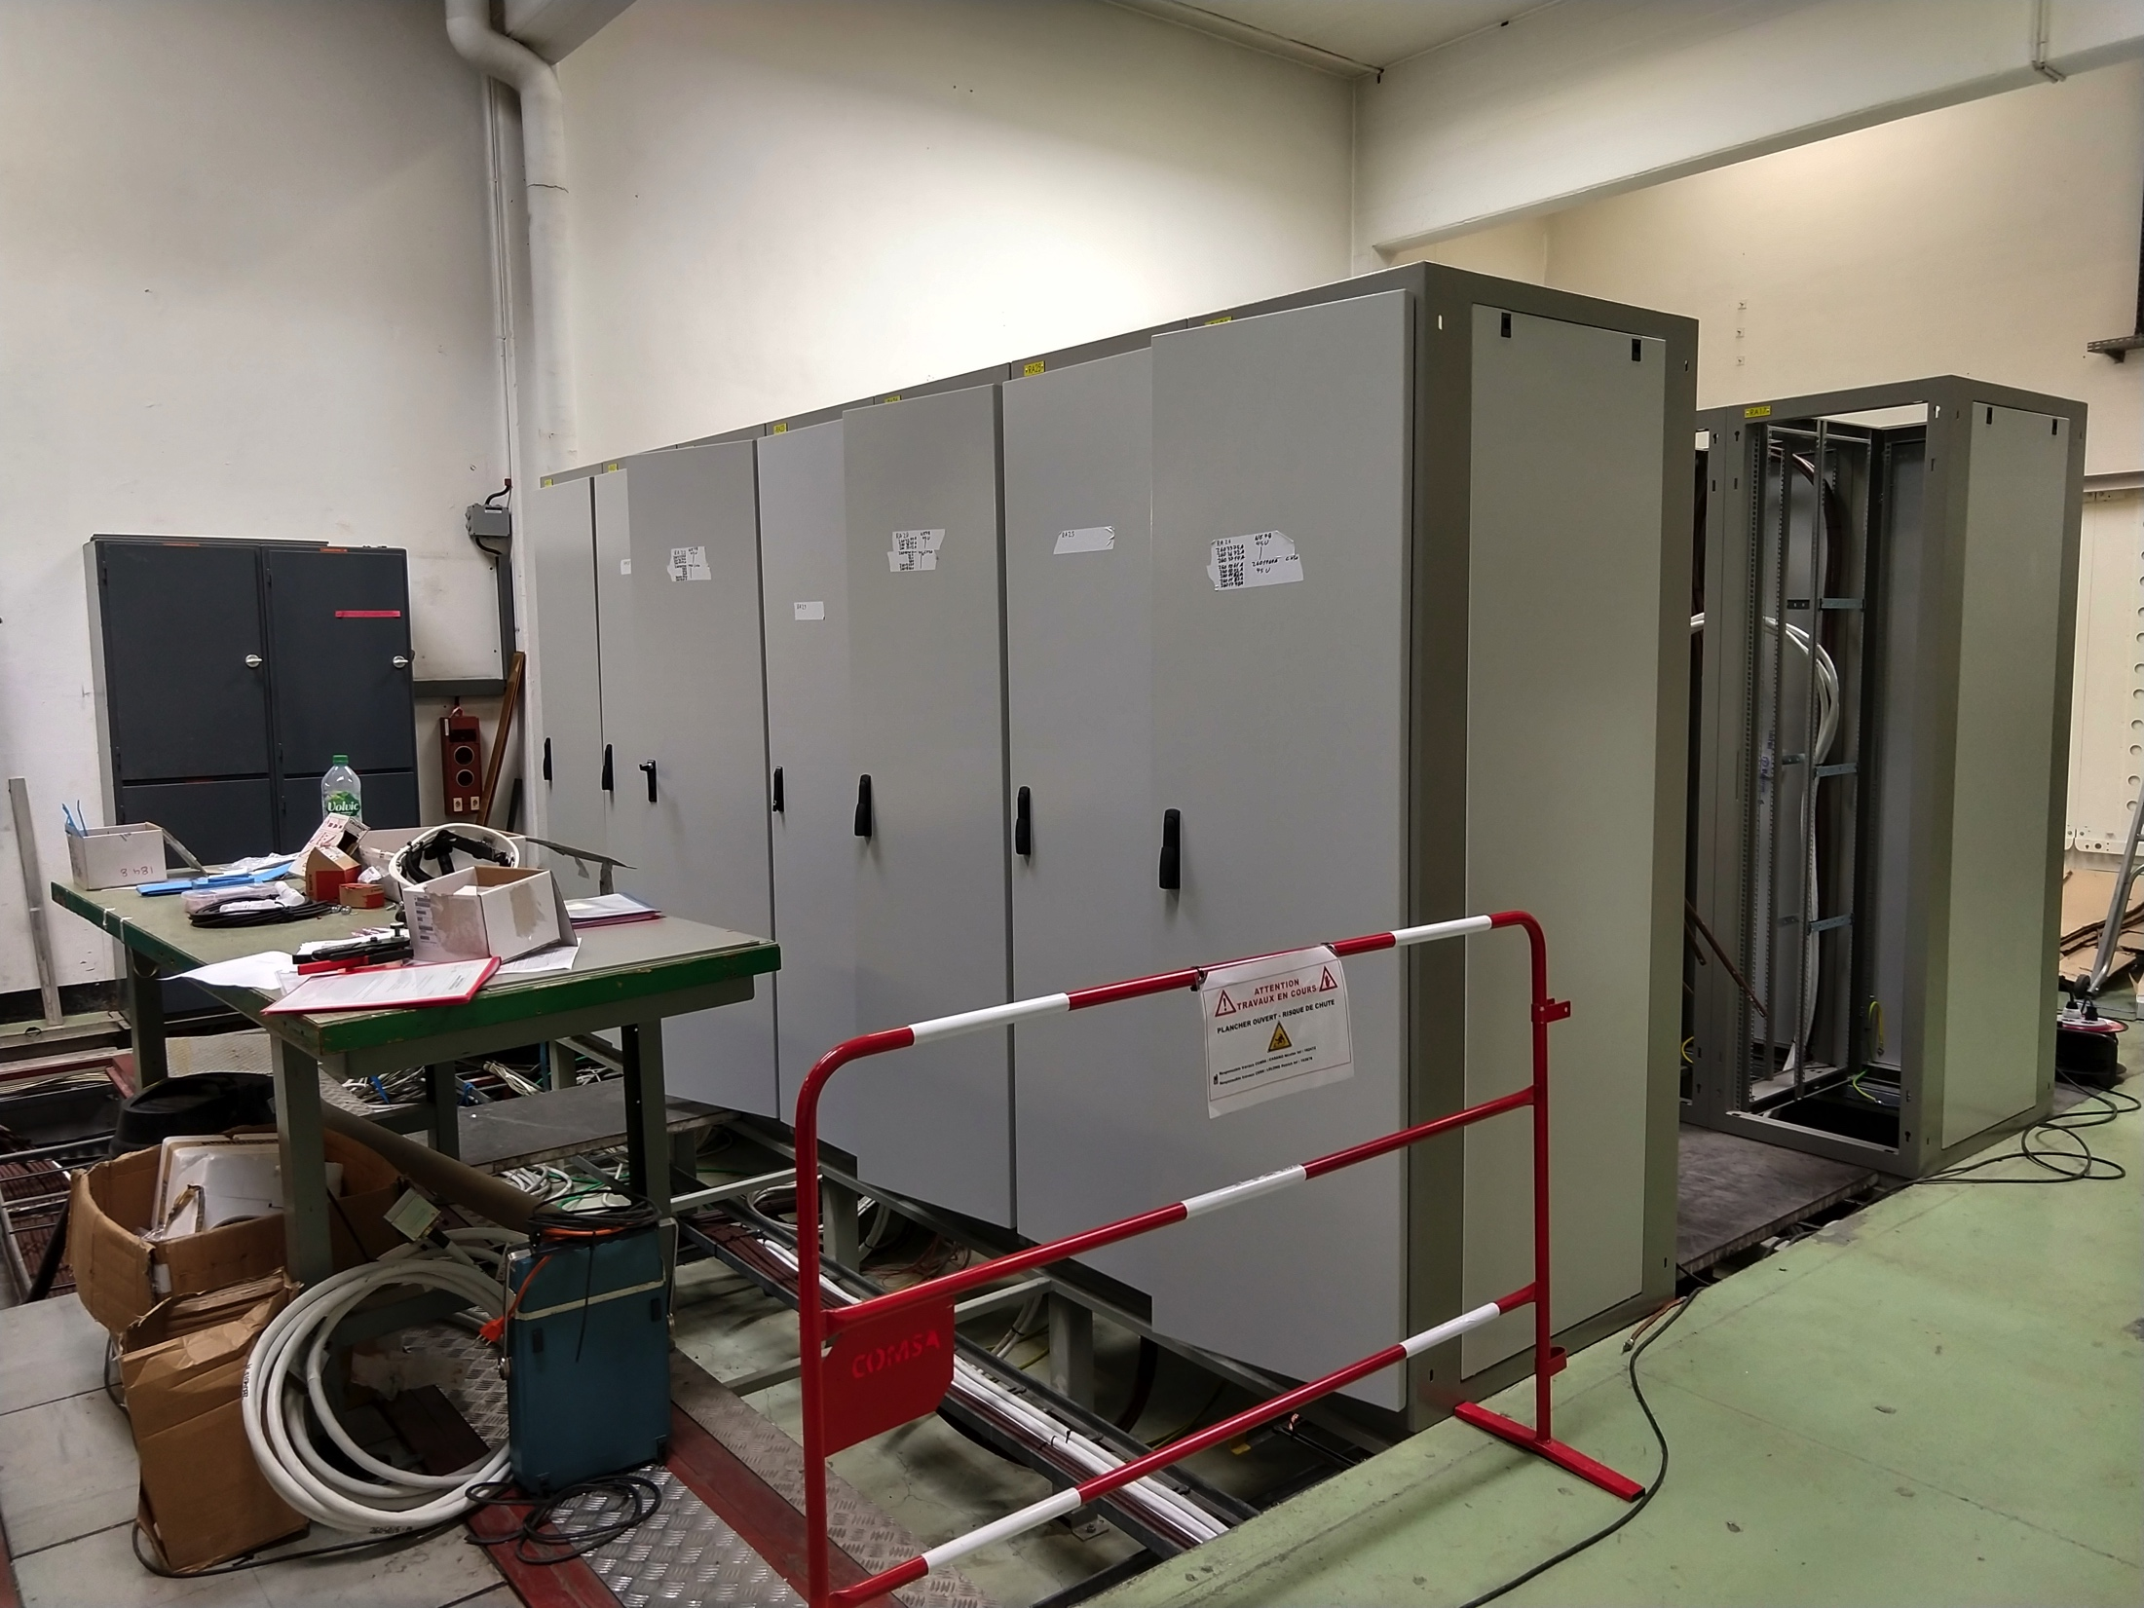
B.355
ME6 powered since last week
Cabling campaign + rack installation ongoing has been completed
EN-EL power works late with respect to the starting date, but James ensure us that the end date will be respected
  Chassis for the TFB racks will not be available at the end of the working slot

Slide 7
Main Units renovation (cons.)
22/43
  already renovated
2/22
  kept in B.150 (MU27 and MU39) for the LINAC4 and BTP works
18/22
  already re-installed and re-aligned in the machine (MU73, MU24, MU22, MU29, MU32, MU13, MU11, MU4, MU30, MU6, MU40, MU12, MU21, MU28, MU33, MU38, MU66, MU67)
2/22
  The re-alignment is ongoing today (MU10 and MU80)
MU44 back to its running position and the alignment is ongoing today
Vacuum leak detected on the vacuum chamber for the MU36 – New vacuum chamber been prepared
Modifications on the MU56 vacuum chamber are under study

Slide 8
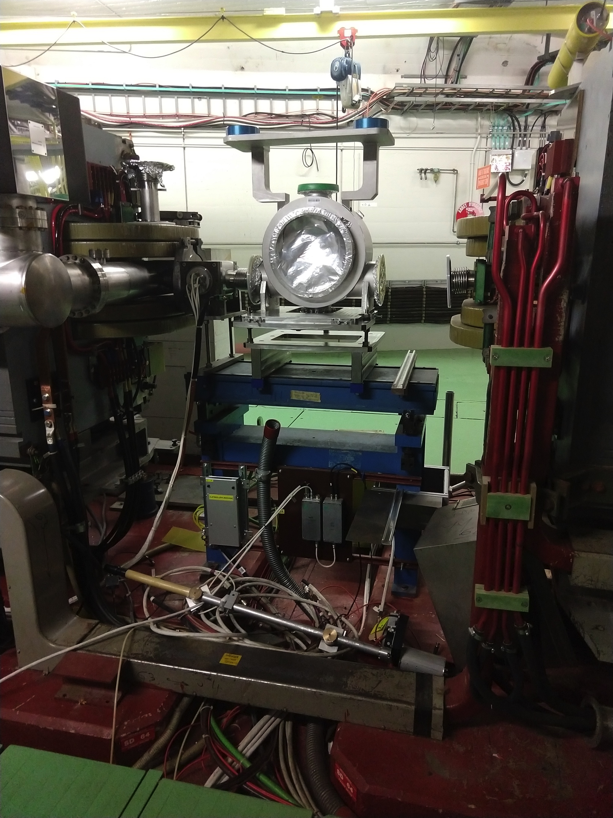
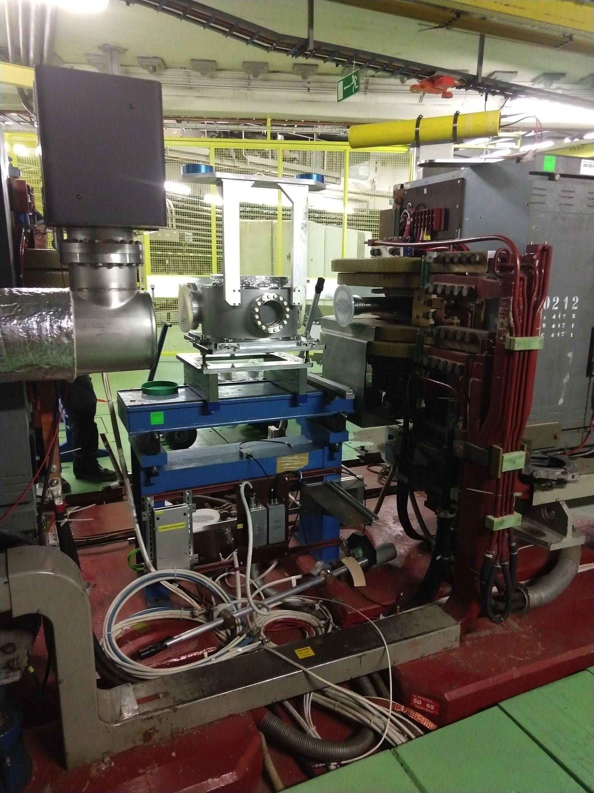
First LIU-PS equipment installed in the machine
Wire Scanners tanks (it doesn’t include the instrument)

Slide 9
Question?

