Slide 1
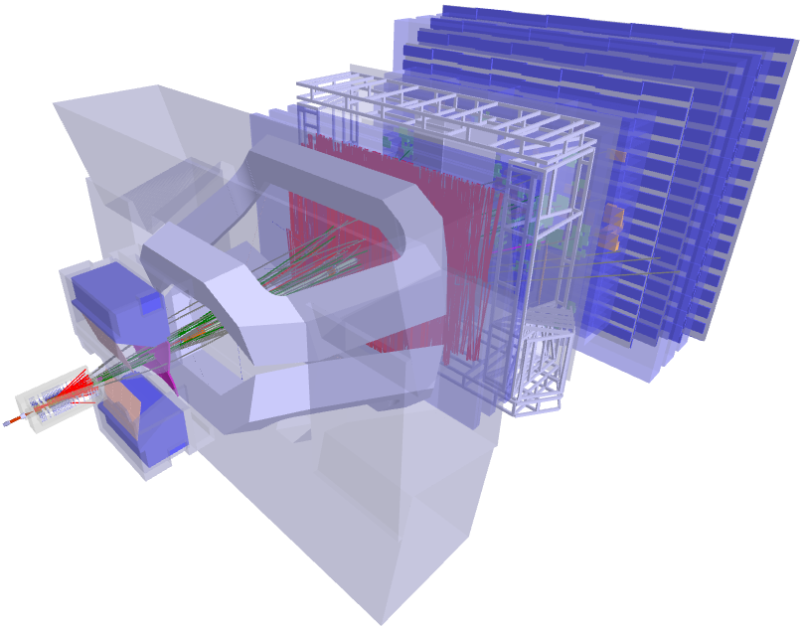
Status of the LHCb Pixel Detector
Edgar Lemos Cid, On behalf of the LHCb VELO Group

Slide 2
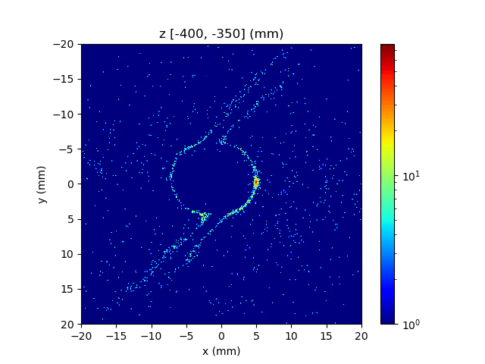
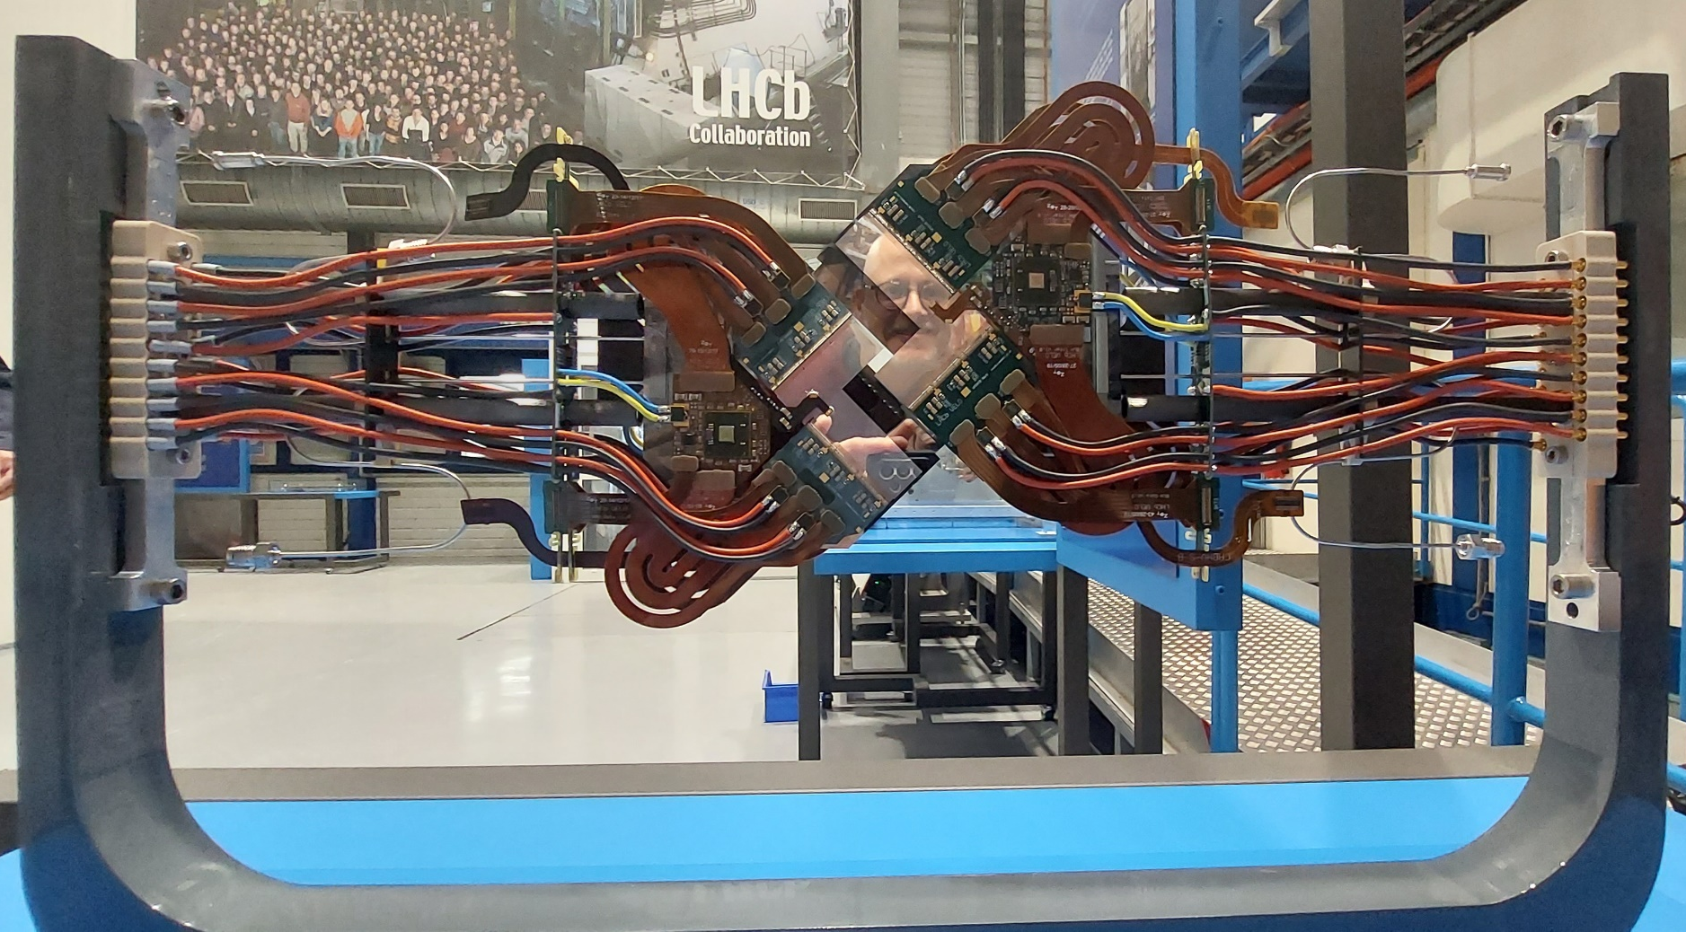
Outline
LHCb VELO Upgrade.
Module Assembly.
Detector Assembly and Installation.
VELO Safety System (VSS) and Detector Monitoring.
VeloPix Calibration: Equalization and Bxid Spread.
Time Alignment.
VELO Closing.
Vertex reconstruction.
DAQ and FPGA clustering.
HV performance.
SMOG 2.

Slide 3
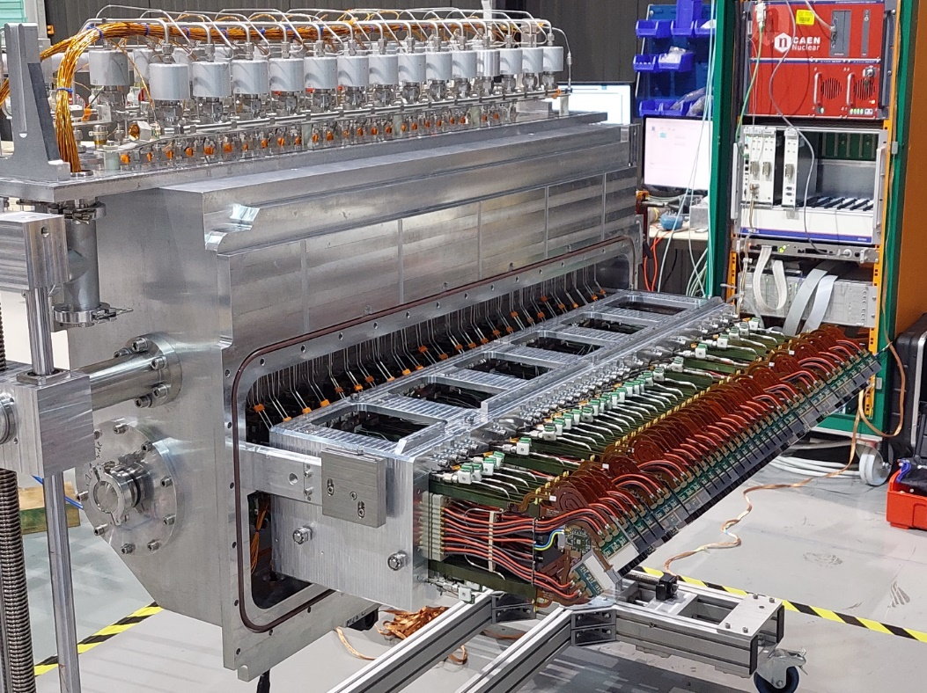
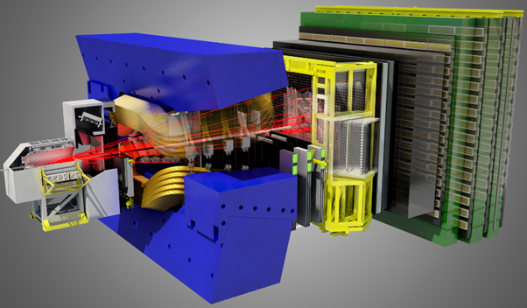
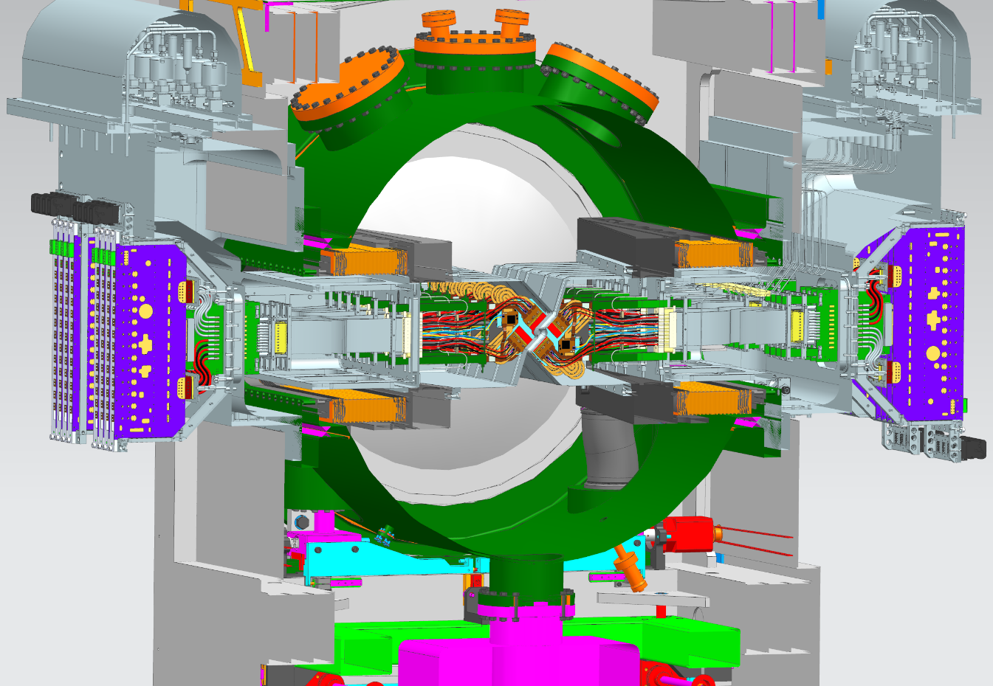
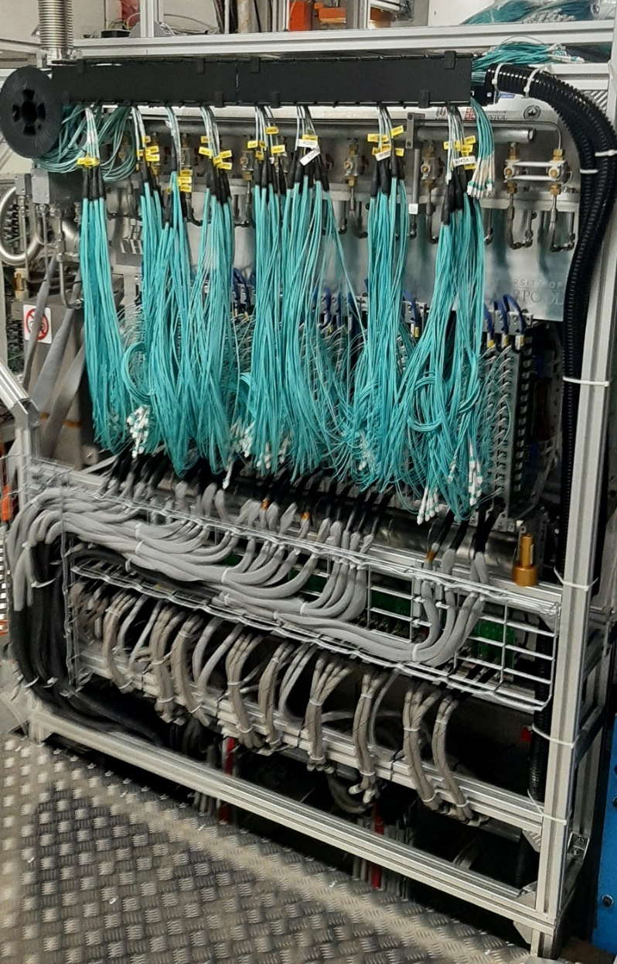
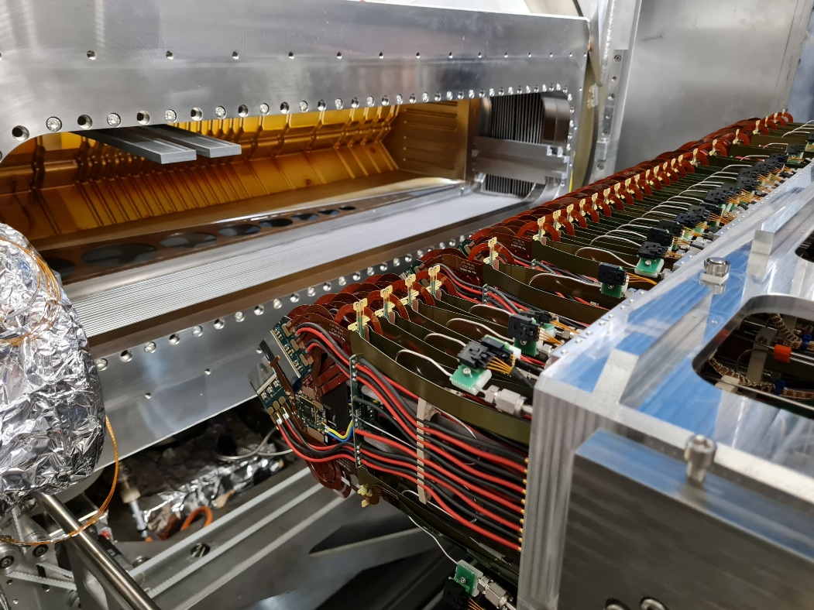
LHCb VELO Upgrade
VELO HALF
LHCb
VELO DESIGN
Primary
vacuum
Modules
BEAM
Secondary vacuum
LHCb is a forward (2 < η < 5) arm spectrometer focusing in b-hadron and c- hadron decays. Studies CP violation, rare decay, …
The Vertex detector (VELO) was successfully updated from silicon strips to pixels in 2022.
  Closest pixel at 5.1 mm to the LHC beam.
  Use increased luminosity (5x).
  Readout all the events at every bunch crossing (40 MHz).
  41M pixels across 52 modules in vacuum.
  Evaporative CO₂ cooling through microchannels.
  RF foil down to thickness of 150 µm.

Slide 4
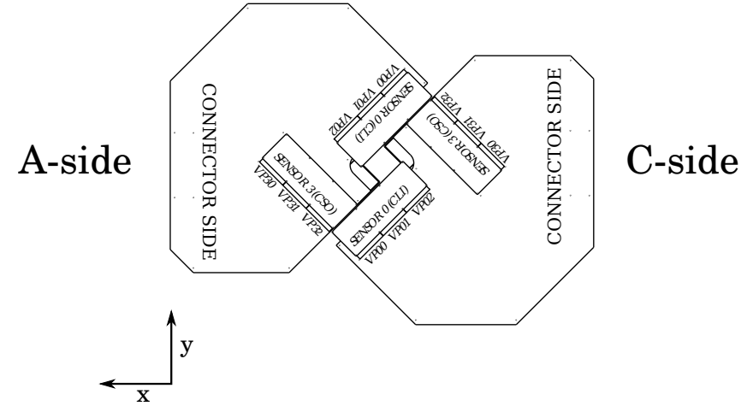
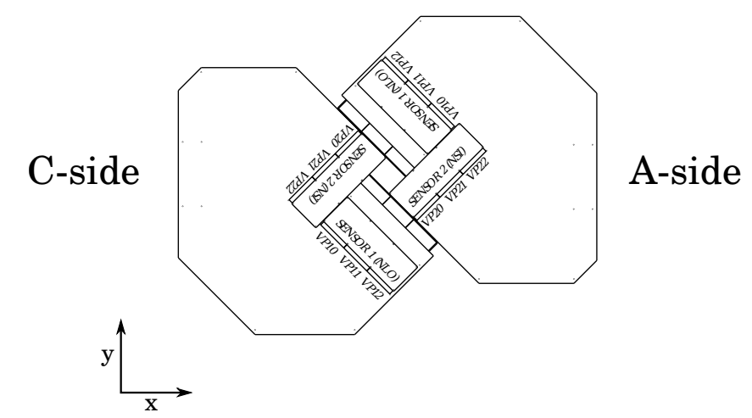
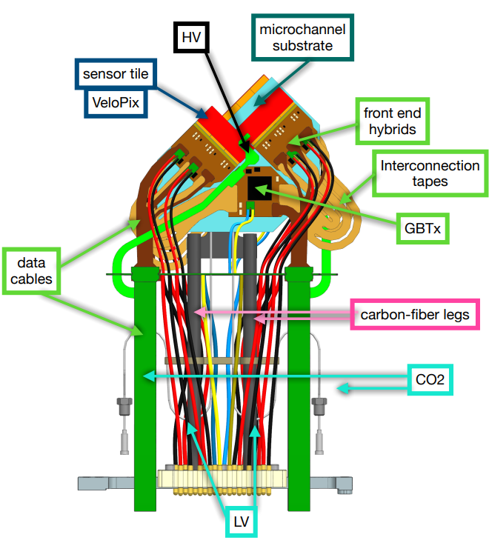
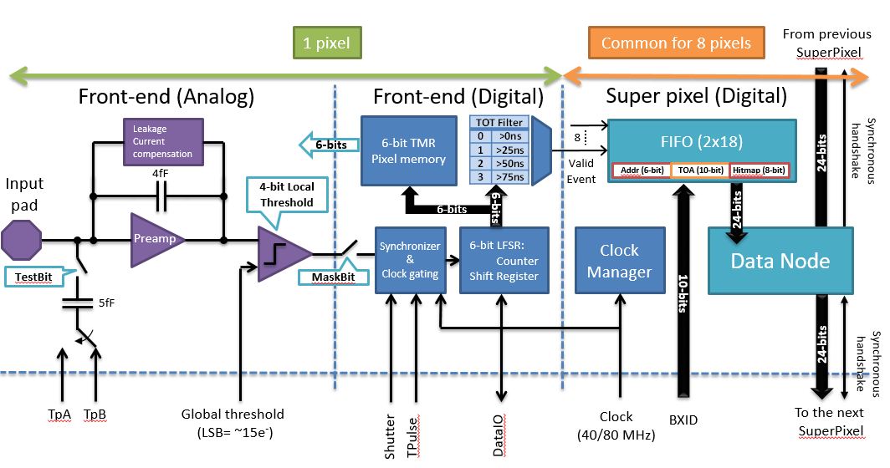
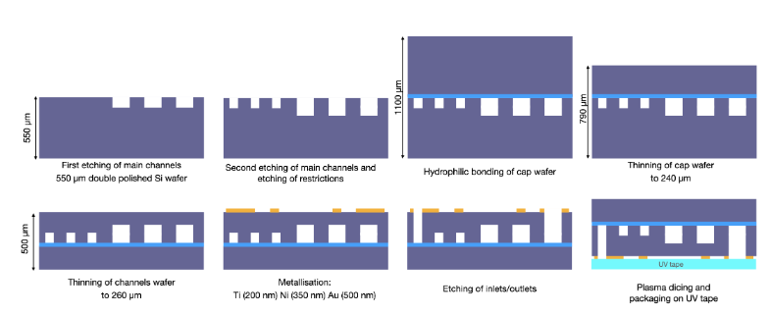
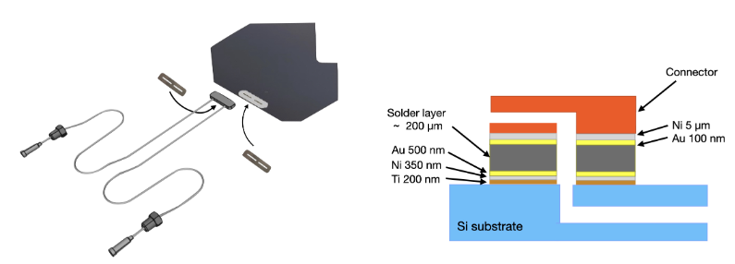
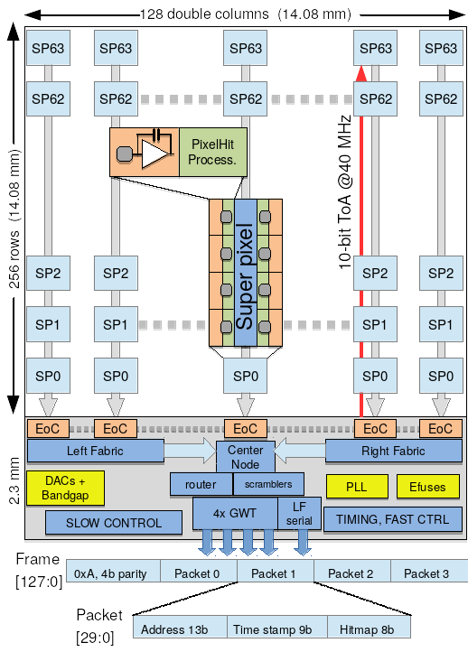
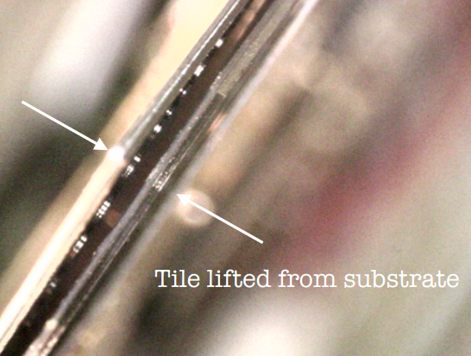

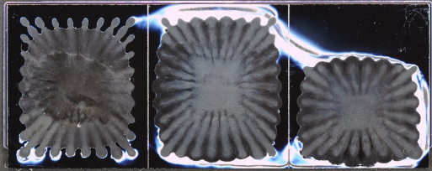
Module Assembly
VeloPix:
256x256 pixels of 55 x 55 µm.
800 Mhits/s/ASIC.
Continuous, trigger-less and binary readout.
Radiation hard up to 400 Mrad and SEE tolerant.
*Talk 2018: VeloPix Readout and ASIC.
Silicon microchannel substrates:
Two phase evaporative CO₂ cooling.
500 µm wafer with 120 x200 µm² microchannels.
Cooling power up to 40 W at -30 ºC.
*Microchannel cooling for the LHCb VELO Upgrade I.
.Challenges in the way.
Glue between ASIC and Substrate.
GBTx cold operation.
Connectors metallization.

Slide 5
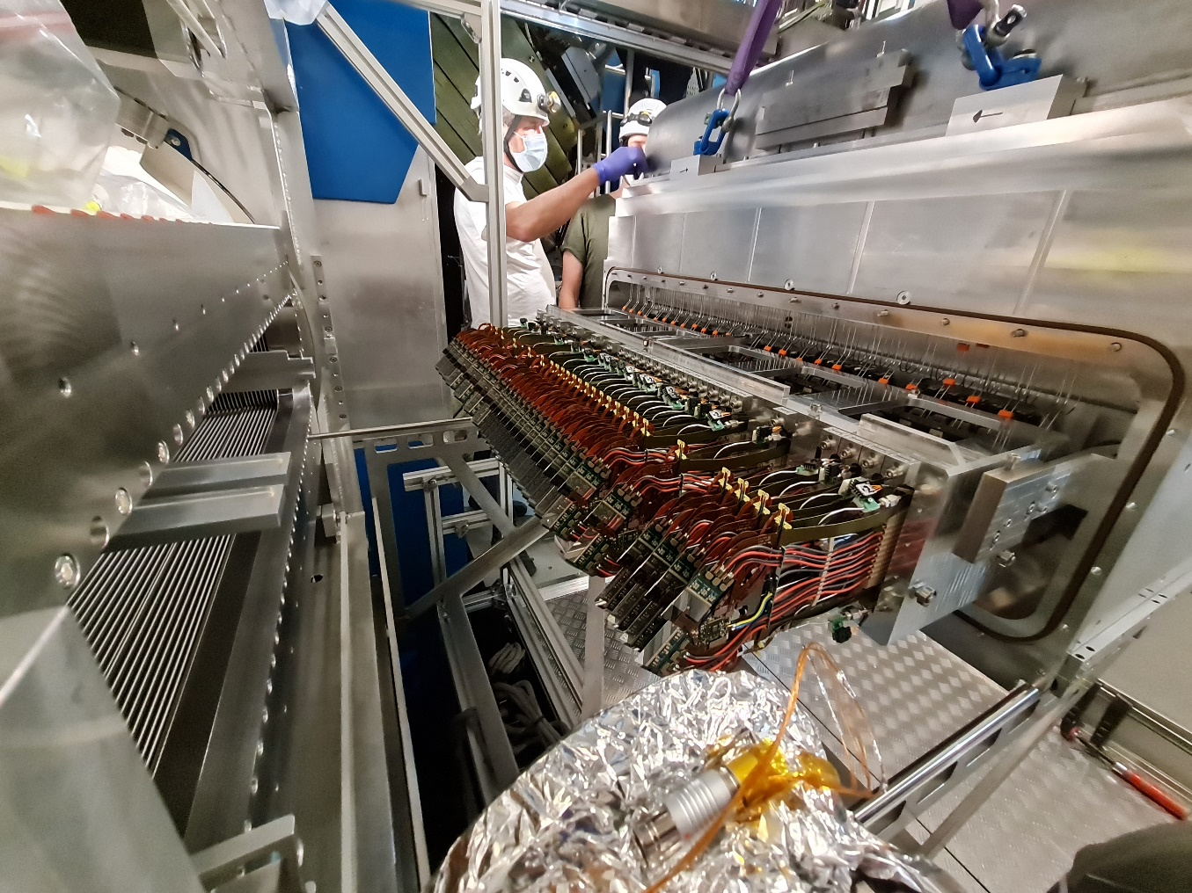
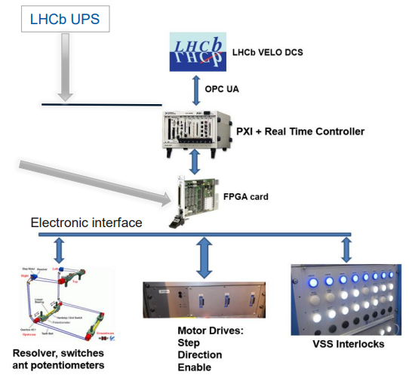
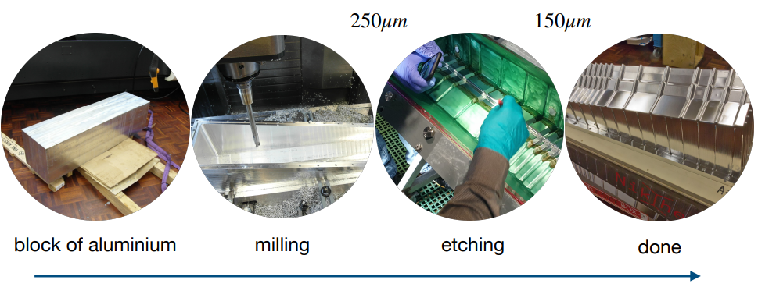
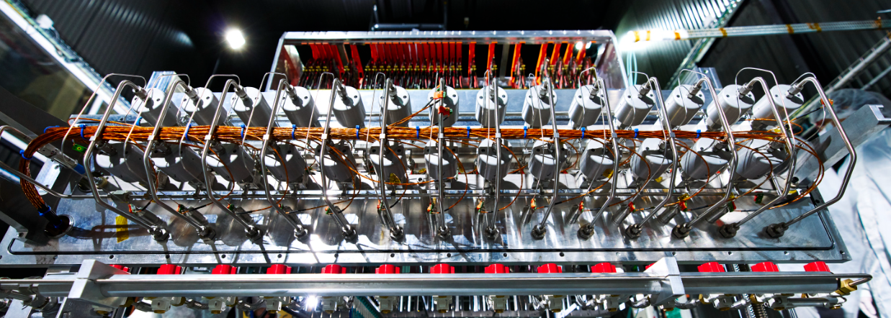
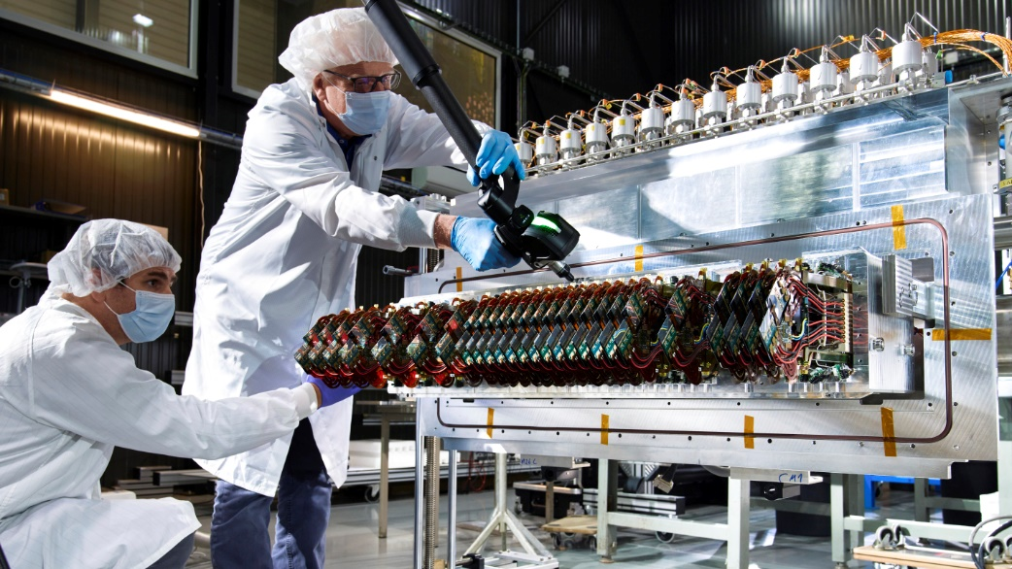
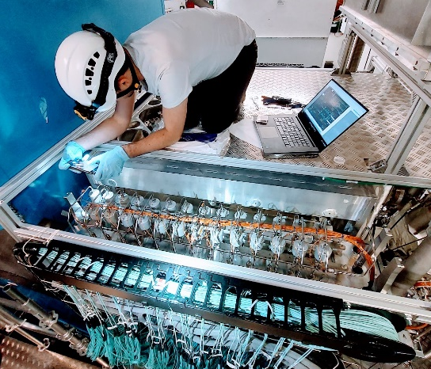
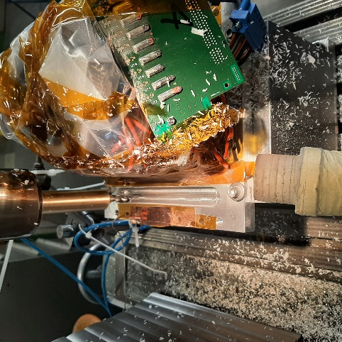
Detector Assembly and Installation
RF Foil:
150 µm thick shield that separate VELO vacuum from LHC vacuum.
3.5 mm from the beam and 900 µm from the sensors.
Thermally stable, shield against RF pick-up from the LHC Beam.
Torlon and Neg coating.
Motion:
Movement to protect the detector during injection. (Min 3.5 mm).
Cooling:
52 microchannel cooling plates boiling at the same time.
Safety system to avoid CO₂ leaks. Max ∆P of 10 mbar between LHC and VELO vacuum.
Metrology:
µm precision measurement needed.
Measurements performed at the module assembly, detector assembly (cold) and before detector installation (Foil & Modules).
Challenges in the way:
Cooling gasket replacement.
Feedthrough board replacement.

Slide 6
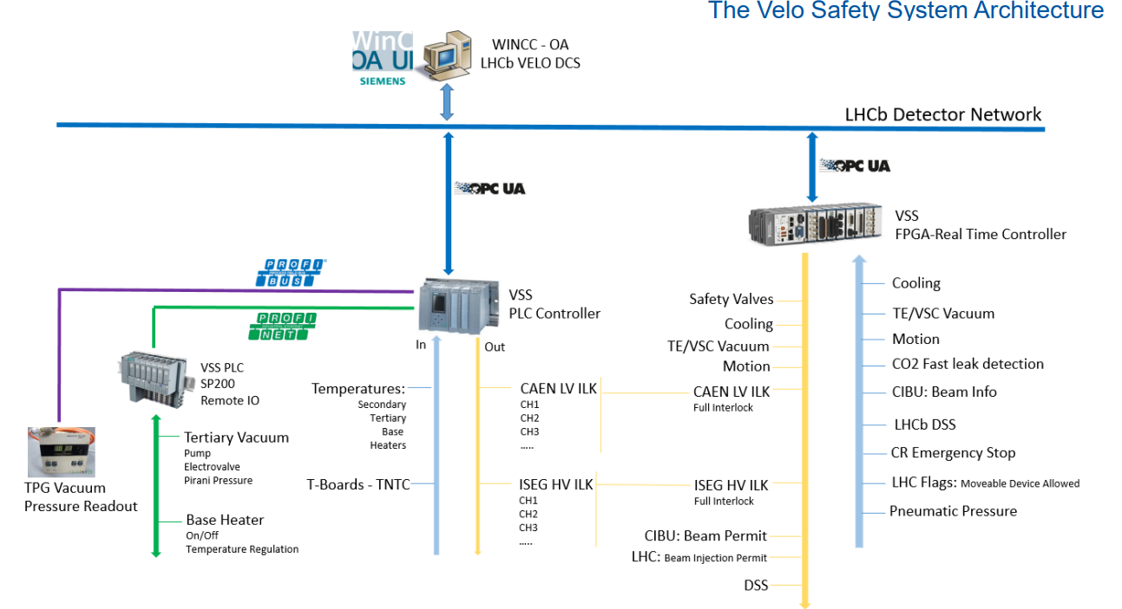
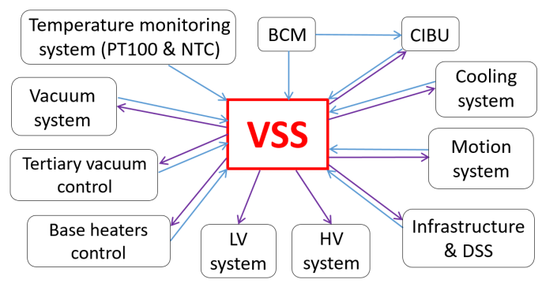
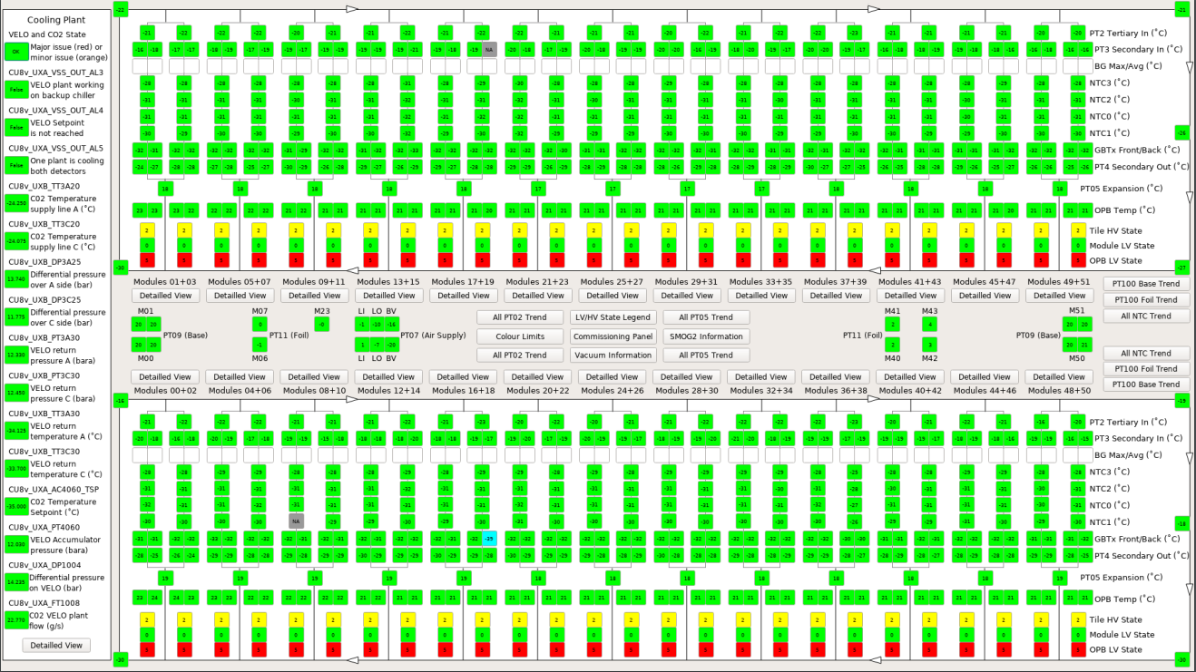
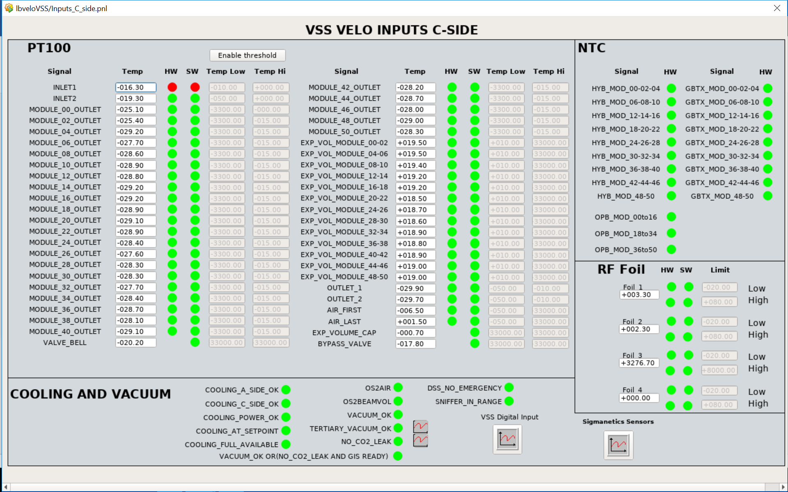
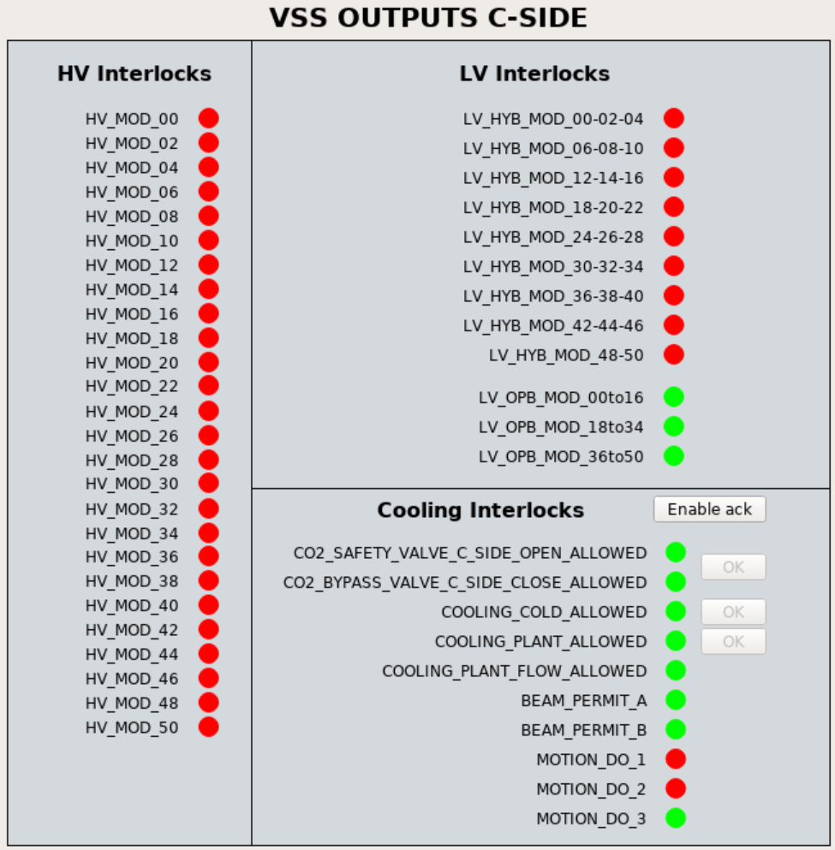
VELO Safety System (VSS) and Detector Monitoring
Detector Monitoring:
Monitoring of 1209 temperatures, LV and HV. 624 more to add one per VeloPix bandgap.
Readings from Vacuum system, SMOG 2 system, cooling plant.
VELO Safety System:
Subsystems interrelation

Slide 7
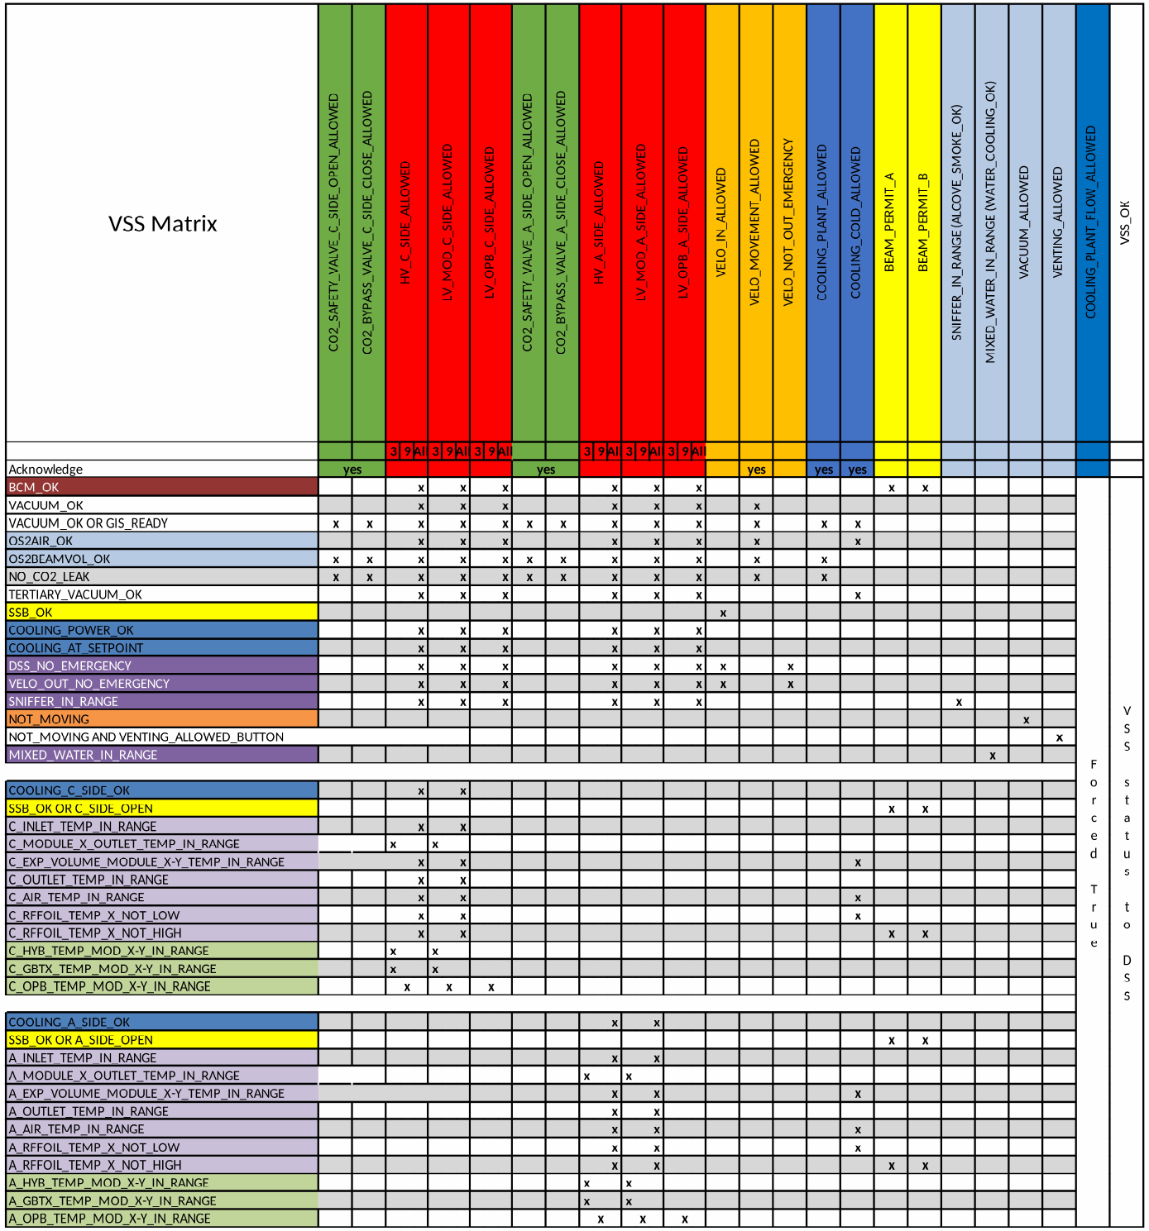
VELO Safety System (VSS) and Detector Monitoring
Detector Monitoring:
Monitoring of 1209 temperatures, LV and HV. 624 more to add one per VeloPix bandgap.
Readings from Vacuum system, SMOG 2 system, cooling plant.
VELO Safety System:
Subsystems interrelation

Slide 8
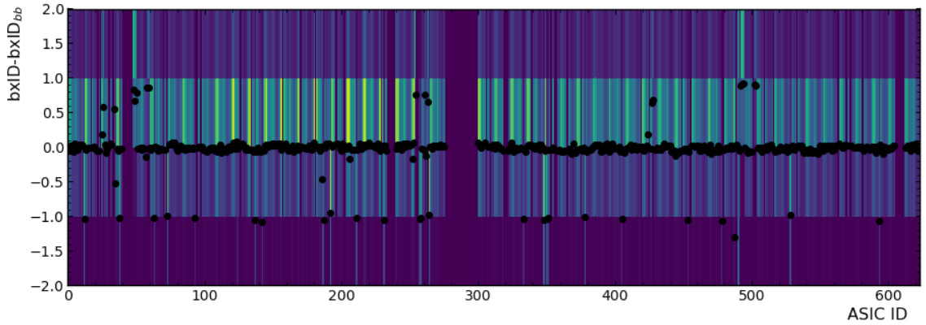
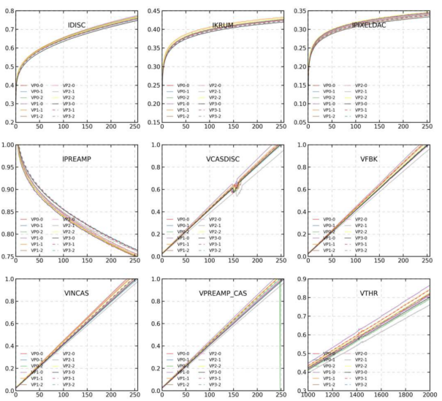
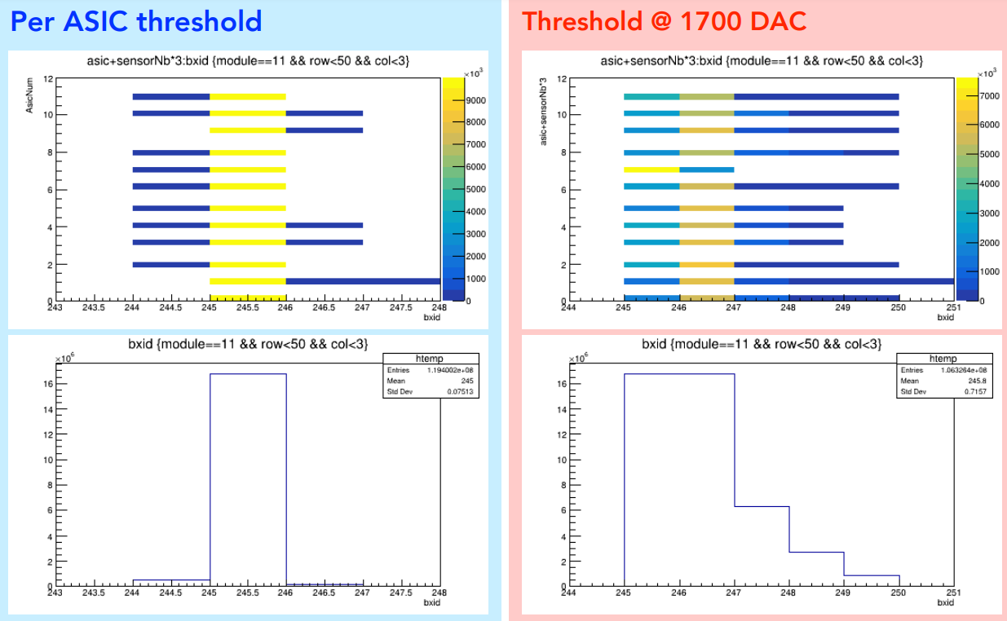
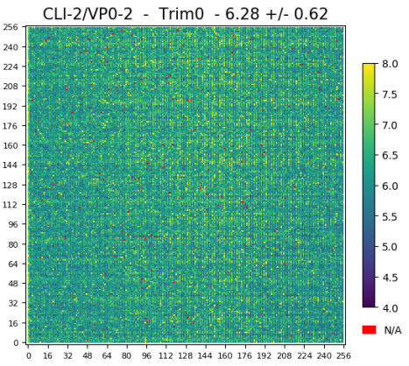
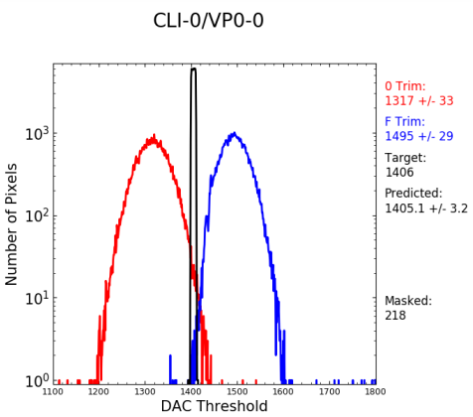
VeloPix Calibration: Equalization & Bxid Spread
Equalization:
Estimated using the noise baseline at different threshold values.
16 fine tune values per each pixel.
Use the extreme values (0, 15) for global Threshold scan and calculation of the optimal value.
Bxid spread:
Equalization not tuned in terms of analog circuit parameters and threshold. First approach to keep the same settings for the full detector.
During time alignment. ToA Bxid different in pixels of the same ASIC. Analog TP see the same effect.
DAC scan and Threshold set to eliminate this effect.
Time alignment
Equalization
DAC Scan
Improvement of Bxid spread
Noise

Slide 9
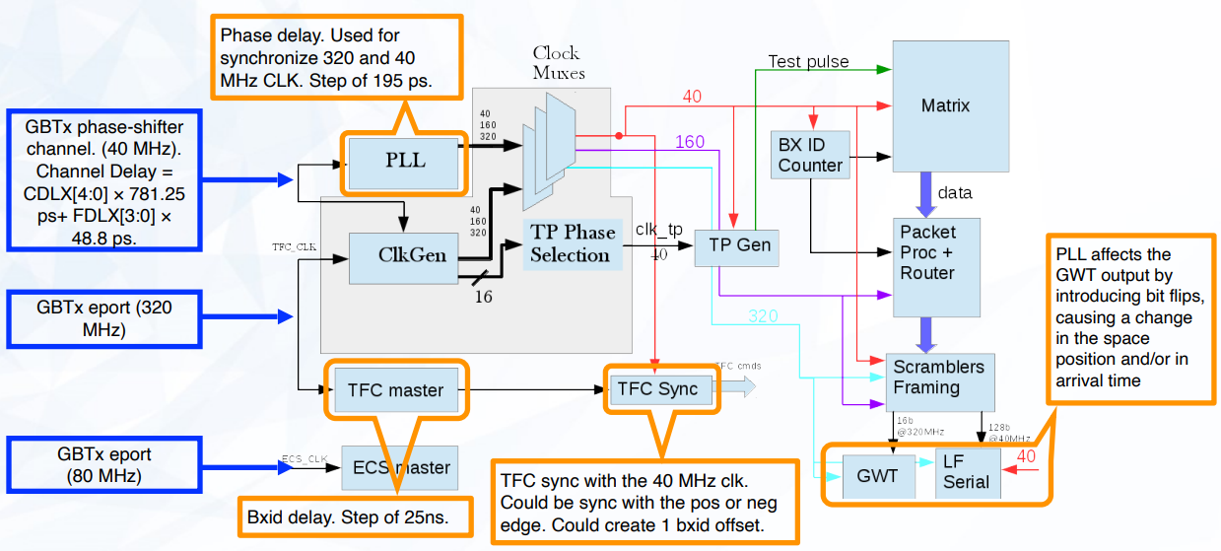
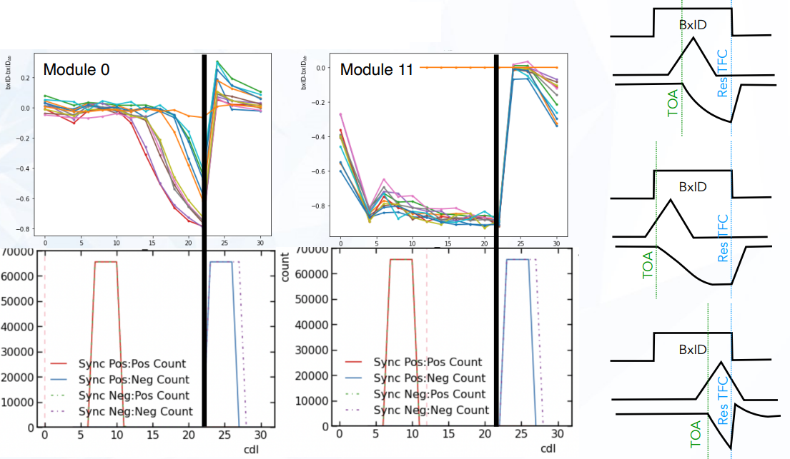
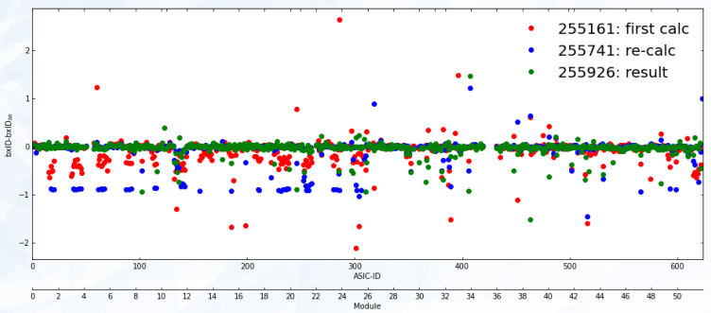
Time Alignment
Time alignment depends on:
  Control FPGA placed on surface.
  GBTx and VeloPix clks
  Time fast control (TFC) & 40 MHz clk sync.
Multiple scan done to understand the detector behaviour.
  PRBS test while scanning the PLL phase.
  Coarse delay scan on the GBTx.
  Scan of the sync of TFC with the 40 MHz clk.
Time alignment procedure
Time alignment performed
CDLX scan
LHCb VELO
preliminary
TFC sync scan
Fraction of bad chips :Total: 5.8%. A side: 8.0%. C side 3.5%
Fraction of out of-time chips: Total: 2.7%. A side: 4.2%. C side 1.3%

Slide 10
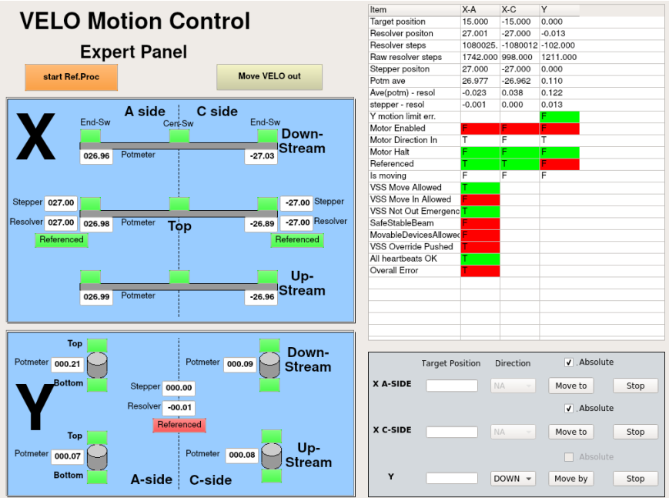
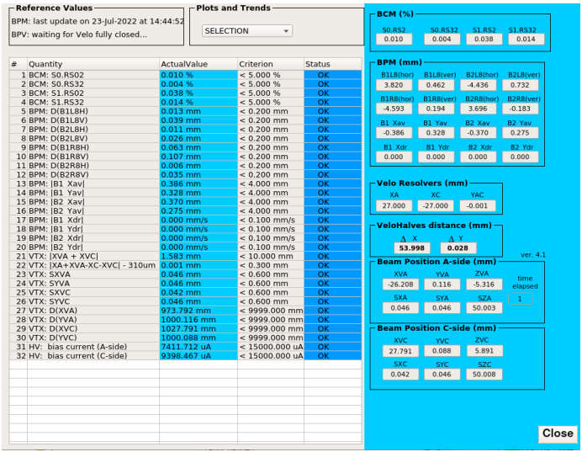
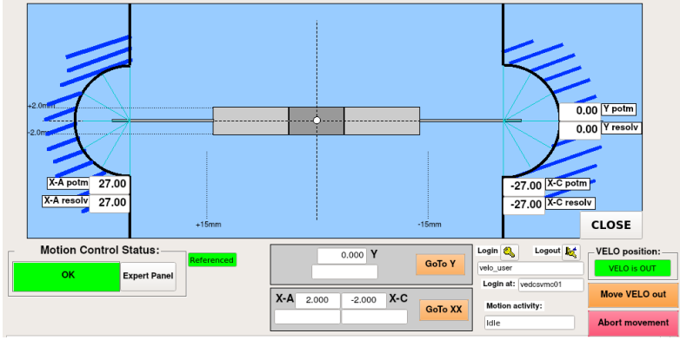
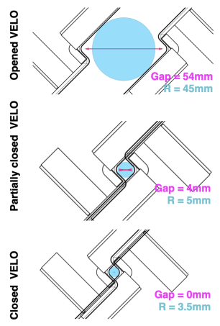
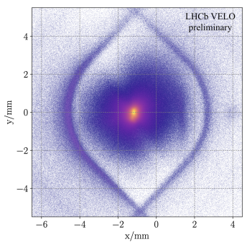
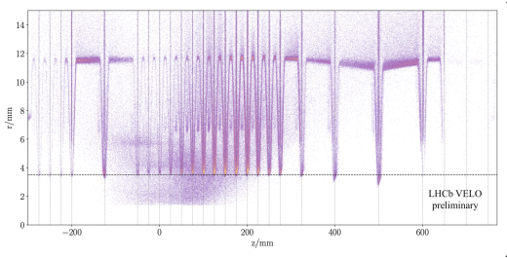
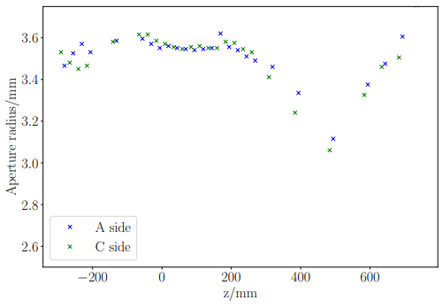
VELO Closing
Closing is based in the Primary Vertex reconstruction from the detector.
Multiple criteria need to be satisfied: VSS, stable beam, FPGA communication, Beam Conditions Monitors, Beam Position Monitors, HV current, …
RF foil reconstructed to proceed to the final closing.
Increased number of colliding bunches to study the temperature and vacuum variation and validate the closing.
Closing Process
Z projection almost close
Z positions with vertex reconstruction
Aperture measurements
LHCb VELO
preliminary

Slide 11
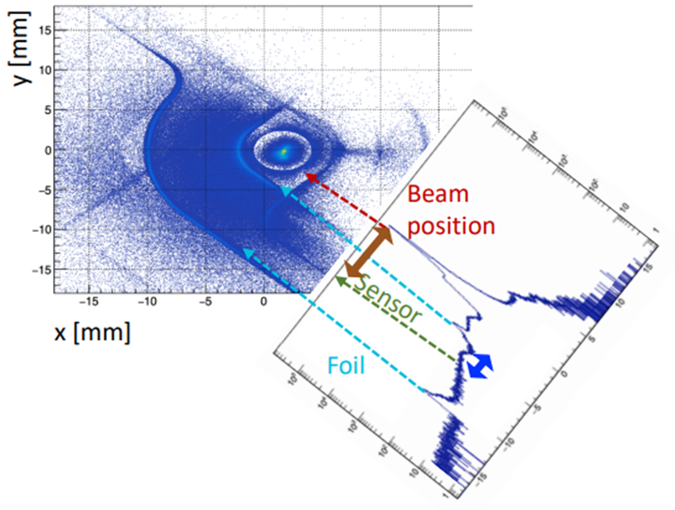
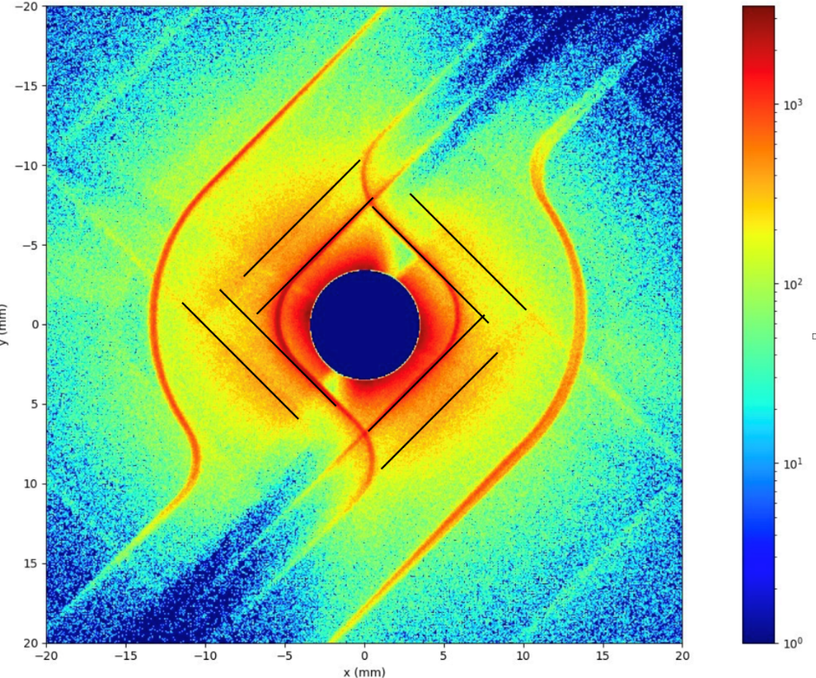
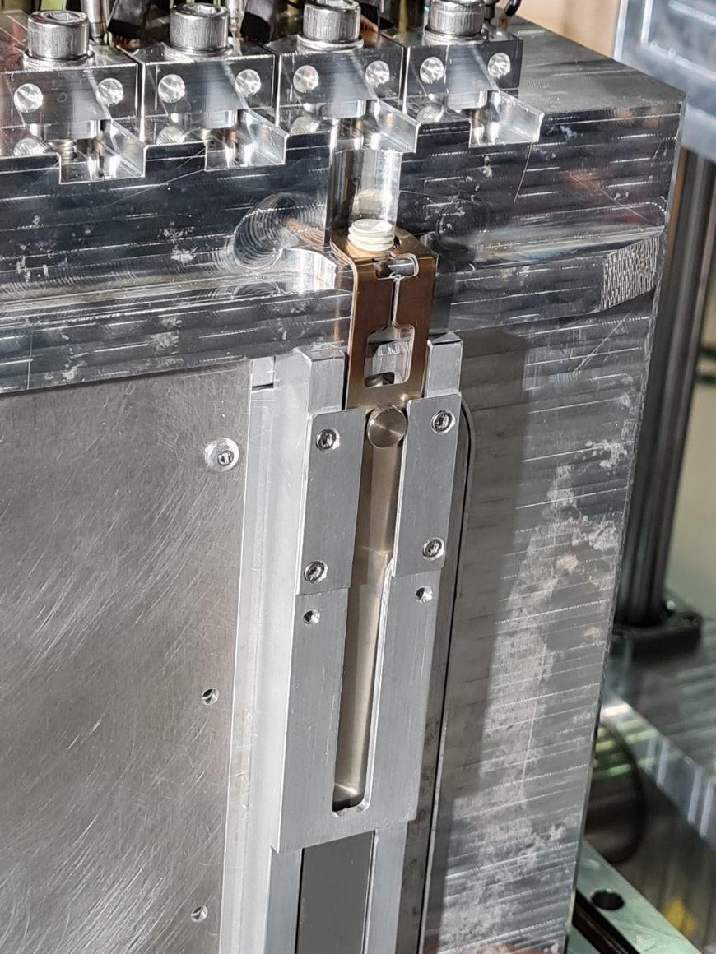
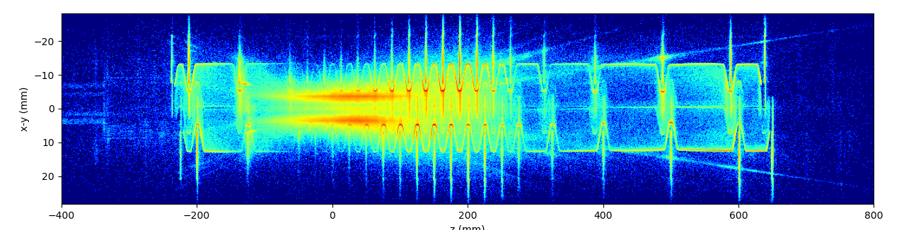
Vertex reconstruction
One spacer was placed in each fixation point (3 per side) of the detector to the motion system to increase the clearance 1 mm.
Vertex reconstruction measurement of module and RF foil position essential to be confident on removing the spacers.
Spacer
Z projection almost close
Vertex reconstruction measurements
Z positions
with vertex reconstruction

Slide 12
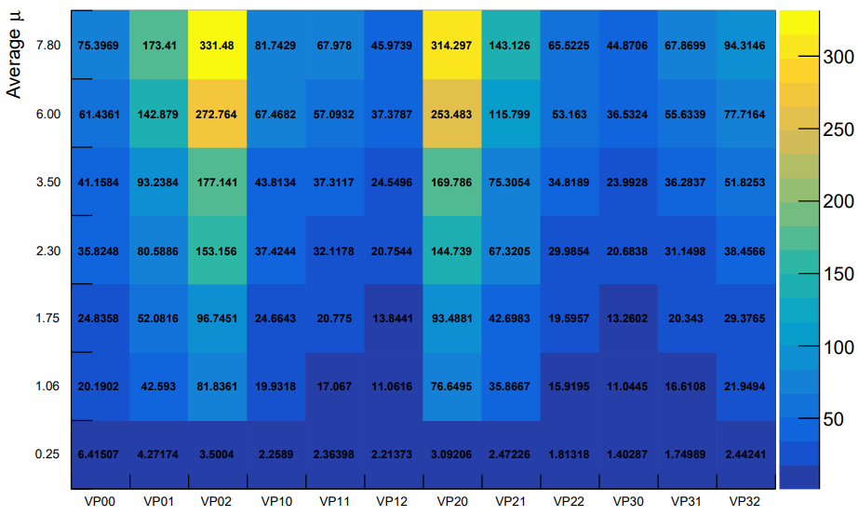




DAQ and FPGA Clustering
VeloPix Hit Rate
VELO DAQ: 20 readout links at 5 Gb/s per module.
Integrating the clustering in the FPGA.
    11% reduction of HLT1 reconstruction sequence.
    O(50) less power consumption in the FPGA compare with the GPU.
*Phase I Upgrade of the Readout System of the Vertex Detector at the LHCb Experiment
*Readout Firmware of the Vertex Locator for LHCb Run 3 and Beyond
µ (Number of collisions) scan in terms of VeloPix activity. Clusters and hit rate per VeloPix to measure luminosity.
VELO Module 19
Rate(Mhits/s)
Clusters rate
Front end
Back end

Slide 13



Leakage current evolution
Multiplicity scan. Current increase linear
Current evolution in the last 2 months
Temperature
LHCb VELO
preliminary
Delivered
Luminosity
Leakage current vs Z position
LHCb VELO
preliminary
Current (A)
On a central
module
LHCb VELO
preliminary
ION run

Slide 14




SMOG 2
SMOG 2 system inject gases (Ar, NE, He and H2) in the LHC beam pipe, acting as the highest-energy fixed-target experiment. (TDR, Physics).
Gas feed system fully commissioning this year.
SMOG
(pAr)
Interaction region
(pp)
LHCb VELO
preliminary
System control
Temperature, vacuum and VELO position

Slide 15

Conclusions
Successful years of detector assembly and commissioned.
Infrastructure systems (cooling, vacuum, LV, HV, motion, mechanics) properly working from first day.
VeloPix tuned to get better performance.
Time alignment performed with the full LHCb.
Closing procedure stabilized and daily operational.
First results on data rate and radiation damage.
SMOG 2 system commissioning for fix target experiment.
Looking forward for a successful
commissioning and data taking
year 2023

Slide 16



