Slide 1
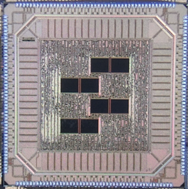
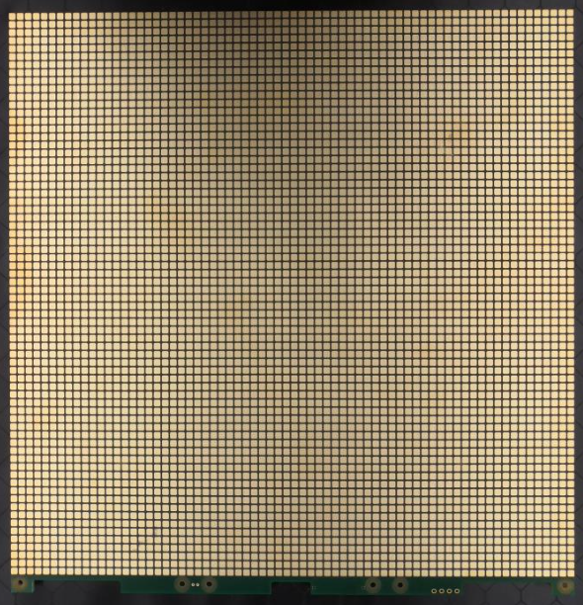
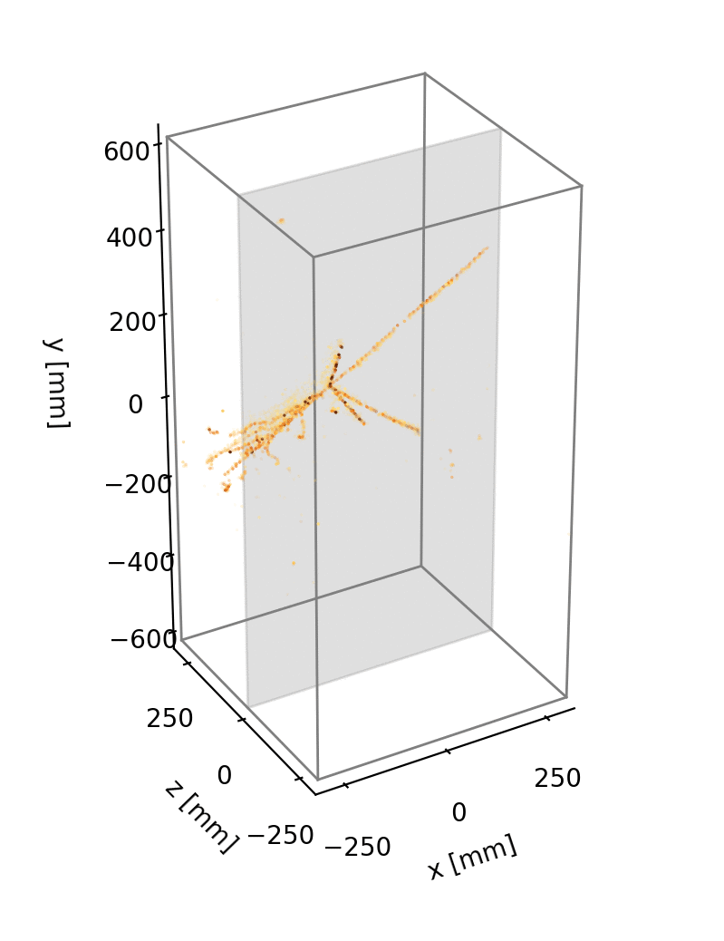
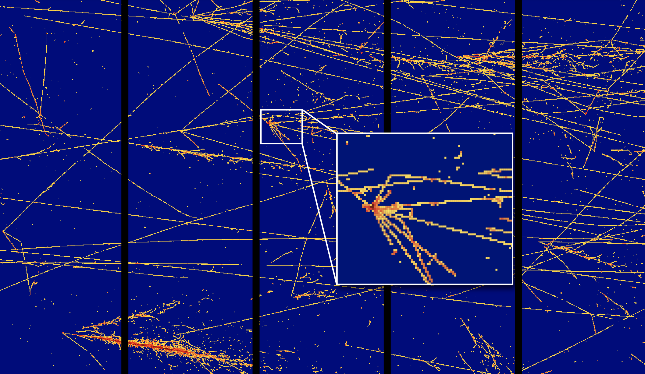
Pixel Readout for Large Cryogenic Detectors
Dan Dwyer (LBNL)
Pixel 2022 (Santa Fe, NM)
12 Dec 2022

Slide 2
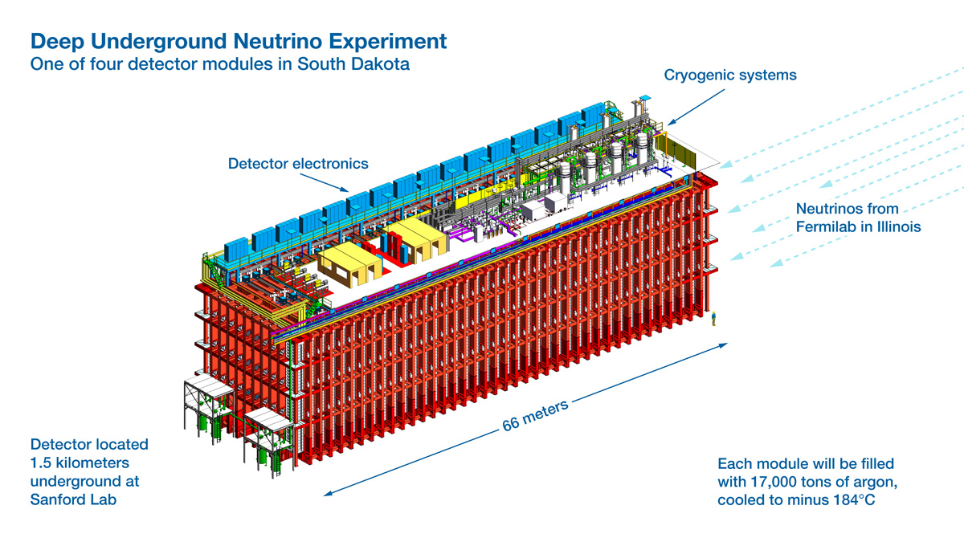
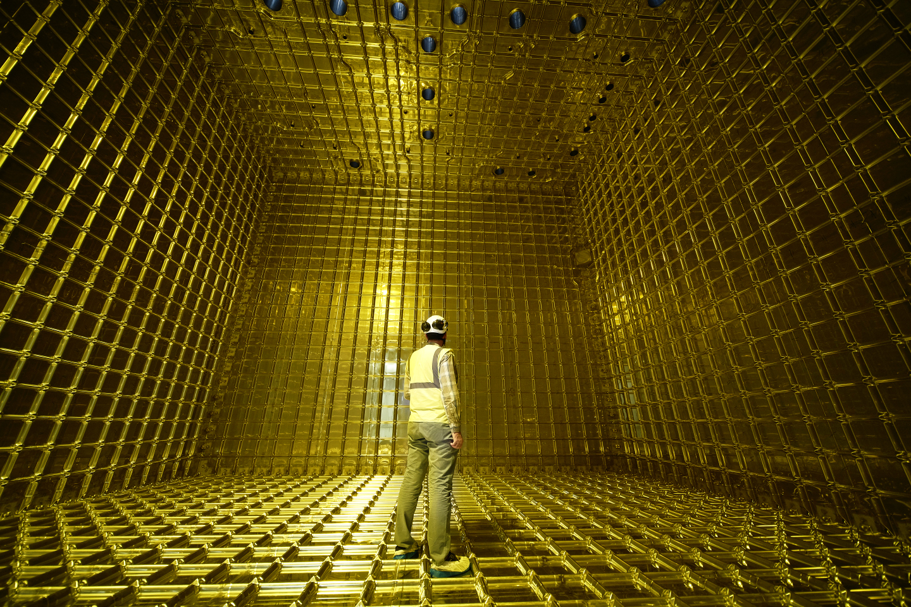
Neutrino Instrumentation Challenge
Deliver mm-scale spatial granularity for stadium-sized detectors.
Example: DUNE
- DUNE consists of four Far Detector modules, with a total volume on the order of 50,000 cubic meters.
- To achieve the required precision, a spatial granularity of ~4mm is required over this volume.
- Corresponds to a detector with a total of ~1 trillion spatial voxels.
DUNE prototype cyrostat (~1/200th of a DUNE Module)

Slide 3
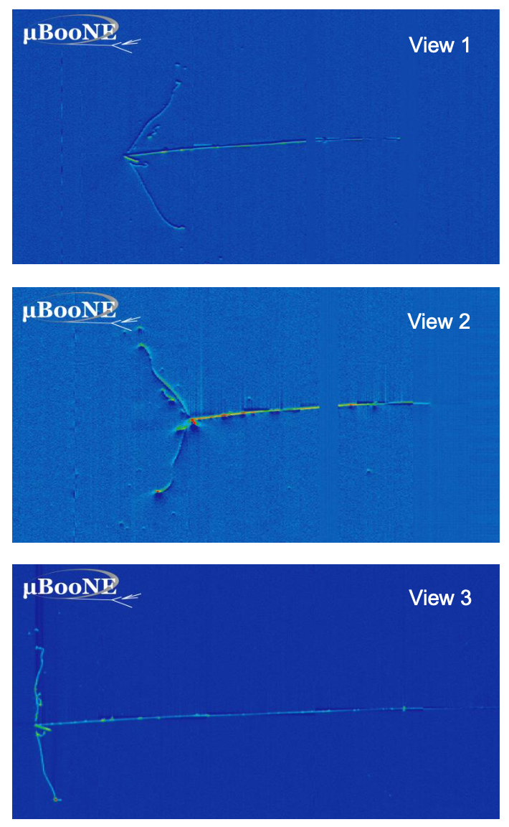
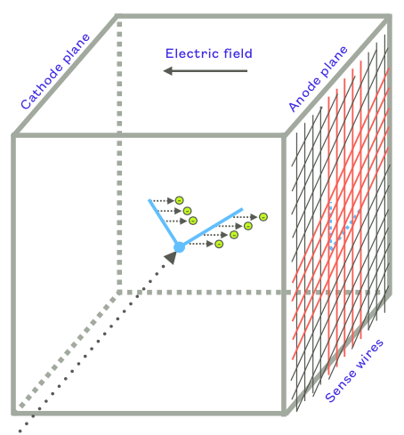
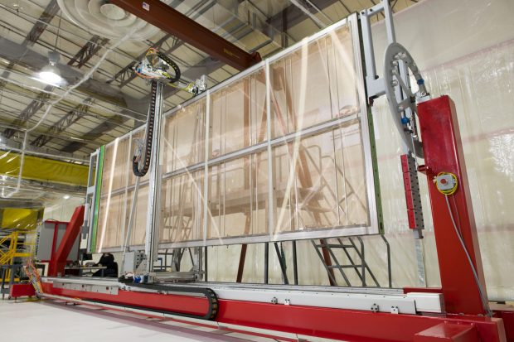
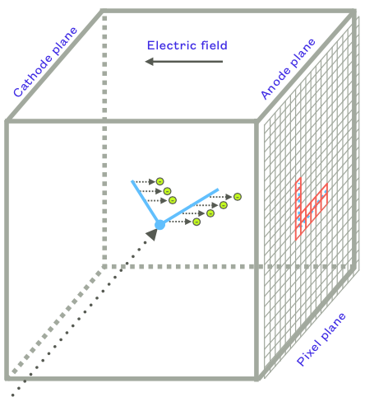
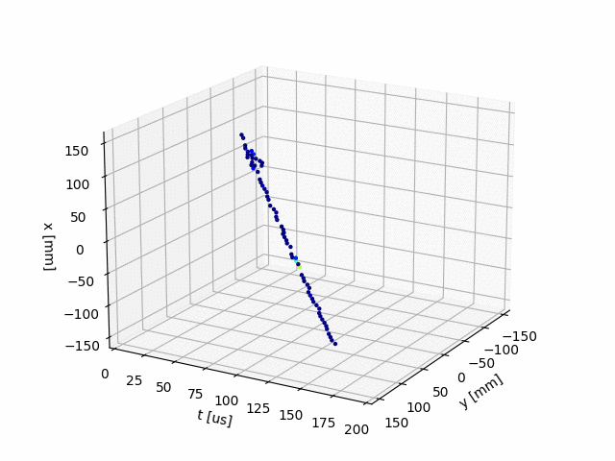
2D vs. 3D LArTPCs
DUNE prototype anode plane
on winding machine
2D Projections in MicroBooNE
2D Projective TPC
2D Wire Plane TPC:
- Established technology,
demonstrated in ProtoDUNE-HD
- Multiple 2D views used to
estimate 3D signal
- Baseline technology for
Far Detector #1 (& Strip variant
planned for FD #2)
3D Pixel TPC:
- True 3D imaging
- Continuous readout,
~100% uptime
- Intrinsically sparse data,
low data volume
Science Gains:
- Improved signal fidelity, S/B
- Enhanced low-energy program
JINST 15 P04009
arXiv:2203.12109
3D TPC
6.4k-channel LArPix
prototype pixel anode tile
Raw 3D Cosmic Ray images in
LArPix prototype LArTPC

Slide 4
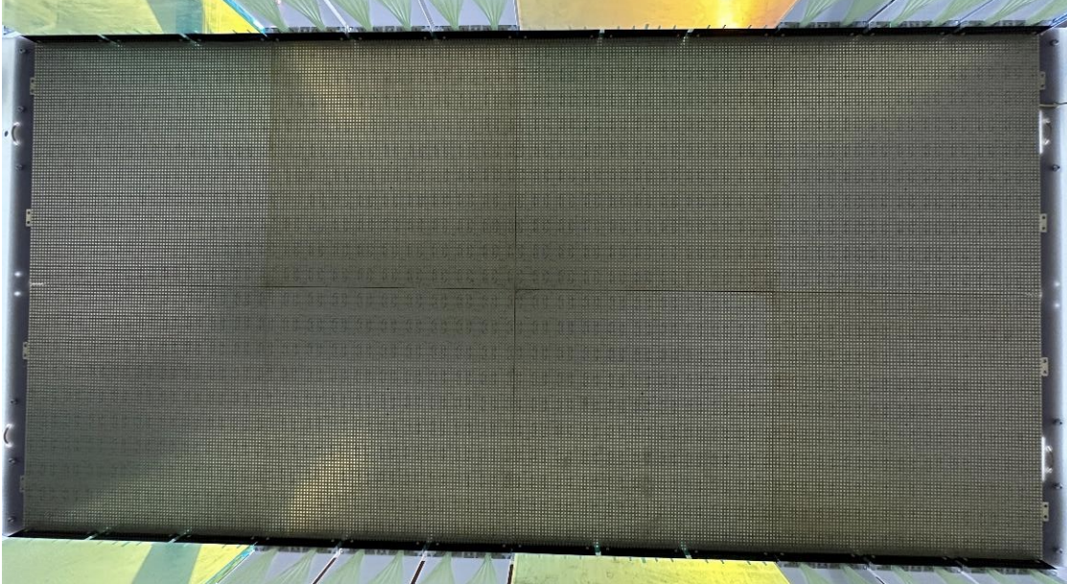
True 3D Readout Technical Targets
For the upcoming large cryogenic detectors (e.g. DUNE)
Resolution and noise
- A granularity of O(mm) in space and O(μs) in time
- Triggering and charge resolution of signals of O(1000 electrons)
Cryogenic compatibility
- Long-term reliable operation at 87 K (in liquid argon)
- Total power dissipation of O(100 μW) per pixel, O(10 W/m²) of sensitive anode
Scalability
- Low-power reliable digital multiplexing of O(10,000 pixels)
- Viable production path for anodes of O(1000 m²)
- Full system production cost of O($10k / m²) at detector scale
Simulation of one neutrino beam spill
in the DUNE LArTPC Near Detector
Prototype LArPix
50k-pixel (0.8 m²)
anode

Slide 5














LArPix

Slide 6
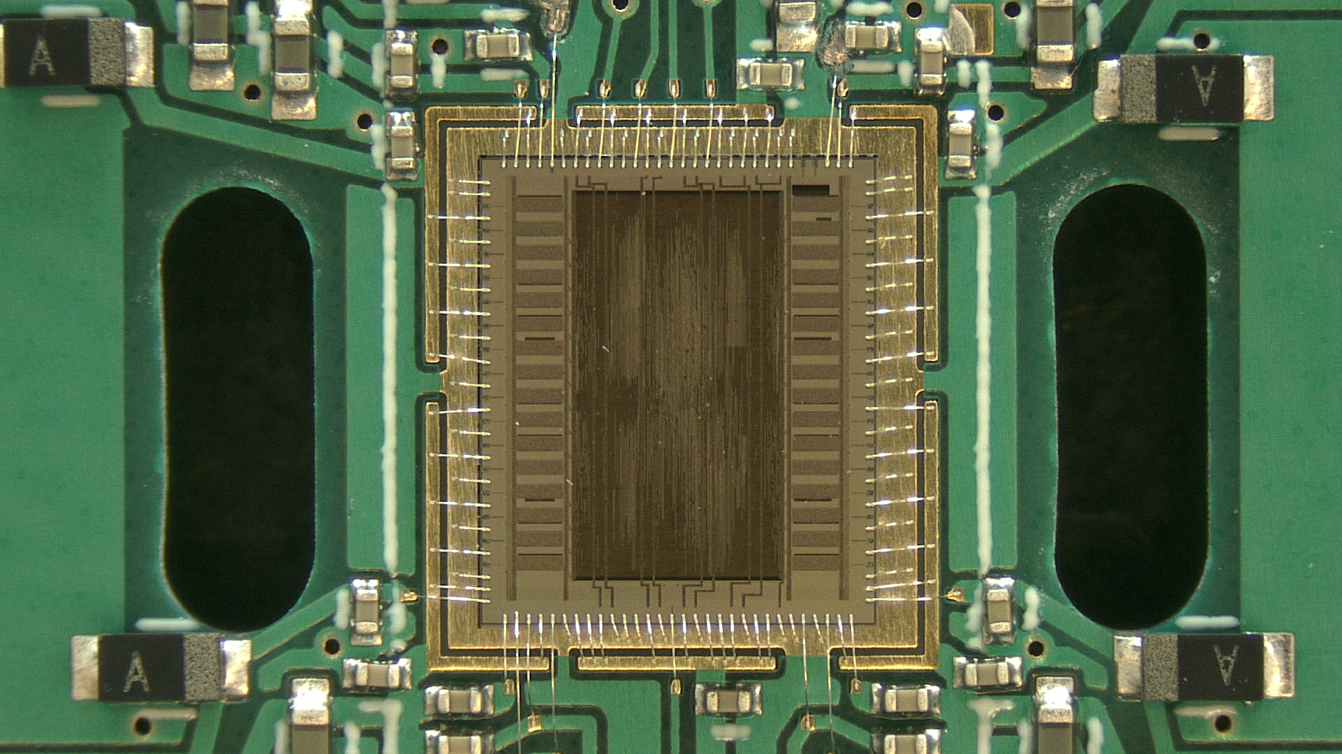
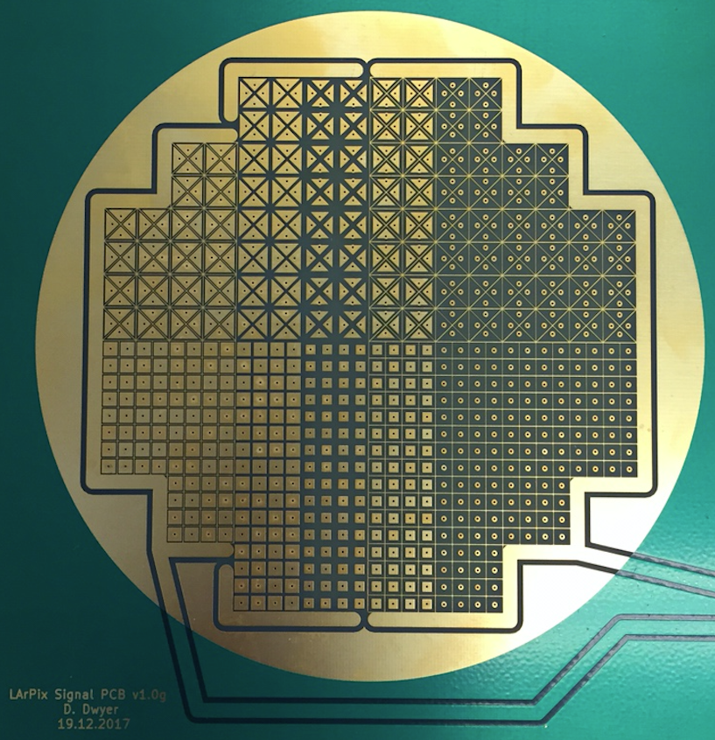
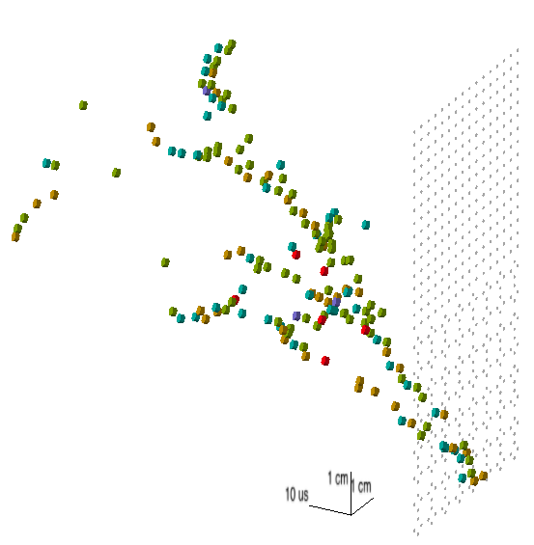
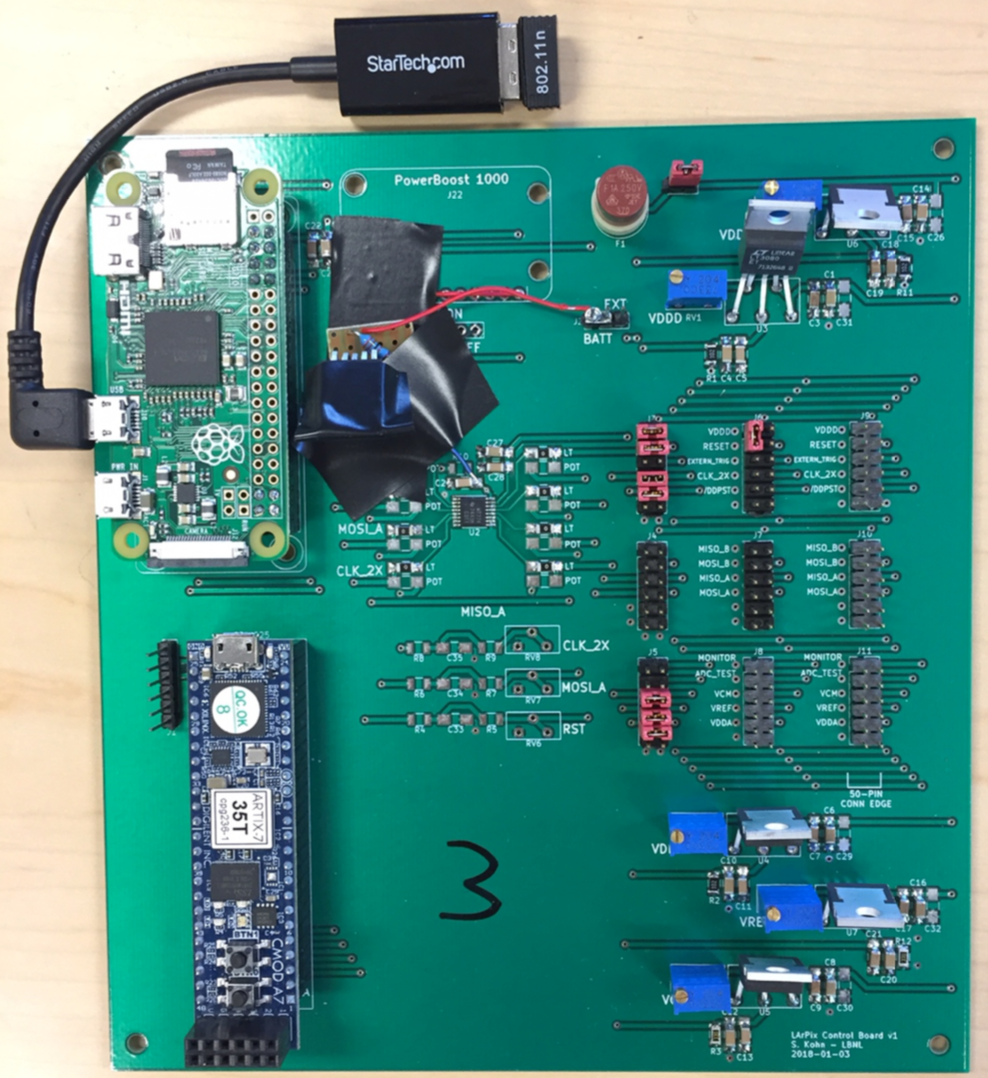
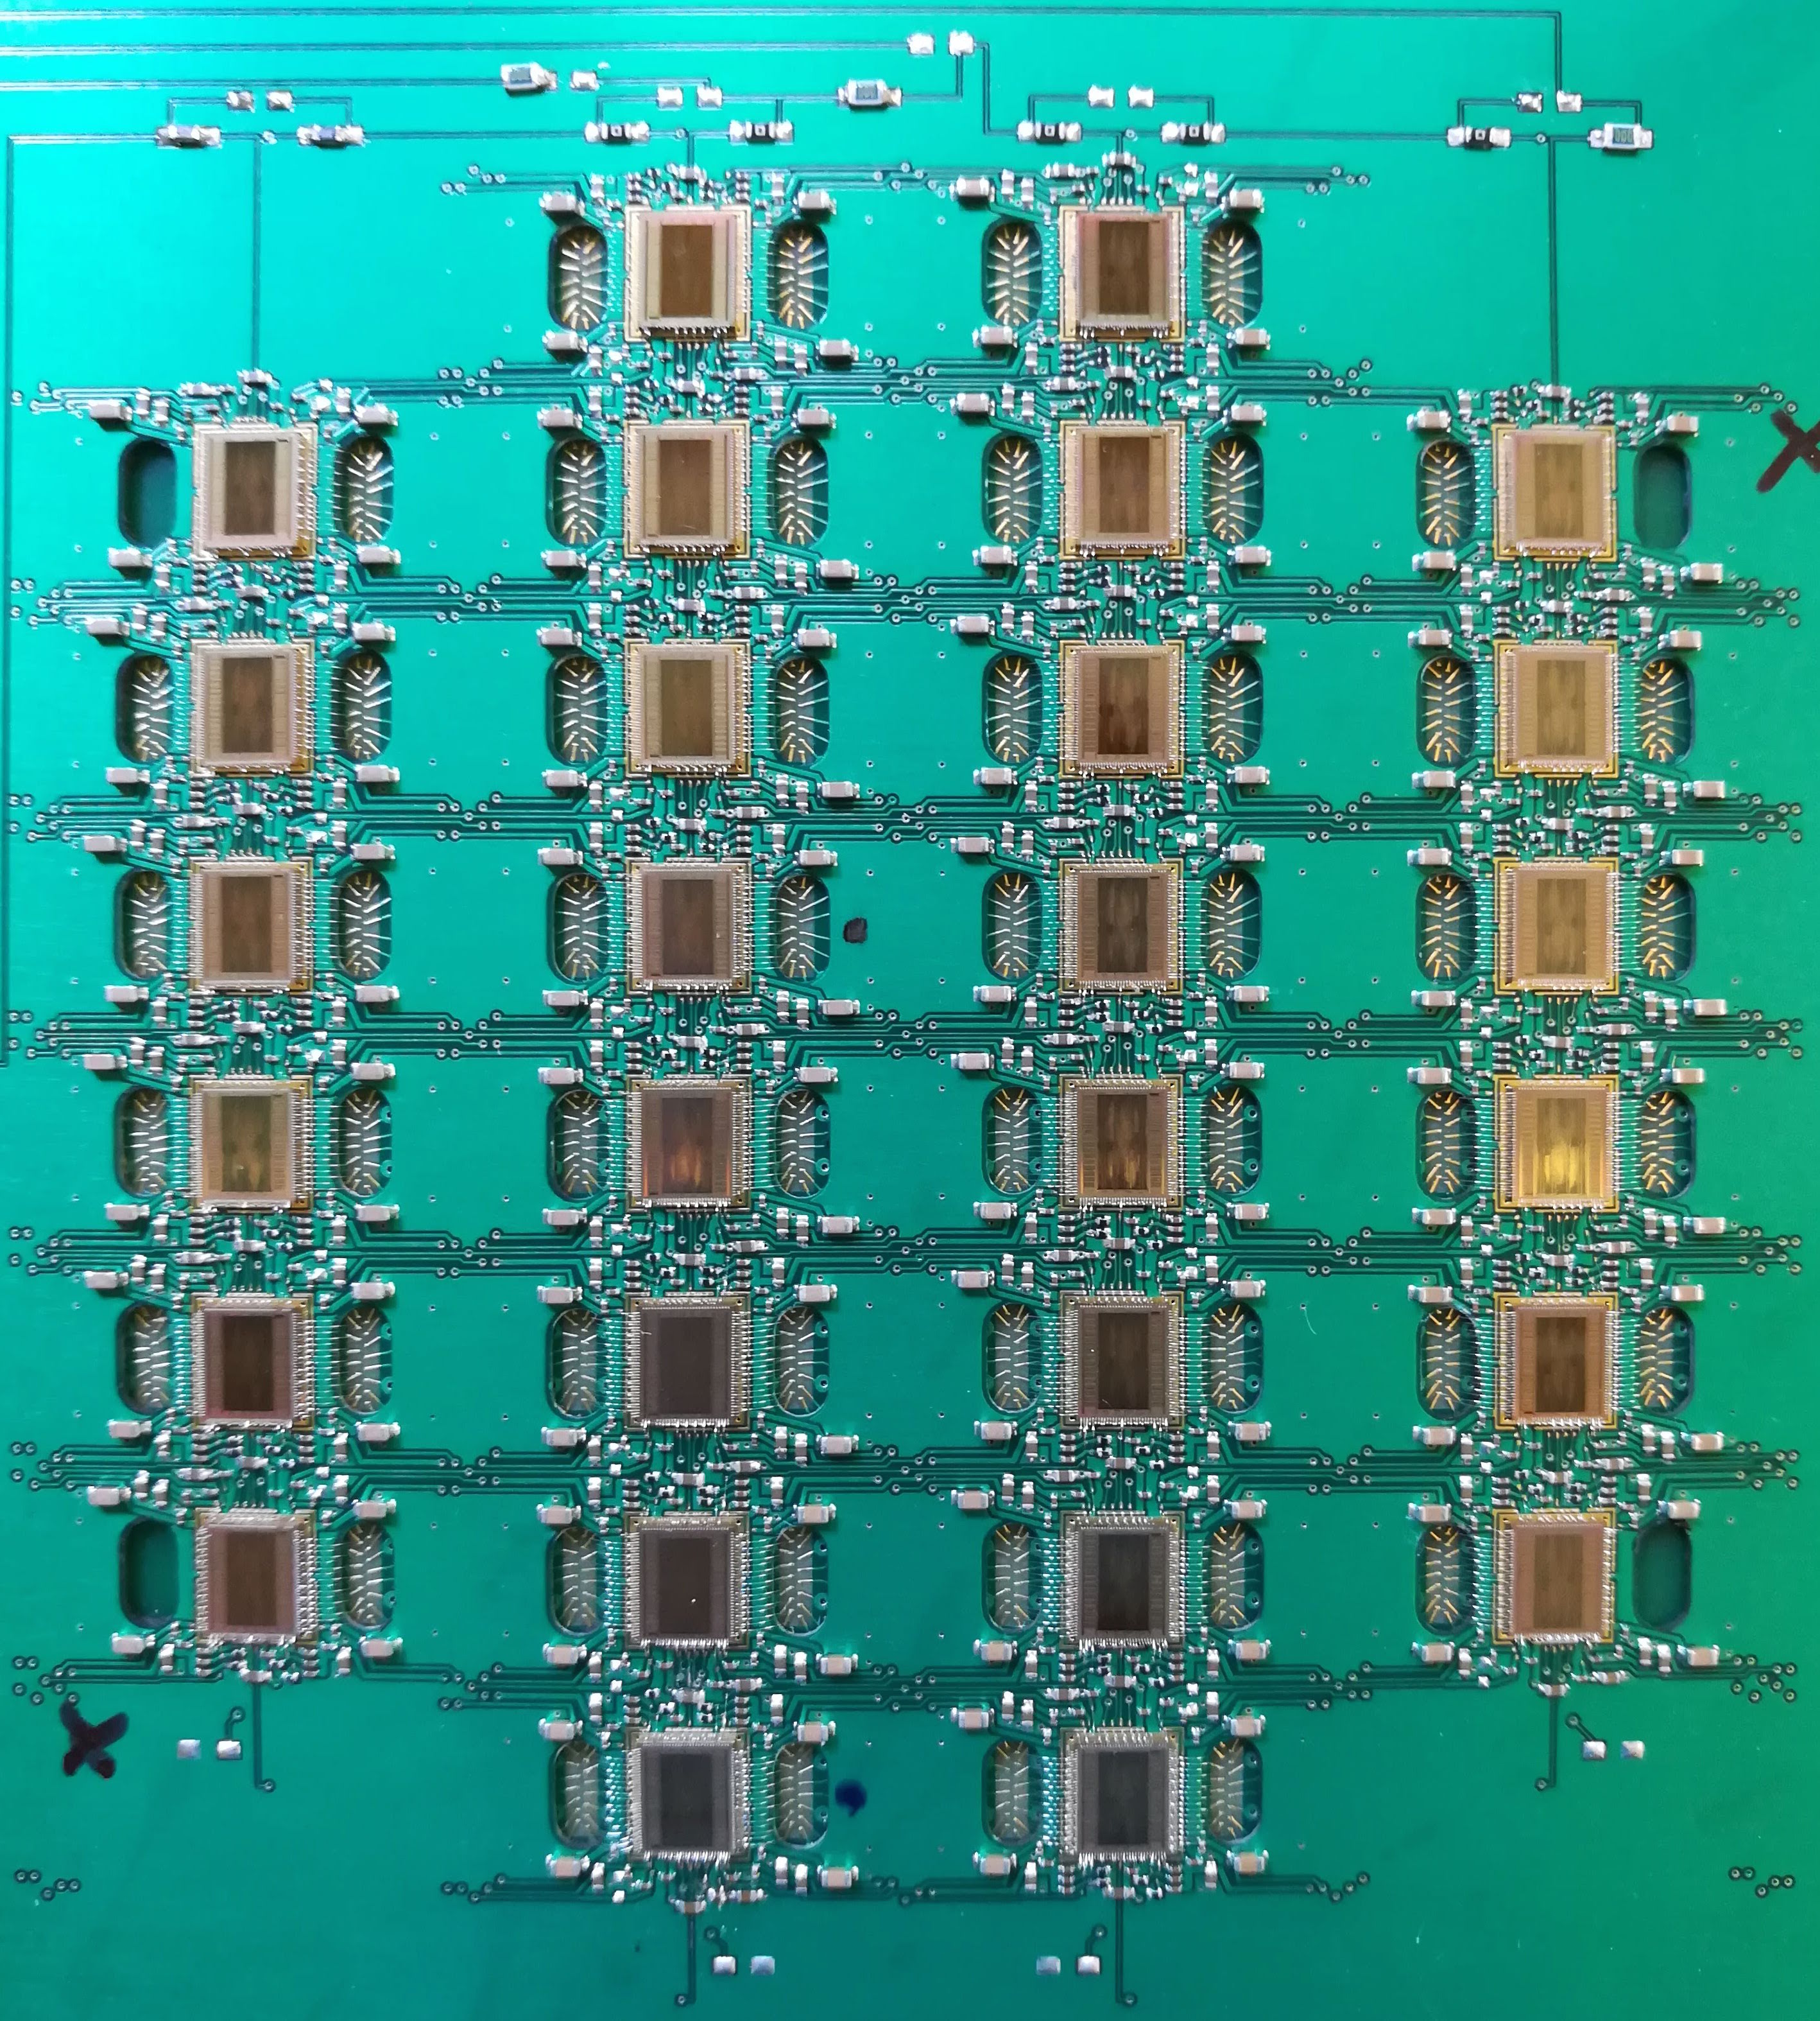
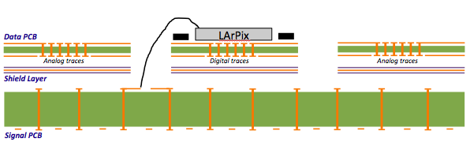
R&D on Feasibility: LArPix-v1 System
LArPix-v1 ASIC
v1 Pixel Anode, Front
LArPix-v1: 2016-2018
Complete 3D Pixel System for LArTPCs:
- Custom ASIC with amplifier, digitizer, multiplexer
- Integrated Pixelated Anode w/ASICs
- Control electronics and software (outside cryo)
Key R&D Achievement:
Demonstrated technical feasibility
-> Successfully imaged cosmic rays in LArTPC
ASIC:
- Cryogenic-compatible
- Low-power: 62 uW/channel
- Low-noise: 275 e- ENC @ 87K
Pixel Anode:
- Cryogenic-compatible
- Low Digital-Analog cross-talk
- O(1k) channel readout via 2 wires
Control electronics:
- Fieldable system: noise-isolated and wifi accessible
Main drawback:
Difficult to scale above O(1k) pixels
- Anode requires manual assembly, bare chip wirebonding
LArPix-v1 Tile Controller
v1 Pixel Anode, Back
3D image of cosmic
shower in a LArTPC
Multi-layer anode cross-section
JINST 13 (2018) P10007

Slide 7
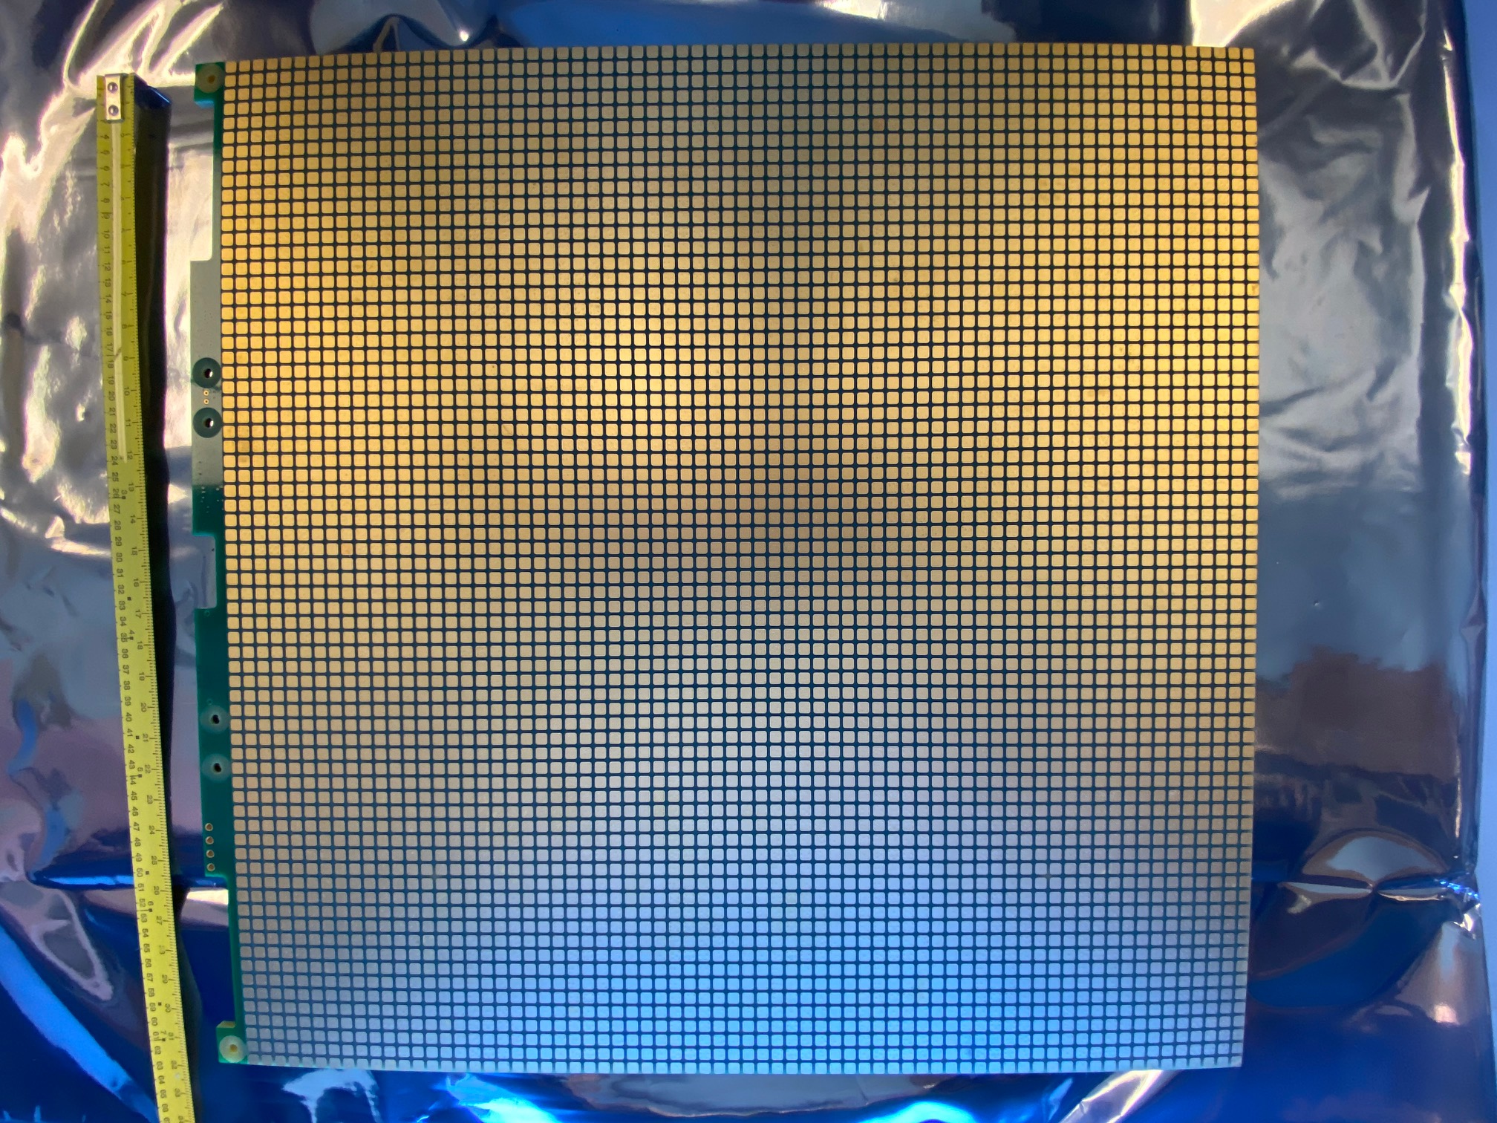
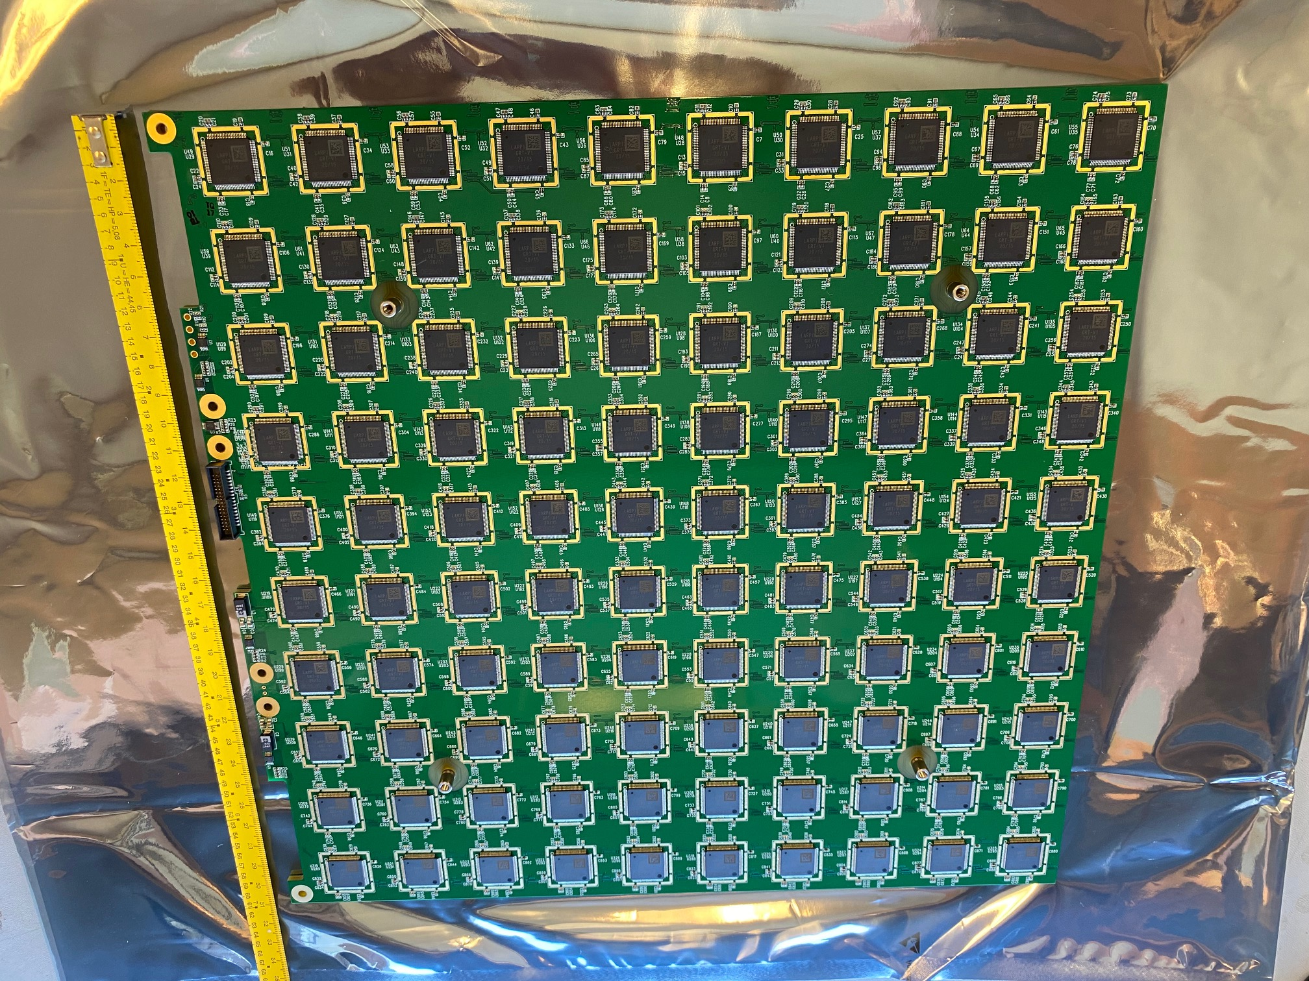
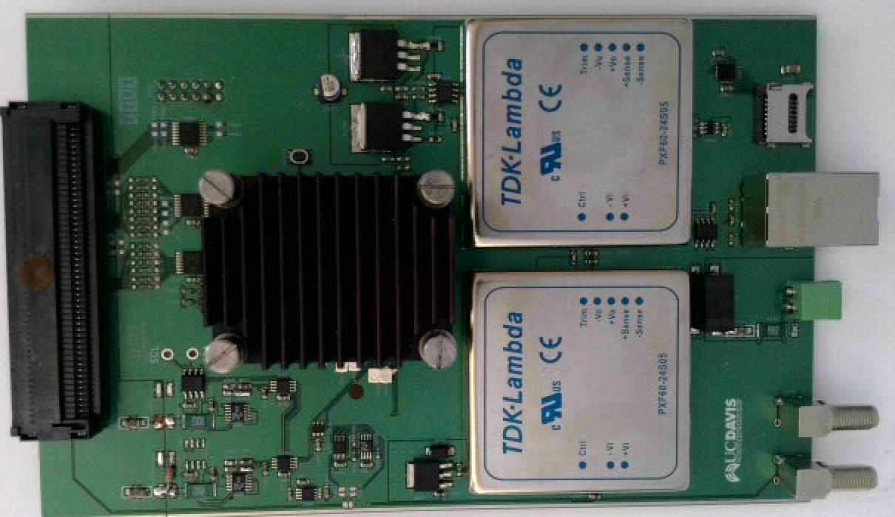
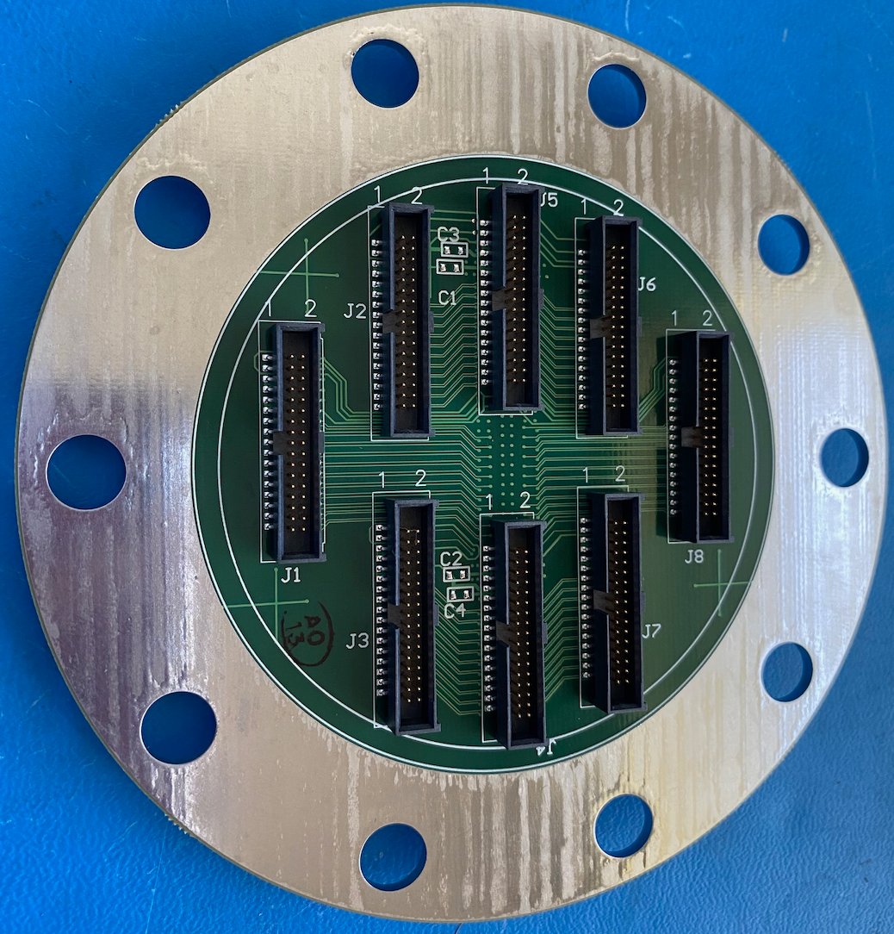
R&D on Scalability: LArPix-v2 System
Production-scale LArPix-v2 Pixel Anode
LArPix-v2: 2019-2021
Substantial Design Evolution:
ASIC Improvements:
- 64 channels/ASIC (twice channel density of v1)
- Hydra-I/O: Dynamic routing, robust to chip failure
- Cryogenic-compatible custom SRAM memory
- Improved tunability, testability
- Packaged to facilitate commercial mass production
Pixel Anode Design Overhaul:
- ‘Tileable’ design to cover anodes of arbitrary scale
- 32cm by 32cm pixel anode PCB tile
- Frontside: 4900 square pixels, 4.4 mm spacing
- Backside: 10x10 grid of ASICs
- Enable fully-commercial mass production and assembly
Warm Controller (PACMAN) Redesign:
- Noise-isolated, compact, flange-mounted
Key R&D Achievement:
Demonstrated robust and scalable pixel anode
- Fast (~few weeks) fully-commercial production/assembly
- Robust to repeated cryogenic cycling
- Successfully imaged cosmic rays in LArTPC
on first try
LArPix-v2 ASIC
PACMAN Tile Controller
Raw 3D images of cosmic rays from initial single-tile test
8-Tile Feedthrough
“LArPix-v2: a commercially scalable large-format 3D charge-readout scheme for LArTPCs”
publication in preparation

Slide 8
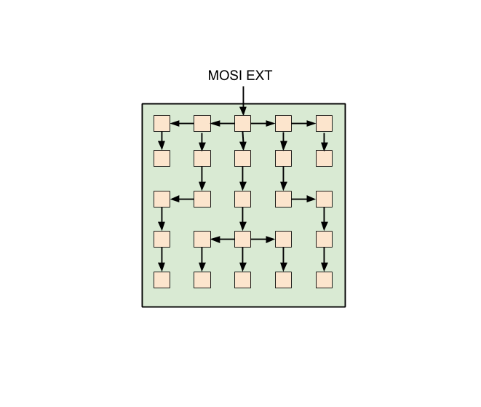
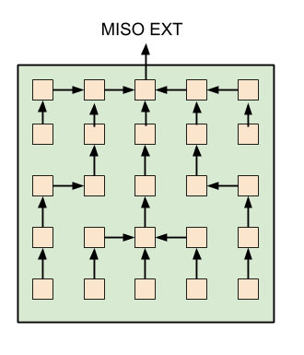
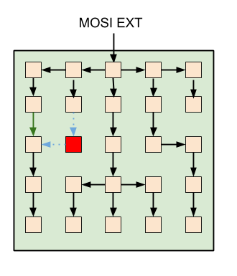
R&D on Robustness: Hydra-I/O
New design for robust I/O and control architecture
Repurpose existing LArPix-v1 low-power data I/O circuit
Very slight change enables richer, dynamic I/O architecture
- I/O can occur between any neighboring chips on pixel tile
- Network is built by explicitly connecting neighboring ASICs in a determined fashion
Successfully exercised with LArPix-v2 chip
Four chips have direct off-tile I/O channels
(10 MHz, < 4 m)
Example: 5 x 5 Pixel Tile
Example failed chip.
Upstream configuration commands
Downstream data flow
Network reconfigured to avoid failed ASIC
AD-HOC NETWORK OF READOUT APPLICATION-SPECIFIC INTEGRATED CIRCUITS FOR RELIABLE DETECTOR INSTRUMENTATION
U.S. Patent Application Ser. No: 63/140,434
2022 R&D 100 Award

Slide 9
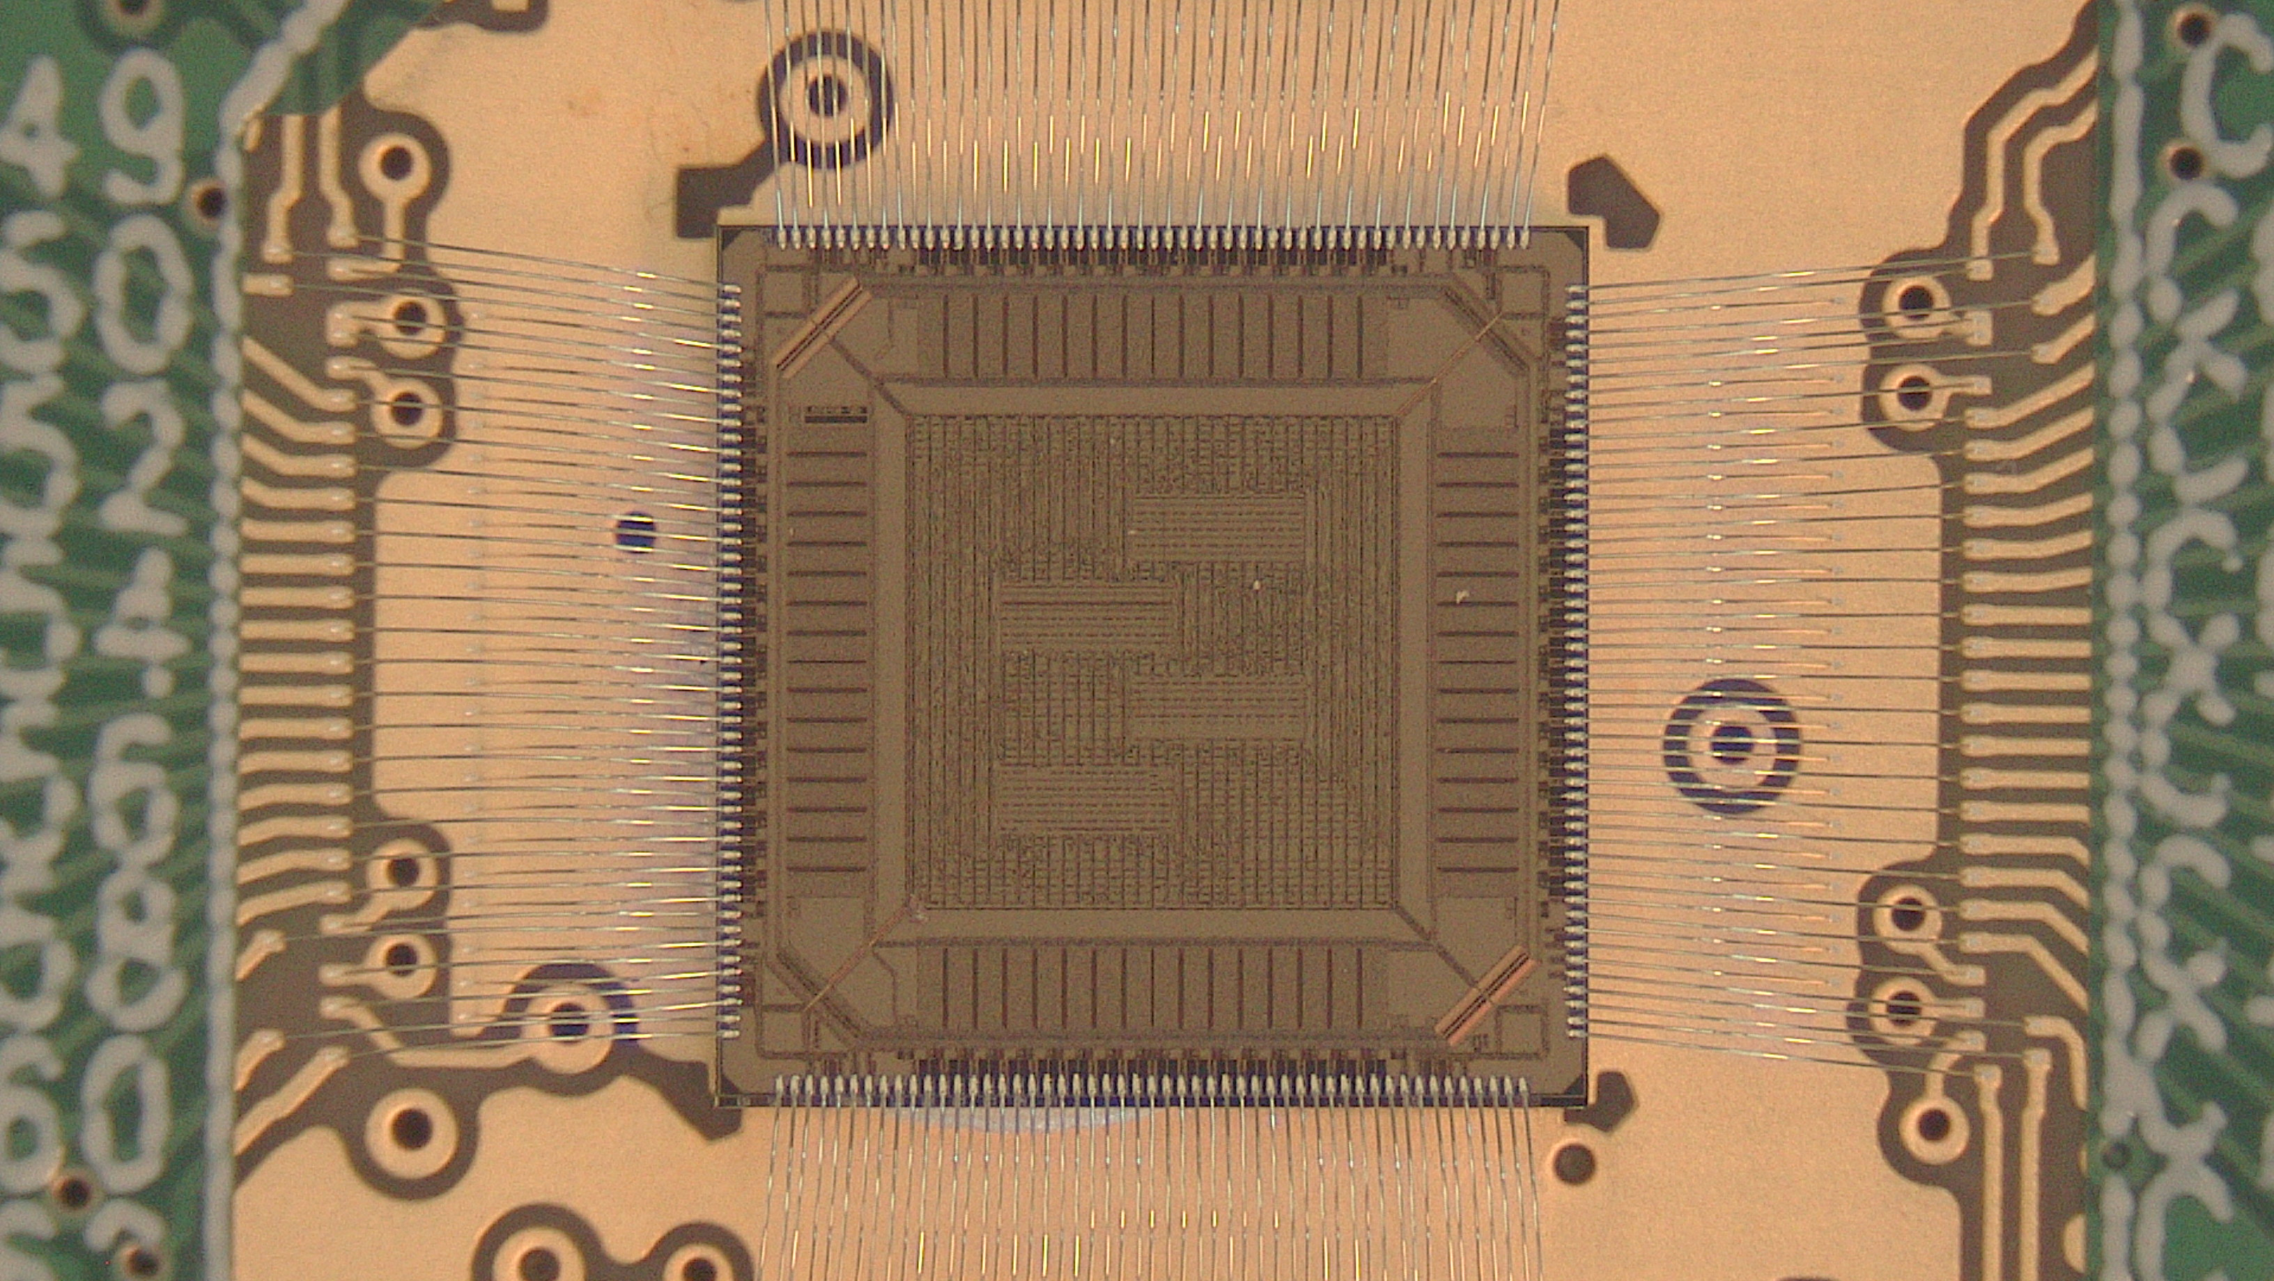
LArPix-v2b: Very low-voltage low-power digital I/O
Custom tunable low-voltage digital transmitter and receiver
- Similar to LVDS in concept, but much lower power: O(10 uW) per transmitter & receiver
- Highly-tunable loop current and termination resistance supports multiple modes of operation (chip-to-chip, multi-drop, etc.)
- Optional mode for automatic transmitter power-down when no data
- LArPix-v2b ASICs received Aug. 2021
- Low-voltage I/O working as designed
- Prototype v2b-based pixel tiles now in production

Slide 10
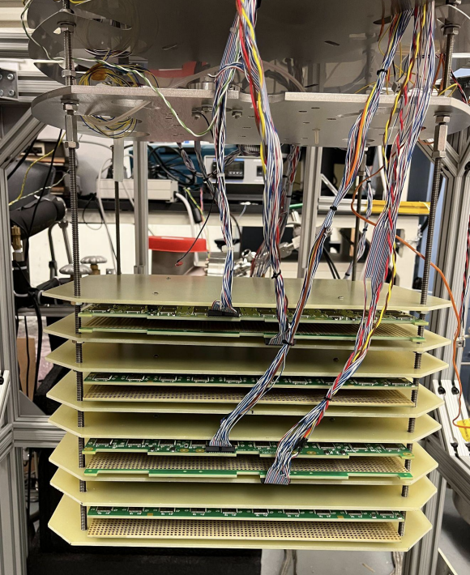
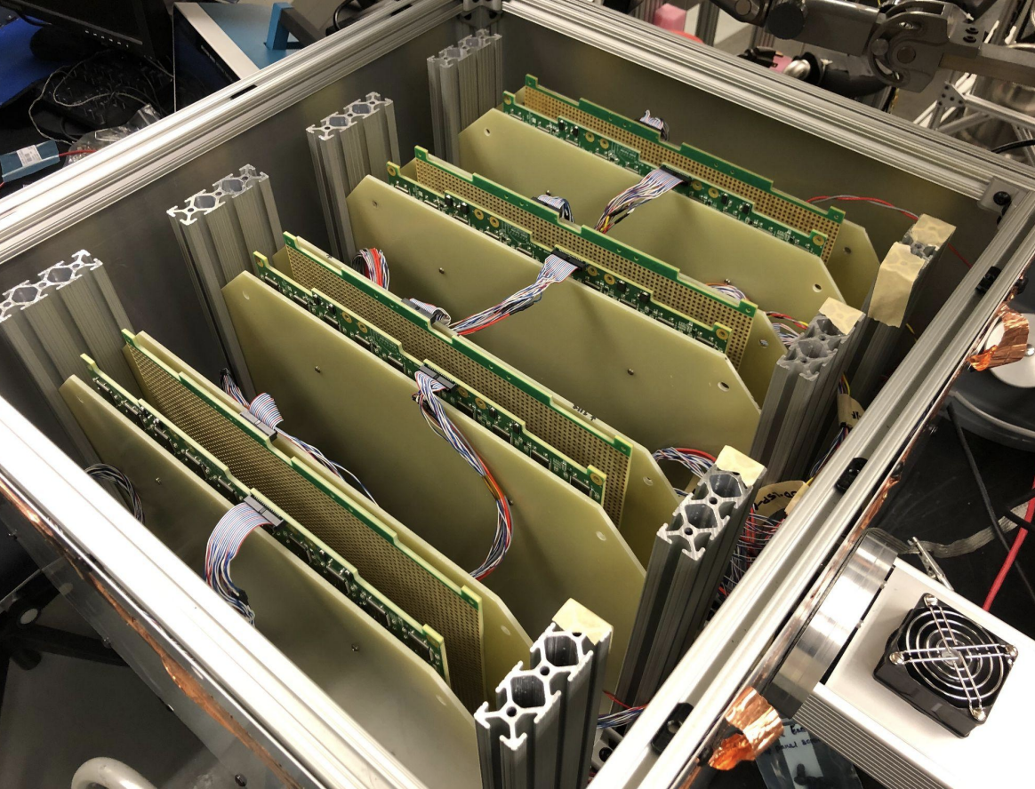
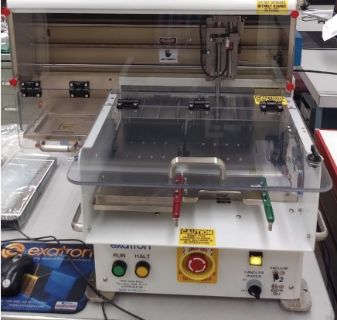
LArPix-v2: Scalable Production and Testing Process
All production/assembly done via commercial vendors; QC testing performed by scientific staff
ASICs produced and packaged
(@ vendors)
Anode tiles produced and checked
(@ vendor)
Controllers, cables, feedthroughs produced and checked
(@ vendor)
Room-temp System Test
Cryo-test of Pixel Tiles
ASIC room-temp QC testing
(@ Lab/Univ. partners)
Anode tiles loaded
and inspected
(@ vendor)
LArPix System
room-temp QC testing
(@ Lab/Univ. partners)
LArPix System
QC Cryo-testing
(@ Lab/Univ. partners)
LArPix-v2 testing:
~8,000 ASICs tested (so far)
~600 chips/day (1 robot)
Results:
~1% DOA
~10% sub-spec performance
LArPix-v2 testing:
~60 tiles tested (so far)
~8 tile batches, ~1hr
Results:
~0.5% chips failed post-assembly
Chip replacement: ~30 min
LArPix-v2 testing:
~60 tiles tested (so far)
~8 tile batches (time limited by LN fill/empty)
Results:
No cryo-failures yet
ASIC Testing Robot

Slide 11
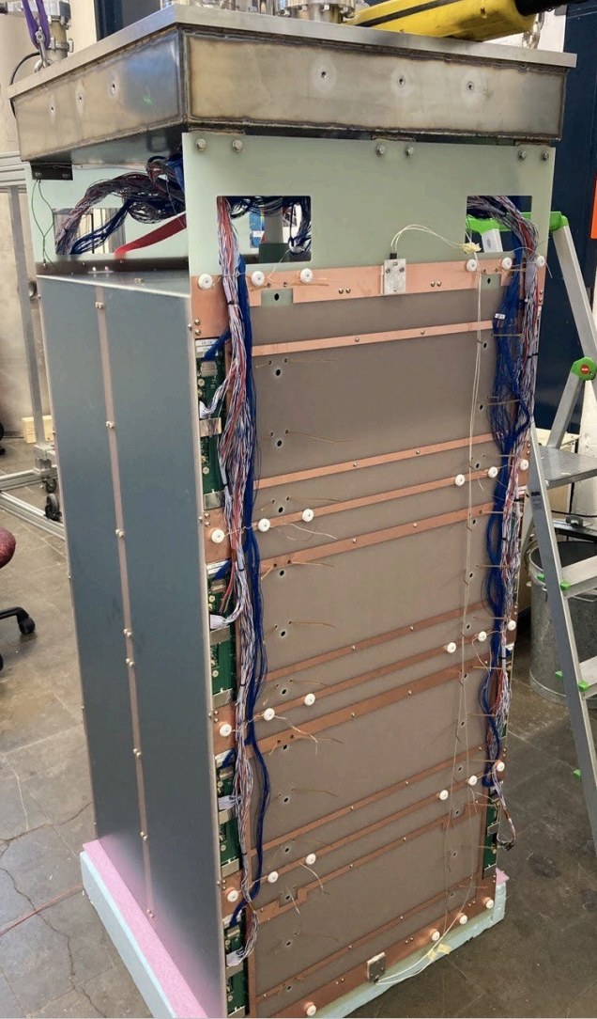
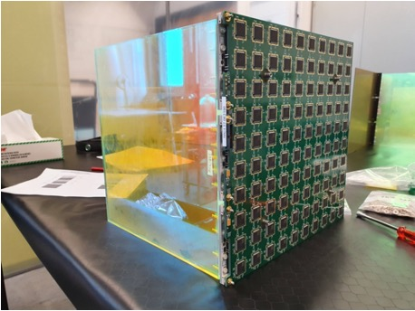
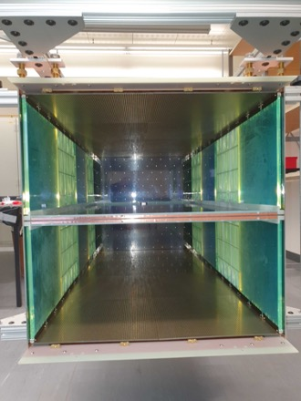
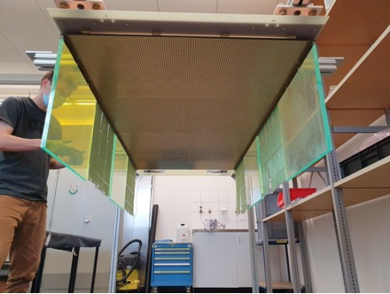
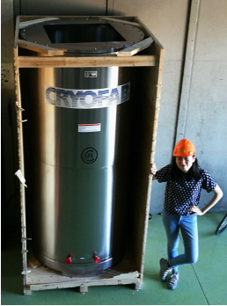
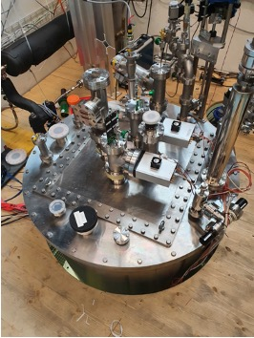
Prototyping: ArgonCube 2x2 LArTPCs
Single pixel tile &
light module assembly
LArTPC module
attached to
cryostat lid
Four ton-scale Prototype TPC Modules
to validate DUNE Near Detector Design
Each TPC Module:
- Active Size: 0.7m x 0.7m x 1.25m
- 16 pixel tiles, with ~80k pixel channels total
- 16 light collection modules, with 96 light sensors (SiPMs)
- Resistive-film-on-fiberglass field cage
Progress @ Univ. of Bern:
- TPC Module 0:
Run 1 (Demonstration): Apr. 1-10, 2021
Run 2 (Extra Cryo-test): Jun. 21-26, 2021
- TPC Module 1 Operation:
Feb. 5-13, 2022
Achievements:
Demonstrated fully-integrated prototype
detector module at a scale relevant to
the DUNE Near Detector
Two anodes, installed
inside field cage
One anode, fully-assembled
Single Module
Cryostat
LArTPC inside cryostat

Slide 12
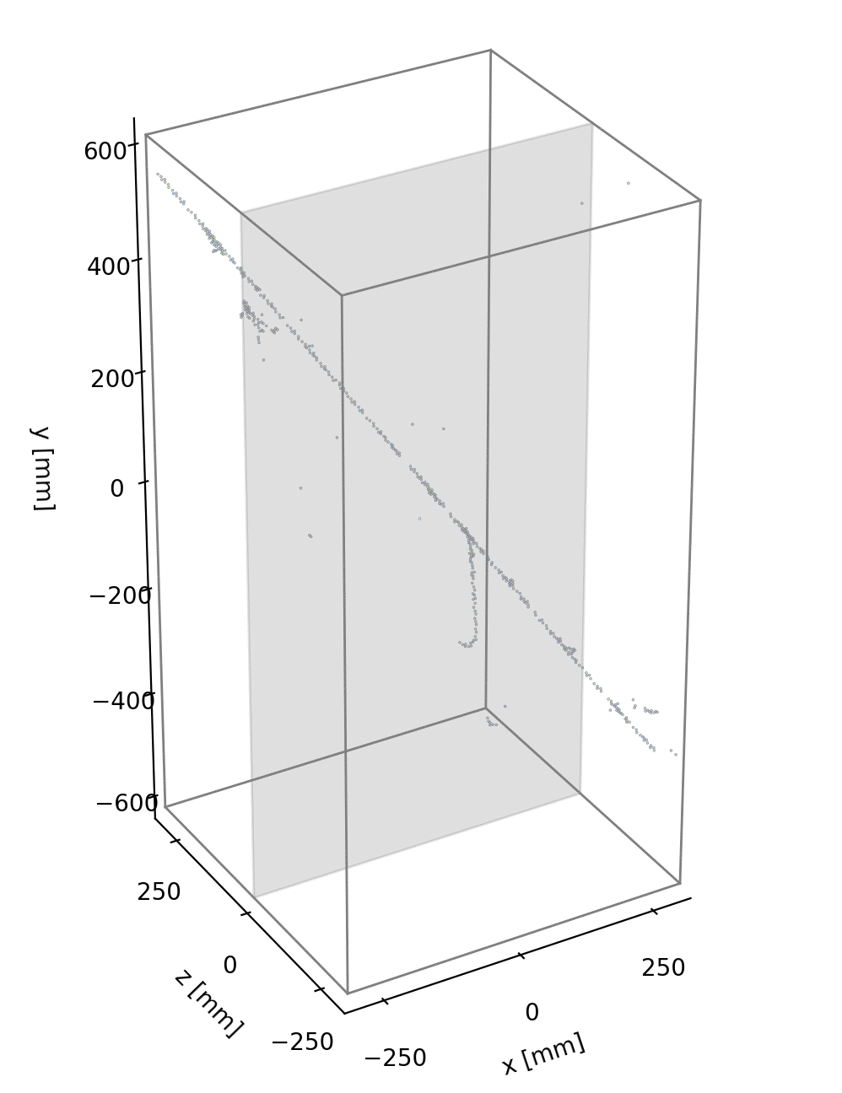
Prototyping: ArgonCube 2x2 LArTPCs
Verified design meets technical requirements:
- Collected >10⁷ cosmic ray events
- Stable HV at ~30kV (~1 kV/cm drift, 2x target)
- Stable Purity at >2ms (>4x target)
- MIP Charge Signal-to-Noise >20:1 (at target)
Typical raw data from cosmic ray interactions imaged in 3D prototype detectors
Continuous readout:
~100% live, independent of light system
Low data rate due to self-triggered design
Arguably the most performant
ton-scale LArTPC to date.
Feb 2023: Four ton-scale TPC modules ready
Mid 2023: Operation in NuMI Neutrino Beam
Prototype for the DUNE Near Detector
Module 0 LArTPC
Module 1 LArTPC

Slide 13
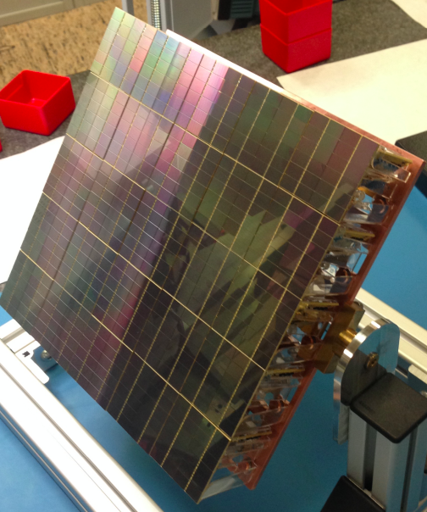
LightPix: Scalable Cryogenic SiPM Readout Electronics
Readout Electronics Needs:
  Low-power cryogenic-compatible scalable SiPM readout electronics at very low system cost
R&D Plan:
  LightPix:
    Adapt existing LArPix ASIC to provide scalable readout for many (e.g. >10⁶) Silicon Photomultipliers
    Reuse all of LArPix system architecture (low-power, cryo-compatible, scalable, O($0.10)/channel system cost)
    Provide a path for highly-granular photodetection systems for very large detectors
Rough concept: Replace LArPix charge-collection pixels with SiPMs
Why LightPix:
Existing readout electronics are either too high power or too high cost for our cryogenic detector needs.
Looking ahead:
Personally, I think LightPix fits
some specific near-term HEP needs (next 5yrs). In the long-term (5-10yrs), my guess is that digitally-integrated SiPMs may eventually provide better performance at lower cost.
e.g. Prototype 6.4k-channel LArPix-v2 tile
e.g. Darkside-20k prototype light sensor

Slide 14
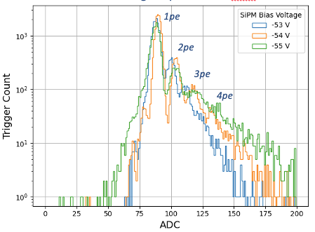
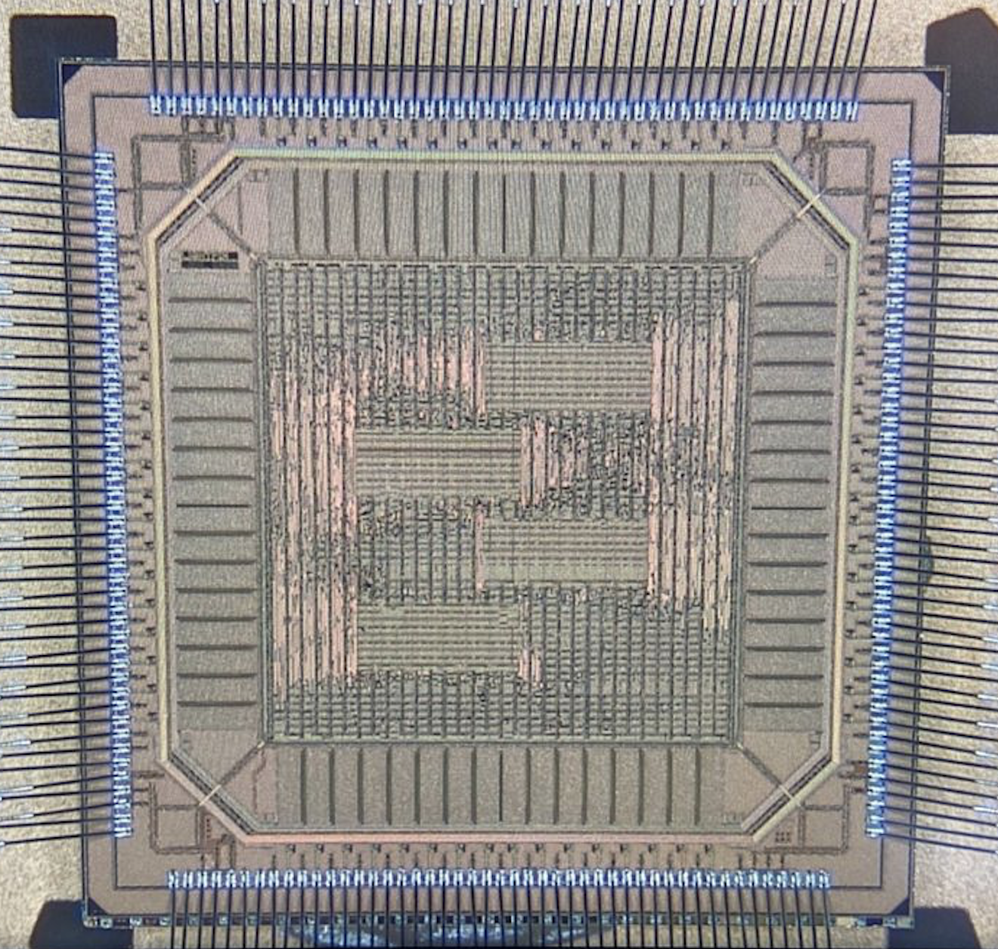
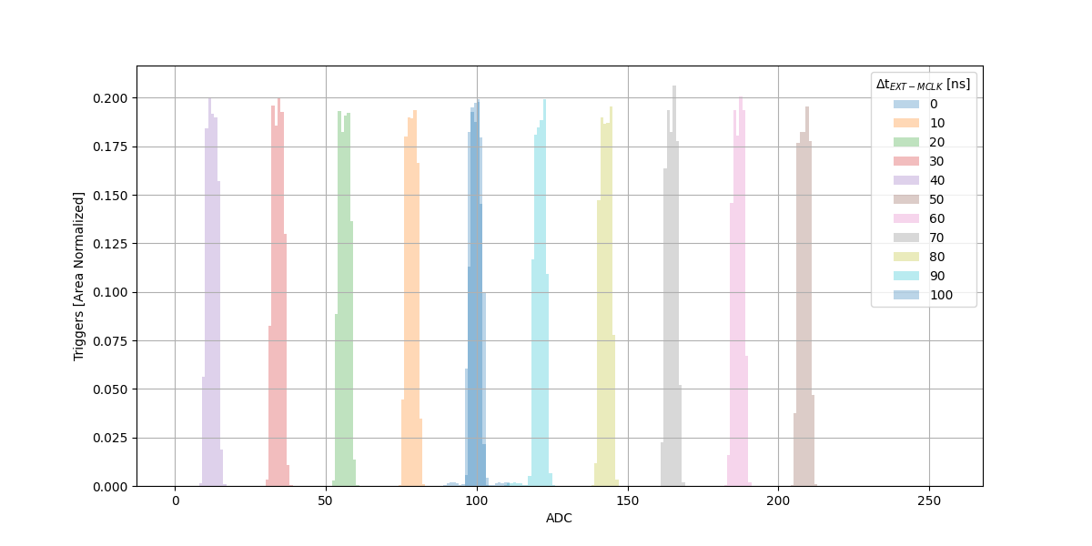
LightPix ASIC
LightPix-v1b ASIC
Photoelectron signal spectrum vs. SiPM bias
LightPix-v1:
- Develop and test dedicated time-to-digital converter (TDC)
to provide < 10ns time resolution
- Add multi-channel coincidence triggering mode to suppress
excess data from dark noise at room temp
Progress:
- Received Aug. 2021
- Power-up, configuration successful
- TDC meets design targets
Next Steps:
- LightPix-v2:
Provide both TDC and ADC functionality
- Deployment and testing of light detector system
in prototype LArTPC
- Exploration/optimization of light detector formats
Very-low-power TDC achieves ~ns-scale
precision in response to external pulse
Offset between
external pulse
and TDC stop
signal
Triggers (normalized)
TDC
Tunable TDC (here ~0.5ns/tick)

Slide 15

QPix

Slide 16
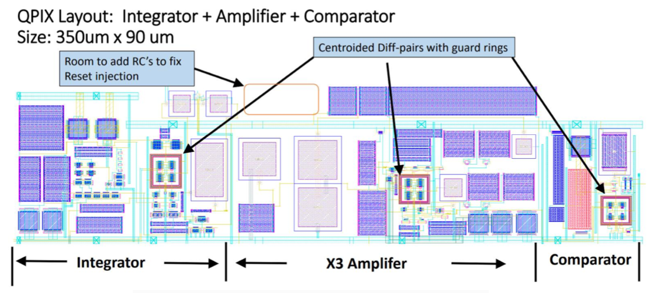
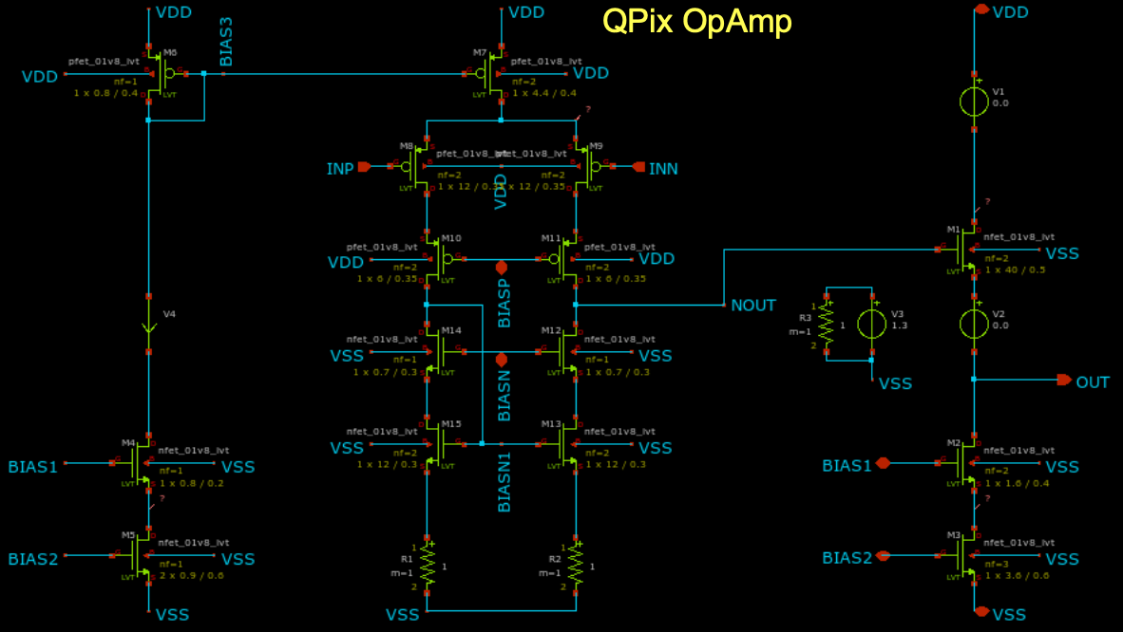
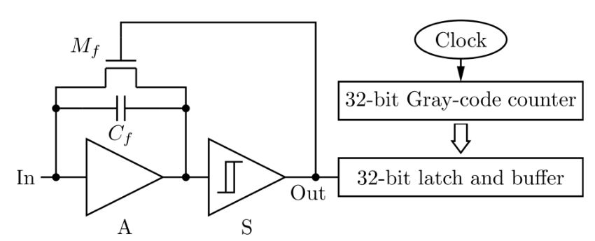
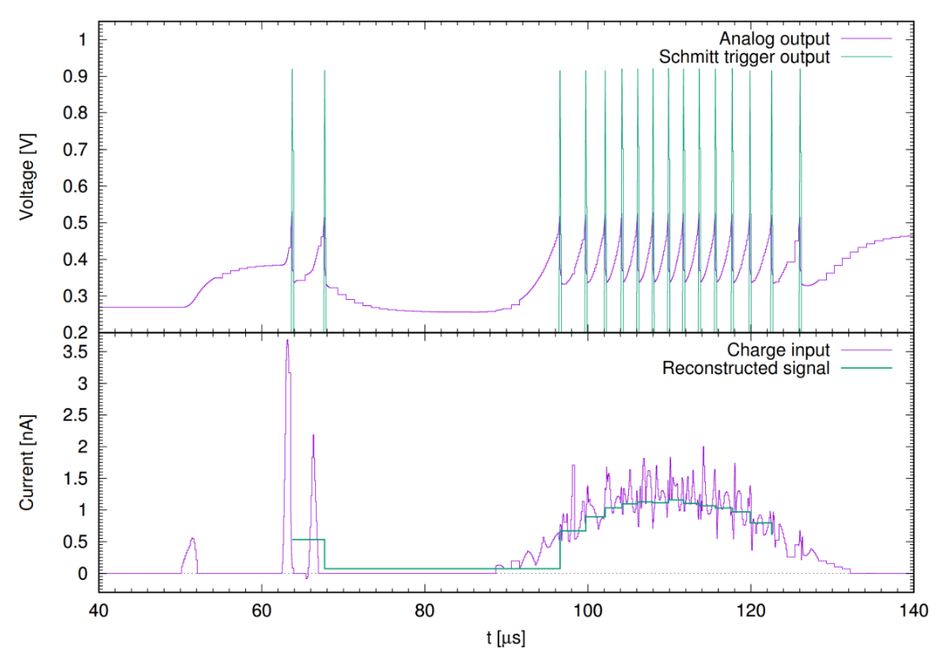
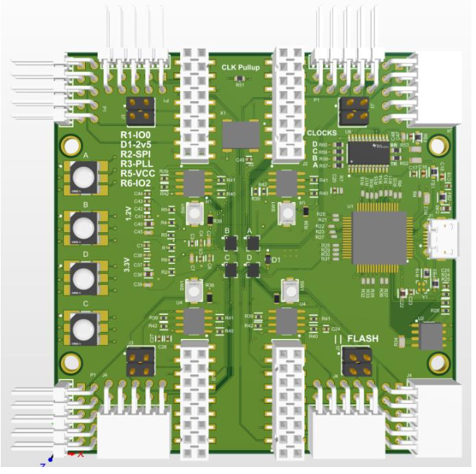
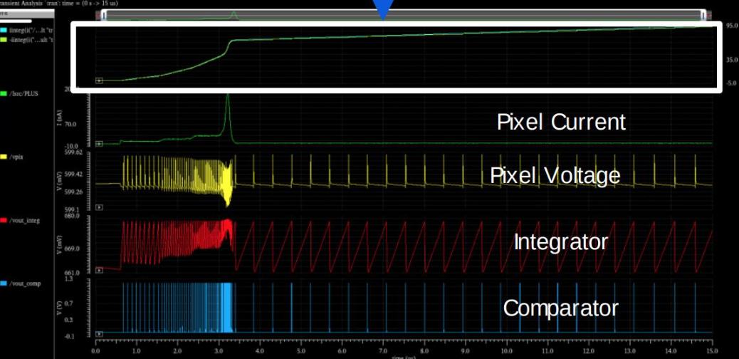
QPix: Concept and Progress
Front-end Prototype ASIC
(180nm, UPenn)
Front-end Prototype ASIC
(130nm, UTA)
Concept: arXiv:1809.10213
Report ‘time between resets’ instead of digitizing charge
Distribution of reset times proxy for signal current on pixel
Digital Back-end Prototype
(FPGA-based, U-Hawaii)
Front-end Design
(65nm, FNAL)

Slide 17
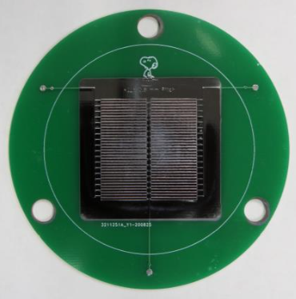
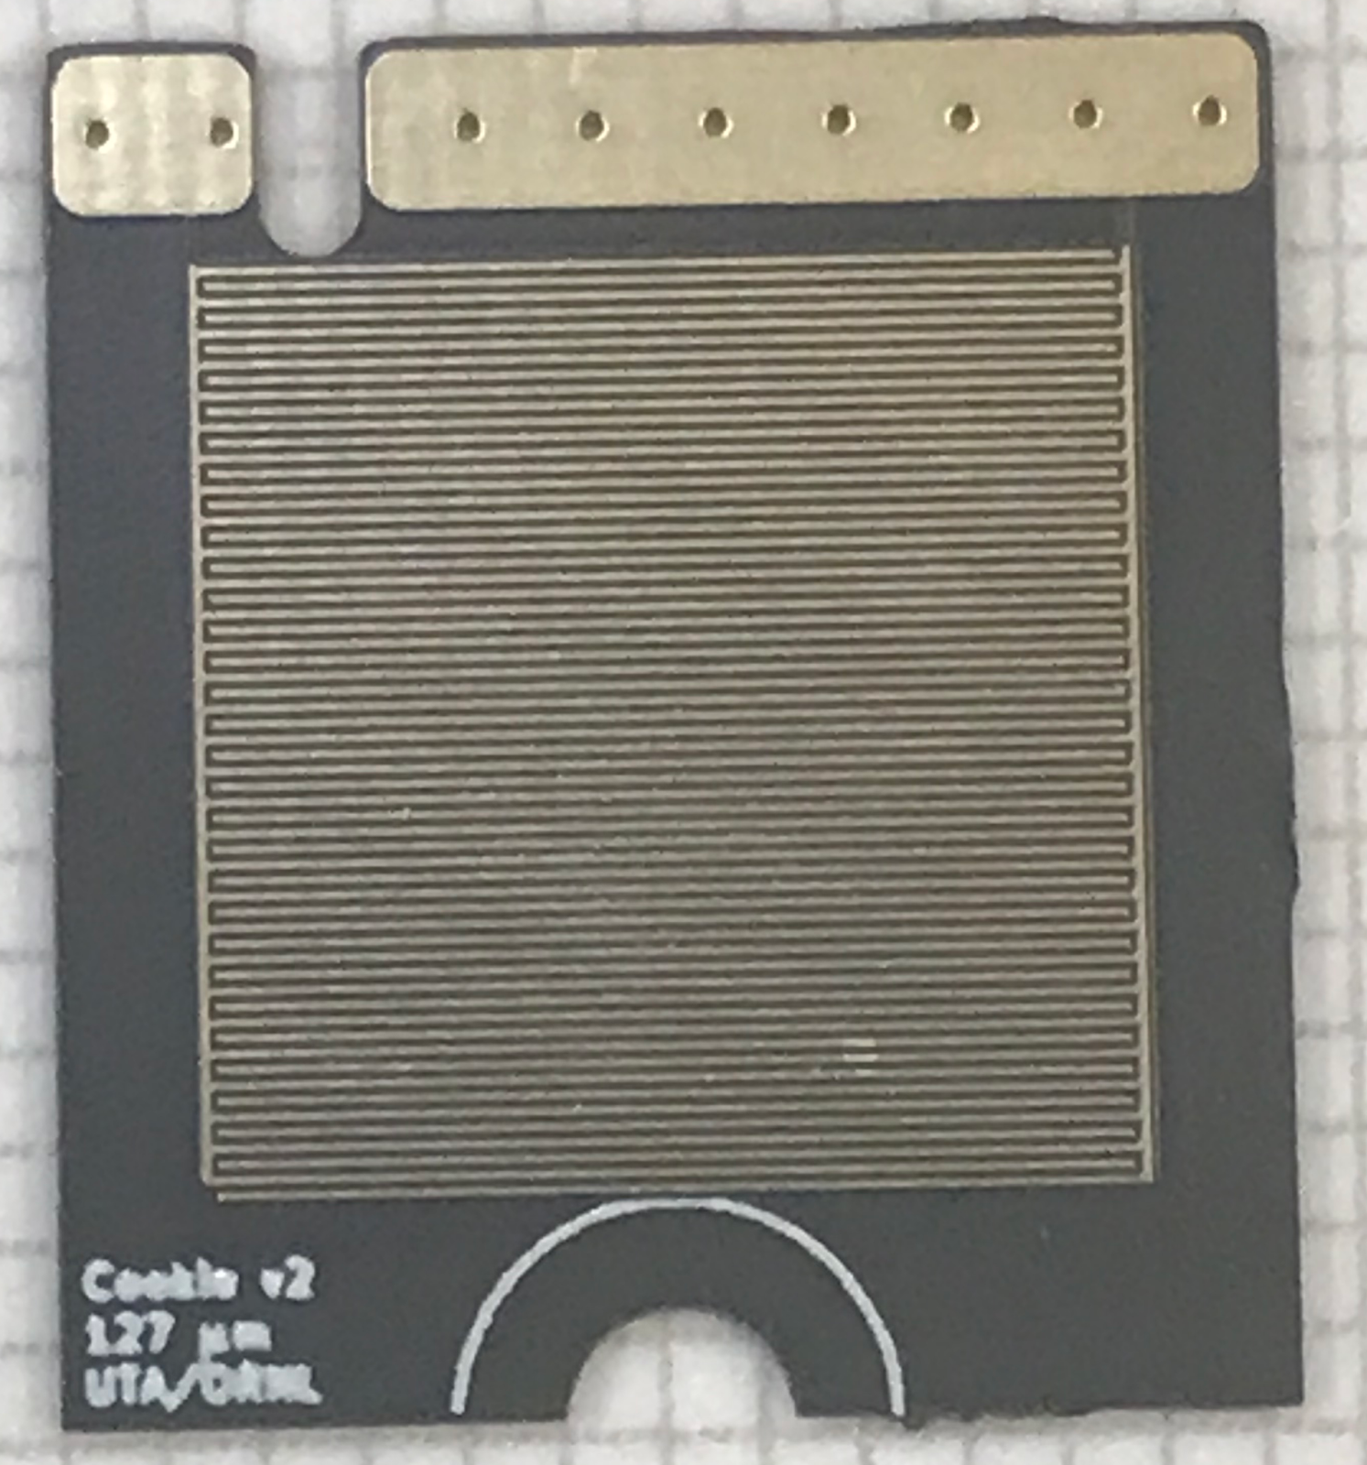
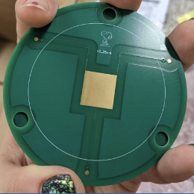
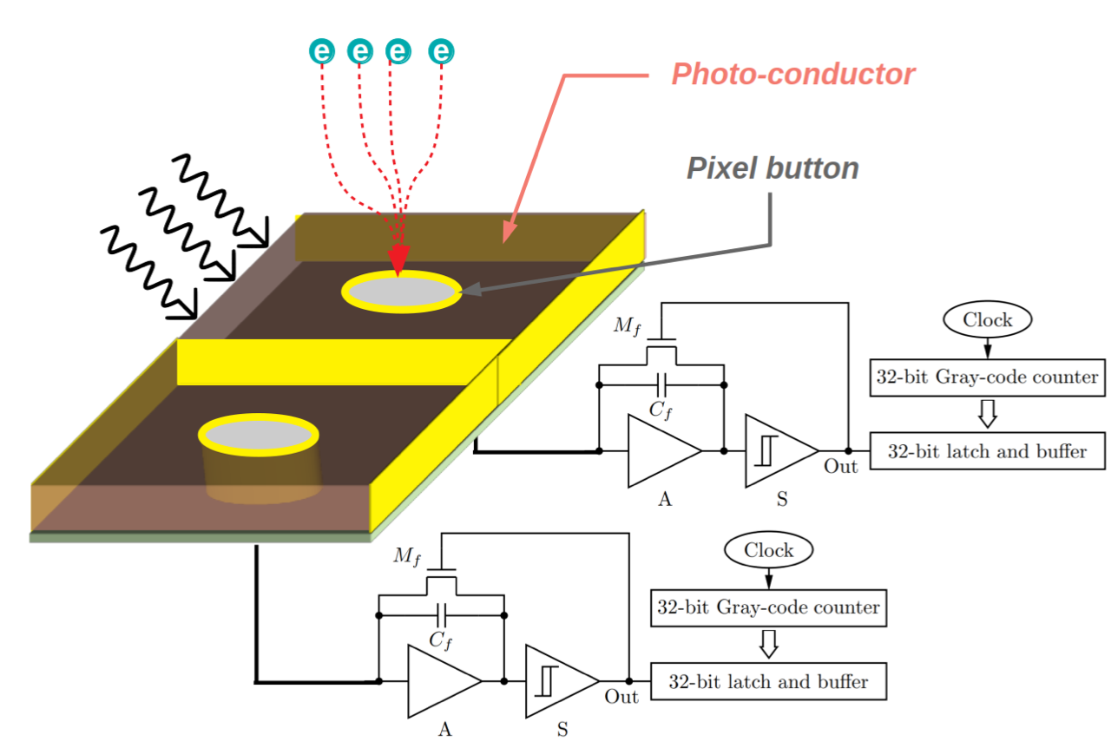

QPix: Light-sensitive Pixels
Prototype PCBs with biased traces coated in ASe
Concept:
Add photoconductive (ASe) film to pixel anode to make
pixels sensitive to both TPC charge and scintillation light
127 um trace spacing
5V/um max field
UTA/ORNL
127 um trace spacing
5V/um max field
UTA/ORNL
25 um trace spacing
40V/um max field
UCSC/UTA/FNAL
Example signal traces in response to light pulses

Slide 18





ARIADNE+
Camera System
Concept:
Achieve Dual-phase TPC 3D readout by
imaging electroluminescence in THGEM
with fast optical cameras
Camera
Systems
TimePix 3 Camera
Relay Optics
Image Intensifier
THGEM
Objective Lens
Advantages:
Low noise via optical-only readout
Low threshold due to gas amplification
Accessible/upgradeable: Cameras outside cryostat
Disadvantages:
Only viable in a dual-phase TPC
- High cathode voltage
- High-field e- extraction region
- THGEM amplification
Scattered/indirect light
Example 3D
cosmic ray
imaged in
prototype

Slide 19

Summary: Neutrino Pixels
LArPix-v2 ASIC
LArPix-v2 Tile
DUNE Near Detector
Prototype LArTPC
Cosmic ray 3D images
from prototype
LArPix:
- True 3D pixelated charge readout for LArTPCs
- Low-noise, low-power, cryogenic-compatible
- Self-triggering, 100% live
- Scalable anode design leverages commercial production
- Two recent 80k-pixel ton-scale prototype exceeded expectations
- Baseline technology for the DUNE Near Detector
LightPix:
- Highly-scalable readout for cryogenic SiPMs
- Reuses much of LArPix system design
QPix:
- Record trigger time distribution instead of digitizing charge
- R&D on ASe coating to make pixels light-sensitive
ARIADNE+:
- Optical 3D readout for dual-phase TPCs
- Successful mid-scale prototyping at CERN
Potential technologies for future highly-granular detectors
LIghtPix-v1 ASIC
QPix ASe prototype
ARIADNE+ Camera System and 3D imaging

Slide 20
Backup

Slide 21




2x2 Module 0 Physics Performance
Energy loss for minimum ionizing muons (dQ/dx)
Data/MC comparison of low-level
self-trigger charge distribution
versus pixel threshold.
Energy loss for stopping muons
Observation of positron decay

Slide 22





ArgonCube 2x2 @ NuMI
2x2 Operation in NuMI Neutrino Beam 2022-2023
- Install four TPC modules in former location of MINOS-ND
- Includes upstream/downstream trackers, repurposed from Minerva
Goals:
- Develop neutrino signal analysis and reconstruction techniques
- 3D reconstruction of neutrino signals
- Charge-light signal correlations, tolerance to beam pileup
- Track matching with external trackers
Status:
- Cryostat & controls commissioned at Bern
Delivered to FNAL: July 2021
- TPC Module 0, 1 commissioned at Bern
Delivered to FNAL: Oct. 2021, June 2022
- TPC Modules 2, 3 currently in production
To be delivered to FNAL: Winter 2022/2023
- Remaining cryogenics system procurements/production
To be delivered to FNAL: Winter 2022/2023
- Installation and commissioning in NuMI hall
Targeting Spring 2023
Demonstration of ½-million pixel detector
in a GeV neutrino beam!

Slide 23
Far Detector Pixel Readout: Key Requirements
My summary of the requirements that would drive system design and production for a future Far Detector
Requirement Approx. Value LArPix Comment
Granularity < 4.7 mm 3.8 mm Latest LArPix-v2b design has 3.8mm pixel pitch
Noise < 1000 e- ENC 900 e- ENC Noise as measured in ~100k-pixel TPC with LArPix-v2a
Threshold < 200 keV 200 keV 1/4-MIP signal efficiency currently marginal for both ND and FD
Power < 20 W/m² 14 W/m² Anode heat flux less than heat from cryostat walls. Mitigate boiling at anode.
Digital Multiplexing > 10⁶ pixels/channel 10⁵ pixels/channel Ok for ND. O(10x) digital aggregator needed to reduce FD cabling/feedthroughs
Reliability/Longevity < 5% failure/10yrs (Unknown) Cryo-longevity to be assessed as part of ND prototyping program
Total system cost < $20k/m² $10k/m² Total production cost includes full system assembly, cold/warm electronics, etc.
Production throughput > 1000 m²/yr O(200) m²/yr OK for ND. 5x needed for FD. May be possible with current or additional vendors.
Testing throughput > 1000 m²/yr O(50) m²/yr 4x needed for ND; 20x needed for FD. More QC testing partners needed.
Science
Engineering
Production
Most important steps toward Pixelization of a Far Detector:
- Design and prototype a cryo-robust digital aggregator
- Develop plan and partners to achieve FD-scale QC testing throughput

