Slide 1
Pixel detectors with built-in signal processing and bandwidth-efficient data transmission
G.W. Deptuch, G.A. Carini, D. Gorni, S. Mandal, S. Miryala, G. Pinaroli,
PIXEL 2022: 12/14/2022

Slide 2


Slide 3
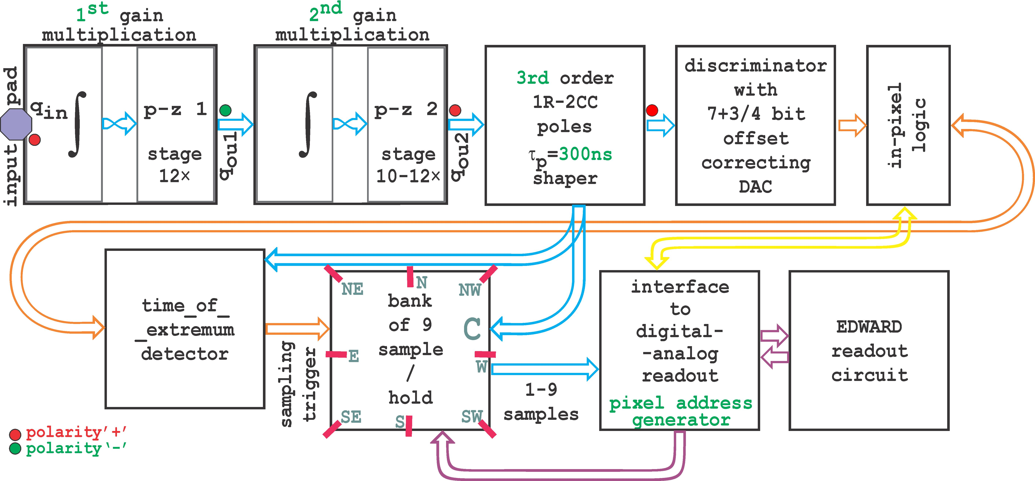
Pixel diagram
detect X-rays < 2 keV ⇒ ENC=O(10 e⁻) + ~10b DR in ~100 ×100 μm²

Slide 4
CSA: Charge Sensitive Amplifier

Slide 5

Commonly used CSA concepts with I_{LEAK} compensation and with p-z cancellation
all shown for holes
Krummenacher’s / Manfredi’s [1]
input charge signal multiplication
$$I_{OUT} =n×I_{IN}$$
Ð
L
L
L
Í
Í
Common Gate
Feedback (CGF) [3]
Common Source Feedback (CSF) [4]
operates in p-z cancellation,
RQI (typ. at some pAs) is required, but difficult to control and match,
larger I_{LEAK}+RQIs ⇒ loss of stability,
multiplied both RQI and sensor I_{LEAK} to next stages ⇒ shift of baseline.
operates in p-z cancellation,
one-fit-all V_{RFB} is needed,
Reset Quiescent Current (RQI) is optional; if used, multiplied RQI to next stages ⇒ shift of baseline.
feedback resistance ∝ current source,
I_{KRUM} must exceed I_{LEAK}, ⇒ parallel noise,
too large I_{LEAK} ⇒ loss of stability [2],
requires large (~pF) C_{int},
not connectable in p-z cancellation.
[1] F. Krummenacher, "Pixel detectors with local intelligence: An IC designer point of view", Nucl. Instrum. Methods Phys. Res., vol. A305, pp. 527-532, 1991, P.F. Manfredi, et al, “The analog front-end section of the BaBar silicon vertex tracker readout IC”, Nuclear Physics B - Proceedings Supplements, Vol. 61, Is. 3, February 1998, 532-538
[2] Y. Hu, et al, "A low-noise, low-power CMOS SOI readout front-end for silicon detector leakage current compensation with capability," in IEEE TCAS I, vol. 48, no. 8, pp. 1022-1030, Aug. 2001
[3] G. De Geronimo et al., “A CMOS detector leakage current self-adaptable continuous reset system: theoretical analysis”, Nucl. Instr. Meth. A 421 (1999) 322-333
[4] G. De Geronimo et al., “Front-End ASIC for a GEM Based Time Projection Chamber”, IEEE Trans. Nucl. Sci Vol. 51, No. 4, August 2004 1313-1317

Slide 6
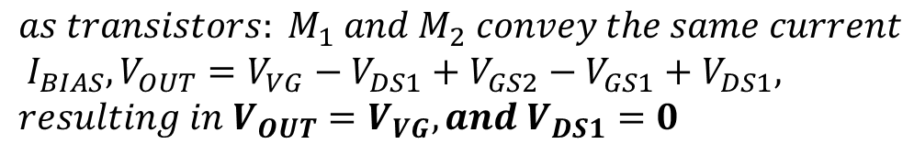
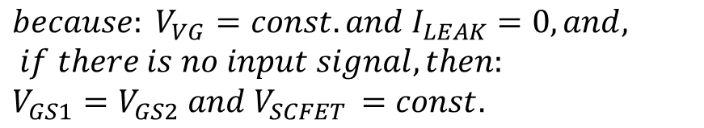
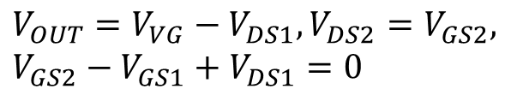
New CSA concept with I_{LEAK} compensation and with p-z cancellation
all shown for holes
assuming:
no body effect in transistors,
negligible sensor leakage current,
very high open-loop gain of amplifier (OpAmp or OTA)
J
J
L
$$V_{OUT}=V_{VG}−V_{DS1}, V_{DS2}=V_{GS2},$$
$$V_{GS2}−V_{GS1}+V_{DS1}=0$$
Í
$$because: V_{VG}=const. and I_{LEAK}=0, and, if there is no input signal, then:$$
$$V_{GS1}=V_{GS2} and V_{SCFET }=const.$$
Ë
CSA with Self-Cascoded Field-Effect Transistor (SCFET) feedback network in configuration for integration of input charge signals [5];
CSA with (SCFET) configured in pole-zero cancellation scheme [5], realizing multiplication (gain) of input charge signal × n;
$$as transistors: M_{1} and M_{2} convey the same current \\ I_{BIAS}, V_{OUT}=V_{VG}−V_{DS1}+V_{GS2}−V_{GS1}+V_{DS1},$$
$$resulting in V_{OUT}=V_{VG}, and V_{DS1}=0$$
… in real conditions, V_{DS1} is only close to “0”, nevertheless transistor M₁ act as diode-connected, providing minimal voltage drop across and external voltage bias on its gate is not required
[5] G. W. Deptuch, P. Otfinowski, “Charge Sensitive Amplifier with Pole-Zero Cancellation”, provisional patent application USPTO Serial No. 63/379,887

Slide 7
Configuration for both polarities
Inverter-type OTA with bias current reuse + active cascode gain boosting
either electrons or holes programmed or switched
single stage amplifier and 90 dB open loop DC gain,
single stage amplifier ⇒ intrinsically stable
M₁ and M₂ = thick gate oxide ⇒ low gate leakage currents,
other transistors to optimize swing and open loop gain,
inverter-type OTA current defined by power supply
local bias generated for cascode ⇒ reduced interferences

Slide 8

Stage cascading
$$I_{OUT} =n×m×I_{IN}$$
1st charge gain stage ‘×n’
2nd charge gain stage ‘×m’

Slide 9
CSA in simulation
Two-stage CSA ⇒ charge multiplication I_{OUT}=12×12×I_{IN}, with C_{f1}=4 fF, C_{c1}=12×4 fF, C_{f2}=40 fF and C_{c2}=12×40 fF and
for Q_{inj}= 1 fC h⁺ (2.25 keV X-ray in Si) and ½ of this value every 2.5 μs interchangeably
bpad
a_{out}
Q_{out} [e]
c_{out}
left axis: magenta ½ fC injections, cyan 1 fC injections, green summed injections.
right axis: yellow Q_{out}

Slide 10
Shaping Filter with Baseline Adjustment

Slide 11
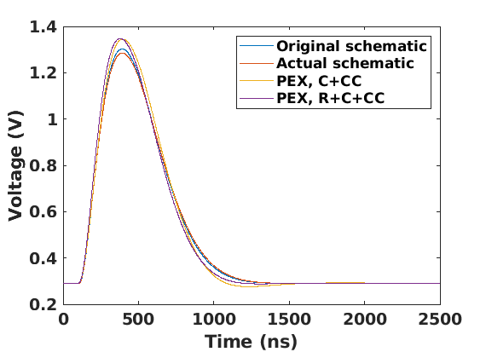
Shaping filter with baseline adjustment
3rd order, 1-real + 2-complex conjugate poles [6], shaping filter (τ_{p}=300 ns) with baseline adjustment using current-mode DAC (7.5 bit equiv. +1 bit for polarity setting DAC – k=8)
R_{pr} = 571.6 kΩ, C_{pr} = 304.0 fF
R_{pc11} = 183.2 kΩ /7 = 26.17 kΩ, C_{pc11} = 4.52 pF
R_{pc12} = 183.2 kΩ, C_{pc12} = 304.0 fF / 2 =152.0 fF, R_{pc13} = 183.2 kΩ
I current DAC = ±250 nA (baseline) + 1 μA (polarity)
DAC current is injected
into node ‘d’ for noise performance
IR drop across R_{pc12} ⇒ shifts of baseline.
$$H_{t}\left(s\right)=\frac{1}{s}\frac{−sC_{c}R_{pr}}{sC_{pr}R_{pr}+1}\frac{1}{s^{2}C_{pc11}C_{pc12}R_{pc12}R_{pc13}+sC_{pc12}R_{pc12}\left(1+\frac{R_{pc13}}{R_{pc11}}+\frac{R_{pc13}}{R_{pc12}}\right)+1}=\frac{−sC_{c}R_{pr}}{sC_{pr}R_{pr}+1}\frac{{−A}_{v}}{\frac{s^{2}}{ω_{0}^{2}}+\frac{s}{ω_{0}Q}+1}$$
C_{c} is coupling capacitance for the last stage of the CSA
[6] G. De Geronimo and S. Li, "Shaper Design in CMOS for High Dynamic Range," in IEEE Transactions on Nuclear Science, vol. 58, no. 5, pp. 2382-2390, Oct. 2011

Slide 12
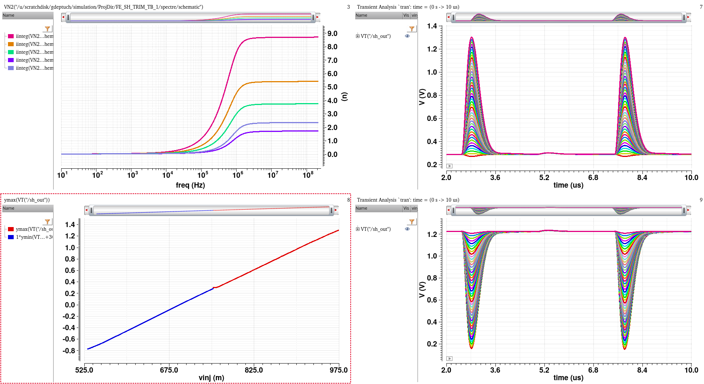
CSA + shaping filter in simulations
two-stage CSA ⇒ charge multiplication I_{OUT}=12×12×I_{IN}, with C_{f1}=4 fF, C_{c1}=12×4 fF, C_{f2}=40 fF and C_{c2}=12×40 fF and semi-gaussian shaping filter (1RP2CCP) τ_{p}=300 ns; C_{DET} = 50 fF, VDDA=1.5 V, I_{bias}=~50 μA/OTA stage.
2.95 mV_{rms} ð ENC=16.5 e⁻
0 h⁺ ÷ 5,580 h⁺
AC noise simulation for positive polarity for 0 pA, 2 pA, 12.5 pA, 25 pA and 50 pA current biasing SCFET feedback in CSA
2.32 mV_{rms} ð ENC=12.9 e⁻
1.93 mV_{rms} ð ENC=10.7 e⁻
22 steps
1.53 mV_{rms} ð ENC=9.5 e⁻
1.32 mV_{rms} ð ENC=7.3 e⁻ (limit)
positive baseline
linearity for positive and negative signals
obtained separately
injection of holes
negative baseline
22 steps
injection of electrons
V_{VG}=752.8 mV
0 e⁻ ÷ 5,580 e⁻

Slide 13
Correct ENC reporting
1.5 ms long simulations - injections every 5 μs
(max noise frequency 250 MHz)
presented in ‘eyeDiagram’ mode with period of 5 μs
Often SNR is incorrectly reported as
As ratio of pulse amplitude (transient sim.) to rms at not signal (AC noise sim.)
ΔE/E=~1.6%
ΔE/E=~0.9%
Simulation test setup for estimation
of noise (SNR and ΔE/E)
CSA uses passive, i.e., capacitors, and active, i.e., transistors, components in feedback path of high open-loop gain amplifier.
FE circuit transfer function is non-nonstationary ⇒ the noise (variance at specific points of time series data) needs to be calculated using transient noise simulation,
ΔE/E=~0.85%
ΔE/E=~0.8%

Slide 14
CRT: Configuration, Readout, Testability

Slide 15
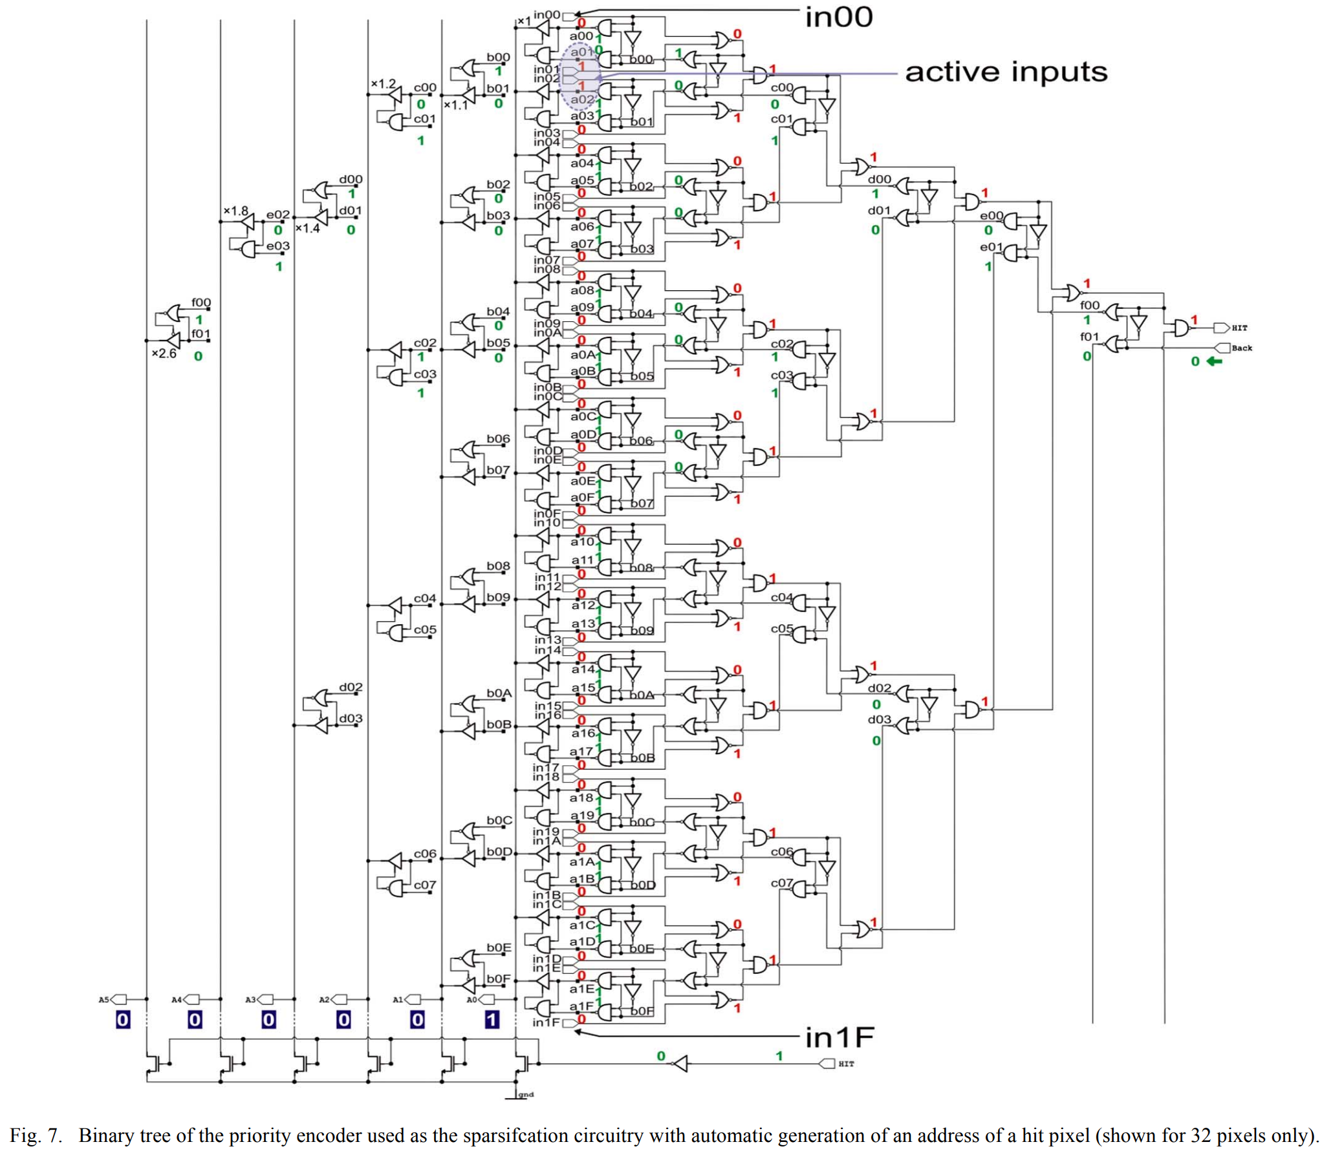
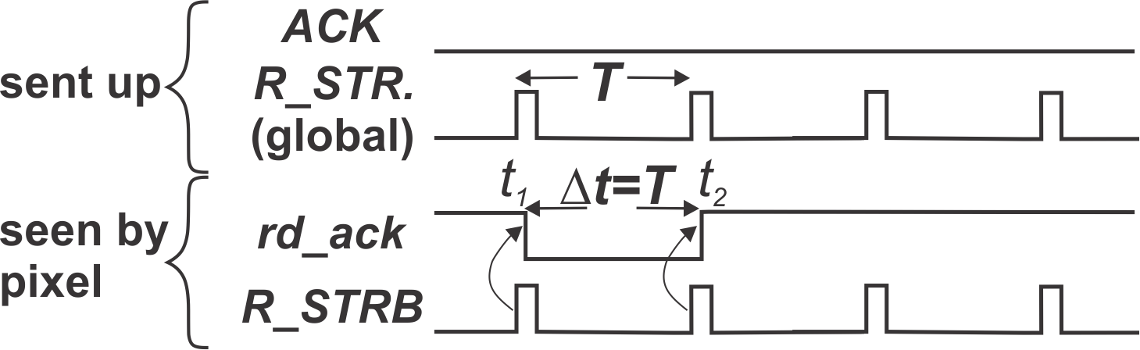
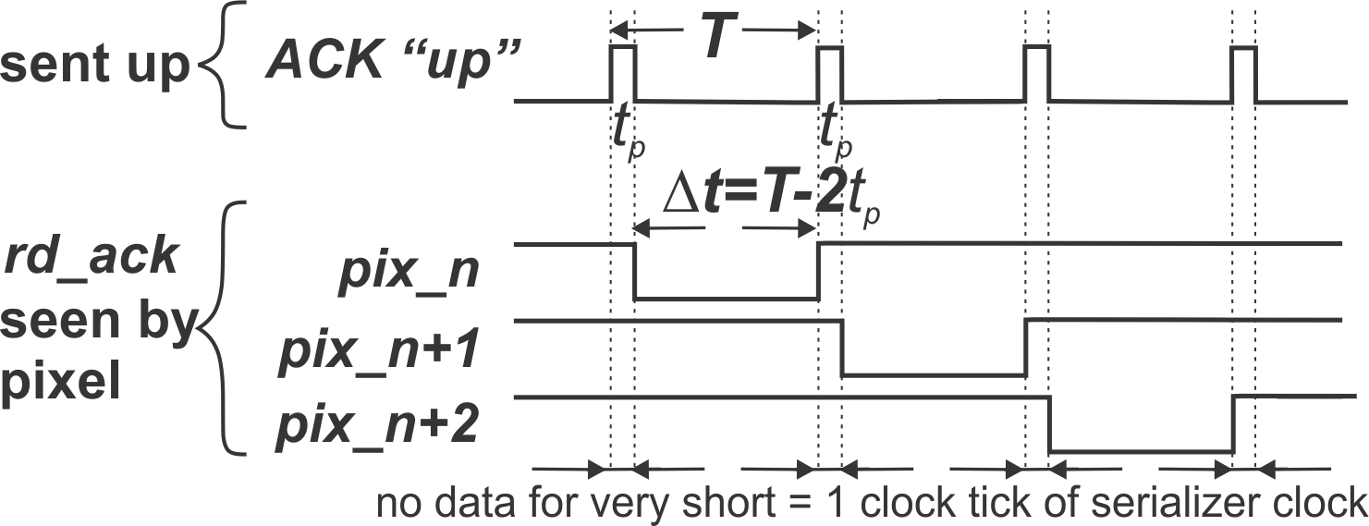
Static arbitration (priority encoder)
How to switch from one pixel to another?
fasten “ACK” apply “ReadStrobe”
L
ACK
common signal to all pixels
L
act on “ACK”
[8]
[7]
L
Peter Fischer’s
Mephisto-like
effectively serializer’s clock (high speed) sent as ack
J
change way of thinking …
[7] G.W. Deptuch et al., "Design and Tests of the Vertically Integrated Photon Imaging Chip," in IEEE Transactions on Nuclear Science, vol. 61, no. 1, pp. 663-674, Feb. 2014
[8] G.W. Deptuch, “VIPIC-Large, Analysis of RStrobe and RStrobe-less solution”, FERMILAB-TM-2709-PPD, https://lss.fnal.gov/archive/test-tm/2000/fermilab-tm-2709-ppd.pdf

Slide 16

Dynamic Arbitration: GALS
[9]
[10]
In inter-processor networks (CALTECH) it was assumed that sources are synchronous and acquisition is asynchronous (Global Asynchronous – Local Synchronous) ⇒ source has ¸ for duration of access to medium
⇒ arbiters with Mueller-C gates, where access granted can only be canceled by source by removing request, an it is impossible to communicate with source after Mueller-C gate is set
L
[10]
but pixel systems are LAGS!
[9] C.L. Seitz, “Ideas About Arbiters”, Lambda 1st Quarter 1980: Vol. 1 Iss. 1, pp. 10-14
[10] Shih-Chii Liu, et al, “Event-Based Neuromorphic Systems”, Wiley 2015

Slide 17
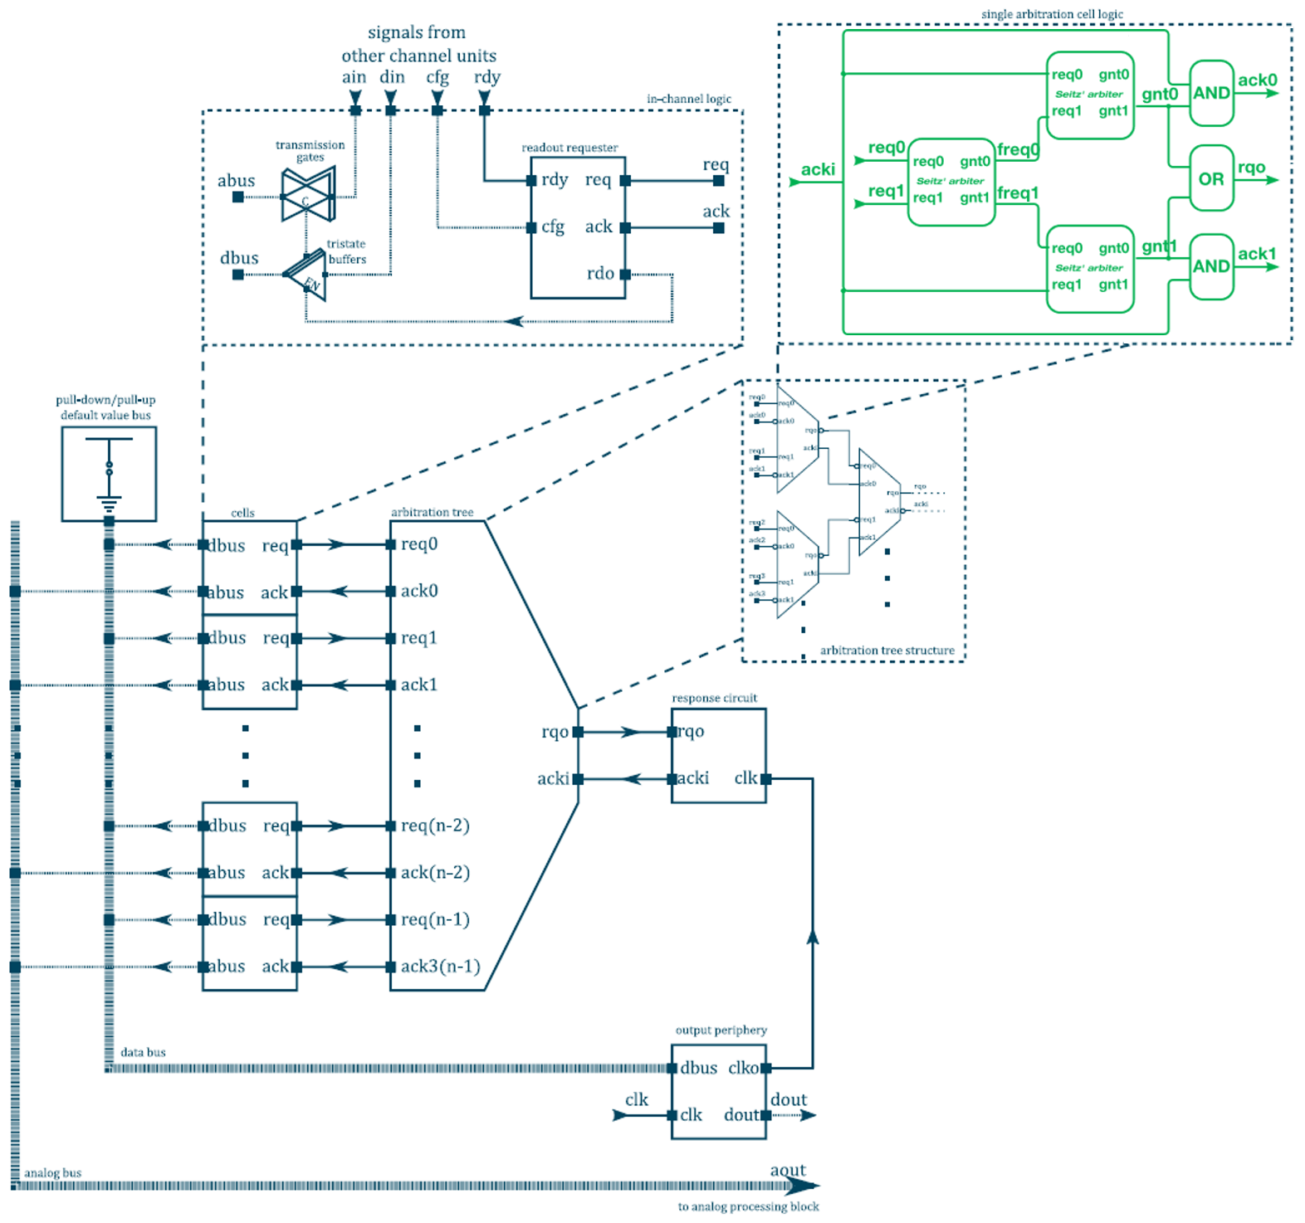
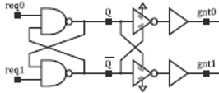
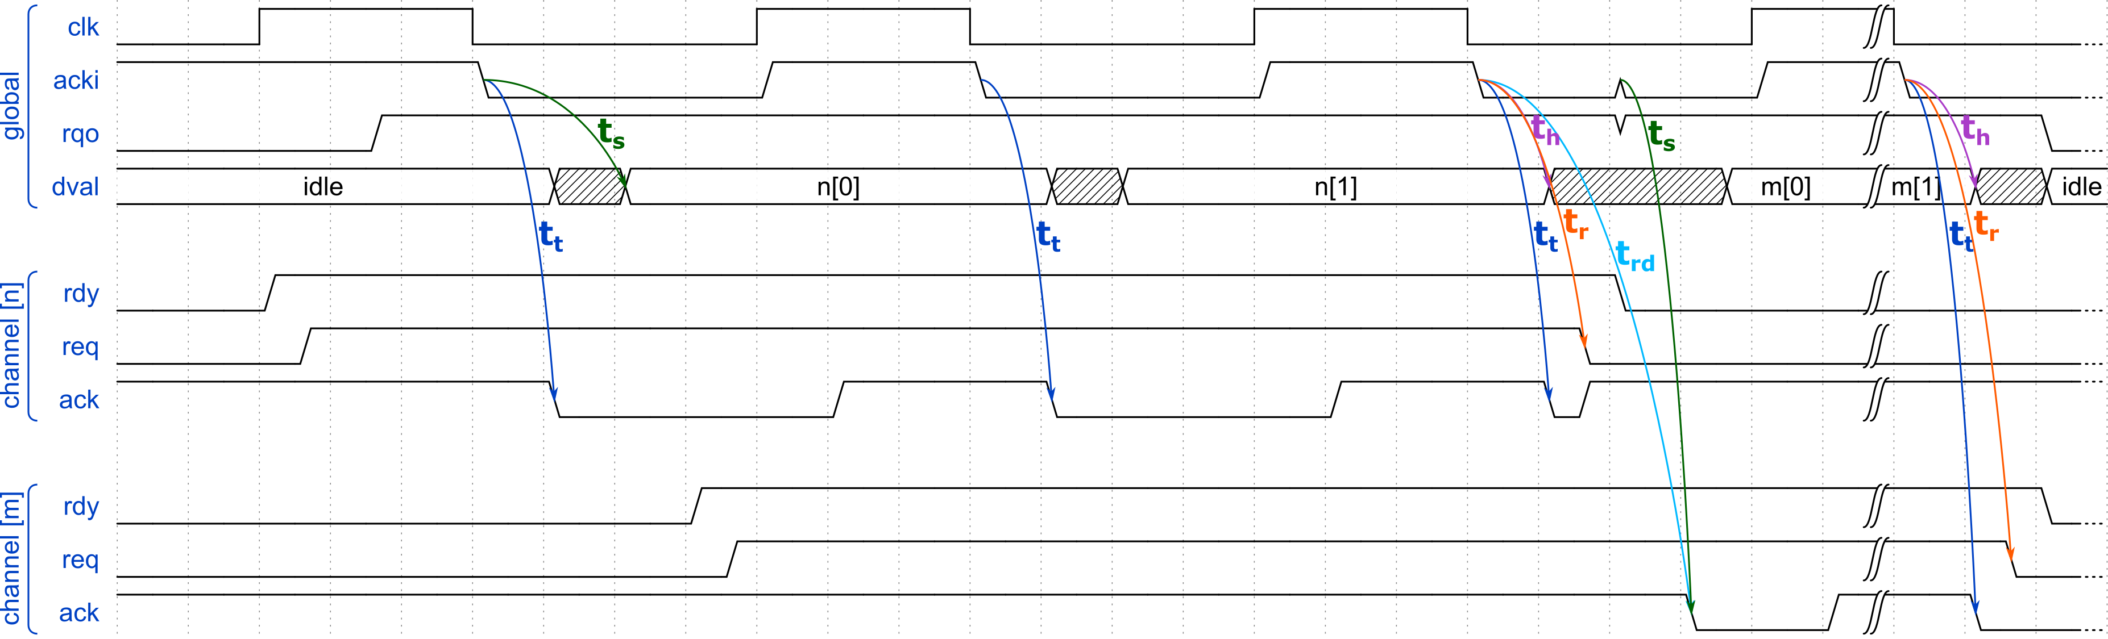
LAGS
fair (unfair) arbitration
= no close neighbor order
ain – analog sample
din – digital data
rdy – ready to read
cfg – config
S2
2 requests are arbitrated by “S1”
1 selected request can make up to “rqo” through “S2” and “S3” only when acknowledge is inactive
when “gnt0” or “gnt1” are active, AND gates, unlike C-gates, allow passing activity on “acki” to channel on established connection!
1 arbiter
needs
3 Seitzes
S1
sets ‘default’
when no
events
S3
J
channel
instructed: terminate or send more data
programmed to output two values / pixel
1st event
no dead time
digital data, e.g., addresses
2nd event
analog data, e.g., amplitudes
[11] D.S. Gorni, G.W. Deptuch, S. Miryala, WO2022221068 - EVENT-DRIVEN READOUT SYSTEM WITH NON-PRIORITY ARBITRATION FOR MULTICHANNEL DATA SOURCES

Slide 18
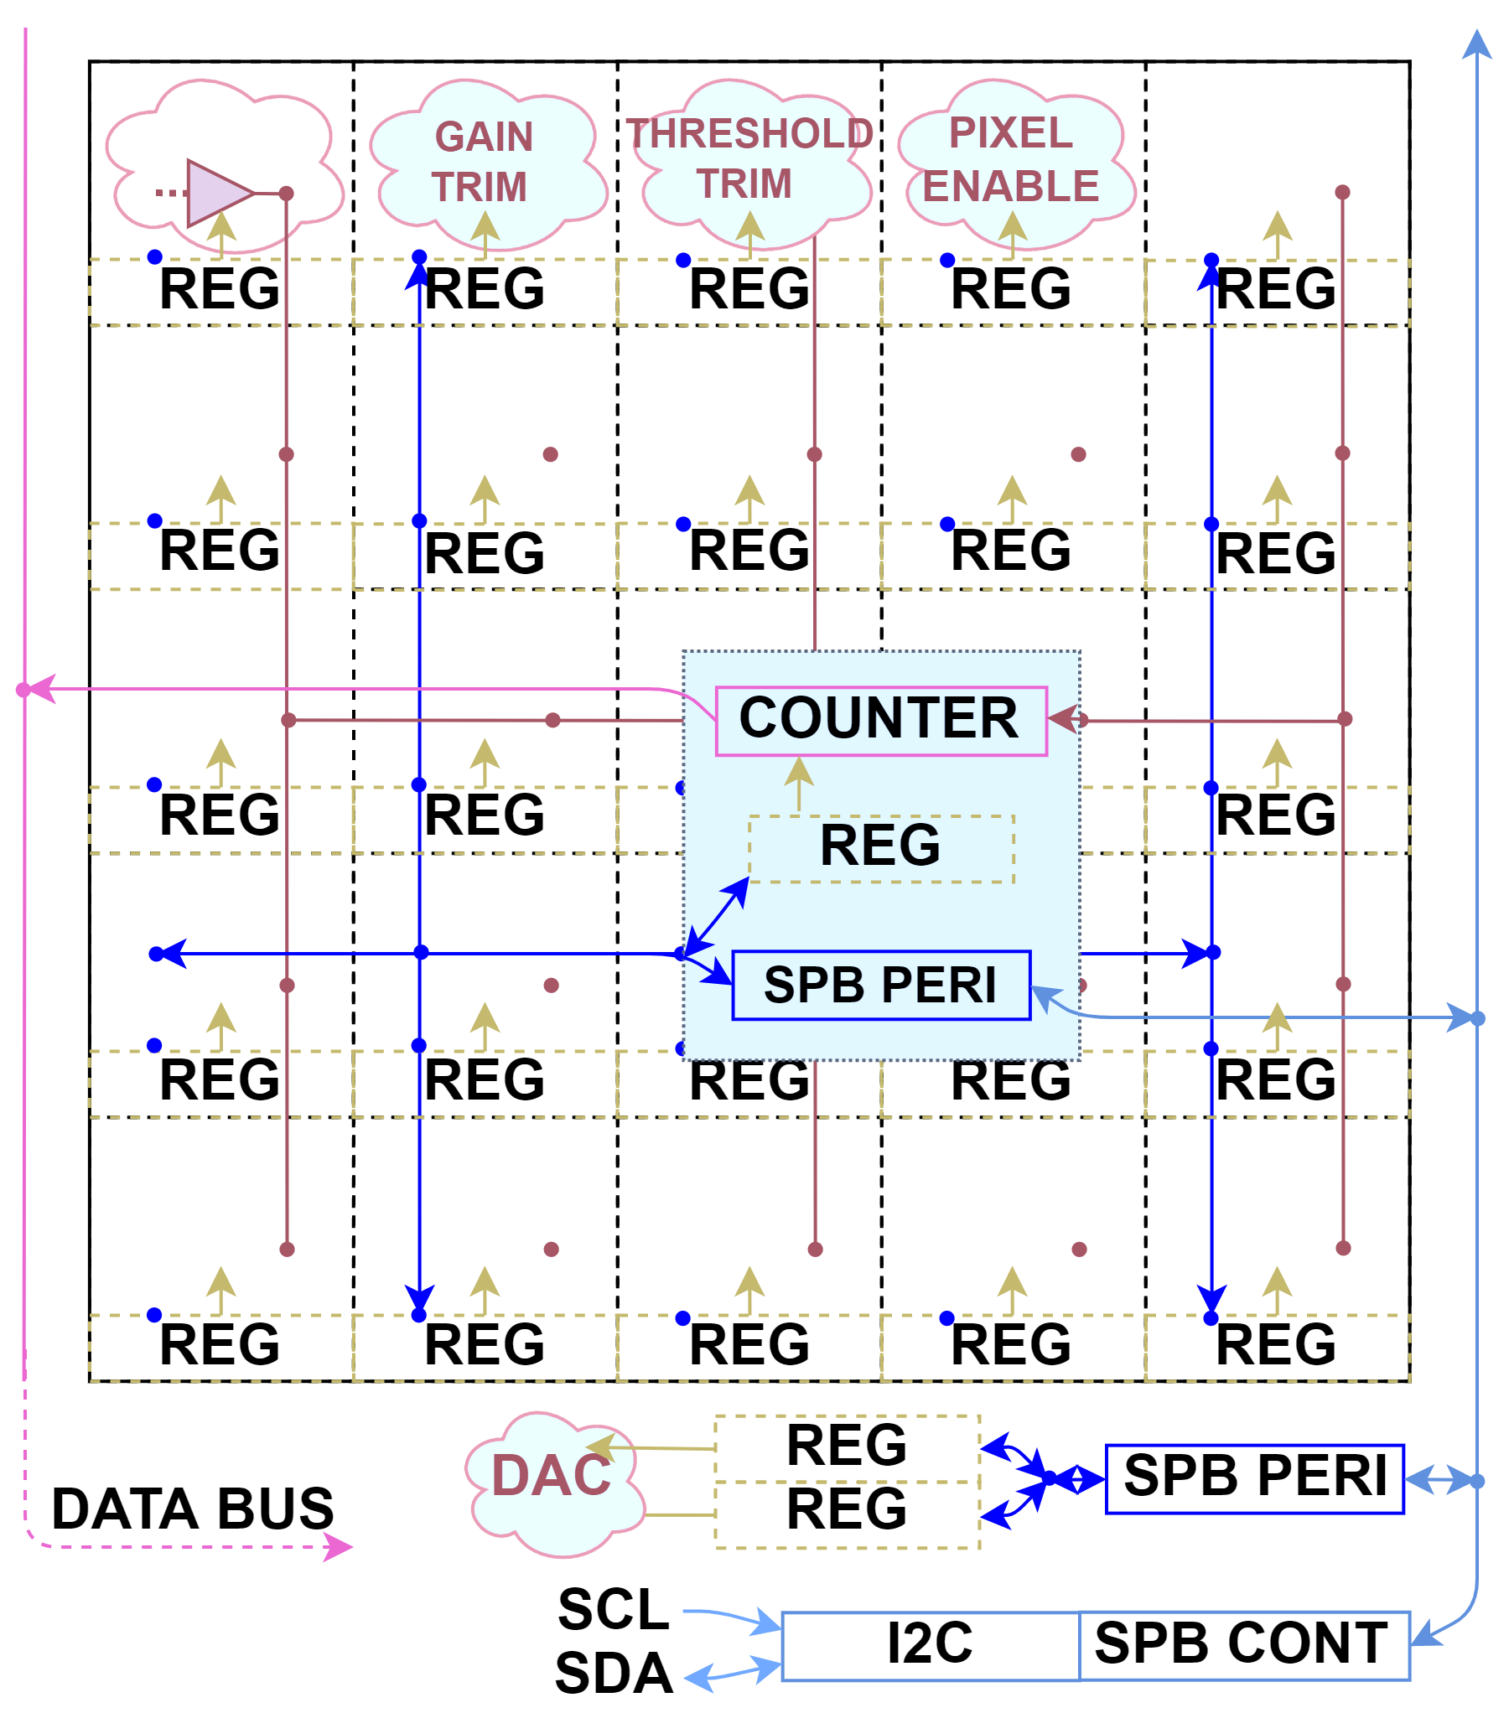
CRT: Configuration, Readout, Testability
T
Testability structures
  Integrated into system
  Enable by configuration
  Using readout path to avoid duplication
Readout path
  EDWARD architecture
  Event-driven synchronized with acquisition clock
Configuration path
  Externally - I2C interface
  Internally - Custom Serial-Parallel Bus (SPB)
  Banks of latches
R
C
PLATFORM:
RTL code of complete Configuration-Testability-Readout features,
parametrized and scalable for “virtual painting” of back-bones of pixel detectors,
code may be shared with interested parties

Slide 19
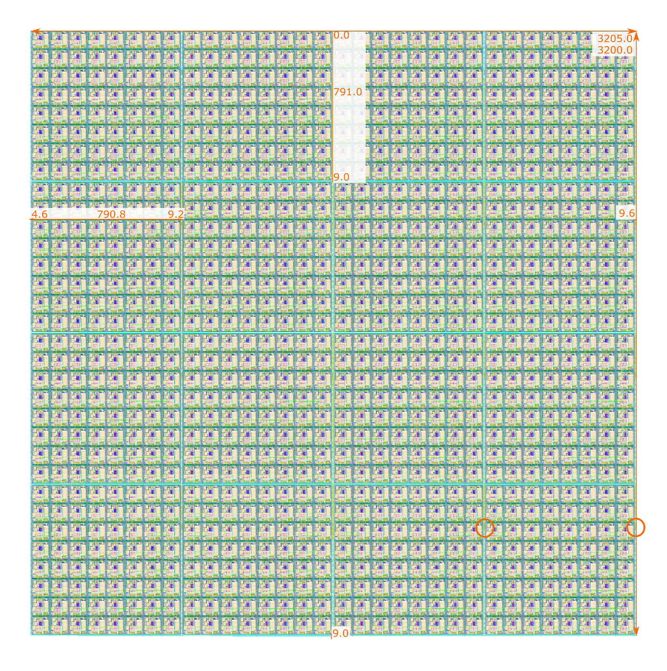
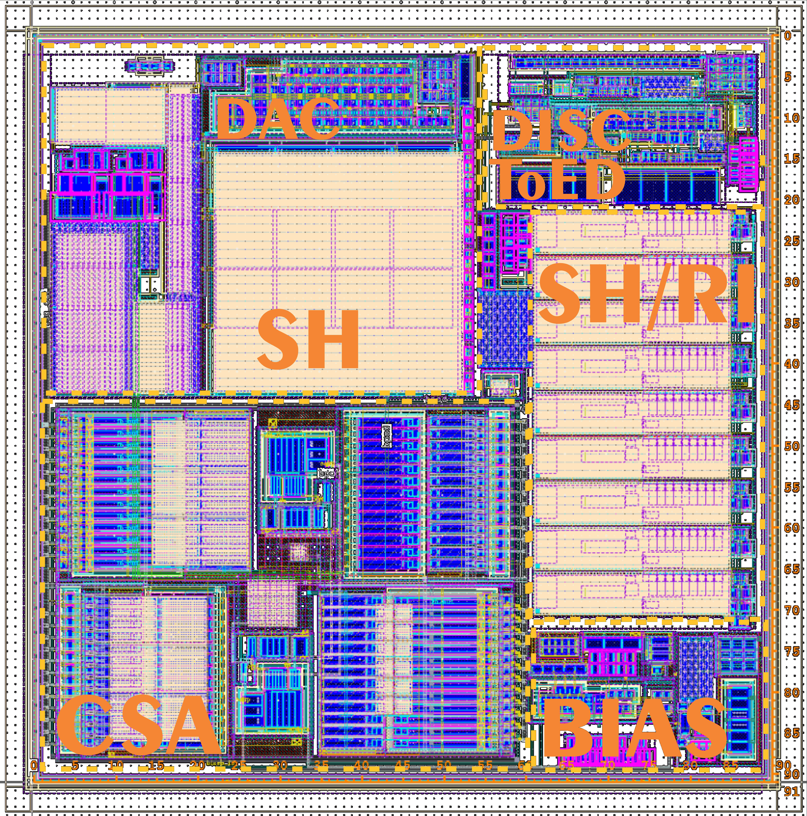
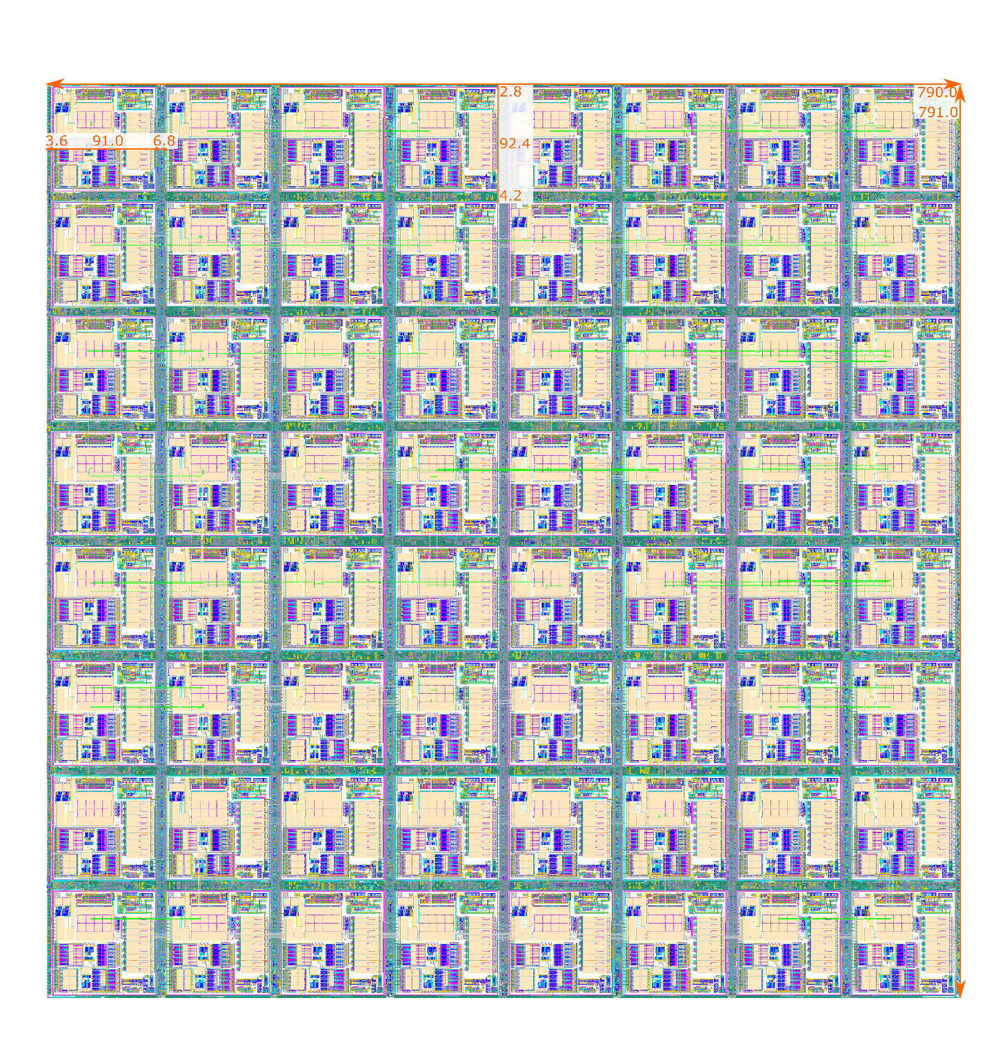
Layout: pixel and CRT skeleton
Pixel Matrix: 4×4
Pixel Group
+ Group CRT
3,205×3,200 mm²
(32×32 100×100 μm² pixels)
Pixel Group:
8×8 Pixel AFE
+ Group CRT
⇒ 790×791 μm²
Pixel AFE: CSA, SH w DAC, DISC, TeOD, SH/RI + BIAS ⇒ 90×91 μm²
32 × 32 pixels matrix obtained by tiling 4 × 4 basic 8 × 8 pixels groups ⇒ suitable for tiling into still larger matrix sizes.

Slide 20
S/H and Readout Interface
BSA prioprietary

Slide 21
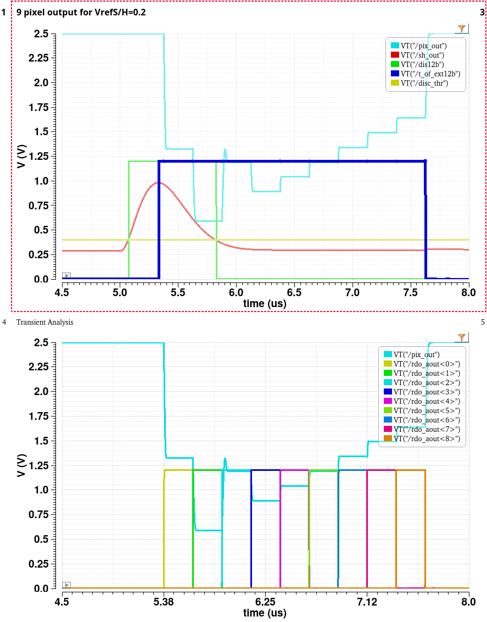
Common Source S/H and Readout Interface
source follower = variable, typically <1, unless complicated architectures [US Patent No 11,108,981 B2]
CS with the S/H capacitor in feedback path is used.
C, N, W, S, E, NW, SW, SE, NE
disc(t)
extr._det(t)
V_{threshold}
shaper(t)
C, N, W, S, E, NW, SW, SE, NE
read0
read1
read2
read3
read4
read5
read6
read7
read8

Slide 22
Summary
Presented design flow for pixel RO ASIC:
  suitable for amplitude spectroscopy with handling of charge shared events
  providing continuous time of operation to handle asynchronous signals
  equipped with true event driven readout
        with analog output, but per/pixel ADC is the next step

