Slide 1
Germanium Charge-Coupled Devices
Christopher Leitz (on behalf of the germanium imagers team)
16 December 2022
christopher.leitz@ll.mit.edu
Acknowledgements:
We gratefully acknowledge support for this work from NASA's Astrophysics Division to MIT Lincoln Laboratory through Astrophysics Research and Analysis grant 80HQTR19T0048.
DISTRIBUTION STATEMENT A. Approved for public release. Distribution is unlimited.
This material is based upon work supported by the National Aeronautics and Space Administration under Air Force Contract No. FA8702-15-D-0001. Any opinions, findings, conclusions or recommendations expressed in this material are those of the author(s) and do not necessarily reflect the views of the National Aeronautics and Space Administration .
© 2022 Massachusetts Institute of Technology.
Delivered to the U.S. Government with Unlimited Rights, as defined in DFARS Part 252.227-7013 or 7014 (Feb 2014). Notwithstanding any copyright notice, U.S. Government rights in this work are defined by DFARS 252.227-7013 or DFARS 252.227-7014 as detailed above. Use of this work other than as specifically authorized by the U.S. Government may violate any copyrights that exist in this work.

Slide 2

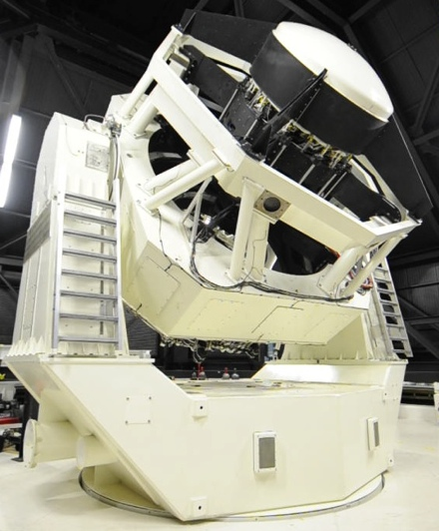
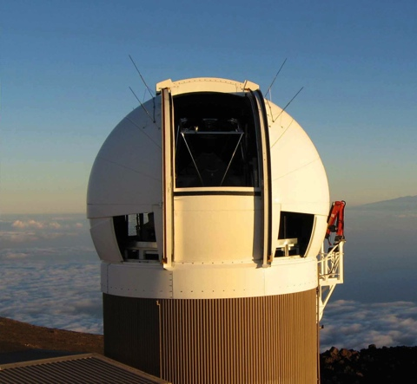
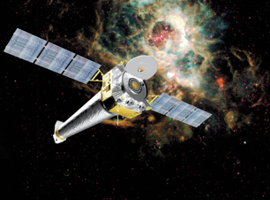
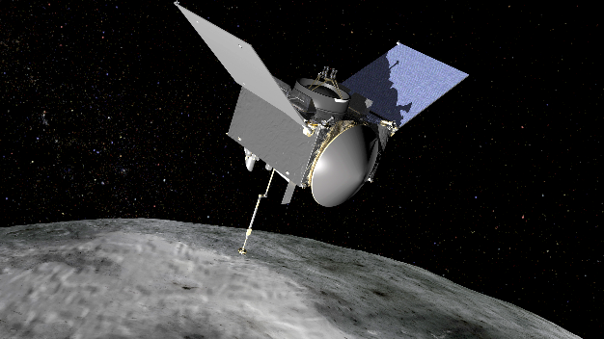
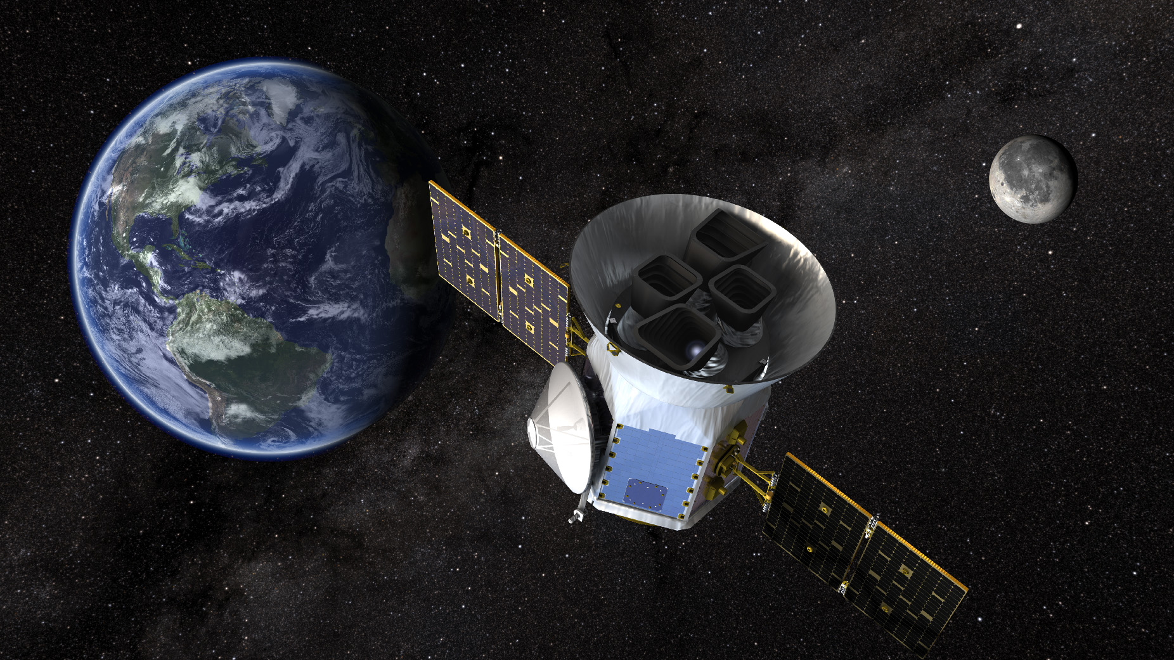
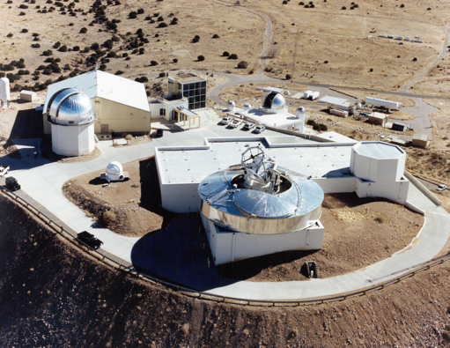
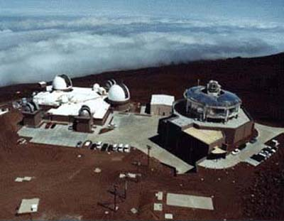
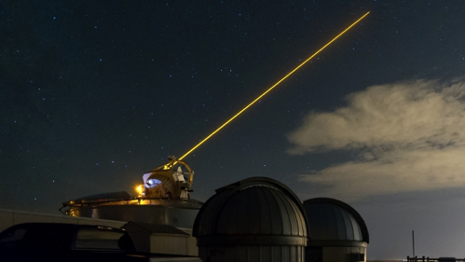
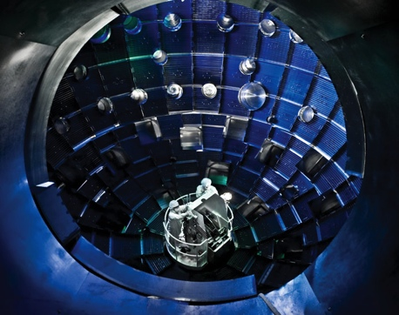
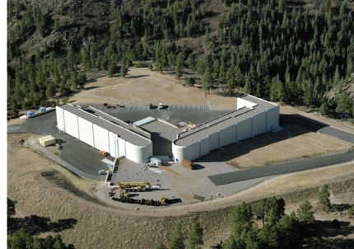


Unique Focal Planes in Support of National Security and Science
Astronomy & Near Earth Object Detection
Space-Based Astronomy
Space Surveillance
Nuclear Stockpile Stewardship (LANL)
Directed Energy
AFRL SOR
National Ignition Facility (LLNL)
AMOS (AF)

Slide 3
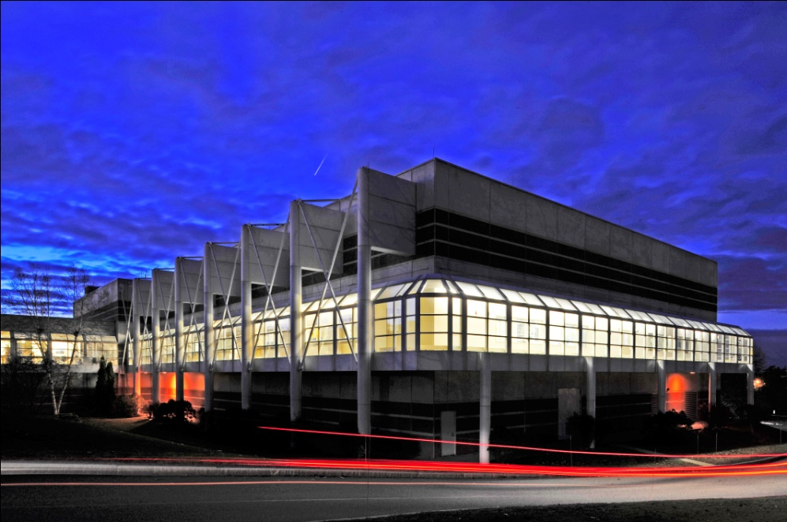
Germanium Detectors Opportunity
X-Ray Sensitivity Comparison
MITLL Microelectronics Laboratory
Elemental high-Z detector material with broadband sensitivity
Germanium wafers processed in same tools used to build silicon detectors for flight missions
Vision: extend the advantages of CCDs (format, noise…) into new material

Slide 4

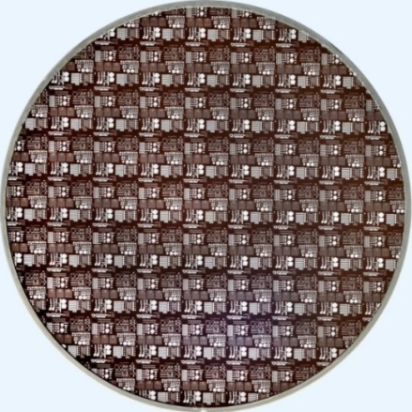
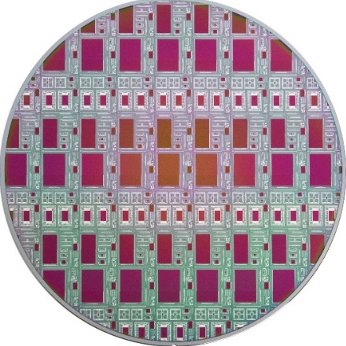
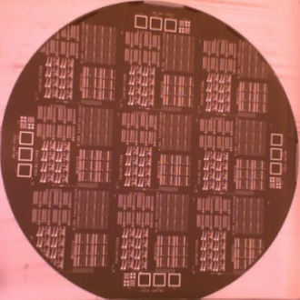
Germanium CCD Development Timeline
2013
2015
2017
2020+
Test Devices
1st-Gen Imagers
2nd-Gen Imagers
Area of current focus
CTI = Charge-Transfer Inefficiency
C.W. Leitz, SPIE Proc. 11454 (2020) C.W. Leitz, SPIE Proc. 11118 (2019); C.W. Leitz, SPIE Proc. 10709 (2018); C.W. Leitz, J. Inst. 12(5) CO5014 (2017).
Notes:
Previously cleared under RR#126466

Slide 5
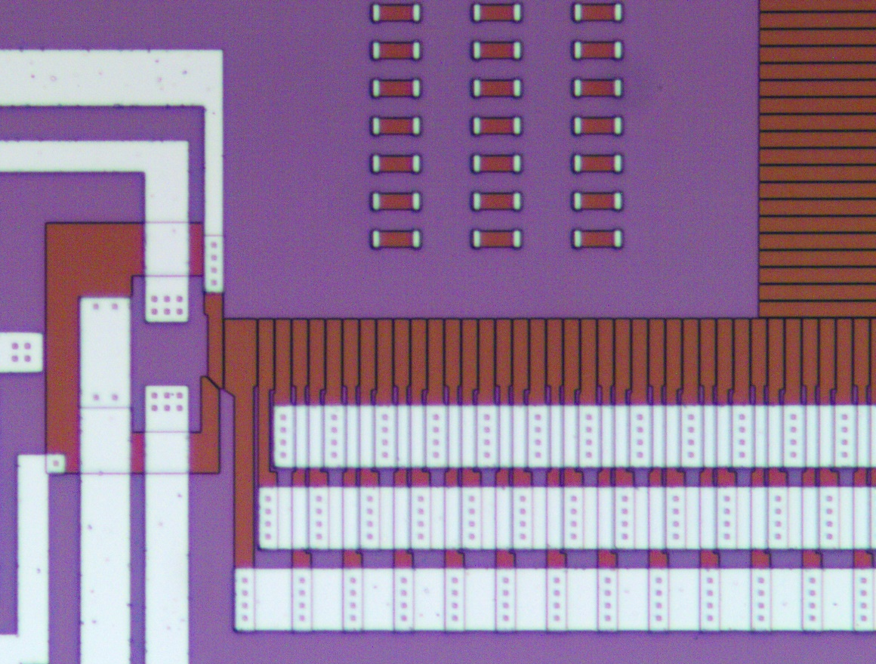
Silicon and Germanium CCD Comparison
Germanium CCDs draw upon long heritage of silicon CCD designs and processes
Silicon CCD
Germanium CCD
Gate dielectric (SiO₂/Si₃N₄)
Gate dielectric (GeO₂/Al₂O₃)
Gates (poly-Si)
Output Amplifier
Gates (TiN)
Pixel
Pixel
Output Amplifier
Serial Register
Serial Register
Routing Metal
Routing Metal
24 µm
20 µm
400 nm

Slide 6
Outline
Background and motivation
Status of technology development
  2nd-generation imager design
  First batch of wafers (“pilot wafers”) & yield enhancement
  Latest batch of wafers
Plans for FY23 and beyond

Slide 7
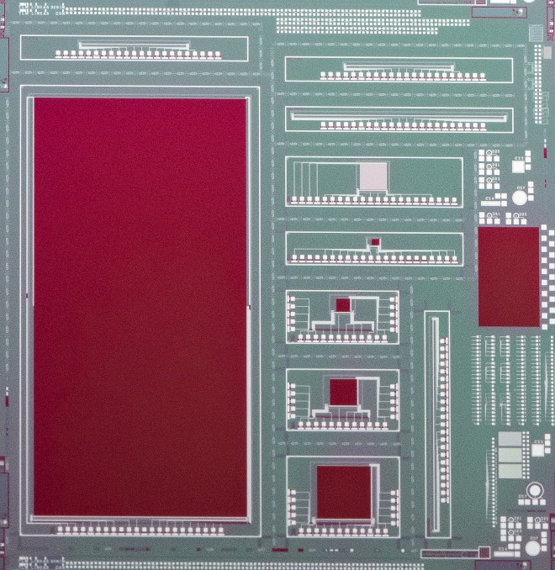
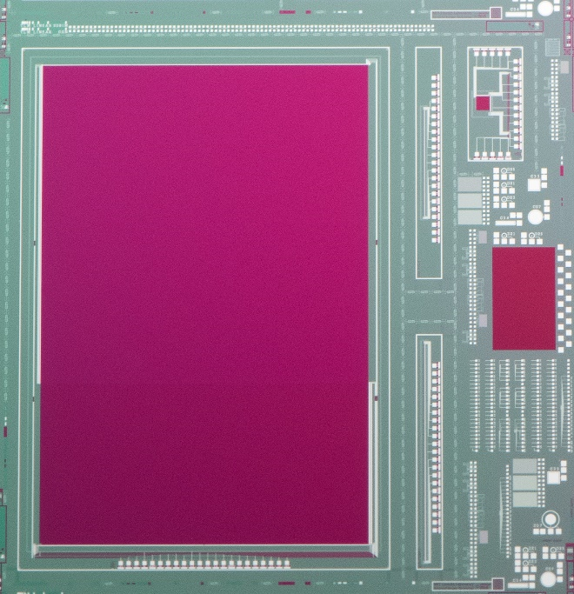
Second-Generation Imagers
  512 × 512 frame-transfer CCD with 24 µm pixels, two MOSFET outputs
  256², 128², 64² full-frame CCDs with 8.1 µm pixels, one MOSFET & one JFET output
  Key yield diagnostic testable at metal-1
1 Mpixel frame-transfer CCD, 8.1 µm pixels
512 × 512 frame-transfer CCD, 24 µm pixels
Wide range of new devices, reflecting lessons from first-generation imagers

Slide 8
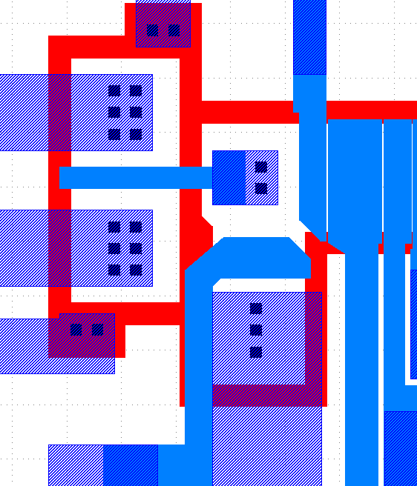
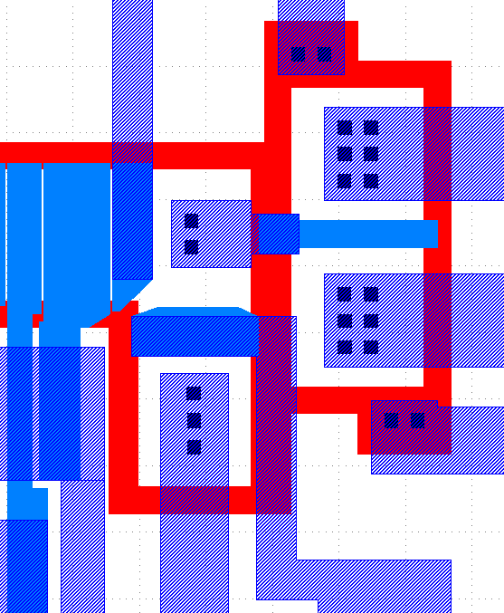
Elimination of Parasitic MOSFET in Output Region
1st-Generation Design
2nd-Generation Design
Output
gate
Legend
Channel Stop
Contact / via
Metal-1
Metal-2
Reset gate
5 µm
5 µm
Rerouted metal-1 features to eliminate parasitic transistors to further improve device performance

Slide 9
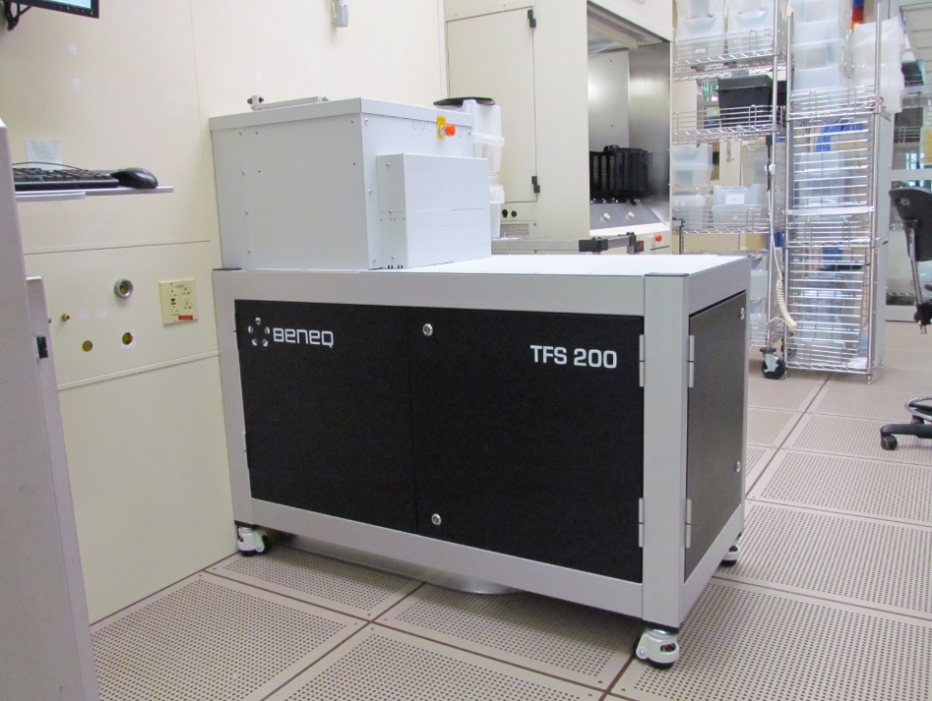
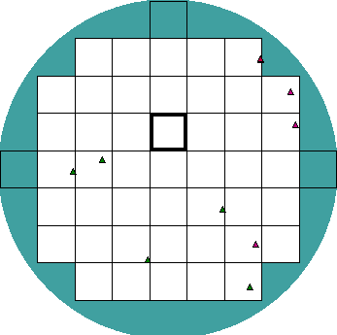
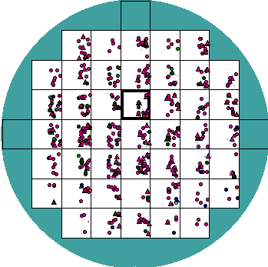
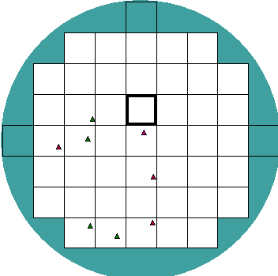
New Al₂O₃ Deposition System
Defect Maps
Region of die measured
Control
(Metal-1 on SiO₂⁾
Metal-1 on Al₂O₃
(existing system)
Metal-1 on Al₂O₃
(new system)
  Particles from previous Al₂O₃ deposition system caused patterning defects which short phases of device
  New system with vastly lower particle counts installed and qualified in late 2020
New, more capable Al₂O₃ deposition system used on four pilot wafers

Slide 10
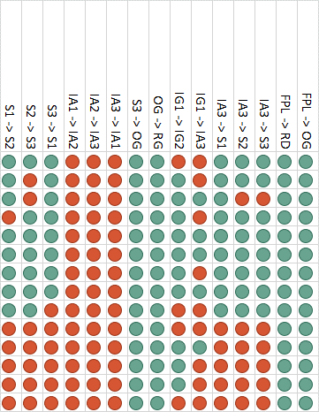
Shorts-Opens Test Summary on Pilot Wafers
Shorts/opens testing showed poor yield on pilot wafers despite use of new Al₂O₃ deposition system
Sample Yield Map for 256 × 256 Full-Frame CCD
All greens needed in a column to ensure that device functions
Analysis of pilot wafers began with shorts/opens testing
  A single short among the 15 different tests results in device failure
No significant yield improvement over previous device runs
  Multiple shorts on all 256² devices tested (at left)
  Average short spacing a few mm
New investigation into yield launched
  Discovered that new Al₂O₃ deposition tool, with much lower particle counts, lifted the veil on a previously hidden failure mechanism

Slide 11
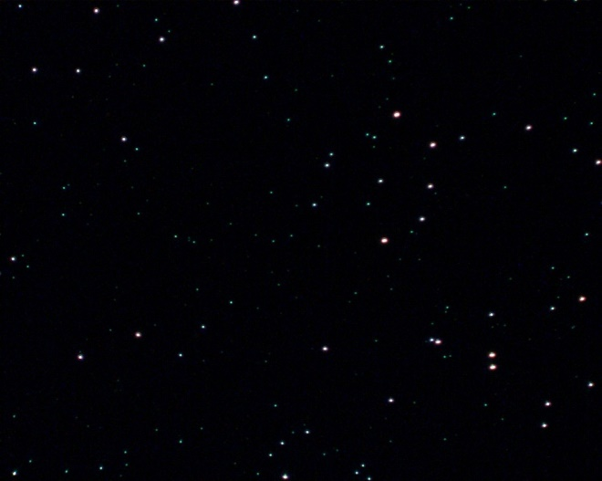

“Starry Night” Defects
Diagnosis
Mitigation
Post-Oxidation
Post-Metal Dep & Etch
Previous Process
New Process
Metal
Ge + O
25 µm
25 µm
Root cause traced to nodules present on wafer surface after gate dielectric growth, composed only of Ge & O
Nodules micro-mask metal gate etch, leaving ring of metal around the center nodule & leading to shorts
New oxidation condition sharply reduces density of starry night defects
Electrical tests on monitor wafers positively correlated starry night defect density to shorts-opens yield

Slide 12
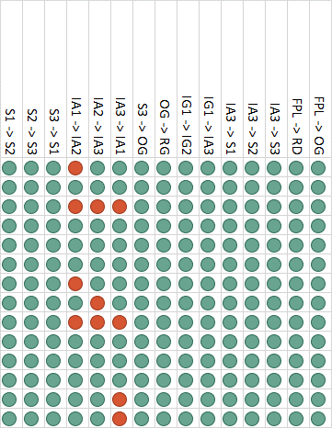
Shorts-Opens Test Summary on Second Batch of Wafers
Sample Yield Map for 256 × 256 Full-Frame CCD
All greens needed in a column to ensure that device functions
Average short spacing ~ 1 m
  Approximately 200x improvement in average short spacing
Enables us to routinely yield larger arrays
  Example here: 7/14 256² arrays are clean
Known issue at metal patterning on these wafers
  Wafer flatness issue mentioned in previous slide
  Yield would have been even higher if not for that
Significant yield improvement in this second batch of wafers & no shortage of ideas for additional improvement!

Slide 13


First (Preliminary) Test Results on Newest Devices
Dark
Flood-Illuminated
256 × 256-pixel array being clocked through MOSFET output at -60°C
Encouraging early result; still a lot of work to do to optimize clocking biases

Slide 14
Conclusions and Future Work
We have realized germanium CCDs that show promise for scientific detectors
Our current efforts are focused on improving performance and yield
  New output amplifier designs to lower read noise and dark current
  Improved processes to reduce density of gate-to-gate shorts which limit device format
Future work:
  Perform device screening on newly completed wafers
  Transition device testing to cryogenic environment
    Collaboration with MIT Kavli Institute for Astrophysics & Space Research
  Begin back-illuminated detector development (pending NASA award)
  Incorporate lessons learned on newly completed wafers to partially-processed wafers
    Seven wafers staged ~6 weeks from completion

