Slide 1

The monolithic ASIC for the high precision preshower detector of the FASER experiment at the LHC
L. Paolozzi
on behalf of the FASER collaboration

Slide 2


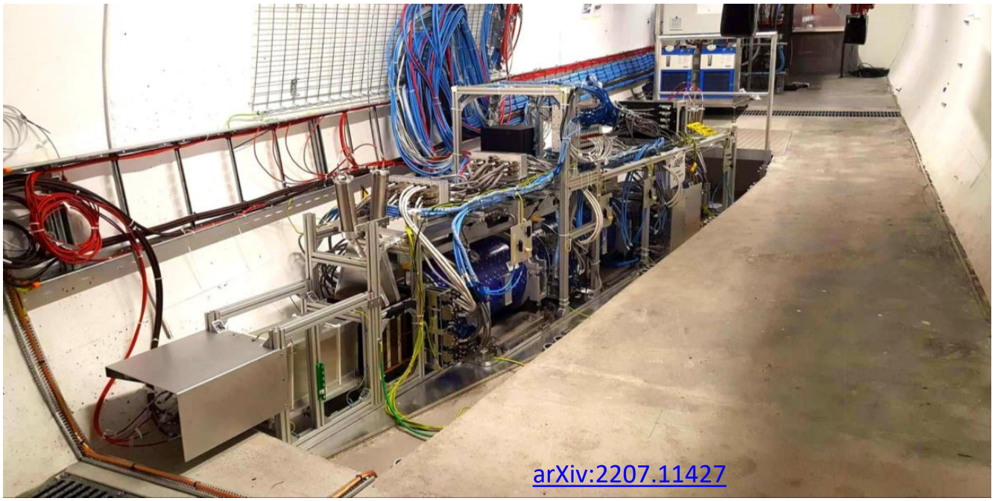
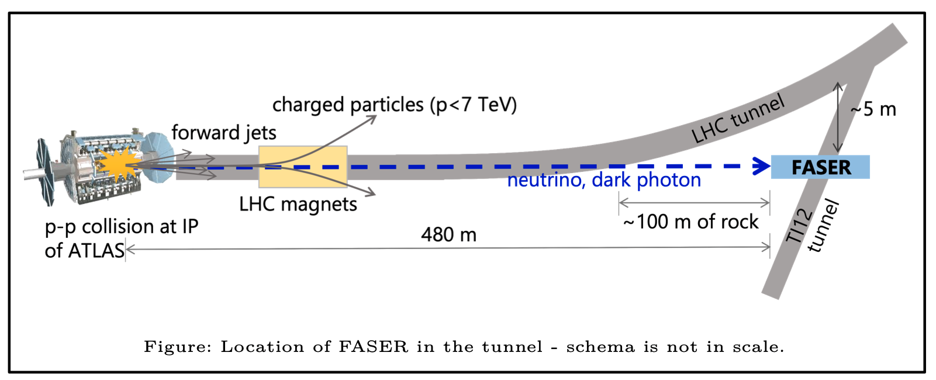
The FASER experiment at LHC
ForwArd Search ExpeRiment
Designed to search for light and weakly-interacting particles + study the interactions of high-energy neutrinos (FaserNu)
Picture taken from symmetry magazine. Artwork by Sandbox Studio, Chicago with Ana Kova.
Zero degrees angle → huge LLPs flux
Fluxes of high-energy SM particles are supressed
Muons and neutrinos only exception
FASER can probe Axion-Like-Particles (ALPs) model

Slide 3
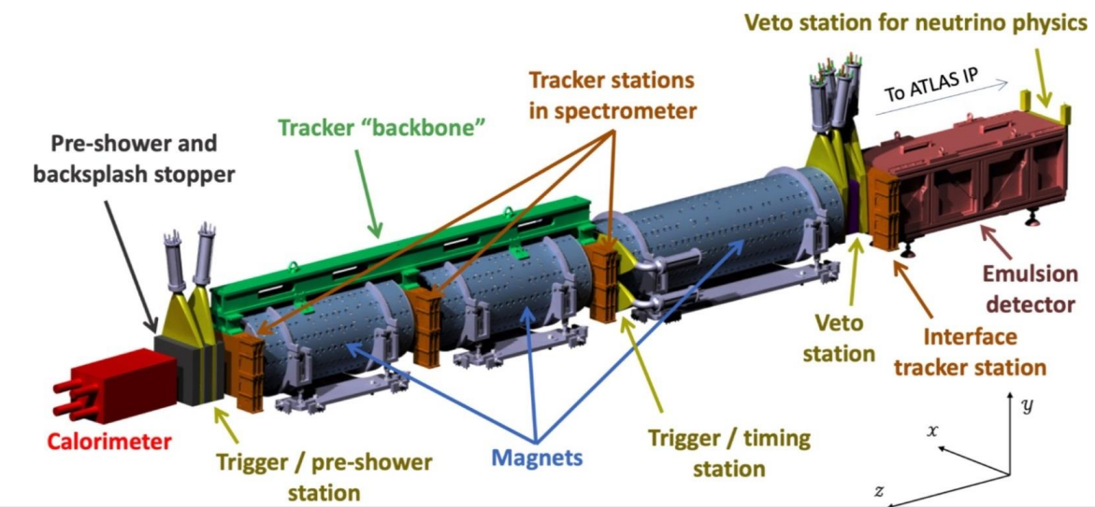
The upgrade of the FASER preshower detector
Current pre-shower:
2 layers of tungsten (1X0) + scintillating detectors No XY granularity.
The upgrade:
A high-granularity/high dynamic range pre-shower based on monolithic silicon pixel sensors.
Discriminate TeV scale electromagnetic showers.
Targeting data taking during last year of LHC run 3 and during HL-LHC.

Slide 4




The upgrade of the FASER preshower detector
Two Fermion signal
Current
pre-shower
VETO
Decay Volume
Tracker
Calorimeter
$$A′$$
Two Photon signal
Current
pre-shower
VETO
Decay Volume
Tracker
Calorimeter
$$Φ$$
$$γ$$
$$γ$$

Slide 5
The upgrade of the FASER preshower detector
Two Fermion signal
High-granularity
pre-shower
VETO
Decay Volume
Tracker
Calorimeter
$$A′$$
Two Photon signal
High-granularity
pre-shower
VETO
Decay Volume
Tracker
Calorimeter
$$Φ$$
$$γ$$

Slide 6
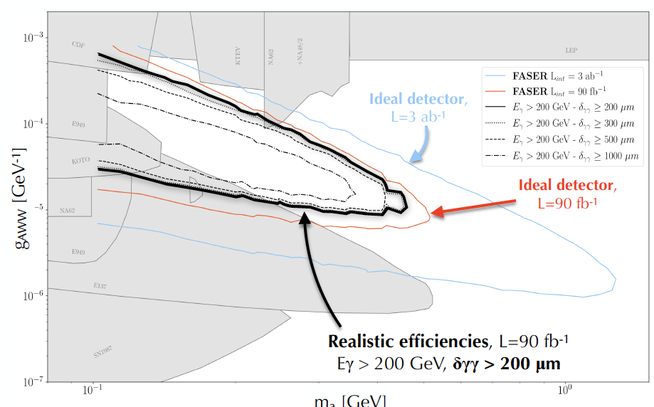
Motivations for a new pre-shower detector
Discovery potential for ALP
Enables measurement:
  Axion-Like Particles (ALP) produced via aWW coupling.
  LLP with neutral pions in the final state.
  Neutrino background suppression.
Reinforces measurement:
  Dark photon and other LLPs decaying into charged fermions.
  LLP with charged and neutral pions in the final state.
Detector requirement:
  Discriminate photons with 200 µm separation to exploit the full potential of the experiment.

Slide 7
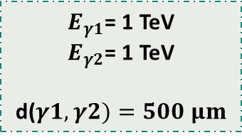
Why 6 planes?
Why pixelated sensors?
PLANE 3
$E_{γ1}$= 1 TeV
$E_{γ2}$= 1 TeV
d($γ1,γ2)=500 μm$
y [μm ]
Events simulated
using Allpix squared
100 µm pixel pitch
x [μm ]

Slide 8
Why 6 planes?
Why pixelated sensors?
PLANE 4
High dynamic range for charge measurement
$E_{γ1}$= 1 TeV
$E_{γ2}$= 1 TeV
d($γ1,γ2)=500 μm$
y [μm ]
Events simulated
using Allpix squared
100 µm pixel pitch
x [μm ]

Slide 9
Why 6 planes?
Why pixelated sensors?
PLANE 5
$E_{γ1}$= 1 TeV
$E_{γ2}$= 1 TeV
d($γ1,γ2)=500 μm$
y [μm ]
Events simulated
using Allpix squared
100 µm pixel pitch
x [μm ]

Slide 10
Why 6 planes?
Why pixelated sensors?
PLANE 6
$E_{γ1}$= 1 TeV
$E_{γ2}$= 1 TeV
d($γ1,γ2)=500 μm$
y [μm ]
Events simulated
using Allpix squared
100 µm pixel pitch
x [μm ]

Slide 11
Why 6 planes?
Why pixelated sensors?
PLANE 6
Very large occupancy
Fake cores from low energy electrons
$E_{γ1}$= 1 TeV
$E_{γ2}$= 1 TeV
d($γ1,γ2)=500 μm$
y [μm ]
Events simulated
using Allpix squared
100 µm pixel pitch
x [μm ]

Slide 12
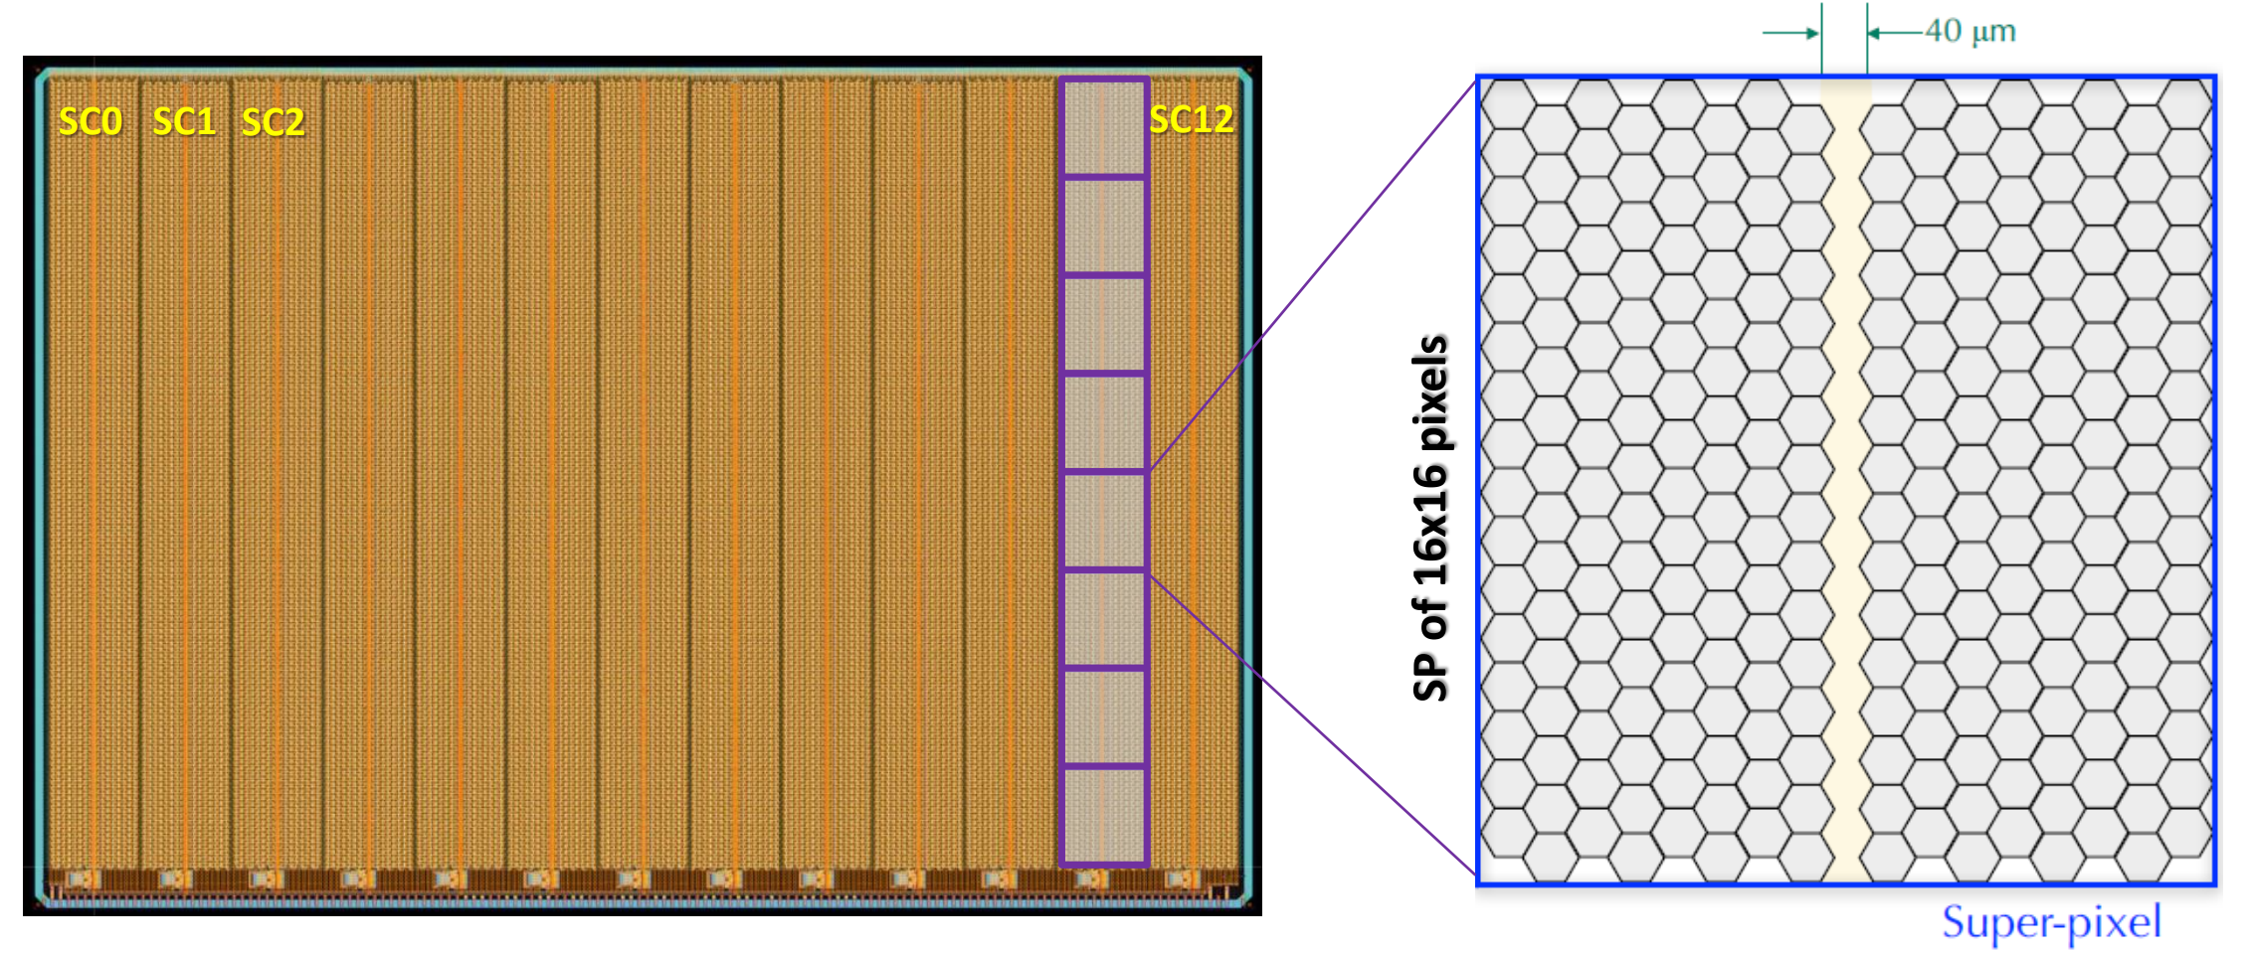
Monolithic ASIC architecture
Chip size of 2.2 x 1.5 cm2, with matrix of 208 x 128 pixels (26’624 total pixels)
13 super-columns (SC) which consist of:
  An active region
  A digital column in the middle (40 µm width), which is inactive
  A SC is composed of 8 super-pixels (SP) of 16x16 pixels.
The dead area in the periphery consists of:
  720 µm on the readout side for the digital processing and I/Os
  270 µm on the guard ring sides
First large-area monolithic detector in SiGe BiCMOS
65 μm

Slide 13
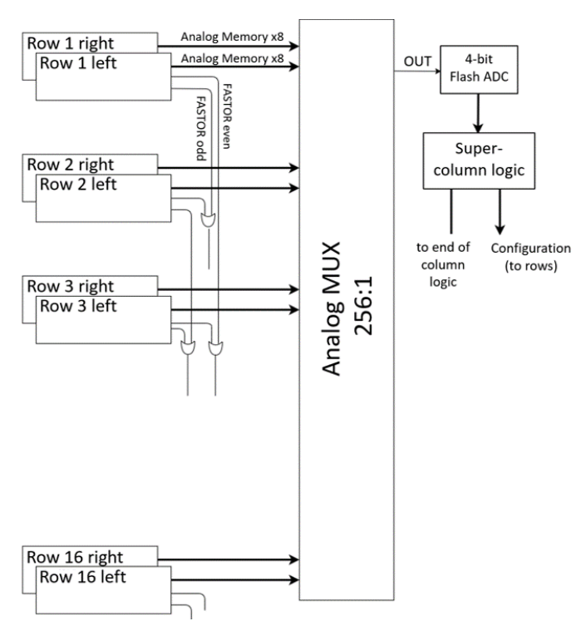
Monolithic ASIC architecture: Super-pixel
The charge needs to be measured for each pixel: acts as an imaging device.
Data is stored on the capacitor in each pixel and converted on the fly with a flash ADC. 256-to-1 MUX.
The capacitor is charged with a constant current during the TOT.
The same ADC will poll all the pixels in a superpixel and convert them as needed.
Flash-ADC

Slide 14
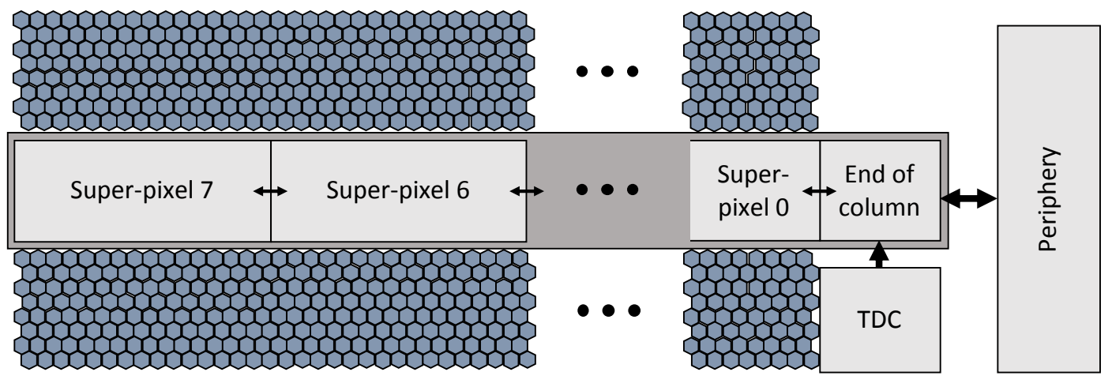
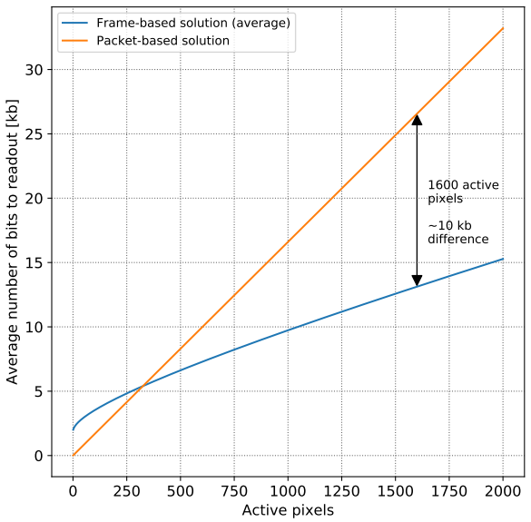
Monolithic ASIC architecture: Super-columns
Super-column logic: it masks the pixels, generates the test-pulses, drives the analog MUX, handles readout and communication with periphery.
Unusual aspect ratio: 1.4 cm by 40 µm.
Super-column level frame-based solution for readout logic in the periphery.
Two clock domains: 50 MHz (programming phase) and 200 MHz (readout phase).

Slide 15
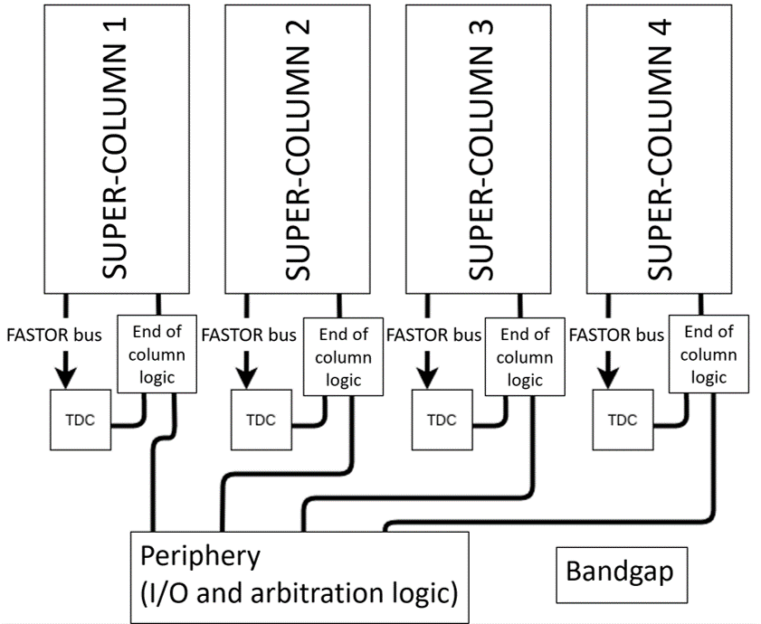
Monolithic ASIC architecture: Periphery and I/O
All the logic is in the super-column.
The periphery interrogates the super-columns from left to right, and handles the chip I/O.
Data are not stored in the chip, but they are sent out on the fly at 200 Mbit/s.
A second output line can be activated, that reads the columns from right to left.

Slide 16
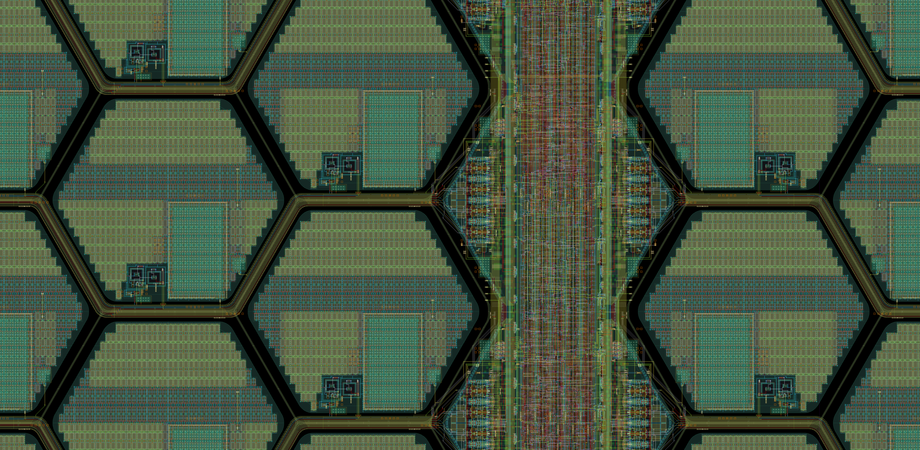
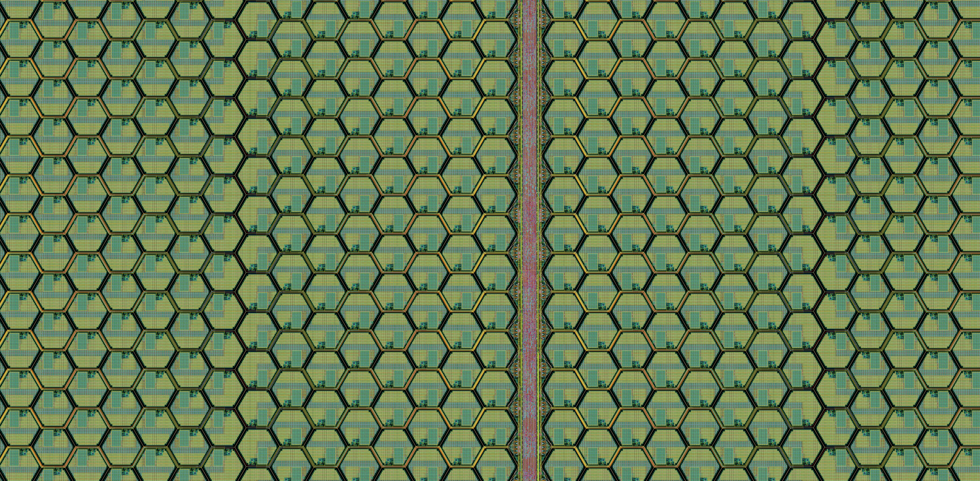
Monolithic ASIC layout
220 Ωcm resistivity substrate
Limitations on active area thickness

Slide 17
Monolithic ASIC layout
220 Ωcm resistivity substrate
Limitations on active area thickness
Triple–well design
Isolation of pmos in pixel is not possible
HBT requires AC coupling to pixel
Limited integration of digital electronics in pixel

Slide 18
Monolithic ASIC layout
220 Ωcm resistivity substrate
Limitations on active area thickness
Triple–well design
Isolation of pmos in pixel is not possible
HBT requires AC coupling to pixel
Limited integration of digital electronics in pixel
Signal routing after discrimination stage
Line shielding to avoid cross talk
Take advantage of HBT robustness to parasitics

Slide 19
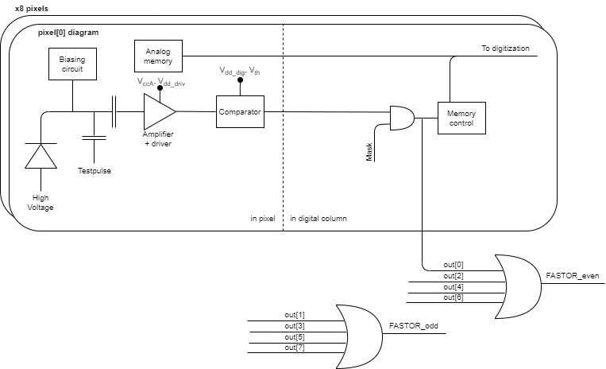
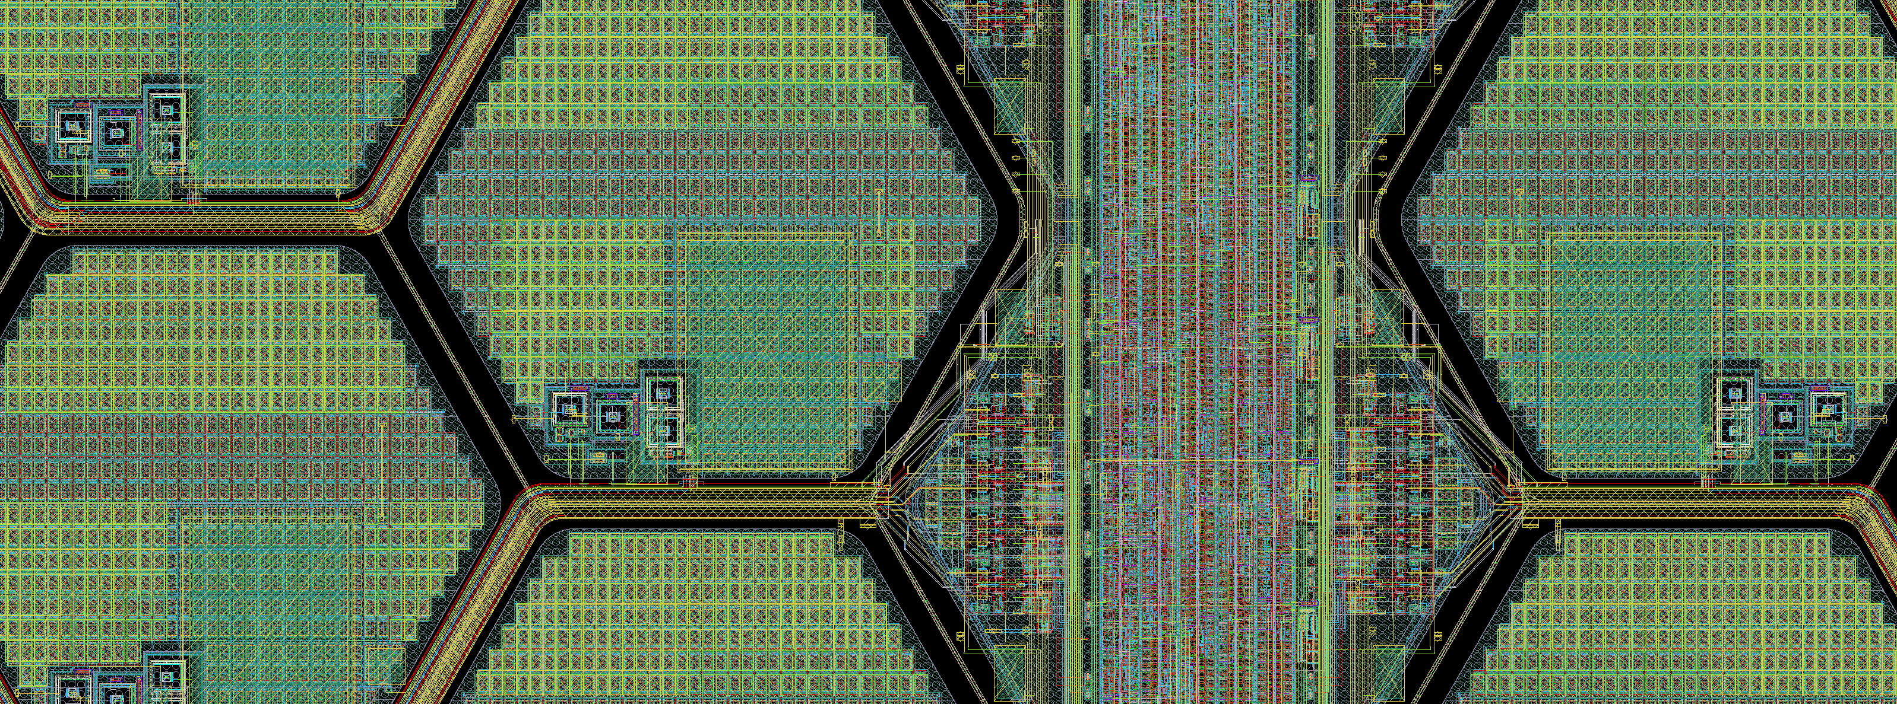
Front-end electronics
ANALOG MEMORY
MEMORY CTRL, MASK AND FAST-OR
FRONT-END
BJT-based preamp with MOS feedback inside pixel area.
Analog memory in pixel.
Low-power discriminator (inside the pixel area)
Memory control circuit outside pixel.
Discriminator output activates the charging of the capacitor C_{mem}.

Slide 20
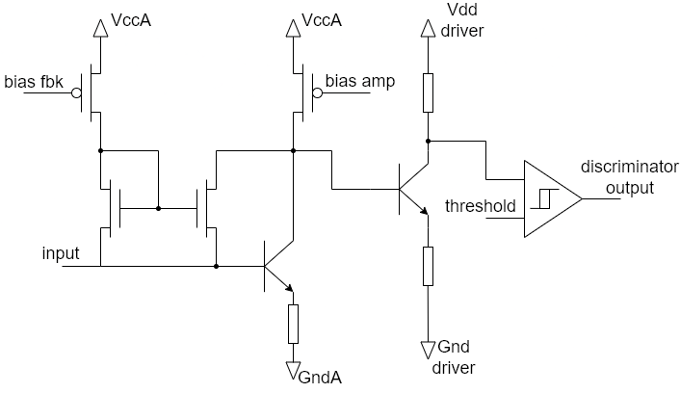
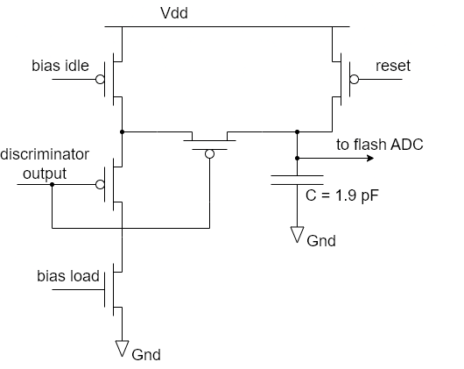
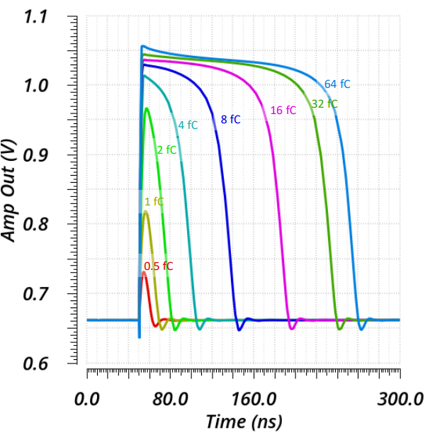
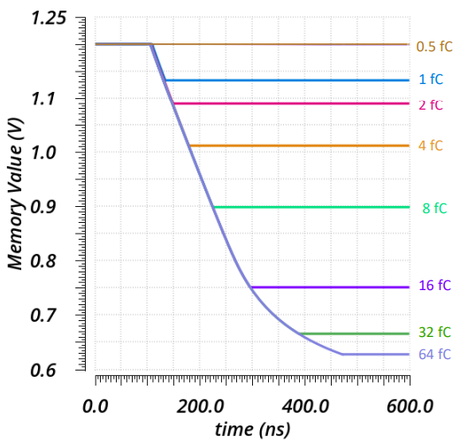
Front-end + Memory control

Slide 21
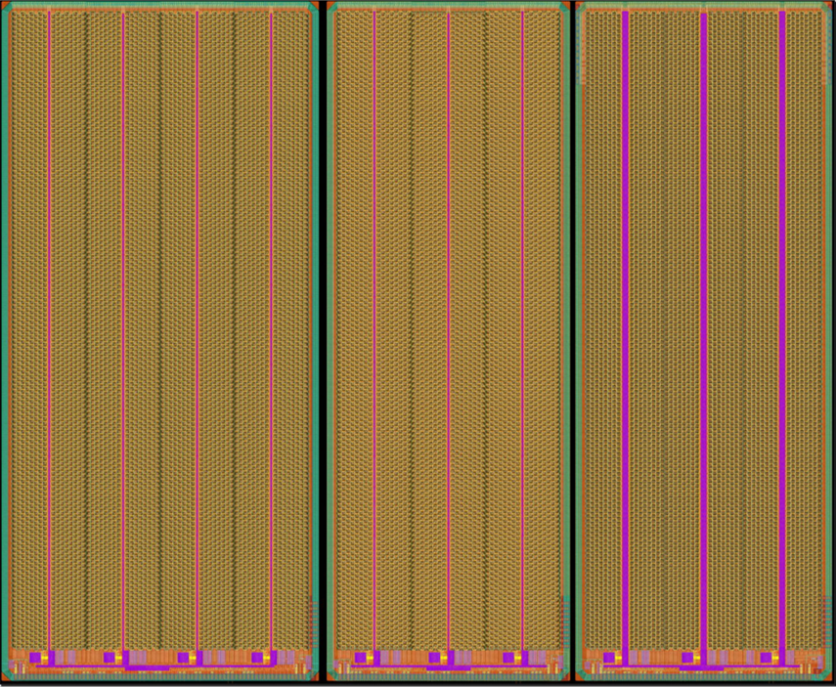
Pre-production prototype
Large area, fully functional prototype.
Three alternative test layouts submitted:
  V1: 4-supercolumn reference design with MOS based discriminator (outside pixel).
  V2: 3-supercolumn variant with BJT-based discriminators featuring lower pixel-to-pixel mismatch (inside pixel).
  V3: 3-supercolumn variant with simplified readout architecture (no analog memory, counters for TOT measurement).
Tests start in June 2022.
15 mm
7.5 mm

Slide 22
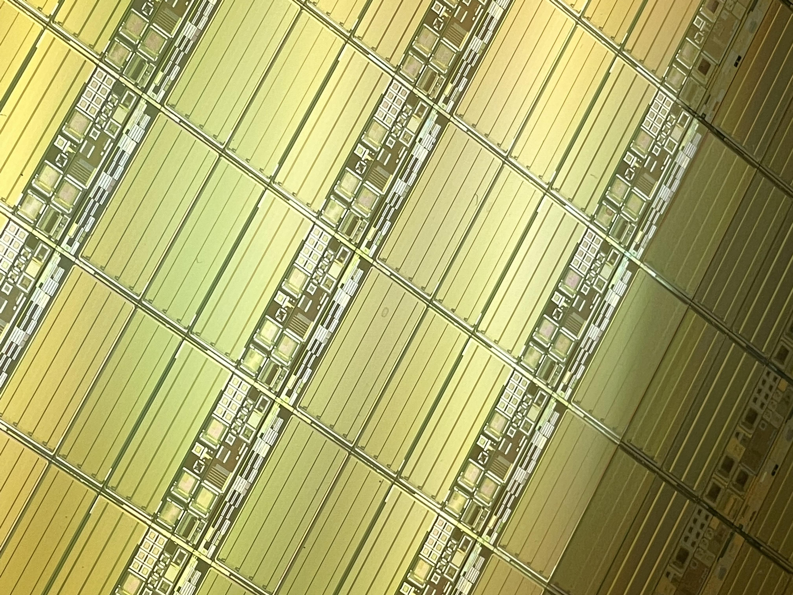
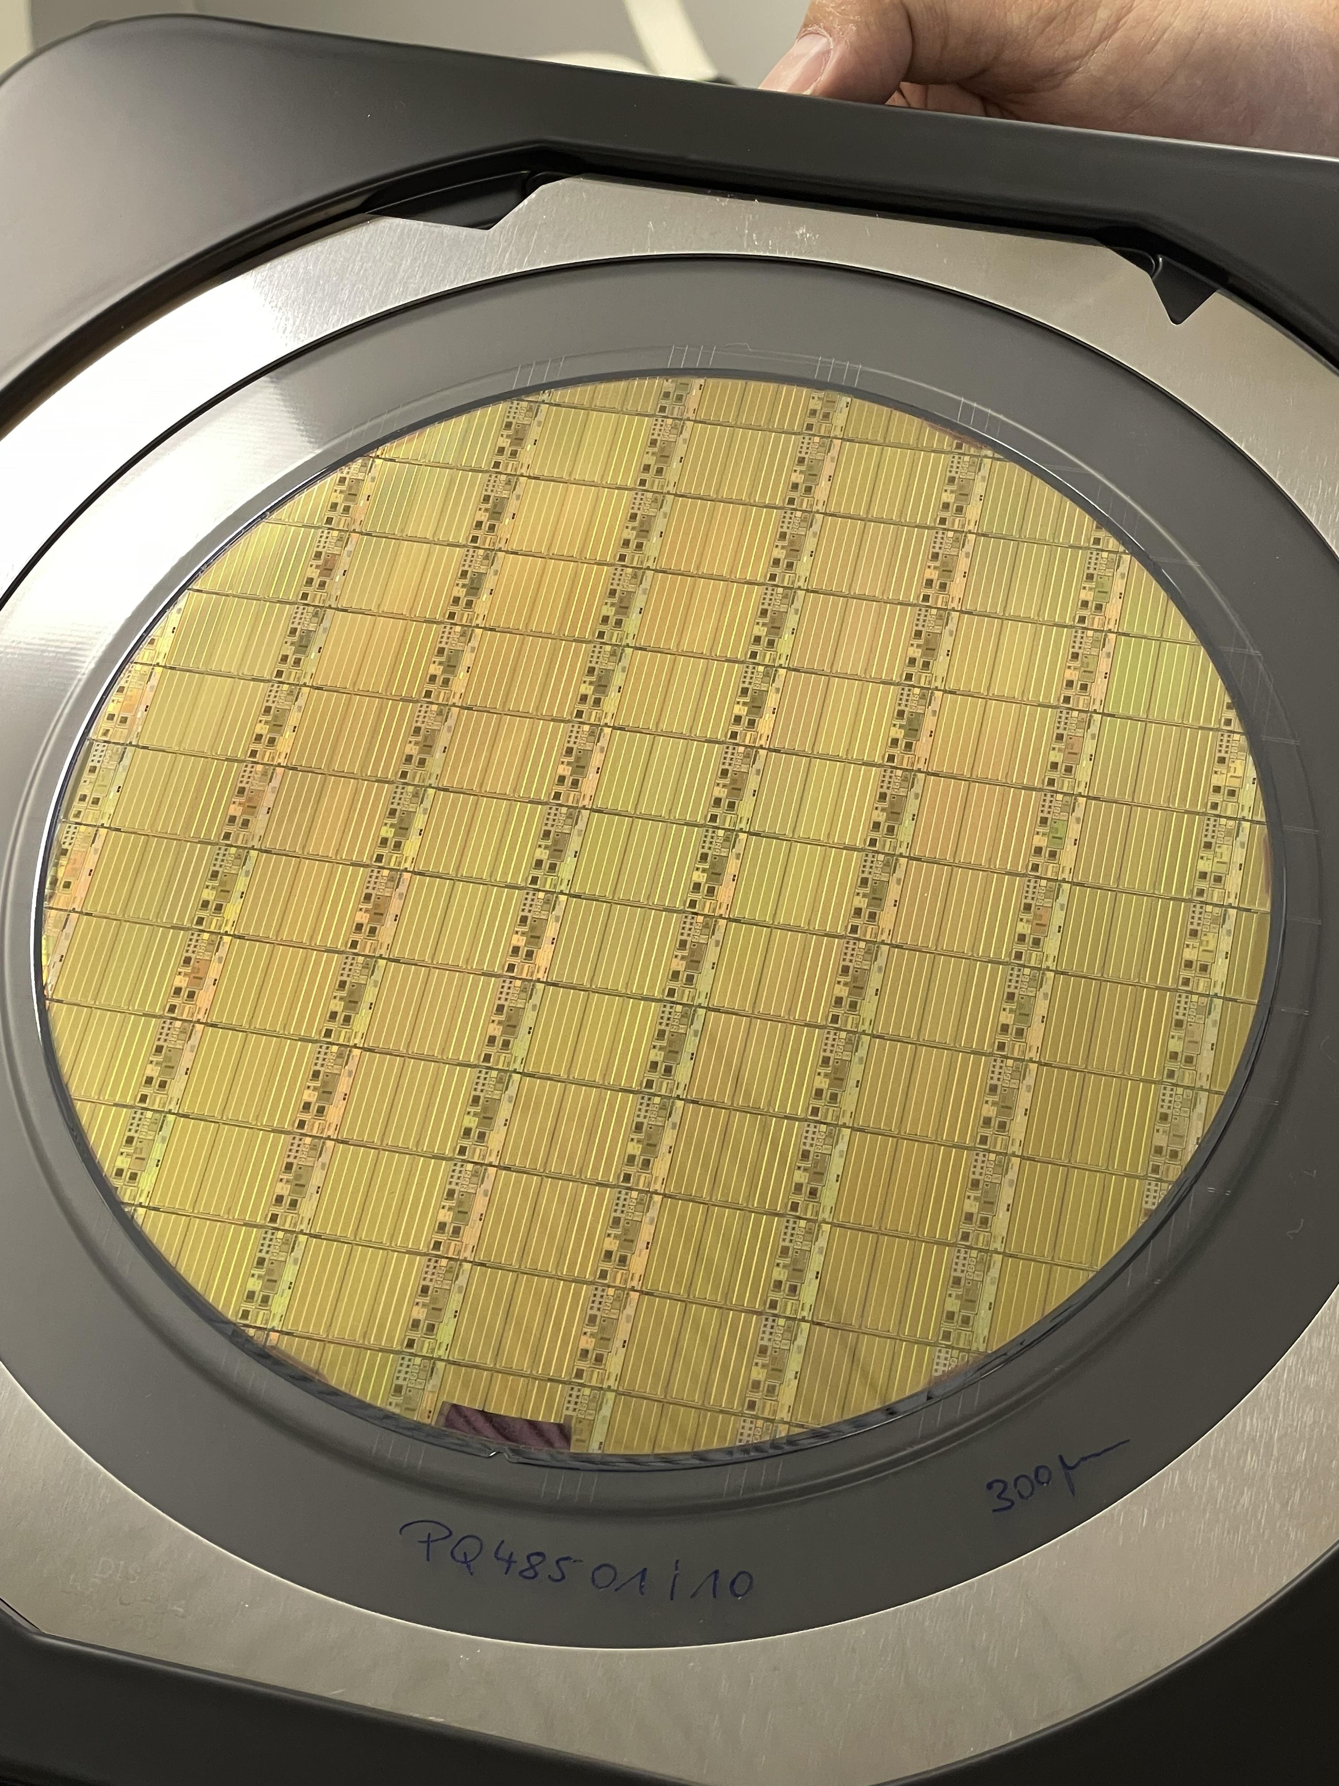
Test of pre-production prototypes
Pre-production wafers have arrived
3 standard wafers
3 special epi wafers
53 chips / layout / wafer

Slide 23
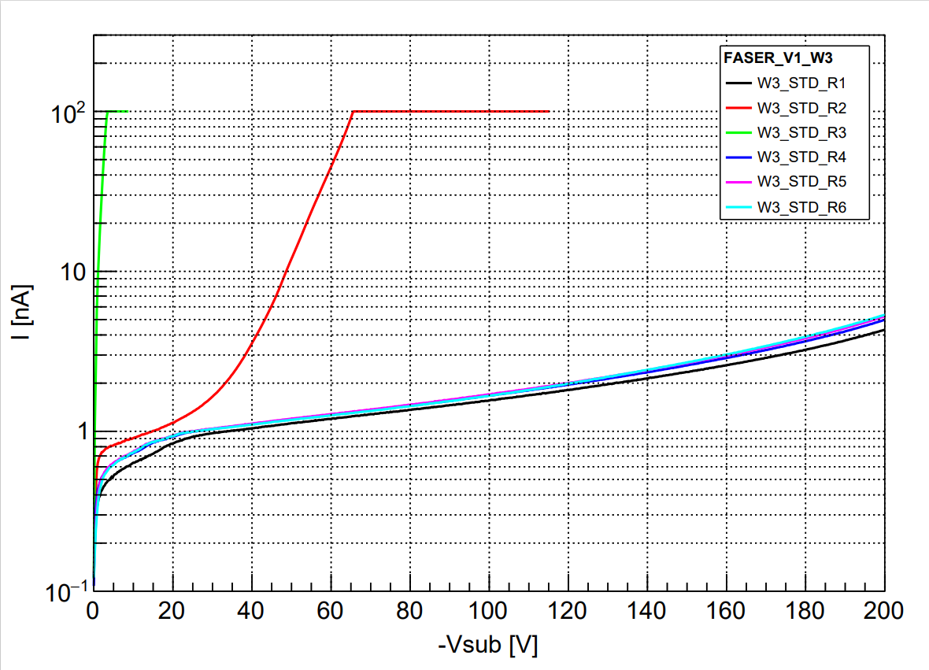
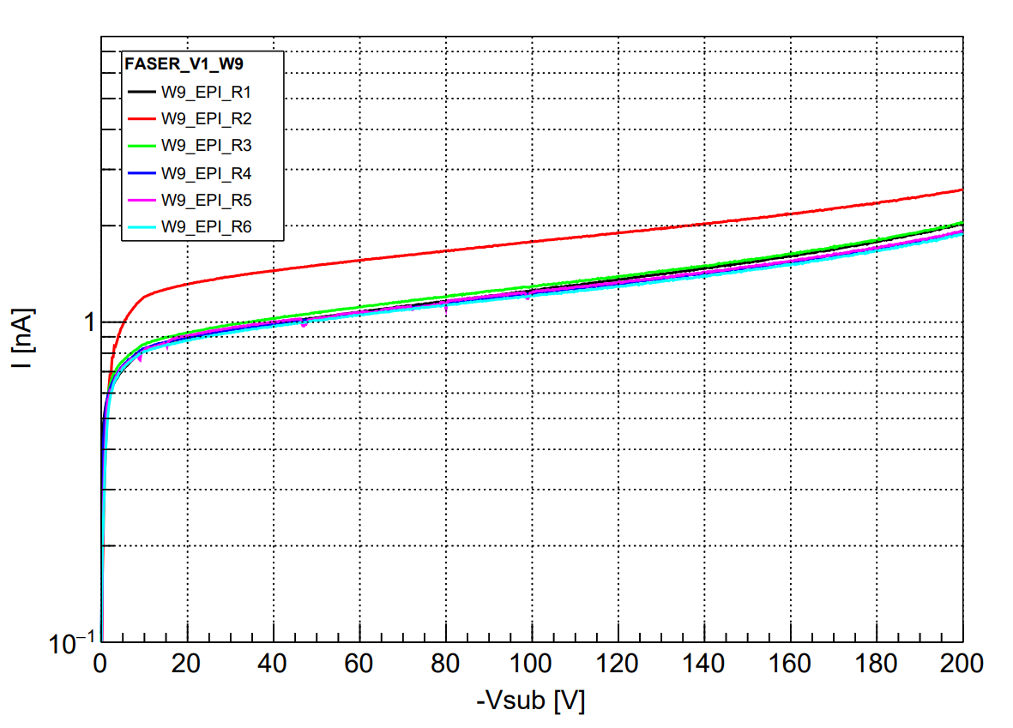
HV test on probe station
Standard wafer
Scratch with needle
Internal guard ring not referred to ground
Epi wafer

Slide 24
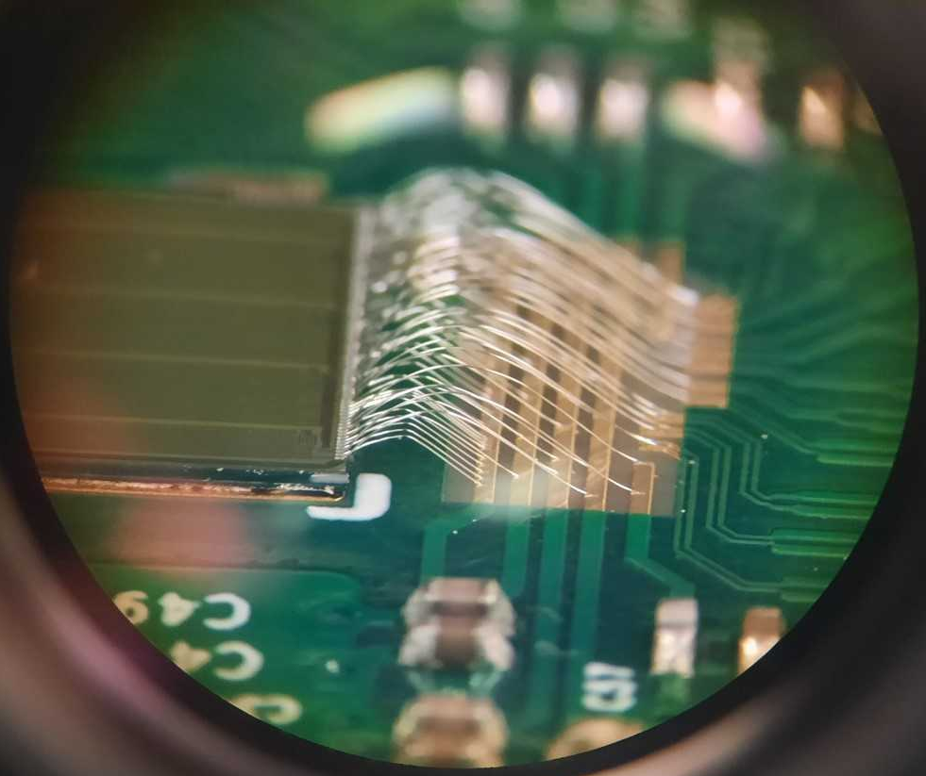
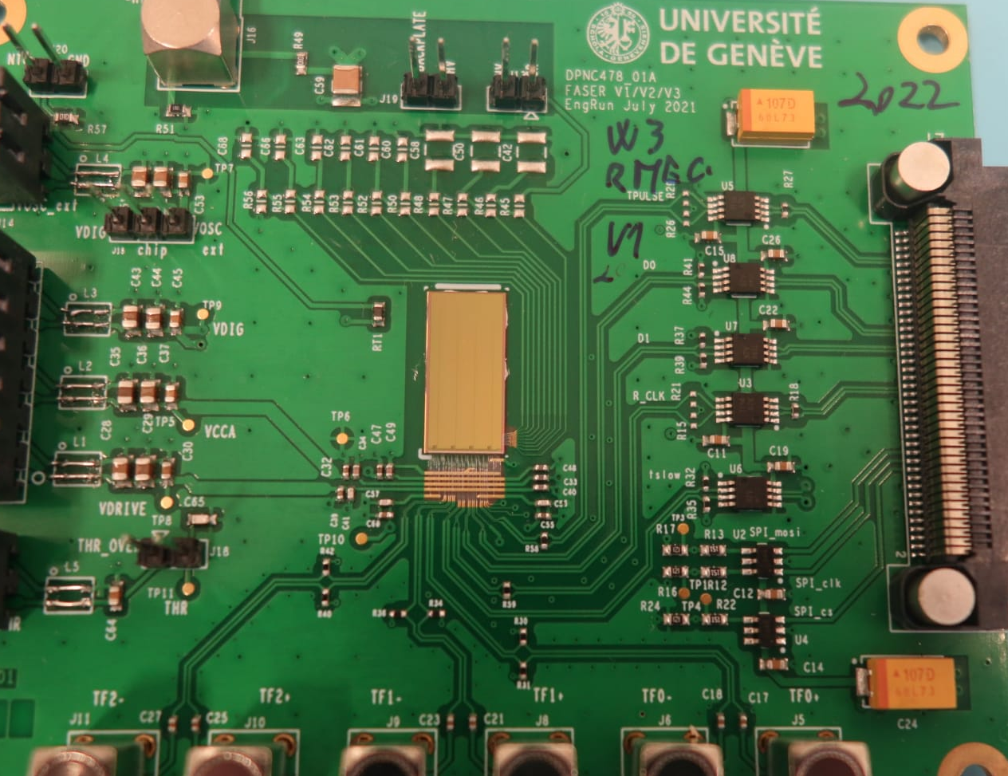
Test on board
First prototypes were bonded and are currently under test.

Slide 25
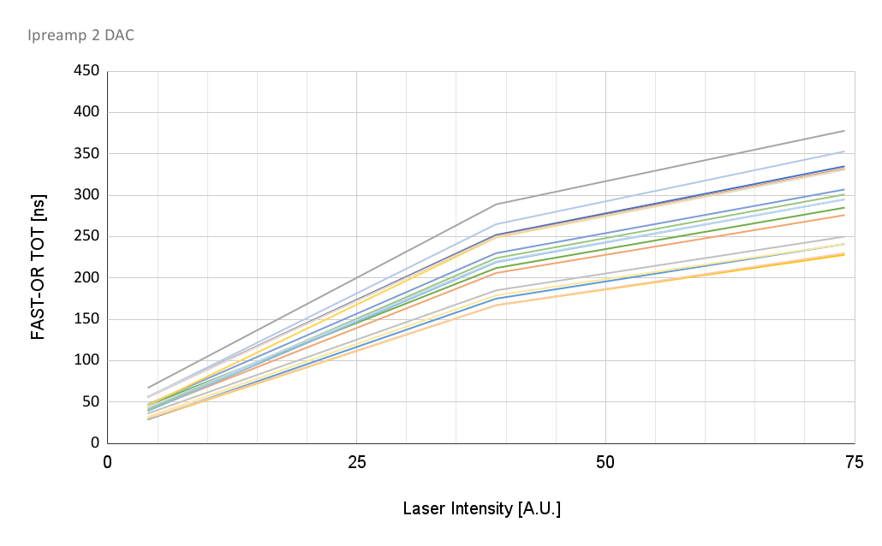
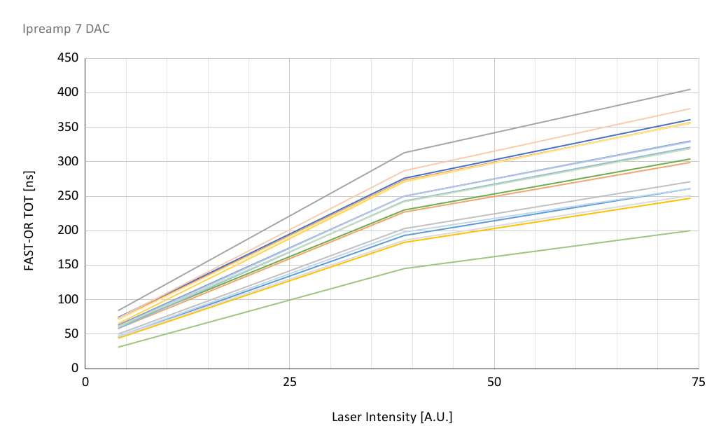
Test with FAST-OR circuits: TOT mismatch
Analog: 0.7 µA / pixel
Analog: 2.3 µA / pixel
Preliminary
Preliminary
Some mismatch observed from amplifier response: need to increase the size of load transistors

Slide 26
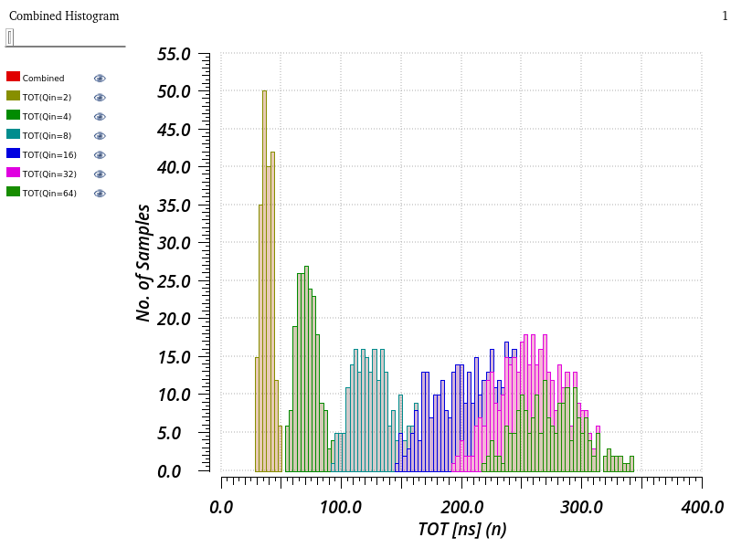
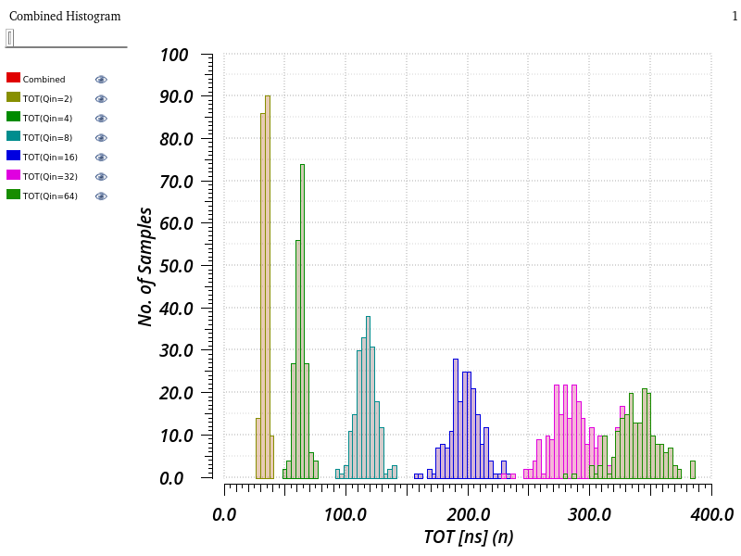
Test with FAST-OR circuits: TOT mismatch
Lesson learned:
Improvement of front-end response uniformity in production ASIC.
Front-end mismatch in pre-production prototype
(Cadence Spectre simulation)
Front-end mismatch in production ASIC
(Cadence Spectre simulation)

Slide 27
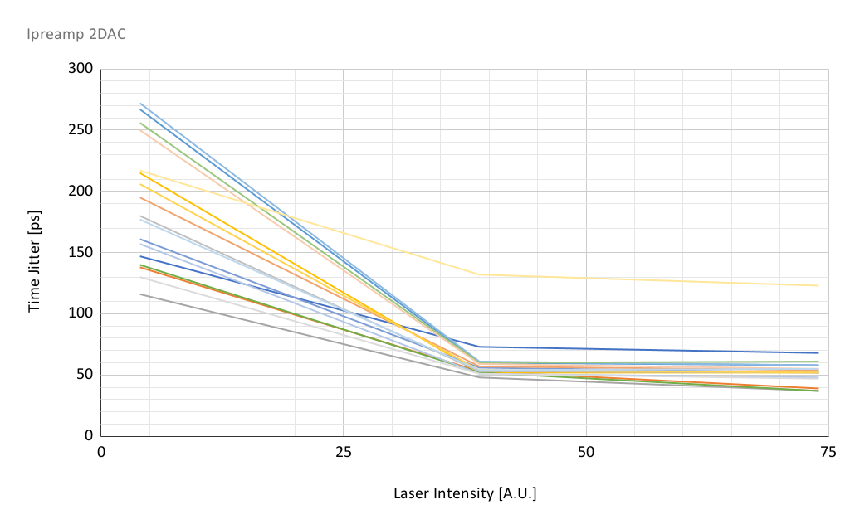
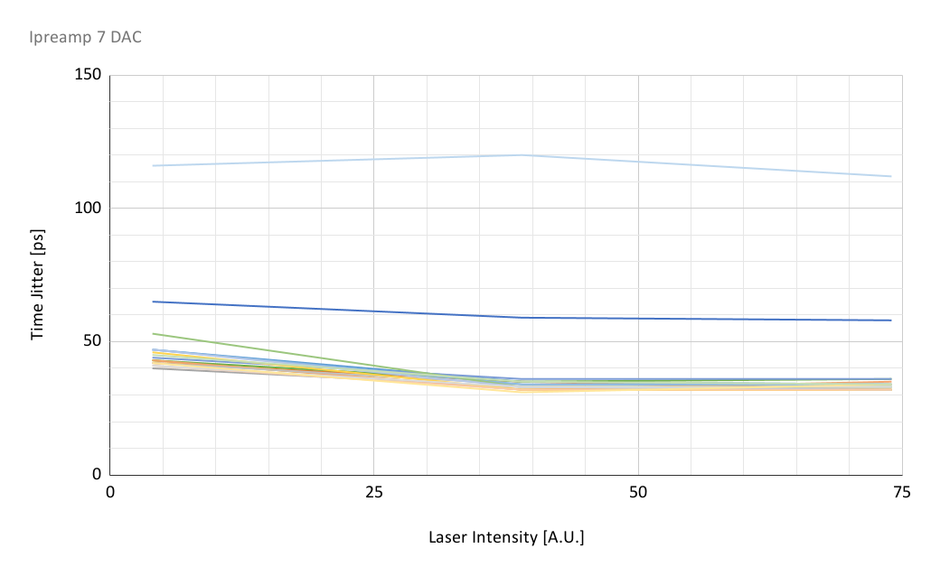
Test with FAST-OR circuits: time resolution
Analog: 0.7 µA / pixel
Analog: 2.3 µA / pixel
Preliminary
Preliminary
Excellent timing performance for the entire range under test

Slide 28
Test with Readout
The readout of V2 is identical to the one envisaged for the final chip.
Corresponding pixels from different super-pixels are read in parallel.
Results will be shown for a conservative readout speed of 20 MHz.
Tests at 50 MHz and 100 MHz were also successful, but they require to adapt the delays to match the cable length.
NOTE: drift of analog memory observed, will require action for final chip. Preproduction prototype can be tested only at high rate.

Slide 29
Front-end + Memory control

Slide 30
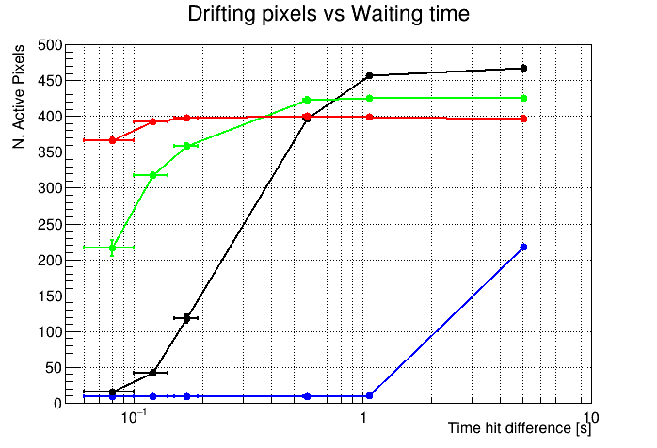
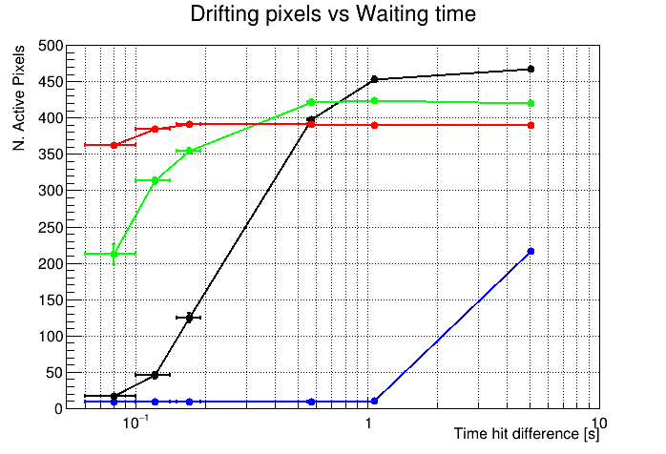
Test with Readout: memory drift
Memory drift, load 5
Memory drift, load 10
__ -40 C
__ 0 C
__ 20 C
__ 40 C
__ -40 C
__ 0 C
__ 20 C
__ 40 C
At room temperature the minimum hit rate is 700 Hz: leakage ~ 85 pA
At -40 C the minimum hit rate is 1 Hz: leakage ~ 60 fA
The pedestal is time dependent and it disappears at low temperature, suggesting the presence of a current leakage.
Moreover, the independence from the memory load current allowed to identify the issue as due to the leakage through the gates of the analog MUX.
A solution to this issue has been already implemented in the final chip.

Slide 31
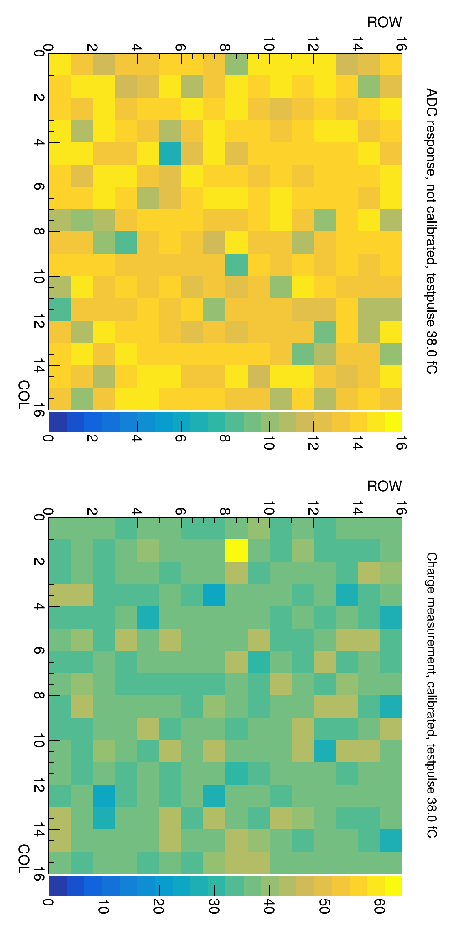
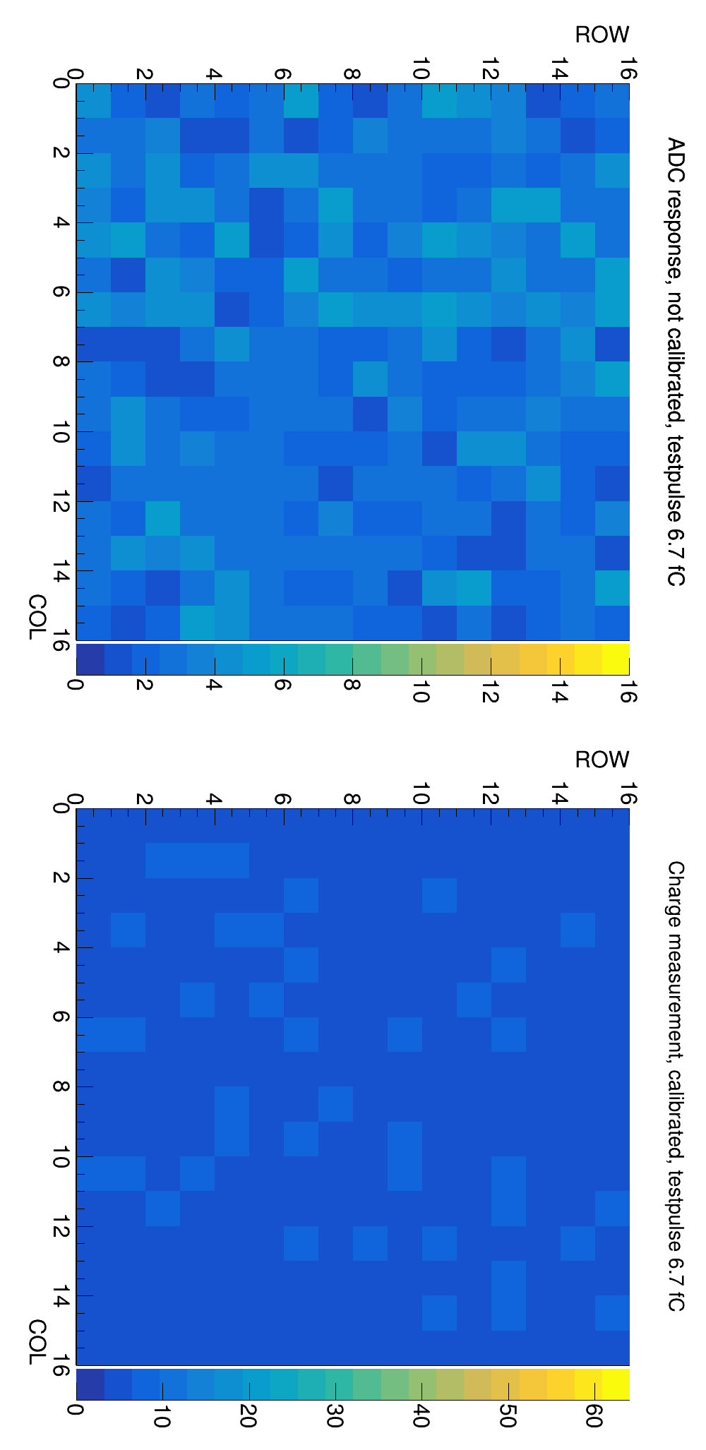
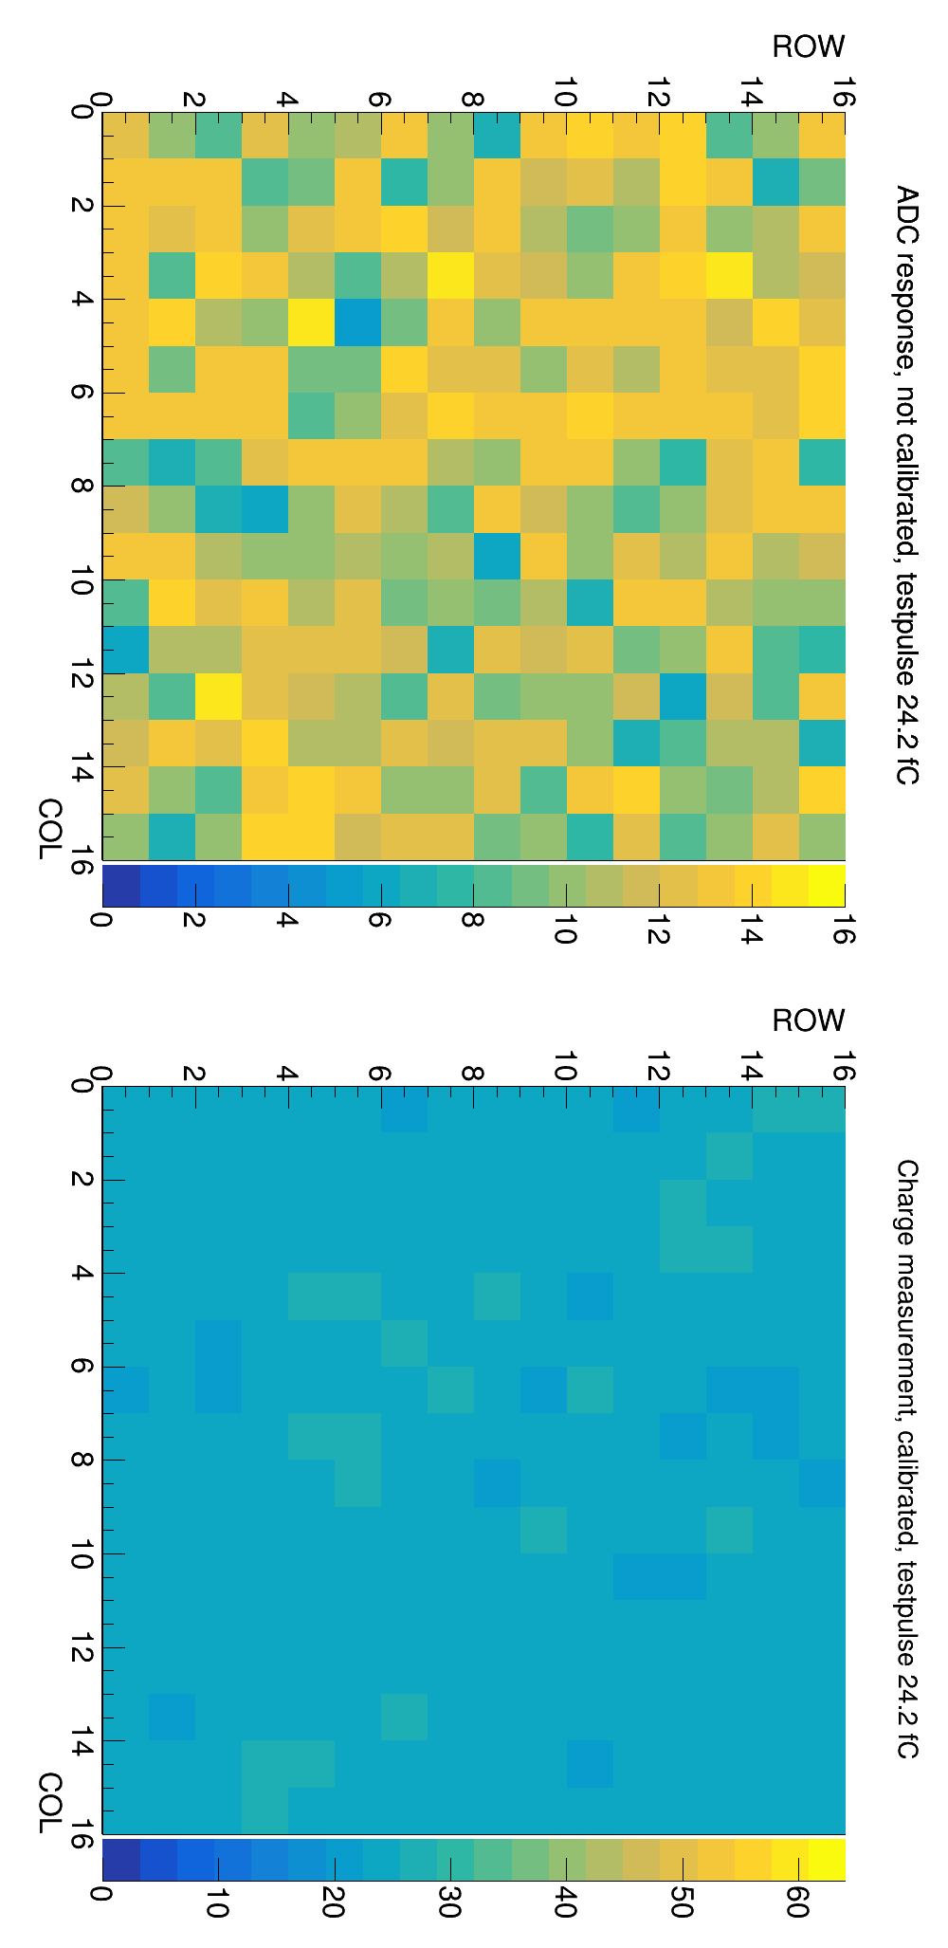
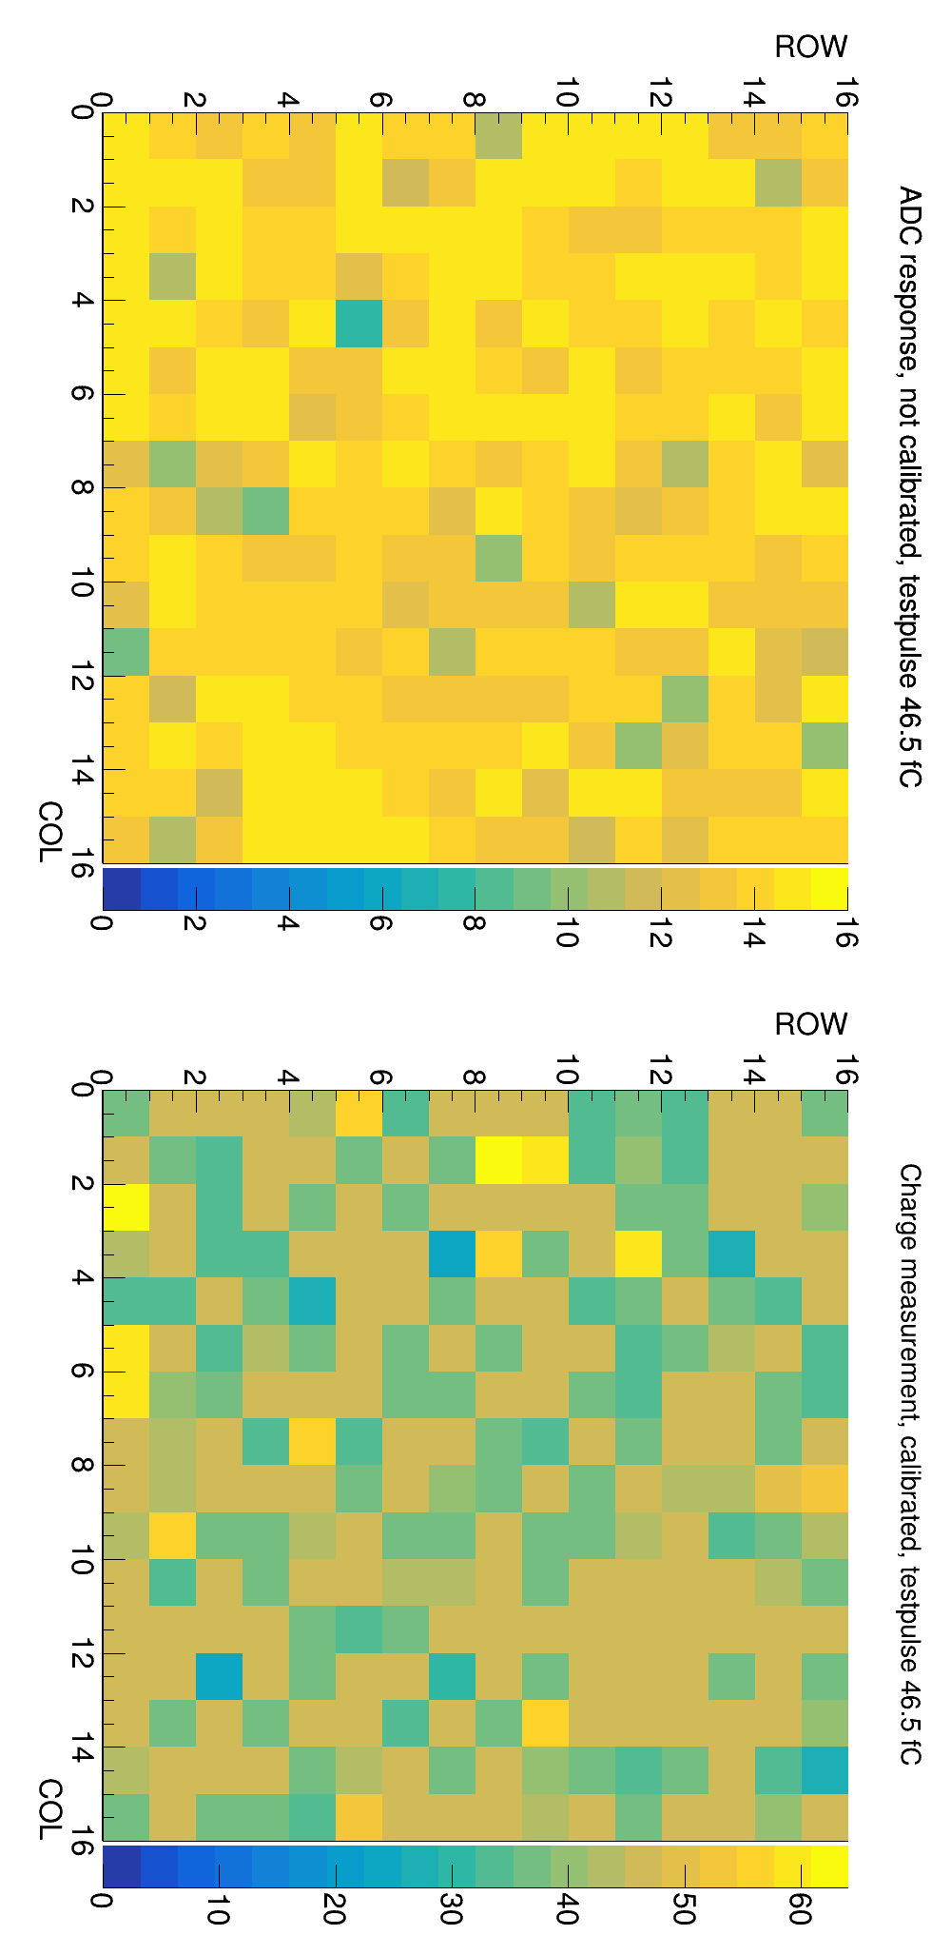
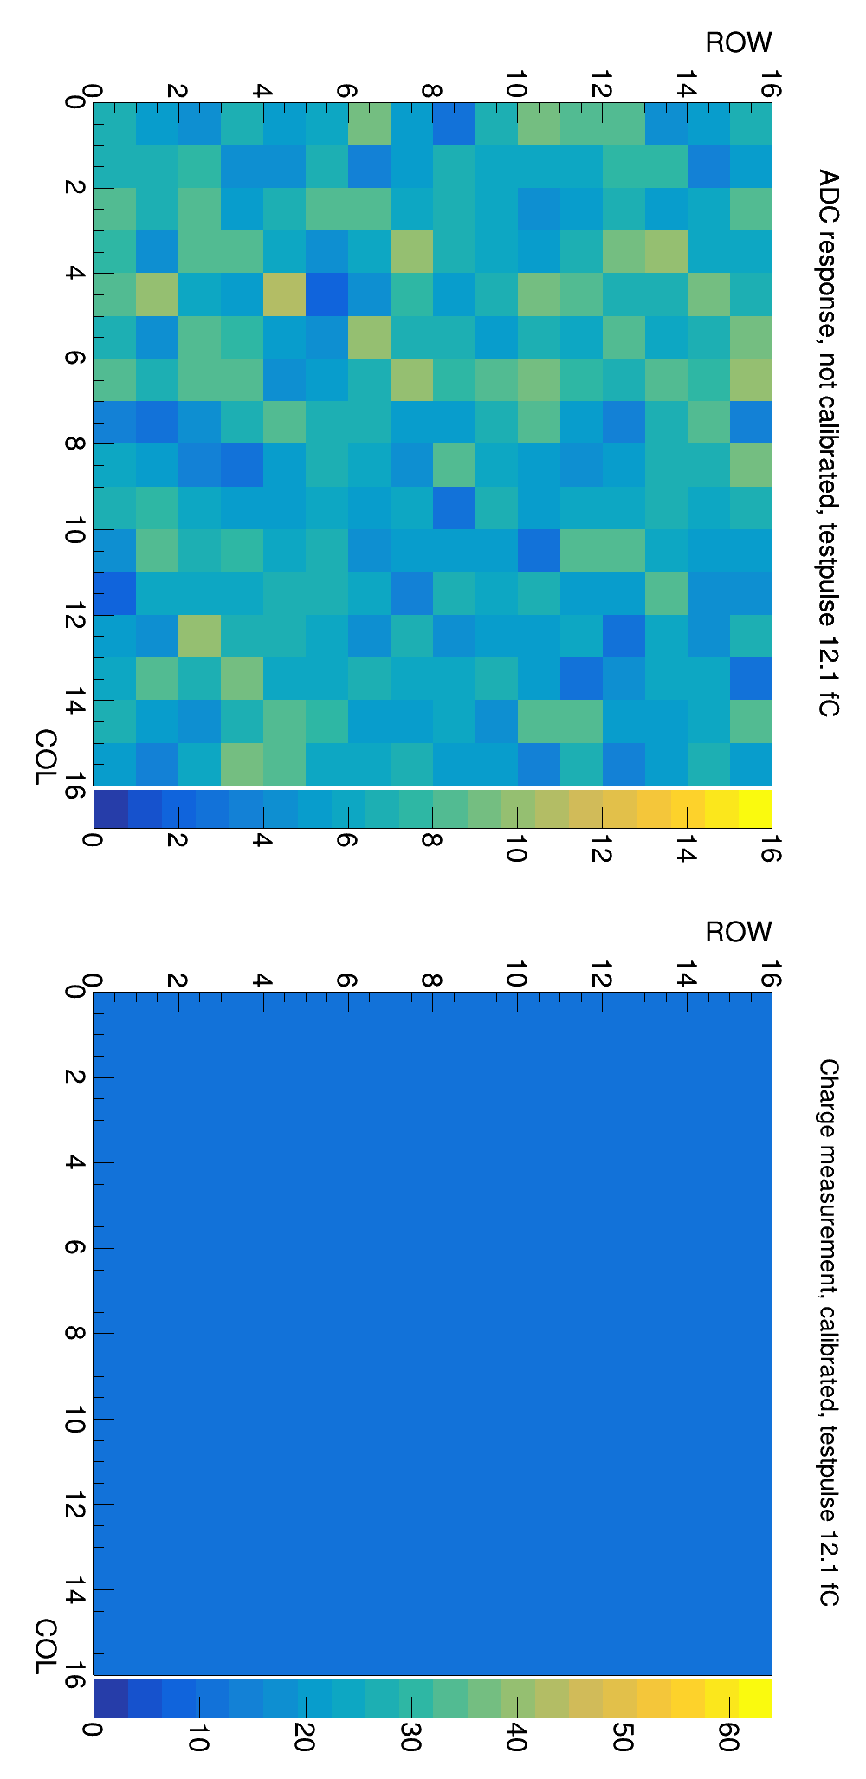
Test with Readout – testpulse calibration
Before calibration
After calibration
Injected charge

Slide 32
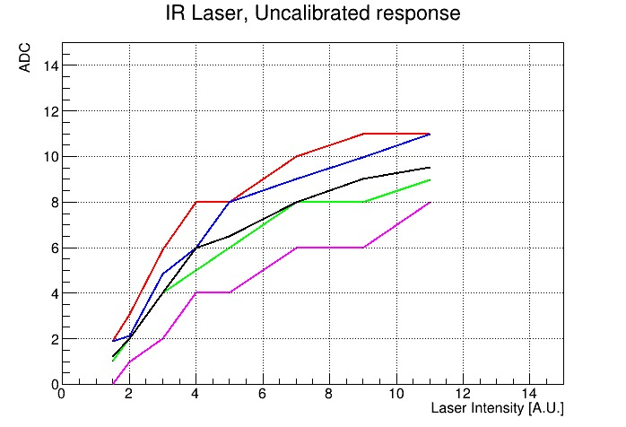
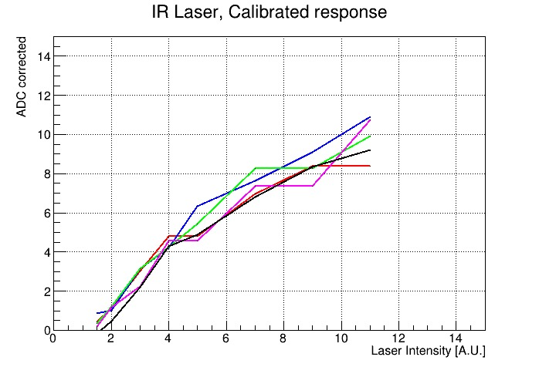
Test with Readout – Calibrated laser response
The pixels below have names: they were selected due to their large mismatch

Slide 33
Conclusions
FASER pre-shower upgrade will be instrumented with the SiGe MAPS designed and developed at UniGe. The chip will be a fast-imaging pixel detector for ultra-high-energy electromagnetic showers.
The pre-production chips delivered in June are working fine with the lab characterization.
Minor bugs have been identified and they will be corrected. Further studies are planned to consolidate the final chip design.
In the last year of Run-3 data taking FASER should have capability needed for two closely spaced photons detection and extend the sensitivity reach in the ALP phase-space.

Slide 34
Backup

Slide 35
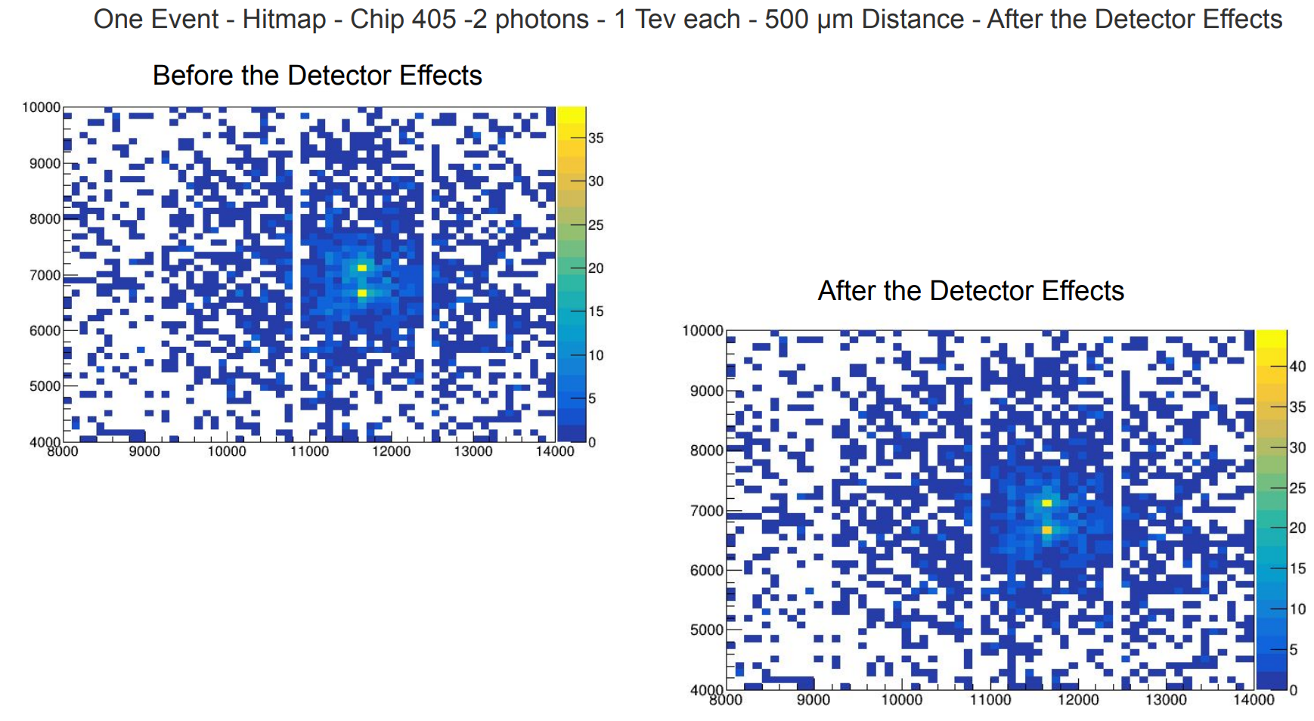

Slide 36
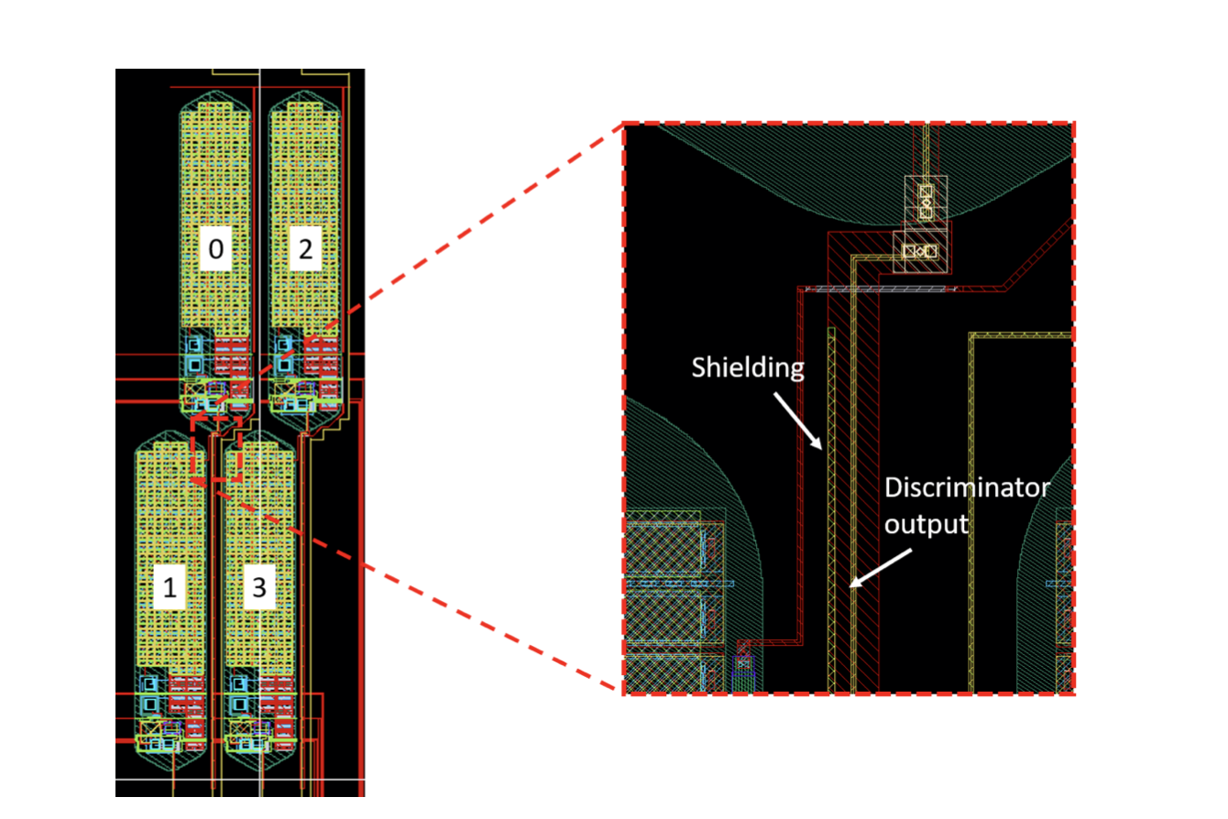
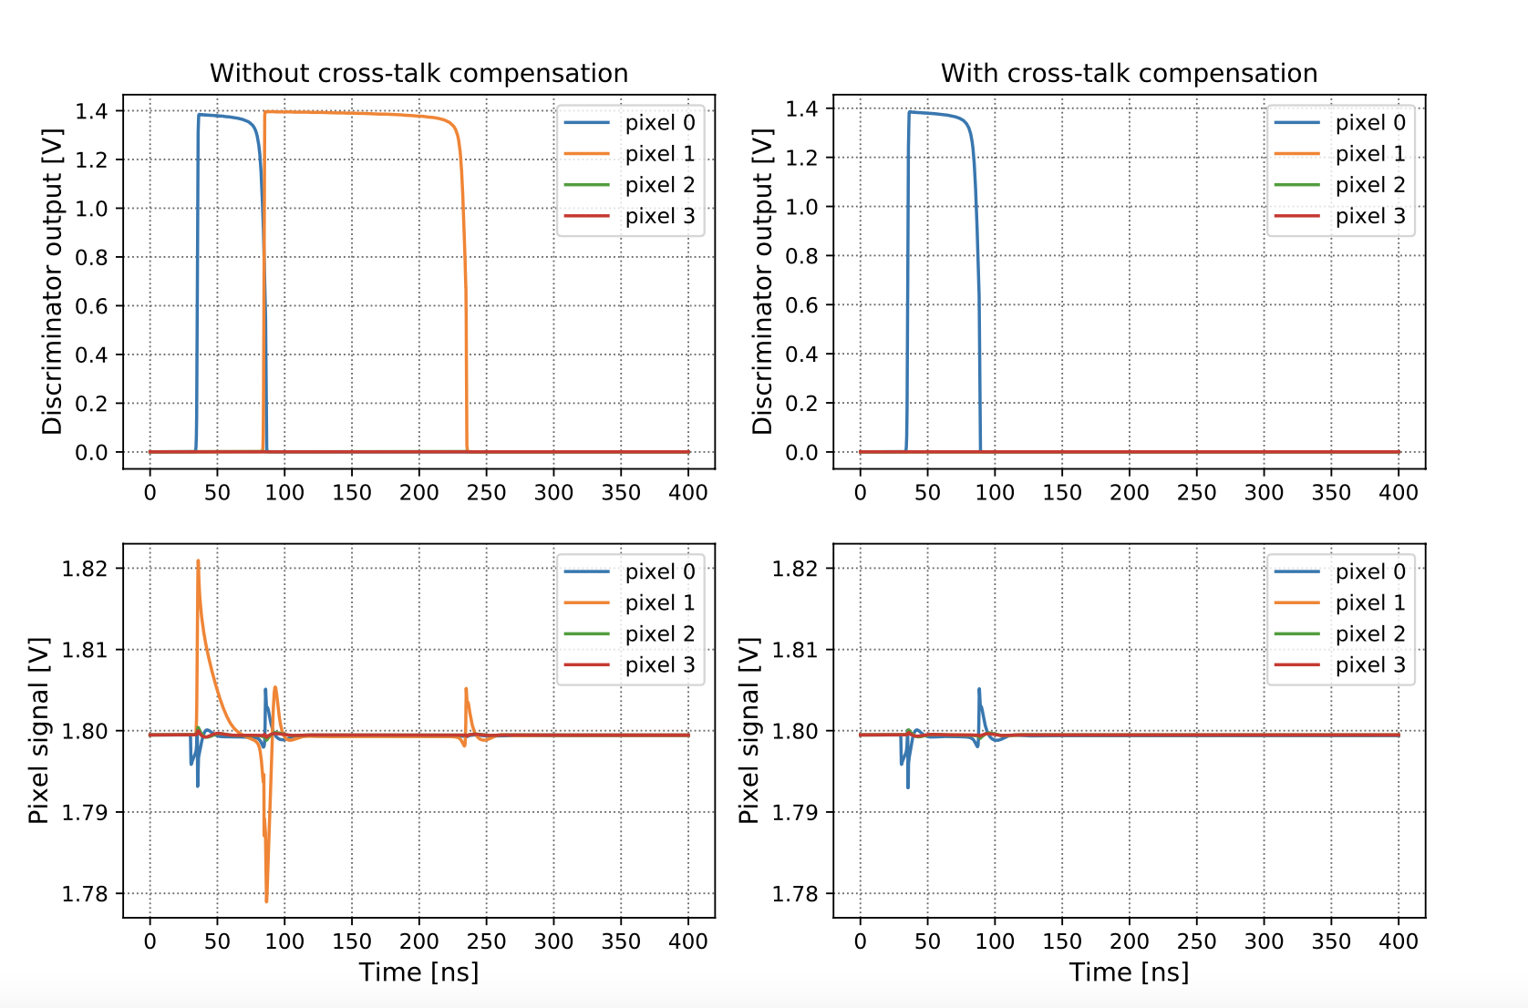
Cross talk shielding from previous prototype

Slide 37
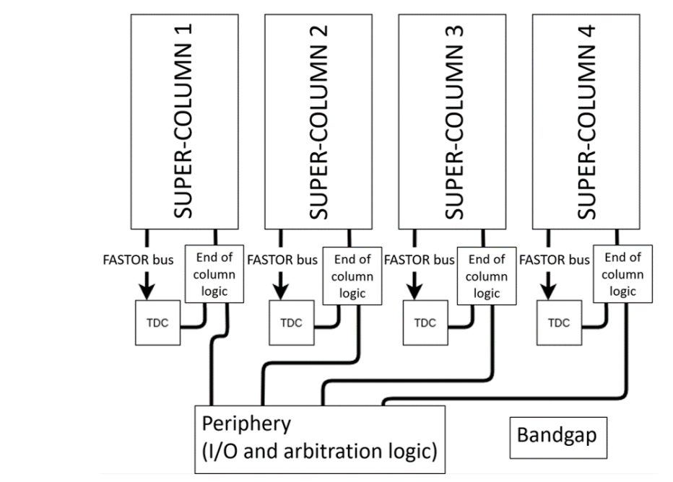
TDC test (preliminary)
Independent from charge readout.
The ring oscillator can be operated at digital power supply or at dedicated voltage.
Operation at digital power supply: binning estimated at 160 ps.
7 bits, 14 states allowed, 114 states forbidden
0 0 1 0 1 0 1
0 1 1 0 1 0 1
0 1 0 0 1 0 1
0 1 0 1 1 0 1
0 1 0 1 0 0 1
0 1 0 1 0 1 1
0 1 0 1 0 1 0
1 1 0 1 0 1 0
1 0 0 1 0 1 0
1 0 1 1 0 1 0
1 0 1 0 0 1 0
1 0 1 0 1 1 0
1 0 1 0 1 0 0
1 0 1 0 1 0 1
Allowed states appear, showing that the TDC is operating as expected.

Slide 38
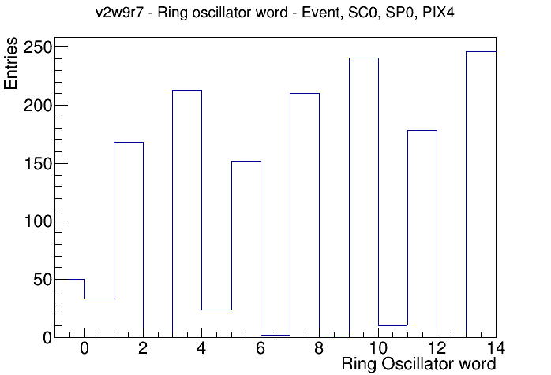
TDC test (preliminary)
Very few forbidden states, mapped to -1.
Possibly bubble errors that can be corrected.
Poor DNL (one bit is essentially lost).
Increase size of Ring Oscillator.
Adjust voltage.
Don’t care

Slide 39
256:1 analog MUX
A₀
A₁
Proposed design: multi-stage approach.
8 stage of 2-to-1 MUXs in series.
Lower capacitance seen at each node than token ring solution.
A₂
To
Flash-ADC
2³=8 pixels example

Slide 40
256:1 analog MUX
A₂A₁A₀=000
A₂A₁A₀=001
A₂A₁A₀=010
Problem of the proposed design: the polling leads to the sharing of the charges of the pixels with ‘higher’ addresses.
This is due to the switching of the LSB of the address (A₀ in the example).
Solution: additional switches connected to the MUX inputs.

Slide 41
256:1 analog MUX
Pixel₀
S₀
A₁
S₁
A₂
Pixel₁
Solution: additional switches connected to the MUX inputs.
For this example:
  Pixel₂₋₃: S₂₋₃ AND with A₁
  Pixel₄₋₅: S₄₋₅ AND with A₂
  Pixel₆₋₇: S₆₋₇ AND with A₁,A₂
S₂
Pixel₂
S₃
Pixel₃
S₄
Pixel₄
S₅
Pixel₅
S₆
Pixel₆
S₇
Pixel₇

Slide 42
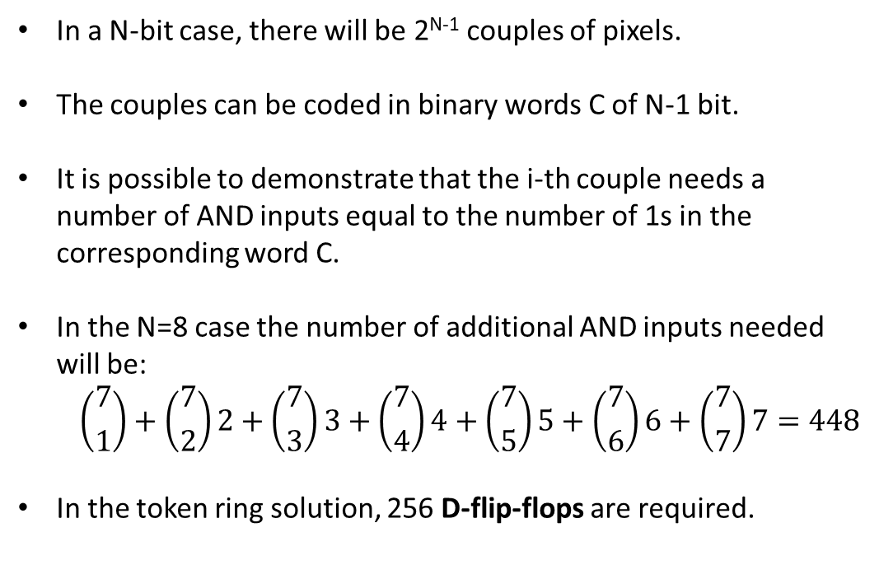
256:1 analog MUX
In a N-bit case, there will be 2^{N-1} couples of pixels.
The couples can be coded in binary words C of N-1 bit.
It is possible to demonstrate that the i-th couple needs a number of AND inputs equal to the number of 1s in the corresponding word C.
In the N=8 case the number of additional AND inputs needed will be:
  $$\left({7 \atop 1}\right)+\left({7 \atop 2}\right)2+\left({7 \atop 3}\right)3+\left({7 \atop 4}\right)4+\left({7 \atop 5}\right)5+\left({7 \atop 6}\right)6+\left({7 \atop 7}\right)7=448$$
In the token ring solution, 256 D-flip-flops are required.
Pixel₀
S₀
A₁
S₁
A₂
Pixel₁
S₂
Pixel₂
S₃
Pixel₃
S₄
Pixel₄
S₅
Pixel₅
S₆
Pixel₆
S₇
Pixel₇

