Slide 1
EOS Winston
Expert Systems for Automated Diagnosis and Remediation
Ishank Arora, IT-ST-FDO
Supervisor: Luca Mascetti

Slide 2

EOS
A disk-based, low-latency storage service
Scale:
Over 280 PB of raw disk space
4.88 billion files
50,000 disks
25+ namespaces

Slide 3
Issues and Anomalies
It works! It works! Wait a second...
The very-critical-mount on EOSPublic is 95% full (of logs dating a year back).
User 1729 is performing read operations at 7201.21 Hz.
Boot failure on 20 nodes in EOSAlice.
Node heart-attack.cern.ch has a heartbeat of 83018
(actual figures).

Slide 4
Project Requirements
Check. Check. Wait a second...
Reduce MTTR and pager fatigue
Remove false positives
Enable the team to focus on the business logic rather than the infrastructure
Provide a common platform for alerts and collaboration

Slide 5

EOS Winston
https://giphy.com/gifs/quentin-tarantino-pulp-fiction-harvey-keitel-DeOa0SqsDH5sc

Slide 6
EOS Winston
An event-driven alerting and mitigation automation platform. It employs expert rules and streaming anomaly detection algorithms to categorise events and execute corresponding runbooks.

Slide 7
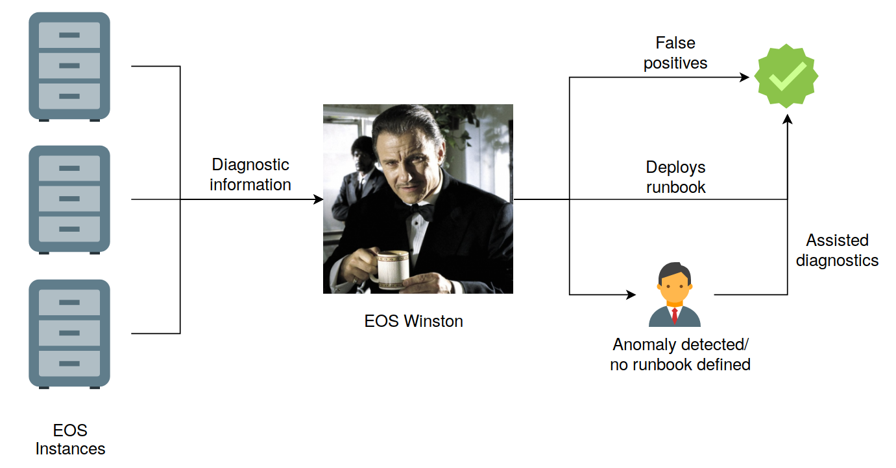
The architecture

Slide 8
StackStorm¹ for automation
(Thank God for open-source)
Pluggable rule engine comprising of triggers and actions
MongoDB for data storage and RabbitMQ for message broking
Supports a wide variety of interfaces, available as packs
Deployed by firms such as Netflix² and NASA
[1]: https://stackstorm.com/
[2]: medium.com/netflix-techblog/introducing-winston-event-driven-diagnostic-and-remediation-platform-46ce39aa81cc

Slide 9
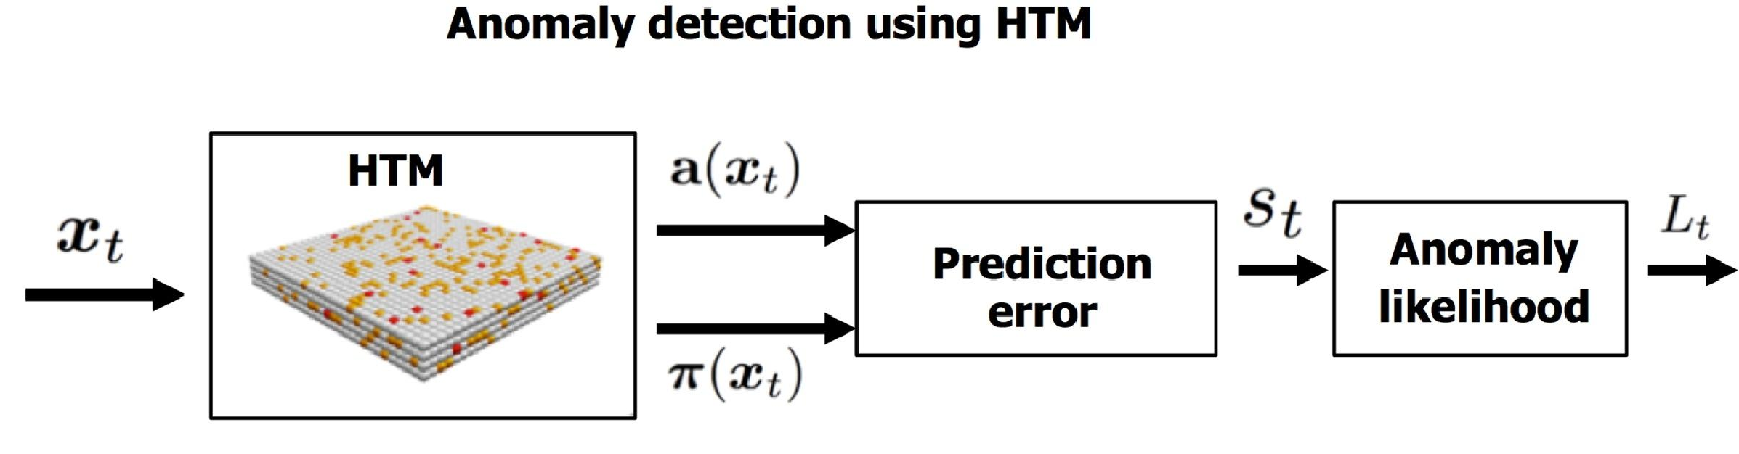
Anomalies in the Average MGM Load
Nupic*: Real-time Streaming Anomaly Detection
Try to identify if there’s a sudden unexplained increase in the average load across all nodes of an EOS instance, or a given user’s activity.
Nupic*, a real-time streaming algorithm, employs Hierarchical Temporal Memory (HTM) networks
*Ahmad, Subutai, et al. "Unsupervised real-time anomaly detection for streaming data." Neurocomputing 262 (2017): 134-147.

Slide 10
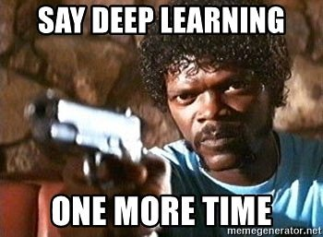
Why not LSTMs?
https://twitter.com/mlinterview/status/996570725921181696

Slide 11
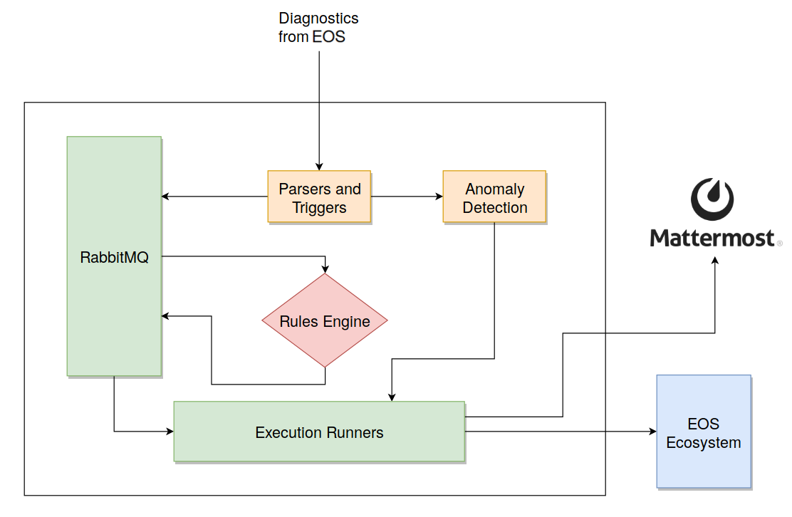
An EOS Winston instance

Slide 12

Implemented Runbooks
Winston in action
https://giphy.com/gifs/reaction-GnEyBQ2M2Vub6

Slide 13
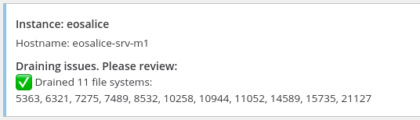
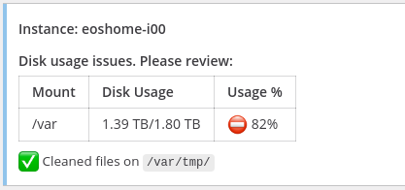
Implemented Runbooks
Winston in action
Drain expired:
/var usage > 80%:

Slide 14

Implemented Runbooks
Winston in action
User activity through the roof:
https://tenor.com/view/brooklynninenine-terry-crews-rosa-diaz-brooklyn99-youre-banned-gif-13390256

Slide 15
ChatOps Integration
Conversation-driven development
Execute workflows as commands through Mattermost
Unifying the communication about what work should get done with the actual history of the work being done
New commands can be implemented by just adding the business logic

Slide 16
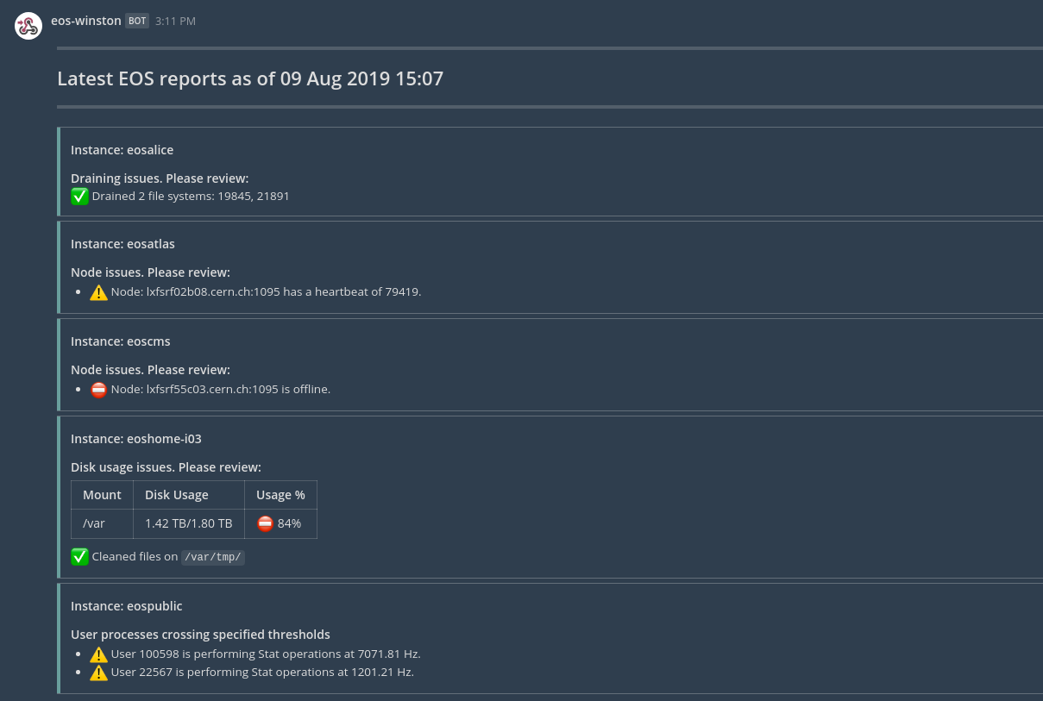
More of Winston

Slide 17
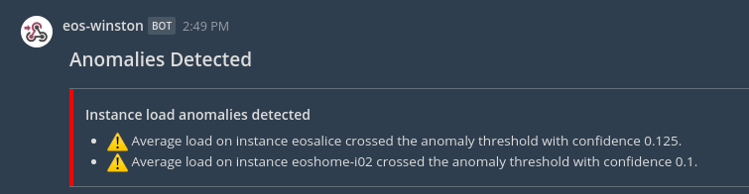
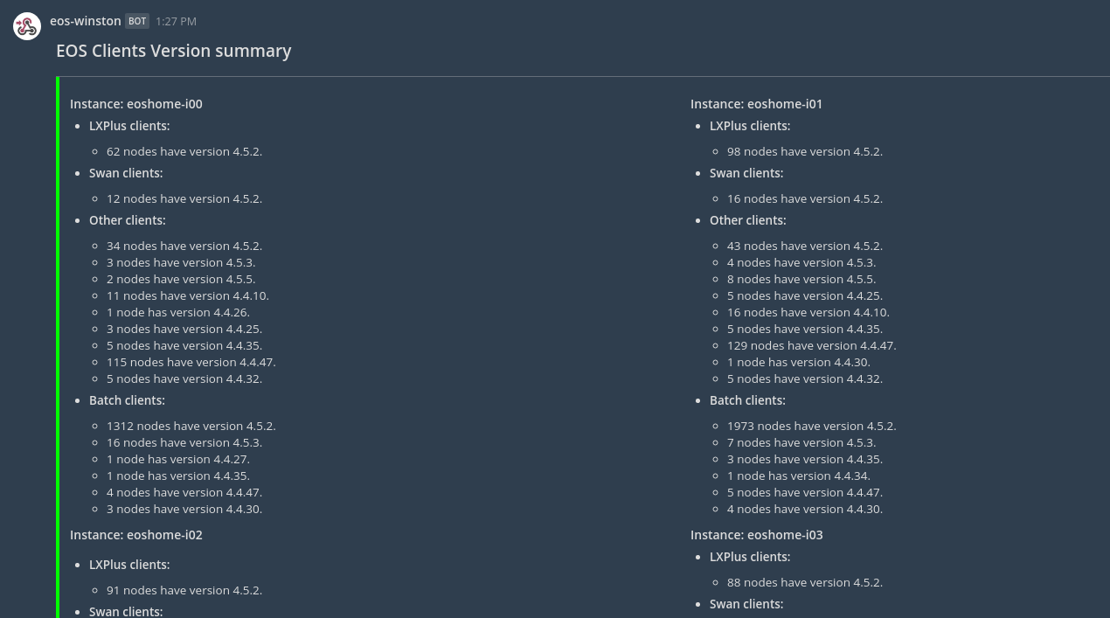
More of Winston (cuz why not)

Slide 18
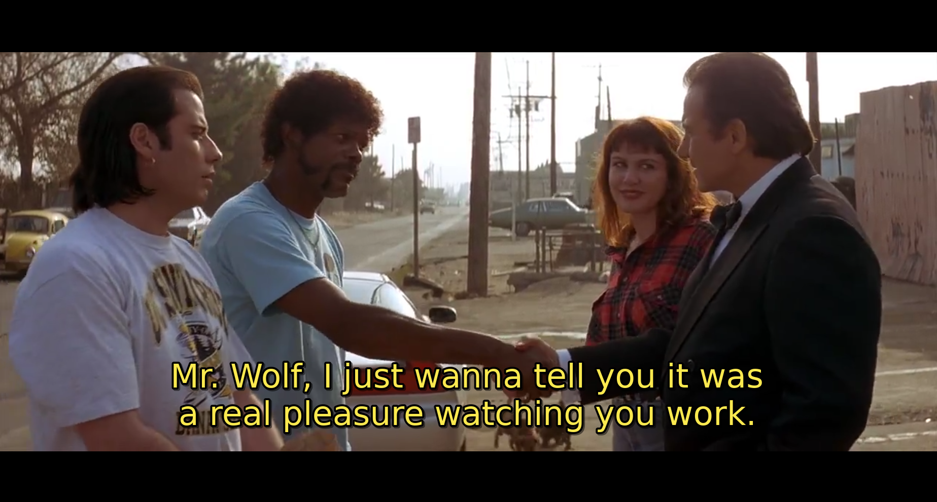
Impact of the Project
https://www.netflix.com/watch/880640

Slide 19

Thank you!

Slide 20
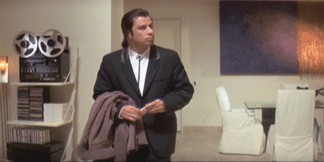
Questions?
ishank.arora@cern.ch
https://giphy.com/gifs/awkward-pulp-fiction-john-travolta-6uGhT1O4sxpi8

