Slide 1
Scaling-out CERN’s IDS with Network Automation
Openlab Lightning Talk 2019
Author:
Andrea Lacava
andrea.lacava@cern.ch | thecave003@gmail.com
Supervisors: Stefan Stancu, Edoardo Martelli
Openlab Collaborator: Extreme Networks
https://www.extremenetworks.com/
August 2019
Notes:
Hi I am Andrea Lacava and this is the report of my last 2 months of work.

Slide 2
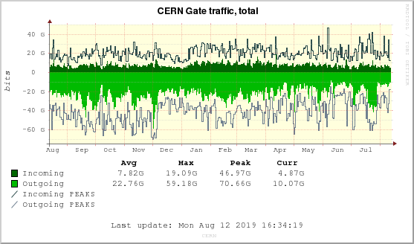
The problem: Keep CERN traffic safe
The volume of traffic entering and leaving CERN is growing continuously
  More than 100 Gbit/s incoming and outgoing traffic
  More than 1 Million simultaneous connections
Traffic needs to be inspected and analyzed in order to ensure security
  We already have an IDS (Intrusion Detection System)
  Thanks to the openlab project with Extreme Networks
Notes:
CERN is one of the most heterogeneous network in the world and in order to keep its traffic safe we’ve to inspect it in real time.
thanks to previous editions of OpenLab.
To do that we’ve already and Intrusion Detection System,
My work focused on improve the actual IDS and ensure its constant availability.

Slide 3






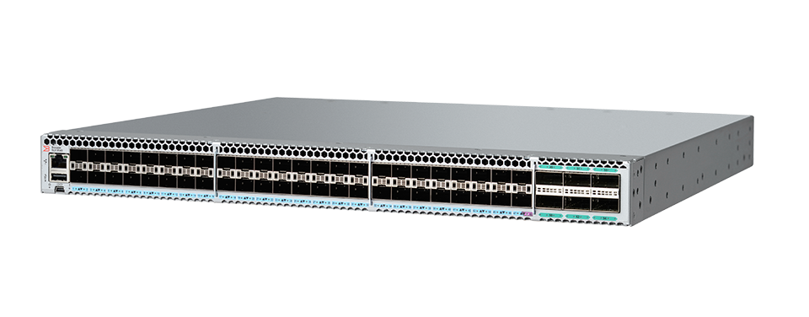


Current setup – Limited scalability
EFO-Bro
integration
(plugin)
Configure
Monitor
SLX 9540
Load balance
Aggregate
mirrored traffic
IDS
(Servers running Bro)
Notes:
In this slide you can see the current setup of IDS:
As you can see from the picture all the traffic between CERN and the Internet is aggregated into an SLX switch from Extreme Network and then is forwarded to a set of IDS servers.
(Symmetric load balancing : both direction of conversation are forwarded to the same IDS server)
This setup however does not guarantee good performances, in the long run the situation will be harder.
ALSO the SLX represents a single point of failures and is it prone to slowdown.
The management of SLX switch and of the IDS system is handled by StackStorm.

Slide 4

aka "IFTTT for Ops"
Event-driven automation engine
Open source & Python friendly
Enables If This Then That paradigm for (Dev)Ops
Modular: users can develop their own Packs.
Pack: A set of Rules triggered by Events that runs Actions
if an IDS server needs maintenance
then take it out from the network load balancer
}
Actions implemented in CERN IDS Pack
if a known traffic type saturates the IDS server
then track only connection initiation and termination
Notes:
Stackstorm is a powerful engine for network automation
It is made of Packs and it is modular and extendable.
A pack is a set of rules triggered by events that runs actions.
And it implements the If This Then That paradigm on networking
For instance..

Slide 5

The solution
Multiple vendor support for the
IDS Stackstorm pack
Notes:
So finally we’ve decided to support multiple hardware vendors in order to improve IDS scalability and availability

Slide 6
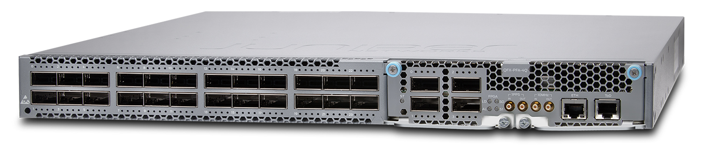
New setup – scalable
EFO-Bro
integration
(plugin)
Configure
Monitor
QFX10002-72Q
Aggregate
mirrored traffic
SLX 9540
Load balance
IDS
(Servers running Bro)
Notes:
Here is the new proposed solution.
By just adding a new powerful QFX switch from Juniper (Networks) that works in parallel with SLX switch to make a better load balancing.
With the new QFX switch we also we can easily manage 100 Gb interfaces which now is hard to handle with just SLX switch.

Slide 7
My contribution
Redesign of the existing CERN IDS Pack
  Added abstraction layer for multiple vendor support
Refactoring of the existing Actions code for the SLX platform
  More than 1000 lines of code reviewed and adapted
Implementation of the same Actions for the QFX platform
  Also reported a deployment related bug in the StackStorm pack engine
Fully functional prototype using the QFX platform
  Production deployment foreseen for Q4 2019
Made good pasta for more than 15 Openlab Students
  "Scalable and delicious" (cit.)
Notes:
My contribution on this project in the first instance was the redesign on the existing pack for the CERN IDS.
I have added an abstraction layer in order to make Actions more general and more modular.
Then I have refactored the existing code in order to support the new configuration
And finally I have implemented the same Actions for the new QFX switch and in doing that I have also spot a critical bug in stackstorm engine so i’ve made it better.
And in the end I have contributed to the multi cultural aspect of CERN I’ve made a good carbonara for more than 15 Openlab students.
Thank you so much

Slide 8

Questions?
andrea.lacava@cern.ch | thecave003@gmail.com
thecave3.github.io/ | www.andrealacava.com

