Slide 1
EOS Integration into OpenStack Manila
Elisabeth Petit – Bois
openlab Summer Student
Kennesaw State University, USA
Andreas-Joachim Peters
EOS Project Leader, Supervisor
CERN, Switzerland
13/08/19

Slide 2

OpenStack at CERN
Reference: [1,2]
Private Cloud
Infrastructure
Provides 5+
CERN Services
12,000+
CERN Users
EOS Integration into OpenStack Manila

Slide 3





EOS at CERN
Reference: [1,2]
- 16K accounts
- 8K clients
- 4K users
Managing ~270PB of Storage
- Experiments
- Projects
- Users
EOS Integration into OpenStack Manila

Slide 4
Motivation
Reference: [3]
"The goal is to enable ... ‘file-systems-as-a-service’ ... [and] it is important to simplify the user experience ... while providing users with more flexibility in selecting the right combination of hardware resources for their activities."
– CERN openlab 2017 White Paper
Future ICT Challenges in Scientific Research
EOS Integration into OpenStack Manila

Slide 5


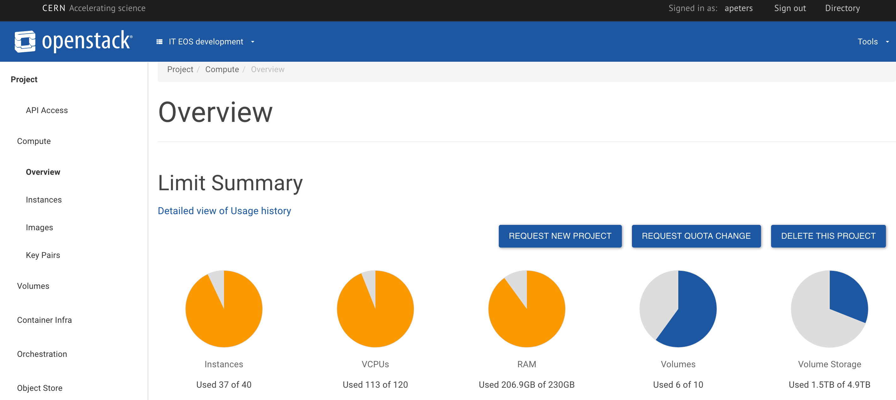
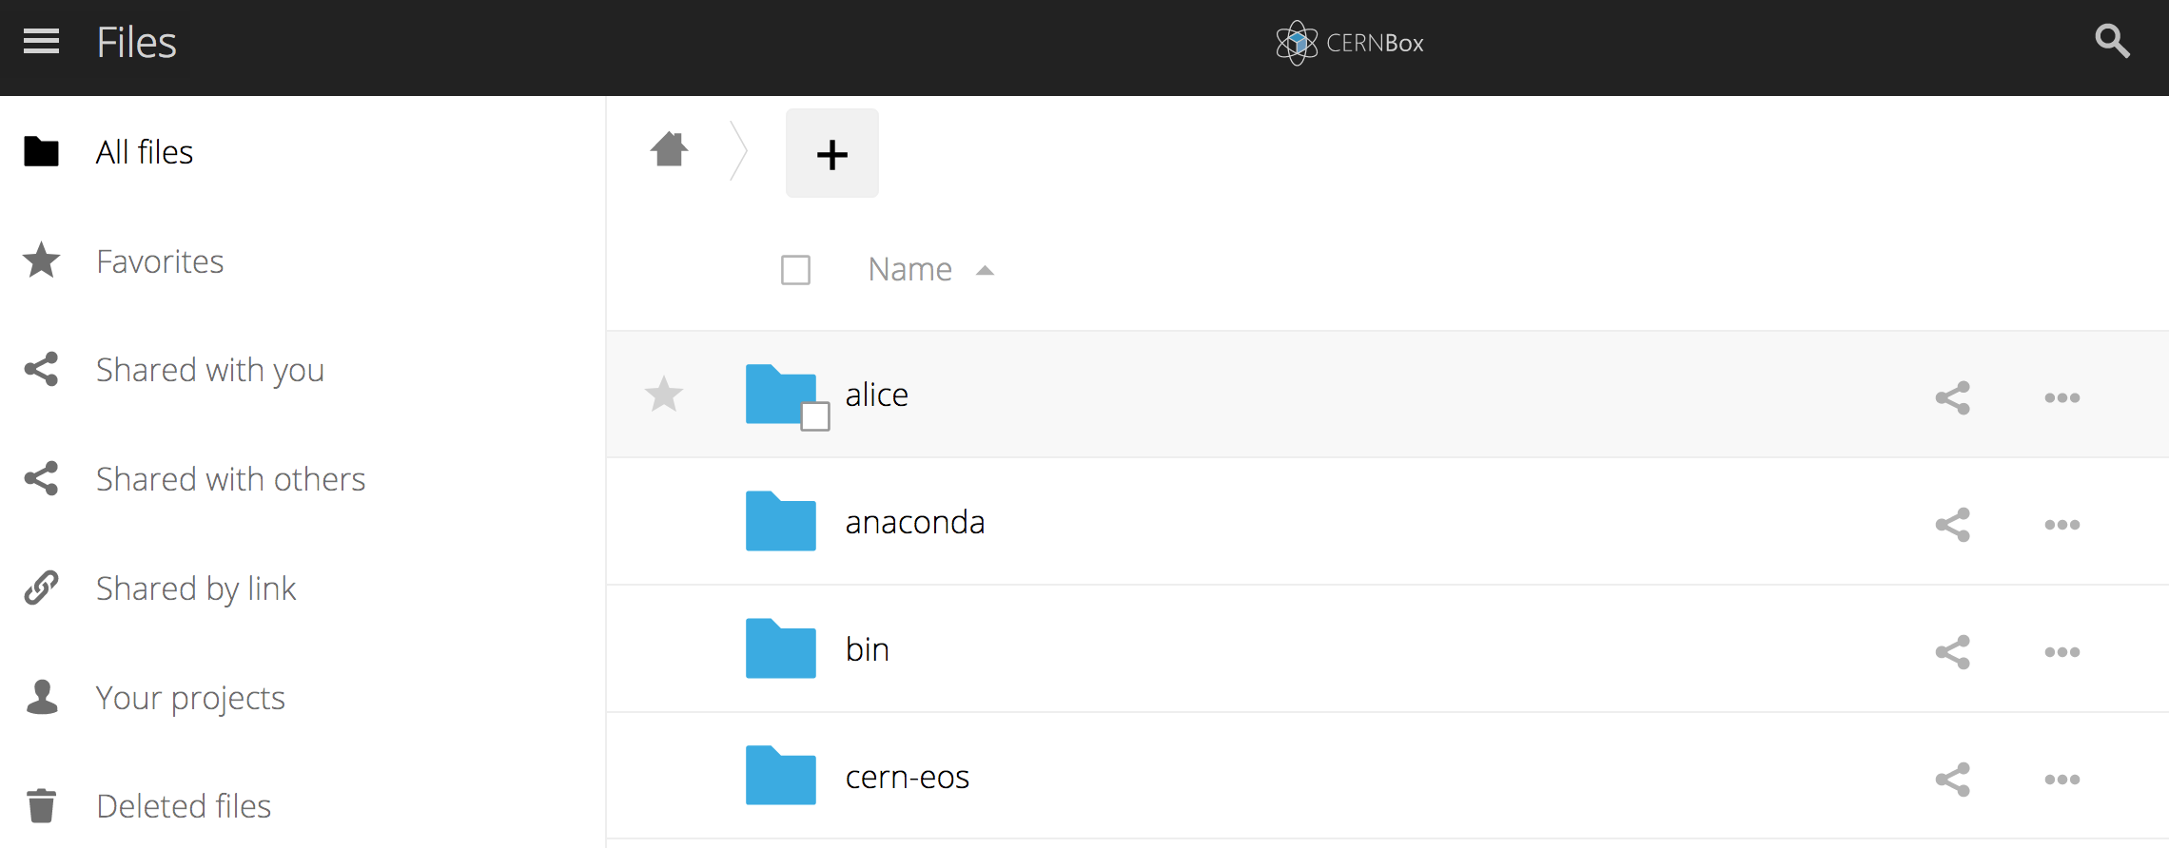
Resource Management Frontend
Sync & Share Frontend
Low-level Storage

Slide 6
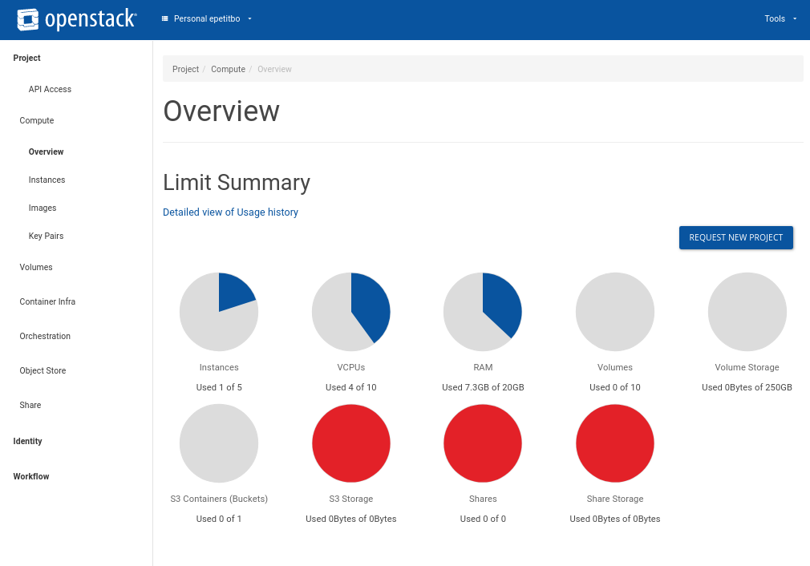
OpenStack UI + Architecture
Reference: [1]
Identity
Keystone
Compute
Nova
Shared Storage
Manila
Networking
Neutron
Block Storage
Cinder
}
Backend

Slide 7




Development Tools
+
EOS Integration into OpenStack Manila
[ https://docs.openstack.org/devstack/latest/ ]

Slide 8
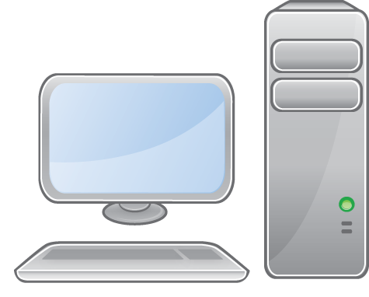
Mock System Solution
Reference: [4,5]
Web Interface
Share Capabilities
create
delete
extend
shrink
manage
unmanage
EOS Service
Emulation
Python
GRPC
Service
OpenStack
EOS Manila
Driver
GRPC
Client
Local Host
EOS Integration into OpenStack Manila

Slide 9
Production System Solution
Reference: [4,5]
Web Interface
EOS
Metadata Service
Share Capabilities
EOS
MGM
GRPC
Service
EOS
File Storage Server
create
delete
extend
shrink
manage
unmanage
/eos
/user
/a ………. /z
OpenStack
EOS Manila
Driver
GRPC
Client
/ashare
EOS Integration into OpenStack Manila

Slide 10
Moving Forward
We have successfully created a working EOS Manila Driver
EOS GRPC interface planned for EOS V4.6 release
    CERNBox spaces will be available on the OpenStack interface
    User will be able to create project spaces on the OpenStack interface
EOS Integration into OpenStack Manila

Slide 11


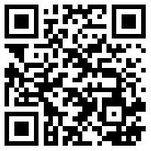
QUESTIONS?
hello@lissythe.dev
epetitbo@students.kennesaw.edu
http://linkedin.com/in/epetitbo

Slide 12
References
[1]: Manila – OpenStack File Sharing Service
https://zenodo.org/record/33192#.XU182HUzYeN
[2]: CERN EOS Service Main Page
http://information-technology.web.cern.ch/services/eos-service
[3]: CERN openlab 2017 White Paper
http://cds.cern.ch/record/2301895?ln=de
[4]: EOS Manila Driver GitHub Repository
https://github.com/cern-eos/eos-manila
[5]: EOS Manila Development Branch
https://gitlab.cern.ch/dss/eos/tree/wip-manila
EOS Integration into OpenStack Manila

Slide 13
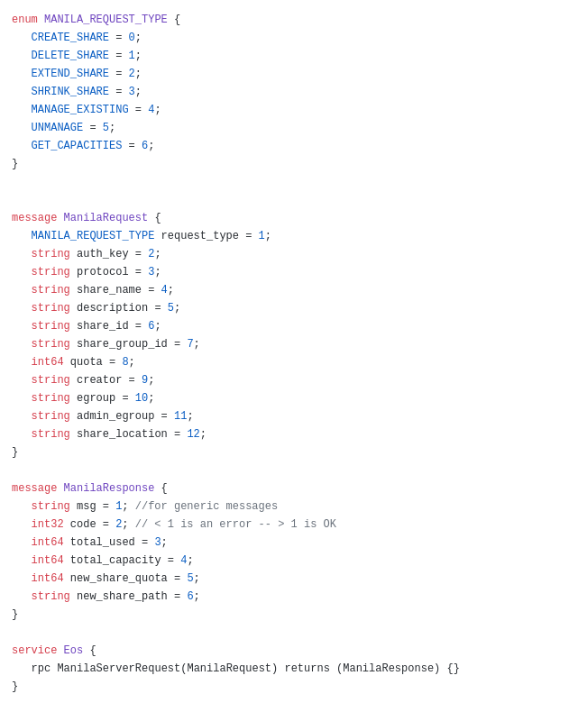
Development Tools: GRPC
Communication medium by which information is sent via “messages”
Messages are defined within a protobuf structure
Based on standard protocols
Easy to integrate

