Slide 1
REANA ↔️ GitLab integration
Leticia Farias Wanderley
Supervisor: Diego Rodríguez Rodríguez
IT-CDA-DR

Slide 2
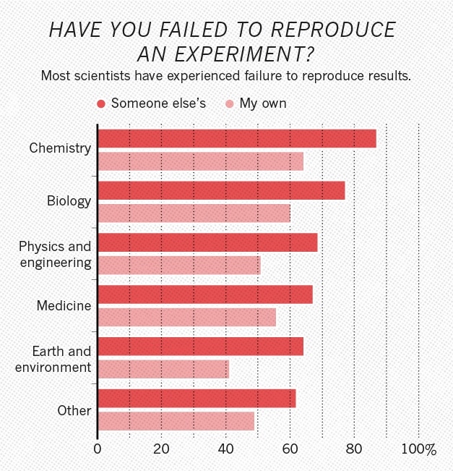
Reproducibility Crisis
https://www.nature.com/news/1-500-scientists-lift-the-lid-on-reproducibility-1.19970
Leticia Farias Wanderley

Slide 3
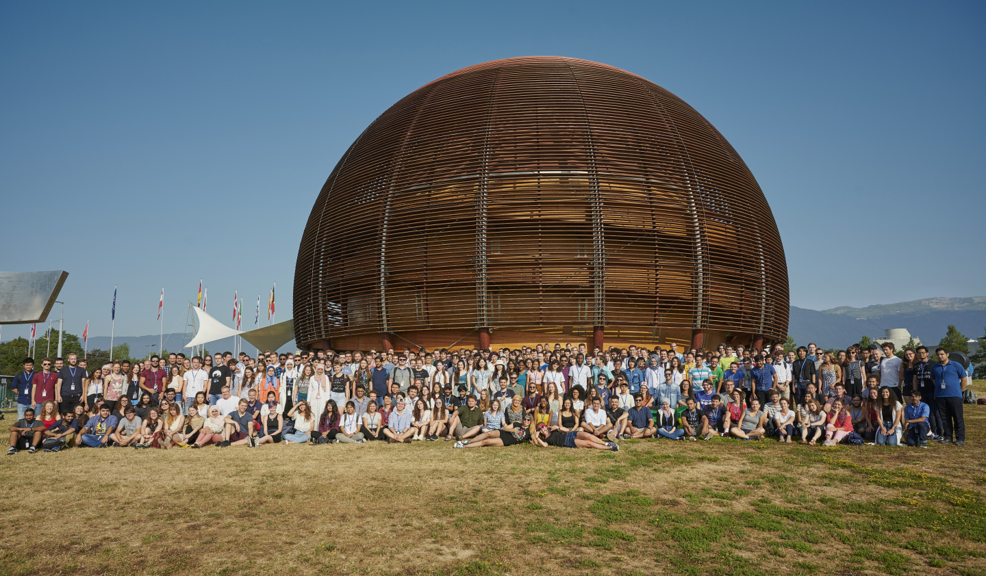
High turnover
of researchers
Leticia Farias Wanderley
Type to enter a caption.

Slide 4






Pillars of a reproducible research analysis
Data
Where is your input data?
Code
Where is your code?
Environment
Which OS and libraries did you use?
Workflow
Which steps did you follow?
Leticia Farias Wanderley

Slide 5
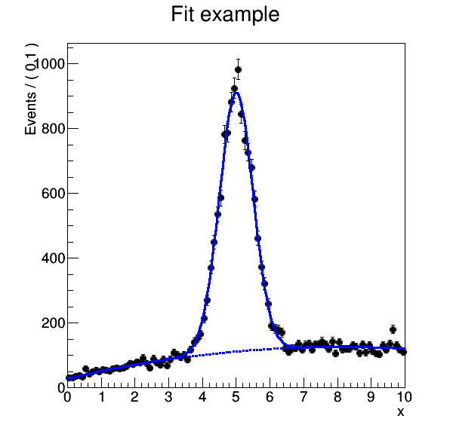
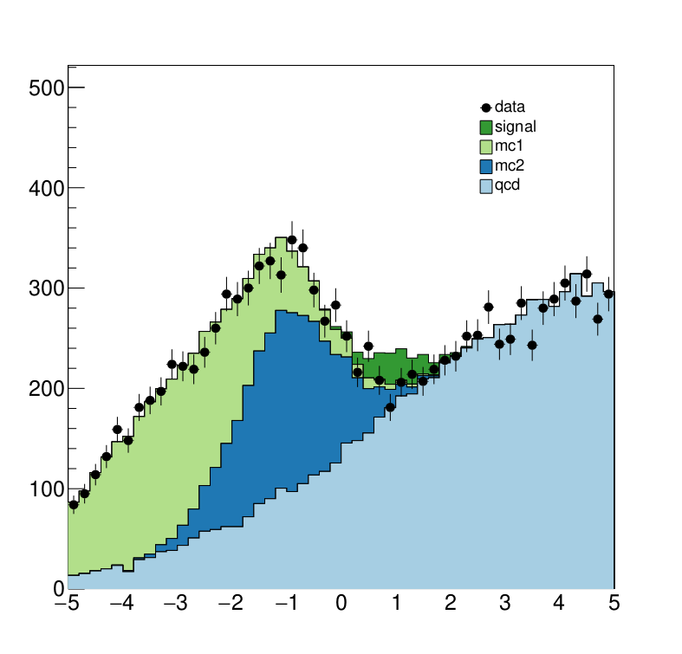

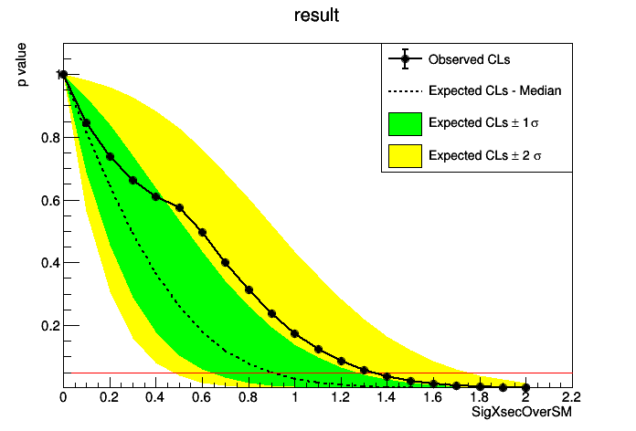
Data
Code
☁️
Environment
Workflow
Leticia Farias Wanderley

Slide 6
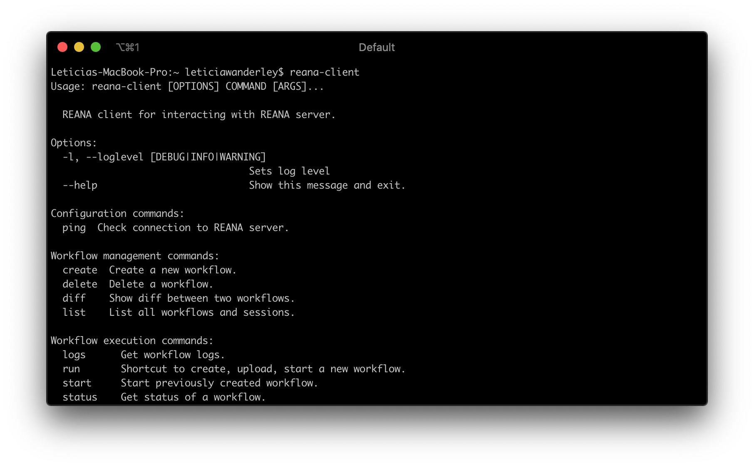
Currently, manual interaction
Leticia Farias Wanderley

Slide 7
Can we do better?
Leticia Farias Wanderley

Slide 8

+
= ?
Leticia Farias Wanderley

Slide 9


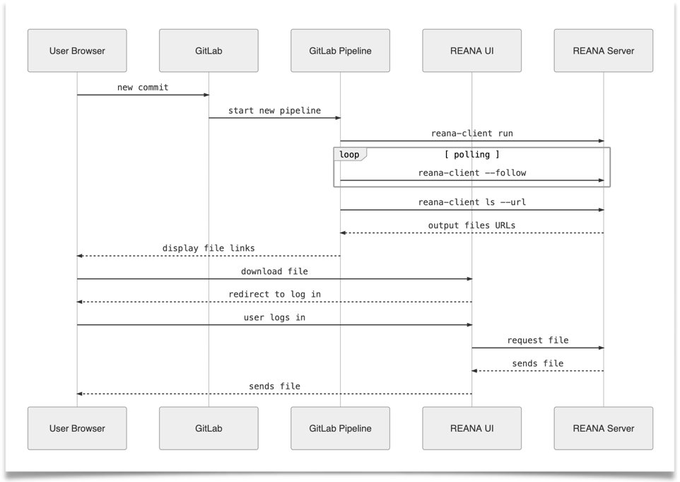
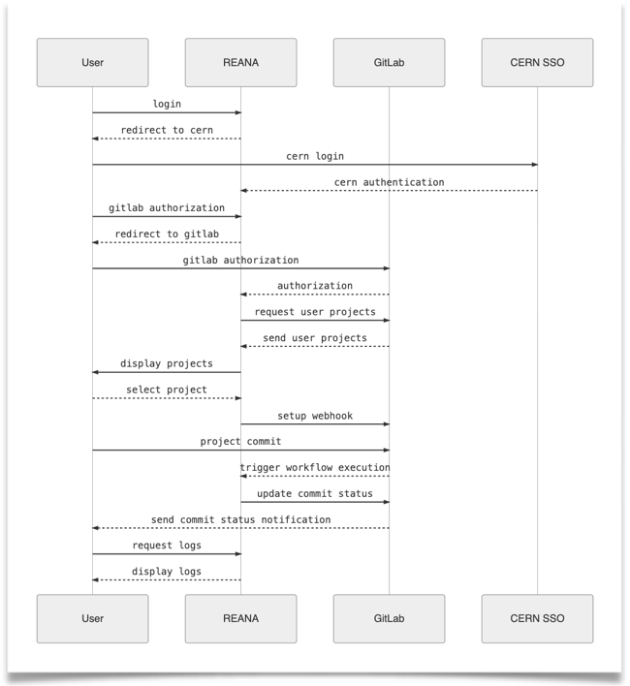
Designed two solutions depending on user needs
Leticia Farias Wanderley

Slide 10
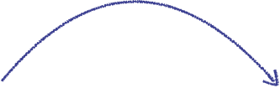

#9z2n
#9z2n
👨🏻‍💻👩🏽‍💻
Physicists
Leticia Farias Wanderley

Slide 11


#9z2n
#9z2n
#9z2n ❌
👨🏻‍💻👩🏽‍💻
#9z2n ❌
Physicists
Leticia Farias Wanderley

Slide 12

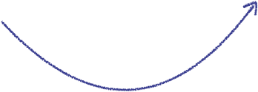
👨🏻‍💻👩🏽‍💻
Physicists
#s6d7
#s6d7
Leticia Farias Wanderley

Slide 13



👨🏻‍💻👩🏽‍💻
Physicists
#s6d7 ✅
#s6d7
#s6d7 ✅
#s6d7
Leticia Farias Wanderley

Slide 14
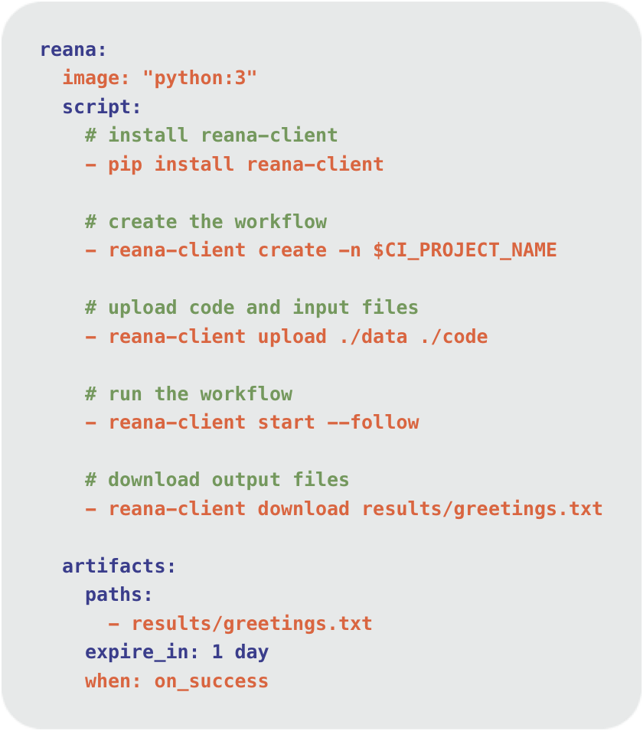
Leticia Farias Wanderley

Slide 15
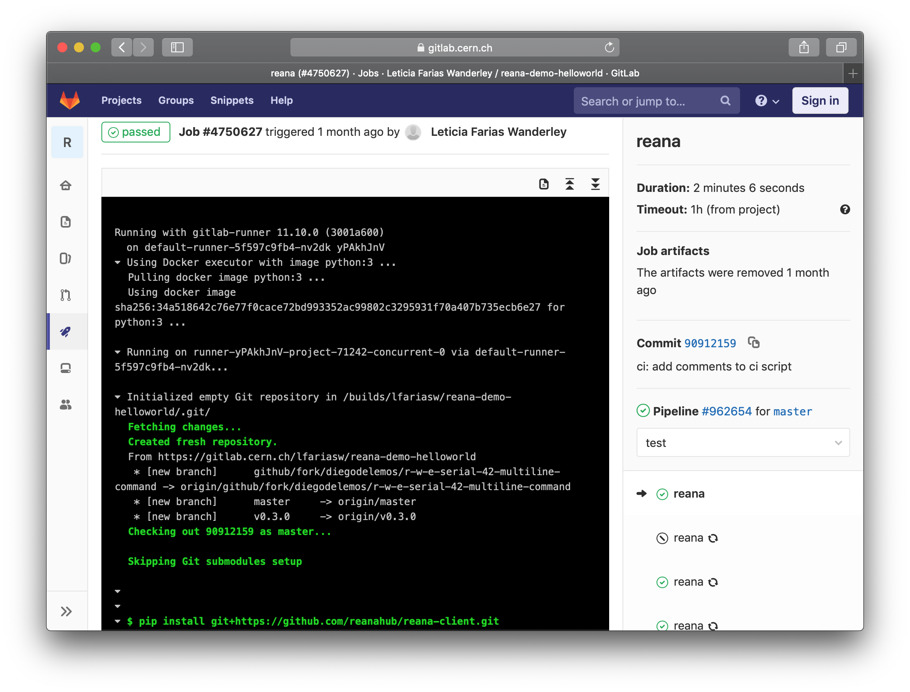
Designed for short execution time
Flexible manual configuration
Leticia Farias Wanderley

Slide 16
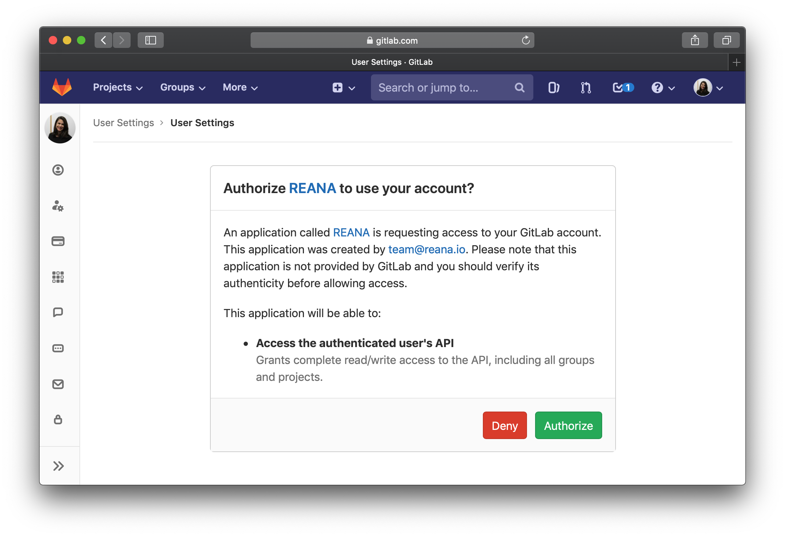
Leticia Farias Wanderley

Slide 17
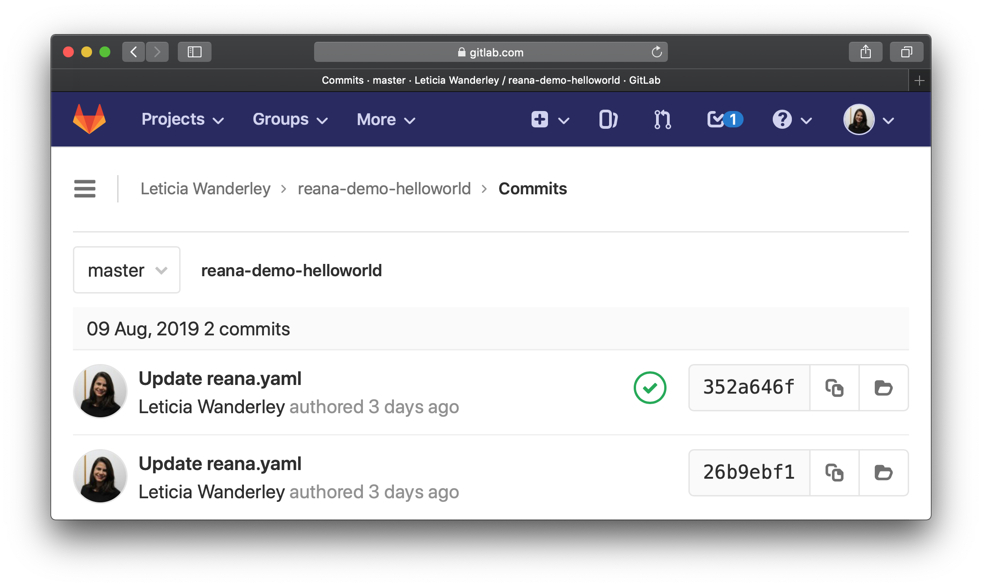
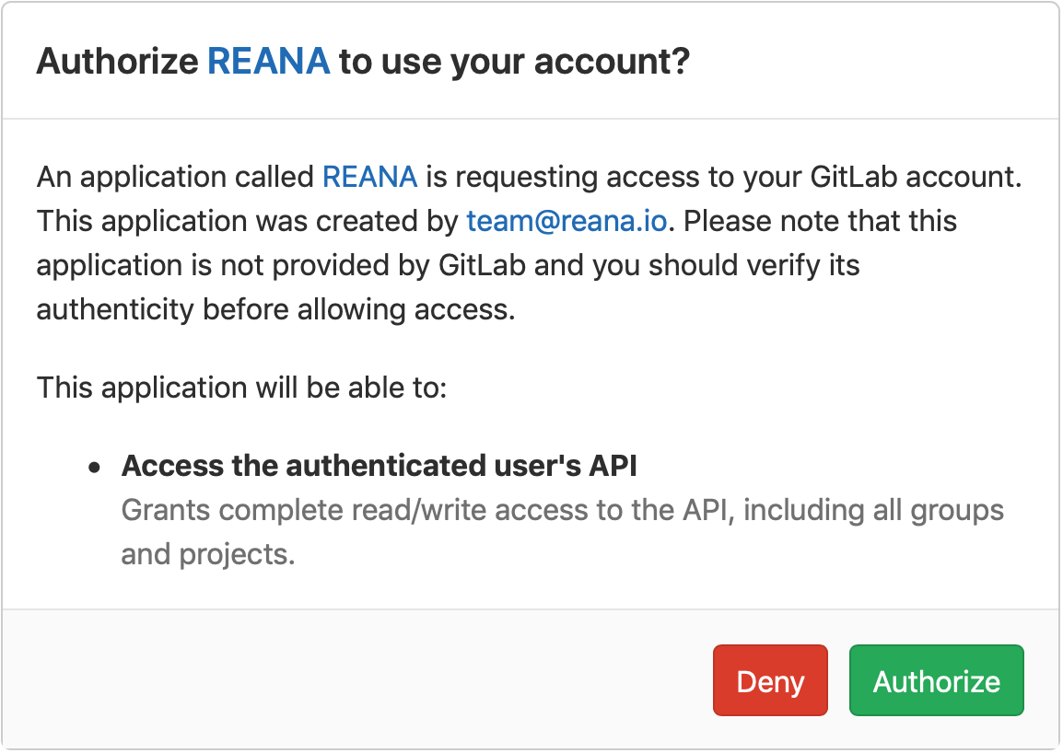
Zero configuration
Unlimited execution time
Leticia Farias Wanderley

Slide 18
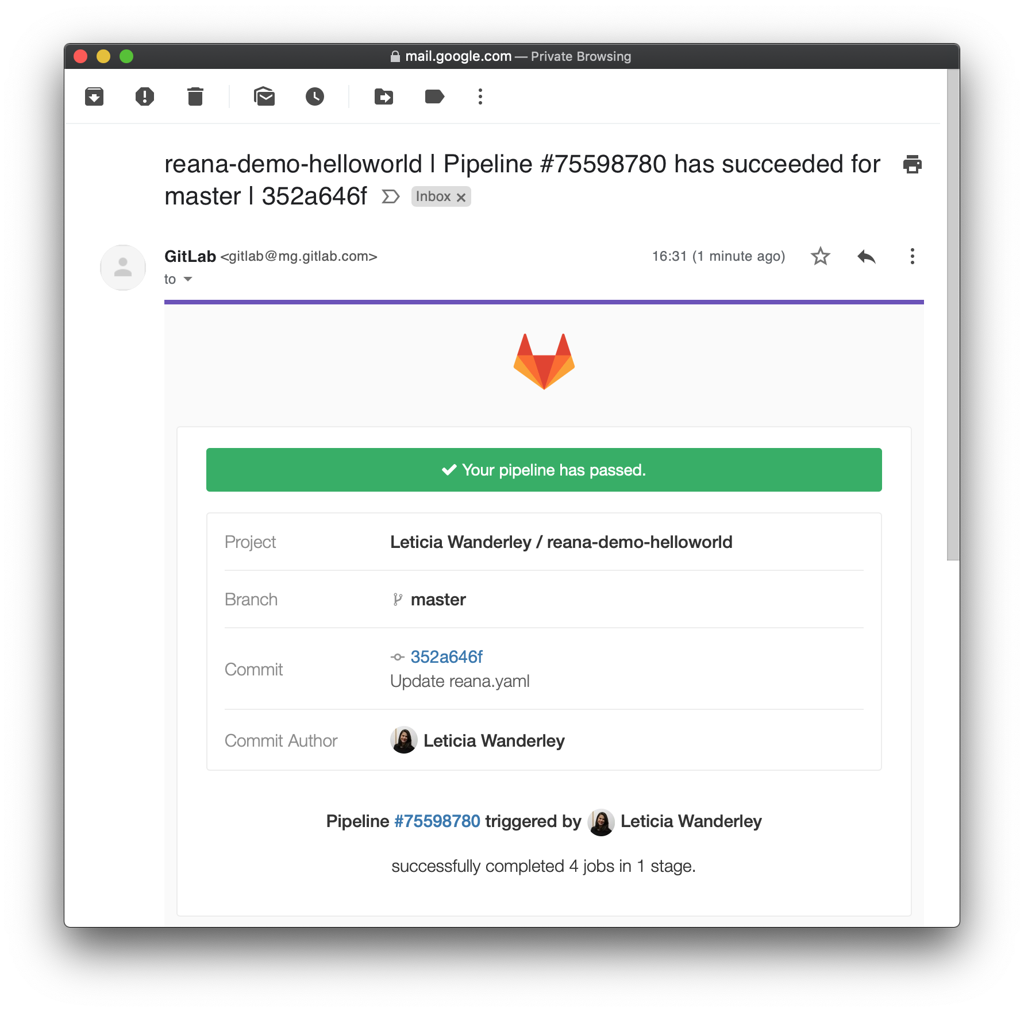
Leticia Farias Wanderley

Slide 19
+
= ❤️
Leticia Farias Wanderley

Slide 20
Impact ⚡️
Implemented and integrated ✅
1st CERN GitLab application ✅
“The integration of REANA with GitLab is a great step towards running reproducible CMS analysis workflows. This will also significantly facilitate our analysis preservation efforts. Clemens Lange (CMS)
Future work 🔮
User configurability
Leticia Farias Wanderley

Slide 21

Thank you!
Special thanks to Alex, Daniel,
and the whole GitLab team @ CERN! 🎊
reana.io
leticiafwanderley@gmail.com
@lfwanderley
@leticiawanderley

