Slide 1
Analysis and Modeling of Storage Access Patterns and Caching Strategies
Shreya Krishnan
Supervisors: Markus Schulz and Andrea Sciaba
Lightning Talk - 13th August 2019

Slide 2
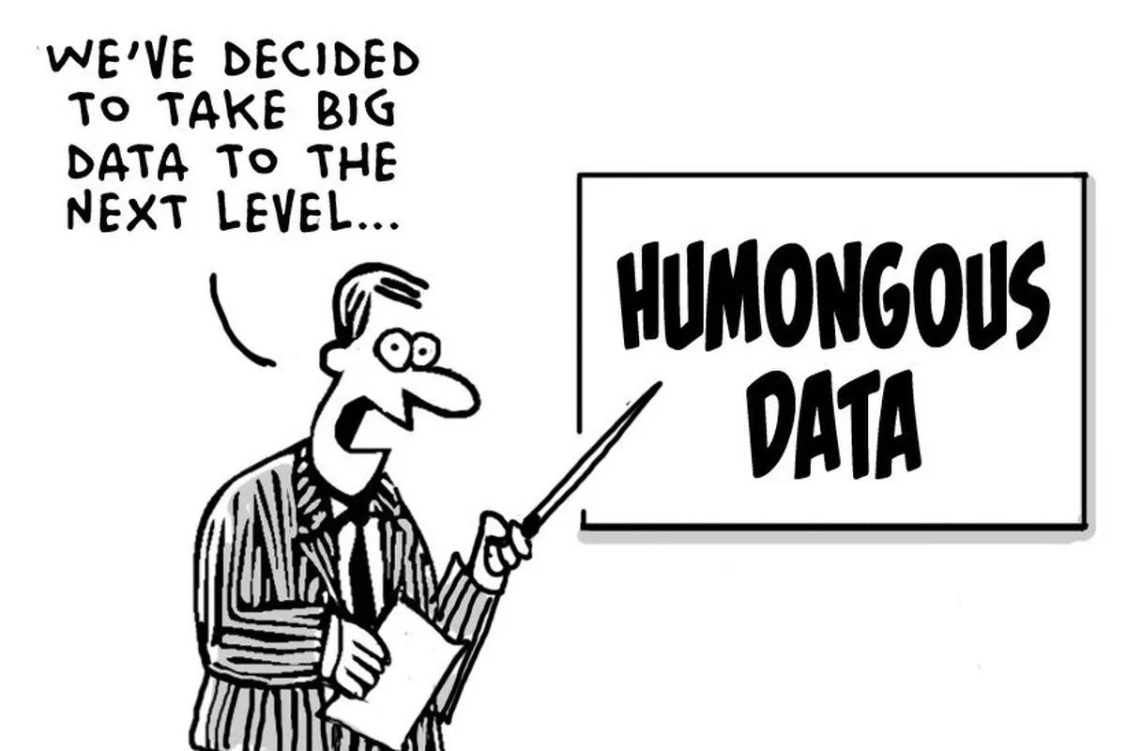
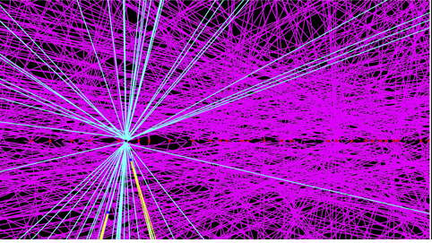

Challenges of the Future: HL-LHC
(More data x higher complexity) + Flat Budget
Much, much, much more...
=
Reduce cost and complexity of storage!

Slide 3
Replace storage by caches @ Tier 2s
We need to Analyse & Model Storage Access Patterns & Caching Strategies
Used CMS Logs
Analysing Caching Strategies
Cache Size
File Eviction Strategy
Trade-off between Network Usage and Cache Size
Modeling file access patterns
Generate a data set based on file access patterns
simulate the behavior of cache
See if the model works!

Slide 4



File Eviction Strategies
Key factor in the design of an optimal cache...
UNUSED FOR N DAYS
Delete files that haven’t been accessed for more than N days.
HIGH WATER MARK
Garbage collection is initiated when used space exceeds the size of cache. This is done by deleting the least recently used files until occupancy falls below 80%
100%
80%
Cache used
0%
I will now discuss some of my results...

Slide 5
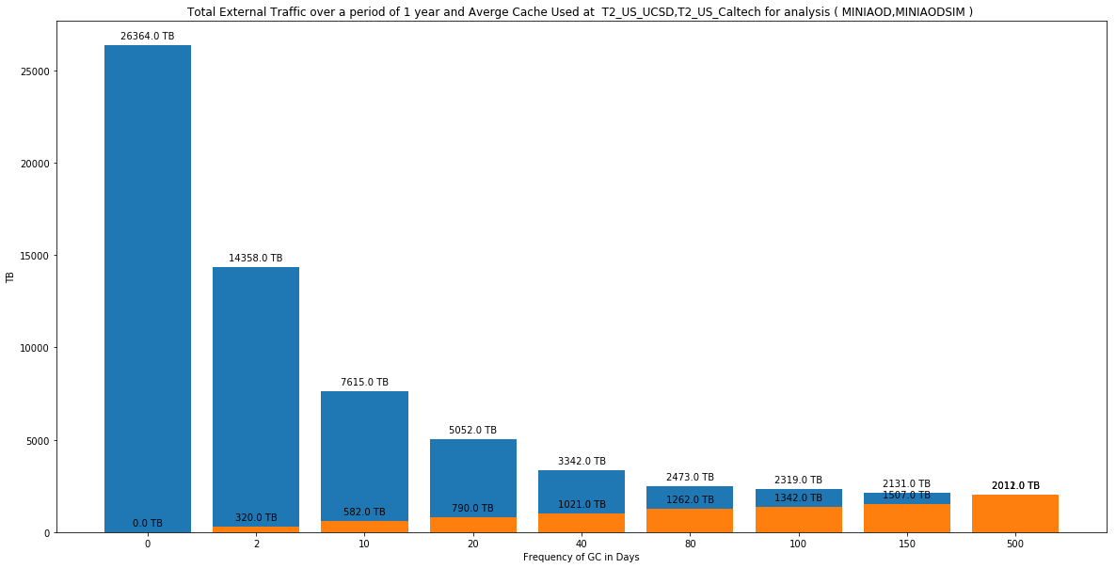

N - Days Strategy
Annual External Traffic
Cache Size required
87%
decrease in yearly traffic
𝜟B.W ~ 1 PB
No Cache
∞ cache with
no deletion

Slide 6
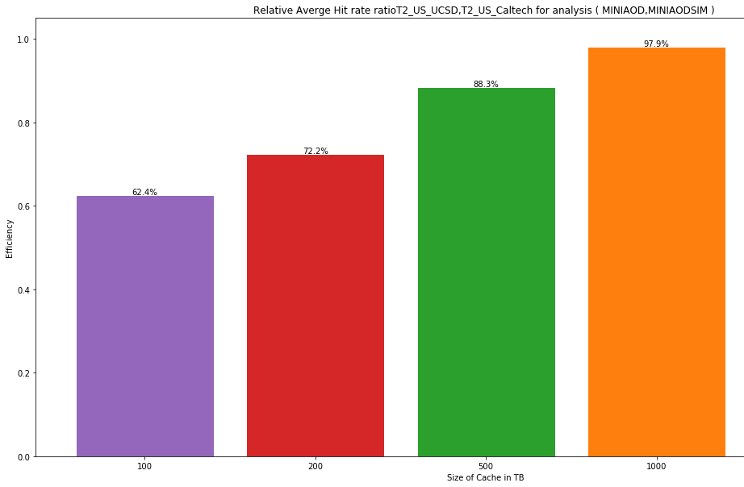
High Water Mark Strategy - Efficiency of Cache
98%
88%
72%
BUT...
62%

Slide 7
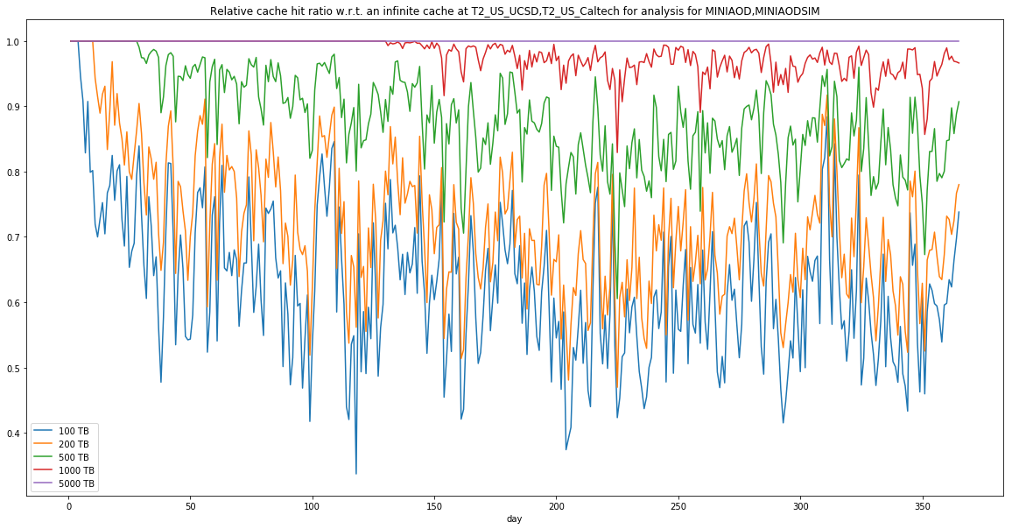
High Water Mark Strategy - Daily Fluctuations
Time it takes to fill up cache
Reference:
Hypothetical “∞ cache”
1
0.98
0.88
Average Relative
Hit Ratio
0.72
0.62

Slide 8
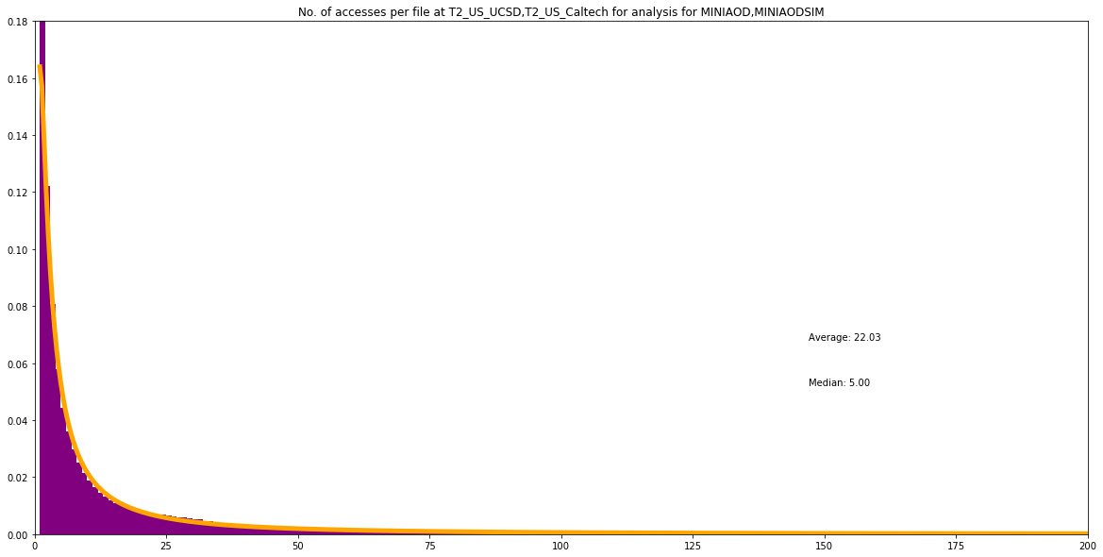
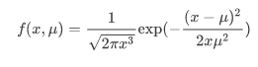
Can we model the Access Patterns?
Distributions of file accesses can be described by just a few parameters!
For Example:
The number of access per file follows an Inverse Gaussian.
Which is given by the probability density function:
No.of access per file

Slide 9
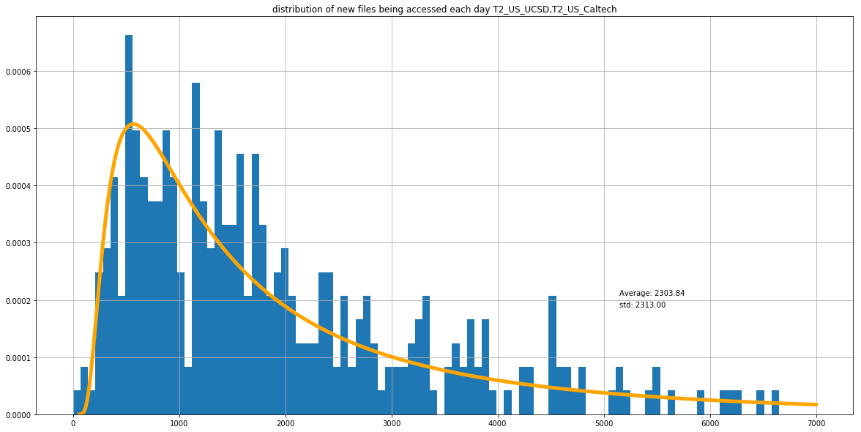
Monte Carlo Model for file accesses
We extract parameters from our previous analysis!
For every day:
  Generate new files
    Average and width of the distribution from data popularity
  Simulate accesses
    Probability based on number of accesses and time since last access
  Update the status of files, write accessed files to simulated data popularity files
  Re-run Cache Simulation using this data set and compare results
Distribution of new data per day

Slide 10
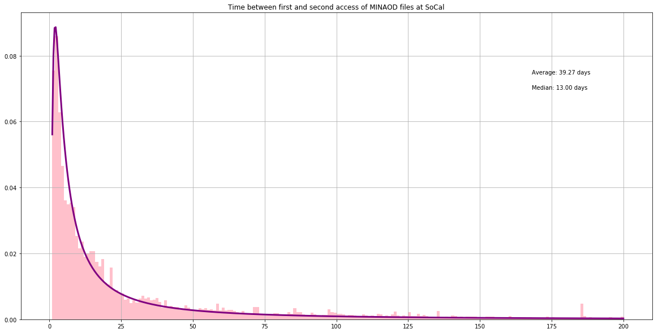
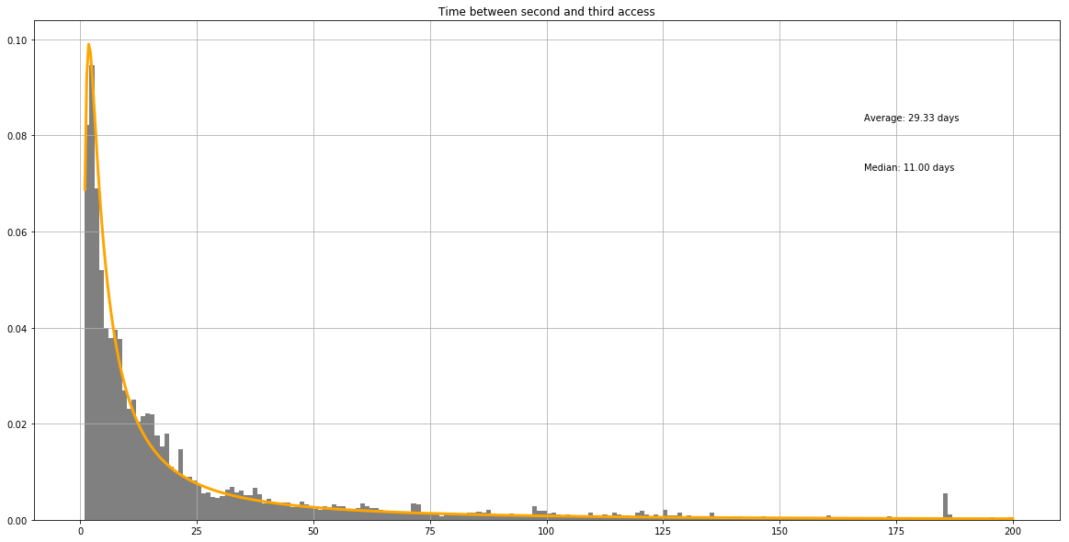
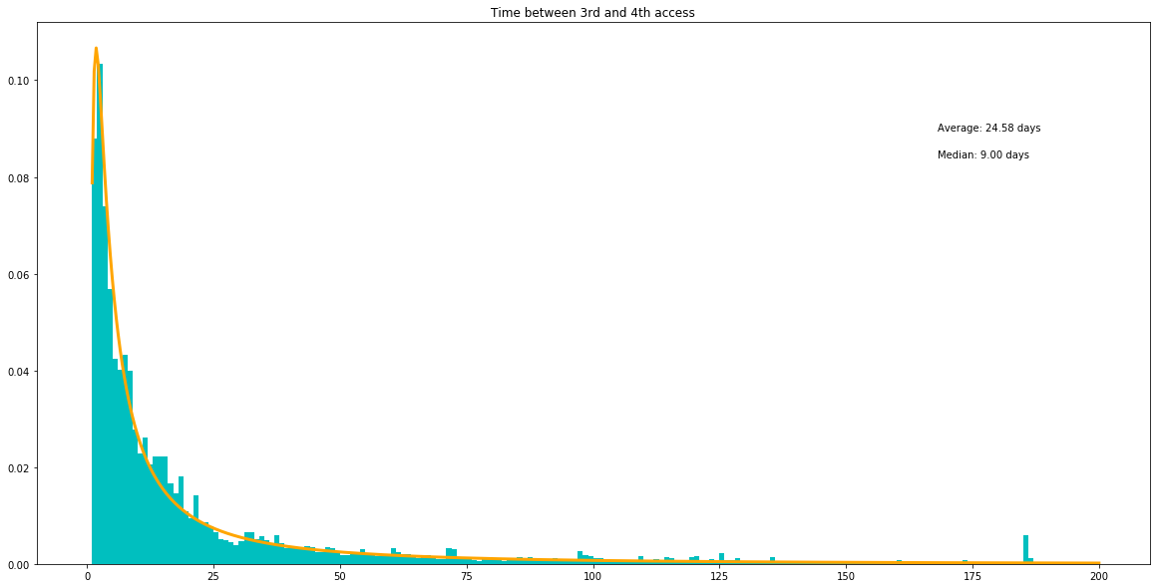
Monte Carlo Model for file accesses
  Simulate accesses
    Probability based on number of accesses and time since last access
...
f(x)
Probability distribution of time between 1st and 2nd access
Probability distribution of time between 2nd and 3rd access
Probability distribution of time between 3rd and 4th access
Interval in Days
Probability that a file will be accessed for the n^{th} time in a certain time interval

Slide 11
Conclusion
These studies have helped us understand the impact of site caches as an alternative to storage quantitatively and we know that this will bring a significant improvement in the way we store and access data across the WLCG.
These studies can be used by site managers for resource planning

Slide 12




If you are interested to know more...
Please reach out to me at:
sshreyakrishnan@gmail.com
sarada.shreya.krishnan@cern.ch
https://www.linkedin.com/in/shreya-krishnan/

