Slide 1






Hamza Javed
Supervisors : Maurizio Perini, Jennifer Ngadiuba, Vladimir Loncar

Slide 2
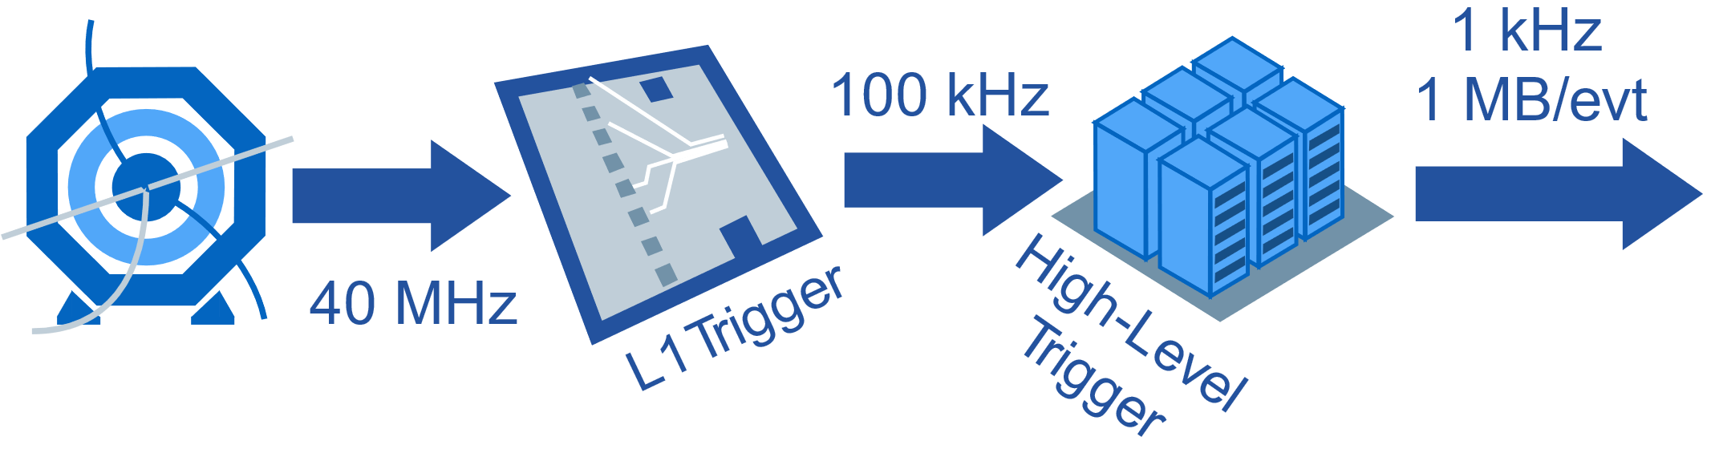
Problem
1 collision every 25 nanoseconds
99.99975% of data has to be rejected
Notes:
1 collision every 25 nanoseconds
Immense Data
Data needs to filtered to an acceptable rate
These filters are also called as Trigger systems.
Practically, these filters are not ideal and lose valuable data.
Through machine learning we can optimize this

Slide 3

Why FPGAs?
During First Trigger
  99.75% rejected
  Decision in ~10 μs
FPGA’s are fast and
massively parallelizable

Slide 4
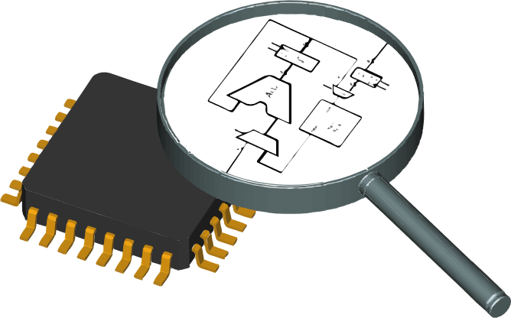
What are FPGAs?
It’s a whiteboard for hardware
Programmable Circuits
Can emulate any logic

Slide 5

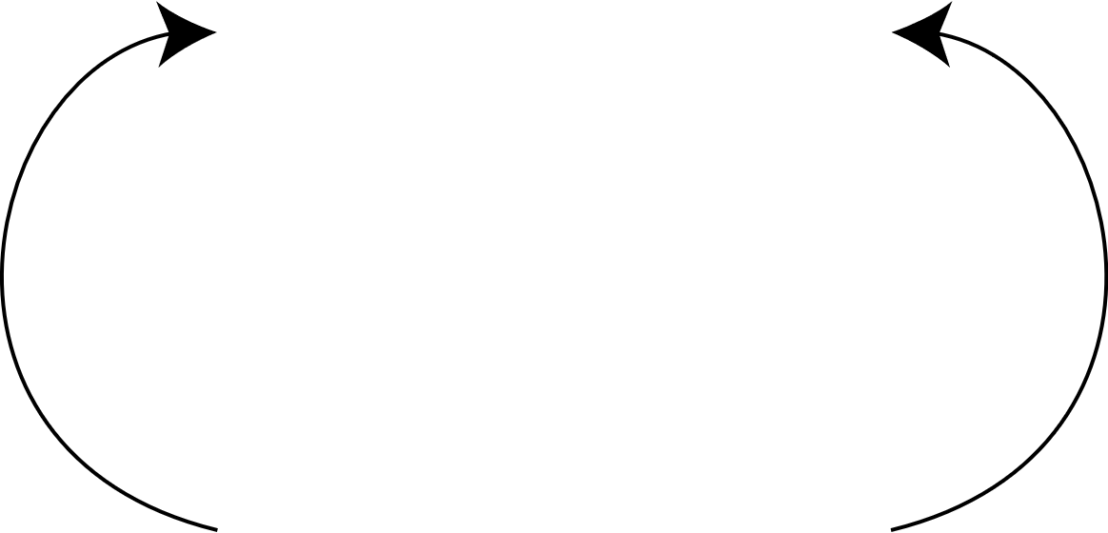

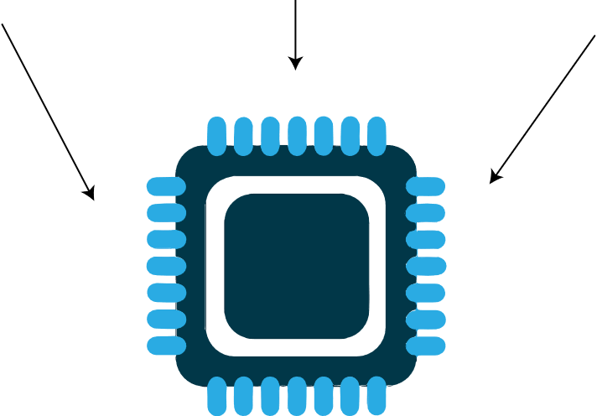
Why Machine Learning?
Classical HEP algorithms for triggers are accurate.
But, Machine Learning algorithms are faster and can be parallelized
Is there a way to combine the two?
Notes:
J

Slide 6
Fast inference of DNN on FPGAs for L1 Systems

Slide 7
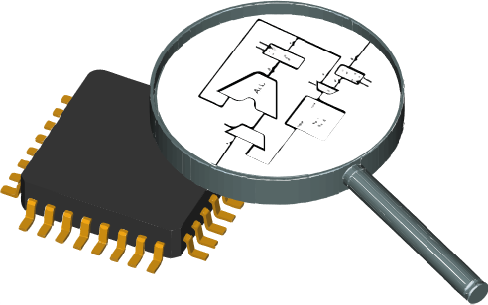


Approach
JSON
HLS + Quartus
Model can be trained in any library
Converted and Optimzied by hls4ml
Deployed on an FPGA
[1] Javier Duarte, Song Han, Philip Harris, Fast inference of deep neural networks in FPGAs for particle physics, 2018.

Slide 8
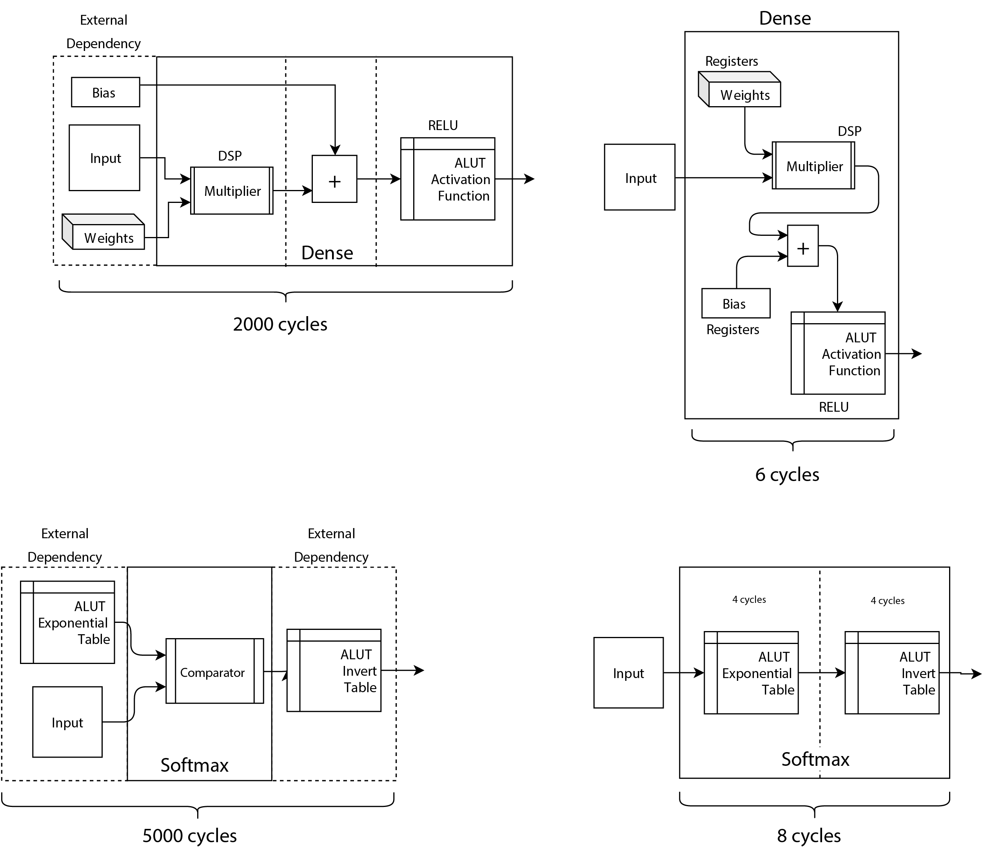
Architecture
Old
New
300x Faster

Slide 9
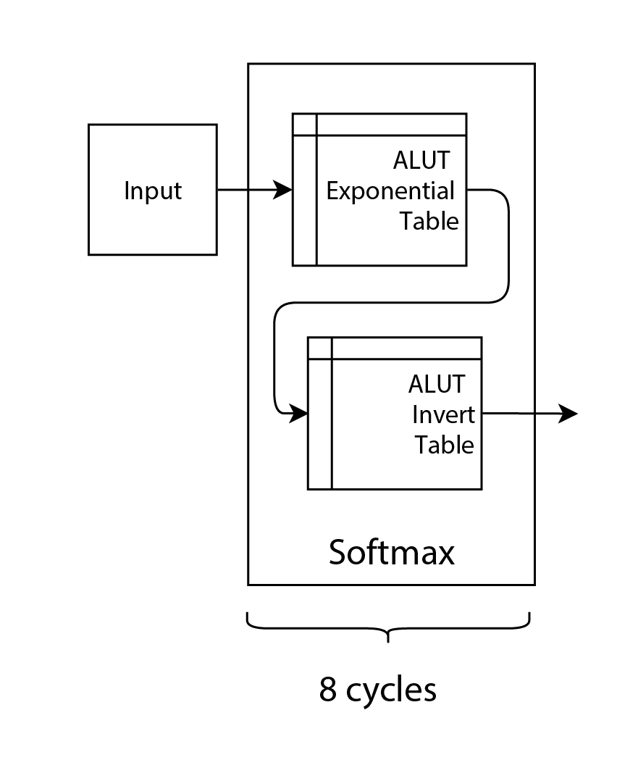
Architecture
New
Old
600x Faster

Slide 10
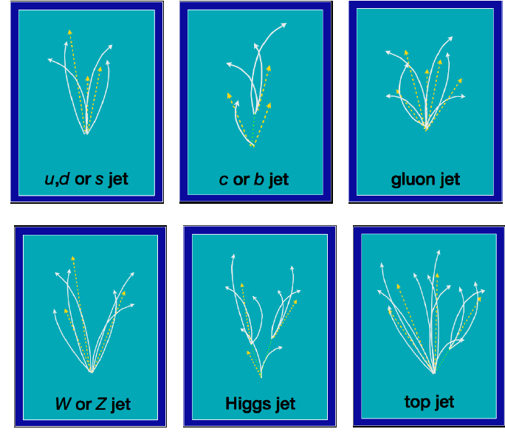
Test Case
A Deep Neural Network trained for jet classification
Five outputs corresponding to each of the g, q, w, z & t jet.
[1] Javier Duarte, Song Han, Philip Harris, Fast inference of deep neural networks in FPGAs for particle physics, 2018.

Slide 11
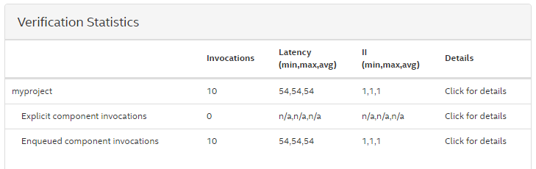
Results
54 x 4ns = 220ns latency (50 times lower)
Throughput of 250M events/sec

Slide 12
Accelerated ML for HLT Triggers using Openvino

Slide 13

What is Openvino?
It’s a toolkit for deploying neural networks across multiple intel platforms.
Highly scalable and cross platform compatible.

Slide 14
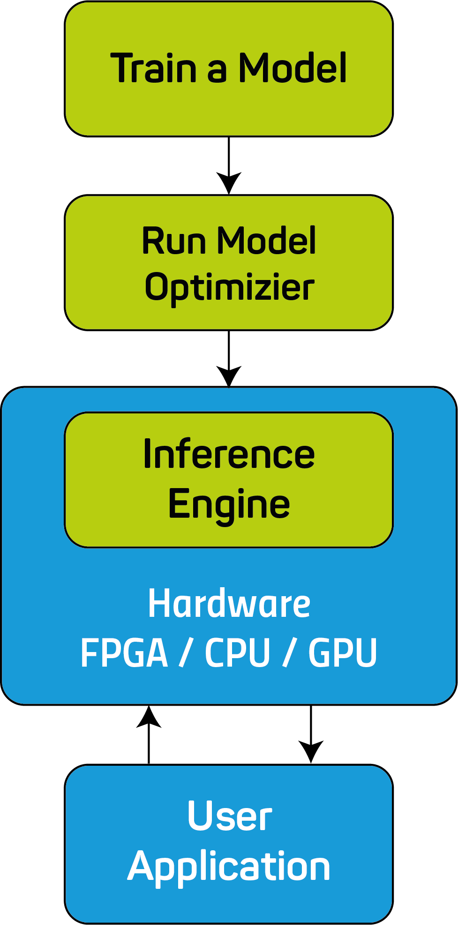
Accelerated ML for HLT Trigger
Custom Resnet-50 model used for identifying top quark jets
Optimized using Openvino.
Tested on FPGA, GPU and CPU
[1] Javier Duarte, Philip Harris, Scott Hauck, FPGA-accelerated mache learning inference as a service for particle physics computing, 2019.

Slide 15
Accelerated ML for HLT Trigger
2x Faster

Slide 16
Accelerated ML for HLT Trigger
Type | Hardware | Accuracy | Inference Time | Max Throughput | Power | Throughput/W
CPU | 2 x Xeon 2.1Ghz, 8 core | 0.91 | 88 ms | 11.36 img/s | ~30W | 0.38
FPGA | Arria 10 PAC - FP16 | 0.91 | 14 ms | 84.44 img/s | ~31W | 2.72
 | Arria 10 PAC - FP11 | 0.88 | 7.5 ms | 187.21 img/s | ~31W | 6.03
GPU | GTX 1080 | 0.90 | 7.5 ms | 192 img/s | ~180W | 1.06
v
v
v
v
FPGA is 3-6x more efficient than a GPU

Slide 17
Acknowledgements
Maurizio Perini, Jennifer Ngadiuba, Vladimir Loncar
Thank You!
hjaved@cern.ch

Slide 18
Questions?

Slide 19
Backup

Slide 20
My Contribution
JSON
HLS + Quartus
Wrote and Optimized HLS4ML for Intel FPGA’s

Slide 21
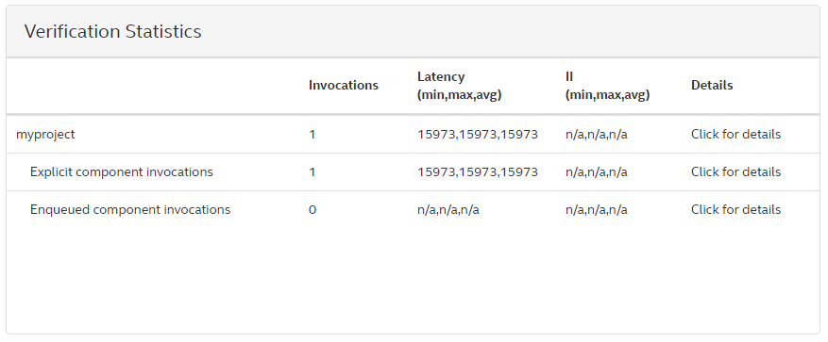
Initial Tests
Latency on the order of 80µs
No pipelining
Unusable for L1 systems

Slide 22

Challenges
Parallelizing operations within a layer.
Achieving sub µs latencies
Speed limitations of Intel’s DSPs.
15973 x 4ns = 64µs latency

Slide 23
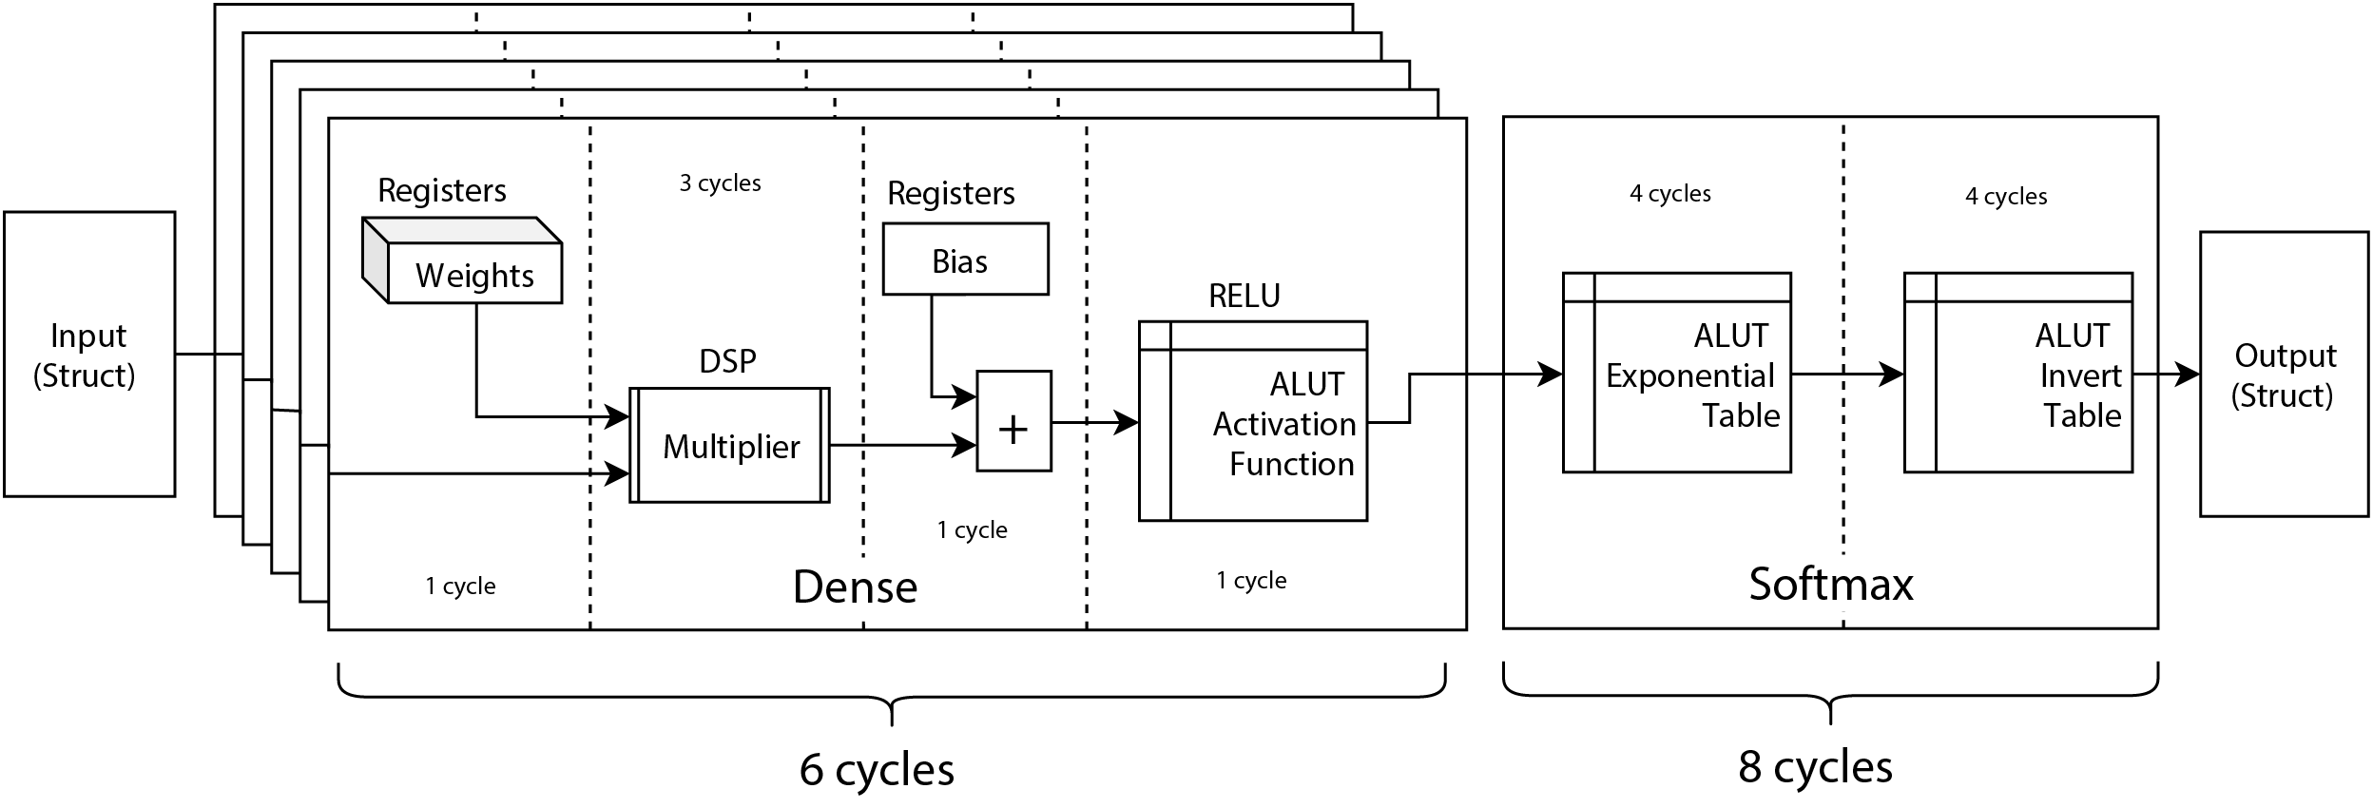
Architecture

